Slide 1
Intel Code Modernisation Project: Status and Plans
Openlab Technical workshop
Federico Carminati
December 9, 2016

Slide 2
Estimates of resource needs for HL-LHC
Data:
Raw 2016: 50 PB → 2027: 600 PB
Derived (1 copy): 2016: 80 PB → 2027: 900 PB
CPU:
x60 from 2016
Technology at ~20%/year will bring x6-10 in 10-11 years
Simple model based on today’s computing models, but with expected HL-LHC operating parameters (pile-up, trigger rates, etc.)
At least x10 above what is realistic to expect from technology with reasonably constant cost

Slide 3

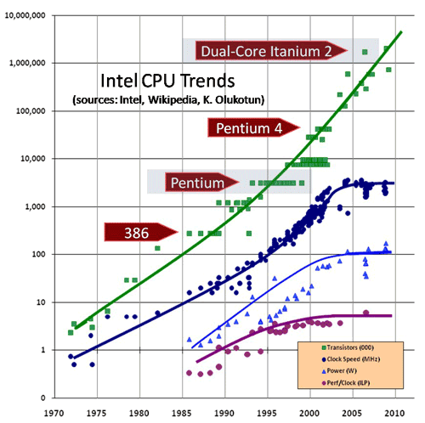
Motivations
(even if you are familiar with them)
The above is true only if we are here
10⁷
10⁶
10⁵
}
transistors
10⁴
We are now probably here
10³
clock
10²
We used to be here
10
1
power
ILP
10⁻¹
70
75
80
85
90
95
00
05
10

Slide 4



The ALFA project
ALICE-FAIR software project aiming to massive data volume reduction by (partial) online reconstruction and compression.
Lets work together

Slide 5
ALFA Framework
A data-flow based model that delivers:
  Transport layer (FairMQ, based on: ZeroMQ, nanomsg)
  Configuration tools
  Management and monitoring tools
  Provide unified access to configuration parameters and databases

Slide 6
FairRoot / ALFA
https://fairroot.gsi.de
Find the correct balance between
reliability and performance
DDS (Dynamic Deployment System)
A toolset that automates and simplifies the deployment of user-defined sets of processes and their dependencies on any available resources
Each "Task" is a separate process, which:
  Can be multithreaded, SIMDized, etc.
  runs on different hardware (CPU, GPGPU, XeonPhi, etc.)
  Be written in an any supported language (Bindings for 30+ languages)
http://dds.gsi.de
Different topologies of tasks can be adapted to the problem itself, and the hardware capabilities

Slide 7
Xeon Phi Support in ALFA/FairRoot
Ongoing work:
Make the dynamic deployment system (DDS) Xeon Phi aware.
Extending the topology properties in DDS to support Xeon Phi

Slide 8
ALFA code modernization on KNL
We just get access to KNL last month. (thanks to Fons and Omar)
Work is ongoing to support the ICC 17.0.0

Slide 9
BioDynaMo — The Biology Dynamic Modeller
Platform for high-performance computer simulations of biological dynamics
Involves detailed physical interactions in biological tissue
Highly optimised and parallelised code
To be run both on HPC and Cloud environments
  Cortical column: 10k neurons - brain cancer (multi-core)
  Cortical sheet: 10m neurons - epilepsy (HPC)
  Cortex: 100m - 10bn neurons - schizophrenia (HPC on Cloud?)

Slide 10
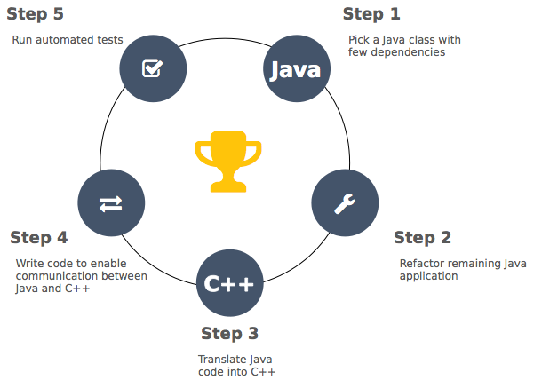
From Cx3D to BioDynaMo
Original Cx3D code in Java (20 kLOC)
Ported to C++
Scalar, serial optimisations
Vectorisation
Parallelisation
Co-processor and GPU optimisations
ROOT for I/O and graphics

Slide 11

An IPCC to modernize the ROOT Math and I/O libraries
Principal Investigator: Peter Elmer
Princeton University
The goal of ROOT IPCC is to modernize and optimize certain critical libraries in the ROOT software framework for multicore and many-core CPU architectures. ROOT is ubiquitous in particle and nuclear physics and used by 20000 scientists in 170 computer centers around the world. The focus of this IPCC is the optimization of the ROOT Math and I/O libraries. The work will prepare the way for CERN's planned upgrades to the Large Hadron Collider which will take particle physics through the 2030s.

Slide 12
Current status: the project was funded 6 months ago. There were some
delays in hiring the person, but we have converged very recently. We
are hiring Vassil Vassilev at Princeton to start on the IPCC project
from January, 2017. Vassil is well known to the ROOT team via his work
on the Cling interpreter. He will continue to be based at CERN to
facilitate collaboration. The proposal from earlier this year focused
specifically on two categories of work: parallelization of ROOT I/O Output (efficient data gather) and vectorization/parallelization of the Math libarie
s (matrixes, "matriplex" to group together large numbers of small matrices, etc.)

Slide 13
The ROOT IPCC will collaborate with:
- the ROOT developers at CERN and FNAL
- the LHC experiments
- a US NSF-funded project DIANA/HEP (http://diana-hep.org/) which is working on performance and interoperability of ROOT
- a US NSF-funded R&D project developing charged parallel tracking algorithms (http://trackreco.github.io/)
- the other HEP-related IPCC projects
At the beginning of January, we will be making a combined work plan with the
ROOT team (CERN, FNAL), the DIANA project, the TRACKRECO project and the other IPCC projects, taking into account the current status of the development.

Slide 14
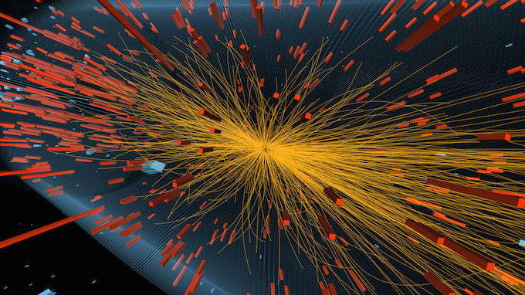
Yellow lines are the trajectories of charged particles. These are reconstructed from individual sensor signals using a iterative technique based on a Kalman Filter.

Slide 15
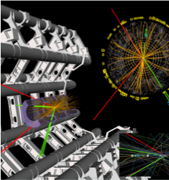
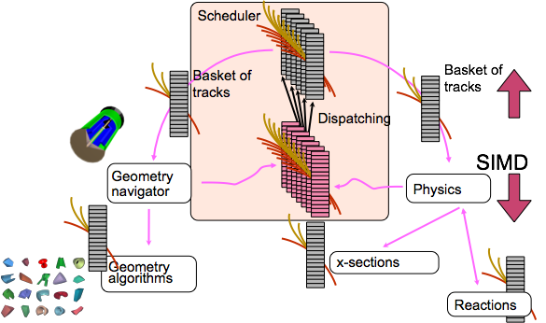
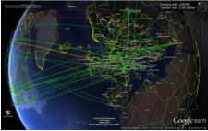
GeantV – accelerating detector simulation
Detailed simulation of subatomic particles in detectors, essential for data analysis
  The LHC uses more than 50% of its distributed GRID power for simulations
A vector-oriented approach for harnessing new computing technology

Slide 16
Basket processing benchmarks on KNL
Presented at ISC16
  Simplified example (concentric cylinder tracker) in “basket mode compared to classical approach (ROOT geometry)
  SIMD vectorization enforced by API, (UME:SIMD backend for AVX512)
Scalability comparable KNC vs. KNL for the ideal and basket versions (~100x)
GeantV approach gives excellent benefits with respect to the classical one (ROOT geometry)
Intel® Xeon Phi™ CPU 7210 @ 1.30GHz, 64 cores
Basket₀
TopNavigator
LayerNavigator<0>
Basket₁
LayerNavigator<1>
Basket₂
Basket₃
LayerNavigator<N>
Basket₄
Basket₅
InnermostLayerNavigator

Slide 17
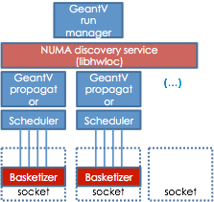
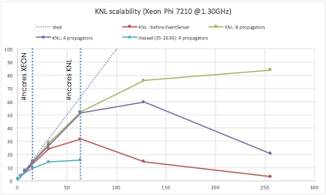
Multi-propagator performance test
Presented at SC16
Good scalability up to the number of physical cores
Simplified calorimeter
Tabulated physics (Electro-Magnetic processes + various materials)
Full track transport and basketization procedure
Scalability gets better by increasing number of propagators
Not final results, still fixing/optimizing
T_{AVX2}/T_{AVX-512} ~ 1.9 !
Handling clusters of threads (NUMA aware in future) with weak inter-communication

Slide 18
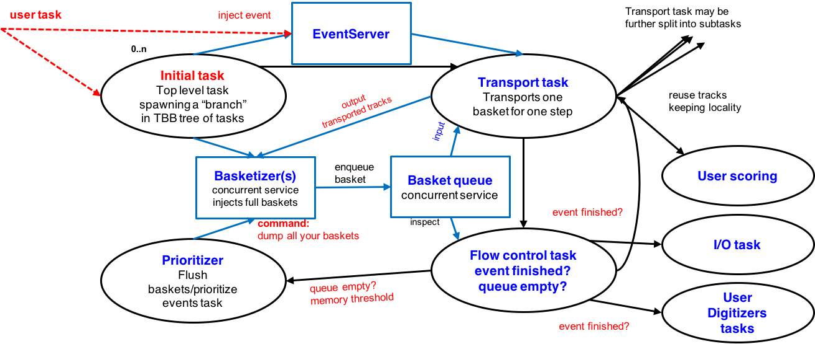
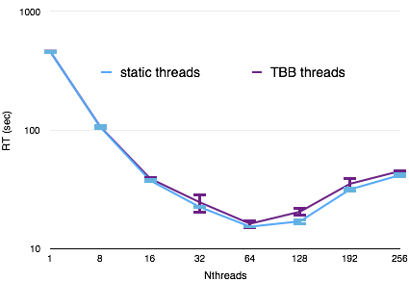
GeantV & TBB
Important for connecting with experiment parallel frameworks
A task-oriented version of the static threads approach for GeantV
  First version to be improved, but performance already not bad
Intel® Xeon Phi™ CPU 7210 @ 1.30GHz, 64 cores

Slide 19
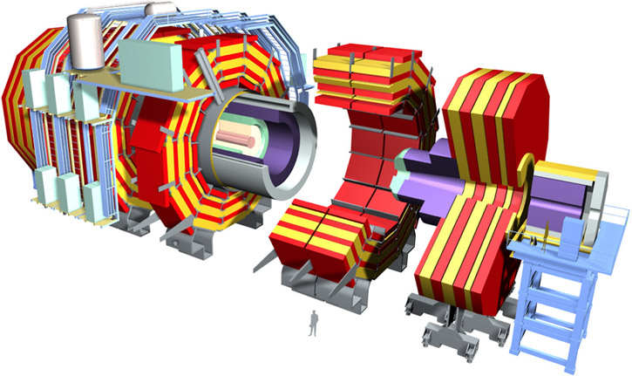
The full prototype
Exercise at the scale of LHC experiments (CMS)
        Full geometry converted to VecGeom + uniform magnetic field
Tabulated physics, fixed 1MeV energy threshold
Full track transport and basketization procedure
First results on scalability (comparison to classical approach single-thread)

