Slide 1
Data Analytics and CERN IT Hadoop Service
CERN openlab Technical Workshop, December 2016
Luca Canali, IT-DB

Slide 2
Data Analytics at Scale – The Challenge
When you cannot fit your workload in a desktop
  Data analysis and ML algorithms over large data sets
  Deploy on distributed systems
Complexity quickly goes up
  Data ingestion tools and file systems
  Storage and processing engines
  ML tools that work at scale

Slide 3
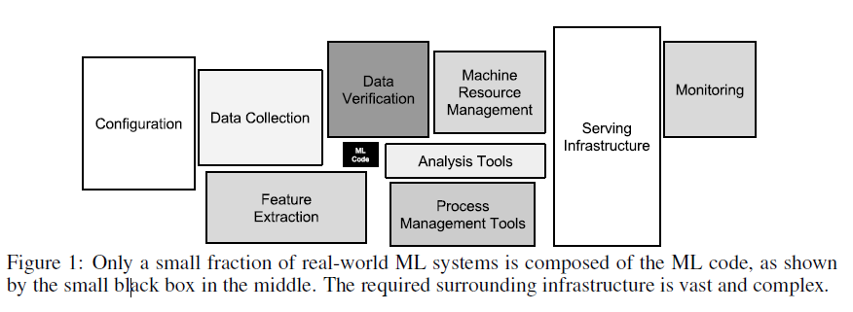
Engineering Effort for Effective ML
From “Hidden Technical Debt in Machine Learning Systems”, D. Sculley at al. (Google), paper at NIPS 2015

Slide 4
Managed Services for Data Engineering
Platform
  Capacity planning and configuration
  Define, configure and support components
Running central services
  Build a team with domain expertise
  Share experience
  Economy of scale

Slide 5
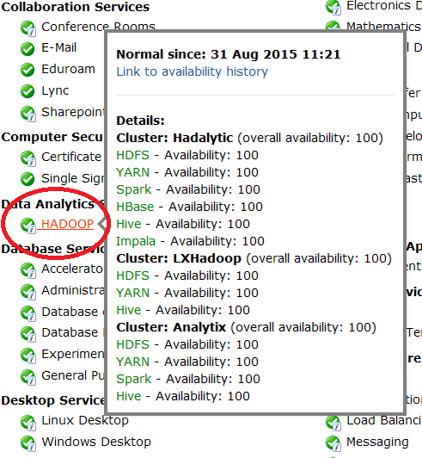
Hadoop Service at CERN IT
Setup and run the infrastructure
Provide consultancy
Build user community
Joint work
  IT-DB and IT-ST

Slide 6
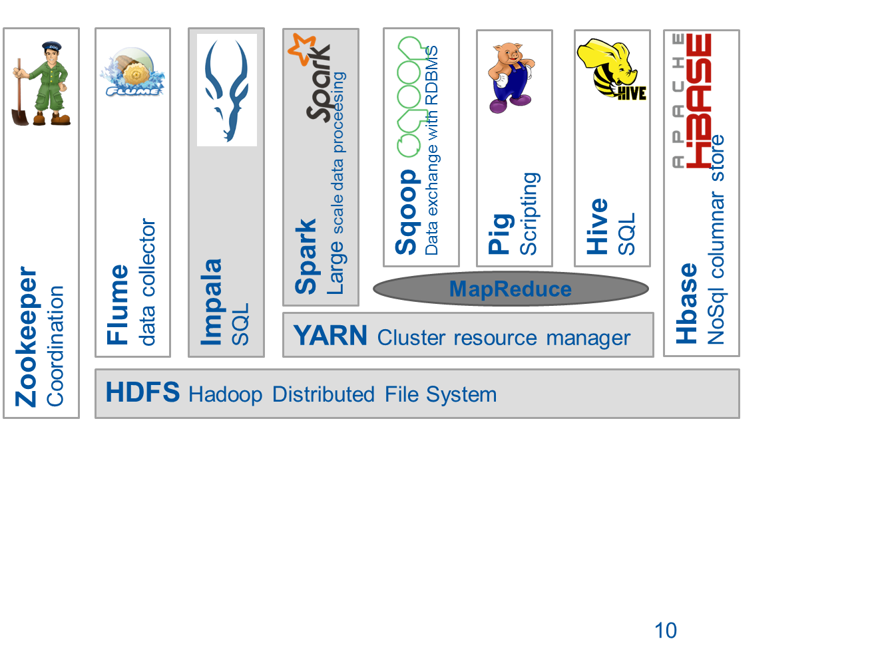

Overview of Available Components (Dec 2016)
Kafka
Streaming/Ingestion

Slide 7
Hadoop clusters at CERN IT
3 production clusters (+ 1 for QA) as of December 2016
Cluster Name | Configuration | Primary Usage
lxhadoop | 22 nodes (cores – 560,Mem – 880GB,Storage – 1.30 PB) | Experiment activities
analytix | 56 nodes (cores – 780,Mem – 1.31TB,Storage – 2.22 PB) | General Purpose
hadalytic | 14 nodes (cores – 224,Mem – 768GB,Storage – 2.15 PB) | SQL-oriented engines and datawarehouse workloads

Slide 8
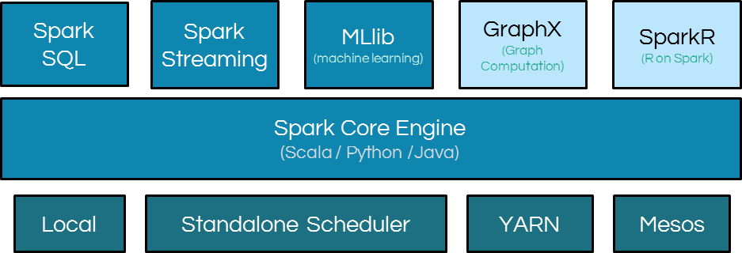
Apache Spark
Spark evolution from map reduce ideas
Powerful engine, in particular for data science and streaming
  Aims to be a “unified engine for big data processing”

Slide 9
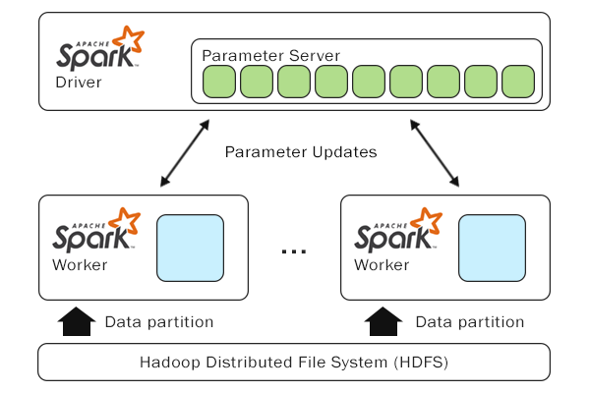
Machine Learning and Spark
Spark addresses use cases for machine learning at scale
Distributed deep learning
  Working on use cases with CMS and ATLAS
  Custom development: library to integrate Keras + Spark
  Testing also other solutions

Slide 10
Some Important Challenges
Infrastructure
Components
Evolution
Running Services
Knowledge sharing and technology adoption

Slide 11
Infrastructure and configuration
What HW to use, how to configure it?
  We are starting small (~ 1000 cores, 3TB RAM, 6 PB disk)
  Commodity HW (standard components at CERN datacenter)
Cloud
  Pilot in the pipeline using private cloud at CERN
    collaboration with OpenStack team
  Future: test public cloud?

Slide 12
Components, Engines and File Formats
State of the art evolves quickly
  Challenge: reviewing application and architecture choices on short cycles (~2 years?)
  Need to minimize technical debt
Examples:
  Yesterday: it was all about map reduce
  Today: Spark, Impala
Service evolution and testing in progress
    Example: Kudu promising to add fast insert and updates and key-based search

Slide 13
Deep Learning
Quickly evolving field
  New tools and platforms
  Role of HW also very important (GPUs, FPGAs, etc)
  Many challenges to understand with distributed learning
Hadoop service at CERN working on
  Integration with Spark
Comment: an area to further explore

Slide 14
Running the service
Configuration:
  Currently using CDH (Cloudera) distribution + puppet
  Plans to test use of Cloudera Manager (at least for monitoring, possibly for installation)
  Backup and recovery: work in progress
  More work needed on monitoring and security, building from current experience
  Further work and understanding on workload management and performance

Slide 15
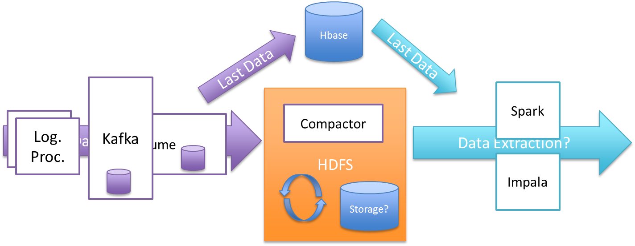
Pilot Implementation – NXCALS
Pilot architecture tested by CERN Accelerator Logging Services
Critical system for running LHC
Challenge: production in 2017
Credit: Jakub Wozniak, BE-CO-DS

Slide 16
Performance and Testing at Scale
Challenges with ramping up the scale
  Example from the CMS data reduction challenge: 1 PB and 1000 cores
    Production for this use case is expected 10x of that.
    New territory to explore
Action: access to HW for tests
  CERN clusters + external resources from partners?

Slide 17
Technology Adoption
Build community at CERN
  Hadoop users forum, analytics working group, openlab workshops, seminars, …
  Build a HEP community around ML
    How to position ML with “current tools for HEP” analysis?
Offer and provide training
  Examples: tutorials by IT-DB, also discussing with tech training at CERN on courses for the catalog,
Link with other scientific communities and industry
  Knowledge sharing

Slide 18
Conclusions
CERN Hadoop and Spark service
  Established and evolving
  Bring “big data” solutions from open source into CERN use cases
  Several production implementations more in pipeline
Brings value for analytics and large datasets
  Machine learning at scale
IT Hadoop service provides consultancy, platforms and tools

Slide 19
Acknowledgements
The following have contributed to the work reported in this presentation
Members of IT-DB-SAS section
  Supporting Hadoop components FE
Rainer Toebbicke, Dirk Duellmann, Luca Menichetti from IT-ST
  Supporting Hadoop Core FE

Slide 20
Discussion / Feedback
Q & A

Slide 21
Backup Slides
Backup Slides with additional details on ongoing projects

Slide 22
Impala - SQL on Hadoop
Distributed SQL query engine for data stored in Hadoop
Based on MPP paradigm (no MapReduce, Spark)
Designed for high performance
  Written in C++
  Runtime code generation using LLVM
  Direct data access

Slide 23
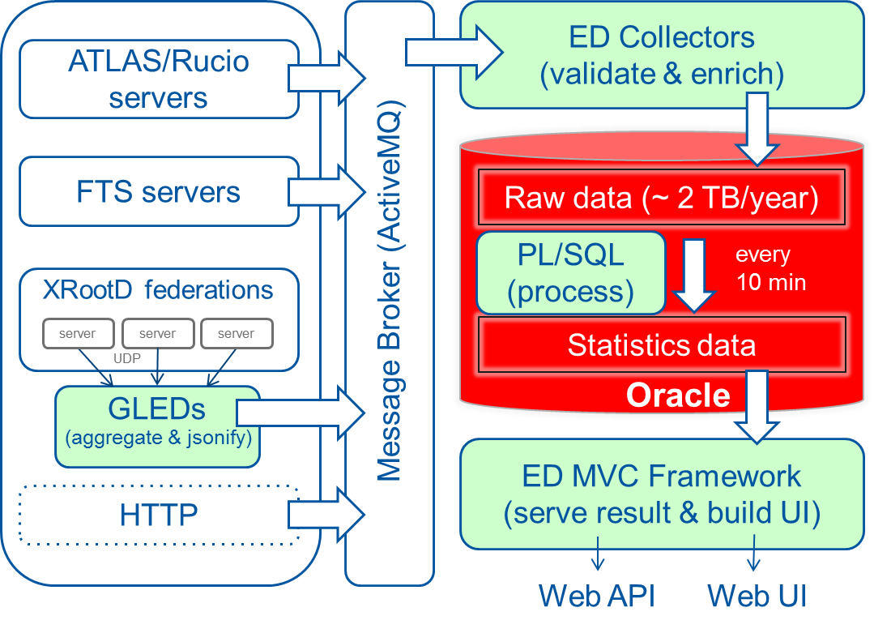






Production Implementation – WLCG Monitoring
Lambda Architecture
Real-time
Batch processing
ACTIVE MQ
HADOOP
Web UI
Modernizing the applications for ever demanding analytics needs
Credit: Luca Magnoni, IT-CM

Slide 24
Projects
Atlas Event Index (Production Service)
  HBASE for fast lookup events; 40 TB/year
LHC Postmortem Analysis
  Real-time Postmortem Analytics of LHC monitoring data – Kafka + Spark
Analysis of industrial controls data
Future Circular Collider: Reliability and Availability analysis
  Integrating heterogeneous data sources
  Correlation between different domains

Slide 25

Connecting Hadoop and Oracle
Advantages
No changes to the application
Data sources are transparent to the users
Opens up the possibility for new analytical queries
Offload data from Oracle to Hadoop
  recent data in Oracle; archive data in Hadoop
Offload queries to Hadoop
Oracle
Hadoop
table partitions
limited storage throughput
scalable storage
create view big_table as
select * from online_big_table where date > ‘2016-05-05’
union all
select * from archival_big_table@hadoop where date <= ‘2016-05-05’
SQL
Oracle
Hadoop
offloaded SQL
Offload interface: DB LINK, External table
SQL engines: Impala, Hive

Slide 26

Jupyter Notebooks
Jupyter notebooks for data analysis
  System developed at CERN (EP-SFT) based on CERN IT cloud
  SWAN: Service for Web-based Analysis
  ROOT and other libraries available
Integration with Hadoop and Spark service
  Distributed processing for ROOT analysis
  Access to EOS and HDFS storage

Slide 27
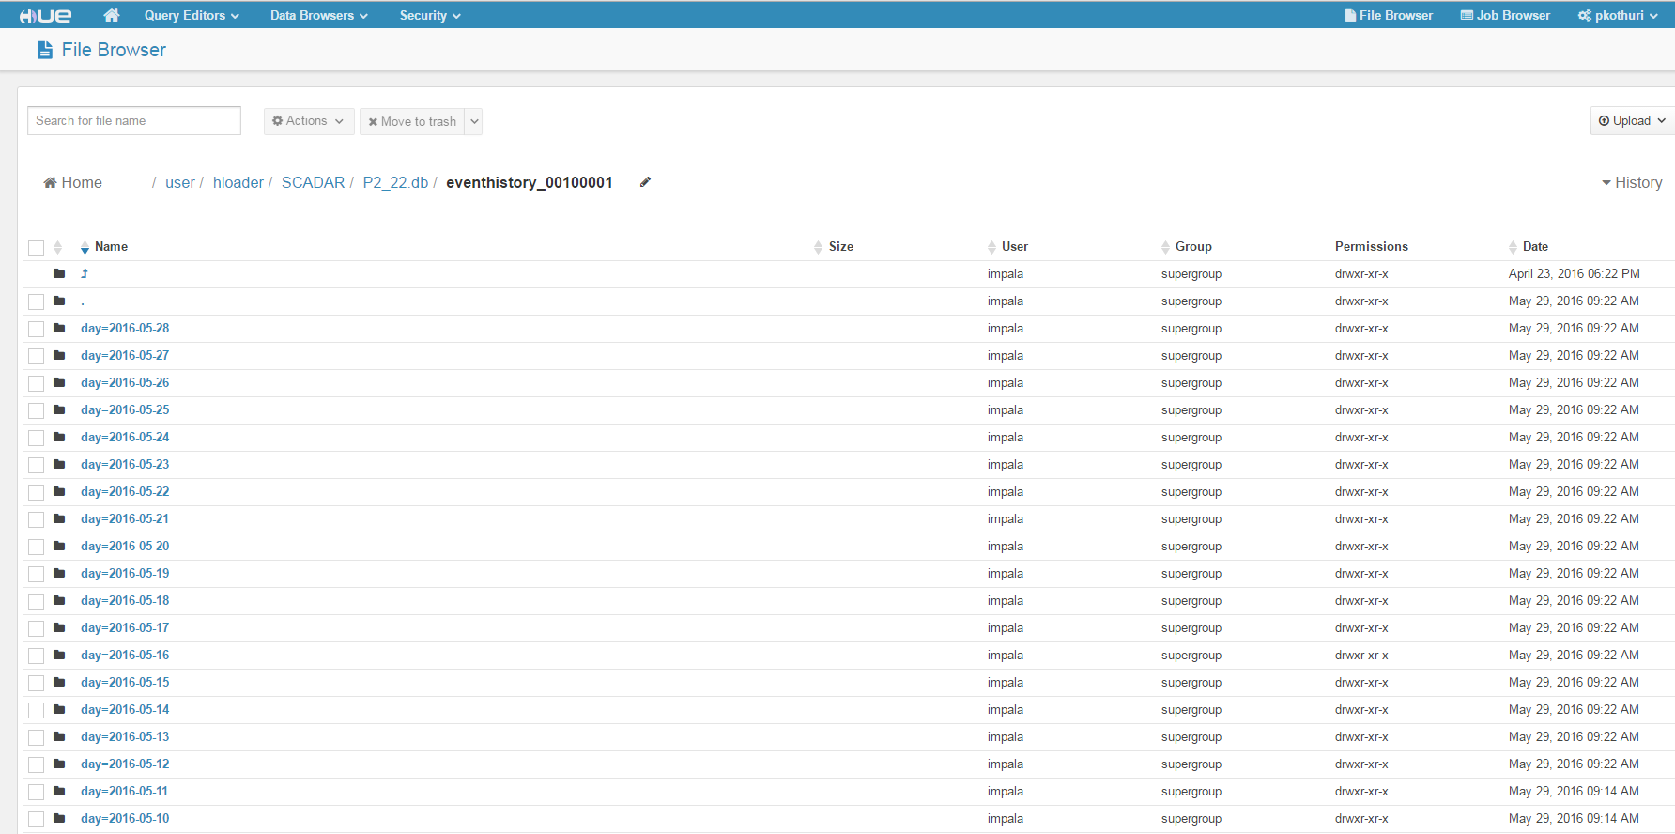
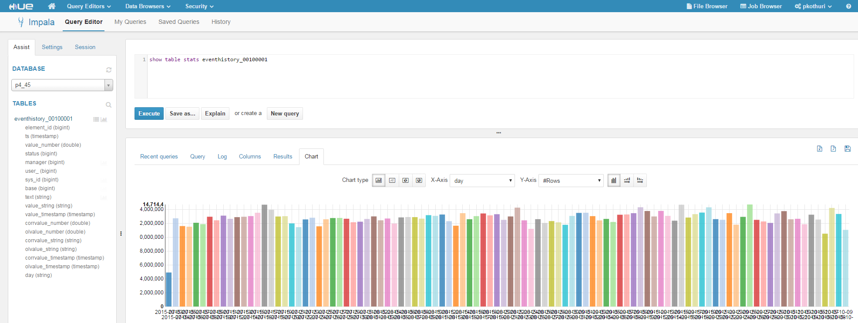
Hadoop User Experience - HUE
Hue is a web interface for analyzing data with Apache Hadoop
  View your data using HDFS filebrowser
  Enhance and Analyze using Query editors for Impala, HIVE
  Analyze & visualize using Spark notebooks (beta)
  Requested by the user community
Available on Hadoop clusters
  https://hue-hadalytic.cern.ch
  https://hue-analytix.cern.ch (soon)

Slide 28
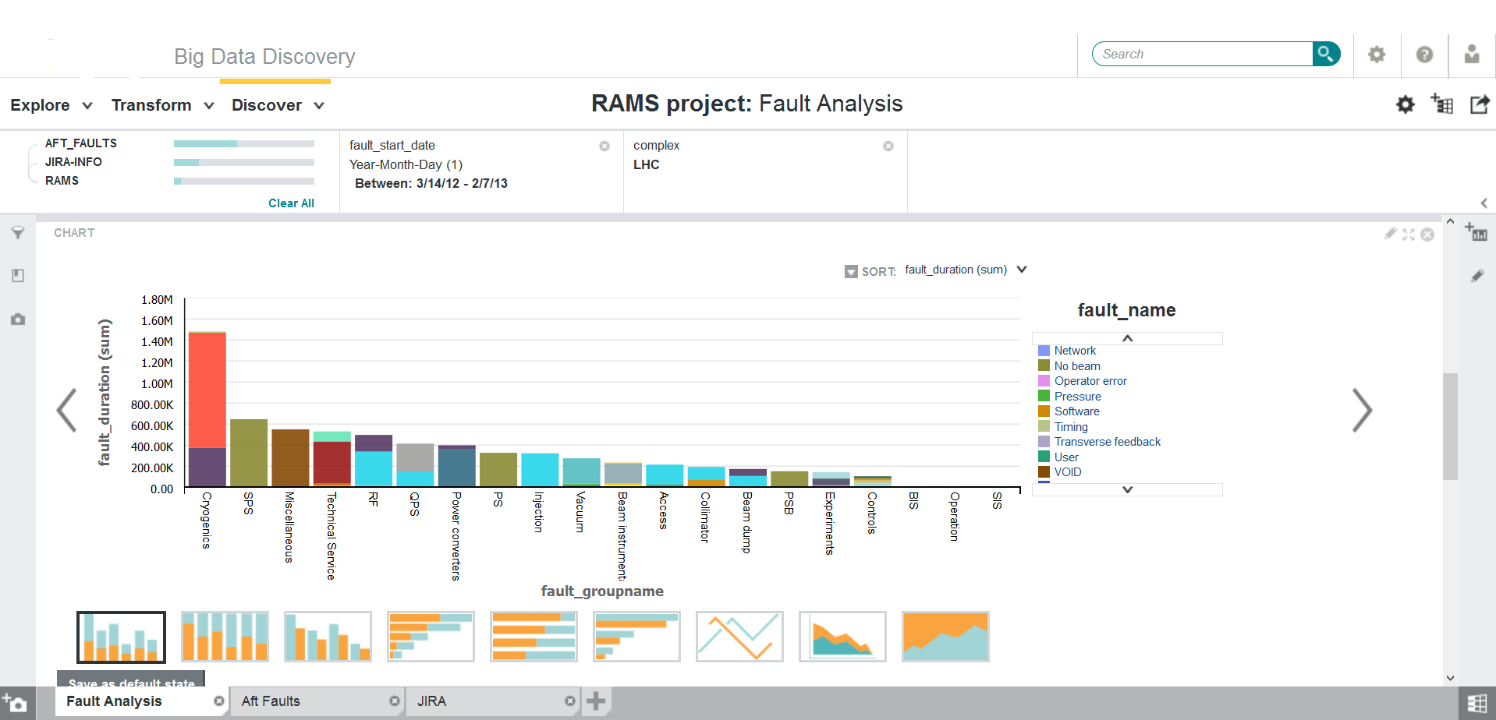
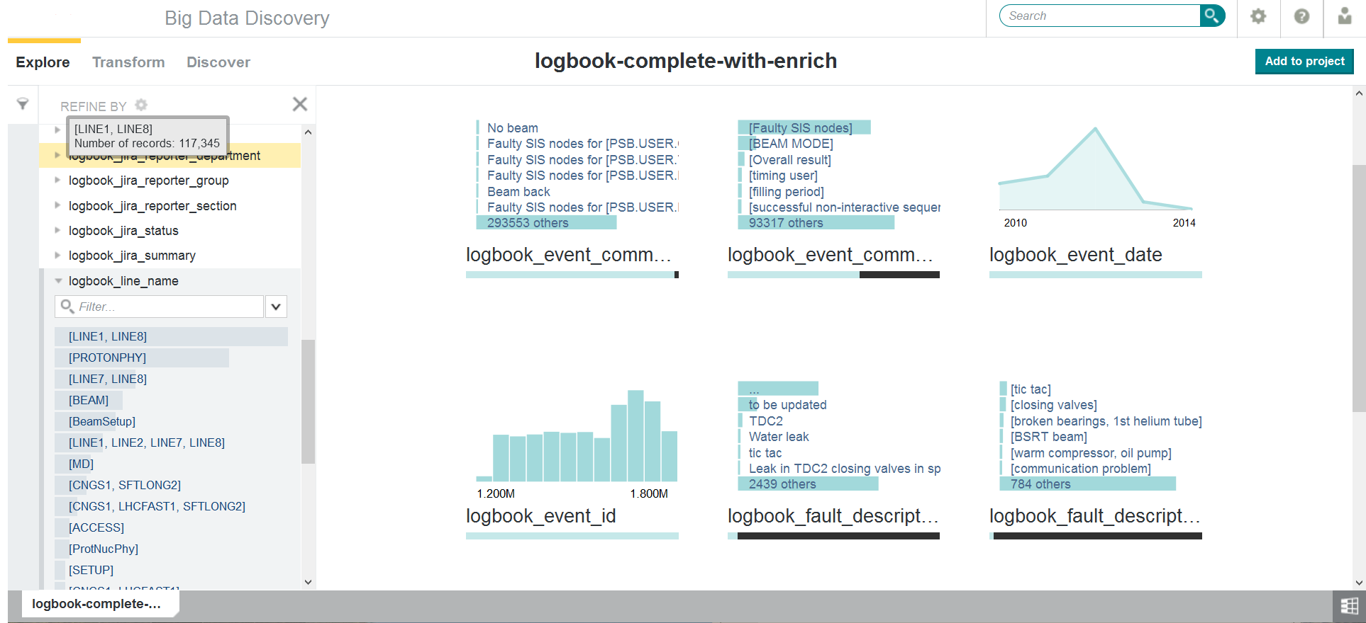
Oracle Big Data Discovery
Features
  Data Exploration & Discovery
  Data Transformation with Spark in Hadoop
    Apply built-in transformations or write your own scripts
    Data Enrichment: Text analytics, geolocation, etc.
  Collaborative environment
CERN SSO integrated
Already available for Hadoop test cluster
Some demos
  https://www.youtube.com/watch?v=Jyw9NtUZ_ks

Slide 29
Hadoop performance troubleshooting
hprofile
  Tool developed by IT Hadoop service to troubleshoot application performance on Hadoop
  Ability to identify part of the code the application is spending most time on and visualize this in a Human readable manner using flamegraphs
Usage and more information
  https://github.com/cerndb/Hadoop-Profiler
  Blog - http://db-blog.web.cern.ch/blog/joeri-hermans/2016-04-hadoop-performance-troubleshooting-stack-tracing-introduction

Slide 30
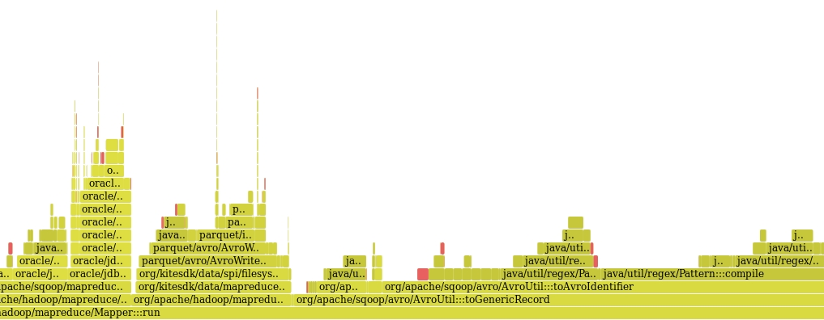
Hadoop performance troubleshooting
This profiler helped to identify the performance bottlenecks in sqoop when importing data in parquet format

Slide 31
Service Evolution
Kudu – New Hadoop storage for faster analytics
  Complements HDFS and HBASE
  Fills the gap in capabilities of HDFS (optimized for analytics on extremely large datasets) and HBASE (optimized for fast ingestion and queries over small datasets)
Backups for Hadoop
Evaluation and possible deployment of Alluxio – in-memory distributed filesystem

