Slide 1
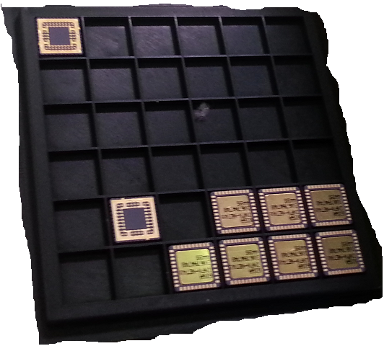
A WRM chip for data driven topological trigger in DUNE
Abdallah¹, G. Aielli¹, R. Cardarelli¹, M. Manca², D. Stefan², R. Sulej²
¹University and INFN of Roma Tor Vergata, Italy; ² CERN; ³FERMILAB

Slide 2
DATA or BIG data?
Do I have a sufficiently high local S/N? → simple trigger detector
How the significance depends on correlation of scattered measurements
Can I predict (→pre-cable) in advance the correlation patterns? (a la LHC experiment…)
What is like the case of DUNE ?
Sensors produces DATA →
  A sensor is whatever is able to produce an observable encoding events in a given format
“real world”
SENSOR
DATA
transducer
encoder
Too BIG for what?
  Sensors produce data faster than we can store
  We need to interact with data to take decisions in real time
BIG is a relative concept – not just a matter of volume
  More than the absolute volume the saliency matters. Model dependent

Slide 3
BIG Data for DUNE
Dune detector: 10^5 channels sampled at 2 MHz at 12 bit
  0.3 Tbyte/s is the sustained data rate producible by the detector
  Most of which is noise…
Neutrino beam from Fermilab → small duty cycle ~5*10⁻⁴ → small data
For unpredictable events such as cosmological events or nucleon decays a trigger is needed → Argon scintillation
  It is ok but the threshold can not be too low to avoid limiting the sensitivity
  Each trigger covers minutes of continuous data (supernova explosion or grav. Waves)
Local signal filtering is ineffective since signal and data are locally similar
A topological trigger, recognizing the track in real time would computationally heavy but good to exploit the maximum discovery potential→ data driven trigger

Slide 4
HEP community awareness at the dawn of ICT era
In the ‘80 a big effort started to solve the problem of fast pattern recognition and neural networks
  Ristori et al. Associative Memories (AM chip)
  Darbo et al. Contiguity processor
  AA.VV. Start of studies on neural network algorithms for tracking
  AA.VV. Fuzzy logic
Modern tracking triggers would like to:
  Suppress the noise
  Reconstruct the track elements
  Classify meaningful events through topology
A regression is the best way to evaluate data against a model→ computation complexity

Slide 5
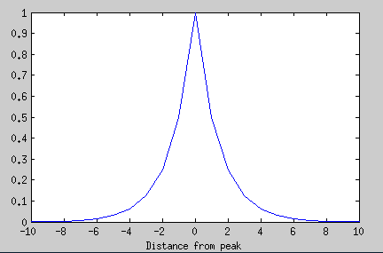
Weighting Resistive Matrix: let the physics compute
An interconnected repetitive resistive network subjected to an electrostatic potential provides the necessary tools
  The diffusion potential as a notion of distance
  The superposition principle ensures the correlation
1
10
V1
R
r
R
r
R
R
R
R
r
r

Slide 6
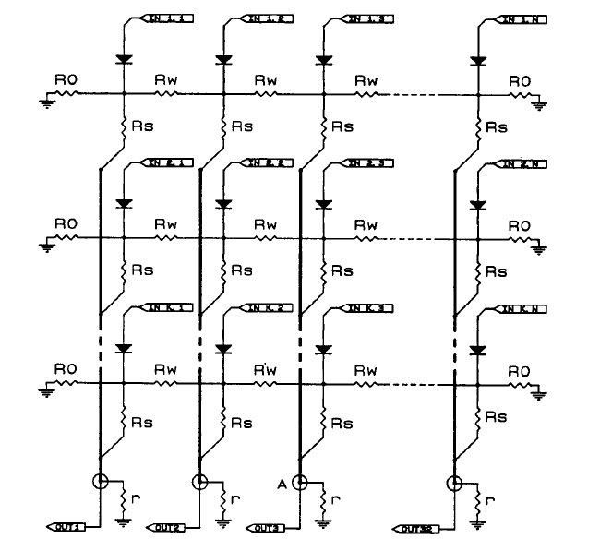
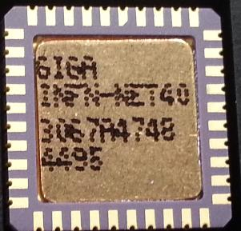
The WRM schema – a simple 1D implementation
Diffusion
From: R. Cardarelli et al.; “On a very fast topological trigger”; NIM A324(1993) 253-259
a virtually infinite resistive network, where the ratio Rw/Rs determines the exponential voltage diffusion rate
Voltage sum

Slide 7
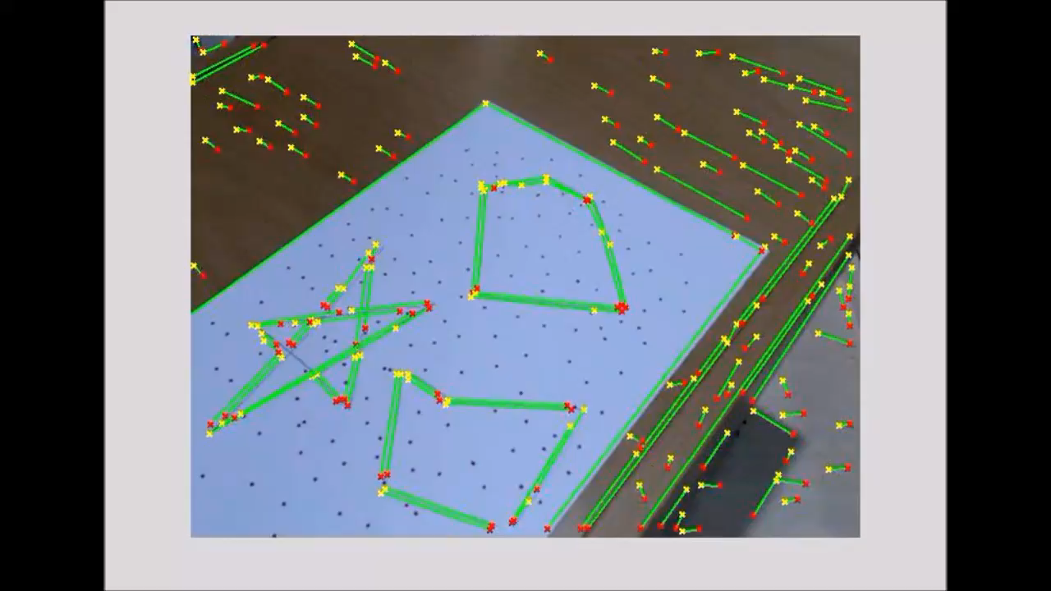
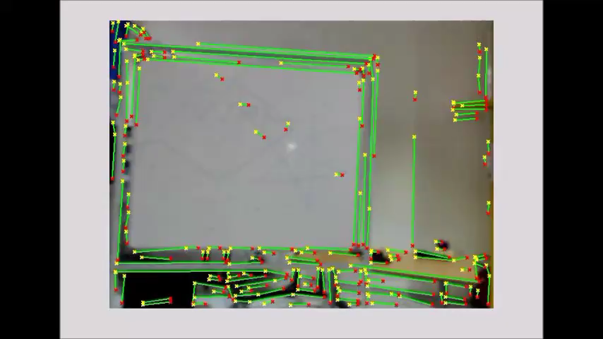

From particle tracks to fast image analysis
The idea: in HEP we can recognize simple 1D trajectories in ~10⁻⁹ s
In computer vision we need to process 1 M pixel in ~ 10⁻² s
We can use 10⁷ longer time to perform much complex pattern recognition
Rebuild the image structures in terms of a parametric representation of its elements
20 years old IC
Digital input
1D diffusion
8x8 inputs only
New tech→ faster speed
Integrated to the sensor
3D diffusion
Programmable matrix size
Present WRM limitations

Slide 8
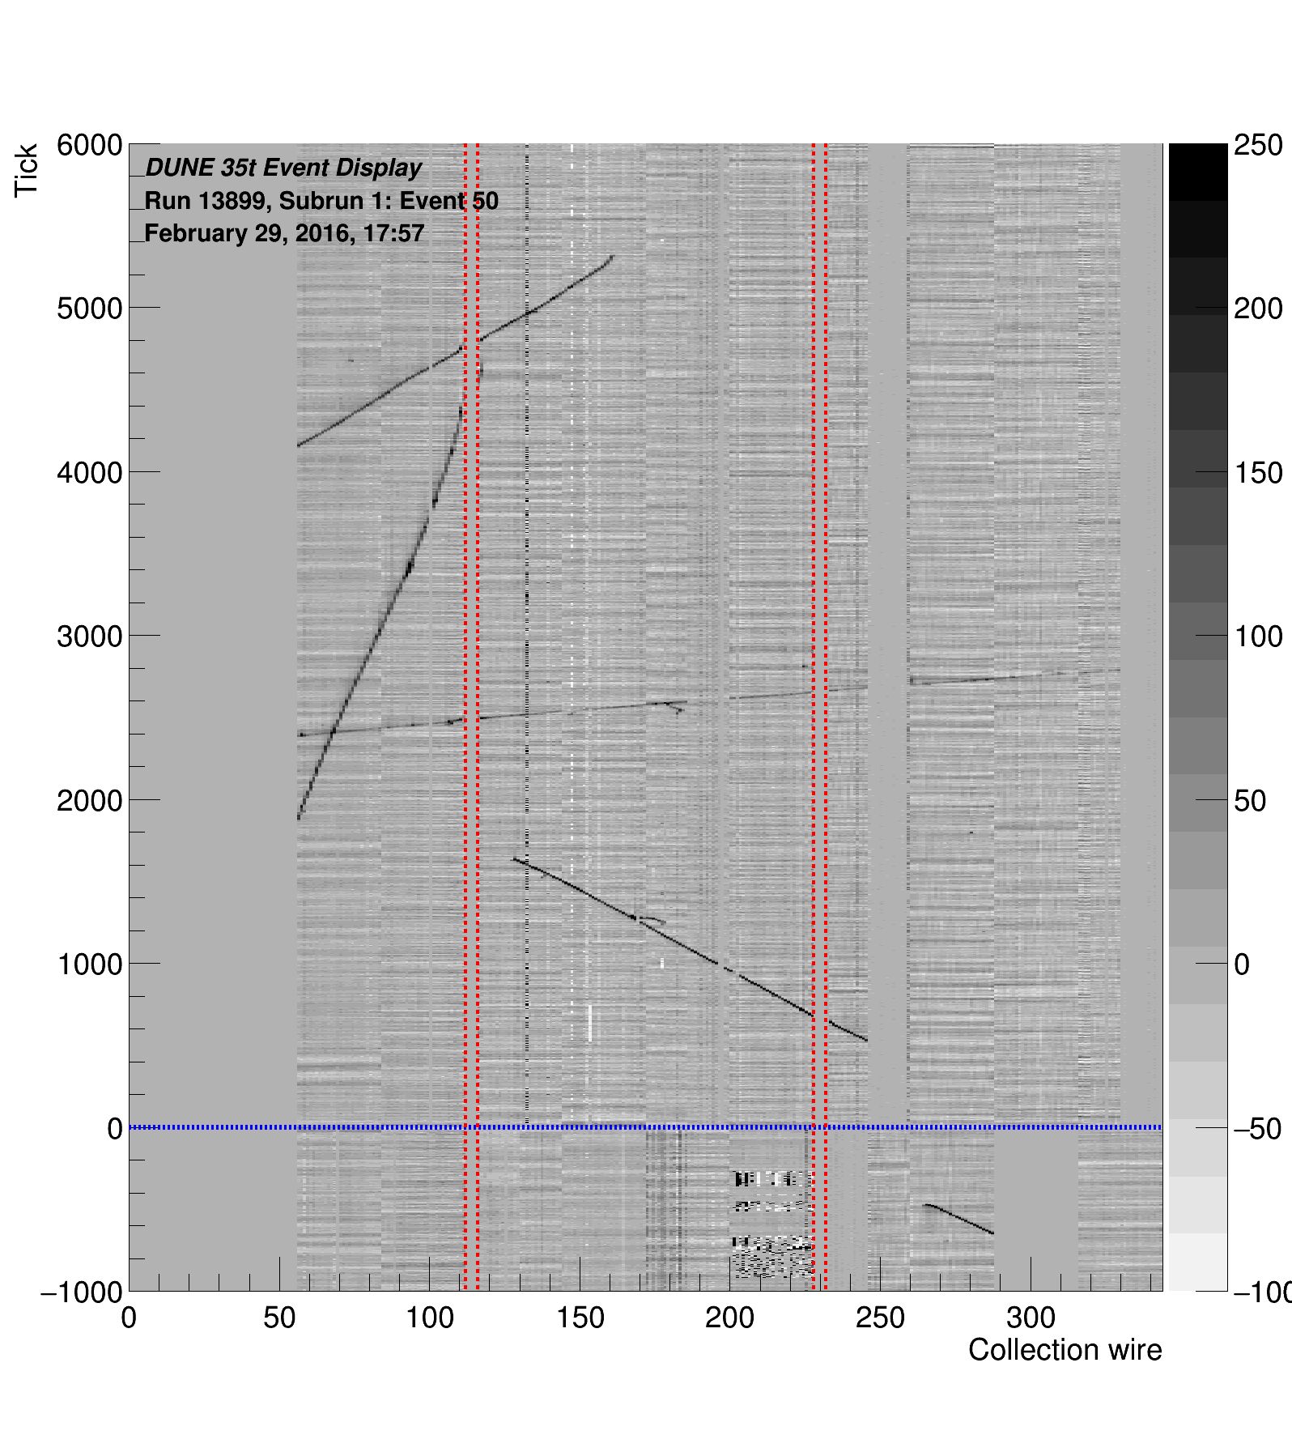
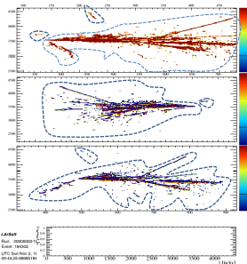
From image analysis to DUNE event detection
Collected data is similar to a normal grayscale image
The idea is to use the WRM to filter out the noise
Crop then region of interest
New WRM layout is object of the present proposal, optimized for the neutrino trigger problem
We want to obtain a fast trigger and optimal zero suppression system!
We aim to redesign the WRM purposely for high performance
~1 GHz processing speed
30x30 matrix → 900 samples per clock
Direct analog input
~12 Tera samples/s

Slide 9
A first test with the existing WRM FPGA emulation
The idea is to generate simply an acceptance mask encapsulating the region of interest
Simulation data (no noise)
WRM retrieved mask

Slide 10
A first test with the existing WRM FPGA emulation (II)
Simulation data (no noise)
WRM retrieved mask
Some spot-like points are still missing since our search patterns are tuned to segments but the efficiency is already high

Slide 11
A first test with the existing WRM FPGA emulation (III)
Simulation data (no noise)
WRM retrieved mask

Slide 12
Backup

Slide 13
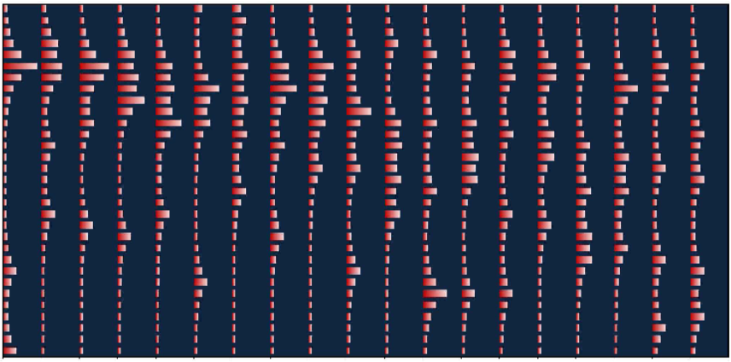
WRM exercise: 3 track vertex with noise
Upper image is the digital input to the WRM.
Can be any digital readout detector
Lower image is the corresponding potential distribution produced by the WRM.

Slide 14
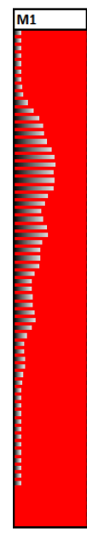
Straight line fit: y=mx+q
For any given m all the q are tested at the same time

Slide 15
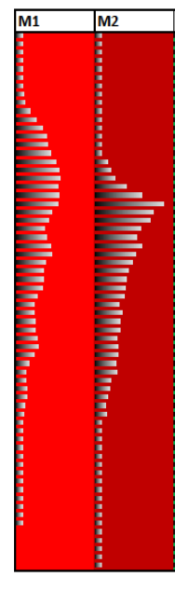
Straight line fit: y=mx+q
For any given m all the q are tested at the same time
A good m,q choiche produce a sharper and higher peak in the parameter space

Slide 16
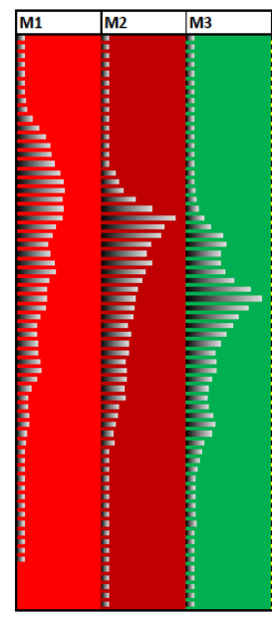
Straight line fit: y=mx+q
For any given m all the q are tested at the same time
A good m,q choiche produce a sharper and higher peak in the parameter space
The test can be done in parallel or the data are feed to the matrix by a circular buffer

Slide 17
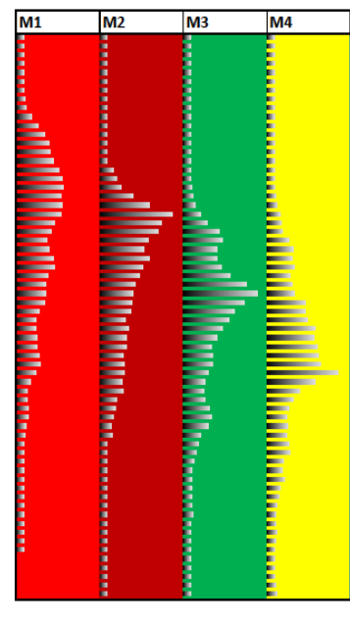
Straight line fit example: y=mx+q
For any given m all the q are tested at the same time
A good m,q choiche produce a sharper and higher peak in the parameter space
The test can be done in parallel or the data are feed to the matrix by a circular buffer

Slide 18
Straight line fit example: y=mx+q
For any given m all the q are tested at the same time
A good m,q choiche produce a sharper and higher peak in the parameter space
In the other cases the distribution is flat
The test can be done in parallel or the data are feed to the matrix by a circular buffer

Slide 19
Vertex identification example
The 5 tested m values displayed as a function of q → local maximum
The three highest peaks are selecting lines crossing in the same point (vertex)
In the (m,q) space 3 aligned points represent a vertex → vertex signature

Slide 20
Straight line fit example: y=mx+q
m
We can treat the parametric plane as new input data → in the new parametric pane m’, q’ of the line represents the vertex
q

