Slide 1
TIARA meeting
Oct. 18, CERN, Geneva
Horizon 2020 Design Study for a future large Research Infrastructure
R. Assmann
Leading Scientist DESY
Coordinator EuPRAXIA

Slide 2
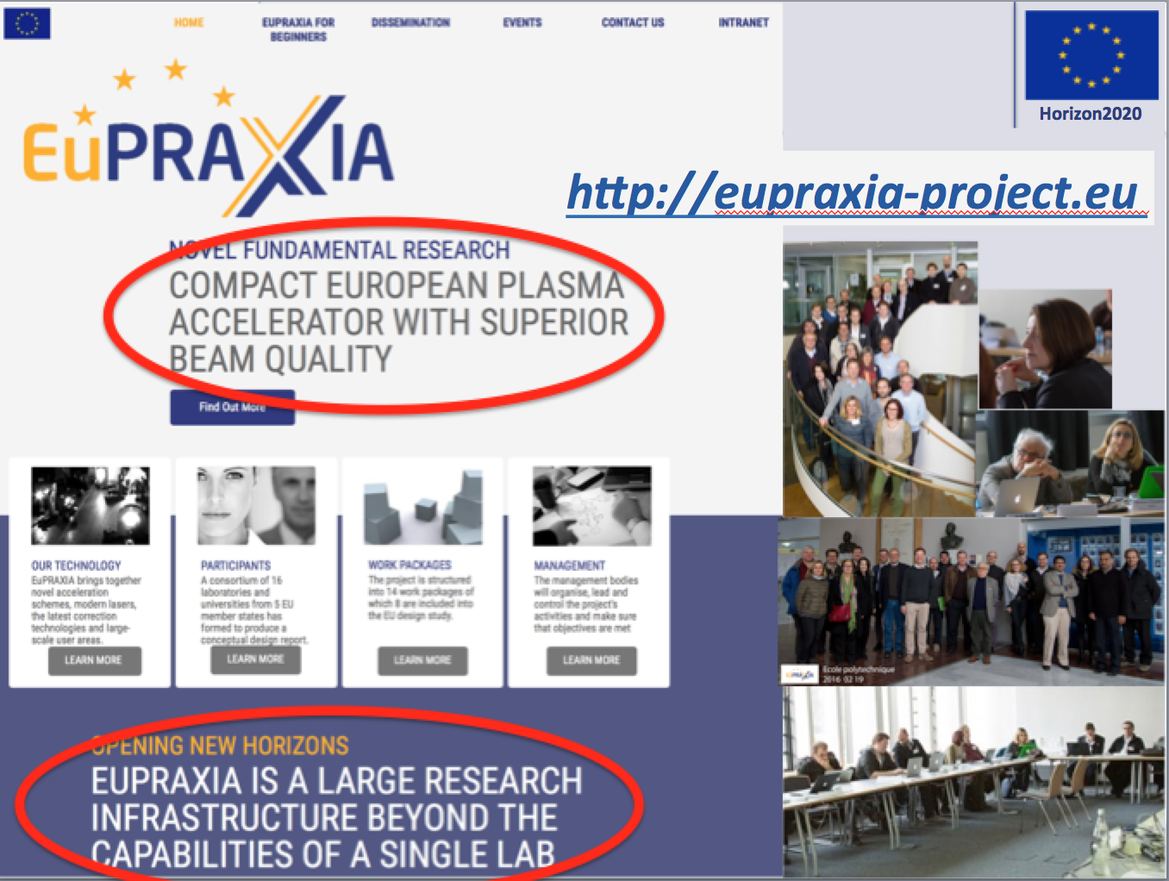
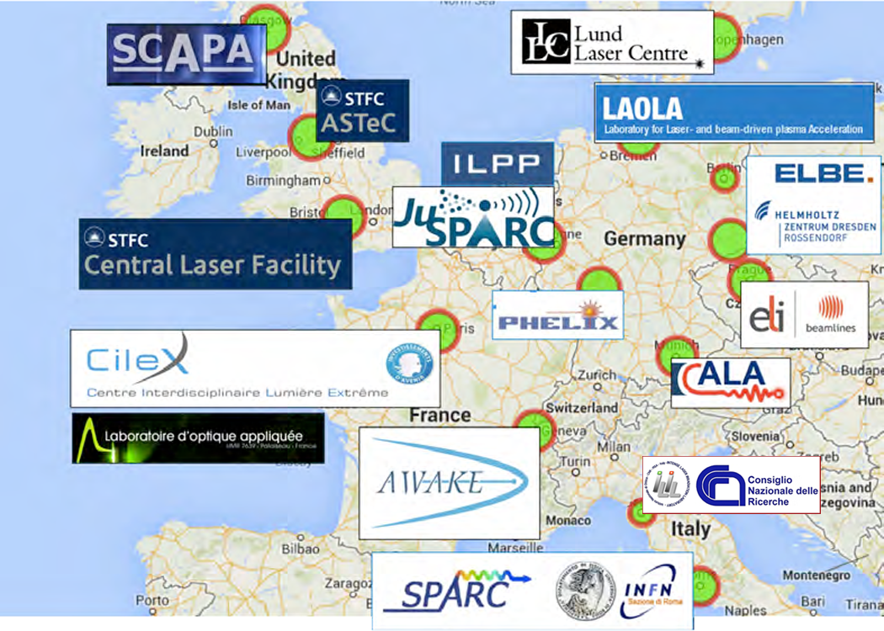

Slide 3
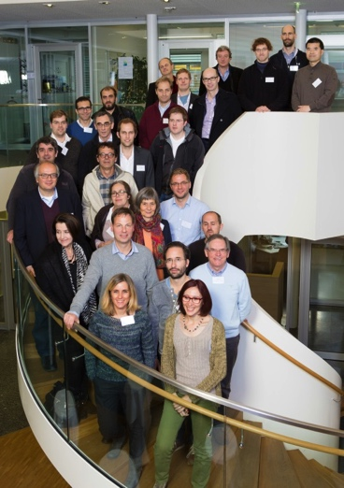
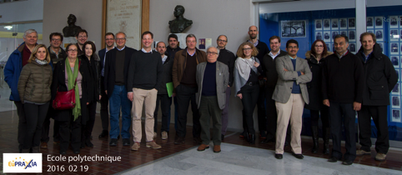
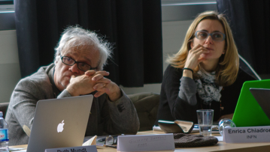
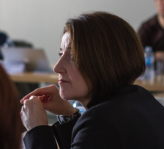
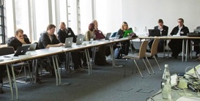
A European Strategy for
Accelerator Innovation
PRESENT EXPERIMENTS
Demonstrating
100 GV/m routinely
Demonstrating GeV electron beams
Demonstrating basic quality
EuPRAXIA INFRASTRUCTURE
Engineering a high quality, compact plasma accelerator
5 GeV electron beam for the 2020’s
Demonstrating user readiness
Pilot users from FEL, HEP, medicine, ...
PRODUCTION FACILITIES
Plasma-based linear collider in 2040’s
Plasma-based FEL in 2030’s
Medical, industrial
applications soon

Slide 4

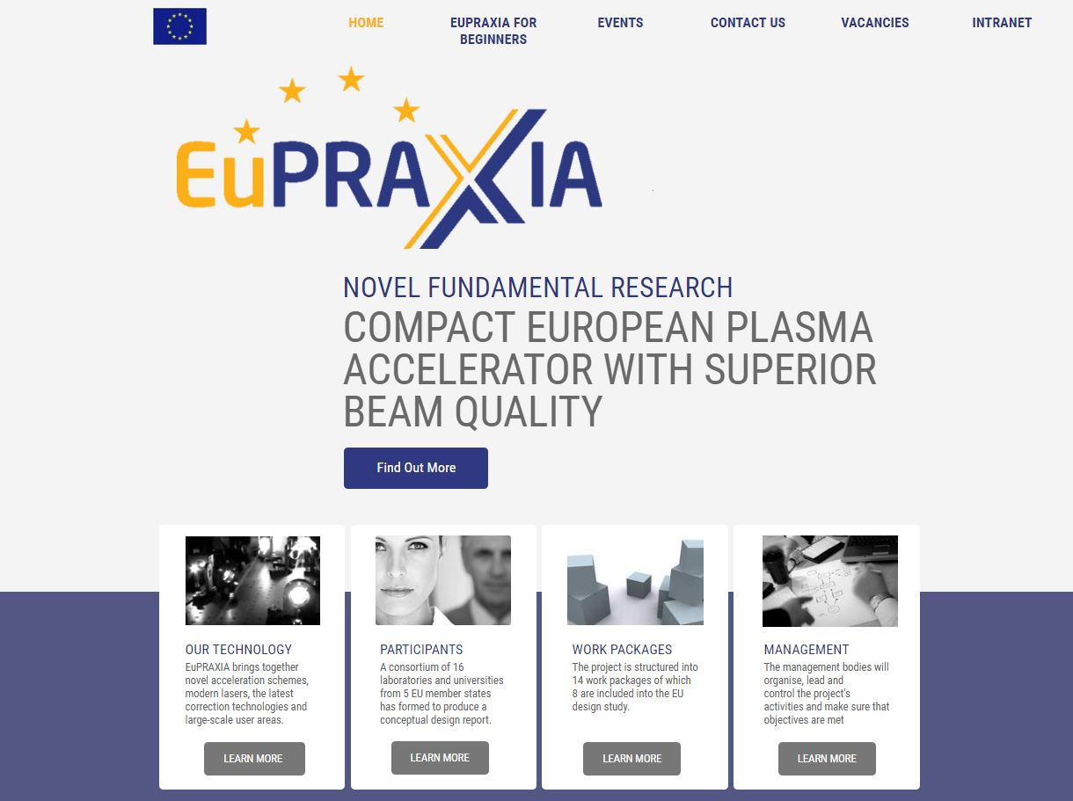

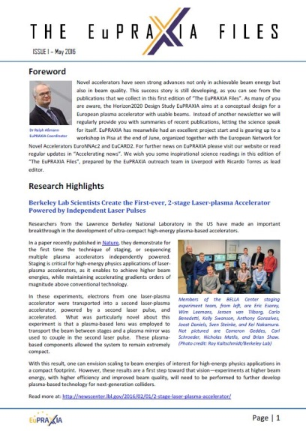

EuPRAXIA Outreach
www.eupraxia-project.eu
#EuPRAXIA
#plasma
#accelerator

Slide 5
Project Organization & Bodies

Slide 6

Participating Institutions
16 beneficiaries, 16 associated partners
Status 8/2016
USTRATH
University of Strathclyde, UK
STFC
Science & Technology Facilities Council, UK
DESY
Stiftung Deutsches Elektronen Synchrotron, Germany
UNIMAN
University of Manchester​, UK
UHH
Universität Hansestadt Hamburg, Germany
ULIV
University of Liverpool​, UK
ICL
Imperial College London, UK
5
UOXF
University of Oxford, UK
10
13
7
9
16
1
5
15
4
14
6
4
Associated Partners
(as of August 2016)
3
8
8
7
9
14
2
3
12
15
6
11
2
10
1
JUS Jiao Tong-University Shanghai
16
CNRS
Centre National de la Recherche Scientifique, France
13
INFN
Instituto Nazionale di Fisica Nucleare, Italy
12
TUB Tsingua University Beijing
1
11
2
CNR
Consiglio Nazionale delle Ricerche, Italy
3
ELI-B Extreme Light Infrastructure-Beams
SOLEIL
Synchrotron SOLEIL - French National Synchrotron​, France
4
PHLAM Lille University
5
HIJ Helmholtz Institute Jena
CEA
Commissariat à l'Énergie Atomique et aux énergies alternatives, France
IST-ID
Associacao do instituto superior tecnico para a investigacao e desenvolvimento, Portugal
ENEA
Agenzia nazionale per le nuove tecnologie, l'energia e lo sviluppo economico sostenibile, Italy
6
HZDR Helmholtz-Zentrum Dresden-Rossendorf
7
LMU Ludwig-Maximilians-Universität München
UROM
Sapienza Universita di Roma, Italy
8
WIGNER Wigner Research Centre of the Hungarian Academy of Science
9
CERN European Organization for Nuclear Research
10
KPSI/JAEA Kansai Photon Science Institute, Japan Atomic Energy Agency
11
OU Osaka University
12
RSC RIKEN SPring-8 Center
13
LU Lund University
14
CASE Center for Accelerator Science and Education at Stony Brook U & BNL
15
LBNL Lawrence Berkeley National Laboratory
16
UCLA University of California, Los Angeles

Slide 7





New Partners
Industrial Participation
Industry: involved through workshops and
Scientific Advisory Board
Contacts still evolving, several cooperations under discussion
New associate partners (documents complete – vote CB 27 Oct 2016):
Karlsruhe Institute of Technology, Germany
Hebrew University of Jerusalem, Israel
Institute of Applied Physics, Nizhny Novgorod, Russia
Joint Institute for High Temperatures, Russian Academy of Sciences, Moscow, Russia
University of Rome, Tor Vergata, Italy
New associate partners (documents under preparation):
1) Forschungszentrum Jülich, Germany, 2) FNAL (Fermilab), US, 3) SLAC, US

Slide 8
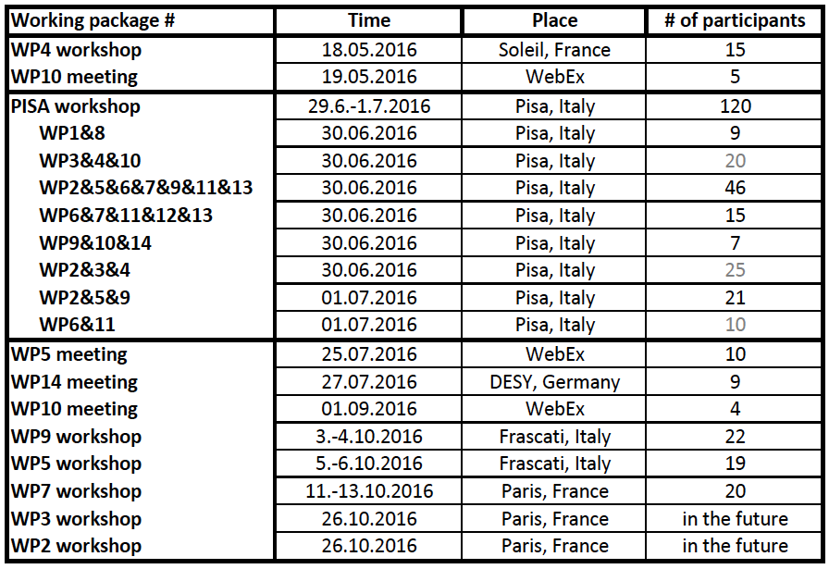
Work Proceeding in Dedicated WP Meetings

Slide 9
Timeline
Proposal submission: 09.2014
Approval: 07.2015
Start: 11.2015
1st year:
  Organization (collaboration agreements, …)
  Hiring of dedicated personnel
  Ten workshops on EuPRAXIA/EuroNNAc matters
  1st yearly meeting Oct. 2016: Decision on set of parameters for first study versions.
Final report & project end: 10.2019
Future Targets:
  ESFRI roadmap in 2018 or 2020
  CDR for 2020
  Operation 2025 to 2035

Slide 10

EuPRAXIA Laser Workshop
WP4 "Laser Design and Optimization”
L. Gizzi & F. Mathieu
On May 18, 2016 at SOLEIL - France.
Leading international laboratories were
represented including:
  Intense Laser Irradiation Laboratoy (INO - Italy),
  the Laboratoire d’Utilisations des
  Lasers Intenses (CNRS - France),
  the Lawrence Livermore National Laboratory (USA),
  the Centro de Láseres Pulsados Ultracortos Ultraintensos
  (University of Salamanca, Spain),
  the Central Laser Facility (Science and Technology Facilities
  Council, UK),
  The Petawatt Laser Facility (University of Texas at Austin, USA)
and international laser manufacturers such as
  Thales (France),
  National Energetics (USA),
  Amplitude Technologies (France),
  Amplitude Systèmes (France) and
  Proton Laser (Spain).
“Brainstorming” session starting basic specifications of the EUPRAXIA laser from EUPRAXIA steering committee, the so-called “100 cube”: 100 J, 100 fs, 100 Hz, contrast 10¹⁰ at 10ps → 1PW @ 100Hz
Detailed report is in preparation for Pisa meeting in June 29, 2016. Participants agreed to meet regularly every 6 months.
100cube Laser
Challenge

Slide 11
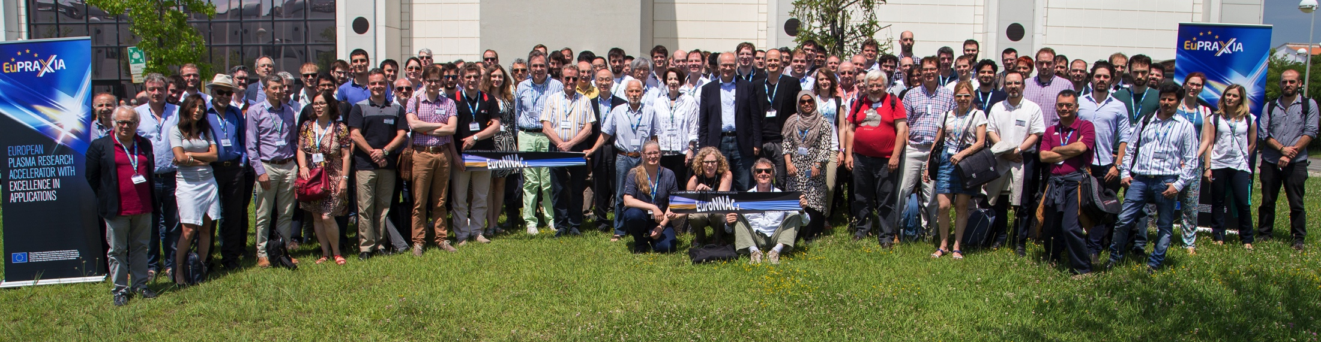
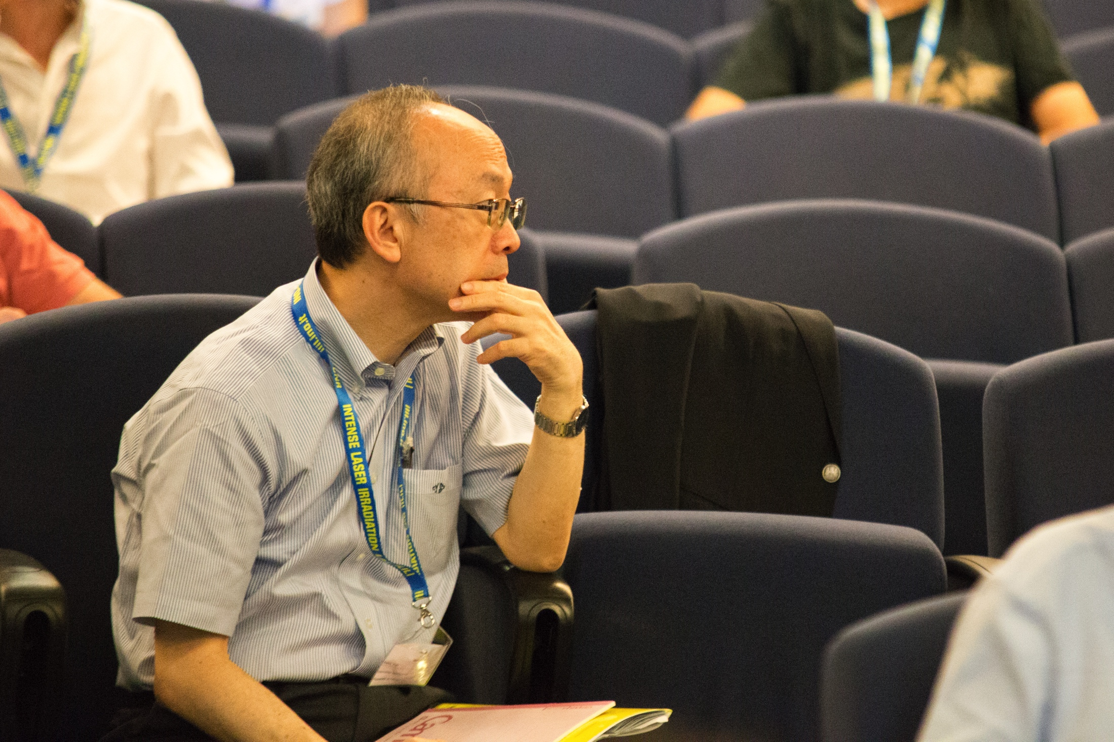
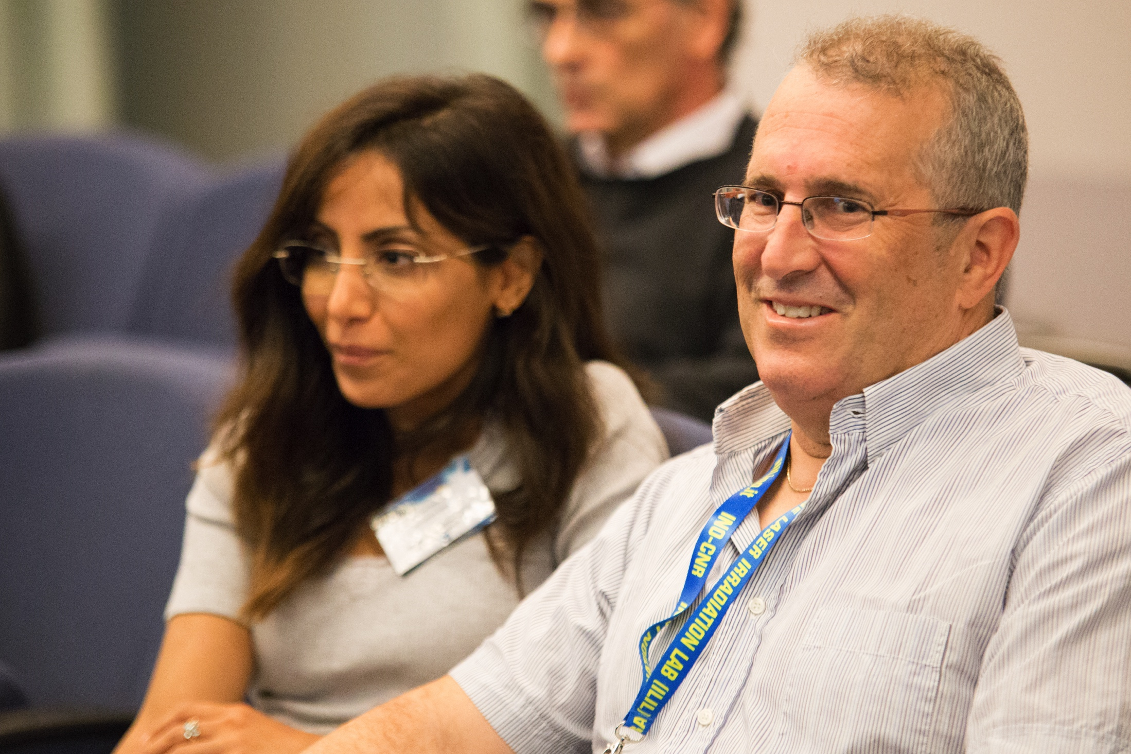
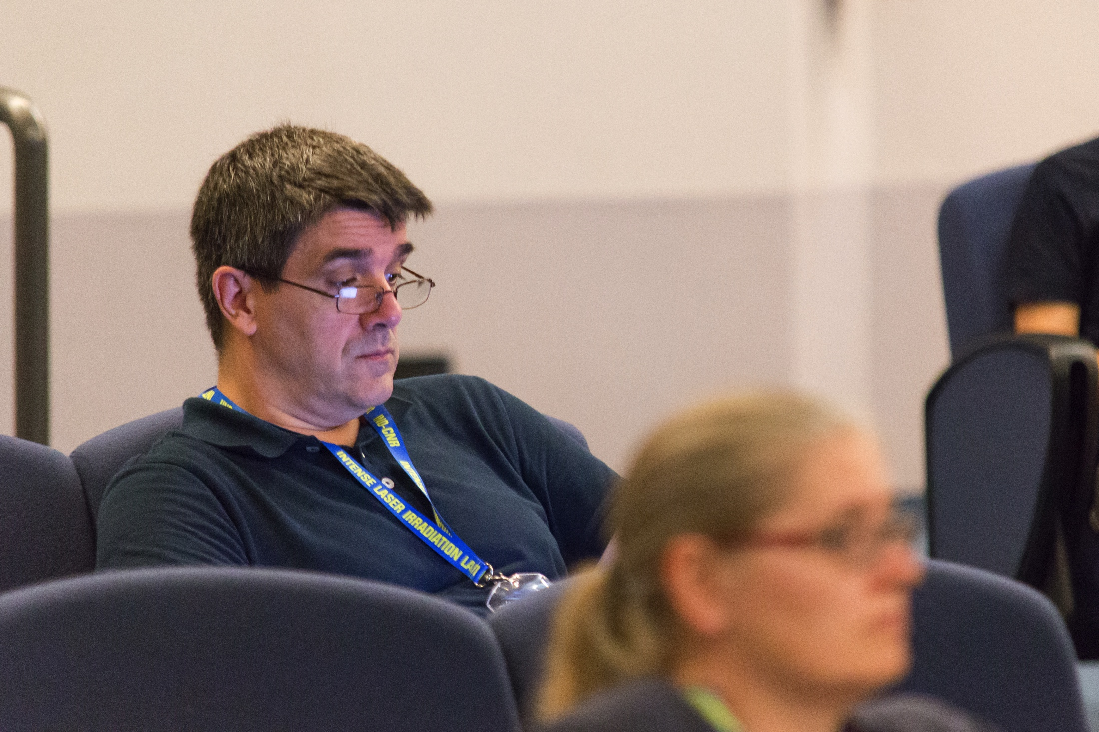
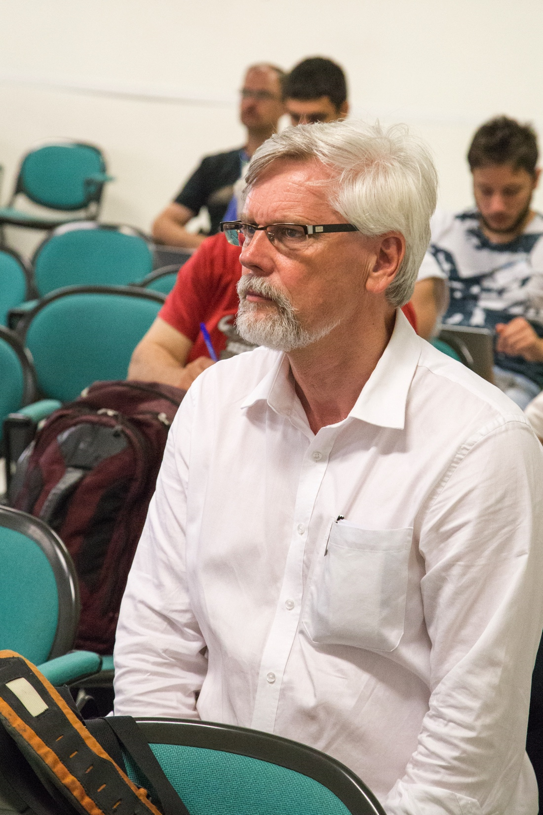
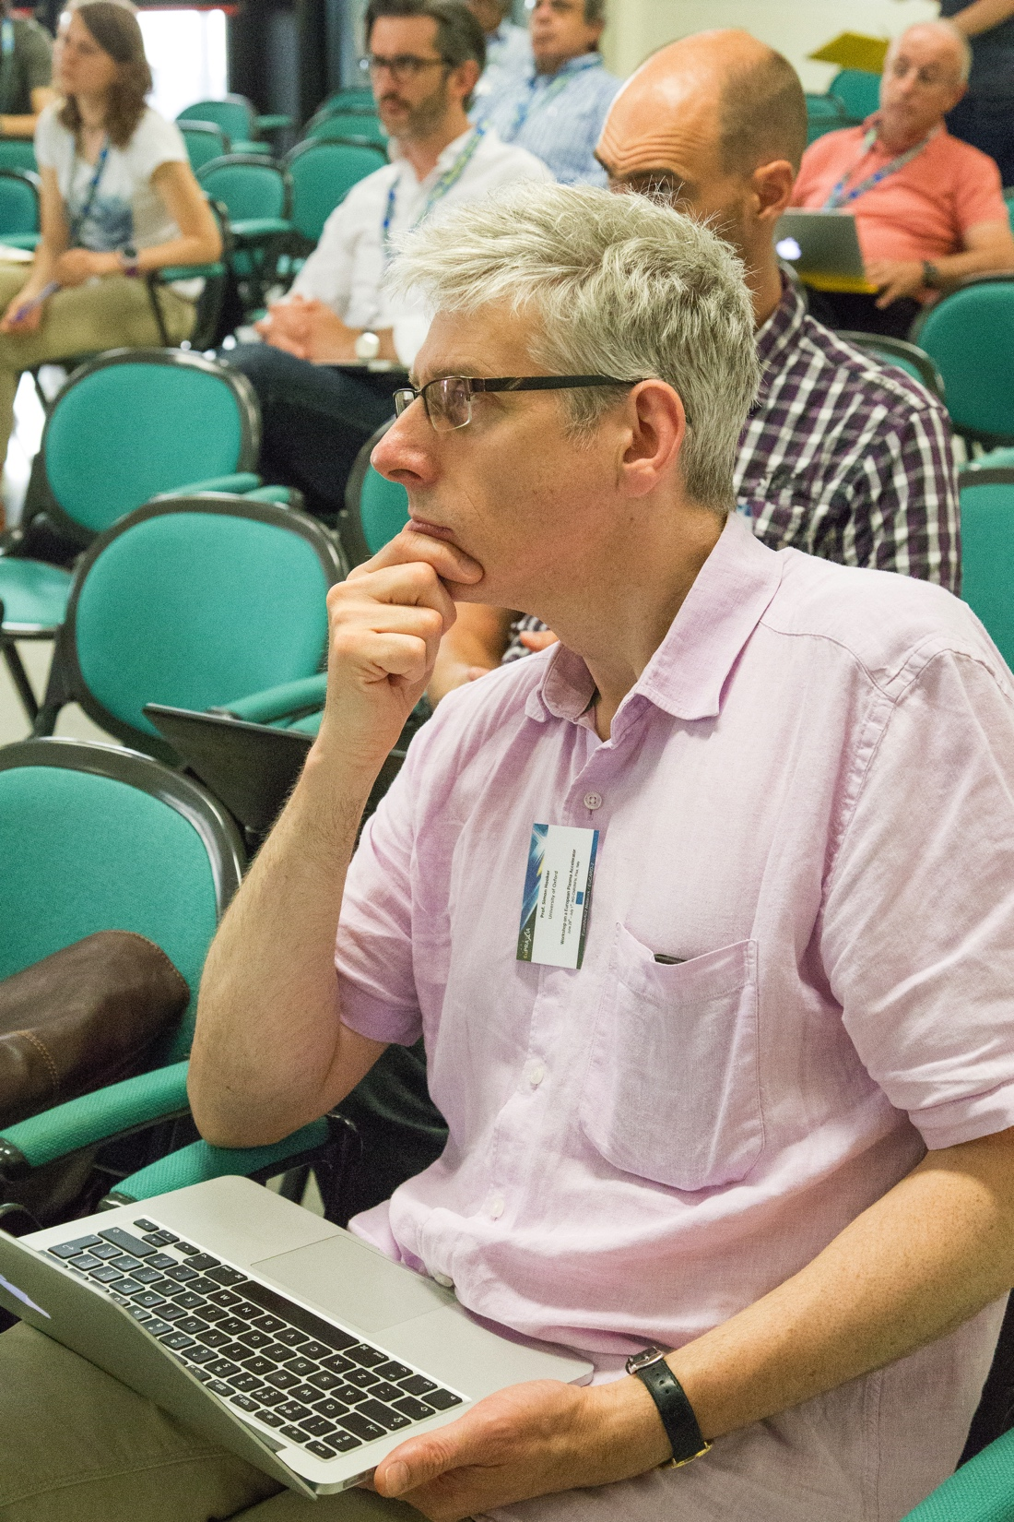
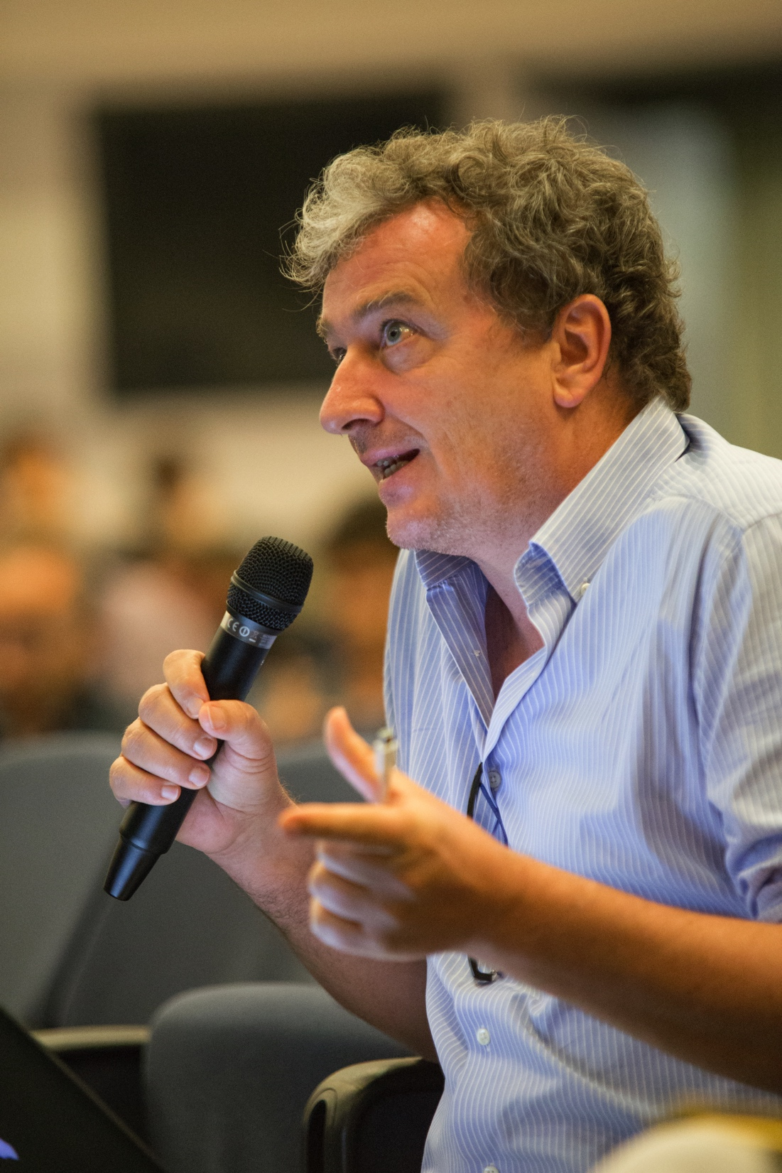
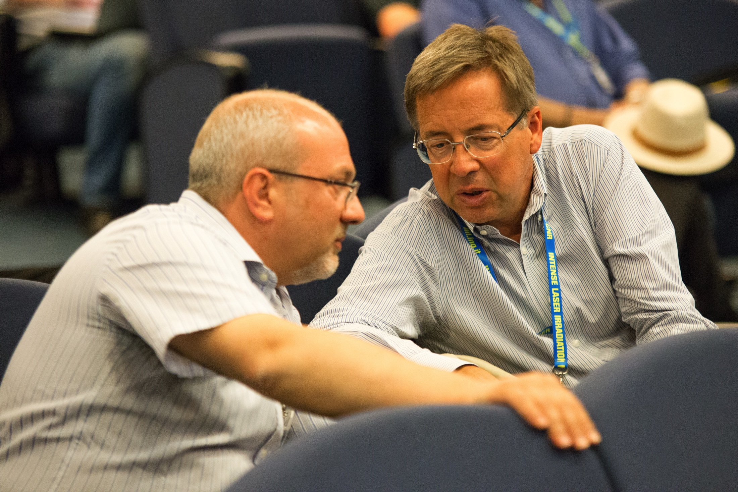
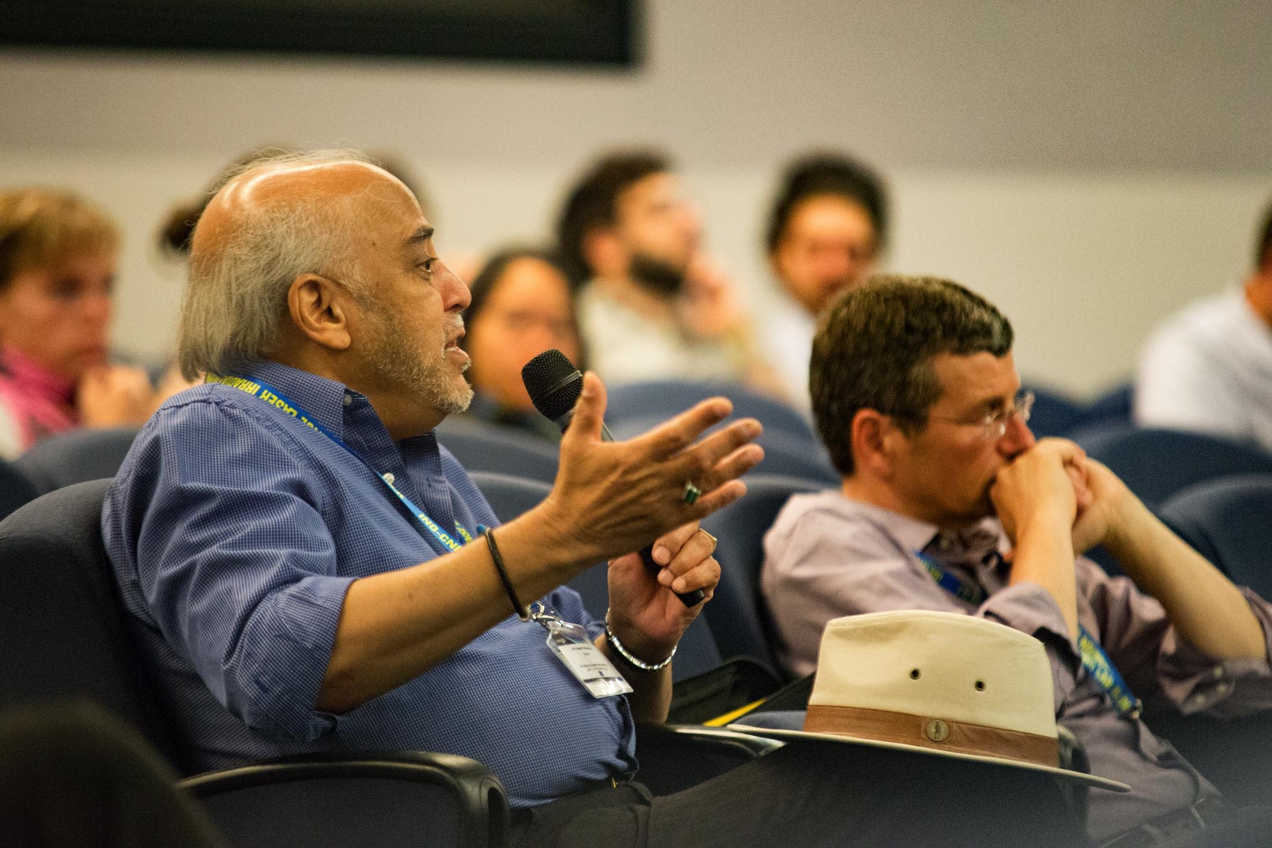
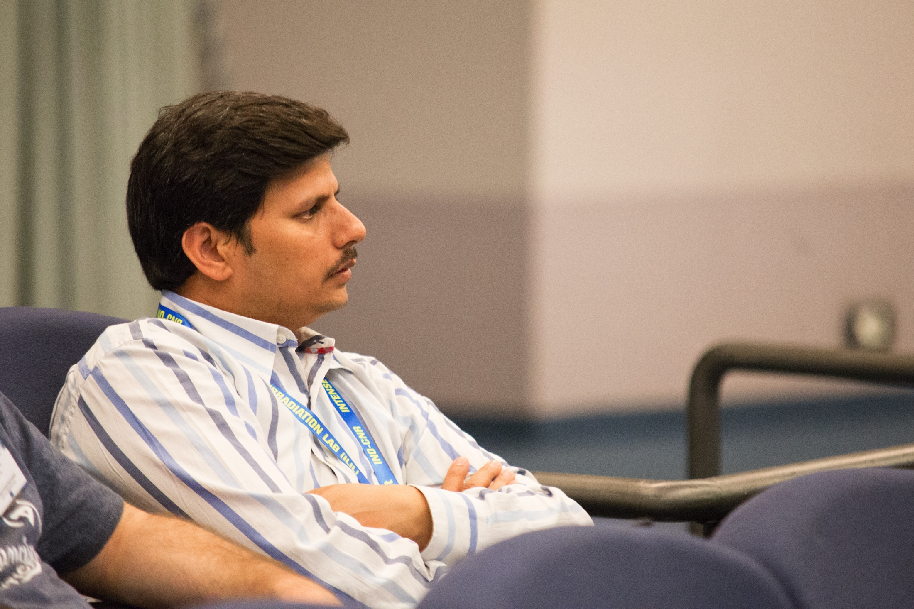
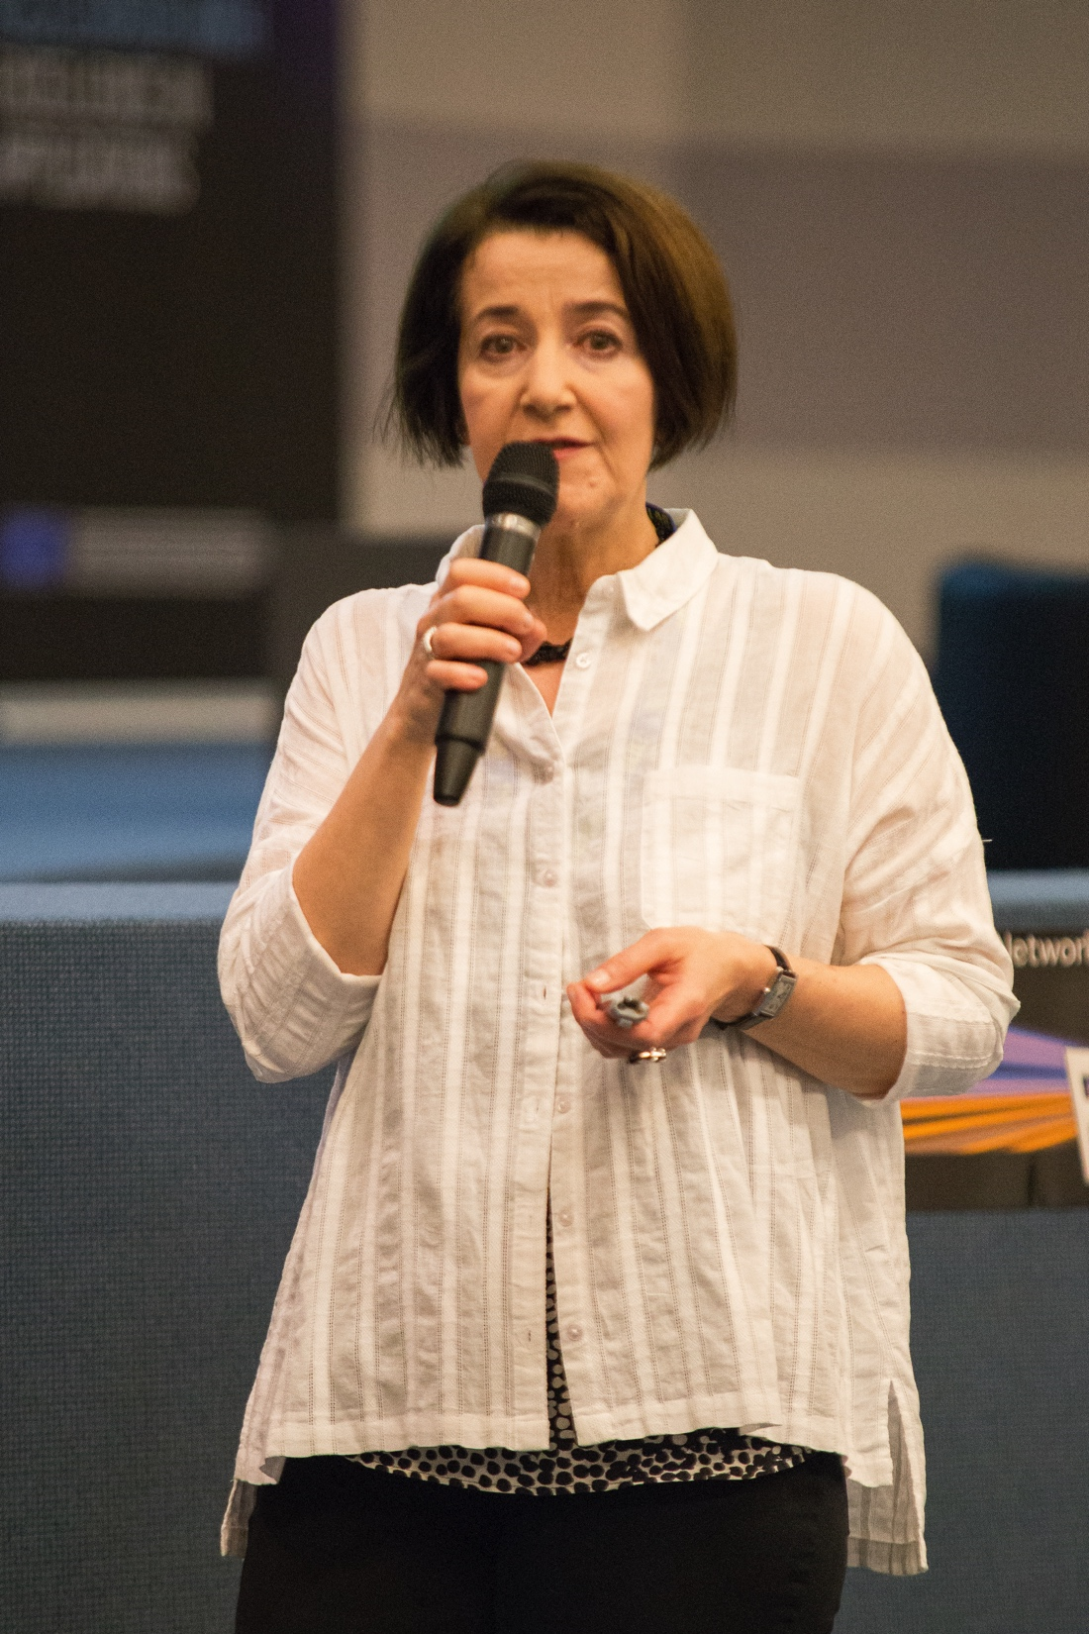
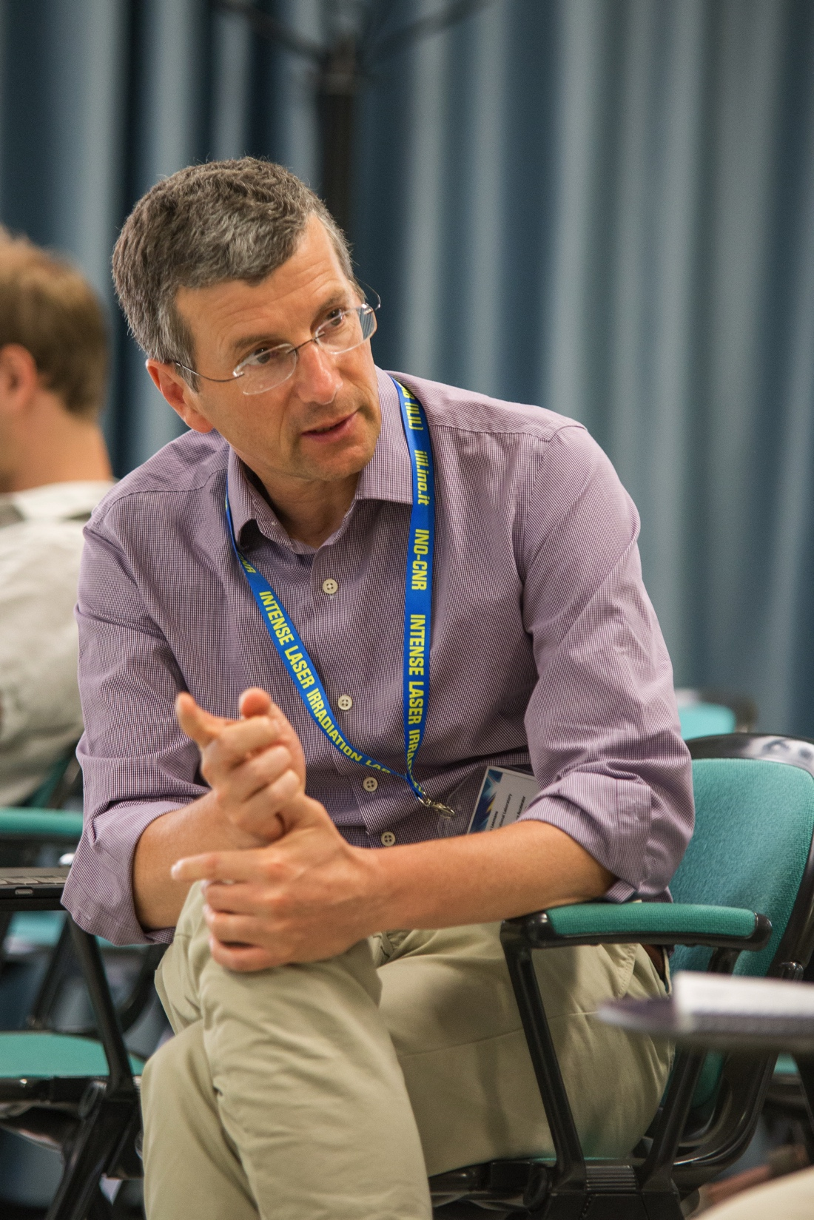
Pisa Meeting
June/July 2016, 120 participants

Slide 12
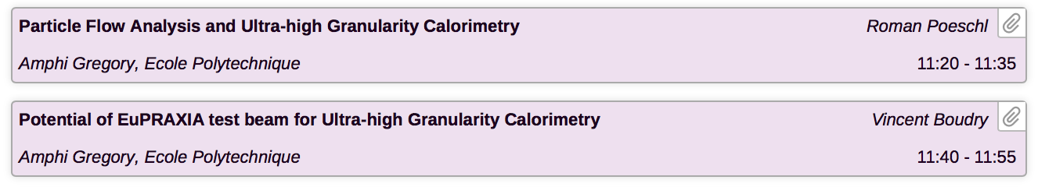
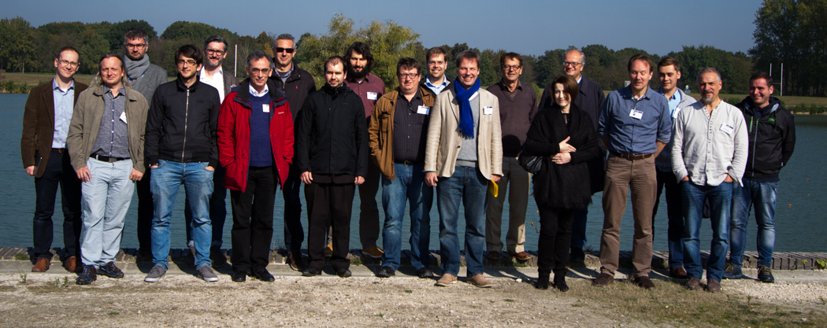
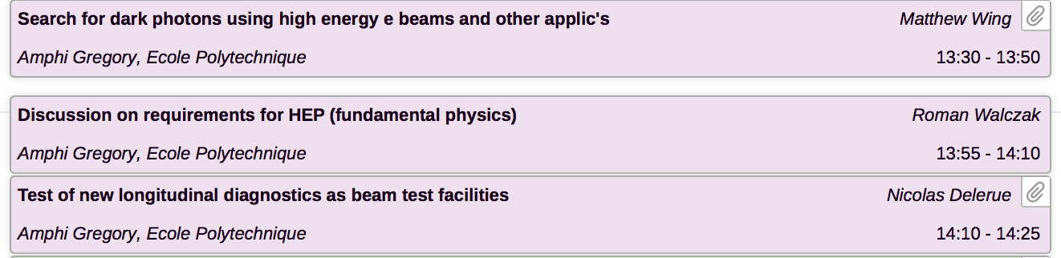
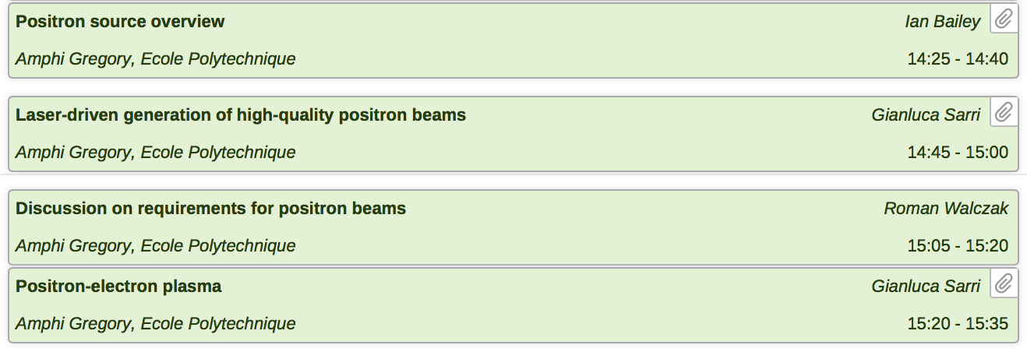
Users Mini-Workshop ecole polytechnique, Oct 11 -13

Slide 13
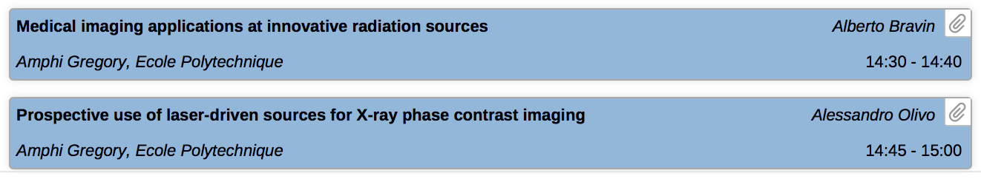
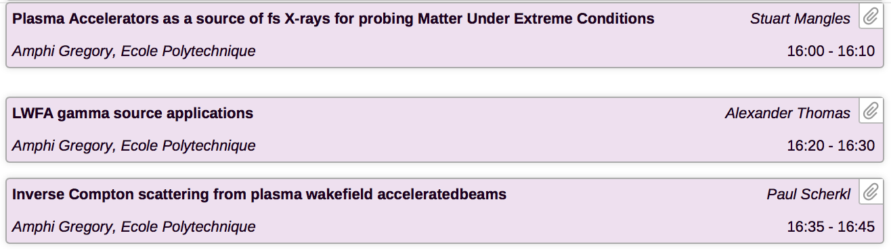
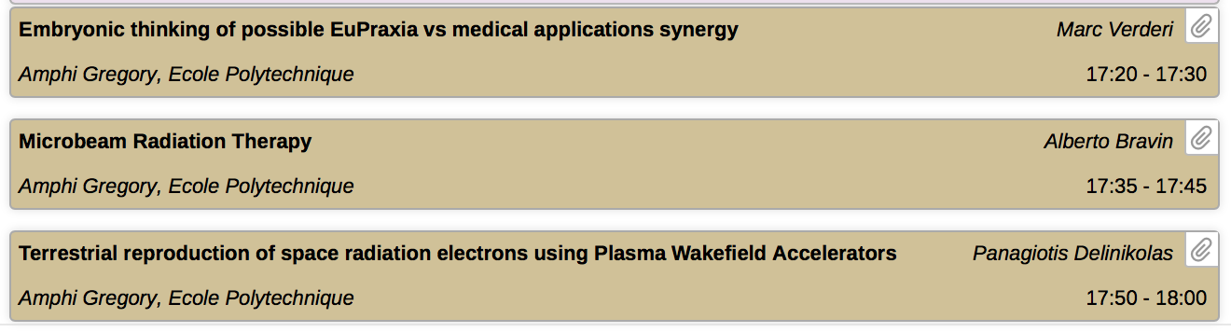
Users Mini-Workshop ecole polytechnique, Oct 11 -13

Slide 14
Highlight Features EuPRAXIA some guaranteed, others required goals
Short electron pulse length (femto-sec)
PW lasers – synchronized to 5 GeV electron beam
Significantly reduced size and cost
Modularity & extendability
Use of industrial laser technology
Optimization systems like in conventional accelerators
high density beams, ultra-fast science
  Reduced background, guaranteed beam quality
  γ – e, γ – γ interaction, novel rad. sources, optical undulators
  Profit from rapid develop-ments in laser industry
limited environments (uni-versities/hospitals), comple-mentary to big facilities, outreach to less developed nations
  path to higher energy by multiple stages

Slide 15
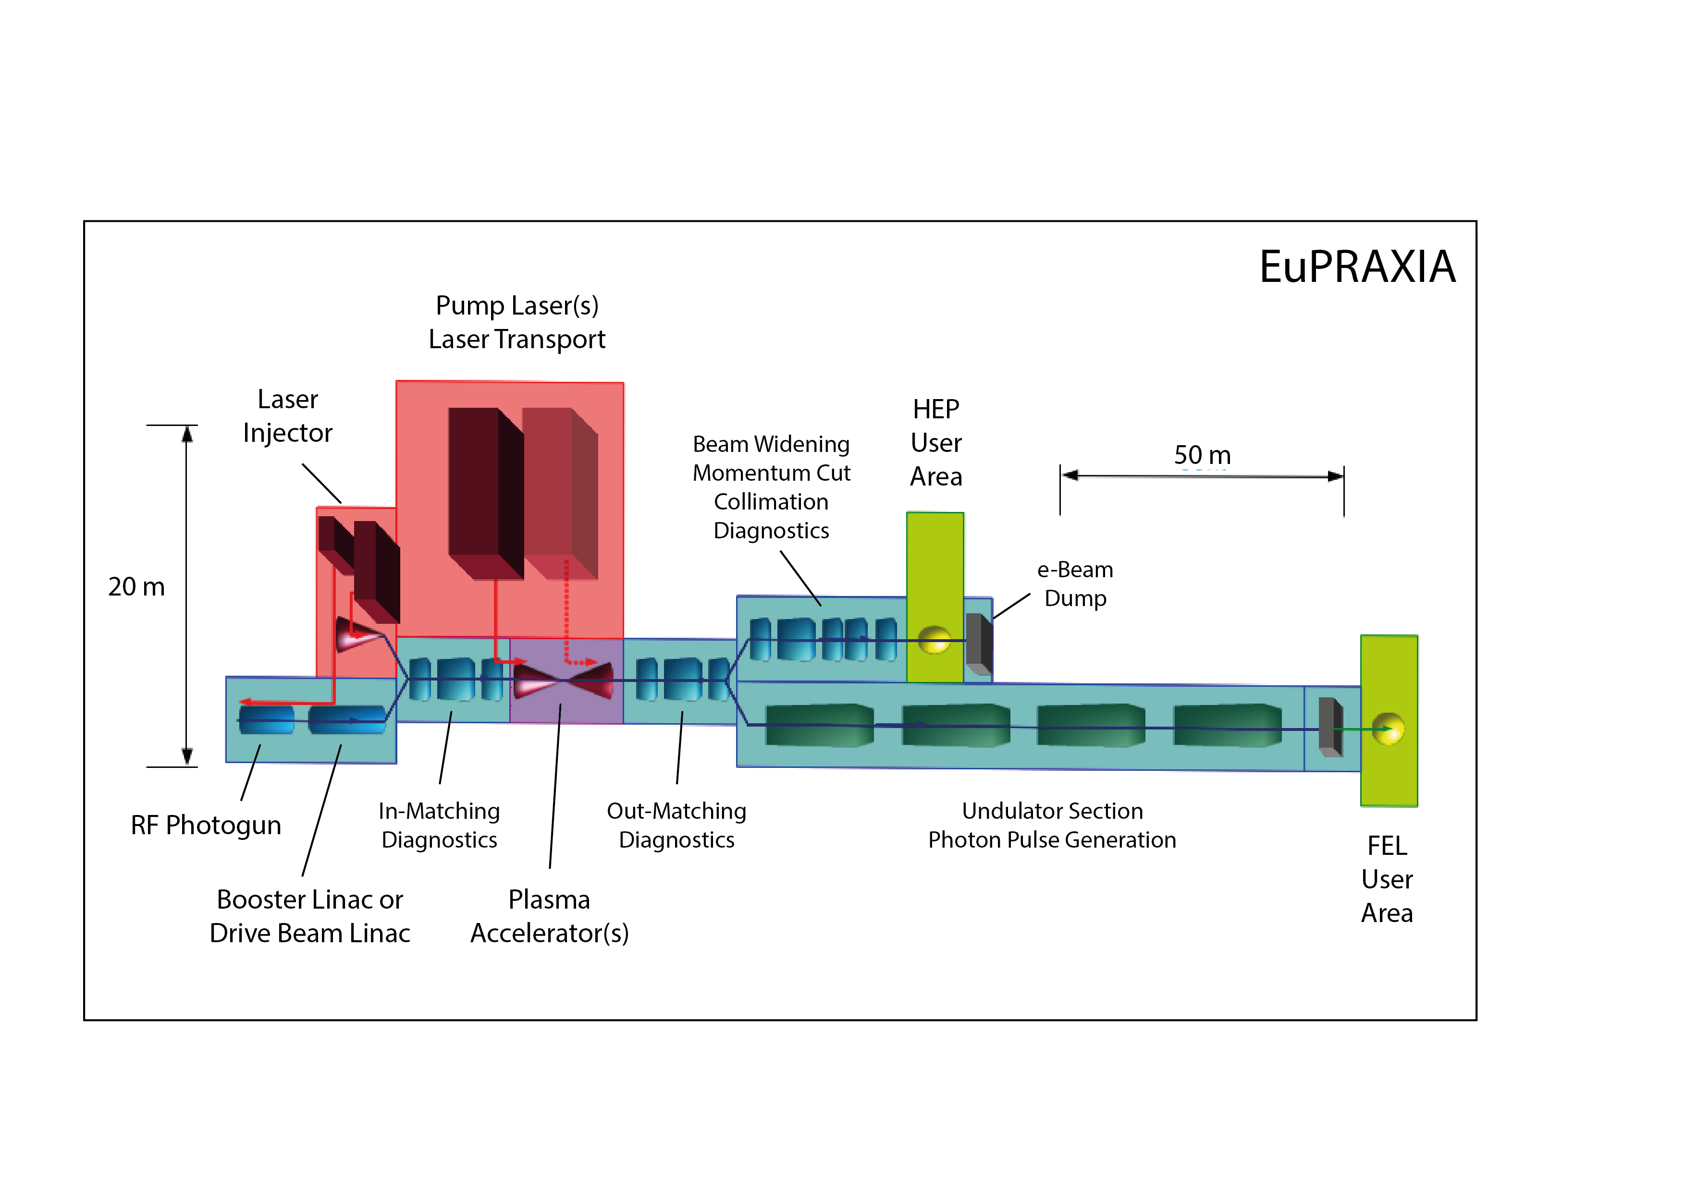
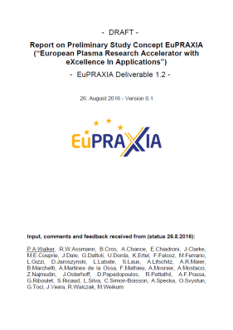
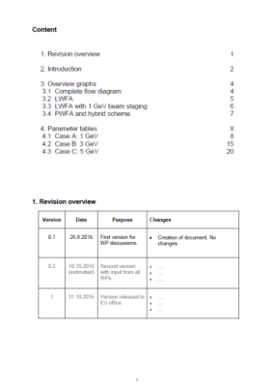
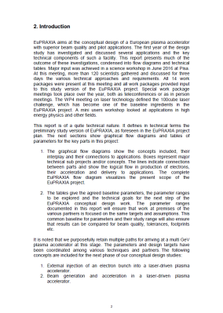
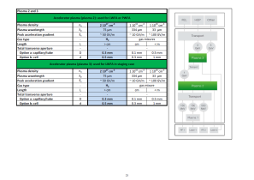
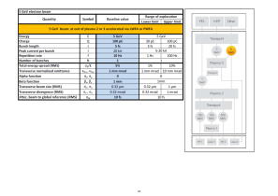
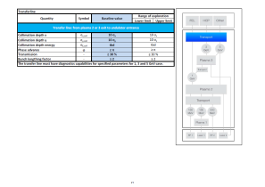
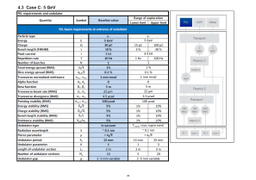
Preliminary Study Concept (Deliverable 1.2)
5 GeV e⁻ Research Infrastructure

Slide 16
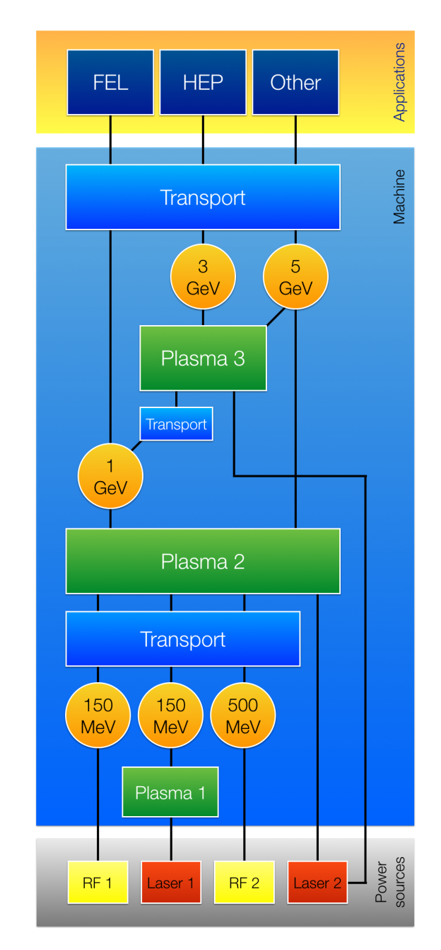
EuPRAXIA Concept
Technical diagrams include:
  Technologies (boxes) used
  Interplay between boxes (and WPs)
  Connections to applications
Design philosophy
  Applications define parameters
  Realistic RF & LWFA e-beam parameters defined
  Plasma & transport structures are defined from need and availability
  RF/Laser infrastructure designed around it

Slide 17
EuPRAXIA Design 1

Slide 18
EuPRAXIA Design 2

Slide 19
EuPRAXIA Design 3

Slide 20
EuPRAXIA Design 4

Slide 21
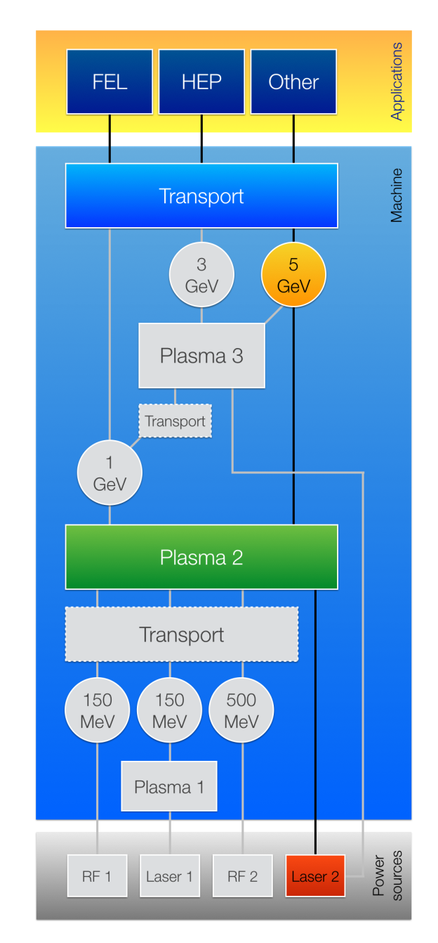
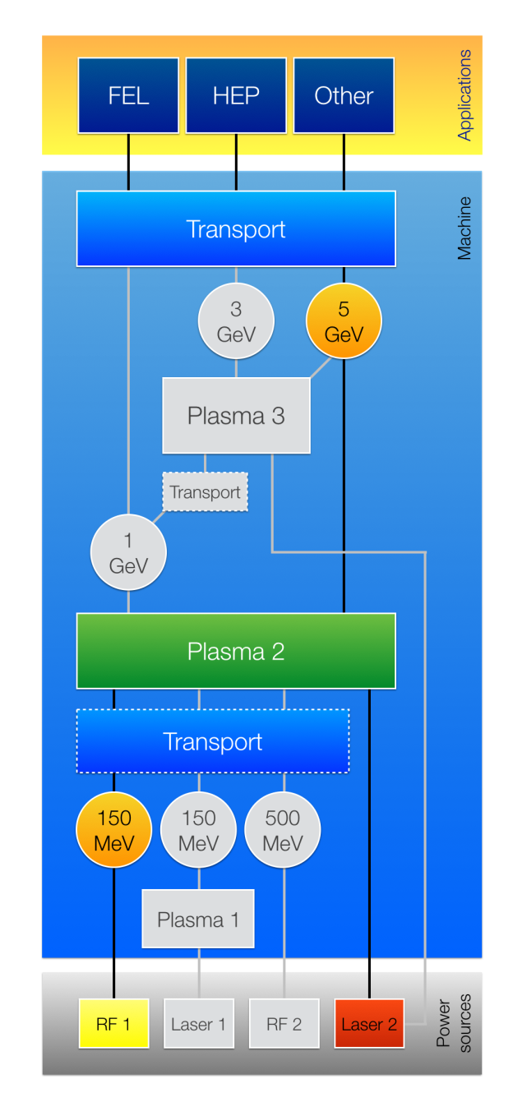
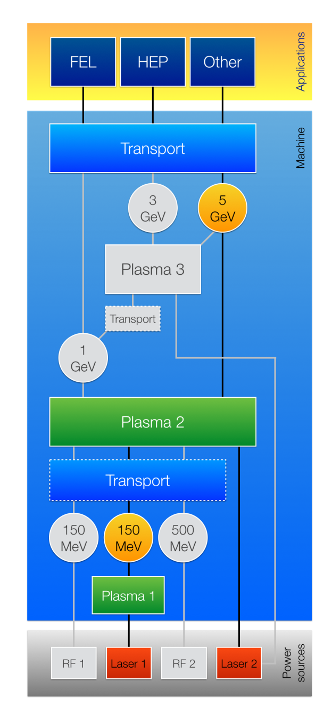
Multiple Operating Modes
Laser Wakefield Acc. with internal or external injection

Slide 22
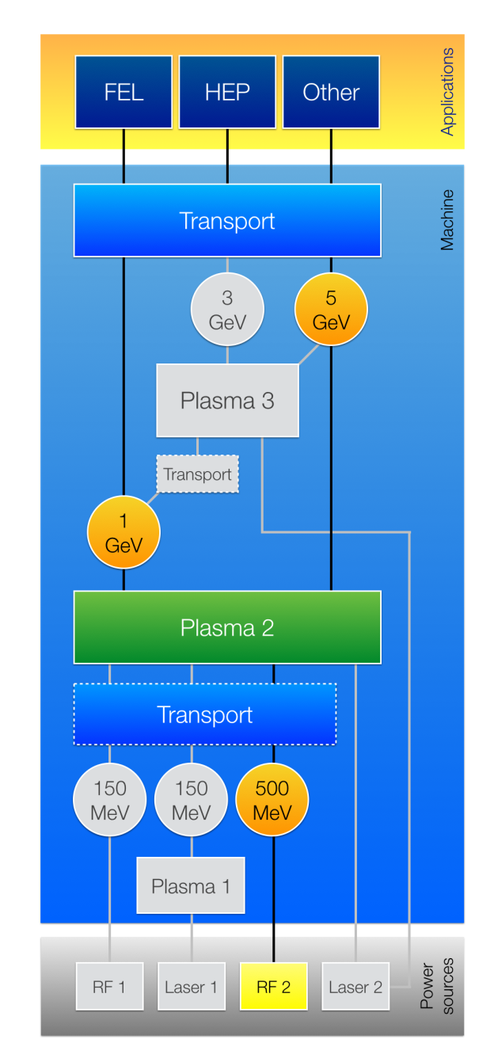
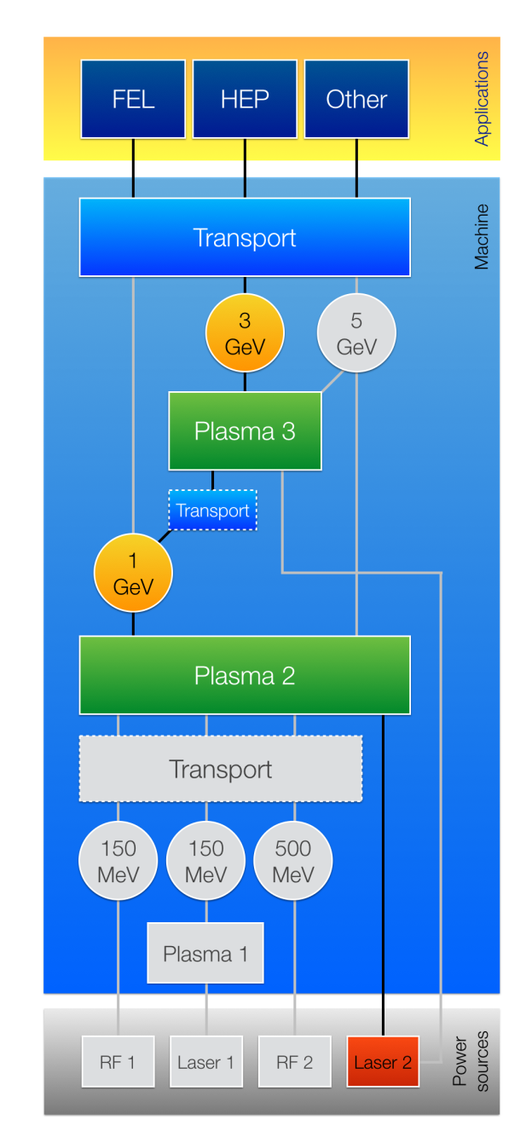
Multiple Operating Modes
Beam-driven or hybrid plasma accelerator

Slide 23
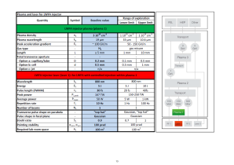
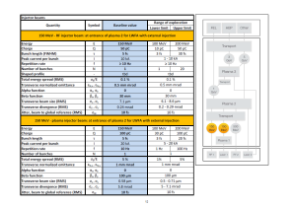
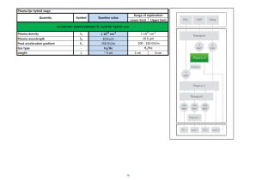
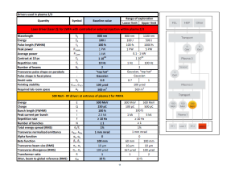
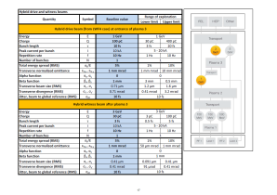
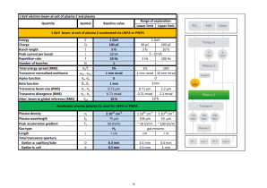
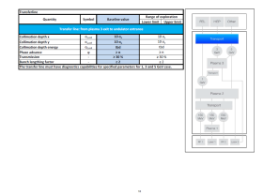



Parameter Tables
Study Version 2016
1 GeV
3 GeV
5 GeV

Slide 24

Parameter Tables
Baseline parameter shown in blue with range
Definitions are in bold print
Diagram shows which element is being defined

Slide 25













Case Studies
Case 1A
Case 1B
Case 2A
Case 2B
LWFA, internal injection
LWFA, external injection (RF)
Case 3A/3B
Case 4A
Case 4B
Case 5
LWFA, ext. inj. (LWFA)
PWFA
Hybrid

Slide 26
Comments Technical Approach
Study cases will be published and will focus the collaboration on the same goals and assumptions
A range for exploration is indicated, making sure we do not miss the best case.
“Boxes” are technical units and will allow relatively “easy” estimations on required footprint and investment.
Important for second year:
  First generic facility layouts with space requirements
  First cost estimates for technical units
  Comparative performance simulations

Slide 27

Scientific Landscape for EuPRAXIA
EuroNNAc2 → EuroNNAc3 in ARIES (thanks to Maurizio and Roy).
Projects and facilities in Europe
International projects: ImPACT
New national initiatives relevant for EuPRAXIA (impact on site choice)

Slide 28
The backbone of our work
→ the European facilities and experiments

Slide 29


Japanese Vision
(working together within EuPRAXIA consortium)
500 M€ ImPACT program for novel technologies in Japan
About 30 M€ investment into laser plasma FEL
Being constructed at SPRING-8/SACLA

Slide 30




European Source for Plasma Accelerators and Radiation
user Communities
Study for a future extension of SPARC at Frascati. Led by Massimo Ferrario. New project for INFN Frascati, Rome.

Slide 31




Helmholtz Association
New generations of compact accelerators.

Slide 32


dedicated acc. R&D facility
280 m beam tunnel
accelerator science programs
adjacent laser laboratories
photon science labs
central campus location
home for future ATHENA_{e} facility, if funded by Helmholtz
Facility for Short INnovative Bunches and Accelerators at DESY (ex DORIS collider)

Slide 33


Important, Realistic Projects:
Get on the ESFRI Roadmap
ESFRI = European Strategy for Research Infrastructures

Slide 34
AHEAD: European Strategy for Research Infrastructures (ESFRI)
Individual experiments and facilities in various countries
Independent funding from national funding agencies
EU Design Study EuPRAXIA common project
(3 M€)
2018 or 2020 ?
ESFRI Roadmap
Project Decision
Preparatory Phase
(2 M€)
Additional national and international funding
Individual support
to ESFRI and other world-class research infrastructures
(5 M€)
EXPERIMENTS
DESIGN WORK → PROJECT WORK

Slide 35
Conclusion
EuPRAXIA is the one of two EU design study for future accelerator research infrastructures in Horizon2020 research program of EU.
32 partners and associated partners presently. More candidates. We aim at an open and integrative approach.
Technical approaches being followed towards 2019 proposal:
  100cube laser challenge, compact accelerator, cost-effectiveness, modular approach, stages with “conventional” beam forming, RF vs novel injectors, best approach (laser vs beam vs hybrid driver), short bunches, feedbacks,...
Project started Nov 2015. Next steps:
  Use cases: Think out of the box – we are flexible at this point – propose what you would need to do interesting pioneering science...
  Set of parameters for first study version end October 2016.
  1st yearly meeting in 27/28 October in Paris.

Slide 36
Thank you for your attention
www.eupraxia-project.eu
#EuPRAXIA
#plasma
#accelerator

Slide 37

Our Roadmap to a Plasma LC

Slide 38




eXcellence
In Applications

