Slide 1
CompactLight:
H2020 Design Study Proposal (previously XbFEL)
Jim Clarke on behalf of the CompactLight Collaboration
TIARA Collaboration Council
18/10/2016 (CERN)

Slide 2
Contents
Context
  XbFEL bid
  Feedback from EU
CompactLight
  Aims
  Participants
Work Package Breakdown
  Top level summary
  WP details
Timeline and Resources
Next Steps

Slide 3
Context
XbFEL Design Study was submitted Sept 2014 (INFRADEV-1-2014-1)
Extract from abstract “With the “X-band technology for FELs (XbFEL)” Design Study we intend to validate the use of the X-band technology for the construction of future FEL based photon sources. The objective is to promote the construction of a new generation of FELs based on a technological solution that is cost and space effective, and power efficient. Our aim is to demonstrate the maturity of the concept through a dedicated design study, opening the way to the next generation research infrastructures in this strategically important area of scientific research.”
Duration 3 years
Lead Institute: ELETTRA - Sincrotrone Trieste
12 participants
Resources
  Full proposal cost: 3.52 M€
  Request from EU: 2.91M€
  No matching resources specified except contributions of SINAP (China) & Australian Synchrotron (total 0.62M€) who are not eligible
  Own resources was described in the text for each institute

Slide 4
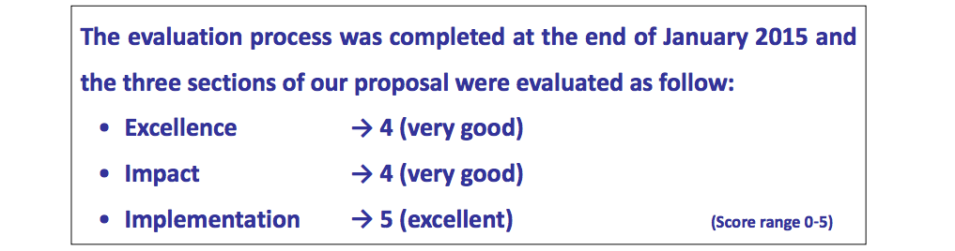
Feedback from EU
Scored very highly, overall very positive
Too much emphasis on demonstration of (X-band) brilliant technology instead of designing a fully fledged user facility.
More clarity needed on how XbFEL fits into ESFRI landscape

Slide 5
Detailed Feedback from EU
Excellence
  The objectives are very clear and pertinent. The proposed approach is credible and fit to achieve the proposed goals. The concept for the design of a new generation of FEL facilities using X-band technology is very sound: X-band technology has demonstrated improved performances in terms of high brightness and cost and power efficiency in a reduced space. However, the proposal builds on the outcome of the CLIC study and does not sufficiently address the need for a further design study on a similar technology. Also, the proposal does not sufficiently demonstrate the scientific added value of its final design product when compared with the existing X-FEL applications.
Impact
  The proposal exhibits a very good potential impact.
  Outreach to industry and technology transfer aspects are adequately addressed, thus enhancing the innovation capacity and integration of new knowledge triggered by the proposal.
  A pool of potential industrial partners is identified by building on existing industrial relations of Elettra-Sincrotrone Trieste and the CLIC collaboration at CERN.
  The proposal positively contributes to industrial competitiveness.
  The development of new technologies for X-FEL facilities, also of interest to scientific partners in other regions of the world, would create new opportunities for European industry in supplying advanced components.
  Other aspects adding value to the proposal include new potential applications of X-FEL beams in other fields, as well as positive environmental aspects linked to the efficiency of X-band technology in terms of minimized size of installation.
  However, the overall and wider impact on the European Research Area, namely synergies with existing ESFRI RIs (e.g. EuroFEL) is not sufficiently addressed and demonstrated.
Quality and efficiency of the implementation
  The proposal presents an excellent work plan. The work plan is very coherent and the work packages are very well structured to ensure effectiveness. The partners have the capacity and competences to successfully manage the project and they have a very good degree of complementarity. The resources committed to the tasks are appropriate. Risk and innovation management are very well addressed, including a work package aimed at relations with industry (WP 6). Given the relatively low-cost "upgrade" capability of the high gradient accelerators proposed, effort was put into enhancing impact through a specially designed integration work package (WP 5) which looks at the operational and cost aspects of new accelerator constructions and of upgrading existing infrastructures.

Slide 6
CompactLight
Submission to INFRADEV-1-2017 (29th March 2017)
Primary Goal: Advance photon science by reducing the size and cost of national and university-scale light source infrastructure
  Design of compact, cost-effective to build and operate (low power consumption), “high” rep rate normal conducting hard X-ray FEL facility
  State of the art Gun and Injector
  X-band Linac with RF systems
  Emerging Undulator technologies
Include “options” within study for using parts of design for other infrastructure
  Soft X-ray FEL
  Upgrading an existing accelerator to higher energy
  Compton back scattering X-ray source
  The possibility to also operate these infrastructures at “low” rep rate
Clear focus on conceptual design of a facility rather than demonstration of the technical maturity of the X-band technology
The “options” will widen the relevance and applicability
Primary Deliverable: CDR of hard X-ray FEL facility with annexes for the 3 infrastructure options above
with future ambition for 2020+

Slide 7
Relevant National/Institute Ambitions
Hard X-ray FEL
  UK
  Turkey
  Shanghai
  Australia
Soft X-ray FEL
  Netherlands
Accelerator Energy Upgrade
  Italy
Compton X-ray source
  Sweden
  Netherlands

Slide 8
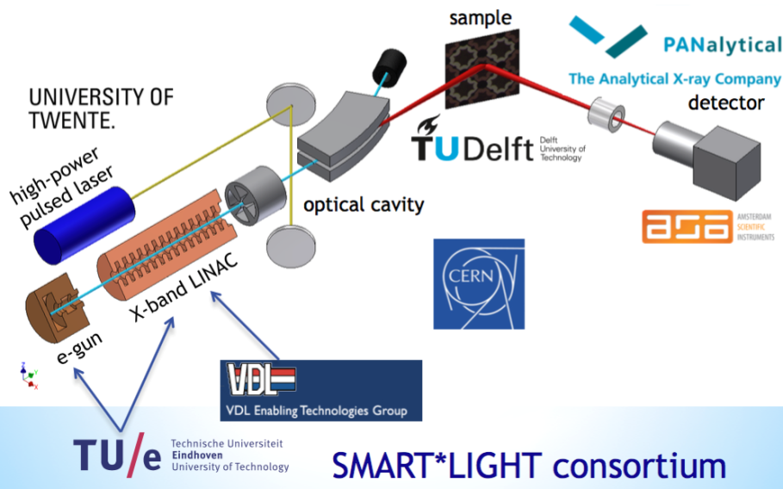
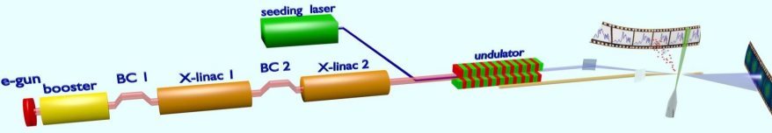
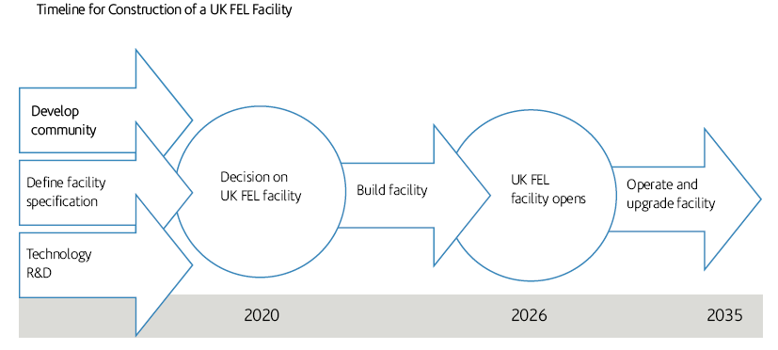
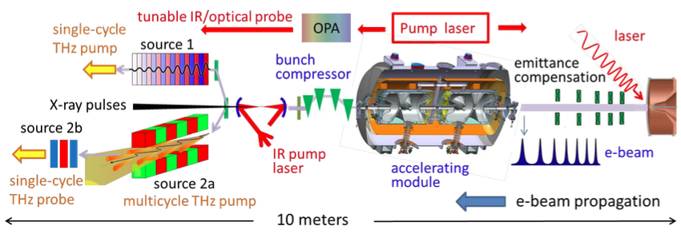

Relevant National/Institute Ambitions
University of Groningen: FEL-NL
Eindhoven University of Technology: Smart*Light
UK FEL Strategy & Timeline towards Hard X-ray FEL
Stockholm/Uppsala FEL centre: X-ray & THz radiation

Slide 9
Participants
From previous application:
  ST Elettra - Sincrotrone Trieste, Italy.
  CERN CERN Geneva, Switzerland.
  STFC Daresbury Laboratory, UK
  SINAP Shanghai Institute of Applied Physics, Shanghai, China.
  VDL VDL ETG T&D B.V., Eindhoven, Netherlands.
  OSLO University of Oslo, Norway.
  IASA National Technical University of Athens, Greece.
  UU Uppsala University, Uppsala, Sweden.
  ASLS Australian Synchrotron, Clayton, Australia.
  UA-IAT Institute of Accelerator Technologies, Ankara, Turkey.
  ULANC Lancaster University, Lancaster, UK.
New, additional, participants:
  TU Eindhoven Technical University, Netherlands
  LNF Frascati National Laboratory, INFN, Italy
  Kyma Undulators production, Italy-Slovenia
  PSI Paul Scherrer Institute, Switzerland
  RUG University of Groningen, Netherlands
  IFIC CSIC/Valencia, Spain
  ALBA CELLS, Spain
  LAL CNRS, France
  KIT Karlsruhe, Germany
Discussing with: Singapore, CIEMAT
Will discuss with DESY (already collaborate with them for special X-band elements) and Milan (Compton Back Scattering)

Slide 10
Work Package Structure
WP 1. Project Management and Coordination
WP 2. Facility Design and Integration
WP 3. Gun and Injector
WP 4. Main Linac & RF Systems
WP 5. Undulators and Light Production
WP 6. Beam Dynamics and Start to End Modelling

Slide 11
WP1. Project Management and Coordination
Lead Institute: Elettra - Sincrotrone Trieste (D’Auria)
Main Tasks
  General governance of Design Study and Project Management.
  Coordination among the participants, communication, meeting organization, project monitoring and reporting.
  Administrative and financial coordination, handling and distribution of funds.
  Dissemination of information.
  Coordination and integration with national and European project roadmaps and siting

Slide 12
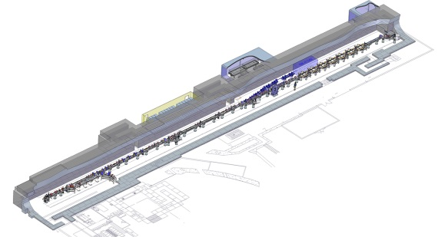
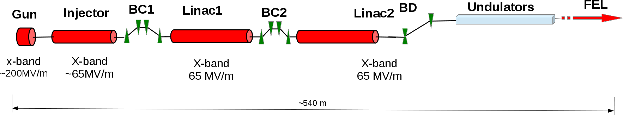
WP2. Facility Design and Integration
Lead Institute: STFC (Clarke)
Main Tasks
  Specification Control and Parameter Tables
  Engineering layouts
  Cost Estimates for Construction and Operation
  Siting specific implementations
  Industry relations and involvement
  CDR coordination and production

Slide 13
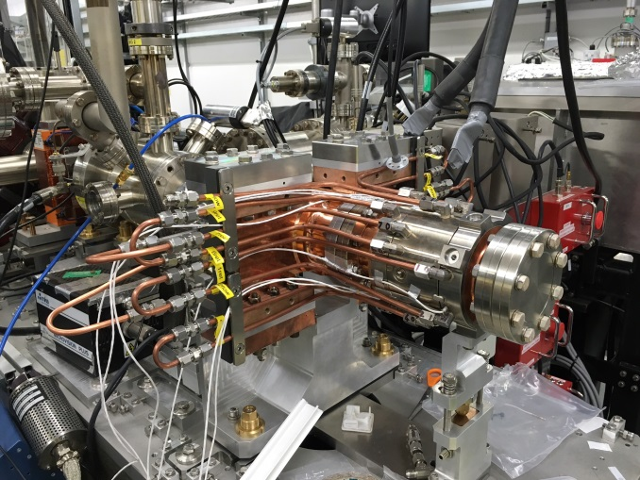
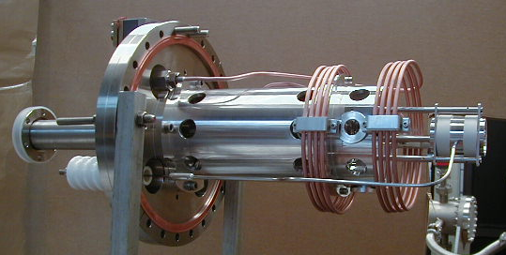
WP3. Gun and Injector
Lead Institute: Eindhoven (Luiten)
Main Tasks
  State of the art Gun/Injector
  Development of novel high rep rate Gun/Injector
  Prototyping and test
400Hz S-band RF gun in CLARA
Ultra-low emittance electron source, TU/e

Slide 14
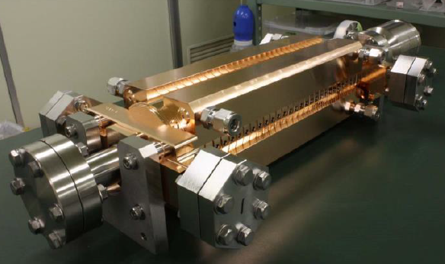
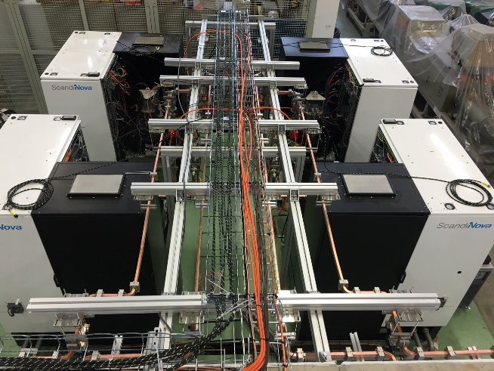
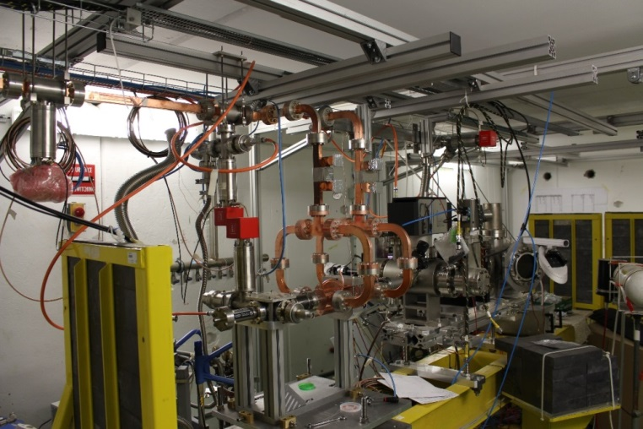
WP4. Main Linac & RF Systems
Lead Institute: CERN (Wuensch)
Main Tasks
  Accelerator Structure design and optimization
  Prototype testing in XBoxes and CALIFES (if approved), synergy with TNA in ARIES
  High stability LLRF, timing, control
  RF system studies including improvements exploiting new ideas on high efficiency klystrons
CLIC Accelerating Structure
XBox-3: 50 MW, 400 Hz
XBox-3: Structure under test

Slide 15
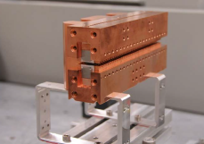
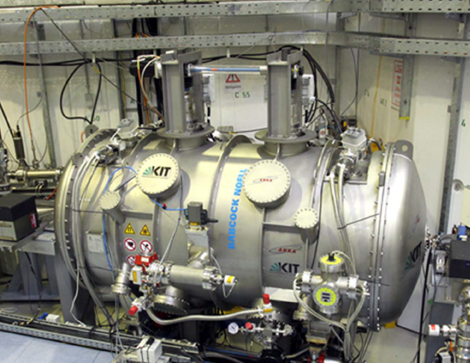
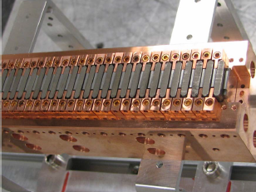
WP5. Undulators and Light Production
Lead Institute: TBD
Main Tasks
  Comparative studies of “ambitious” undulators on the timescale of 4-5 years, matched to overall design (eg cryo PMU, SCU)
  Similar for CBS: state of art, future capabilities
  FEL modelling and optimisation
  CBS output modelling
Cryo PM Undulator prototypes: HZB/UCLA
Superconducting Undulator installed at KIT

Slide 16
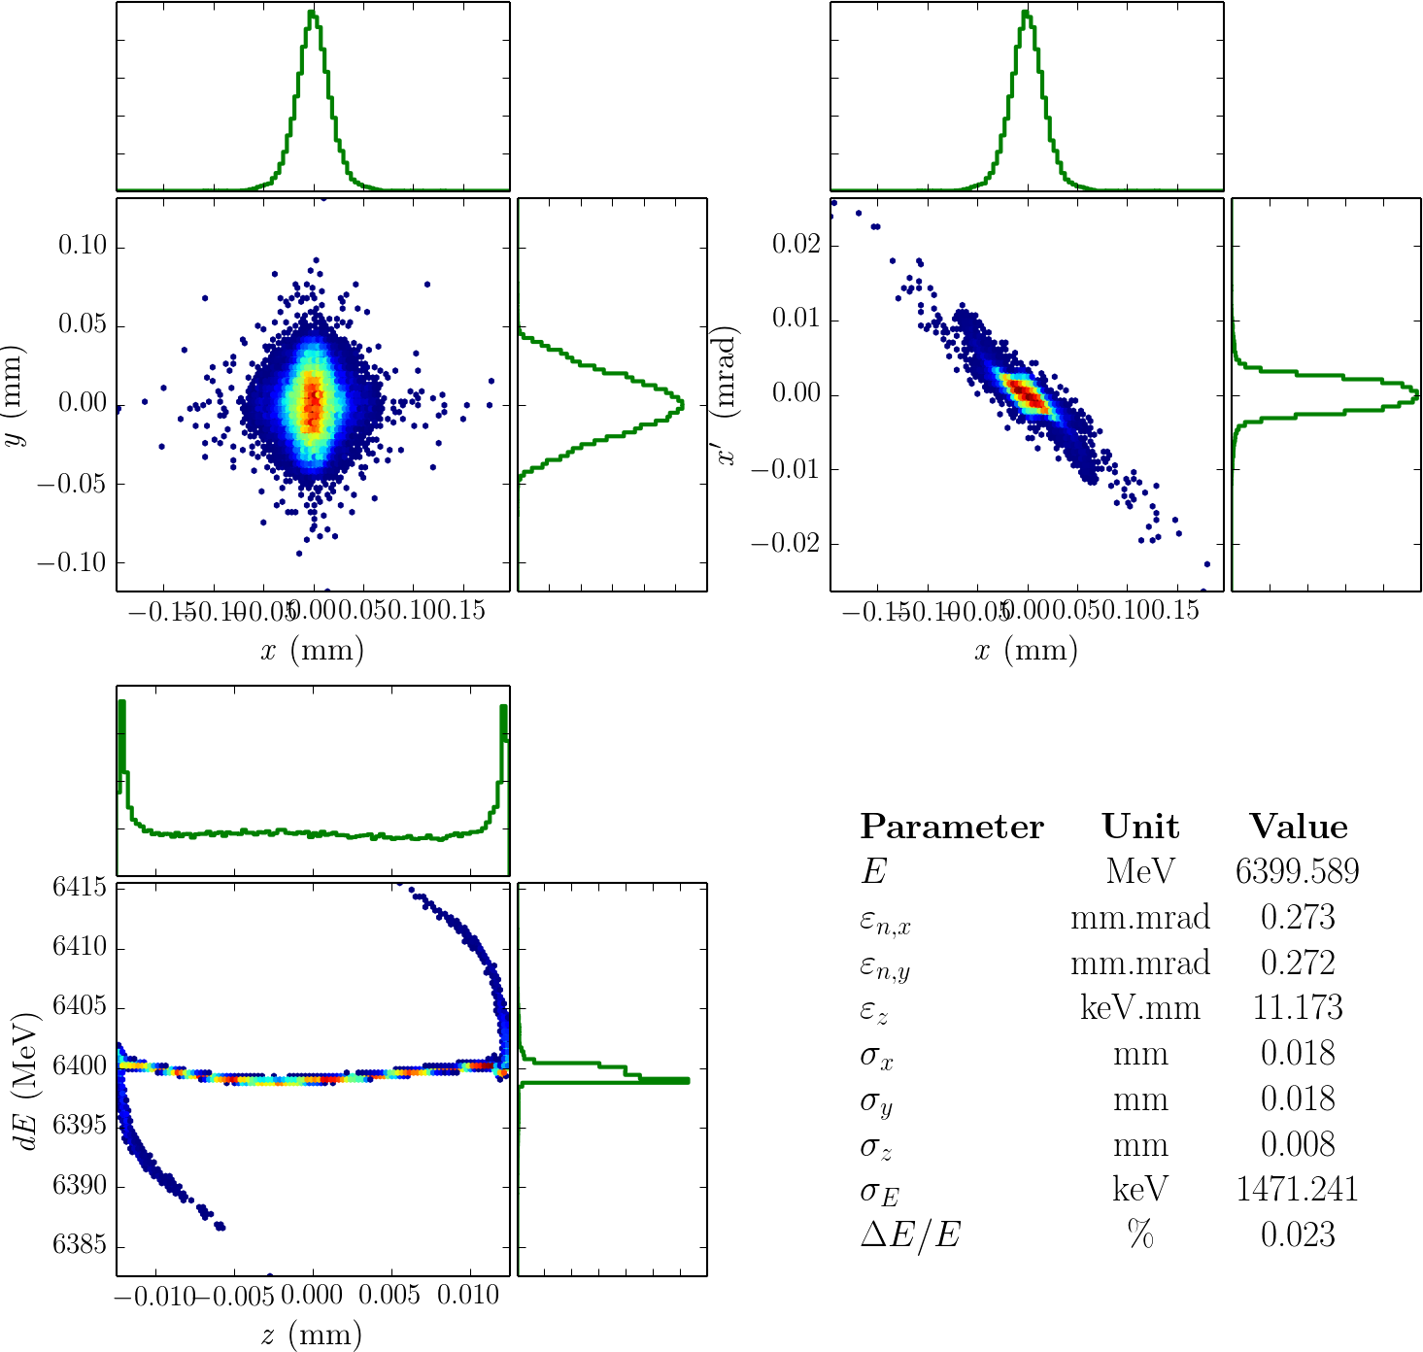
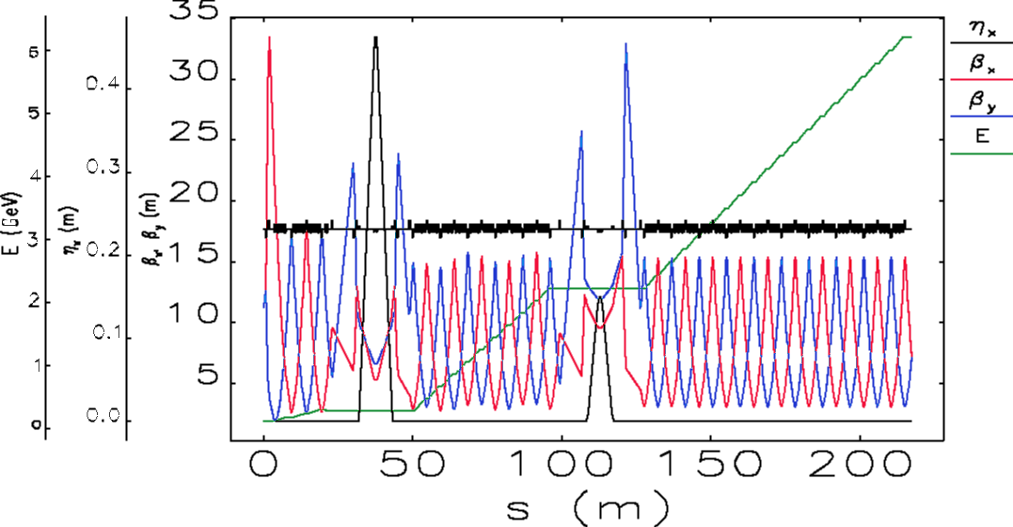
WP6. Beam Dynamics and Start to End Modelling
Lead Institute: IAT Ankara (Aksoy)
Main Tasks
  Modelling and optimisation of physics layout
  Start to end simulations
  Delivery of consistent tools, beam parameters for all options
Simulations for Turkish X-band FEL accelerator section, Ankara University

Slide 17
Timeline & Resources
Anticipated Request from EU: 3.0M€
Anticipated Duration: 3 or 4 years
Assumed start date: Jan 2018

Slide 18
Next Steps
Establish complete team for proposal preparation
Confirm WP leadership, participation and contributions
Hold detailed meeting in November

