Slide 1
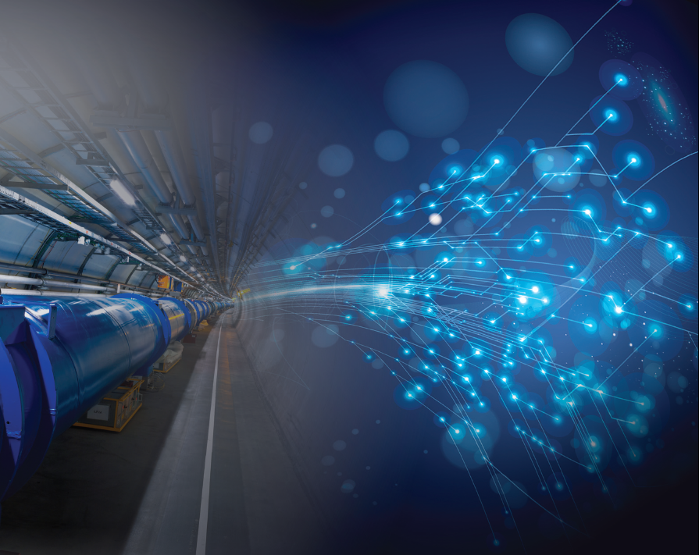
CAMPUS
R. Aleksan
CEA/DSM/IRFU
October 18th, 2016
Complex of Accelerator for Mutidisciplinary Projects and USers
Proposal
Study an accelerator complex based on a High-Performance CW superconductive electron linac
High Performance, i.e. High-Charge short bunch, low emittance, High repetition rate … (to be defined according to applications)
in the range from 500 MeV min to 1 GeV (or more!)
Able to serve several thematics and communauties
With the potential to be « easily » upgradable

Slide 2
Thematics
Possible scientific areas addressed by the complex includes:
Research in Particle and Nuclear Physics
Research in condensed matter and solid state physics
Research in particle accelerator science and technology (possibly including also PWFA)
Research in science and technology for detector systems (beam tests)
Generation of light source THz and FEL, (note however that CAMPUS would not be a dedicated light source)
Warning
The following information is very preliminary and specifics may change

Slide 3
The Accelerator Complex
This complex should be versatile and would be developed progressively in several stages.
Step 1 :
Construction of an electron CW linear accelerator with an energy of 500 (and which could be upgraded 1 GeV (or more), which will:
  Provide a beam test facility for detector system R&D
  Enable accelerator R&D to push the beam performance (small emittance, ΔE/E et pulse sizes, high rep rate and intensity…
  Enable Nuclear physique studies (fixe target to be explored)?
  Provide other very interesting applications:
    Positron Source
    Neutron Source
    Photon and γ sources (THz, FEL and Compton γ’s)

Slide 4
Target Parameters of the linac:
Very intense electron source with excellent timing
 | Low Rep (baseline) | High Rep | Comments
Energy (MeV) | 500 | 500 | 4 CW TESLA modules
Bunch charge (pC) | 300 | 60 | APEX type gun
Frep max (kHz) | 1000 | 10 000
Energy Spread ΔE/E | <10⁻³ ? | <10⁻³ ?
Beam Current (mA) | 0,3 | 0,6
Beam Power (kW) | 150 | 300 | LCLS-II = 250 kW @4GeV
Bunch length σ rms (fs) | 500 | 500 | to be confirmed by simulations
I peak (kA) | 0,6 | 0,12
Norm Emittance (mm.mrad) | 0,55 | 0,24
Linear Polarization | > 90% | > 90%
ERL (with higher rep rate) may be envisioned for specific applications

Slide 5
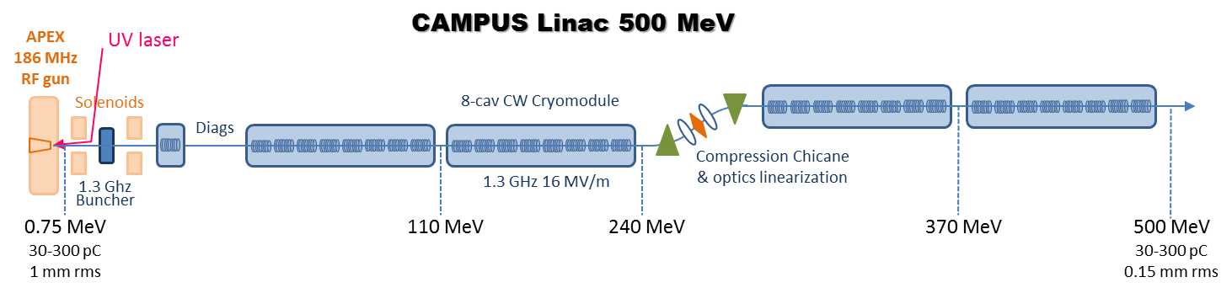
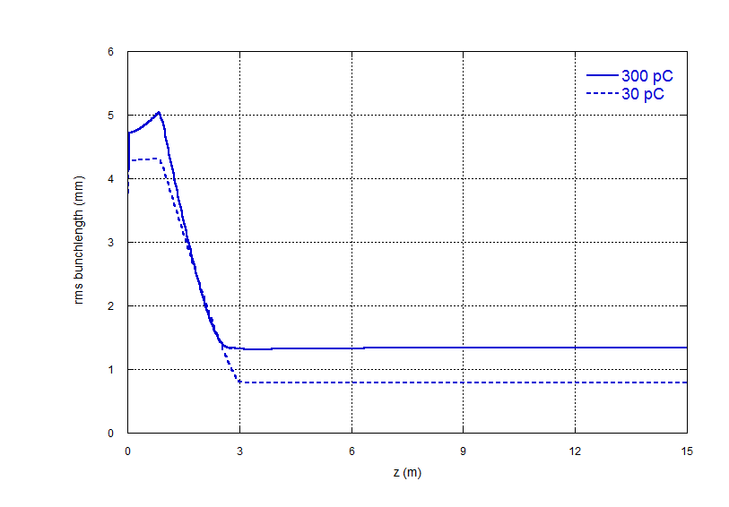
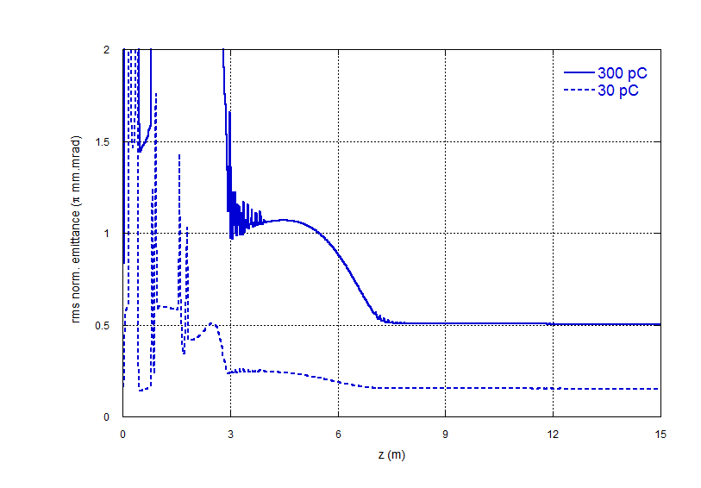
ERL (with higher rep rate) may be envisioned for specific applications.
Recirculation arc would need to be inserted between cryomodules 2 and 3.

Slide 6
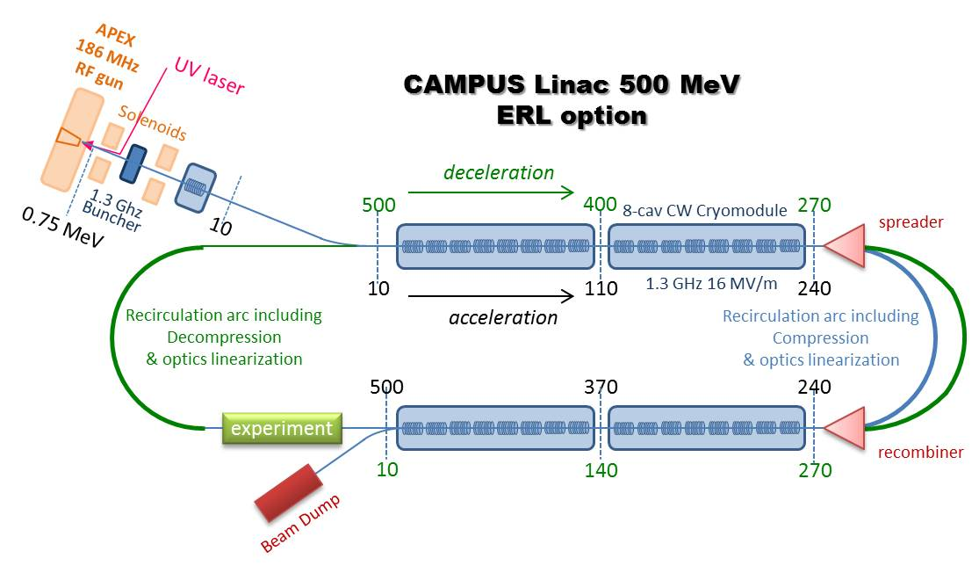
Baseline with « ERL compatible » layout
ERL operation useful for specific applications, e.g. FEL, THz, γ-ray beams...
Baseline: single pass ERL. Multi-Pass could be studied for energy upgrade
Strong synergy with the PERLE project possible : to be explored

Slide 7
Electron Lab
Many applications
FEL Studies (Strong synergies with LUNEX5 @SOLEIL)
THz source
Test Beam Facility for
  Accelerator R&D
  Detector R&D
Nuclear Physics Studies?

Slide 8
Positron Lab
Slow Positron source (0-50 KeV)
Flux of 1-3 10⁹ e⁺/s could be envisioned (may be increased further depending on target) with excellent timing (<100ps limited by the moderation)
Unique in the world
Strong expertise in the field in l’IRFU (Gbar)
Condensed matter and solid state physics
Target and moderator design dealing with full beam power are the critical issues.
Could possibly enable to increase further the flux up to 10¹⁰ e⁺/s ?

Slide 9
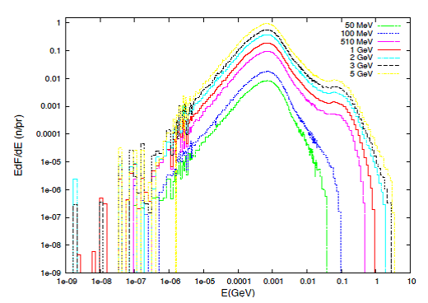
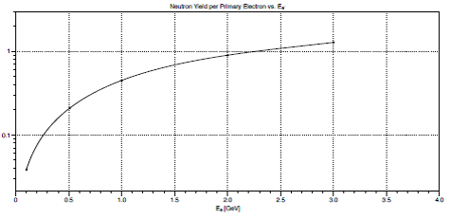
Neutron Lab
Neutron Source
Flux with CAMPUS : ~4 10¹⁴ n/s for E_{e} = 500 MeV and 150 kW
Thermal neutron Radiography
Neutron based material research
BNCT studies
Target design is the critical issue
~0.2 n/e(500MeV)
n/e

Slide 10
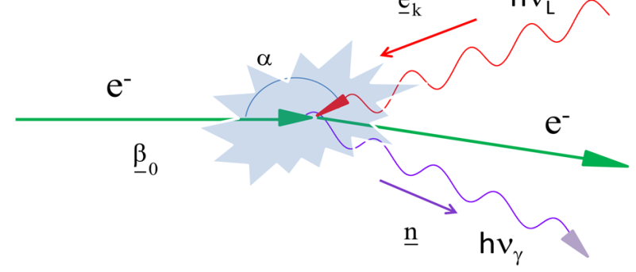
γ-ray Lab
Step 2 :
Development of γ−ray sources in the range from 100 KeV to several MeV ( <37 MeV for 1 GeV e).
It is achieved by backward compton scattering using an intense laser source with a high average power as proposed by par G. Mourou using large number of fiber lasers or Fabry-Perot cavity or a combination of both.
3 CM
2 CM
6 CM
5 CM
4 CM

Slide 11
Target Parameters:
Linac | Low Rep. | High Rep. | Comments
Bunch length rms (fs) | 500 | 500 | to be confirmed by simulations
Norm Emittance (mm.mrad) | 0,55 | 0,24
Beta* (mm) | 30 | 30
Beam size rms (μm) | ~4 | ~3
Could envision ERL
Pro:
Low power budget
Increase Rep. Rate and bunch charge
Higher γ flux
Con:
Energy upgrade more complicated but possible through multipass ERL
Laser | High pulse | Low pulse | Comments
Energy/pulse (J) | >1 | >0,1 | to be confirmed by simulations; a0 may be an issue, beam sizes need to be optimized for better γ energy spread
Wavelegth (nm) | <515 | <515
Rep. Rate (kHz) | >10³ | >10⁴
Ave. Power (kW) | >10³ | >10³
a0 | 0,31 | 0,17
Beam size rms (μm) | ~4 | ~3
Δν/ν | 1.5 10⁻ ³ | 1.5 10⁻ ³
Gamma Beam |  |  | Comments
E max (MeV) | ~9 | ~9 | to be confirmed by simulations
N gamma/s | >1 10¹⁵ | >6 10¹⁴
Peak Brilliance | >3 10²³ | >7 10²²
Useful for :
  test γ−beam for detector system R&D
  Accelerator R&D
  Nuclear Physics (photo-fission…)
  … + other applications to be studied, e.g. neurobiology (brain tomography) supplementary to IRM)

Slide 12
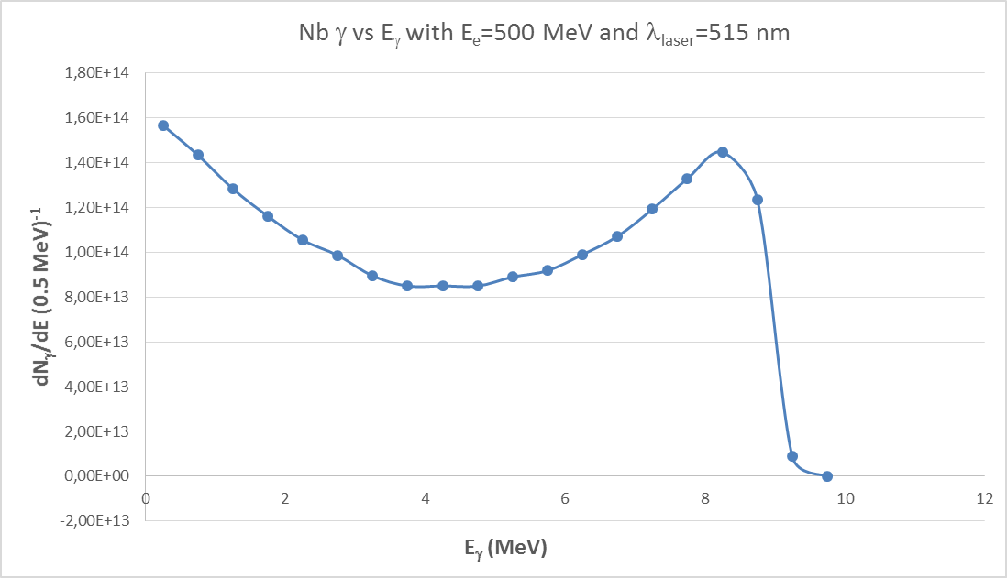
CAIN Simulation
Total Flux >10¹⁵ γ/s

Slide 13
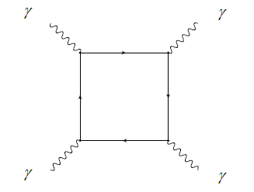
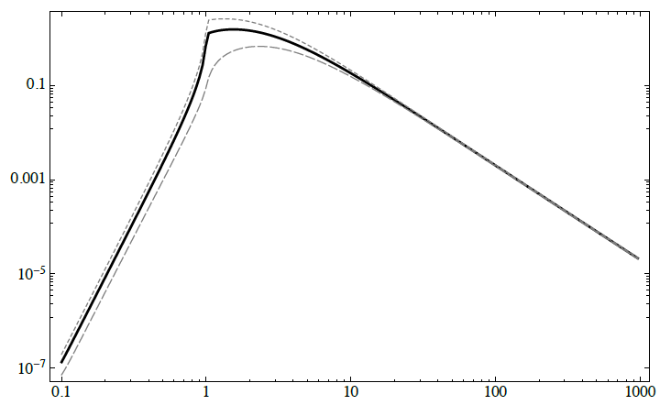

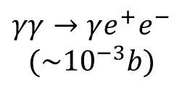


Step 3 :
Study of Collider (γ−e, γ−γ) demonstrator
Development for low energy γ−e, then γ−γ colliders:
Un real challenge
$γγ→e^{+}e^{−}$ (~0.1b)
$γγ→e^{+}e^{−}e^{+}e^{−}$ (~${10}^{−4}b)$
1.0
$$γγ→γe^{+}e^{−}$$
$${(\sim 10}^{−3}b)$$
$$γγ→γγ$$

Slide 14
Target Parameters:
γ−e : E(cm) < 140 MeV (10 MeV vs 500 MeV)
γ−γ : E(cm) < 10 MeV
will be done by adding a second linac with same characteristics.
Linac | Low Rep. | Comments
Bunch length rms (fs) | 500 | to be confirmed by simulations
Norm Emittance (mm.mrad) | 0,55
Beta* (mm) | 30
e Beam size rms (μm) | ~4
e Beam size rms CP (μm) | ~4
Luminosity (cm⁻² s⁻¹) | 1 10²⁹ | CP-IP = 10mm very préliminary
Useful for:
  Particle physics
  Accelerator R&D for high energy γ−γ colliders
Note: construction of a second Linac may also allow:
To increase the e⁻ energy (i.e. 700-1000 MeV) for a single beam
Higher γ energy (35 Mev)
ERL for the collider

Slide 15
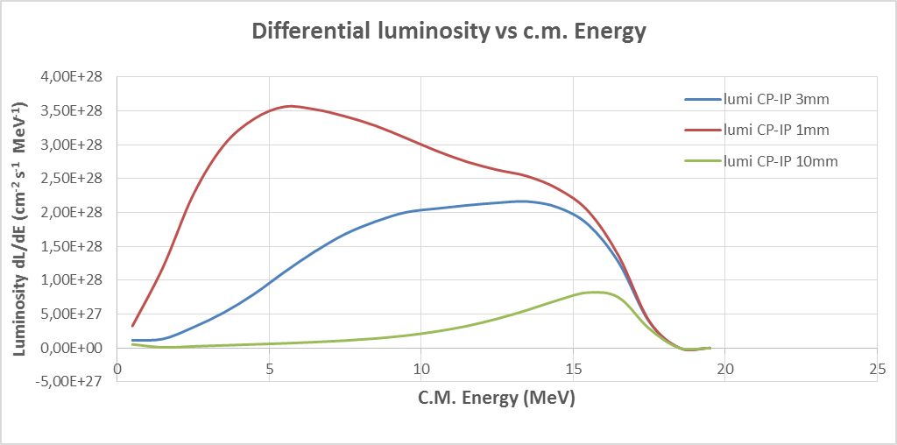
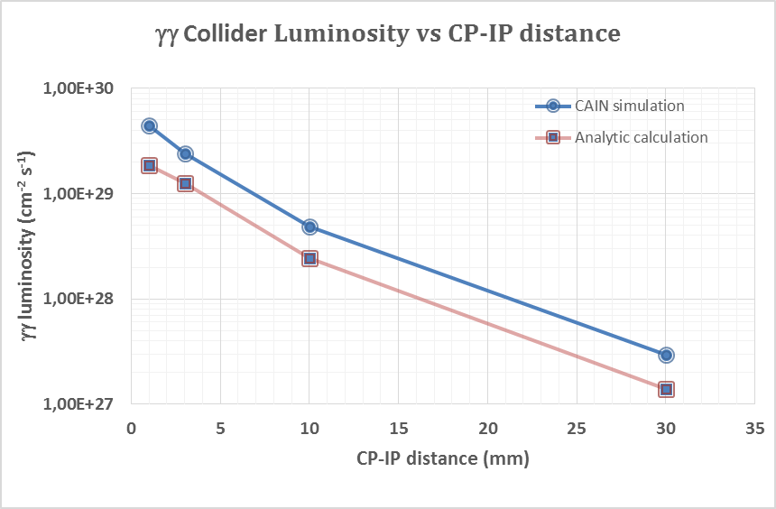

Slide 16
To be successful, mandatory to get the support of the potential user community:
Particle and Nuclear Physics
Condensed Matter and Solid State Physics
Light Sources (THz, FEL, γ) users
Accelerator and Detectors developpers
Applications industrielles (e.g. Lithographie)
…
A workshop on applications would be necessary
Several potential partners have been contacted and there is interest in several countries:
CERN, Italy, Germany, Spain, UK

Slide 17
Conclusions
CAMPUS is an ambitious project
  With high scientific and technical potential
  Muldisciplinary
    For its realization
    For its exploitation
  It could federate many communities
CAMPUS an emerging project
For go forward, a larger effort at European level is necessary
Initiate discussion within TIARA to launch possibly a DS in H2020: interest in Italy, Gernamy, Spain, UK
As a first step, a workshop on applications would be necessary

Slide 18
Additional slides

Slide 19
Linac-based positron source for positron spectroscopy
Fast gamma detector (time)
Biological shield
Electron target
Moderator
(annealed W)
γ
e⁻
γ
e⁺
Beam transport (keV energy to keep timing)
Beam shaping
(buncher, chopper, focussing)
Sample
e⁻
e⁺
500 MeV
e⁺
e⁻
Bremsstrahlung
Positrons
~eV
0-30 keV
(-100 keV)
~100 ps
γ
Gamma detector (HPGe)
energy
Time resolution: ~100 ps FWHM
Lifetime range to measure:
~90 ps … 142 ns
Detection methods:
lifetime
Doppler broadening
angular correlation
µm beam diameter is an advantage (possible only with a loss of intensity)

Slide 20
Positron Lab
Nr. | Name | Incident beam | Max energy of incident beam | Power of incident beam | Time resolution of positrons | Slow positron flux (e+/s) | References | Remarks
1 | Livermore NL (USA) | electron linac | 100 MeV | 40-48 kW (?) | max 1440 cps, 10 ns - 3 µs pulses | 1.2x10⁹ (peak) 5.4x10⁸(continuous) | [Livermore1985] | dismounted
2 | Univ. Mainz (Germany) | electron linac | 200 MeV | 5.6-28 kW | 100 Hz, µs pulses | 5x10⁶ (steady state) 2x10⁷ (short run) | [Mainz1984], [Mainz1988] | dismounted
3 | Justus-Liebig-Universität Giessen (Germany) | electron linac | 35 MeV (65 MeV max.) | ~3500 W | µs pulses | 1.5x10⁷ (continuous) 1.05x10⁸ (short run) | [Giessen1987], [Giessen1988], [Mainz1988] | dismounted
 | Oak Ridge NL (USA) | electron linac | 150 MeV | 60 kW | 6-20 ns | ? | [OakRidge1990]
4 | University of Ghent (Belgium) | electron linac | 40 MeV used (90 MeV max.) | 4 kW (?) | quasi-continuous | 2x10⁷ | [Ghent1990a], [Ghent1990b] | dismounted
5 | AIST, Tsukuba (Japan) | electron linac | 70 MeV | 300 W | 4 µs (200 ps bunched) | 10⁷ | [Akahane1990] | in regular use
6 | Mitsubishi (Japan) | electron linac | 18 MeV | 33 W | 5 µs | 7.7x10⁵ | [Mitsubishi 1991] | test only?
7 | KEK (Tsukuba) | electron linac | 55 MeV | ? | 10 ns or 1 µs | 5x10⁷ | [KEK2012] | in regular use
8 | Rossendorf (Germany) | electron linac | 30 MeV CW | 3 kW | 250 ps | 10⁶ | [Rossendorf2016] | starting
9 | Beijing (China) | electron linac | 1.3 GeV | ? | 2.5 ns, 12.5 Hz | 5x10⁶ | [Beijing2004] | ?
10 | NEPOMUC (Munich, Germany) | high n flux reactor | n.a. | n.a. | 200 ps (bunched) | 0.9x10⁹ (<10⁷ @200ps) |  | in regular use
11 | Nort Carolina State Univ, PULSTAR (USA) | reactor | n.a. | n.a. |  | 6x10⁸ | [PULSTAR2009]

