Slide 1
15 T Dipole Demonstrator: design parameters and work status
Alexander V. Zlobin
US-EuroCirCol video meeting
18 October 2016

Slide 2
US Magnet Development program
FNAL 15 T Dipole demonstrator is the program key milestone for FY17

Slide 3
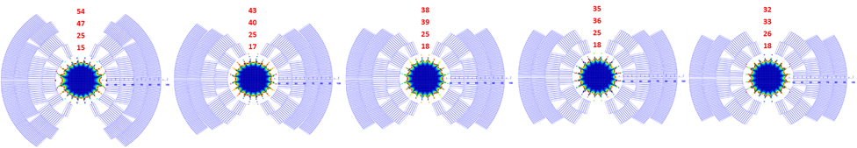
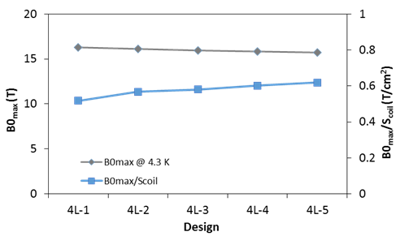
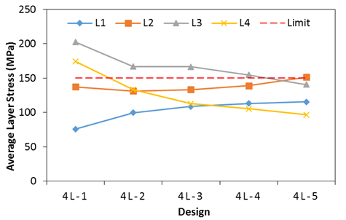
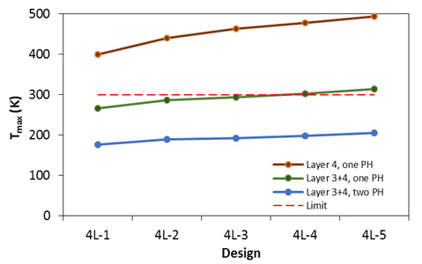
Coil Design Study [1]
Parameter | Cable 1 | Cable 2
Number of strands | 28 | 40
Strand ID, mm | 1.0 | 0.7
Mid-thickness, mm | 1.870 | 1.319
Width, mm | 15.10 | 15.10
Keystone angle, deg | 0.805 | 0.805
Coil aperture: 60 mm
Coil cross-section: 4 layers, graded
Design parameters: B_{max}, a_{n}/b_{n}, coil volume, coil stress, quench protection
4L-1
4L-2
4L-3
4L-4
4L-5

Slide 4
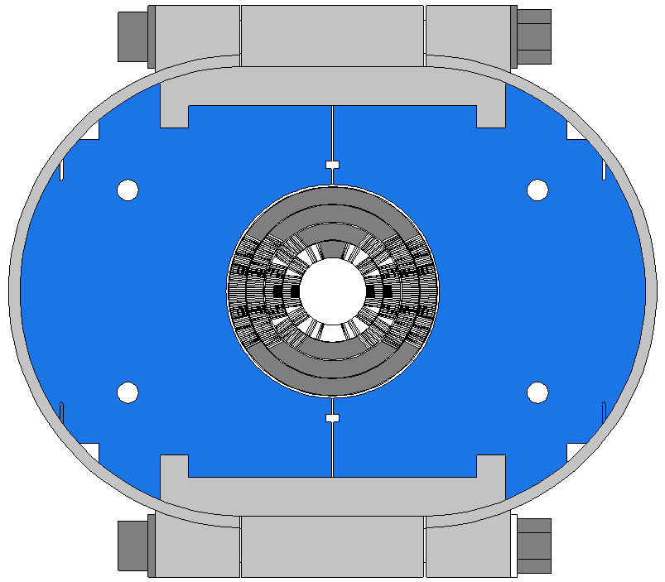
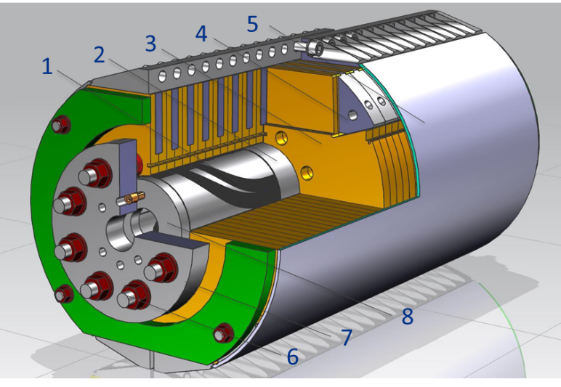
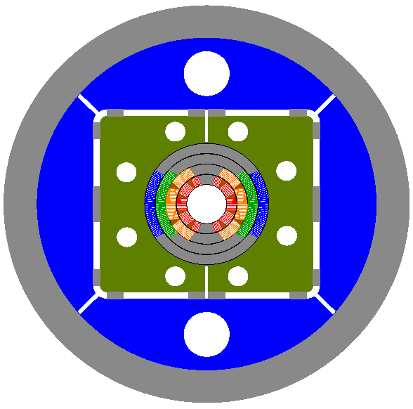
Mechanical Structure [2], [3], [5]
Thin coil-yoke spacer (no collar)
Mechanical structure:
  Design 1: SS C-clamps and 20-mm thick skin
  Design 2: Al I-clamps and 12-mm thick skin
  Design 1: 50-mm thick Al shell
Axial support: thick SS rods and end plates
Cold mass OD<610 mm (VMTF Dewar limit)

Slide 5
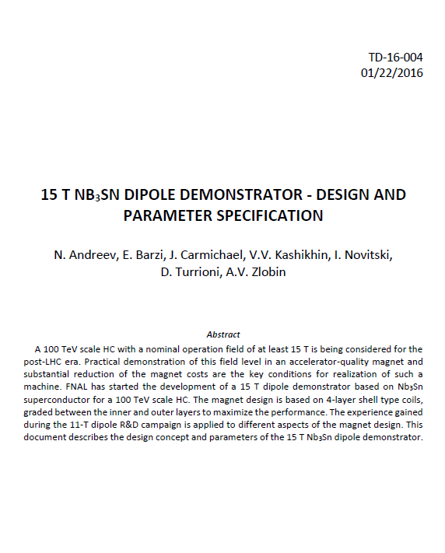
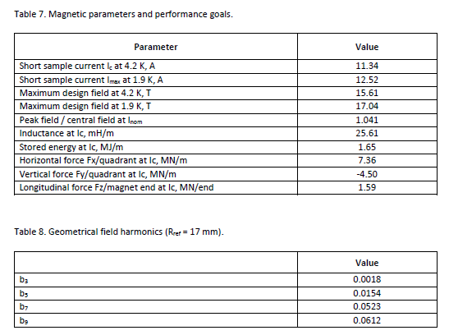
Magnet Design Specifications

Slide 6
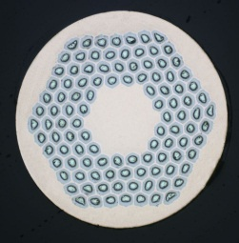
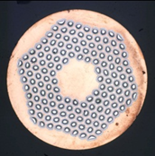
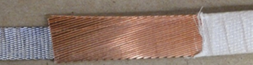


Strands and Cables [4]
RRP108/127
RRP150/169
Magnet short sample estimated based on the cable test data:
  11.1 kA (B_{ap}=15.3 T) at 4.5 K
  12.2 kA (B_{ap}=16.7 T) at 1.9 K

Slide 7
15 T Dipole Demonstrator Status
Magnet design study phase is complete
Magnet (design 2) and tooling engineering design is complete
  Engineering design of design 3 is planned for Q1 FY17
Tooling and parts procurement is in progress
L1-L2 cable was developed, fabricated and tested
L3-L4 cable is available from the 11 T dipole program
Outer (L3 and L4) and inner (L1 and L2) practice coils are complete
Coil fabrication has started
Magnet assembly and first tests are planned for summer 2017

Slide 8
Publications
A.V. Zlobin, N. Andreev, E. Barzi, V.V. Kashikhin, I. Novitski, “Design concept and parameters of a 15 T Nb₃Sn dipole demonstrator for a 100 TeV hadron collider”, IPAC2015, Richmond, May 2015.
V.V. Kashikhin, N. Andreev, E. Barzi, I. Novitski, A.V. Zlobin, “Magnetic and structural design of a 15 T Nb₃Sn accelerator dipole model”, CEC/ICMC2015, Tucsan (AR), June 2015.
I. Novitski, N. Andreev, E. Barzi, J. Carmichael, V. V. Kashikhin, D. Turrioni, M. Yu, A.V. Zlobin, “Development of a 15 T Nb₃Sn Accelerator Dipole Demonstrator at Fermilab”, IEEE Trans. on Appl. Supercond., Vol. 26, Issue 3, June 2016.
E. Barzi, N. Andreev, P. Li, V. Lombardo, D. Turrioni, A.V. Zlobin, “Nb₃Sn RRP® Strand and Cable Development for a 15 T Dipole Demonstrator,” IEEE Trans. on Appl. Supercond., Vol. 26, Issue 3, June 2016.
I. Novitski, A.V. Zlobin, “Development and Comparison of Mechanical Structures for FNAL 15 T Nb₃Sn Dipole Demonstrator”, NAPAC2016, Chicago, Oct 2016.

