Slide 1
15T Demonstrator: mechanical design, analysis and optimization
Igor Novitski
Video Meeting
18 October 2016

Slide 2
Outline
Magnet concept evolution
Models and Materials
Design 1: C-Clamp
Design 2: IC-Clamp
“HD-2” structure optimization
Design 3: AL Cylinder
Summary

Slide 3
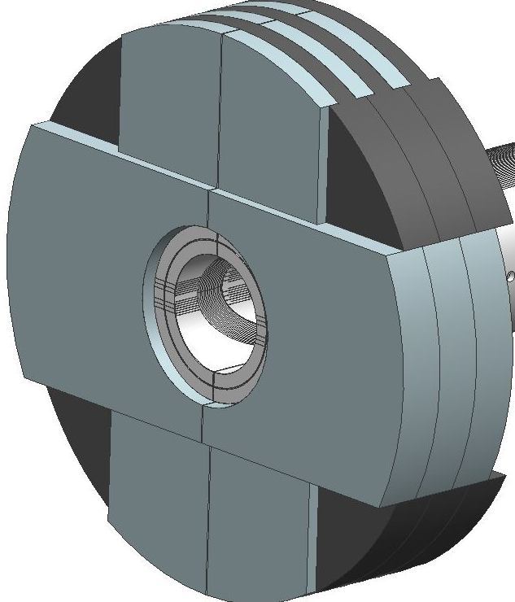
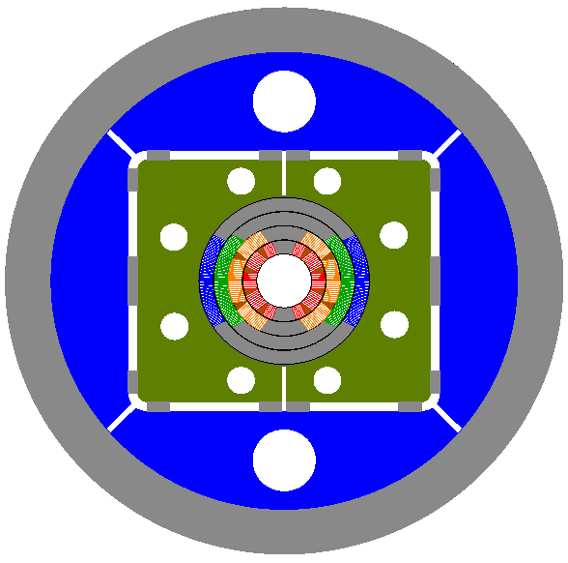
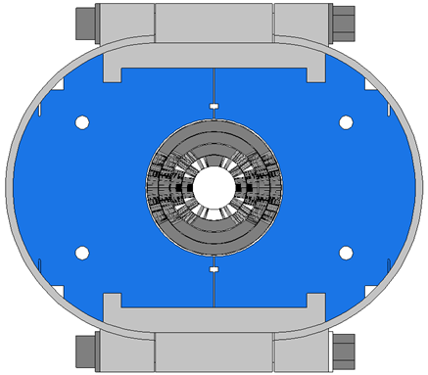
Magnet Concept Evolution
C-Clamp Magnet
I-Clamp Magnet
Al Shell Magnet

Slide 4
Geometry Comparison
15T Dipole
D20
VMTF Dewar

Slide 5
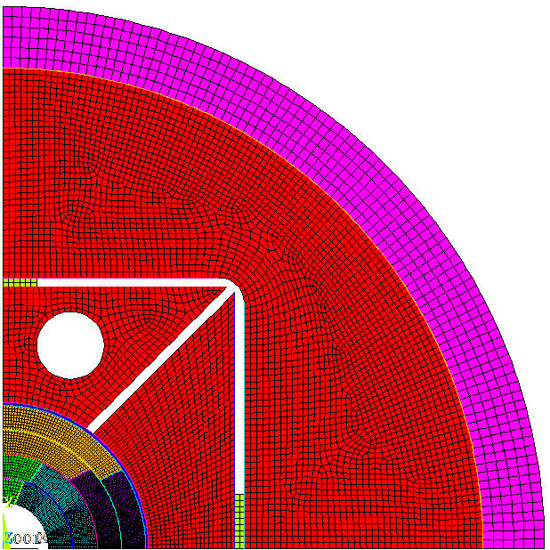
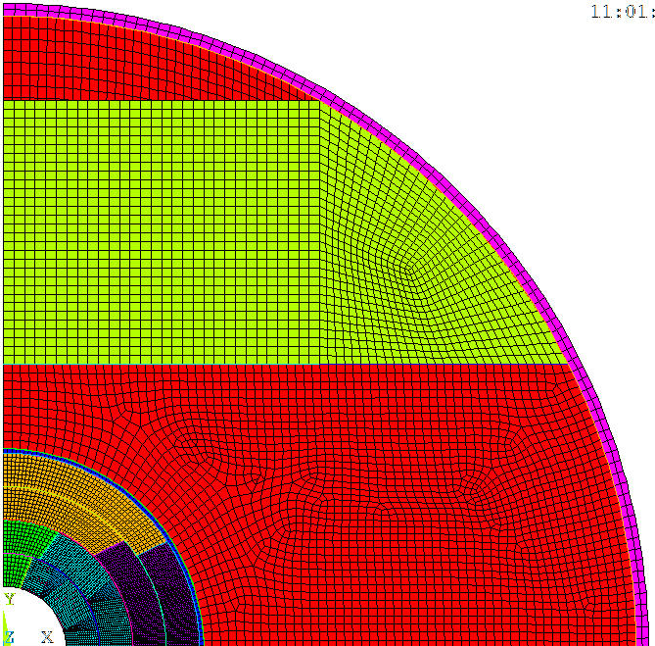
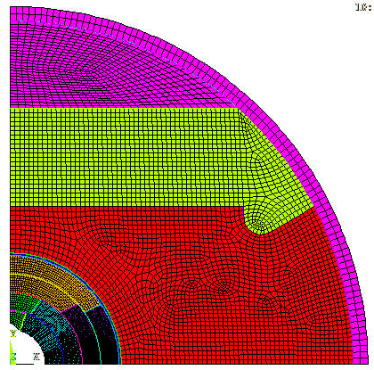
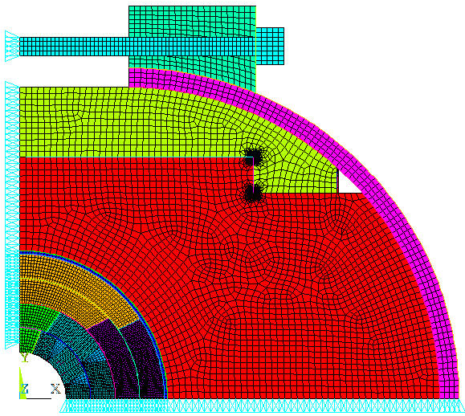
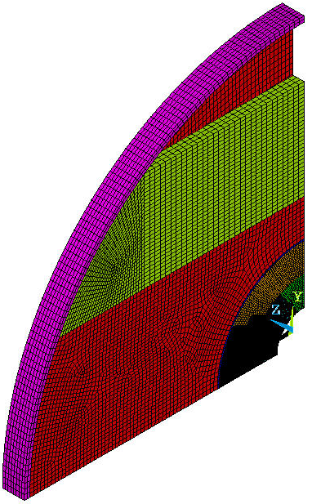
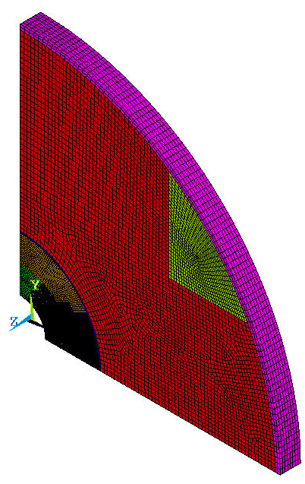
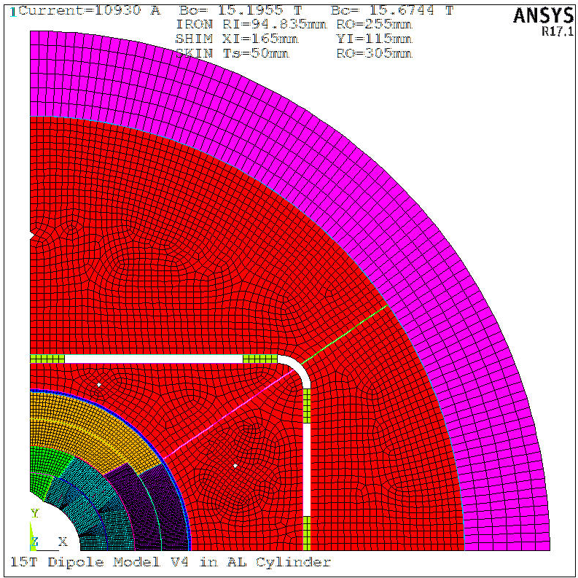
FEA Models
Coils in “HD2” Structure
C-Clamp Magnet
I-Clamp Magnet

Slide 6
Material Properties
Structural element | Material | Thermal contract. (300-2 K), | Elasticity modulus, GPa |  | Yield stress, MPa
 |  | mm/m | warm | cold | warm | cold
Coil (rad/azim) | Nb₃Sn composite | 2.9/3.3 | 35/20 | 40/40 | n/a | n/a
In.coil pole blocks | Ti-6Al-4V | 1.7 | 115 | 125 | 650 | >900
Out.coil pole blocks | St St | 2.9 | 195 | 215 | 230 | 500
Wedges | Bronze | 3.2 | 110 | 120 | 280 | 350
Coil-yoke spacer | St St | 2.9 | 190 | 210 | 230 | 500
Clamp | Aluminum | 4.1 | 70 | 81 | 500 | 700
Yoke | Iron | 2.0 | 205 | 225 | 220 | 500
Skin | St St 316 | 2.9 | 190 | 210 | 290 | 580

Slide 7
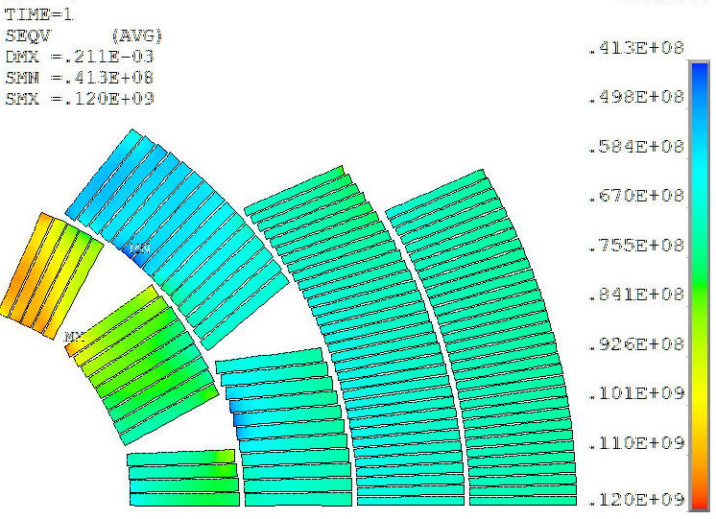
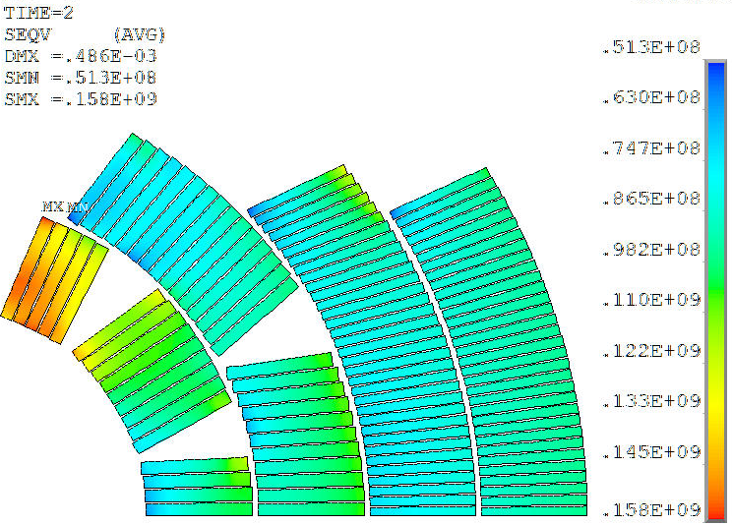
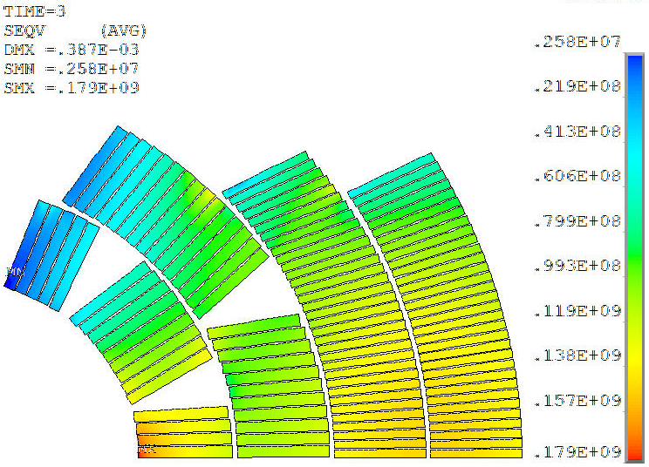
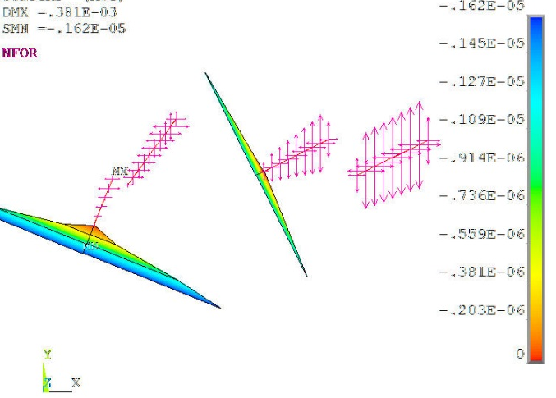
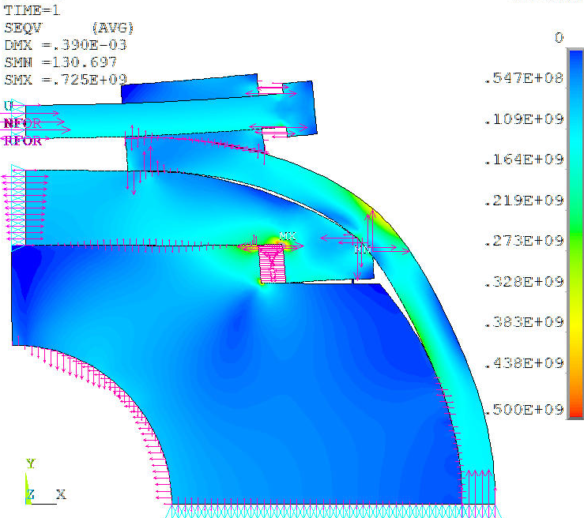
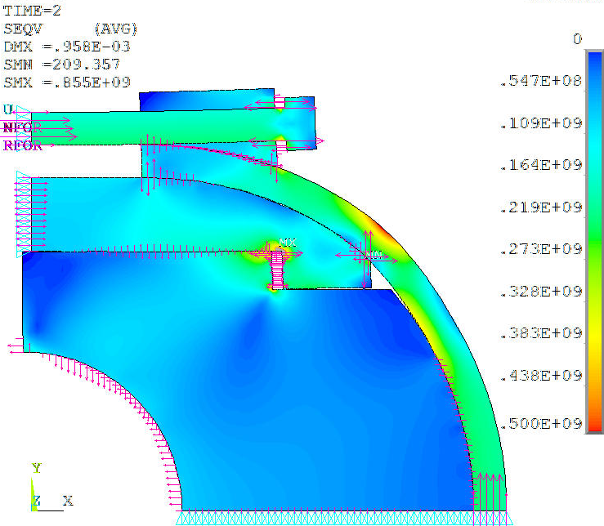
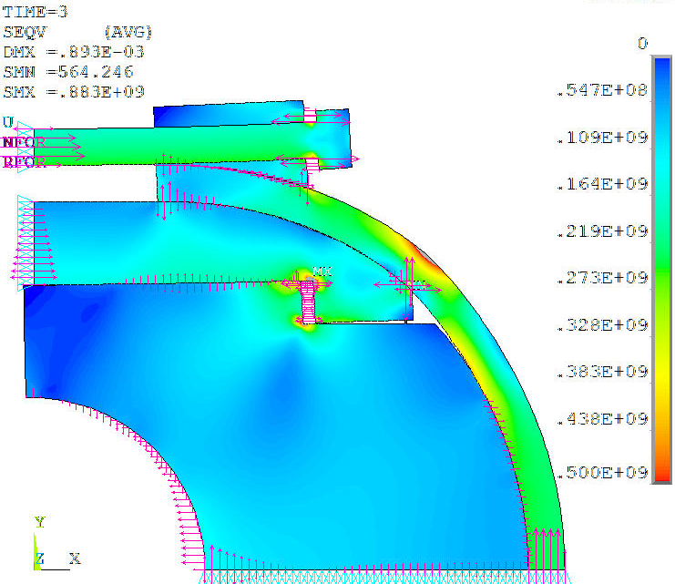
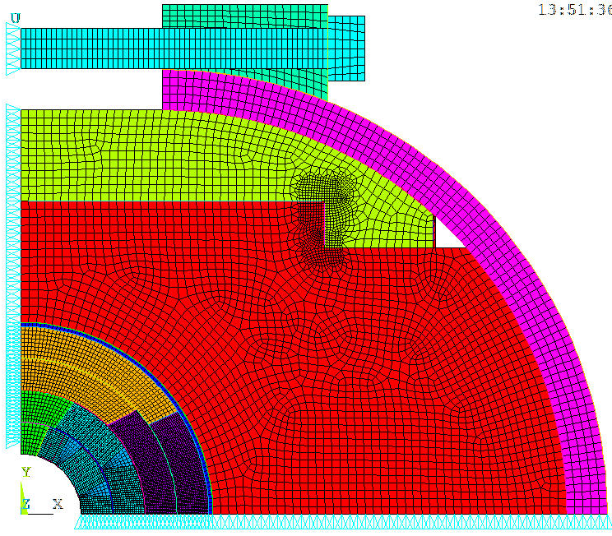
Design 1: C-Clamp+20mm Skin, FEA Results
300K
4K
4K+15T
Seqv=120MPa
Seqv=158MPa
Seqv=179MPa
Inner Pole Gap=0.002mm
Seqv=725MPa
Seqv=850MPa
Seqv=880MPa

Slide 8
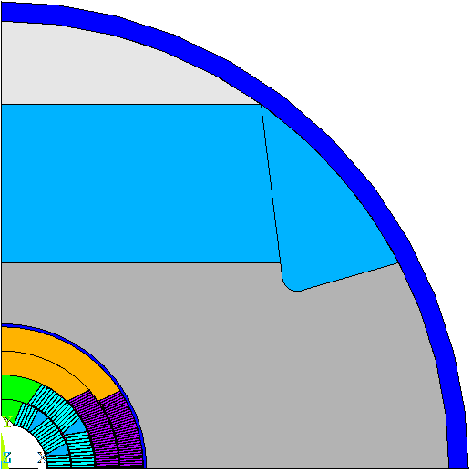
Design 2: IC-Clamp+12mm Skin, FEA Model
δ Skin and skin thickness
X1
Yoke-Yoke
gap taper
Y2
Clamp-Yoke
angle and
interference
X2
R
Shell-Yoke Rad
interference
Y1
Coil-Coil Rad
interference
Step
Pole slot
Clamp-Skin Rad
Yoke-Skin Rad
interference
Mid-Plane shims

Slide 9
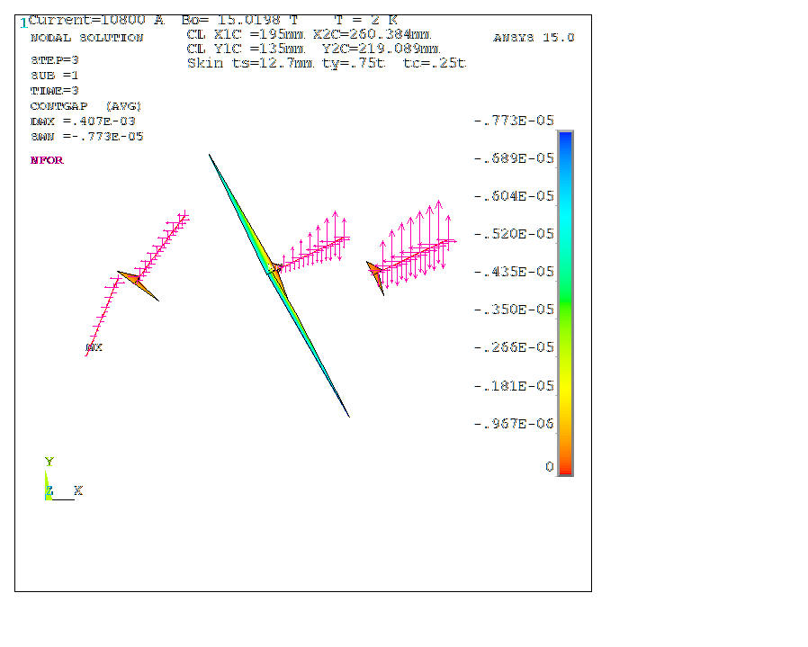
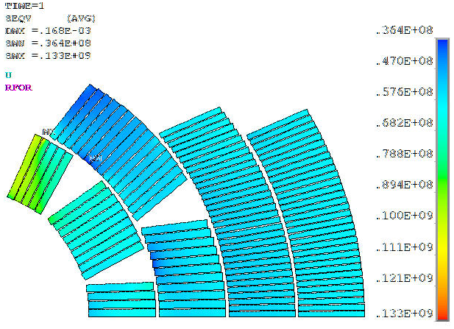
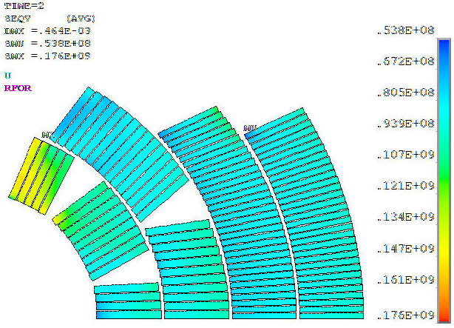
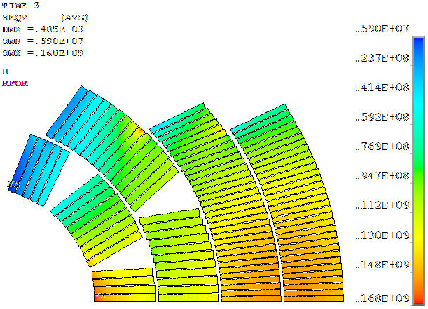
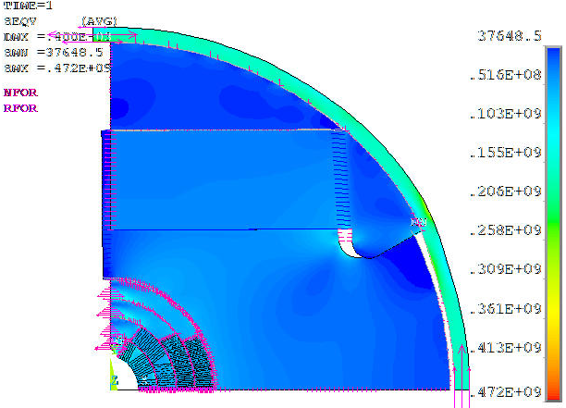
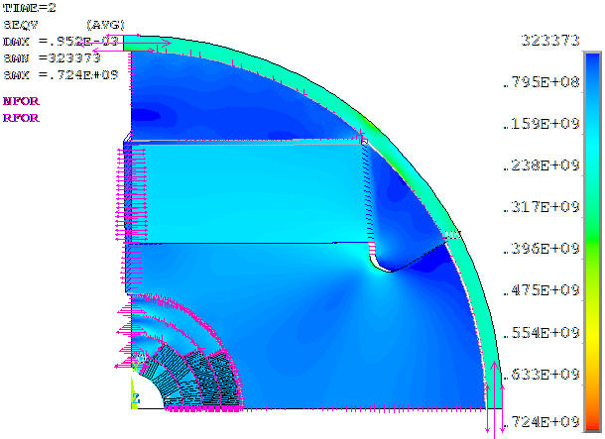
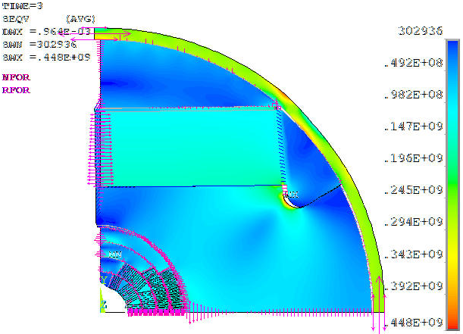
Design 2: IC-Clamp+12mm Skin, FEA Results
300K
4K
4K+15T
Seqv=133MPa
Seqv=176MPa
Seqv=168MPa
Inner Pole Gap=0mm
Spole=472MPa
Sskin=280MPa
Spole=724MPa
Sskin=404MPa
Syoke=448MPa
Sskin=428MPa

Slide 10
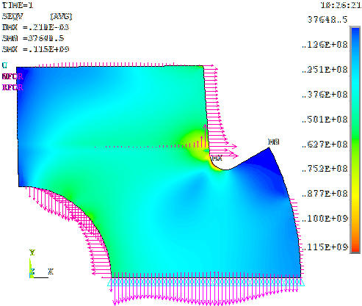
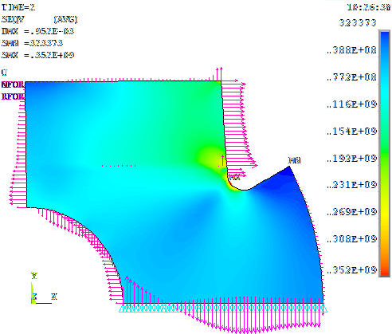
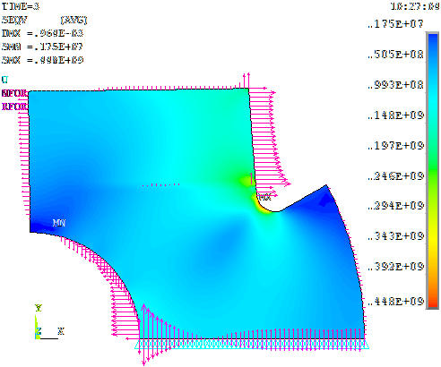
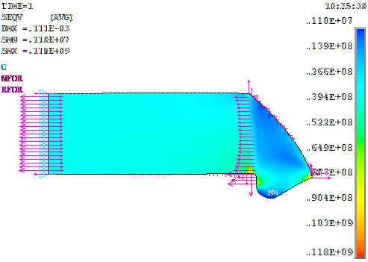
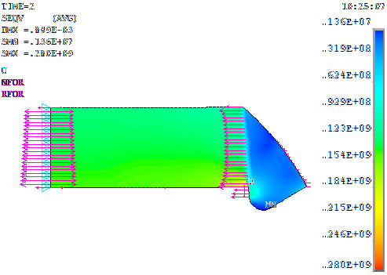
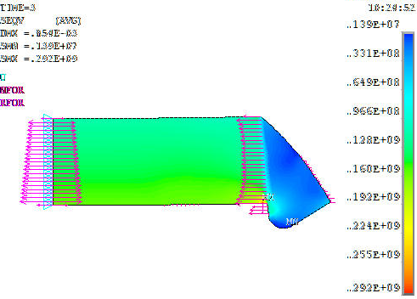
Design 2: IC-Clamp+12mm Skin, FEA Results
300K
4K
4K+15T
Seqv=115MPa
Seqv=353MPa
Seqv=448MPa
Seqv=118MPa
Seqv=280MPa
Seqv=292MPa

Slide 11
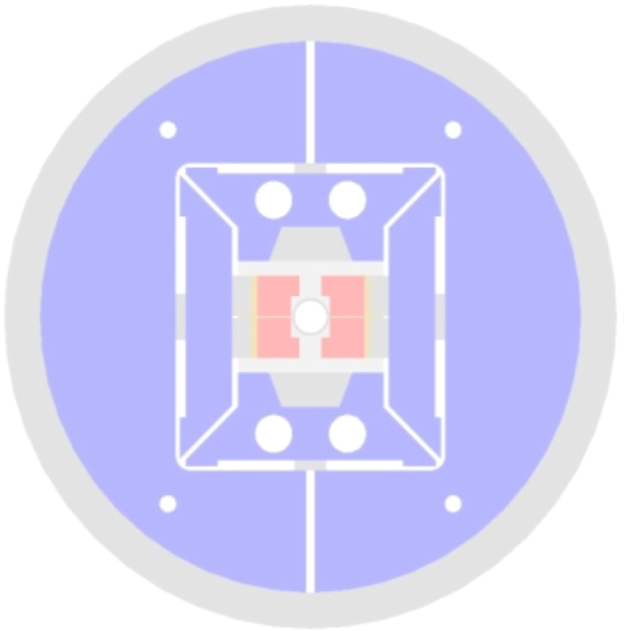
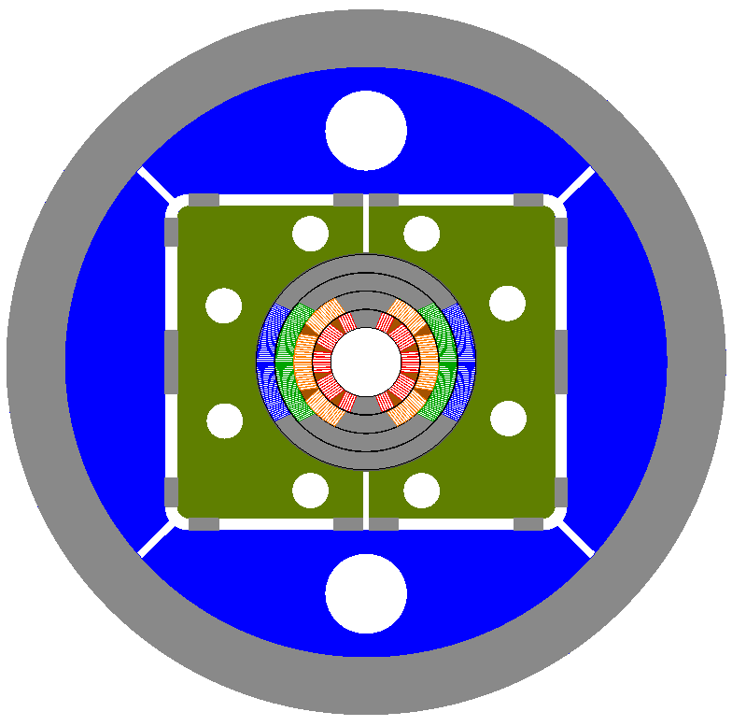
AL Shell Design
HD2
15 T Alternative

Slide 12
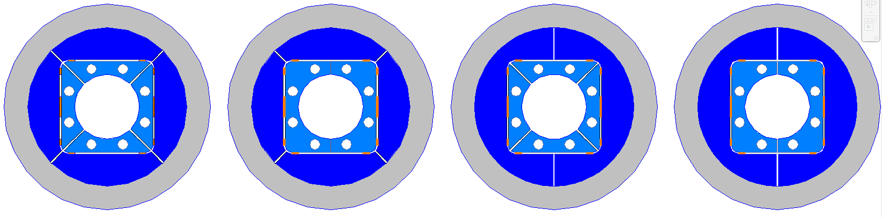
Parametric Model of the Structure
1
2
3
4
Al Shell: 50 and 70 mm thick
Iron Pad: 2 or 4-piece
Iron Yoke: 2 or 4-piece

Slide 13
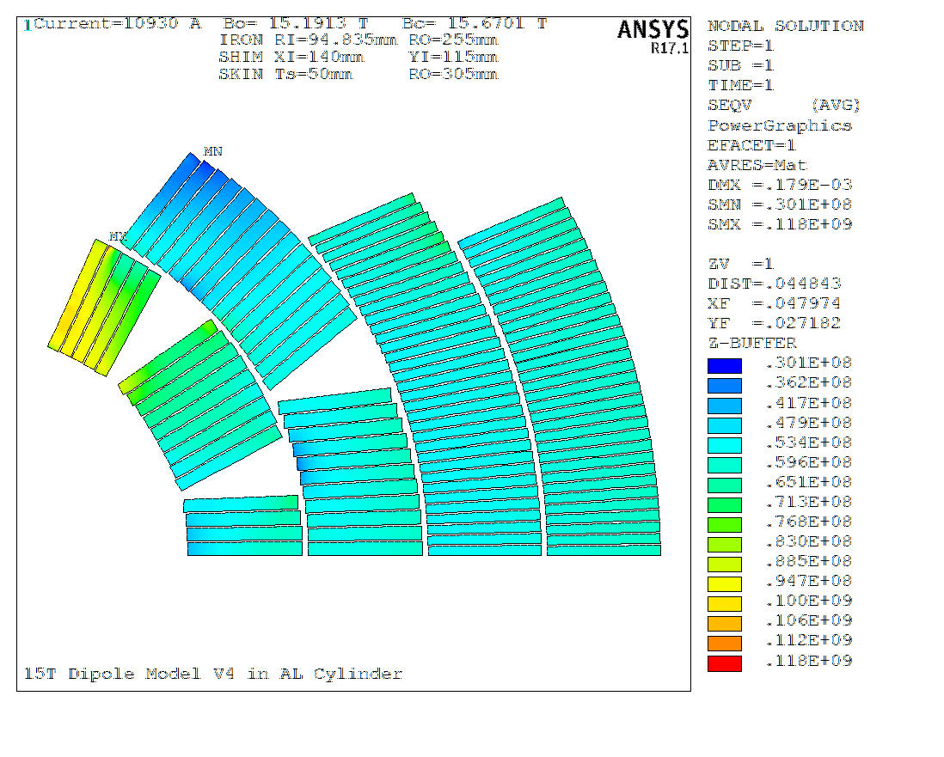
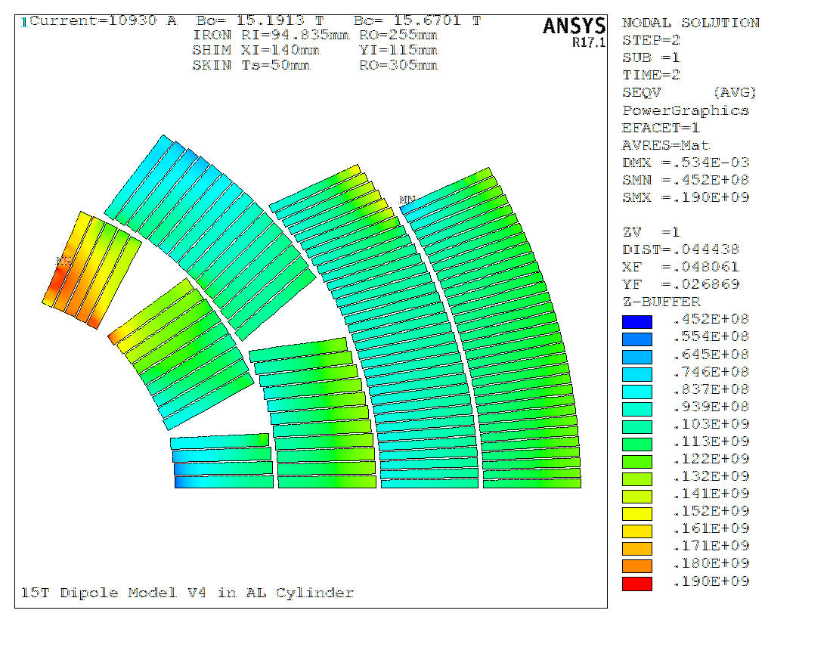
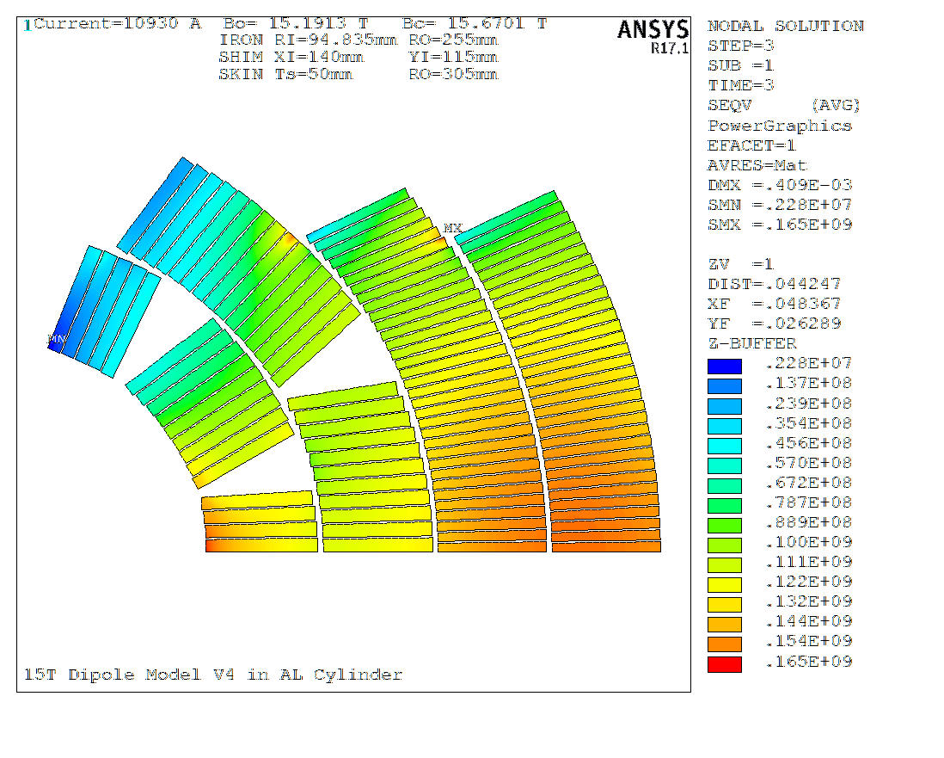

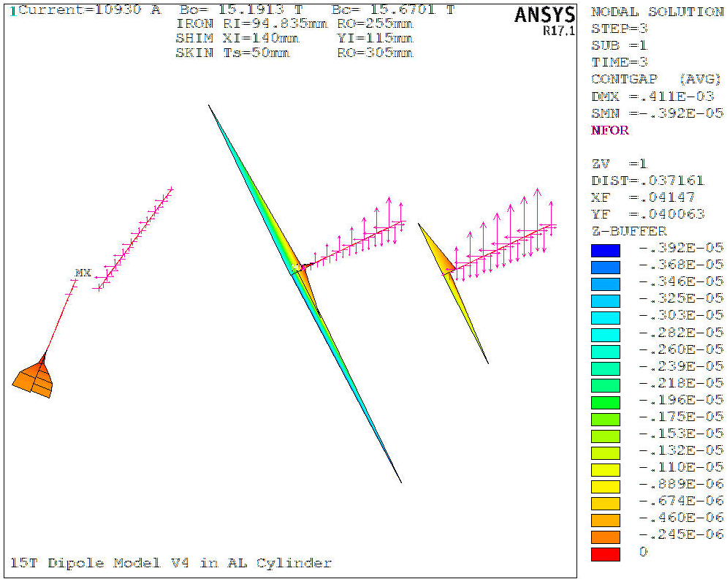
Design 3: 50mm AL Cylinder, FEA Results
300K
4K
4K+15T
Seqv=118MPa
Seqv=190MPa
Seqv=165MPa
Inner Pole Gap=0.3um

Slide 14
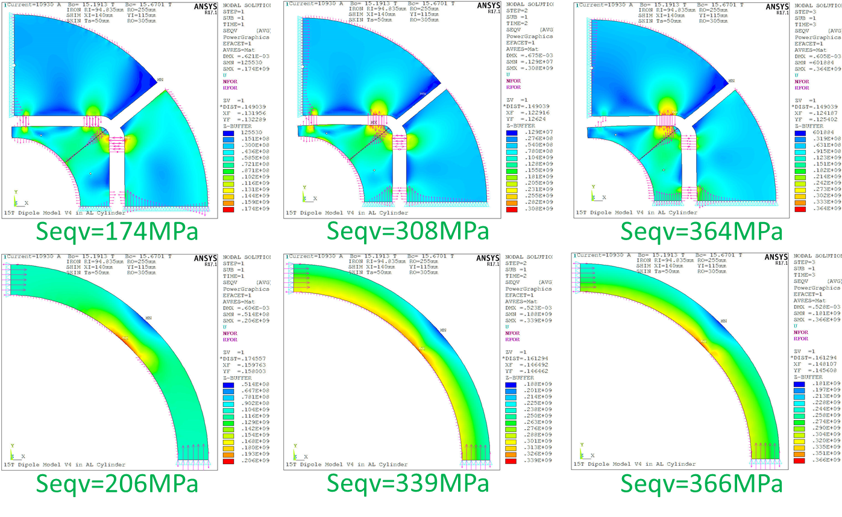
Design 3: 50mm AL Cylinder, FEA Results
300K
4K
4K+15T

Slide 15
15 T Demonstrator Support Structures
Baseline
Alternative
Igor Novitski | Mechanical analysis
October 18, 2016

Slide 16
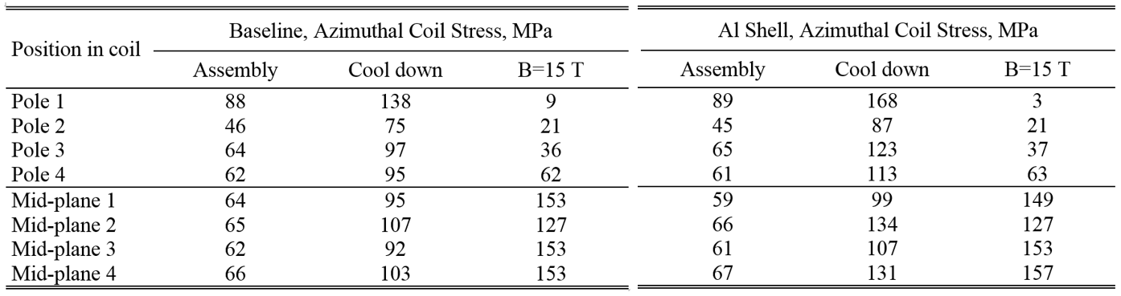
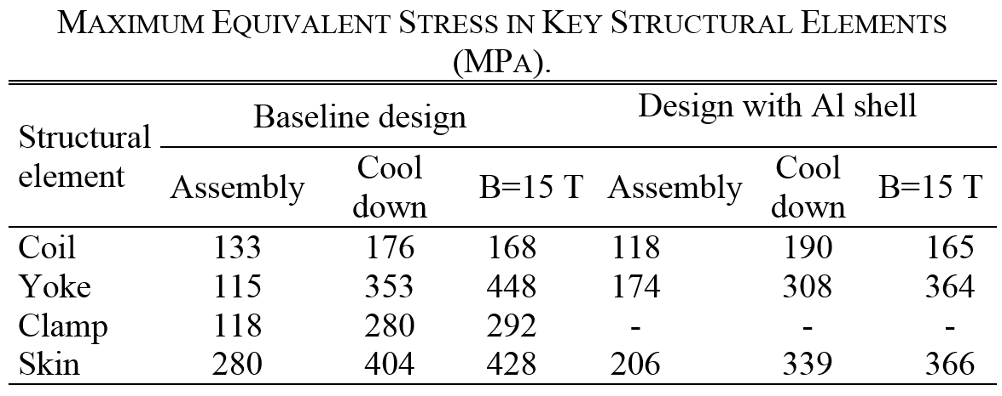
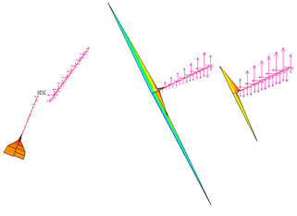
Comparison of Baseline and Alternative Designs
Contact gaps at poles
Al Shell at 15T:
Inner Pole Gap=0.3um (30%)
Layer 3 pole Gap=4um (15%)
Baseline at 15T:
Inner Pole Gap =0um
Layer 3 pole Gap=7um (20%)

Slide 17
Summary
  Several concepts of mechanical structure have been analysed and compared.
  Mechanical designs with IC-Clamps (Baseline) provides the required coil prestress and restricts turn radial, azimuthal and longitudinal motion for the operating current range up to 15T.
  Alternative magnet support structure based on a 50 mm thick aluminum shell, 4-piece iron yoke and 2-piece iron pad behave likewise.
  Both structures allow keeping the stresses in the coil and support structure within acceptable limits during magnet assembly and operation.

