Slide 1




EuroCircol – The Cosine-theta Configuration:
Electromagnetic Design Ver. 2.1
Massimo Sorbi
on behalf of INFN team:
Giovanni Bellomo, Barbara Caiffi, Pasquale Fabbricatore,
Stefania Farinon, Vittorio Marinozzi, Giovanni Volpini
Massimo Sorbi, US-EuroCirCol video-meeting, 18 Oct. 2016

Slide 2

Outline:
  Main design parameters
  Magnetic design
  Protection
Massimo Sorbi, US-EuroCirCol video-meeting, 18 Oct. 2016

Slide 3
1.1 Main design parameters
Constraints for the magnet design
Bore inner diameter | 50 mm
Beam distance | 250 mm
Bore nominal field | 16 T
Operating temperature | 1.9 K
Oper. point on the load line (with “self field”) | ≤86 %
Strand number per cable | ≤60
Cable insulation thickness | 0.15 mm
Cu/NCu | ≥0.8
Field harmonics (geometric/saturation) | ≤3/10 units
Peak temperature (105 % of operating current) | ≤350 K
Yoke outer radius | 400 mm
Maximum voltage to ground | ~1 kV
88% before
1.0 before
Magnetic design for a double aperture magnet
Mechanical design for a single aperture magnet
Massimo Sorbi, US-EuroCirCol video-meeting, 18 Oct. 2016

Slide 4
Additional costrains (reviewer suggestions):
Maximum strand diameter: 1.2 mm
Minimum dimensions of wedge between blocks: ~1 mm
Other costrains:
Number of layers: (even) → 4
This drive to have an optimized value of current of ~10.5 kA and so a number of strands < 40.
Massimo Sorbi, US-EuroCirCol video-meeting, 18 Oct. 2016

Slide 5
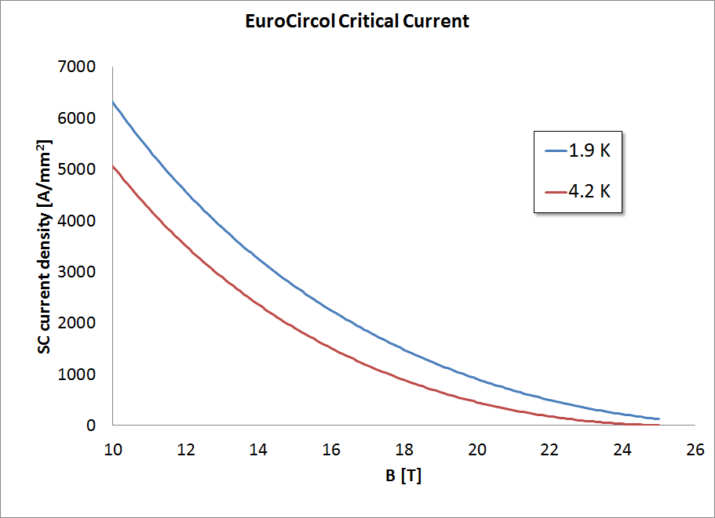
1.2 Main design parameters
Critical current density in S.C.
fraction, on extracted strands,
i.e. including cable degradation
Jc @ 16T, 1.9 K
~2250 A/mm²
Jc @ 16T, 4.2 K
~1500 A/mm²
Jc @ 18T, 4.2 K
~890 A/mm²
Jc @ 18T, 1.9 K
~1500 A/mm²
Massimo Sorbi, US-EuroCirCol video-meeting, 18 Oct. 2016

Slide 6
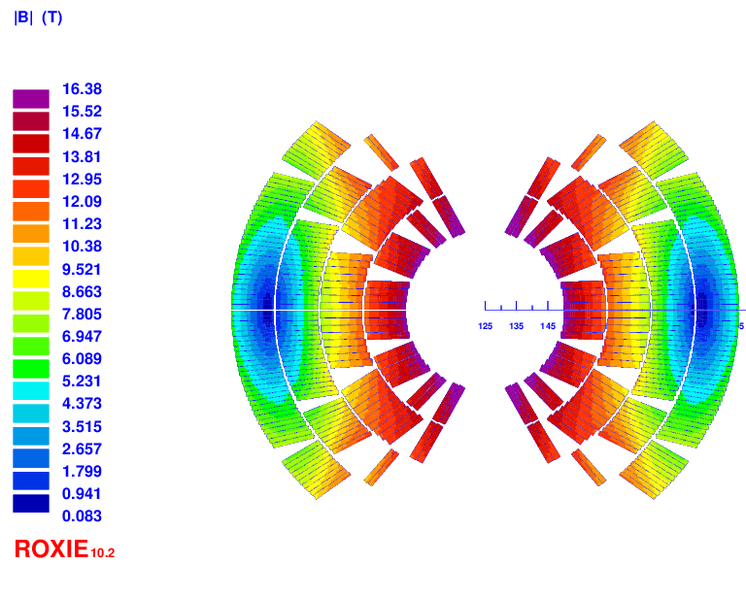
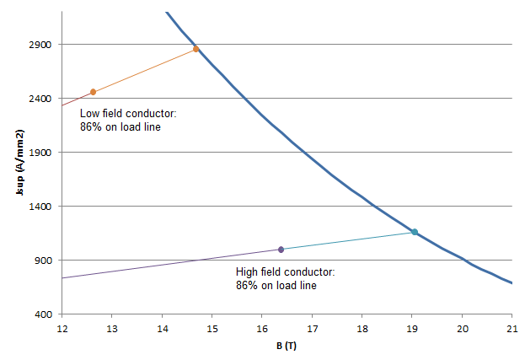
Configuration: 16T-22b-36-optd5f6
Main characteristics:
2 double-pancakes
2 conductor size
Splitting of pole blocks to decrease peak-field
B peak
16.37 T (with strand ’’self-field’’)
Turn number:
Layer 1: 13
Layer 2: 20
Layer 3: 30
Layer 4: 38
Tot: 202/ap.
high-field cond.
low-field cond.
Massimo Sorbi, US-EuroCirCol video-meeting, 18 Oct. 2016

Slide 7
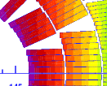
2.1 Magnetic design – cross section
 | Cable 1 (inner) | Cable 2 (outer)
Strand number | 22 | 36
Strand diameter | 1.1 mm | 0.712 mm
Bare width | 13.2 mm | 13.5mm
Bare inner thickness | 1.892 mm | 1.225 mm
Bare outer thickness | 2.072 mm | 1.343 mm
Insulation | 0.15 mm | 0.15 mm
Keystone angle | 0.5° | 0.5°
Cu/NCu | 0.85 | 2.15
Operating current | 11180 A | 11180A
Copper current density | 1165 A/mm² | 1143 A/mm²
Operating point on LL (1.9 K) | 86% | 86%
Wedge minimum
thikness: 0.80 mm
In LHC: 0.70 mm
In D11: 0.98 mm
including the ’’self-field’’

Slide 8
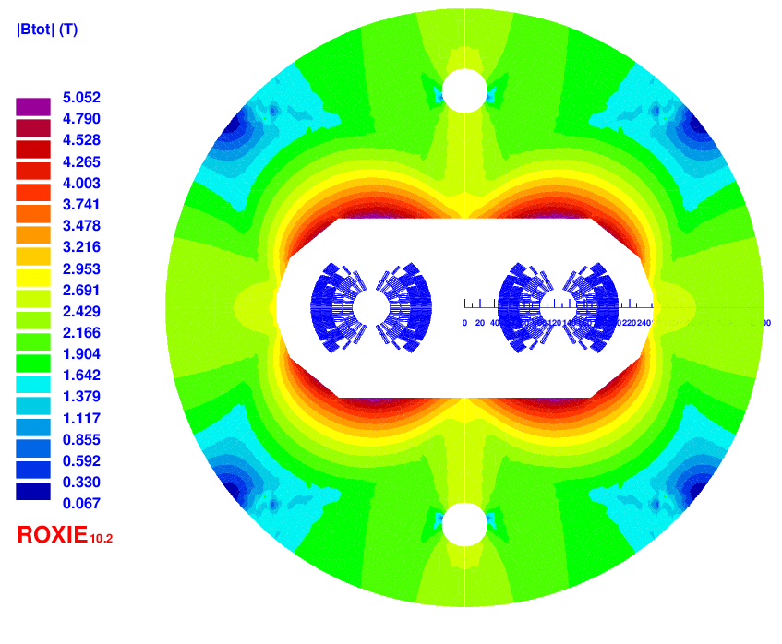
2.2 Magnetic design – iron yoke
Possible lay-out of iron yoke for the positioning of collar in double aperture
Collar +
Bladder & key
Inductance@I_{op} (1 ap) | Stored energy (1 ap)
19.9 mH/m | 1.3 MJ/m
Massimo Sorbi, US-EuroCirCol video-meeting, 18 Oct. 2016

Slide 9
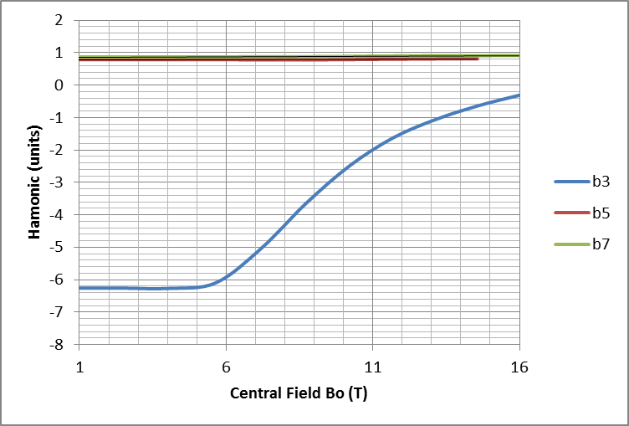
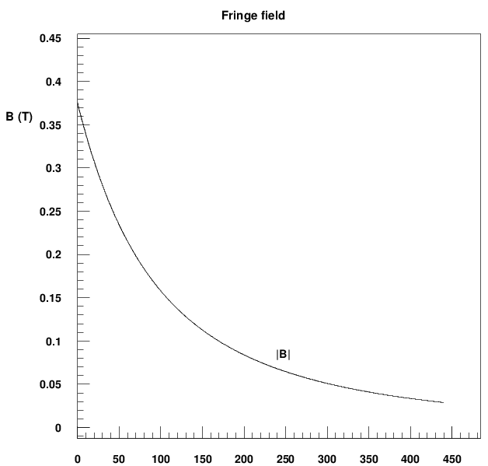
2.3 Magnetic design – field quality
b2 optimization not performed
Persistent currents not considered
NORMAL RELATIVE MULTIPOLES @ 16 T:
b 1: 10000 b 2: 10.83 b 3: -0.31
b 4: -0.25 b 5: 0.82 b 6: -0.01
b 7: 0.92 b 8: -0.00 b 9: 0.80
b10: 0.00 b11: 1.09 b12: 0.00
b13: -0.15 b14: 0.00 b15: 0.01
Fringing field < 0.1 T at 200 mm from yoke
Massimo Sorbi, US-EuroCirCol video-meeting, 18 Oct. 2016

Slide 10
2.4 Magnetic design – strand area
Conductor 1:
22 strands
∅ = 1.1 mm
Cu/NCu = 0.85
J_{cu} = 1143 A/mm²
Strand Area = 27.6 cm²/apert.
Weight (FCC) = 3.14 ktons
Conductor 2
36 strands
∅ = 0.712 mm
Cu/NCu = 2.15
J_{cu} = 1165 A/mm²
Strand Area= 39.0 cm²/apert.
Weight (FCC) = 4.44 ktons
COND. AREA (double ap.): = 133.2 cm²
FCC-hh dipoles:
COND. MASS: = 7.59 ktons
Data for FCC-hh collider
Number of dipole units | 4578
Dipole lenght | 14.3 m
Conductor density | 8.7 kg/dm³
Massimo Sorbi, US-EuroCirCol video-meeting, 18 Oct. 2016

Slide 11
Massimo Sorbi, 1st Review of EuroCirCol WP5 , 11-13 May 2016
2.5 Magnetic design – strand area
Option to reduce cost
Conductor 2
23 (SC)+13 (Cu) strands
∅ = 0.712 mm
Cu/NCu in S.C. strand= 1.0
J_{cu} = 1165 A/mm²
Strand Area (SC)= 24.9 cm²/apert.
Strand Area (Pure Cu) = 14.1 cm²/apert.
SC strand weight (FCC) = 2.84 ktons
Pure Cu strand weight (FCC) = 1.61 ktons
Pure Cu cost << SC cost
Stability as in cable 1 (Cu/NCu = 1)
Current diffusion time in the Cu strands to be evaluated and compared with discharge time
  Zero order evaluation seems ok (few ms)
TOTAL SC STRANDS: = 7.59 5.98 ktons (-21%)
Massimo Sorbi, US-EuroCirCol video-meeting, 18 Oct. 2016

Slide 12
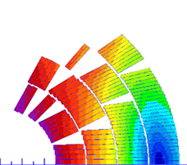

3.1 Protection
Simulations from Coodi (Tiina Salmi)
Main assumptions:
  No energy extraction
  Quench induced in the whole magnet 40 ms after initial quench start
  Inductance dependence on the current
  Material properties from NIST
Results (105 % of I_{op}):
  Hot spot temperature: 344 K
  Maximum voltage to ground: 0.77 kV
  Layer-to-layer max voltage: 0.91 kV
  Turn-to-turn max voltage: 86 V
More details in the Tiina Salmi EuroCirCol presentations
Massimo Sorbi, US-EuroCirCol video-meeting, 18 Oct. 2016

