Slide 1



16 T Cosθ DIPOLE Mechanical Analysis
STEFANIA FARINON
on behalf of INFN team:
G. Bellomo, P. Fabbricatore, B.CAIFFI, V. Marinozzi, M. Sorbi and G. Volpini

Slide 2
Overview
Principal stresses and failure criteria
2D model: plain strain vs plain stress
2D mechanical optimization
Cosθ 2D models:
CONFIGURATION 1 – vertical cut
CONFIGURATION 1I – horizontal cut
CONFIGURATION 1II – hybrid
CONCLUSIONS

Slide 3
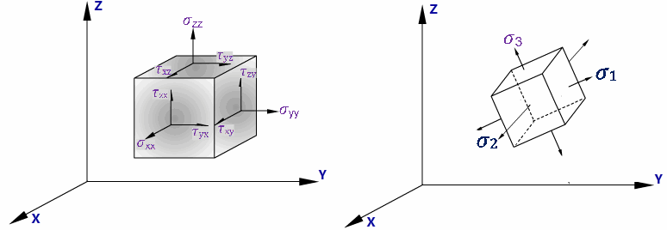
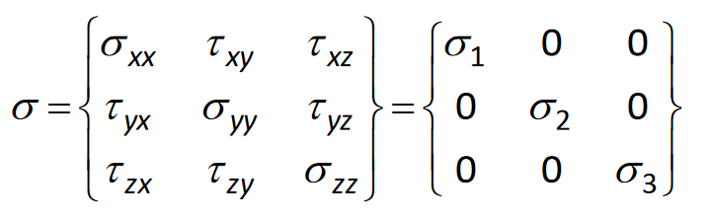
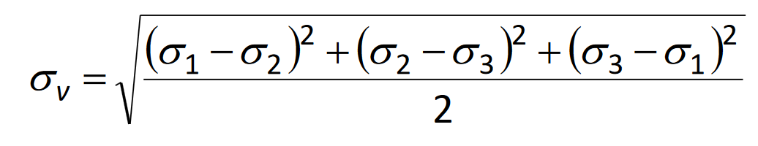
PRINCIPAL STRESSES
The principal stress σ1, σ2 and σ3, defined for each single element, are those in which the stress-strain tensor is diagonal
(σ3< σ2< σ1).
σ3 ~ σx in block coil geometry
σ3 ~ σθ in cosθ geometry
Von Mises stress is defined as:
Stress-strain tensor
In cartesian coordinate system
PRINCIPAL coordinate system: system in which the SS tensor is DIAGONAL

Slide 4
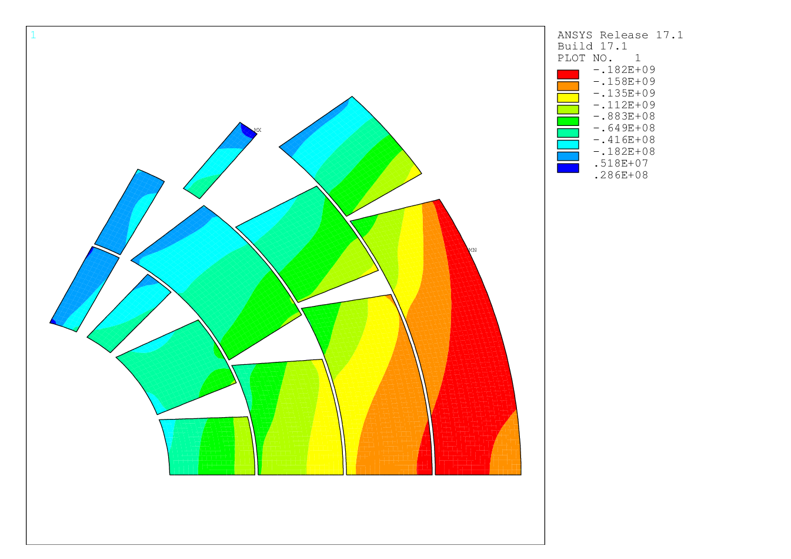
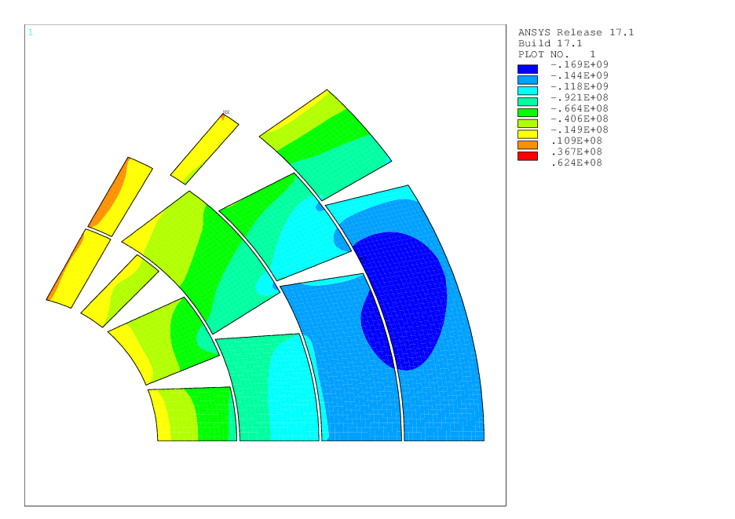
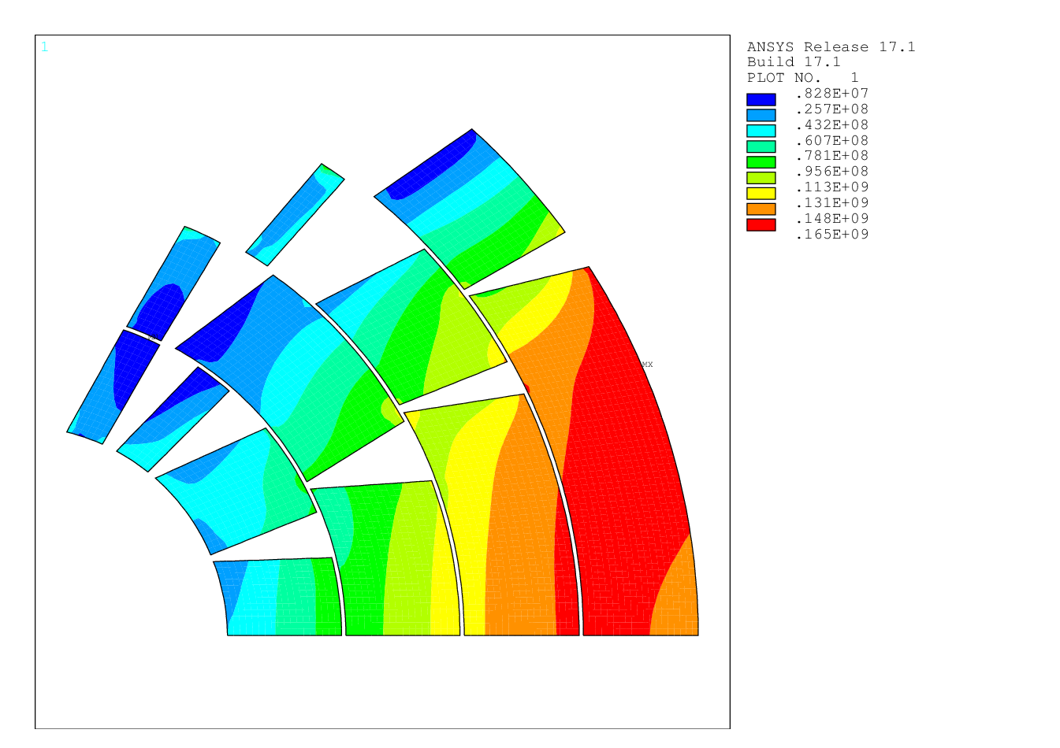
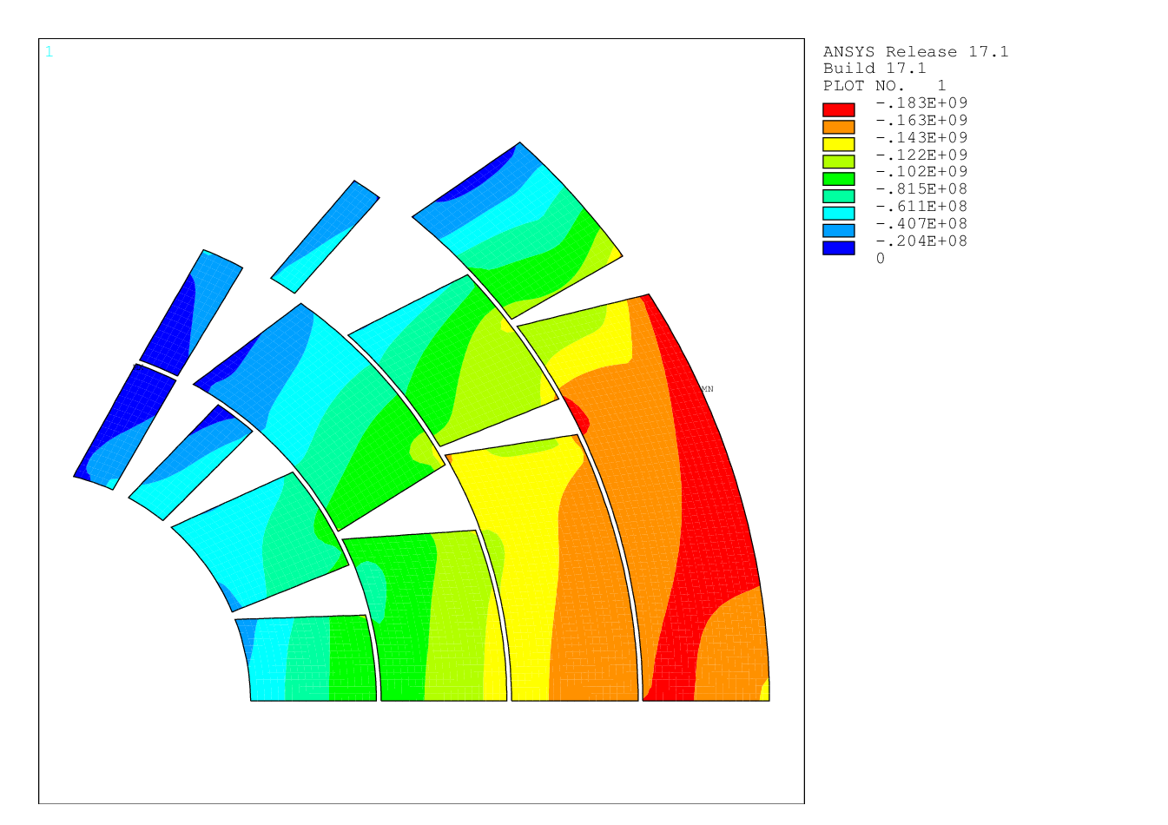
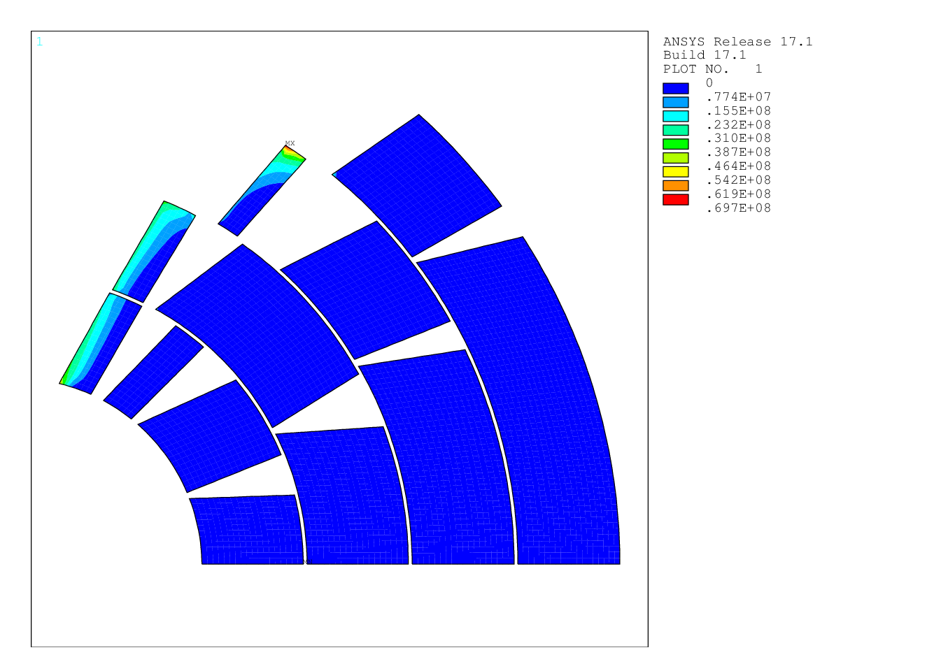
STRESSES
σθ
σ_{r}
σ_{VM}
σ₃
σ₁

Slide 5
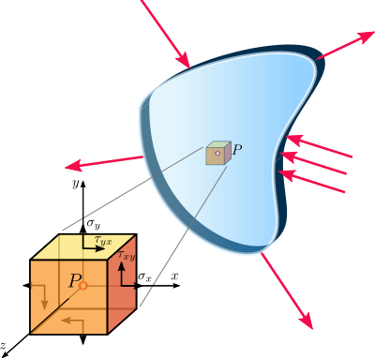
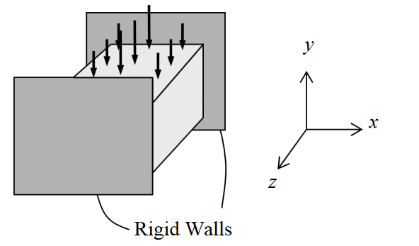
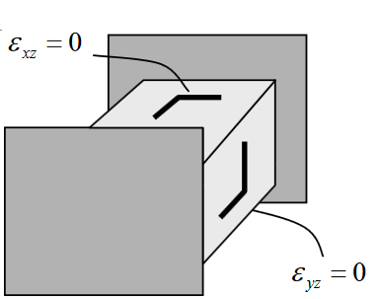
PLANE STRESS vs PLANE strain
Plane strain
Plane stress
Plane stress is a stress state that varies only in the X and Y directions. The stress in the Z direction is always zero, as are the XZ and YZ shear stresses.
Plane stress is generally used on flat, thin structures, where the deformation is assumed to be solely in the plane of the structure.
Plane strain is a stress state that varies only in the X and Y directions. The strain in the Z direction is always zero, as are the XZ and YZ shear strains, since the boundaries are fixed.
Plain stress approximation is less conservative but more compatible with 3D simulation results.

Slide 6
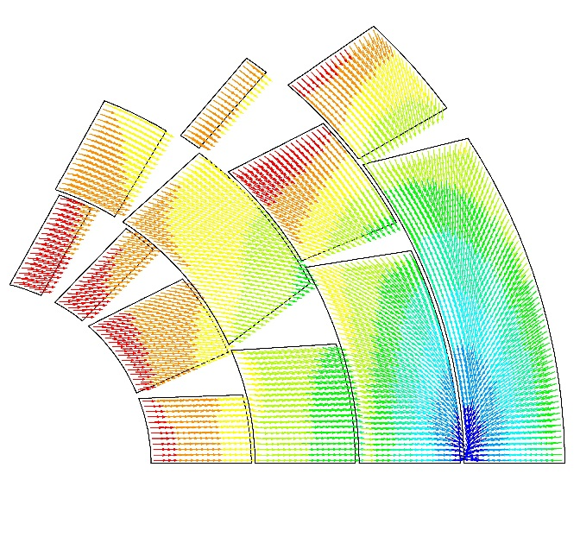
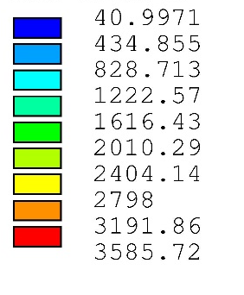
2d mechanical optimization
Cables undergo degradation if:
stress on conductors >150 MPa @room temperature;
stress on conductors > 200 MPa @cold;
stress on conductors > 150 MPa @cold after energization in the high field region → attention must be given in particular to first layers.
Tensile stress on the iron yoke at 4 K < 200 Mpa.
Contact pressure Ti pole-conductors > 2 MPa after energization at 16T.
F[N]
41
435
829
1223
1616
2010
2404
2798
3192
3586

Slide 7
Material parameters
 | E modulus [GPa] (T=4K) | E modulus [GPa] (T=300K) | α (K⁻¹) | ν_{xy}
Conductor | E_{x}=33 E_{y}=27.5 | E_{x}=30 E_{y}=25 | α_{x}=3.08E-3/296 α_{y}=3.36E-3/296 | 0.3
Steel | 210 | 191 | 2.8e-3/296 | 0.28
Iron | 224 | 204 | 2.0e-3/296 | 0.28
Aluminum | 79 | 72 | 4.2e-3/296 | 0.3
Copper | 110 | 100 | 3.4e-3/296 | 0.3
Resin | 27.5 | 25 | 2.5e-3/296 | 0.2
Titanium | 126.5 | 115 | 1.7e-3/296 | 0.3
+10%

Slide 8
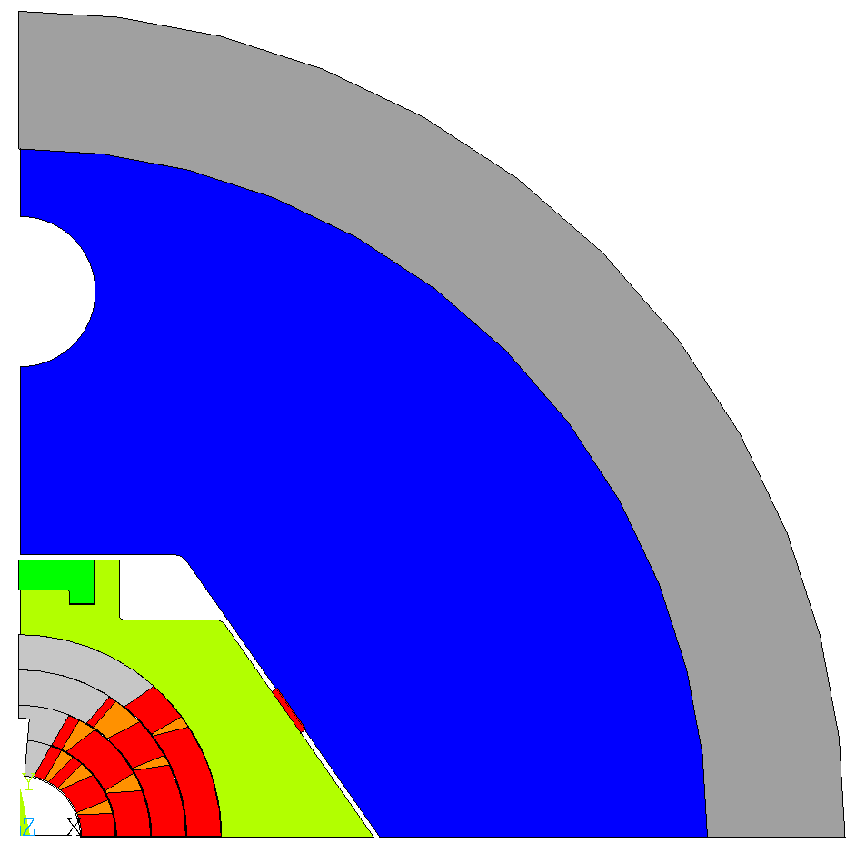
CONFIGURATION 1
ANSYS model
Bladder & key configuration
Key length= 20 mm, interference= 0.6 mm
Vertical cut both in the steel collar and in the iron yoke
C-clamp mandatory to achieve enough contact pressure at the pole, interference= 0.15 mm
Al alloy
Vertical cut
55 mm
Iron
C-clamp
155 mm
SS
key
40 mm

Slide 9
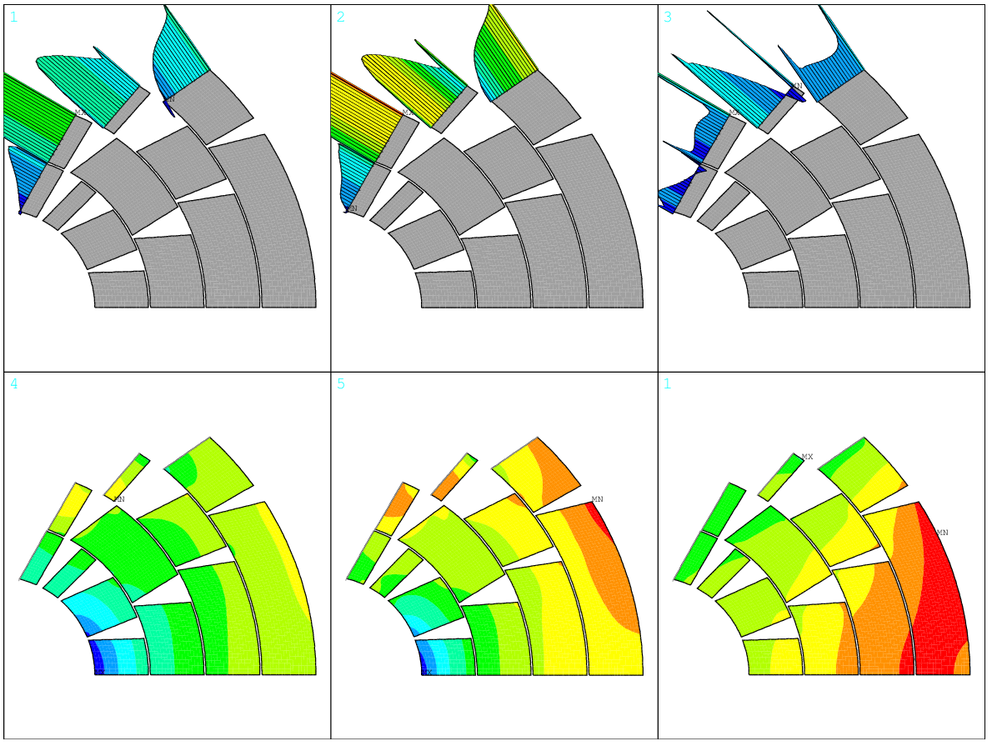
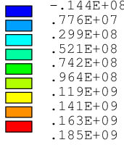
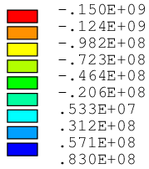
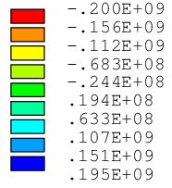
Contact pressure and principal stress
Assembly
Cool Down
Energization
Contact Pressure [Pa]
Contact Pressure [Pa]
Contact Pressure [Pa]
Azimuthal Stress σ _{θ} [Pa]
Azimuthal Stress σ _{θ}[Pa]
Azimuthal Stress σ _{θ} [Pa]
B.Caiffi WP5 Coordination Meeting
σ_{θ peak}= -111 MPa
σ _{θ peak}=-195 MPa
σ _{θ peak}= -182 MPa

Slide 10
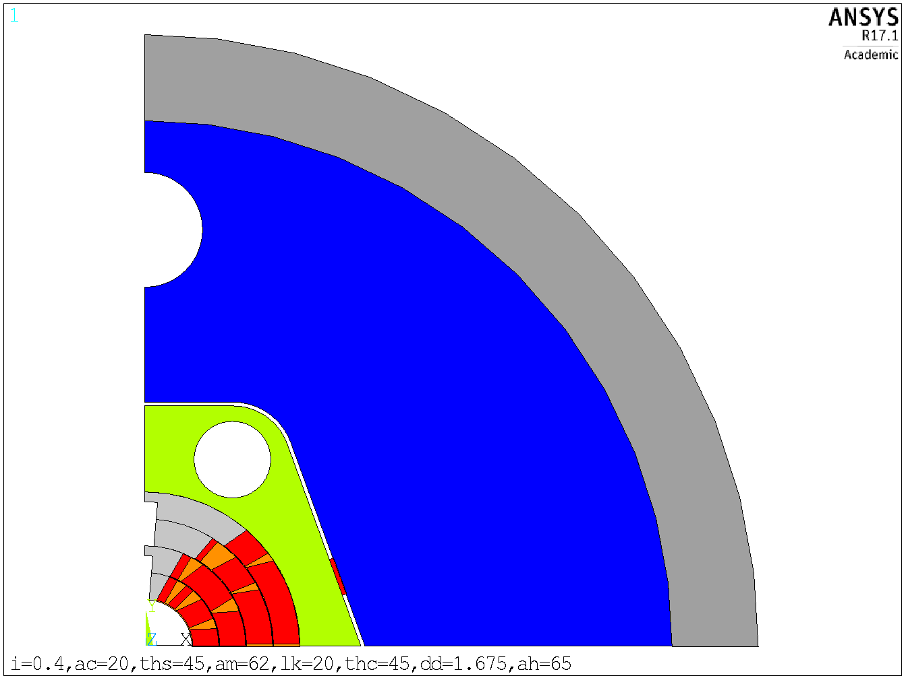
CONFIGURATION 2
Bladder & key configuration
Key length= 20 mm, interference= 0.4 mm
Horizontal cut both in the steel collar and in the iron yoke
Al alloy
Iron
45 mm
SS
160 mm
key
30mm
Horizontal cut

Slide 11
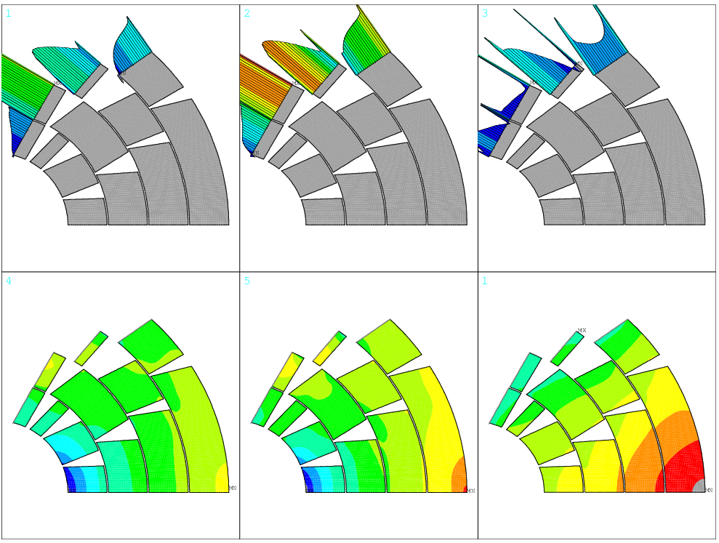
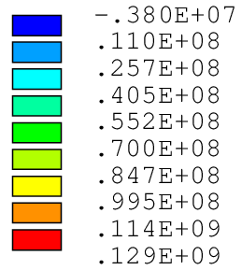
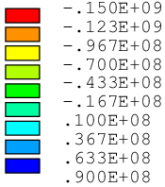
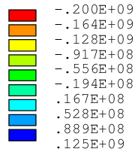
Contact pressure and principal stress
Assembly
Cool Down
Energization
Contact Pressure [Pa]
Contact Pressure [Pa]
Contact Pressure [Pa]
Azimuthal Stress σ _{θ} [Pa]
Azimuthal Stress σ _{θ}[Pa]
Azimuthal Stress σ _{θ} [Pa]
σ_{θ peak}= -97 MPa
σ _{θ peak}=-206 MPa
σ _{θ peak}= -232 MPa

Slide 12
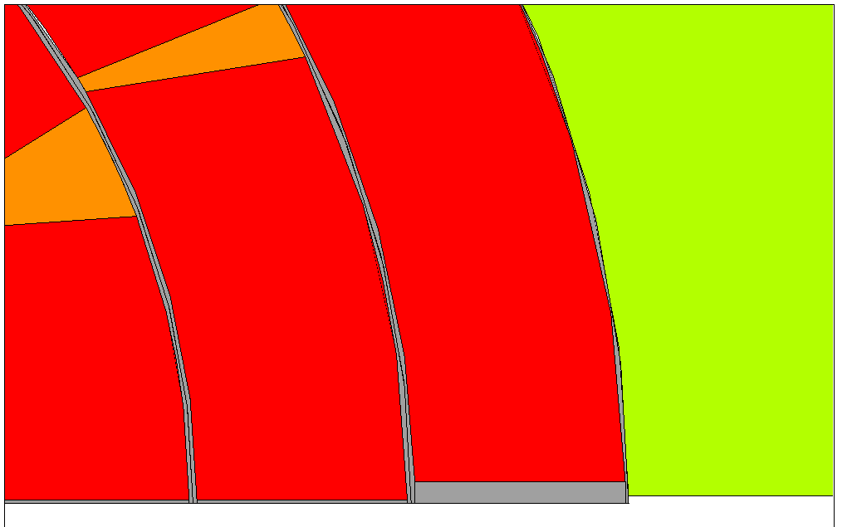
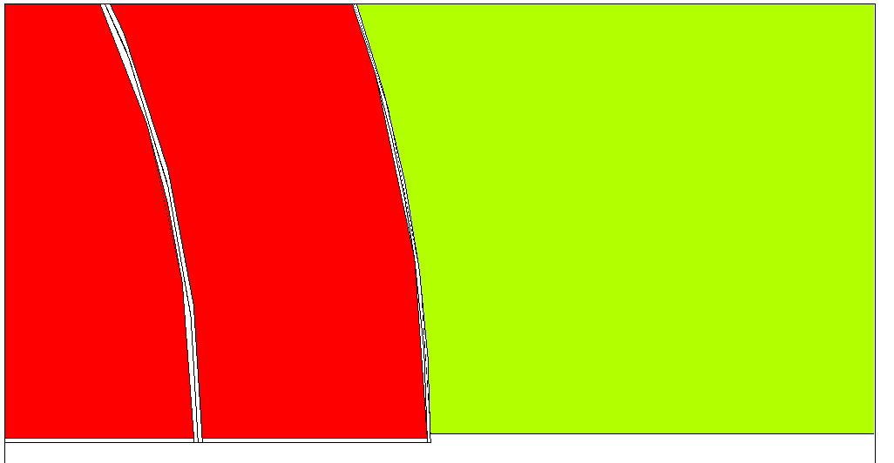
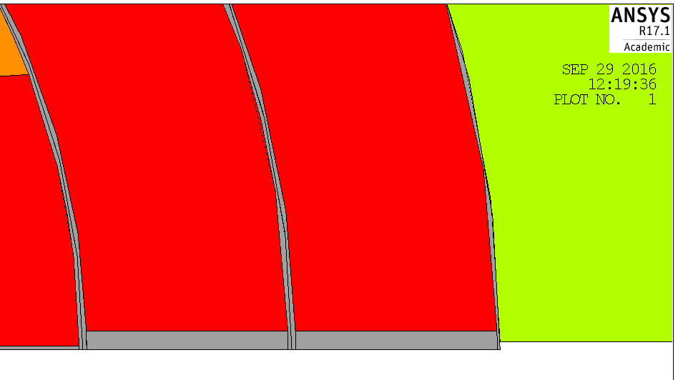
CONFIGURATION 2
IVth layer shifted upward by 1 mm
A
Peak stress due to the edge
IIIrd and IVth layers shifted upward by 1 mm
B

Slide 13
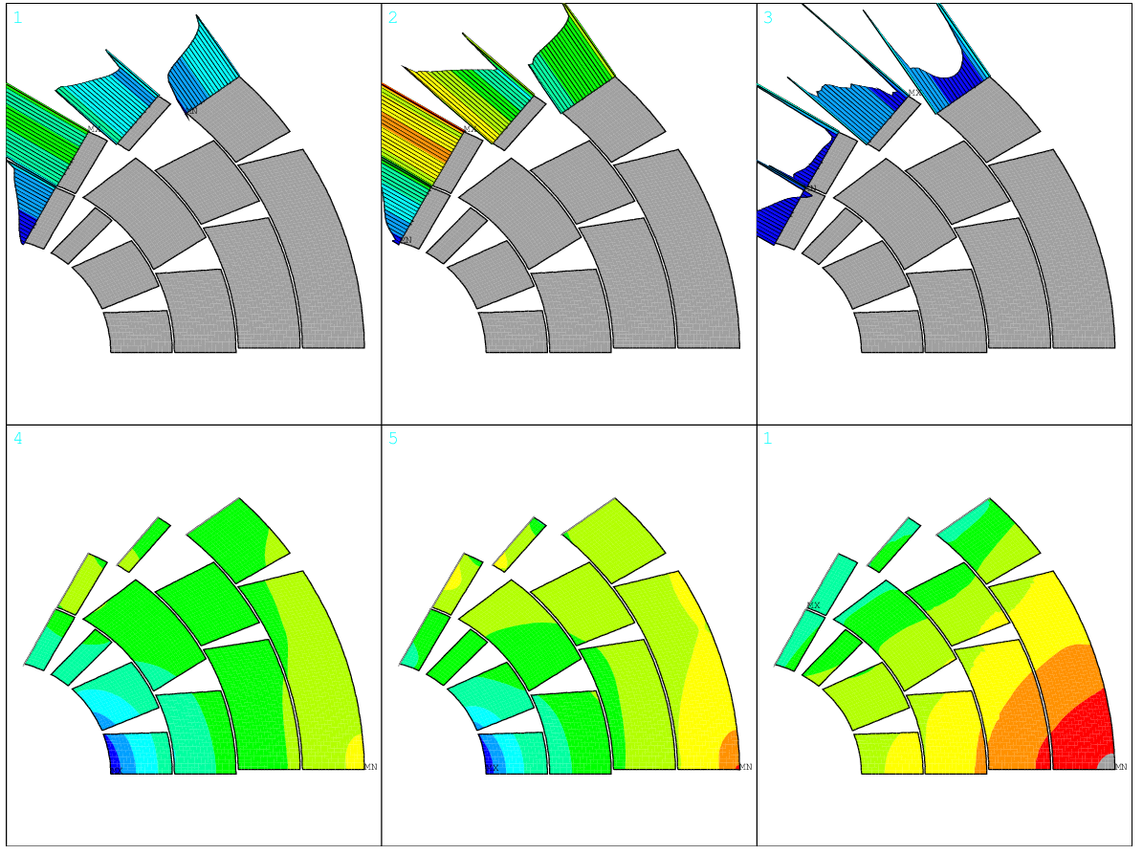
Contact pressure and principal stress
Assembly
Cool Down
Energization
Contact Pressure [Pa]
Contact Pressure [Pa]
Contact Pressure [Pa]
Azimuthal Stress σ _{θ} [Pa]
Azimuthal Stress σ _{θ}[Pa]
Azimuthal Stress σ _{θ} [Pa]
σ_{θ peak}= -90 MPa
σ _{θ peak}=-187 MPa
σ _{θ peak}= -225 MPa

Slide 14
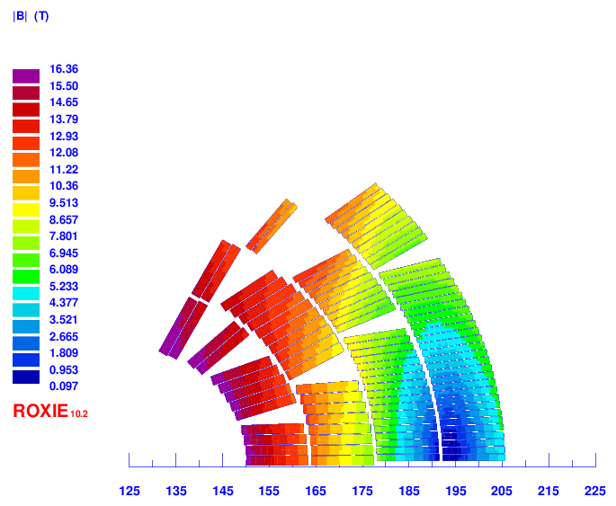
Turn number:
Layer 1: 13
Layer 2: 20
Layer 3: 30
Layer 4: 38
Tot: 202/ap.
Wedge minimum
thikness: 0.86 mm
In LHC: 0.70 mm
In D11: 0.98 mm
16T-22b-36-optd6f7
Field harmonics < 1 unit
 | Cable 1 (inner) | Cable 2 (outer)
Strand number | 22 | 36
Strand diameter | 1.1 mm | 0.712 mm
Bare width | 13.2 mm | 13.5mm
Bare inner thickness | 1.892 mm | 1.225 mm
Bare outer thickness | 2.072 mm | 1.343 mm
Insulation | 0.15 mm | 0.15 mm
Keystone angle | 0.5° | 0.5°
Cu/NCu | 0.85 | 2.15
Operating current | 11180 A | 11180A
Copper current density | 1165 A/mm² | 1143 A/mm²
Operating point on LL (1.9 K) | 86% | 86%
Cable 1 (inner) | Cable 2 (outer)
22 | 36
1.1 mm | 0.712 mm
13.2 mm | 13.5mm
1.892 mm | 1.225 mm
2.072 mm | 1.343 mm
0.15 mm | 0.15 mm
0.5° | 0.5°
0.85 | 2.1
11200 A | 11200 A
1167 A/mm² | 1154 A/mm²
86% | 86%

Slide 15
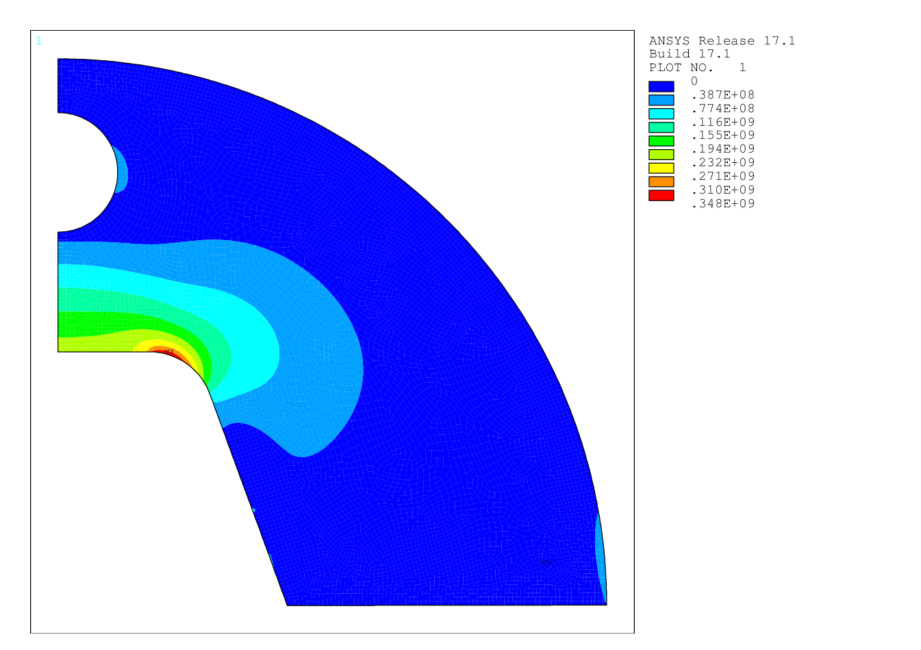
Tensile stress in the iron
Tensile stress peak in the iron (σ_{1 peak}) ~ 350 MPa

Slide 16
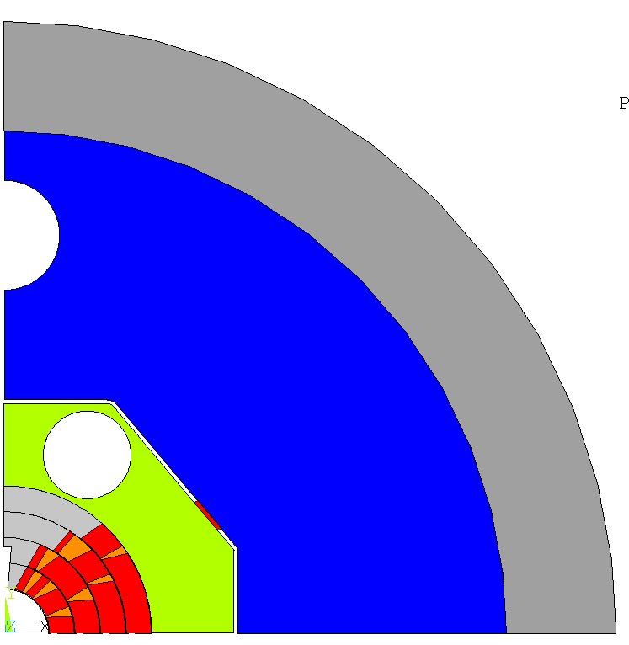
CONFIGURATION 3
Al alloy
Bladder & key configuration
Key length= 20 mm, interference= 0.5 mm
Horizontal cut in the steel collar
→greater contact pressure at the pole
Vertical cut in the iron yoke
→smaller tensile stress on the iron
Vertical cut
Iron
60 mm
150 mm
SS
45 mm
Horizontal cut

Slide 17
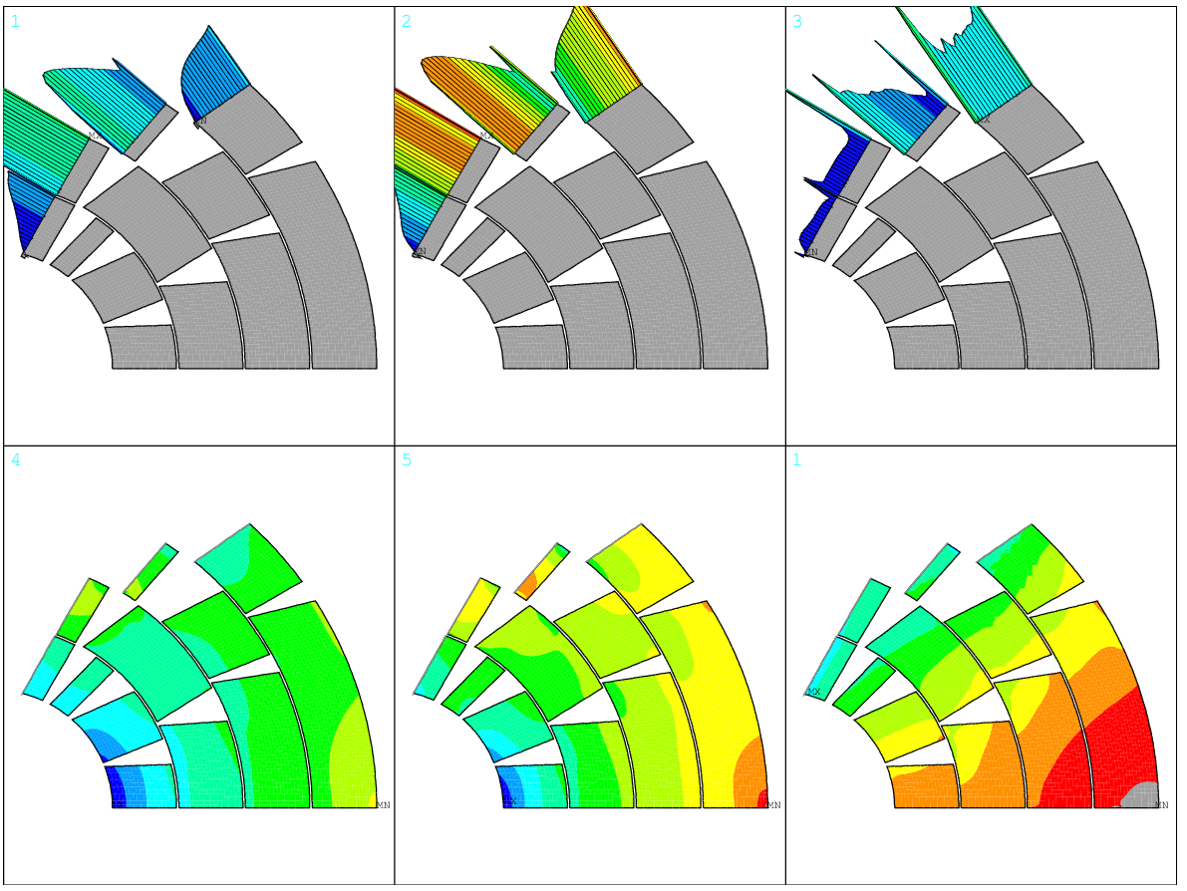
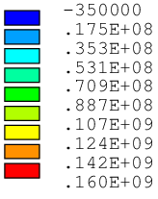
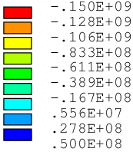
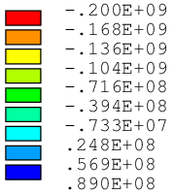
Contact pressure and principal stress
Assembly
Cool Down
Energization
Contact Pressure [Pa]
Contact Pressure [Pa]
Contact Pressure [Pa]
Azimuthal Stress σ _{θ} [Pa]
Azimuthal Stress σ _{θ}[Pa]
Azimuthal Stress σ _{θ} [Pa]
B.Caiffi WP5 Coordination Meeting
σ_{θ peak}= -107 MPa
σ _{θ peak}=-226 MPa
σ _{θ peak}= -219 MPa

Slide 18
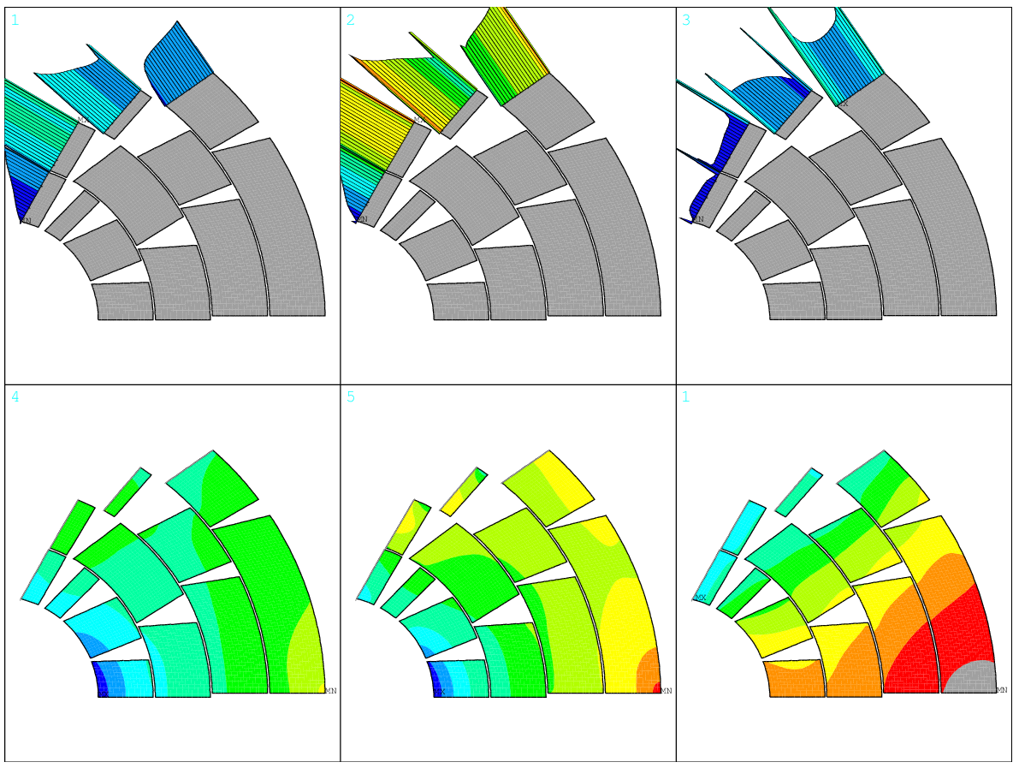
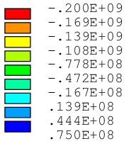
Contact pressure and principal stress
Assembly
Cool Down
Energization
Contact Pressure [Pa]
Contact Pressure [Pa]
Contact Pressure [Pa]
Azimuthal Stress σ _{θ} [Pa]
Azimuthal Stress σ _{θ}[Pa]
Azimuthal Stress σ _{θ} [Pa]
B.Caiffi WP5 Coordination Meeting
σ_{θ peak}= -102 MPa
σ _{θ peak}=-210 MPa
σ _{θ peak}= -216 MPa

Slide 19
Conclusions
The mechanics of the 16T costheta dipole has been investigated, giving particular importance to the fulfillment of the following requirements: stress on conductors <150 MPa @room temperature, stress on conductors < 200 MPa @cold and contact pressure Ti pole-conductors > 2 MPa after energization.
Different configurations were considered, among those the more promising were presented:
CONFIGURATION 1- vertical cut in the steel collar and the in the iron yoke
Bladder&Key + C-clamp mandatory to achieve contact pressure at the pole
Almost fulfill stress limits on the conductor
Good contact pressure at the pole for all the layers
CONFIGURATION II – horizontal cut in the steel collar and in the iron yoke
Almost fulfill stress limits on the conductor
Good contact pressure at the pole for all the layers
Very high values for tensile stress on the iron (350 MPa)
CONFIGURATION III- hybrid solutions, horizontal cut in the steel collar and vertical cut in the iron yoke
Almost fulfill stress limits on the conductor
Good contact pressure at the pole for all the layers

