Slide 2
Longitudinal painting requirements
Vincenzo Forte, Chiara Bracco TE/ABT/BTP
Elena Benedetto BE/ABP/HSI
Acknowledgements: J. Abelleira, A. Lombardi, G. Rumolo, R. Wegner

Slide 3
Outline
Longitudinal painting vs. un-modulated energy injection
  The processes
  Physical parameters
  Present hardware limitations
  Simulations set-up and comparison for
    Transverse emittance
    Losses
    Transverse space charge
Longitudinal painting optimization process
Summary and conclusions
Longitudinal painting requirements and optimization
Vincenzo Forte, Chiara Bracco - TE/ABT/BTP
Elena Benedetto – BE/ABP/HSI

Slide 4
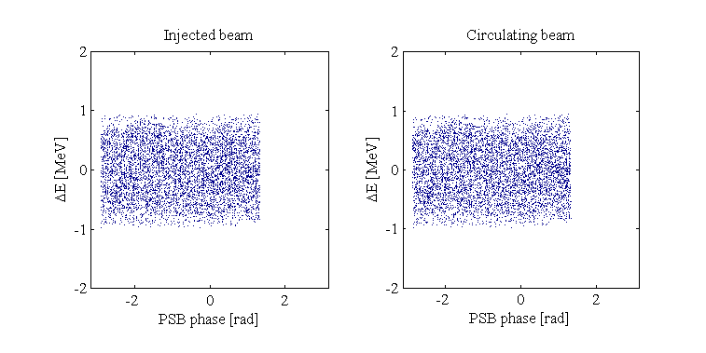
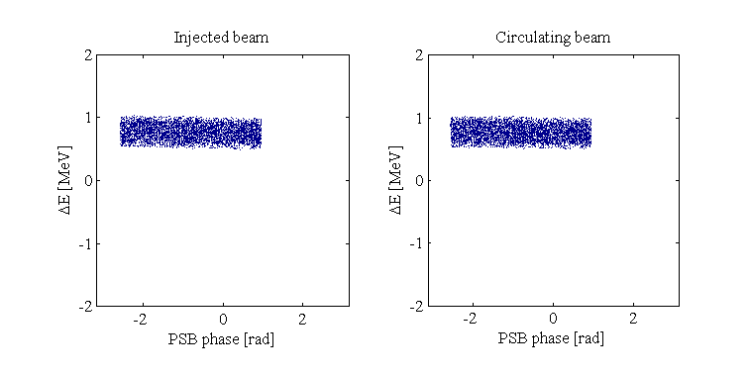
The processes
Multi-turn un-modulated energy injection
  The L4 bunch trains arrive to the PSB with the same central energy E₀ = 160 MeV
  The rms energy spread δE is usually large (~400-450 keV) to compensate peaks of line density
  → bad for space charge
  The chopping factor is fixed (~60%)
Multi-turn longitudinal painting
  The L4 bunch trains arrive to the PSB with different (turn-by-turn) central energy around E₀ = 160 MeV
  The rms energy spread δE is fixed (120-250 keV)
  The chopping factor is varying to follow the longitudinal iso-Hamiltonian contours for a given longitudinal emittance.
Longitudinal painting requirements and optimization
Vincenzo Forte, Chiara Bracco - TE/ABT/BTP
Elena Benedetto – BE/ABP/HSI

Slide 5
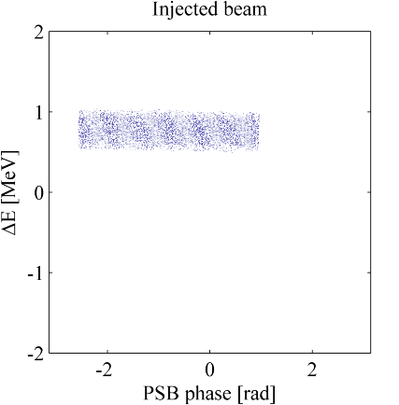
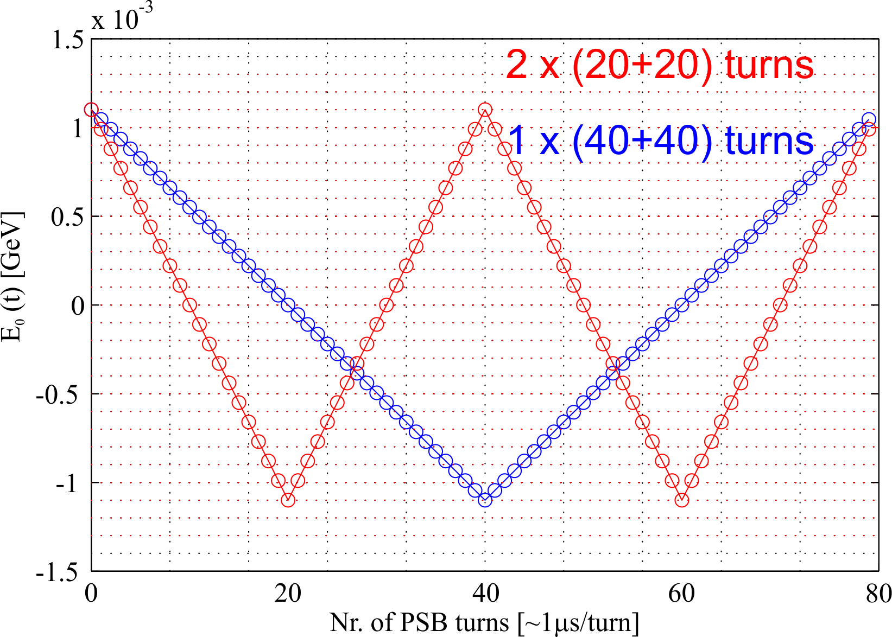
Physical parameters
The rms energy spread δE
  Imposed by the de-buncher
  Fixed during the injection process
The central energy E₀(t)
  Imposed by the last two PIMS
  Can be swept turn-by-turn at injection
The central energy sweeping rate dE₀(t)/dt
  Imposed by the last two PIMS → change of phase and, thus, power requested to the de-buncher
E₀(t)
δE
2π ⋅ chopping factor
The chopping factor (≤1)
  Imposed by the chopper
  Rations the effective current/turn at the PSB entrance
    I_{eff}(t) = chop. factor × unchopped current = chop. factor × 40 mA
  Can be modulated turn-by-turn at injection
  Determines the number of turns to be injected for any given target intensity
The number of injectable turns
  Is limited by the BI.DIS at <150 per PSB ring
A possible energy sweep through the PIMS
Longitudinal painting requirements and optimization
Vincenzo Forte, Chiara Bracco - TE/ABT/BTP
Elena Benedetto – BE/ABP/HSI

Slide 6
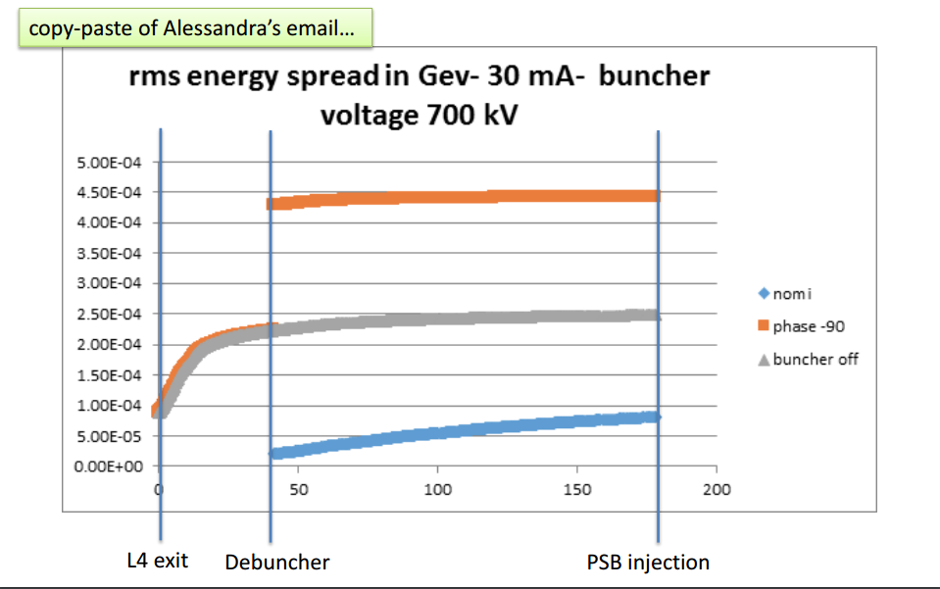
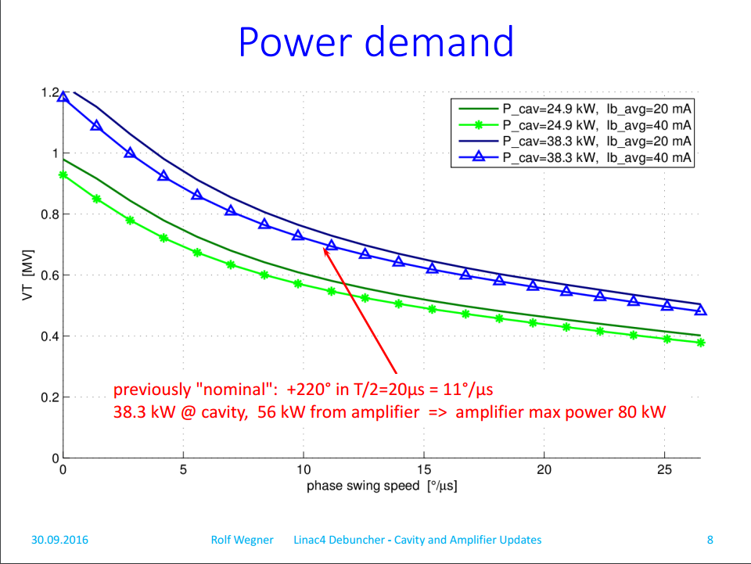
Present hardware limitations
The present de-buncher power supply has power limitations → cavity power limited to 24.9 kW
  δE =120 keV rms (historical reference value for energy spread) can be reached with a maximum of ~5.5 °/μs at 40 mA → sweeping with the PIMS between ±1.2 MeV in 40+40 turns (or ±0.8 MeV in 20+20 turns)
    → Previous expectations were 11 °/μs sweeping with the PIMS between ±1.2 MeV in 20+20 turns → to be obtained cavity power must increase to ~38.3 kW → Upgrade of the de-buncher amplifier would be needed!
  →With present performances the rms energy spread at the PSB entrance will reasonably vary in between
  80 keV ÷ 450 keV with ~5.5 °/μs (1 sweeping period in 80 turns (40+40) turns
Can we relax some injection parameters to avoid the power amplifier upgrade? We need longitudinal painting simulations vs. un-modulated injection simulations…
  Is a slower sweeping rate acceptable? → 1x(40+40) vs. 2x(20+20) turns
  Could we think to sweep in a more limited range? → ±0.8 MeV vs. ±1.2 MeV
  Is the natural energy spread (~250 keV, de-buncher OFF) acceptable?
  Can we survive without longitudinal painting in a first phase?
δE
Plots from E. Benedetto, A. Lombardi, R. Wegner presentations
at LIU-PSB Injection Meeting #23
Longitudinal painting requirements and optimization
Vincenzo Forte, Chiara Bracco - TE/ABT/BTP
Elena Benedetto – BE/ABP/HSI

Slide 7
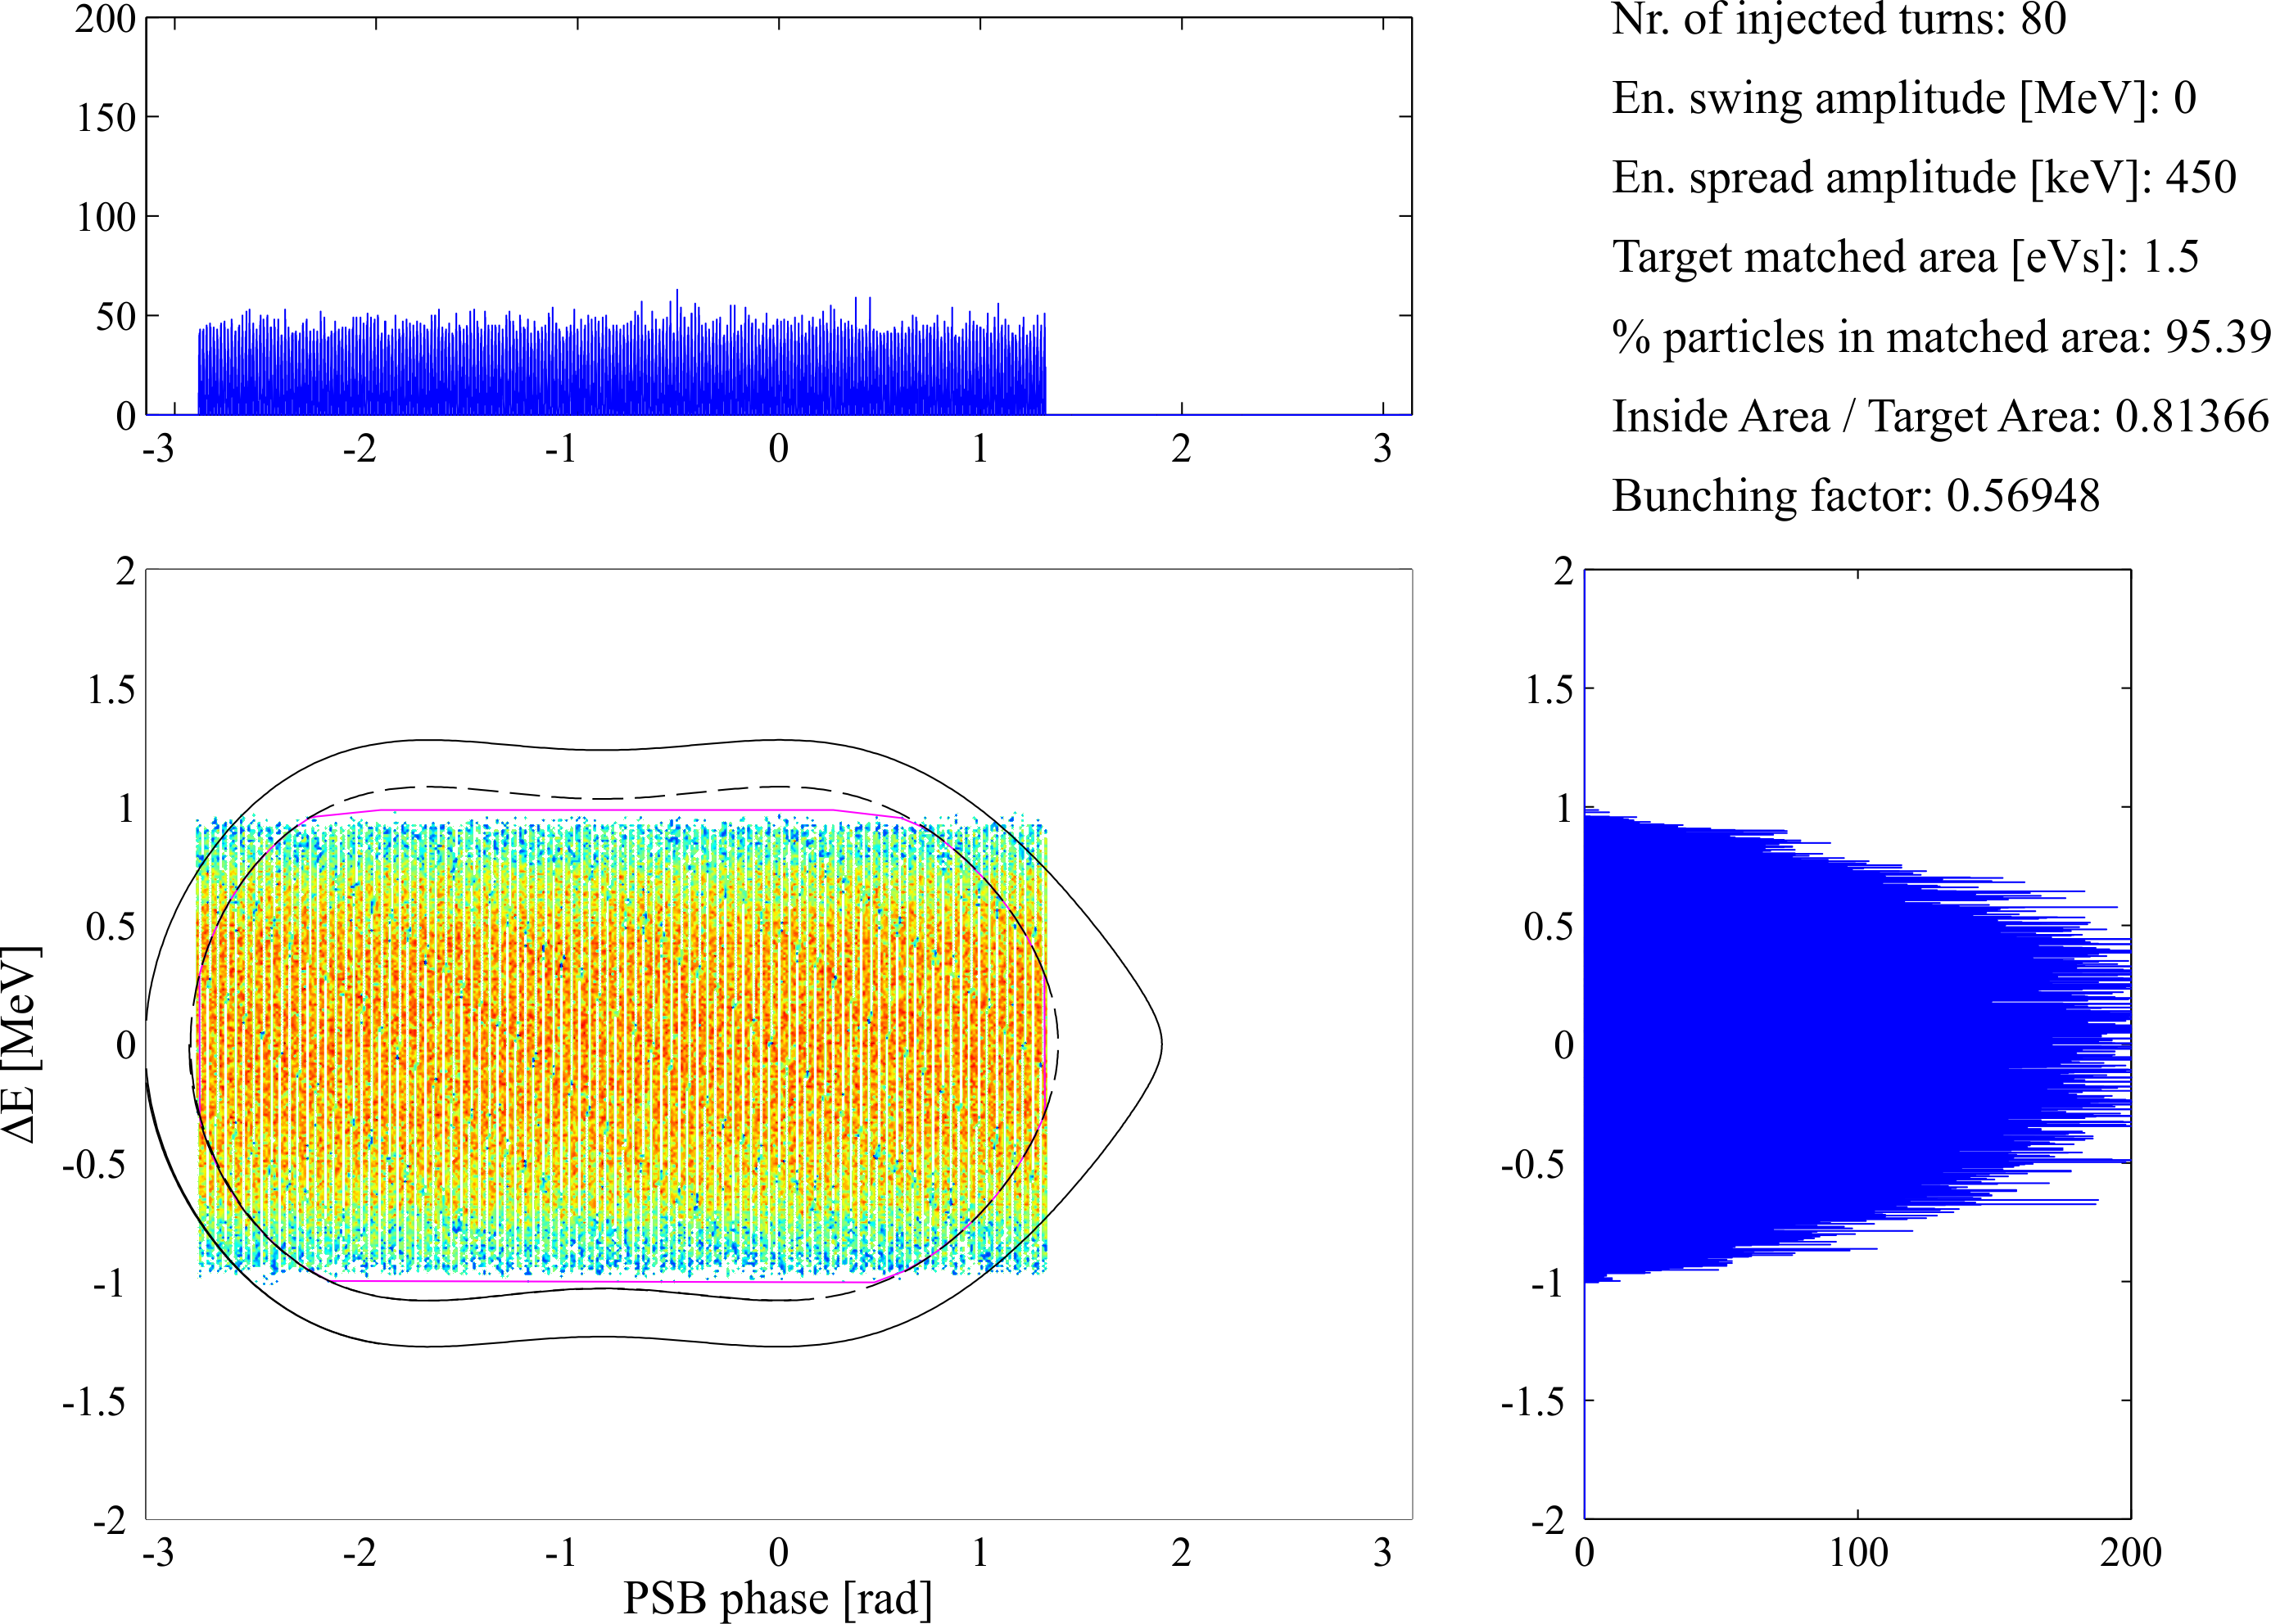
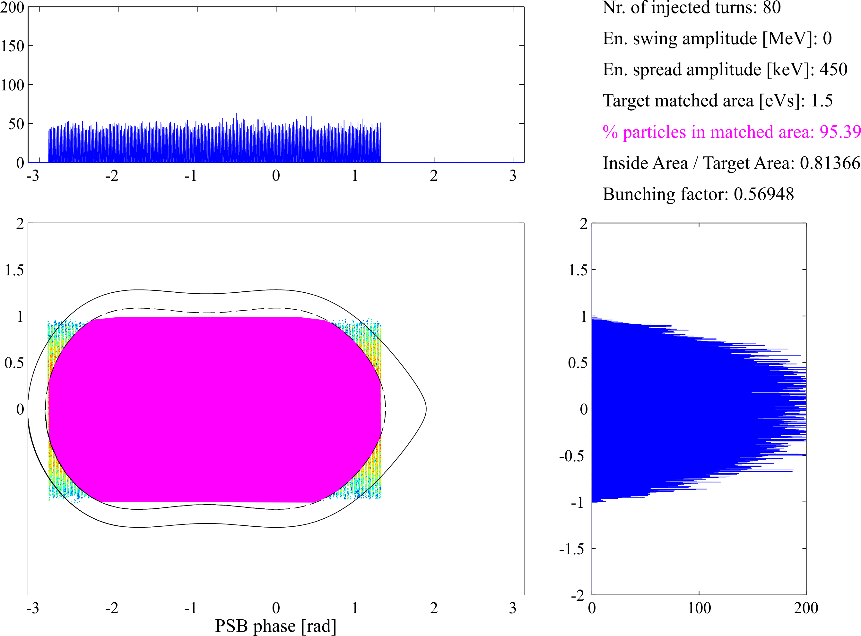

Longitudinal distribution optimization
An optimized painting is necessary both in un-modulated and modulated conditions
  A numerical optimization process for the most uniform fill of the target matched area has been prepared
  The optimization is based on a “uniformity index” (U.I.) which has been chosen, in frozen conditions (i.e. no tracking), as the product of:
  The choice of the ‘best’ fill is the one correspondent to the highest uniformity index
U.I. = (Particles inside matched area / Total particles) × (Inside area / Target matched area)
Un-modulated injection
δE [keV rms] | Chop. Factor [-] | Matched area [eVs] | Particles inside matched | Inside area/target area | U.I.
400 | 0.69 | 1.5 | 0.95172 | 0.74752 | 0.711
450 | 0.69 | 1.5 | 0.93807 | 0.81418 | 0.764
400 | 0.68 | 1.5 | 0.9544 | 0.74222 | 0.708
450 | 0.68 | 1.5 | 0.941 | 0.81528 | 0.767
400 | 0.68 | 1.5 | 0.95944 | 0.74299 | 0.713
450 | 0.68 | 1.5 | 0.94548 | 0.81357 | 0.769
400 | 0.67 | 1.5 | 0.96345 | 0.7405 | 0.713
450 | 0.67 | 1.5 | 0.95387 | 0.81366 | 0.776
400 | 0.66 | 1.5 | 0.97166 | 0.73602 | 0.715
450 | 0.66 | 1.5 | 0.96276 | 0.80601 | 0.776
400 | 0.65 | 1.5 | 0.97807 | 0.7327 | 0.717
450 | 0.64 | 1.5 | 0.97167 | 0.79778 | 0.775
400 | 0.64 | 1.5 | 0.98565 | 0.72328 | 0.713
450 | 0.63 | 1.5 | 0.98012 | 0.78465 | 0.769
400 | 0.62 | 1.5 | 0.9913 | 0.71242 | 0.706
450 | 0.6 | 1.5 | 0.98772 | 0.76563 | 0.756
400 | 0.6 | 1.5 | 0.99563 | 0.69656 | 0.694
450 | 0.58 | 1.5 | 0.99372 | 0.7448 | 0.740
400 | 0.58 | 1.5 | 0.99854 | 0.67563 | 0.675
450 | 0.55 | 1.5 | 0.99763 | 0.71126 | 0.710
400 | 0.55 | 1.5 | 0.99984 | 0.64264 | 0.643
450 | 0.5 | 1.5 | 0.9997 | 0.66541 | 0.665
U.I. = 0.776
Longitudinal painting requirements and optimization
Vincenzo Forte, Chiara Bracco - TE/ABT/BTP
Elena Benedetto – BE/ABP/HSI

Slide 8
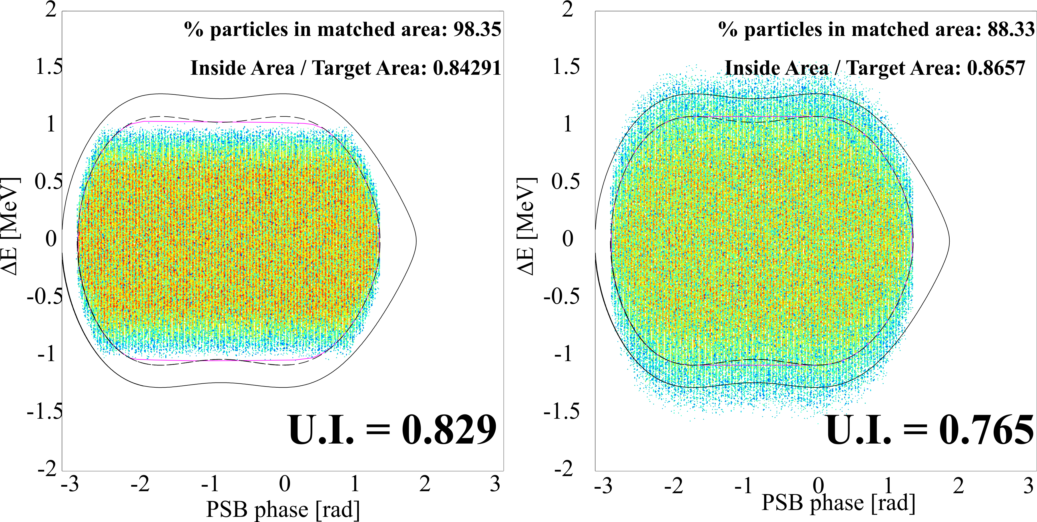
Longitudinal distributions optimization
An optimized painting is necessary both in un-modulated and modulated conditions
  The uniformity index U.I. is usually higher in longitudinal painting conditions → reason behind the painting itself !
  The number of modulations influences very little the uniformity.
  The higher the peak energy sweep amplitude ΔE₀ , the smaller the minimum chopping factor for a given longitudinal emittance contour
  A smaller energy spread helps to be more precise in painting the contour for a given energy sweep.
Longitudinal painting
Nr. of modulations [-] | ΔE₀ [MeV] | δE [keV rms] | Matched area [eVs] | Particles inside matched area | Inside area/target area | Min. chopping factor | U.I.
1 | 0.8 | 120 | 1.5 | 0.98353 | 0.84291 | 0.55 | 0.829
1 | 1.1 | 120 | 1.5 | 0.94151 | 0.86583 | 0.06 | 0.815
1 | 0.8 | 250 | 1.5 | 0.94259 | 0.86532 | 0.55 | 0.816
1 | 1.1 | 250 | 1.5 | 0.88329 | 0.8657 | 0.06 | 0.765
2 | 0.8 | 120 | 1.5 | 0.98368 | 0.83807 | 0.56 | 0.824
2 | 1.1 | 120 | 1.5 | 0.93647 | 0.8658 | 0.36 | 0.811
2 | 0.8 | 250 | 1.5 | 0.94405 | 0.86568 | 0.56 | 0.817
2 | 1.1 | 250 | 1.5 | 0.87876 | 0.86584 | 0.36 | 0.761
Painting with smaller energy spread
Painting with larger energy spread
Different modulations
Longitudinal painting requirements and optimization
Vincenzo Forte, Chiara Bracco - TE/ABT/BTP
Elena Benedetto – BE/ABP/HSI

Slide 9
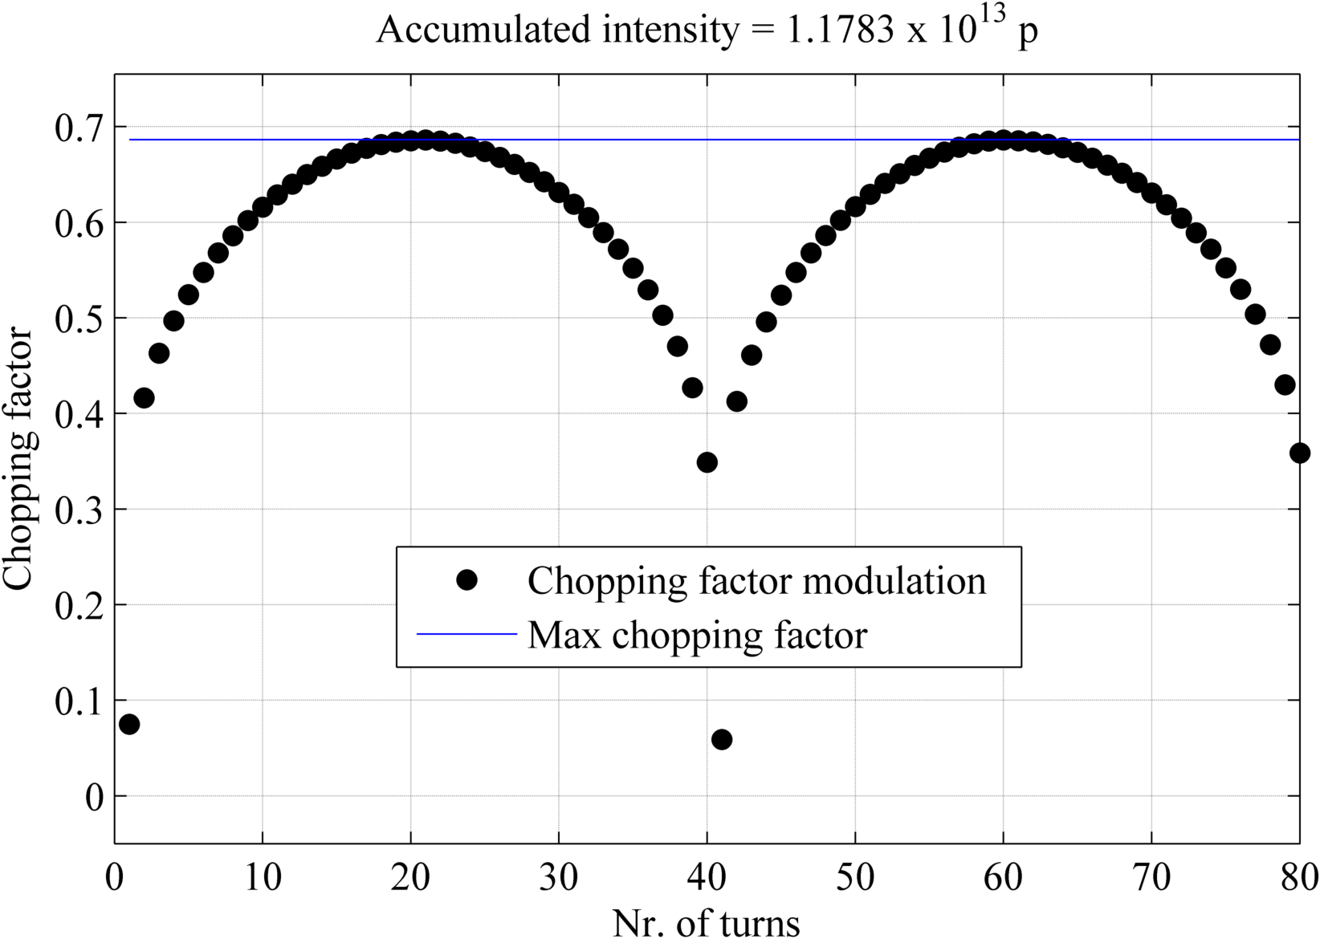
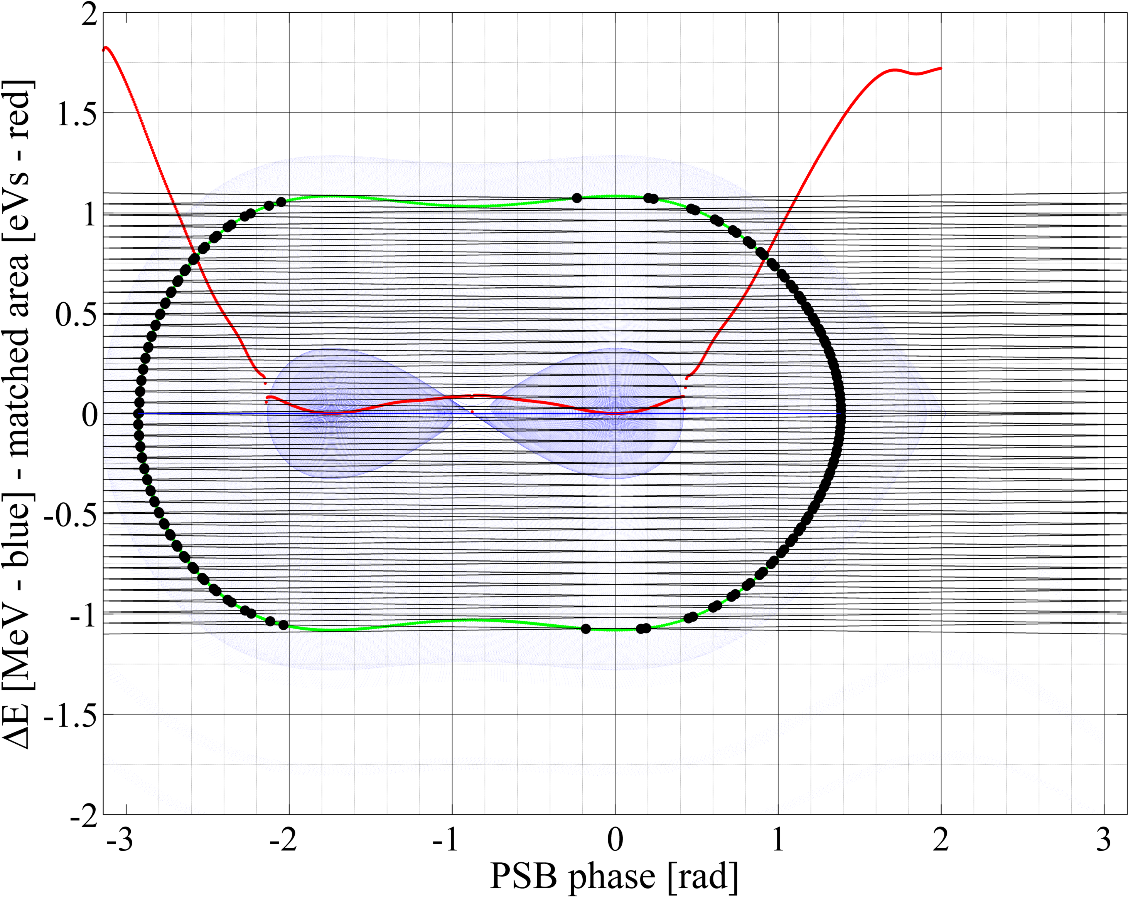
Simulations set-up
Simulations set for future NORMGPS/HRS beams (target 1.3e13 p. and ε_{x}/ε_{y}= 13(15) / 6(8) um)
  The multi-turn capture process (~10 ms from injection) has been simulated in PTC-Orbit
  ‘Usual’ double RF bucket with V_{h1}= 8 kV and V_{h2}= 6 kV with Δφ=220 deg
  Fixed KSW painting function and vertical offset for transverse emittance tailoring as in PSB-MKKSW-EN-0001
  Transverse + longitudinal space charge
  80 turns imposed in 1x(40+40) or 2x(20+20) turns sweep or without sweep
  ±0.8 MeV and ±1.1 MeV sweeping max amplitude
  80 keV and 120 keV rms for the longitudinal painting
  450 keV rms (after optimization) for the un-modulated injection
  Variable chopping factor patterns for longitudinal painting depending on selected target long. emittance contour
Figures of merit of the simulation results:
  Transverse emittance
  Losses for activation reasons
  Line density / bunching factor for tr. space charge
Very small chopping factor
Longitudinal painting
± 1.1 MeV sweep - 1 x (40+40) turns
Longitudinal painting requirements and optimization
Vincenzo Forte, Chiara Bracco - TE/ABT/BTP
Elena Benedetto – BE/ABP/HSI

Slide 10
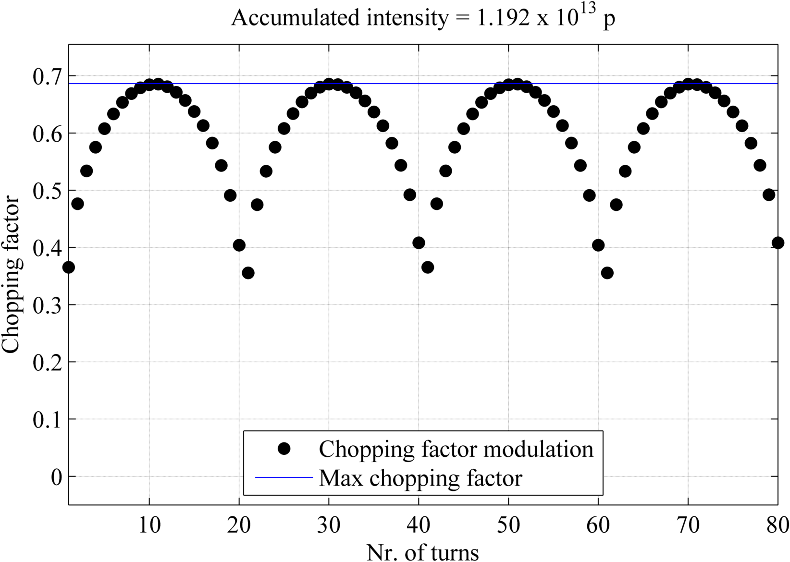
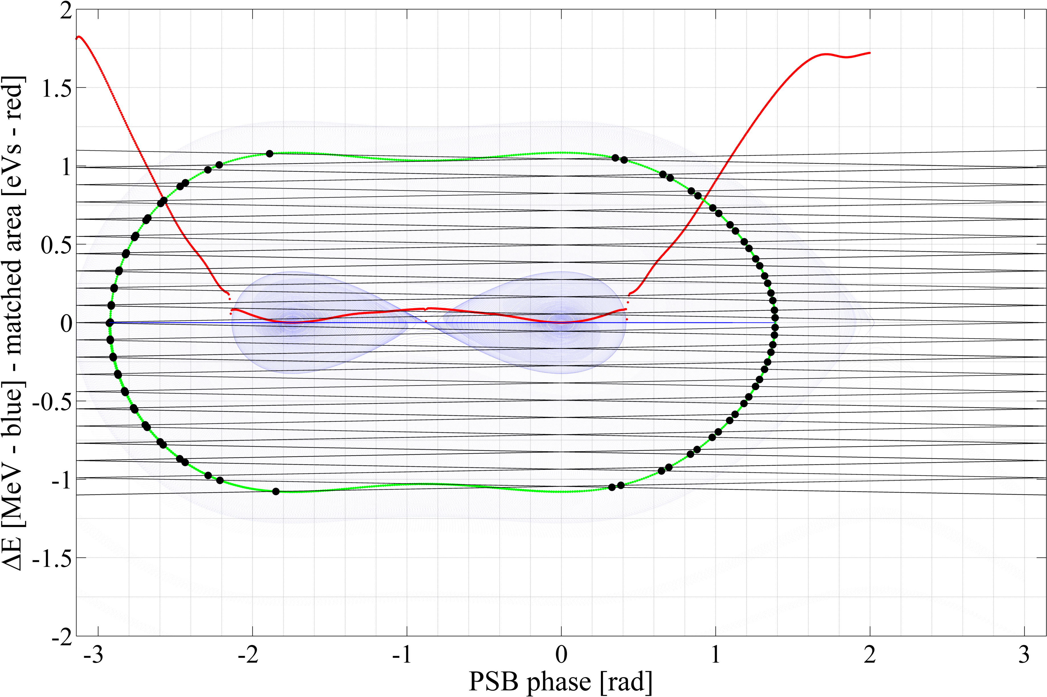
Simulations set-up
Simulations set for future NORMGPS/HRS beams (target 1.3e13 p. and ε_{x}/ε_{y}= 13(15) / 6(8) um)
  The multi-turn capture process (~10 ms from injection) has been simulated in PTC-Orbit
  ‘Usual’ double RF bucket with V_{h1}= 8 kV and V_{h2}= 6 kV with Δφ=220 deg
  Fixed KSW painting function and vertical offset for transverse emittance tailoring as in PSB-MKKSW-EN-0001
  Transverse + longitudinal space charge
  80 turns imposed in 1x(40+40) or 2x(20+20) turns sweep or without sweep
  ±0.8 MeV and ±1.1 MeV sweeping max amplitude
  80 keV and 120 keV rms for the longitudinal painting
  450 keV rms (after optimization) for the un-modulated injection
  Variable chopping factor patterns for longitudinal painting depending on selected target long. emittance contour
Figures of merit of the simulation results:
  Transverse emittance
  Losses for activation reasons
  Line density / bunching factor for tr. space charge
Longitudinal painting
± 1.1 MeV sweep - 2 x (20+20) turns
Longitudinal painting requirements and optimization
Vincenzo Forte, Chiara Bracco - TE/ABT/BTP
Elena Benedetto – BE/ABP/HSI

Slide 11
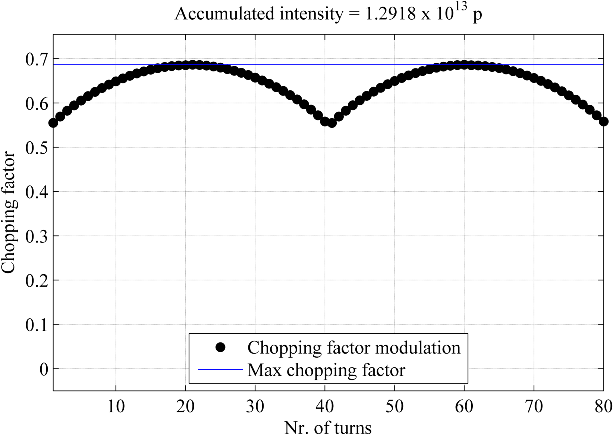

Simulations set-up
Simulations set for future NORMGPS/HRS beams (target 1.3e13 p. and ε_{x}/ε_{y}= 13(15) / 6(8) um)
  The multi-turn capture process (~10 ms from injection) has been simulated in PTC-Orbit
  ‘Usual’ double RF bucket with V_{h1}= 8 kV and V_{h2}= 6 kV with Δφ=220 deg
  Fixed KSW painting function and vertical offset for transverse emittance tailoring as in PSB-MKKSW-EN-0001
  Transverse + longitudinal space charge
  80 turns imposed in 1x(40+40) or 2x(20+20) turns sweep or without sweep
  ±0.8 MeV and ±1.1 MeV sweeping max amplitude
  80 keV and 120 keV rms for the longitudinal painting
  450 keV rms (after optimization) for the un-modulated injection
  Variable chopping factor patterns for longitudinal painting depending on selected target long. emittance contour
Figures of merit of the simulation results:
  Transverse emittance
  Losses for activation reasons
  Line density / bunching factor for tr. space charge
Longitudinal painting
± 0.8 MeV sweep - 1 x (40+40) turns
Longitudinal painting requirements and optimization
Vincenzo Forte, Chiara Bracco - TE/ABT/BTP
Elena Benedetto – BE/ABP/HSI

Slide 12

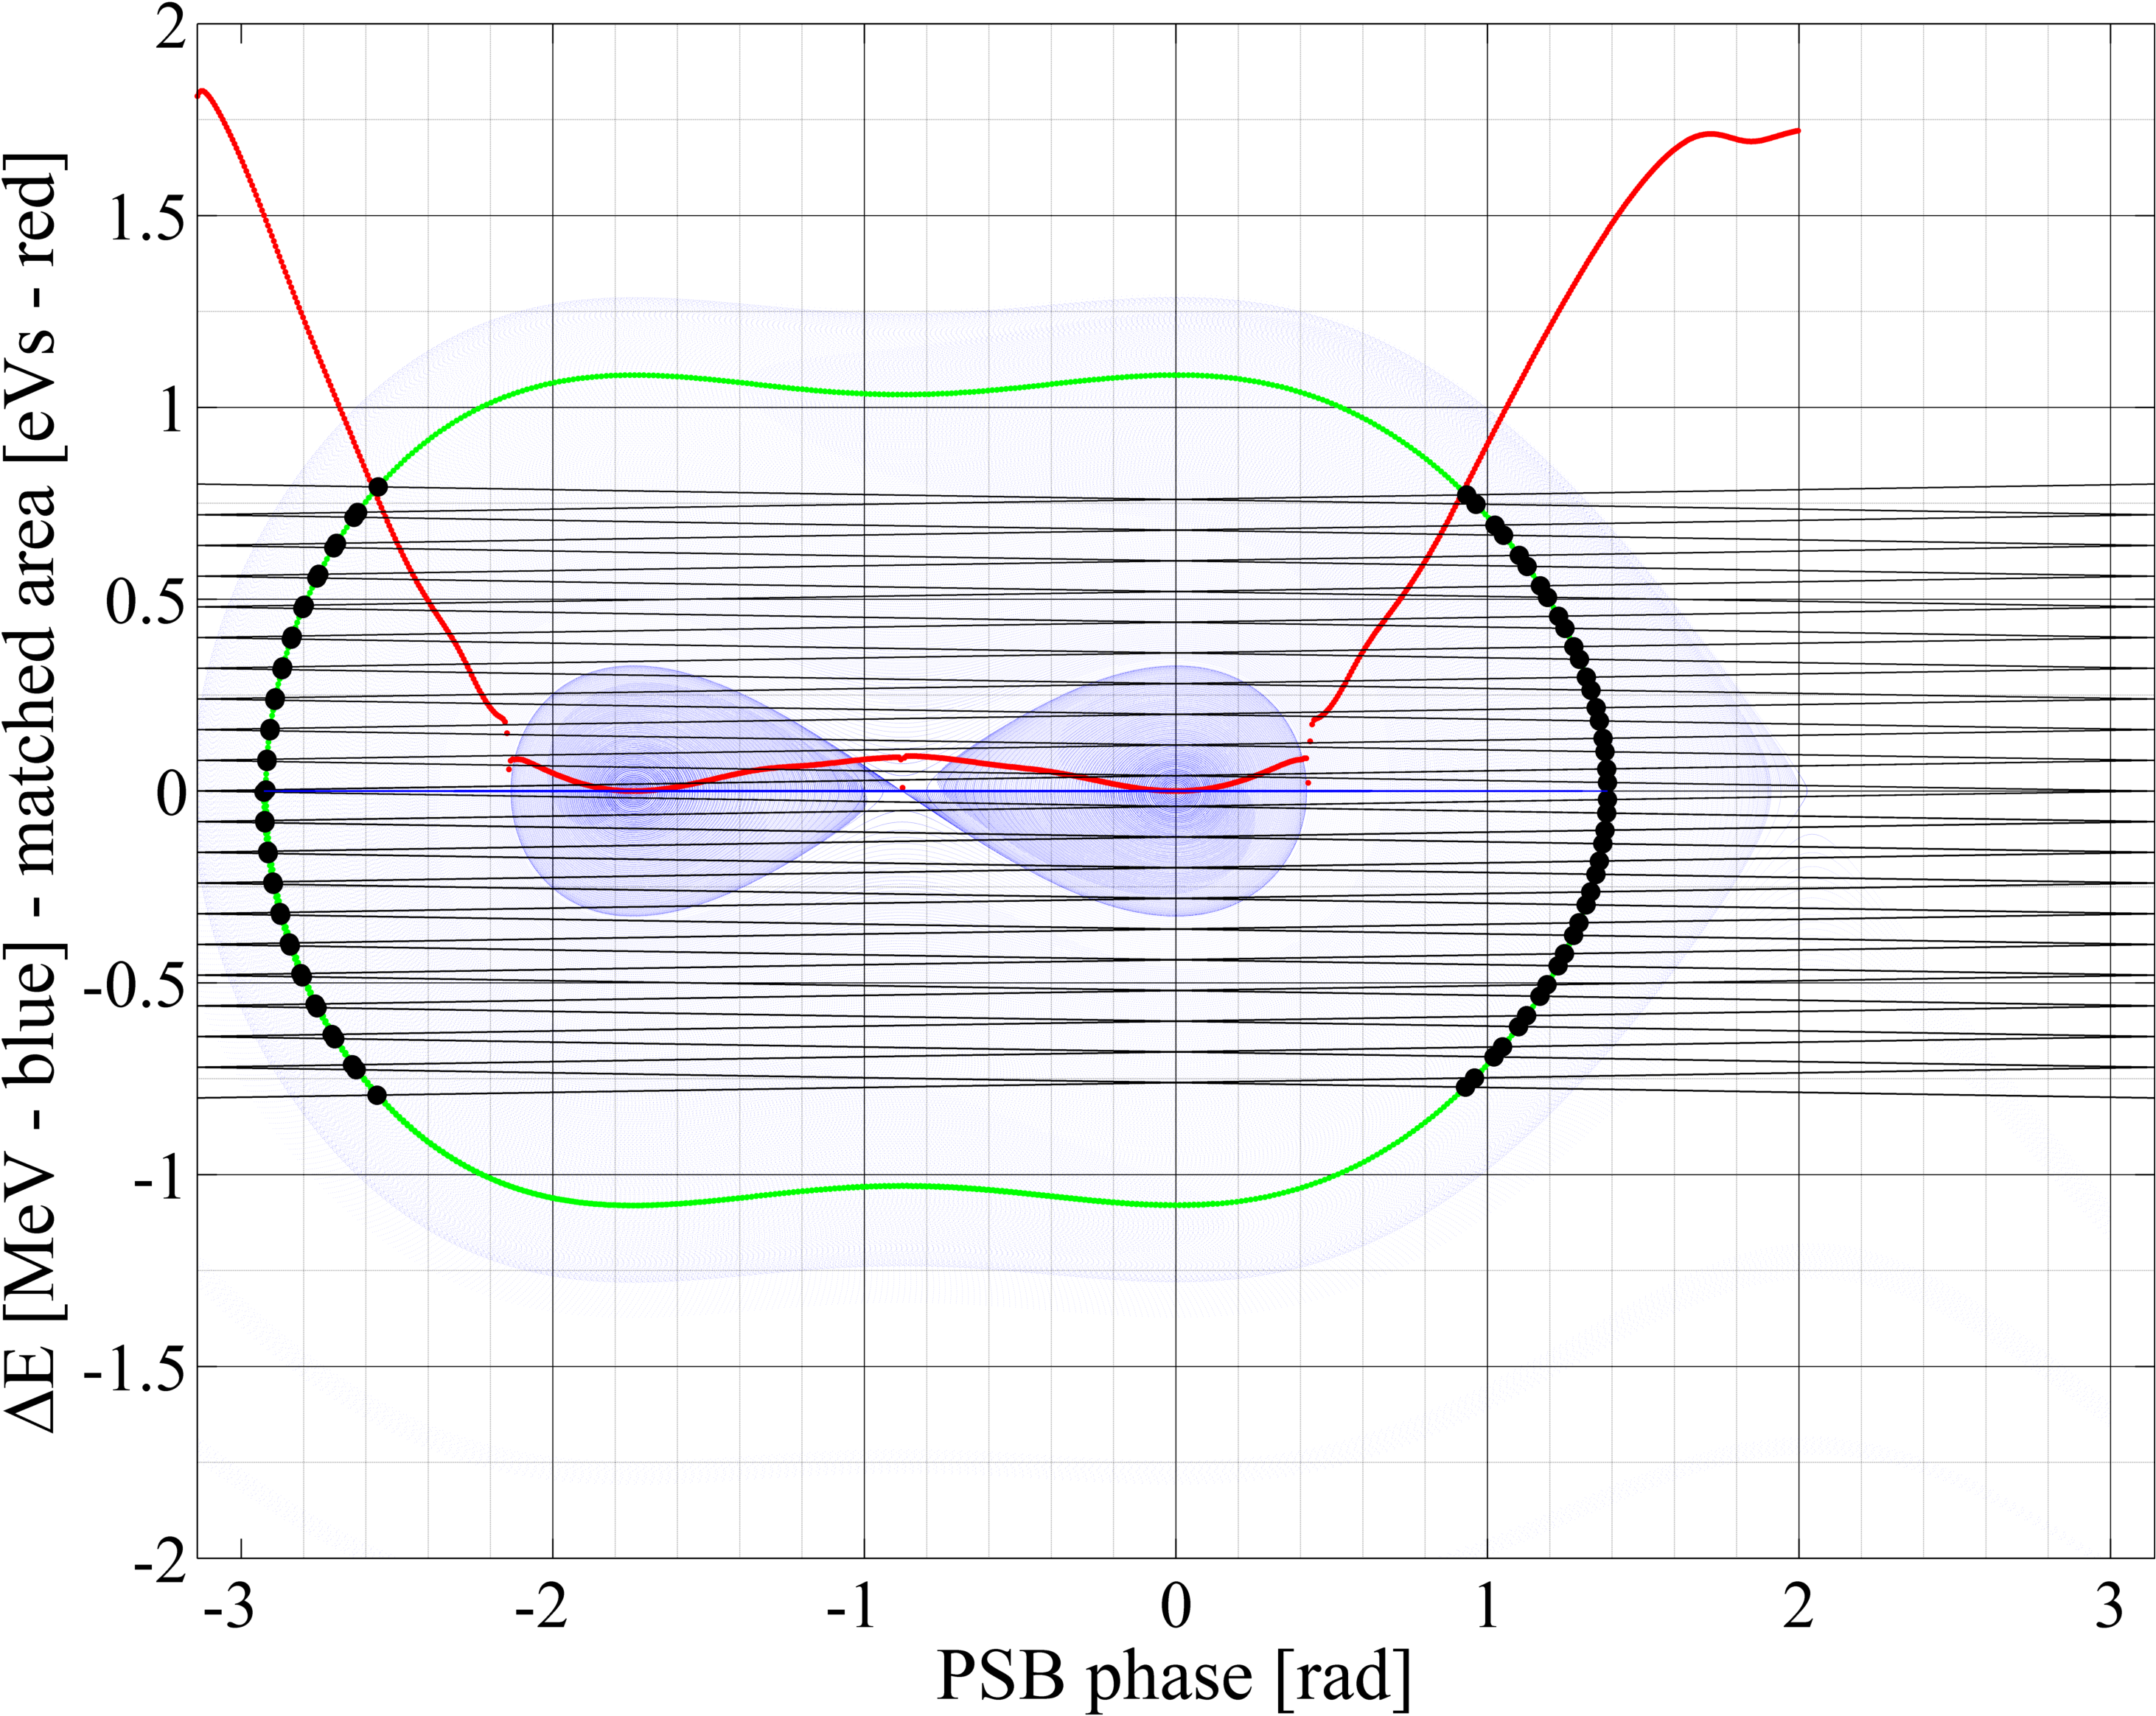
Simulations set-up
Simulations set for future NORMGPS/HRS beams (target 1.3e13 p. and ε_{x}/ε_{y}= 13(15) / 6(8) um)
  The multi-turn capture process (~10 ms from injection) has been simulated in PTC-Orbit
  ‘Usual’ double RF bucket with V_{h1}= 8 kV and V_{h2}= 6 kV with Δφ=220 deg
  Fixed KSW painting function and vertical offset for transverse emittance tailoring as in PSB-MKKSW-EN-0001
  Transverse + longitudinal space charge
  80 turns imposed in 1x(40+40) or 2x(20+20) turns sweep or without sweep
  ±0.8 MeV and ±1.1 MeV sweeping max amplitude
  80 keV and 120 keV rms for the longitudinal painting
  450 keV rms (after optimization) for the un-modulated injection
  Variable chopping factor patterns for longitudinal painting depending on selected target long. emittance contour
Figures of merit of the simulation results:
  Transverse emittance
  Losses for activation reasons
  Line density / bunching factor for tr. space charge
Longitudinal painting
± 0.8 MeV sweep - 2 x (20+20) turns
Longitudinal painting requirements and optimization
Vincenzo Forte, Chiara Bracco - TE/ABT/BTP
Elena Benedetto – BE/ABP/HSI

Slide 13
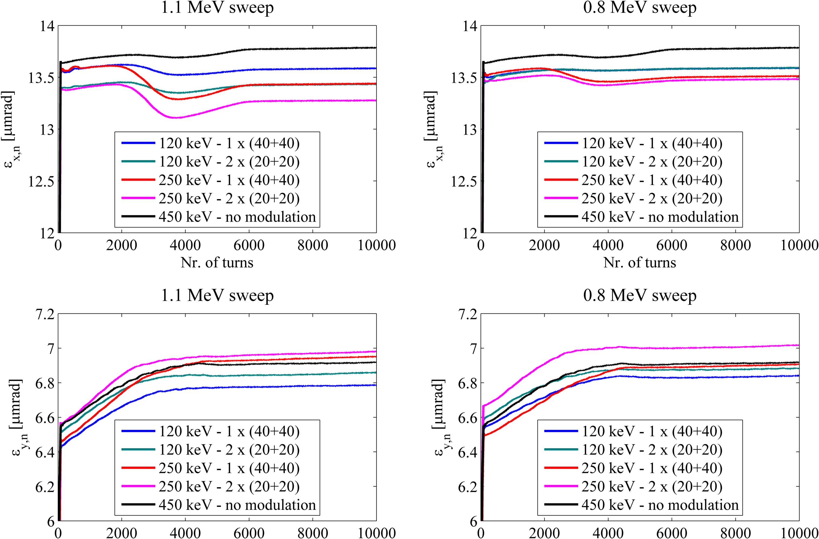
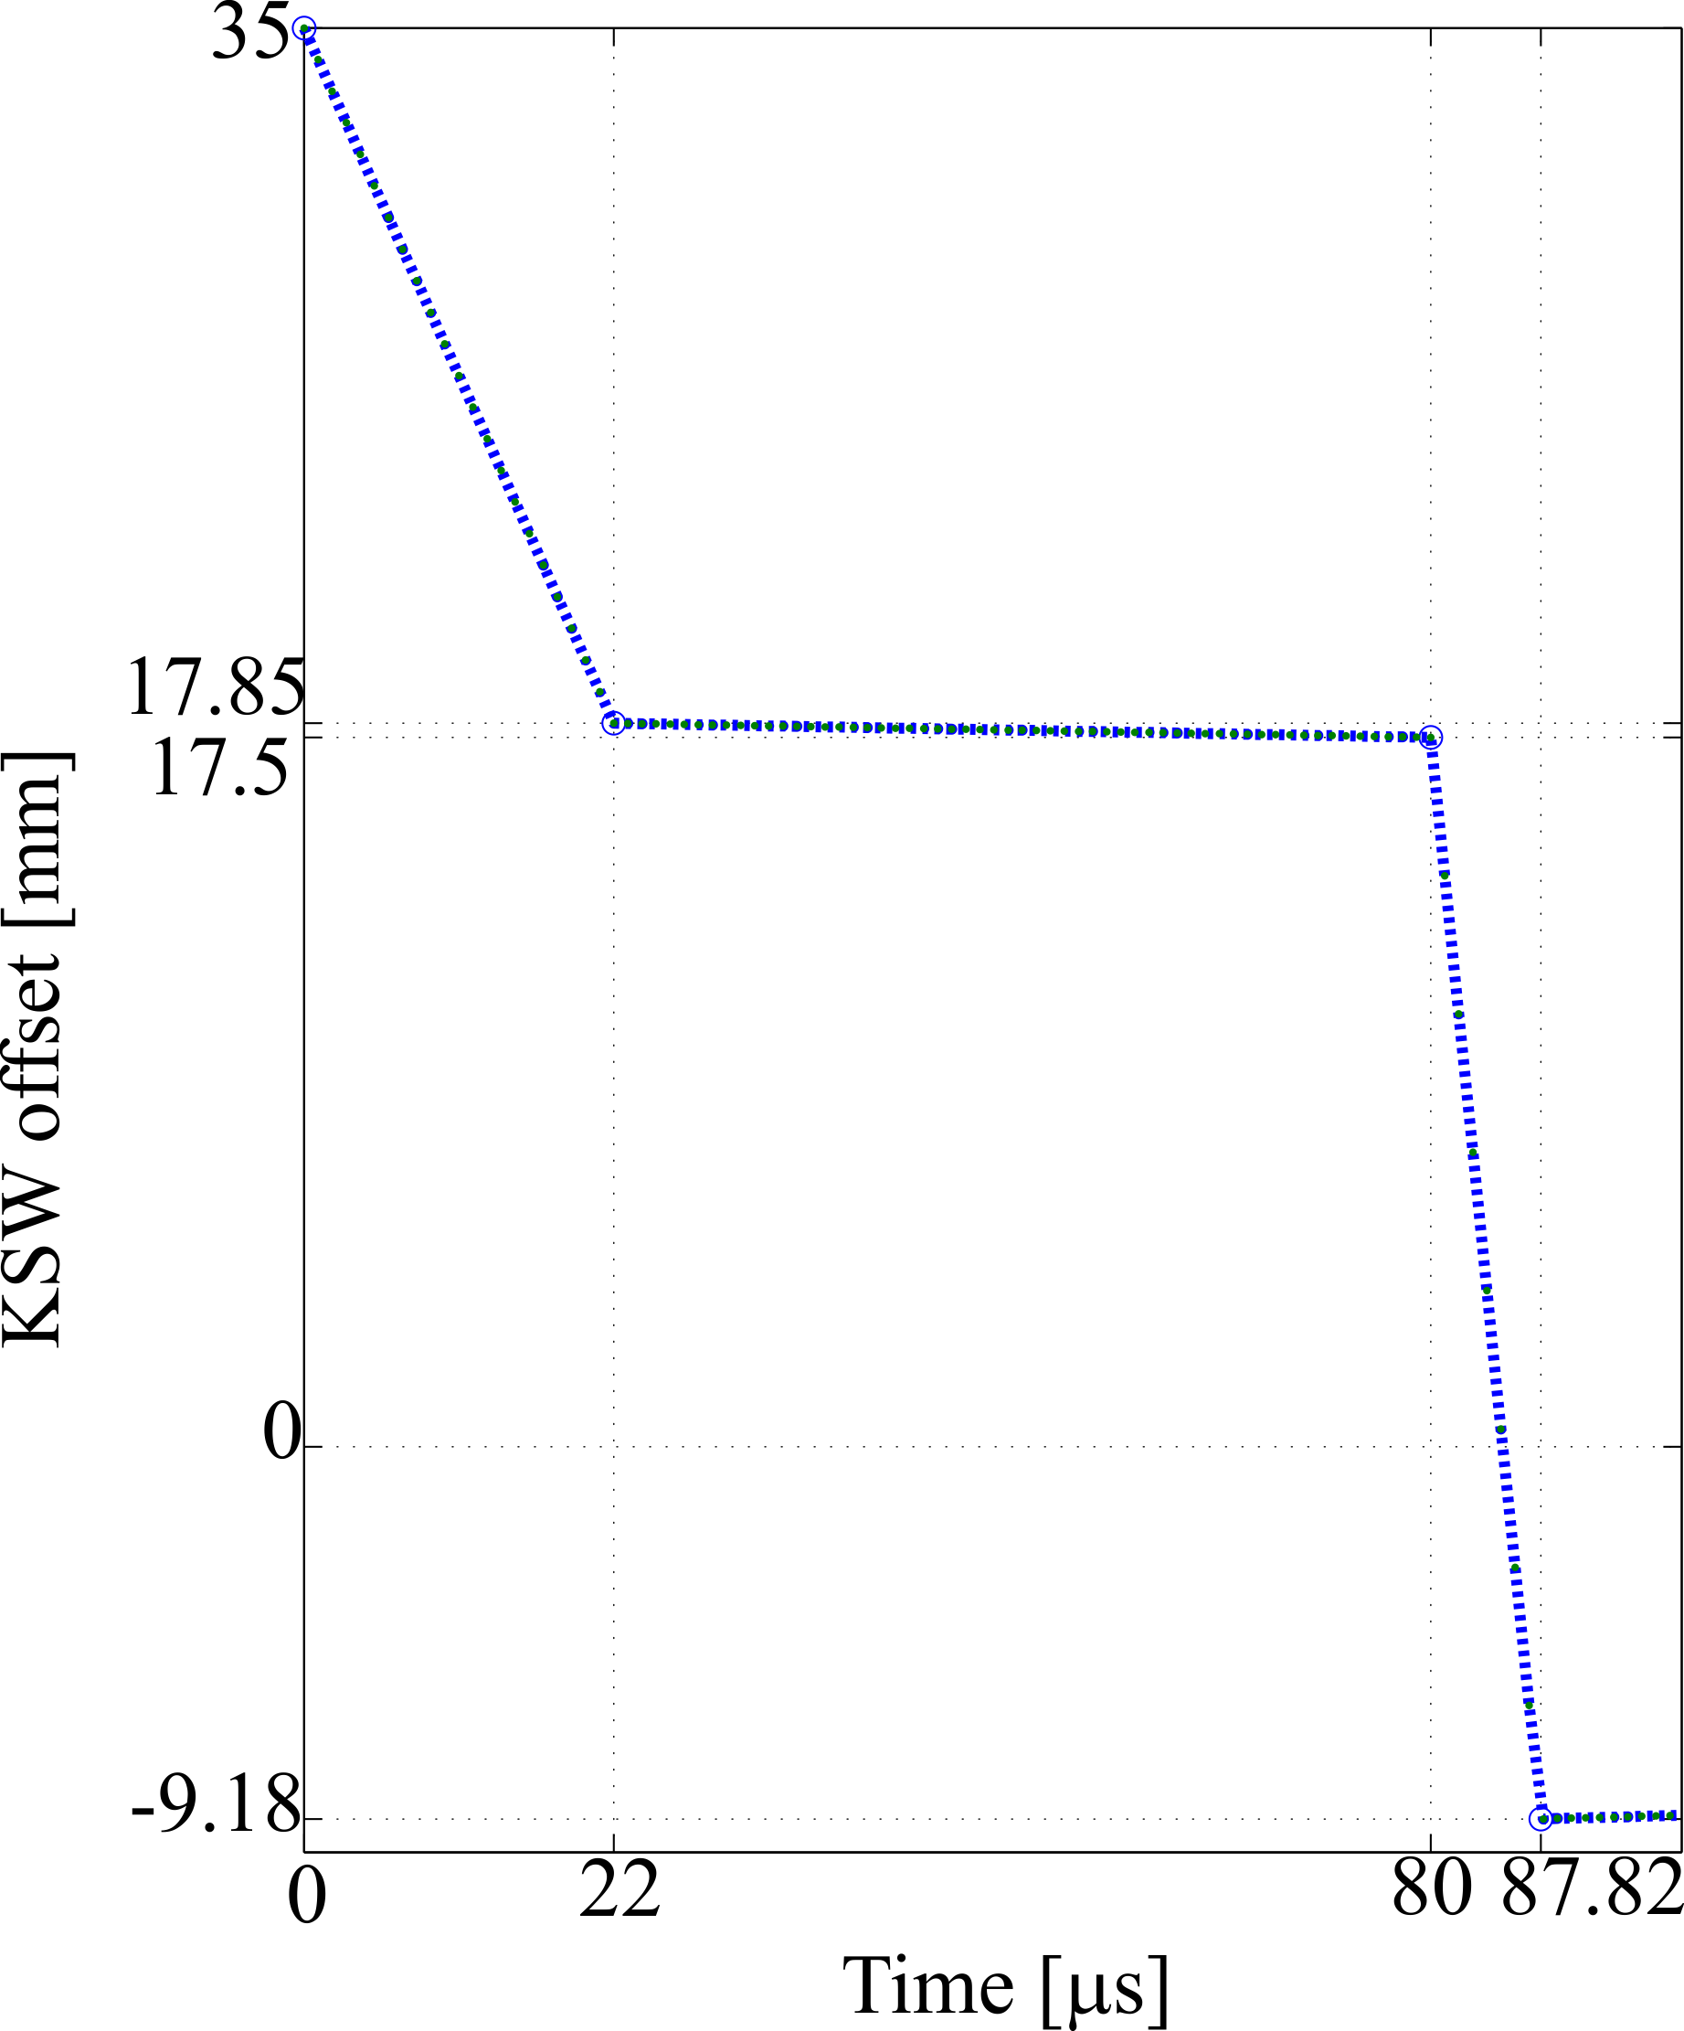
Simulation results
Transverse emittance
  The NORMGPS beam (I=1.3e13 p.) has target emittance of ε_{x}/ε_{y}= 13(15) / 6(8) μmrad
  The transverse emittance is created by the transverse painting process through the KSW (fast) and BSW (slow) decay waveforms.
  The emittances are similar for the cases with and without longitudinal painting and in agreement with the required specifications.
KSW decay waveform adapted for 1 x (40+40) turns
(ref. PSB-MKKSW-EN-0001)
Longitudinal painting requirements and optimization
Vincenzo Forte, Chiara Bracco - TE/ABT/BTP
Elena Benedetto – BE/ABP/HSI

Slide 14
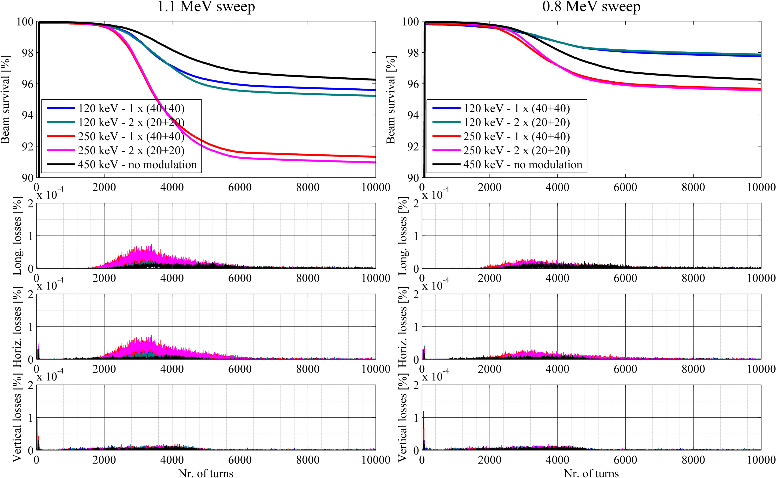
Simulation results
Losses
  The NORMGPS beam (I=1.3e13 p.) is a high intensity beam → Already few percents of losses (in the machine) can cause RP issues
  Losses in the simulations are mainly caused by exceeding the longitudinal acceptance and beam loading induced by longitudinal space charge.
  The results show an improvement for a reduced amplitude of the sweep (0.8 MeV)
Longitudinal painting requirements and optimization
Vincenzo Forte, Chiara Bracco - TE/ABT/BTP
Elena Benedetto – BE/ABP/HSI

Slide 15
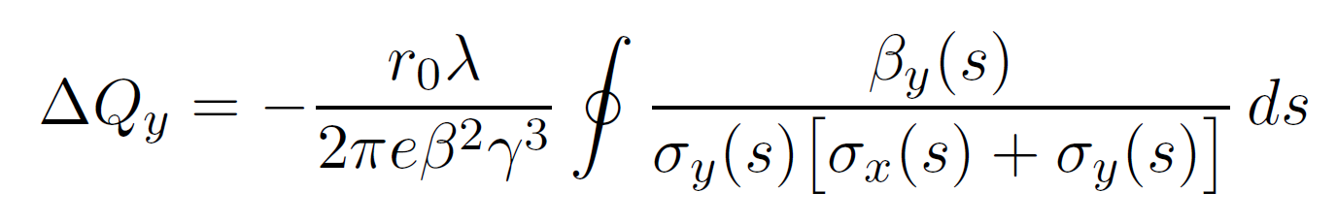
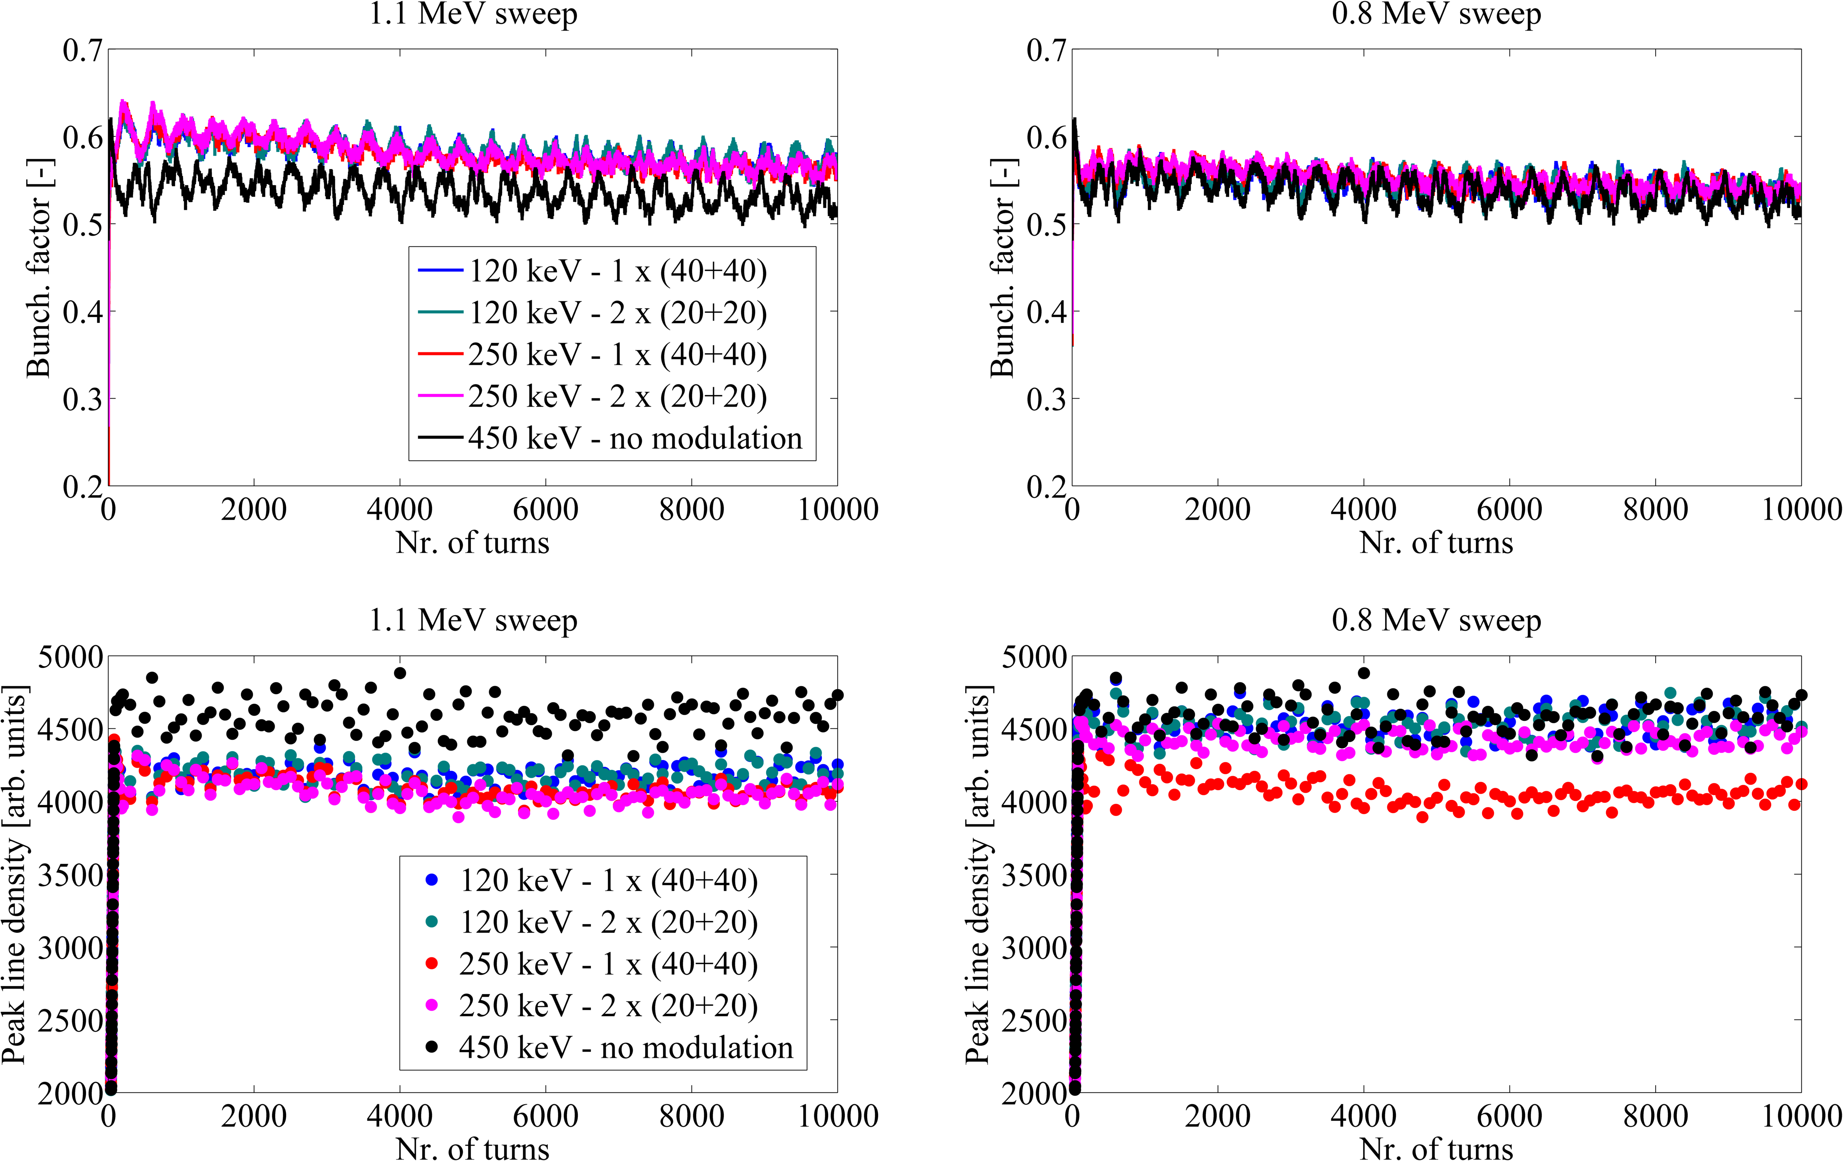
Simulation results
Peak line density
  An advantage of the longitudinal painting is to lead to a SMALLER peak line density (10%), compared to the un-modulated energy case.
Longitudinal painting requirements and optimization
Vincenzo Forte, Chiara Bracco - TE/ABT/BTP
Elena Benedetto – BE/ABP/HSI
  * See also C. Carli, R. Garoby, Active Longitudinal Painting for the H⁻ Charge-Exchange Injection of the Linac4 Beam into the PS Booster, CERN, AB-Note-2008-011 ABP

Slide 16
Summary
Main purpose of the painting is a uniform fill of the iso-Hamiltionian contour for a given matched area. The longitudinal painting is, for the PSB, foreseen for beam intensities ≥ 6e12 ppr.
A ‘uniformity index’ has been introduced to optimize the longitudinal phase space fill.
Comparative (full capture) simulations for the high intensity NORMGPS/HRS beams in the PSB (1e13 ppr) have been performed for longitudinal painting and un-modulated injection.
A parametric scan has been performed for the longitudinal painting for different sweeping amplitudes rates (0.8 MeV and 1.1 MeV) , E₀ change rate ( 1x(40+40) turns and 2x(20+20 turns) ) and rms energy spreads (120 keV and 250 keV)
The longitudinal painting, compared to the un-modulated injection, for the NORMGPS/HRS beams has shown:
  Transverse emittances in specs → less relevant for ISOLDE beams
  Reduced losses for a reduced sweeping amplitude with smaller sensitivity with respect to the central energies change rates, but contour area not fully filled
  Reduced line densities especially for larger sweep → GOOD for space charge mitigation
  Smaller sensitivity of the parameters to the E₀ change rate (except for a reduced peak line density case 1 x (40+40) and δE=120 keV rms).
Longitudinal painting requirements and optimization
Vincenzo Forte, Chiara Bracco - TE/ABT/BTP
Elena Benedetto – BE/ABP/HSI

Slide 17
Conclusions
The longitudinal painting can be an important tool for the PSB: it helps to have more control of the longitudinal phase space, as done for the transverse painting.
The E₀ change rate has shown no major influence in the analysed cases high intensity ISOLDE beams.
  A fast change rate might be needed if one wants to use the painting in future for low intensity beams and higher brightness
The energy sweep amplitude depends on the RF bucket shape and on the target longitudinal emittance that one wants to paint at injection.
A small energy spread δE is always helpful (~100 keV rms). A larger one could lead to losses if not associated to a reduced energy sweep amplitude, with risk of un-uniform painting→ trade-off
The difference between longitudinal painting and no energy modulation depends on the iso-Hamiltonian shapes → Triple RF (idea from E. Benedetto and S. Albright) could furtherly help with un-modulated injection or also in combination with longitudinal painting.
  Promising first tests in the PSB
Longitudinal painting requirements and optimization
Vincenzo Forte, Chiara Bracco - TE/ABT/BTP
Elena Benedetto – BE/ABP/HSI

Slide 19
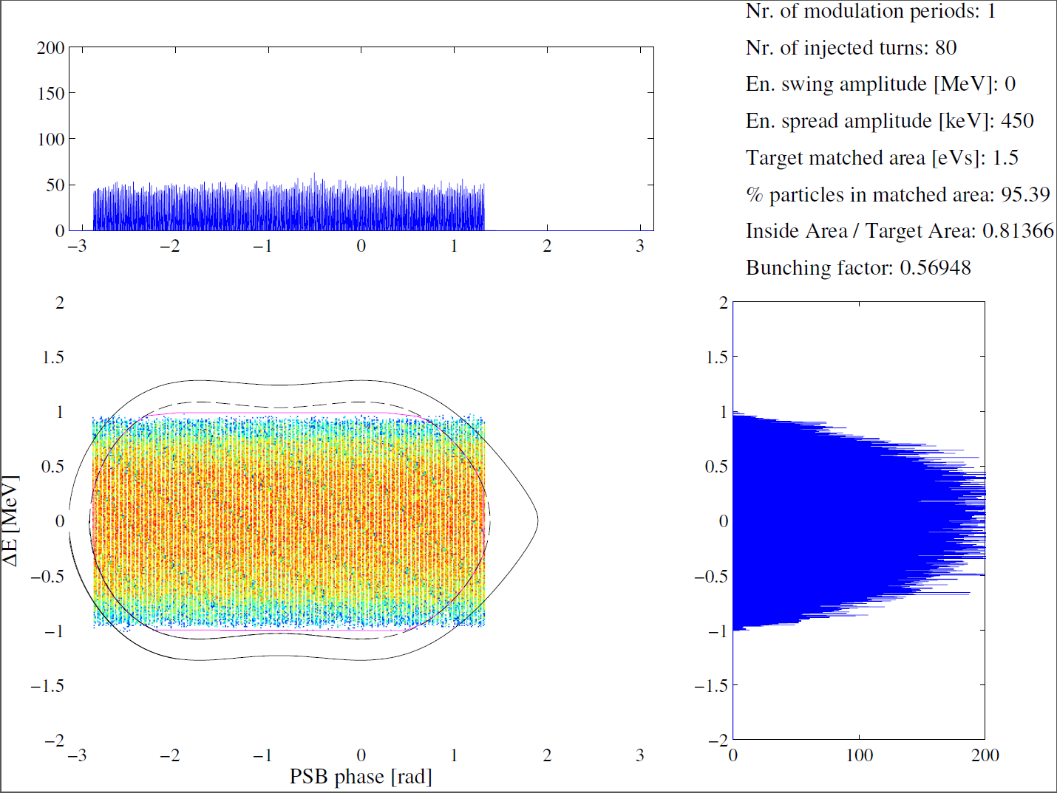
Appendix – total longitudinal distributions used in simulations
Un-modulated
Longitudinal painting requirements and optimization
Vincenzo Forte, Chiara Bracco - TE/ABT/BTP
Elena Benedetto – BE/ABP/HSI

Slide 20
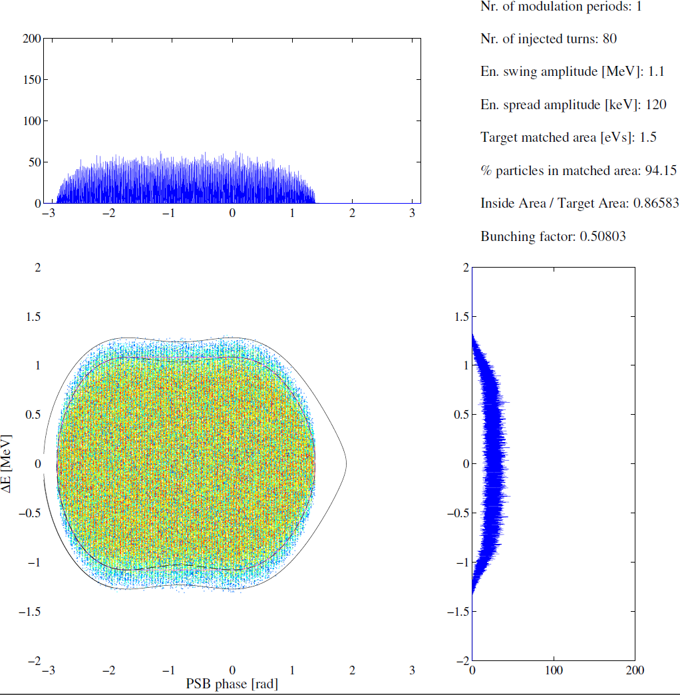

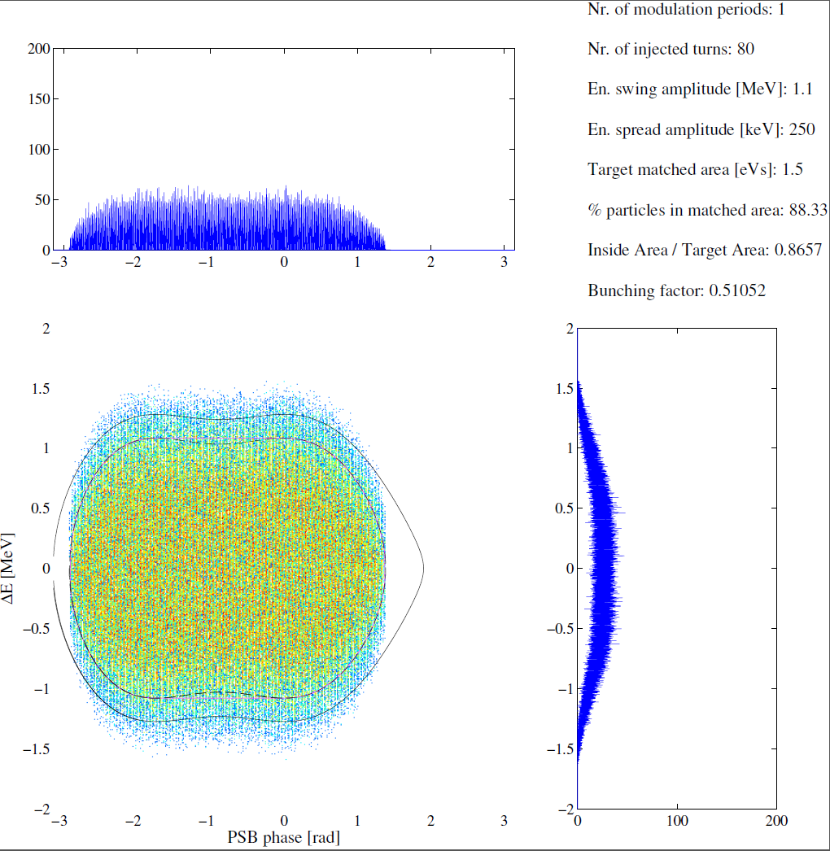
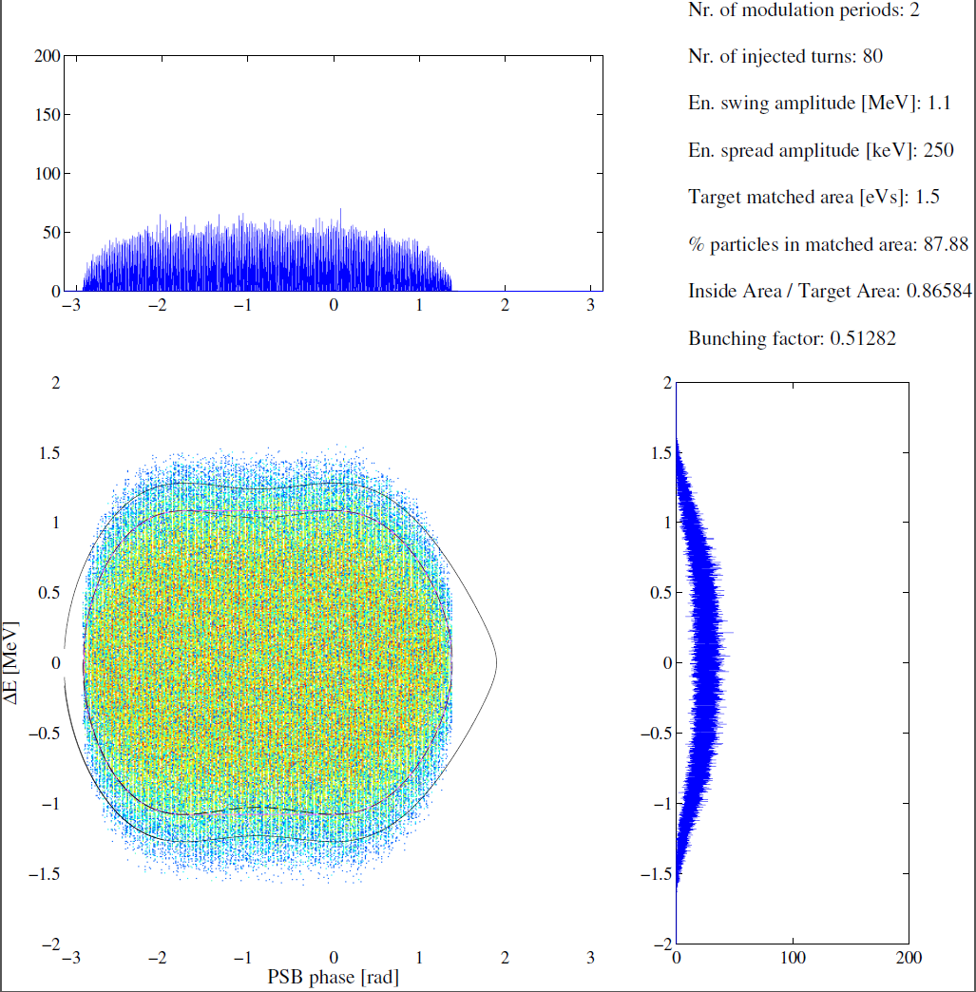
Appendix – total longitudinal distributions used in simulations
Modulated 1.1 MeV sweep amplitude
Longitudinal painting requirements and optimization
Vincenzo Forte, Chiara Bracco - TE/ABT/BTP
Elena Benedetto – BE/ABP/HSI

Slide 21
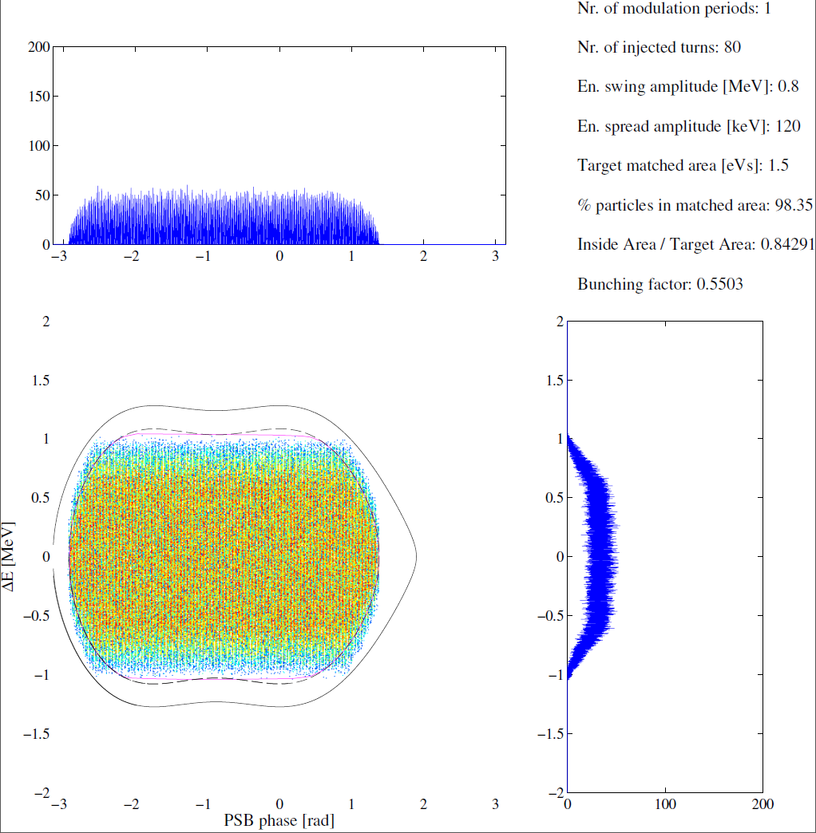
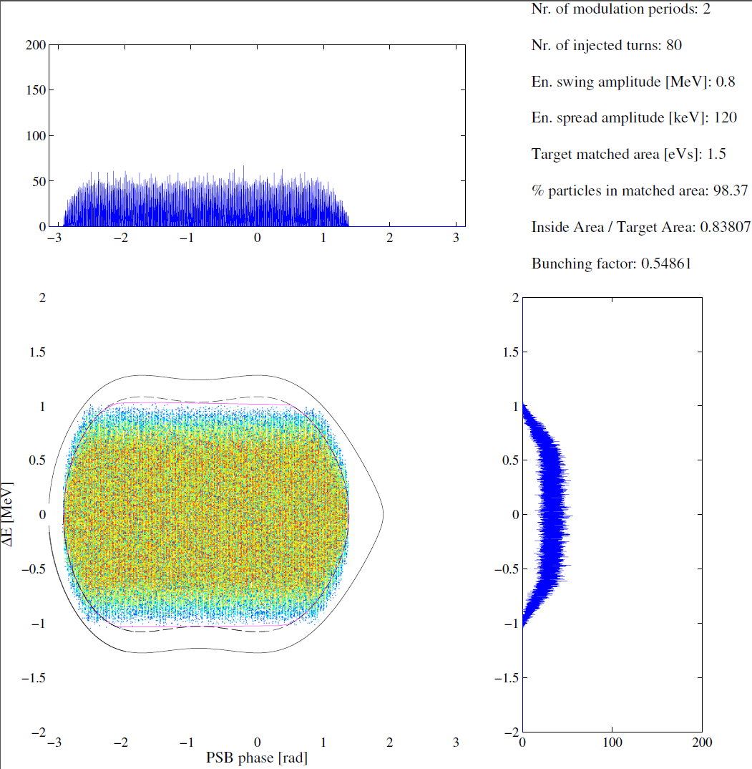
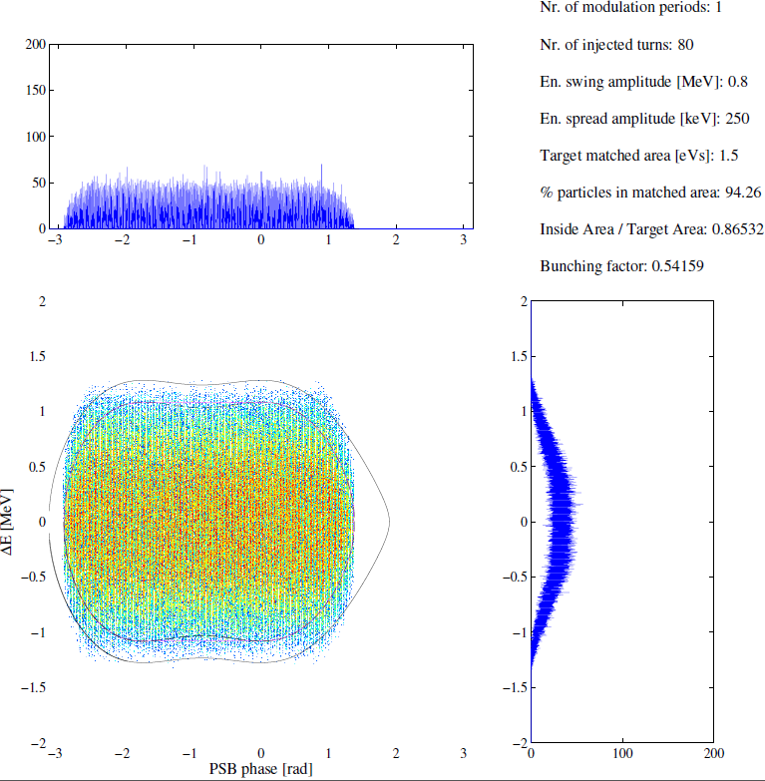

Appendix – total longitudinal distributions used in simulations
Modulated 0.8 MeV sweep amplitude
Longitudinal painting requirements and optimization
Vincenzo Forte, Chiara Bracco - TE/ABT/BTP
Elena Benedetto – BE/ABP/HSI

Slide 22
Simulation results
Bunching factor and peak line density
  An advantage of the longitudinal painting is to lead to an higher bunching factor, with reduced beating, and a smaller peak line density, compared to the un-modulated energy case.
  Simulations showed an increase of the bunching factor (and a decrease of the peak line density λ) of a factor up to ~10% for large sweeps (1.1 MeV) *→ Potential benefit for reduced space charge tune spread in higher brightness beams.
Longitudinal painting requirements and optimization
Vincenzo Forte, Chiara Bracco - TE/ABT/BTP
Elena Benedetto – BE/ABP/HSI
  * See also C. Carli, R. Garoby, Active Longitudinal Painting for the H⁻ Charge-Exchange Injection of the Linac4 Beam into the PS Booster, CERN, AB-Note-2008-011 ABP

