Slide 1
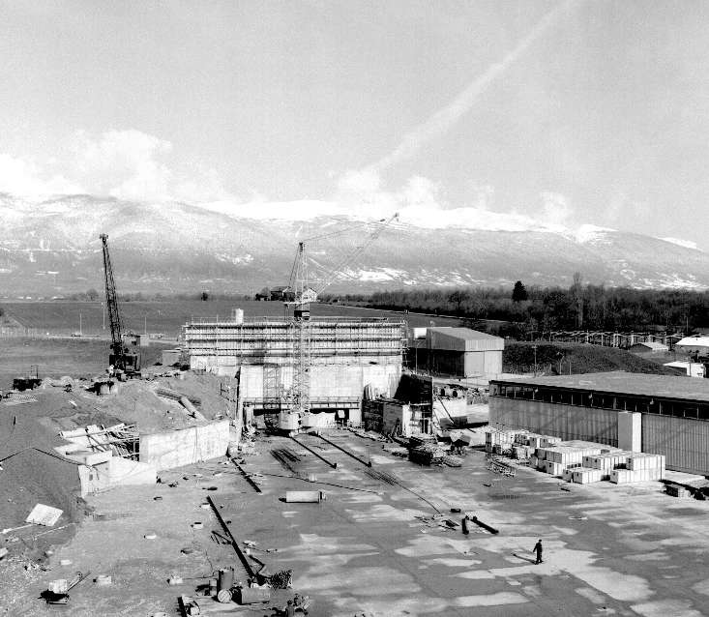
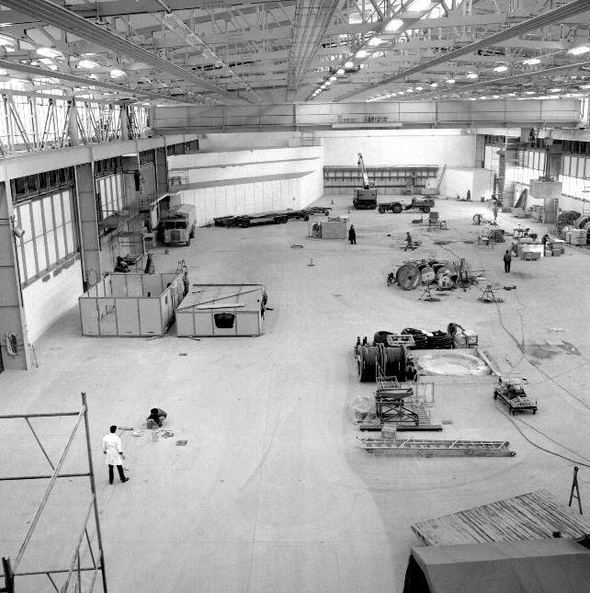
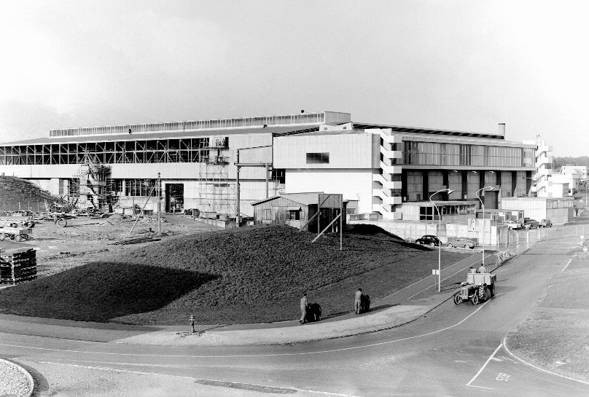

Project Safety “Issues”
East Hall under construction - 1962
Erwan Harrouch/ EN-EA, 21-10-2016

Slide 2
Presentation outline
How safety is managed in the project
Status of the Launch Safety Agreement (LSA)

Slide 3
How safety is managed in the project
Project Leader
S. Evrard
EN-EA
Responsible for safety in the project
Delegate part of his safety duties
Directly exchange on safety matters
East Area Renovation Project Team
Project Safety Officer
E. Harrouch
EN-EA
Coordinate safety matters on the behalf of the project leader
Provide rules and requirements from HSE
Provide project information for expertise by HSE
HSE Linkperson
A. Henriques HSE/SEE
Provide expertise in matter of safety
HSE Experts

Slide 4
Status of the Launch Safety Agreement (LSA)
The Launch Safety Agreement initiate this structure
  First meeting held on the 19/09 : HSE transmitted the template and first safety matters are discussed
  The Launch Safety Agreement should include the following information :
    A description of the project
    A preliminary list of hazard identified : This list only include hazards that will be generated by the project once completed. (Worksite hazards should be mentioned but not detailed)
    Based on these information, HSE will provide a list of rules and regulation to be applied to the project.

Slide 5
Status of the Launch Safety Agreement (LSA)
The Launch Safety Agreement initiate this structure
  Second meeting held on the 17/10 : The PSO transmitted back the LSA with a list of identified hazards.
Next step :
  The document is now in the hands of HSE : a panel of expert will meet and define all the rules and regulations applicable,
  The draft version transmitted is attached to the Indico of this meeting, please do not hesitate to send me any additional hazard that has not been identified or corrections to this list.

Slide 6
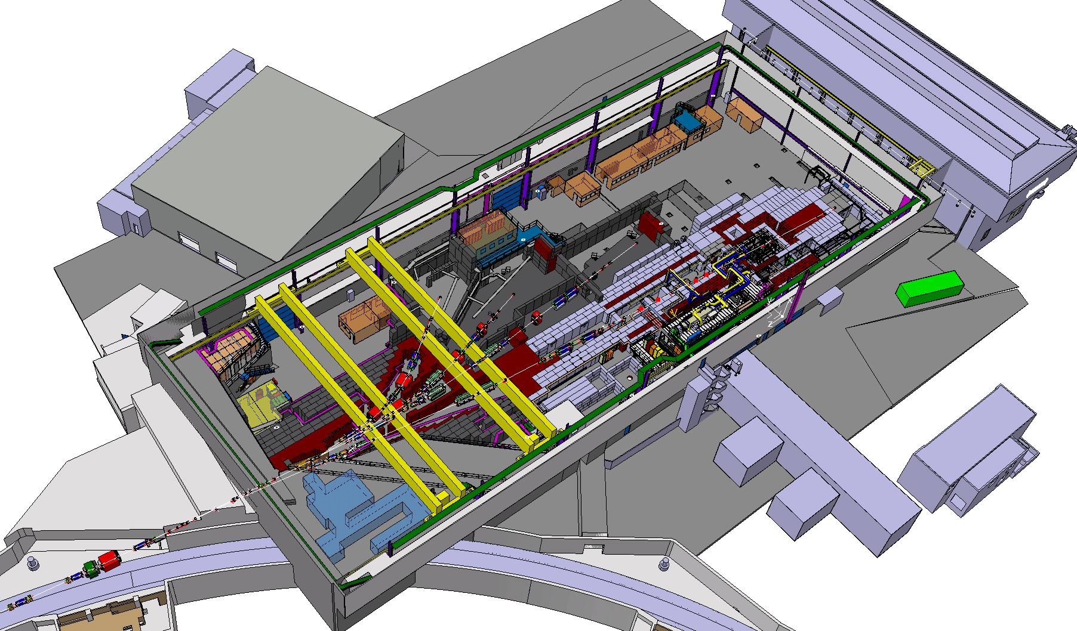

THANKS FOR YOUR ATTENTION ! QUESTIONS ?
East Area Renovation

