Slide 1
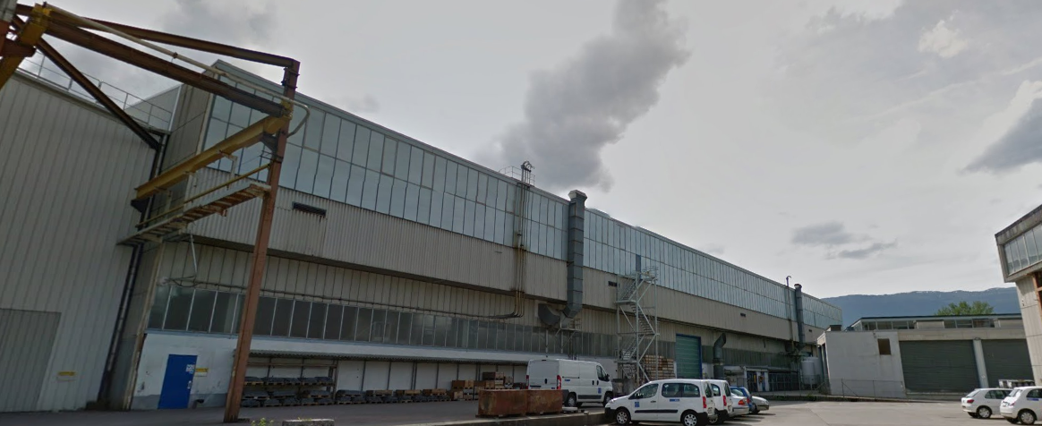
East Hall Renovation
Civil Engineering works
S.Mcilwraith – C.Gasnier (SMB-SE)
21/10/2016
B.157 project meeting
S.Mcilwraith – C.Gasnier

Slide 2
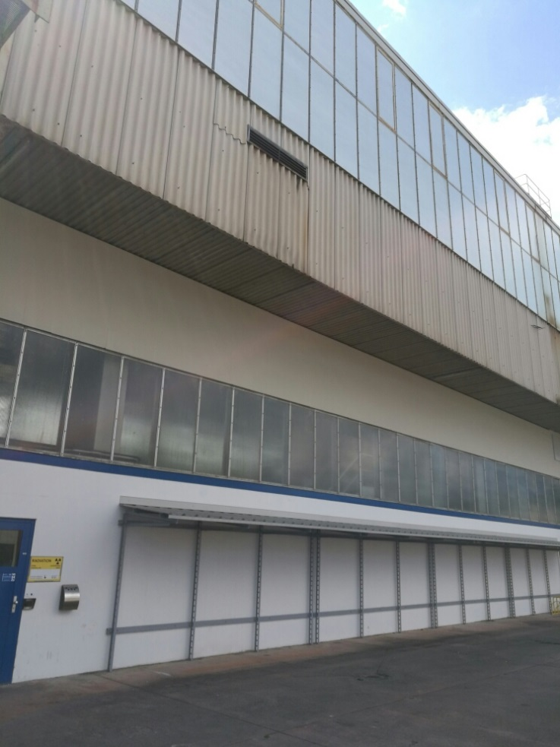
Project Background
IPP validated in 2016 in order to improve the safety and the thermal comfort of the building :
  Façades contain asbestos and provide a very poor insulation
  ➔ Refurbishment with new cladding and glazing
  Ceiling contains asbestos and provides a very poor insulation
  ➔ Removal of the old panels (asbestos) and installation of new insulated ceiling panels
B.157 project meeting
S.Mcilwraith – C.Gasnier

Slide 3
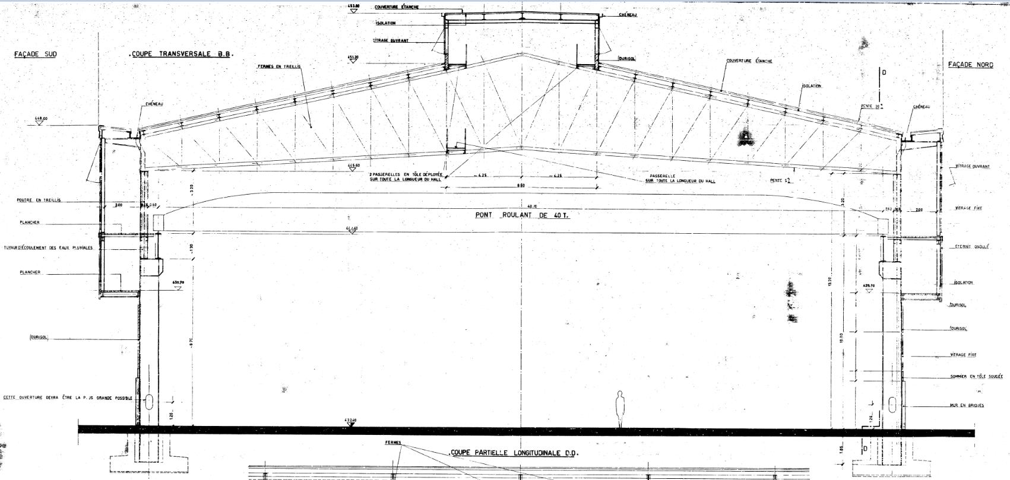
Overview
  Ceiling :
    Insulation panels ➔ 4600 m2
  Facades :
    Glazing ➔ 1500 m2
    Cladding ➔ 1200 m2
  Option
    Catwalk➔ 450m2
  Each item contains asbestos (either in panels or joints)
B.157 project meeting
S.Mcilwraith – C.Gasnier

Slide 4
1. Upper-level interior of building
8 months
6 months
6 months
This planning can be optimized by dividing the building into zones.
Different tasks can be partially superposed
~12 months
B.157 project meeting
S.Mcilwraith – C.Gasnier

Slide 5
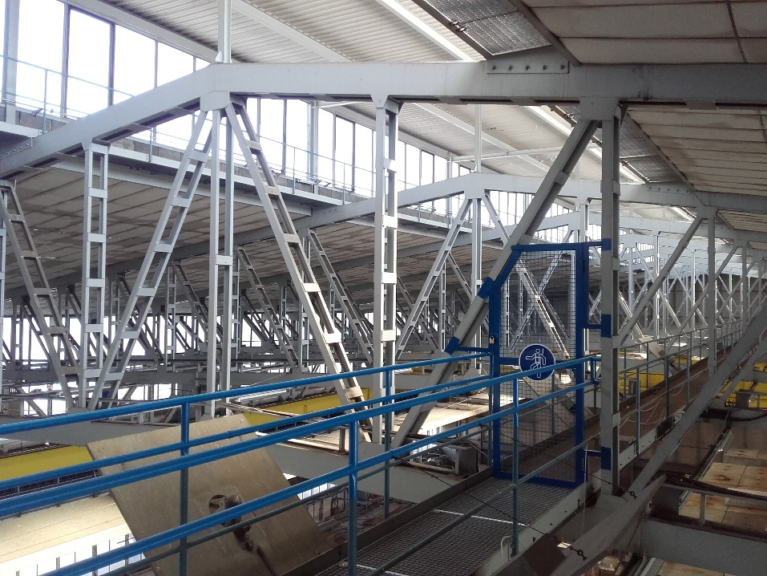
1. Upper-level interior of building
Upper windows to replace
Ceiling panels to replace
Suspended scaffolding
(~5000 m²)
B.157 project meeting
S.Mcilwraith – C.Gasnier

Slide 6
2. Exterior of building
2 months / facade
3 months / facade
➔ Approx. 5 months of work per façade in total.
B.157 project meeting
S.Mcilwraith – C.Gasnier

Slide 7

2. Exterior of building
Fibre-cement cladding to be replaced (1200 m²)
Glazing to replace(1500 m²)
Note: Possibility to reduce mid-level glazing to be investigated
B.157 project meeting
S.Mcilwraith – C.Gasnier

Slide 8
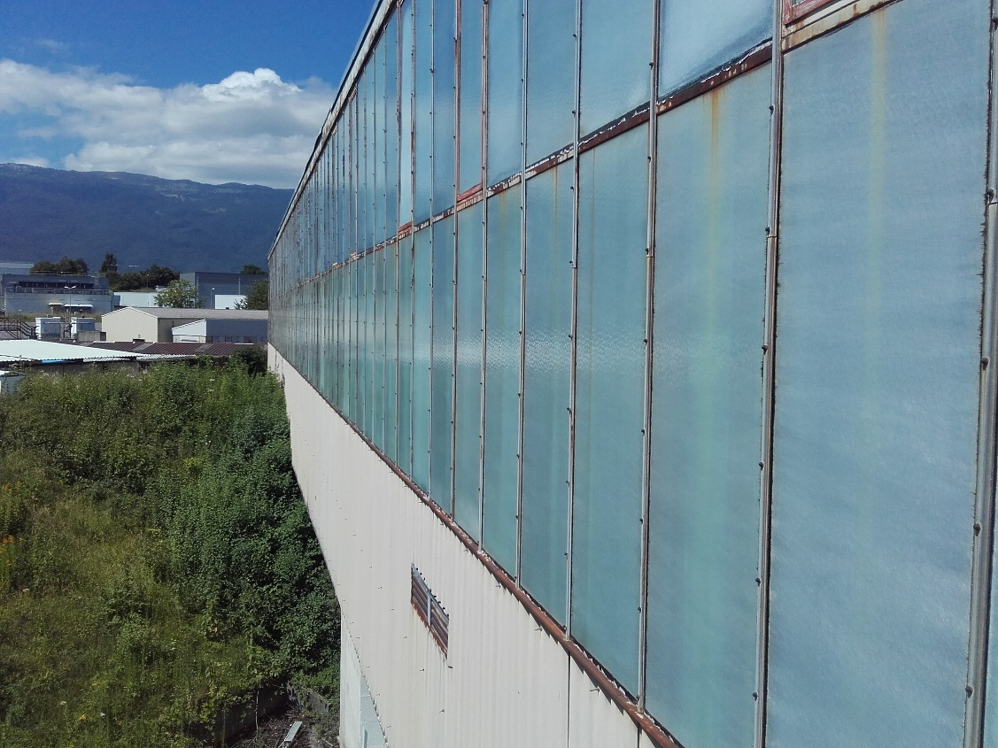
2. Exterior of building
Constraint on façade works :
On the west side of the building, the PS ring makes the access to the facades difficult.
➔ Access on the backfill of the PS may be necessary however this option must be investigated more deeply
B.157 project meeting
S.Mcilwraith – C.Gasnier

Slide 9
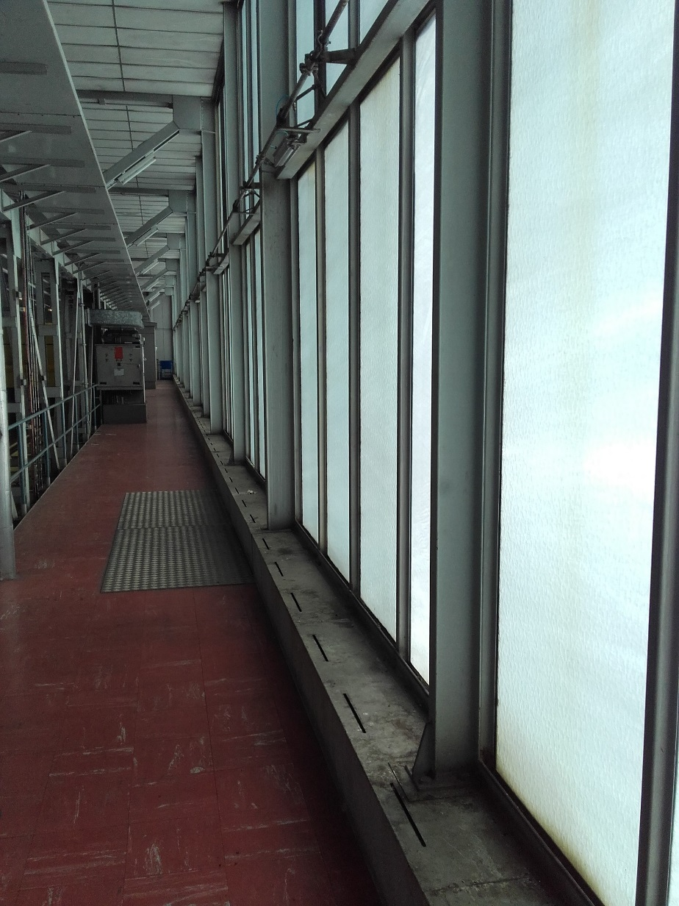
3. Option: Mid-level interior of building
Estimated time for removal of asbestos-containing vinyl tiles: unknown
  Proposed strategy: Authorise a test for a length of 5 – 10m to ascertain the required total work (possibility to choose zone most in need of repair)
Estimated time for installation of metal floors ≈ 6 weeks
Catwalks containing asbestos to be replaced
(450 m²)
B.157 project meeting
S.Mcilwraith – C.Gasnier

Slide 10
Procurement strategy
Design and preparatory works:
  Price enquiry for architect, mandate to include:
    Thermal studies
    Working conditions with respect to natural light
    Building permit
    Preparation of tender documents
Construction:
  Price enquiry for suspended scaffoldings
  IT for asbestos removal and reconstruction of ceilings and facades
    ➔ MS already established
  Option : Catwalk asbestos removal and reconstruction (blanket contract or included in IT)
B.157 project meeting
S.Mcilwraith – C.Gasnier

Slide 11
Next steps
Scope to be frozen (SMB-SE & project team)
Purchasing strategy to be validated (SMB-SE & project team)
Price enquiry documents for architect to be prepared (following validation of purchasing strategy)
Construction program to be established (SMB-SE, project team and other infrastructure packages)
B.157 project meeting
S.Mcilwraith – C.Gasnier

Slide 12
Technical points to be confirmed
Will the CE works be conducted under radiation controlled zone regulations ?
How advanced are the other WPs ? What conflicts / co-activities / task interfaces exist ?
B.157 project meeting
S.Mcilwraith – C.Gasnier

Slide 13
Thank you for your attention.
Any questions ?
B.157 project meeting
S.Mcilwraith – C.Gasnier

