Slide 1
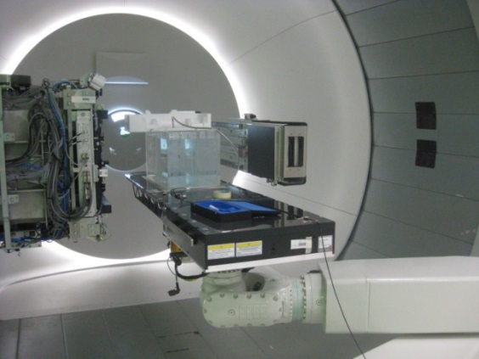
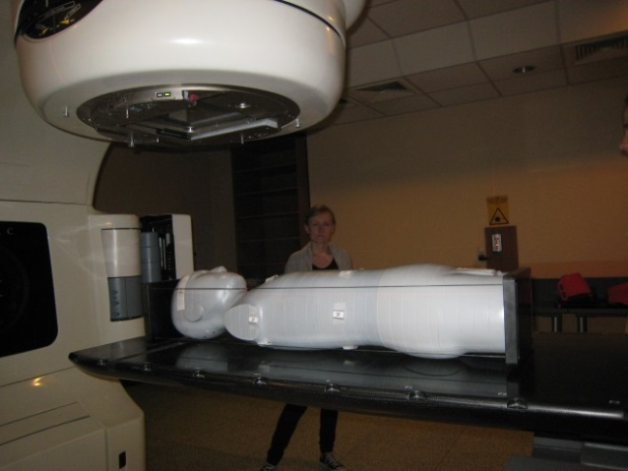
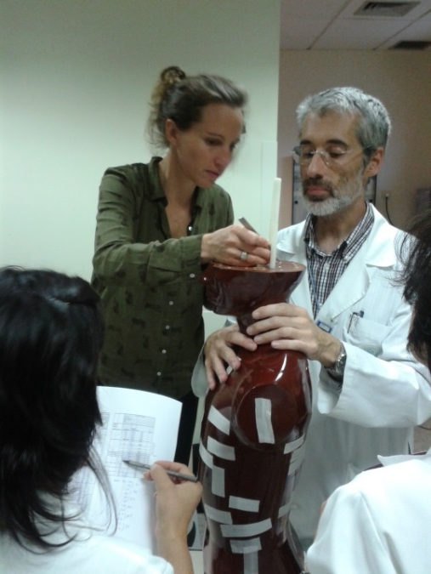
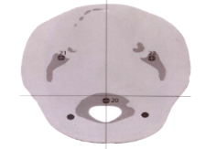
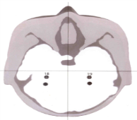
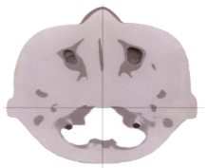
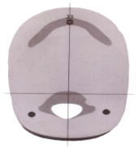
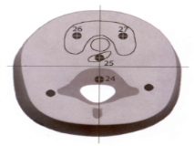
EURADOS Working Group 9:
Radiation Dosimetry in Radiotherapy
WG9 CERN meeting 17-18 October 2016

Slide 2
The European Radiation Dosimetry Group (EURADOS)
A self-sustainable network of more than 60 European institutions and 300 scientists active in the field of radiation dosimetry.
The aim: to promote research and development and European cooperation in the field of dosimetry of ionizing radiation.
Working Groups (WGs) in various dosimetric disciplines:
Harmonization of individual monitoring
Environmental dosimetry
Computational dosimetry
Internal dosimetry
Radiation dosimetry in radiotherapy
Dosimetry in diagnostic imaging
Retrospective dosimetry
Dosimetry in high energy radiation fields.
WG9 CERN meeting 17-18 October 2016

Slide 3
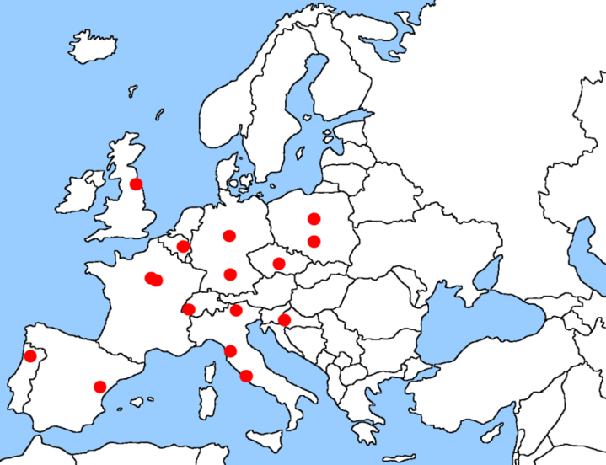
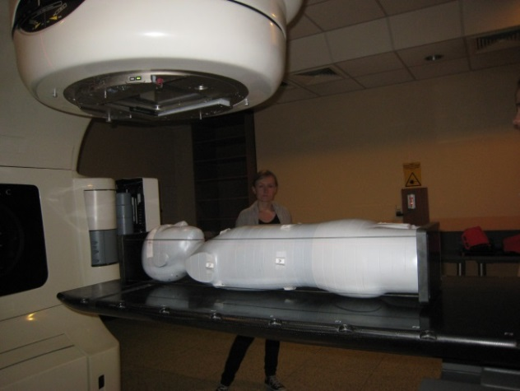
WG9 Objectives
Investigate dosimetric aspects of proton radiotherapy, including patient dosimetry and the measurement and modelling of ambient neutron and proton fields
Development of “the complete dose specification” from all sources of radiation to all parts of the body, delivered as part of radiotherapy planning & treatment (collaboration with WG12)
Develop & harmonise dosimetry techniques in radiotherapy
Measure out-of-field doses for input to secondary malignancy risk models and epidemiological studies of late effects
Facilitate development and application of novel dosemeters
WG9 CERN meeting 17-18 October 2016

Slide 4
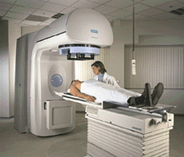
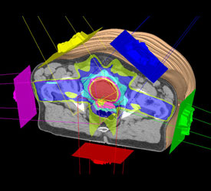
Radiotherapy
A key component of cancer therapy
Doses to target calculated with sufficient accuracy
Out of field doses are less easily measured or calculated
Epidemiological studies need (ideally) a complete dose specification
Source: Philips Healthcare
WG9 CERN meeting 17-18 October 2016

Slide 5
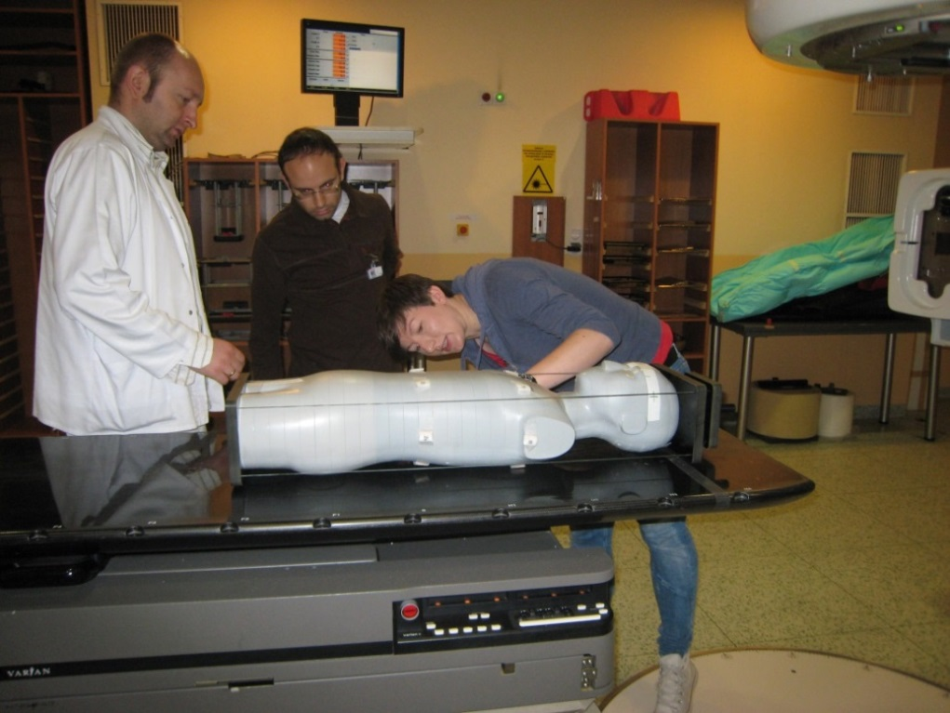
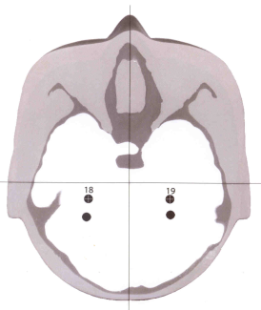
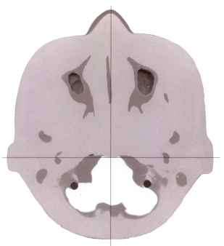
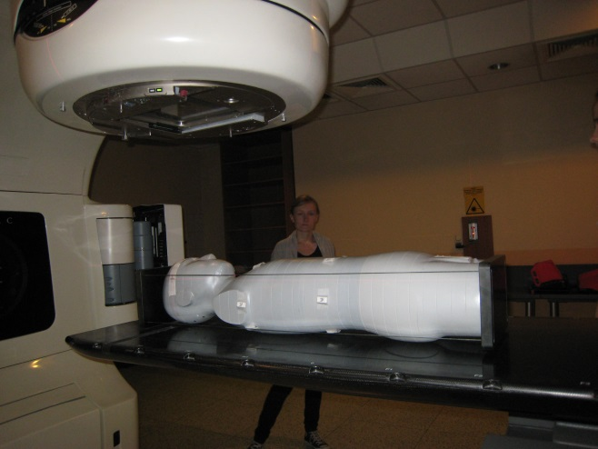

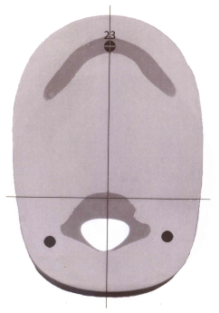
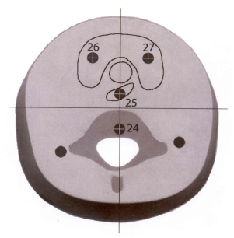
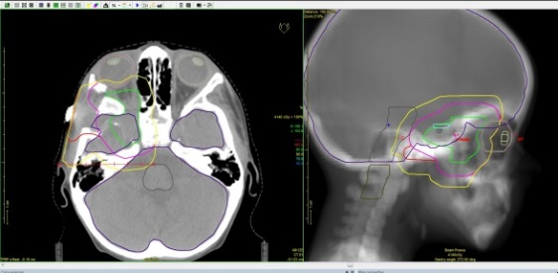
Photon radiotherapy: Paediatric treatments
Measuring out-of-field doses from a paediatric brain tumour treatment (photons)
Institute of Nuclear Physics (IFJ) and Centre of Oncology, Krakow
Ruđer Bošković Institute, Clinical Hospital for Tumours & Clinical Hospital Centre, Zagreb
WG9 CERN meeting 17-18 October 2016

Slide 6
Photon radiotherapy: Paediatric treatments
Paediatric brain tumour treatment
(photons)
WG9 CERN meeting 17-18 October 2016

Slide 7
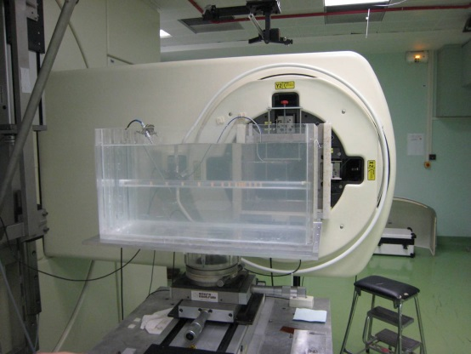
Input to analytical models
Photon dosimetry: water tank experiments
Commissariat à l'Énergie Atomique (CEA, LIST, LNE/LNHB) Saclay, 2010, 2011
WG9 CERN meeting 17-18 October 2016

Slide 8
Input to analytical models
Collaboration with Prof. Wayne Newhauser, Louisiana State University
Measured and calculated relative absorbed doses for 6 MV beam and 10 cm depth in water from the EURADOS dataset, following training of the model
A simple, descriptive, and broadly applicable model of therapeutic and stray absorbed dose from 6 MV to 25 MV photon beams
Christopher Schneider, Wayne D Newhauser, Lydia Jagetic, Uwe Schneider, Robert Kaderka, Saveta Miljanić, Željka Knežević, Liliana Stolarcyzk, Marco Durante, Roger Harrison (manuscript in preparation)
WG9 CERN meeting 17-18 October 2016

Slide 9
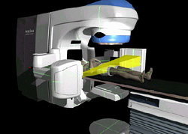
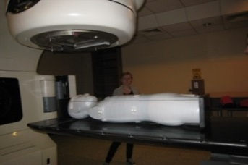
Total dose from radiotherapy and imaging: the complete dose specification (WG9/12 collaboration)
Objective:
Measure total dose for out-of-field organs in selected paediatric RT treatments (CT dose + OBI dose + RT dose)
Determine the fractional contribution of each component in the total organ and tissue dose
Anthropomorphic phantoms (10y + 5y) + several dosimeter types (RPL, TLDs, OSLs)
+
+
CT
OBI
Linac
WG9 CERN meeting 17-18 October 2016

Slide 10
Total dose from radiotherapy and imaging: the complete dose specification (WG9/12 collaboration)
Objective:
Measure total dose for out-of-field organs in selected paediatric RT treatments (CT dose + OBI dose + RT dose)
Determine the fractional contribution of each component in the total organ and tissue dose
Anthropomorphic phantoms (10y + 5y) + several dosimeter types (RPL, TLDs, OSLs)
+ PET, SPECT, SPECT / CT, molecular radiotherapy..……...?
+
+
CT
OBI
Linac
WG9 CERN meeting 17-18 October 2016

Slide 11
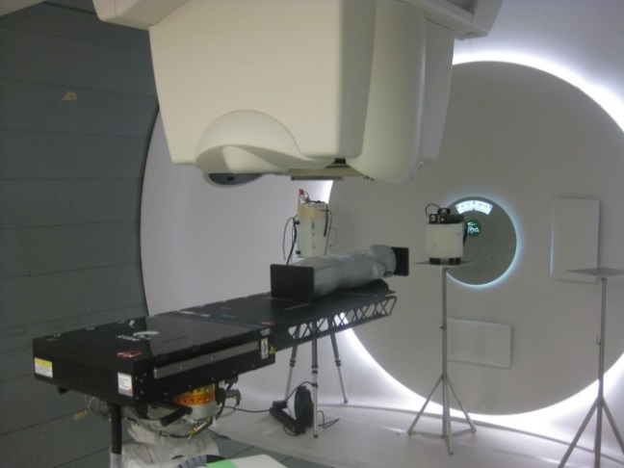
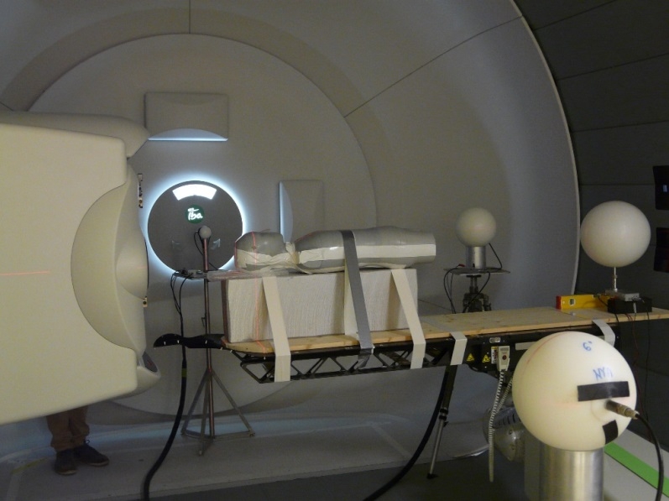
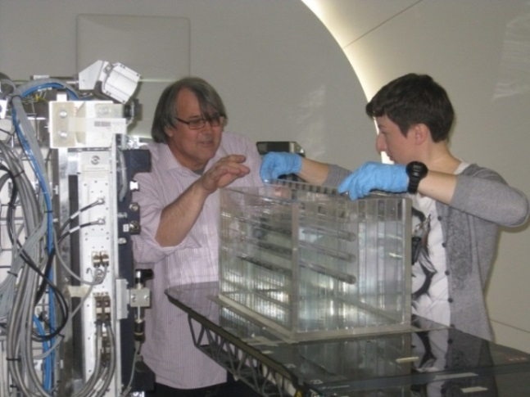
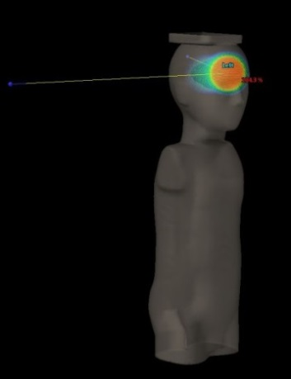
EURADOS Working Group 9:
Sub-Group WG9.2 Hadron Radiotherapy: Pawel Olko
Topics of interest:
In –phantom dosimetry of secondary and scattered radiation in hadron therapy
WG9 CERN meeting 17-18 October 2016

Slide 12
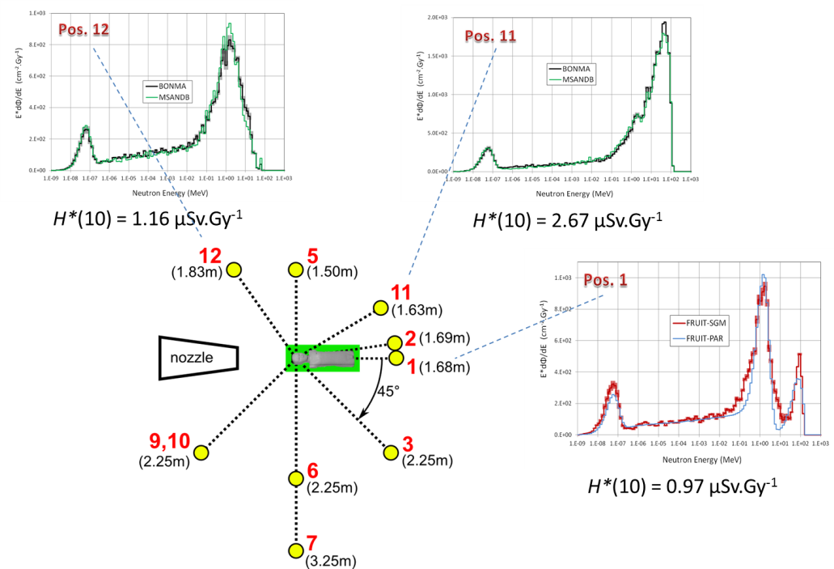
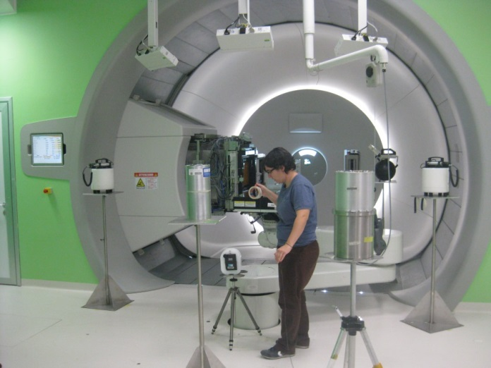
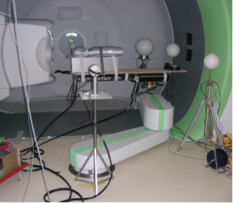
EURADOS Working Group 9:
Sub-Group WG9.2 Hadron Radiotherapy
Topics of interest:
In –phantom dosimetry of secondary and scattered radiation in hadron therapy
Environmental neutron and gamma radiation dosimetry in hadron therapy facilities (patient oriented)
A comprehensive spectrometry study of stray neutron radiation field in scanning proton therapy. Mares et al. Phys. Med. Biol. 61 (2016) 4127–4140
WG9 CERN meeting 17-18 October 2016

Slide 13
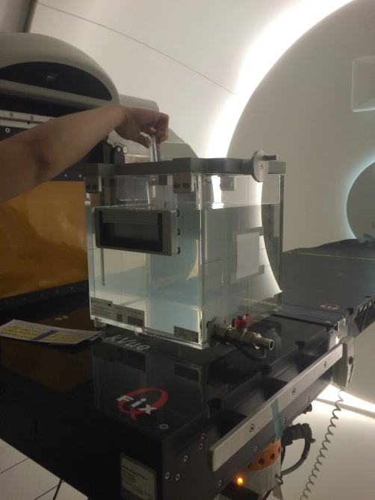
EURADOS Working Group 9:
Sub-Group WG9.2 Hadron Radiotherapy
Topics of interest:
In –phantom dosimetry of secondary and scattered radiation in hadron therapy
Environmental neutron and gamma radiation dosimetry in hadron therapy facilities (patient oriented)
System for mailed dosimetry audits of proton therapy radiotherapy beams (in progress: experiments to determine suitable detectors)
Experiments in Bronowice Cyclotron Center IFJ PAN, Kraków
Modulation width
Range
Dose response
1 | SCK-CEN | EPR | Alanine
2 | ISS | EPR | Alanine
3 | IFJ-PAN | EPR | Alanine
4 | SCK-CEN | OSL | Luxel
5 | RBI | RPL | GD-302M
6 | RBI | RPL | GD-352M
7 | SCK-CEN | TLD | MCP-n
8 | IFJ-PAN | TLD | MTS-N
9 | IFJ-PAN | TLD | MCP-N
WG9 CERN meeting 17-18 October 2016

Slide 14
EURADOS Working Group 9:
Sub-Group WG9.1 Computational Methods in Medical Physics:
Sebastian Trinkl
Objectives
Supporting experiments with simulations
  pediatric phantom measurements
  Supporting mailed proton therapy audit measurements
Joint WG activities (high energy neutron benchmarking: WG6, 9, 11)
(To validate computational and measurement methods at high energies)
Treatment planning system (TPS) validation
Overall dose estimation in radiotherapy
WG9 CERN meeting 17-18 October 2016

Slide 15
Summary
Out-of-field doses to organs in photon and proton therapy for input to risk calculations
The complete dose specification (WG9/12 collaboration) (total dose from radiotherapy and imaging)
Out-of-field measurements for validation of analytical models > TPS development
Inter-centre proton dose intercomparisons & mailed dosimetry audits of proton dosimetry
Spectrometry studies of stray neutron radiation fields in scanning proton therapy.
Neutron benchmarking (WG 9, 6 and 11)
Computational simulation support for experiments
WG9 CERN meeting 17-18 October 2016

Slide 16
Thank you

