Slide 1



Dose reduction in PET scans
Paul Lecoq
CERN, Geneva
This work is performed
in the frame of the ERC Advanced Grant Agreement N°338953–TICAL
and the COST Action TD1401

Slide 2

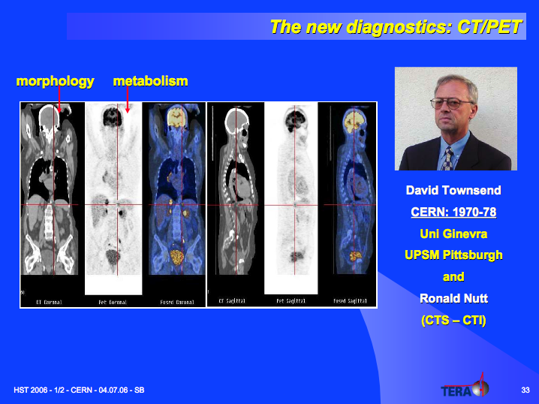
PET/CT Combine anatomic and functional/MI information
Invention of the PET/CT
CT 10 to 20 mSv
PET about 10 mSv
Standard radiography
0.1 mSv
Geneva University

Slide 3
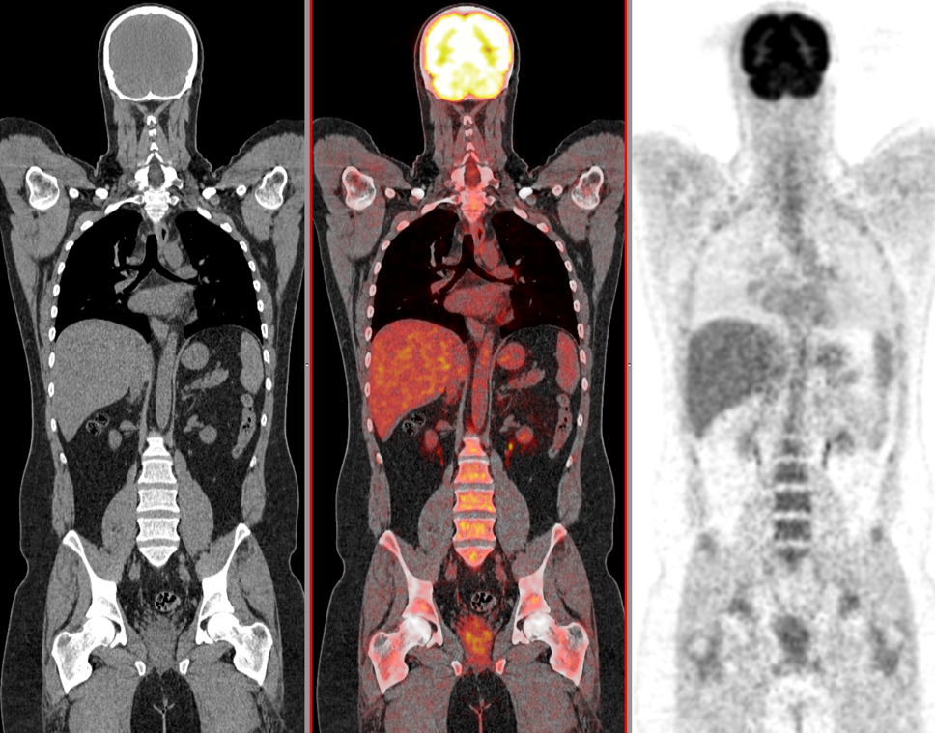
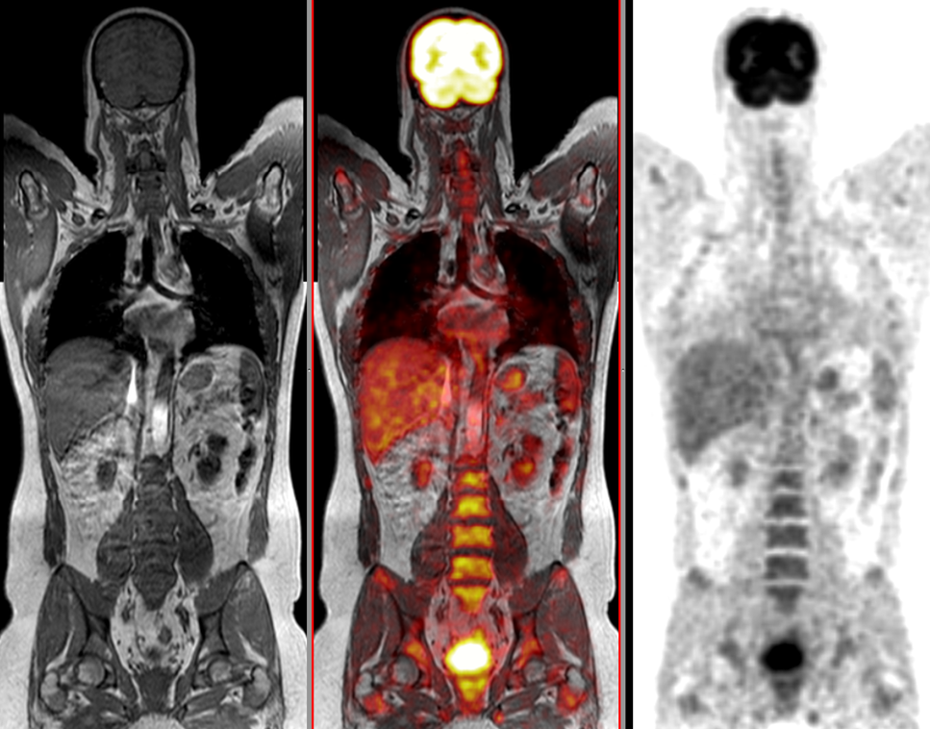
PET/MR Combine anatomic and functional/MI information
CT in PET-CT
MR in PET-MR
Anatomic
Low soft tissue contrast
Fast
Attenuation correction
10 to 20mSv
Anatomic + some functionality
High soft tissue contrast
Slow (depending on MR sequences)
No attenuation correction
NO DOSE

Slide 4
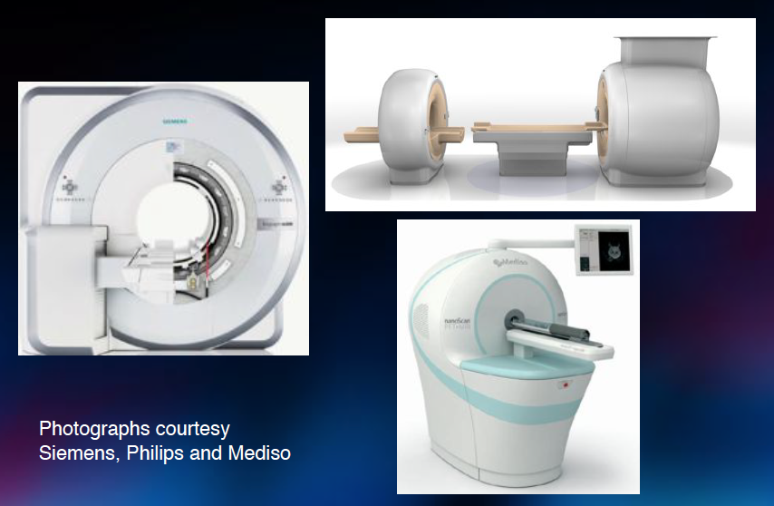
Commercial PET/MR scanners

Slide 5
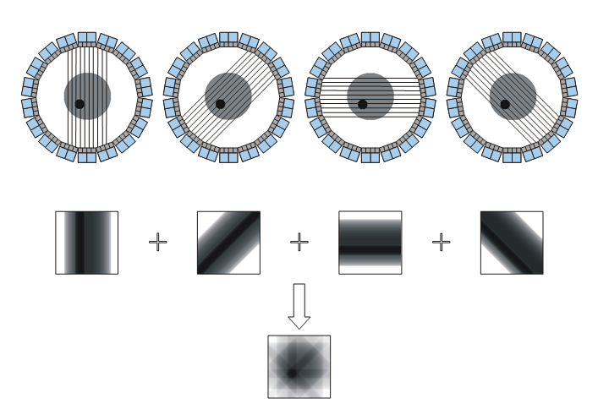
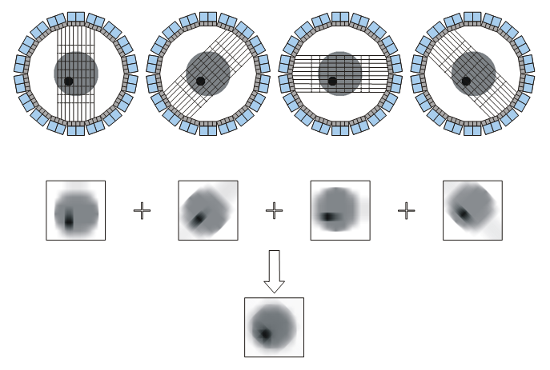
Time of Flight PET
Detector B
Δt = t_{A} – t_{B} = [(d+d₁) – (d-d₁)]/c
d₁ = c Δt/2
t_{B}
d
d₁
Patient
e⁺
10ps TOF resolution
δx = 1.5mm
SNR_{TOF}/SNR_{CONV}= 16!
e⁻
t_{A}
SNR_{TOF} = √(2D/cDt) · SNR_{conv}
Detector A
δt (ps)
δx (cm)
SNR*
10
100
300
500
0.15
1.5
4.5
7.5
16
5.2
3.0
2.3
* SNR gain for 40 cm phantom

Slide 6
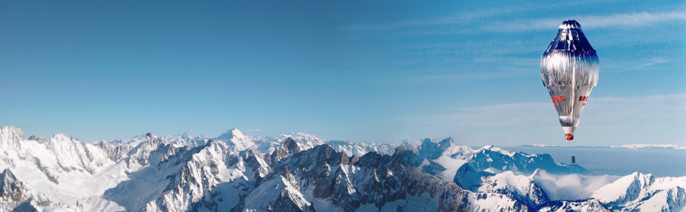
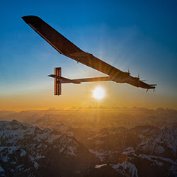
The 10ps challenge
1992: FAI raised a challenge for the first balloon circumnavigation
March 1999: Breitling Orbiter III circumnavigate the globe in 19 days 1 hour 49 minutes and won the Budweiser Cup
July 2016: Solar Impulse closed the loop of
the Round-the-World without fuel attempt
This is a clear-cut case to shed light on TOF-PET with CTR < 10 ps FWHM and raise a challenge on
≤ 1mSv PET exposure = 1 flight Paris-SF
positron tomography
Courtesy of C. Morel, CPPM
Notes:
FAI: Fédération Aéronautique Internationale,
International Aeronautic Federation

Slide 7
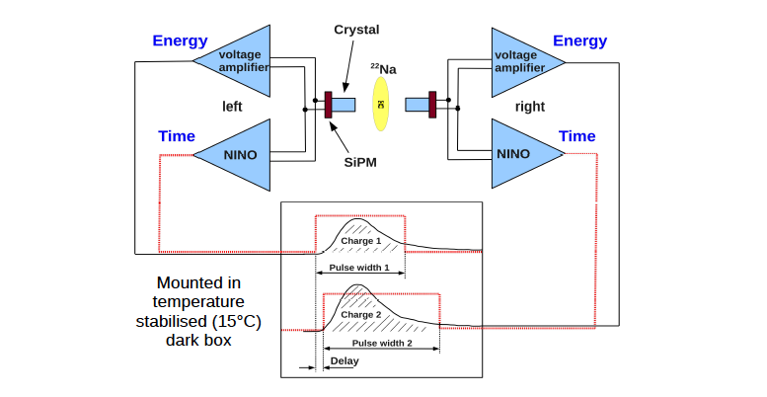
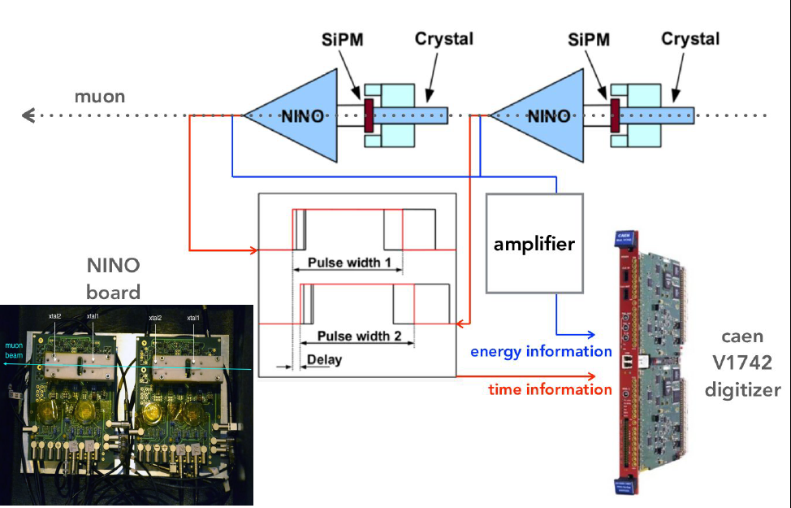
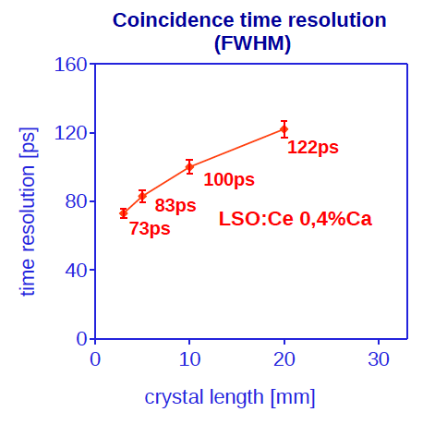
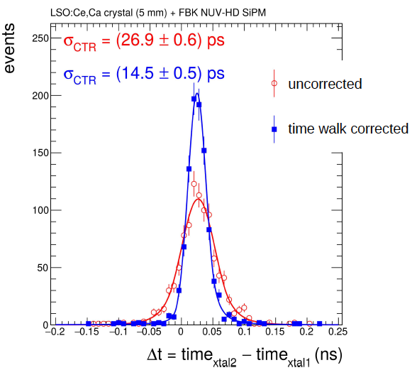
Best timing results at CERN
LSO:Ce, 0.4%Ca, melmount coupled to 3x3mm² NUV SiPM from FBK, 55%PDE
511 KeV
150GeV muons
5MeV deposited
S. Gundacker et al., CERN
2x2mm² section

Slide 8
The detection chain
Crystal
SiPM
electronics
γ
Δt
θ2
t_{kth pe} =
Δt
+ t_{k’ ph}
+ t_{transit}
+ t_{SPTR}
+ t_{TDC}
Conversion depth
Scintillation
process
Transit time
jitter
Single photon
time spread
TDC
conversion time
Light generation
Light transport
Photoconversion
Random deletion 1
Absorption
Self-absorption
Unwanted pulses 1
DCR, cross talk
Afterpulses
Random deletion 2
SiPM PDE
Unwanted pulses 2
DCR

Slide 9
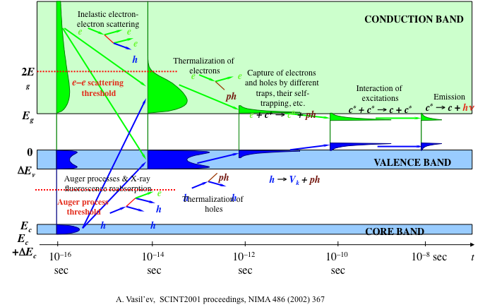
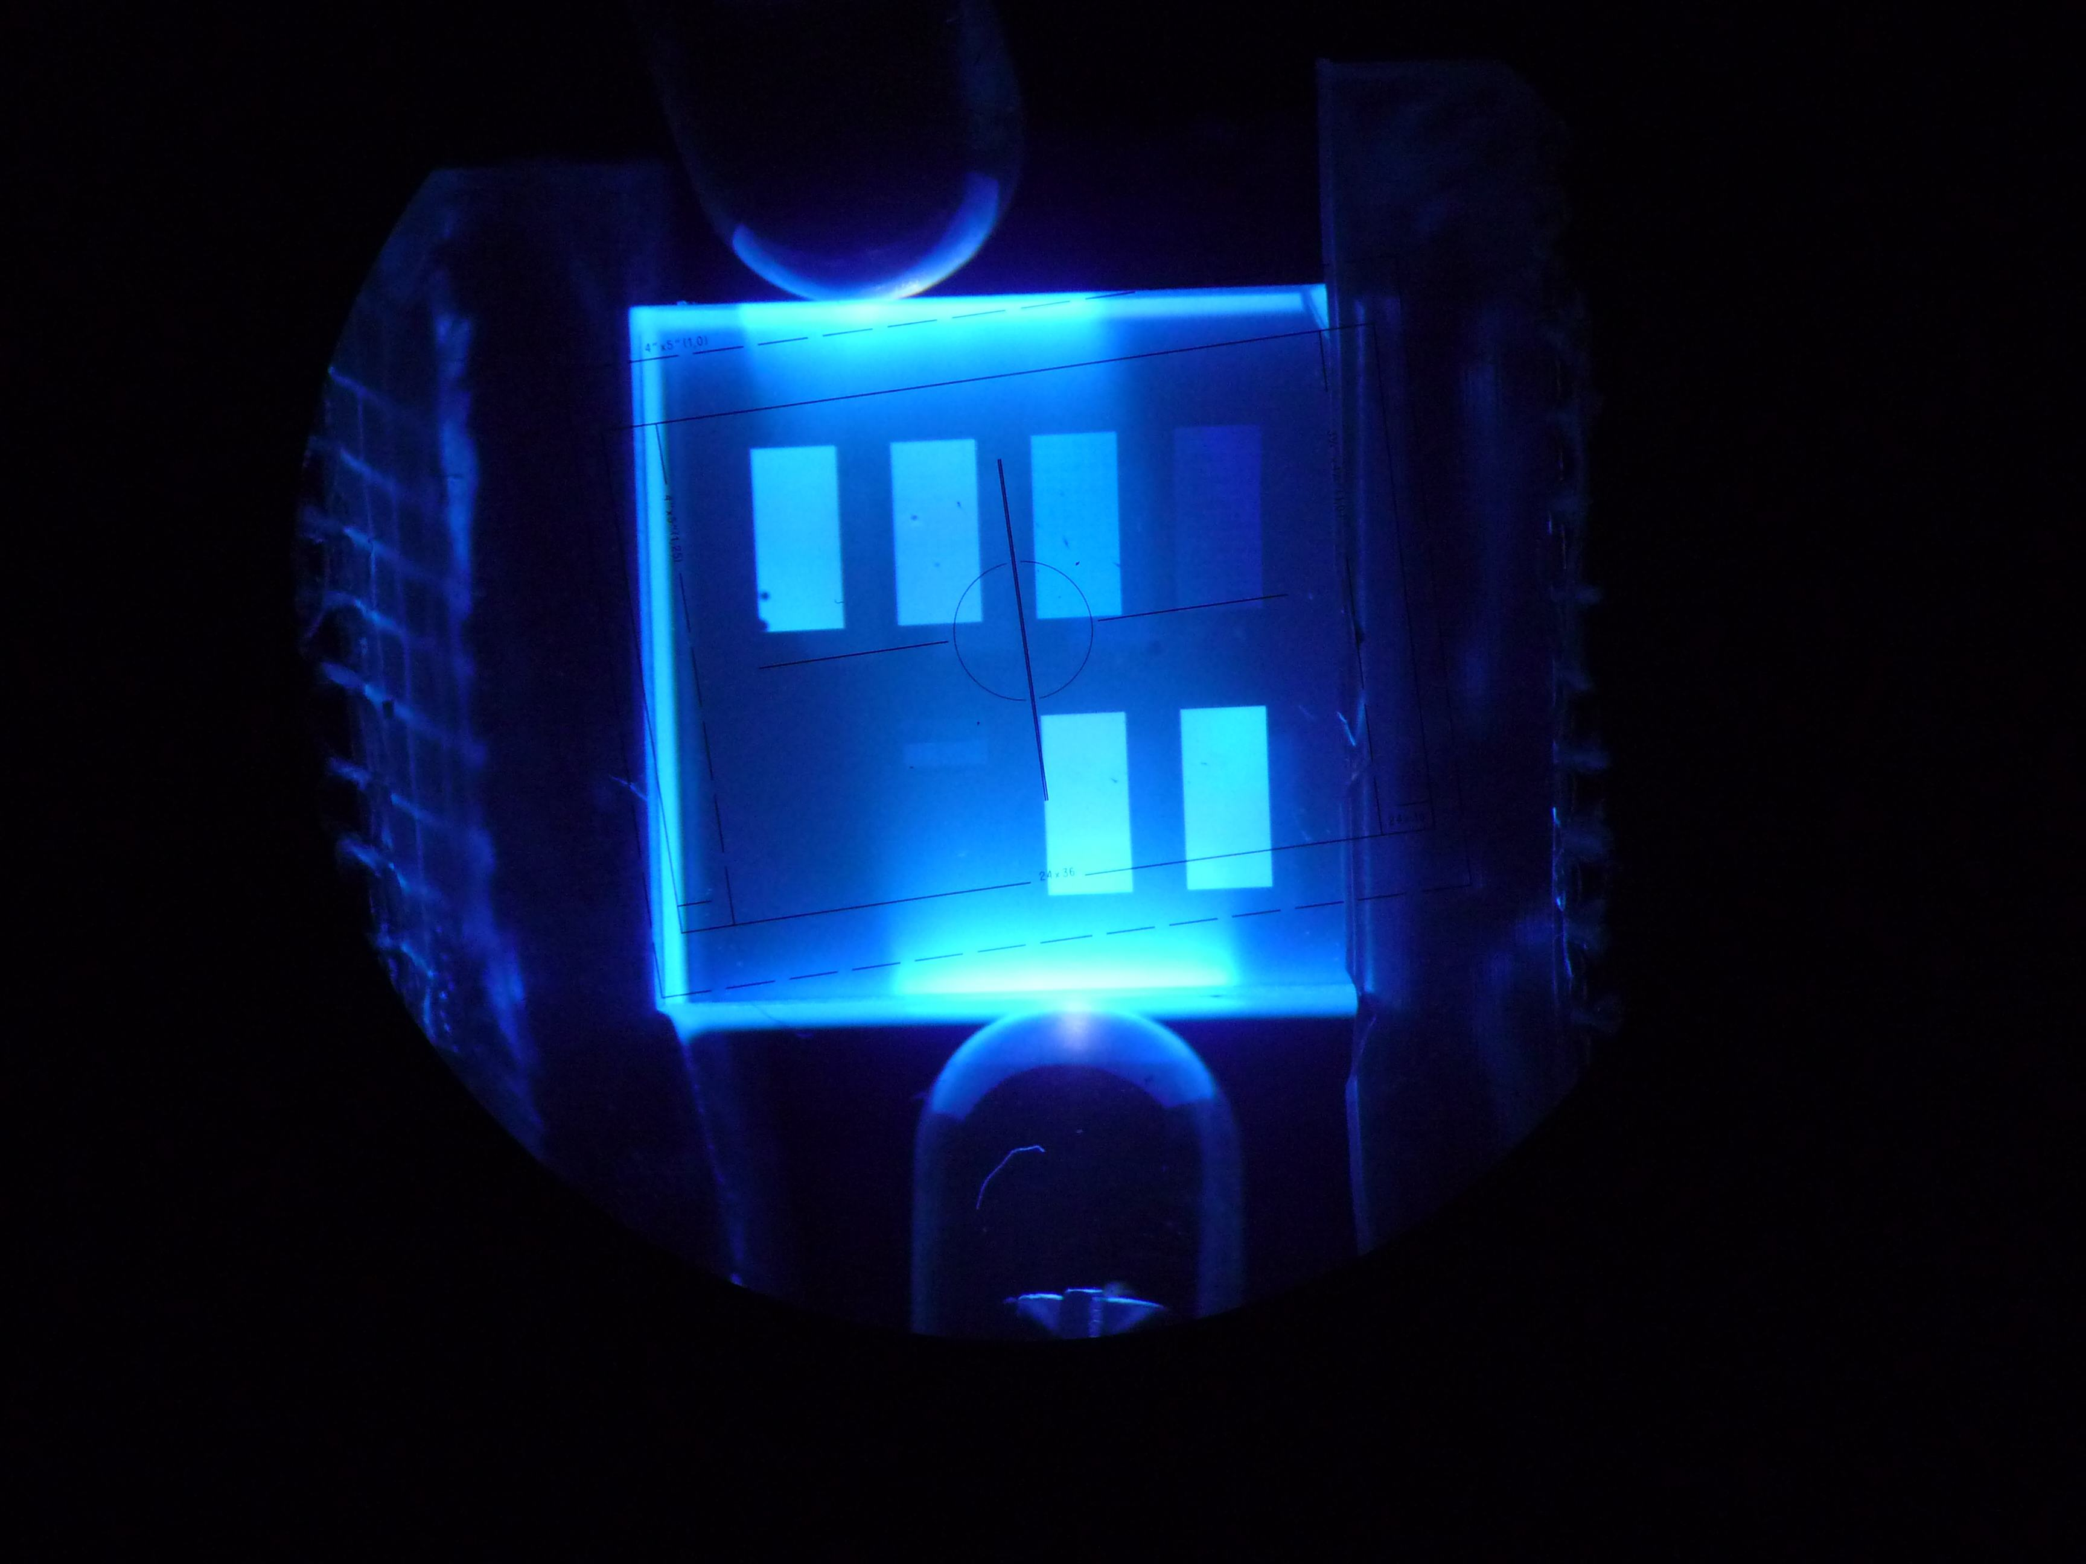
Factors influencing scintillator time resolution
P. Lecoq et al, IEEE Trans. Nucl. Sci. 57 (2010) 2411-2416
Besides all factors related to photodetection and readout electronics the scintillator contributes to the time resolution through:
  The light production mechanism
    Light yield,
    Rise time,
    Decay time
  The light transport in the crystal
    Time spread related to different light propagation modes
  The light extraction efficiency (LY➔LO)
    Impact on photostatistics
    Weights the distribution of light propagation modes

Slide 10
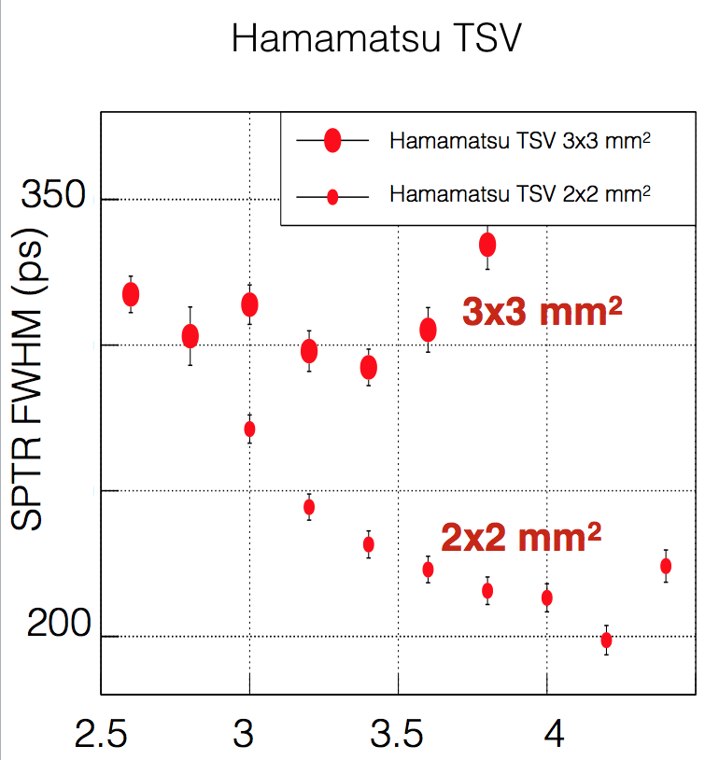
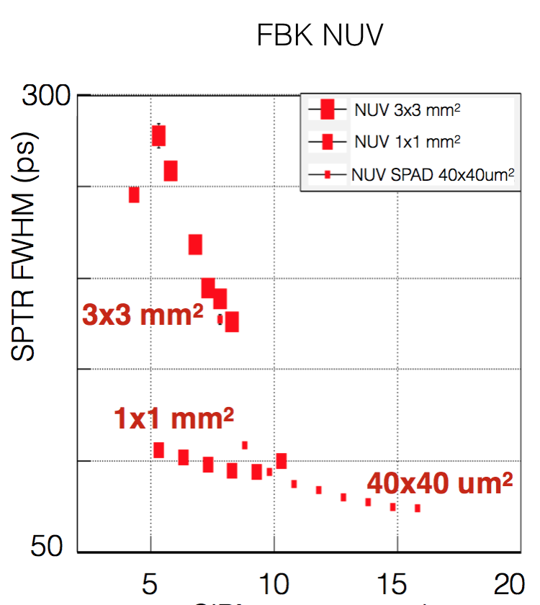
SPTR dependence on
SiPM area
SiPM bias overvoltage (V)
SiPM bias overvoltage (V)
M. Nemallapudi et al, Single Photon Time Resolution of State of the Art SiPMs, Submitted to JINST, May 1016

Slide 11
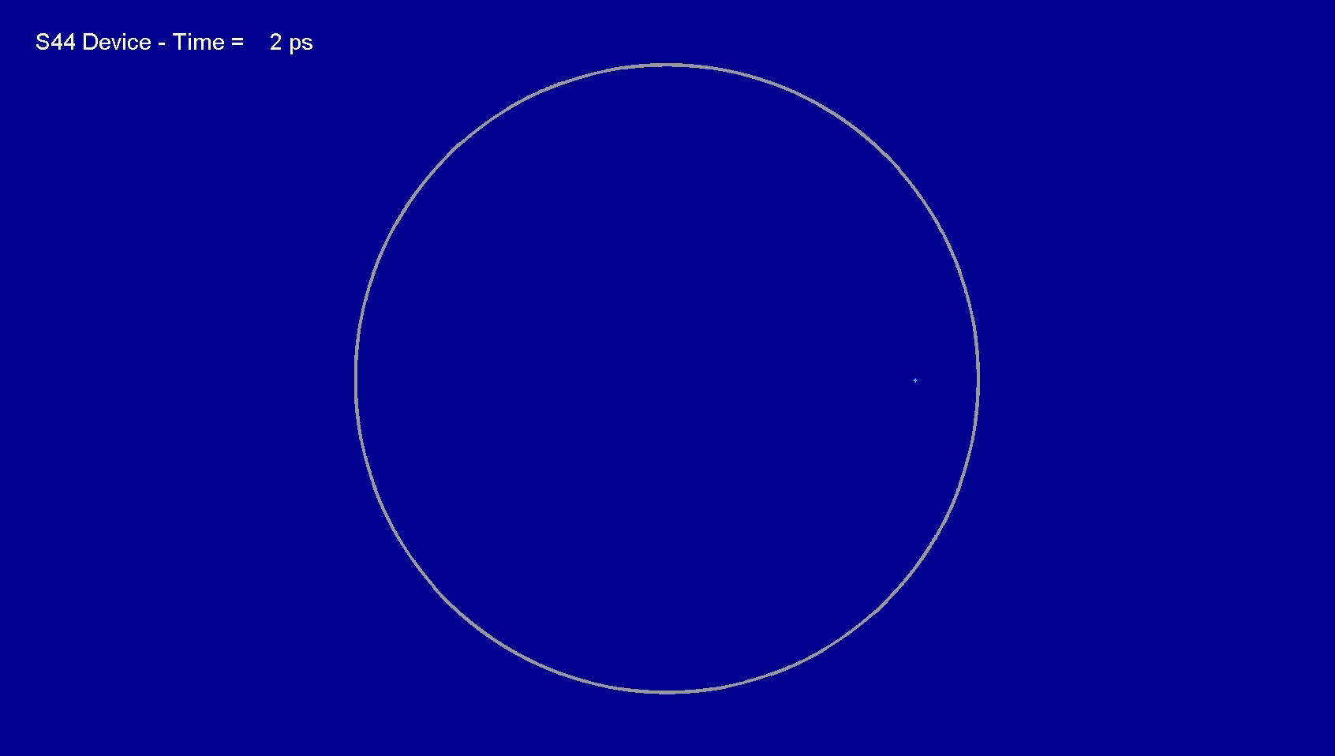
Avalanche development in a 50μm diameter SPAD
Ivan Rech, Politecnico di Milano
Notes:
Two factors determine the timing resolution of a SiPM.
the time jitter of the avalnche development within a SPAD
The time transit spread of the signals from different SPADs to the collecting anode.
On the first point the group of Cova and Rech in Milano are studying the influence of the SPAD geometry on the avanche development.
This is a measurement, not a simulation! This is slow motion move showing in 30sec the 1.2ns development of the avalanche in a 50microns circular SPAD
***
photon-triggered secondary avalanches start to develop
***
(The image is the level of the current, but the emitted light is proportional to the current so to end is the same- the emission is centered around 1um and reach 4-500nm in the blue and 1.3 1.4 in the IR-Yes the point is the assisted mechanism- the rim is more intense because it is less quenched by the space charge resistor.)

Slide 12
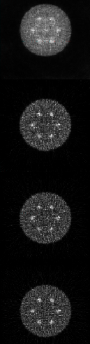
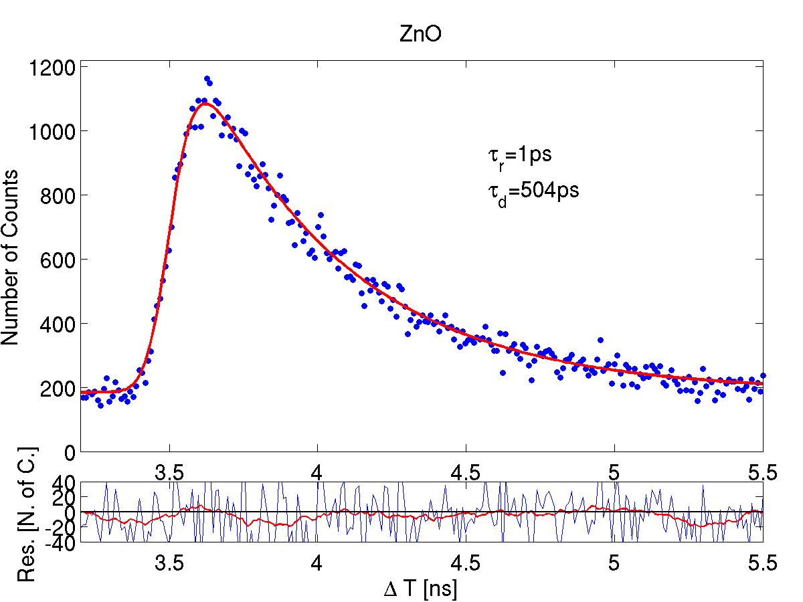
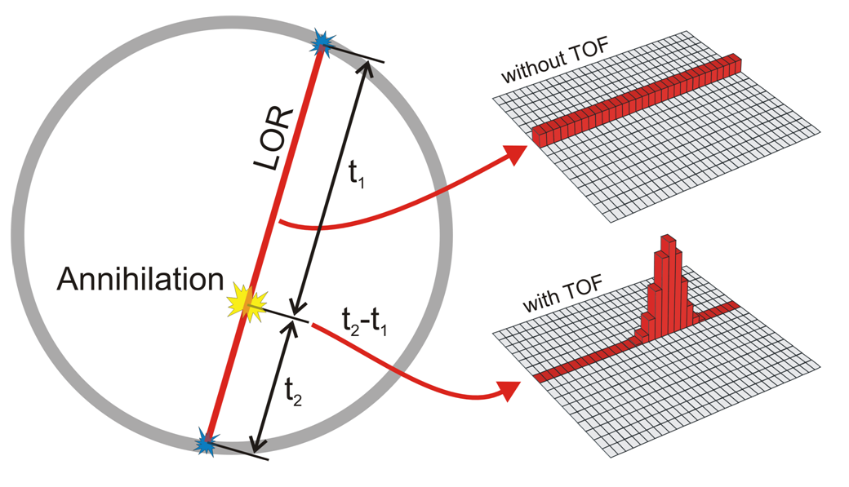
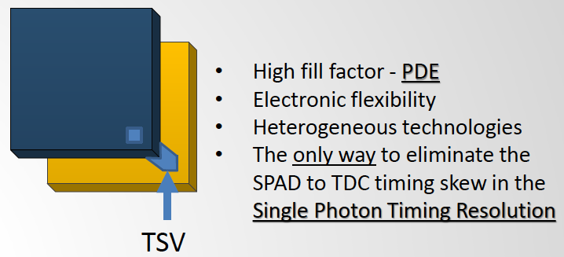
Fast sintillation timing: the way to reconstructionless TOFPET
P Lecoq et al. Nucl. Instrum. Meth. A 718 (2013) 569
  No TOF
ZnO:Ga
Ultrafast
Nano-crystals
  700 ps
  500 ps
Digital 3D SiPM
Photonic crystals
  300 ps
Notes:
ZnO:Ga 20 fold increase in photon density as compared to LSO:Ce, Ca. 500ps compared to 30ns, light yiled 1/3 of LSO:Ce, Ca

Slide 13

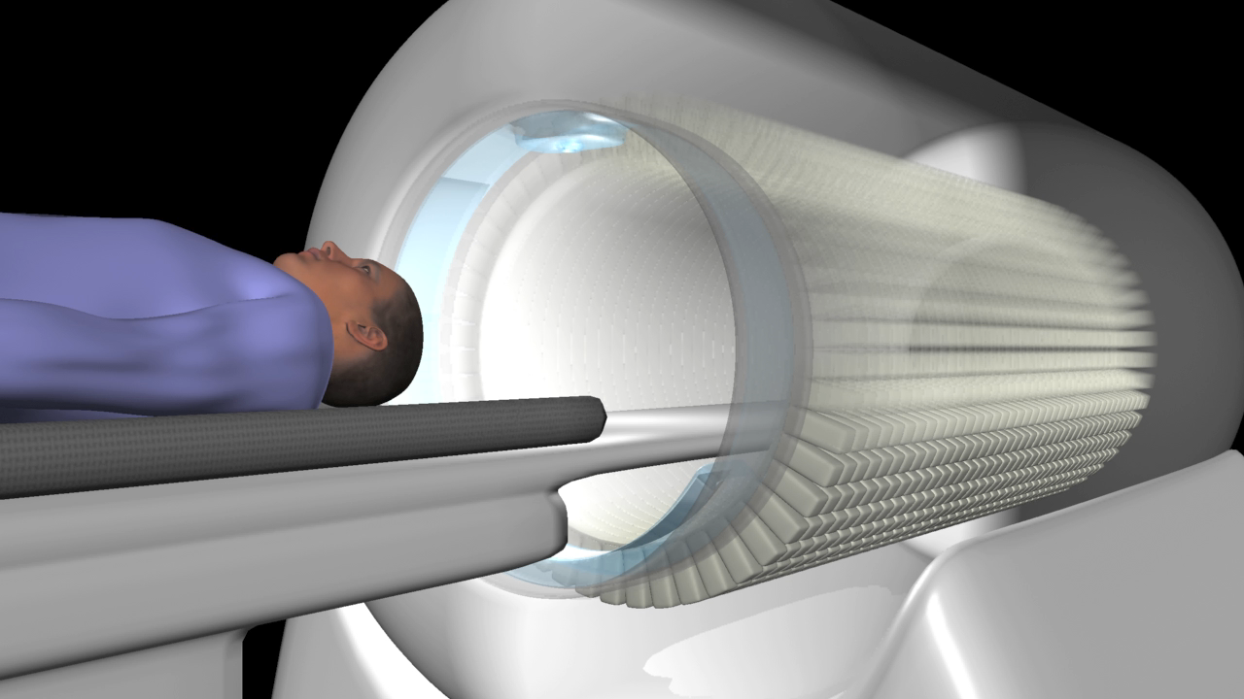



EXPLORER:
A Total-Body PET Scanner
EXPLORER.ucdavis.edu

Slide 14
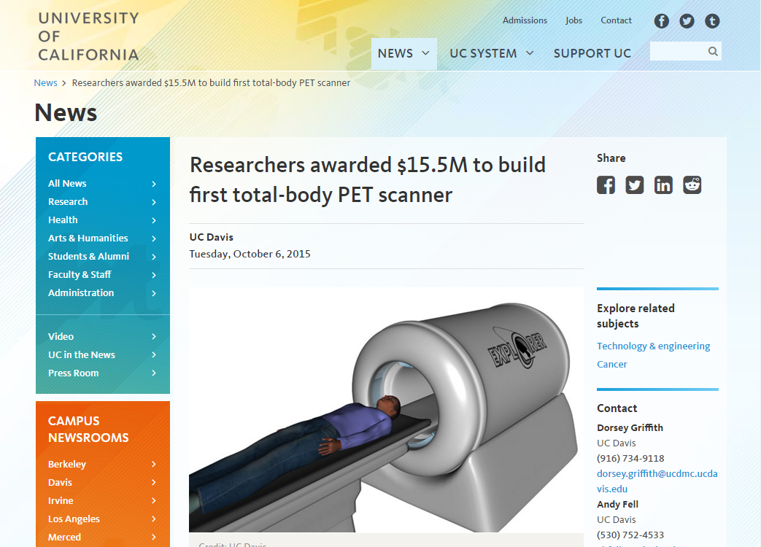
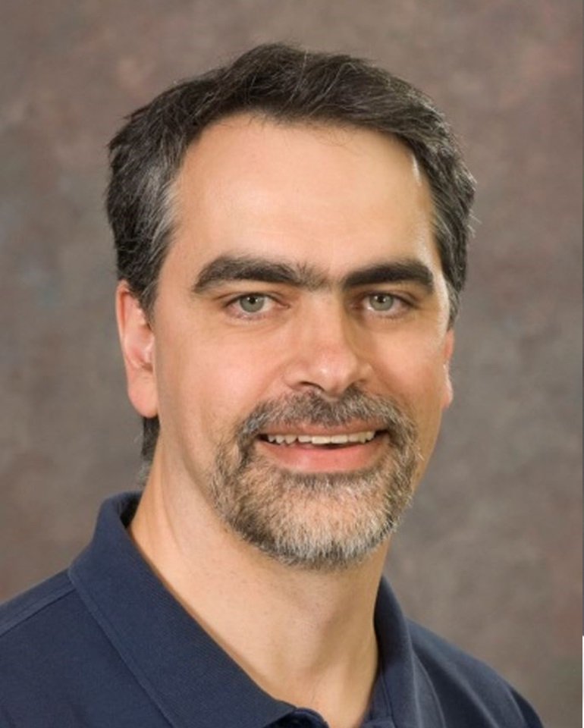
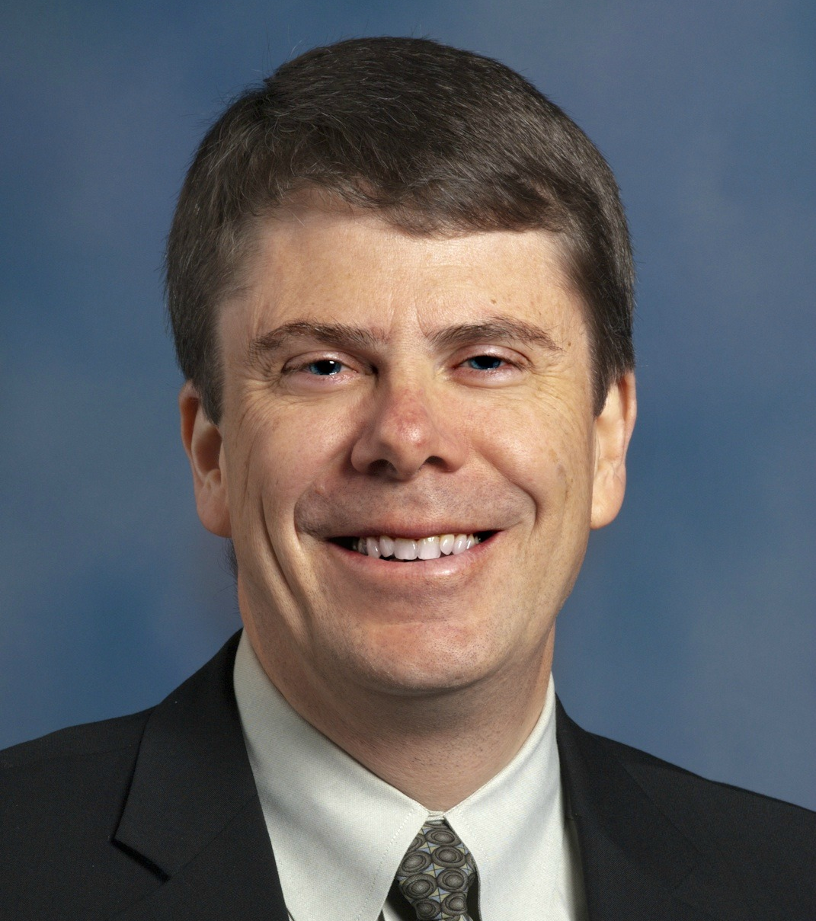
EXPLORER:
A Total-Body PET Scanner
Ramsey Badawi
Simon Cherry
Notes:
to consolidate the full portfolio of the applications case upon which the securing of funding rests
bottom line on this one is that although the project initially sounds pretty technologically daunting, we actually have the technology

Slide 15
EXPLORER:
Design parameters
 | Siemens mCT
Axial FOV (cm) | 21.8 | 200
Ring diameter (cm) | 84.9 | ~80
Scintillator | LSO | LYSO
Spatial resolution (mm) | 4.1 | <4
TOF resolution (ps) | 530 | <400
Integrated CT unit? | Yes | Yes
DOI Measurement? | No | Yes
No
Notes:
Why…does not surround the patient with detectors, much of the radiation is missed.

Slide 16
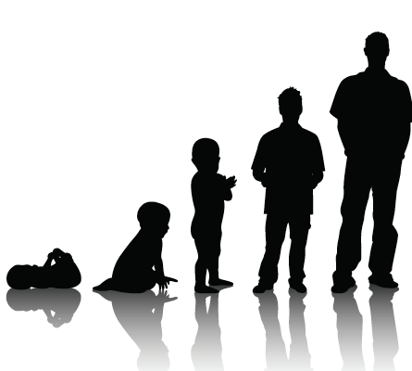
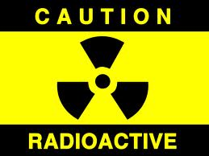
EXPLORER or 10ps TOFPET
Image Gently (Low Dose)
Up to 40-fold reduction in dose
  Whole-body PET at ~ 0.15 mSv
  Annual natural background is ~ 2.4 mSv
  Return flight (SFO-LHR) is ~ 0.11 mSv
  PET can be used with minimal risk – new populations
Conventional PET
EXPLORER or 10ps TOFPET

Slide 17
Image Gently (Low Dose)
Maternal-Fetal interaction
Clinical Need
  15M babies born pre-term (< 37 weeks) / year
  1.1M die because of pre-term complications / year
  Many surviving pre-term babies have problems as adults (disabled, diabetes, hypertension, heart disease, obesity)
Identify Problems In Utero
  Trace nutrient transport from mother to fetus
  (oxygen, glucose, amino acids, fatty acids)
  Image at < 0.05 mSv
The potential for low dose functional studies in maternal-fetal medicine using combined PET and MRI
Terry Jones and Thomas F. Budinger. Journal of Nuclear Medicine 2013, 54: 2017-2018

Slide 18
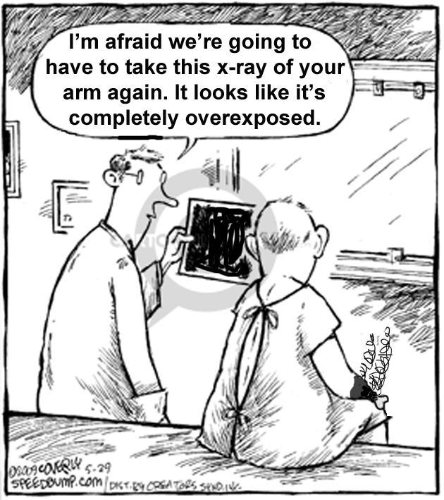
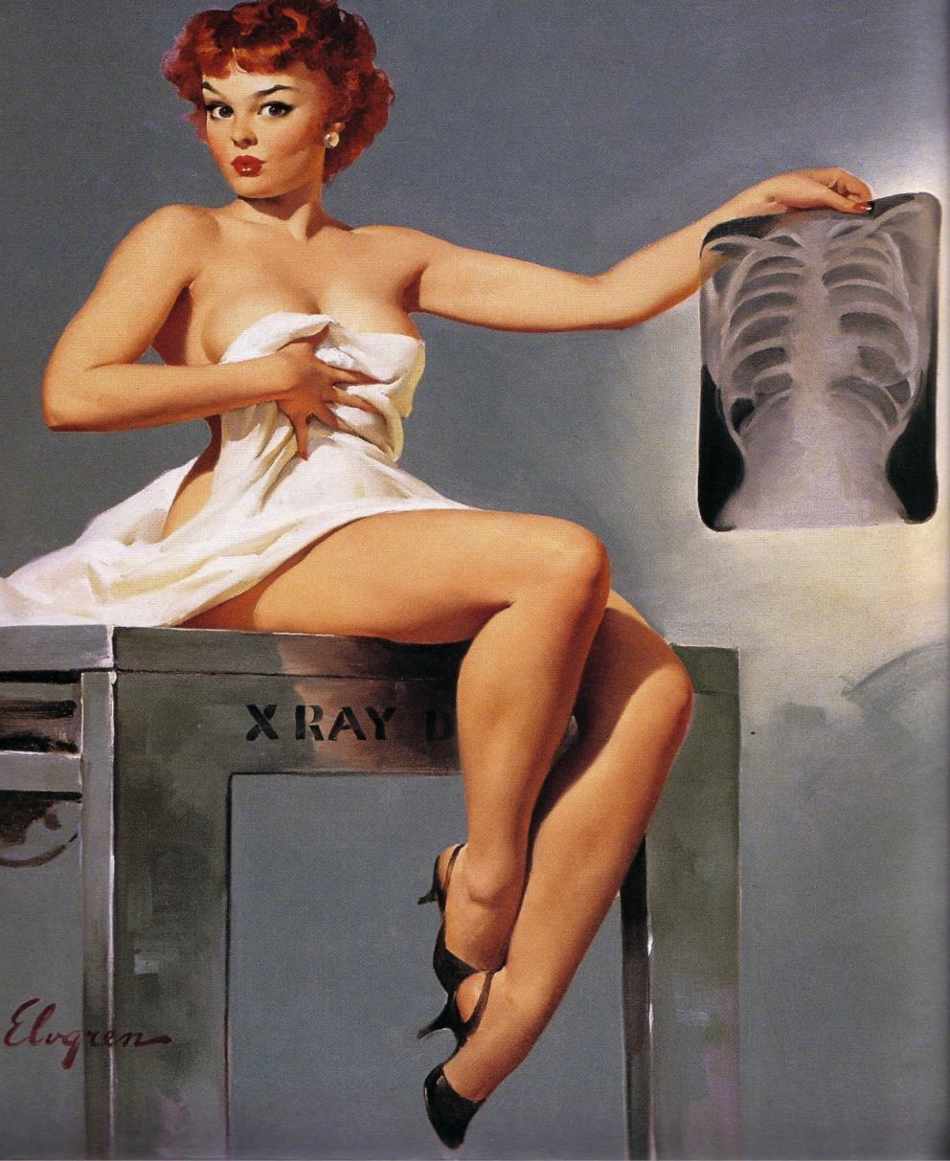
Thank you
Notes:
PET and CT are very powerfull imaging techniques but theyr are using ionizing radiation.
Then it depends what you want to see. Imaging the surface of the patient is not damaging but does not bring much information, at least from the medical point of view.
Ionizinng radiation must of course be used with soeme care. But technological advances open the way to examinations at the level or even less than the natural background

