Slide 1
Photon Spectrometry with Dosepix
Winnie Wong, University of Houston and Medipix2 Collaboration
On behalf of the Medipix Design Team at CERN
Eurados Workshop
17 October 2016

Slide 2
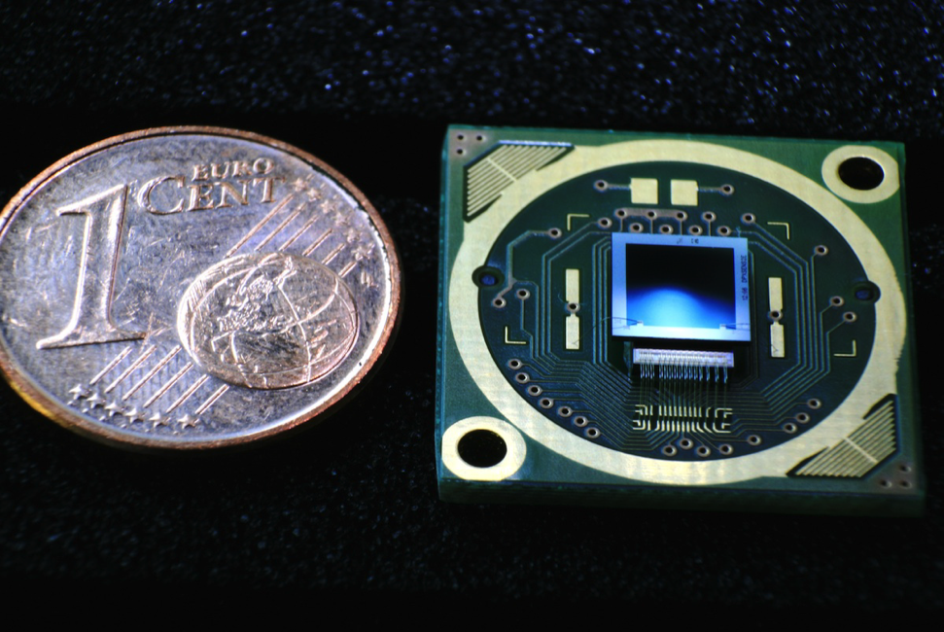
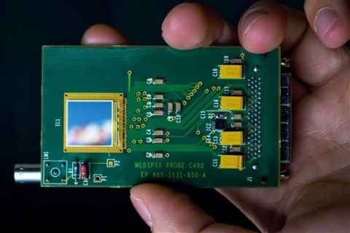
Outline
Hybrid pixel detectors
Single quantum processing
Medipix
Dosepix
    Count rate
    X-ray spectroscopy
            Primary beam
            Scatter radiation

Slide 3
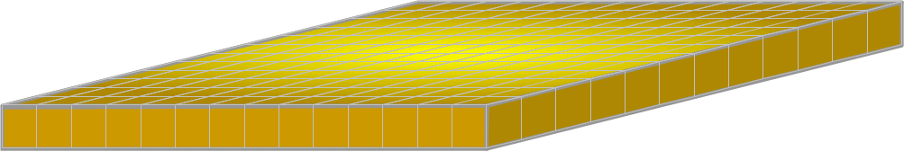
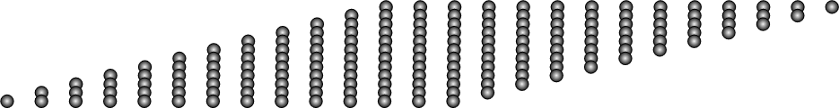
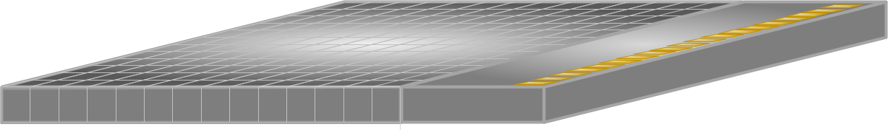
Hybrid Pixel Detectors
Semiconductor sensor
Bump bonds (electrical connections)
Application-Specific Integrated Circuit (“ASIC”, aka chip)

Slide 4
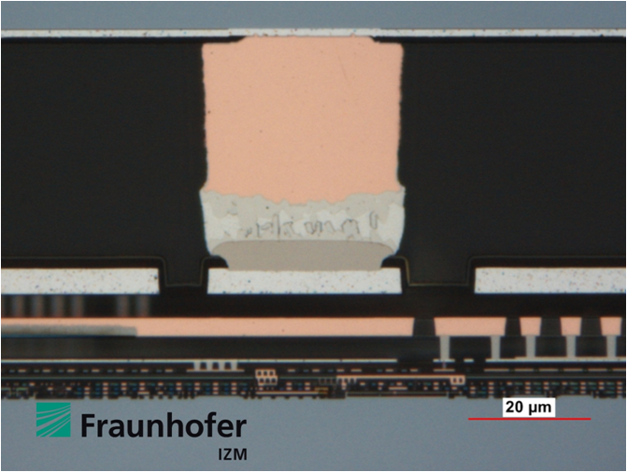
Hybrid Pixel Detectors
Silicon sensor
Copper pillar (bump bond)
Transistors and metal connections on the ASIC
Cross-section of the Dosepix detector
Image courtesy of Fraunhofer IZM
Appropriate sensor material for application: e.g. Si, GaAs, CdTe
Optimised electronics for speed, power consumption, functionality, etc.
100% fill factor and 100% use of pixel area for circuit implementation
  Permits single quantum processing

Slide 5




Single Quantum Processing with
Hybrid Pixel Detectors
V
ToT = 29 x 100 ns = 2.9 μs = 20 keV
ToT = 16 x 100 ns = 1.6 μs = 13 keV
Photon counting
E.g. Medipix2,
Medipix3
Analogue
threshold
Time over threshold (ToT)
E.g. Timepix,
(Timepix2),
Timepix3,
Dosepix
t
10 MHz Clock
100 ns

Slide 6
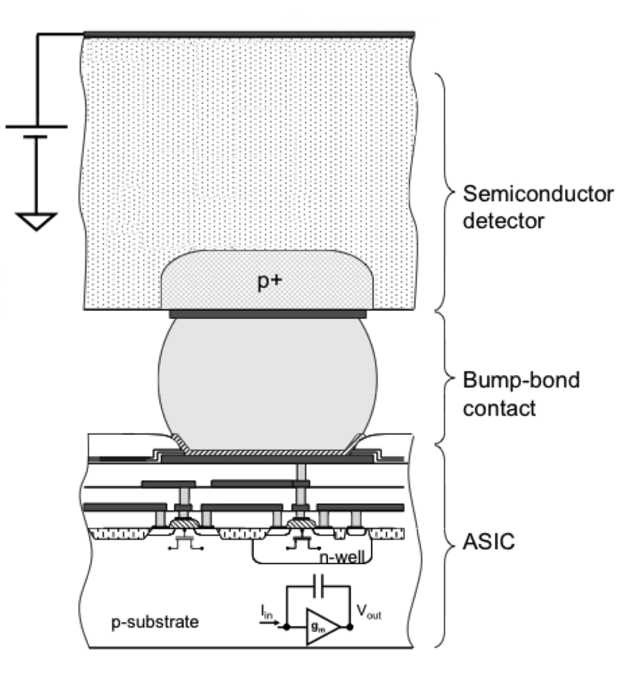
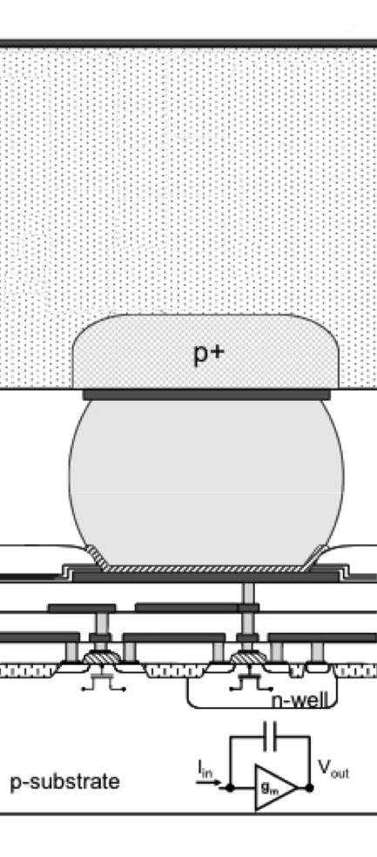
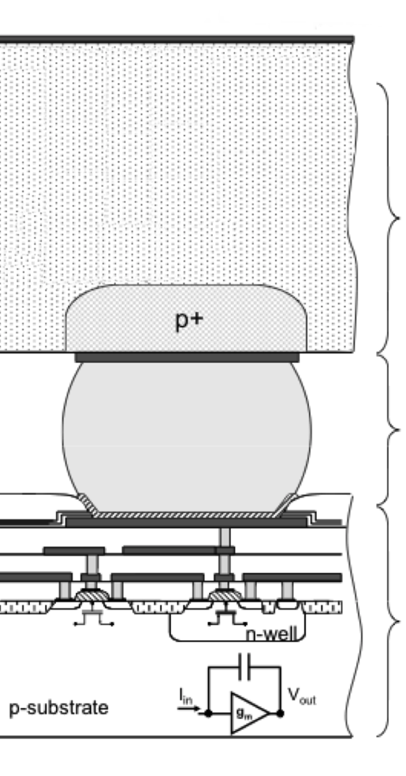
Photon Interaction with Sensor
Photoelectric effect
Compton scattering
Charge sharing
-
-
+ -
- +
-
-
-
-
n-
- +
+ -
-
+ -
-
-
-
-
- +
-
-
-
-
-
-
-
-
-
+ -
- +
-
-
-
-
-
-
-
-
-
-
+ -
-
+ -
-
+ -
-
-
-
+ -
-
- +
- +
- +
- +
+ -
+ -
-
-
-
-
+ -
- +
+ -
-
-
-
-
-
-
- +
- +
+ -
-
+ -
- +
-
-
- +
-
-
-
-
-
+
+ -
+ -
+ -
+ -
- +
- +
+
+
+
+
+
+
+
+
+
Semiconductor Sensor
+
+
+
+
+
+
+
+
+
+
+
+
+
+
+
+
+
+
+
+
+
+
+
+
+
+
+
+
+
+
+
+
+
+
+
+
+
+
+
+
+
+
+
+
Bump bond (electrical contact)
Chip (aka ASIC)
Notes:
Photoelectric effect, signal is seen by one pixel
Photoelectric effect, charge sharing due to diffusion
Compton scattering

Slide 7
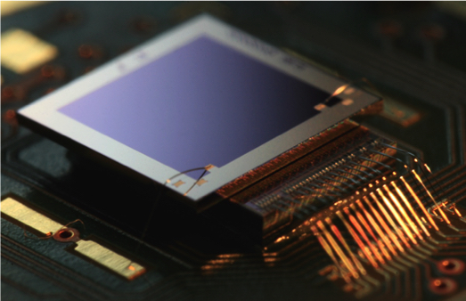
Dosepix
Main application: dosimetry
Developed by: CERN, U. Erlangen, IBA Dosimetry
ASIC:
  16x16 pixels=256 parallel spectrometers:
    1 global voltage threshold (programmable)
    16 energy bin thresholds per pixel (programmable)
    12-bit ToT: energy
    Automatic binning in pixel
Sensor:
  300 μm Si, segmented into
    64 pixels of 55x55 μm²
    192 pixels of 220x220 μm²
3.5 mm
3.5 mm
Si sensor
Dosepix ASIC
Photo source: T. Gabor
Notes:
3048 (15x256) is the theoretical number of bins that can be programmed on the chip, but in practice you would want to assign the same bin programming to multiple pixels to increase the active area per bin to gather more statistics. I typically program 60 unique bins across the chip, with the energy range dependent on the measurement I want to take.

Slide 8
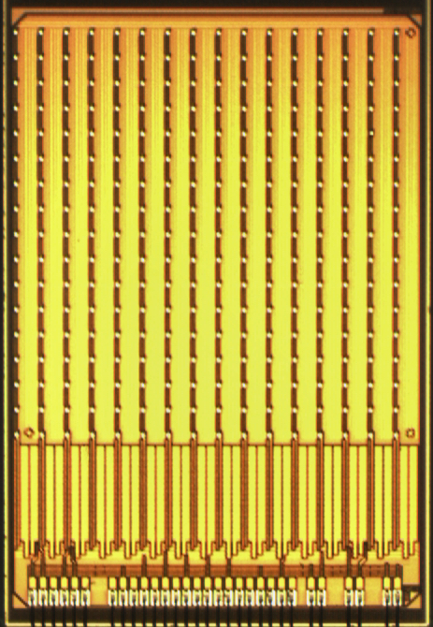
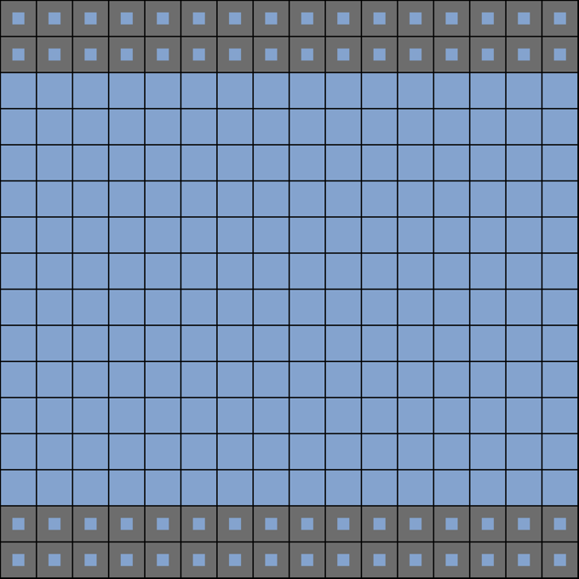
Dosepix ASIC
(photo)
Silicon sensor
(drawing)
3.52 mm
3.52 mm
3.52 mm
3.52 mm
220 μm
220 μm
55x55 μm² active area with 220 μm pitch
220 μm

Slide 9
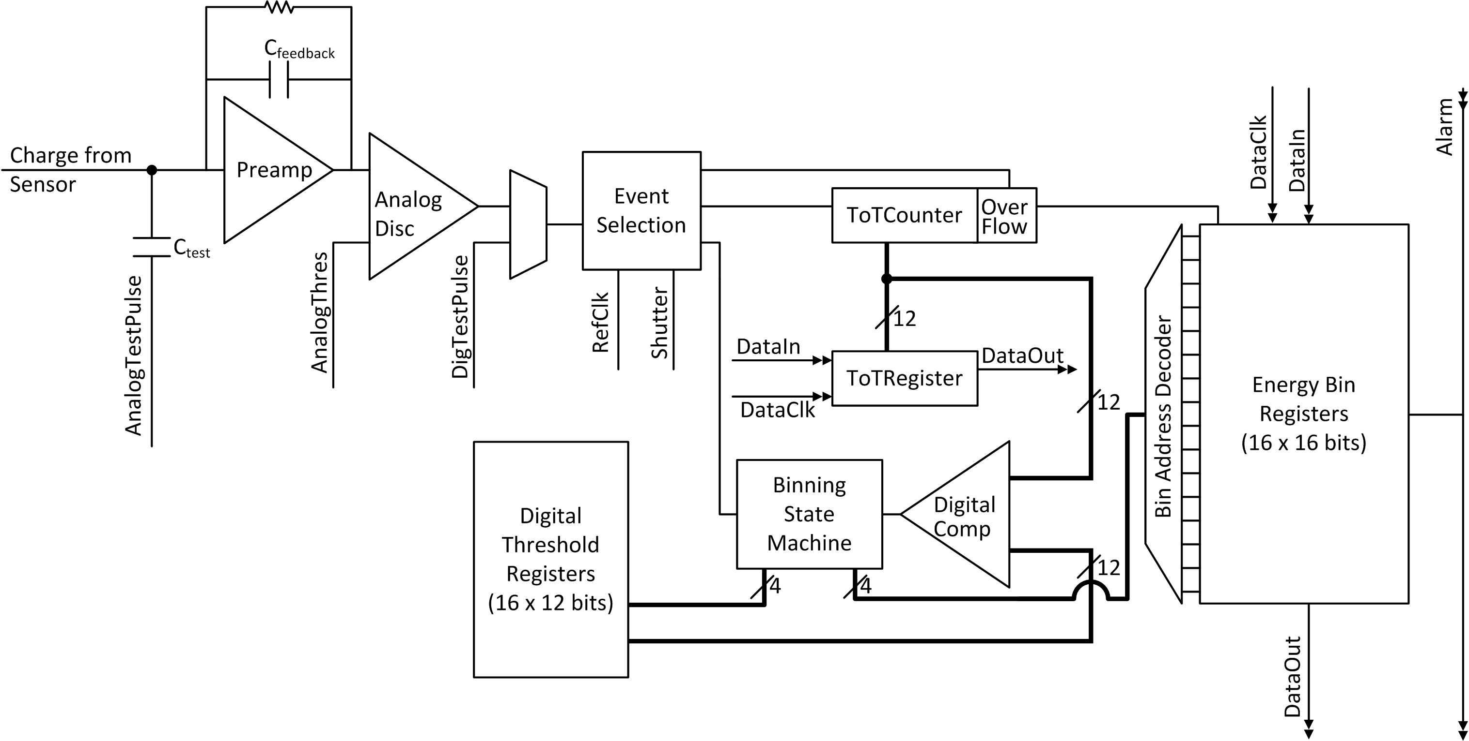
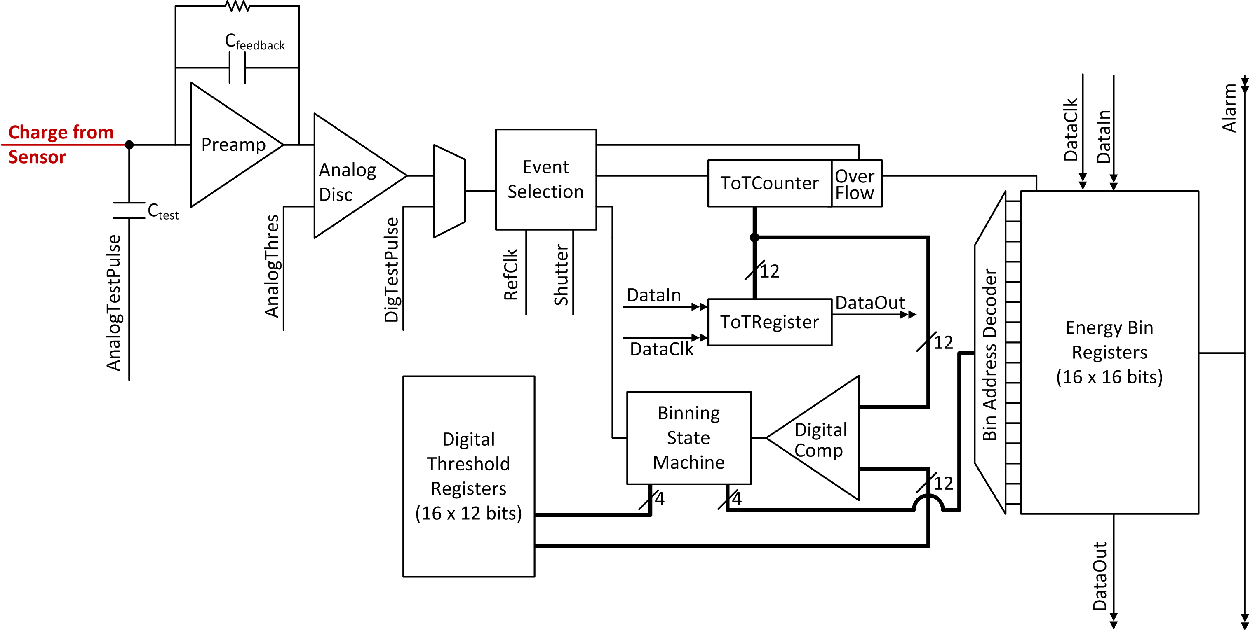
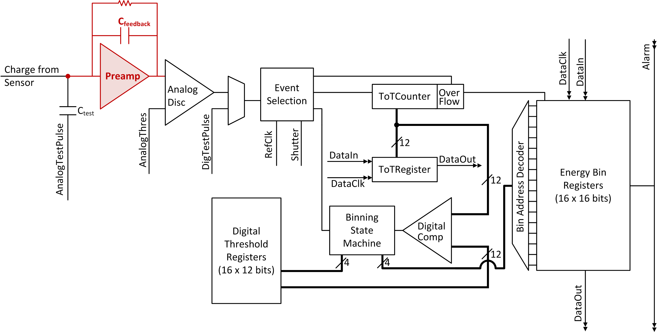
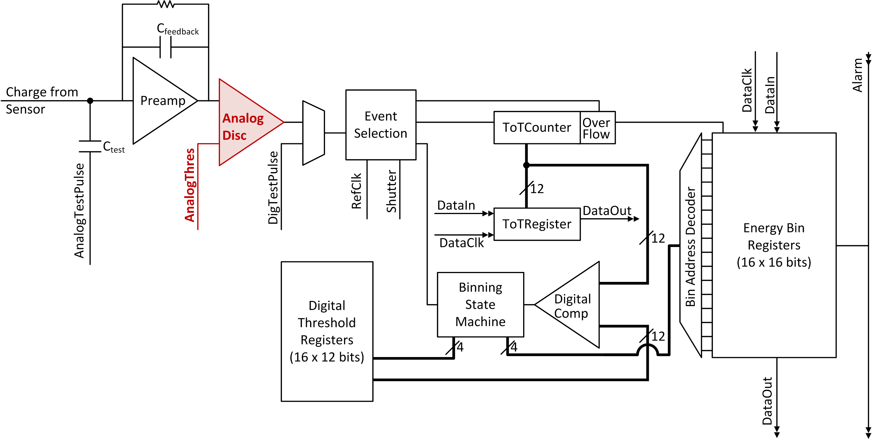
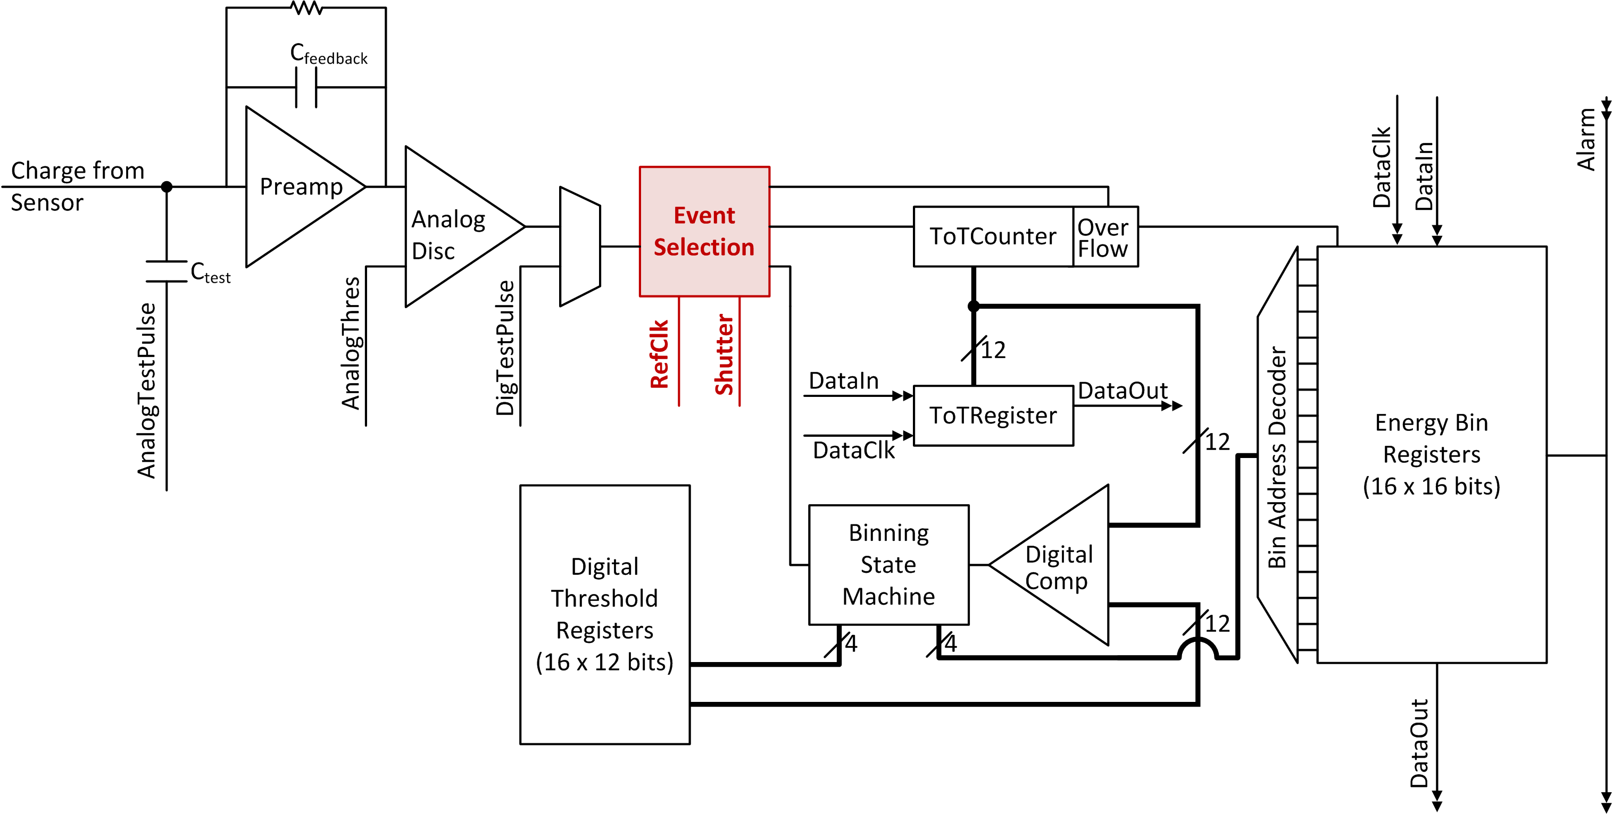
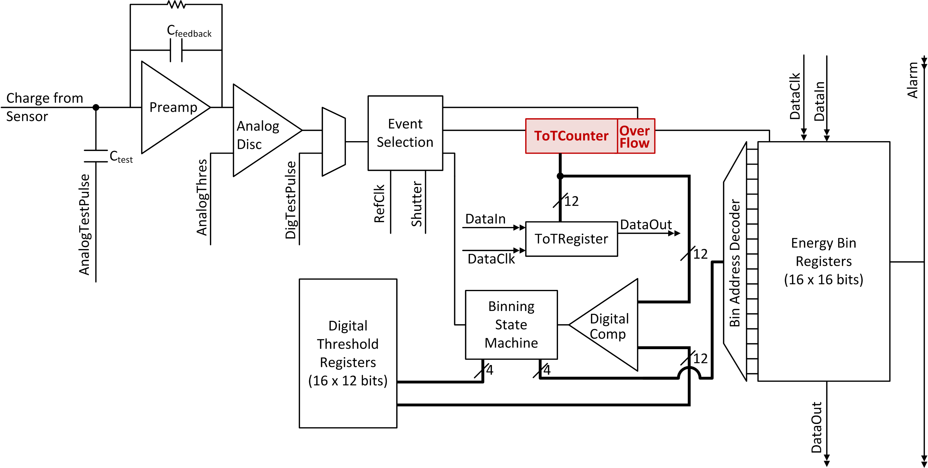
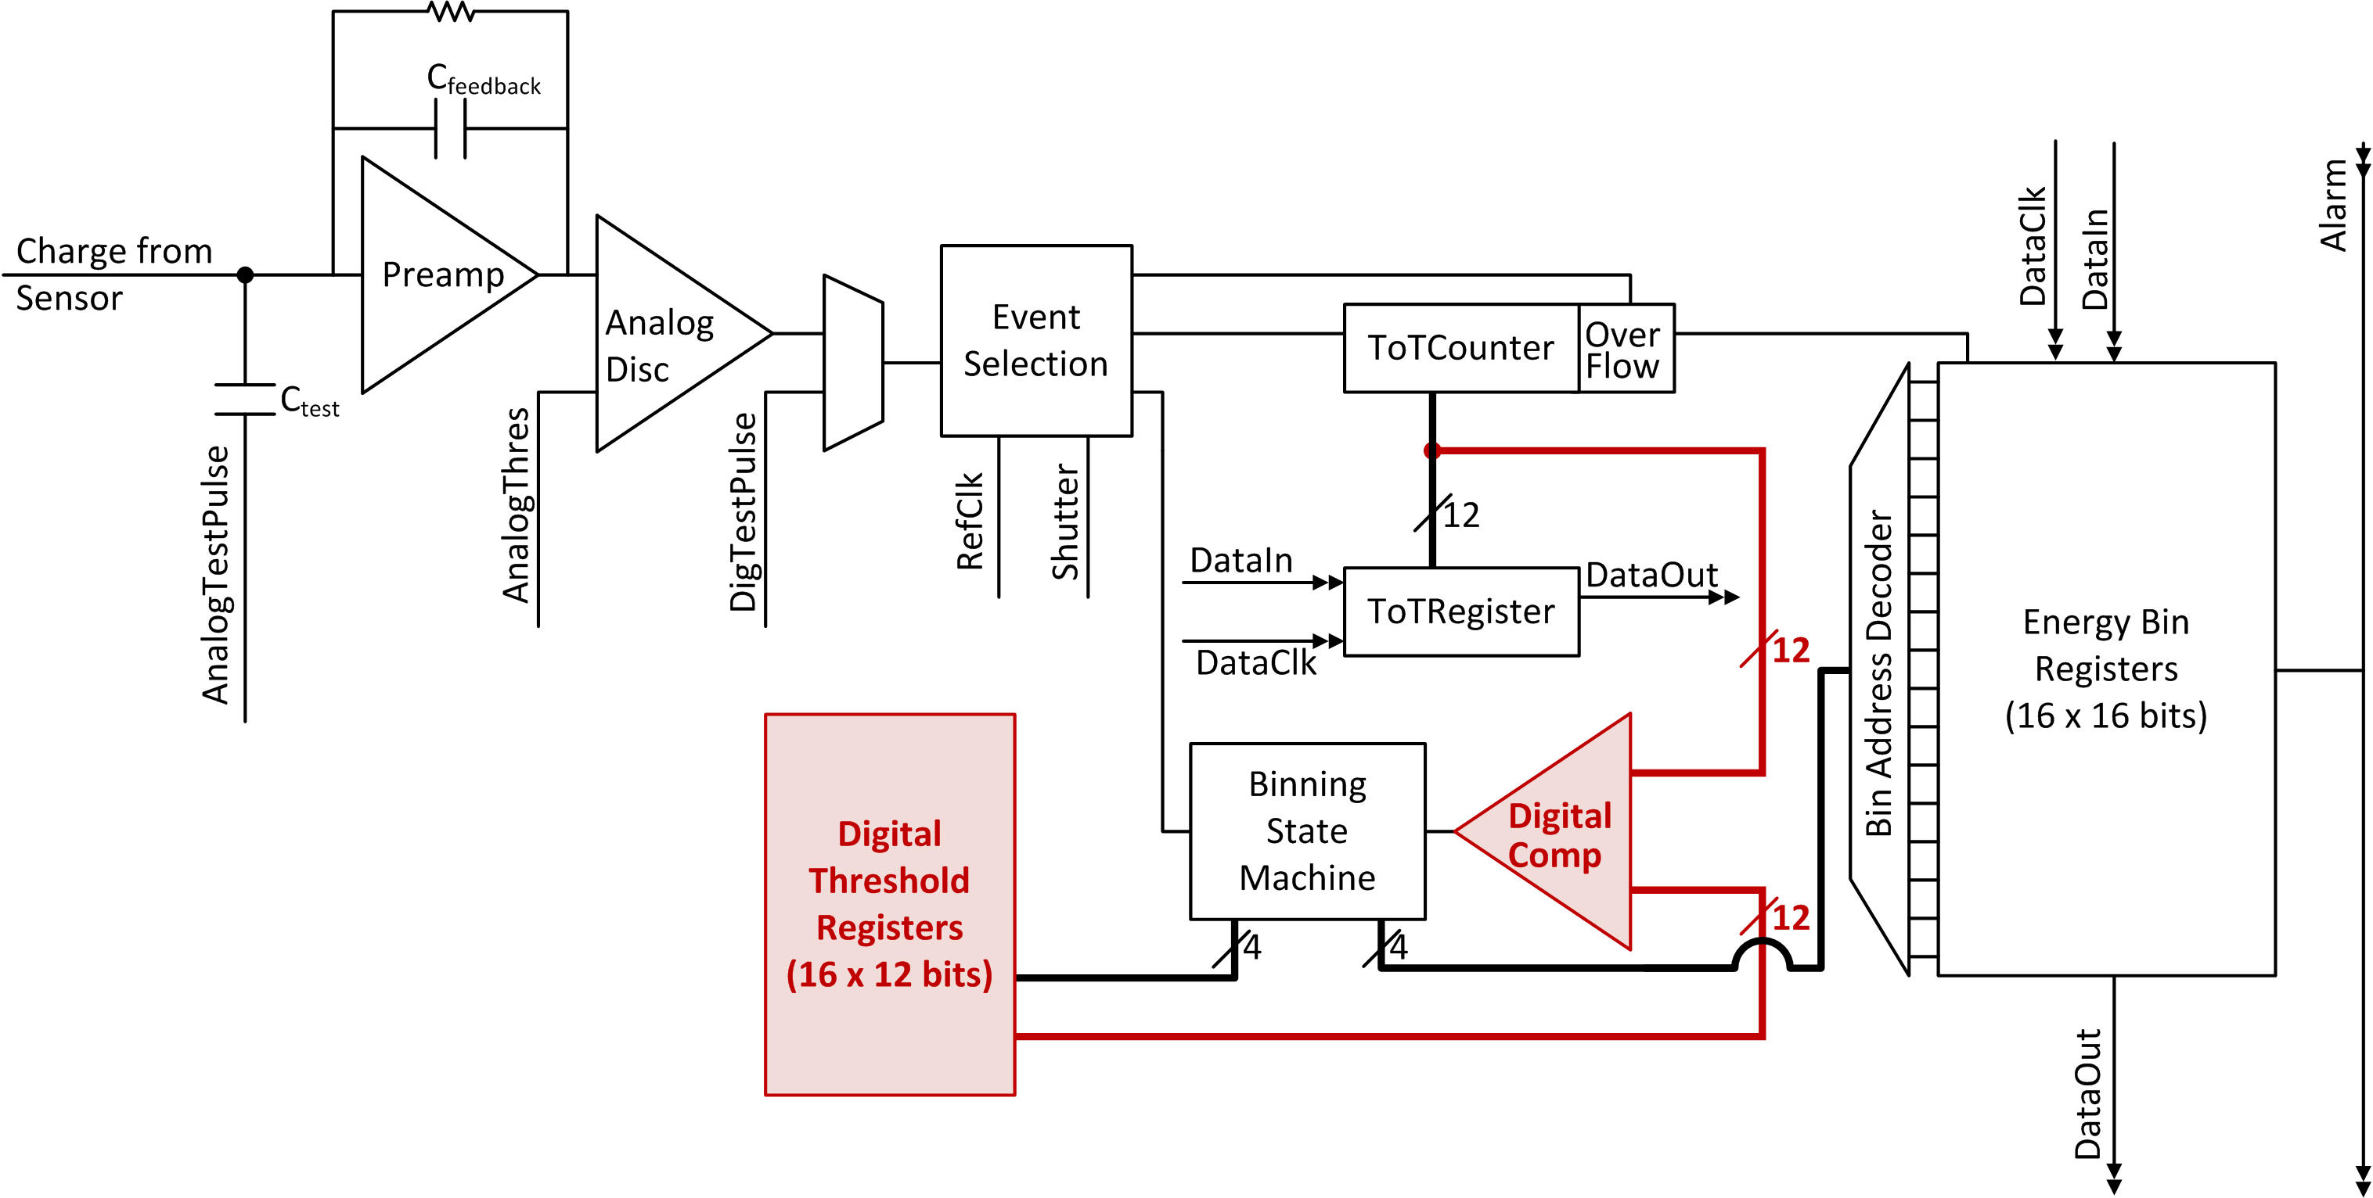
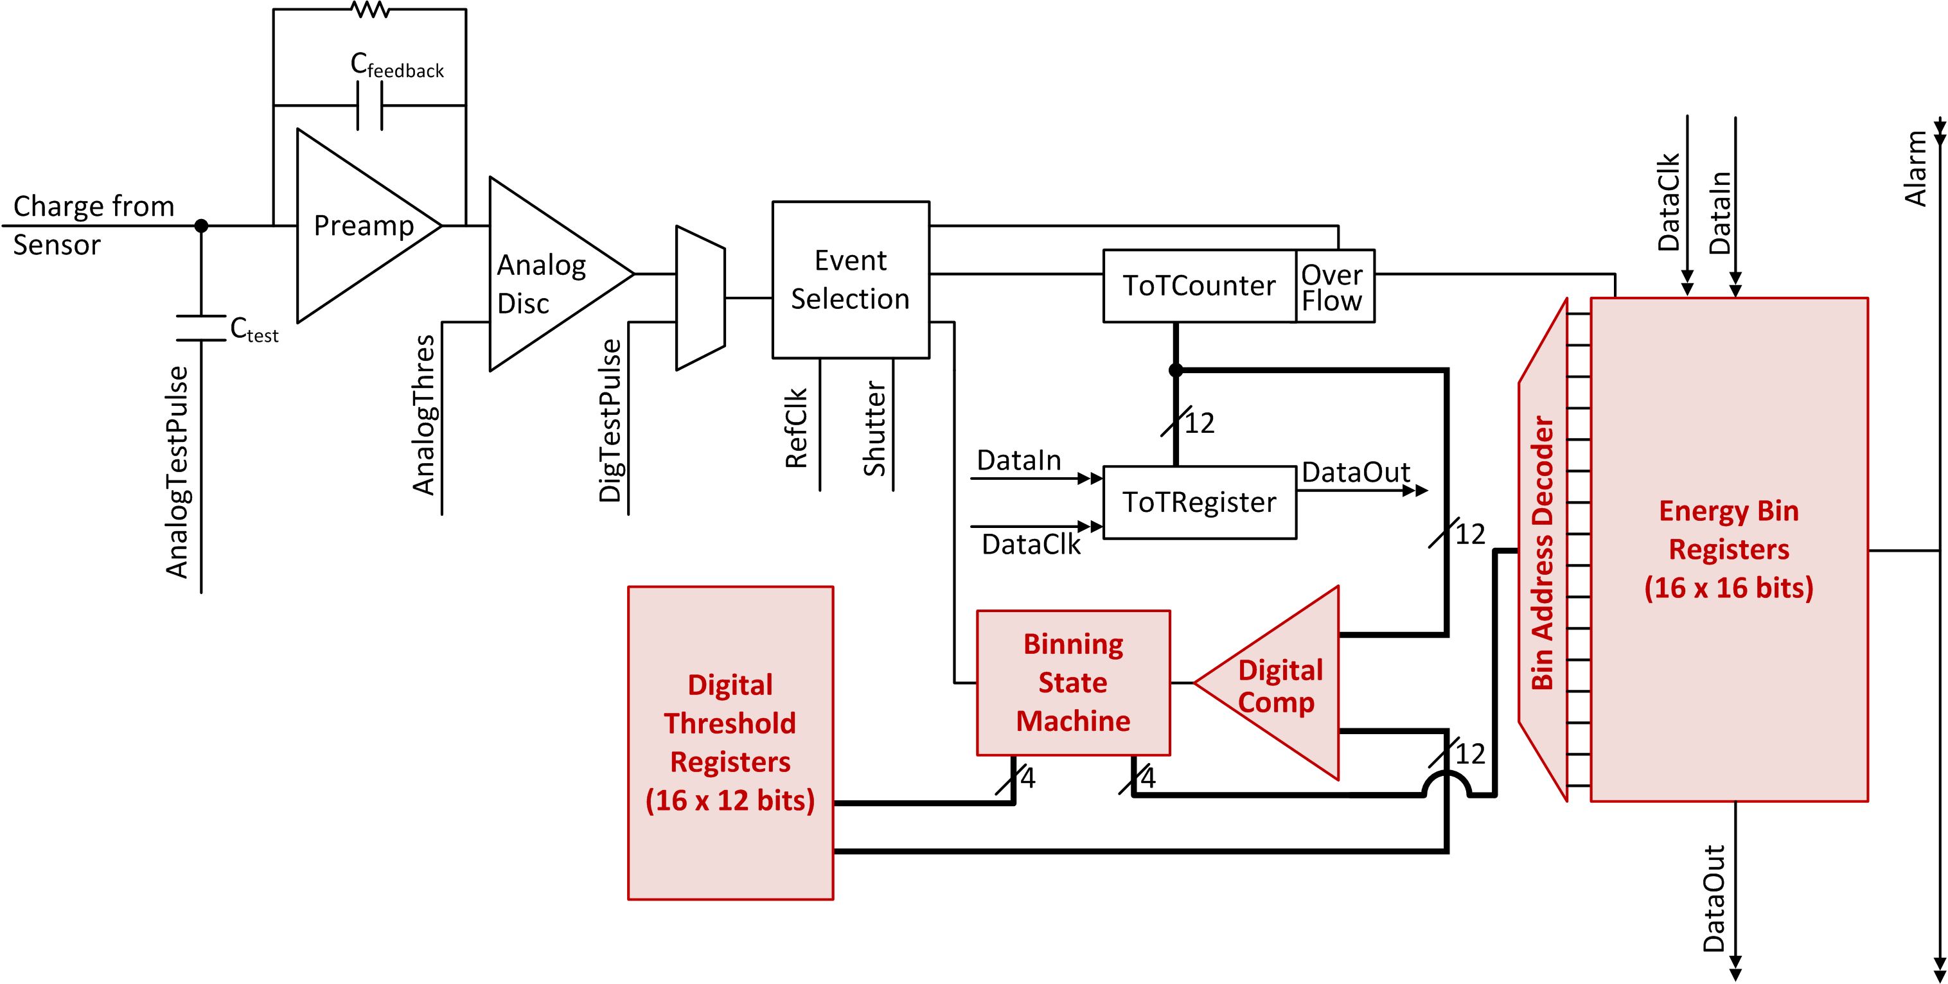
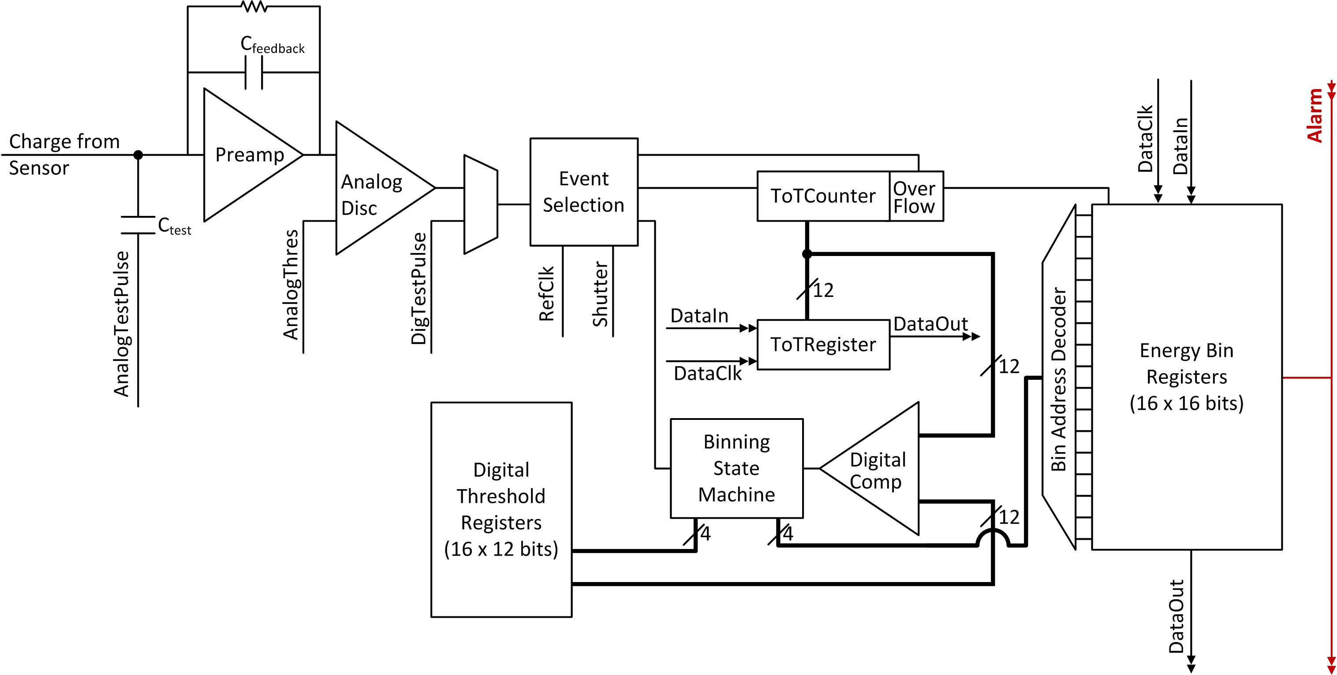
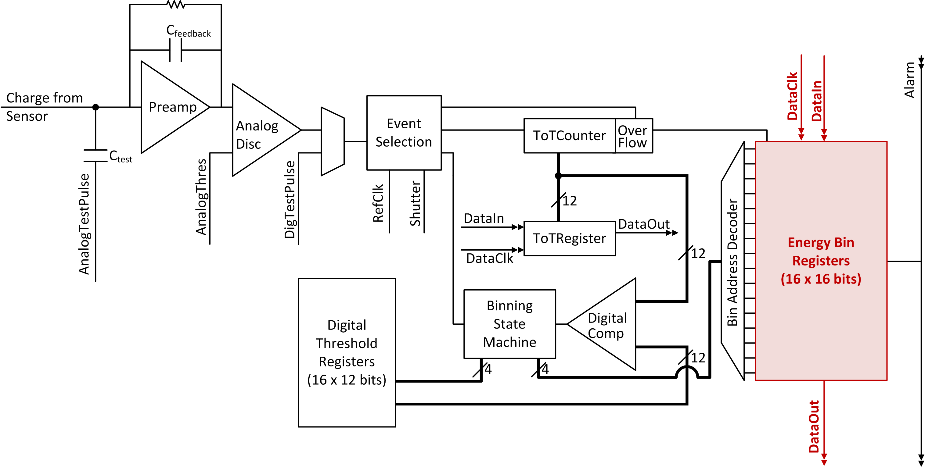
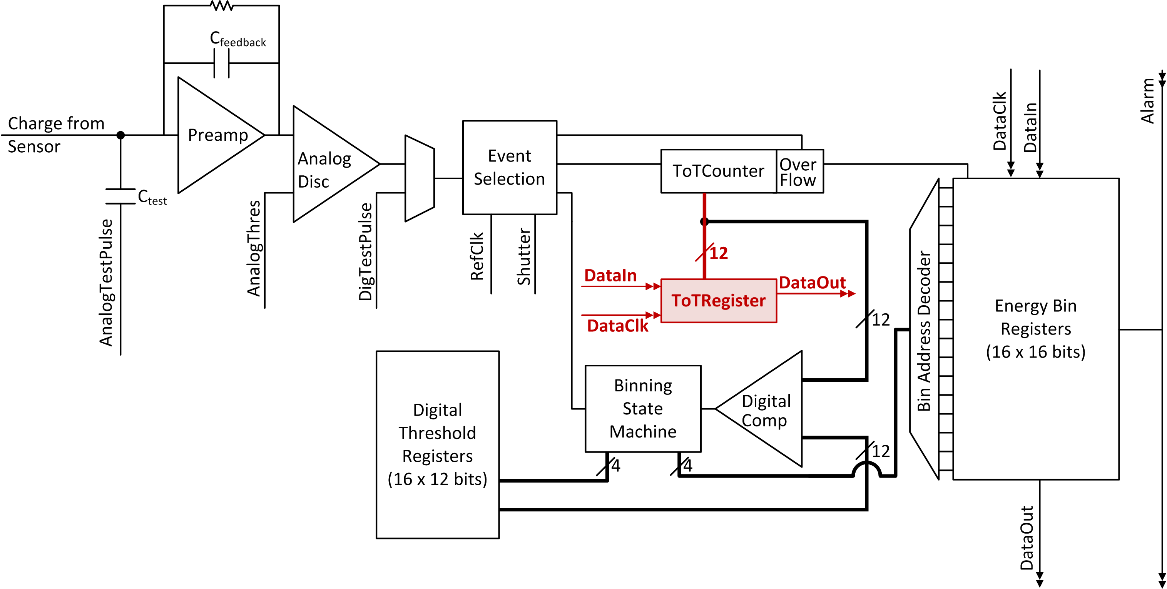
Pixel Block Diagram
W. Wong, PhD Thesis, 2012

Slide 10
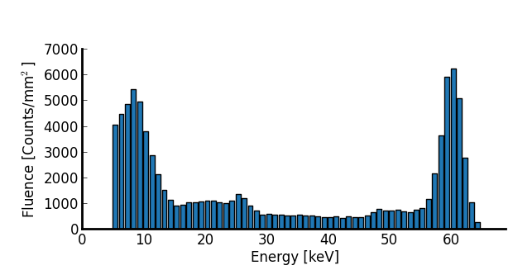
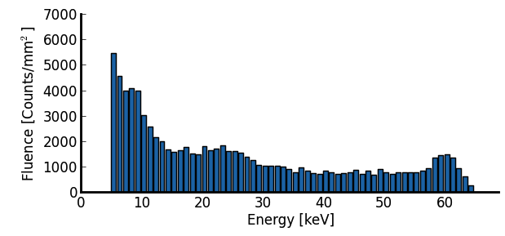
Spectral Response
Spectrum of gamma emissions from an Am²⁴¹ source, filtered to block alphas
Cu
fluorescence
(8 keV)
Am²⁴¹ γ
(26.4 keV, 59.5 keV)
60 bins programmed from 5 – 64 keV
(1 keV per bin)
220 μm
Pixels
55 μm
Pixels
Notes:
Assembly29, 120 files, 60 seconds each
Tradeoff between the two pixel sizes: large pixels have less charge sharing, small pixels see lower fluxes

Slide 11
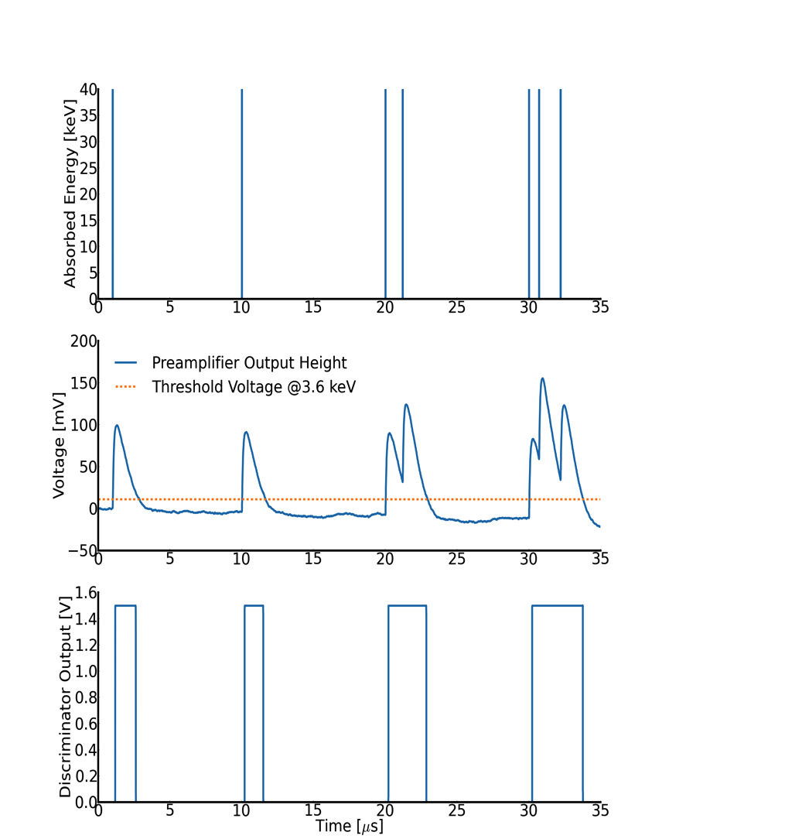
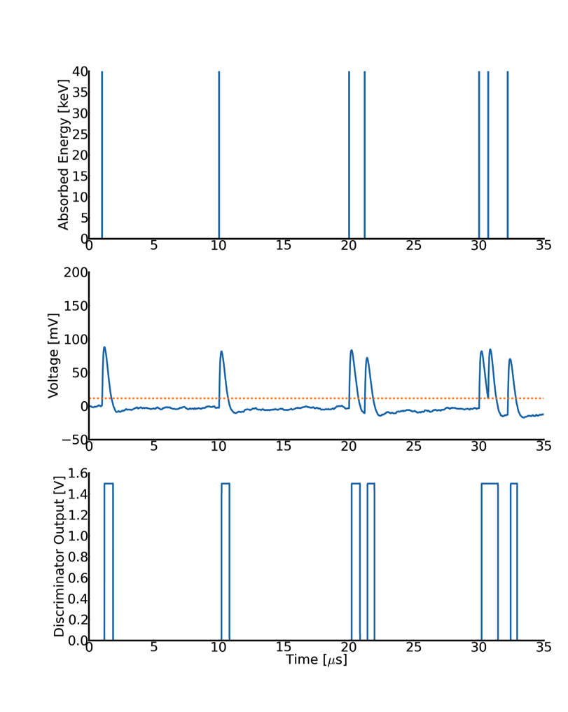
Pileup
Reset current = 2.5 nA
Reset current = 7.4 nA
Pileup
Notes:
15.38 15.38
1.21 -0.27
11.72 13.3
1.27 4.05
13.32 4.05

Slide 12
Characterised Response
 |  | Energy Resolution, FWHM (220 μm pixels) |  |  | Maximum Linear Count Rate (220 μm pixels)
Reset Current | Minimum Threshold | @ 8.5 keV | @ 20 keV | @ 40 keV | @ 30 keV | @ 40 keV
2.6 nA | 3.54 keV | 1.43 keV (16.8%) | 2.81 keV (14%) | 3.18 keV (8%) | 1.69 Mcounts/s/mm² | 1.67* Mcounts/s/mm²
7.4 nA | 4.27 keV | 2.17 keV (25.5%) | 2.91 keV (14.5%) | 3.79 keV (9.5%) | 4.11 Mcounts/s/mm² | 3.57 Mcounts/s/mm²
*Note: Pileup starts well below the maximum linear count rate (at approx. 10⁵ counts/s/mm²) and will distort spectrum measurements.
E. Frojdh et al., NIMA 2015
Power Consumption = 15 mW to process 10⁵ counts/s/mm²
under nominal chip settings

Slide 13
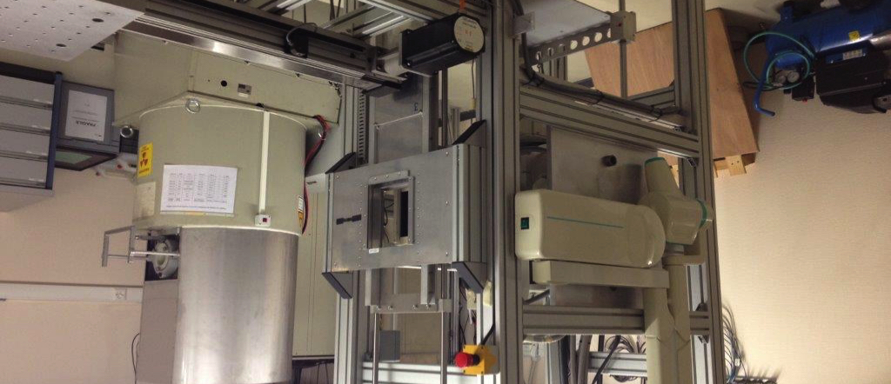
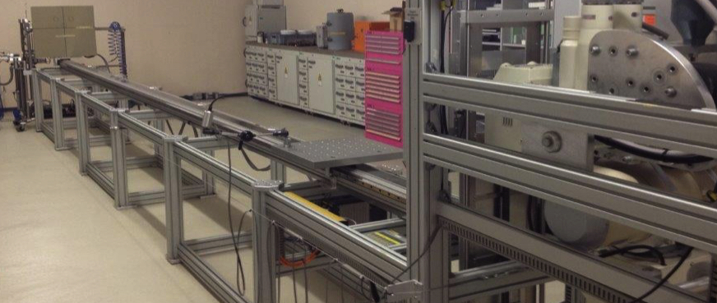
RQR Measurement Setup
Toshiba KXO-80G
X-ray generator with a tungsten anode
Dosepix location, perpendicular to and centred on the beam
5 m
RX Toshiba KX0-80G at Institute for Radiation Physics, University Hospital of Vaud

Slide 14
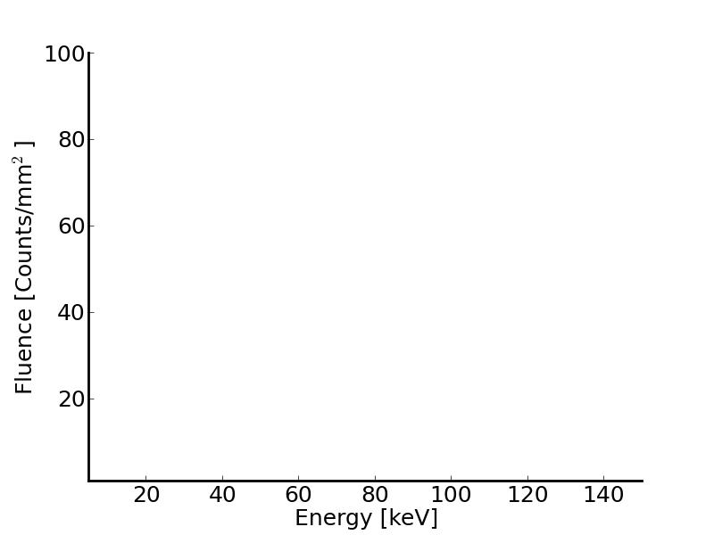
Background Measurement
No beam, no hits (“noise free”)
60 bins programmed from
5 – 150 keV

Slide 15
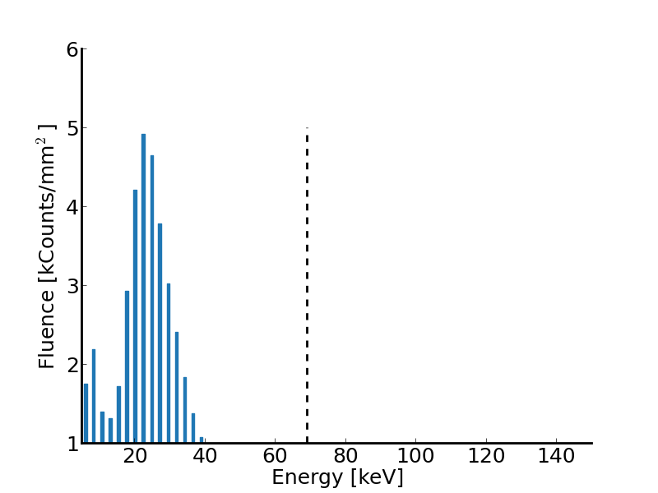
Primary Beam Spectrum
RQR-5*, 10 mA @ 2s
1 “frame” of data in the 220 μm pixels
60 bins programmed from
5 – 150 keV
kVp
*Reference Radiation Qualities, IEC 61267

Slide 16
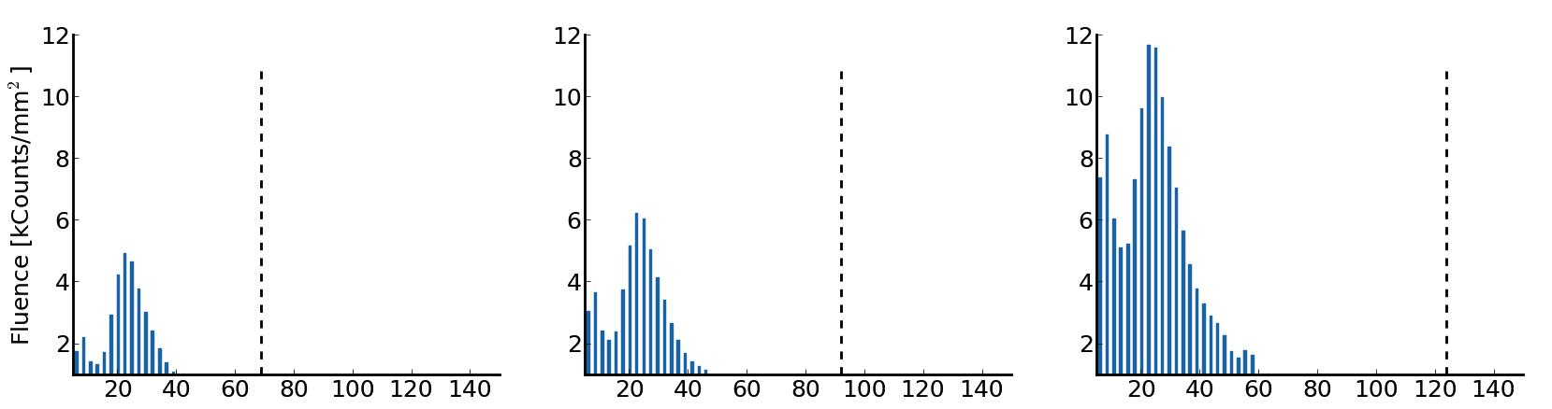
Primary Beam Spectra
10 mA @ 2s
1 “frame” of data in the 220 μm pixels
RQR-5
RQR-7
RQR-9
E_{mean}=25.0 keV
E_{mean}=26.2 keV
E_{mean}=27.4 keV
Characteristic X-rays?
Notes:
Mean and Max energy is already useful information for radiation protection officers designing appropriate shielding. This information would be unavailable in passive dosimeters or even active dosimeters if what they measure is integrated energy deposition rather than fluence per energy

Slide 17
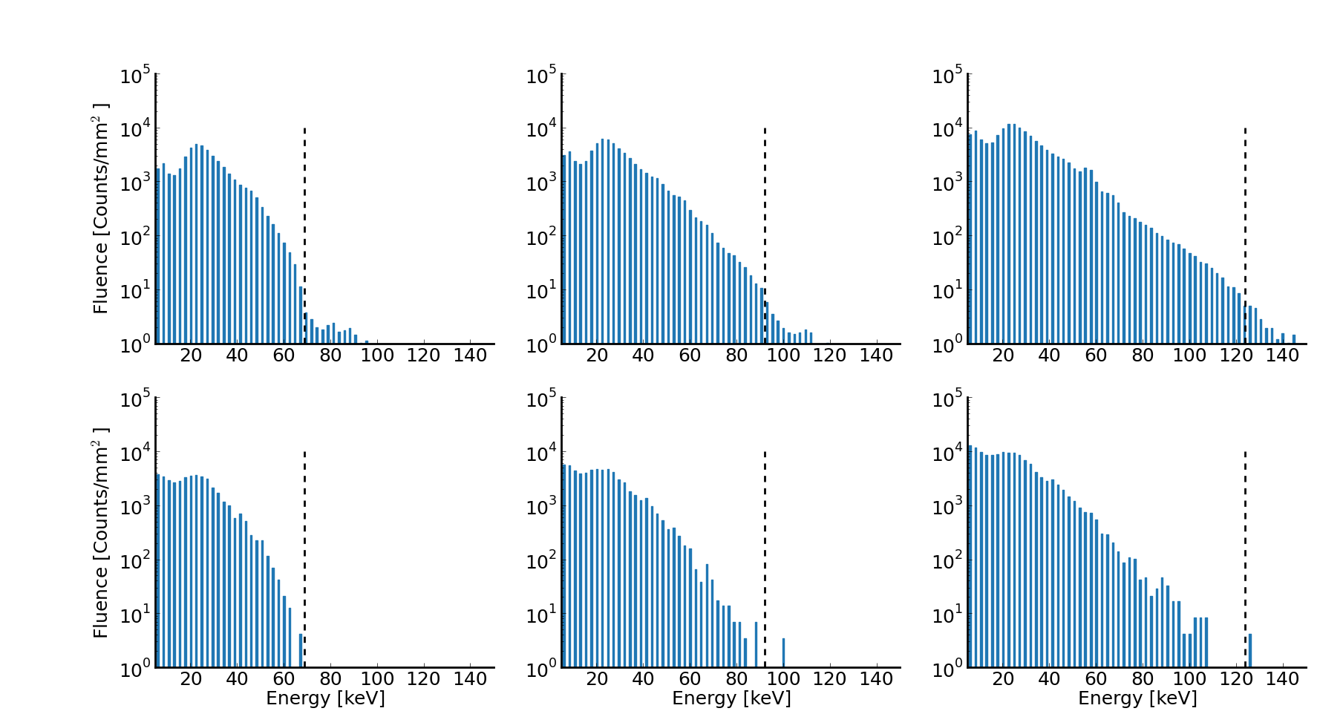
Primary Beam Spectra
10 mA @ 2s
Log
RQR-5
RQR-7
RQR-9
E_{mean}=25.0 keV
E_{mean}=26.2 keV
E_{mean}=27.4 keV
E_{max} =127 keV
E_{max} =150 keV
E_{max} =150 keV
21.2 kHits/s/mm²
31.0 kHits/s/mm²
67.5 kHits/s/mm²
220 μm pixels
Pileup of 28 counts (0.066%)
Pileup of 27 counts (0.040%)
Pileup of 21 counts (0.016%)
E_{mean}=20.9 keV
E_{mean}=21.8 keV
E_{mean}=22.6 keV
E_{max} =68 keV
E_{max} =101 keV
E_{max} =127 keV
20.7 kHits/s/mm²
30.7 kHits/s/mm²
67.4 kHits/s/mm²
55 μm pixels
Pileup of 0 counts
(0%)
Pileup of 3 counts (0.006%)
Pileup of 4 counts
(0.003%)

Slide 18
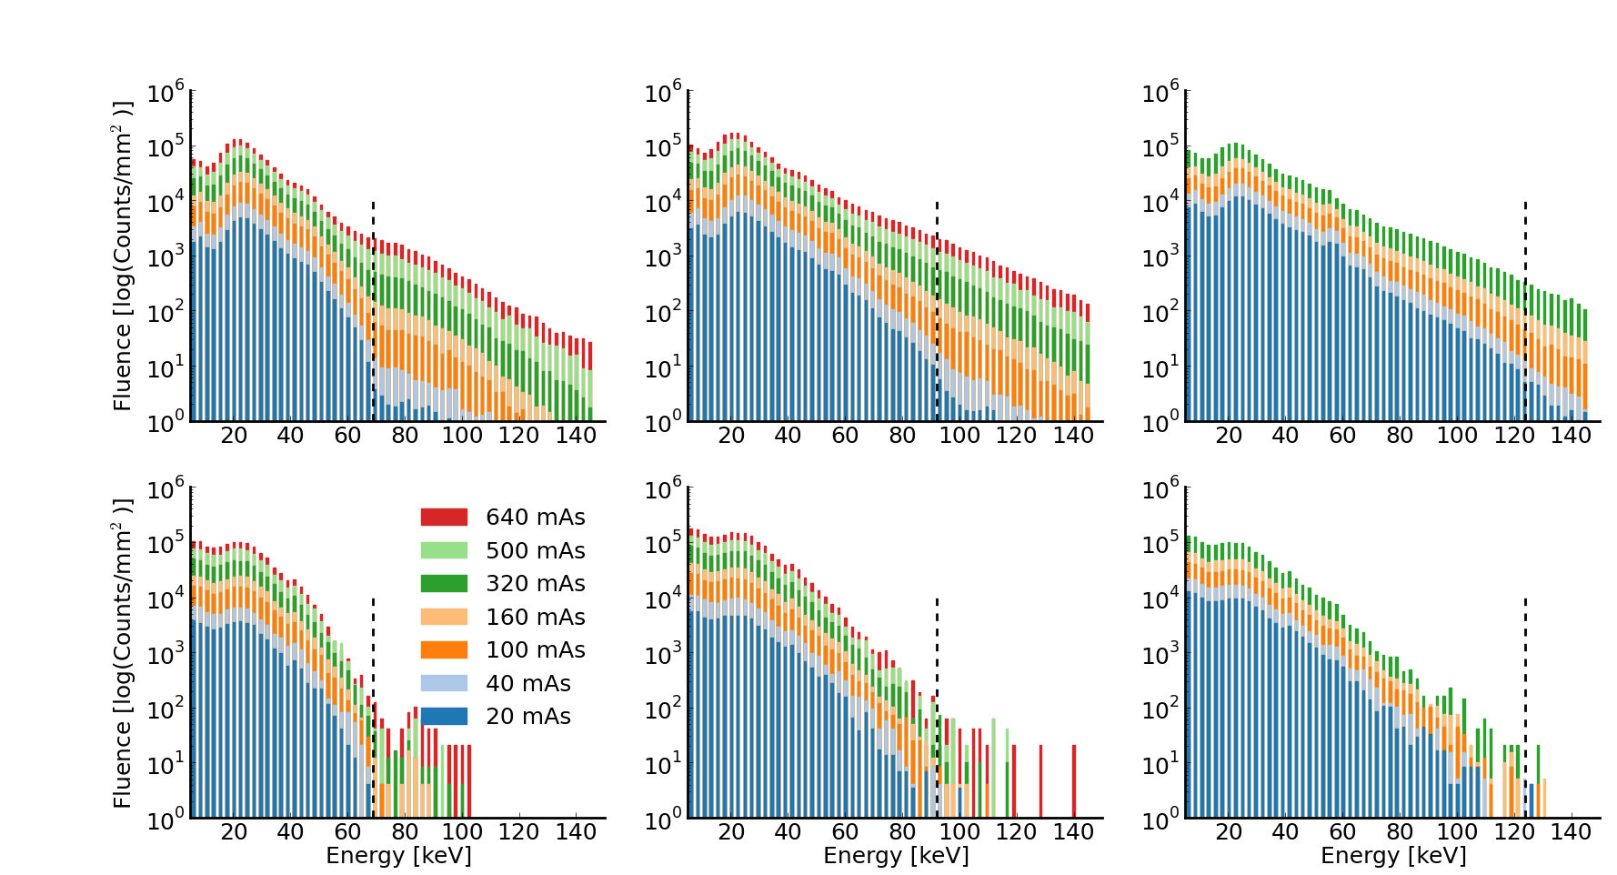
Primary Beam Spectra for Increasing mAs
Log
RQR-5
RQR-7
RQR-9
220 μm pixels
55 μm pixels

Slide 19
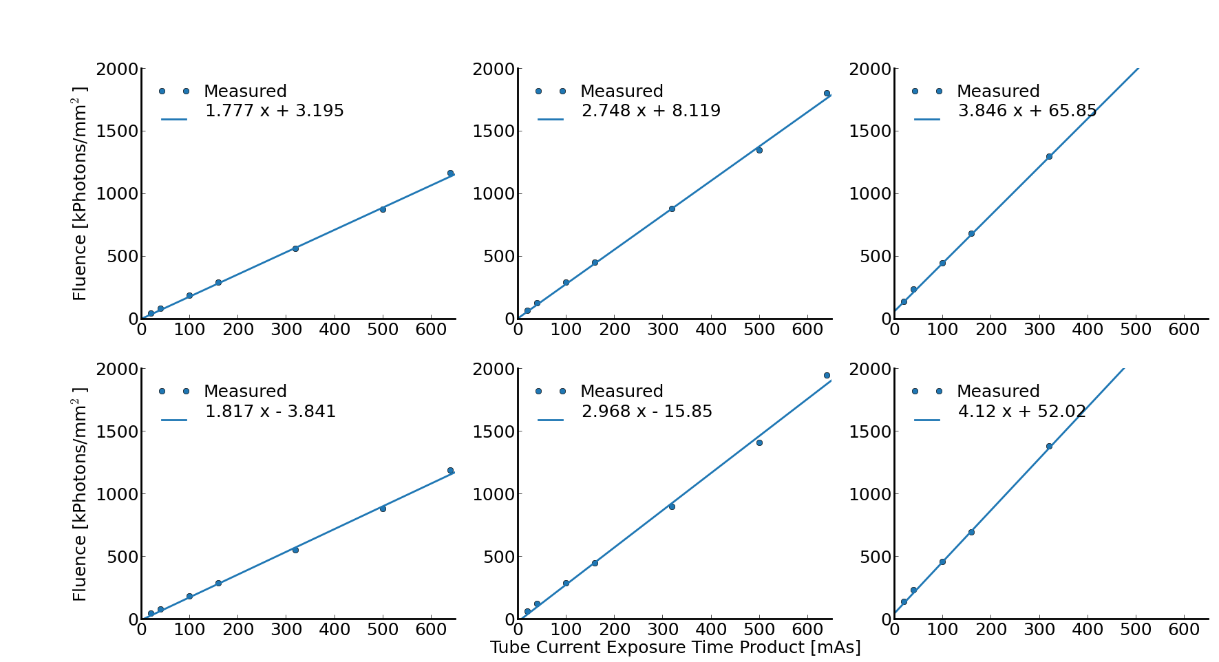
Primary Beam Fluence for Increasing mAs
RQR-5
RQR-7
RQR-9
220 μm pixels
55 μm pixels

Slide 20
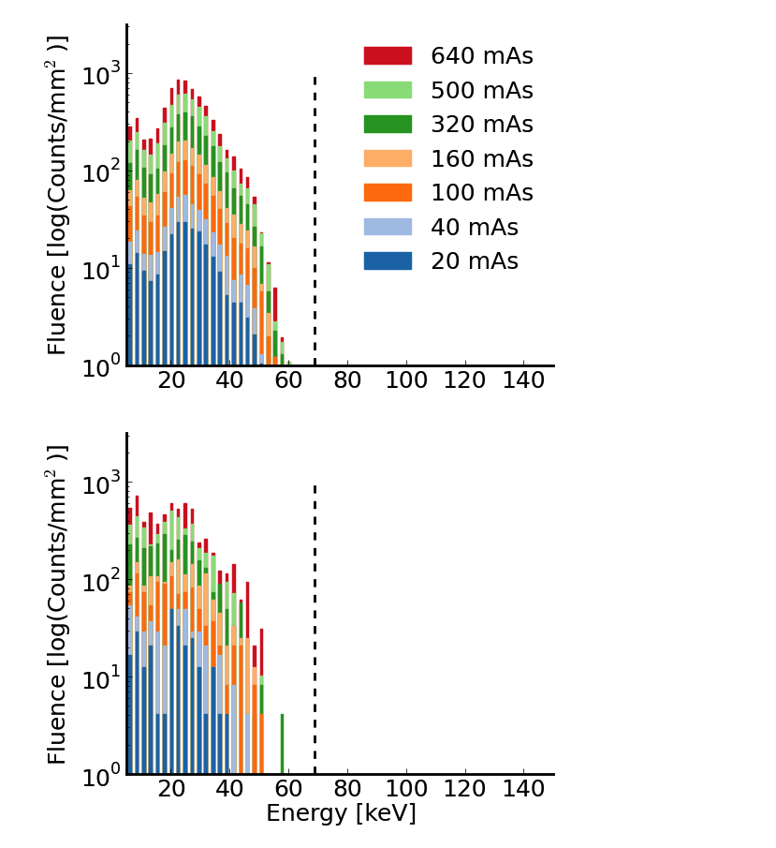
Scatter Radiation Measurements
Log
RQR-5
220 μm
Pixels
55 μm
Pixels

Slide 21
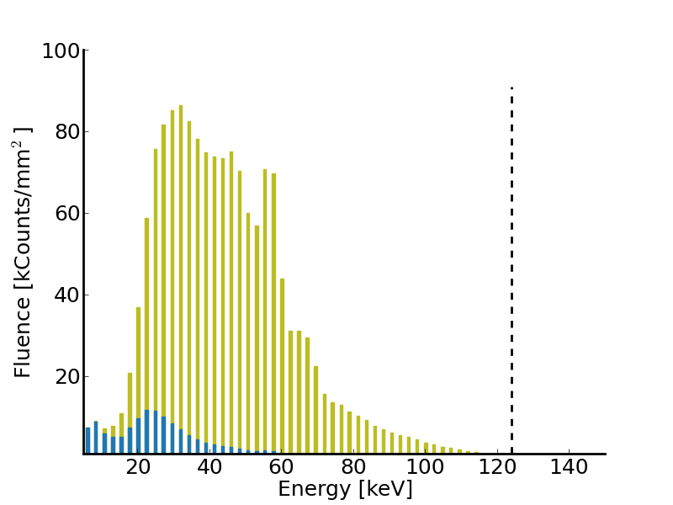

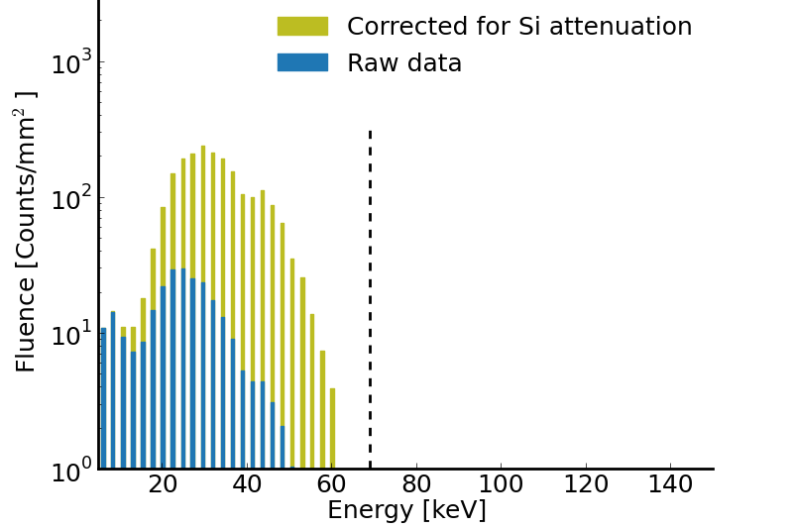

Scatter Radiation Measurements
Log
RQR-5
On-going work:
Correct for Si absorption efficiency
Develop spectrum reconstruction
  Study impact of charge sharing, Compton Scattering, etc.
Calculate air kerma
Characterise scatter radiation in CT scan
220 μm
Pixels
RQR-9 Primary Beam
in the 220 μm pixels
20 mAs
Scatter Radiation
in the 220 μm pixels
20 mAs
Linear
55 μm
Pixels
E_{mean, raw} = 27.4 keV
E_{mean, corrected}= 45.1 keV
Characteristic X-rays?

Slide 22
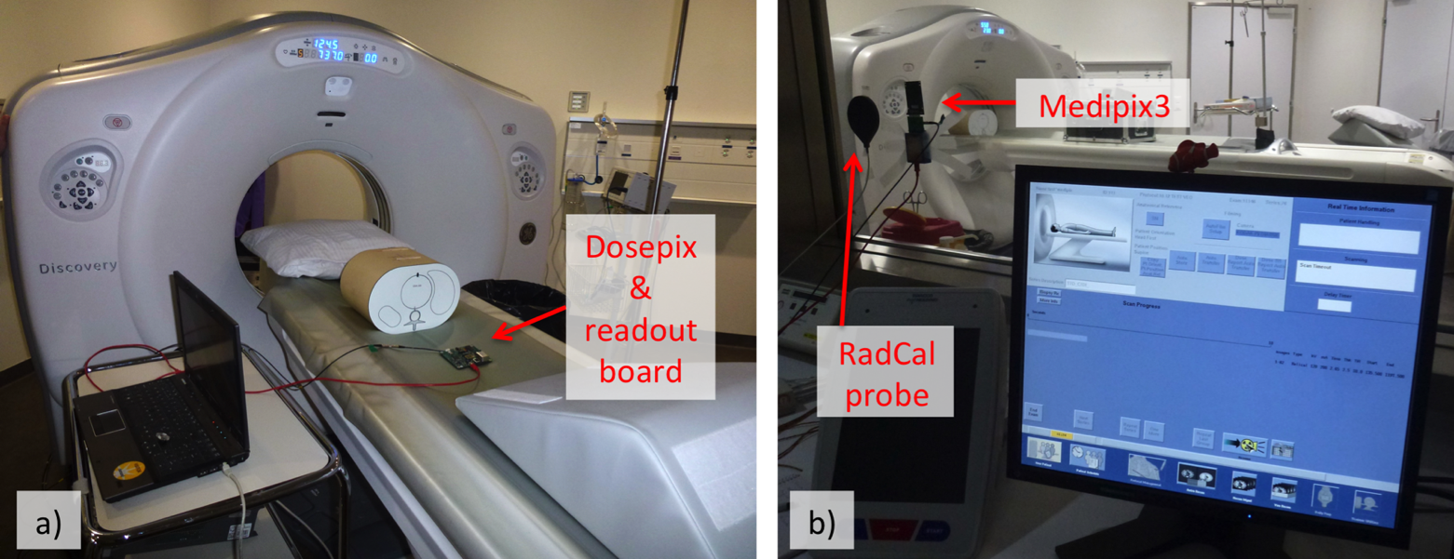
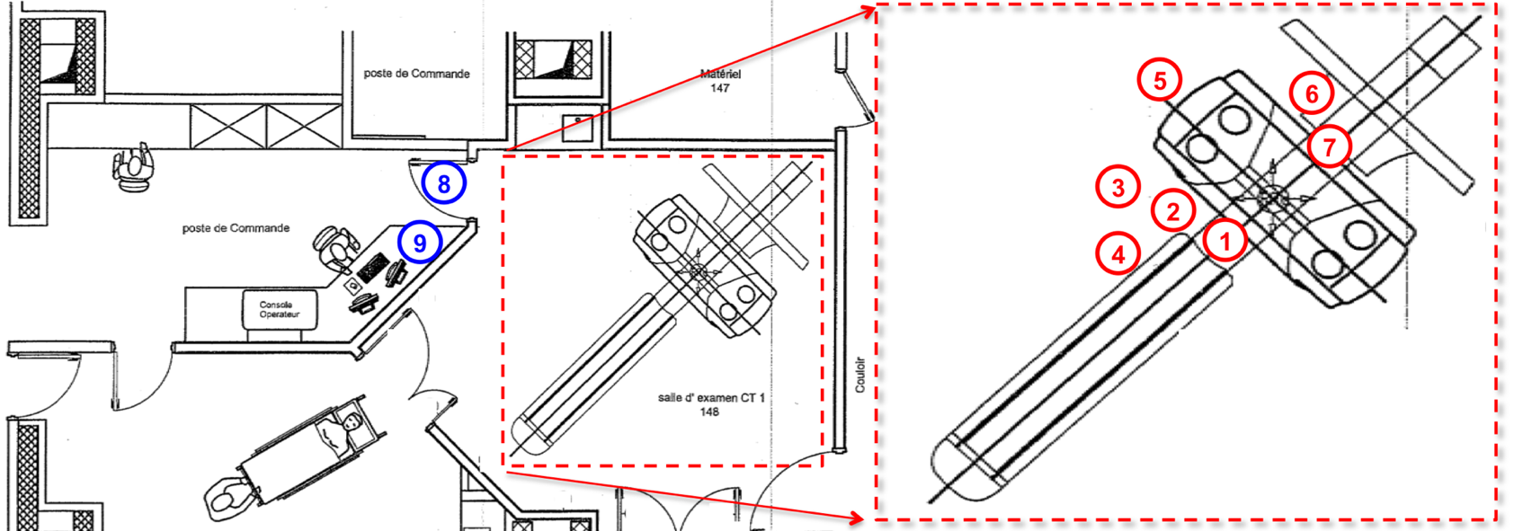
Scatter Radiation in CT Scan
Patient imaging facility, University Hospital of Vaud

Slide 23
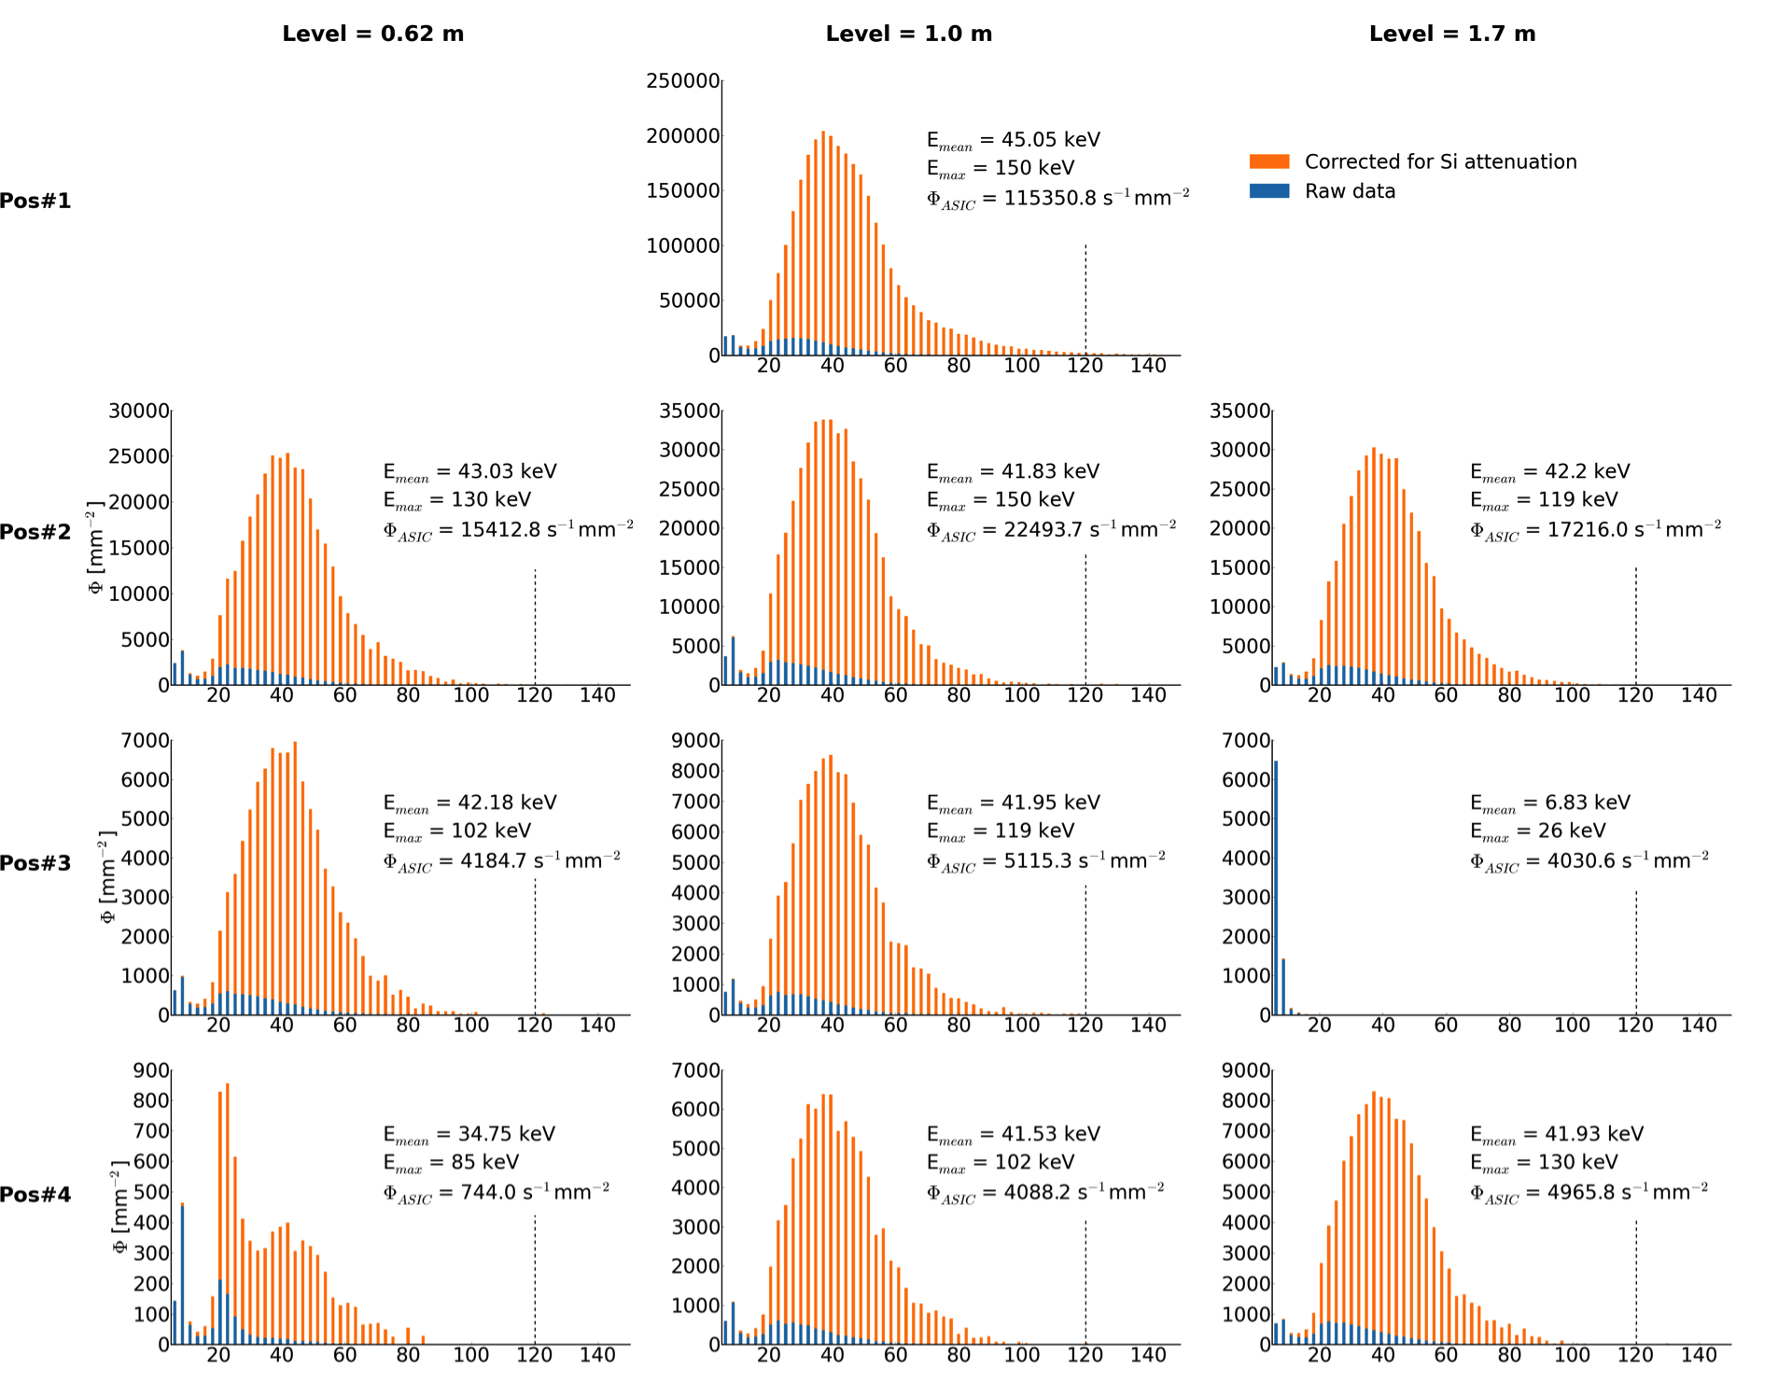
Scatter radiation spectra during scan of a QRM anthropomorphic thorax phantom:120 kVp, 200 mA

Slide 24
Summary
Hybrid pixel detectors permit choice of appropriate sensor material
Absorbed energy can be measured by:
  Pulse Height
  Time over Threshold (ToT)
Our detectors measure fluence at a given energy
  Dosimetric endpoints can be calculated offline with energy dependent conversion factors
  Raw fluence data remains available for future calculations or definitions

Slide 25
Extra slides

Slide 26
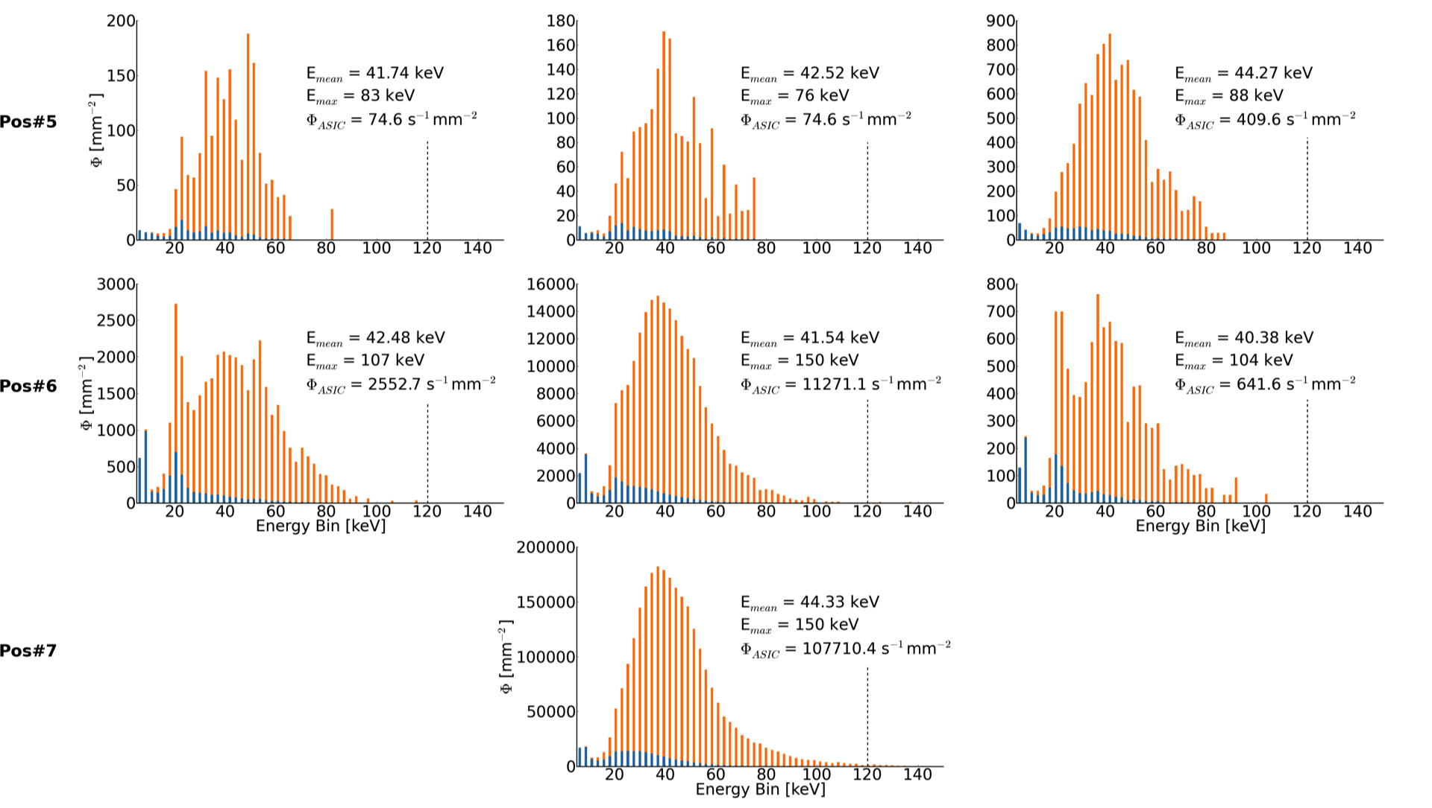
Scatter radiation spectra during scan of a QRM anthropomorphic thorax phantom:120 kVp, 200 mA
Eurados WG9 Meeting, CERN, 17.10.2016
winnie.wong ‘at’ cern.ch

Slide 27
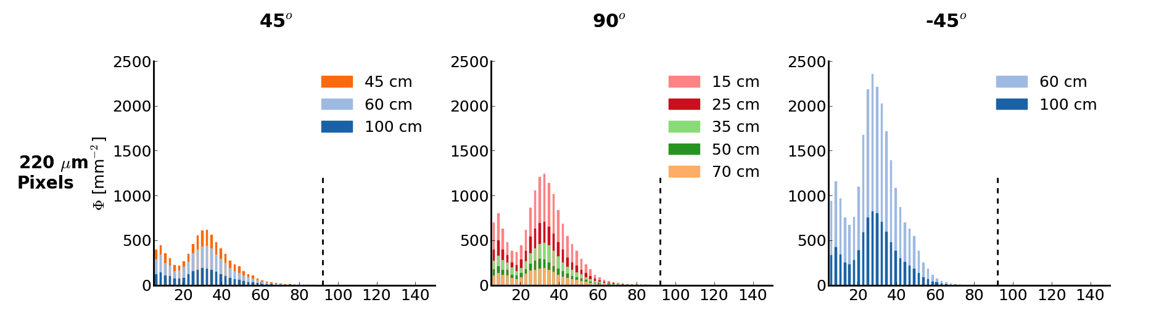
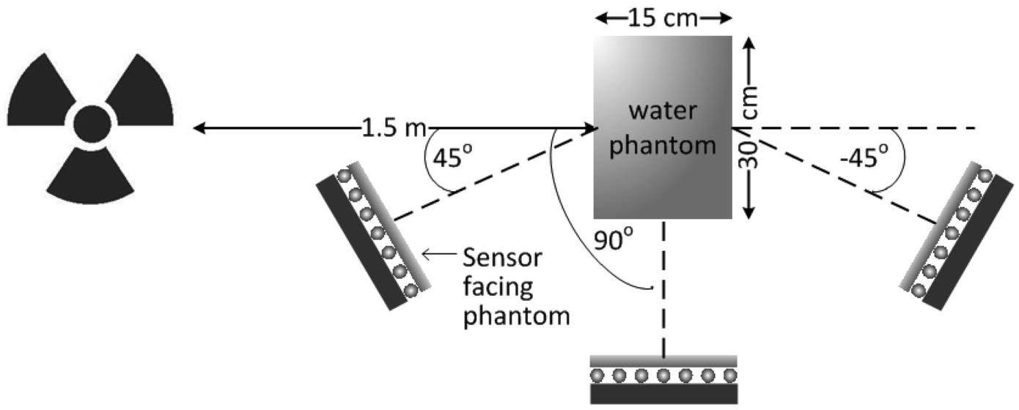

Slide 28
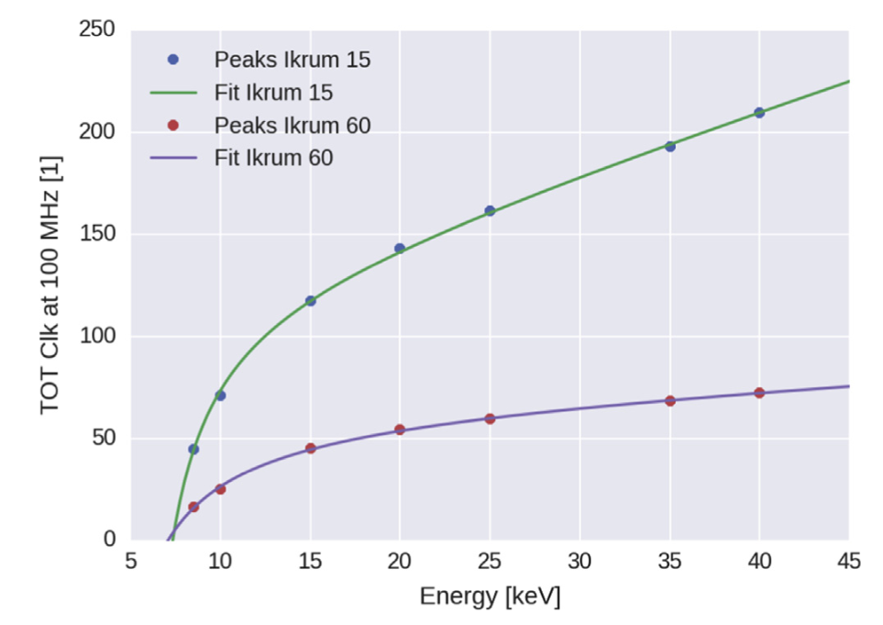
Energy Calibration
Characterisation with monochromatic synchrotron radiation at ANKA Synchrotron
ToT relationship with photon energy for two programmable reset currents
I_{krum}: preamplifier reset current
IKRUM 15 = 2.5 nA
IKRUM 60 = 7.4 nA
E. Frojdh et al., NIMA 2015
Notes:
What causes the two slopes

Slide 29
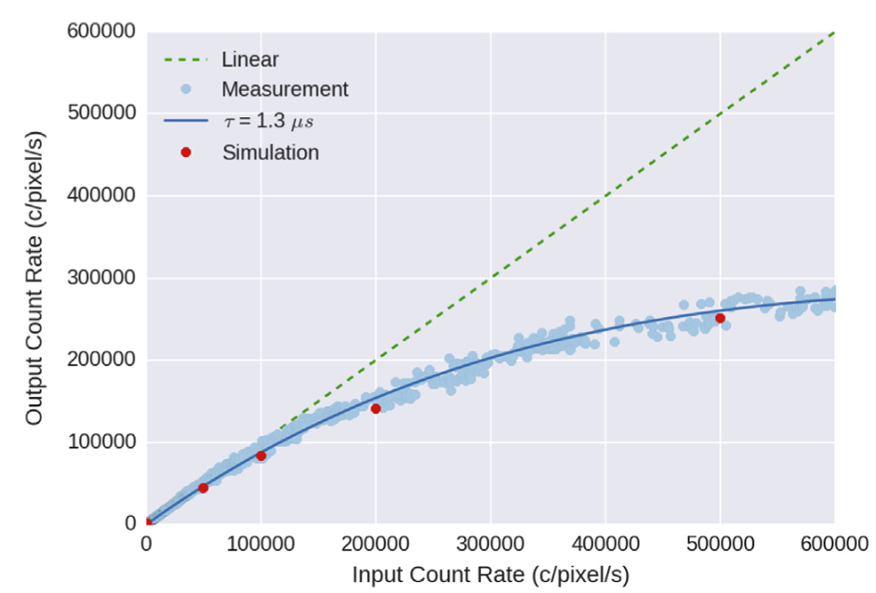
Count Rate
Measurements with 40 keV monochromatic synchrotron radiation at ANKA Synchrotron
Measured
with 2.6 nA reset current (IKRUM=15),
in 220 μm pixels
E. Frojdh et al., NIMA 2015

Slide 30
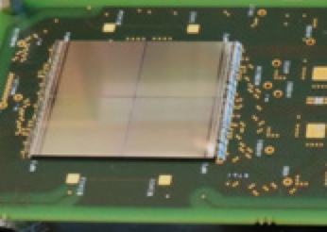
Medipix3
Main application: X-ray imaging
Developed by: Medipix3 Collaboration
ASIC:
  1.4 cm x 1.4 cm active area (can be tiled for more area)
  Configurable pixel size
      55x55 μm² (65k pixels)
      110x110 μm² (16k pixels)
  2-8 thresholds depending on mode
  (programmable)
  6, 12, or 24-bit photon counting: intensity
  Charge summing mode
Sensor:
  300 μm Si, 2 mm CdTe, etc.
1.4 cm
1.4 cm
2 x 2 tiles of Medipix3 detectors
Photo source: diamond.ac.uk

Slide 31
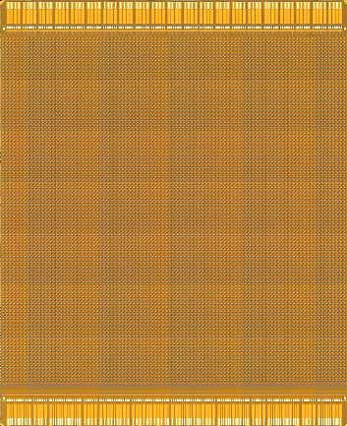

Photon Spectroscopy with the
Photon Counting Medipix3
Single Pixel Mode (SPM)
Notes:
Charge sharing due to diffusion

Slide 32
Photon Spectroscopy with the
Photon Counting Medipix3
Single Pixel Mode (SPM)

Slide 33
Photon Spectroscopy with the
Photon Counting Medipix3
Charge Summing Mode (CSM)

Slide 34
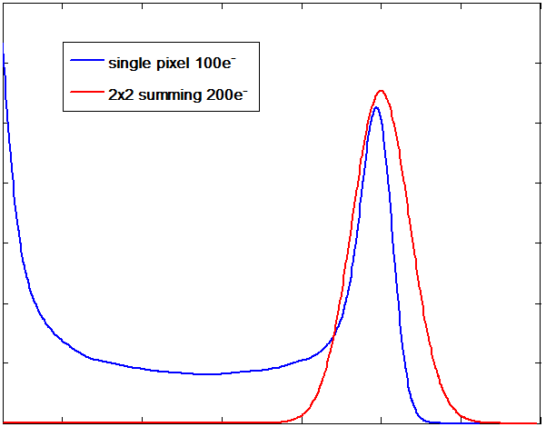
Photon Spectroscopy with the
Photon Counting Medipix3
Simulation of spectroscopy with monochromatic
10 keV beam
L. Tlustos, PhD Thesis, 2005

Slide 35
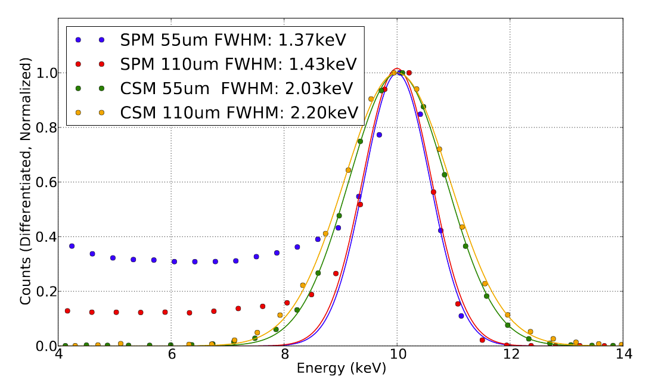
Photon Spectroscopy with Medipix3 & Si
SPM: Single Pixel Mode
CSM: Charge summing mode
ASIC: Medipix3RX
Sensor: 300 μm Si
Threshold scans
E. Frojdh et al. JINST 2014

Slide 36

Timepix
Main application: particle tracking
Developed by: Medipix2 Collaboration
ASIC:
  65k square pixels, 55 μm pitch
    1 threshold (programmable)
    14-bit Time over Threshold (ToT): energy
    14-bit Time of Arrival (ToA): time
Sensor:
  300 μm Si, 2 mm CdTe, etc.
  Micro-channel plate,
  gain gas grid, etc.
Photo source: J. Jacubek

Slide 37






Mixed Field Dosimetry with Timepix
⁵⁵Fe (γ)
⁹⁰Sr (β)
²⁴¹Am (α,γ)
5.8 keV gammas
0.5 MeV betas
5.5 MeV alphas,
59.5 keV gammas
α
γ
Notes:
Energy of Fe55 gamma=5.8 keV

Slide 38






Mixed Field Dosimetry with Timepix
⁵⁵Fe (γ)
⁹⁰Sr (β)
²⁴¹Am (α,γ)

Slide 39






Mixed Field Dosimetry with Timepix
¹⁰⁹Cd (γ)
⁹⁰Sr (β)
²⁴¹Am (α,γ)
Notes:
Can also get directional information from time of arrival

Slide 40




Heavy Ion Dosimetry with Timepix
0º
60º
90º
180 MeV/A Ne
¹¹B
¹¹B
600 MeV/A Si
L. Pinsky et al., Proc IEEE Aerospace Conf, 2007
δ

Slide 41


Space Dosimetry with Timepix
Photo source: NASA

Slide 42



Space Dosimetry with Timepix
(Timepix) REM on ISS
For each track:
Estimate species by footprint
Calculate dE/dx, angle of incidence, path length, etc.
Calculate dose in silicon
Convert to dose in water
Intra-vehicular
TPEC
ISS TPEC
Pinsky et al., Presentation at VCI 2016, Vienna
Stoffle et al., NIMA, 2015
Kroupa et al., Life Sciences, 2015
Notes:
Exposure times are dynamic, aiming for 4% occupancy. This example SAA frame had an exposure time of 0.9s

