Slide 1
3D Energy Deposition Measurements in Hadron Therapy with GEMPix
Johannes Leidner, Fabrizio Murtas, Marco Silari

Slide 2
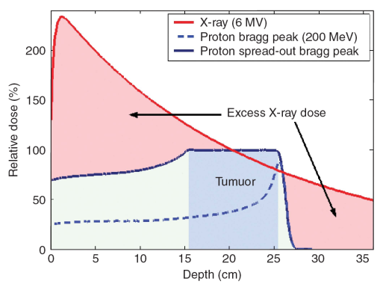
Introduction: Radiation Therapy
Cancer therapy:
  Surgery
  Chemotherapy
  Radiation therapy
    X-rays
    Proton- / Hadrontherapy
Need for quality assurance tools, beam monitors, …
Typical system: water phantom + ion chamber
New detectors needed for Proton- / Hadrontherapy!
Beam
Bragg Peak
→ GEMPix in water phantom

Slide 3
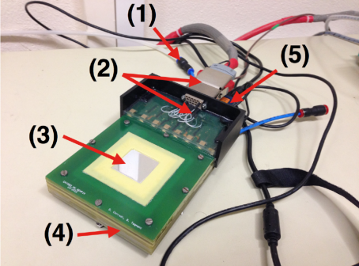
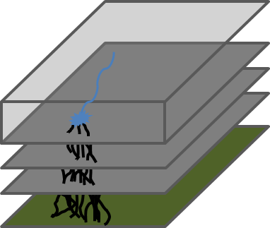
The GEMPix Detector
GEMPix: 3 GEMs + Timepix
9 cm³ Ar:CO₂:CF₄
Several applications of the GEMPix: Hadrontherapy, Microdosimetry, Radiotherapy, Radioactive waste, …
Gas detection
GEM1
GEM2
GEM3
Read-out
Gas supply
HV supply
Mylar entrance window
GEM foils
FITPix readout

Slide 4
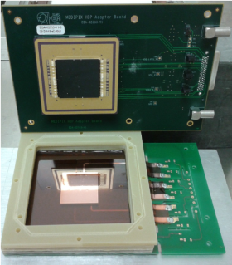
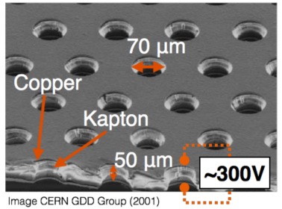
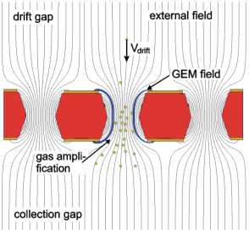
GEMPix: GEMs + Timepix
3 GEMs:
Kapton foil with thin copper layers
Gas amplification in holes (large field)
Total gain of max 10⁵
4 Timepix chips:
512 x 512 pixels
each 55µm x 55 µm
detection threshold per pixel of 1000 electrons

Slide 5
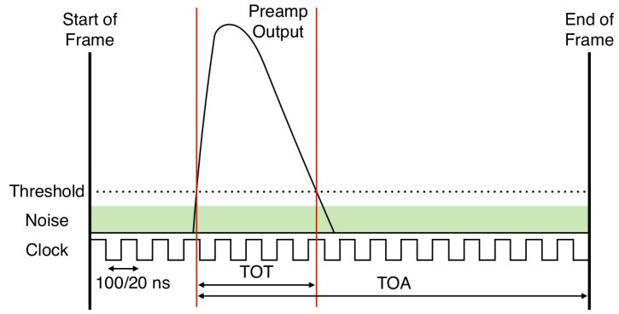
Timepix: Time and Charge Measurements
Different modes possible:
  Pulse counting
  Time of Arrival (TOA) → 3D track reconstruction
  Time over Threshold (TOT) → Charge and dE/dx
Timepix 3 will e.g. provide TOA+TOT simultaneously

Slide 6
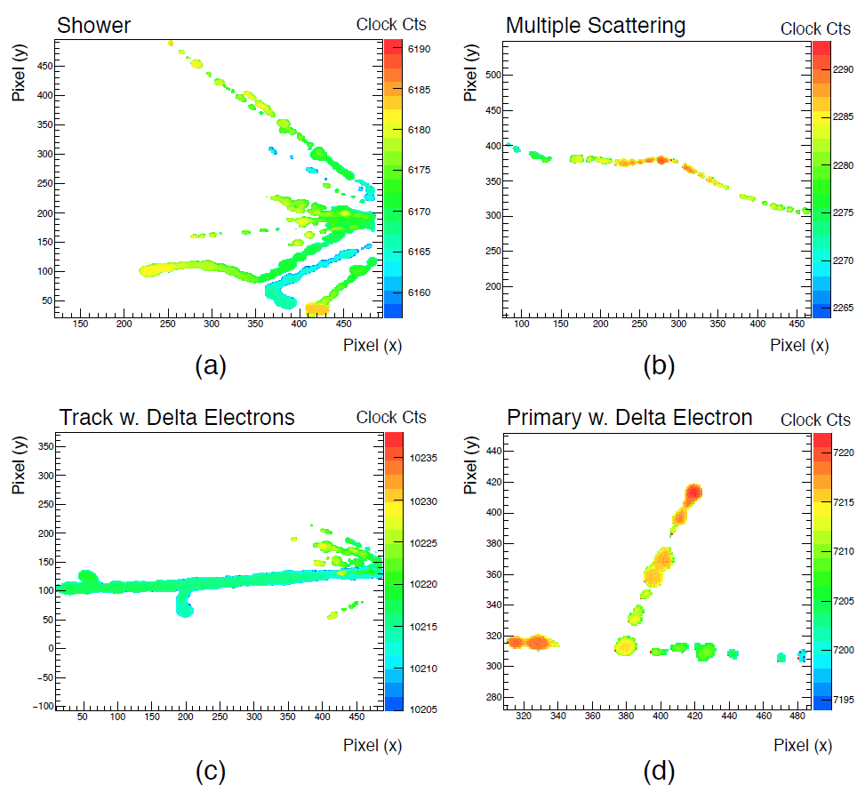
3D Track Reconstruction (TOA)
3x3 cm²
Z coordinate (1 cm)
Possibility to study single particles
→ lateral measurements
→ secondaries
Z coordinate (1 cm)

Slide 7
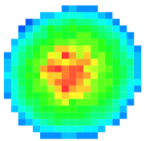
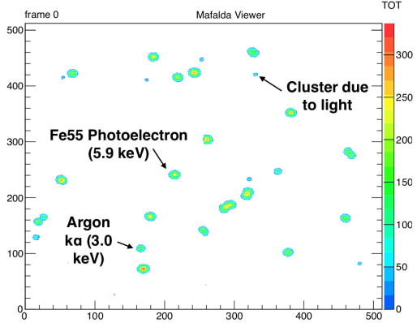
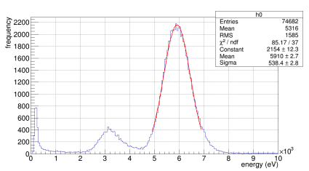
Charge Measurement (TOT)
X-ray detection: 6 keV from ⁵⁵Fe (1s frame)
Single 6 keV X-Ray
20% energy resolution for 6 keV
20% energy resolution

Slide 8
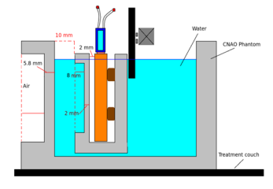
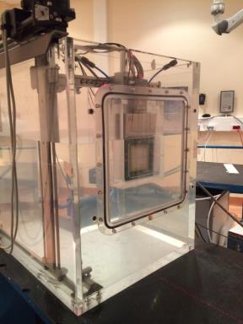
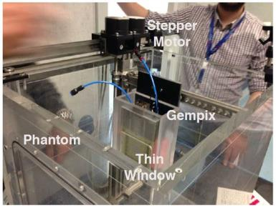
Setup at CNAO
Beam
GEMpix
Water phantom
GEMPix inserted in a water phantom

Slide 9
Measurements at CNAO
Carbon ions
Energy: 280 or 332 MeV/n
Scan along beam axis, ~30 positions
Frames (pictures) of 20 ms taken, 5-10 frames per position
TOT mode
Total: 20 min per scan
→ Frames provide beam monitoring
→ Integrated TOT counts per position provide Bragg Curve
→ 3D reconstruction of energy deposition

Slide 10
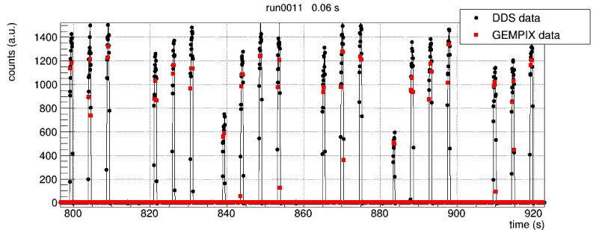
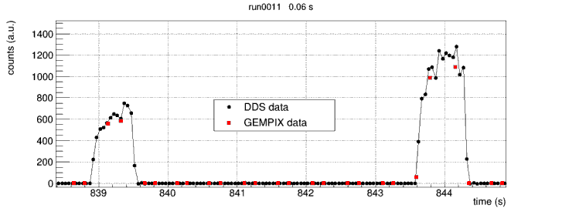
Comparison DDS and GEMPix
Good agreement between DDS and GEMPix

Slide 11
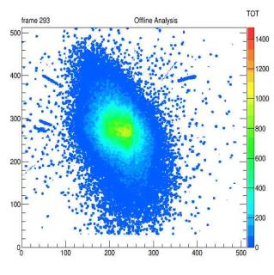
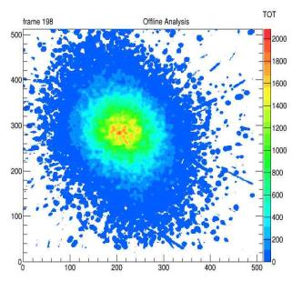
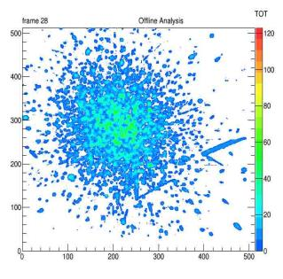
Beam Monitor
Plateau
Peak
Tail
Beam spot taken on Plateau, Bragg Peak and Tail
Frame length: 20 ms / 100 ms (before / after the Bragg Peak)
Beam halo: single particle reconstruction

Slide 12
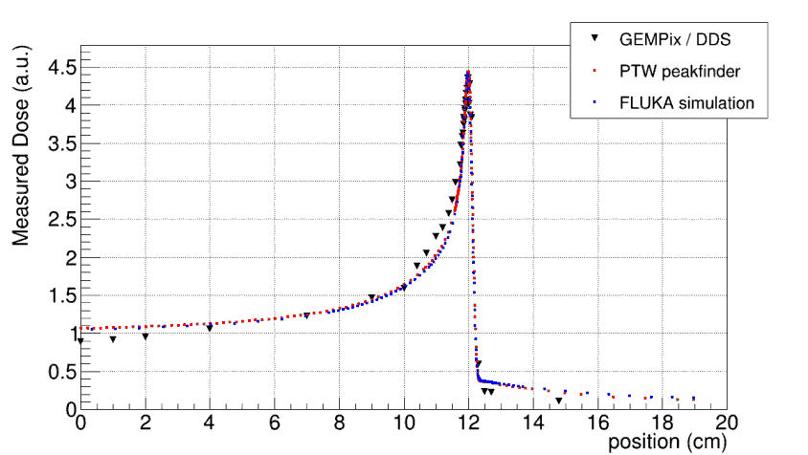
Depth Scan: Bragg Curve
Beam
Investigations on differences on-going
In general: good agreement between reference measurements / simulation and GEMPix

Slide 13
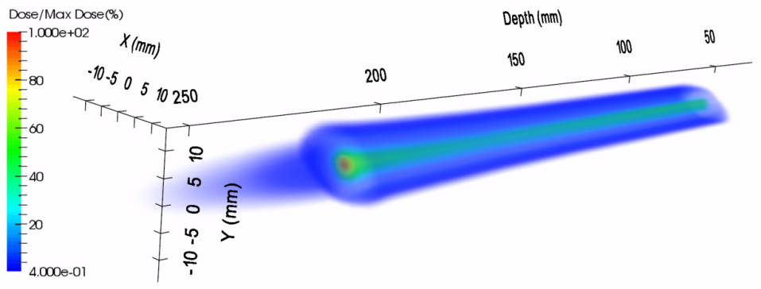
3D Reconstruction
Beam
Bragg Peak
Fragmentation Tail

Slide 14

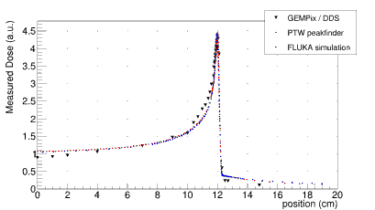
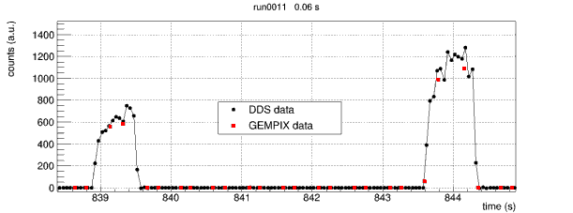
Old Setup
GEMPix
+ CNAO water phantom
+ CNAO Dose Delivery System
→ GEMPix must be dismounted after each shift
→ Timing issues with reference system
→ Study of differences in Bragg curve with more reliable setup
→ New issues when going to other beam facility?
→ Development of an integrated system!

Slide 15
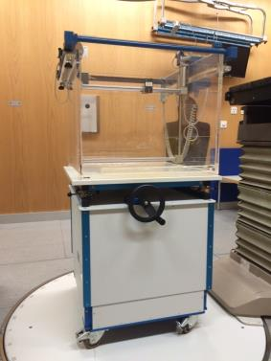

Outlook: Integrated System
IC
Beam
Integrated system with GEMPix, water phantom, ion chamber as reference
Water phantom was donated by Luzern hospital
Ion chamber (PTW 34080) acquired
Funded by MAPF
Integration HW/SW at CERN Idea^{S}
Tests at Linac4 (160 MeV)
Measurements at clinical facilities
Independent of local beam delivery system
70cm
PTW
34080
Wellhoefer Blue Phantom

Slide 16
Thank you for your attention!

