Slide 1



WP1: Collimation Activities at RHUL
L. Nevay, S. Boogert, S. Gibson,
R. Kwee-Hinzmann, H. Garcia Morales,
HL-LHC-UK Meeting
13th October 2016

Slide 2
Introduction
BDSIM Status
Experimental Backgrounds
Off-Momentum Collimation Studies

Slide 3
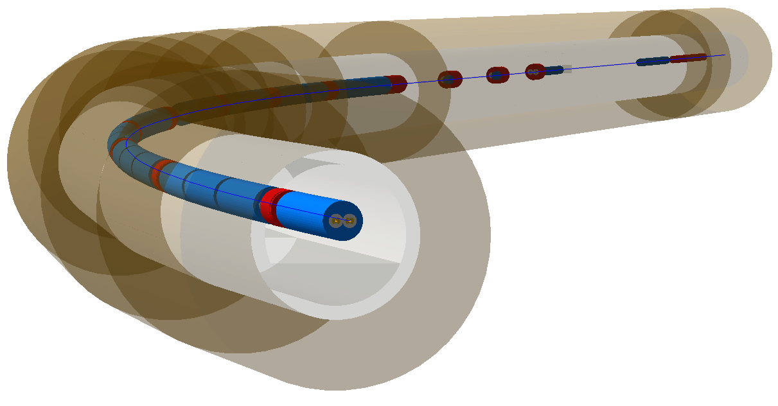
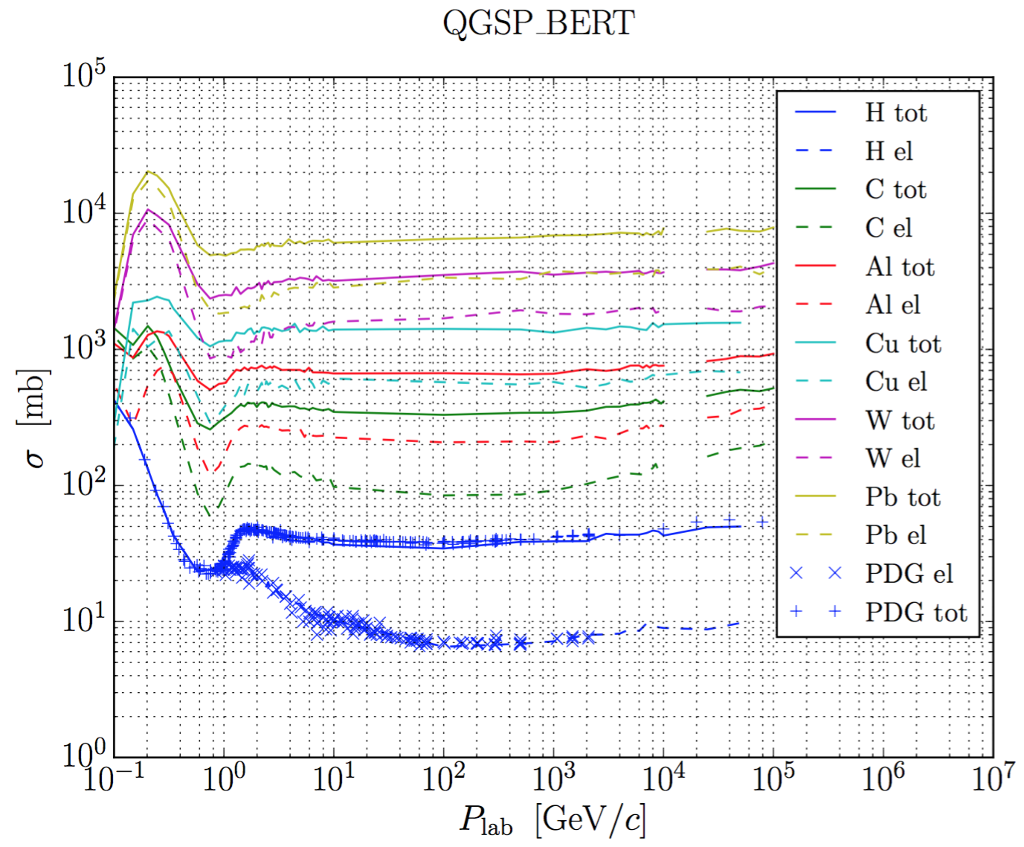
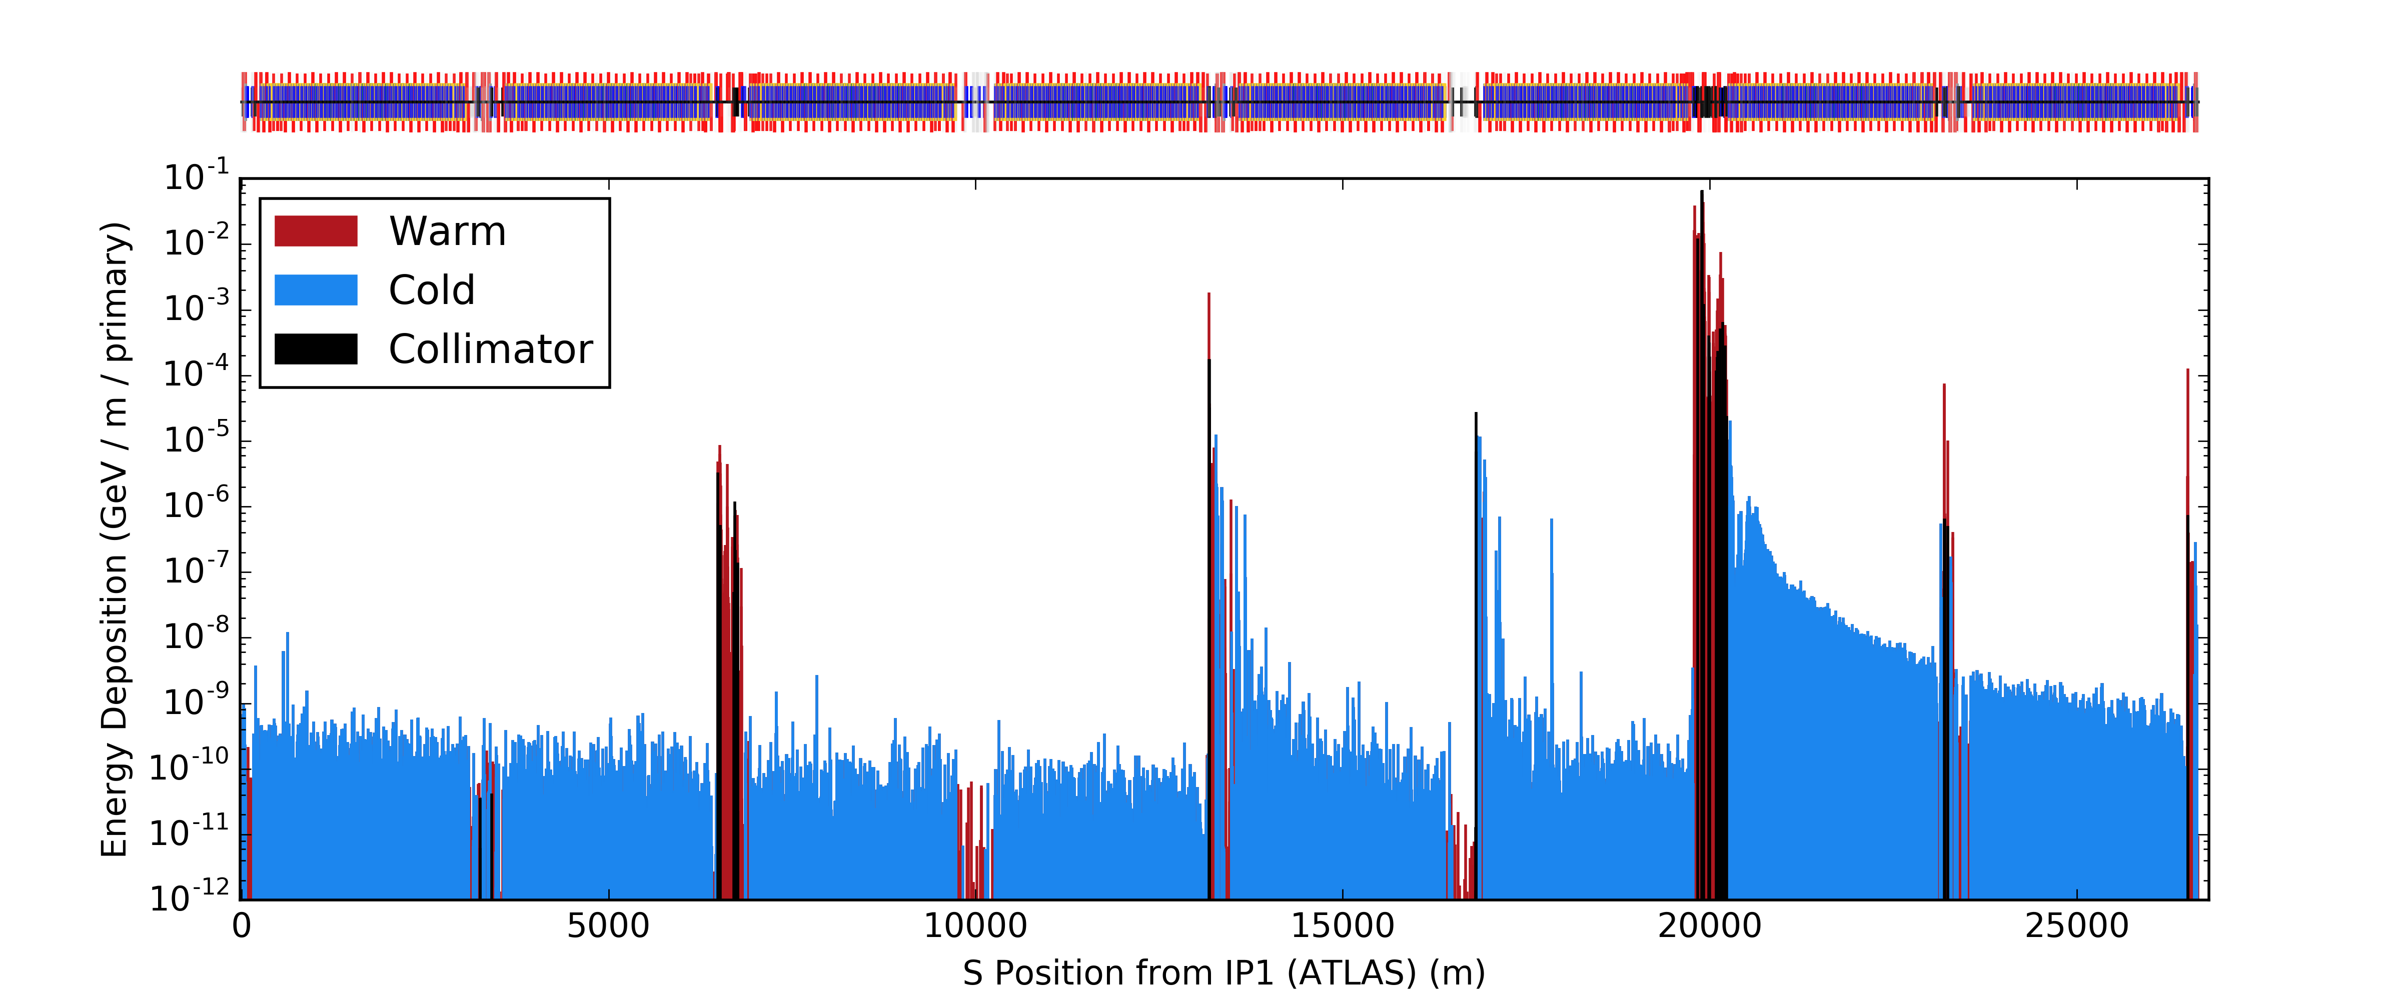
Geant4 Based Simulations
Alternative simulation tool BDSIM developed at RHUL
Builds Geant4 accelerator model from MADX optics
Produces energy deposition maps as well as loss maps
Recent developments will be presented at 6th HL-LHC Meeting
  per event (primary loss) energy deposition and analysis
  scattering process cross-section and scaling comparison
  field map and geometry support
B1 4TeV energy deposition map
preliminary cross-section comparison with PDG
L. Nevay, S. Boogert

Slide 4
Experimental Backgrounds

Slide 5
Machine induced background simulations in HL-LHC
R. Kwee-Hinzmann
What is machine background?
  anything that produces signals in the detector not originating from collisions but from lost beam particles.
Several sources of background are known:
  beam-gas interactions, considered up to 550m away from IP
  beam halo leaking from IR7 to tertiary collimators (~150m from IP)
  global beam-gas (elastic and inel. scatters impacting on TCTs)
  cross-talk (protons from sdiff process in other IPs impacting on TCTs)
Study background sources in current LHC and HL-LHC
  4 TeV, 6.5 TeV, HL 7 TeV: local beam-gas and B1- and B2-halo for several collimator layouts and optics in HL
In terms of background, which collimator layout is favorable HL?

Slide 6
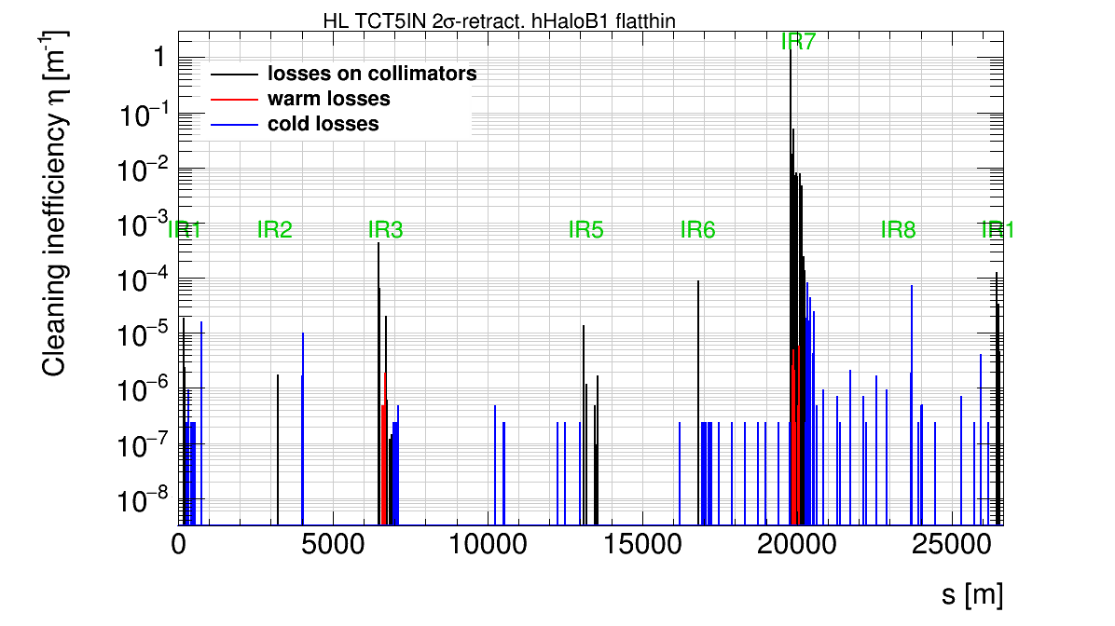
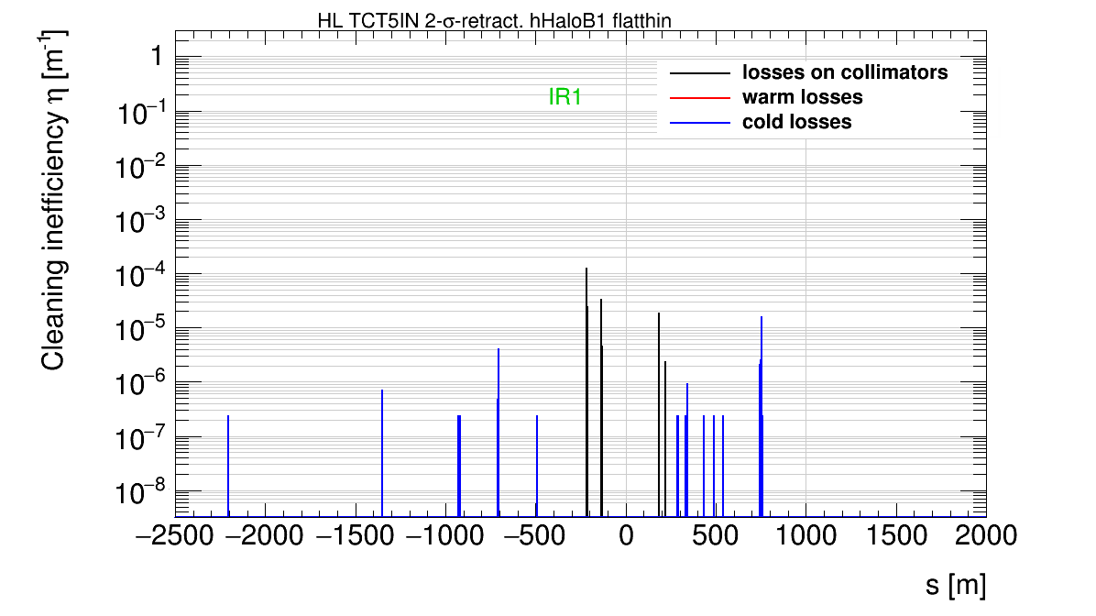
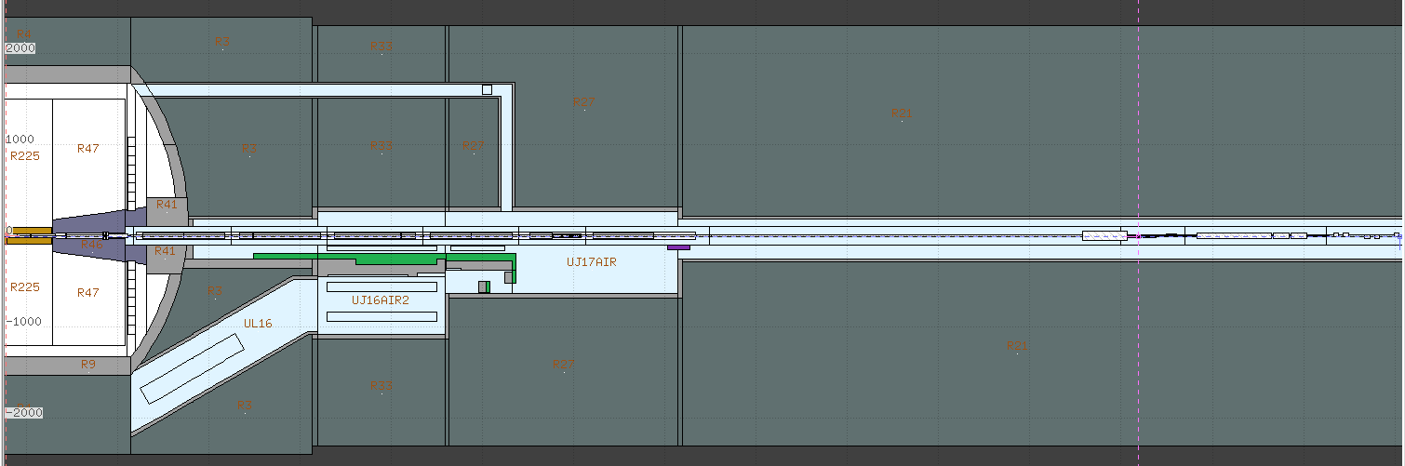
Simulation setup for halo induced showers
R. Kwee-Hinzmann
SixTrack lossmap in full ring
losses on TCTs in IR1
zoom
TCTH+TCTV
  Use right side of P1 in FLUKA to simulate showers
load TCT hits from h+v halo
simulations into FLUKA
TCTH
TCTV

Slide 7
Simulation Method
R. Kwee-Hinzmann
interface plane
record each shower particle at interface plane at z = 2260 cm

Slide 8
Beam halo simulations
HL-LHC
R. Kwee-Hinzmann
Due to HL layout changes there possible new aperture bottlenecks
Q4, and possibly Q5, need additional protection.
Example study cases: TCT5s in/out for halo background
  to quantify the effect and compare baseline (TCT5s in) to current LHC
Show here the results using
  2sigma – retracted collimator settings (now baseline),
  HLLHC v1.0/v1.1, beta* = 15cm round beam optics.

Slide 9
Beam halo simulations
HL-LHC
R. Kwee-Hinzmann
Normalisation to stable beam operation assuming a beam lifetime for halo losses on collimators of 100h
Normalise by initial flux and take into account the efficiency of collimator settings
  (TCP-to-TCT conversion factors)
For Run II 6.5 TeV results, use 2015 conditions
  (beta* = 80cm, TCTs at 13.7sigma)
2736 bunches with 2.2e11p/b
TCT4 only B1: 1.1e-4
TCT4 only B2: 2.3e-4
TCT5 in B1: 1.5e-4
TCT5 in B2: 2.4e-4
2748 bunches with 1.2e11p
6.5 TeV B1halo: 1.2e-5
6.5 TeV B2halo: 1.6e-5

Slide 10
Comparison of TCT5 in/out
B1
R. Kwee-Hinzmann
energy distribution of all particles
energy distribution of all particles in phi
Expect small improvement with additional TCT5s.

Slide 11
Comparison of TCT5 in/out
B2
R. Kwee-Hinzmann
energy distribution of all particles
energy distribution of all particles in phi
Preliminary result (needs to be scrutinized in more detail).

Slide 12
Compare baseline case to Run II (2015) Halo – B1
R. Kwee-Hinzmann
energy distribution of all particles
energy distribution of all particles in phi
Almost an order of magnitude more from B1 in HL

Slide 13
Compare baseline case to Run II (2015) Halo – B2
R. Kwee-Hinzmann
energy distribution of all particles
energy distribution of all particles in phi
~20 times more particles and energy from B2 in HL.

Slide 14
Summary & Plans
R. Kwee-Hinzmann
TCT5s do catch a lot of the IR7 leakage, but contribute thereby also to halo-showers at the interface plane. Only small gain for background in B1. B2 to be studied in more detail.
Several other cases studied in HL:
  Nominal (values from the design report) against 2sigma-retracted settings: reduce halo background by a factor 2-3 with retracted settings for B1.
  Round versus flat beam optics in 2sigma-retracted settings: expect similar level of halo background as for round beams in B1.
  Showers in a crab cavity failure.
Plan to simulate showers to experiments from pressure bumps in recent machine tests.

Slide 15
Off-Momentum Collimation

Slide 16
Off-Momentum
Cleaning Simulation
H. Garcia-Morales
The goal is to create a model of the off-momentum halo.
This model will improve the understanding of the off-momentum dynamics and will increase the collimation efficiency for off-momentum particles.
Never simulated before.
Future applications.
  Losses at the start of the ramp.

Slide 17
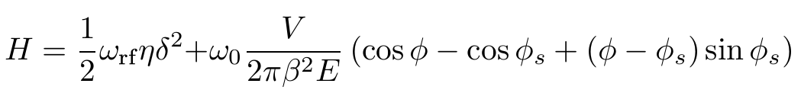
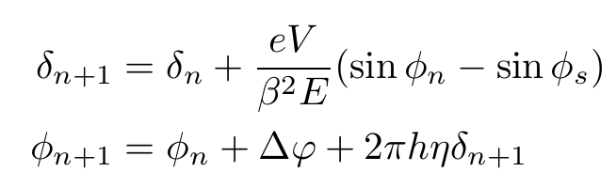
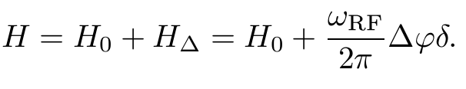
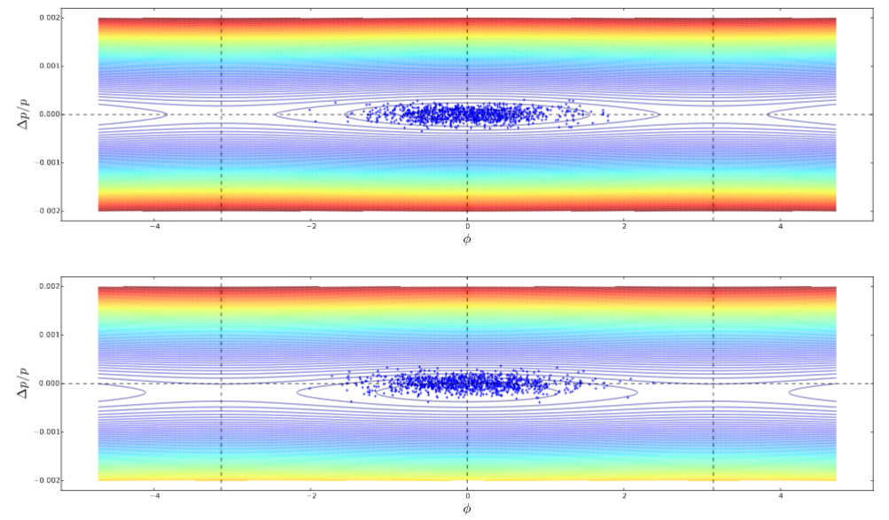
Longitudinal Model
H. Garcia-Morales
Based on general longitudinal Hamiltonian.
The reference energy is changed trimming the RF frequency as it is done in the real machine.
This trimming induces the RF bucket to move or higher or lower energies.
Eventually, particles are captured by the off-momentum collimator in IR3.

Slide 18
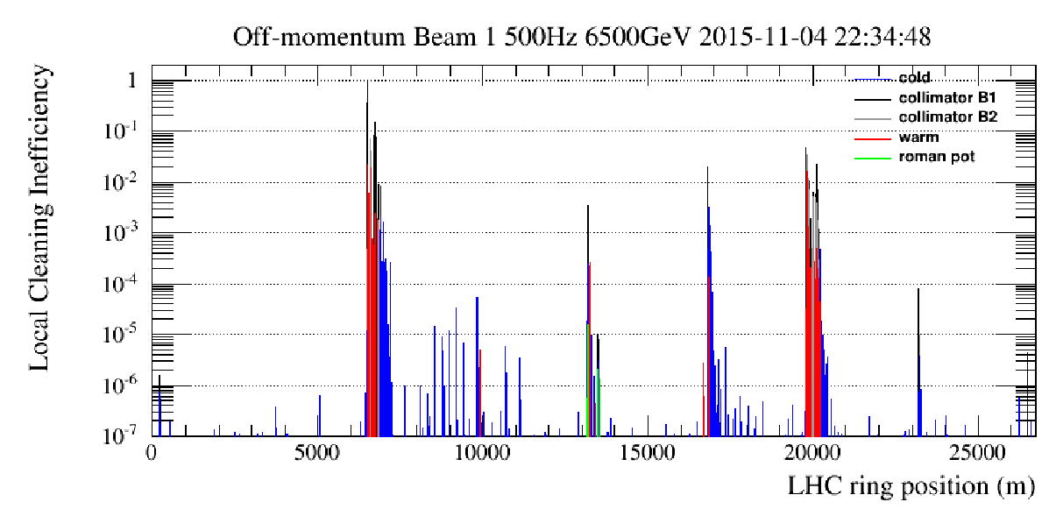
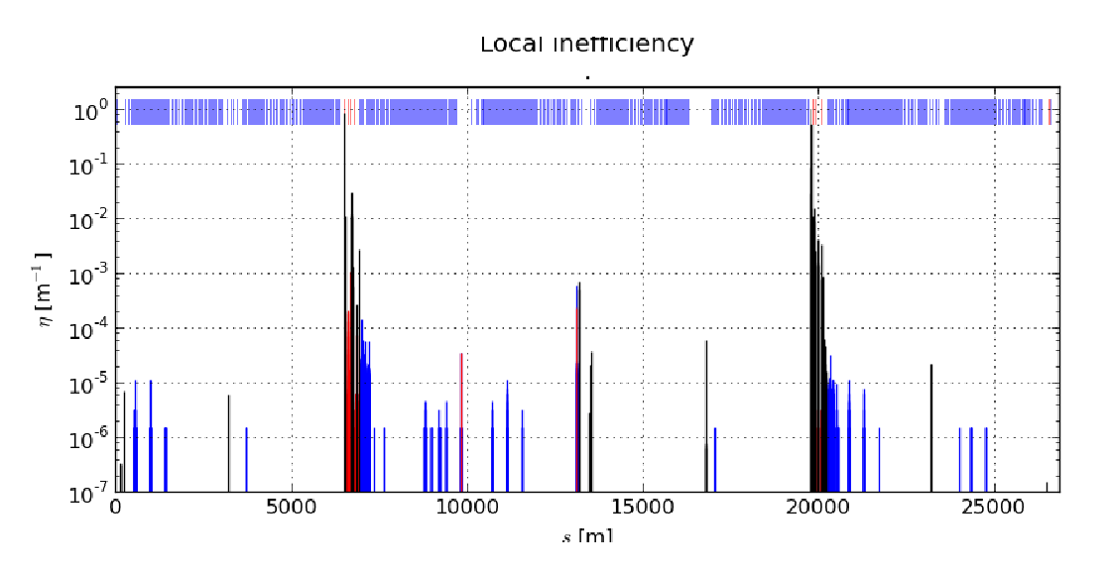
Loss map simulations
H. Garcia-Morales
Applying the model shown above, we are able to simulate the off-momentum loss-map acquisition.
Simulations agree quite well with measurements.
The model is able to reproduce losses observed in IR4 in previous runs.

Slide 19
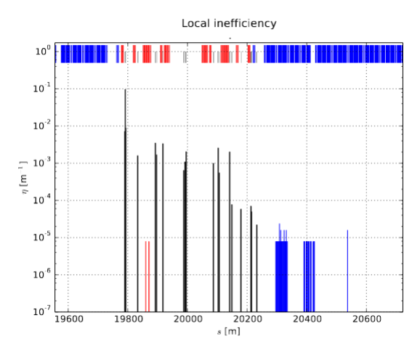
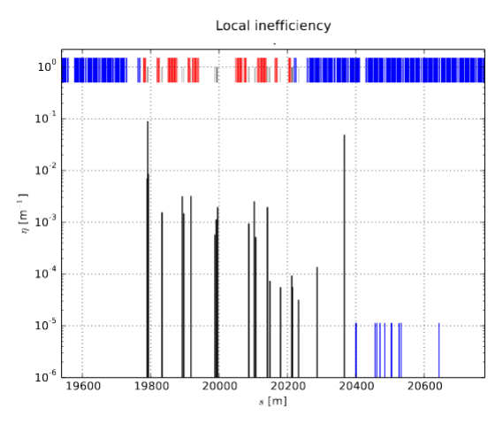
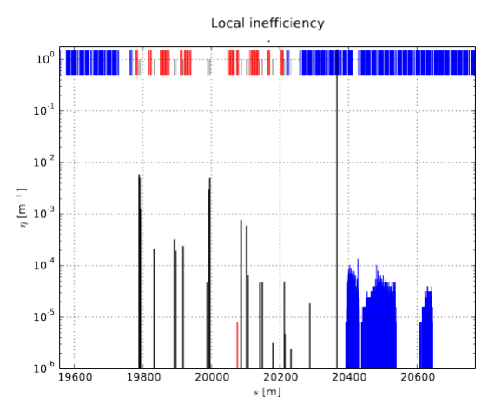
HL-LHC simulations
H. Garcia-Morales
DS collimators may act as primary collimators for off-momentum particles if settings are tight enough.
Cannot go below 10 sigma.
TCLD retracted
TCLD as prmary collimator
TCLD
12.5 sigma
TCLD
10 sigma

Slide 20
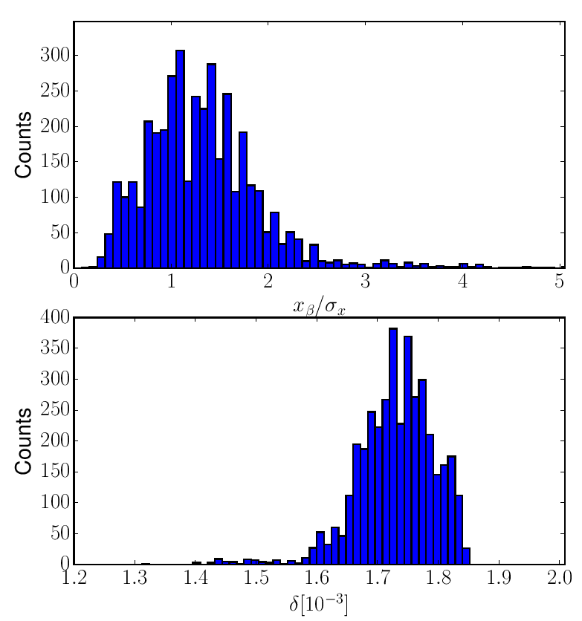
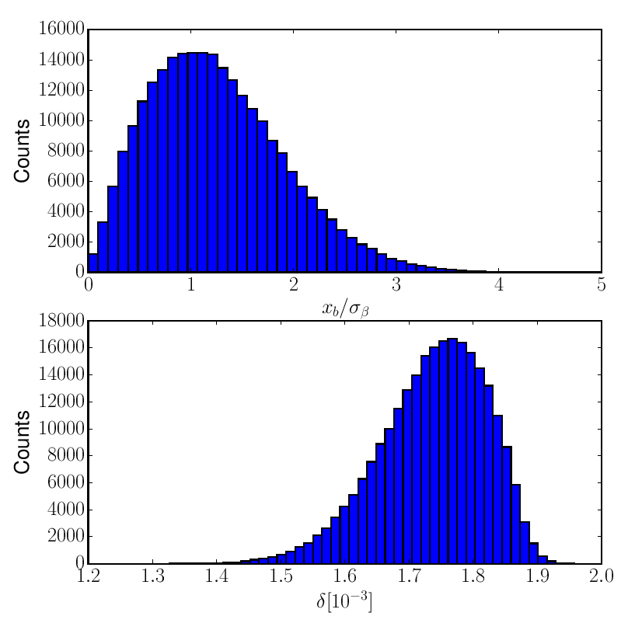
Distribution model
H. Garcia-Morales
From simulations shown above, we can extract the distribution of the impacts in the primary collimator in IR3. The goal is to sample the distribution directly at the collimator location. In such a way we increase the simulation speed.
Simulation
Model

Slide 21
Summary
H. Garcia-Morales
We have created a new set of tools to simulate the off-momentum cleaning in the LHC and the HL-LHC.
The model fits quite well with measurements.
The model allows sampling the particle distribution directly at the primary momentum collimator.
For the HL-LHC it is shown that there are some constraints on the TCLD settings (>10sigmas).
Results are being summarized in a paper to be submitted soon to a journal.

Slide 22

Thank you

