Slide 1

Transient Thermal Electromagnetic Behaviour of HL-LHC SC-Link
Global Analysis and Experimental Studies
Y Yang, I Falorio, J Pelegrin, E A Young
University of Southampton, UK
S Giannelli, A Ballarino
CERN, Switzerland

Slide 2
Outline
Background
Quench load and safe circuit discharge upon cable quench
Transient magnetic field imposed on neighbouring cables upon fast discharge of a circuit
AC loss measurements
Quench by local disturbances in helium gas

Slide 3
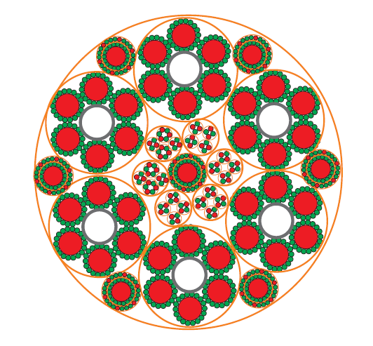

Layout of SC Link at LHC P1 and P5
Cu
MgB₂ , Φ = 1 mm
18 MgB₂ wires
Φ = 6.5 mm
20 kA
Six cables, Φ = 19.5 mm
Concentric ± 3 kA
Seven cables, Φ = 8.4 mm
0.4 kA
Four cables
0.12 kA
Eighteen cables
Φext ∼ 65 mm
A. Ballario, EUCAS 2013, Genova

Slide 4
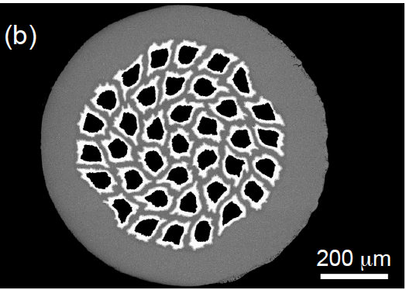
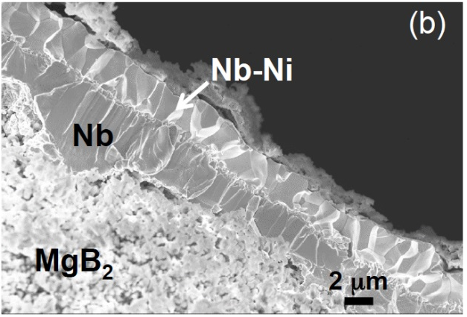
Superconducting Material: State-of-the-art
Launched development of MgB₂ round wire
Φwire = 1 mm
37 MgB₂ filaments
Twisted filaments (LT=100 mm)
Φeq_MgB₂ = 56 μm
ACu ∼ 5 % Awire (th=30 μm)
Cu plating
Sn coating of Cu surface
Ic(25 K, 0.9 T) > 186 A
Launched procurement of 80 km of wire
Unit lengths ≥ 500 m
20 km at CERN
60 km delivered before end 2015
Use of Nb barrier
A. Ballario, EUCAS 2015, Lyon

Slide 5
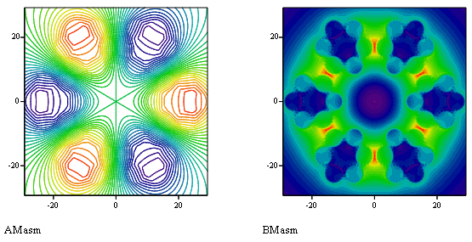
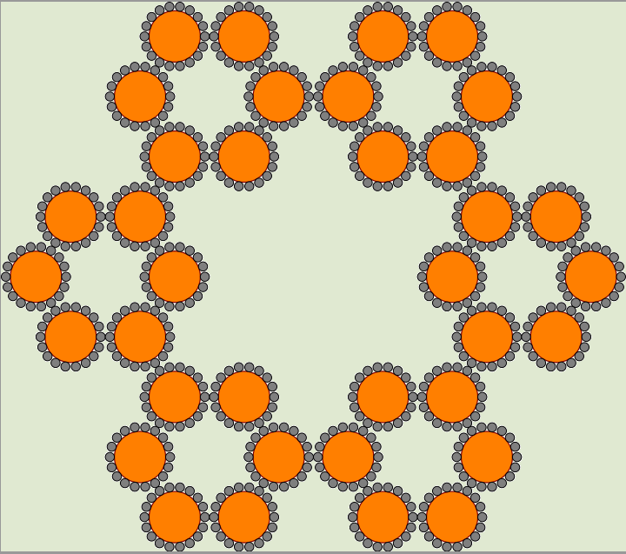
Self-Fields and Inductances
3kA coaxial cables have minimum impact on the overall field distribution within the link, hence not considered.
Cables/Link layout
6x20kA , 7x3kA, 4x0.4kA, 8x.12kA
0.12/0.4kA cables not exposed to the 20kA fields , hence not considered.
65mm
Main Characteristics
Maximum Field:
1x20kA: B_{max}=0.47 T
(±)20kA: B_{max}=0.90 T
3x(±)20kA: B_{max}=0.75 T
Inductances
(±)20kA: L = 0.19 μH/m
3x(±)20kA: L = 0.32 μH/m
Insignificant compared to
those of the magnets in circuit
Lines of force Magnetic field
6x20kA fully powered

Slide 6
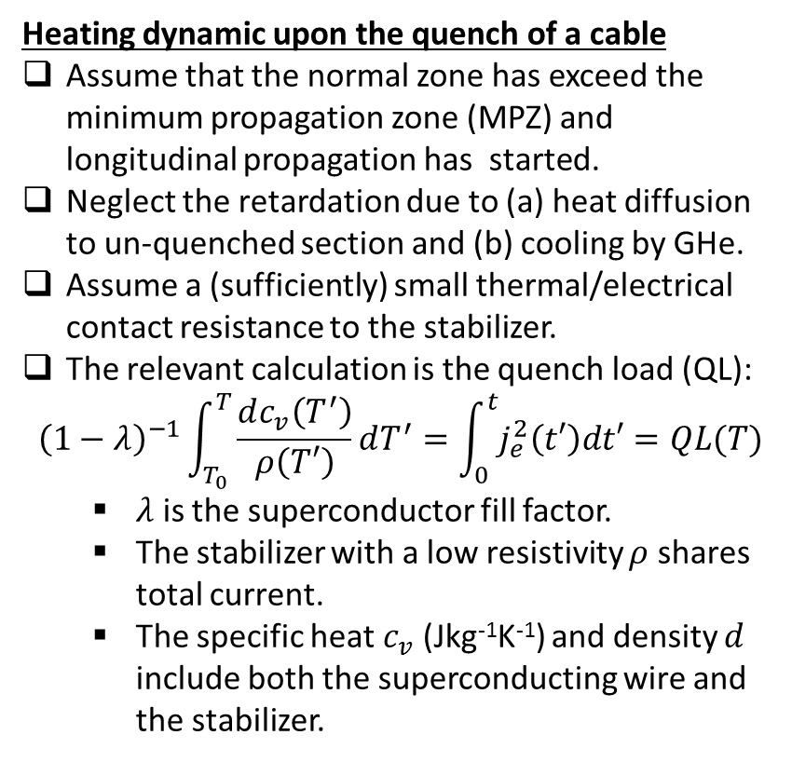
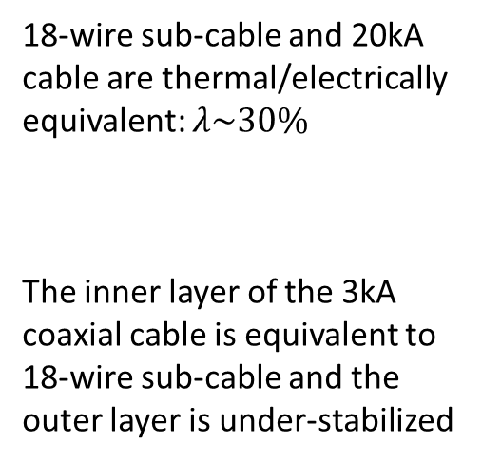
Thermal Transients: Quench Load of Cables
Heating dynamic upon the quench of a cable
Assume that the normal zone has exceed the minimum propagation zone (MPZ) and longitudinal propagation has started.
Neglect the retardation due to (a) heat diffusion to un-quenched section and (b) cooling by GHe.
Assume a (sufficiently) small thermal/electrical contact resistance to the stabilizer.
The relevant calculation is the quench load (QL):
$${\left(1−λ\right)}^{−1}\int_{T_{0}}^{T}{\frac{dc_{v}\left(T^{′}\right)}{ρ\left(T′\right)}}dT^{′}=\int_{0}^{t}{j_{e}^{2}\left(t′\right)dt′}=QL(T)$$
  $λ$ is the superconductor fill factor.
  The stabilizer with a low resistivity $ρ$ shares total current.
  The specific heat $c_{v}$ (Jkg⁻¹K⁻¹) and density $d$ include both the superconducting wire and the stabilizer.
18-wire sub-cable and 20kA cable are thermal/electrically equivalent: $λ\sim 30\%$
The inner layer of the 3kA coaxial cable is equivalent to 18-wire sub-cable and the outer layer is under-stabilized

Slide 7
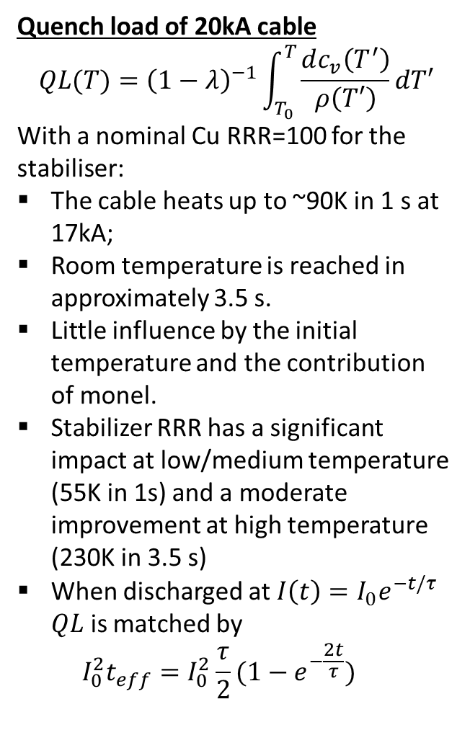
Thermal Transient: Quench of Cables
Quench load of 20kA cable
$$QL(T)={\left(1−λ\right)}^{−1}\int_{T_{0}}^{T}{\frac{dc_{v}\left(T^{′}\right)}{ρ\left(T′\right)}}dT′$$
With a nominal Cu RRR=100 for the stabiliser:
The cable heats up to ~90K in 1 s at 17kA;
Room temperature is reached in approximately 3.5 s.
Little influence by the initial temperature and the contribution
of monel.
Stabilizer RRR has a significant impact at low/medium temperature (55K in 1s) and a moderate improvement at high temperature (230K in 3.5 s)
When discharged at $I\left(t\right)=I_{0}e^{−t/τ}$ $QL$ is matched by
${{I_{0}^{2}t}_{eff}=I}_{0}^{2}\frac{τ}{2}(1−e^{−\frac{2t}{τ}})$
Discharging at τ < 2 s virtually ensures that the maximum temperature will not exceed 100K.
Problem eliminated with a even faster discharge, but will likely be without energy extraction from magnets.

Slide 8
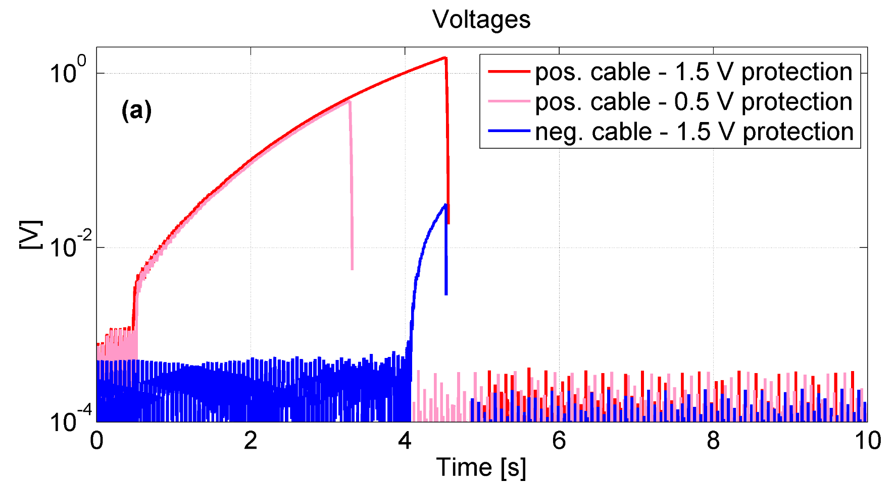

Recent results at CERN:
consistent with QL calculation
Hot spot temperature lower than QL: not fully propagated
Measurement performed at 15 K, 3000 A
Max hot-spot temperature reached T_{hs}~340 K with no degradation of cable performance
25 K, 3 kA, 100 mV detection threshold → 15 MIITS of “quench capital” before detection → final T_{max} ∼ 150 K with 3 s time constant of the circuit
A. Ballarino, 27/10/2015

Slide 9
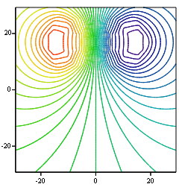
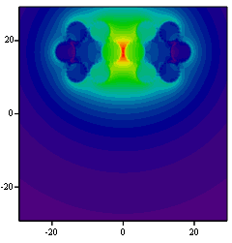
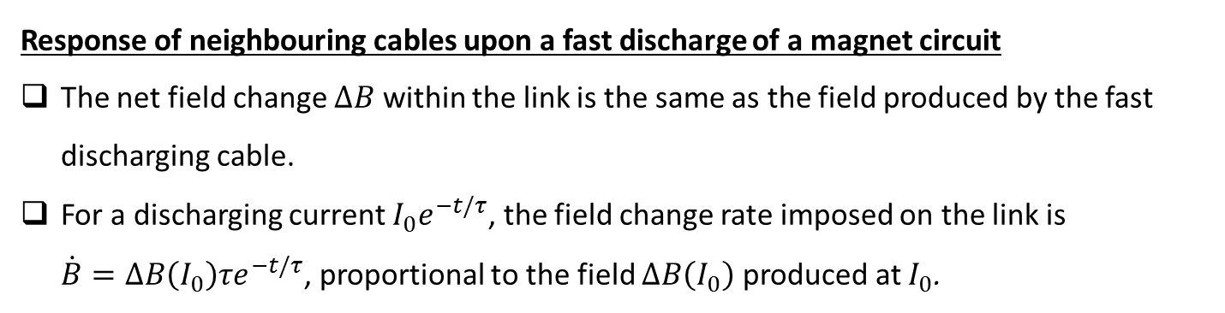
Electromagnetic Transient:
Field imposed by a circuit discharge
Response of neighbouring cables upon a fast discharge of a magnet circuit
The net field change $ΔB$ within the link is the same as the field produced by the fast discharging cable.
For a discharging current $I_{0}e^{−t/τ}$, the field change rate imposed on the link is
$\dot{B}=ΔB\left(I_{0}\right)τe^{−t/τ}$, proportional to the field $ΔB\left(I_{0}\right)$ produced at $I_{0}$.
-17
kA
+17kA

Slide 10
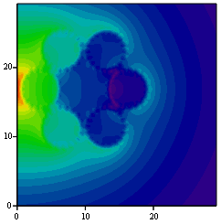
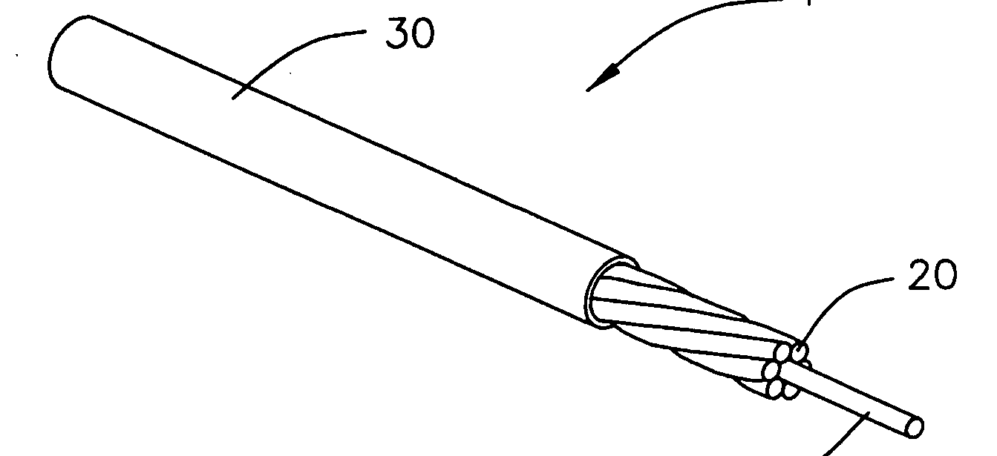
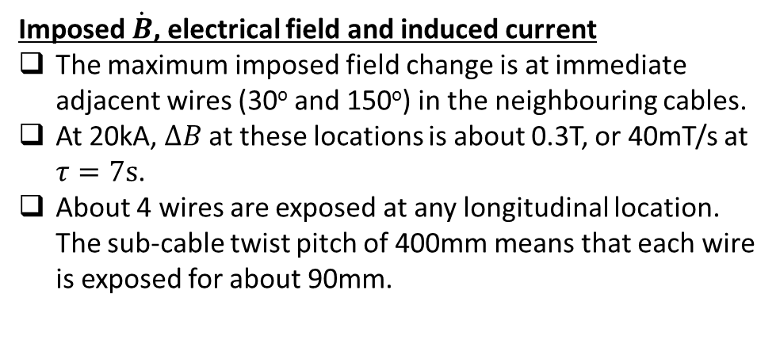
Electromagnetic Transient:
Field imposed by a circuit discharge
Imposed $\dot{B}$, electrical field and induced current
The maximum imposed field change is at immediate adjacent wires (30º and 150º) in the neighbouring cables.
At 20kA, $ΔB$ at these locations is about 0.3T, or 40mT/s at $τ=7s$.
About 4 wires are exposed at any longitudinal location. The sub-cable twist pitch of 400mm means that each wire is exposed for about 90mm.
0.3T @17kA

Slide 11
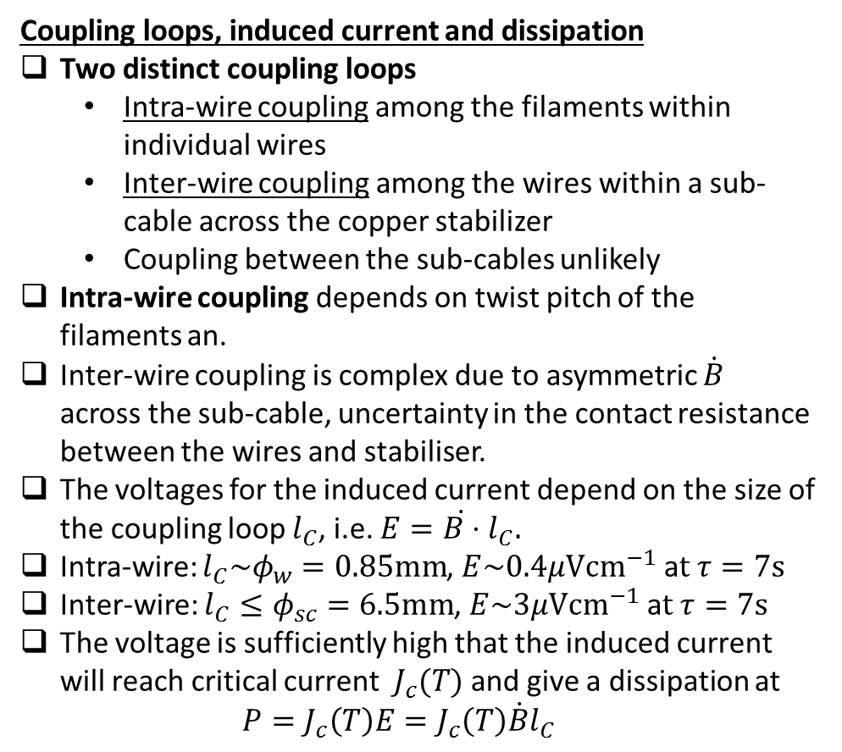


Electromagnetic Transient:
Field imposed by a circuit discharge
Coupling loops, induced current and dissipation
Two distinct coupling loops
  Intra-wire coupling among the filaments within individual wires
  Inter-wire coupling among the wires within a sub-cable across the copper stabilizer
  Coupling between the sub-cables unlikely
Intra-wire coupling depends on twist pitch of the filaments an.
Inter-wire coupling is complex due to asymmetric $\dot{B}$ across the sub-cable, uncertainty in the contact resistance between the wires and stabiliser.
The voltages for the induced current depend on the size of the coupling loop $l_{C}$, i.e. $E=\dot{B⋅}l_{C}.$
Intra-wire: $l_{C}\sim φ_{w}=0.85mm$, $E\sim 0.4μ{Vcm}^{−1}$ a$t τ=7s$
Inter-wire: $l_{C}≤φ_{sc}=6.5mm$, $E\sim 3μ{Vcm}^{−1}$ a$t τ=7s$
The voltage is sufficiently high that the induced current will reach critical current $J_{c}(T)$ and give a dissipation at
$P=J_{c}\left(T\right)E=J_{c}\left(T\right)\dot{B}l_{C}$
$$l_{C}\sim 1mm$$
$$l_{C}\sim 6.5mm$$

Slide 12
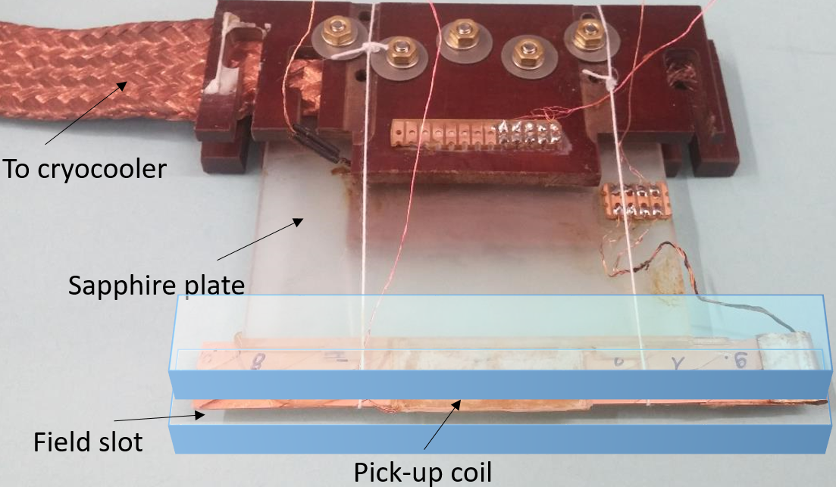
Electromagnetic Transients:
AC Loss Measurements
Applied sinusoidal field
  B₀ ≤ 0.2 T
  5Hz ≤ f ≤ 2kHz
Measurements
  3K ≤ T ≤ 100K
  Single-turn saddle pick-up coil
  Sample length L ≤ 100mm
B_{ac}
C_{i}
MgB₂ wire
C_{o}
Resistive matrix
MgB₂ wire
Focus on the coupling among the wires in a sub-cable
A simpler arrangement: two wires soldered to the long edges of a metal shim of 6mm wide and 0.5mm thick
Cu, Cu braids and brass shims were used

Slide 13
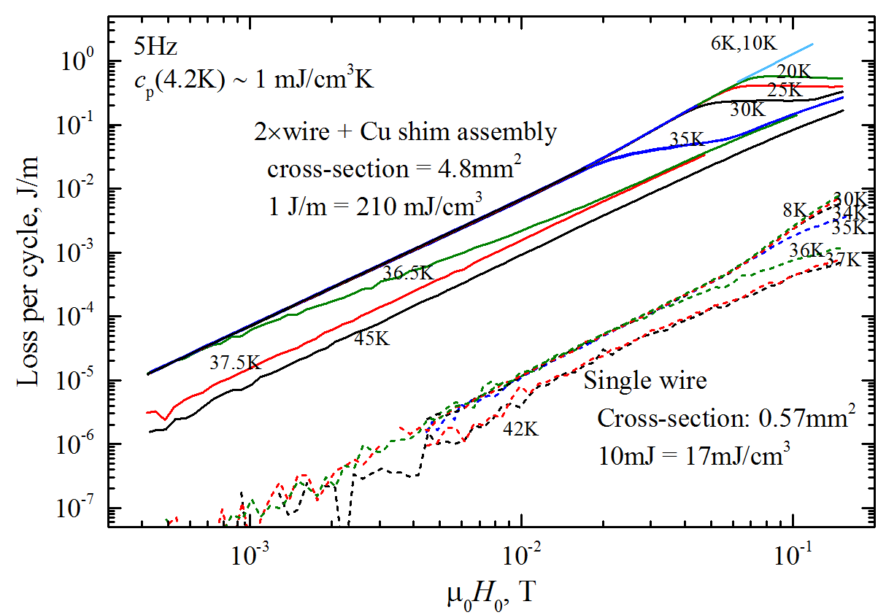
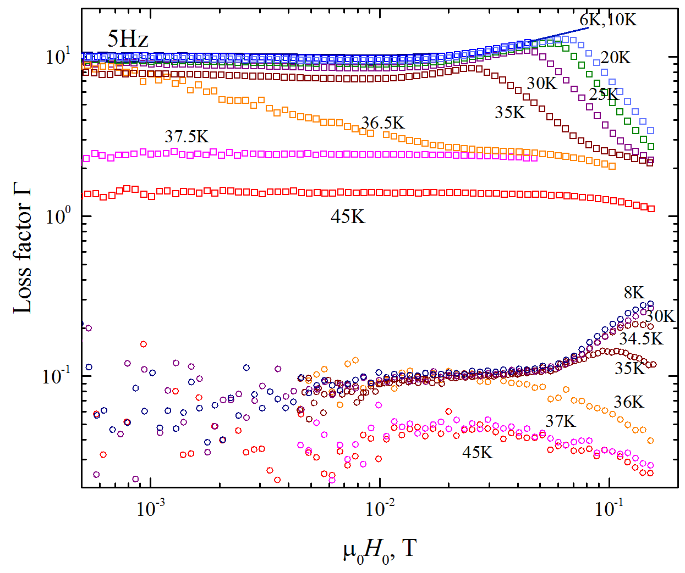
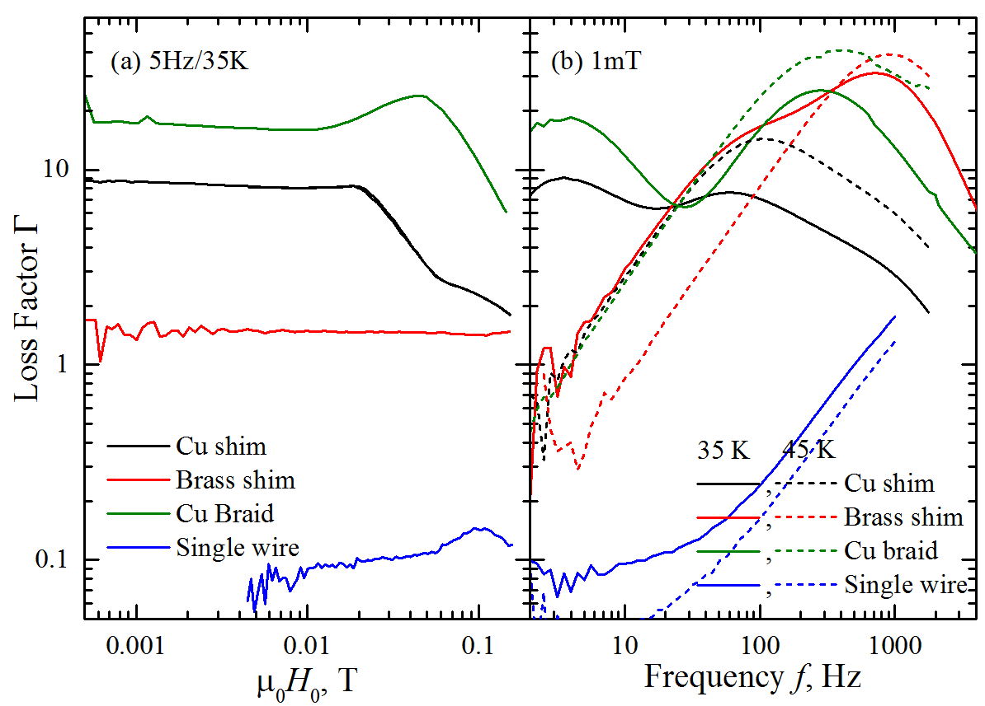
Electromagnetic Transients:
AC Loss Measurements
Losses in the assembly is 1000x of a single wire;
Losses in superconducting state is 10x of normal state;
Coupling transition field higher at low temperature;
Losses are eddy current like (Q ~ B² and Г ~ constant) in decoupled regime;
Losses vary with matrix resistivity as expected: reduced coupling and shorter time constant at higher ρ;
Decoupled regime has a longer time constant;
High coupling current losses with Cu matrix quite high;

Slide 14
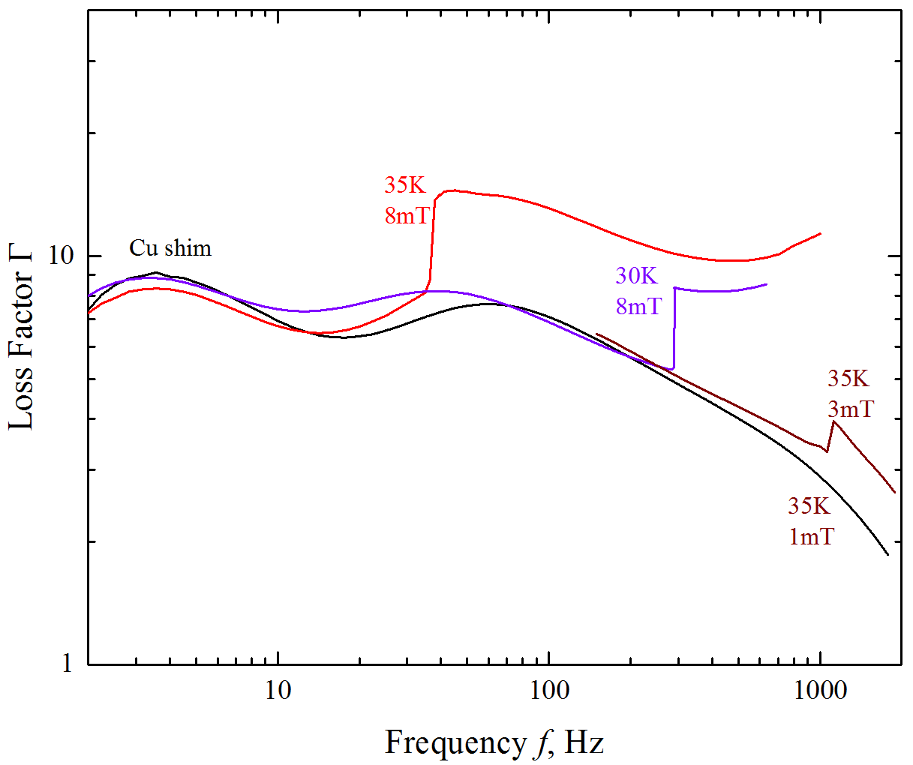
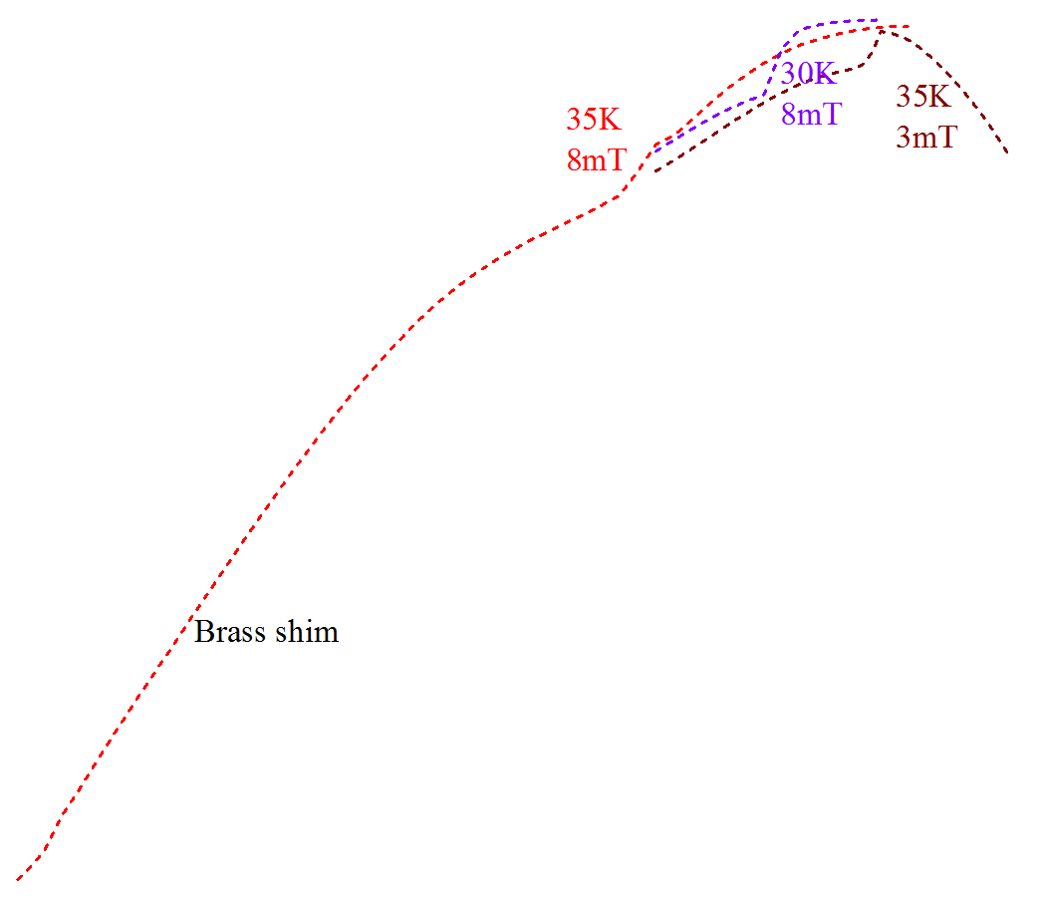
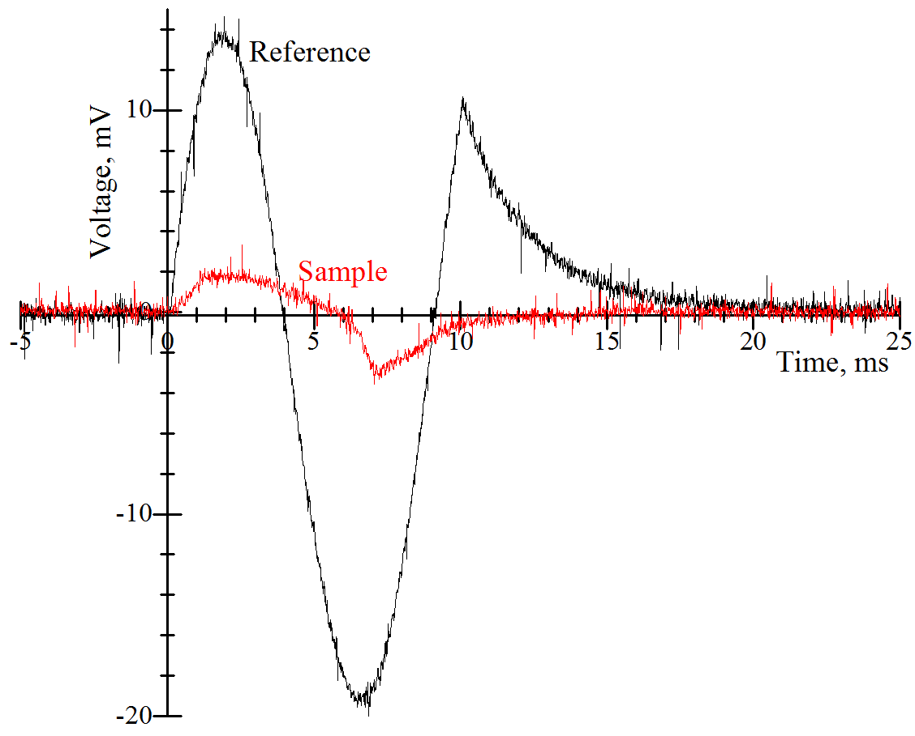
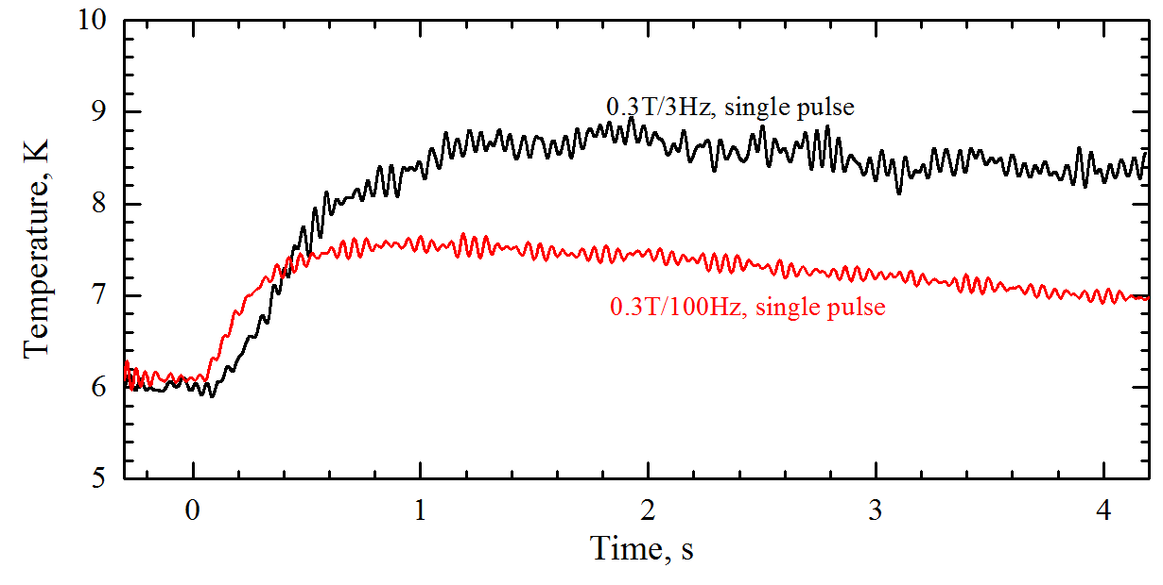
Electromagnetic Transients:
AC Loss Measurements
Sharp coupling transition at high field/frequency , leading in significantly higher losses;
Higher coupling frequency with higher matrix resistivity;
There are scopes for compromise between stability and coupling losses;
Losses from a single pulse can be measured directly using a thermometer;
Coupling

Slide 15
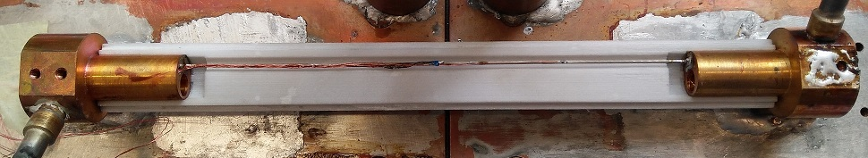
Quench of MgB2 by Local Disturbances, adiabatic
Heater
V0 = 20 mm
V1 = 70 mm
VL
VR
Quench measurements:
Temperature 36 K, 34.5 K, 32.5 K
Steep dIc/dT = 50A/K

Slide 16
Quench by Local Disturbances, adiabatic
Higher MQE at lower operating current
MPZ voltage:
Relative slow increase with decreasing current for MgB₂: fasting weakening of the power law index
increases of ~9 times from 99%Ic to 87%Ic in YBCO

Slide 17
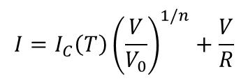
Quench by Local Disturbances, adiabatic
Difference in voltage observed between YBCO and MGB2 correspond to a difference in n-number
Faster drop in n-number in Mgb2 where quench voltage remains very low at all currents
Novel methodology to calculate n-number from normal zone temperature and voltage, by using power-law equation
Increasing n-number with decreasing temperature, expected change of slope of MgB2 n-number as temperature further lowered
$$I=I_{C}\left(T\right){\left(\frac{V}{V_{0}}\right)}^{1/n}+\frac{V}{R}$$

Slide 18
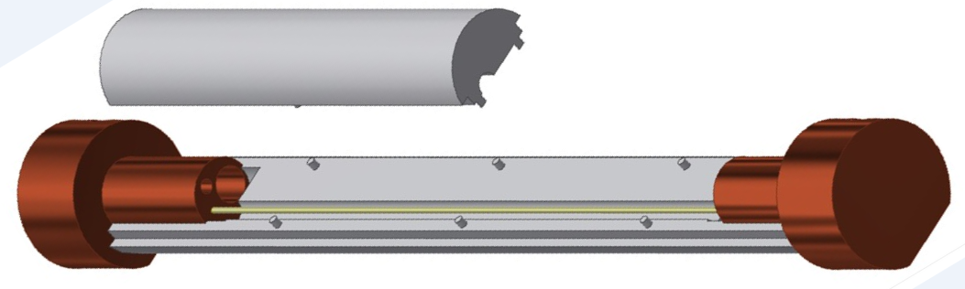
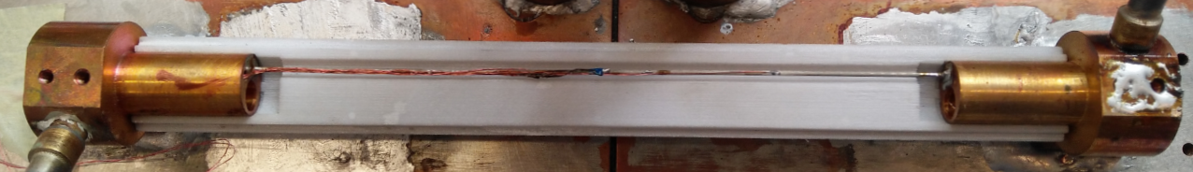
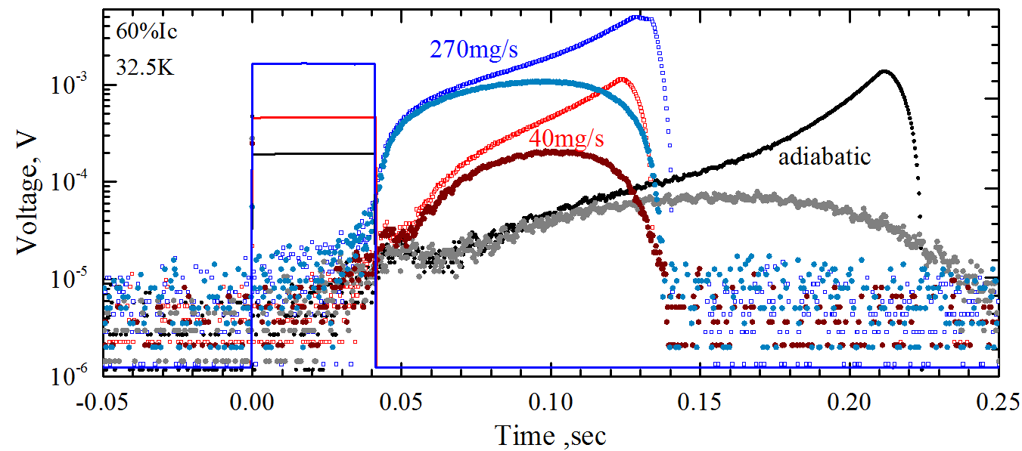
Quench by Local Disturbances in Helium gas
Flow channel formed using 3d-prited artefacts;
Flow rate up to 270mg/s covering laminar and turbulent regimes;
Outer surfaces insulated, negligible heat loss to He gas during pulses;
Flow change D = 3mm
Helium out
Helium in
Heater
MgB₂ wire
Helium gas cooling increases the minimum quench energy (MQE) and leads to much higher MPZ voltage:
Better stability and easier detection

Slide 19
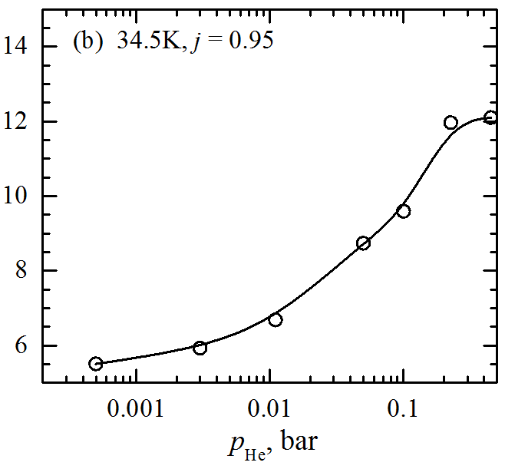
Quench by Local Disturbances in Helium gas
He flow MQE deviates from (1-j) reduction of the critical state;
Enhancement MQE by helium flow encouraging, but seemed higher than expectation as small ΔT of the MPZ is small;
Natural convection also results in higher MQE with smooth dependence on He pressure;

Slide 20
Conclusions
Quench calculation confirmed by experiments
Transient magnetic field scenario outlined
Significant ac loss in simple cable assembly observed experimentally
Quench by local disturbances in helium gas studied experimentally, higher MQE and MPZ voltages confirmed
Thank You
Funded by
HILUMI Design Study (EU FP7 2011-2015)
HL-LHC-UK (CERN/STFC 2016-2020)

