Slide 2

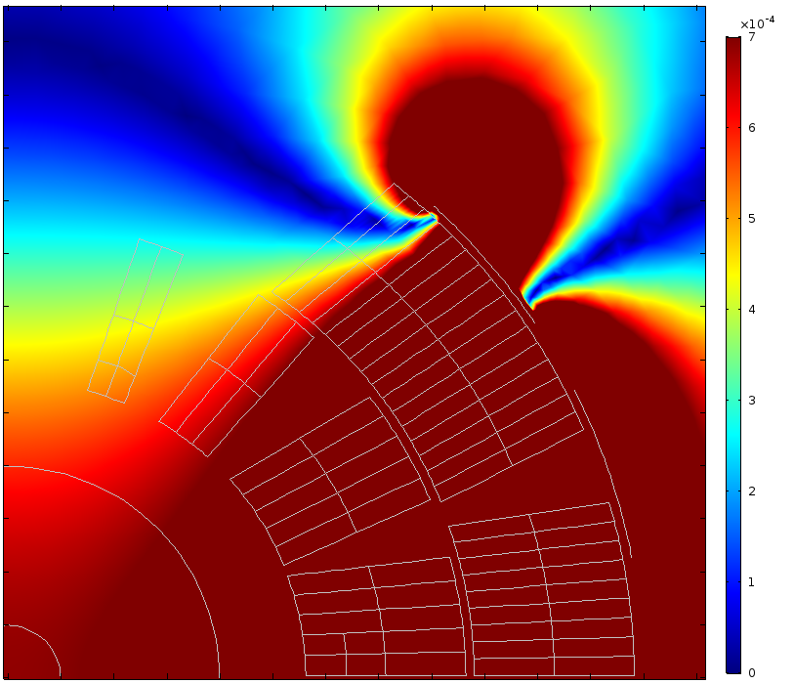
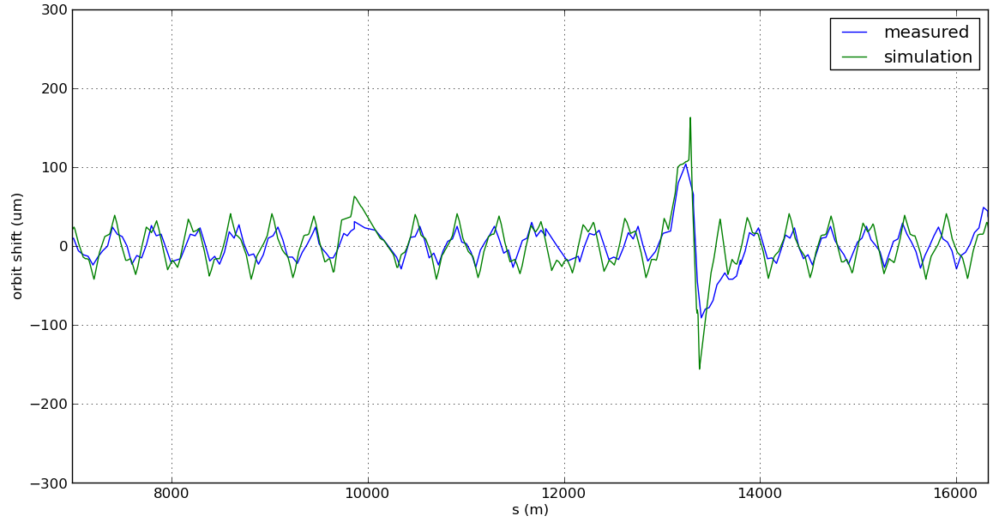
MD#1826: Measurement of QH vertical kick
Introduction:
  During training and beam induced quenches a vertical orbit oscillation was observed, the beam stays in the machine for a few ms afterwards.
  Quench Heaters are thought to be the source of this kick.
  The simulations fit the orbit measurements.
Merit of the MD:
  Confirm the Quench Heaters are the cause.
  Measure amplitude at injection and dump delay in case of spurious firing.
  Verify polarity of the connection on critical magnets and dependence on beta function.
  This is an important input for the magnet protection the HL magnets protection
  (11T, triplet, …)
10µm
35 turns, ~3ms
QH induced B_{x}=0.7 mT

Slide 3
MD#1826: Procedure to follow
Procedure:
  Over-inject a nominal per beam.
  Fire the QH (at injection energy).
  Measure orbit and dump delay.
  Quench recovery.
  Short pre-cycle.
Preparation, special settings & readiness:
  Firing the QH can be done by simulating a quench signal via the QPS.
  Just like during the HW commissioning but with beam.
  No other special settings required.
Time Requested: 3 magnets x 2h = 6h
Foreseen for MD block 5: Friday 28 October 3-8AM
Between 1 and 2 hours

Slide 4
MD#1826: Magnet to be used
Magnet Protection aspect:
  MBC28L5 is known to have QH connected in a skew dipole way. We start from this one and explore the half-cell around it, but:
  MBA29L5, #2151, 2 propagated quenches @3538 A & 5234 A
  MBC28L5, #3211, beam induced quench@10971 A
  MBB28L5, #2148, training quench @10942 A, propagated @6530 A
  MBA28L5, #1186, 2 propagated quenches @6705 A & 2552 A
  MQXBL1 (close to 31L2), MQXBL2 (same plus recent MKI erratic)
  MQXBL5, OK
If there is time:
  MQXBR5, OK
  MB.A27.L5, lots of quenches, not OK
  MBA31L5, #3207, training quench @10728A, propagated @549A
Approved by MP3

Slide 6
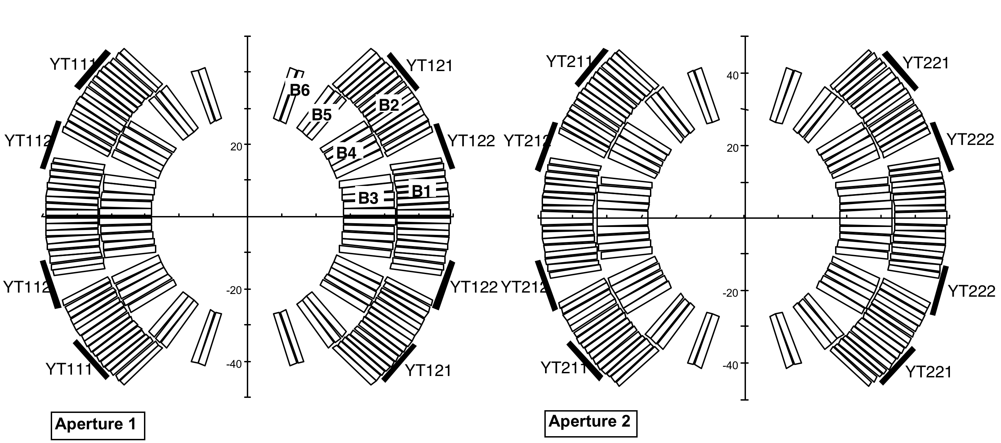
MD#1182: Measurement of QH vertical kick
Most common connection scheme for the main dipole
+
-
-
+
B_{x}≠0
B_{x}≠0
+
-
+
-

Slide 7
MD#1182: Measurement of QH vertical kick
Orbit oscillation amplitude at the TCPD as a function of the MB where the QH is fired (simulation)

Slide 8
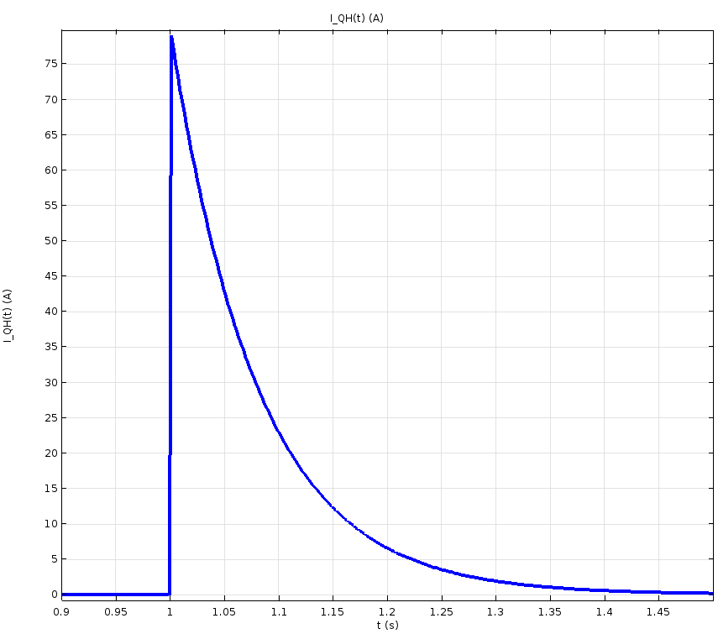
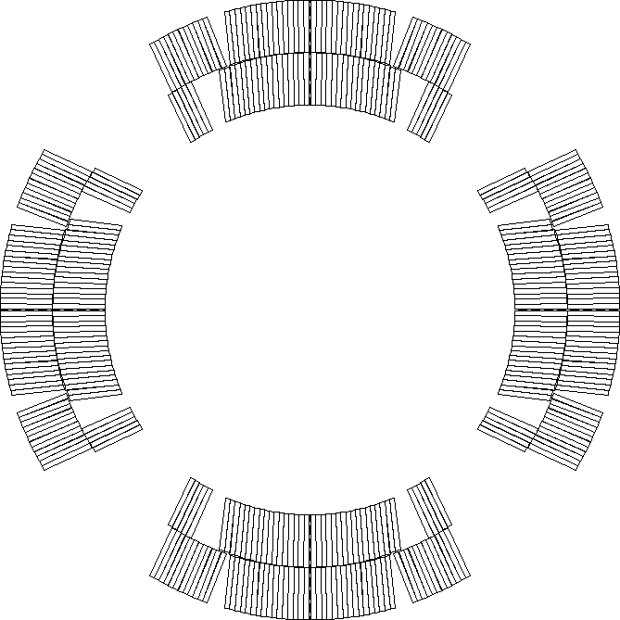
MD#1182: Measurement of QH vertical kick
Baseline connection scheme for the Hi Lumi triplet.
QH current decay
LF3
LF2
HF2
HF3
HF4
HF1
IN3
IN2
80ms
LF4
IN4
IN1
LF1
LF1
IN1
IN4
LF4
20µs
IN2
IN3
HF1
HF4
HF2
LF2
LF3
HF3

