Slide 1
Preliminary estimations of the RF gun with 6.5 nC
A.Barnyakov, D. Nikiforov, A. Levichev
BINP
A.E.Levichev@inp.nsk.su

Slide 2
Outline
RF Gun overview
Description of BINP RF gun prototype
RF Gun requirements
Possible FCC Gun Design
Beam dynamics simulation
Conclusion

Slide 3
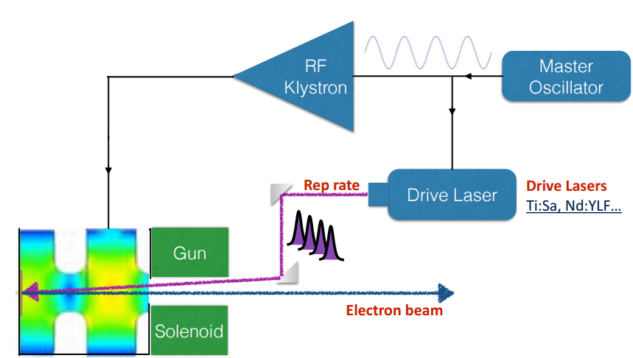
RF Gun Overview
S-band
An ultra short laser pulse ejects a bunch of electrons into accelerating RF field.
Photocathode material:
Metal: Cu, Mg….
Semi-conductor: CsTe, AsGa…

Slide 4
RF Gun Overview
  The RF Gun concept offers many advantages:
  The electron bunch length is determined by the laser pulse width, which may be less then 100 fs at present time. This eliminates the need for a buncher section.
  Very low emittance can be produced simply by decreasing the laser spot size at the photocathode.
  The RF Gun can provide very high acceleration gradients, minimizing the space charge emittance growth when the electrons are nonrelativistic.
  The gun can operate at the same RF frequency as the linac (in our case 2856 MHz)
  Emittance terms:
  Six main emittance terms contribute to the electron beam’s total normalized RMS emittance.
1) The Space charge emittance (due to the SC repulsion)
2) RF emittance (due to the defocusing kick at the gun exit)
3) Field asymmetry (misalignment of the max. accelerating field and the beam line axes)
4) Cathode magnetic field emittance (due to cathode magnetization)
5) Intrinsic emittance (depends on the difference in laser photon energy and the work function of the cathode material)
6) Physical temperature of the cathode

Slide 5
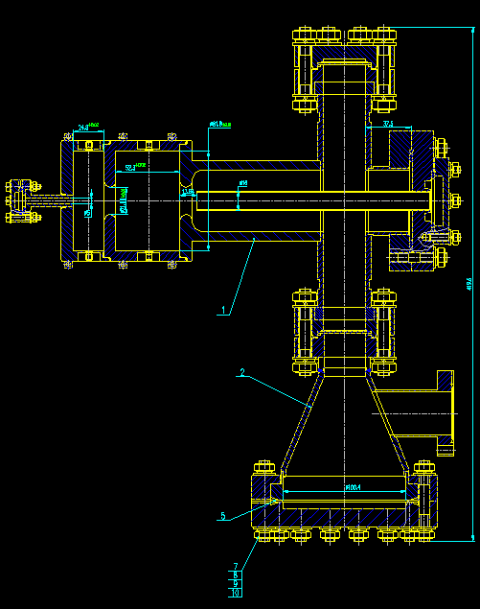
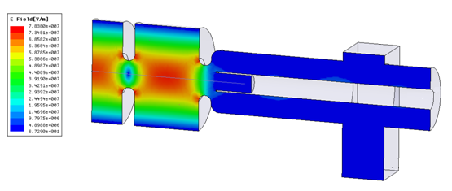
Description of BINP RF gun prototype
RF Gun parameters | Value
Frequency (MHz) | 2856
Oscillation mode | π
Energy (MeV) | up to 3
Input power | up to 4 MW

Slide 6
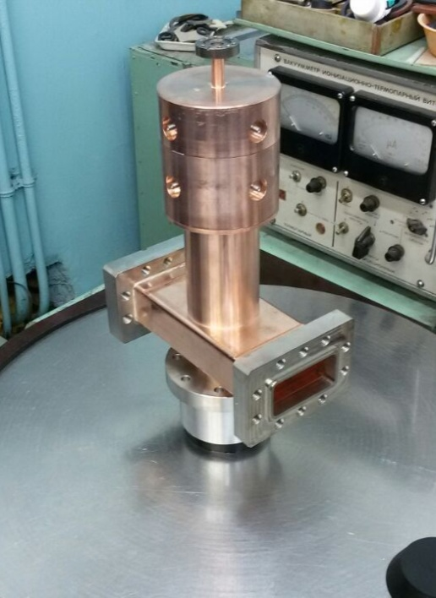
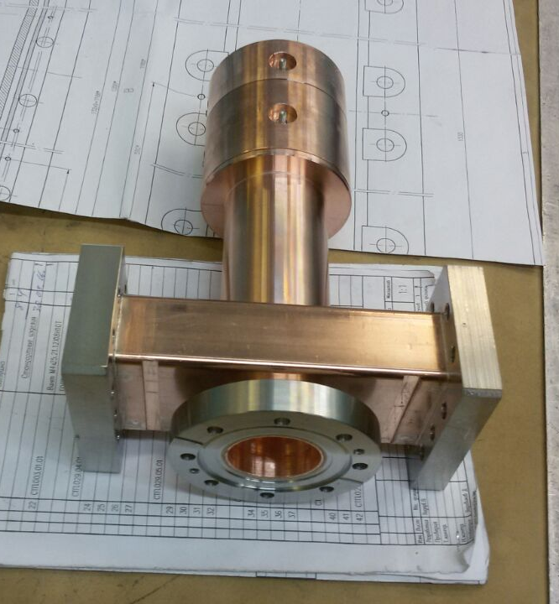
BINP RF gun prototype

Slide 7
FCC RF Gun requirements*
Gun Parameters | Value
Energy (MeV) | 10-12
Charge (nC) | 6.5
Horizontal emittance (um) | 0.35 (or less)
Vertical emittance (um) | 0.5 (or less)
Longitudinal sigma (mm) | 1
Transverse sigma (mm) | 1-2
*- Salim Ogur private discussion

Slide 8
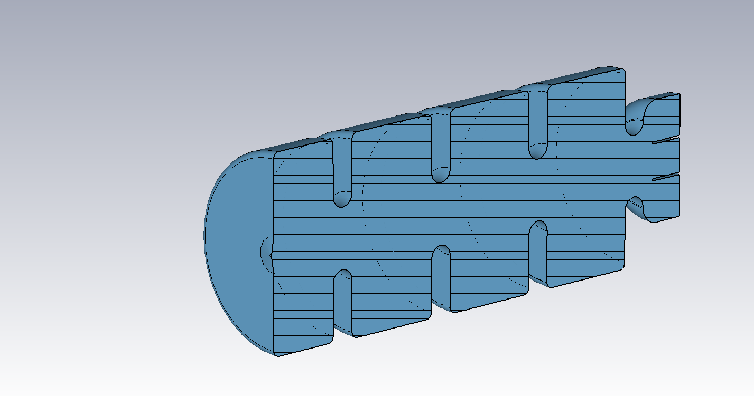
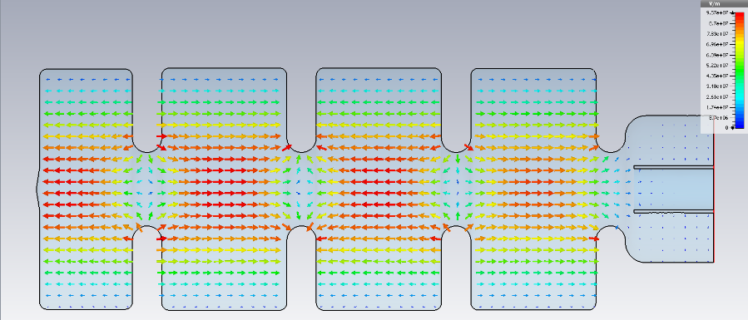
Possible FCC Gun Design
3+1/2 cavity cells with coaxial type feeder for power supplying
The phase shifting of oscillating mode is π

Slide 9
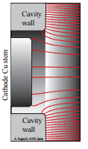
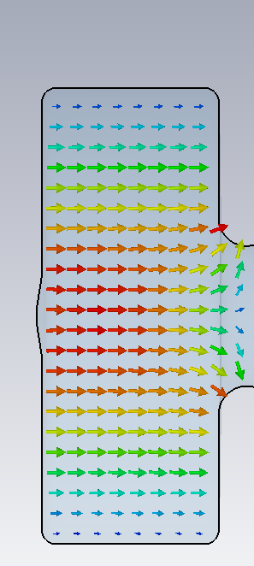
Possible FCC Gun Design (RF focusing)
Numerical simulations and theoretical analyses deliver, that small emittances are obtained, when the cathode is pulled behind the back wall of the cavity. In this area there is an effect of RF focusing acting by the distortion of force lines of the accelerating field, where the radial electric field component compress the beam. Such "cathode RF focusing" partially reduce the increase of transverse emittance
V.Volkov, D.Janssen, “RF Focusing - an Instrument for Beam Quality Improvement in Superconducting RF Guns”, 7th European Particle Accelerator Conference, Austria Center Vienna, June 2000, p.2055-2057.]
D.Janssen, V.Volkov, “RF focusing-an instrument for beam quality improvement in superconducting RF guns”, Nuclear Instruments and Methods in Physics Research, A 452 (2000) 34-43.

Slide 10
Beam dynamic simulation
Available codes: ASTRA, CST Microwave Studio
ASTRA simulation parameters
Number of electrons | 10^4
Thermal emittance | 0.00
Initial kinetic energy | 0.6 eV
Total charge | 6.5 nC
Cathode spot size | 2 mm
Initial transverse distribution | Flat-top
Laser pulse duration | 5 ps
Laser injection phase | 7 deg
Magnetic field on the cathode | 0 T
Peak accelerating field | 100 MV/m
Focusing solenoid field | 0.55 T

Slide 11
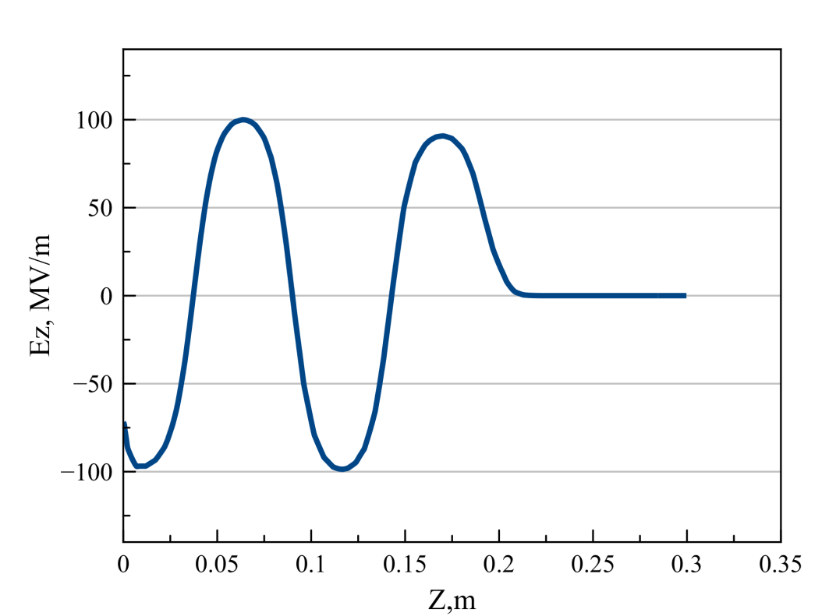
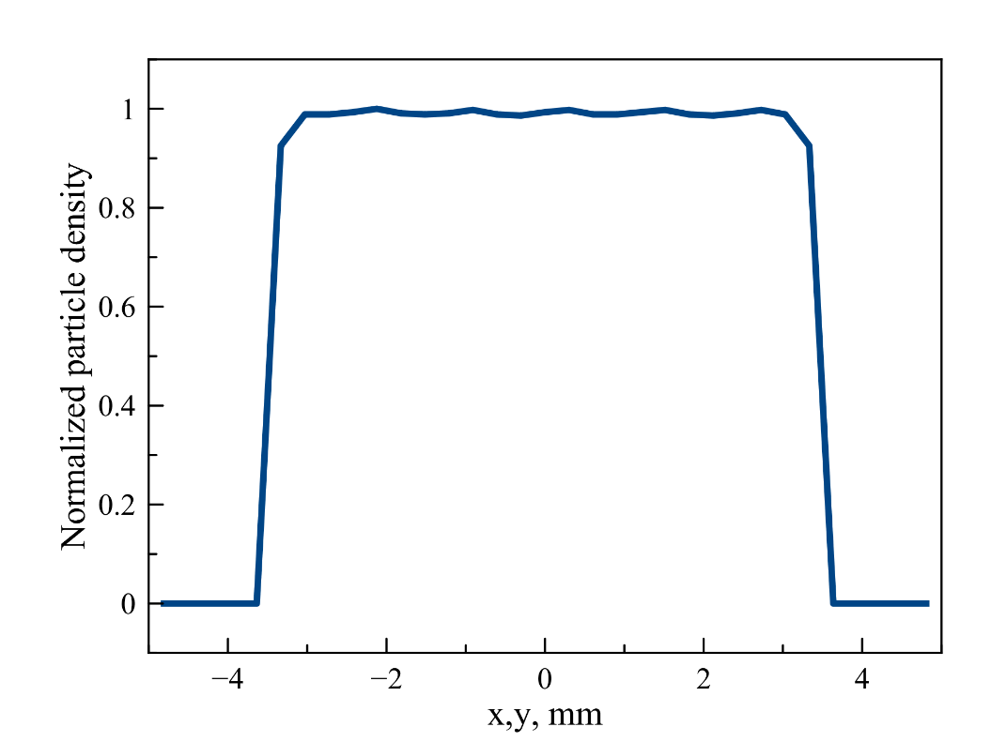
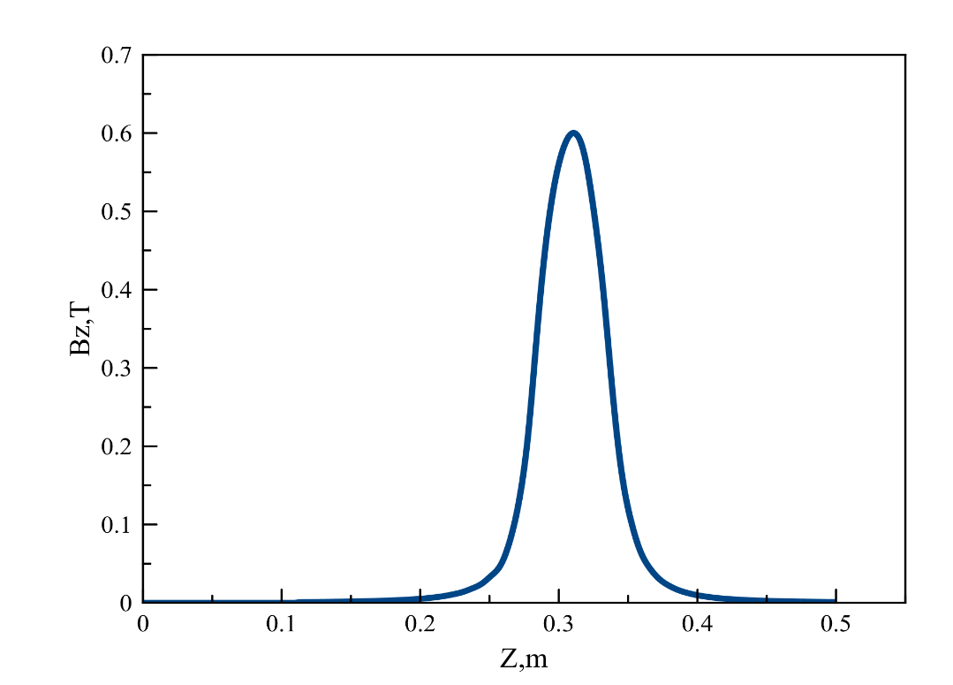
Electric and magnetic field distributions
Parameters | Value
Input RF power | 18 MW
The solenoid length | 50 mm
Initial beam transverse distribution | Flat-top

Slide 12
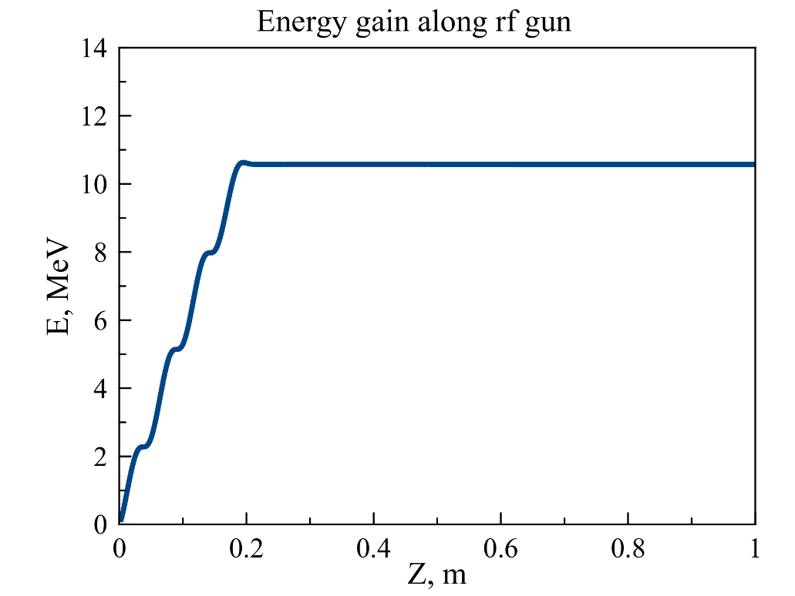
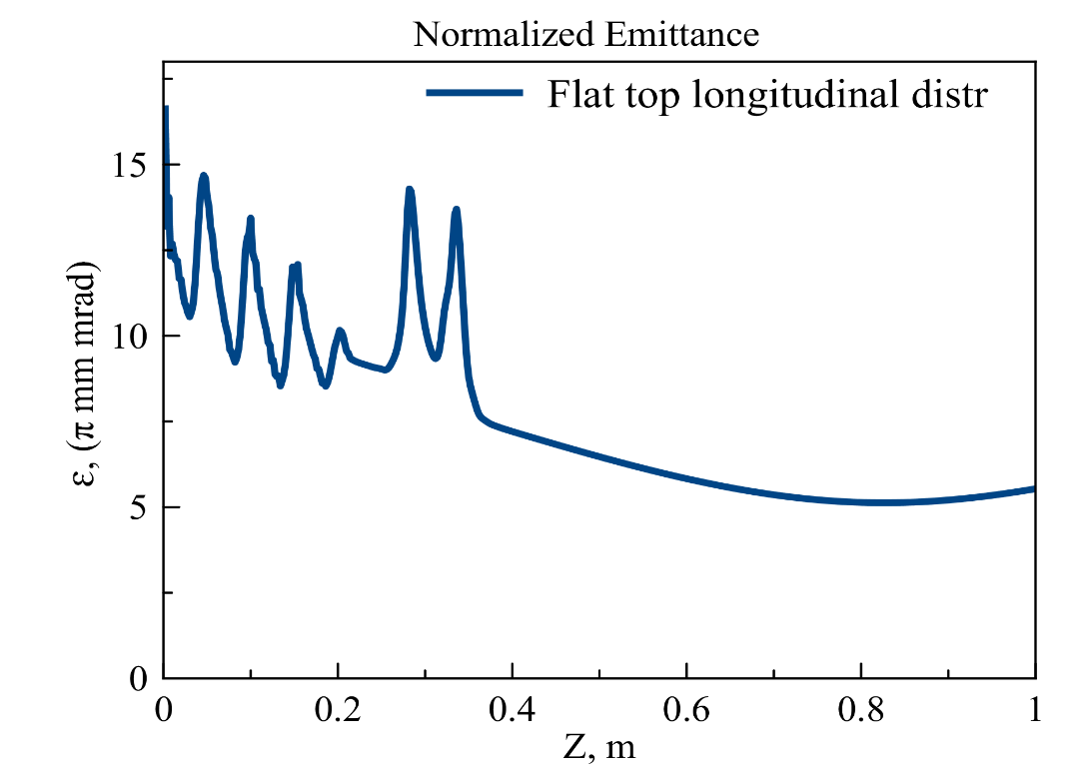
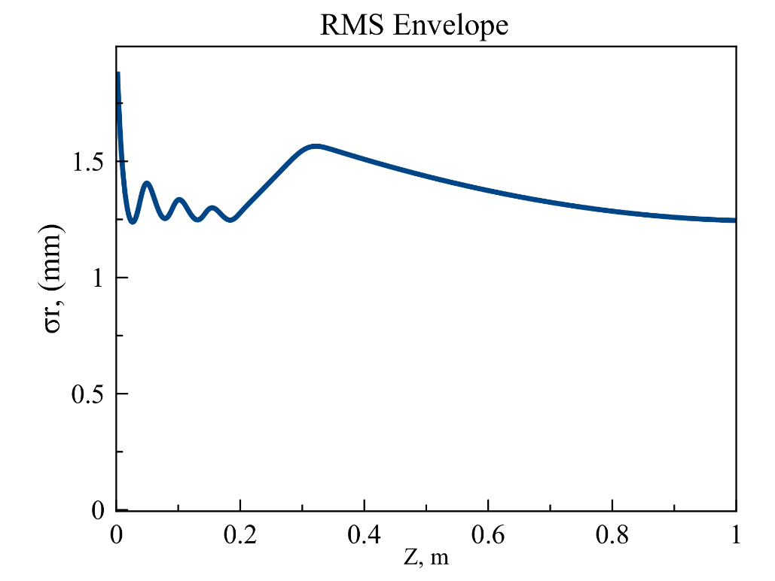
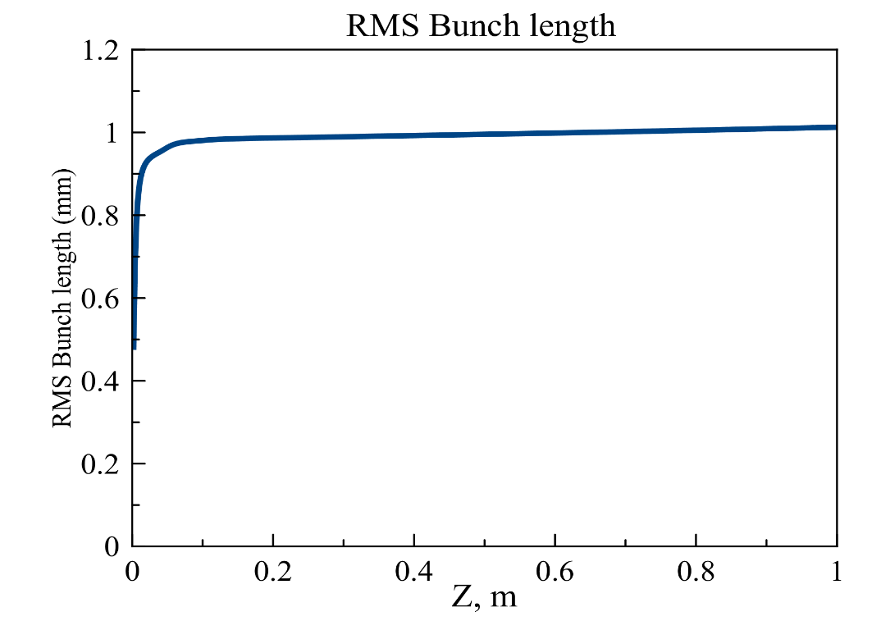
Beam dynamics

Slide 13
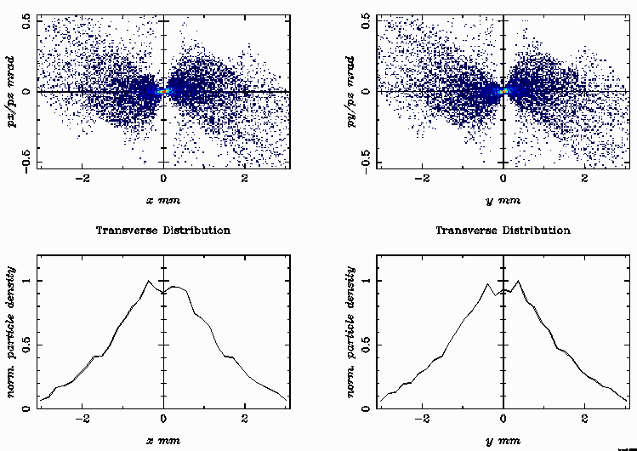
Transverse phase spaces

Slide 14
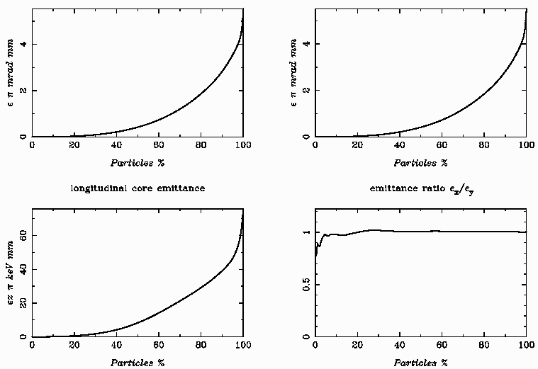
Normalized core emittance

Slide 15
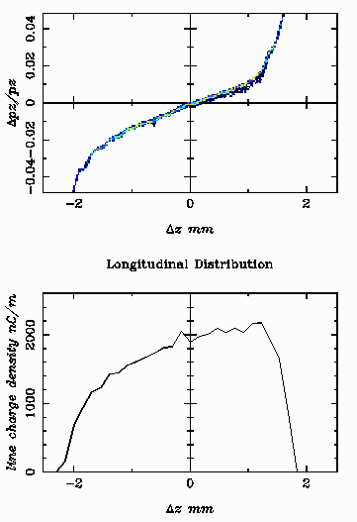
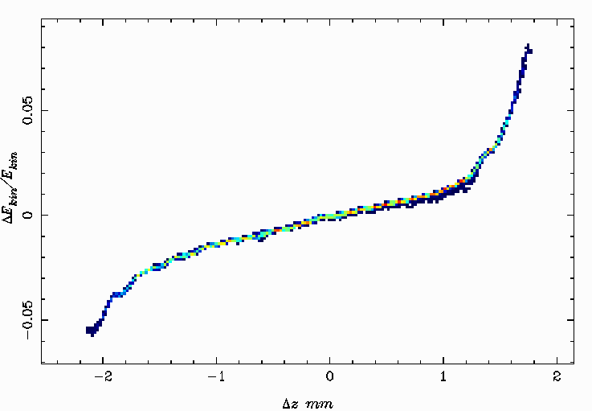
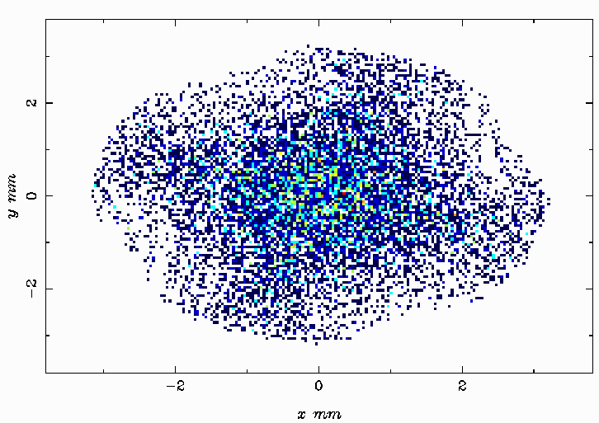
Longitudinal phase space and beam profile

Slide 16
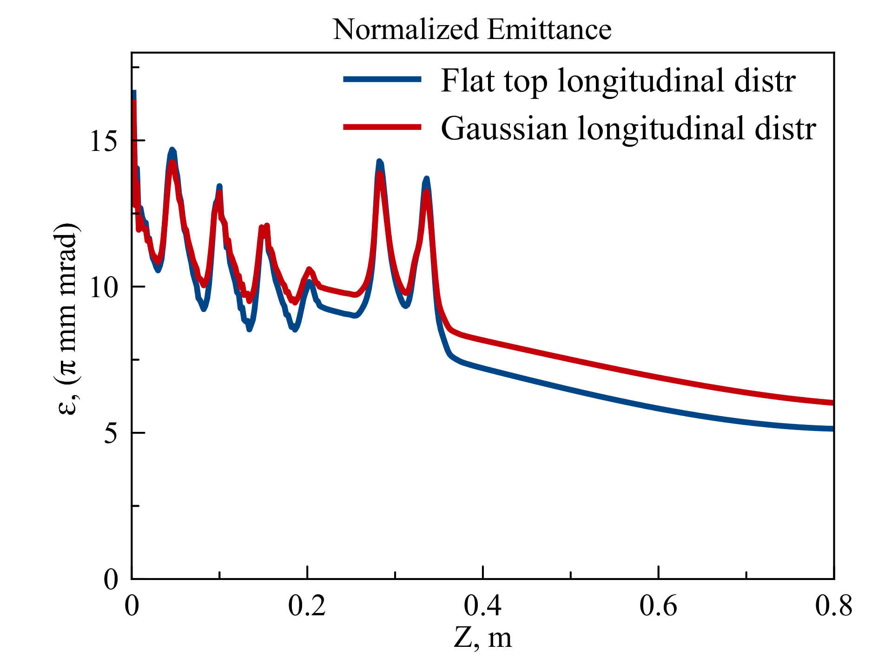
Comparison of Flat Top with Gaussian distribution

Slide 17
Output beam parameters
Beam parameters
Charge | 6.5 nC
Average energy | 10.5 MeV
Energy spread | 1.5%
Normalized transverse emittance | 5 π mm mrad (0.24 um)
RMS transverse emittance (geom) | 0.1 π mm mrad
RMS beam length | 1 mm
Beam radius | 3 mm

Slide 18
Conclusion
RF gun:
1. Design of the gun can be improved
2. The shape of the electrode near the cathode has to be researched. It is improved the beam dynamics.
Conditions for low emittance:
1. Flat top profile of the laser
2. Symmetrical coaxial type feeder for RF power supplying
3. Beam energy
4. Initial transverse beam size and length
Choice of photocathode and laser system:
1. To produce 6.5 nC the cathode material has to be researched
2. Parameters of the laser has to be chosen
3. The cathode life time has to be researched (high power laser will destroy the cathode)
4. Input cathode system, allowing the gun training, has to be developed

Slide 19



Space charge limit
Intrinsic emittance
RF emittance

