Slide 1

BRINGING REALTIME MEDIA CAPABILITIES TO YOUR INTERFACE WITH WEBRTC
Francisco Valentín
14/02/2017

Slide 2
BRINGING REALTIME MEDIA CAPABILITIES TO YOUR INTERFACE WITH WEBRTC
Francisco Valentín
14/02/2017
Francisco Valentín
14/02/2017

Slide 3

Web
RTC
Francisco Valentín
14/02/2017

Slide 4
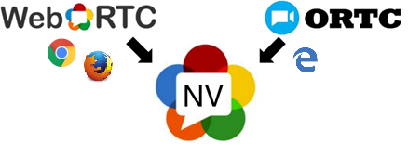
Web
RTC
JavaScript API for peer-to-peer Real-Time Communications
Video, audio, IM, data in the browser
Plugin-free!
5 years relationship
Originally just for Chrome, Firefox and Opera
Microsoft entered the game with ORTC
Native iOS and Android code too

Slide 5










Web
RTC: offspring

Slide 6
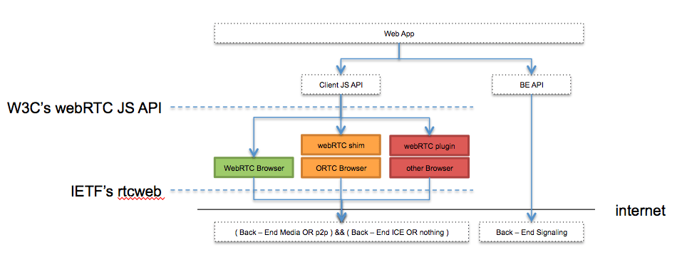
Web
RTC:
Source: webrtcbydralex.com

Slide 7



Web
RTC: polyfill
Your JavaScript code
Adapter.js (shim)
WebRTC 1.0
ORTC

Slide 8
Web
RTC: polyfill (without)
navigator.getUserMedia = navigator.getUserMedia || navigator.mozGetUserMedia || navigator.webkitGetUserMedia;
window.RTCPeerConnection = window.RTCPeerConnection || window.mozRTCPeerConnection || window.webkitRTCPeerConnection;
window.RTCIceCandidate = window.RTCIceCandidate || window.mozRTCIceCandidate || window.webkitRTCIceCandidate;
window.RTCSessionDescription = window.RTCSessionDescription || window.mozRTCSessionDescription || window.webkitRTCSessionDescription;

Slide 9

Web
RTC: Interfaces
MediaStream (aka getUserMedia)
RTCPeerConnection
RTCDataChannel

Slide 10
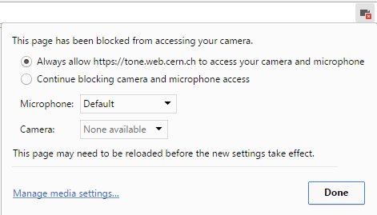
Web
RTC: Media Stream
Detect’s the user devices and creates a stream
1 stream = synchronized media tracks (audio, video)
var constraints = {video: true};
navigator.getUserMedia(constraints, successCallback, errorCallback);

Slide 11
Web
RTC: Peer Connection
Establishes a P2P channel with the other end.
Provides security and bandwidth allocation.
Codes/decodes incoming and outgoing streams (VP8, OPUS)
Creates the SDP (Session Description Protocol) from the MediaStream.

Slide 12
Web
RTC: Peer Connection (2)
pc = new RTCPeerConnection(null);
pc.onaddstream = gotRemoteStream;
pc.addStream(localStream);
pc.createOffer(gotOffer);
function gotOffer(desc) {
pc.setLocalDescription(desc);
sendOffer(desc);
}
function gotAnswer(desc) { pc.setRemoteDescription(desc);}
function gotRemoteStream(e) { attachMediaStream(remoteVideo, e.stream);}

Slide 13
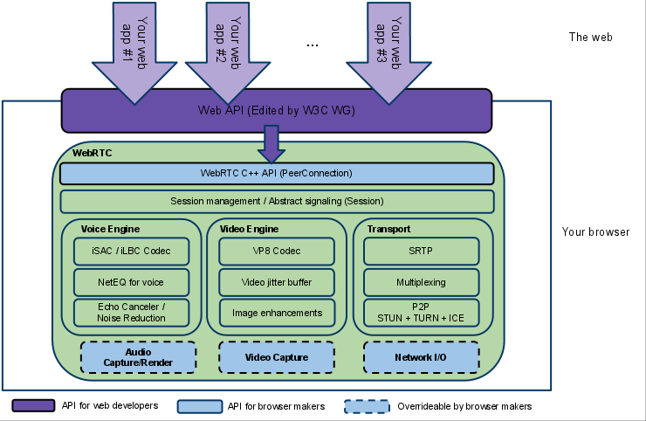
Web
RTC: Peer Connection (3)

Slide 14
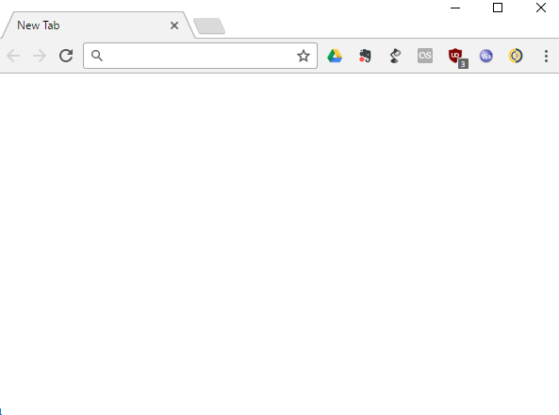

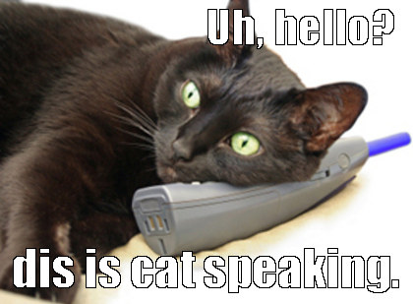

Web
RTC: P2P

Slide 15



Web
RTC: P2P – Nope with NAT
NAT

Slide 16

Web
RTC: P2P – You need STUN
Who am I?

Slide 17
Web
RTC: You want a Back End
Media transmission is P2P
You need a backend to discover other peers.
You need signalling to offer your media capabilities to others.
Source: webrtcbydralex.com

Slide 18
Web
RTC: P2P with Back End
Back End
Initial signalling exchange
Initial signalling exchange
SIP
XMPP
NODE

Slide 19
Web
RTC: Data Channel
For arbitrary binary streams (gaming, IoT)
Same API as WebSockets.
Unreliable / reliable transmission.

Slide 20
Web
RTC: Full Picture
STUN
Back End

Slide 21
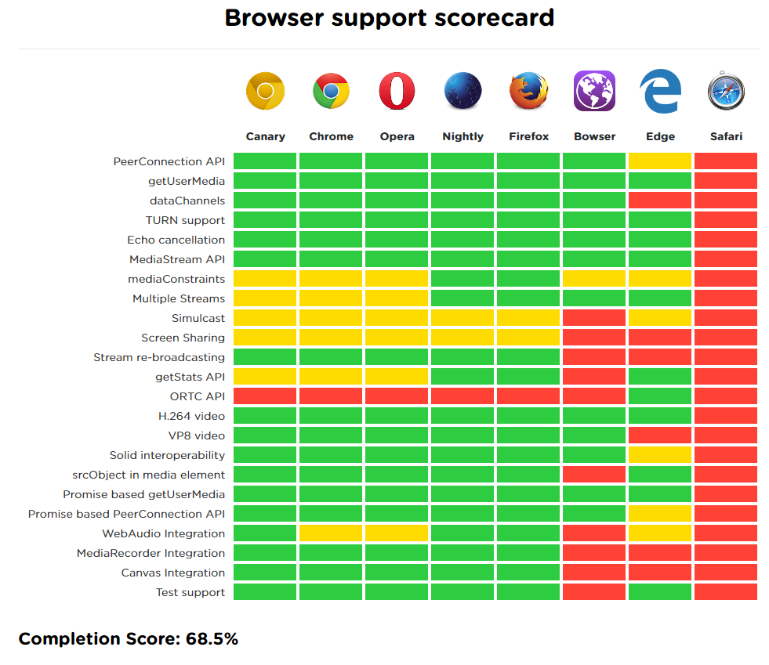
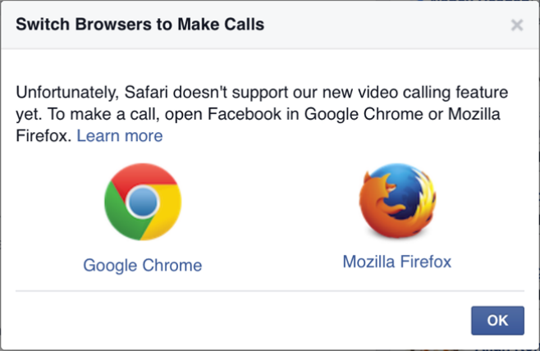
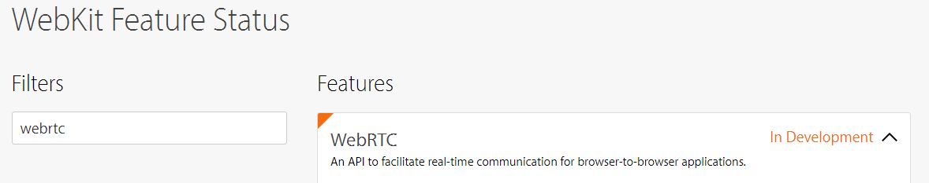
isWebRTCreadyyet.com

Slide 22

Web
RTC: Conclusion
Entry-level: basic JS skills
Uncomplicated API
Easy to set-up a demo with Node.js
You need to understand the STUN and
Back End signalling exchange…
…or you can use a CPaaS:
Twilio, ONSIP, Nexmo, TokBox, Tropo.
(or a framework: easyRTC, simpleWRTC, OpenRTC, PeerJS)

Slide 23
Questions?
Francisco.Valentin@cern.ch

