Slide 1
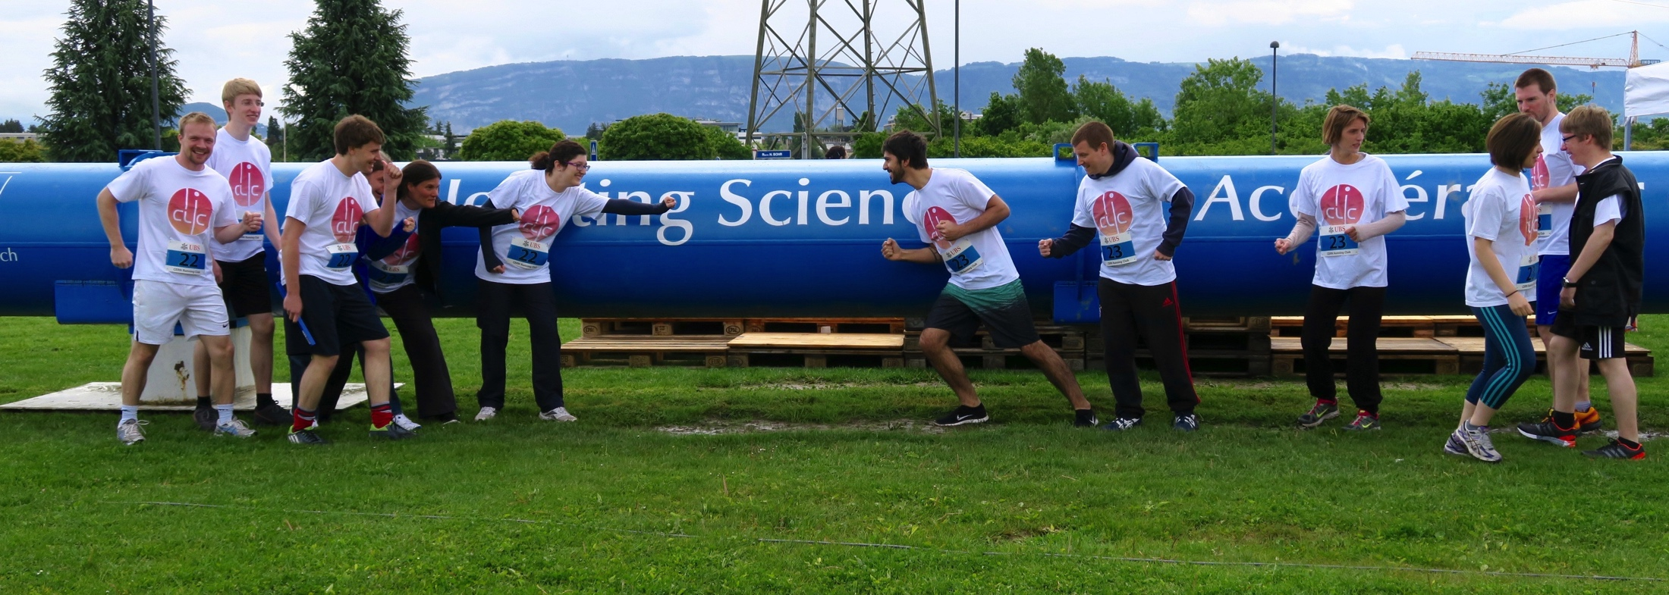
CLICdp welcome and news
Lucie Linssen
CLIC workshop
March 7th 2017

Slide 2
Outline
CLICdp collaboratrion
CLICdp at this workshop
Re-submission of the CLIC Higgs overview publication
CLICdp plans for the European strategy update
CLIC and possible ambitions beyond 3 TeV
Upcoming LC events

Slide 3
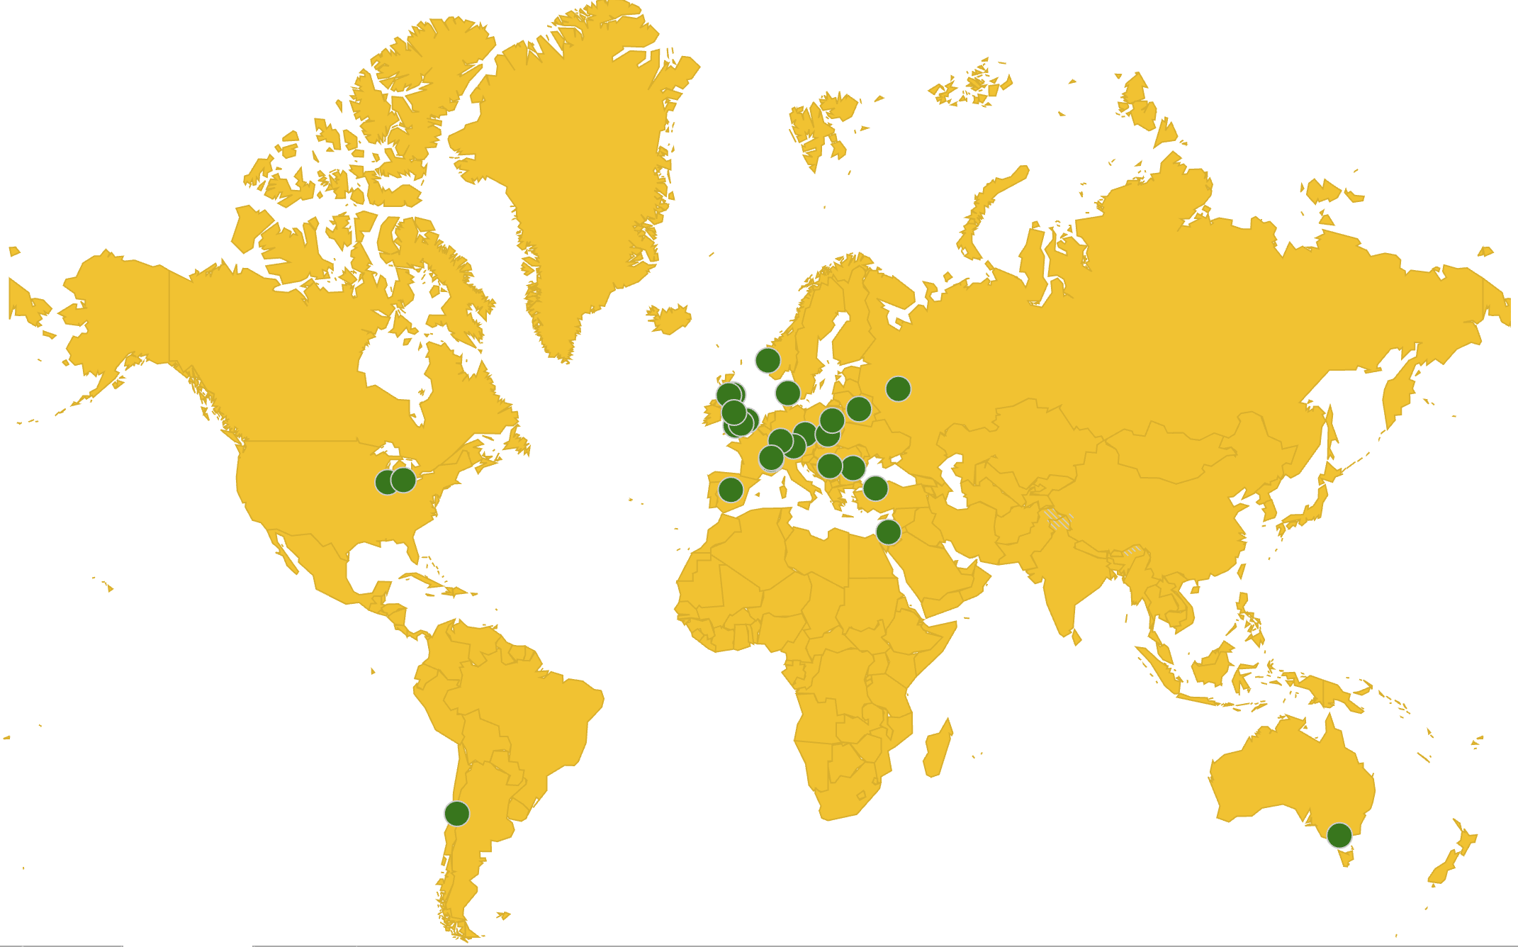
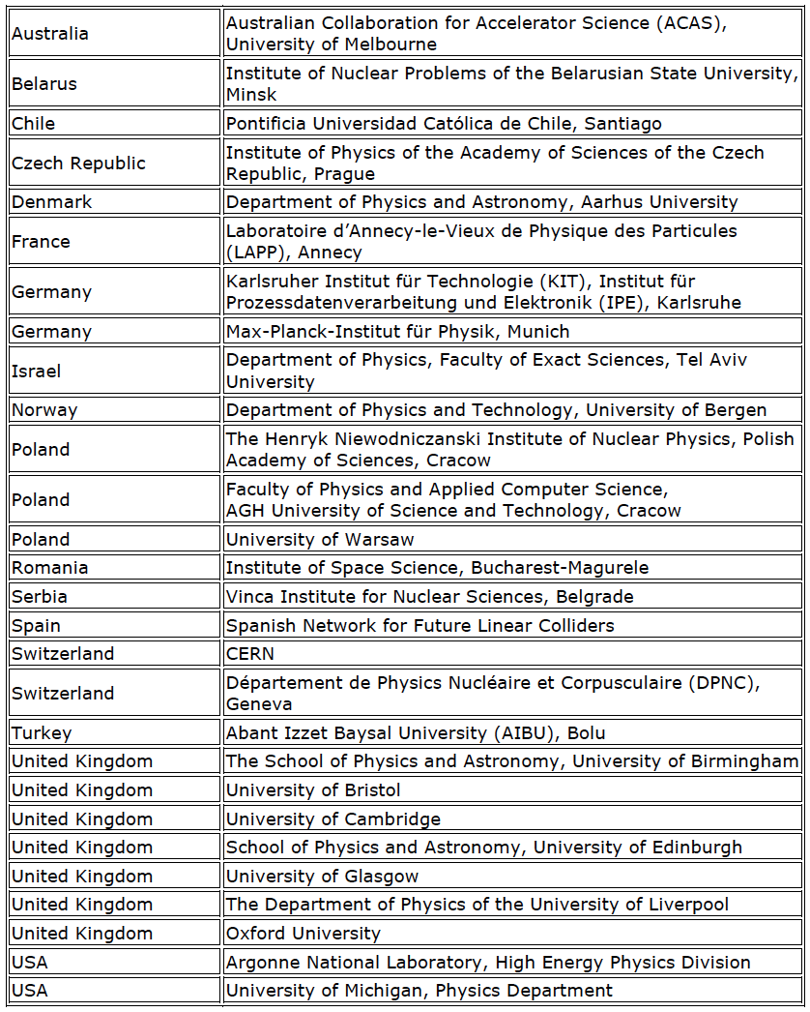
CLICdp collaboration
CLICdp
29 institutes from 18 countries
~150 members
Most recent institute joined:
Abant Izzet Baysal University (AIBU) in Bolu, Turkey
Representative: Haluk Denizli
Welcome !
http://clicdp.web.cern.ch/content/collaboration

Slide 4
CLICdp at this workshop
Workshop 2017:
~220 registrants (226 in 2016)
~80 physics/detector registrants (~67 at last CLICdp 2-day meeting)
~50 physics/detector presentations (all plenary)
Topical sessions and conveners:
Physics and Analysis (Igor Boyko, Wolfgang Kilian, Victoria Martin, James Wells)
Detector Validation / Detector Calibration and Alignment (Jean-Jacques Blaising, Philipp Roloff, Matthias Weber)
Software (Frank Gaede, Aidan Robson, Andre Sailer)
Vertex and Tracker R&D (Daniel Hynds, Andreas Nurnberg, Joost Vossebeld)
FCAL / ECAL / HCAL R&D (Marek Idzik, Eva Sicking)
Workshop dinner => Wednesday evening in CERN restaurant R1, included in workshop fee
CLICdp dinner => Thursday evening in St Genis => 47 participants ≈ maximum
Unfortunately, no snowshoe outing on Friday, due to weather conditions

Slide 5
Re-submission of CLIC Higgs physics paper
Higgs Physics at the CLIC Electron-Positron Linear Collider
https://arxiv.org/abs/1608.07538 and CLICdp-Pub-2016-001
Was submitted to EPJC in August 2016
Comments received from EPJC in Oct 2016:
  Systematic errors
  Detailed questions on various analyses
  Editing comments
Re-submitted to EPJC on 3/3/2017
Victoria Martin, Aidan Robson, Philipp Roloff, Frank Simon
Principal changes with respect to Aug 2016 version:
New section dedicated to systematic errors
Higgs self-coupling analysis => replaced by the recent analysis by Bono and Rosa
  Larger statistical error than before, still with room for improvement
Correlations taken into account in combined Higgs coupling fits.
Added a version of combined fit that includes theoretical errors.
Note that:
To avoid public presentation of different versions of our Higgs results,
for now please use the plots and figures from https://arxiv.org/abs/1608.07538

Slide 6
CLICdp documents in preparation for next European Strategy
CLICdp reports serving as ingredients for a CLIC summary report:
Updated Baseline for a Staged Compact Linear Collider (380 GeV, 1.5 TeV, 3 TeV) ✔
  arXiv:1608.07537, CERN-2016-004
  Higgs Physics at the CLIC Electron-Positron Linear Collider ✔
  arXiv:1608.07538
The new optimised CLIC detector model CLICdet ✔✔
  CLICdp note CLICdp-Note-2017-001 (detector/SW validation in progress)
An overview of CLIC top physics
  CLIC top physics publication => complete draft before the end of 2017
Extended BSM studies (hopefully also motivated by LHC discoveries)
  CLIC BSM overview publication in 2018
CLIC R&D report => with main CLIC technology demonstrators
  Summary publication(s) in 2018
Plan for the period ~2019-2025 in case CLIC would be supported by next strategy

Slide 7
CLIC and possible ambitions beyond 3 TeV
Exploring ambitious possibilities of:
Initial 380 GeV CLIC collider + extension to >>3 TeV using new technologies
Explored in a series of meetings, mostly accelerator experts + Philipp Roloff
https://indico.cern.ch/event/607729/
(open meetings, see mandate attached there)
Understanding such possibilities may allow to adapt CLIC design to future options
A main concern:
Difficult to accelerate positrons using plasma acceleration techniques
Sample of related questions for the physics:
What about?
Photon (1 TeV) – proton (LHC) collider?
Photon – photon collider at 2.4 TeV ?
Asymmetric electron – positron collisions ?
…….

Slide 8
Some upcoming LC community events
CLICdp 2-day meeting, planned for August 29-30 2017 @ CERN
2017
CALICE collaboration meeting, March 22-24, LLR Paris
https://agenda.linearcollider.org/event/7454/
Workshop on top physics at the LC, June 7-9, CERN
http://indico.cern.ch/event/595651/
LC vertex detector workshop, April 30 – May 3,Ringberg Schloss,
https://agenda.linearcollider.org/event/7450/
ALCWS, June 26-30, SLAC
Currently a 2-hour CLICdp session planned on Monday 26/6
Linear Collider workshop LCWS17, Strasbourg, France
Proposed dates: week Oct 23 – Oct 27 or week Oct 30 - Nov 3

Slide 9
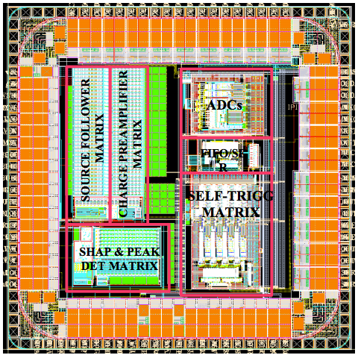
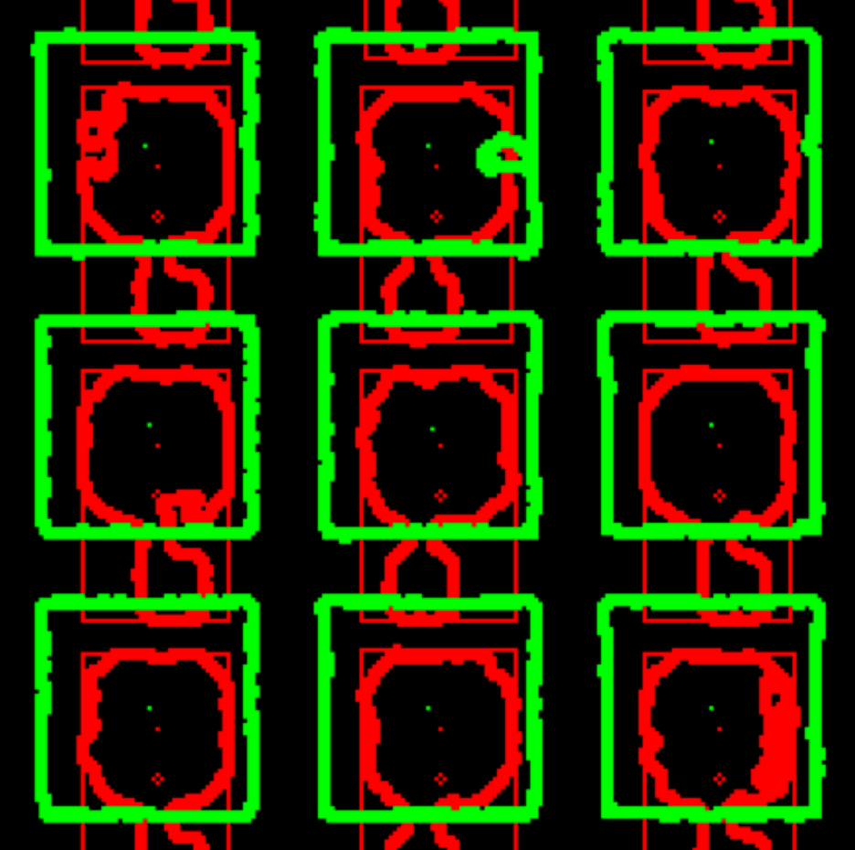
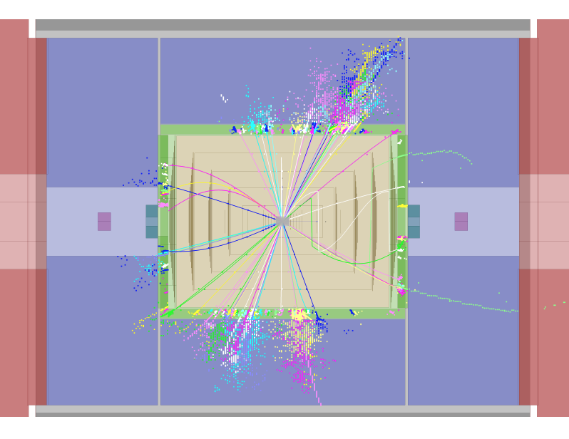
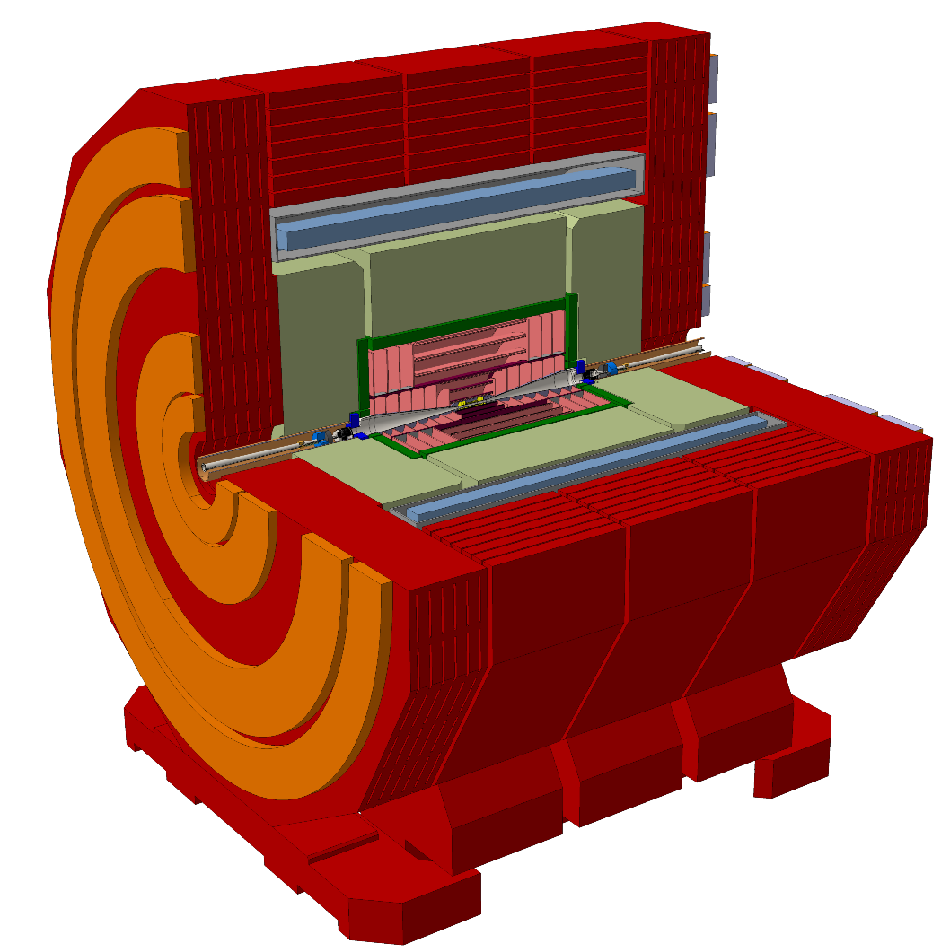
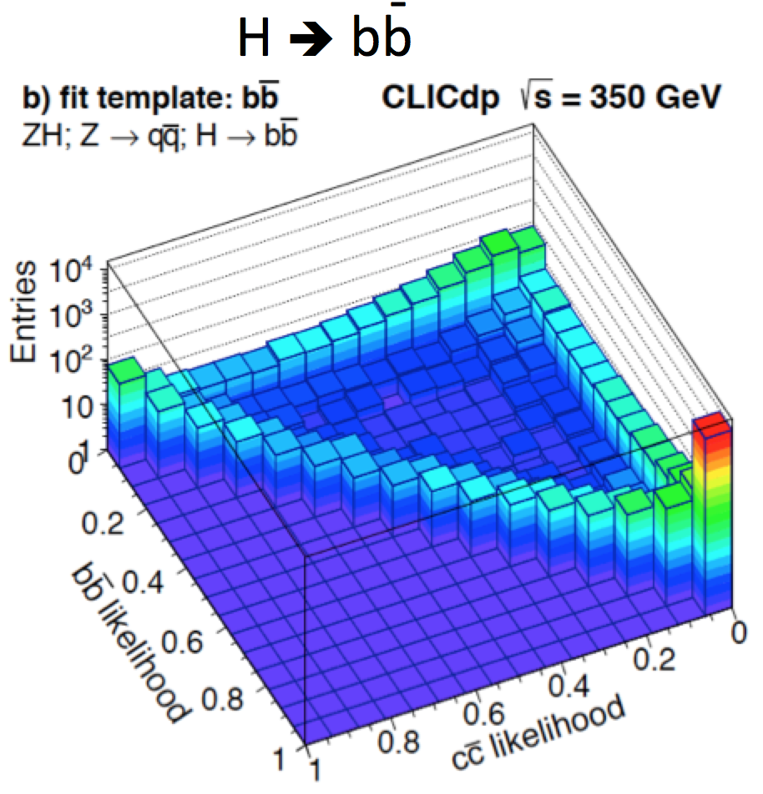
Thank you for attending,
and have a nice workshop !
S/B ~ 10⁻⁵
Work in progress
CLIC 3 TeV

Slide 10
extra slides

