Slide 1
RF activities for SwissFEL
Paolo Craievich on behalf of RF group - Paul Scherrer Institut
High-Gradient applications outside particle physics, CLIC Workshop, 6-10 March 2017

Slide 2
Outline
Some RF activities in SwissFEL
  2.5 cell S-band RF gun
  Status of C-band linac
Consolidation of the RF technology at PSI
  CERN-PSI X-band accelerating structures
  Post-undulator X-band Transverse Deflecting Structures
  → ongoing collaboration between CERN-PSI-DESY
  RF Travelling-Wave Electron Guns

Slide 3
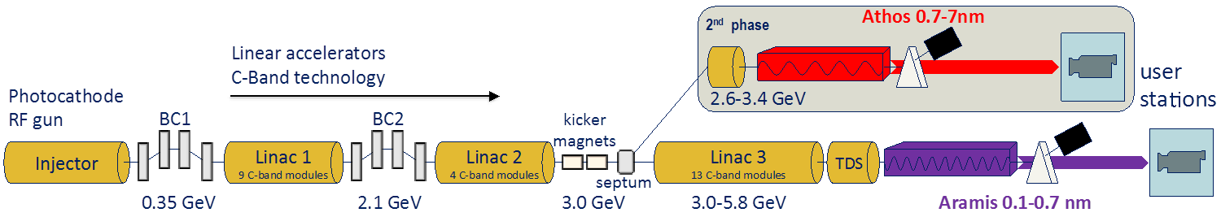
SwissFEL overview
Athos 0.6–6 nm
Aramis 0.1–0.6 nm
ARAMIS
  Hard X-ray FEL, λ=0.1 - 0.6 nm (12-2 keV)
  Linear polarization, variable gap, in-vacuum undulators
  First Pilot Experiment by End 2017 (SASE)
  Operation modes: SASE & self seeded
ATHOS – Beam Energy 2.78 – 3.22 GeV
  Soft X-ray FEL, λ=0.6 - 6.0 nm (2-0.2 keV)
  Variable polarization with Apple-X undulators (2 m length)
  2nd construction phase 2017 – 2020
  Operation modes: SASE & self seeded & many more
  Main parameters
  Wavelength from 0.1 nm–6 nm
  Photon energy 0.2-12 keV
  Pulse duration (rms) 2 fs - 30 fs
  e⁻ Energy (0.1 nm) 5.8 GeV
  e⁻ Bunch charge 10-200 pC
  Repetition rate 100 Hz

Slide 4
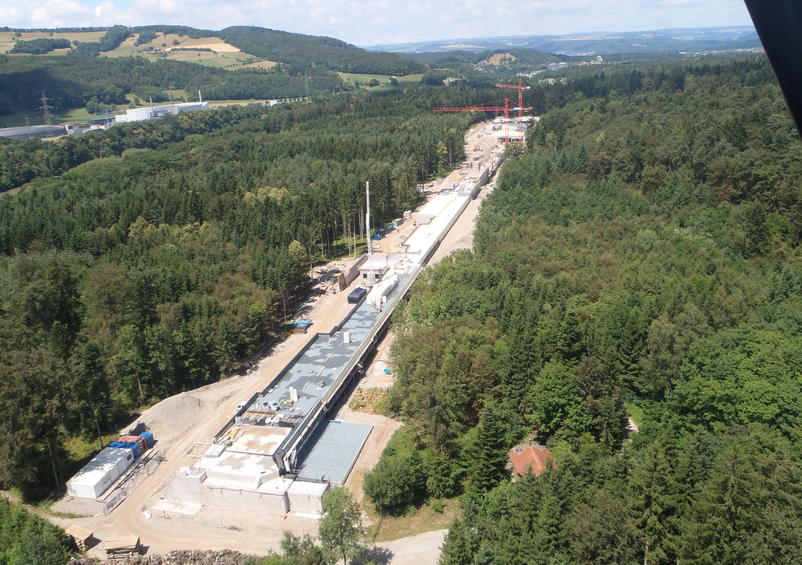
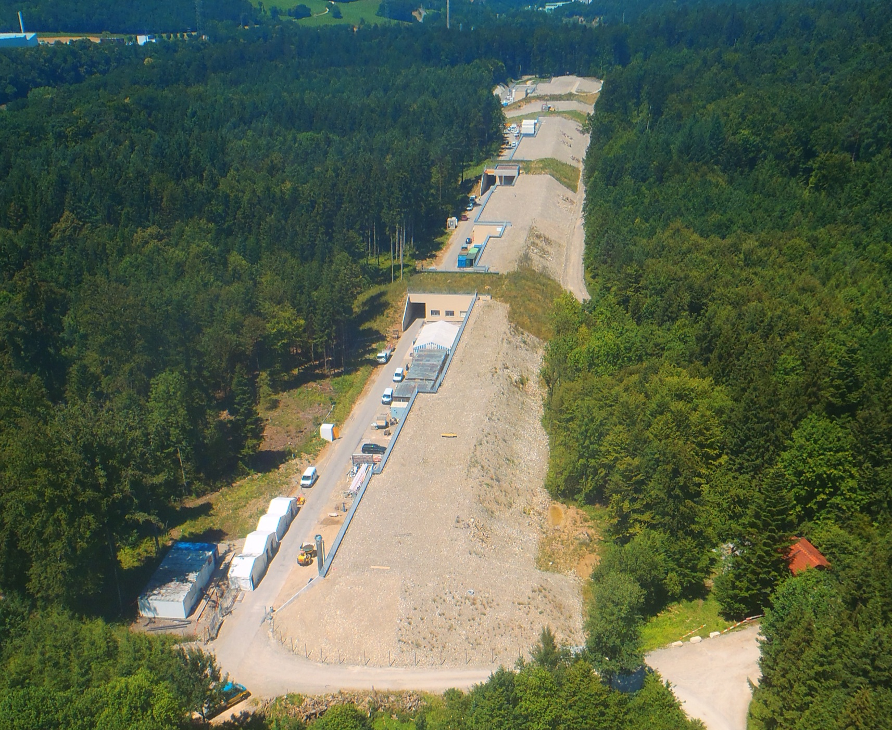
SwissFEL site
Proton cyclotrons
Experiment hall
Linac
Undulators
SLS synchrotron
Building key figures
overall length: 740 m
soil movements: 95’000 m3
casted concrete: 21’000 m3 or 50’000 t
Injector

Slide 5
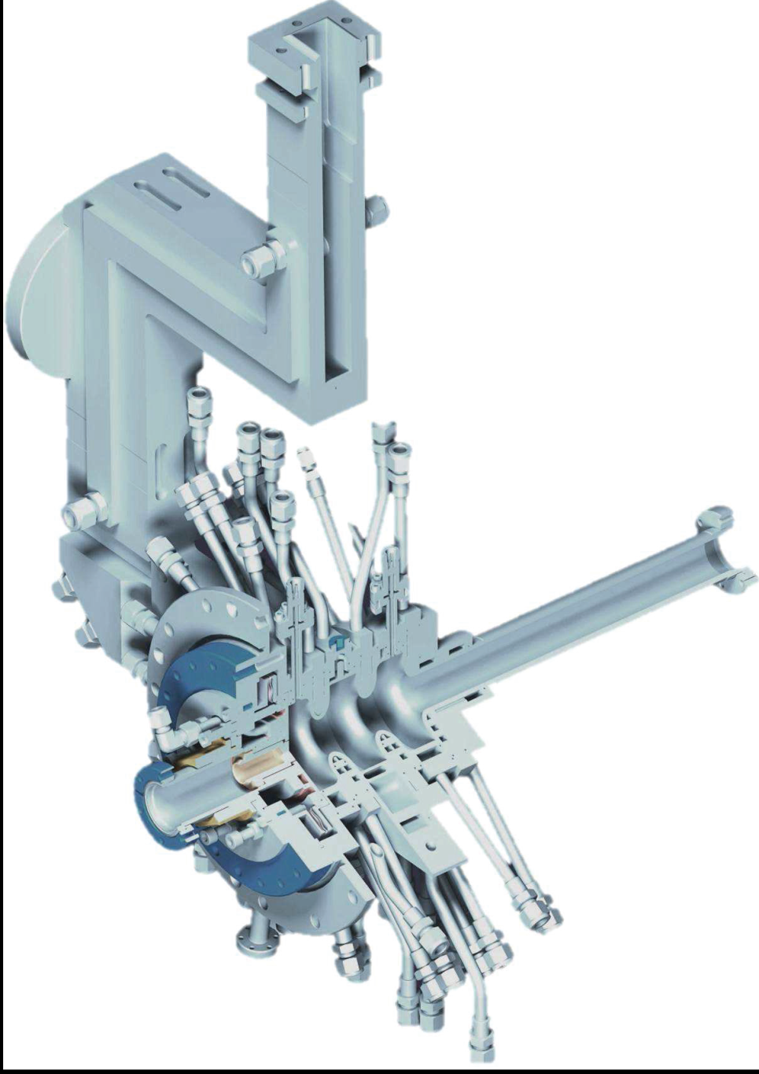
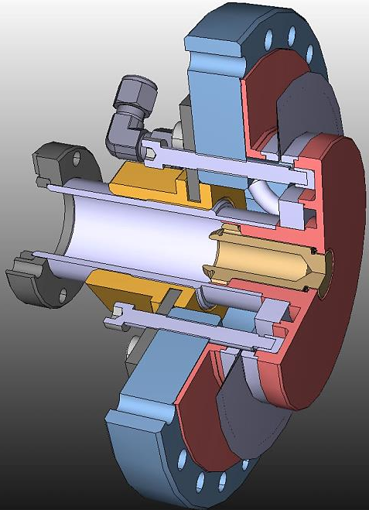
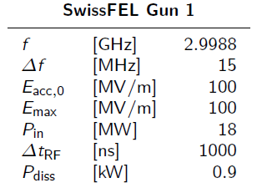
2.5 cell S-band RF gun
Best design features from LCLS and CTF/PHIN RF guns adopted
Machined “on tune” according to HFSS
No tuning plungers
No tuning step during machining
Quadrupole compensated symmetric coupler
Load lock chamber
β=2
RF and mechanical design: PSI
Fine machining cavities : VDL
Pre-machining & brazing: PSI workshop

Slide 6
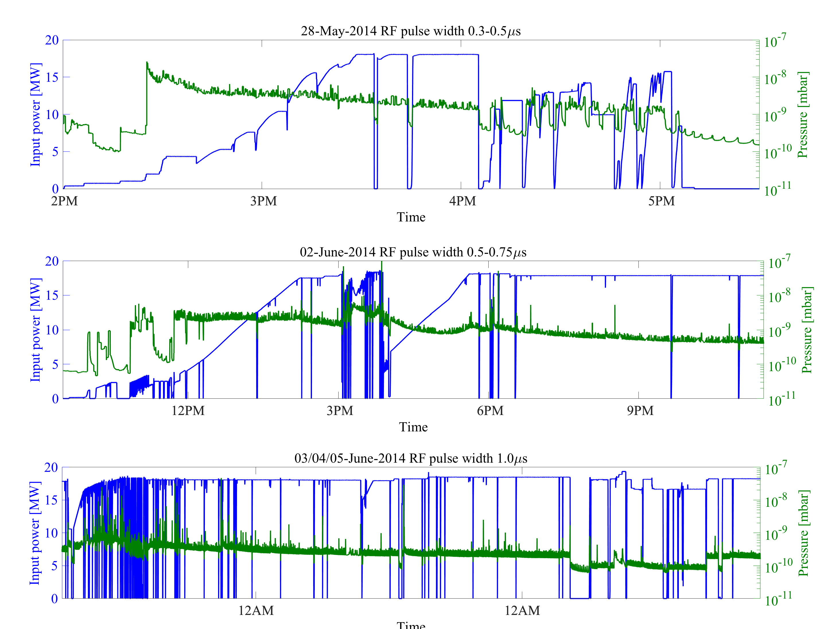
RF conditioning at SITF
Blue lines: RF power
Green: vacuum pressure
Notes:
The gun was conditioned over a period of one week at 100 Hz, pulse width 1.0us, maximum electric field 110 MV/m (nominal 100 MV/m)
It is worthwhile to note that nominal RF power of 18 MW with the RF pulse width of 1 μs in the first week of operation was reached.

Slide 7
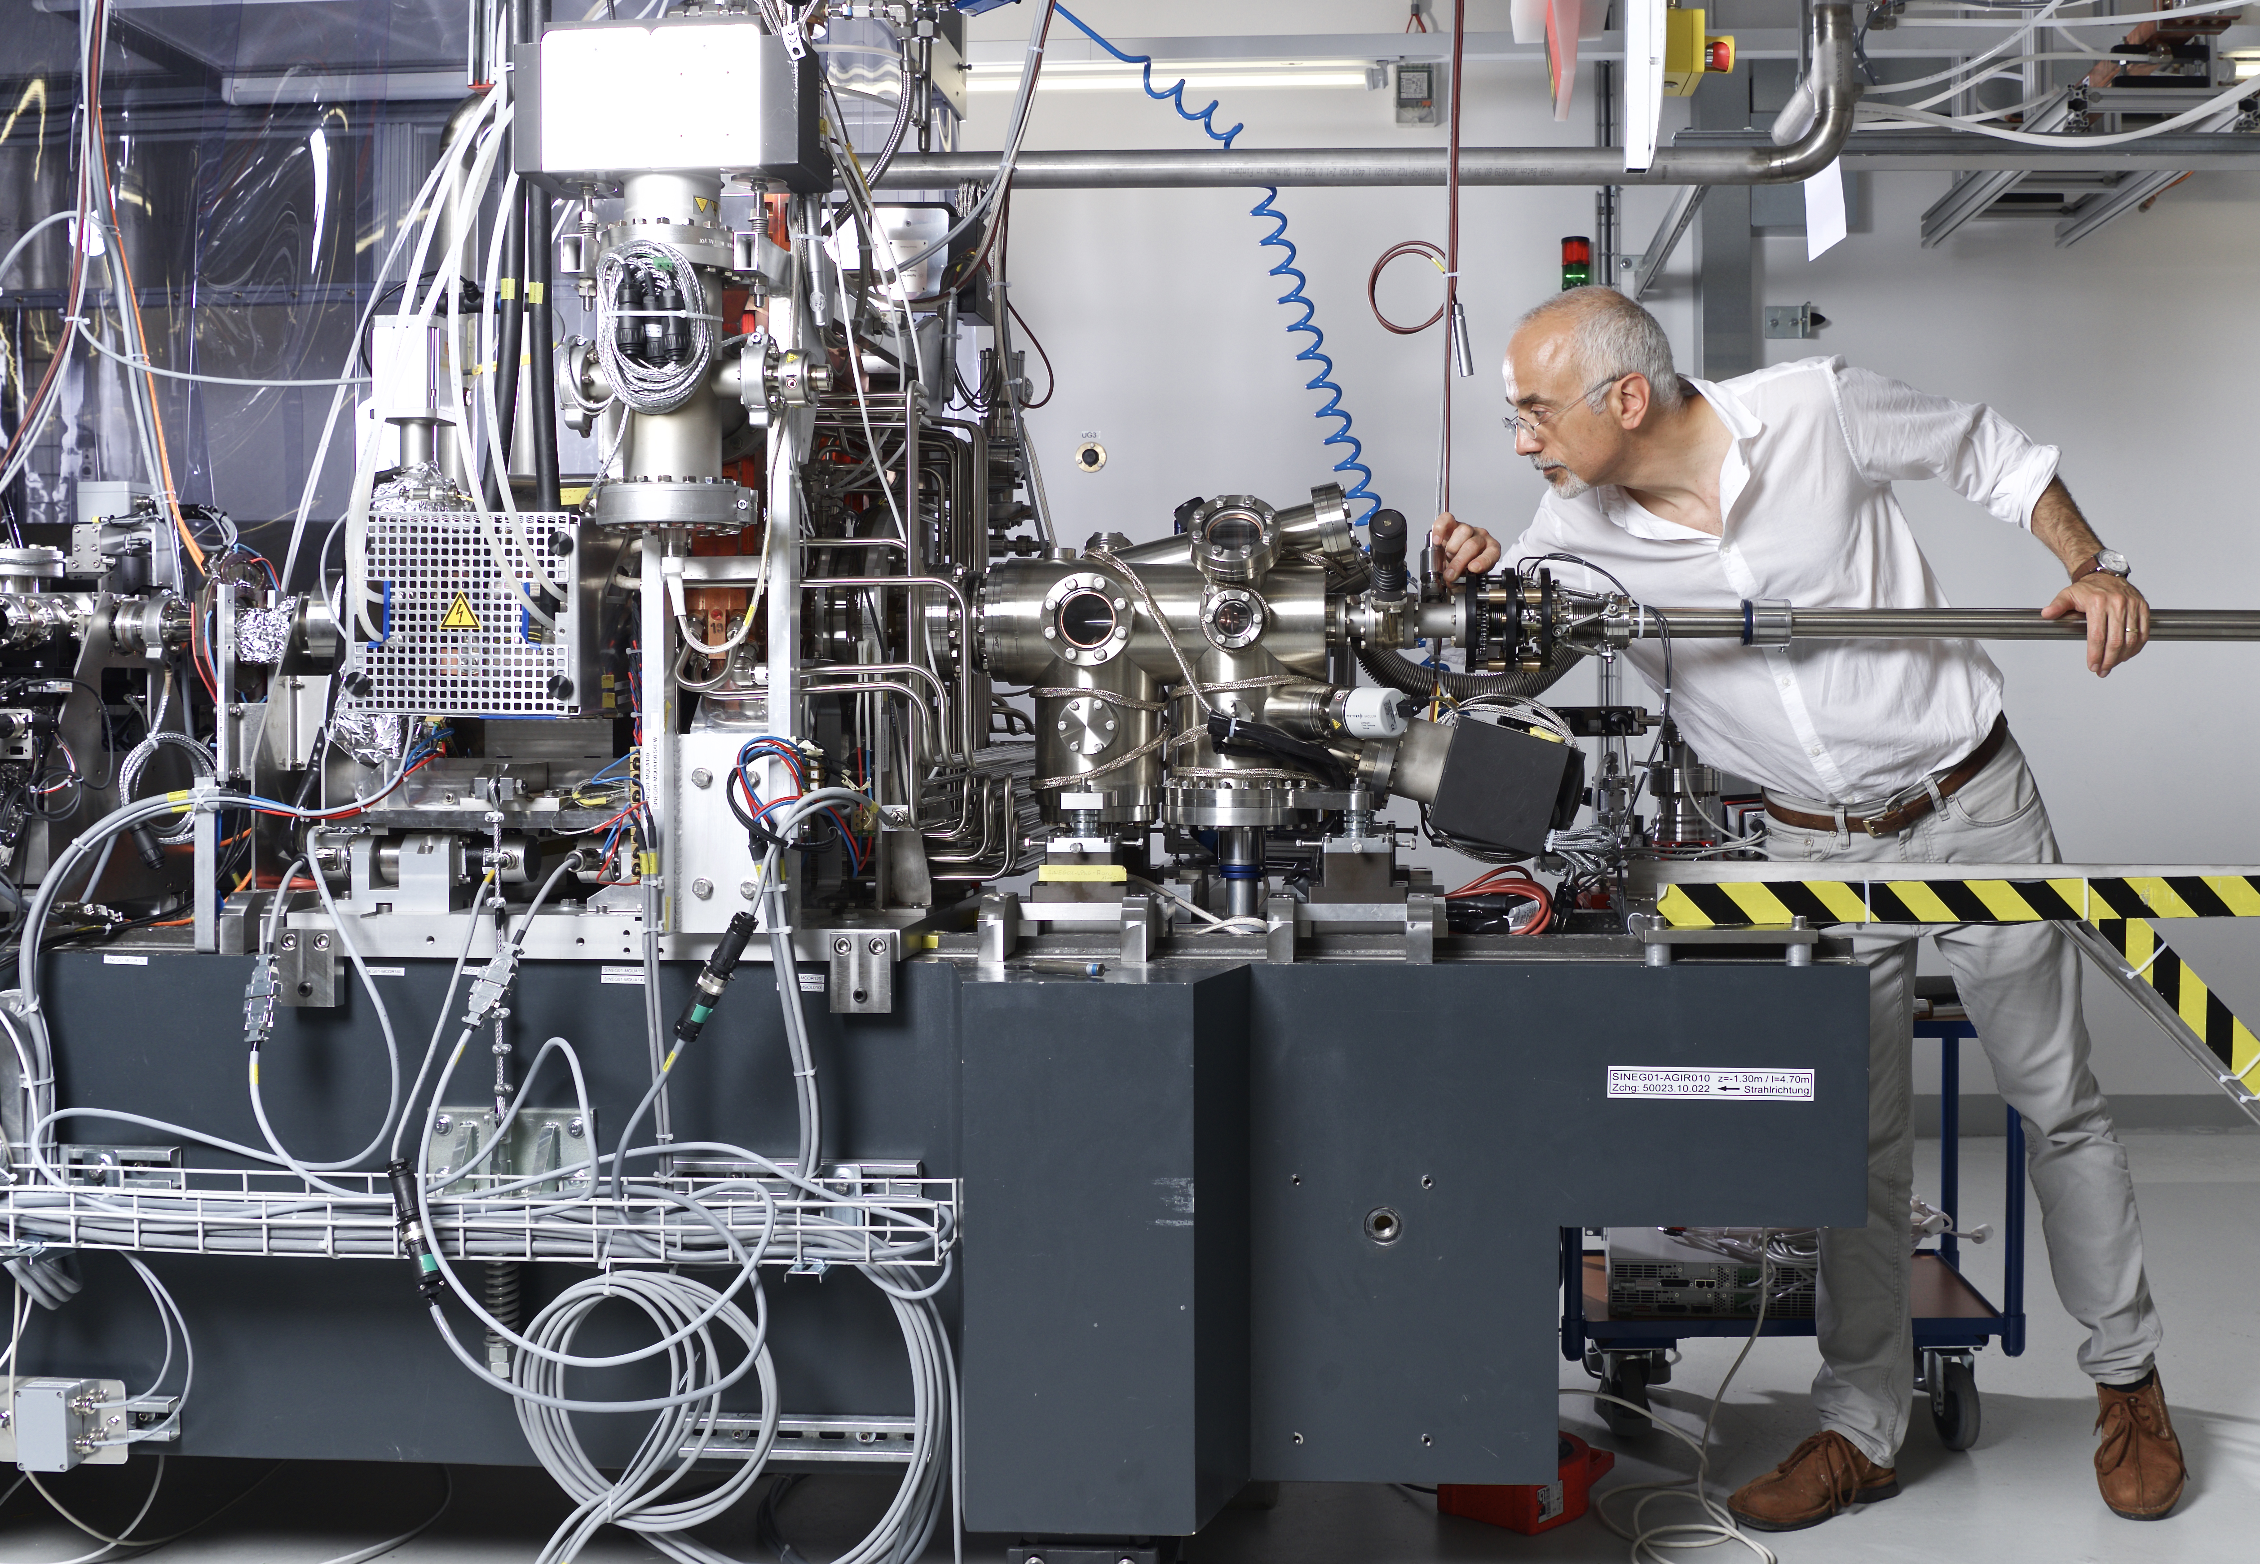
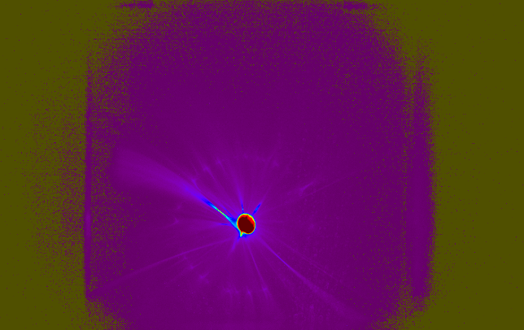
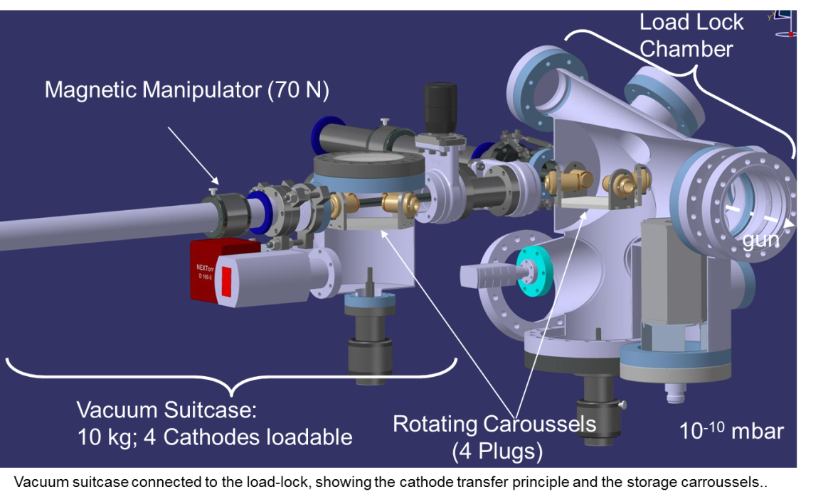
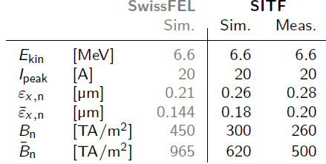
Gun installed in SwissFEL
First beam August 24, 2016
Reference performances
(Q = 200 pC and E_{cath}=100MV/m)

Slide 8
SwissFEL C-Band module
Main LINAC | #
LINAC module | 26
Modulator | 26
Klystron | 26
Pulse compressor | 26
Accelerating structure | 104
Waveguide splitter | 78
Waveguide load | 104
C-band-klystron
5.7 GHz, 50 MW, 3 μs, 100 Hz
BOC
pulse
compressor
four 2 m long C-band structures, 28 MV/m
220 MeV energy gain per module (+10% overhead)
9 m

Slide 9
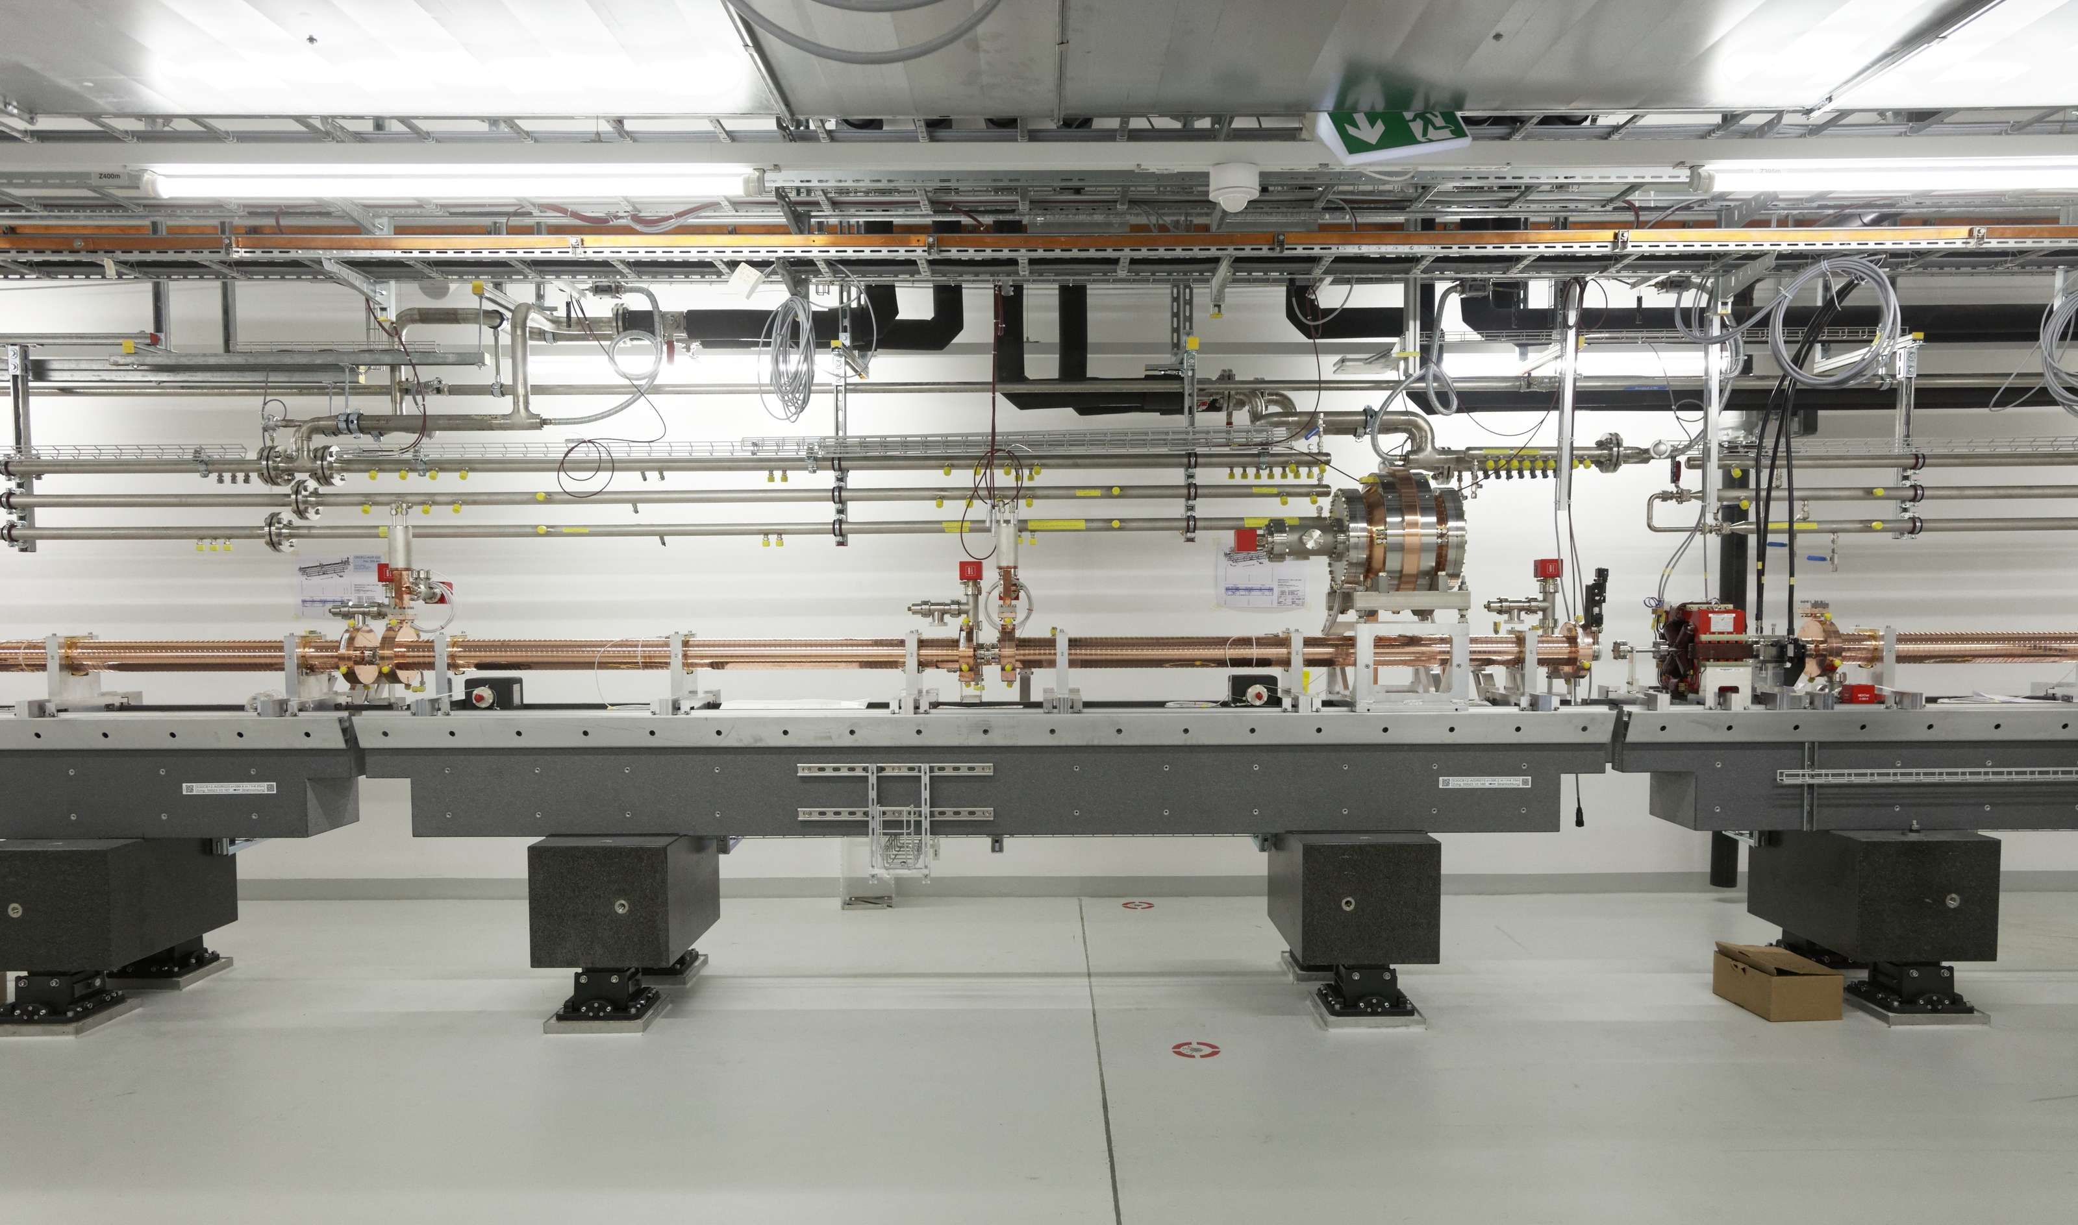
Installation of last Linac girder: Sept. 13, 2016

Slide 10
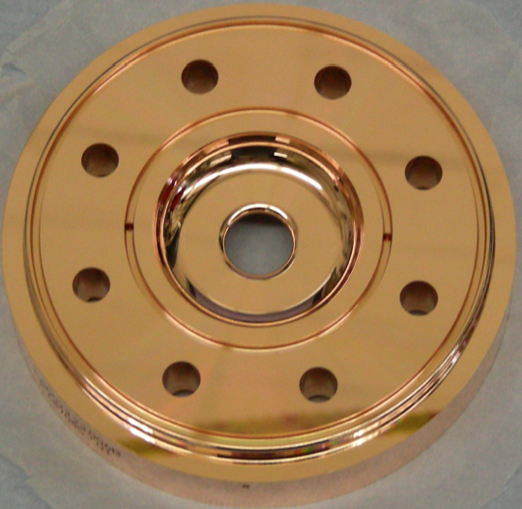
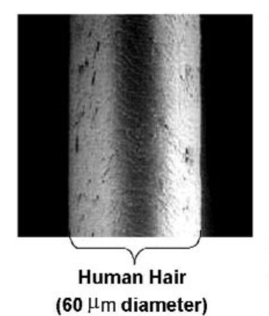
C-band structures: ultra-precision machining
Iris diameter 2a
2a
2b
Cell diameter 2b
Courtesy of J.Y. Raguin
Typical examples of metrology on a structure:
top histogram iris diameter, bottom histogram iris cell diameter

Slide 11
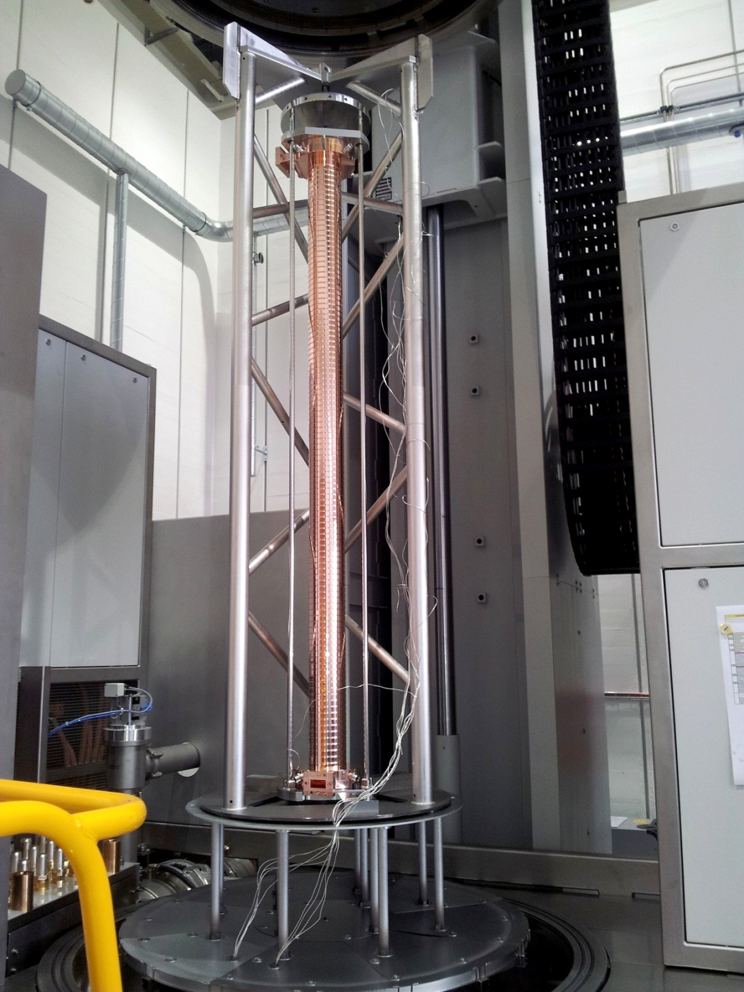
C-band structures
Structures are machined “on tune”, no provisions for dimple tuning!
Cup manufacturing with micron precision at VDL ETG Switzerland
Coupler manufacturing at VDL ETG
Stacked by robot at PSI
Vacuum-brazed at PSI
Production rate: 1-2 / week
Production finished August 2016
High power results for first structure:
  Conditioned to 52 MV/m
  Break-down rate at 52 MV/m
  ≈ 2 x 10⁻⁶
  At nominal 28MV/m,
  break-down rate negligible (well below the specified threshold of 10⁻⁸)
R. Zennaro et al.,
“Measurement and High Power Test of the First C-Band Accelerating Structure for SwissFEL”, Proceedings of LINAC2014, Geneva, Switzerland

Slide 12
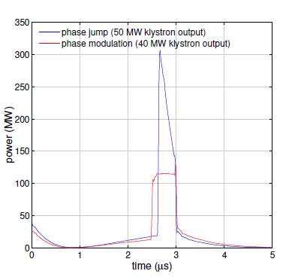
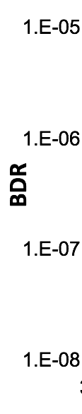
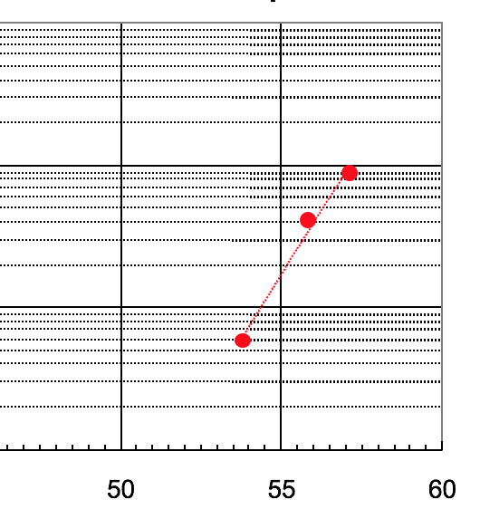
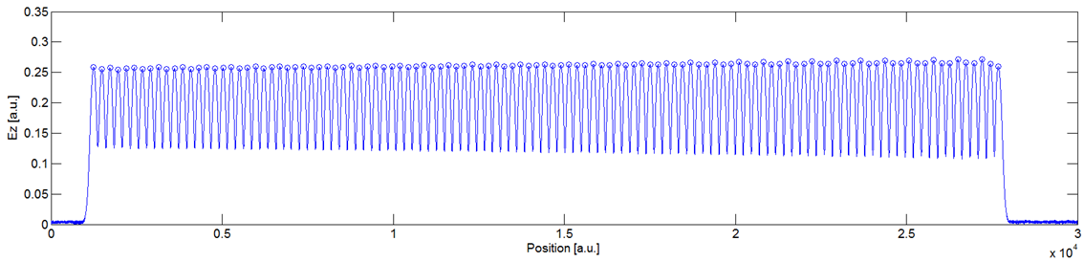
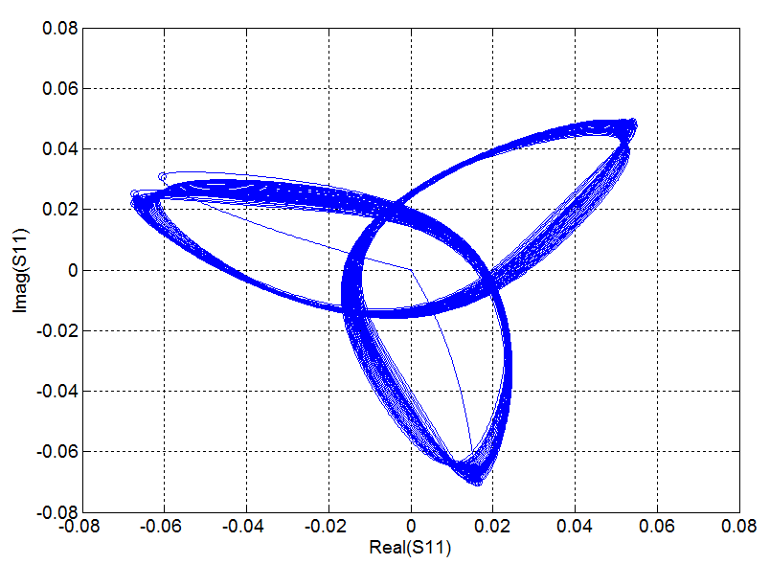
Pulse compressor, max. gradient and bead-pull
BDR on C-band short prototype
E (MV/m)
No tuning steps from the cups production to the installation into the bunker.
RMS phase error typically < 1 deg
Bead pulling for 120° avg. phase adv.
References: R. Zennaro and A. Citterio
Notes:
RF design: Single cavity, Whispering gallery mode, intrinsic high Q>200000
Adapted from the original design for S-Band of I. Syratchev (CERN).
Production:100% in house

Slide 13
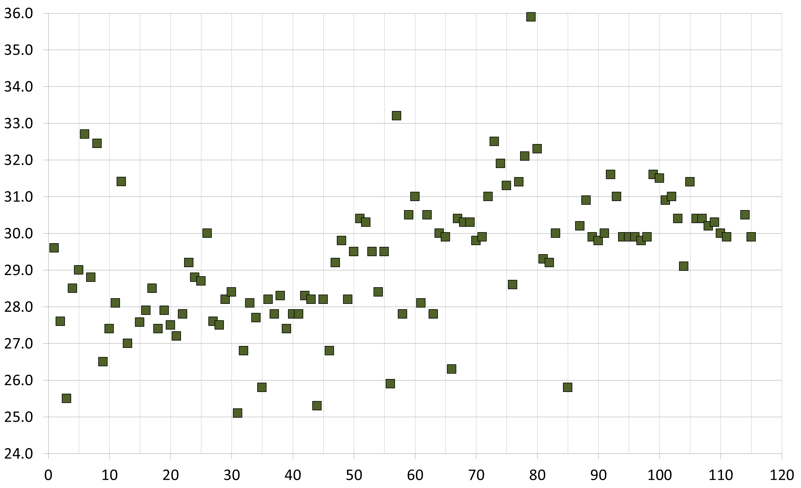
Temperature distribution @5712 MHz
Δ1°C = 0.75 µm @ ~44mm cell diameter
Temperature
Number of structure

Slide 14


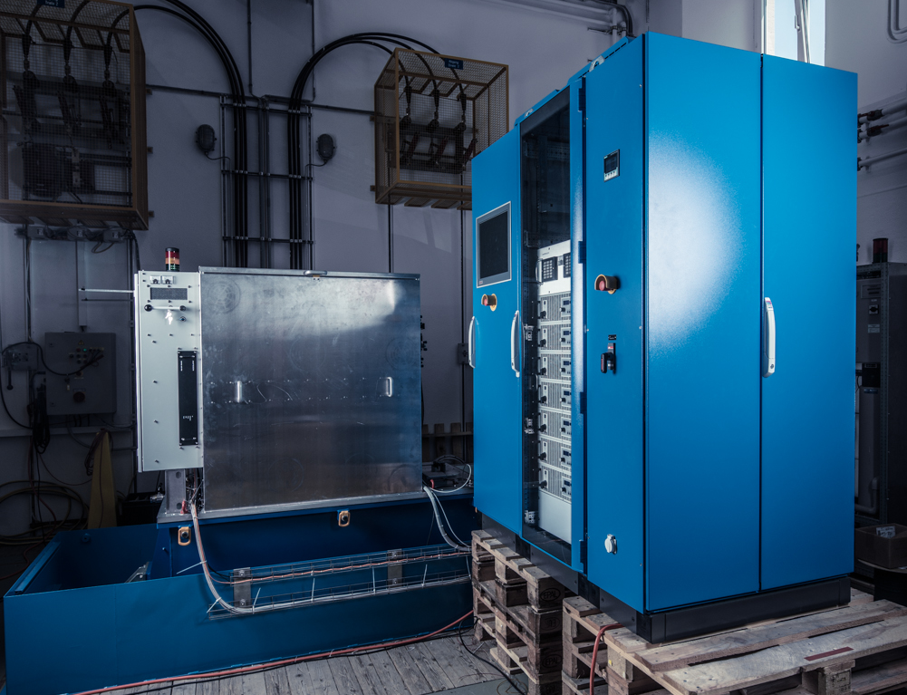
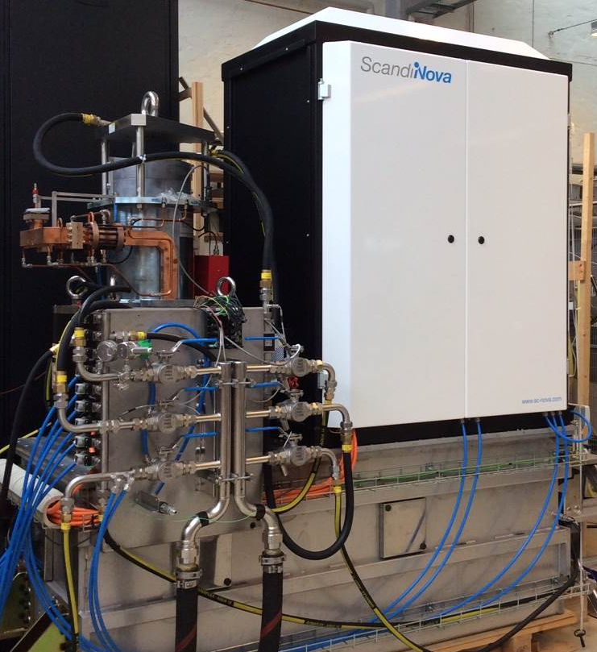
Solid-state modulators for C-band linac
Two prototypes were tested at PSI for evaluation of the series.
50 MW / 3µs RF, 370kV / 344A / <20 ppm voltage stability pulse to pulse @ 100 Hz
Type-μ modulator prot. for PSI C-band
K2-3 proto. for PSI C-band
- 13 modulators (Linac 1, Linac 2)
- 13 modulators (Linac 3)
Progressive increase of beam energy to final energy of 5.8 GeV
  First Pilot Experiments by End 2017 (requested 3 GeV beam)

Slide 15
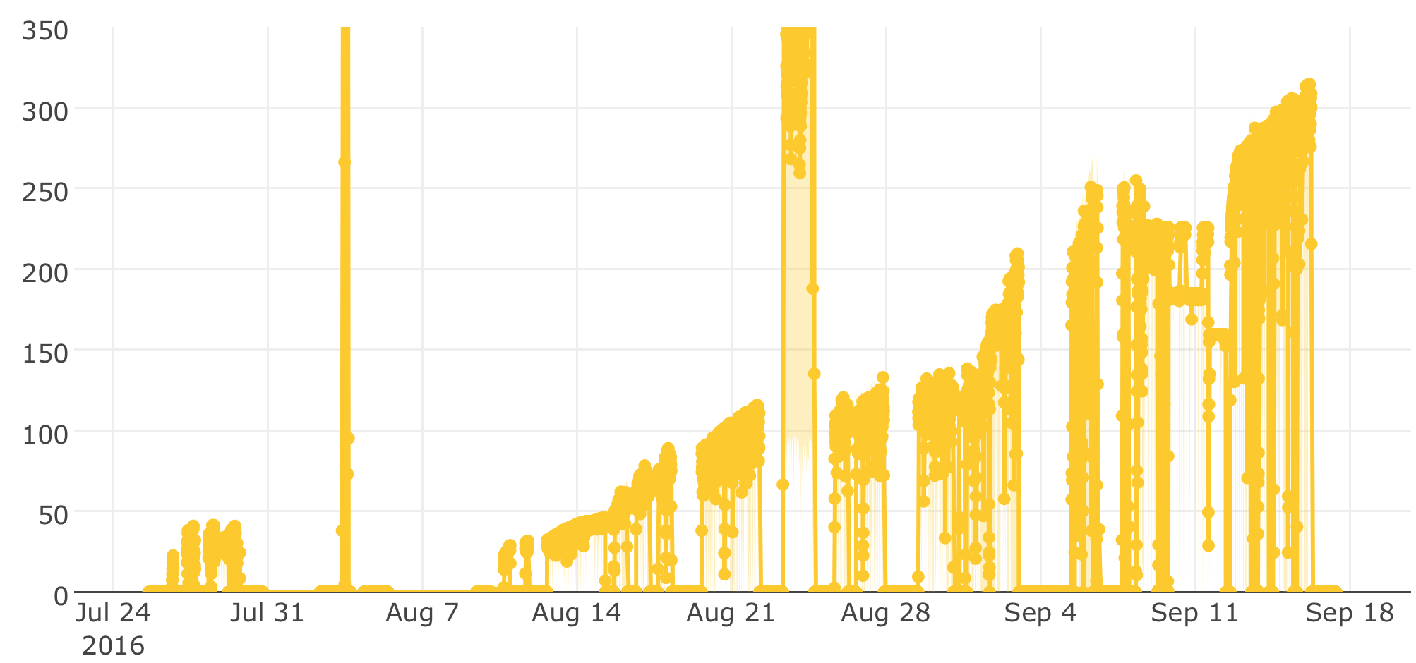
Conditioning of first C-band module
RF peak power after BOC (MW)
First acceleration of e⁻-beam:
Energy gain: 241 MeV
Nominal parameters for Linacs 2&3
Module conditioning: Reached almost maximum available RF power
(50 MW, 3 µs, full compression)
SwissFEL energy gain scheme based on BOC performances:
Linac 1 with phase modulation operation: on-crest energy gain of 52 MeV/structure (~26 MV/m) @40 MW from klystron.
Linac 2 and 3 with phase jump operation: on-crest energy gain of 58 MeV/structure (~29 MV/m) @36 MW from klystron.
References: R. Zennaro, F. Löhl et al.

Slide 16
Overview SwissFEL RF
Present status
operational
Operational but not fully conditioned
Installed but not commissioned
To be installed and commissioned
Injector
S-band
X-band (linearizer)
S-band TDS
LH
BC1
1
2
3
4
5
6
7
Linac 1 (9 modules) Linac 2 (4 modules)
ATHOS line
•••
•••
BC2
1
2
•••
9
10
•••
13
Ampegon kly. modulators
Athos Linac (Ampegon modulator)
Athos X-Band TDS
Athos undulator line
Extraction elements
Linac 3 (13 modules)
Aramis undulator line
•••
Deflector (S30CB14)
E-collimator
1
•••
12
13
Scandinova klystron modulators

Slide 17
Consolidation of the RF technology at PSI
PSI has developed a production line of high technological content for high-quality, high-gradient C-band accelerating structures for the SwissFEL project.
PSI is interested in extending, consolidating and broadening its know-how to S-band and X-band frequencies
→ RF group is establishing international collaborations on different topics:
  CERN-PSI: development of X-Band high-gradient accelerating structures structures in tuning-free C-band design;
  CERN-DESY-PSI: development of innovative X-band tuning-free transverse deflecting structure with a novel variable polarization feature, also see B. Marchetti’s talk.
  FERMI@Elettra-PSI: development of S-band high-gradient accelerating in tuning-free C-band design, see C. Serpico’s talk held on Monday.
Consolidation of the exiting C- band technology in accelerators applications: development of C-band traveling-wave photo guns for the SwissFEL project and for a multipurpose photo-injectors.

Slide 18
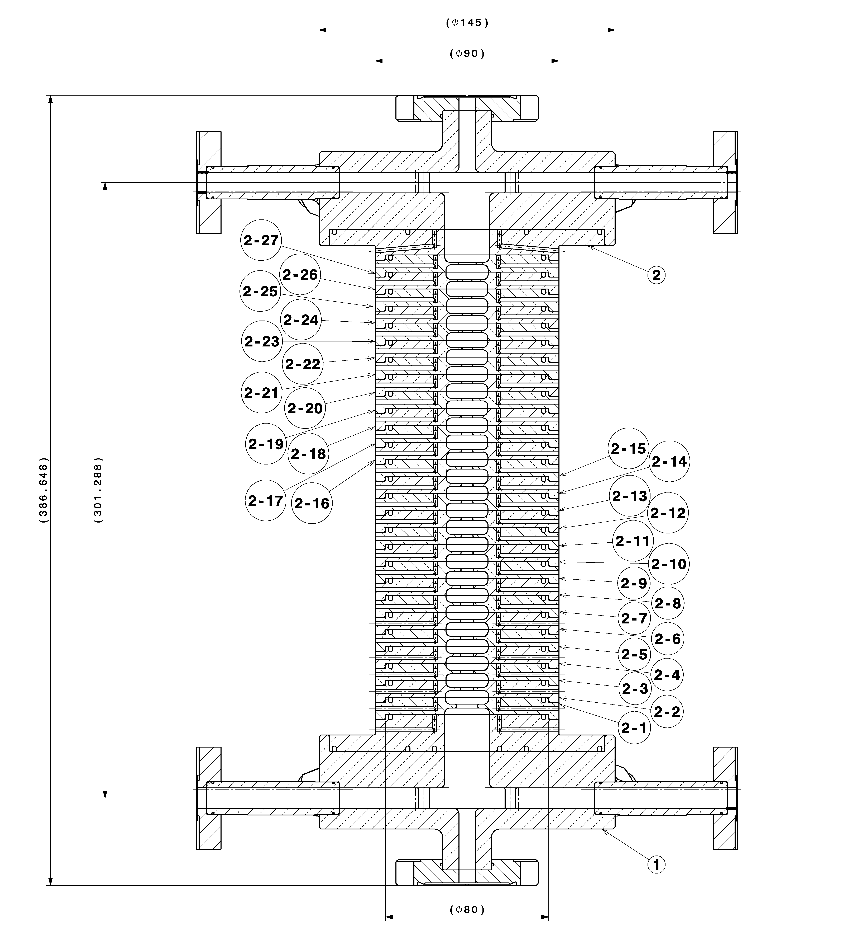
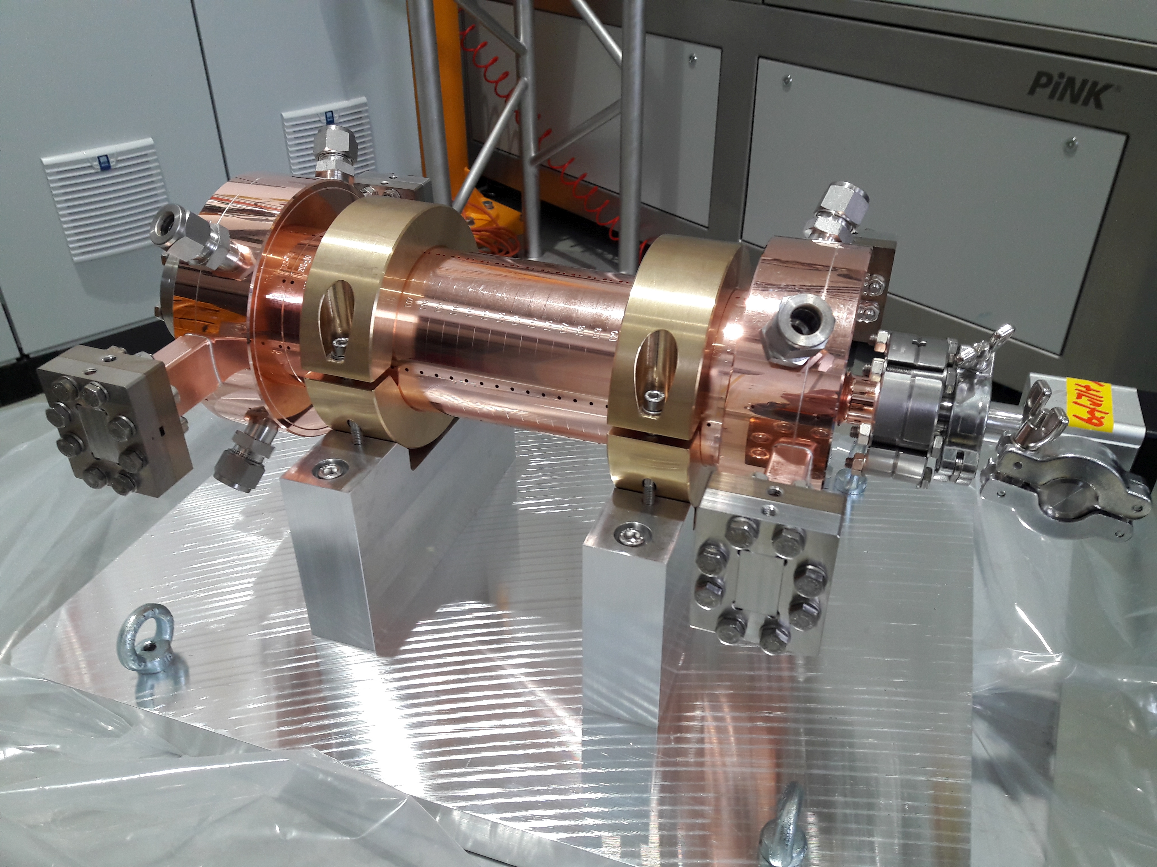
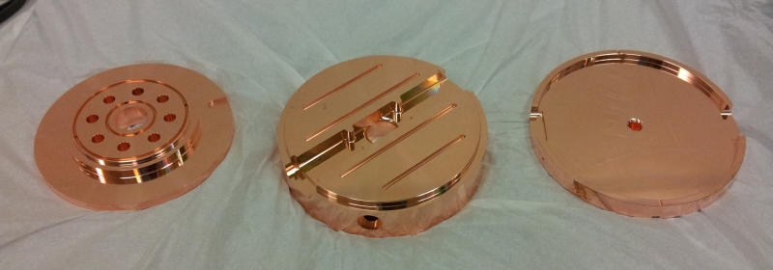
CERN-PSI X-band accelerating structures
27 cells + input couplers (2π/3)
Tolerances on the drawing is ±2 μm (iris aperture and cell diameter (R_{a} = 25 nm).
Parts are all fabricated (by VDL)
Assembling and brazing at PSI
2 structures:
  first one ready for high-power tests at CERN
  second one is brazed and vacuum tight and ready for bead-pull measurements at CERN.

Slide 19
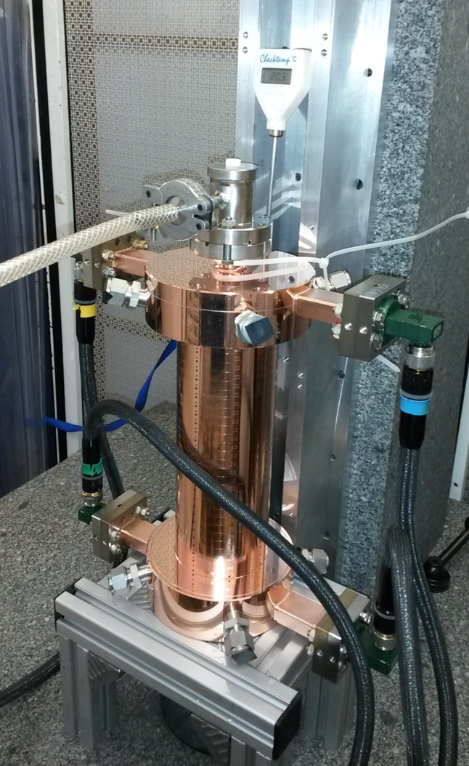
First X-band accelerating structure
Working frequency is 29°C (design 30°C)
Matching is at -30 dB level.
Courtesy of Rolf Wagner (CERN)
Notes:
There is a mismatch between the last 2 cells which creates the standing wave pattern and a smaller mismatch at the input of the structure

Slide 20
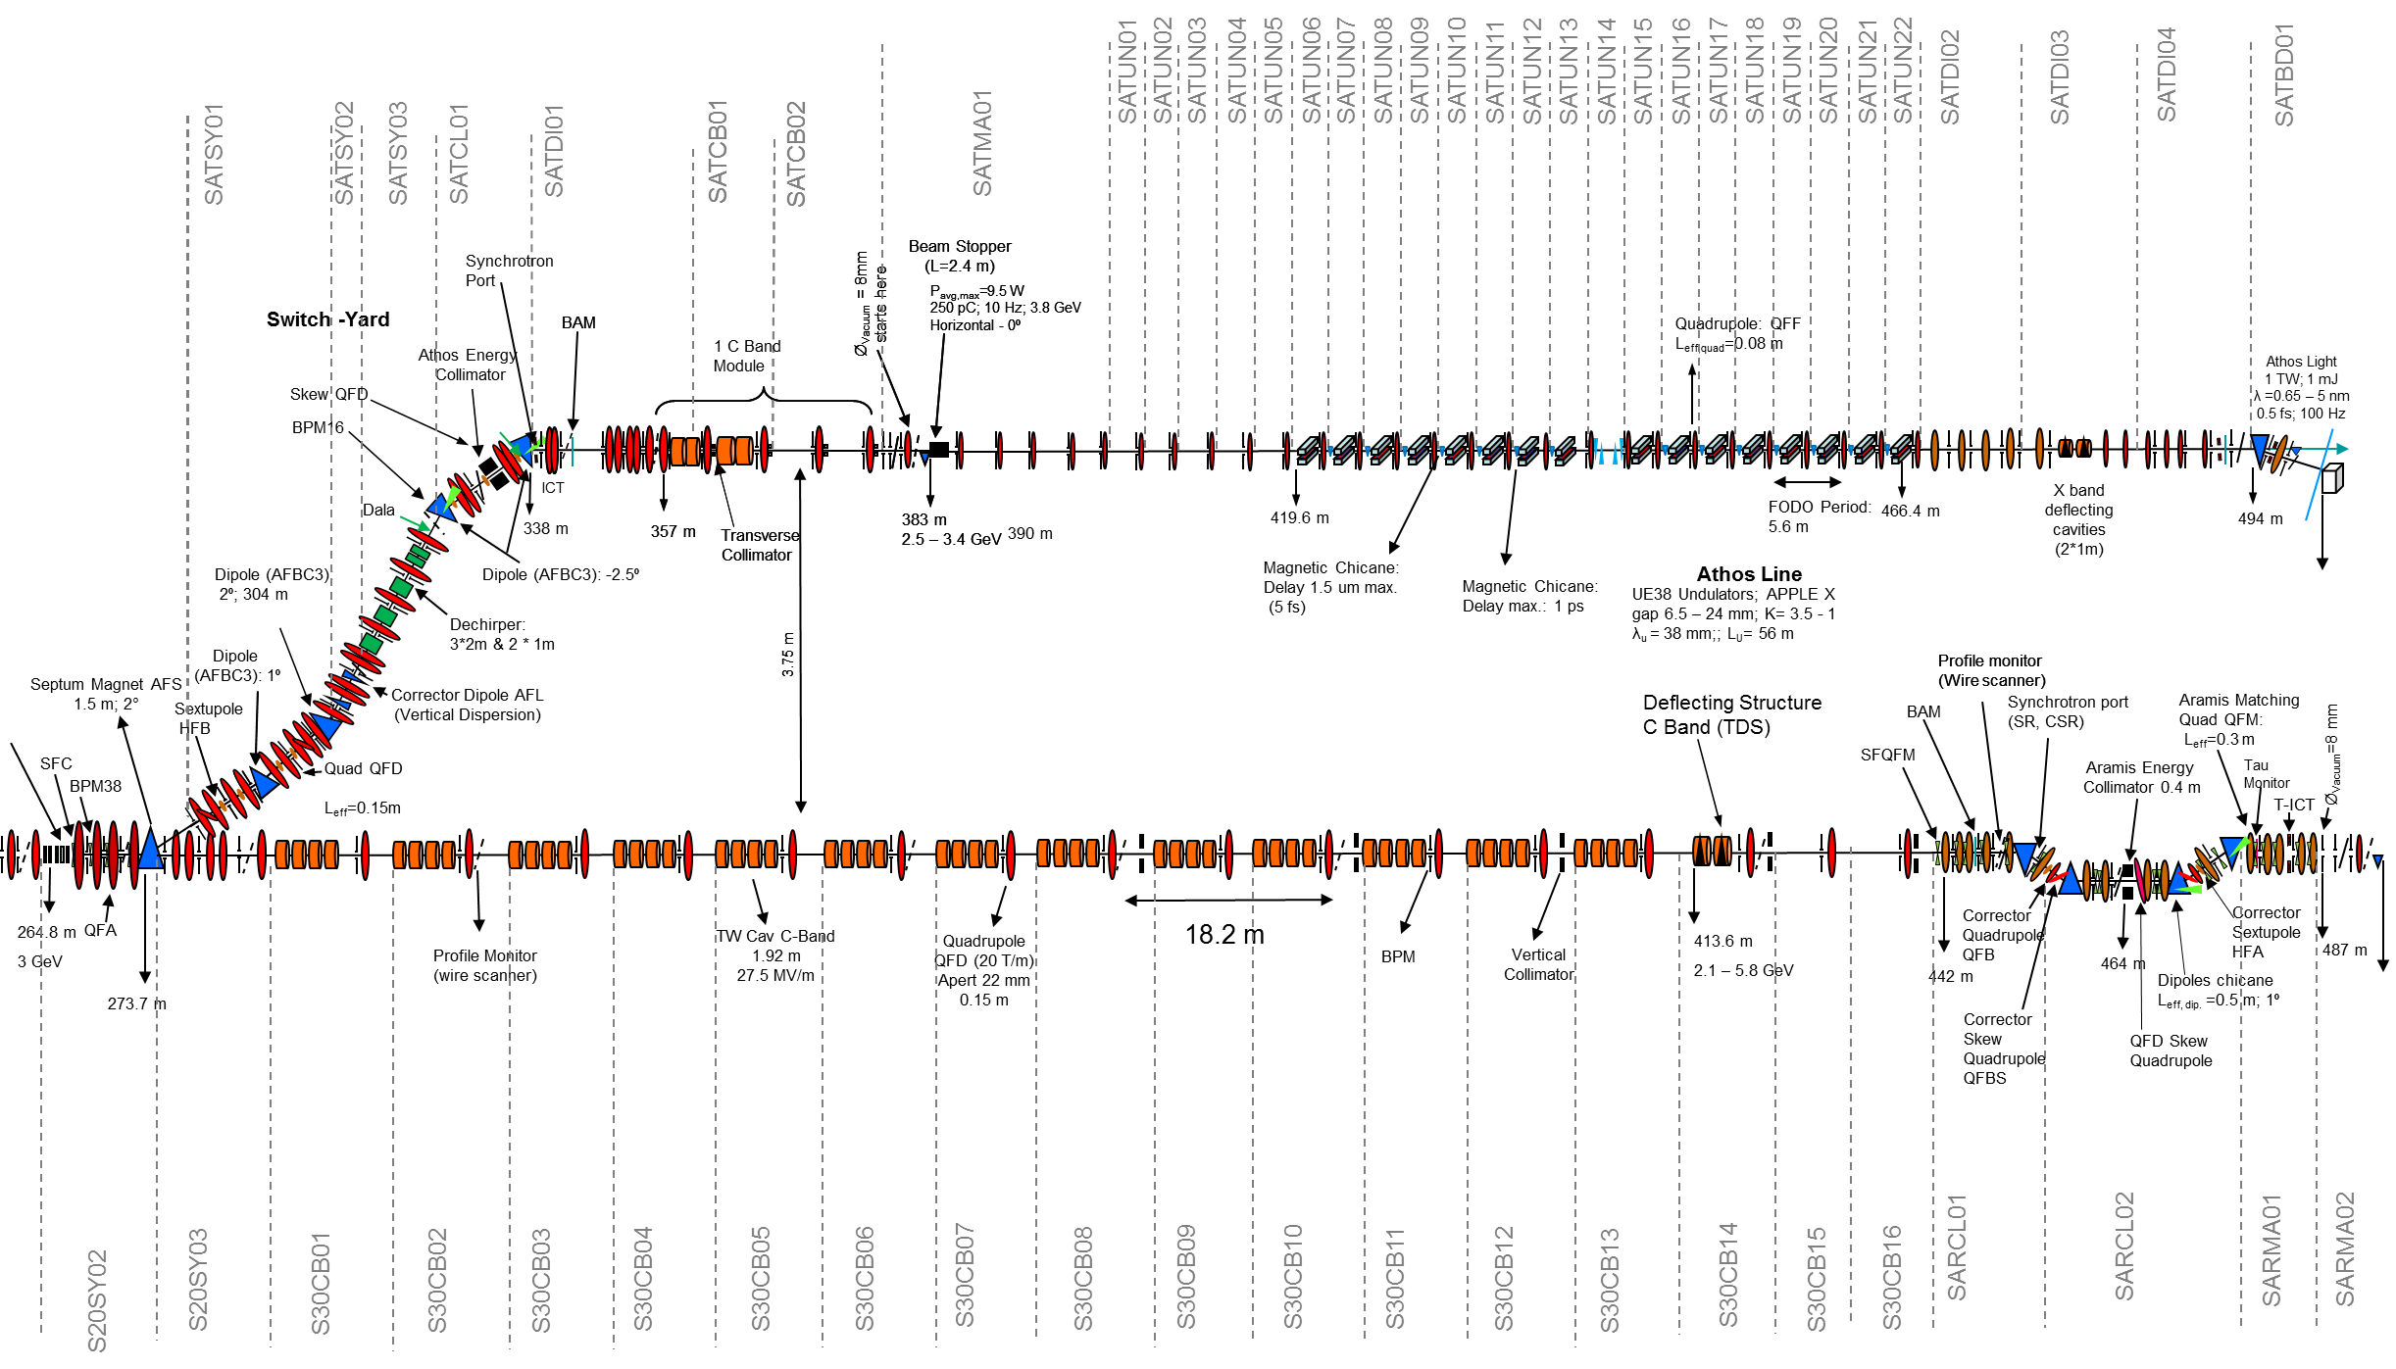
Post-undulator X-band TDS for Athos beamline
Athos Linac
(one C band module)
16 Apple X Undulator UE38 (module 2 m long)
15 Magnetic chicane: delay, compress and shift bunches
Post Undulator
X band TDS
Courtesy R. Ganter
Resonant kicker
Septum (28 ns)
Reference for post-undulator TDS: C. Behrens et al., „Few-femtosecond time-resolved measurements of X-ray free electron laser“ , Nat. Comm. 4762 (2014).

Slide 21
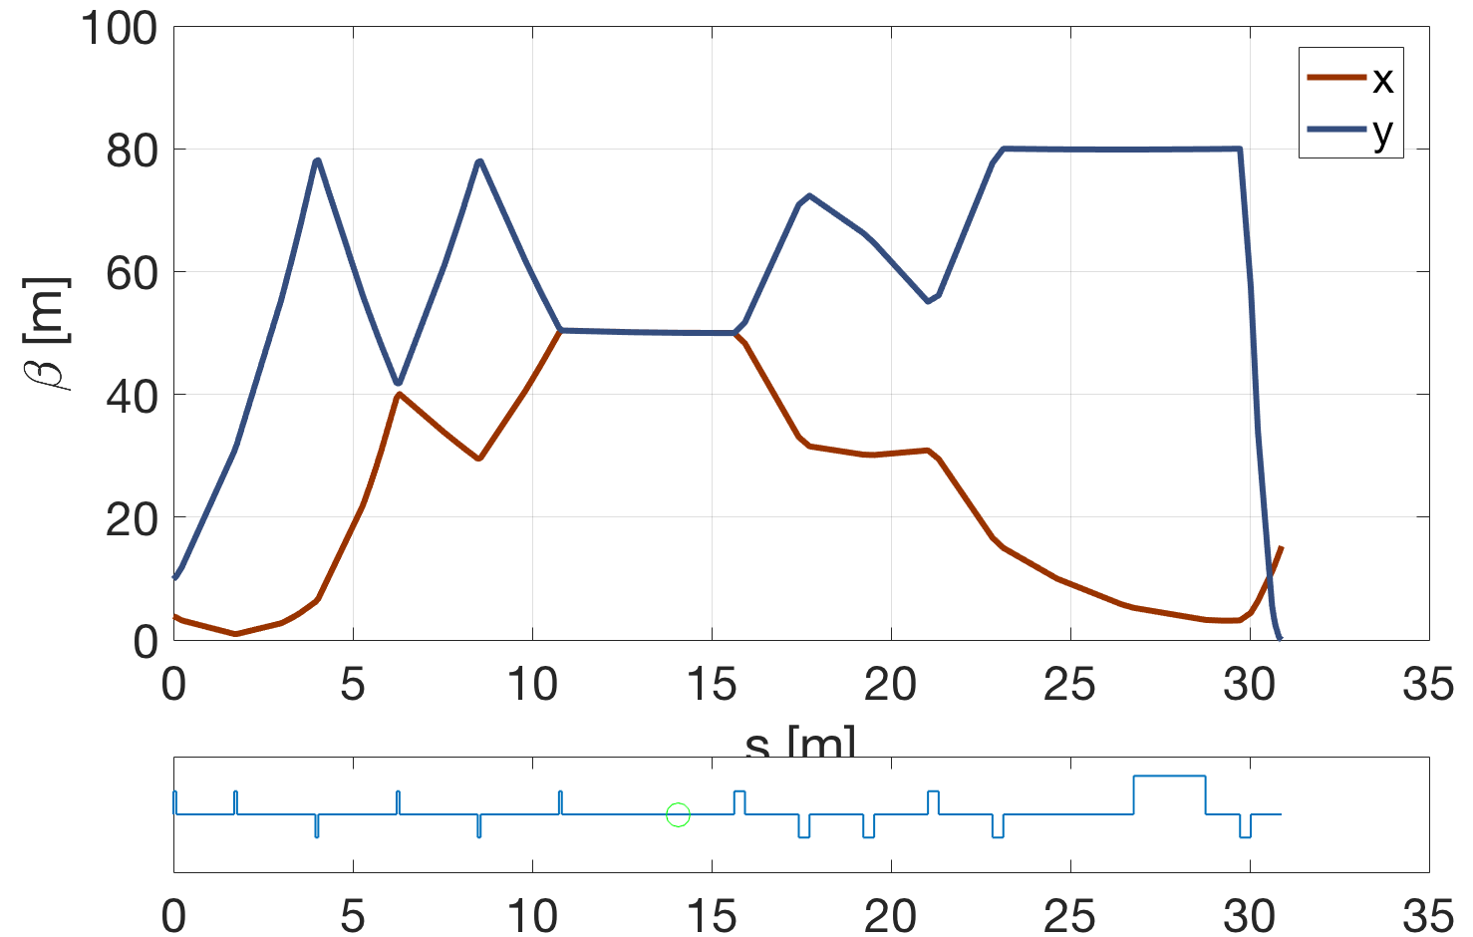
Beam parameters and measurement concept
Parameter | Value | Unit
e⁻ charge | 10 - 200 | pC
Peak current | 2-3 | kA
Pulse duration | 2 - 30 | fs (rms)
e⁻ Energy | ≤ 3.5 | GeV
Emittance | ≤ 300 | nm
Energy spread | ≤ 350 | keV
Beam measurements:
Slice emittance on both planes
Projected emittance on both planes
Electron and photon pulse length
Energy spread induced by FEL process
Profile monitor
Spectrometer dipole (vertical)
X-band TDC
Undulator end
Quad to get dispersion
Quads to match beta functions in the TDS
Quads to measure the beam
Profile monitor
β_{x} = β_{y} = 50 m → optics for both polarizations
Energy resolution
  Due to betatronic effect < 180 keV (beam size)
  Due to screen resolution = 150 keV
  But TDC induces energy spread!
courtesy of E. Prat

Slide 22
Resolution, induced energy spread and jitter
Resolution 0.95 fs @45MV and β_{d} = 50 m
Resolution 0.71 fs @60MV and β_{d} = 50 m
β_{d} = 50 m
500 keV

Slide 23
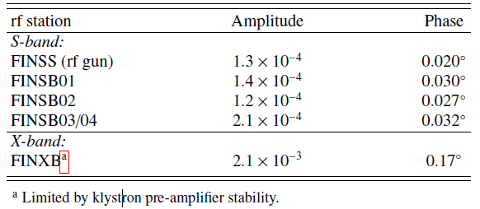
RF stability – X-band linearizer
Typical rf stability figures (rms values) over one hour of operation for all rf stations operated at the SITF [1]:
0.018°
1.8e-4
0.072°
Pre-amplifier: Advance System Engineering, Model 174 X TWT
Specifications for the SwissFEL:
Frequency band | Frequency [MHz] | RF tolerance / phase noise (rms) [fs] / [°] | ref. distr. phase noise performance (rms) [fs] / [°] | max. added phase noise vec. mod. (rms) [fs] / [°] | max. allowed added phase noise pre-amplifier / (klystron/HV mod.) (rms) [fs] / [°] | required HV modulator stability (rms)
X-band | 11995.2 | 16.7 fs / 0.072° | 3.5 fs / 0.015° | 6.1 fs / 0.026° | 10.7 fs / 0.046° | < 29 ppm
[1] T. Schietinger et al., “Commissioning experience and beam physics measurements at the SwissFEL Injector Test Facility “, PR AB (2016)
Ref.: T. Schilcher

Slide 24

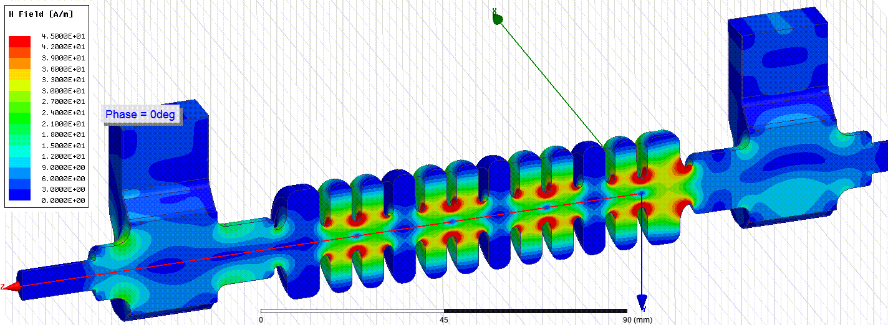
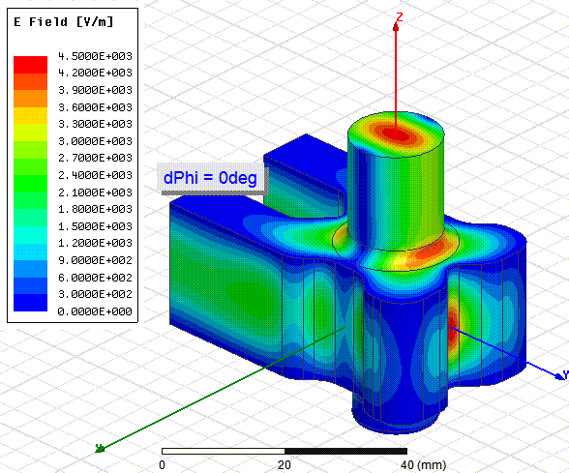
Ongoing collaboration for X-band TDS
Establishing a collaboration between CERN, PSI and DESY
TDS with a novel variable polarization feature
→ tuning may be difficult because a tight symmetry is required!
RF design by A. Grudiev in CLIC-note-1067 (2016)
First prototype with tuning-free assembly procedure developed at PSI
Eventually starting with the series for PSI and DESY applications
Courtesy of A. Grudiev
Variable Polarization
Circular TE11 Mode Launcher

Slide 25
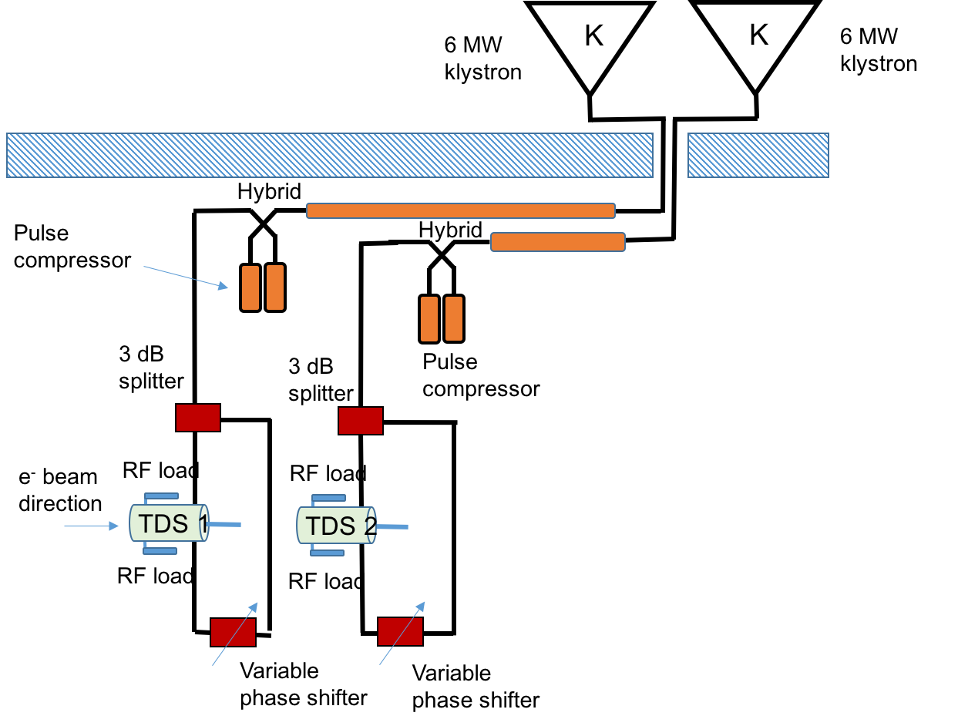
RF waveguide network (first concept)
First concept based on CERN Xbox3 system with a 6 MW Toshiba klystron, Scandinova K200-type modulator (1.6mx1.3m), SLED system and waveguide components
30MVx1TDS@6MW
K200 modulator
References at CERN:
G. McMonagle for klystron and modulator
N. Catalan for waveguide components

Slide 26
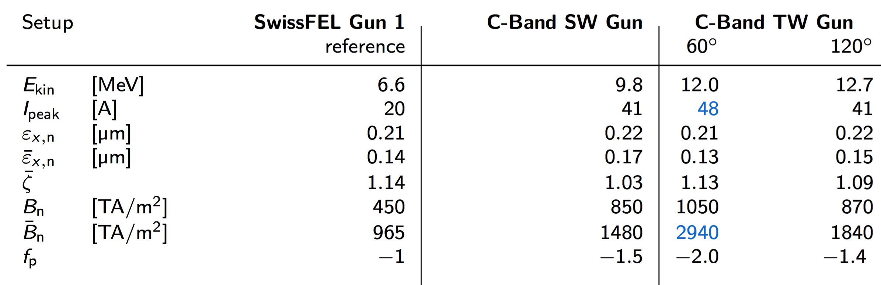
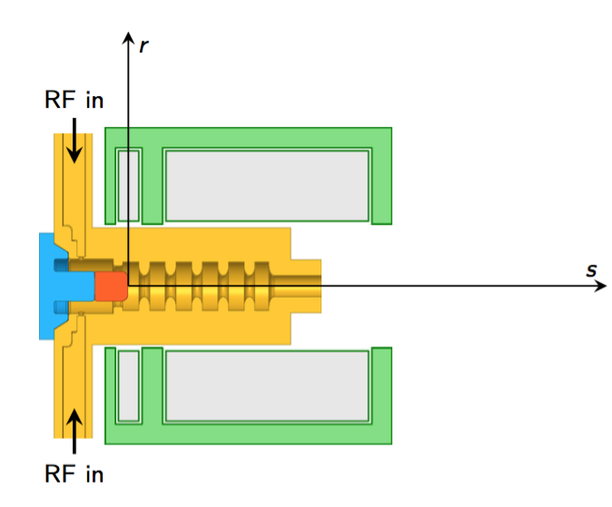
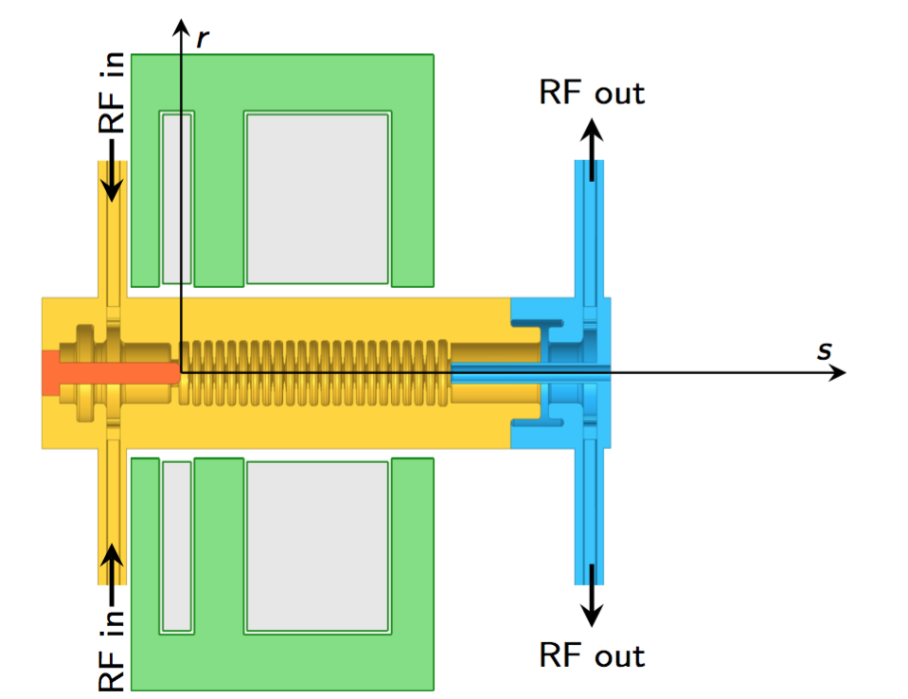
RF Travelling-Wave Electron Gun
Motivation: exploring new designs of electron source at C-band frequency that could represent a future upgrade of the SwissFEL injector.
Constrains: possible beam dynamics improvements were investigated by substituting only the electron gun and the relative solenoid while leaving the rest of the injector (downstream of the first booster structure) almost unchanged.
Brightness a factor 3 higher than the SwissFEL
Peak current a factor 2 higher than SwissFEL gun
Very conservative value of the field at cathode (135 MV/m with a filling time < 100 ns)
M. Schaer et al., PR AB 19, 072001 (2016).

Slide 27
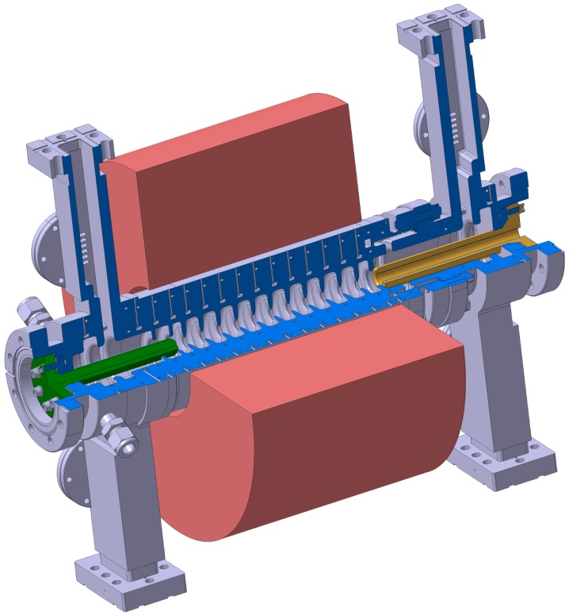
C-band RF Travelling-Wave Electron Gun
An innovative coaxial RF coupling from the cathode side enables
the placement of the focusing solenoid around the cathode with a simplified magnet design that integrates main and bucking coil
the elimination of the quadrupole components of the RF fields in the region where the beam is accelerated
the introduction of gaps with vanishing RF fields, making the gun compatible with the load-lock system without the need of special RF contacts
C-band TW Gun
Frequency | 5.712 GHz
Phase advance per cell | 60 deg/120 deg
# cells | 21/10
Structure length | 215/220 mm
Q | 4700/10000
Filling time | 73/90 ns
Iris radius | 5.5 mm
Group velocity | 0.95/079 % of [c]
Nominal gradient | 135 MV/m
Nominal power | 57.9/37.4 MW
Repetition rate | 100 Hz
M. Schaer et al., PR AB 19, 072001 (2016).

Slide 28
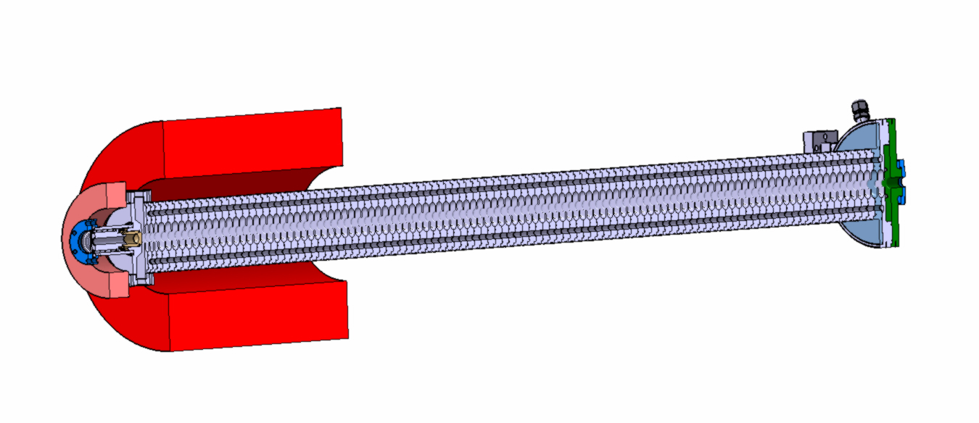
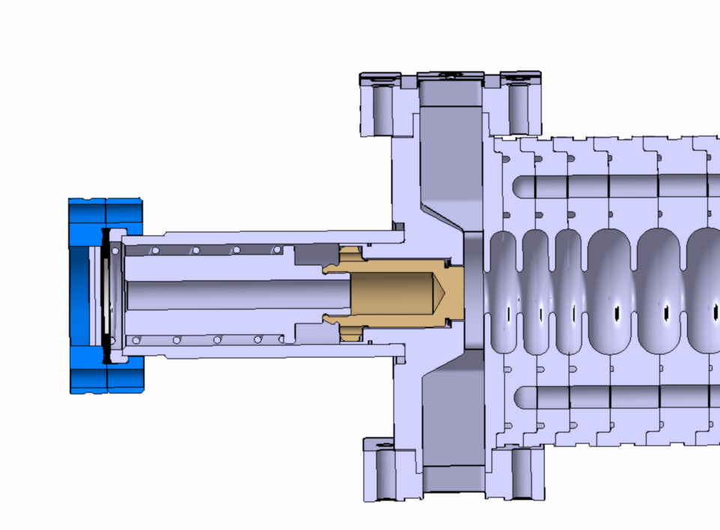
Multipurpose C-band TW photo-injector
Development of an innovative and compact C-band traveling-wave photo injector based on the C-band accelerating structures 2-m long
This project is part of the consolidation of the exiting C- band technology in accelerators applications (RF photo-injectors for free-electron lasers, synchrotron light source, time-resolved electron diffraction, and advanced accelerator concepts)
Length (m) | 2.108
Number of accelerating cells | 113
Phase advance/cell (deg) | 120
Frequency (GHz) | 5.712
Repetition rate (Hz) | 100
Filling time (ns) | 330
Gradient (MV/m) | 20
Max. field at cathode (MV/m) | 80
Output beam energy (MeV) | 42
Input power (MW) | 20
Details of the input coupler and cathode plug
Preliminary simulations:
Bunch charge | 0.1pC | 15pC | 150pC
Bunch Length | <20fs | 4ps | 5 ps
Energy spread | 15keV | 30keV | 70keV
Emittance | <0.1urad | <0.1urad | <2.5uad
Ref.: R. Zennaro and L. Stingelin

Slide 29
Conclusions
Status of the SwissFEL linac
  Progressive increase of beam energy to final energy of 5.8 GeV
  First Pilot Experiments by End 2017 (requested 3 GeV beam)
Pathway towards a consolidation of the RF technology at PSI
  X-band high-gradient accelerating structures (CERN-PSI)
  X-band TDS for the characterization of ultra-short bunches (CERN-PSI-DESY)
  S-band high-gradient accelerating structures (FERMI-PSI)
  C-band Travelling-wave photo-guns

Slide 30
Acknowledgements
Special thanks to the colleagues at PSI:
R. Zennaro, A. Citterio, L. Stingelin, M. Pedrozzi, F. Löhl, M. Bopp, E. Prat, S. Reiche et al.
and to the colleagues from CERN and DESY working on X-band TDS collaboration, in particular:
  A. Grudiev, W. Wuensch, N. Catalan Lasheras, G. Mcmonagle (CERN)
  B. Marchetti, F. Christie, R. D‘Arcy, D. Marx (DESY)
Thank you for the attention!!

