Slide 1
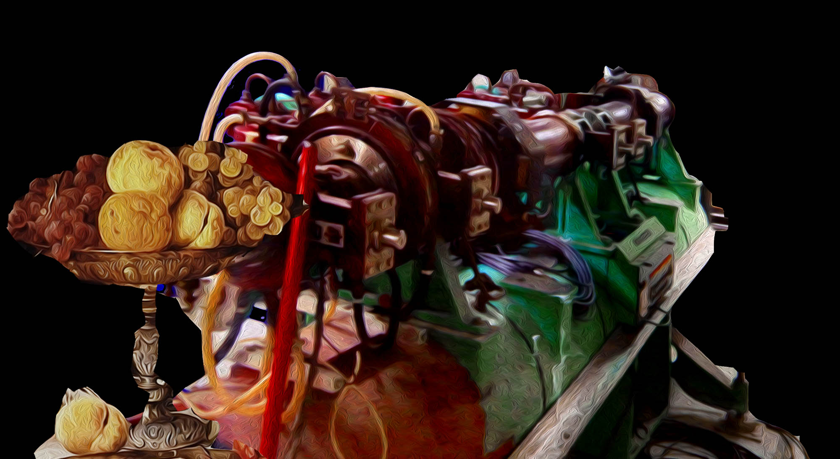
Australian light sources: XFEL and Compact Compton Source
Mark Boland
Australian Synchrotron and University of Melbourne
On behalf of the Australian collaborators on CLIC
CLIC Workshop 9 March 2017

Slide 2
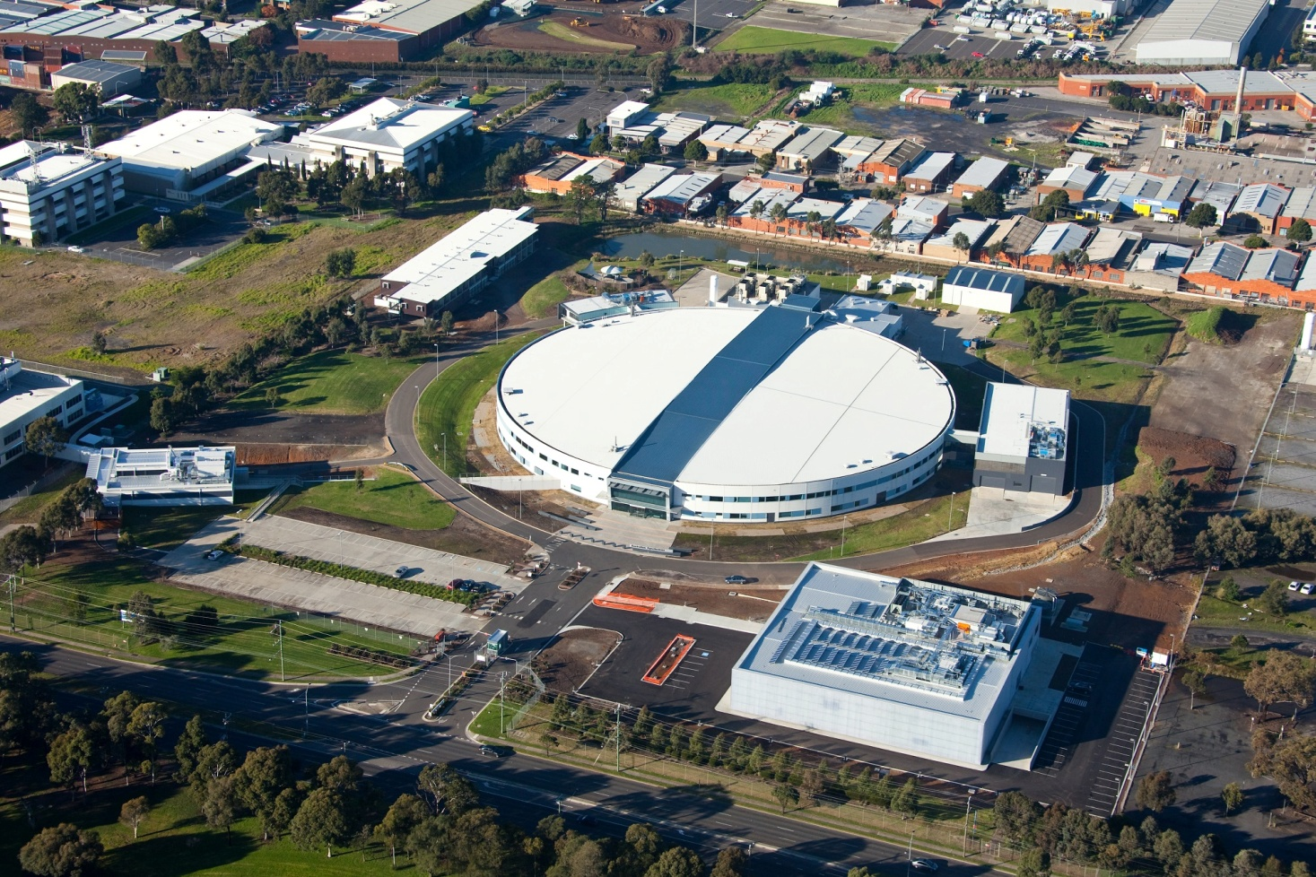
Australian Synchrotron Light Source
User Accommodation
Engineering Workshop
Metrology Laboratory
RF Laboratory
Medical Imaging
Beamline
National Synchrotron
Science Centre
Australian Synchrotron (2014)

Slide 3
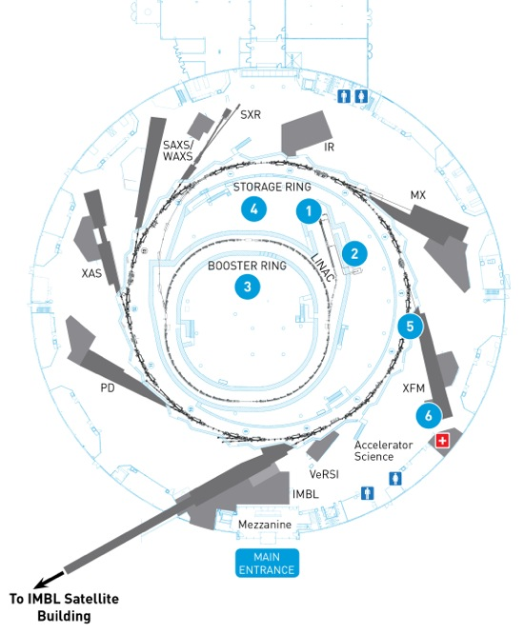
Photon Beamlines
10 existing beamlines
Space for 20+ total
$10M-$20M per beamline

Slide 4
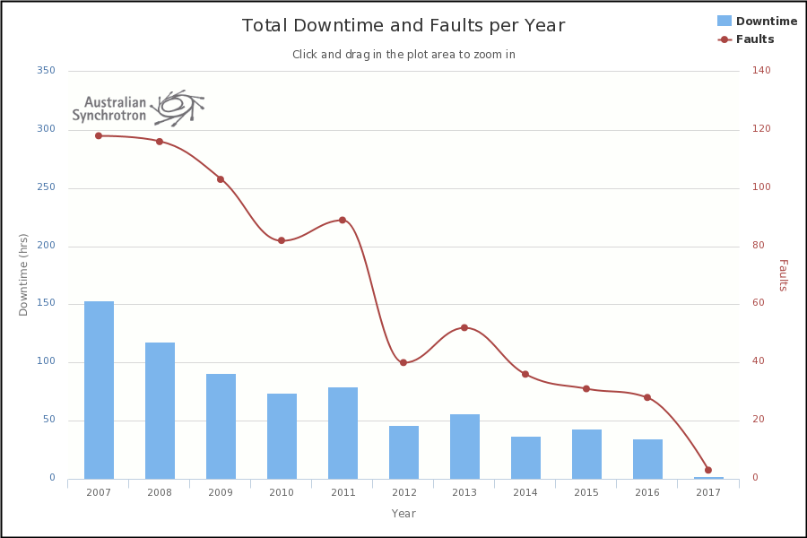
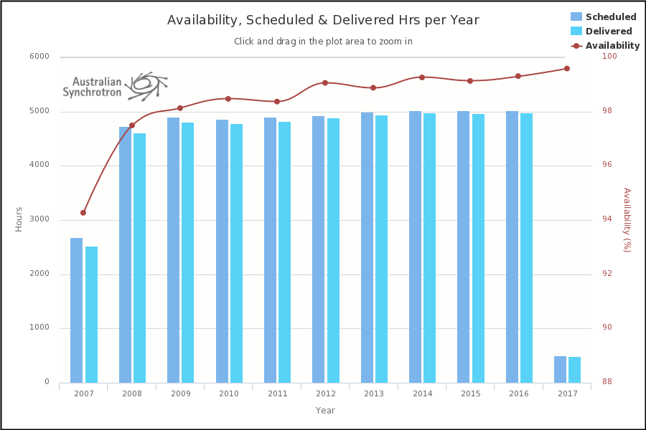
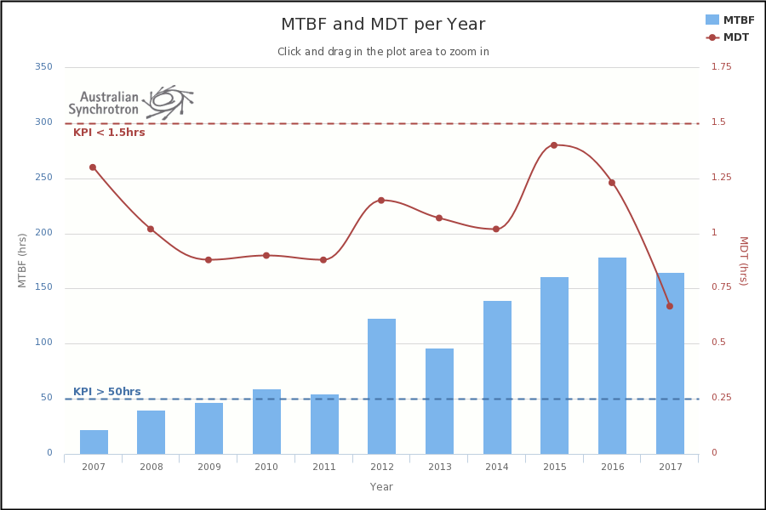
Operational Statistics
98% beam availability
MTBF > 150 hr
MDT < 1 hr
Faults and downtime minimised

Slide 5
New Developments
Light source taken over by Australian Nuclear Science and Technology organisation (ANSTO) in Sydney
$520M ten year funding through 2027
Funding is for refurbishment and operations only
Capex funding being sought for new beamlines
XFEL development pushed out to after the storage ring is fully occupied with beamlines
New priority for compact sources located at universities driven by User Community demand

Slide 6
Activities with the CLIC Collaboration
Structure manufacture and assembly (Ashley French, 2009-2010)
Thermal Shock and cooling modelling in PETS (Tessa Charles, 2010)
Damping ring vertical emittance tuning modelling and measurements for CDR (Kent Wootton 2011-2014)
Dowd, R., Boland, M., et al. Achievement of ultralow emittance coupling in the Australian Synchrotron storage ring. Phys. Rev. ST Accel. Beams, 14(1):012804 (2011).
Wootton, K. P., Boland, M. J., et al. Observation of picometer vertical emittance with a vertical undulator. Physical Review Letters, 109(19):194801 (2012).
Wootton, K. P., Boland, M. J., Corbett, W. J. et al. Storage ring lattice calibration using resonant spin depolarization. Physical Review Special Topics: Accelerators and Beams, 16(7):074001 (2013).
Wootton, K. P., Boland, M. J. and Rassool, R. P. Measurement of ultralow vertical emittance using a calibrated vertical undulator. Physical Review Special Topics: Accelerators and Beams, 17(11):112802 (2014).
XbFEL modelling (Tessa Charles, 2014-2016)
T. K. Charles, D. M. Paganin, A. Latina, M. J. Boland and R. T. Dowd, accepted Physical Review Accelerators and Beams (2017)
XBOX3 commissioning (Matteo Volpi, Thomas Lucas and Paul Giansiracusa 2016-2017)

Slide 7

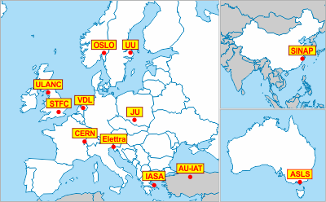
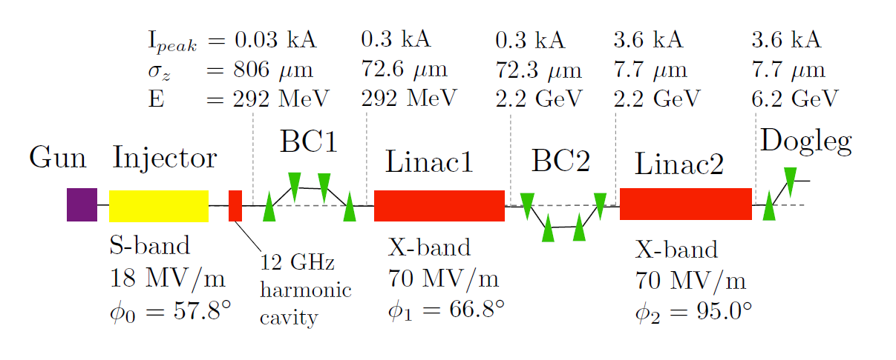
Baseline CLIC X-band FEL design
A. Aksoy

Slide 8
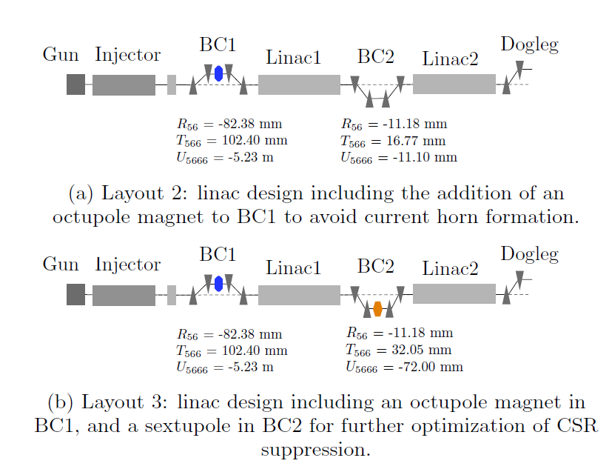
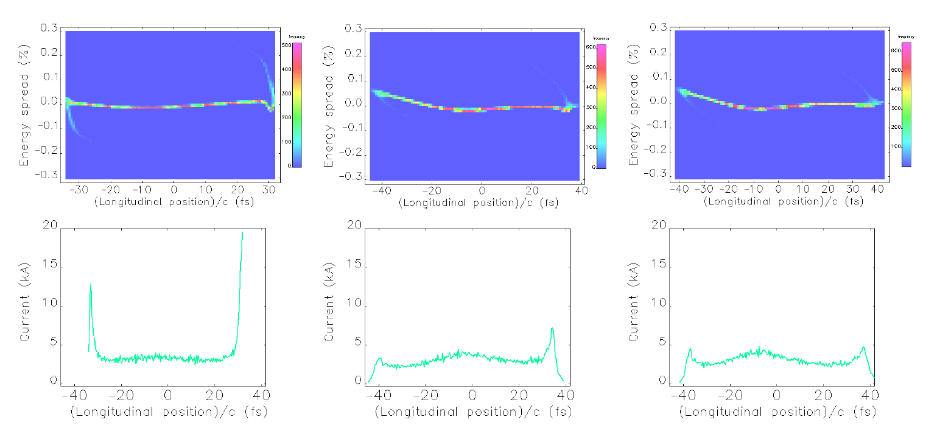
Current-horn suppression for reduced CSR-induced emittance growth
T. Charles

Slide 9
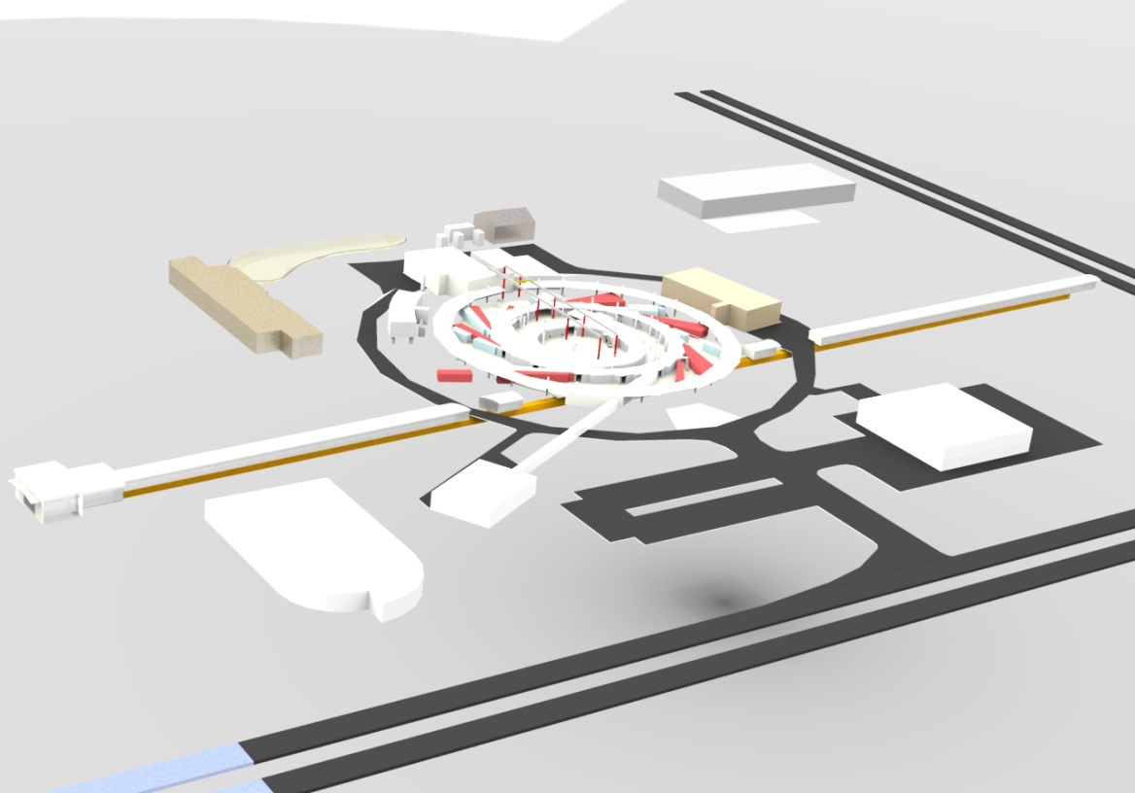
AXXS
AXXS – Australian X-band X-ray Source
AXXS n. /ˈæksɪs/ fig. A central prop, which sustains any system.
Development plan for the Australian Light Source community:
  develop the remaining beamlines (space for an additional 6 IDs)
  upgrade the storage ring lattice to MBA (compact MAX IV magnets?)
  upgrade the injector to a full energy x-band linac (3 GeV)
  upgrade to additional linac for XFEL (6 GeV)

Slide 10

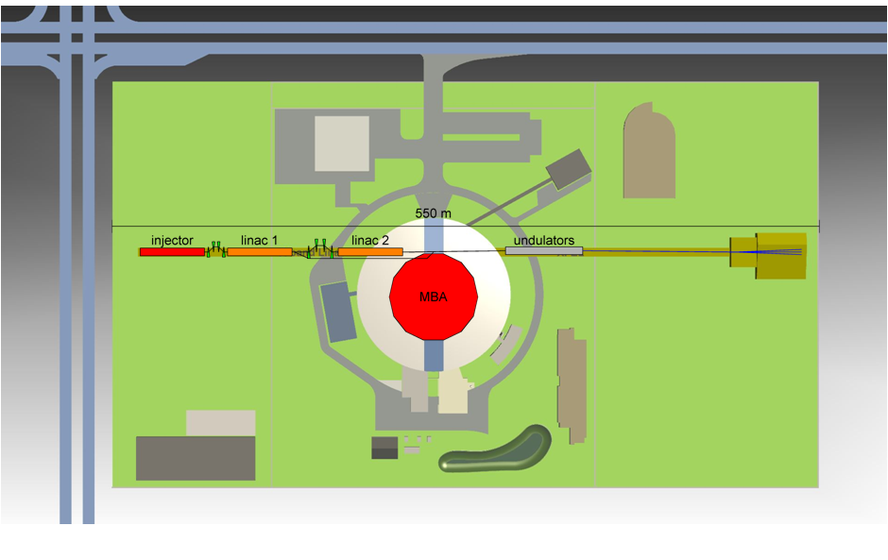
XFEL User Community in Australia
Strong XFEL user base with regular beamtime on LCLS and members of review committees for European XFEL
Strong government funding, especially in life sciences
Site constraint 550 m:
Same tunnel, energy and source points for storage ring upgrade.
Time constraints: need to finish building out the remaining beamlines before justifying a new ring or FEL.

Slide 11
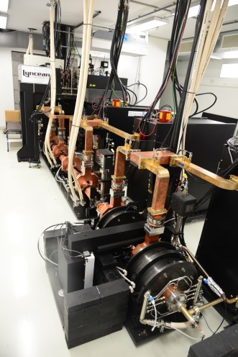
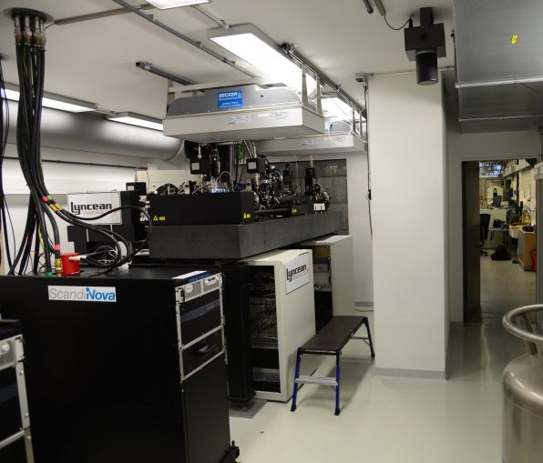
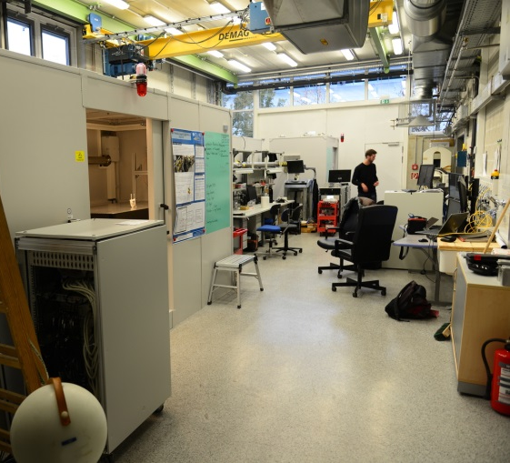
Users requesting compact light sources
User want to compliment the storage ring light source x-ray beamlines with their own compact light sources
  Reduce time between beamtime
  Enable proof-of-principle experiments before synchrotron beamtime
  Better prepared users for higher quality beam at synchrotron facility
  Broaden the light source user community (some potential users never apply for beam time due to the low proposal acceptance rate)
Example facility at Technical University Munich MuCLS
E. Eggl et al., “The Munich Compact Light Source: initial performance measures,” J. Synchrotron Radiat., vol. 23, no. 5, pp. 1137–1142, Sep. 2016.
4.6 m circ.
Storage ring
Source ~8 m
Beamline ~17 m
S-band linac

Slide 12
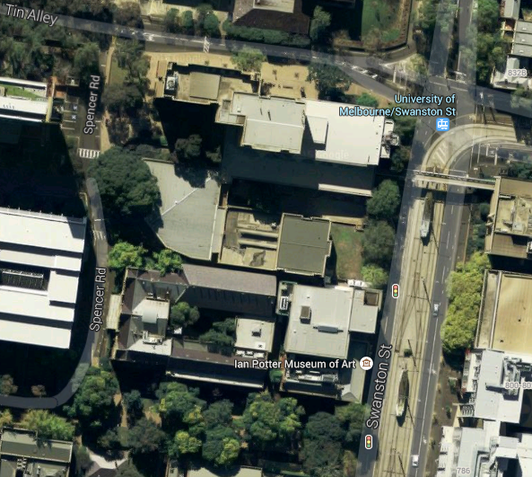
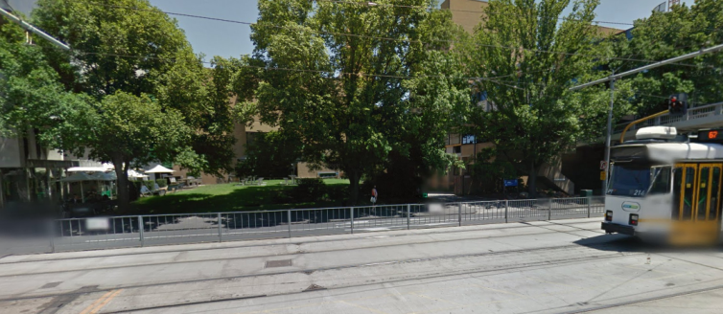
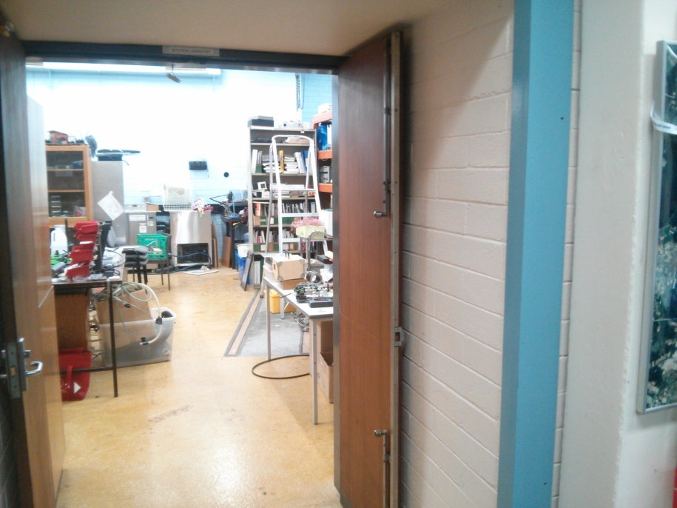
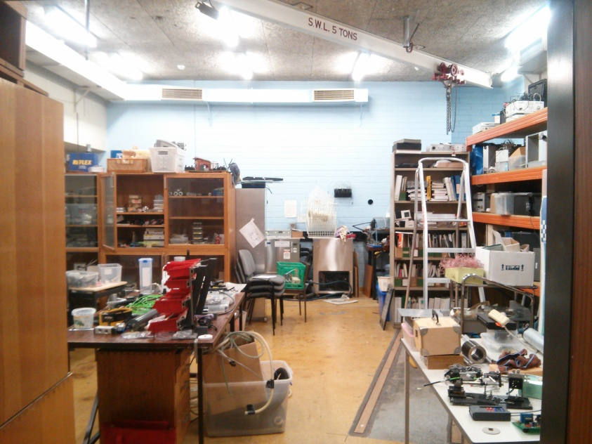
Accelerator R&D at Melbourne University
Build expertise through light source, CERN and CLIC collaborators
Driven primarily by x-ray user community needs
Starting to engage industry partners, e.g. RFS Word in Melbourne
Applying for Australian Research Council grants and partnering in H2020 proposals
Steel/Pb
Vault door
5 T crane

Slide 13
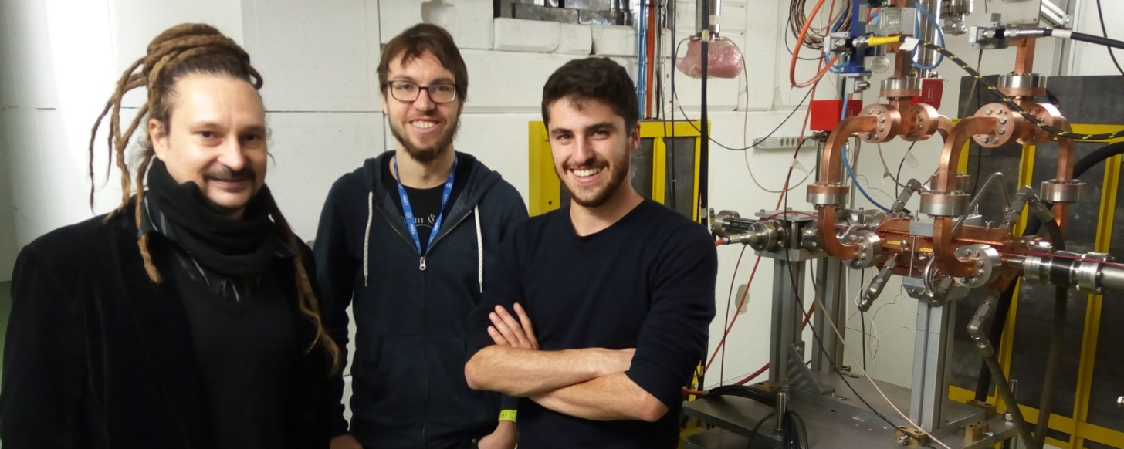
Introducing the team
Mark Boland (Australian ACAS Team Leader)
Geoff Taylor (Australian ATLAS Team Leader)
Roger Rassool (Particle and X-ray Detectors)
Matteo Volpi, Tom Lucas and Paul Giansiracusa, XBOX3 commissioning and XBOX1 and XBOX2 operations
Tessa Charles, submitted PhD on magnetic chicane for electron bunch compression

Slide 14
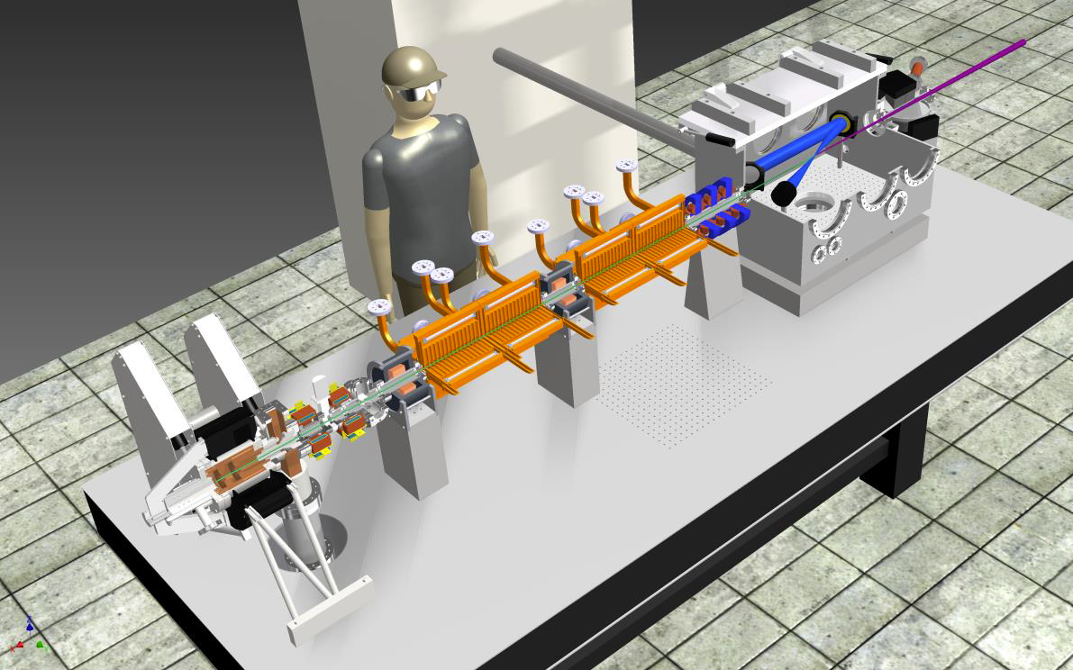
Collaboration with TU/e on Smart*Light
Inverse Compton Scattering source of quasi monochromatic x-rays (see details in Jom Luiten talk from TU/e this session)
Xavier Stagier to spend 2 month in Melbourne first half of 2017
Share RF source and s-gun resources
Develop similar proof of concept machines in Eindhoven and Melbourne 2017-2019

Slide 15
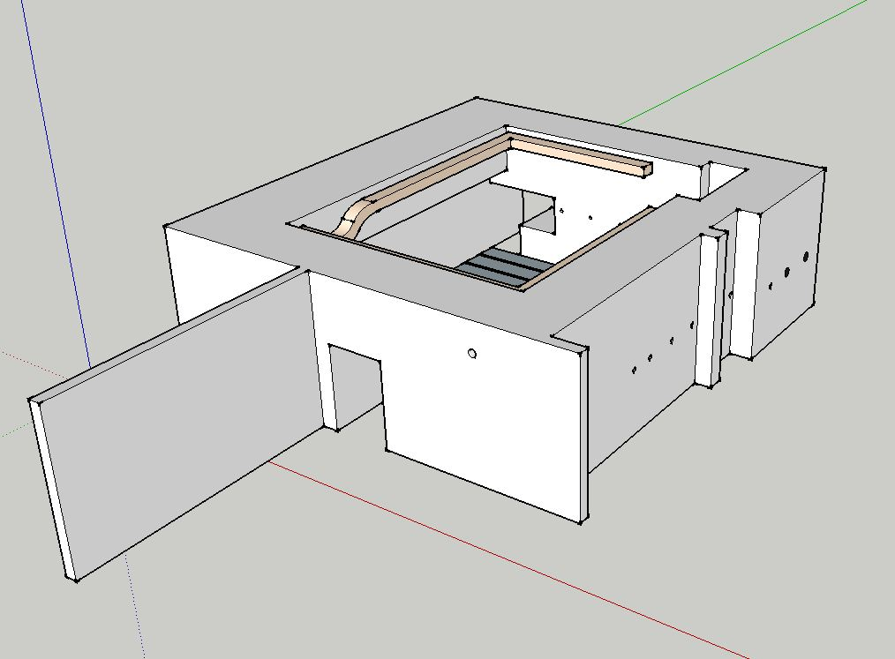
Accelerator Bunker at University of Melbourne
Previously used for 35 MeV betatron
Space for x-band linac and laser for Compton source

Slide 16
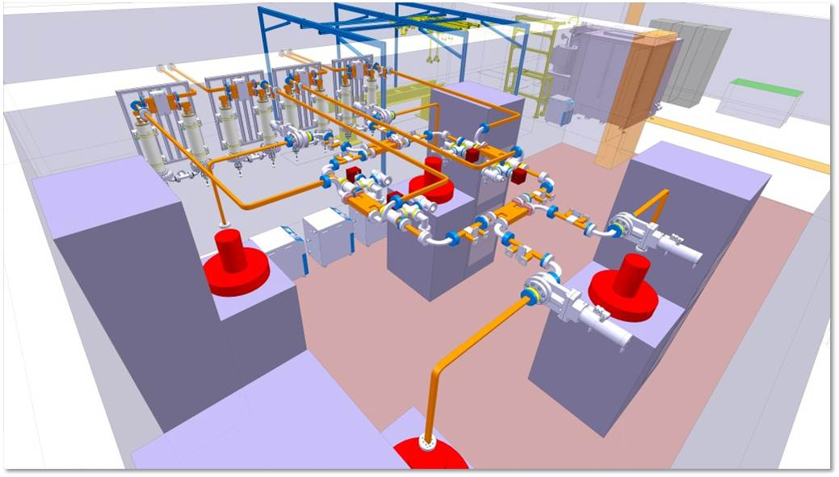
XBOX3 partly to Melbourne ~18/19
Bring part of XBOX3 to Melbourne for high gradient test stand and future linac based x-ray source

Slide 17
Future
Enthused by CLEAR and ARIEL access programme and another 4 years+ of electron accelerator activities at CERN
Started collaborating with TU/e on compact x-ray source
Participating in H2020 application CompactLight
Strong user request for distributed compact x-ray sources to compliment large storage ring beamlines

Slide 18
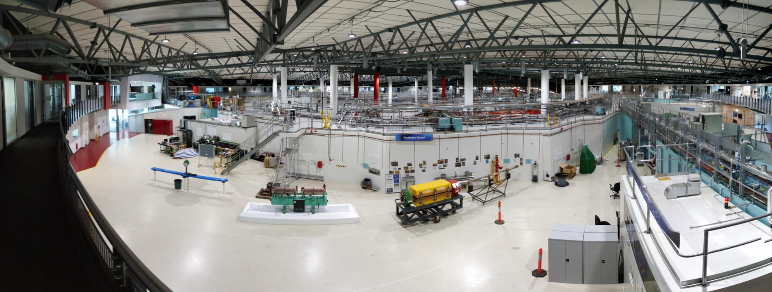
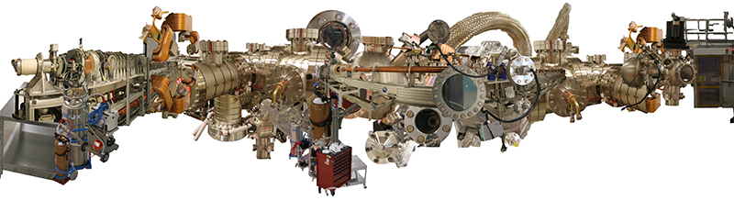
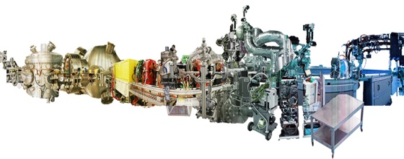

Slide 19
