Slide 1
X-band Facilities and High Gradient Tests Stands Around the World
CLIC Workshop
G. McMonagle
06/03/2016

Slide 2
OUTLINE
Geographic representation X band test facilities and high gradient test stands
  Summary of frequency, power and modulator type per location
Preliminary test results of High Efficiency BAC type multi-beam klystron at CERN

Slide 3

Location of Xband Facilities and High Gradient Tests Stands
DESY
Sincretrone Trieste
CPI Industries
Daresbury, CLARA
Berkley
PSI
KEK
SLAC
CERN
Tsinghua
MIT BATES
University of Valencia
INFN Frascati
SINAP
Toshiba (Canon)
Electron devices
Lawrence Livermore
PAL
Existing facilities
Klystron Manufacturers
Melbourne University
Future Planned Facilities
Projects under Study

Slide 4
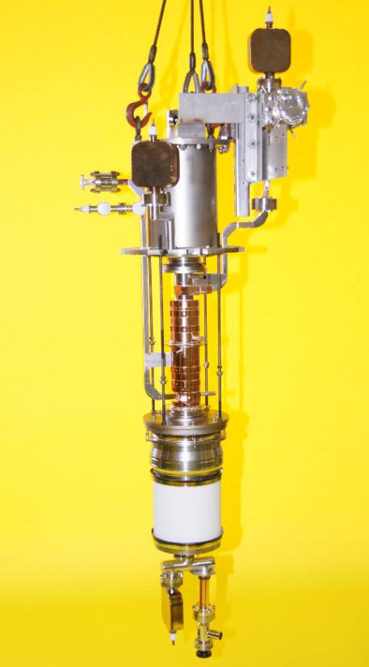
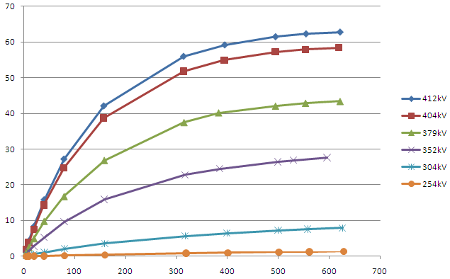
SLAC KLYSTRONS (XL5, XL4)
Parameters | Specifications |  | units
 | XL5 | XL4
RF Frequency | 11.9942 | 11.424 | GHz
Peak RF power | 50 |  | MW
RF pulse length | 1.5 |  | µs
Pulse repetition rate | 50 (100) |  | Hz
Klystron voltage | 410-470 |  | kV
Micro perveance | 1.15E-6

Slide 5
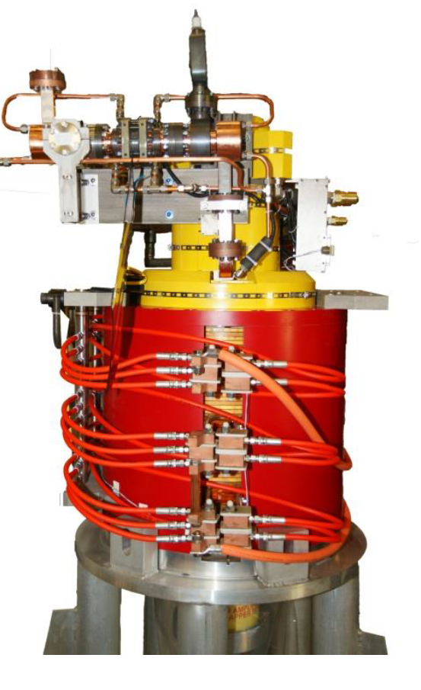
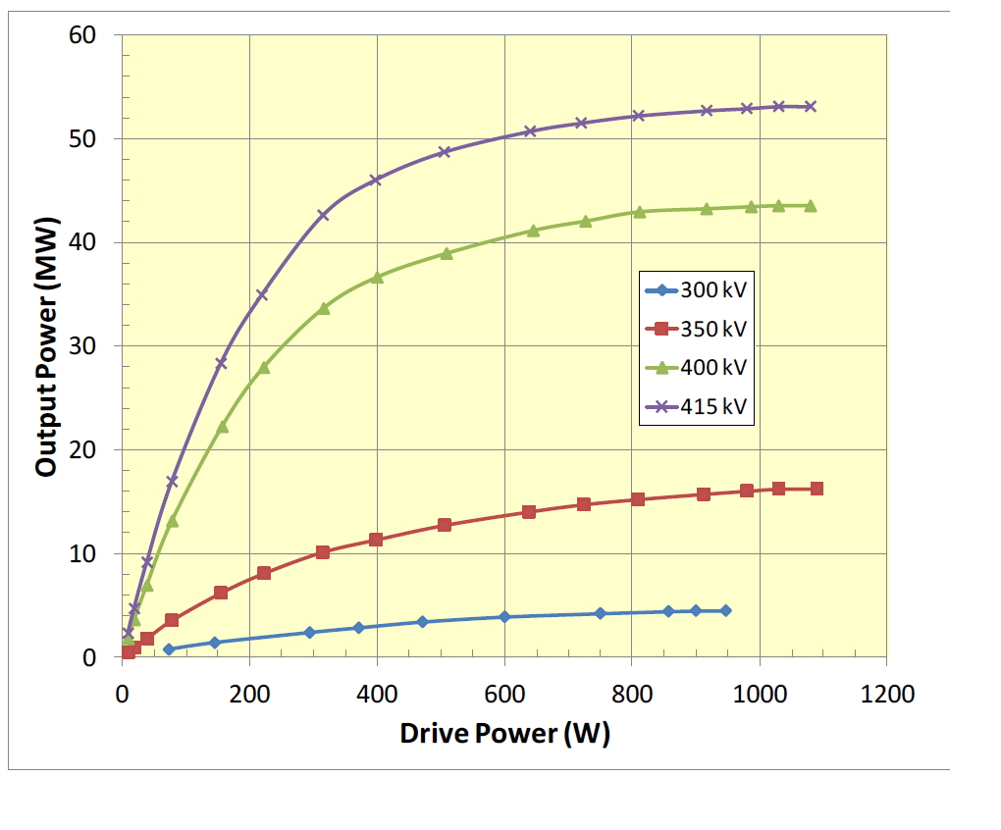
CPI KLYSTRONS (VKX-8311A, VKX- xxxx)
Parameters | Specifications |  | units
 | VKX-8311A | VKX- xxxx
RF Frequency | 11.9942 | 11.424 | GHz
Peak RF power | 50 |  | MW
RF pulse length | 1.5 |  | µs
Pulse repetition rate | 50 (100) |  | Hz
Klystron voltage | 410-470 |  | kV
Micro perveance | 1.15E-6

Slide 6
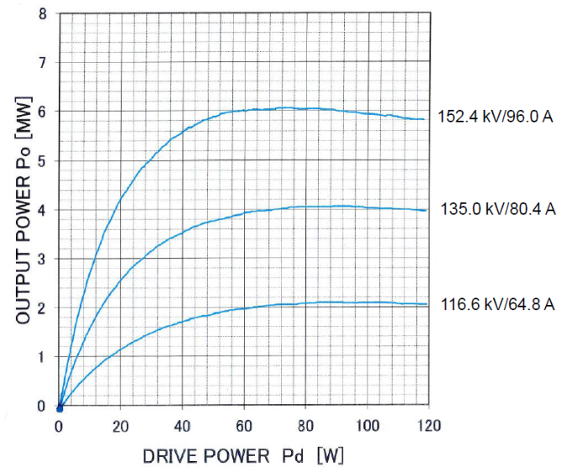
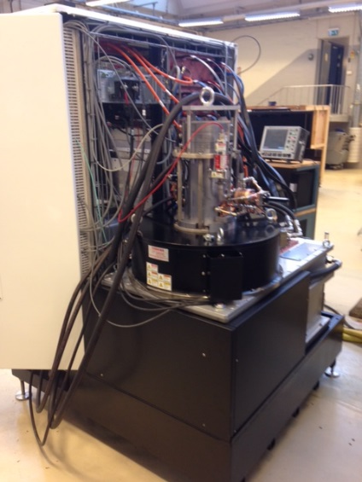
TOSHIBA KLYSTRONS (E3768B, E37113)
Parameters | Specifications |  | units
 | E3768B (PPM) | E37113
RF Frequency | 11.424 | 11.9942 | GHz
Peak RF power | 50 | 6 | MW
RF pulse length | 0.8 | 5 | µs
Pulse repetition rate | 60 | 400 | Hz
Klystron voltage | 450 | 150 | kV
Micro perveance |  | 1.5

Slide 7
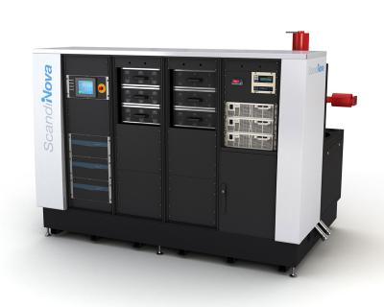
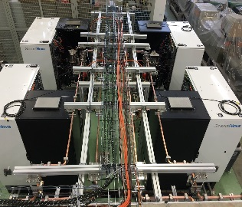
CERN Facilities
Xbox 1 and Xbox 2 (High Gradient Test facilities)
CPI VKX-8311A (previously XL5) klystrons
Scandinova solid state modulators
Xbox 3 (multi slot High Gradient Test Facility)
Toshiba E37113 klystrons
Scandinova solid state modulators

Slide 8
PSI and Sincretron Trieste
SwissFEL
XL5 klystrons (spare CPI VKX-8311A )
Scandinova solid state modulator
Note:- C band modulators also use Ampegon modulators
Could possibly be used in Xband as well
Elettra
XL5 klystrons
Pulse Forming Network , thyratron switch modulator (built in house)

Slide 9
SLAC, Lawrence Livermore,Berkeley, MIT BATES
FACET NLCTA ASTA ….
XL4 klystrons
Pulse Forming Network , thyratron switch modulator (built in house)
NLCTA , two pack four pack and 8 pack modulator studies
Lawrence Livermore
XL4 klystron
Scandinova solid state Modulator
Berkley
XL4 klystron
Modulator ?
MIT BATES
9.3 GHz L3 klystron
Modulator Solid State Scandinova

Slide 10
KEK and PAL
NEXTEF
PPM 11.424 GHz klystrons
Pulse Forming Network , thyratron switch modulator
PAL XFEL
XL4 klystron
Pulse Forming Network , thyratron switch modulator

Slide 11
Tsinghua, SINAP, DESY, Univesity Valencia, Melbourne University
Tsihghua test stand (2017)
VKX-xxxx, CPI 11.424 GHz Klystron
Solid State Scandinova Modulators
SINAP, Compact FEL (2017-18)
VKX-xxxx, CPI 11.424 GHz Klystron
Modulators being constructed in China
DESY, SINBAD and FLASH
CPI VKX-8311A and or Toshiba E37113
Modulator technology and manufacturer not yet chosen
University of Valencia IFIMED RF Test Infrastructure (2017)
CPI klystron Sband 7.5 MW 400Hz
Solid State Modulator, Jema Spain
Melbourne University (2018-19)
50% of Xbox3

Slide 12
Objective
Prepare and share a table within the community
Facilities
Experiments
Expertise
contacts

Slide 13
High Efficiency BAC type multi-beam klystron at CERN
The first prototype of a commercial S-band MBK, that employs the new bunching technology (Bunching, Alignment and Collecting, BAC) was designed and fabricated at VDBT Moscow and successfully tested at CERN.
Design based on retrofitting an existing klystron
MBK-147 , 40 beamlets, 60kV, 290 A 42% RF power production efficiency, PPM focusing.
To minimise the development and fabrication costs
It was decided to keep
Original 40 beam cathode
PPM focussing
Collector
Original RF circuit length (24cm)
Frequency, GHz | 2,9985
Peak output power, MW | >6
Average power, kW | 30
Beam voltage, kV | <60
Number of beams | 40
Pulse length, us | 5
Efficiency, % | >60
Pulse repetition rate, Hz | 300
BAC MBK klystron design parameters

Slide 14
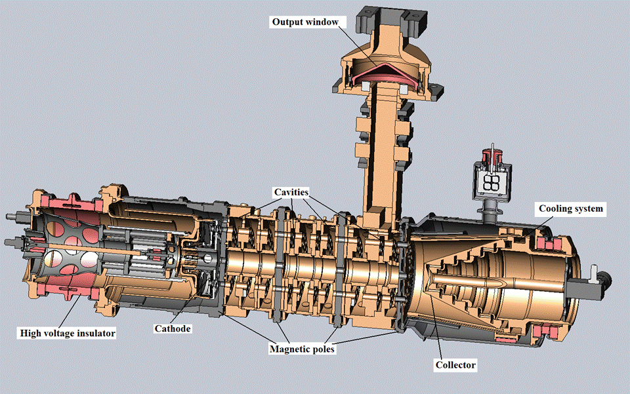
High Efficiency BAC type multi-beam klystron at CERN
General view of BAK MBK (without magnets).
BAC MBK installation at the test stand in CERN

Slide 15
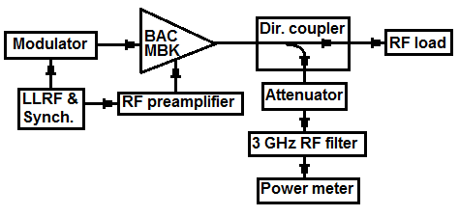
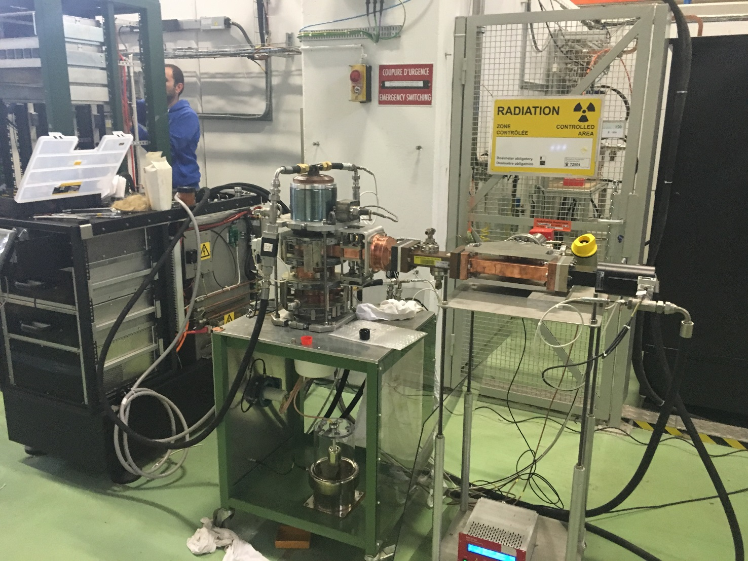
High Efficiency BAC type multi-beam klystron at CERN
Test Setup
Vacuum pumping port
RF Load
Original Scandinova K1 modulator
Thanks to ADAM
Turns ration modified to achieve
60kV, 190 A (original 190kV 90A)
New heater power supply needed
Klystron cathode in air
Current transformer
Capacitive voltage divider

Slide 16
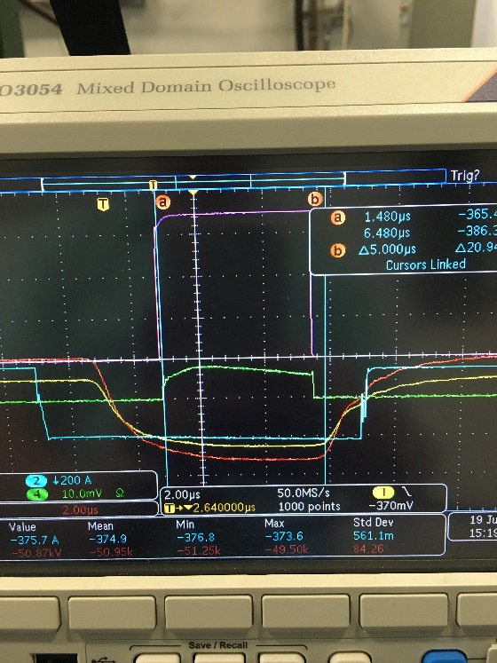
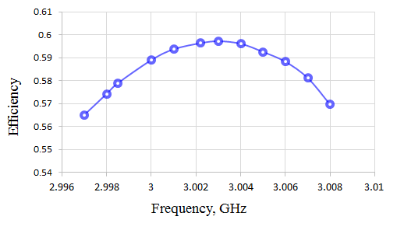
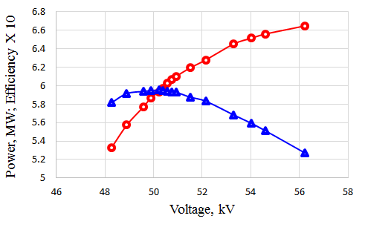
High Efficiency BAC type multi-beam klystron at CERN
Beam transmission optimized at 50.25kV
Pulsed with pulse length up to 9 µs
Repetition rate 120 Hz
Frequency optimization slightly off
Klystron efficiency vs. frequency at 50.25 kV and 195 A (in saturation)
The efficiency (triangular) and RF power production (circle) in saturation at 3.003 GHz as functions of high voltage.

Slide 17
High Efficiency BAC type multi-beam klystron at CERN
Conclusions
The first commercial prototype of a high efficiency BAC S-band MBK was successfully tested at CERN
The results are very encouraging and prove that new bunching technology can significantly boost the efficiency of klystron amplifiers.
The klystron efficiency was increased from 42 % to 60 % simply by replacement of the original RF circuit with the new BAC RF circuit.
Second klystron built in Moscow, initial results show correct frequency and 62% efficiency.
Smaller and more compact modulator design being considered by Scandinova and final testing may take place at CERN this year.

