Slide 1




High-gradient test of a structure built from halves
T. Argyropoulos
On behalf of the XBOX team at CERN
CLIC Workshop 2017
CERN 06/03/2017

Slide 2
Outline
Introduction
Xbox-2: T24-OPEN
  Conditioning
  Performance
  High-gradient studies
Summary

Slide 3
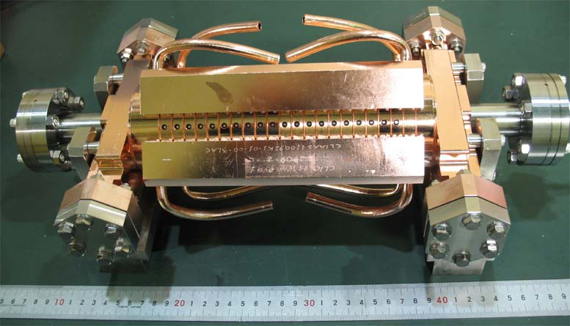
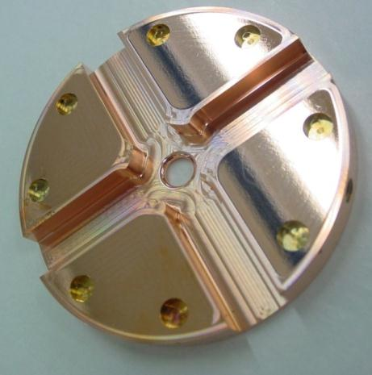
Introduction
Recent developments in design and production of normal-conducting RF structures raised the achievable accelerating gradient of 20-100 MV/m.
High-Gradient technology could be exploited in certain applications (Linear Colliders, FEL, hadron therapy etc).
For the Compact Linear Collider (CLIC) 10ths of thousands accelerating cavities are needed on pulse mode operation with the requirements:
  100 MV/m on axis accelerating RF field (tens of MW) , ~180 ns pulse length
High-power RF fields can lead to a vacuum arc formation (Breakdown) inside the structure → degrades beam transmission and acceleration → loss of Luminosity
  CLIC specification on the Breakdown rate (BDR): 3x10⁻⁷ BD/pulse/m
Main Linac Accelerating Structure: CLIC-G prototype (TD26CC), Travelling-Wave at 11.994 GHz

Slide 4
High-gradient testing
The High-Gradient performance needs to be tested in advance at high-power test stands
Different CLIC prototypes of accelerating structures have been tested so far at CERN, KEK and SLAC , and high gradients above 100 MV/m have been achieved at low breakdown rate.
At CERN: three X-band (12 GHz) klystron-based test stands (Xboxes)
  support the development of high-gradient accelerating structures and high-power, 50-100 MW range, and RF components for the CLIC project.(N. Catalan-Lasheras et al, IPAC14)

Slide 5
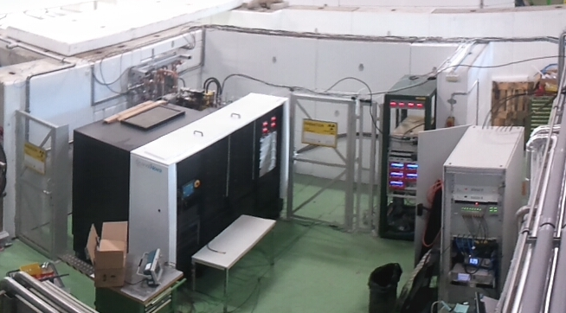
The Xbox-2 test stand at CERN
The Xbox-2 is the second generation of CLIC high-power klystron-based test stand at CERN.
Same infrastructure design as Xbox-1.
Close access to the bunker where the accelerating structure is tested.
RF Power capabilities: up to 150 MW 250 ns
BUNKER:
Acc. Structure under test
Pulse compressor, (250ns, ~3 x power)
Klystron
(50MW, 1.5us)
LLRF
Scandinova Modulator
TWT (~1 kW)

Slide 6
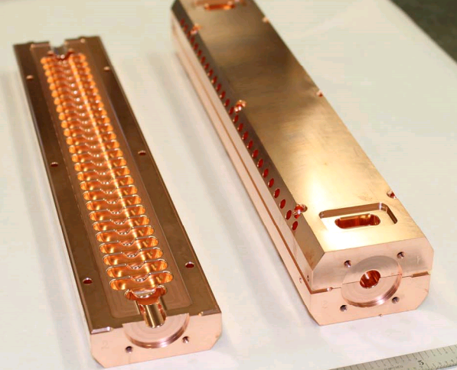
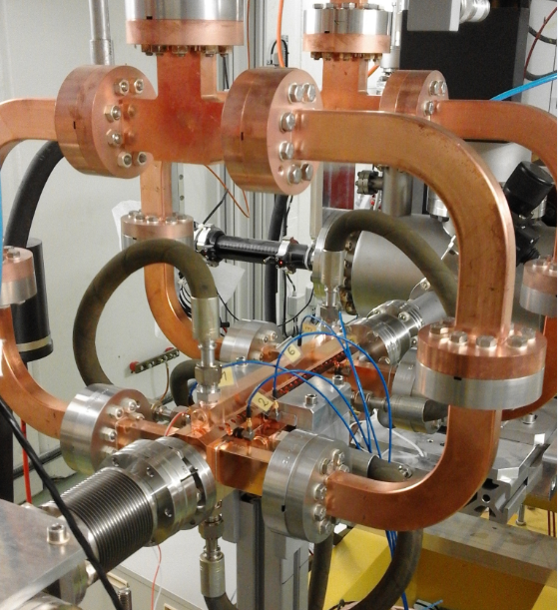
T24-OPEN
A new prototype, CLIC-G “OPEN”, was designed and built by CERN and SLAC.
Milled structure built in two halves and brazed together→ potential advantages compared to traditional structures (individual cells are brazed together):
Only two pieces per structure → significantly decrease in surface area to be machined.
Free choice of joining since no RF currents between halves: brazing, welding…
Overall reduction of the total fabrication cost of the structure.
What about the structure performance?
T24-OPEN installed at Xbox-2
24 regular cells (20cm-long) and two matching cells.
Same dimensions of irises as CLIC-G
No HOM damping
H. Zha, A. Grudiev, V. Dolgashev, IPAC2015
W. Wuensch et al., LINAC2016

Slide 7
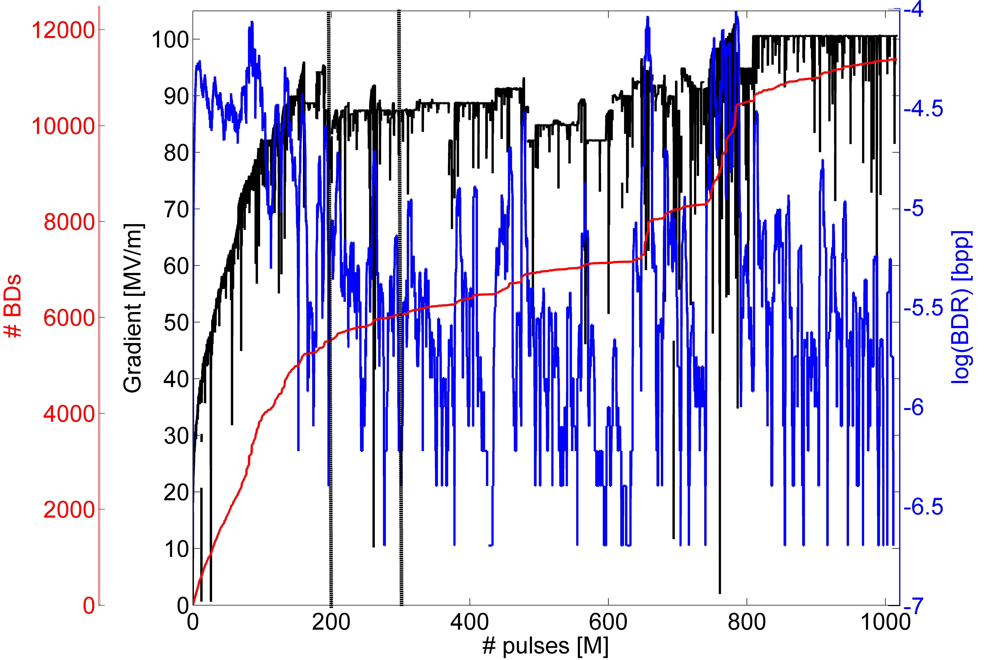
T24-OPEN Full history
100 ns
155 ns
200 ns
BDR falls during flat E run
Structure being well conditioned towards 100 MV/m at BDR below 1x10⁻⁶ BDs/pulse
Operation was restricted by radiation in the test area (bunker shielding issue)
Improved shielding → conditioned to 100 MV/m
4-Sep-2015
14-Nov-2016

Slide 8
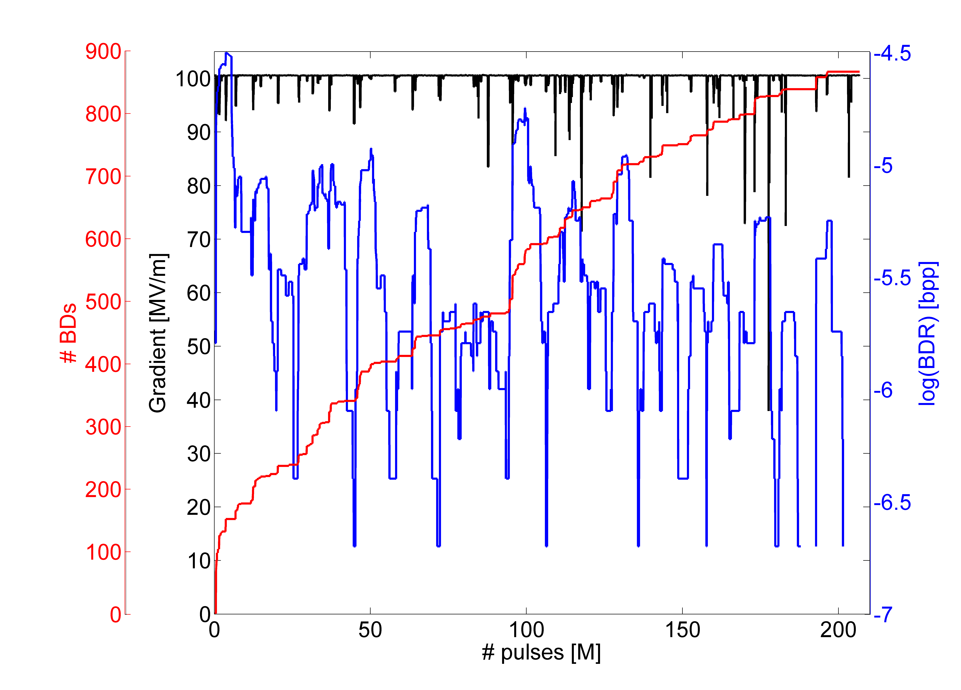
Last run @ 45 MW peak INC power
Run at constant peak power continuously for 2 months
Structure was conditioning to 1E-6 bpp
No obvious reason for this high rate

Slide 9
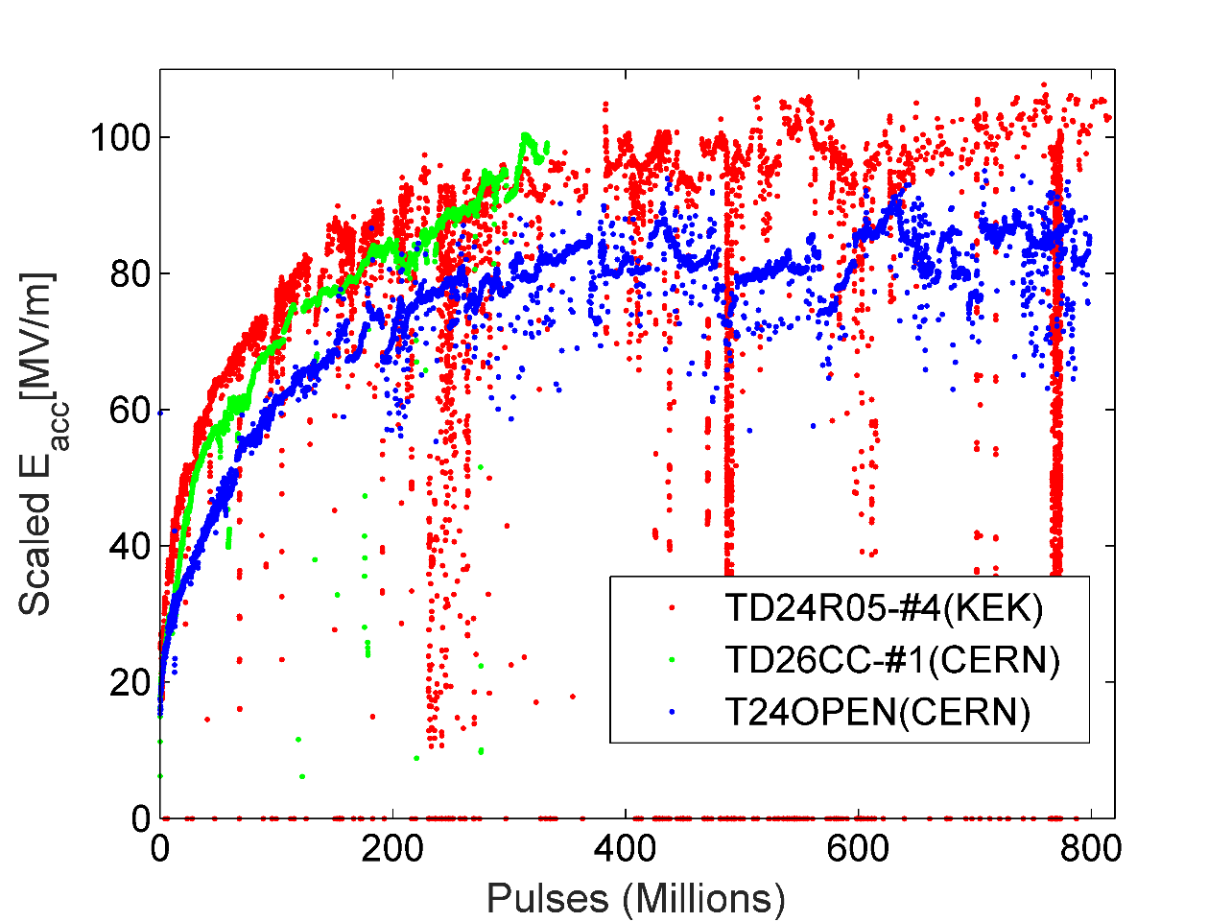

T24-OPEN Conditioning
The T24-OPEN structure follows the same conditioning trend as previously tested structures with different design.
Data scaled at 200 ns and 1e-6 bpp
$$E_{0}∝{BDR}^{1/30}τ^{−1/6}$$
Previously tested
T24OPEN

Slide 10
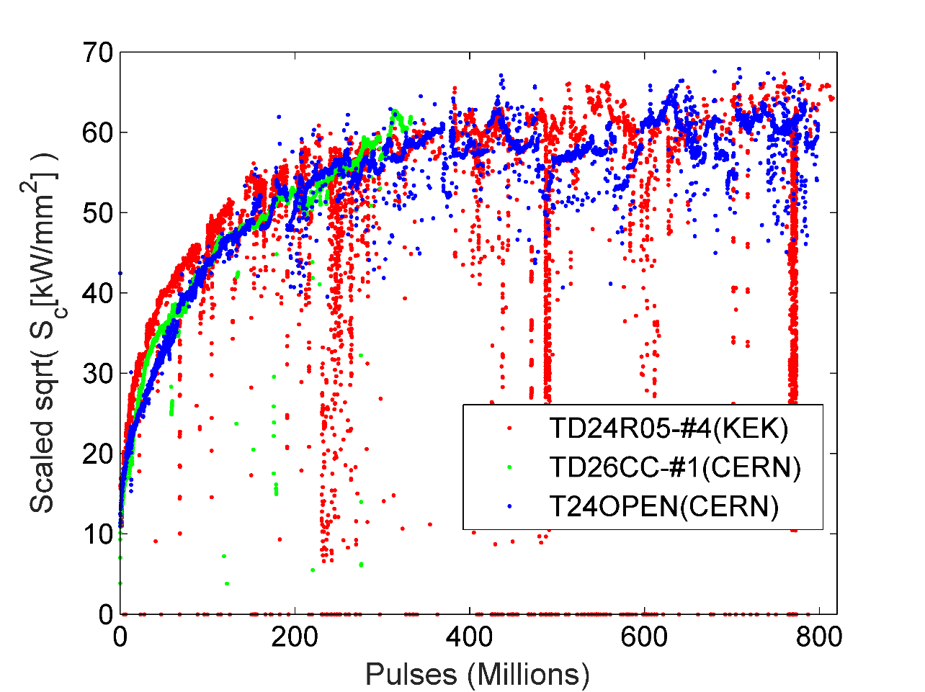

T24-OPEN Conditioning
Unlike other CLIC designs, the T24-OPEN presents 20% higher surface E fields E_{surf} → E_{surf} rises faster in time
Modified Poynting vector, S_{c} fits better with conditioning curves of previous tests in other disk-based structures. (A. Grudiev, S. Calatroni, W. Wuensch, PRSTAB 12, 102001 (2009))
Data scaled at 200 ns and 1e-6 bpp
$$S_{c}∝{BDR}^{1/15}τ^{−1/3}$$

Slide 11
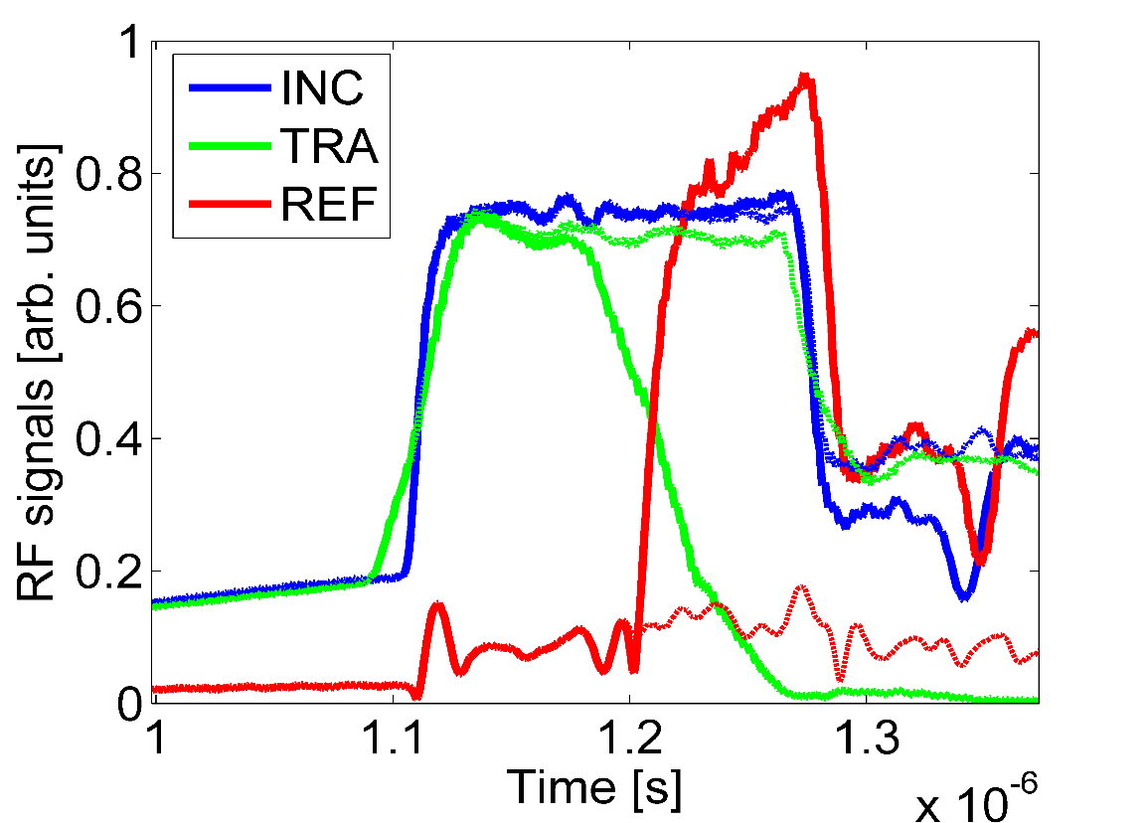
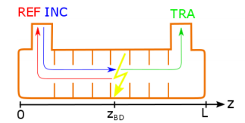




Breakdown positioning
Diagnostics of where the breakdown is triggered inside the structure during the testing can be done by analysing the RF signals → Directional couplers to read the RF signals
When breakdown occurs:
Transmitted power drops
Reflected power rises
Edge method: Trip time delays, combined with RF group velocity v_{g}, gives the onset position of the breakdown.
Trip time delay: $t_{d}= t_{drop}^{TRA}−t_{rise}^{REF}$
$$z_{BD}∝v_{g}^{RF}(t_{drop}^{TRA}−t_{rise}^{REF})$$

Slide 12
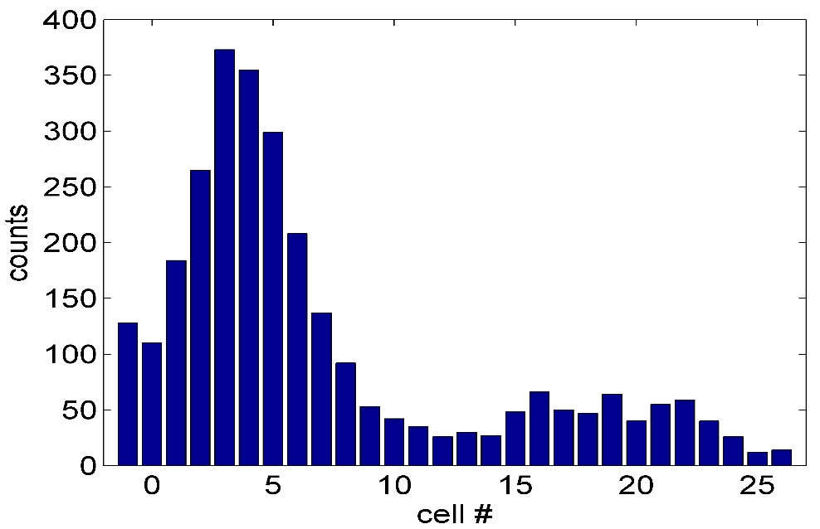
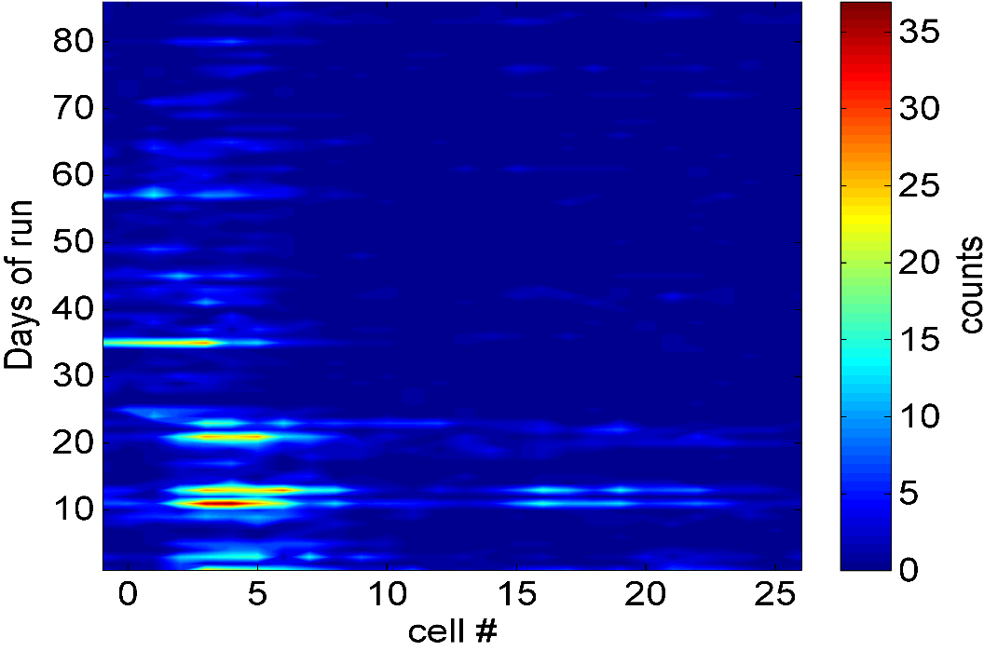
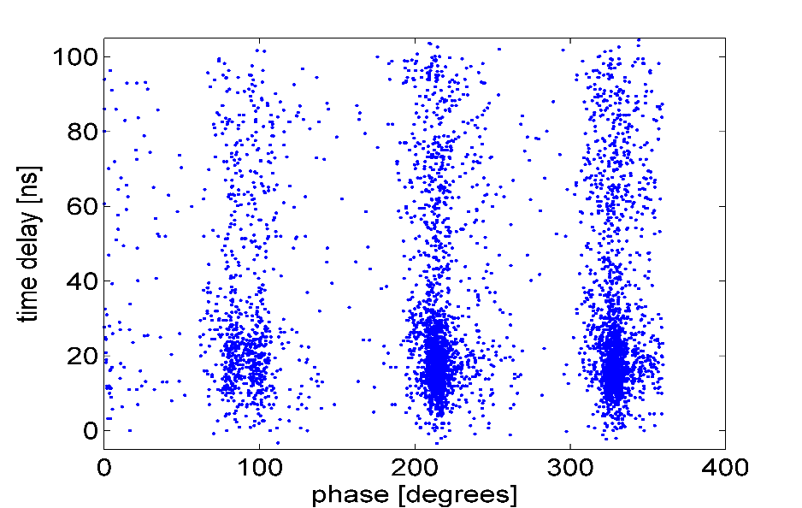
Breakdown positioning
In the structure
More BDs in the beginning of the structure (started after Dec 2015)
Not hot cell development → BDR was decreasing
Phase distribution of the BDs spaced by ~120 degrees.
Combination of timing and phase information → better accuracy in breakdown localization
Nov
2016
Aug 2016

Slide 13
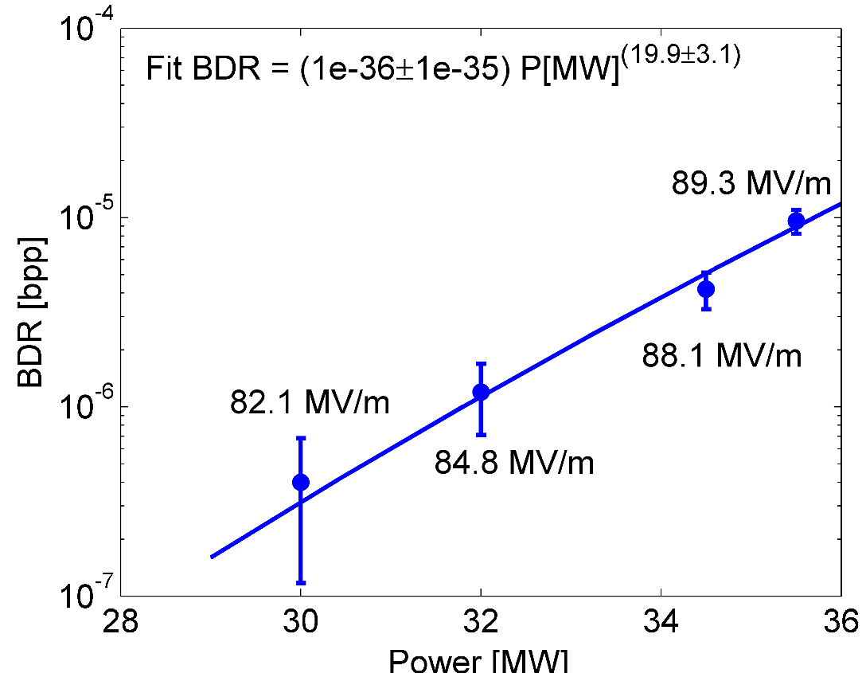
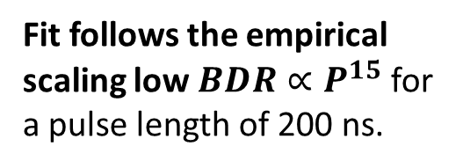
BDR dependence on Power
Measurements for constant power: many interruptions due to interventions for Xbox-3 installations → idle periods in between → possible effect on the statistics.
BDR calculated only for the last 5M pulses of each constant power run.
Fit follows the empirical scaling low $BDR∝P^{15}$ for a pulse length of 200 ns.

Slide 14
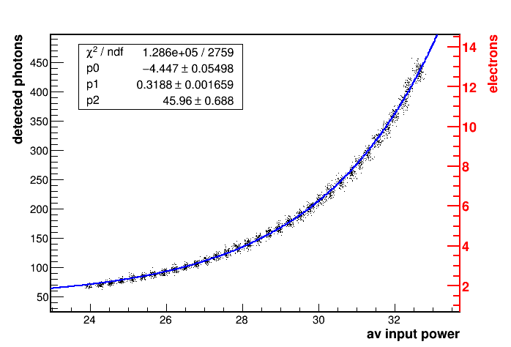
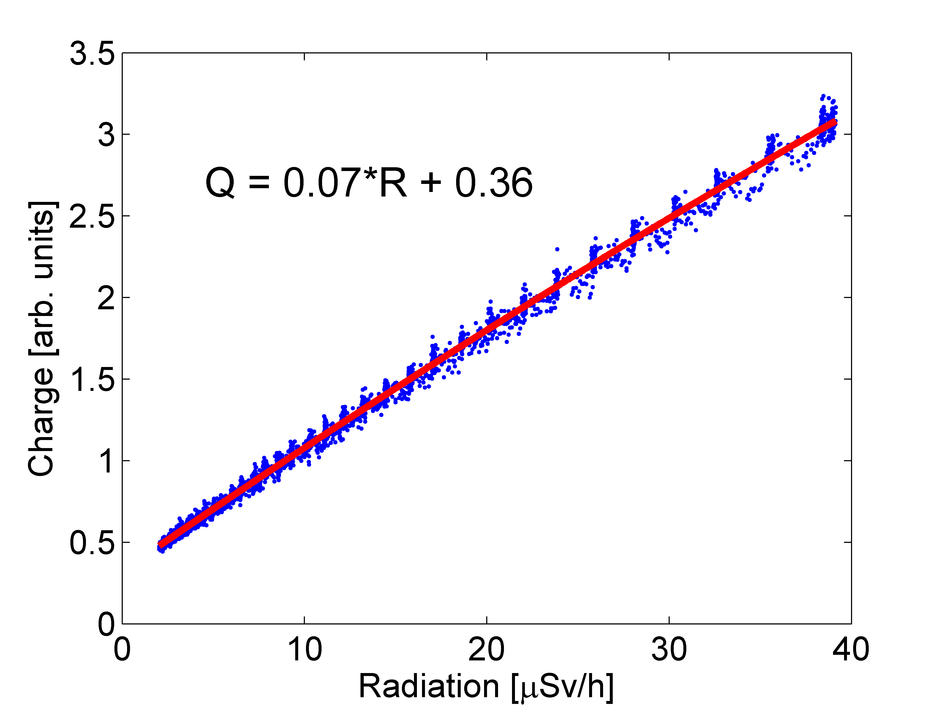
Dark current measurements
Dark Current is measured: Faraday Cups, Beam Loss Monitors (BLM) (M. Kastriotou and now T. Geoffrey Lucas), Radiation Monitors (CERN Radioprotection group)
Measurements with BLM (March 2016)
Exponential fit function as in the theoretical model
Linear relation to the radiation monitor placed downstream of the structure

Slide 15
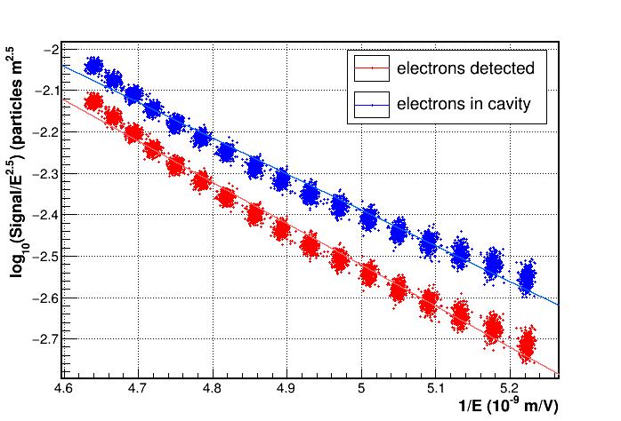
Field enhancement factor
Fowler-Norheim plot gives a β = 29, similar to the β for the disk-based structures. Similar values obtained also from FC and Radiation monitor.
Blue points are the number of electrons inside the cavity estimated by FLUKA simulations.
β = 33.4
β = 29.1

Slide 16
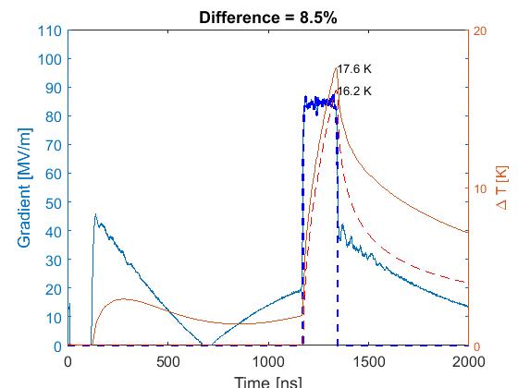
Pulse shape dependence on BDR
Two pulse shape configurations are used: with and without Pulse compressor (PC)
Pulse surface heating increased with PC → higher effective field → higher BDR is expected (F. Wang, C. Adolphsen, C. Nantista, PRSTAB 14, 010401 (2011))
Solid= with pulse compressor
Dashed= without pulse compressor

Slide 17
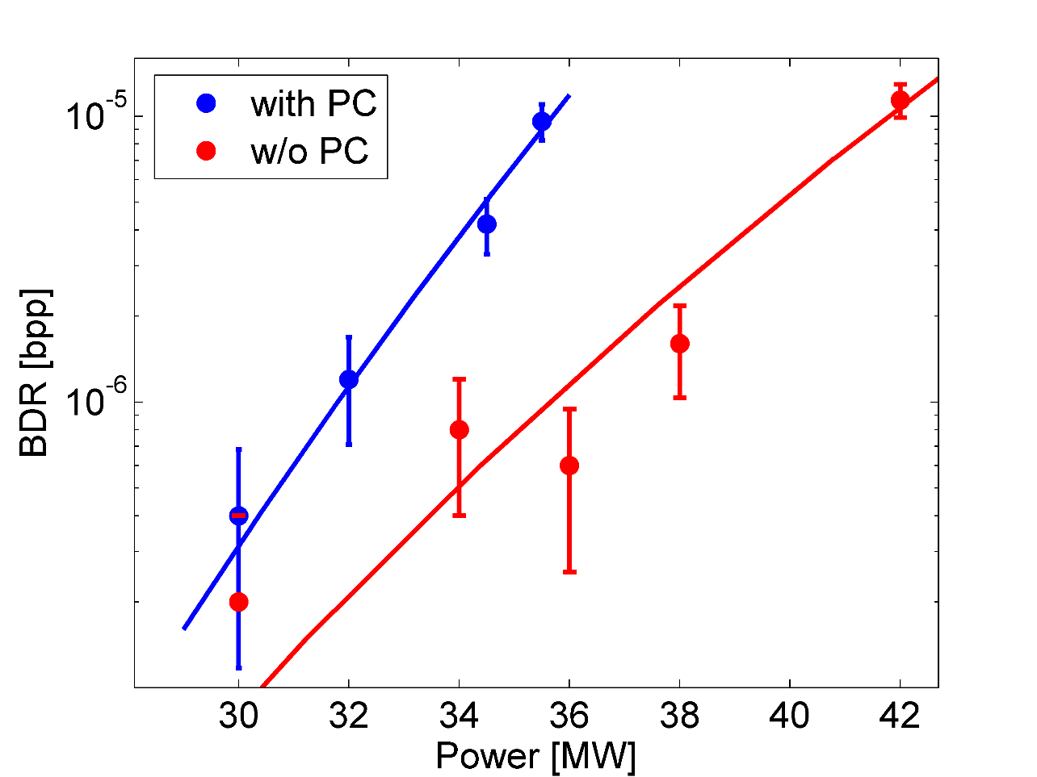
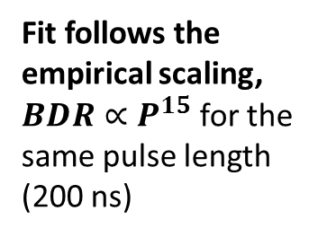


Pulse shape dependence on BDR
Measurements showed that BDR with the PC is larger than without PC
$$f∝ P^{(14.5 ±1.7)}$$
Fit follows the empirical scaling, $BDR∝P^{15}$ for the same pulse length (200 ns)
$$f∝ P^{(19.9 ±3.1)}$$

Slide 18
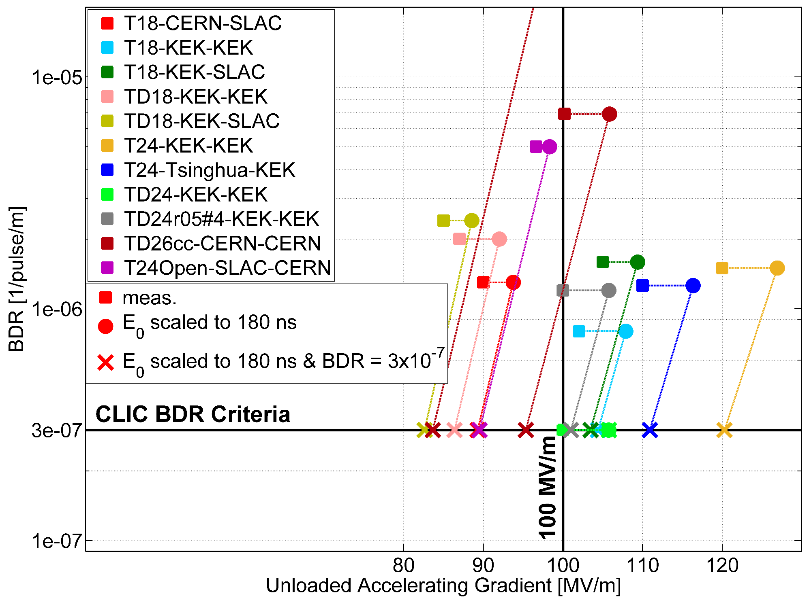

Conditioning summary
Empirical scaling :
$$BDR∝E_{0}^{30}τ^{5}$$
T24-OPEN

Slide 19
Summary
Milled structures have potential advantages - cost, treatment, materials
T24-OPEN built in halves was installed at Xbox-2 test stand at CERN for checking its performance with respect to the disk-based structures
  Structure conditioning: similar trend as the other structures
  Breakdown localization: more BDs in the beginning but not hot cell developed
  Field emission: similar enhancement field factor β as the other structures
High-gradient studies of the pulse shape effect on the structure performance : Pre-pulse due to the PC increased the BDR

