Slide 1
DVM Summary and
Acoustic Microscopy Imaging of Cu Sample
Antti Meriläinen^{1,2}, Robin Rajamäki³, Ivan Kassamakov^{1,2}, Markus Aicheler², Walter Wuensch³, Kenneth Österberg^{1,2} and Edward Hæggström¹
1) Department of Physics, University of Helsinki
2) Helsinki Institute of Physics
3) CERN

Slide 2
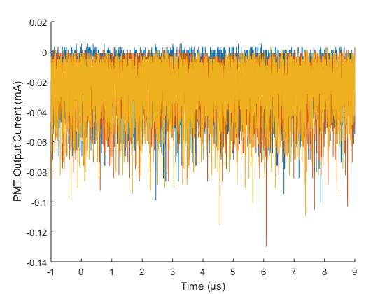
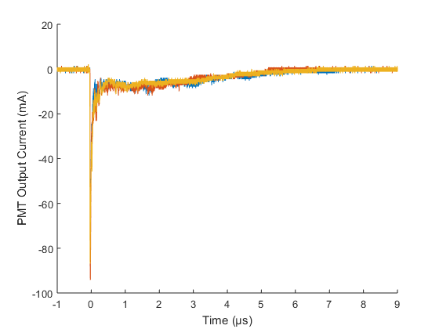
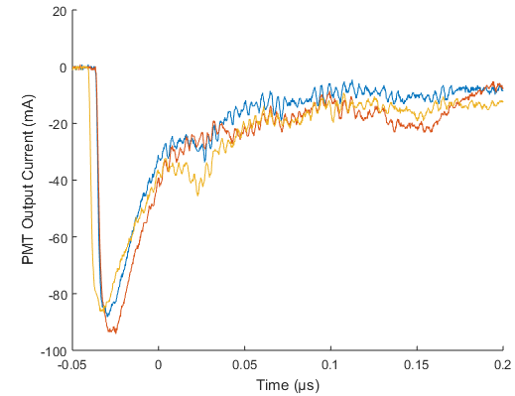
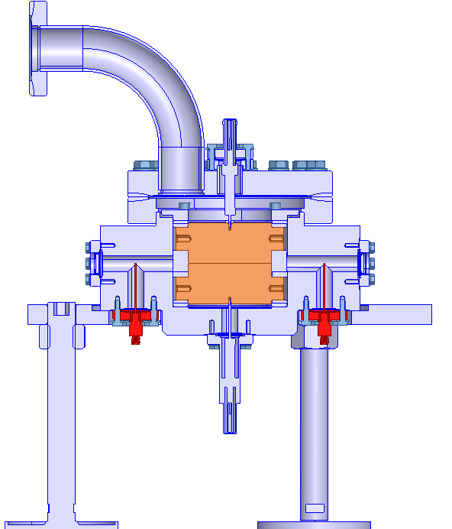
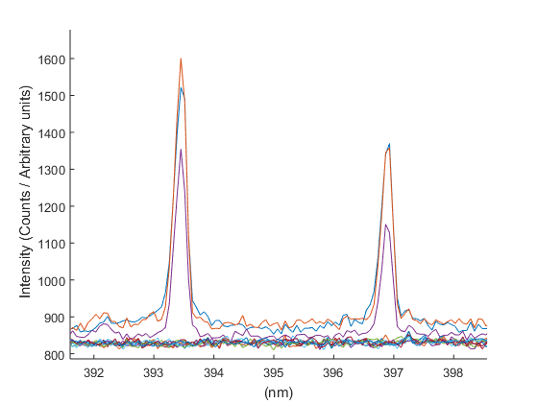
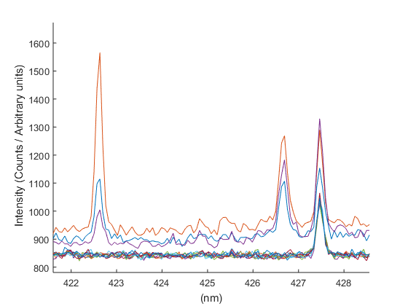

Summary of DVM 2016
Absorption
Lamp On
Spark
~40 000x Larger than Lamp
After Glow
→ No. of Atoms?
Emission
O I, O II
(Cu I, II)
(C IV)
O III
Cu I, II
C IV
O II
(Cu I)
Light in
Light out?
Cu I
O II
C II
PMT
19.2.2016

Slide 3
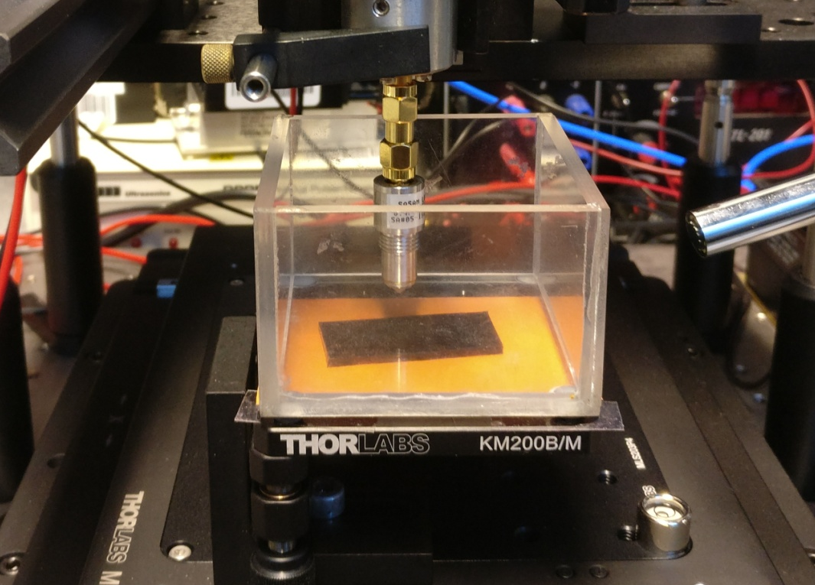
Why Acoustic Microscope
Optical methods do not measure elasticity
Tapping mode AFM is not easy to calibrate for elasticity
µCT Does not see elasticity close to the surface
Ultrasound transducer
Sample holder
Tilt stage
XY Stage
10 mm

Slide 4
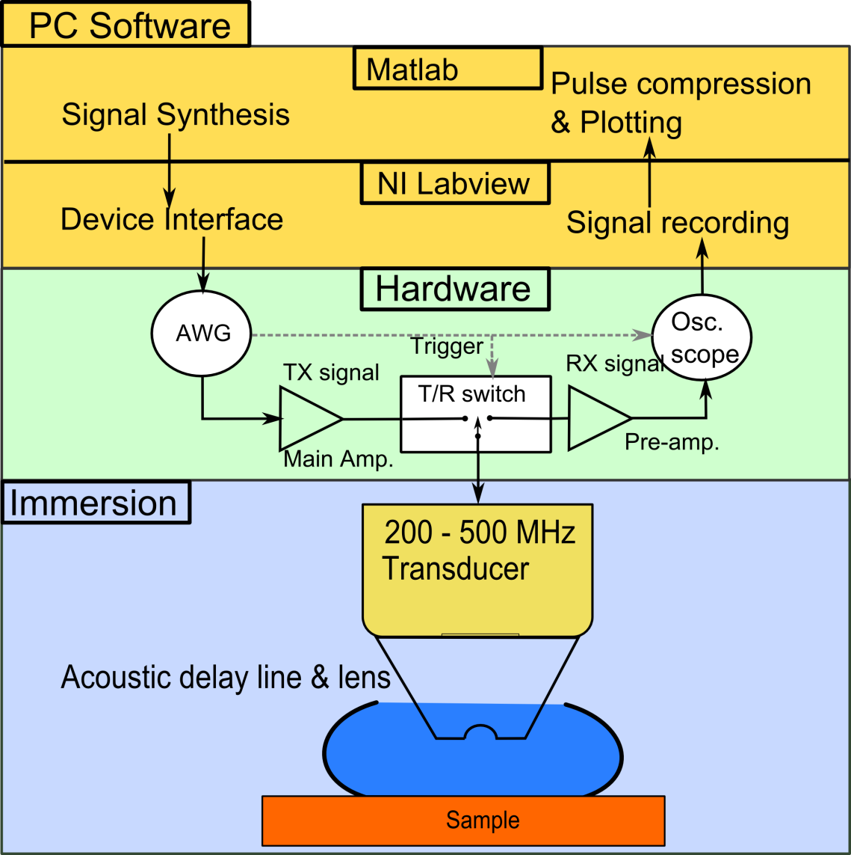
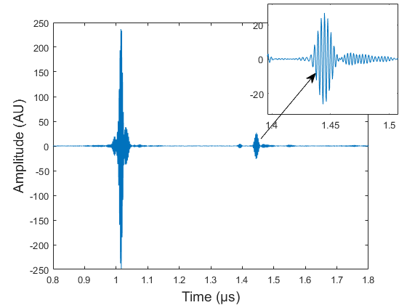
Pulse Echo Measurements
Single Pixel
Time-of-Flight
Echo Amplitude
Time-of-Flight: Surface Topography
Amplitude: Mechanics

Slide 5




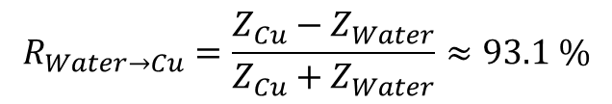

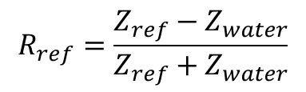




Math of Acoustic Reflection
Time-of-Flight
$$C is Speed of Sound$$
$$s=\frac{c_{Water}}{t}$$
$$t is Time of Flight$$
Echo Amplitude
$$R_{Water→Cu}=\frac{Z_{Cu}−Z_{Water}}{Z_{Cu}+Z_{Water}}≈93.1 \%$$
$$R_{ref}=\frac{Z_{ref}−Z_{water}}{Z_{ref}+Z_{water}}$$
$$Z_{Cu}=\frac{R_{ref}+ \frac{A_{Ref}}{A_{Cu}}}{R_{ref}− \frac{A_{Ref}}{A_{Cu }}}Z_{Water}$$
$$\frac{A_{Cu}}{A_{Ref}}=\frac{R_{Cu }(Z_{Cu})}{R_{Ref}}$$
$$Z_{Cu}=\frac{K_{Cu}+ \frac{4}{3}G_{Cu}}{C_{Cu}}$$
$$A=Ech{oes}^{′} Amplitude$$
$$K is Bulk Modulus$$
$$G is Shear Modulus$$

Slide 6
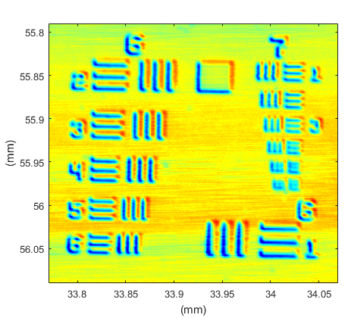
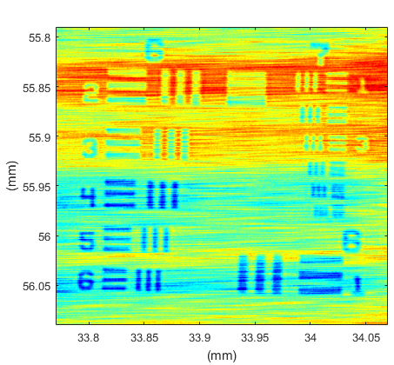
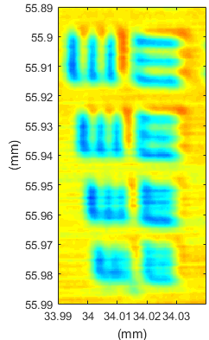
Lateral Resolution
Amplitude
Time-of-Flight
3.10 µm
2.76 µm
Step Height: 85 nm (White-light-interferometer: WLI)
2.46 µm
2.19 µm

Slide 7
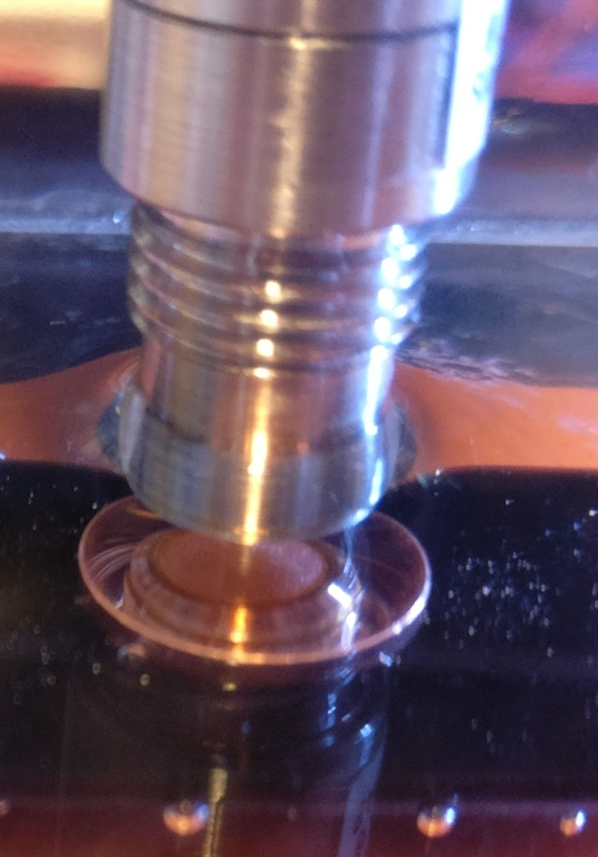
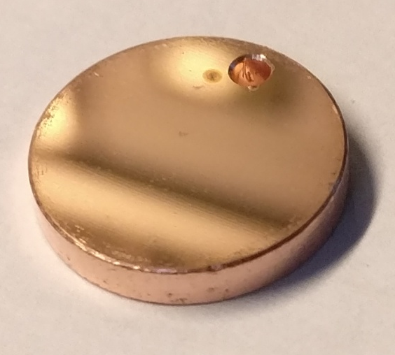
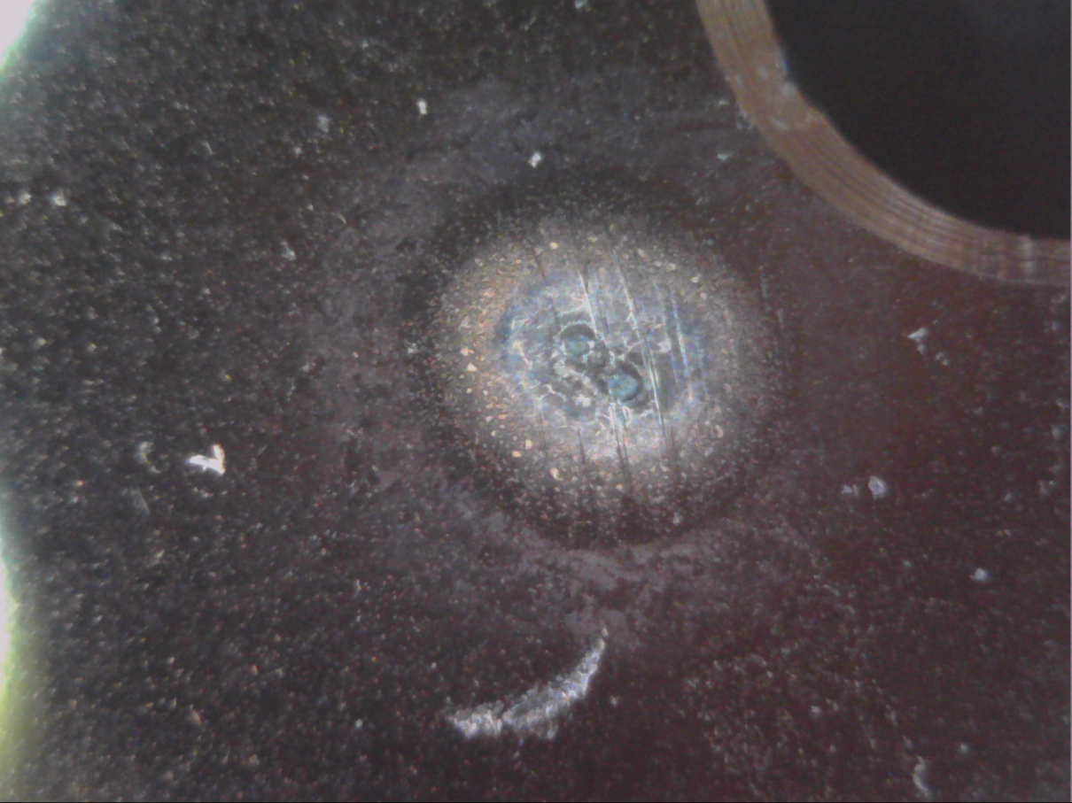
Copper Sample ID5 #495
1 mm
1 mm
0.1 mm

Slide 8
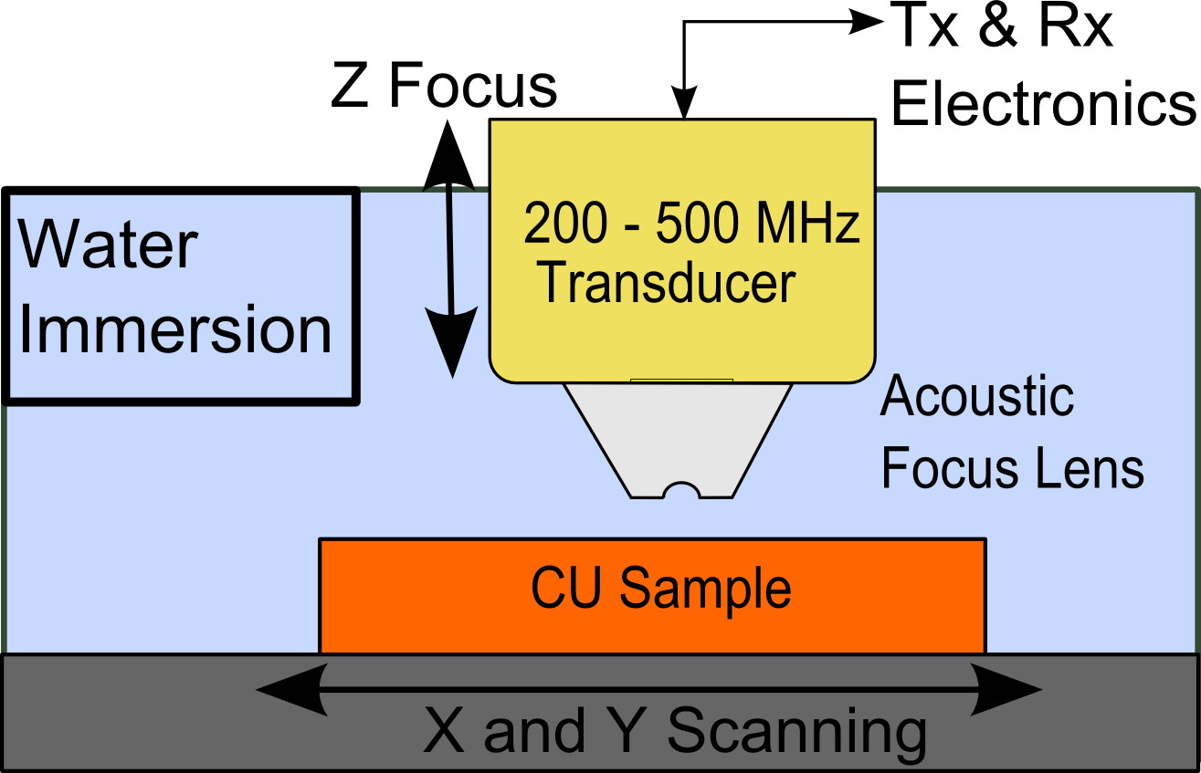
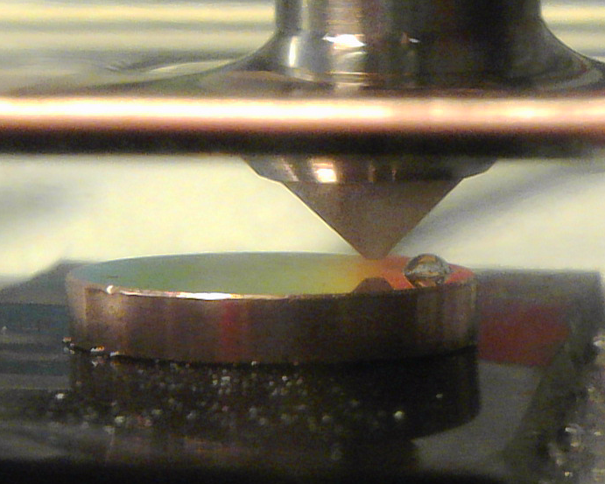
Scanning Acoustic Microcopy
10 mm
Frequency range: 240 – 480 MHz
Pixel-by-Pixel Imaging
Areas 1 mm * 1 mm
  ~Stepping 2 µm
Focus size: less than 3 µm
Imaging time: ~1 hour/mm²

Slide 9
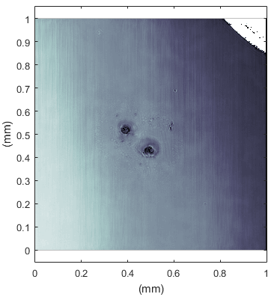
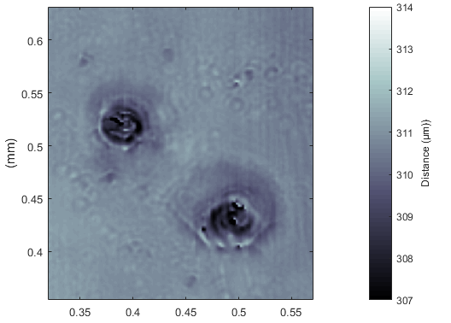
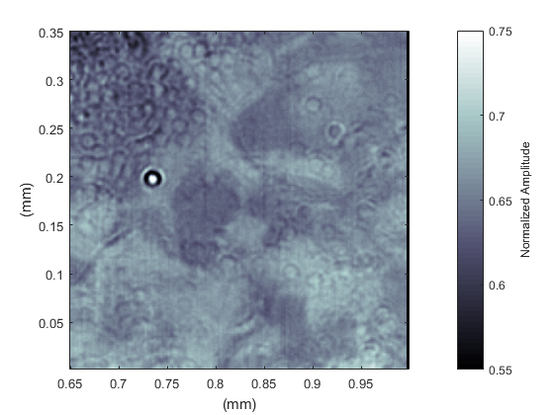
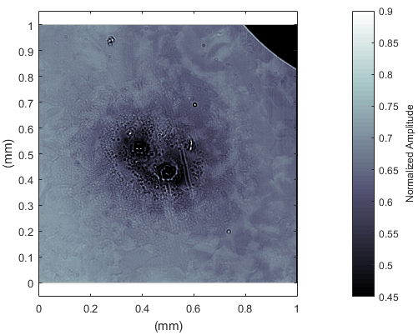
Results: Copper Sample
Microscope
TOF
0.1 mm
Amplitude

Slide 10
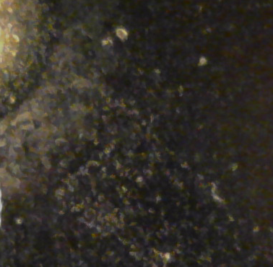
Results: Copper Sample

Slide 11
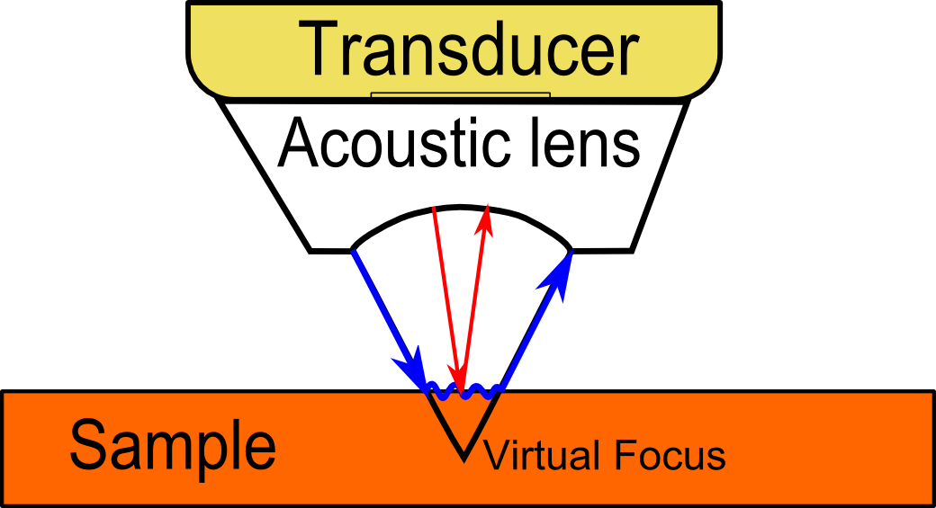
Future Work
Surface Elasticity (GPa)
  Acoustic Impedance Calculations
  Scattering from non-flat surface
Surface Wave-Velocity
  Another acoustic parameter
  V(z) -Technique
  Young’s Modulus
Look Under the Surface
  Hard with Focused Transducer
  Time-Reversal -Techniques?

Slide 12
Questions and Comments
Thank You!

Slide 13

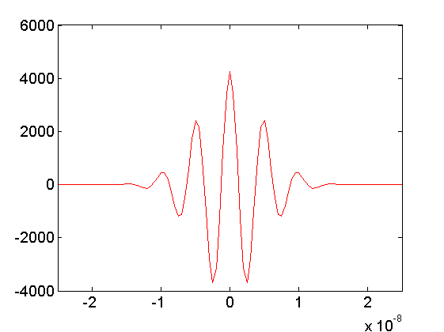
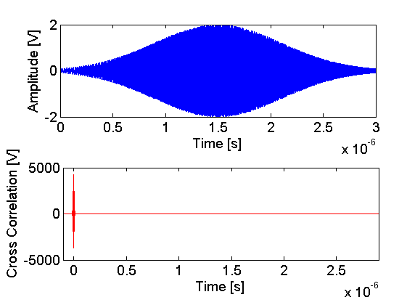


Pulse Compression
Cross Correlation
dt descript depth resolution
dt depends on bandwidth
dt

Slide 14
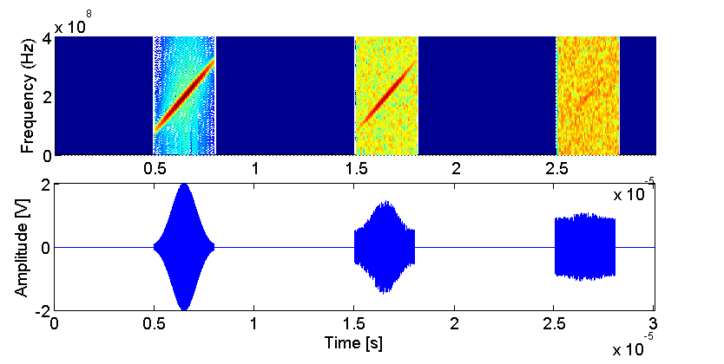
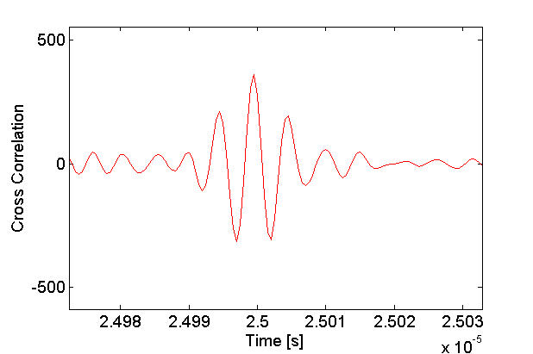
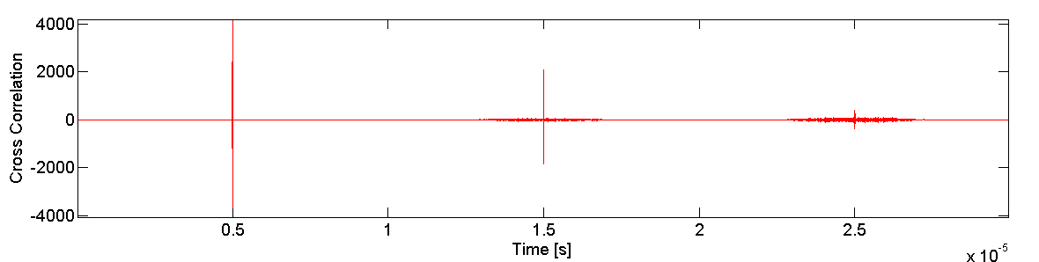
Coded Signal and SNR
SNR =1
SNR =0.1

