Slide 1
Two-beam module studies update
07/03/17
Alex Vamvakas
on behalf of the TBM team

Slide 2
Outline
2016 activities:
  LAB modules installation
  SAS mock-up production
  FEA simulator
  Dogleg structure thermal study
Future activities:
  LAB modules testing
  Transportation test
  New generation module

Slide 3
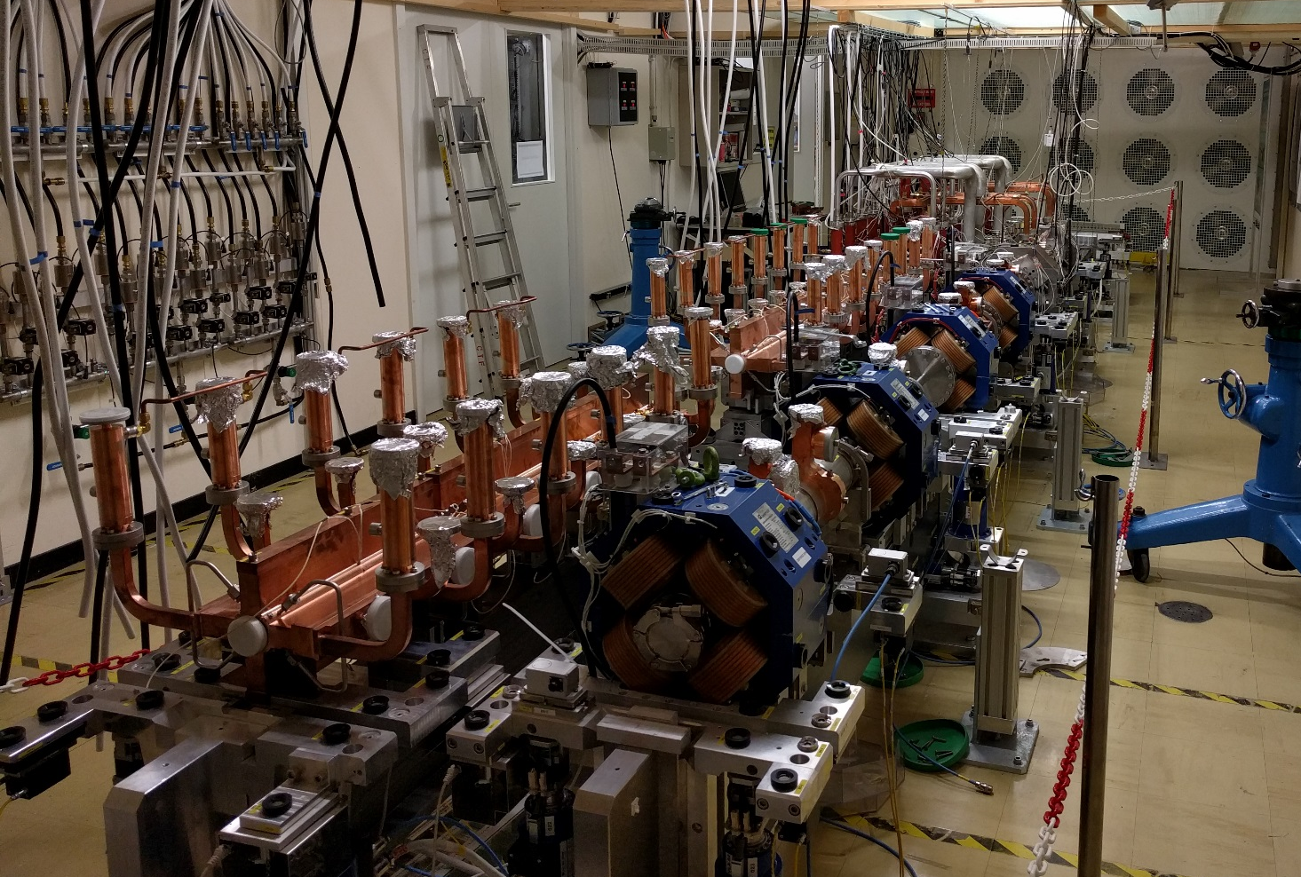
Installation of LAB modules
All major components installed
Missing:
  Waveguides, vacuum and cooling
First tests already started
  Measuring the effect of assembling steps on alignment
Thermal and vacuum tests to follow this year

Slide 4
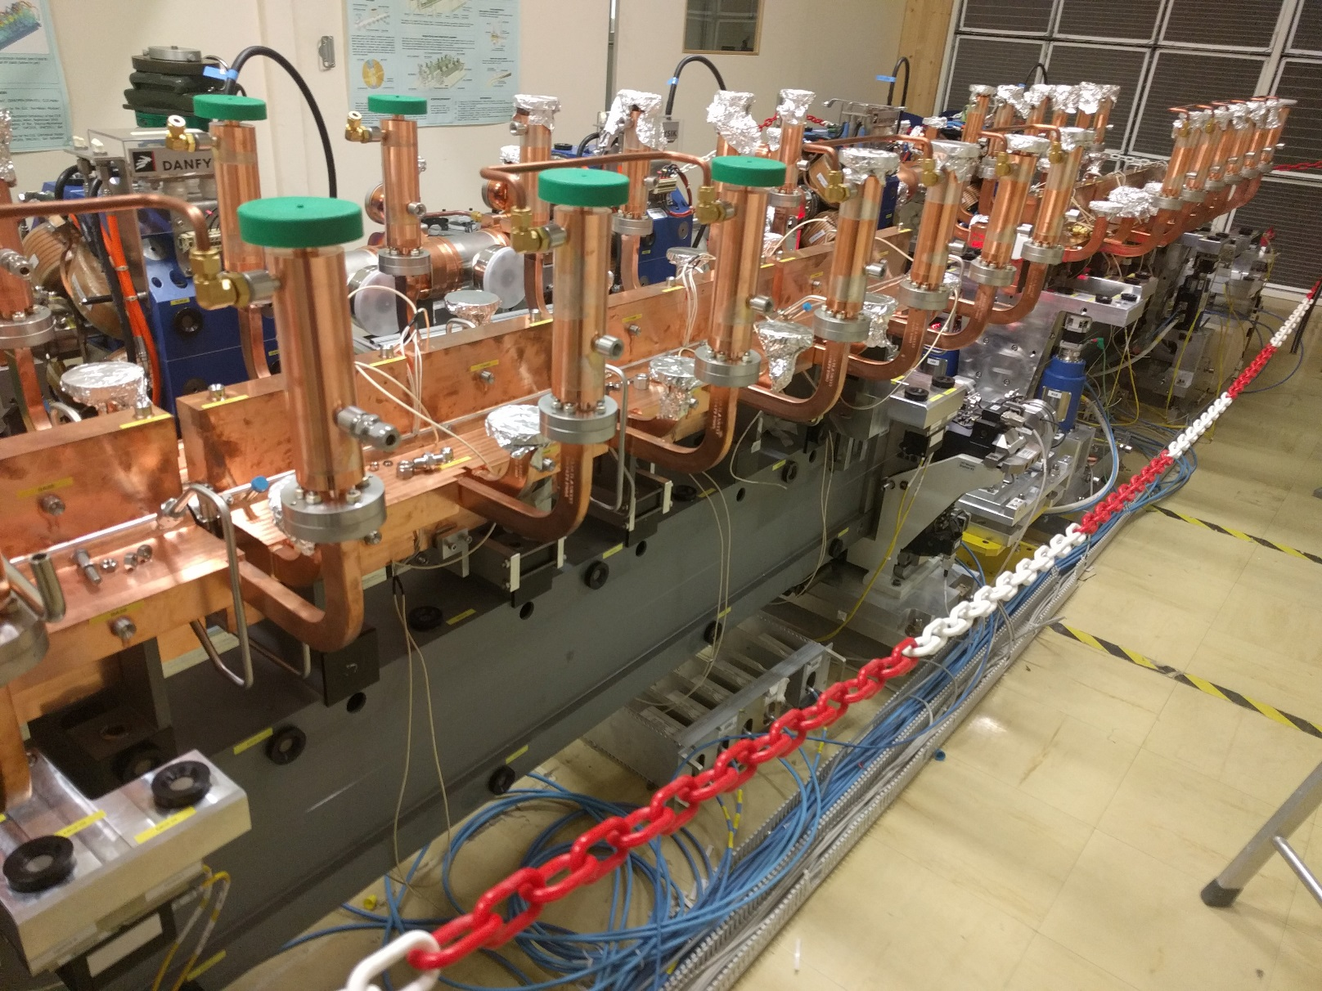
SAS mock-up production
Simplified geometry
Small series production
  6 units in industry
  1 unit at CERN
4 out of 7 units needed reworking
Finally all pieces accepted

Slide 5
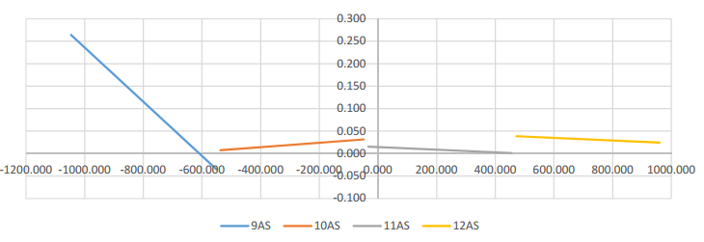
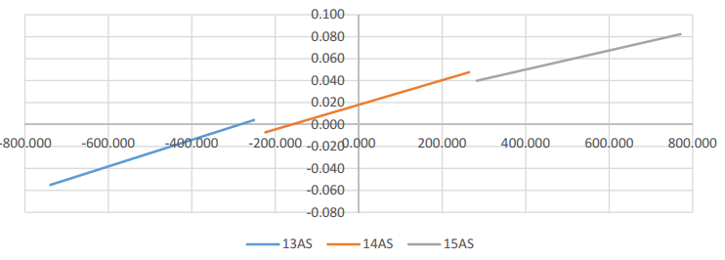
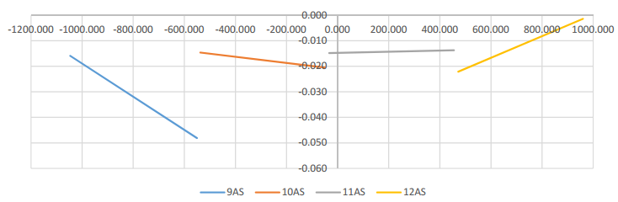
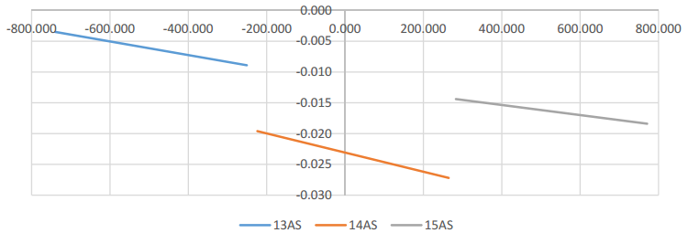
Metrology data
Measurements from the installed AS
  Not yet fully understood where errors come from
A. Zemanek, V. rude
transversal
vertical

Slide 6
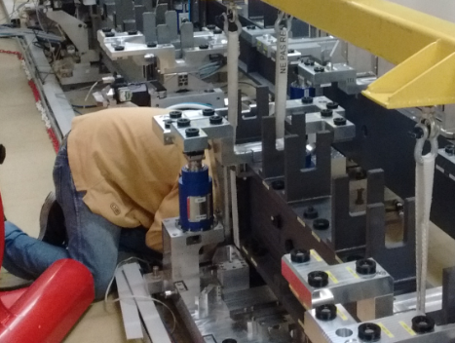
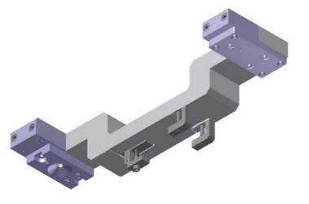
Lessons learnt
Very difficult to assemble to required tolerance
Supporting concept needs to be reworked
  Too sensitive for real-world assembly
  Free DoFs need to be fixed
Flexure based WPS arms work
  Repeatable through heat cycles
  Very sensitive to external loads
DBQ and BPM need a rigid connection
PETS were over constrained

Slide 7
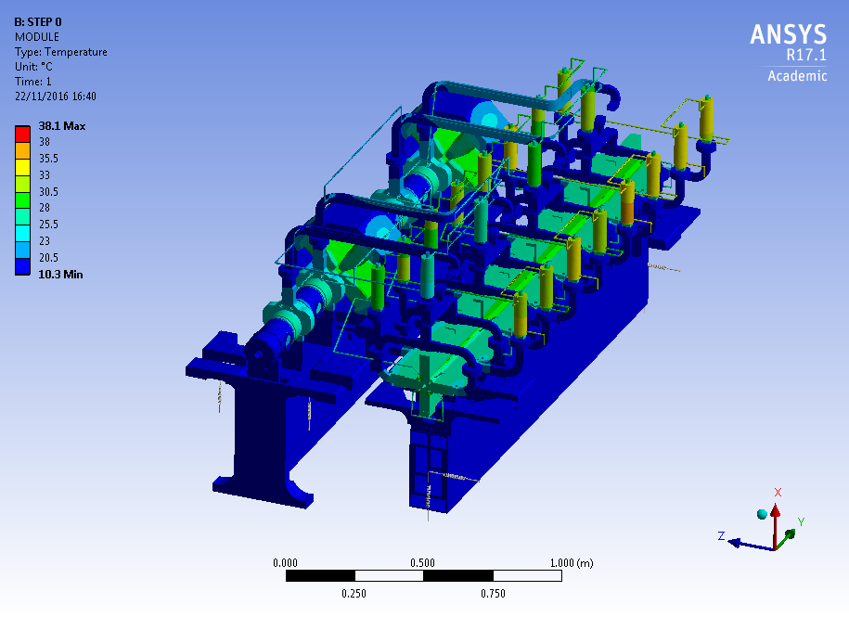
FEA simulator
Updated version
Includes the design changes
Very clean, neat and coherent
See A. Moilanen’s presentation

Slide 8
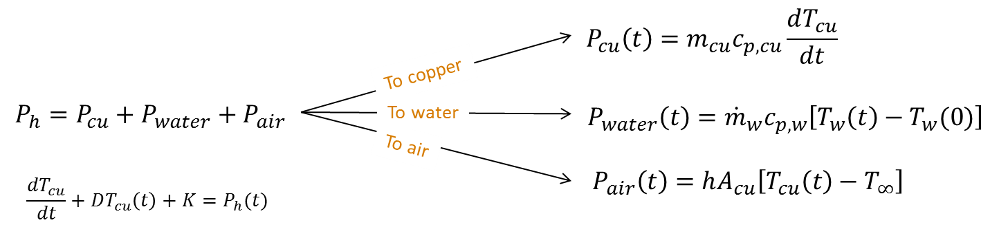
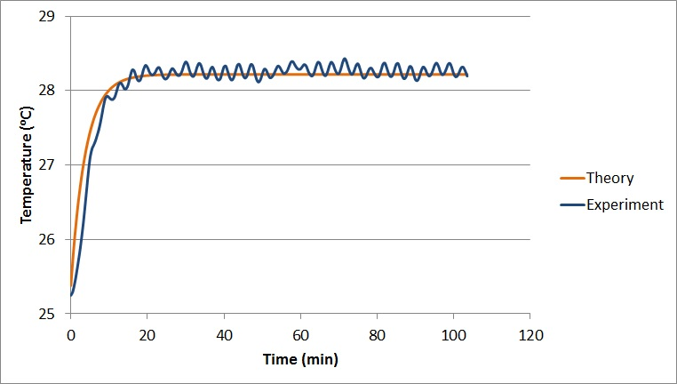
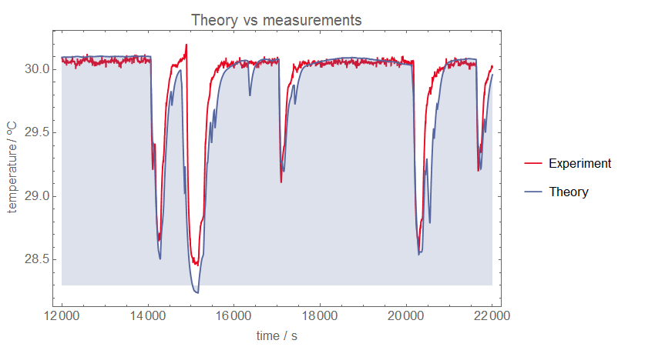
AS transient study in Dogleg
Temperature response at constant power dissipation: Experimental vs theoretical data, LAB TBM, 2014 tests
Temperature response during breakdowns: Experimental data vs theoretical model
Dogleg, 2016
A. Aasley

Slide 9
Future activities

Slide 10
Transportation test
AS – girder assembly
Fiducialise before transportation
Log vibration loads on a typical scenario
Measure relative movement at the end
Aims:
  Evaluate current design
  Test new design ideas for more robust fixing techniques
SAS
Girder
Tracker

Slide 11
New generation module
CLIC implementation meetings
  Gather information from all working groups
  Update specifications
New design takes into account complete life cycle
  Manufacturing
  Conditioning
  Transportation and installation
  Commissioning
  Operation
3D integration design
Updated cost model

Slide 12
Thank you!

