Slide 1




Design and Beam Dynamics Studies for Primary 5 GeV e⁻ Linac
Umut Keskin^{1,2,3}
¹Ankara Institute of Accelerator Technologies
²CERN
³Abant Izzet Baysal University
CLIC Workshop 2017 - CERN, 6-10 March 2017
Dr. Andrea Latina²
Dr. Daniel Schulte²
Prof. Dr. Haluk Denizli^{1,2,3}

Slide 2
Outline
CLIC Workshop 2017 - CERN, 6-10 March 2017
Introduction
Beam Parameters and FoDo Cell Designs
Impact of Misalignments
Conclusion
Outlook

Slide 3
CLIC Workshop 2017 - CERN, 6-10 March 2017
CLIC Workshop 2017 - CERN, 6-10 March 2017
Introduction
Beam Parameters and FoDo Cell Designs
Impact of Misalignments
Conclusion
Outlook

Slide 4
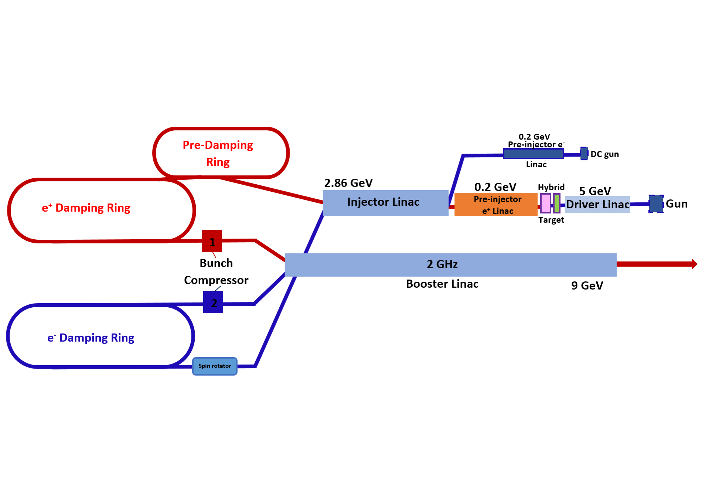
Introduction
CLIC Workshop 2017 - CERN, 6-10 March 2017
Our motivation for this work is to design and optimize the primary 5 GeV e⁻ linac.
This is an important task because this linac will consume higher power than any other linac in the CLIC main beam injector complex.
Also, explore further information about this machine such as possibilities for new set of parameters etc.

Slide 5
CLIC Workshop 2017 - CERN, 6-10 March 2017
Introduction
Beam Parameters and FoDo Cell Designs
Impact of Misalignments
Conclusion
Outlook

Slide 6
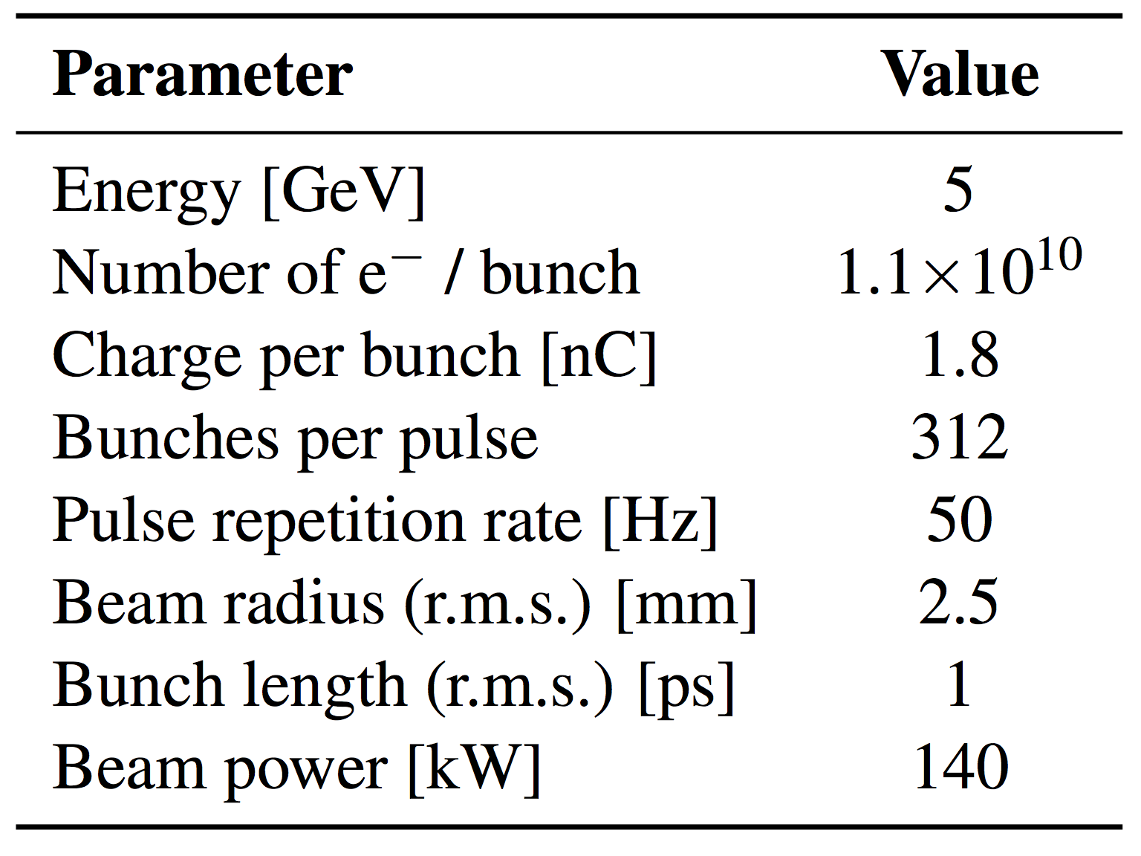
Beam Parameters
CLIC Workshop 2017 - CERN, 6-10 March 2017
  BUNCH PARAMETERS
  Bunch length, 𝜎_{z} = 300 µm
  Energy spread = 1%
  Number of particles : 1x10¹⁰
  Beam radius = 2.5 mm
  ε _{x} = 832x10⁻⁷ m.rad
  ε _{y} = 4384x10⁻⁷ m.rad
  RF PARAMETERS
  Gradient = 30 MV/m
  Cavity Length = 1.5 m
  f = 2.0 GHz
  Phase advance per cell = 2π / 3
  Filling factor = 71.58%
  LATTICE PARAMETERS
  Phase advance, µ = 90º
  Quadrupole length = 0.2m
  Drift length = 0.25 m
  Beam pipe = 2 cm
  Quadrupole radius = 5 cm
Primary 5 GeV e⁻ beam parameters from CLIC-CDR.

Slide 7
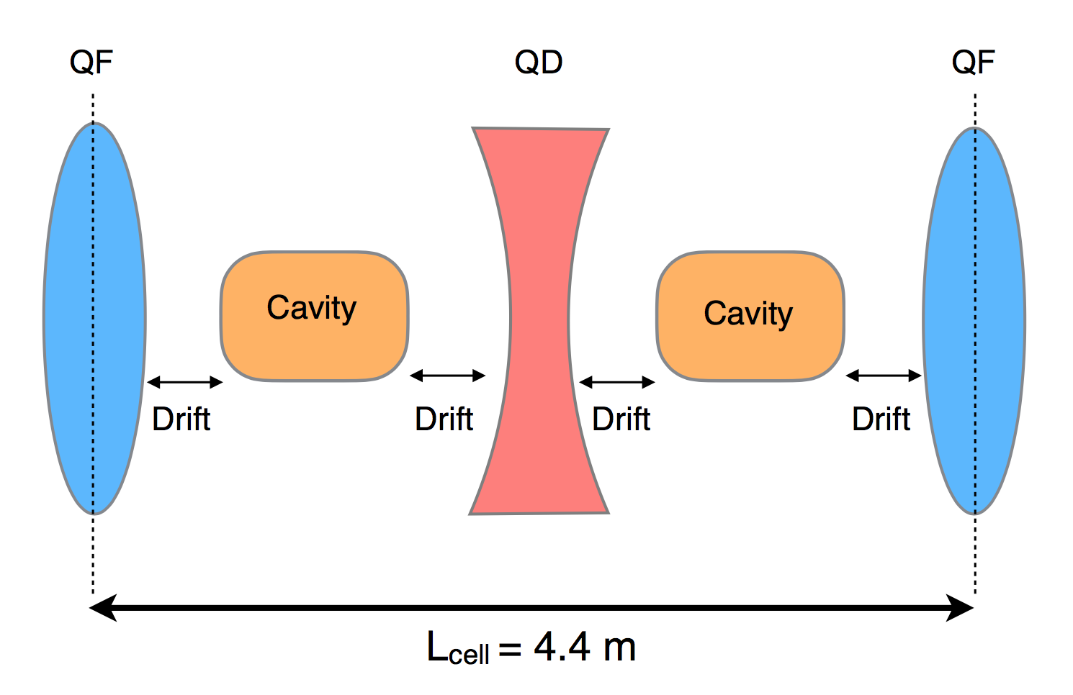
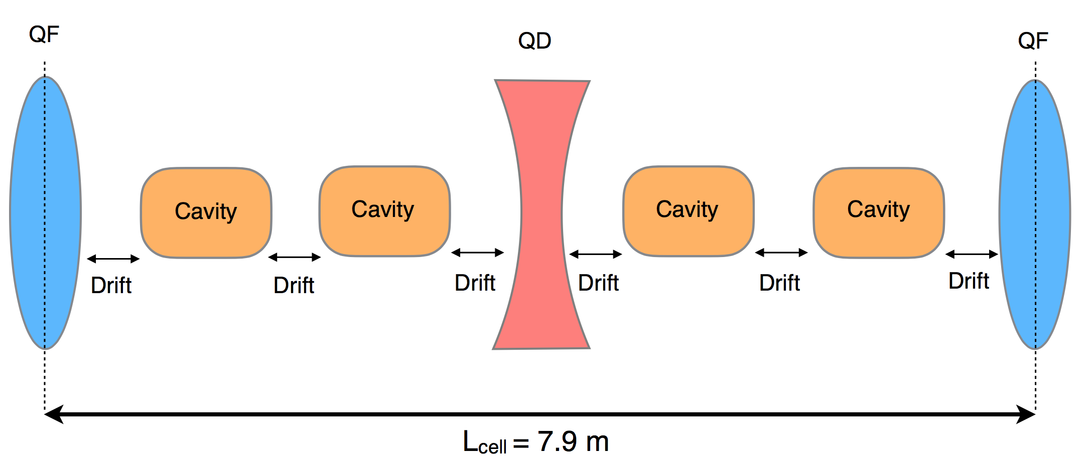
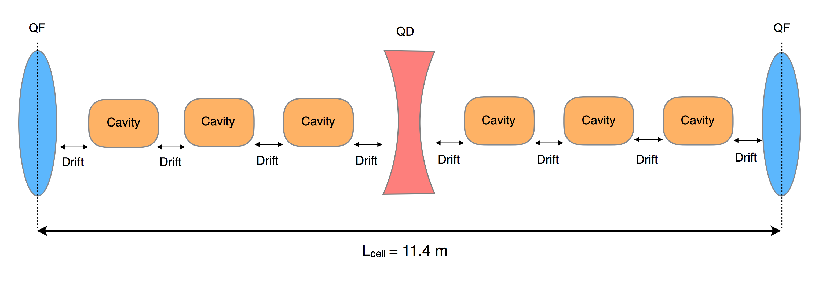
FoDo Cell Designs
CLIC Workshop 2017 - CERN, 6-10 March 2017
Matching Area 1
Matching Area 2
7 FoDo cells with one accelerating structure (30.8 m) → 50 MeV to 0.68 GeV
9 FoDo cells with two accelerating structures (71.1 m) → 0.68 GeV to 2.30 GeV
10 FoDo cells with three accelerating structures (114 m) → 2.30 GeV to 5.00 GeV
Total length of the linac = 230.5 m
Total number of quadrupoles = 61
With this design, in first and second sections, the design can not exceeds quadrupole field more than 0.5 T which is maximum limit of ≤ 1.2 T. At the third section, the machine reachs about 1.03 T maximum at the last quadrupole which is also lover than ≤ 1.2 T limit.

Slide 8
FoDo Cell Designs: Optimization
CLIC Workshop 2017 - CERN, 6-10 March 2017
Little fluctuation in emittance growth for default beam with no misalignments.
Emittance growths → Nearly 0.0% at “x” and 0.3% at “y” (energy spread = 1%)

Slide 9
CLIC Workshop 2017 - CERN, 6-10 March 2017
Introduction
Beam Parameters and FoDo Cell Designs
Impact of Misalignments
Conclusion
Outlook

Slide 10
Impact of Misalignments
CLIC Workshop 2017 - CERN, 6-10 March 2017
Elements such as quadrupoles, cavities and BPMs were misaligned randomly ;
  100 µm random misalignment for each quadrupole
  100 µm random misalignment for each cavity
  100 µm random misalignment for each BPM
  And 100 µm random misalignment for all elements at once
For correcting these misalignments ;
  BPMs were set to 1 µm and 100 µm resolution
  And after each quadrupole, dipole correctors were added to the beamline for correction

Slide 11
Impact of Misalignments
CLIC Workshop 2017 - CERN, 6-10 March 2017
This graphs show simulations of 100 machines average.
100 µm random misalignment for each quadrupole in the beamline.
1 to 1 correction works well.
100 µm BPM resolution was used.

Slide 12
Impact of Misalignments
CLIC Workshop 2017 - CERN, 6-10 March 2017
Wakefield effects included for 2 GHz S-band structures and each cavity misaligned 100 µm randomly.
This graphs also show simulations for average of 100 machines.
BPMs were added before each quadrupole and 100 µm BPM resolution was used.

Slide 13
Impact of Misalignments
CLIC Workshop 2017 - CERN, 6-10 March 2017
BPMs also have very very little effect on the emittance growth.
But, when correction was made, BPMs act like focusing quadrupoles and a little bit of increasing for the emittance growth can be seen comparing to default and it is about 2.5%.
BPM resolution also 100 µm.

Slide 14
Impact of Misalignments
CLIC Workshop 2017 - CERN, 6-10 March 2017
When all the elements in the beamline were misaligned all together about 100 µm randomly, emittance was grown about 2.95% at x and 1.5% at y.
Even there is no correction, this growth is not too much for all elements misaligned together.

Slide 15
CLIC Workshop 2017 - CERN, 6-10 March 2017
Introduction
Beam Parameters and FoDo Cell Designs
Impact of Misalignments
Conclusion
Outlook

Slide 16
Conclusion
CLIC Workshop 2017 - CERN, 6-10 March 2017
Beam dynamics studies and first design of primary 5 GeV e⁻ linac for CLIC main beam injector complex were done.
Impacts of misalignments on the beamline for this preliminary design were studied also.
With these results we can deliver beam in the beamline, but a real optimization study for that design and further possible design options must be done.

Slide 17
CLIC Workshop 2017 - CERN, 6-10 March 2017
Introduction
Beam Parameters and FoDo Cell Designs
Misalignment Work for Testing the Machine Stress for Errors in Setup
Conclusion
Outlook

Slide 18
Outlook
Aim of the further work about this study is to improve the design, maybe with multiple design options.
This design uses very high gradient for cavities, what is next in the further work with is a real optimization for this machine with multiple design options.
With real optimizations in the further work, the main goal is lowering the power consumption and cost of this linac.
Also evaluating the requirements from the point of view of the target which electrons impinging on and maybe possible lover energy linac designs such as 3 GeV and 4 GeV after that study.
CLIC Workshop 2017 - CERN, 6-10 March 2017

Slide 19
CLIC Workshop 2017 - CERN, 6-10 March 2017
THANK YOU
FOR YOUR ATTENTION !

Slide 20
BACKUP: FoDo Cell Designs
CLIC Workshop 2017 - CERN, 6-10 March 2017
Parameters
  Focusing strength, k = 3.2141 m⁻²
  ß_{x} = 7.3511 m
  ß_{y} = 1.4016 m
  Phase Advance, µ = 90º
  Gradient = 30 MV/m
  Each drift = 0.25 m
  Each cavity = 1.5 m
  Each quadrupole = 0.2 m
  Accelerating in one structure = 0.045 GeV
  Accelerating in one cell = 0.09 GeV

Slide 21
BACKUP: FoDo Cell Designs
CLIC Workshop 2017 - CERN, 6-10 March 2017
Parameters
  Focusing strength, k = 1.7901 m⁻²
  ß_{x} = 13.3195 m
  ß_{y} = 2.4245 m
  Phase Advance, µ = 90º
  Gradient = 30 MV/m
  Each drift = 0.25 m
  Each cavity = 1.5 m
  Each quadrupole = 0.2 m
  Accelerating in one structure = 0.045 GeV
  Accelerating in one cell = 0.18 GeV

Slide 22
BACKUP: FoDo Cell Designs
CLIC Workshop 2017 - CERN, 6-10 March 2017
Parameters
  Focusing strength, k = 1.2405 m⁻²
  ß_{x} = 19.2919 m
  ß_{y} = 3.4488 m
  Phase Advance, µ = 90º
  Gradient = 30 MV/m
  Each drift = 0.25 m
  Each cavity = 1.5 m
  Each quadrupole = 0.2 m
  Accelerating in one structure = 0.045 GeV
  Accelerating in one cell = 0.27 GeV

