Slide 1

Standard Model Measurements
Lucia Di Ciaccio
Université de Savoie MB & CNRS/IN2P3
Presenting results from ATLAS, CMS, LHCb, D0 and HERA Collaborations

Slide 2
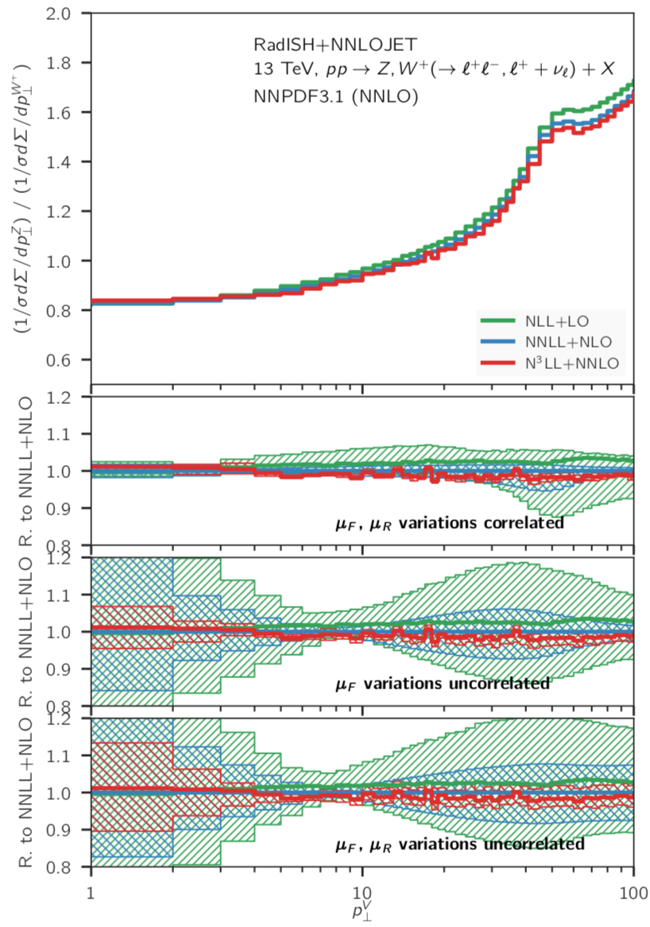
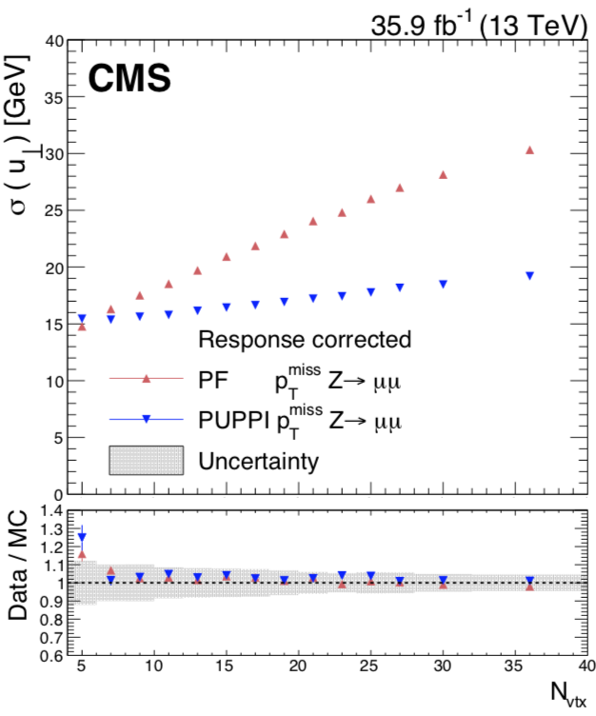
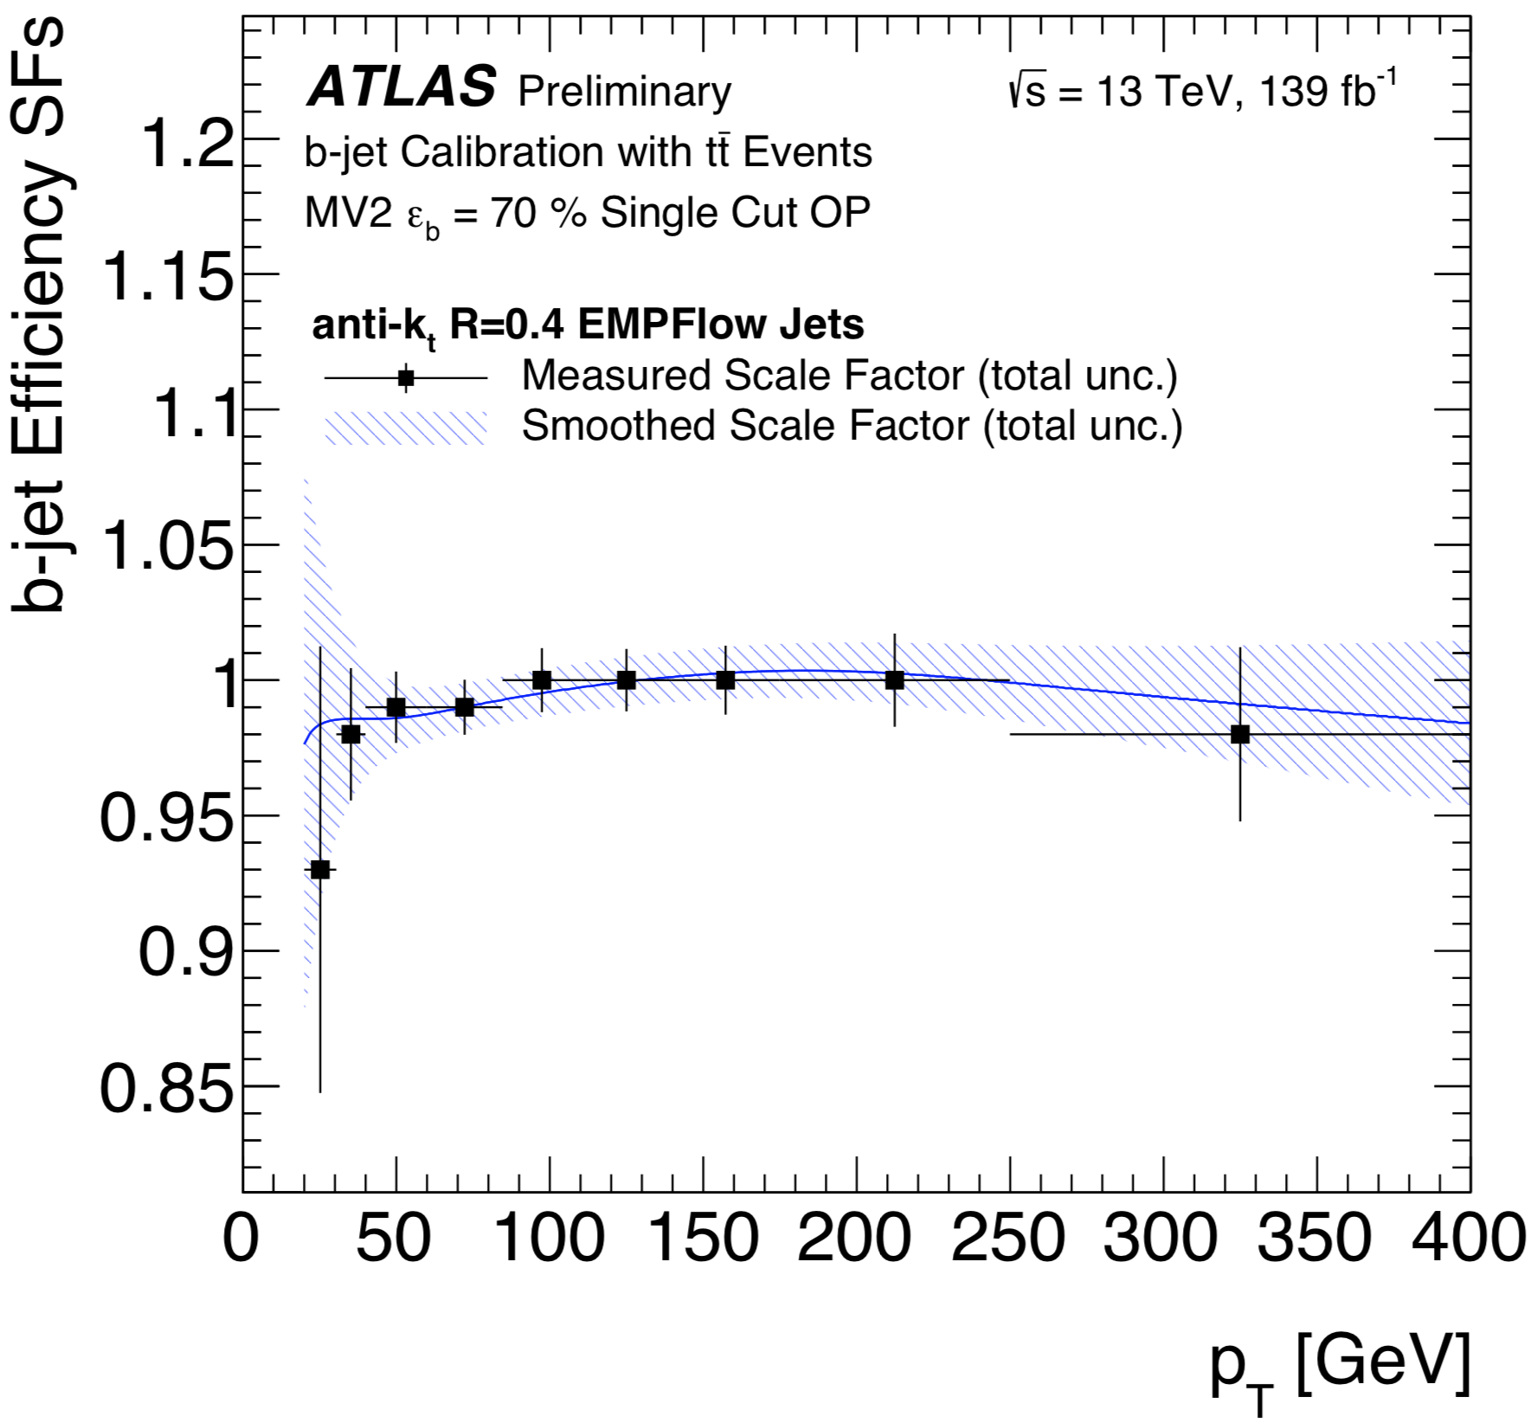
SM measurements: introduction
“SM everywhere” → important to understand until which point it describes our world
- Need to perform SM measurements as best we can
- Need to look for "Beyond SM”. Twofold interest in SM measurements:
- look for deviations wrt SM
- SM is a background for direct searches
LHC Run 2 (2015-2018) has ended
→ additional ~ 140 (~ 6, LHCb) fb⁻¹ @ 13 TeV being analysed
- essential work in performance
- steps forward in physics calculations and modelling
1905.05171
Ratios Z/W⁺
JINST 14 (2019) P07004
(1907.05120)
PUPPI: Pile-up per
particle identification
N³LL+NNLO
~ 1% uncertainty
~ Recoil resolution
https://atlas.web.cern.ch/Atlas/GROUPS/
PHYSICS/PLOTS/FTAG-2019-004/
N_{vtx}
p_{T}^{V}

Slide 3
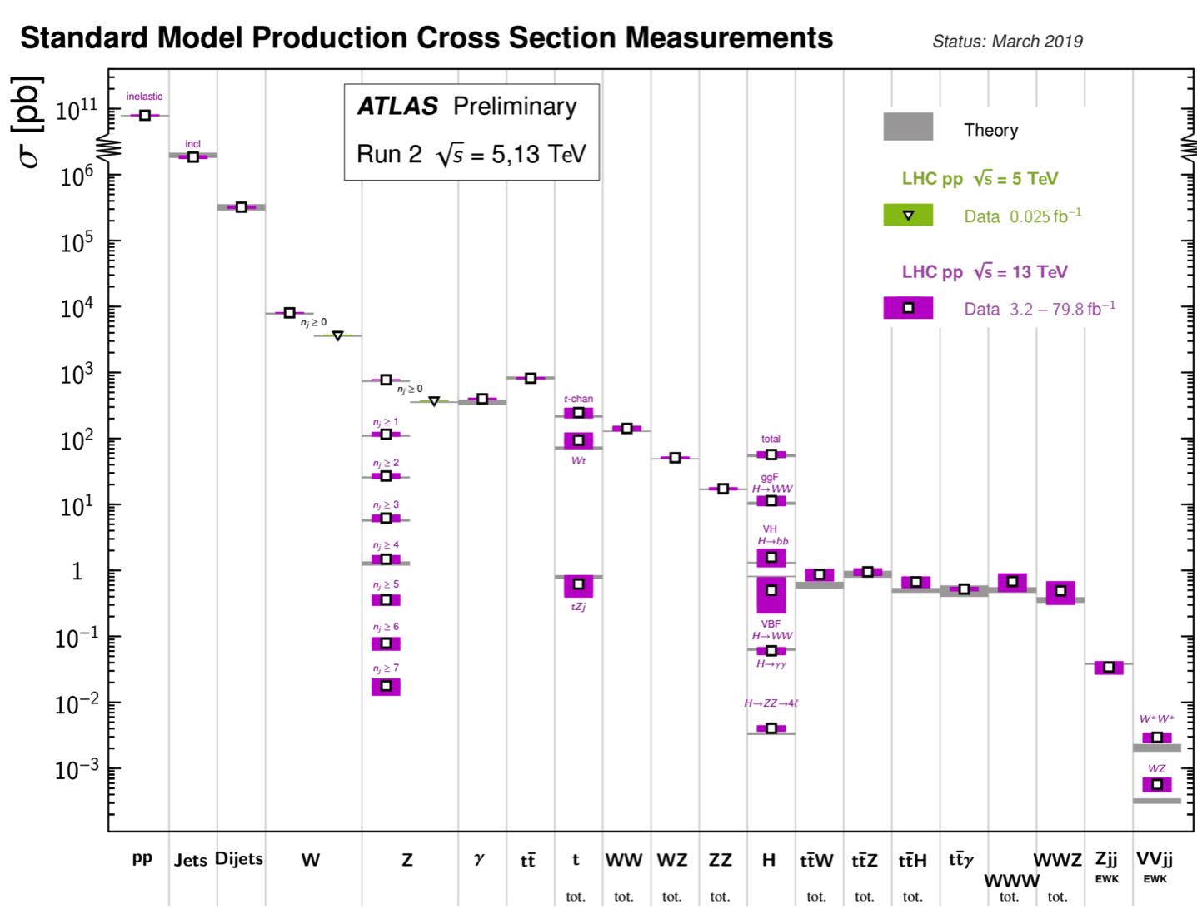
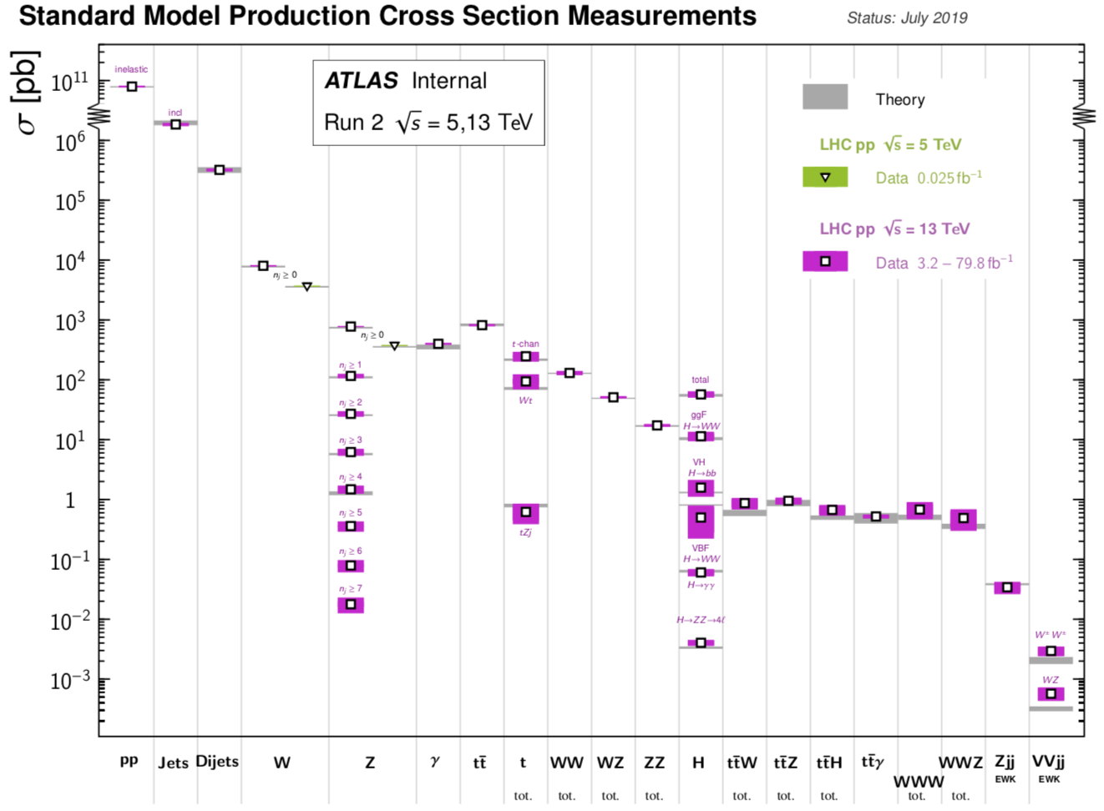
SM measurements: outline
Tests of QCD
new
ATL-PHYS-PUB-2019-012
V(V=W,Z) + Jets, Photons
p_{T}^{V}
Jets
W, Z
γ
top
E.w. precision tests
VV
m_{W}, sin²θ_{W}, m_{top}
new
tt+V
VVV
Vjj
VVjj
> 10⁹
Top couplings and more …
ttZ, 4 tops, A_{c}^{top},
single top
new
Gauge boson couplings
LHC Run 2 results only
VV, Vjj , VVjj & VVV
new
Standard Model is (nearly) everything (so far)
→ quick overview of (10 !) & few recent results
new

Slide 4
Tests of QCD

Slide 5
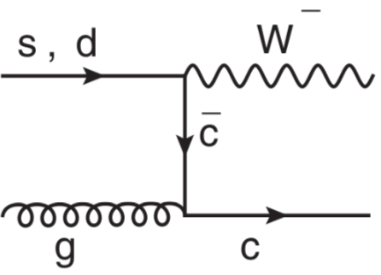
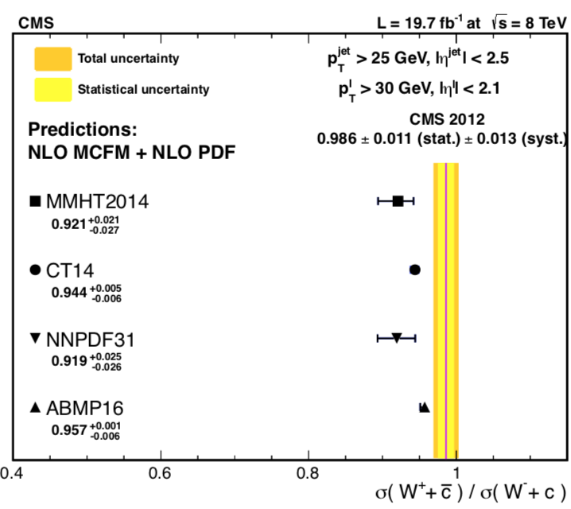
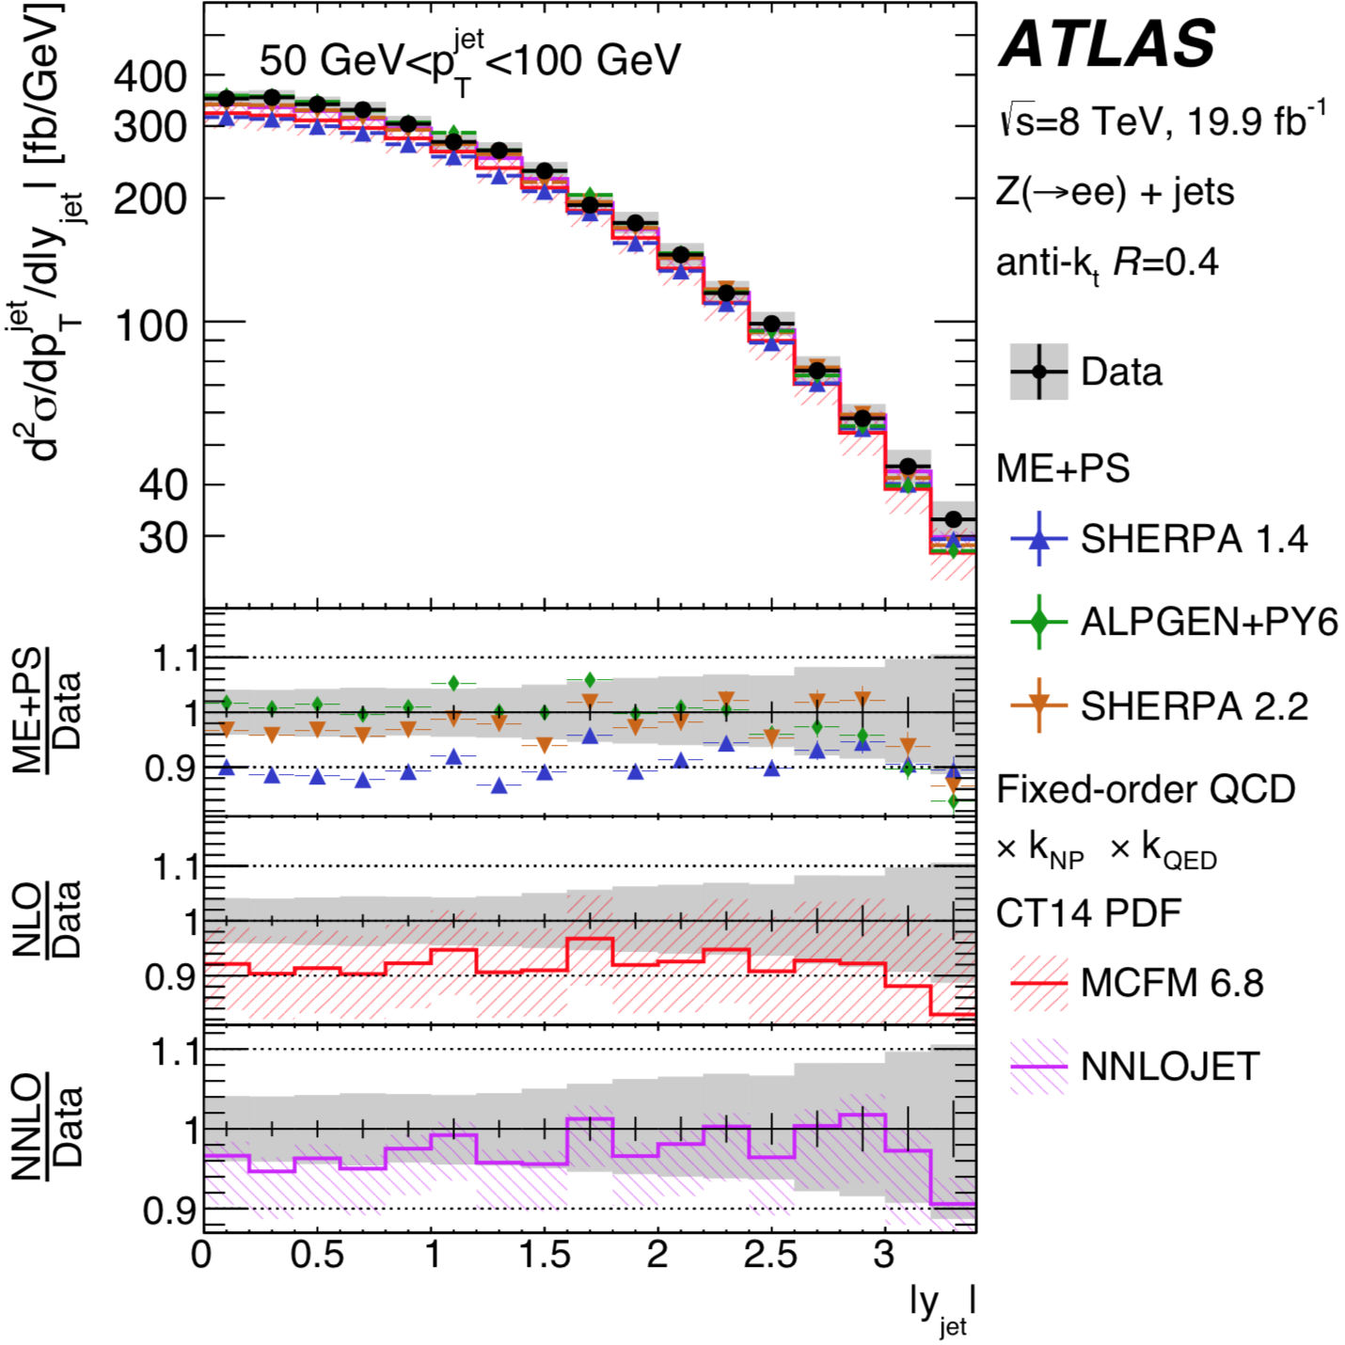
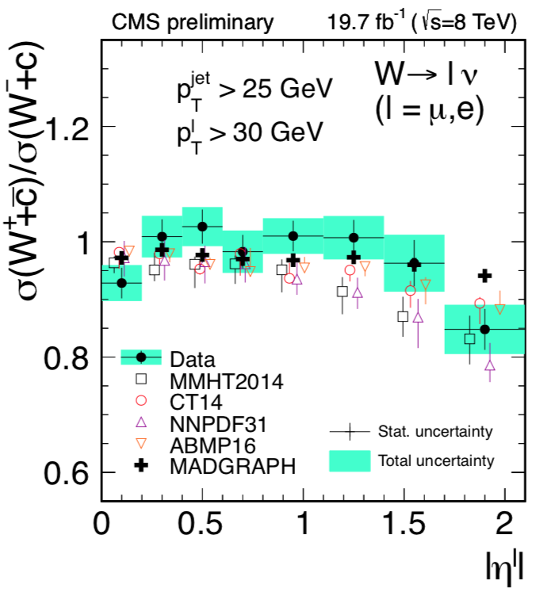
Probing QCD: V+jets (V=Z,W)
Cross section measurements of V+jets test NLO & NNLO QCD predictions
SMP-18-013
New ATLAS: inclusive jets + Z(ee) vs jet |y| and |p_{T}|
NNLO parton-level fixed-order predictions ( corrected )
improve agreement with data
MCFM
STDM-2016-11
new
new
New CMS: W + c
Access to the
strange quark
content in proton
@ Q ~ m_{W}
Jets + Z(ee)
new
NLO
Potential to
constrain the
parton distribution
functions
SMP-18-013
NNLO

Slide 6
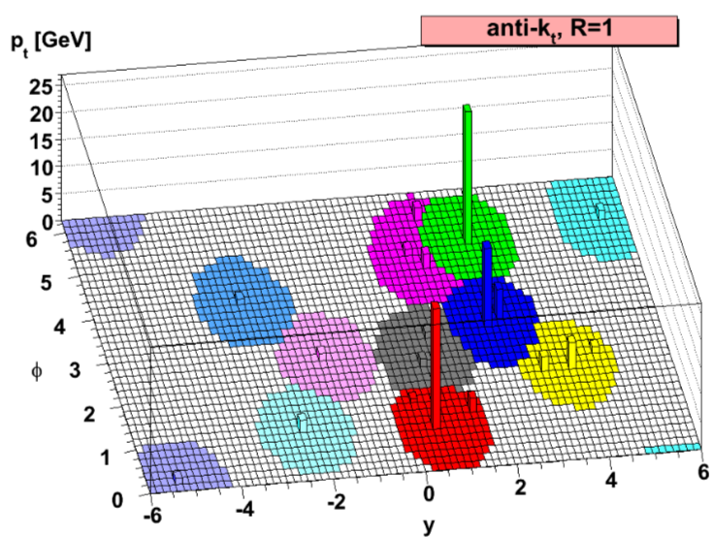
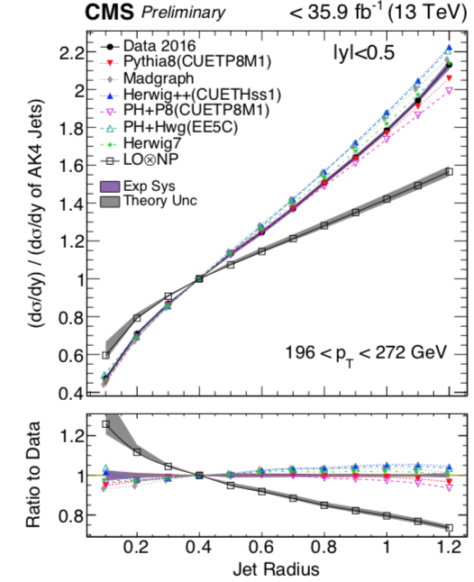
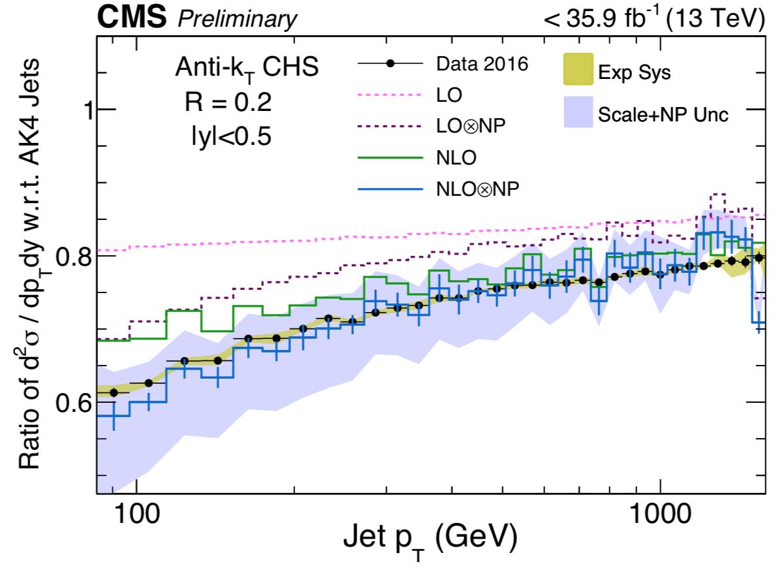
Probing QCD: cross section vs jet size
Dependence of the jet production cross section on the anti-k_{T}
distance parameter R tests the modeling of the perturbative and
nonperturbative (NP) processes in parton evolution
Ratio of jet cross section:
w.r.t. R = 0.4 jet
JHEP 0804:063,2008
New CMS: NLO + NP corrections
gives a good description of data
Ratio of jet cross sections: R= 0.2 jets/R= 0.4 jet
new
SMP-19-003
NLO
LO+NP
SMP-19-003
new
NLO(NLOJET++) + NP

Slide 7
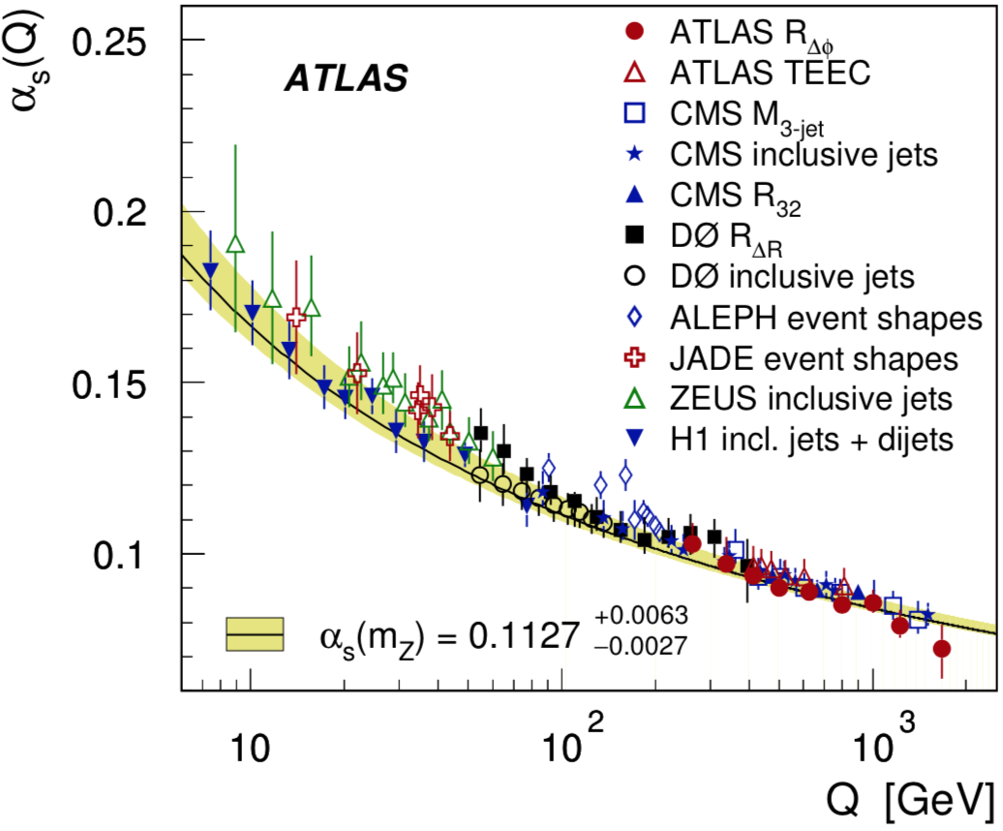
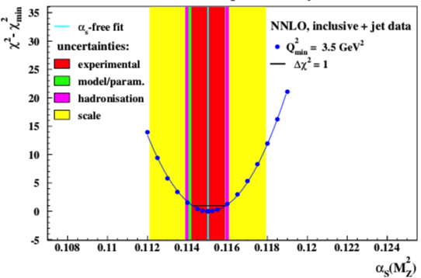
Recent α_{s} measurements
α_{S} from fraction R_{∆φ} of dijet events with
∆φ₁₂ < ∆φ _{max}= 7/8π
(use 0 < y* < 1.0, y∗ = |y₁ − y₂|/2)
Δφ₁₂
→ Test scale evolution of α_{s} up to 1.7 TeV
α_{s}(m_{Z}) from a global NNLO QCD fit including
inclusive DIS and jet data (jet predictions from NNLOJET)
Simultaneous determination of the PDFs and α_{s}(m_{Z}):
α_{s}(m_{Z}) = 0.1150 ± 0.0008 (exp) ^{+ 0.0002} (model)
± 0.0006 (hadr) ± 0.0027 (scale)
PRD 98 (2018) 092004
^{- 0.0005}
~ 30% reduction of scale uncertainty wrt
NLO analysis
H1 and Zeus preliminary
_
α_{s}(m_{Z}) fit triple differential tt cross section @ NLO
(CMS, 1904.0523) including HERA DIS data
for simultaneously α_{s}, m_{t}^{pole} and PDF extraction:
α_{S}(m_{Z}) = 0.1135 ± 0.0016(fit) + ^{0.0002} (model)
+^{0.0008} (PDF param) + ^{0.0011}(scale)
^{-0.0004}
^{-0.0001}
^{-0.0005}
H1prelim-19-041
ZEUS-prel-19-001
→ Value compatible with competitive uncertainty

Slide 8
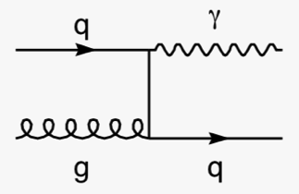
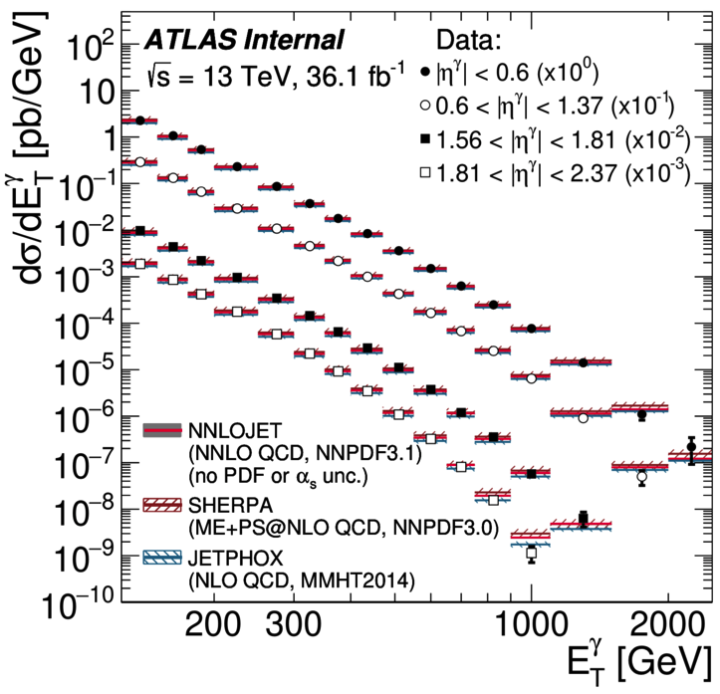
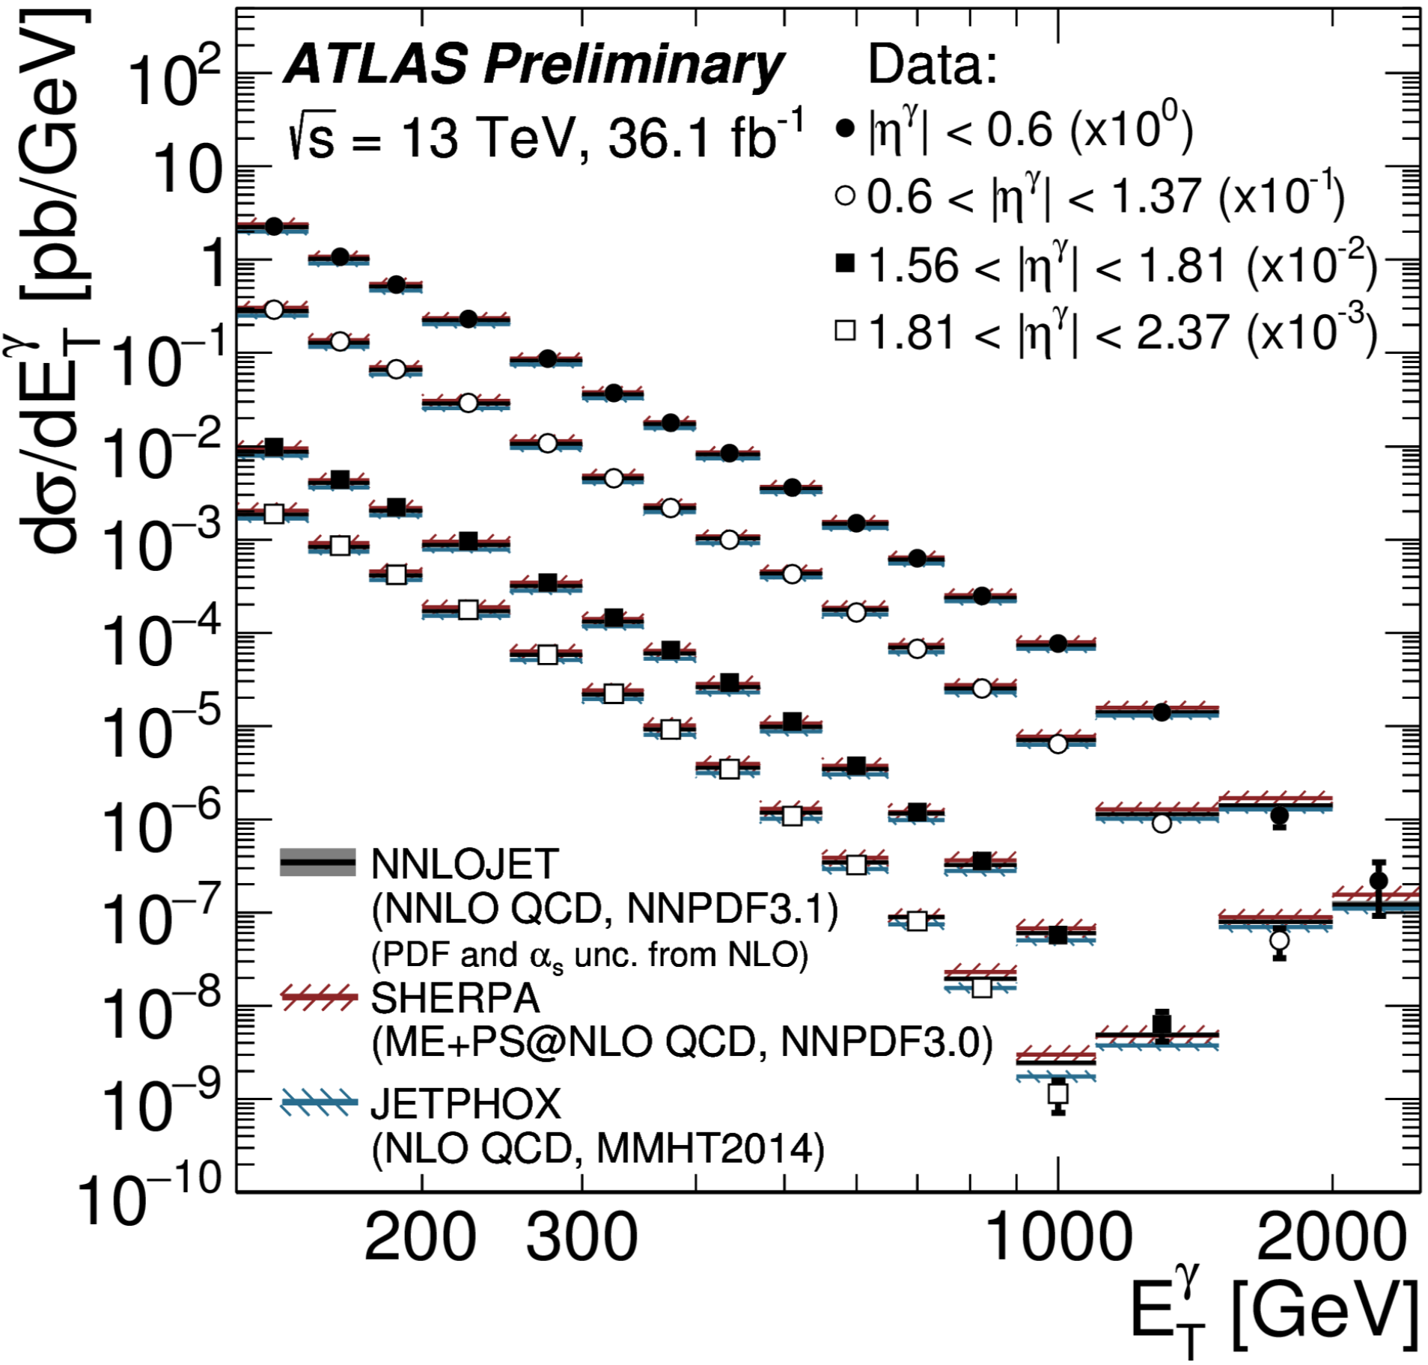
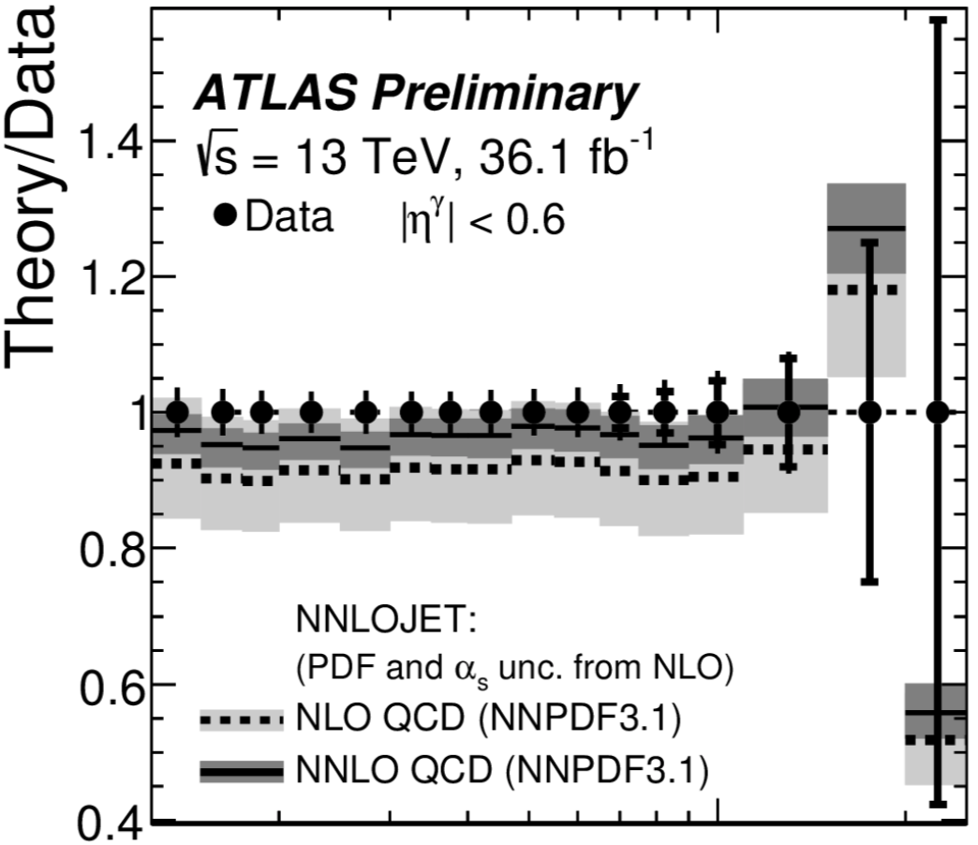
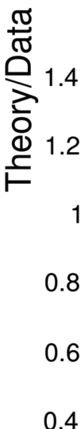
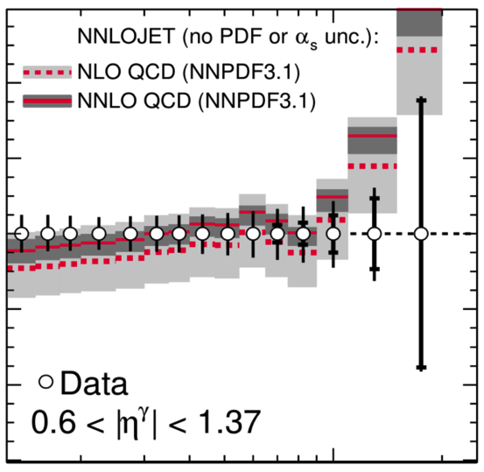

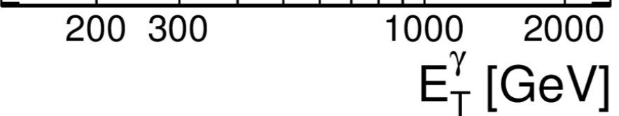
Photon (+ jet) cross sections
Test pQCD with a hard colorless probe + sensitivity to gluon density in the proton
New ATLAS result: better γ calibration & identification
→ reduced experimental systematic uncertainty (by up to ~ 40%)
Cross sections vs E_{T}^{γ} & |η^{γ}| : good description of data already @ NLO QCD
Recent NNLO calculations (NNLOJET) lead to a reduction of the theory scale
uncertainty, ( < ~ 5%) and to an improved description of the measurements
STDM-2017-29
new
Isolated γ
new
STDM-2017-29

Slide 9
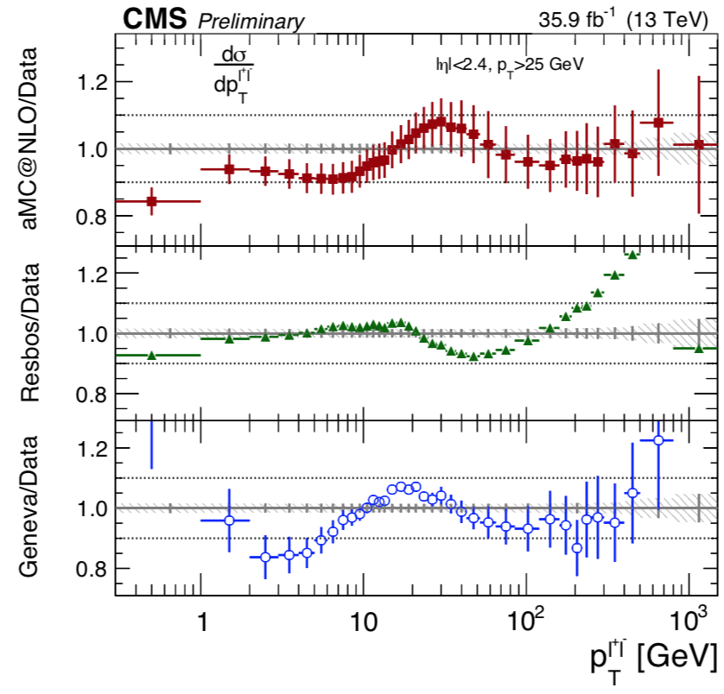
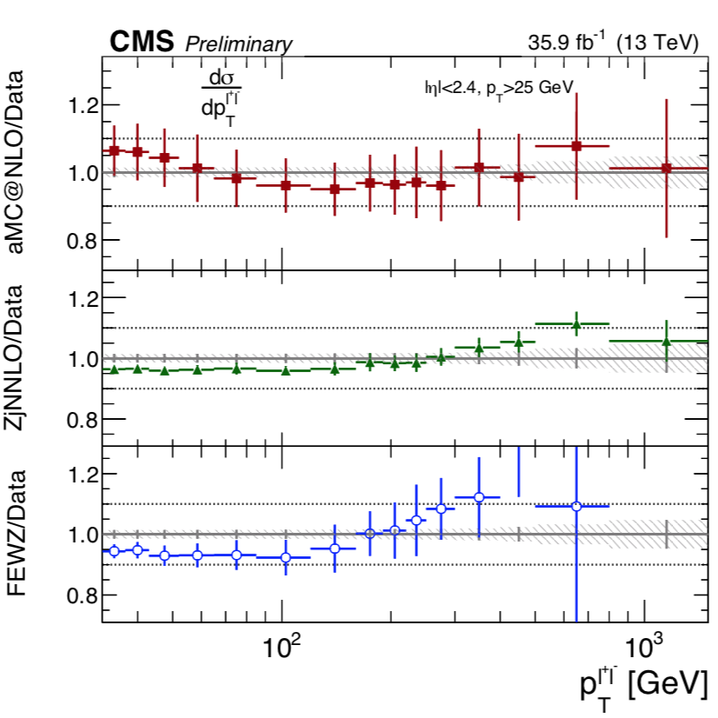
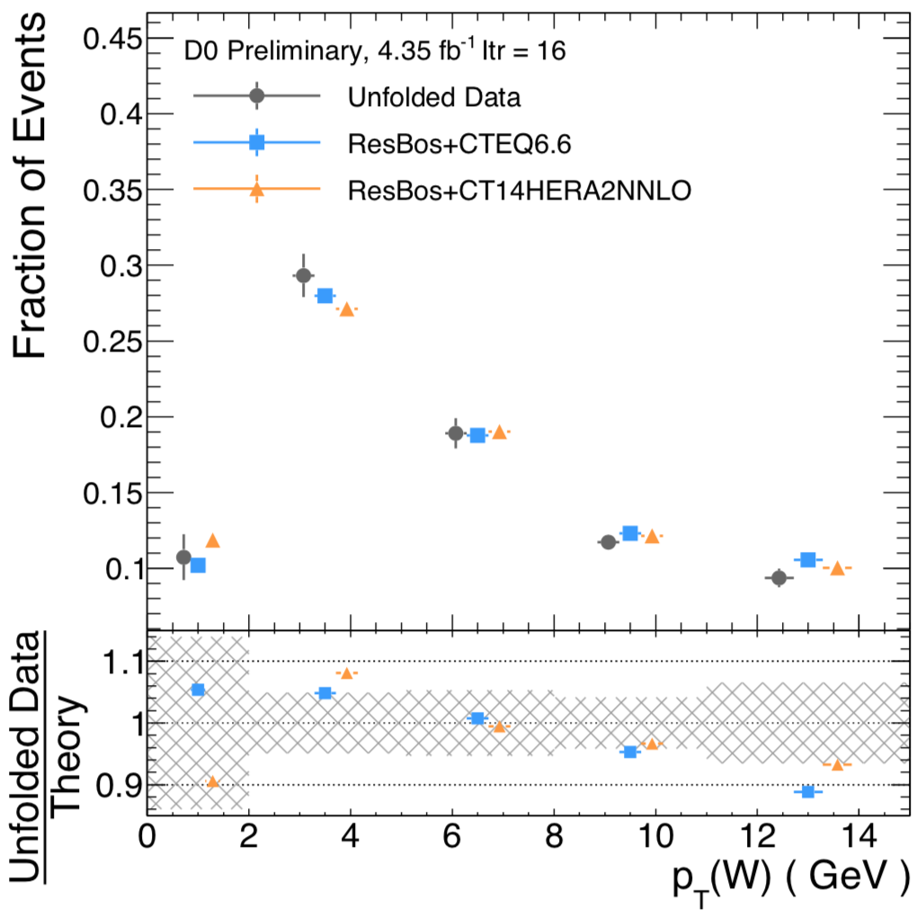
Gauge boson p_{T}^{V} (V = W, Z)
p_{T}^{V} distribution (V = W, Z): probes various aspects of the strong interactions
(fixed order, resummed, parton shower calculations)
New D0 p_{T}^{W}: measurement where the production dominated by valence quarks
CMS p_{T}^{Z}: for normalised σ, uncertainty < 0.5 % for p_{T}^{Z} < 50 GeV, ~ same as ATLAS
Predictions describe data within theory uncertainties:
@ low p_{T}: RESBOS calculation (resummed NNLL) does a good job (but no
uncertainties available)
@ high p_{T} : good description with MadG5_aMC@NLO; Z+j @ NNLO small uncertainties
(-)
Key ingredient for a precise measurement of the W± mass @ pp colliders
CMS-PAS-SMP-17-010
p_{T} > 32 GeV
D0 note 6508-CONF
new
NLO
NNLO Z+j
NNLO
p_{T}^{Z}
p_{T}^{Z}
p_{T}^{W}

Slide 10
E.w. precision measurements

Slide 11

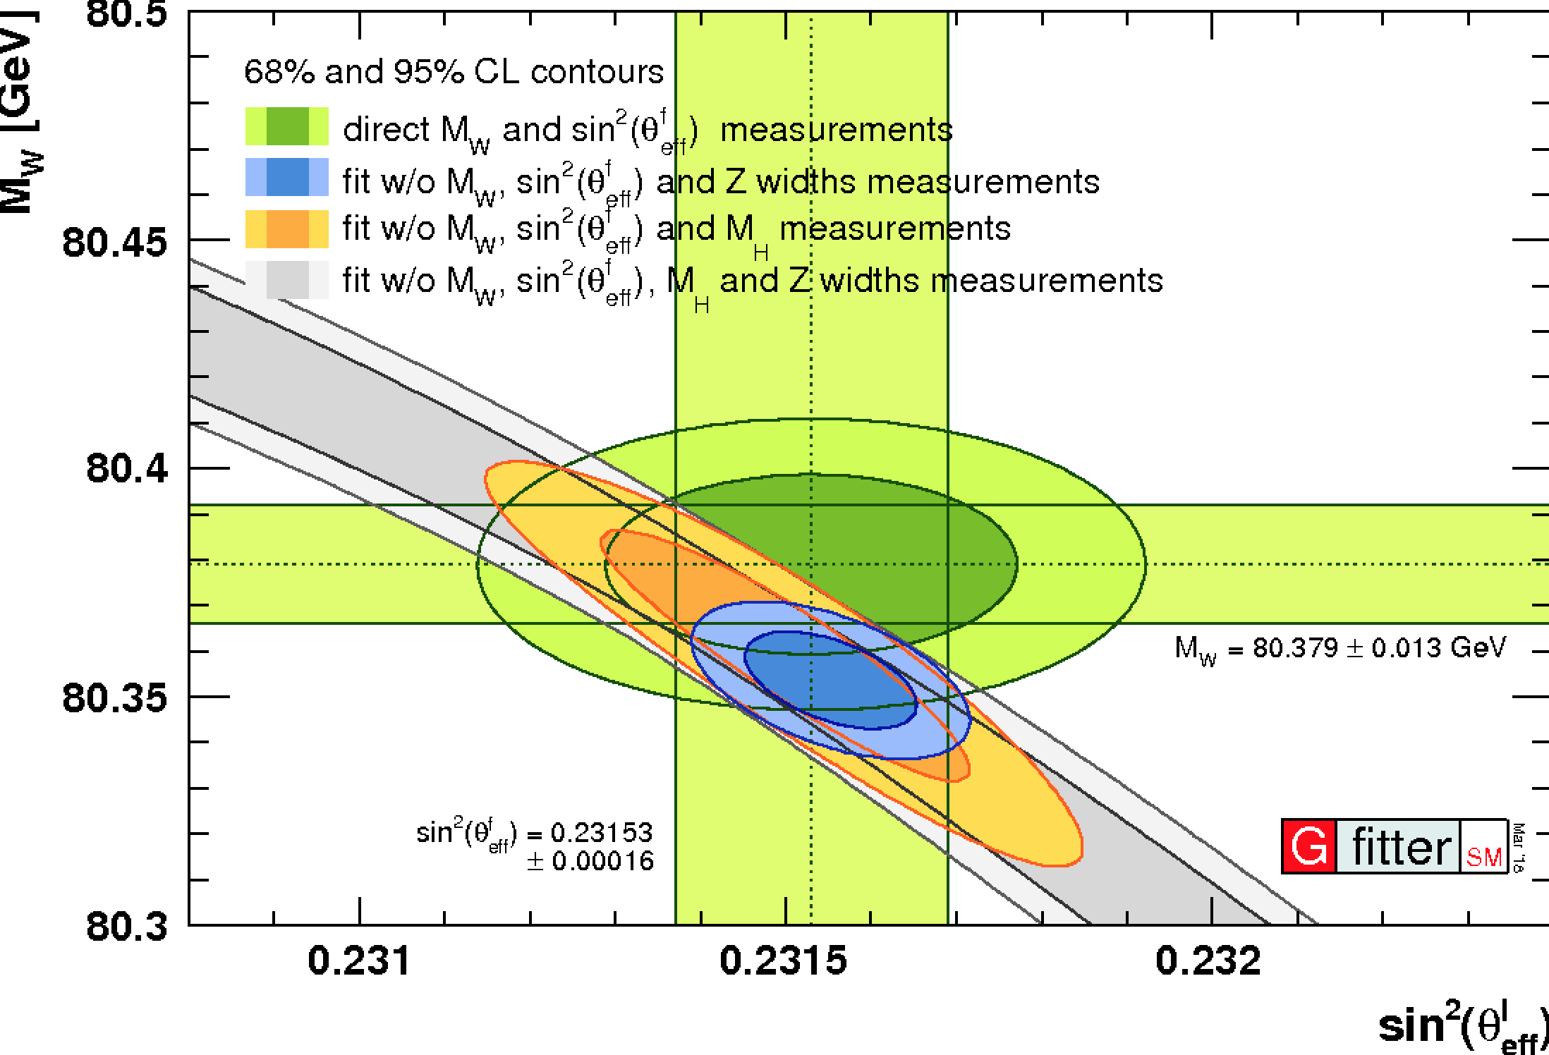
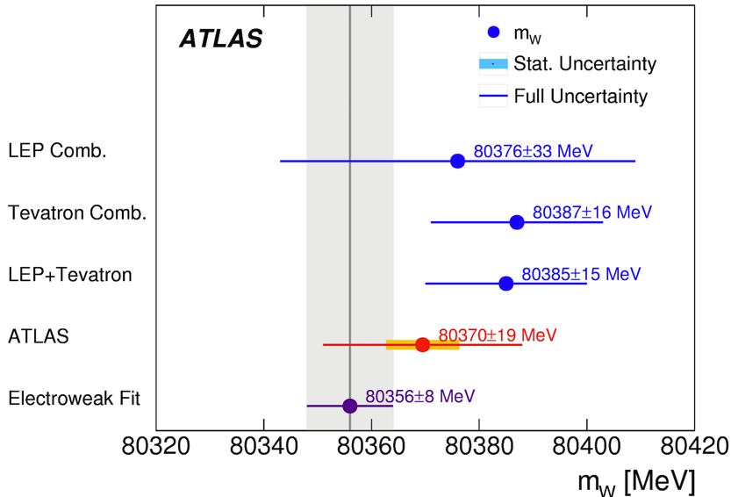
Probe BSM via electroweak precision tests: m_{W}, sin²θ_{W,} m_{top}
m_{W}, sin²θ_{W}: important parameters of SM.
Can be calculated from 3 measured e.w. observables
(ex. from 3 best measured: α_{em}, G_{F} and m_{Z}
plus corrections including m_{top} & m_{H} )
f (m_{top}², ln m_{H}) ~ few %
Comparing indirect to direct measurements
tests SM internal consistency → BSM probe
→ Need to measure:
Δm_{W} ≤ 8 MeV,
Δsin²𝜃_{W} ≤ 7 *10⁻⁵
Δm_{top} ≤ 1 GeV
(-)
PDF source of main systematics @ pp colliders
(followed by QCD modelling)
Eur. Phys. J. C 78 (2018) 110
Projections from LHCb, 1808.08865:
m_{W} measurement @ forward rapidities
direct
- complementary lepton acceptance 2 < η_{l} < 5
→ partial anticorrelation of PDF w.r.t. existing
measurements, Eur. Phys. J. C75 (2015) 601)
direct
indirect
→ Δm_{W}^{PDF} ~ 2 MeV with LHeC

Slide 12
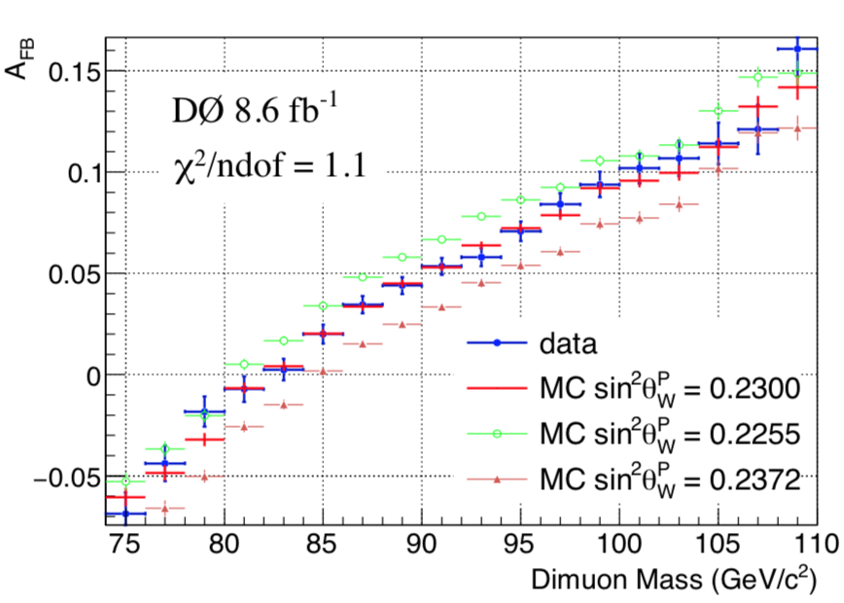
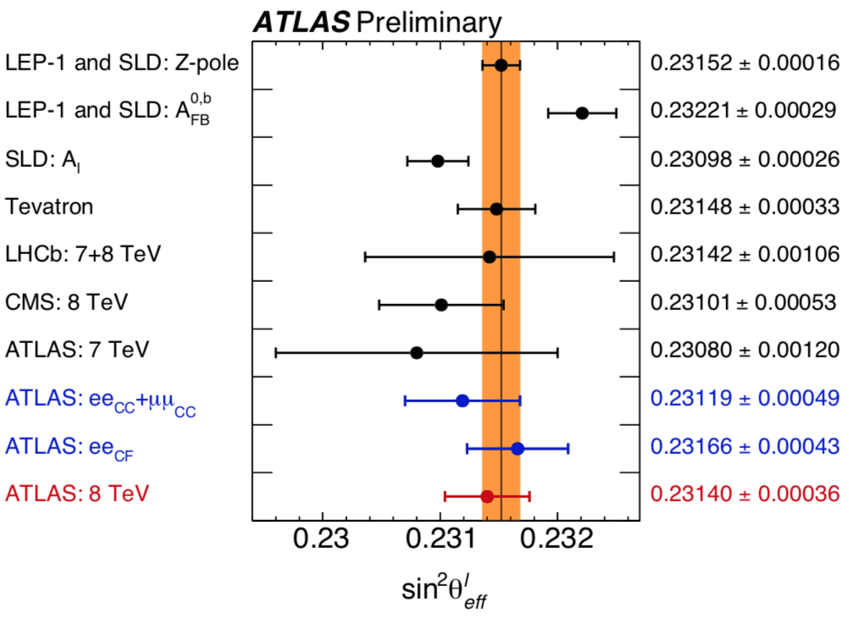
Probe BSM via electroweak precision tests (m_{W}, sin²θ_{W,} m_{top})
l⁻
_
σ _{F} – σ _{B}
sin² θ_{eff} = k_{lep} sin² θ_{W}
q
^{lep}
(k_{lep} e.w. corrections)
B
ϑ*
q
F
A_{FB}=
l⁺
σ _{F} + σ _{B}
Tension between the most sensitive results
PRL 120(2018) 241802
(-)
Methods @ pp colliders:
* Forward Backward Asymmetry (A_{FB}) in Z (→ll) decays
template fits (vs m_{ll}, in bins of y_{ll})
* Angular decomposition of the Drell-Yan cross-section
qq →Z/γ∗ → ll
Z/γ∗ → μμ
_
ATLAS-CONF-2018-037
PDF source of main systematics
Projections from LHCb (1808.08865):
advantages @ higher Z rapidities:
- the forward-backward asymmetry is larger
- the parton direction is better known
A future e⁺e⁻ collider may reach
Δ sin² θ_{W} ~ 5 *10⁻⁶
^{lep}

Slide 13
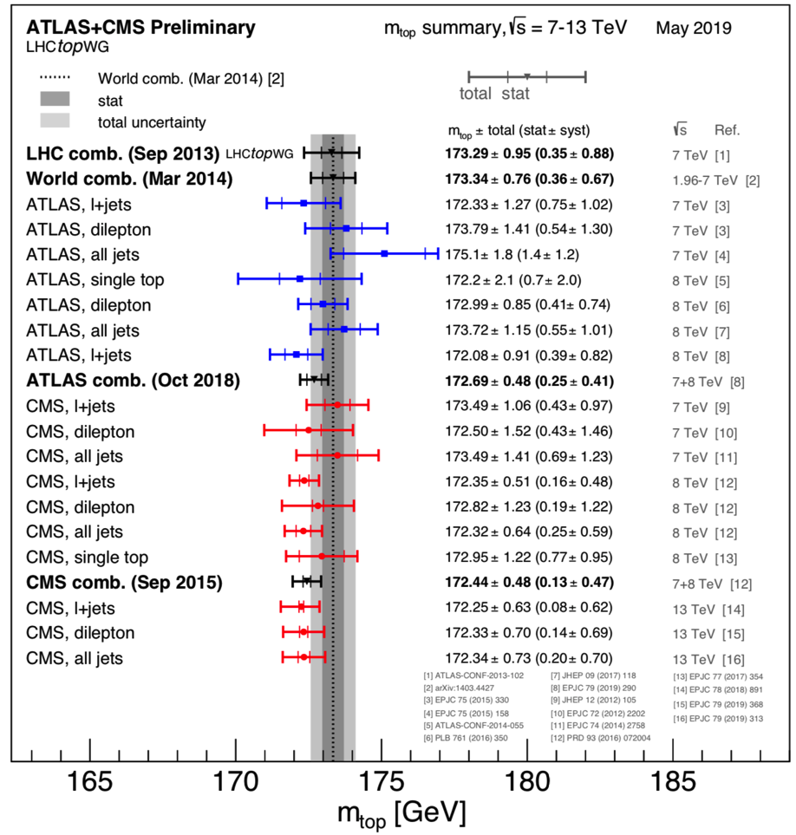
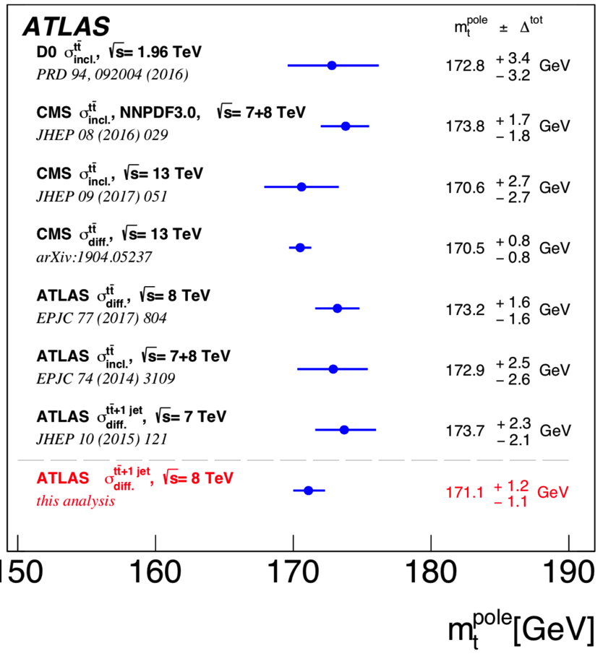
Probe BSM via electroweak precision tests (m_{W}, sin²θ_{W,} m_{top})
Direct measurements: m_{t} from decay products
^{dir}
m_{t}^{dir}
-
Indirect measurements: fit tt X-sections + theory
- Extract the pole mass m_{t}^{pole}
CMS (1904.05237): simultaneous α_{S} and m_{t}^{pole}
extraction using NLO calculations.
Tot. uncertainty below 1 GeV
m_{t}^{pole}
Direct measurements
new
from CMS (TOP-19-005):
m_{t} @ high Lorentz boosts: a single jet includes
all t → bW → bqq’products
promising observable could calculated at particle
level from theory
Indirect measurements
m_{t}^{boost} = 172.56 ± 2.47 GeV (36 fb⁻¹ @13 TeV)

Slide 14
Top measurements for couplings & BSM

Slide 15
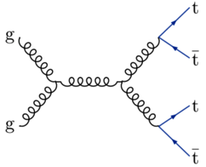
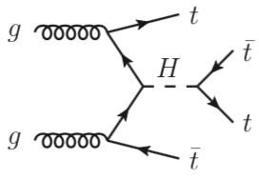
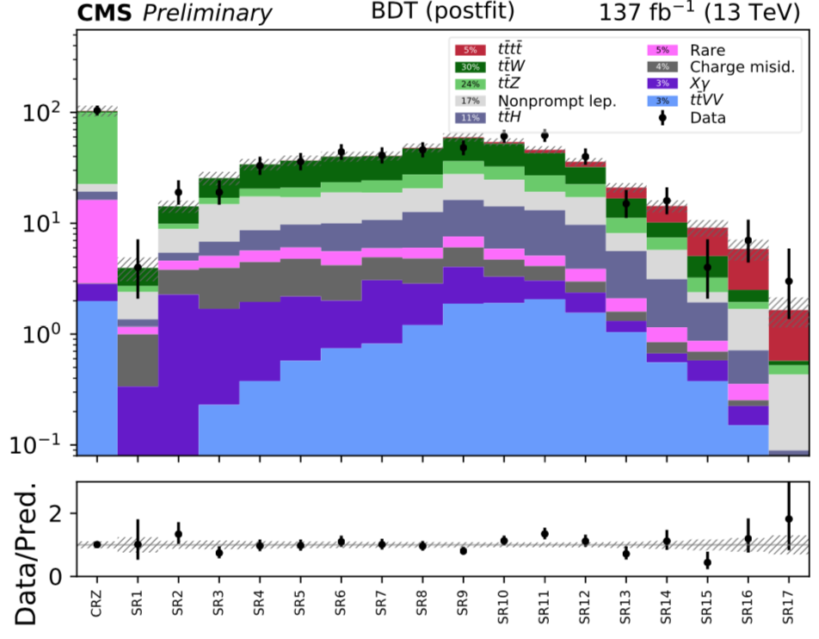
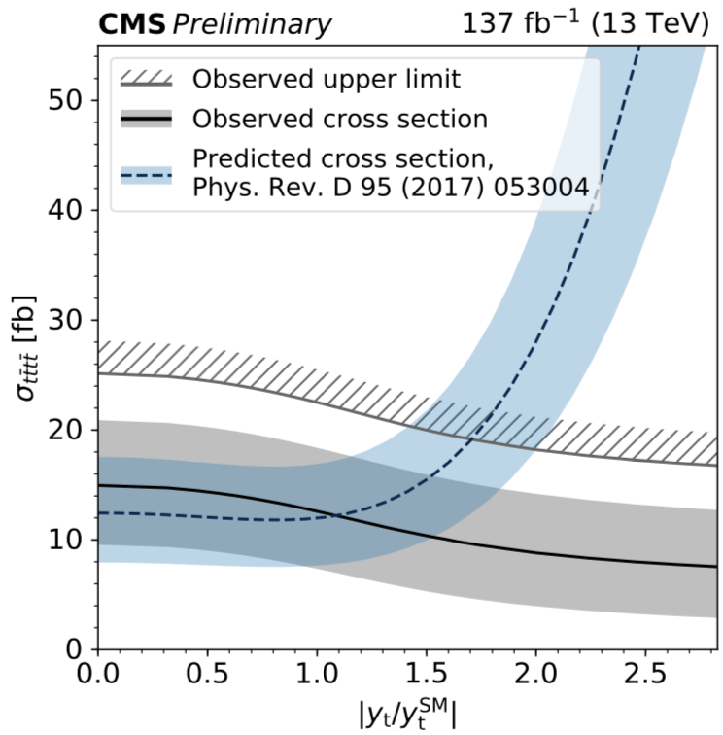
-
-
Rare processes: tttt (4 tops)
^{NLO}
Not yet observed : σ_{tttt} (SM) ~ 12 fb
PAS-TOP-18-003
Sensitive to BSM effects
way to assess the top Yukawa coupling
CMS full Run 2 data (ss dileptons & ≥ 3 l+jets):
fit many signal and control regions
Significance: 2.6 (2.7) σ obs(exp.)
→ Challenging !
PAS-TOP-18-003
Top Yukawa coupling: |y_{t}/ySM_{t}| < 1.7 @ 95%
comparable with recent CMS limit from tt kinematic
distributions in lepton+jet : |y_{t}/ySM_{t}| < 1.67 (1907.01590)
complementary to coupling extraction in ttH & tH
-
-
-
Limits on (pseudo) scalar A/H → tt

Slide 16
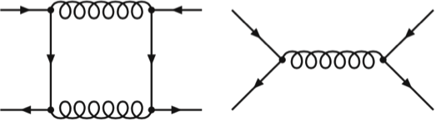
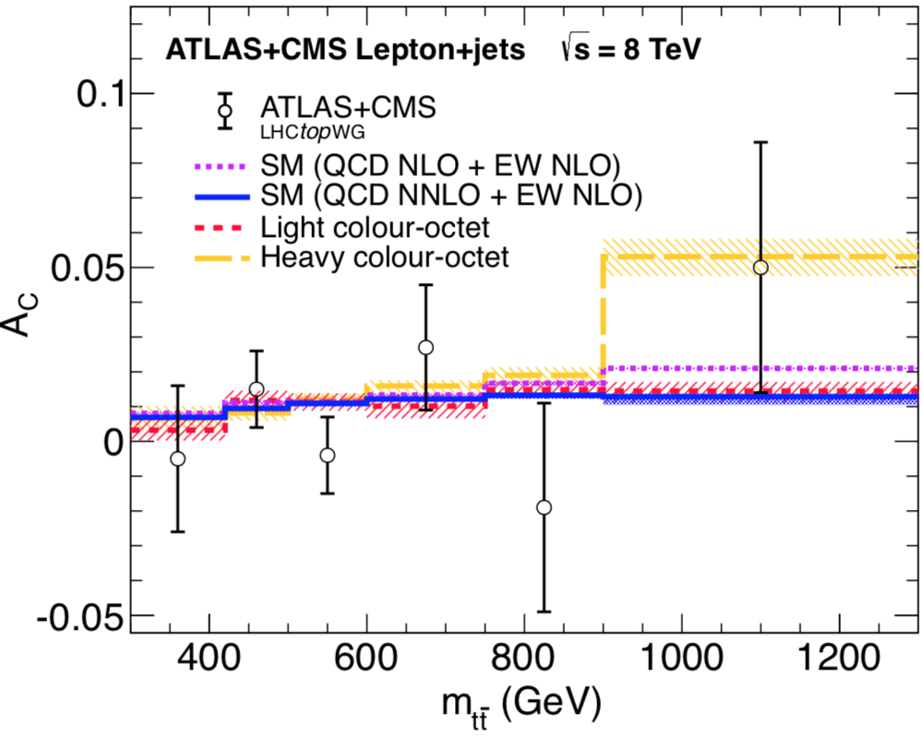
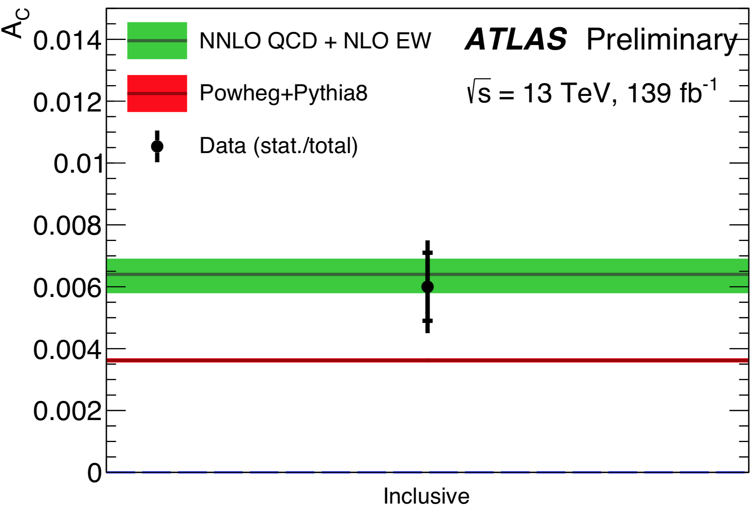
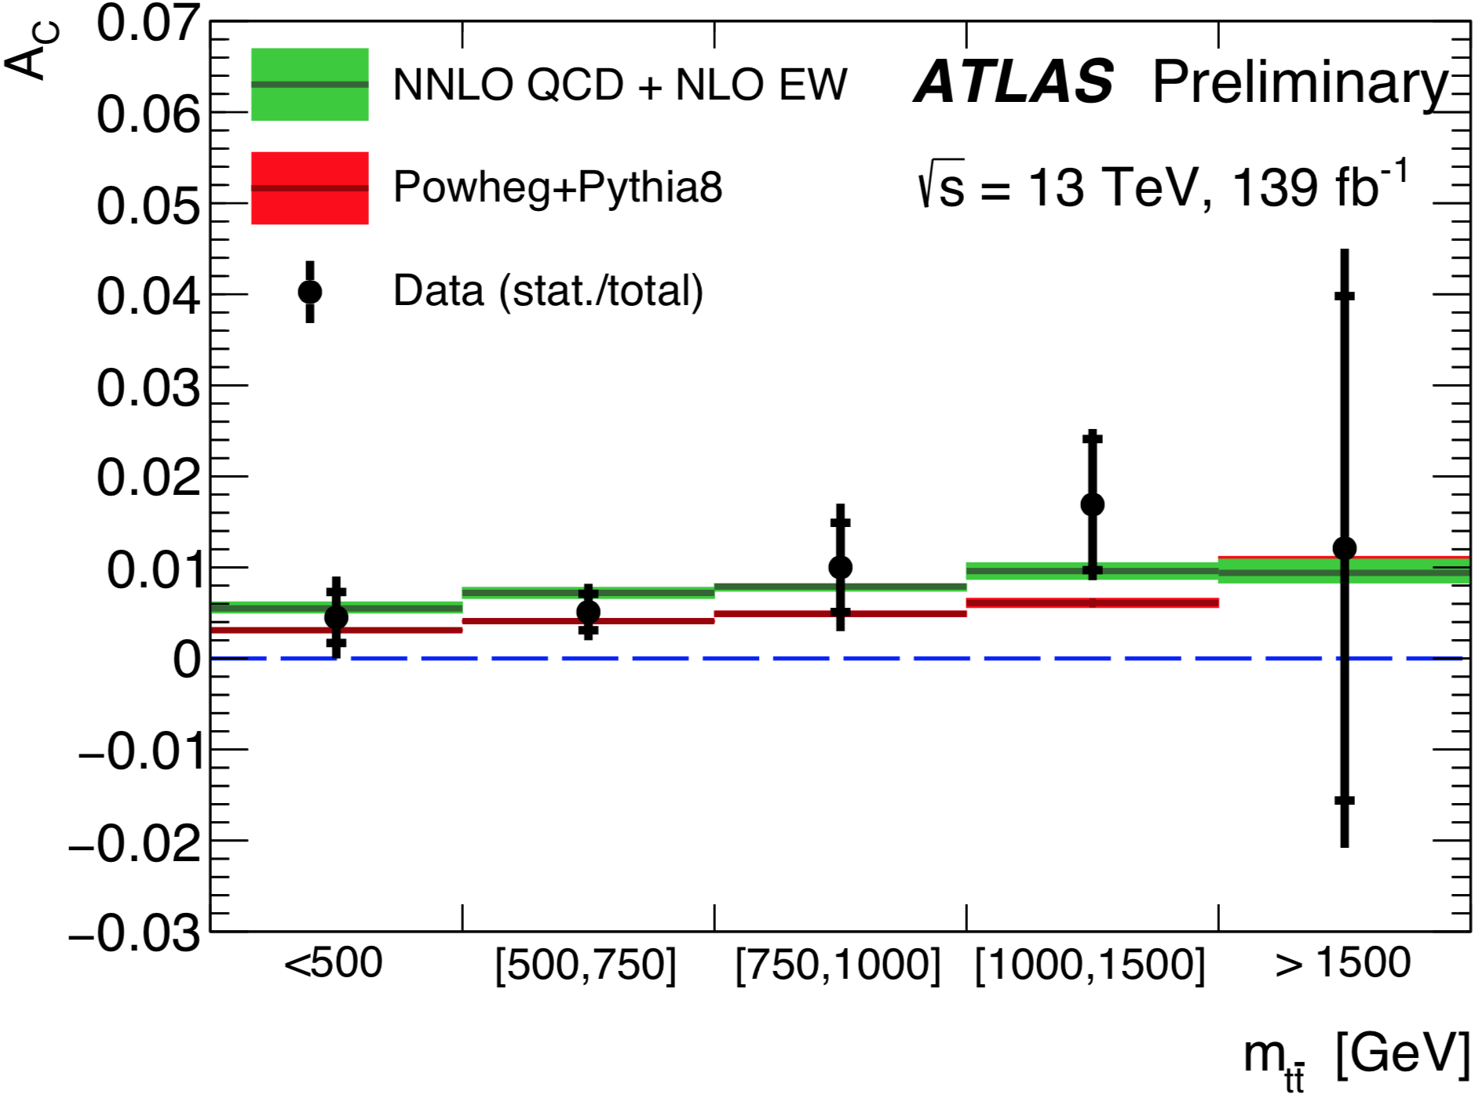
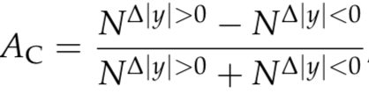

-
Top properties in tt: charge asymmetry, A_{C}
_
In SM A_{C} results from the interference of HO amplitudes in qq and qg initial states
→ t prefers q direction
Small effect, enhanced @ high tt mass ( m_{tt} ) and
longitudinal tt boost ( β_{tt} )
_
_
Enhanced in some BSM theories
ATLAS + CMS results @ 8 TeV in agreement with
NLO and NNLO but also compatible with zero A_{C}
New ATLAS result full Run 2 data: lepton + jet with
resolved and boosted jet
lept+jets
ATLAS-CONF-2019-026
Inclusive A_{C} is four
standard deviation
from zero
& in agreement with
NNLO predictions +
EW NLO
new
Limits on coeff.
dim-6 EFT operators C⁻/Λ²
new

Slide 17
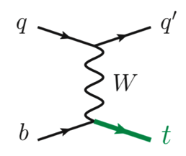
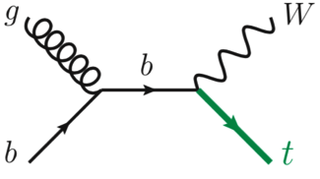
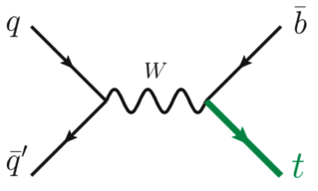
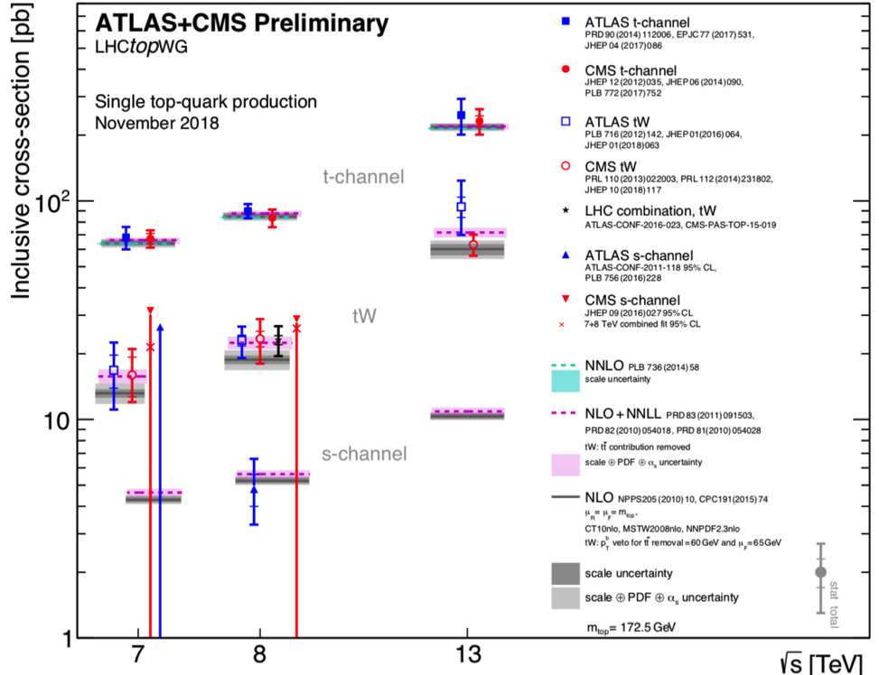
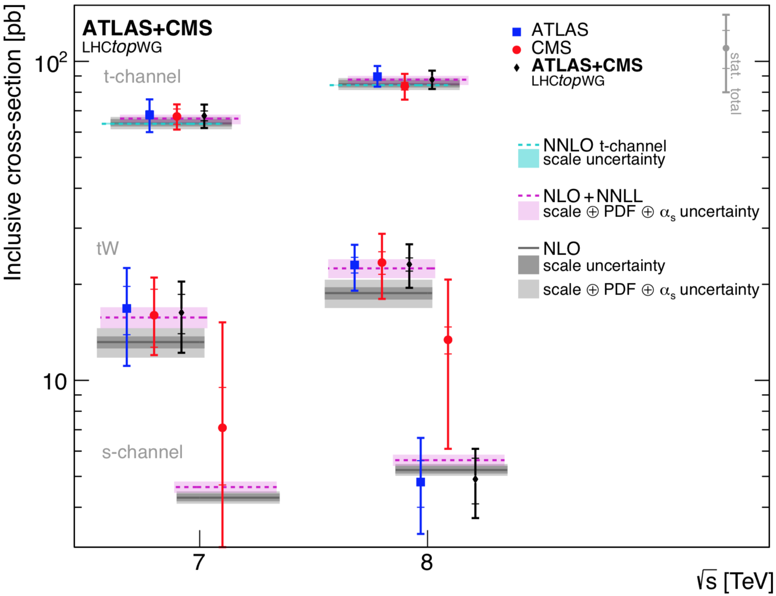
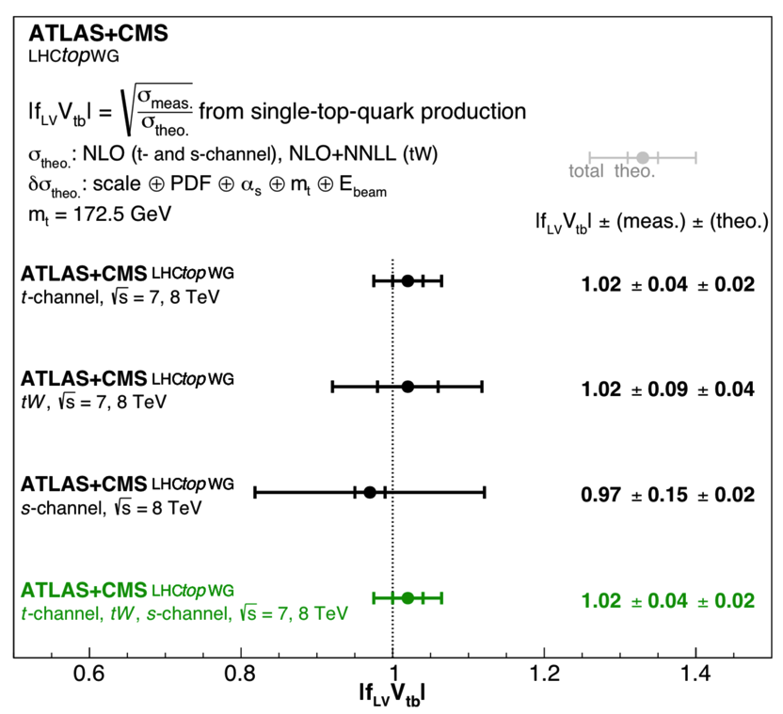
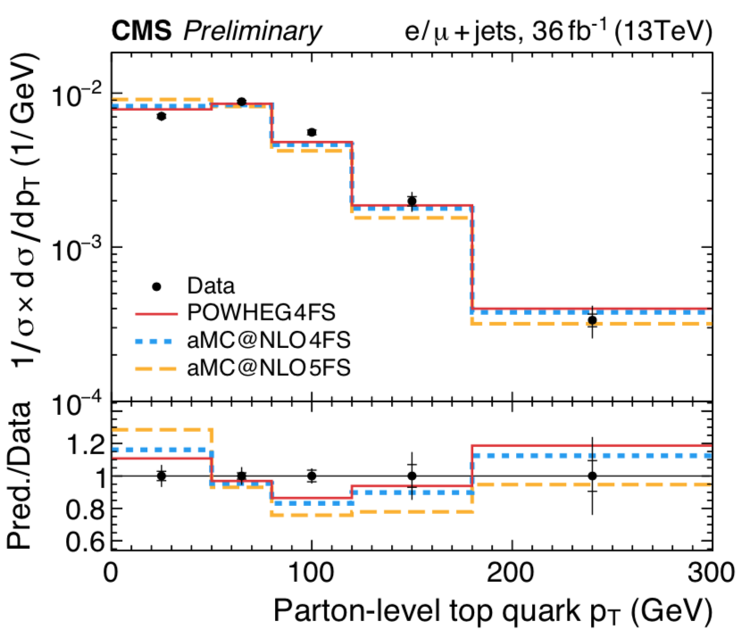
Single top cross section
Investigation of the Wtb vertex
LHC best combined precision 7@8TeV:
ATLAS+CMS X-section: ~ 7% (t-channel)
NLO+NLL predictions ~ 3 % (t-channel)
JHEP 05 (2019) 088
| f_{LV} * V_{tb} | = 1
within ~ 4%
t-channel
(f_{LV} form factor
for BSM
contributions)
CMS-PAS-TOP-17-023
Differential cross-section measurements:
better description with 4 Flavour than 5F scheme

Slide 18
Gauge boson couplings

Slide 19
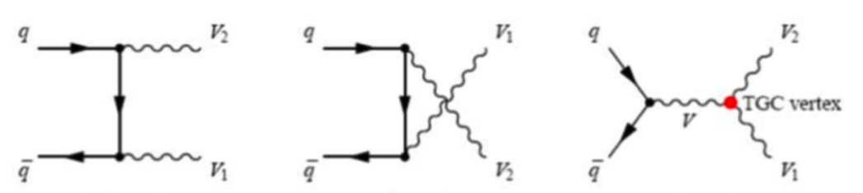
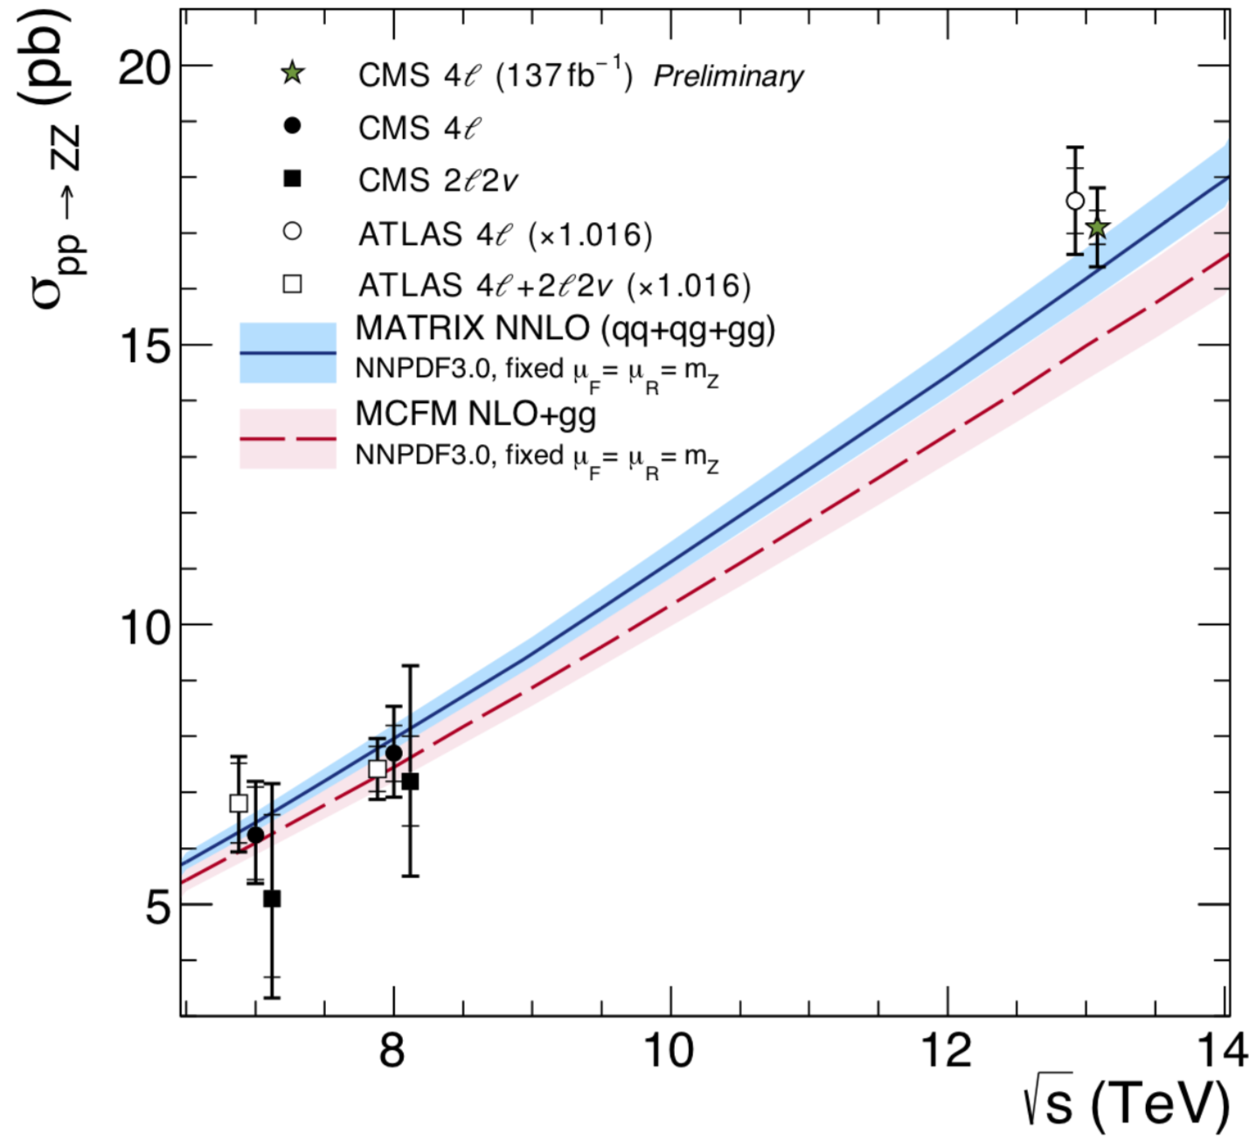
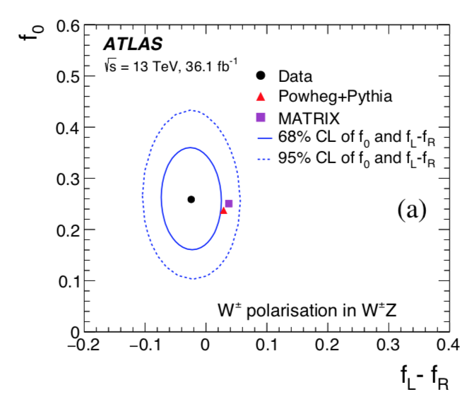
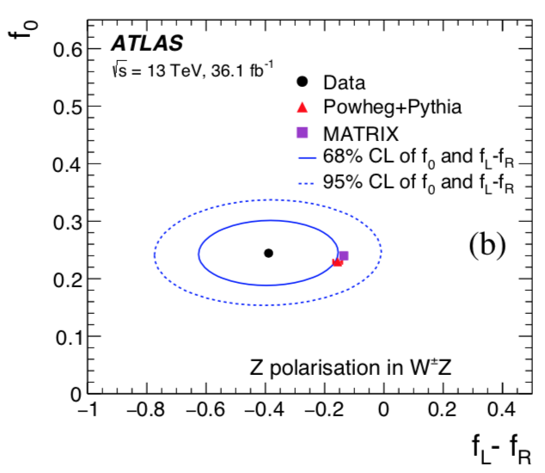
Multi gauge boson production
VV / Vγ / γγ / VVV (V=W, Z)
- Investigate the non-abelian structure of the SM at the highest energy
- Sensitive to new physics via anomalous Triple (Quartic) Gauge Couplings (aTGC, aQGC )
Dibosons: many measurements, NNLO necessary to describe data
CMS: σ_{tot} (ZZ) with full Run 2 data. Uncertainties: stat ~ syst ~ lumi
ATLAS measures the helicity fractions of W± and Z in WZ events in agreement with SM
predictions. First step on the way to perform polarization measurements in VBS processes
EPJC 79 (2019) 535
WZ →lllν
ZZ→ 4l
SMP-19-001

Slide 20




Multi gauge boson production
ATLAS-CONF-2019-034
Di-boson Z(ll) γ : new ATLAS full Run 2 data.
new
Differential X-sections vs E_{T}^{γ}, |η_{γ}|, p_{T}^{llγ}, m(llγ)
~ 5% experimental uncertainty in most of E_{T}^{γ} bins.
NNLO describes E_{T}^{γ} within uncertainties
& improve data description
Z(ll) γ
Tribosons: rare process
1903.10415
- Recent ATLAS result finds 4.1 𝛔 evidence
(3.1 σ exp.) for WWW+WWZ+WZZ combined
- Recent CMS result (1905.04246, ~ 36 fb⁻¹ @ 13 TeV)
focuses on WWW in the 2ss- and 3-lepton channels
Confidence intervals for aQGC (dim-8 operators,
more later). Limits on axion-like particles

Slide 21



Single gauge bosons & di-bosons with dijets
(EW Vjj & EW-VVjj)
VBF
VBS
Vector Boson Fusion (EW-Vjj) and Vector Boson Scattering (EW-VVjj)
- milestones studies of EW sector
- sensitive to new physics in the 3 or 4 boson vertex
ν
jet
Δy_{jj}
z
VBF and VBS tagged by 2 jets with large separation in rapidity
jet
- Large mjj for leading two jets
- Low jet activity in the central region
W-VBF
“QCD-mediated” V+jj and VV+jj
(interference !). Often largest background.
perform common fit to signal and control
regions
Observed :
VBF: EW-Wjj and EW-Zjj (ATLAS&CMS)
VBF
VBS: EW-ssWWjj(ATLAS&CMS)
EW-WZjj(ATLAS),EW-ZZjj (ATLAS)
new
Evidence:
VBS: EW-Zγjj (CMS) @ 8 TeV & 13 TeV
VBS
new
Agreement with SM predictions
→ limits on aTGC and aQGC

Slide 22





Observation of EWK-ZZjj & evidence EWK-Zγjj
CONF-STDM-2019-11
ATLAS: observation of EWK-ZZjj with full Run 2 data
(4l and llνν)
new
Fit to a multi-variable combination (BDT):
signal strength = 1.4 ± 0.3
Significance 5.5 (4.3) σ obs. (exp.)
σ_{fid} = 0.82 ± 0.21 fb
ZZ→4l
CMS: Evidence of EWK-Zγjj 36 fb⁻¹ @13 TeV (Z → ll)
QCD-ZZjj
2 D fit to mjj & Δηjj: signal strength = 0.64 ^{+ 0.23}
_{- 0.21}
EWK-ZZjj
Significance 4.7 (5.5) σ obs. (exp.) combined with 8 TeV
BDT
Z →μμ
Z →ee
new
new
new
ZZ→llνν
EWK-ZZjj
mjj
mjj
BDT

Slide 23




Anomalous gauge boson couplings@ 13 TeV
New Physics added to the SM Lagrangian as higher dimensional operators:
Dimension-6 operators
Give rise to charged aTGC & aQGC
Dimension-8 operators:
Give rise to aQGC
V(jj) V jj
V(jj) V jj
V(jj) V jj

Slide 24






Conclusions
LHC Run2 very successful → Large data sets available
Improved performance
+ Many important SM measurements with significantly increased precision
+ Exploration of differential distributions in high p_{T} jet, photon, W, Z, top final states
+ Many rare processes observed
Major advances in techniques for theoretical calculations
→ stringent test of SM
EFT: starting to be able to fit Wilson coefficients in multiple sectors simultaneously
Rich interplay between EW precision + Higgs + top + diboson fits.
→ EW & EFT fits: important tools to search for BSM
Need theory guidance for the interpretation of experimental results
Solid basis for the future of the our discipline (colliders & beyond colliders)
THANKS TO ALL MY ATLAS, CMS, LHCb, HERA & TEVATRON COLLEAGUES WHO
PROVIDED ME WITH MATERIAL, COMMENTS & ANSWERS TO MY QUESTIONS

Slide 25
Additional recent results

Slide 26

Slide from Maria, Florencia, Nadjieh (CMS): Top mass from boosted top
new

Slide 27





Jets & azimuthal decorrelations
Azimuthal decorrelations (Δφ₁₂): sensitive
to higher orders, parton showering and resummation
Δφ₁ = azimuthal angular separation
between the leading jets
pQCD fixed-order calculations unstable for ∆φ₁₂ ≈ π,
→ resummation of soft parton emissions
approximated with parton shower evolution
Δφ₁₂
Δφ₁₂
Normalized differential cross section vs Δφ₁₂
in 2 (and 3 jets) events in nearly back-to-back jet topologies in bins of leading jet p_{T}
2-jets
1902.04374
PH-2J PowHeg 2→2 NLO
3-jets
PH-3J Powheg 2→3 NLO
Need to improve
the modelling of the
accompanying soft
parton radiation because
no model describes
simultaneously
the 2- and 3-jet measurements
(differences up to 15% )

Slide 28


Slide 29









Single gauge boson production: W
Large data sets and accurate predictions
→ stringent SM measurements
DYNNLO
Recent results:
- W charge asymmetry (ATLAS) vs |η_{μ}| discriminates
among PDFs ( asymm. uncertainty ~ 0.002 - 0.003 )
W→μν
- W+c-jet (CMS) use D*: tension with ATLASepWZ16 PDFs
where strange-quark is unsuppressed @ at low x
1904.05631
New PDF set: ATLASepWZWjet19 include W+jet data
r_{s} reduced @ high x but still enhanced at low x
To be followed: understanding the strange quark
in proton important for the m_{W}
measurement @ LHC
EPJC 79 (2019) 269
W + c
EPJC 79 (2019) 269
+ MCFM
r_{s}
PHYS-PUB-2019-016
29

Slide 30



Single gauge boson production&decay: Z/γ*→ ll
dσ/dm_{ll} for 15 < m_{ll} < 3000 GeV ( @ 13 TeV ) in full phase space, corrected for FSR
Agreement with SM theoretical predictions (large stat. uncertainties at the highest masses)
1812.10529
Sizable effect from Photon-Induced (PI) contribution in the high- mass region
(comparison with LUXqed PDF set)

Slide 31




_
Top (tt) cross section measurements
σ_{tt} provides information on:
􏰁 - Top mass, α_{s,} 􏰁gluon PDF at high x
Most precise σ_{tt} measurements: ~ 4%
limited by luminosity & experimental
systematics. Agreement with full
NNLO+NNLL calculations
σ _{tt} (ee, eμ, μμ) multi-differential
cross section :
normalised single, double & triple
differential cross sections. Many
variables unfolded to parton and
particle level (p_{T}^{t}, y_{T}^{t}, M_{tt,}p_{T}^{tt}, … )
1904.0523
MCs have harder top p_{T} spectra
wrt data, effect increases with
higher m(tt) values
_
Significant impact on gluon PDF
at large x, when fitting simultaneously
α_{s} , m_{t}^{pole}, and PDFs
Data/simu

Slide 32




_
Associate production: tt + Z
Rare process probing top coupling to Z
tt
Sensitive to BSM physics ( VLQ, 4/3
charged top, …)
ttV, V= W, Z, observed already @ 8 TeV
by ATLAS & CMS
10⁻³
@ 13 TeV:
ttV
σ _{ttZ} = 1.00 ^{+ 0.06} (stat) ^{+ 0.07} (syst) pb
^{- 0.05}
^{- 0.06}
consistent with SM
ATL-PHYS-PUB-2018-034
CMS-PAS-TOP-18-009
77.5 fb⁻¹ (13 TeV)
ttZ inclusive &
differential
cross sections:
1-& 2-d fits to extract
limits on coefficients of
dimension-6 operators in
an Effective Field Theory

Slide 33




_
Top (tt) + heavy flavours
H , Z
_
_
_
_
JHEP 04 (2019) 046
Background to ttH(bb) & tt tt
Challenges: multiple scale and
many processes contribute
ATLAS: dilepton and lepton+jets
CMS: dilepton and all-jet
Measure integrated and (ATLAS)
differential cross sections
CMS-PAS-TOP-18-11
Dilepton and lepton+jets :
- cross sections higher than predicted,
still compatible within uncertainties
- fair agreement for the shapes for most
of the predictions
Tensions between all-jet cross
section measurements and
predictions
Parton Agnostic
Parton Based
Full

Slide 34




Rare processes with one top: tZq, tγq
Sensitive to BSM effects
- tZq & tγq include TGC diagrams (WWZ & WWγ)
- modified production could indicate FCNC
- tγq sensitive to the top quark charge
tZq
pp → tZq . Best signal region: 3 leptons, 2-3 jet (1b)
Main bkg: diboson
BDT (CMS), NN (ATLAS) trained in each signal region
ATLAS 36 fb⁻¹: first evidence : 4.2 (5.4) σ obs (expt)
CMS 77.4 fb⁻¹: observation > 5 σ obs.
PRL 121(2018)221802
PRL 122(2019) 132003
tγq
pp → tγq : first evidence for (4.4 σ obs., CMS)
Template fit to BDT distributions
σ(pp → tγq) × B(t → μνb) = 115 ± 17(stat) ± 30(syst) fb
SM value: 81 ± 4 fb

Slide 35


Rare processes: tttt (4 tops)
^{NLO}
σ_{tttt} (SM) = 9.2 fb (30% scale uncertainties)
Sensitive to Beyond SM effects
Way to asses the top Yukawa coupling
ATLAS 36 fb⁻¹ :
Template fit to H^{had} = ∑ p_{T}^{j} in bins of b-jet
multiplicity 2.8 (1.0) σ obs(exp.) significance
CMS 137 fb⁻¹: 2.6 (2.7) σ,
BDT and cut base approach. Fit many regions
2.6 (2.7) σ obs(exp.) significance
|y_{t}/ySM_{t}|<1.7
PRD 99, 052009 (2019)

Slide 36

Quantum Interference Between Single and Doubly Resonant Top Quark
Phys. Rev. Lett. 121, 152002 (2018)
Identical WWbb final states,
Good description by predictions including
recent fixed-order calculations of the full
next-to-leading-order (NLO) pp → l+νl−ν ̄bb ̄
process

Slide 37



Slide 38

Top properties
ATL-PHYS-PUB-2018-034

Slide 39


Top properties: polarisation, spin correlations
_
1903.07570
t and t produced non polarised (QCD conserves
C and P ) with t and t spins correlated.
_
→ Test of BSM effects via EFT, (ChroMagnetic
Dipole Moment ..)
Top decays before hadronisation
→ Spin information preserved in the decay products
_
use Δφ_{ll} (&Δη_{ll} ) between leptons in tt (dilepton)
A more direct study extracts 15 coefficients
characterising spin dependence of tt
production. Large uncertainties still.
_
CMS-PAS-TOP-17-023
Δφ_{ll} tension between NLO & data
likely explained by missing higher order
Polarisation, CMDM, in agreement with
SM within uncertainties

Slide 40

Slide
from
Christian
Schwanenberger

Slide 41


Multi gauge boson production
VV / Vγ / γγ / VVV (V=W, Z)
- Investigate the non-abelian structure of the SM at the highest energy
- Sensitive to new physics via anomalous Triple (Quartic) Gauge Couplings (aTGC, aQGC )
ATL-PHYS-PUB-2019-012
Dibosons:
- Many measurements
- NNLO necessary to describe data
STDM-2018-03
WZ→ 3lν
Larger samples allow for differential cross sections
Ratio with respect to NNLO

Slide 42

VBS with semileptonic final states: V(jj) V(lν/l)+jj
Semi-leptonic final states complementary to fully-leptonic :
- The latter less background, good for observation (first VBS observation, 2017, in
W±W±jj ⟶l±l±jj, most favorable EW/QCD production ratio)
- The former higher BR, probe higher energy tails where aQCG effects more prominent
Latest results (VZjj & VWjj): exploit boosted topology V→jj (V as large merged jet)
Recent ATLAS (1905.07714) ~ 36 fb⁻¹ @ 13 TeV:
also resolved jets. 0/1/2 leptons
1905.07445
- Use MVA including quark-gluon separation
- 2.7 𝛔 significance (2.5 𝛔 exp.)
Recent CMS (1905.07445):
- Main aim: search for aQGCs (& Higgs±)
- Fit to m_{WV} and m_{ZV} distributions
- Uncertainties: QCD scale, PDF uncertainties,
V+jets background shape
- Stringent constraints on parameters for
dimension 8 operators

