Slide 1


Constraints on Quantum Gravity
Hirosi Ooguri
Caltech and Kavli IPMU
EPS-HEP Conference, 15 July 2019

Slide 2

It is often said that string theory predicts the vast landscape
of vacua and that any effective field theory can be realized
somewhere in the landscape. In particular, it accommodates
de Sitter vacua with a wide range of values of dark energy.

Slide 3

Or, does it?

Slide 4
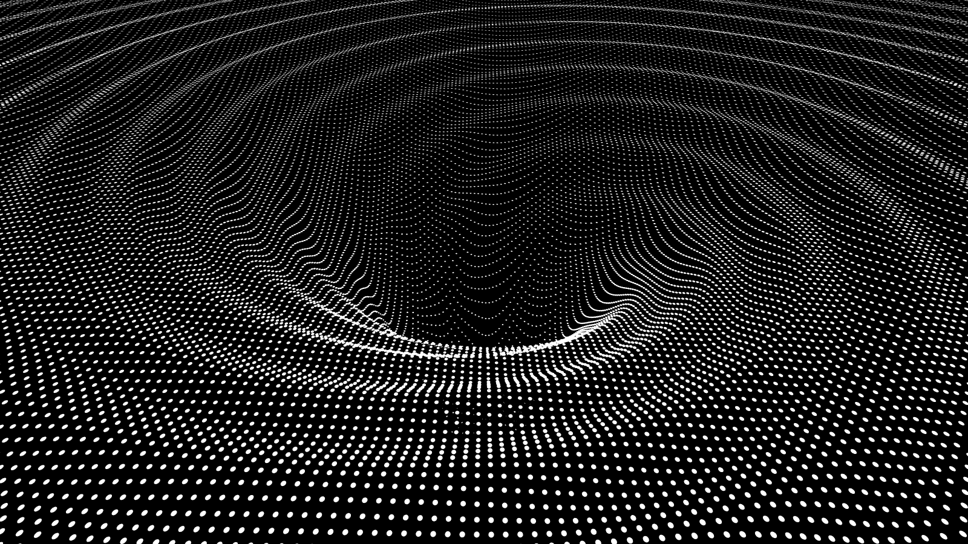
Gravity is different

Slide 5
Swampland Question
Given an effective theory of gravity, how
one can judge whether it is realized as a
low energy approximation to a consistent quantum theory with ultraviolet completion, such as string theory?
Vafa: hep-th/0509212;
Vafa + HO: hep-th/0605264

Slide 6
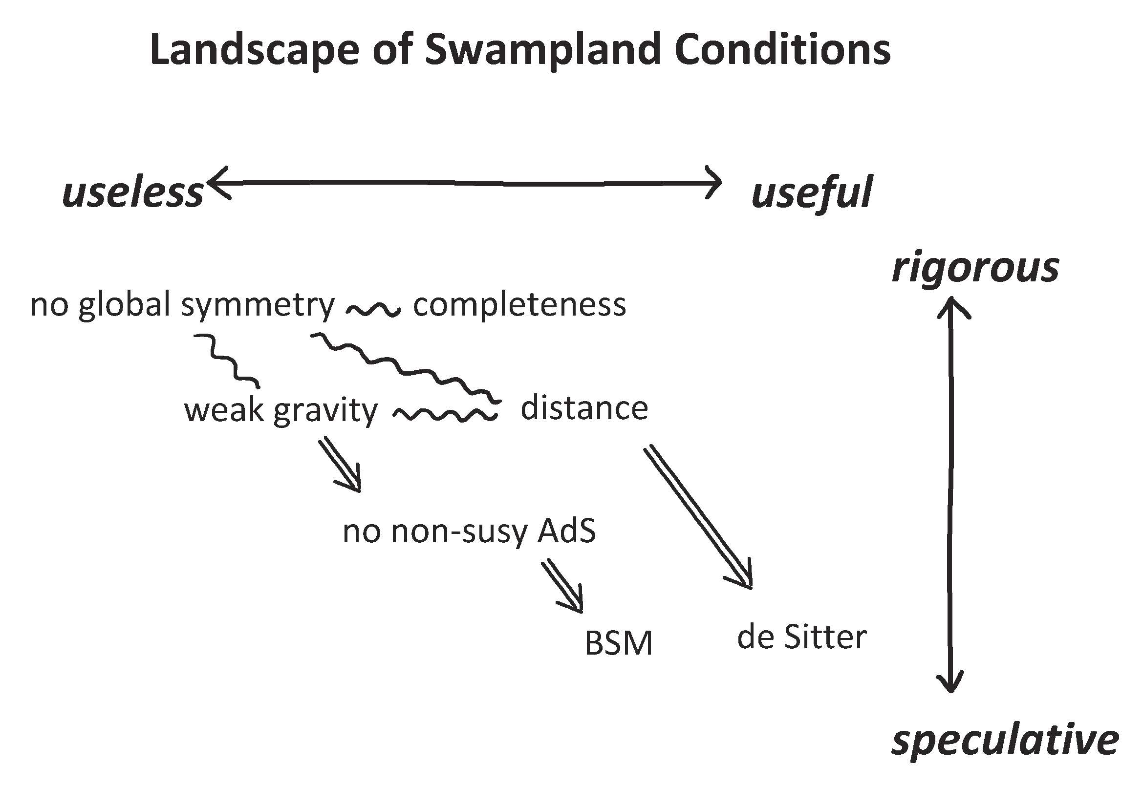

Slide 7
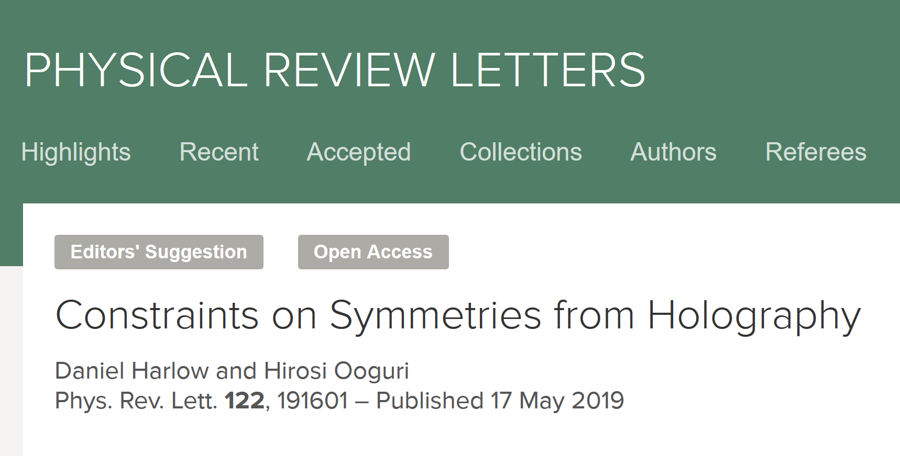
No global symmetry
… proof of concept of the Swampland
arXiv:1810.05337 (5 pages announcement)
arXiv:1810.05338 (175 page complete proof)
Proven in the context of AdS/CFT

Slide 8
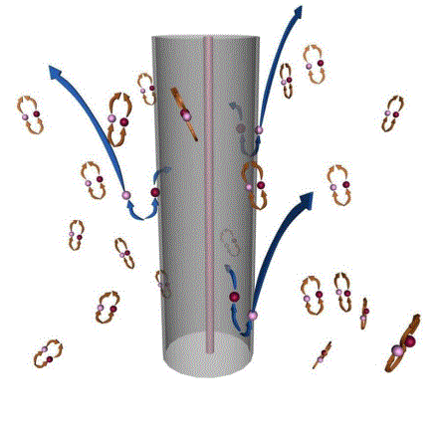
No global symmetry
For over 50 years, many theorists have argued that a consistent quantum theory of gravity cannot have global symmetry.
The standard argument makes use of the Hawking radiation and the Bekenstein-Hawking formula.

Slide 9
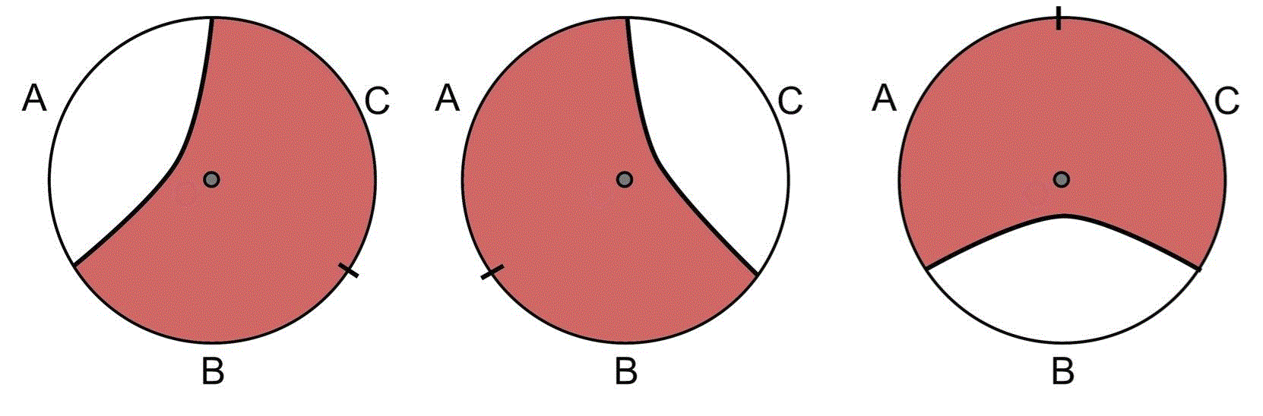
No global symmetry
Our new proof makes use of the recently discovered relation between the holography of quantum gravity and quantum error correcting codes in quantum information theory.
Almheiri, Dong, Harlow: 1411.7041
Harlow: 1607.03901

Slide 10
No global symmetry
Generalized Noether Theorem:
For a region R of a Cauchy surface, we can define a unitary operator U(g, R) for every element of the symmetry group G.
When R is a union of disjoint subregions, this unitary operator can be expressed as a product of operators associated to each region:
This is obvious for continuous symmetry with Noether current, but this theorem holds for discrete symmetry also.

Slide 11
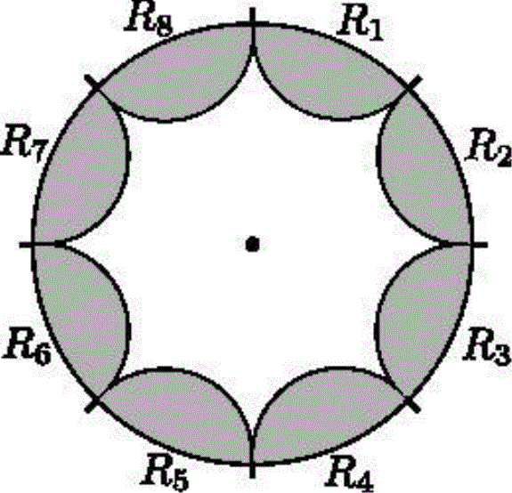
No global symmetry
If a gravitational theory has global symmetry,
there must be a bulk local operator that transforms faithfully into another local operator.
Symmetry generator,
x
commute with the local operator
at x in the bulk.
Contradiction

Slide 12
No global symmetry
Assuming that our theorem holds in the flat spacetime limit, the B - L symmetry of the Standard Model of Particle Physics must be violated and the proton must decay.
We have also proven the completeness hypothesis which says that all possible charges for long range gauge symmetry must be realized.
Assuming this completeness theorem holds in the flat spacetime limit, it predicts magnetic monopoles.

Slide 13

So far, I have presented
the theorems I can prove.
Now, we are entering
the territory of conjectures.

Slide 14
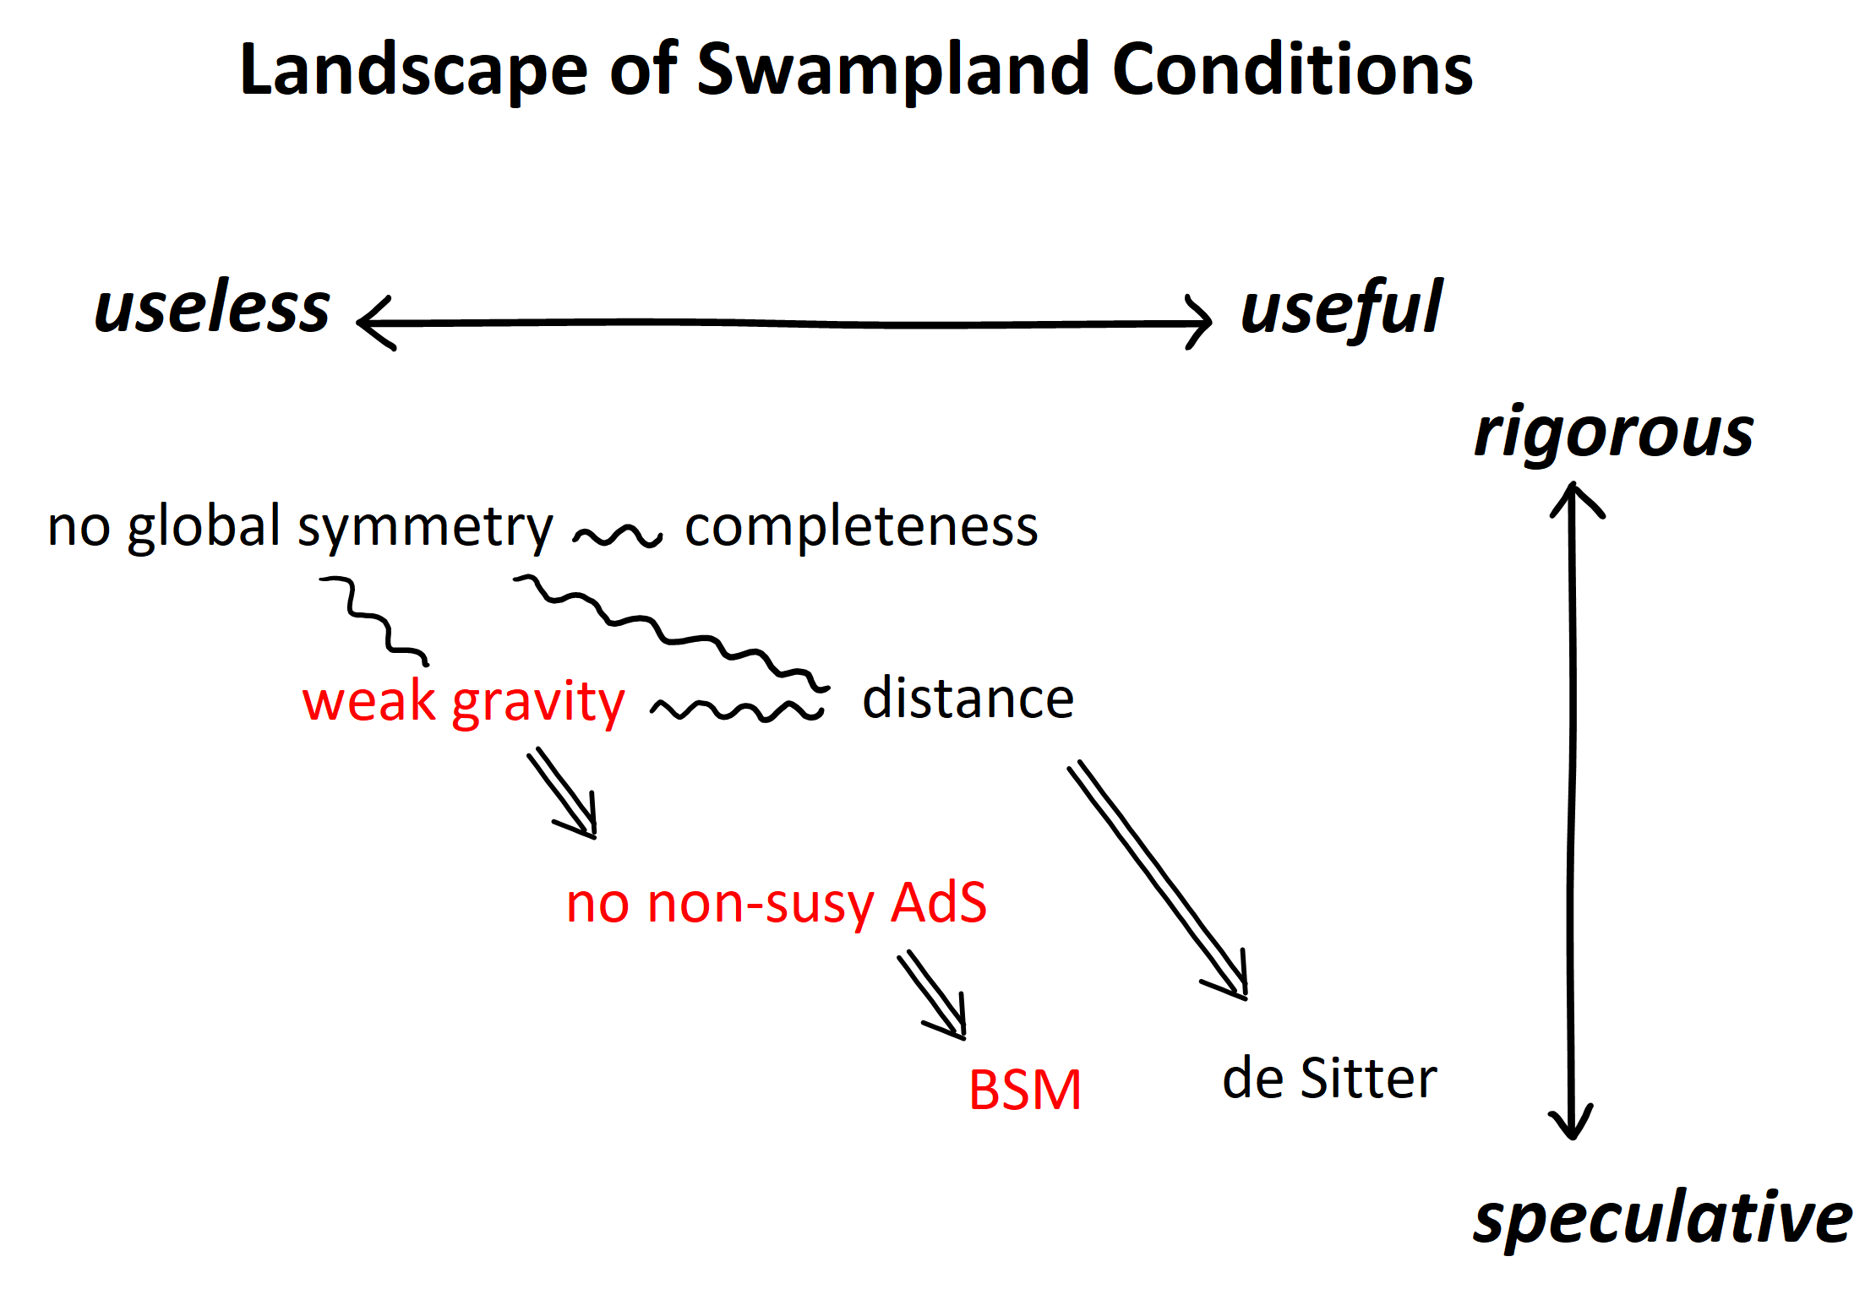

Slide 15


Weak Gravity Conjecture

Slide 16
Our no global symmetry theorem states that any symmetry
in quantum gravity is either broken or gauged.
How is global symmetry broken/gauged?
Our completeness theorem states that every finite dimensional unitary representation of gauge symmetry must appear.
Can we bound the mass of the lightest charged particle?
The weak gravity conjecture
attempts to quantify these.

Slide 17
Weak Gravity Conjecture
In any low energy theory described by the Einstein gravity + Maxwell field + finite
number of matters, if it has an UV completion as a consistent quantum theory, there must
be a particle with charge Q and mass m,
such that:
Arkani-Hamed, Motl, Nicolis, Vafa: hep-th/0601001

Slide 18
Weak Gravity Conjecture
Motivated by:
Black Hole Physics
True in all known constructions from string theory
Connection to the Cosmic Censorship Hypothesis

Slide 19
Weak Gravity Conjecture
What if
?
Vafa + H.O.: 1610.1533
It implies that anti-de Sitter space is unstable without supersymmetry.
It rules our certain types and masses of the neutrinos in the Standard Model.
(neutrino mass) < (dark energy)
4
Ibanez, Martin-Lozano, Valenzuela: 1706.05392,1707.05811;
Hamada, Shiu: 1707.06326; Gonzalo, Herraez, Ibanez: 1803.08455

Slide 20
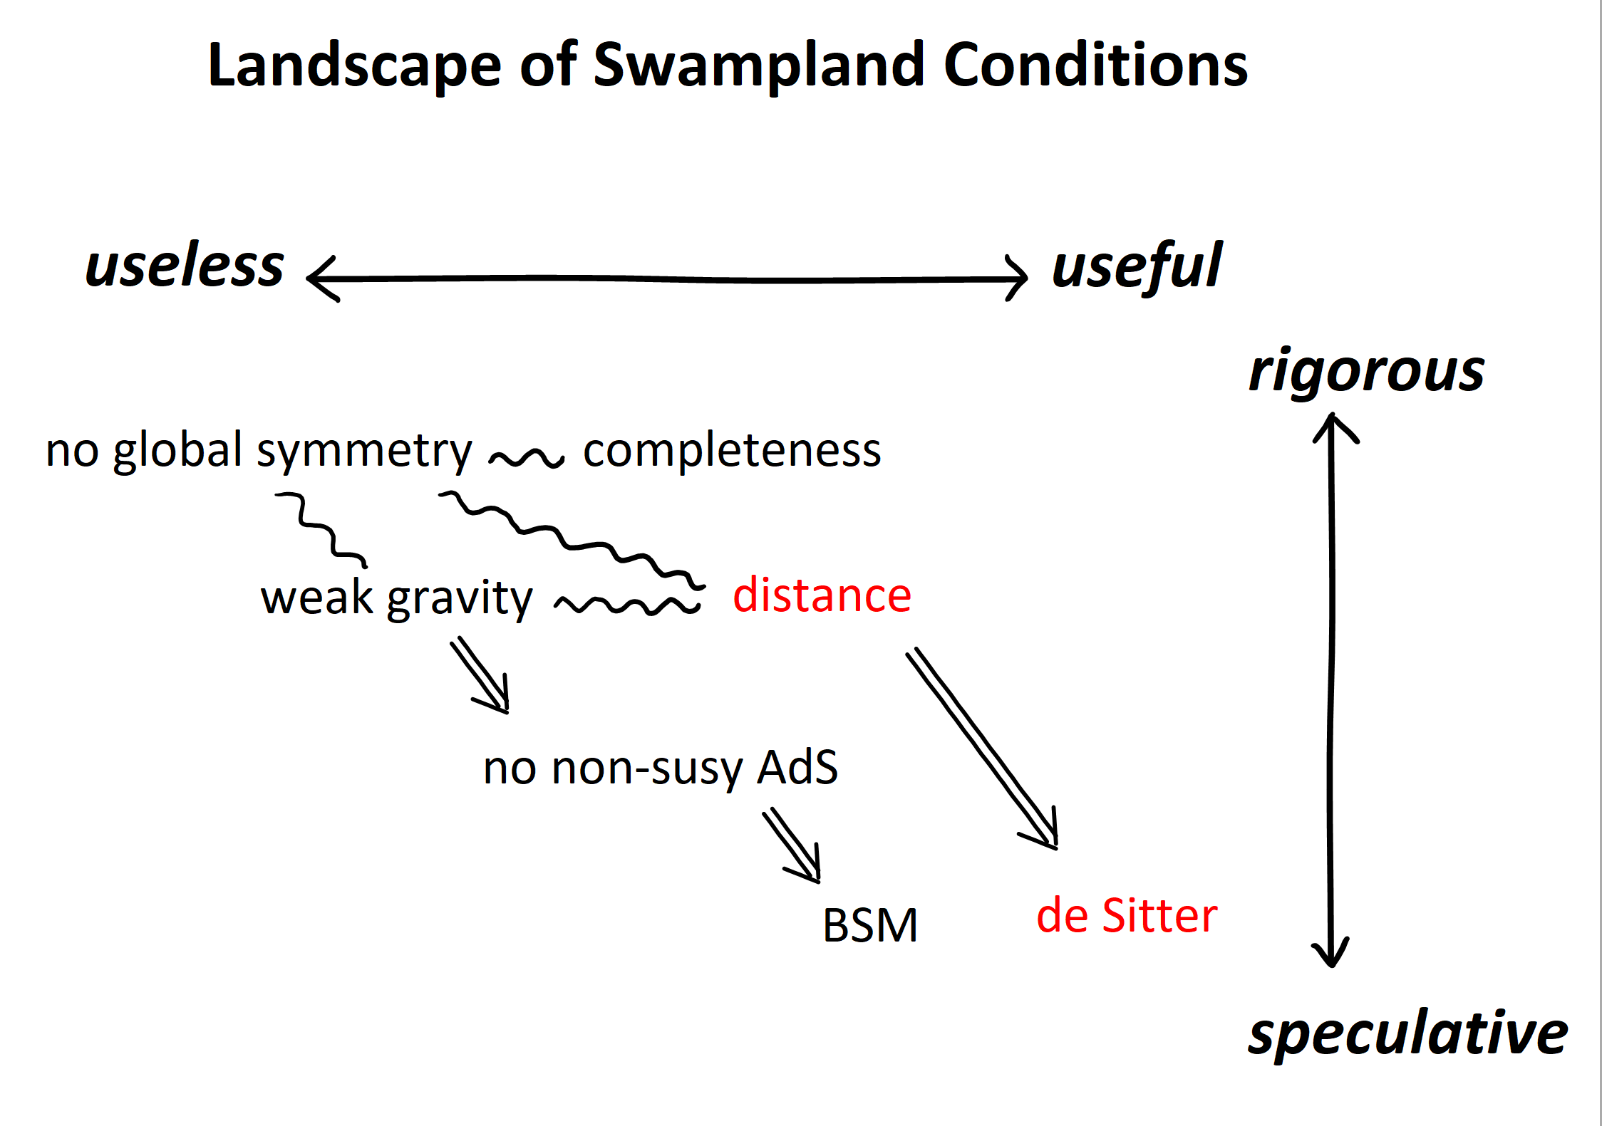

Slide 21
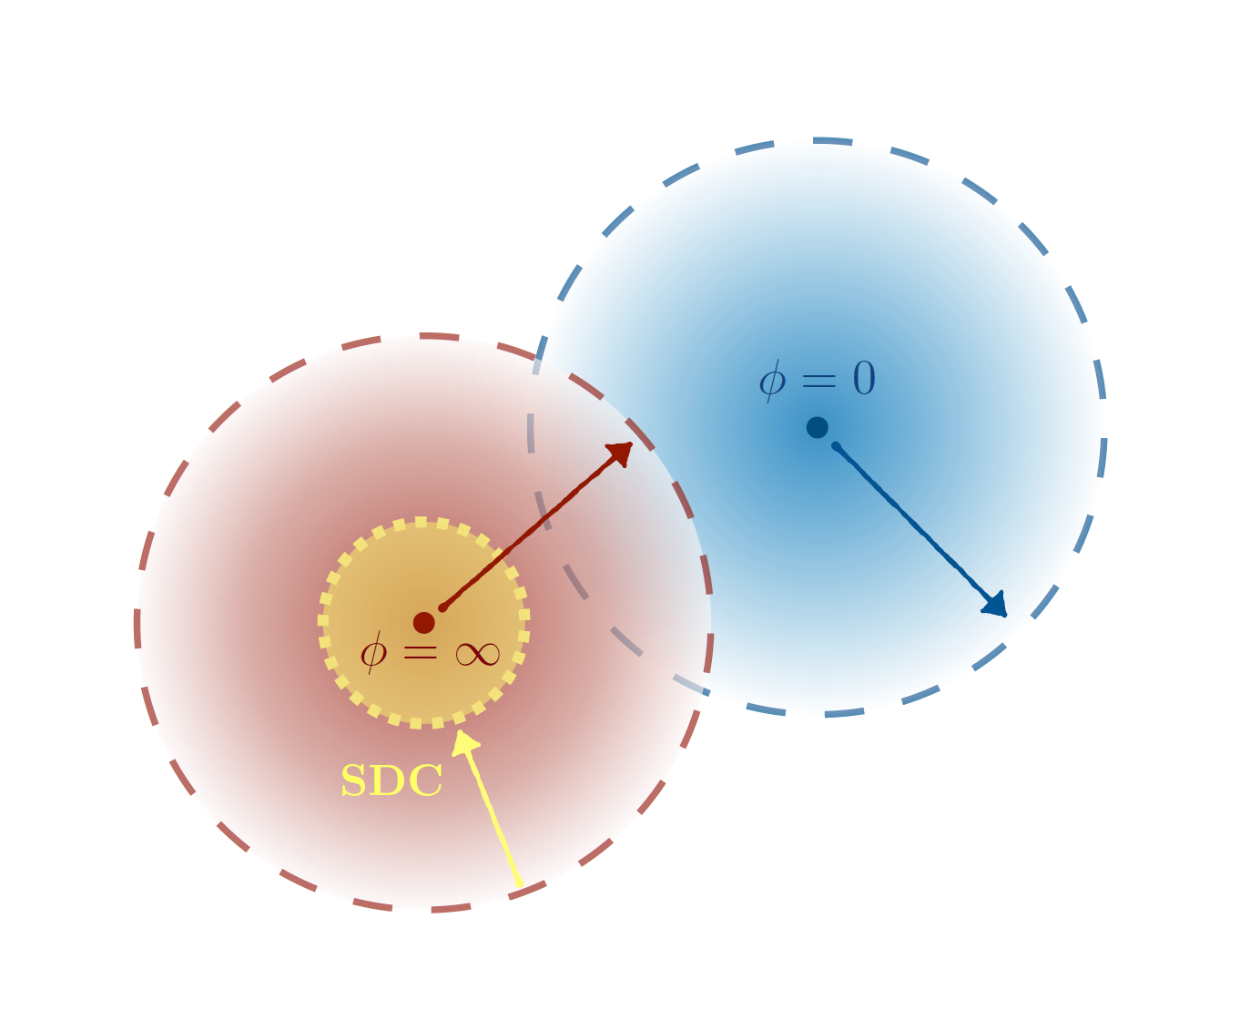
Distance Conjecture

Slide 22
Our proof of the no global symmetry theorem
works for spontaneously broken global symmetry.
In particular, shift symmetry of a scalar field,
often invoked in inflation models, must be broken.
How is the shift symmetry broken?
The distance conjecture
attempts to quantify this.

Slide 23
Distance Conjecture
String theory has no continuous free parameters.
All parameters can vary locally
— they are expectation values of scalar fields.
The distance conjecture is about properties of
the moduli space of such scalar fields, with
the metric defined by their kinetic terms.
Vafa + HO: hep-th/0605264

Slide 24
Distance Conjecture
1. Moduli space is non-compact.
Pick any point, one can go infinite distance away from it.
2. Long distance excursion over the moduli space generates
a tower of new particles with exponentially small masses.
3. The low energy effective theory defined at the original point
breaks down because of the new light degrees of freedom.
Vafa + HO: hep-th/0605264

Slide 25
Distance Conjecture
1. True in all known constructions in string theory
(numerous non-trivial tests with Calabi-Yau compactifications)
2. Connection to Trans-Planckian Censorship.
3. Connection to Weak Gravity Conjecture
4. False for non-gravitational systems
5. gives a universal upper-bound on the inflation excursion.

Slide 26
De Sitter Conjecture
Low energy effective theory of string theory contains several scalar fields.
Can they be all stabilized and produce a positive cosmological constant?
Dine-Seiberg Problem (1985)
The expectation value of the dilaton determines the string coupling constant.
A perturbatively generated potential cannot stabilize the dilaton.
— it is (almost) impossible to demonstrate existence of meta-stable
de Sitter vacua in the perturbative expansion in the string coupling.
The race track mechanism could in principle evade the problem, but it has been difficult to implement this idea in top-down constructions.

Slide 27
De Sitter Conjecture
generalizes the Dine-Seiberg problem to any direction in the moduli space
Obied, Spodyneiko, Vafa + H.O., arXiv:1806.08362.
Palti, Shiu, Vafa + H.O., arXiv: 1810.05506.
Suppose you found a positive meta-stable point in the potential. If the Hessian eigenvalues of the potential are bounded below by a minus of the potential,
an accelerating universe with an apparent horizon is allowed.
The Bousso bound dictates that the entropy inside of the apparent horizon is bounded by its area, which scales as an negative power of V.
On the other hand, the parametric control means that the meta-stable point is in
one of the asymptotic region of the moduli space, where according to the distance conjecture, infinite towers of light particles emerge and generate a large entropy.
Contradiction

Slide 28
De Sitter Conjecture
generalizes the Dine-Seiberg problem to any direction in the moduli space
Obied, Spodyneiko, Vafa + H.O., arXiv:1806.08362.
Palti, Shiu, Vafa + H.O., arXiv: 1810.05506.
In any asymptotic direction in the moduli space, the potential V
for scalar fields must satisfy:
or

Slide 29
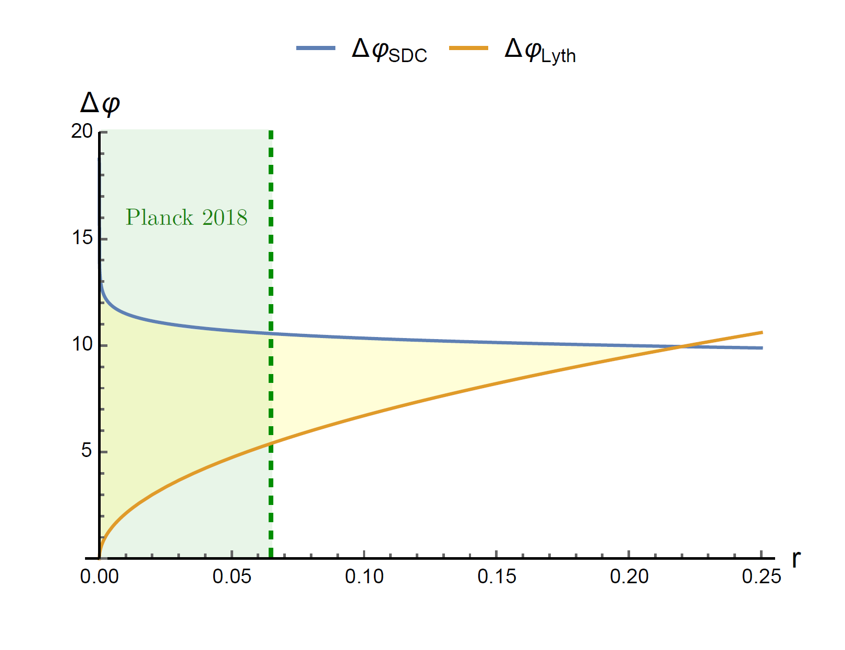
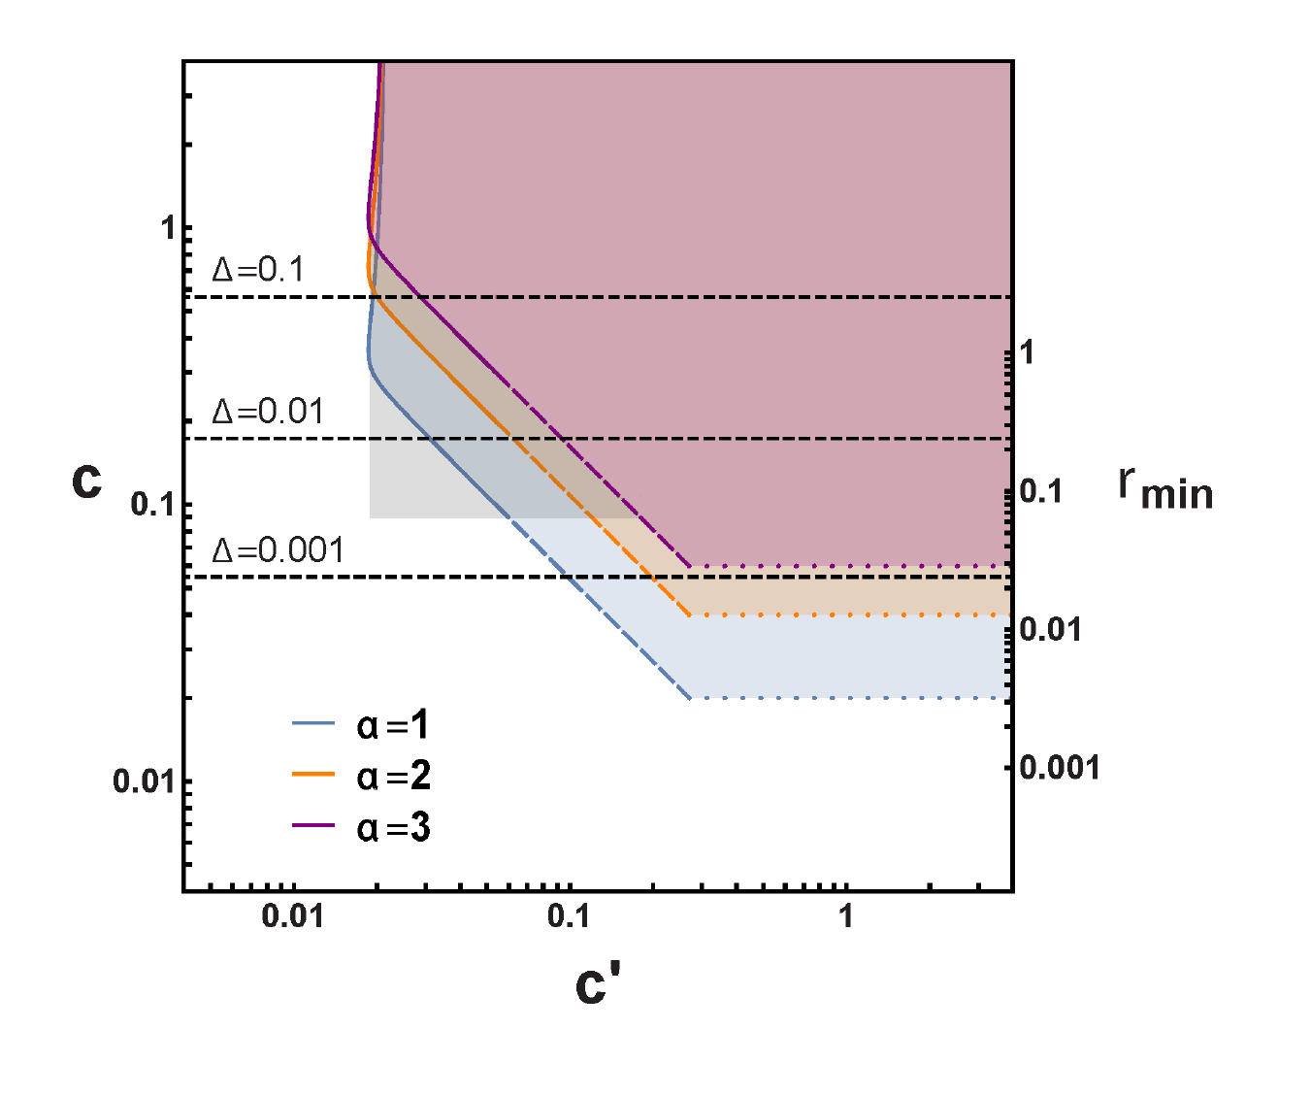
The distance conjecture and the de Sitter conjecture
do not exclude the inflation scenario, but they can put non-trivial constraints on inflation models.
Distance Conjecture
De Sitter Conjecture
Scalisi, Valenzuela: 1812.07558
Chiang, Leedom, Murayama: 1811.01987

Slide 30
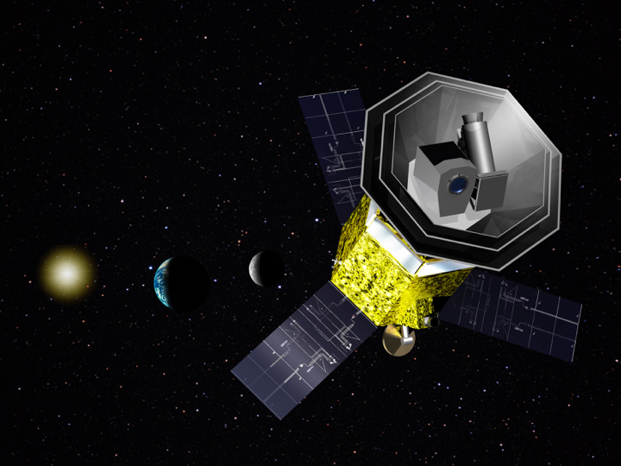
JAXA has approved the launch of the LiteBIRD satellite in
8 years to perform all-sky CMB polarization survey and to test cosmic inflation (single-ﬁeld large-variation slow-role models).

Slide 31
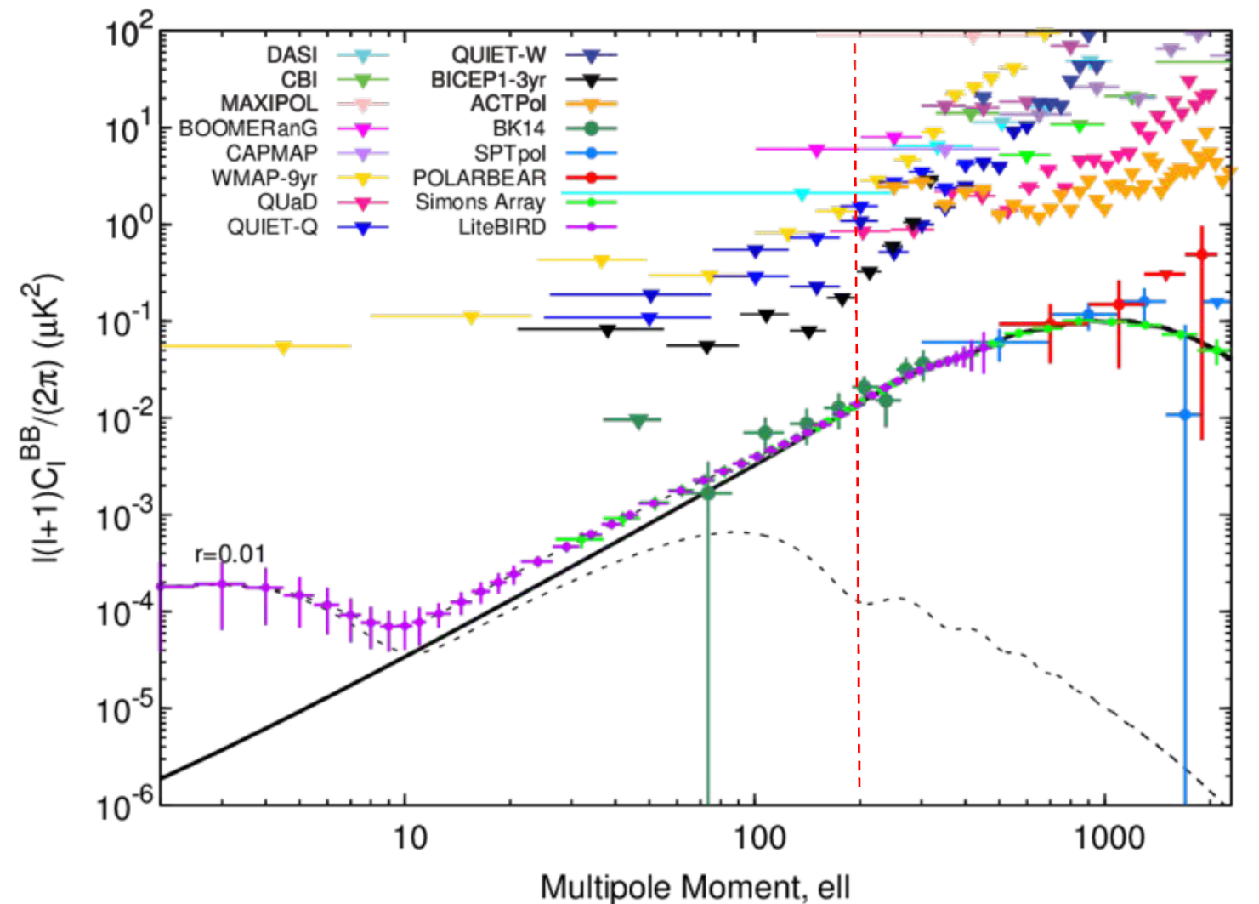
LiteBIRD provides an unprecedented
opportunity for String Theory to be falsified.

