Slide 1
Leonardo Senatore (Stanford)
Some aspects of
Theoretical Cosmology

Slide 2
How Inflation begins
and
a connection to Differential Geometry

Slide 3
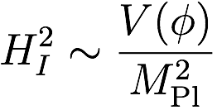



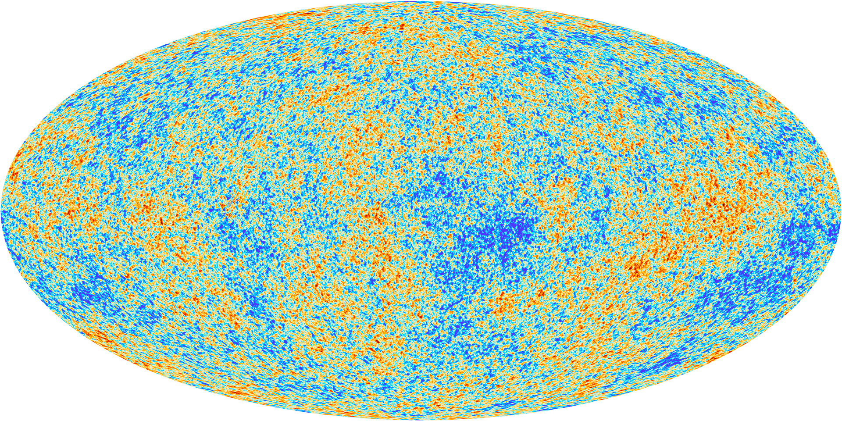
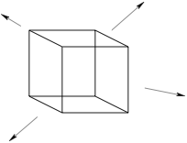

The Problem
V
If we have the inflaton on top of his potential
  and the space is homogeneous on a patch
  then inflation starts
Question: how likely is to have an homogenous patch of this size?
  If we imagine random initial condition, since overdensities lead to collapse, every point will tend to collapse into a black hole by the time start inflation, compelling argument (at least to me) implies that if
  this is the so-called `initial patch problem’
    Particularly relevant for low energy models
  and we will show that this argument is not really correct

Slide 4

Highly Debated

Slide 5

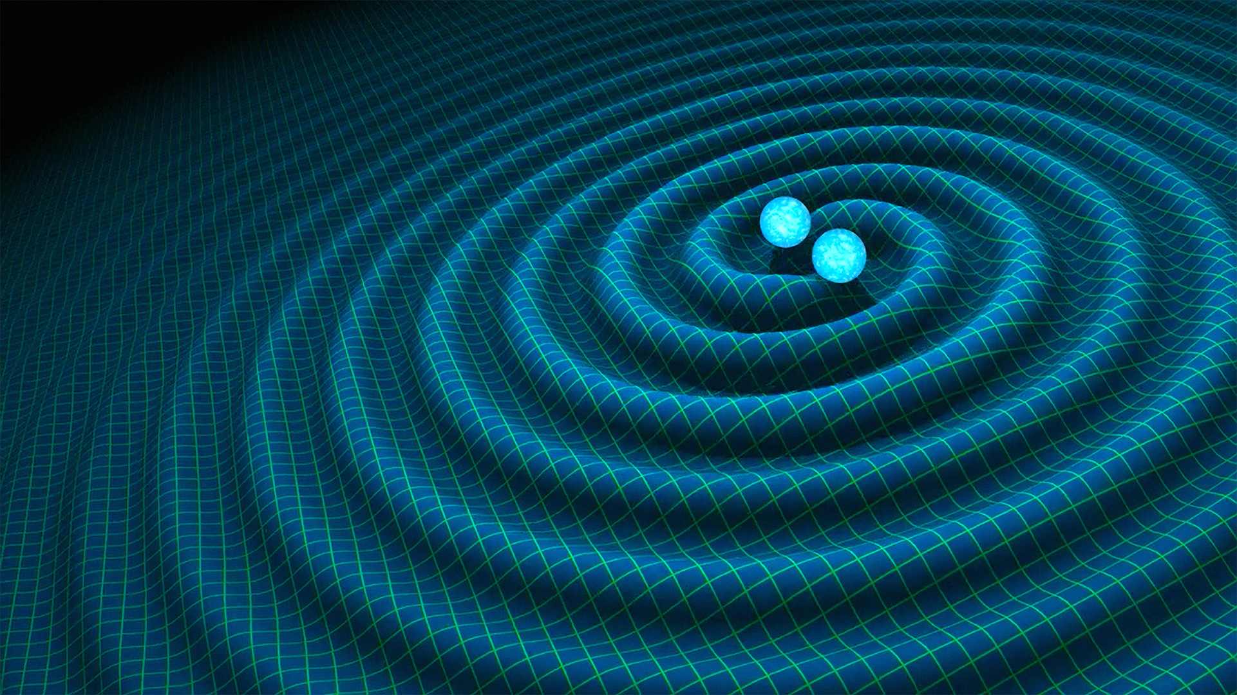
How did inflation start?
with Kleban JCAP 2016
Hard to make progress: evolution in completely inhomogenous universe leads to singularities, difficult to describe
However, recently progress was made in two unrelated aspects of science
  numerical codes that can handle singularities
  the Thorston Geometrization Classification (i.e. the Poincarè Hypothesis), has been proven
Pretorious 2005
Thorston, Hamilton,
Perelman
Fields Medal 2006

Slide 6

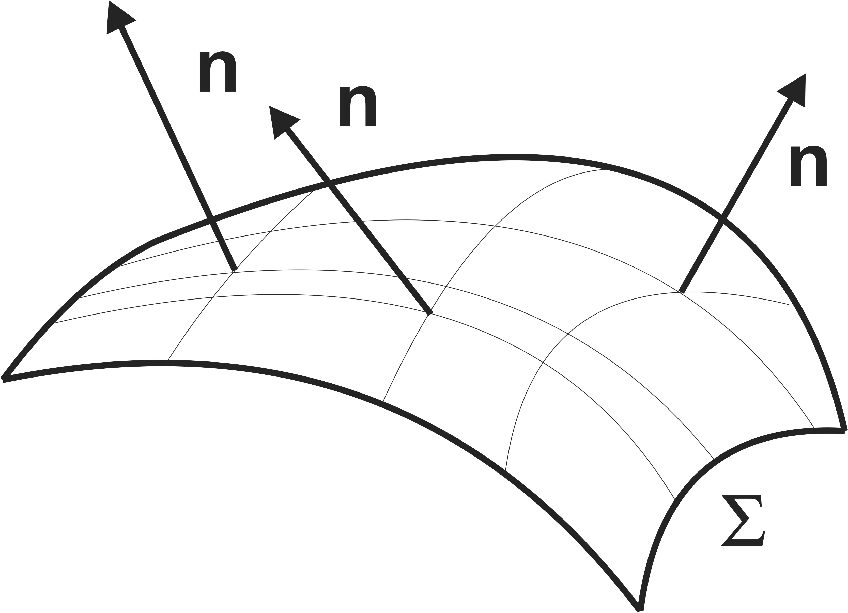
Numerical Experiment
with East, Linde and Kleban JCAP1609
Clough, Lim, di Nunno, Fishler, Flauger, Paban JCAP1709
Clough, Flauger, Lim JCAP1805
We start with an highly inhomogenous configuration:
And find that inflation starts
V

Slide 7
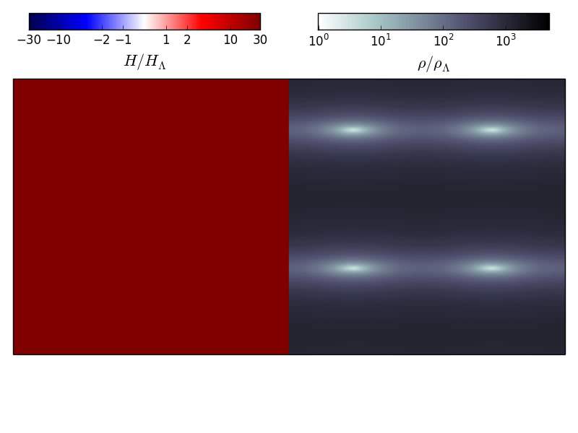
Simulation
with East, Linde and Kleban JCAP1609
Inflation starts
BH emit GW

Slide 8




Analytically:A no Big-Crunch theorem
with Kleban, JCAP 2016
see also Barrow and Tippler 1985
with Creminelli and Vasy 2019
Consider a cosmological spacetime with an initial surface expanding everywhere.
Can the universe globally collapse?
Since
there must exist a maximal surface, where

Slide 9

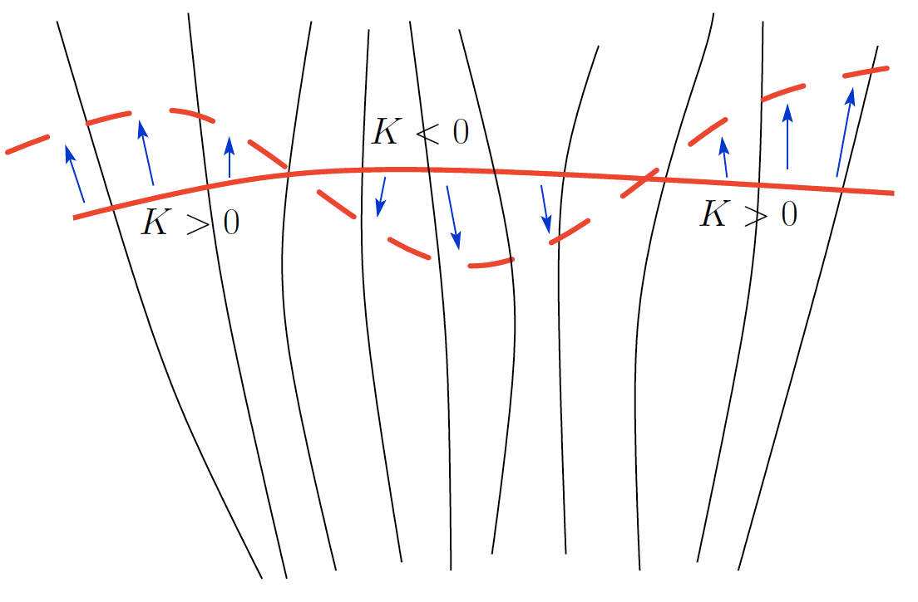

Mean-Curvature Flow
with Kleban, JCAP 2016
with Creminelli and Vasy 2019
Take a surface, and deform it forward or backward according to sign of
The change of volume:
So this procedure either converges to an extremal surface, if it can exist, with
or it gives a surface of larger volume indefinitely
The surface will never its a spacetime singularity nor become singular.
  This is a field of Mathematics, and now it has a new connection to Physics

Slide 10

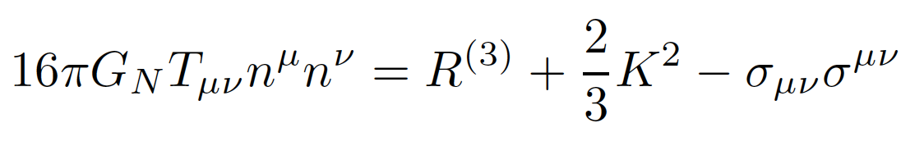


A no Big-Crunch theorem
with Kleban, JCAP 2016
see also Barrow and Tippler 1985
with Creminelli and Vasy 2019
To have a global recollapse,
there must exist a maximal surface, where
Consider the following linear-combination of Einstein Equations
Using Gauss-Codazzi
  where
On Extremal surface

Slide 11
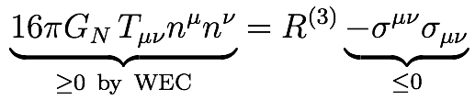

A no Big-Crunch theorem
with Kleban, JCAP 2016
see also Barrow and Tippler 1985
with Creminelli and Vasy 2019
If we impose Weak Energy Condition
If there is a topological condition such that
The equation cannot be satisfied, extremal surface does not exists
The Thorston Geometrization Classification, indeed shows that “most” of 3-manifold must have
  for these topologies, some regions of the universe keep expanding, notwithstanding the development of singularities

Slide 12



Thorston Geometrization Classification
To determine which manifolds must have , consider that all compact oriented 3-manifold fall into one of these three classes
  (i) ``Closed’’: any function on can be the of a smooth metric on
    ex:
      and connected sums
  (ii) ``Flat’’: a function on can be the of a smooth metric on if it is negative somewhere or zero everywhere
    ex:
      and connected sums
  (iii) ``Open’’: a function on can be the of a smooth metric on if it is negative somewhere
    ex:
  Any connected sum of (i) and (ii) with a factor of (iii) is of kind (iii)
Thorston, Hamilton, Perelman

Slide 13
A no Big-Crunch theorem
with Kleban, JCAP 2016
see also Barrow and Tippler 1985
Therefore, in most manifolds (fast) expansion has to continue.
  this, and some additional results using mean curvature flow, suggests that
  it is extremely likely that expansion continues, volume reaches infinity, inhomogenous energy dilutes, potential energy (which does not dilutes) dominates, inflation starts notwithstanding the formation of singularities.
  partial, stronger, results in 3+1d
In 2+1d, this statement as recently been rigorously proved by
  using the expertise of the Math Department Professor
with Creminelli, Kleban, Vasy in progress
with Creminelli, Vasy 2019

Slide 14
The Cow
Pictorial representation of the late time manifold

Slide 15


Summary on starting Inflation
For years, widely believed: to start inflation, need an homogenous patch.
  This seemed to require fine tuning: `initial patch problem’
By using numerical GR simulations that are able to handle singularities and horizons
& less-usual mathematical techniques such as mean curvature flow and topology
we have shown that inflation starts very often, and actually seems always to start in some topologies:
    2+1d proved
    3+1d partial-statements proved
these results are apparently appealing also for mathematicians
So, we can take that inflation starts….

Slide 16
… but we mentioned Black Holes…
… we cannot think to LIGO/VIRGO…

Slide 17
Lessons for Fundamental Physics from
LIGO/VIRGO

Slide 18
An EFT for testing extensions of GR
with Gravitational Waves
with Endlich, Huang and Gorbenko
2017
with Sennett, Brito, Buonanno and Gorbenko
in completion

Slide 19
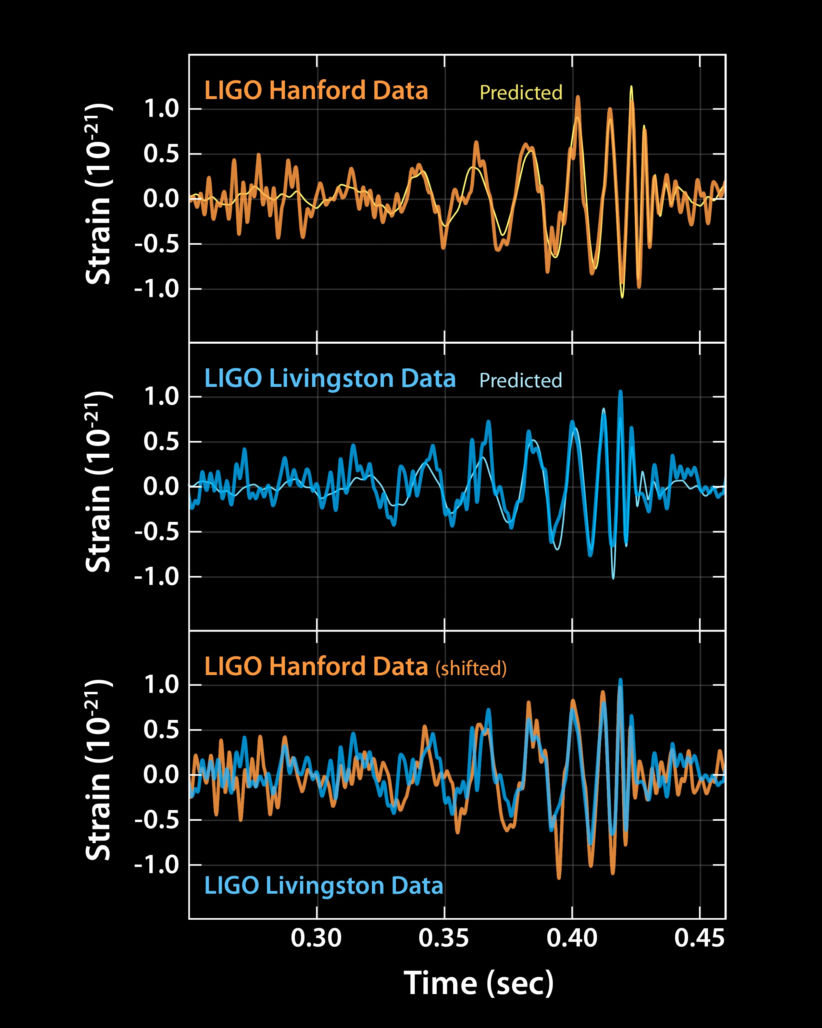
An EFT for probing extensions of GR at LIGO
Gravity waves have just been discovered.
  An amazing lesson of perseverance for whole mankind
They will teach us a lot about astrophysics compact objects
Can these observations teach us something about the fundamental nature of gravity?
The most general parametrization (i.e. EFT) for doing that with the following requirements:
  testable at LIGO/VIRGO
  no additional degree of freedom
  no violation of locality (superluminality, etc.)
  in no conflict to other GR experiments

Slide 20




An EFT for probing extensions of GR at LIGO/VIRGO
The most general such a Lagrangian is
No superluminality
Testable at LIGO
Not ruled out by GR tests
  this `soft’ UV complition is the same that happens in scattering when the Higgs enters: the amplitude soft growing
  in all test prior LIGO/VIRGO, at UV scale
with Endlich, Huang, Gorbenko 2017
Camanho, Edelstain, Maldacena, Zhiboeadov 2016

Slide 21


An EFT for probing extensions of GR at LIGO/VIRGO
The most general such a Lagrangian is
In this way, information from LIGO/VIRGO can be mapped into parameters of a fundamental physics Lagrangian
  similar to what we do in particle physics at colliders (Precision EW tests, or the LHC Brazilian-flag plots)
instead of into some arbitrary and potentially-unphysical rescaling of the post-Newtonian parameters of the templates
    this was suboptimal
    explored physically uninteresting regions such as superluminal ones.

Slide 22


An EFT for probing extensions of GR at LIGO/VIRGO
Predictions
For , leading signal is in In the insparalling phase:
  Using the EFT of , change the potential energy of the two bodies, and their single-body effective radiation multipoles
For , leading signal is in the modification of Black Hole geometry and quasi normal modes spectrum
Similar considerations apply to the exchange of axions in neutron-neutron merger
Goldberger and Rothstein 2004
with Cardoso, Kimura, Maselli 2018
Huang, Johnson, Samunski, Sakellariadu, Zhang 2018

Slide 23
First bounds on fundamental Lagrangian from LIGO data
with Sennett, Brito, Buonanno, Gorbenko, Senatore
in completion
LIGO members, preliminary
Excluded!

Slide 24
Lessons on Dark Energy from LIGO/VIRGO
Creminelli, Vernizzi, 2017
Sakstein, Jain, 2017
Ezquiaga, Zumalacarregui, 2017
Baker etal, 2017
Copeland etal 2018
Creminelli, Lewandowski, Tambalo, Vernizzi 2018

Slide 25
The universe is Accelerating
Many people, especially outside of Europe, and including me, have a favorite explanation:

Slide 26

The universe is Accelerating
Many people, especially outside of Europe, and including me, have a favorite explanation:

Slide 27
The universe is Accelerating
Many people, especially outside of Europe, and including me, have a favorite explanation:
it agrees with data to ~4%

Slide 28

Weinberg probably got it right (again)
S. Weinberg, prior the detection of the acceleration of the universe, predicted, based on Anthropic reasoning, the value of the observed cosmological constant. It worked.
  In a universe dominated by cosmological constant, structures do not form any longer
  for experimentalists to be there, cosmological constant better dominate after structure form
  If there is a landscape with lots of local values of , observes will be where structures are, and so where is small enough.
  But since it is hard to make small, most likely will be closed to threshold: it will dominate just after structure formed
This is exactly where we found
This interpretation finds support in the presence of the Landscape, and in the Higgs tuning.
There are issues of, to me, detail, and, also, this is truly revolutionary point of view.

Slide 29
Observational side
Due to such a revolutionary change of point of view, and due to the fact that, observationally, we are probing with unprecedented precision the low-redshift universe, many people have started focusing of theories that tend to modify gravity.
  it is unclear if any of them actually addresses the Cosmological Constant problem
These are just theories where one adds a degree of freedom that, due to FRW spacetime, spontaneously breaks time translation.
There is an extremely large field, especially in Europe.
And tremendous progress in this field has come from the following experimental fact

Slide 30
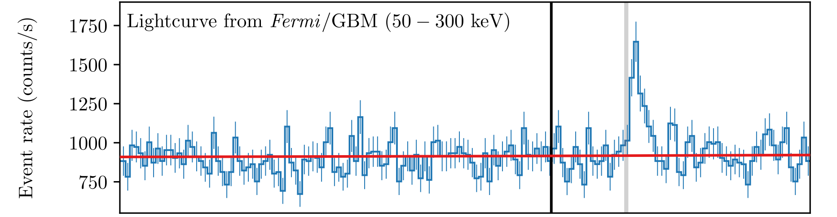
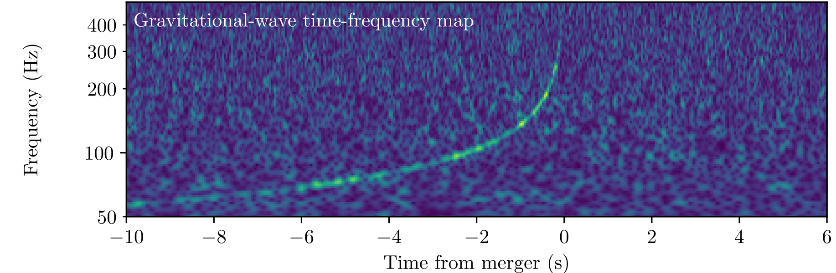
Black-Hole Neutron-Star merger
GW170817 = GRB170817A

Slide 31
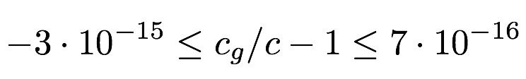
Black-Hole Neutron-Star merger
GW170817 = GRB170817A

Slide 32
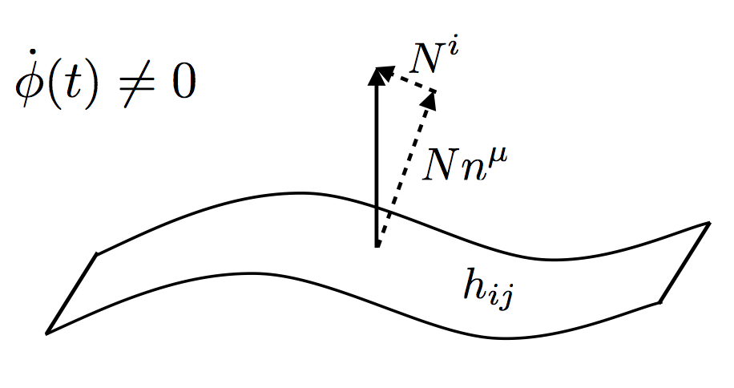
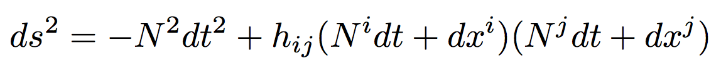
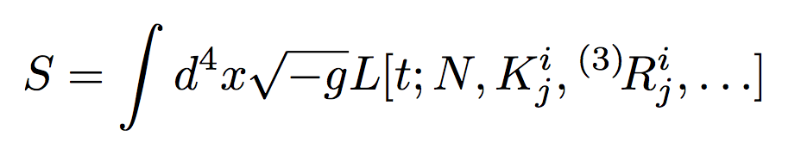
The EFT of Dark Energy
It is possible to write down the most general theory for the fluctuations
Assume that time-translation are spontaneously broken, there is preferred slicing, write the most general Lagrangian
Action contains all possible scalar under spatial diffs, oder by number of perturbations and derivatives
with Creminlli, Luty and Nicolis, 2006
Vernizzi, Piazza, + many others

Slide 33
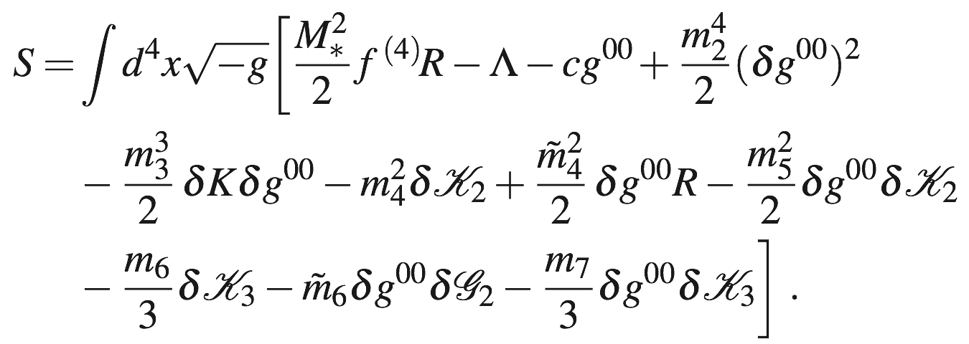
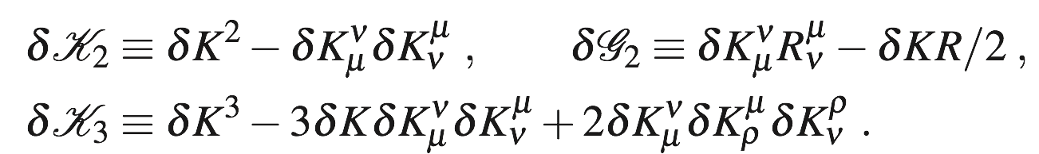


The EFT of Dark Energy
At level of fluctuations
for LSS, we are interested in

Slide 34




The EFT of Dark Energy
At level of fluctuations
for LSS, we are interested in
All models unified in one Lagrangian
Quintessence and Brans-Dicke
Dark Energy speed of sound
DGP and brading
Galileon, Hordensky and
Beyond Hordensky
Non-linear terms, screening

Slide 35

The EFT of Dark Energy
At level of fluctuations
for LSS, we are interested in
All models unified in one Lagrangian
Changes the speed of sound of gravity waves

Slide 36


The EFT of Dark Energy
At level of fluctuations
for LSS, we are interested in
All models unified in one Lagrangian
=

Slide 37
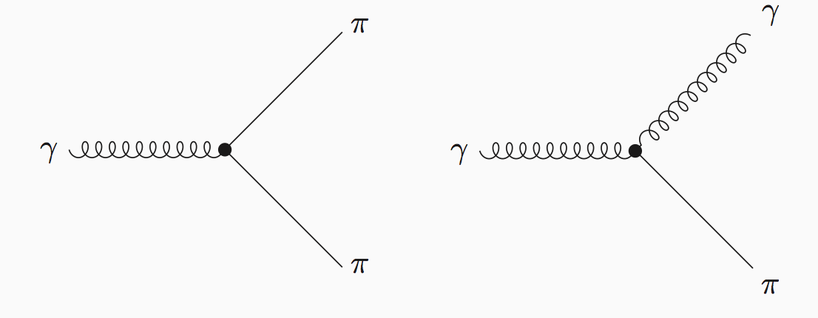
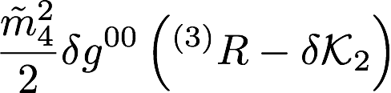
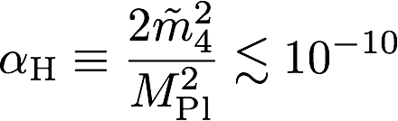
The EFT of Dark Energy
The non-relativistic dynamics allows also gravitational waves to decay into dark energy.
Irrelevant for LSS observations

Slide 38
The EFT of Dark Energy
The non-relativistic dynamics allows also gravitational waves to decay into dark energy.
Irrelevant for LSS observations

Slide 39
The EFT of Dark Energy
Somewhat unexpectedly, the discovery of gravitational waves has hit very heavily the theories of dark energy.
Some theories are surviving (at least so far), but, to me, we are talking of corners.
Plus, we already have a theory that works very well:
  and which goes well together in what we are seeing in the standard model Higgs.
So, we go back to the early universe, where, with Inflation,. we definitely have something to better understand.

Slide 40
The way ahead

Slide 41
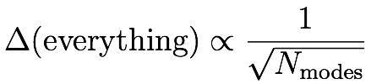
Cosmology is a luminosity experiment
Tremendous progress has been made through observation of the primordial fluctuations
We are probing a statistical distribution:
  In order to increase our knowledge of Inflation, apart for one expetion, we need more modes:
Planck has just observed almost all the modes from the primordial CMB
Large-Scale Structure offer the only medium-term place for hunting for more modes
  but we are compelled to understand them better
    Lots of applications for
      astrophysics, inflation, dark energy, neutrinos, dark matter, etc.

Slide 42
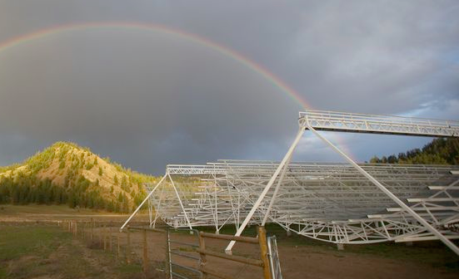

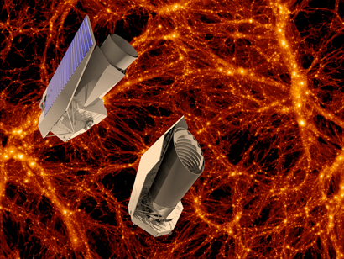
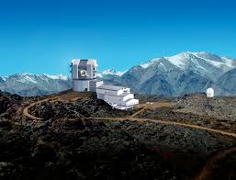
What is next?
LSST, Euclid and Chime are the next big missions: this is our next chance
  we need to understand how many modes are available
  Need to understand short distances
Chime
Euclid
LSST

Slide 43

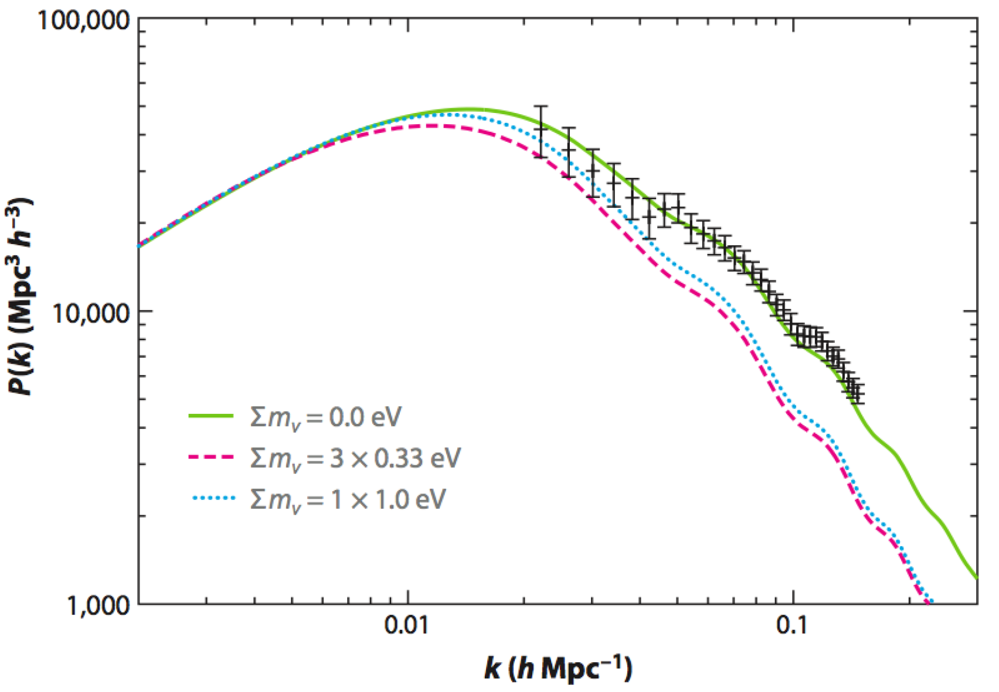
Massive Neutrinos
Not only inflation
Neutrinos have a mass, their energy affects the gravitational clustering
By understanding the clustering, we can measure their mass
We need to understand these curves
Nobel Prize and Breakthrough prize 2015
from Wong 2011

Slide 44
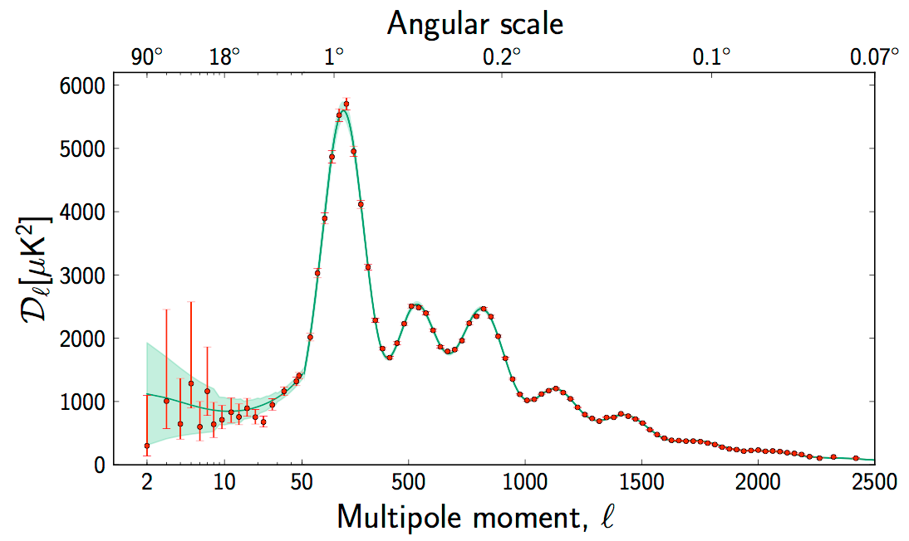
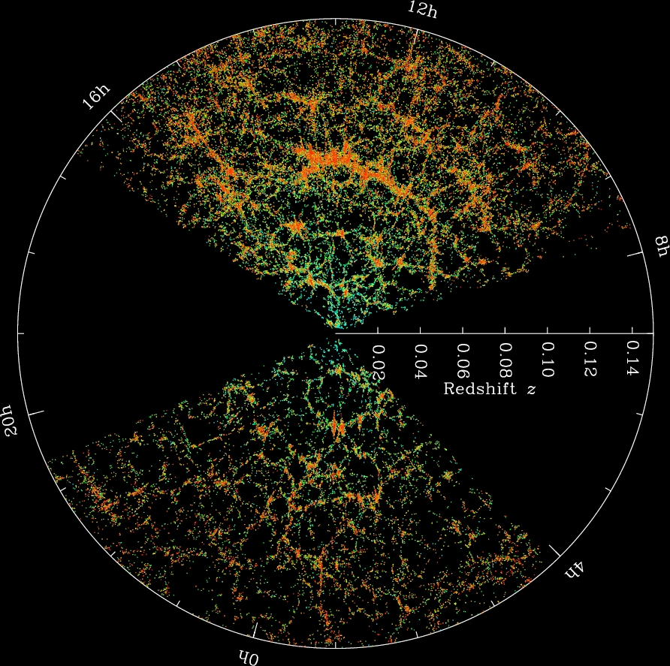
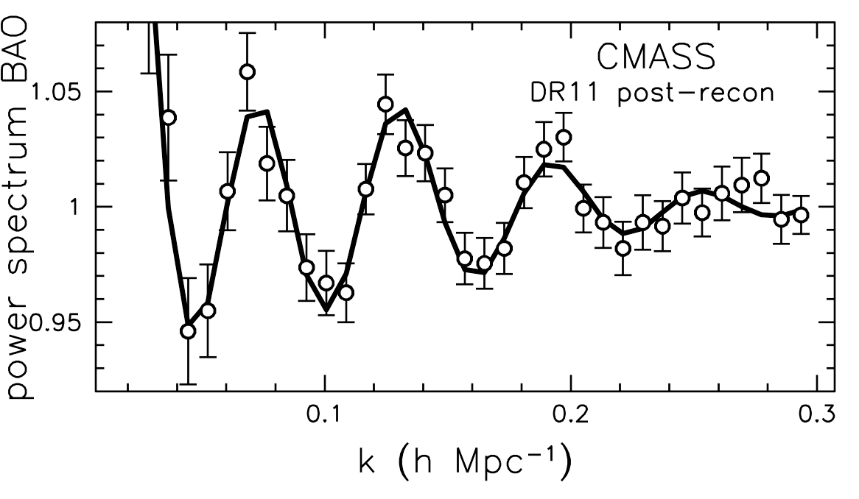
Some marvelous results already achieved
Baryon Acoustic Oscillations in Galaxies distribution
CMB
Galaxies
BOSS, SDSS
But most new information is just about low-z universe
Wherever CMB was not degenerate, it dominates

Slide 45
The Effective Field Theory
of
Large-Scale Structure

Slide 46
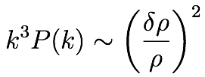
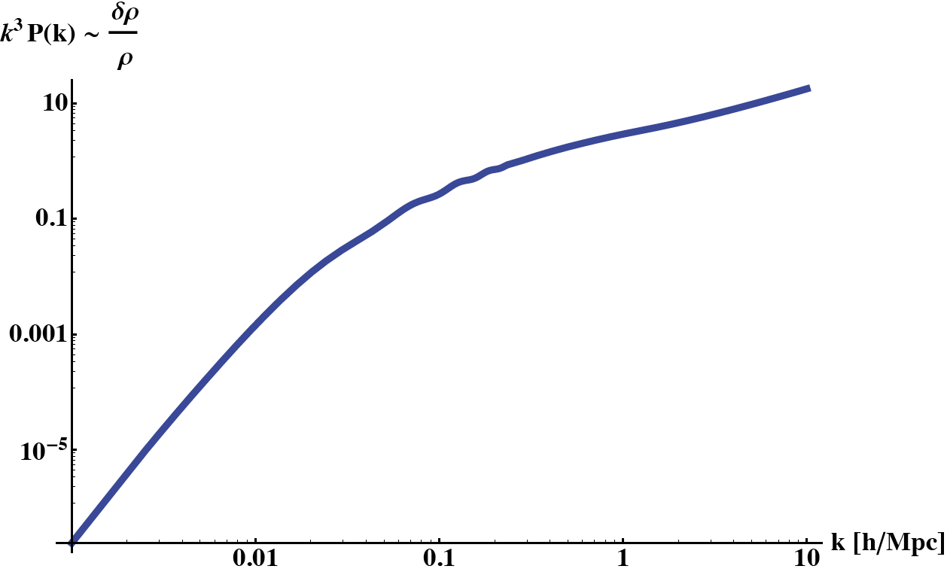
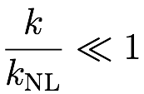
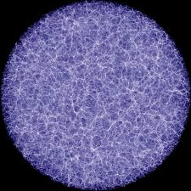
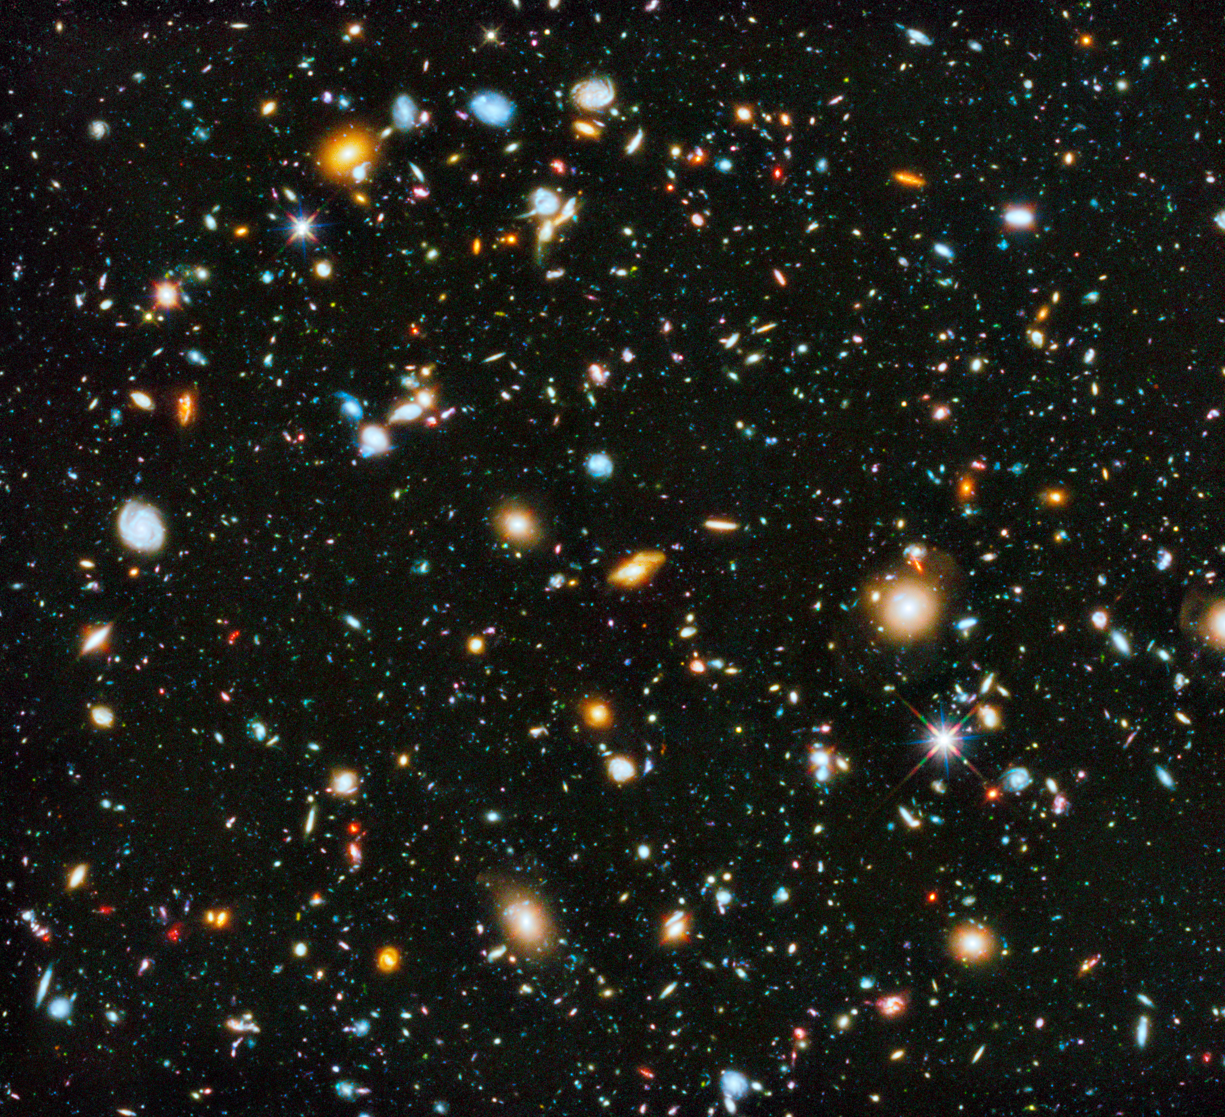
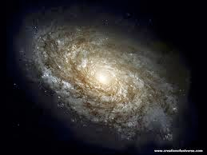

The EFTofLSS: A well defined perturbation theory
Non-linearities at short scale

Slide 47

A long, long journey
  Dark Matter & Baryons
  Galaxies
  Redshift space
  IR-resummation
  Of course, none of this would have been possible without the precedent work of people like Bernardeau, Bond, Boucher, Kaiser, Matsubara, MacDonald, Peebles, Refregier, Scheth, Scoccimarro, Seljak, Wechsler, White, and Zeldovich…
  But the EFTofLSS provides the first (and only) rigorous, convergent formalism to the true answer for
    to do fundamental physics, we have to be very accurate, and therefore rigorous.

Slide 48

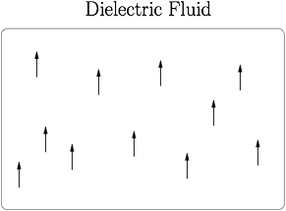
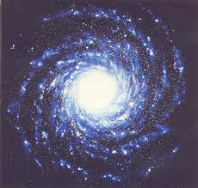
The EFTofLSS and Dieletric Materials
  The theory of dielectric materials is the theory of a massless spin-one object (light) interacting with composite objects (atoms)
  Very similarly, the EFTofLSS is the theory of massless spin-two object (gravity), interacting with composite objects (galaxies)
    so it is conceptually quite easy
  It is also similar to the Chiral Lagrangian

Slide 49

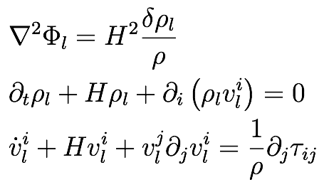

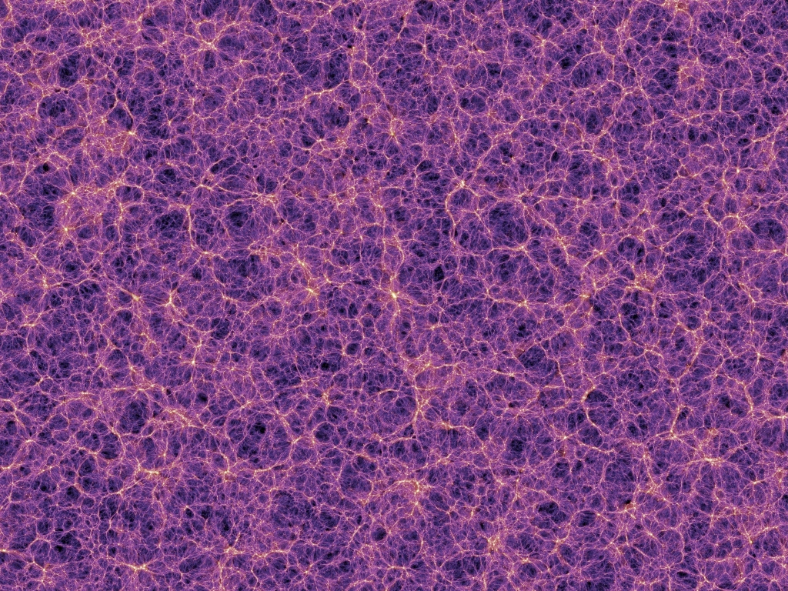
The Effective ~Fluid
In history of universe Dark Matter moves about
  it is an effective fluid-like system with mean free path ~
Skipping many subtleties, the resulting equations are equivalent to fluid-like equations
short distance physics appears as a non trivial stress tensor for the long-distance fluid
with Baumann, Nicolis and Zaldarriaga JCAP 2012
with Carrasco and Hertzberg JHEP 2012
with Porto and Zaldarriaga JCAP 2014

Slide 50
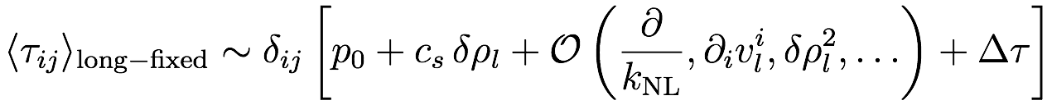

Dealing with the Effective Stress Tensor
For dealing with long dist., expectation value over short modes (integrate them out)
At long-wavelengths, the only fluctuating fields have small fluctuations: Taylor expand
We obtain equations containing only long-modes
How many terms to keep?
  each term contributes as an extra factor of
every term allowed by symmetries

Slide 51
Perturbation Theory
with the EFT

Slide 52


Perturbation Theory within the EFT
In the EFT we can solve iteratively , where

Slide 53

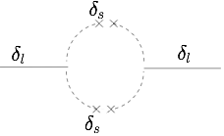




Perturbation Theory within the EFT
Solve iteratively in
Since equations are non-linear, we obtain convolution integrals (loops)
Integrand has support at high wavenumber where expressions do not make sense
Need to add counterterms from to make the result finite and correct
we just found loops and renormalization applied to galaxies

Slide 54
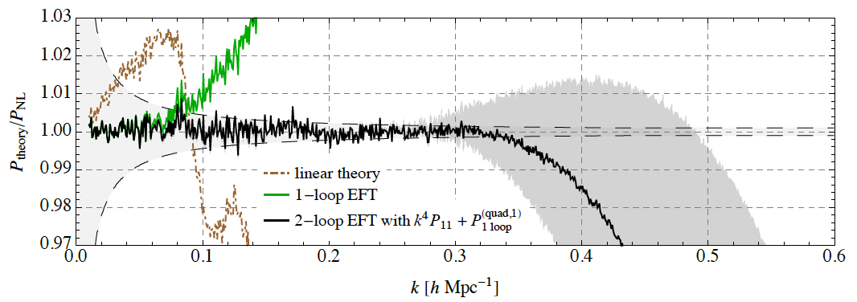


EFT of Large Scale Structures at Two Loops
Order by order improvement
Theory error estimated
k-reach pushed to
Huge gain wrt former theories
All Former Theories
fail at k~0.03
Estimated Theory
error
3 parameters
with Carrasco, Foreman and Green JCAP1407
with Zaldarriaga JCAP1502
with Foreman and Perrier 1507
see also Baldauf, Shaan, Mercolli and Zaldarriaga 1507, 1507

Slide 55

IR-resummation and the BAO peak
Perturbation theory is extremely slow to converge due to the effect of IR-displacements. They affect the feature in real space named BAO peak
The first, and in a sense unique, consistent way to resum the IR-displacements was obtained in
~Similar to soft photons
with Zaldarriaga JCAP2015

Slide 56
IR-resummation and the BAO peak
It works very well
Similarly well in redshift space
with Zaldarriaga JCAP2015
with Trevisan JCAP1805
non-IR-resummed
IR-resummed
with Lewandowski et al PRD2018

Slide 57
Analysis of the BOSS/SDSS data
Jerome Gleyzes, Nickolas Kockron, Dida Markovic, Leonardo Senatore, Pierre Zhang,
Florian Beutler, Hector Gill-Marin
in completion

Slide 58
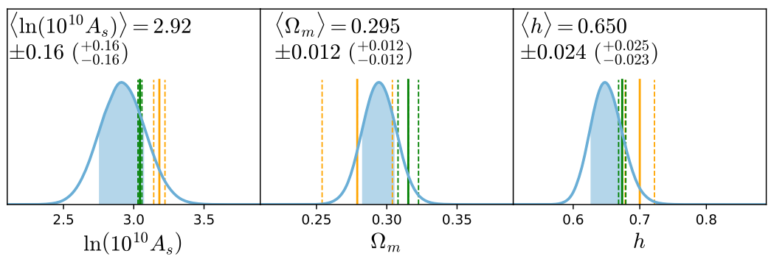


Analysis of the SDSS/BOSS data
Preliminary results of the power spectrum analysis of the CMASS&low-z samples
some results are preliminary
  more checks, plots, runs, still to do
We assume flat and Planck’s
and measure
These preliminary results, if confirmed, tell us that there is the potentiality of much improving the whole legacy of SDSS.

Slide 59

Analysis of the SDSS/BOSS data
Preliminary results of the power spectrum analysis of the CMASS&low-z samples
Major improvement with respect to what done before
Error bars comparable to CMB
New way to measure , and a further data point in the `tension’.

Slide 60
Summary
Several aspects of physics in cosmology:
Numerical GR and unusual Math
  to explain how the universe started
LIGO/VIRGO
    the nature of gravity
    hitting hard Dark Energy
The Effective Field Theory of Large Scale Structure
    The `Chiral Lagrangian’ for galaxies
    applied to data: it works!

Slide 61




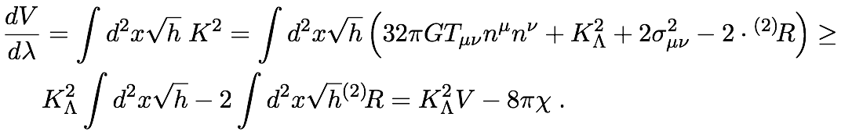
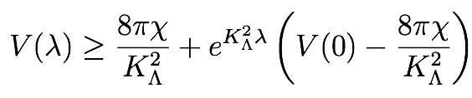



Proof in 2+1 dimensions
We would like to prove that an initial expanding topologically-non-closed 2+1dim cosmology, with a positive cosmological constant and matter satisfying suitable energy conditions, reaches de Sitter space almost everywhere.
In 2+1 dimensions, the usual Einstein equation:
On MCF-surfaces:
  here we assumed WEC
The solution reads
  for all topologies but the sphere, the volume goes to infini
where

