Slide 1

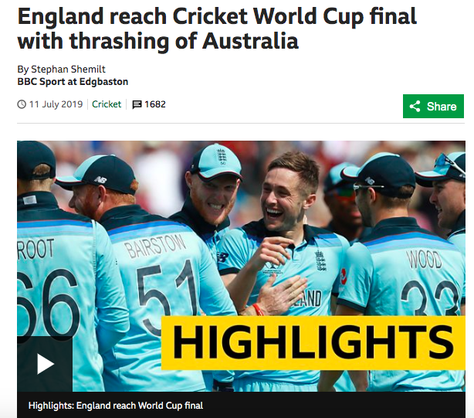
Jon Butterworth
University College London
EPS Ghent
July 2019
Notes:
Will have personal bias

Slide 2
A necessarily personal selection…
Jon Butterworth
University College London
EPS Ghent
July 2019
Notes:
The importance of communication (to each other, public, other scientists, potiicians) is such that…

Slide 3
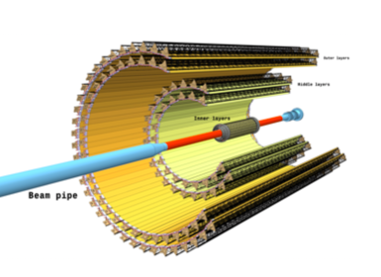
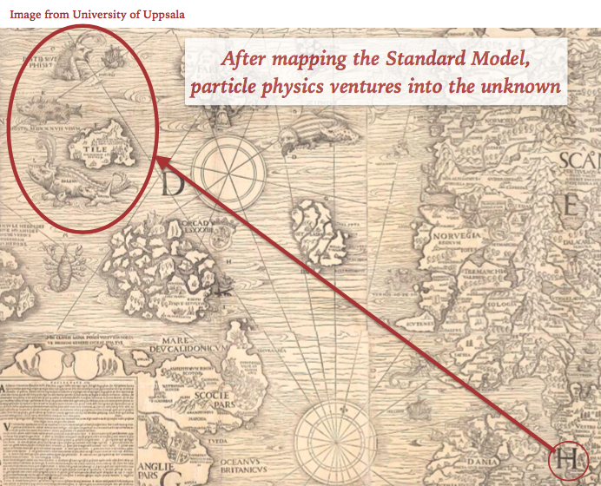
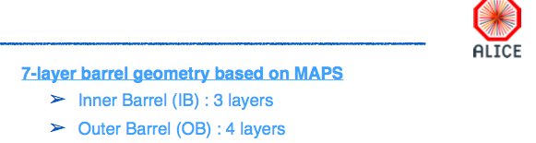
MAPS MAPS MAPS…
Yasser Corrales Morales
Marco Van Leeuwen
Caterina Doglioni

Slide 4
Notes:
Antimatter and quarks

Slide 6
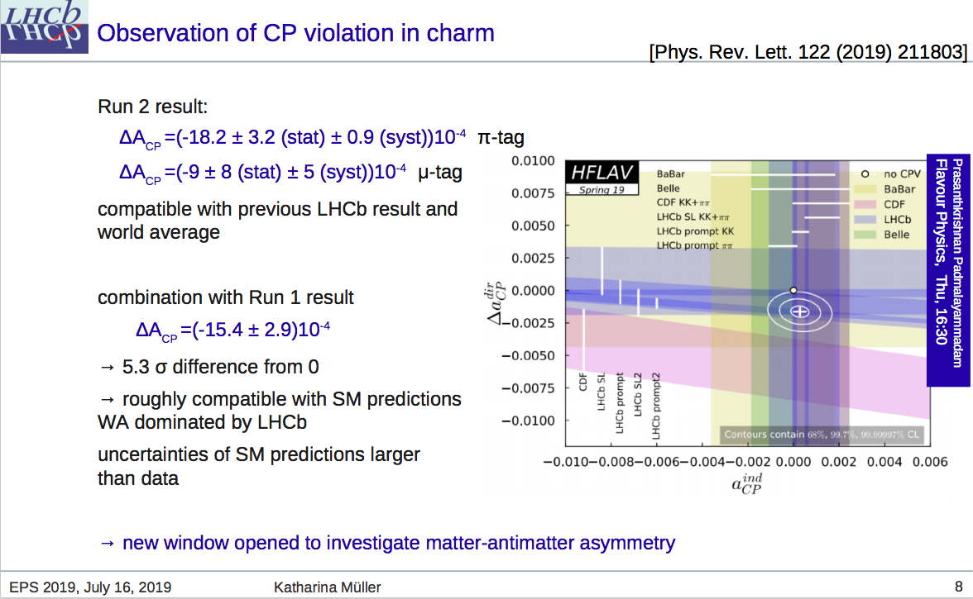
CPV in charm
Katherina Müller

Slide 7
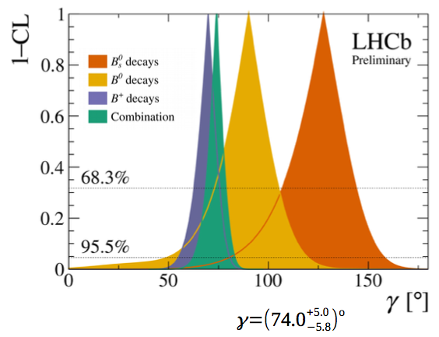
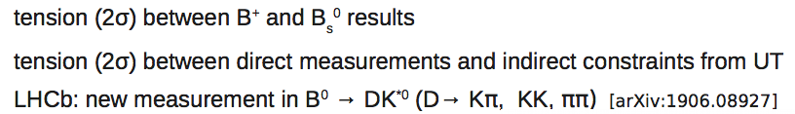
Flavour Anomalies
Katherina Müller
Johannes Albrecht
Francesco Forti
Combination of γ measurements

Slide 8
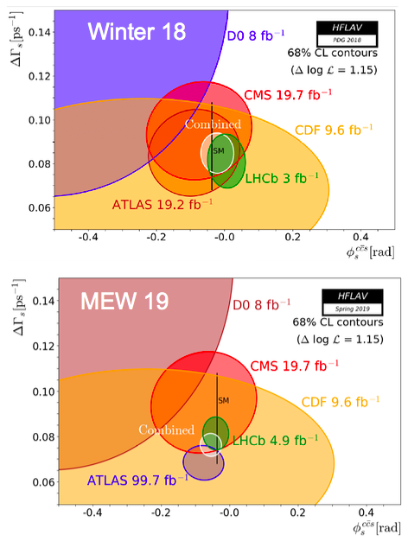
Flavour Anomalies
Katherina Müller
Johannes Albrecht
Francesco Forti
Combination of γ measurements
B_{s} mixing

Slide 9
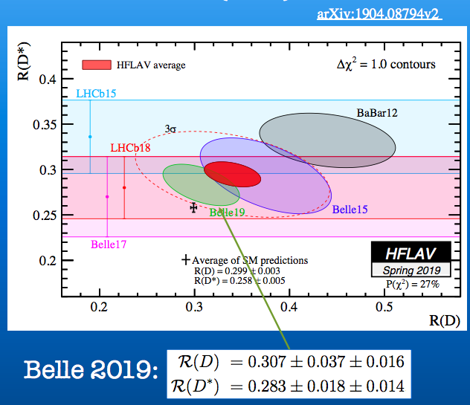
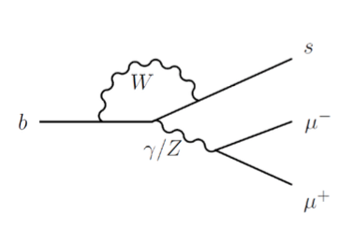
Flavour
Katherina Müller
Johannes Albrecht
Francesco Forti
Combination of γ measurements
B_{s} mixing
Common quark-level connections: b → s l⁺l⁻

Slide 10
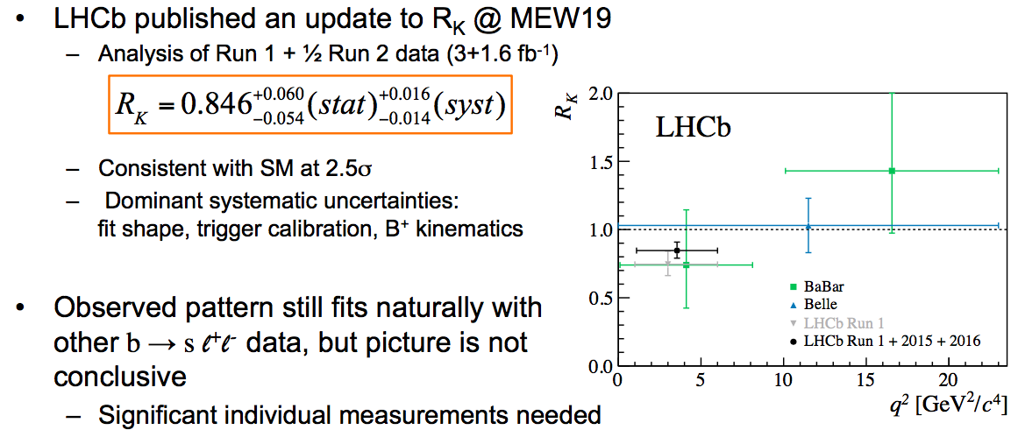
Lepton Flavour Anomalies
Francesco Forti
Johannes Albrecht
Marco Nardecchia
Interesting pattern seen, but no conclusive individual measurements (yet)
  Intense experimental program ongoing to verify anomalies
“Time to shift point of view and consider richer flavour structures” Marco N on direct search results.
Also pending charged lepton results soon…

Slide 11
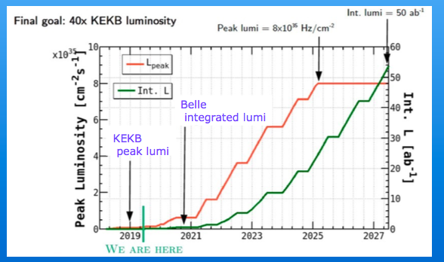
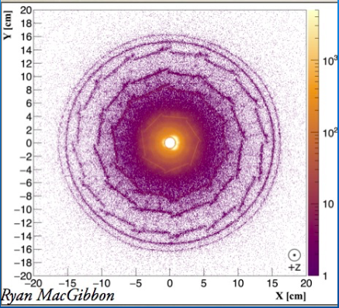
Belle II is here…
Francesco Forti

Slide 13
Super-Kamiokande
Sub-GeV π⁰-like Two-Ring
500
0
1.3

Slide 14
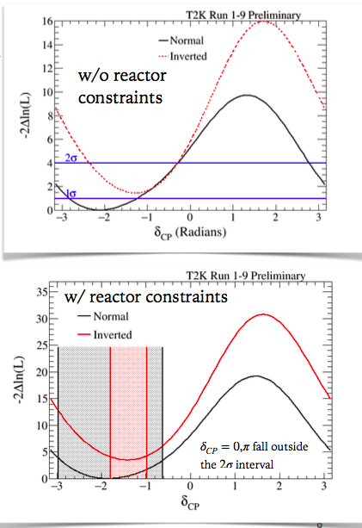
Neutrinos
Gioacchino Ranucci
Francesca Di Lodovico
Sylvia Pasquale
New source of CP violation within the “SM”?
Notes:
Theta13
T2K delta CP

Slide 15
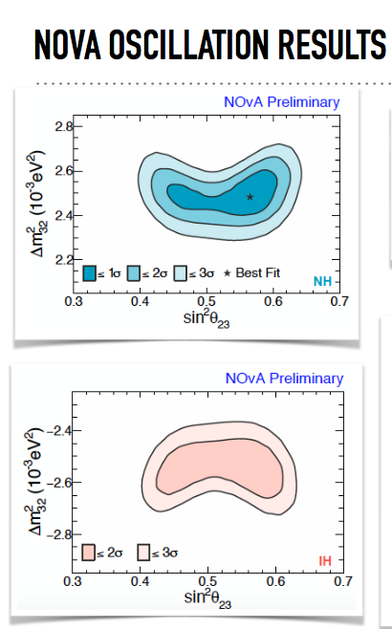
Neutrinos
Gioacchino Ranucci
Francesca Di Lodovico
Sylvia Pasquale
New source of CP violation within the “SM”?
Normal or inverted hierarchy?
Notes:
Theta13
T2K delta CP

Slide 16
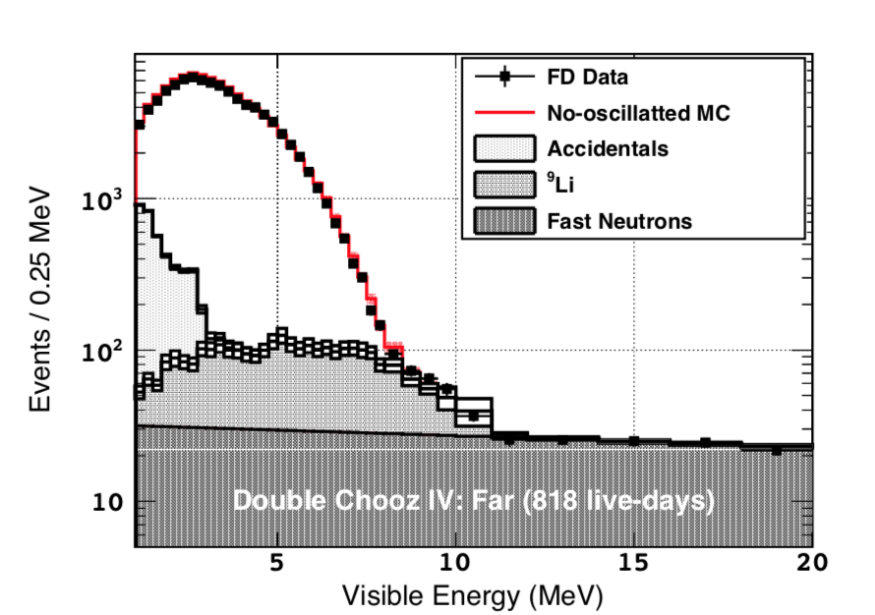
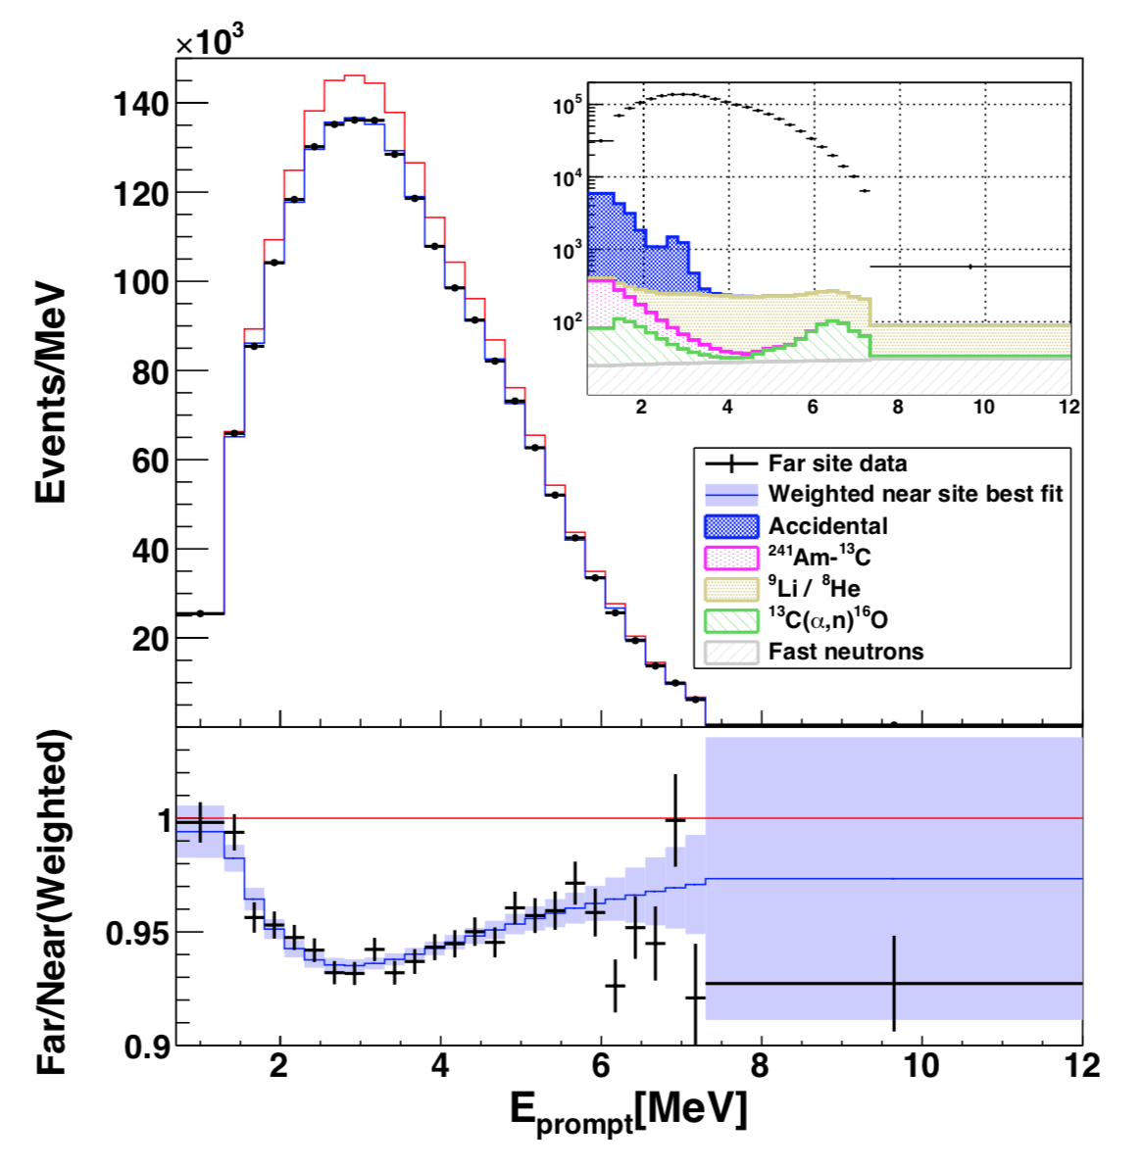
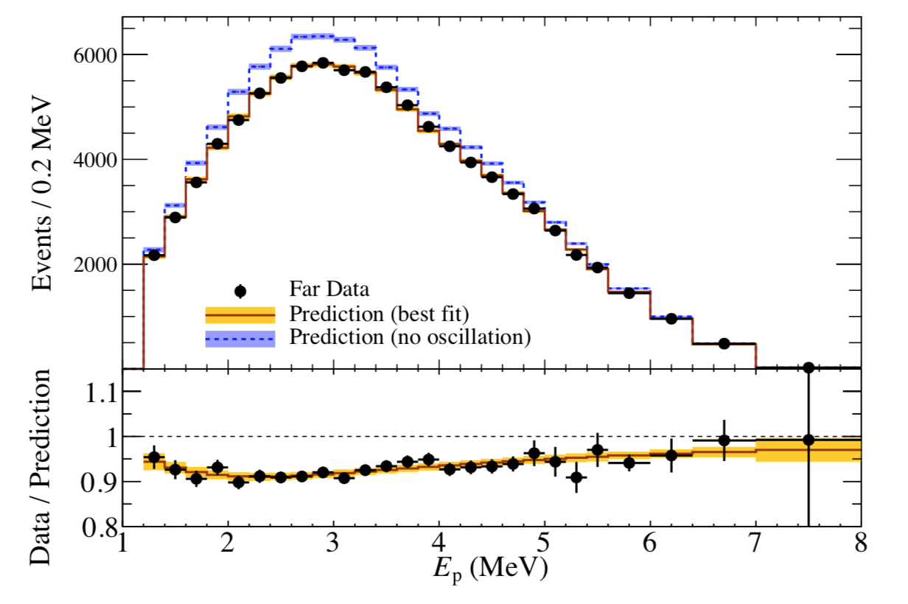



θ13
Gioacchino Ranucci
Double Chooz
Daya Bay
RENO
sin²(2θ13)
0.105 ± 0.014
0.0856 ± 0.0029
0.0896 ± 0.0068
(best precision)
Mass splitting
N/A
(external constraint)
x 10⁻³ eV²
(NO)
x 10⁻³ eV²
(IO)
(2.68 ± 0.14) x 10⁻³ eV²
arxiv: 1901.09445 (unpublished)
Phys.Rev.Lett. 121 (2018) 241805
Phys.Rev.Lett. 121 (2018) 201801
16

Slide 18
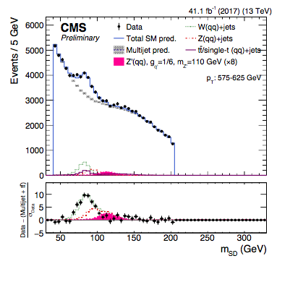
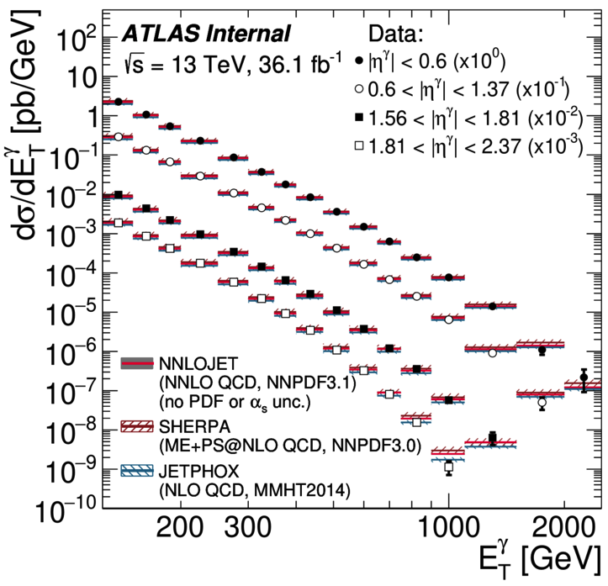
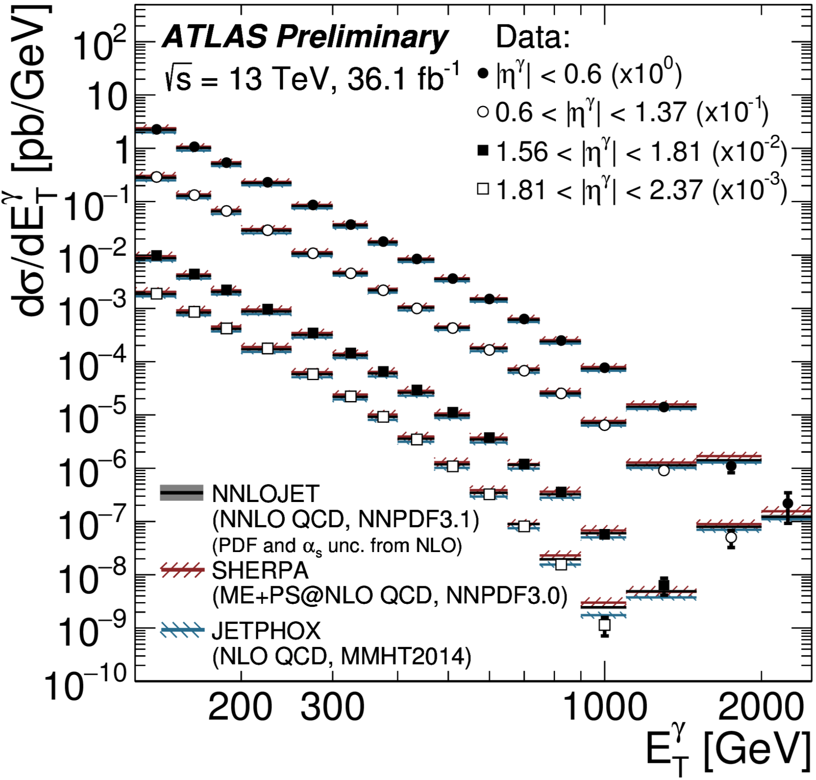
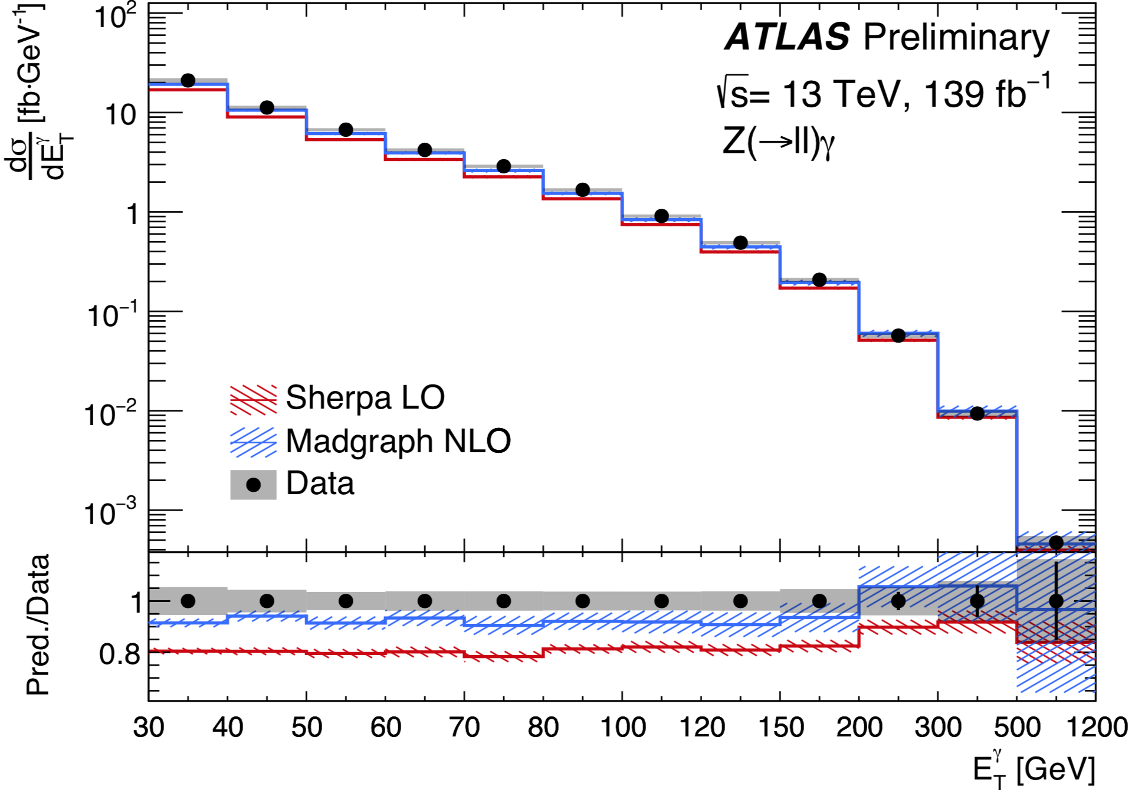
New “Standard Model” Physics
Andreas Hoecker
Lucia Di Ciaccio
Isolated γ
new

Slide 19
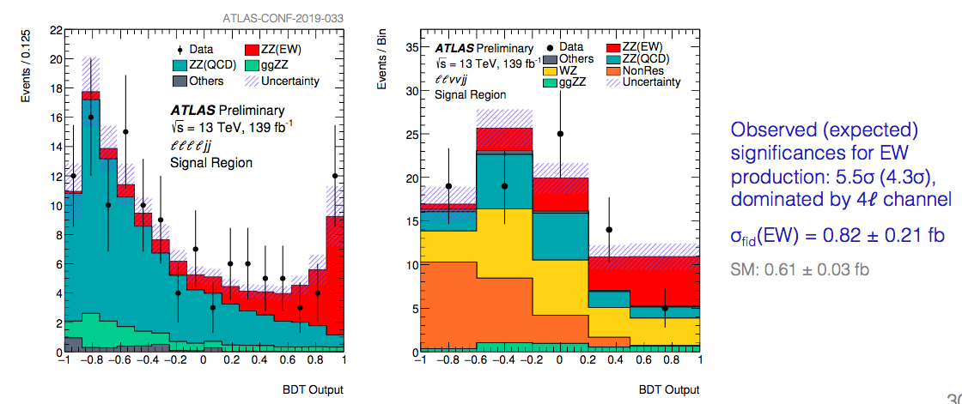
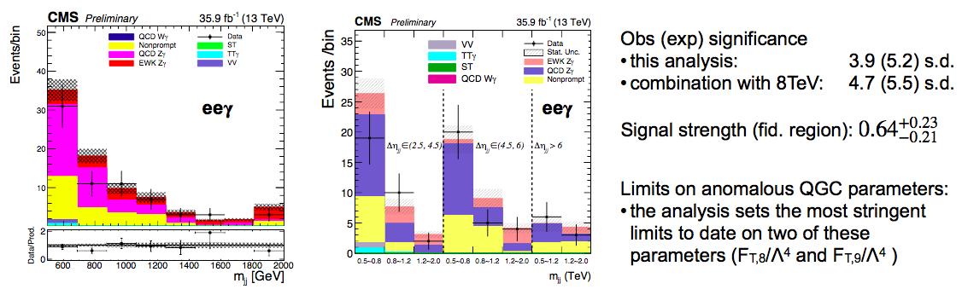
New “SM” physics: Dibosons
Andreas Hoecker
Lucia Di Ciaccio
Also γ γ in Heavy Ions collisions
Diboson searches with jet substructure

Slide 20
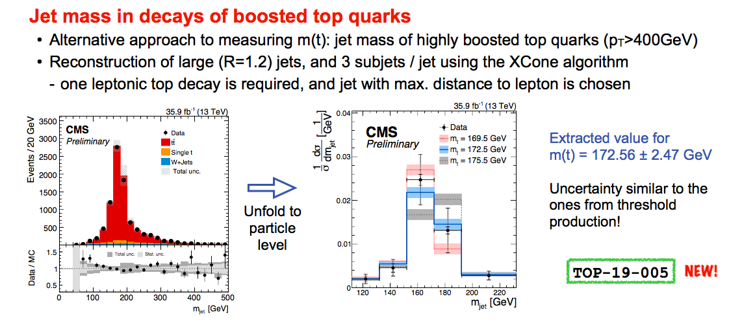
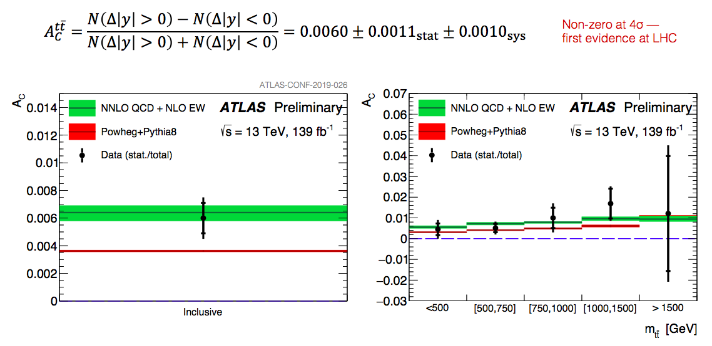
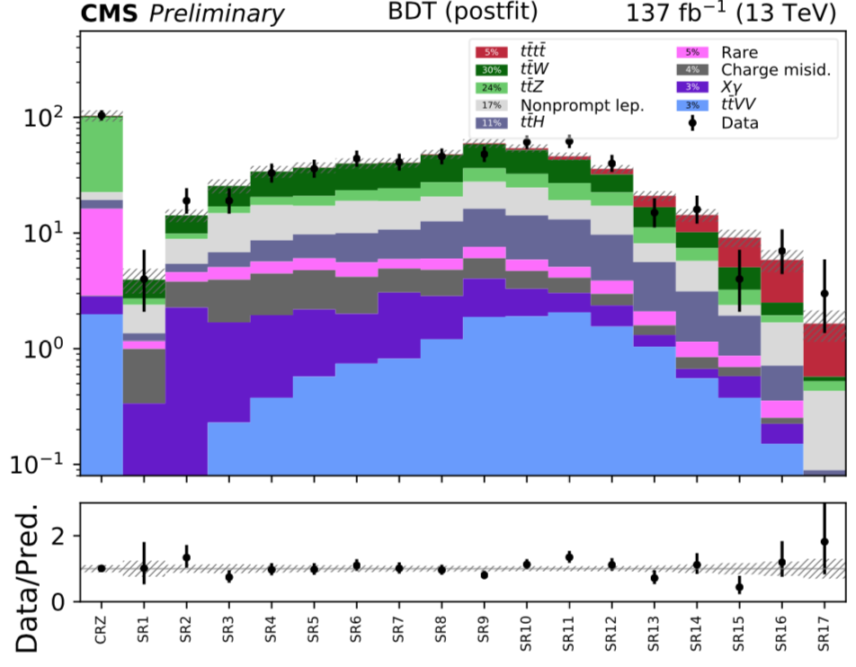
New “SM” Physics: Top
Wolfgang Adam
Lucia Di Ciaccio

Slide 22
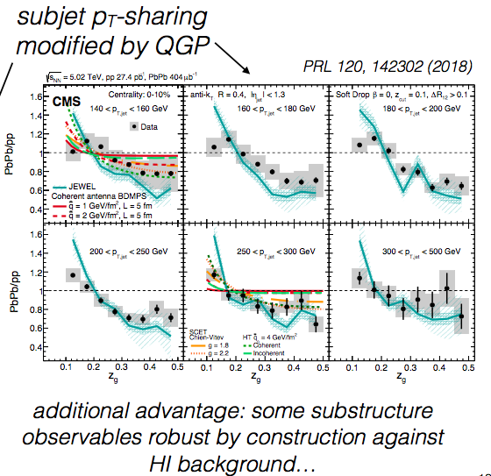
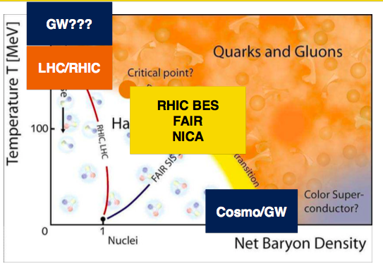
High Density QCD
Marco Van Leeuwen
Dennis Perepelitsa
Carlos Albert Salgado Lopez

Slide 23
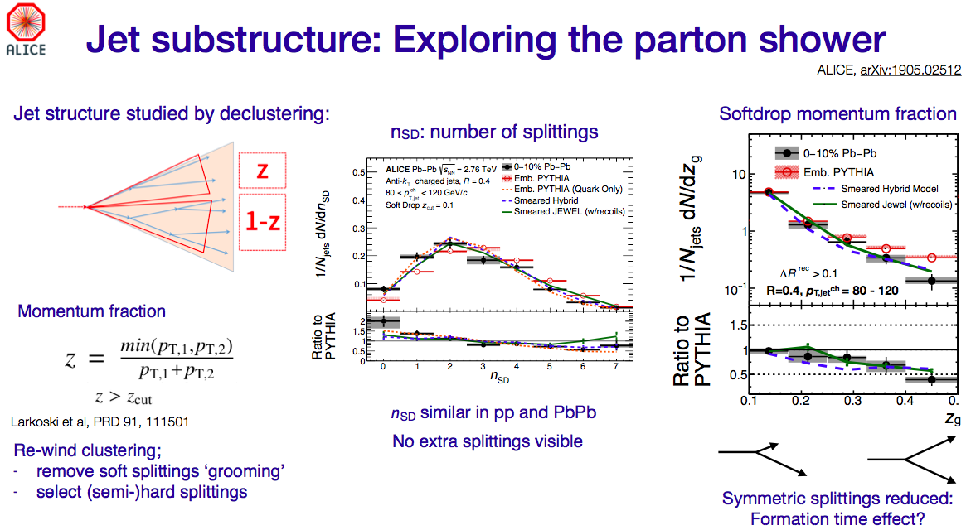
High Density QCD
Marco Van Leeuwen
Dennis Perepelitsa
Carlos Albert Salgado Lopez

Slide 24
High Density QCD
Jan Fiete Grosse-Oetringhaus
Small system observations challenge two paradigms at once
  Smallest system in which heavy-ion “standard model” remains valid?
  Can the standard tools for pp physics remain standard?
Traditional HEP and traditional HI studies grow together
  Tremendous experimental and theoretical progress in last 5+ years
  The underlying QCD is the same theory
Aim: Demonstrate that unified description from pp (ee) to Pb-Pb
is feasible or show that different mechanisms are justified

Slide 26
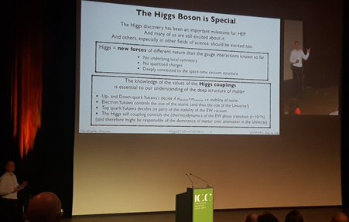
Christoph Grojean

Slide 27
The Higgs boson is “really” new physics.
Roberto Salerno
Christoph Grojean

Slide 28
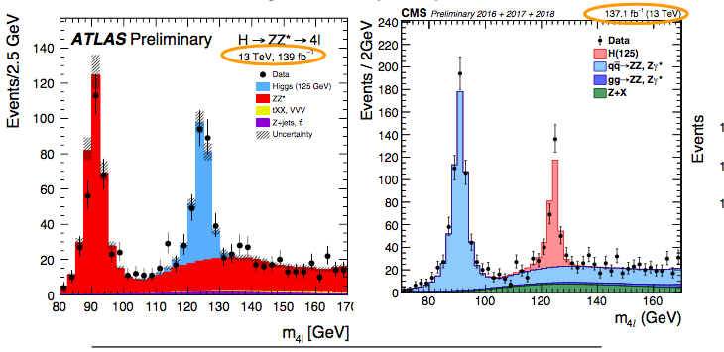
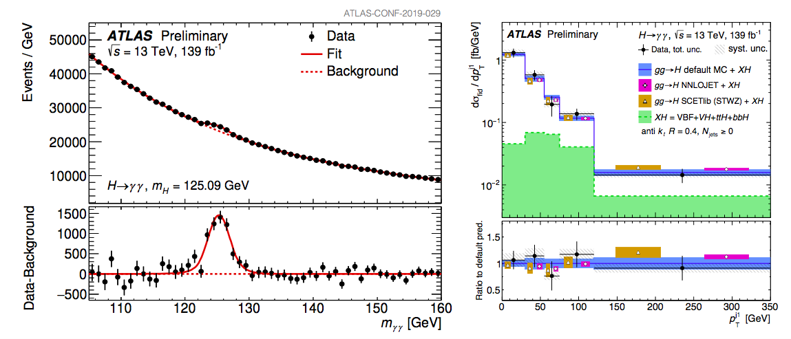
The Higgs
Roberto Salerno
Andreas Hoecker
Wolfgang Adam

Slide 29
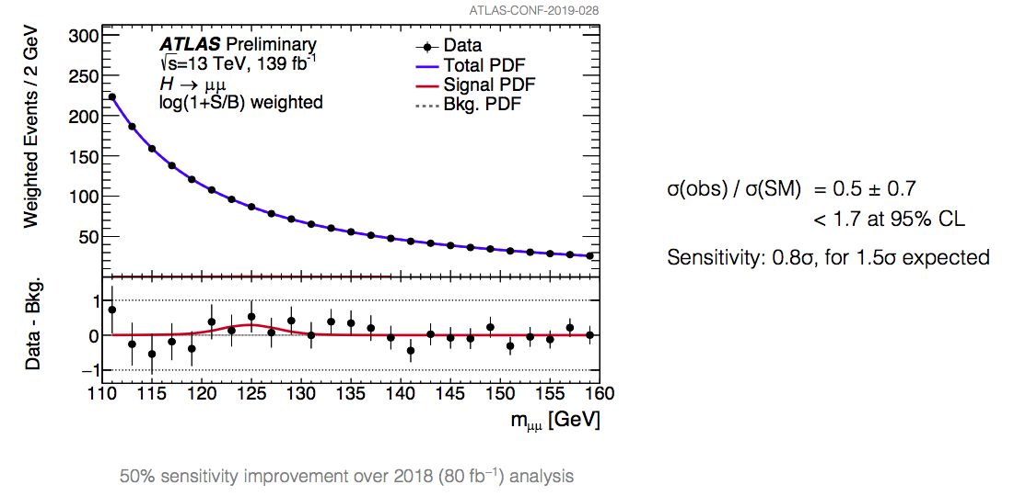
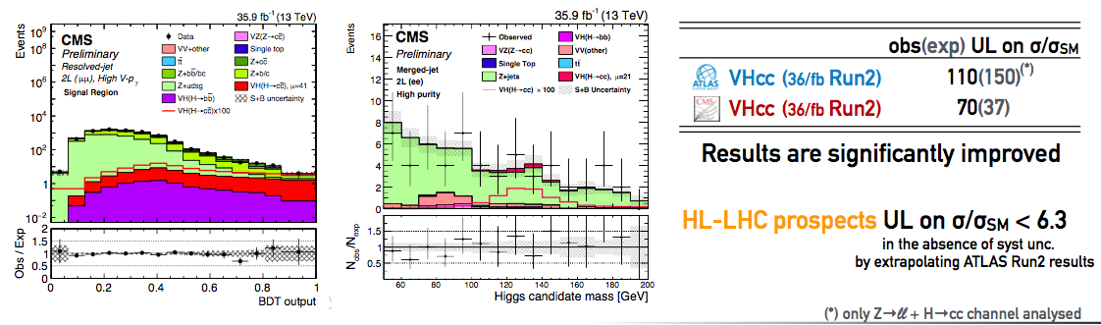
Higgs: The next Generation
Roberto Salerno
Andreas Hoecker
Wolfgang Adam

Slide 30
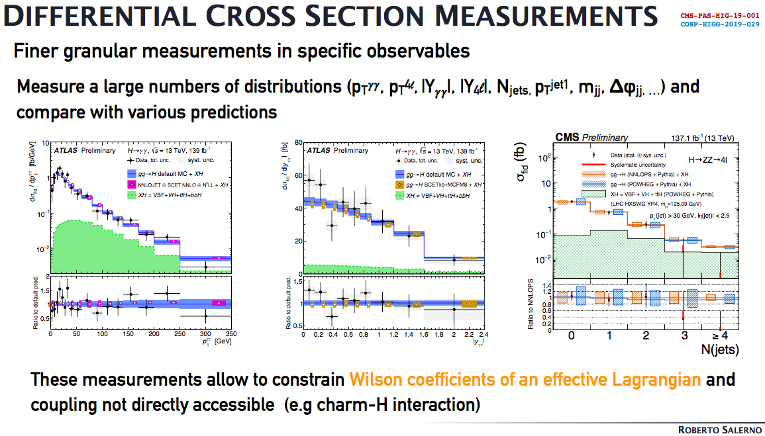

Slide 31
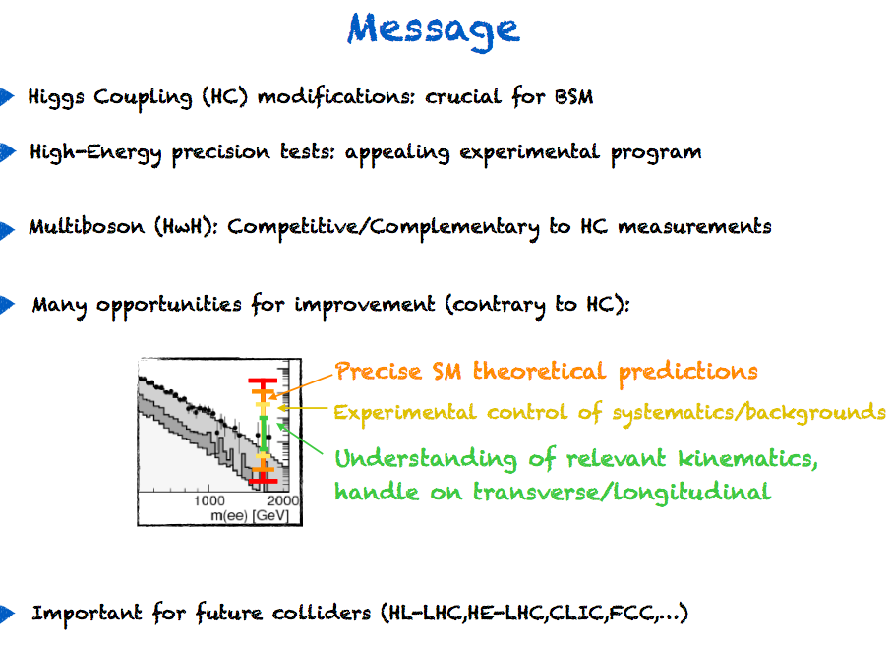
“Higgs without Higgs”
Francesco Riva

Slide 32


Slide 33
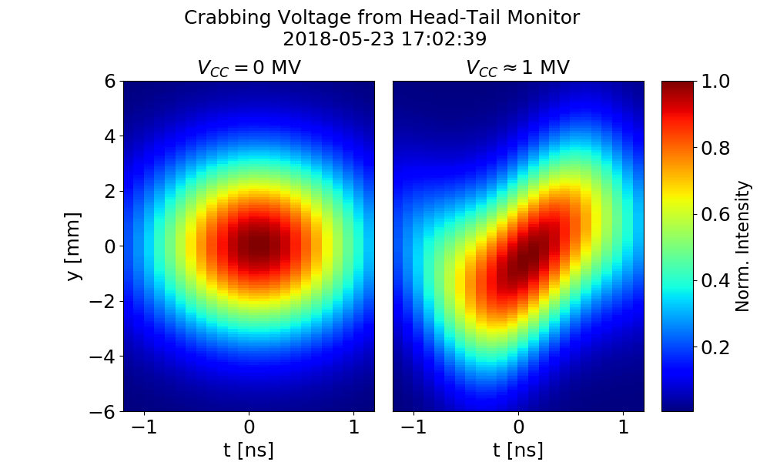
LHC/accelerators…
LS2 work on track (LHC injectors upgrade project)
Compensation crossing angle: First proton crabbing (SPS)
14 Tesla magnet
Oliver Brüning

Slide 34
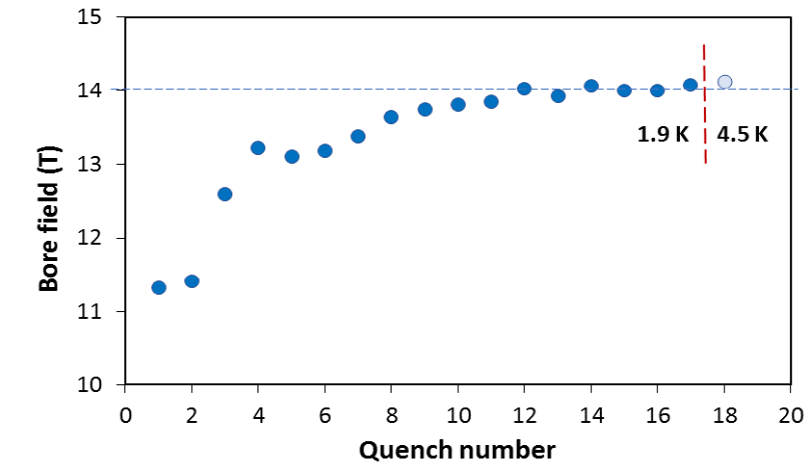
14 T magnet tested at FNAL!
84% on the laodline at 1.9 K
92% on the loadline at 4.2 K
15 T dipole demonstrator
Staged approach: In first step pre-stressed for 14 T (as planned for the first stage)
Second test foreseen in fall 2019 with additional pre-stress for 15 T
In the US, the FCC current density target (1500 A/mm² at 16 T) has been achieved! Industrialization and cost reduction has yet to come
Caterina Biscari

Slide 35
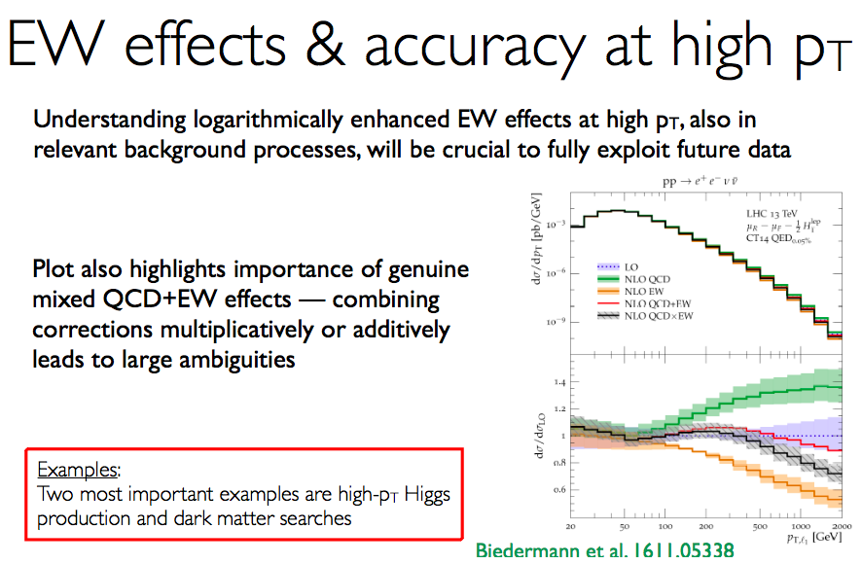
QCD & QED mixed
Giulia Zanderighi

Slide 36
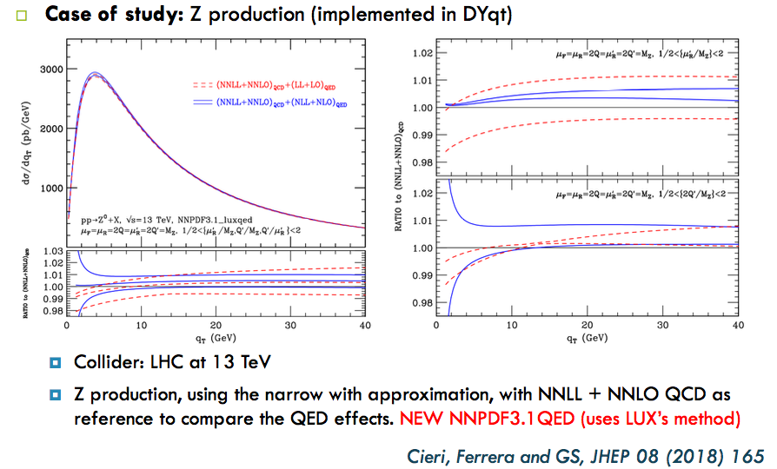
QCD & QED mixed
German Sborlini
Scale dependence reduced
Is either factorised or additive ok? Or?
Giulia Zanderighi

Slide 37
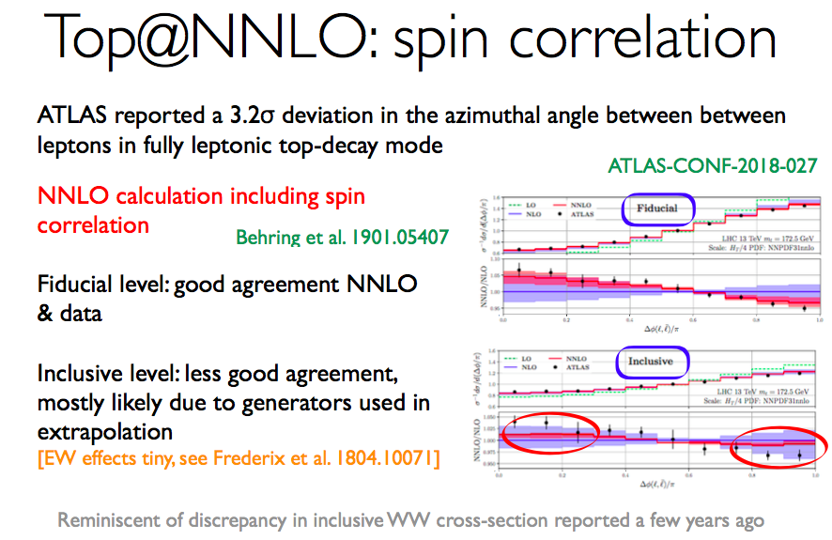
Resummations with fiducial cuts. (Particle level?)

Slide 38
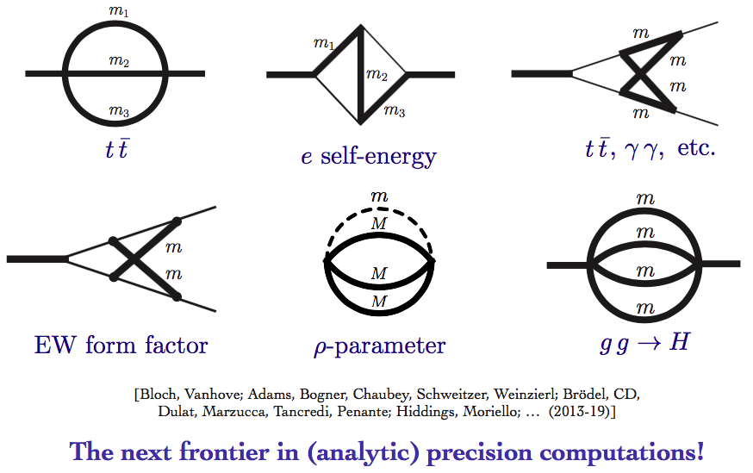
Theory advances…
Elliptical Feynman diagrams: links with pure maths
Also ingredients to compute quark initiated process at N³LO. Very new. Need better PDFs (calculation & measurement)
Claude Duhr

Slide 39
C. Wormell, JMB from A Map of the Invisible

Slide 40
C. Wormell, JMB from A Map of the Invisible

Slide 41
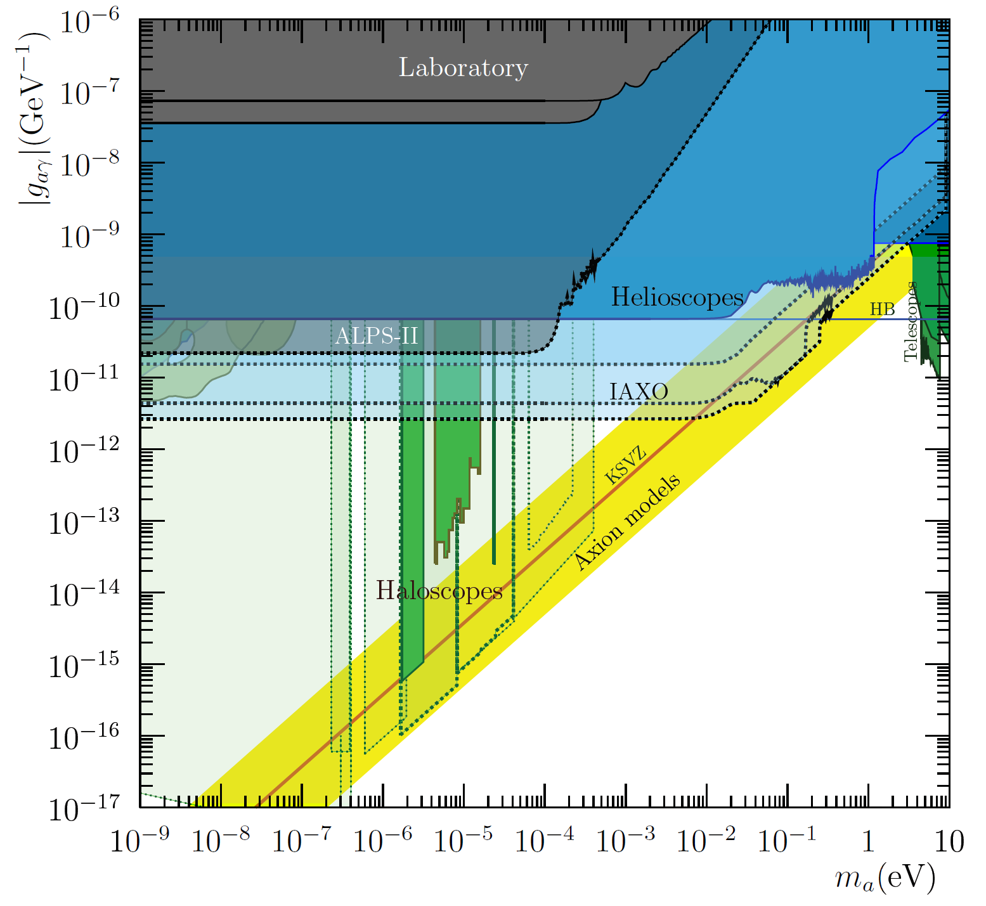
Dark Matter
Igor Garcia Irastorza
Carlos de los Heros
A lot of “model building” activity in recent years, leading to QCD axion models outside the conventional band…
  Normally populating higher g_{aγ}.
  Very interesting for experiments!
Kfir Blum

Slide 42
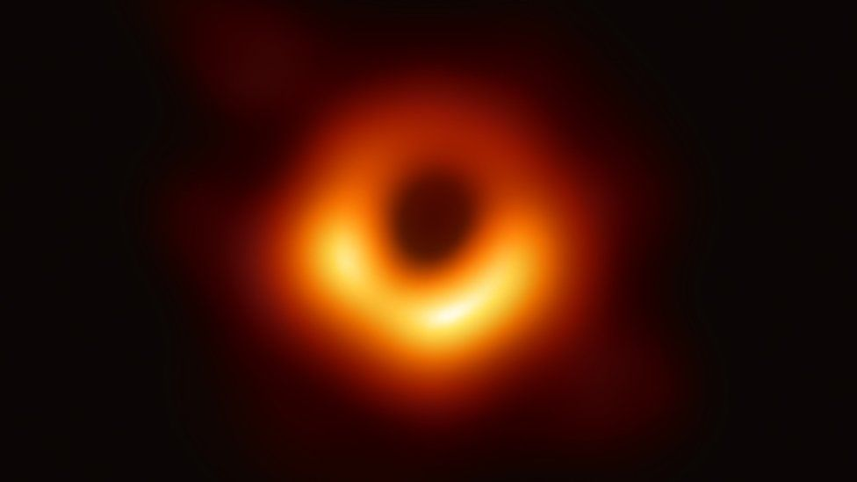
Dark Matter
Igor Garcia Irastorza
Carlos de los Heros
A lot of “model building” activity in recent years, leading to QCD axion models outside the conventional band…
  Normally populating higher g_{aγ}.
  Very interesting for experiments!
Ultra-light DM limit from black hole picture
Kfir Blum

Slide 43
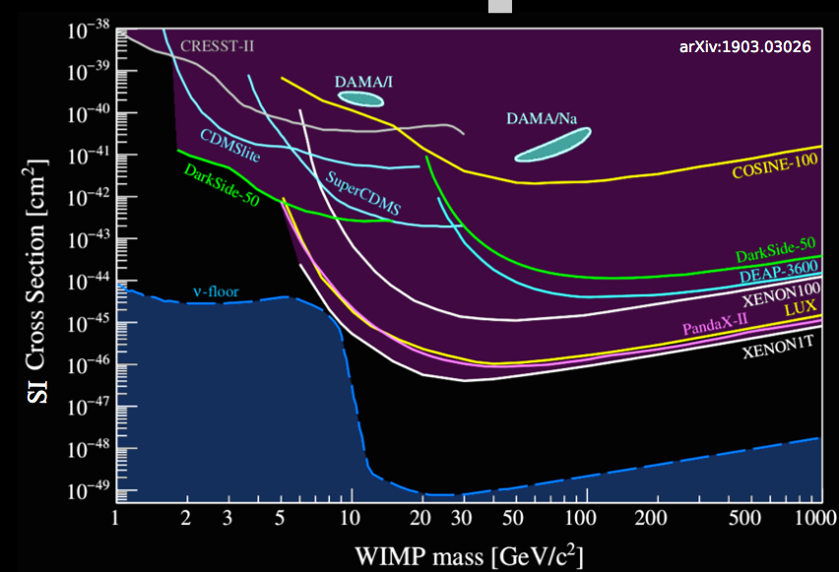
Dark Matter
Igor Garcia Irastorza
Carlos de los Heros
A lot of “model building” activity in recent years, leading to QCD axion models outside the conventional band…
  Normally populating higher g_{aγ}.
  Very interesting for experiments!
Ultra-light DM limit from black hole picture
Kfir Blum
A swamp, not a floor…
Notes:
Also beware of model dependencies.

Slide 44
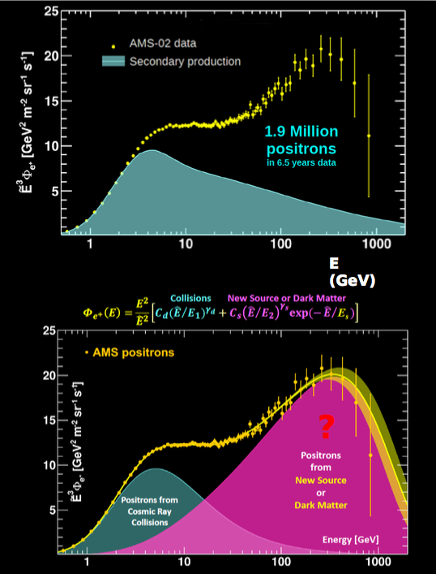
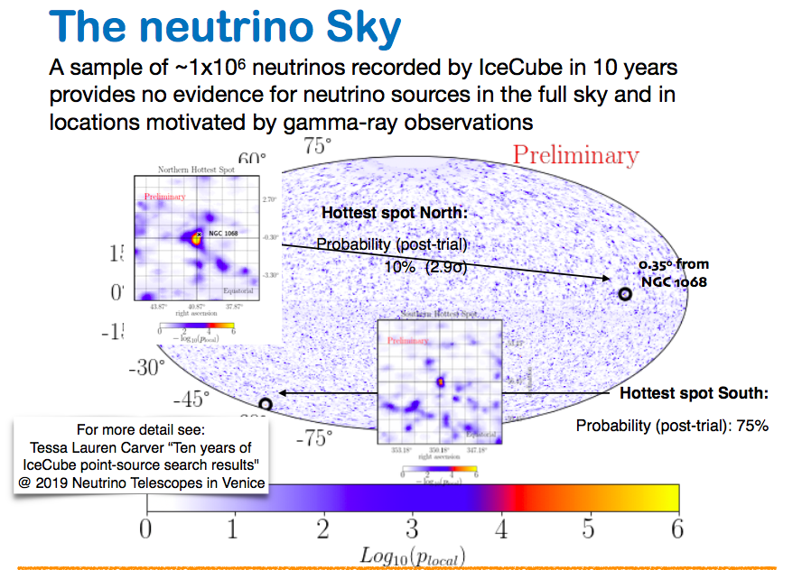
Astroparticle & Cosmology
(high-energy)
Leonardo Senatore
Elisa Bernardini
Marek Kowalski
Barbara De Lotto
Francois Bouchet

Slide 45
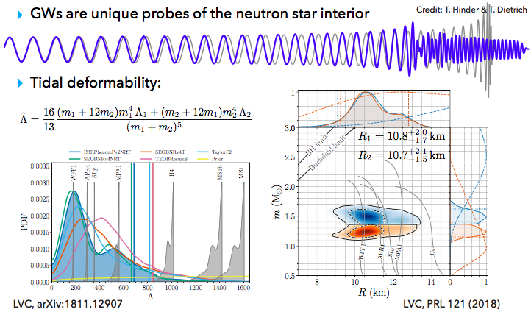
Astroparticle & Cosmology
Patricia Schmidt
Carlos Albert Salgado Lopez

Slide 46
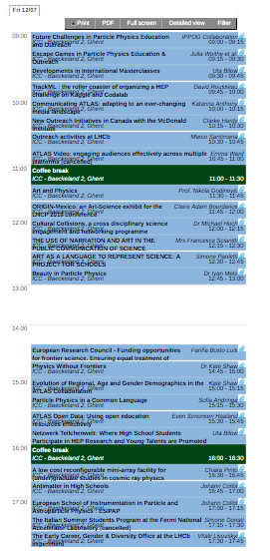

Outreach, education, diversity
Andy Charalambous, A God’s toolbox

Slide 47

Outreach, education, diversity
Andy Charalambous, A God’s toolbox

Slide 48

Outreach, education, diversity
Andy Charalambous, A God’s toolbox

Slide 49
High Luminosity LHC
From a data point of view we are adiabatically approaching this this era now
Lots of work needed to actually deliver the full potential
Step-by-step physics for the next several years
  Theory & experiment
  Each step is a step into new territory
  We don’t really know how far this can take us yet
Some thoughts based on this week and more

Slide 50



Wolfgang Adam
Open data
  See how different the attitude is in the gravitational wave community (Patricia Schmidt)
Innovative analysis methods
  Also long lived particles, delayed decays, pointing photons…

Slide 51

A thoughtful theory response to data

Slide 52

Searches
Marie-Hélne Genest
Isabell Melzer-Pellmann

Slide 53
Searches
Marie-Hélne Genest
Isabel Melzer-Pellman

Slide 54

Searching thoroughly…
Peter Athron
e.g. GAMBIT: Moving away from simplified benchmark model points.

Slide 55

Searching thoroughly…
Peter Athron
e.g. GAMBIT: Moving away from simplified benchmark model points.

Slide 56
Searching thoroughly…
and flexibly

Slide 57
Model independence, precision and shelf-life
Searching thoroughly…
and flexibly

Slide 58
Model independence, precision and shelf-life
Searching thoroughly…
and flexibly
Fiducial

Slide 59

Model independence, precision and shelf-life
Searching thoroughly…
and flexibly
Fiducial

Slide 60
Model independence, precision and shelf-life
Searching thoroughly…
and flexibly
Fiducial
Particle-level

Slide 61
Model independence, precision and shelf-life
Searching thoroughly…
and flexibly
Fiducial
Particle-level

Slide 62
Model independence, precision and shelf-life
Searching thoroughly…
and flexibly
Fiducial
Particle-level
Irreducible background subtraction

Slide 63

Model independence, precision and shelf-life
Searching thoroughly…
and flexibly
Fiducial
Particle-level
Irreducible background subtraction
  Dangerous to use control regions or ratios if you move away from simplified “benchmarks”

Slide 64

MORE
TO COME

Slide 65

  Fine tuning? Natural?
MORE
TO COME
Notes:
Underlying theory

Slide 66
Enormous effort, dedication, belief, hard work over years
  Also true of New Zealand…we need some luck
  Either way, better to play than not.
MORE
TO COME

Slide 67
Enormous effort, dedication, belief, hard work over years
  Also true of New Zealand…we need some luck
  Either way, better to play than not.
Long term:
  Competition of ideas in ESPP update
MORE
TO COME

Slide 68
Enormous effort, dedication, belief, hard work over years
  Also true of New Zealand…we need some luck
  Either way, better to play than not.
Long term:
  Competition of ideas in ESPP update
Near term/now:
  (HL)-LHC, competition between LHCb, ATLAS, CMS, now Belle II
  Serious work to deliver beam, experiments and theory improvements
  Continuing, deepening links with astroparticle physics
  HyperK, DUNE, charged lepton flavour…
MORE
TO COME

Slide 69
Enormous effort, dedication, belief, hard work over years
  Also true of New Zealand…we need some luck
  Either way, better to play than not.
Long term:
  Competition of ideas in ESPP update
Near term/now:
  (HL)-LHC, competition between LHCb, ATLAS, CMS, now Belle II
  Serious work to deliver beam, experiments and theory improvements
  Continuing, deepening links with astroparticle physics
  HyperK, DUNE, charged lepton flavour…
  …
MORE
TO COME
SOME GOLDEN YEARS AHEAD FOR HEP
Notes:
Maybe overdid the sporting but at least no politics
Diversity

Slide 70
Thank you

