Slide 1
Measurement of top-quark pairs cross-sections at ATLAS
Michele Faucci Giannelli
On behalf of the ATLAS collaboration

Slide 2
Top differential cross-sections in ATLAS
ATLAS has performed many differential cross-sections measurement of top-pair observables at 7, 8 and 13 TeV
  More than 15 published papers and more to be submitted
Will focus on most recent publications at 13 TeV in several channels
  di-lepton channel (Eur. Phys. J. C77 (2017) 299)
  l+jets channel (boosted and resolved) (JHEP 11 (2017) 191)
  l+jets channel vs # jets (JHEP 10 (2018) 159)
  di-boosted hadronic channel (Phys. Rev. D 98 (2018) 012003)

Slide 3
Outline
Introduction
Topologies and reconstruction
Results
Conclusions

Slide 4
Summary of cross-sections
Reco to parton unfolding
Theory
Partons
Full Phase space
Experiment
Reconstruction
Parton to particle (i.e. apply shower)
Particle
Fiducial Phase space
RIVET
Reco to particle unfolding
Data and MC can have a significant difference in the normalisation
  Absolute differential cross-sections takes into account the normalisation and give the actual cross-section
  Normalised differential cross-sections provide shape information with higher precision
    several uncertainties cancel when dividing for the total cross-section

Slide 5
Topologies and reconstruction
di-lepton channel: neutrino weighting (top variables)
l+jets resolved channel: pseudo-top
l+jets boosted channel: only 1 large-R jet
Hadronic di-boosted channel: 2 large-R jets
u/d/s/c
lepton
υ
W
2 Large-R jets:
J1 > 500 GeV
J2 > 300 GeV
b
Leptonic top:
lepton
E_{T}^{Miss}
Closest b-jet to lepton
t
W reconstruction:
select the two jets that best reconstruct the W mass
t
W
lepton
Select two highest p_{T} b-jets
u/d/s/c
b
u/d/s/c
u/d/s/c
Large jet R=1: p_{T}>300GeV, mass> 100 GeV
Hadronic top:
two light jets
other b-jet
Top selection is identical at reconstruction and particle level
l+jets in #jets analysis: define three regions with exactly 4, 5 or 6 and more jets

Slide 6
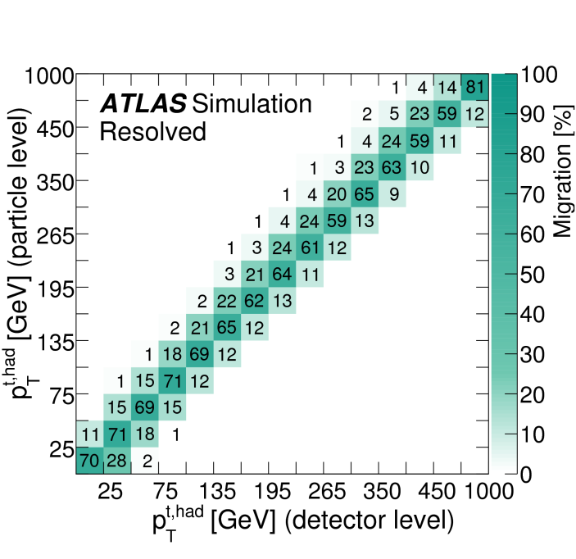
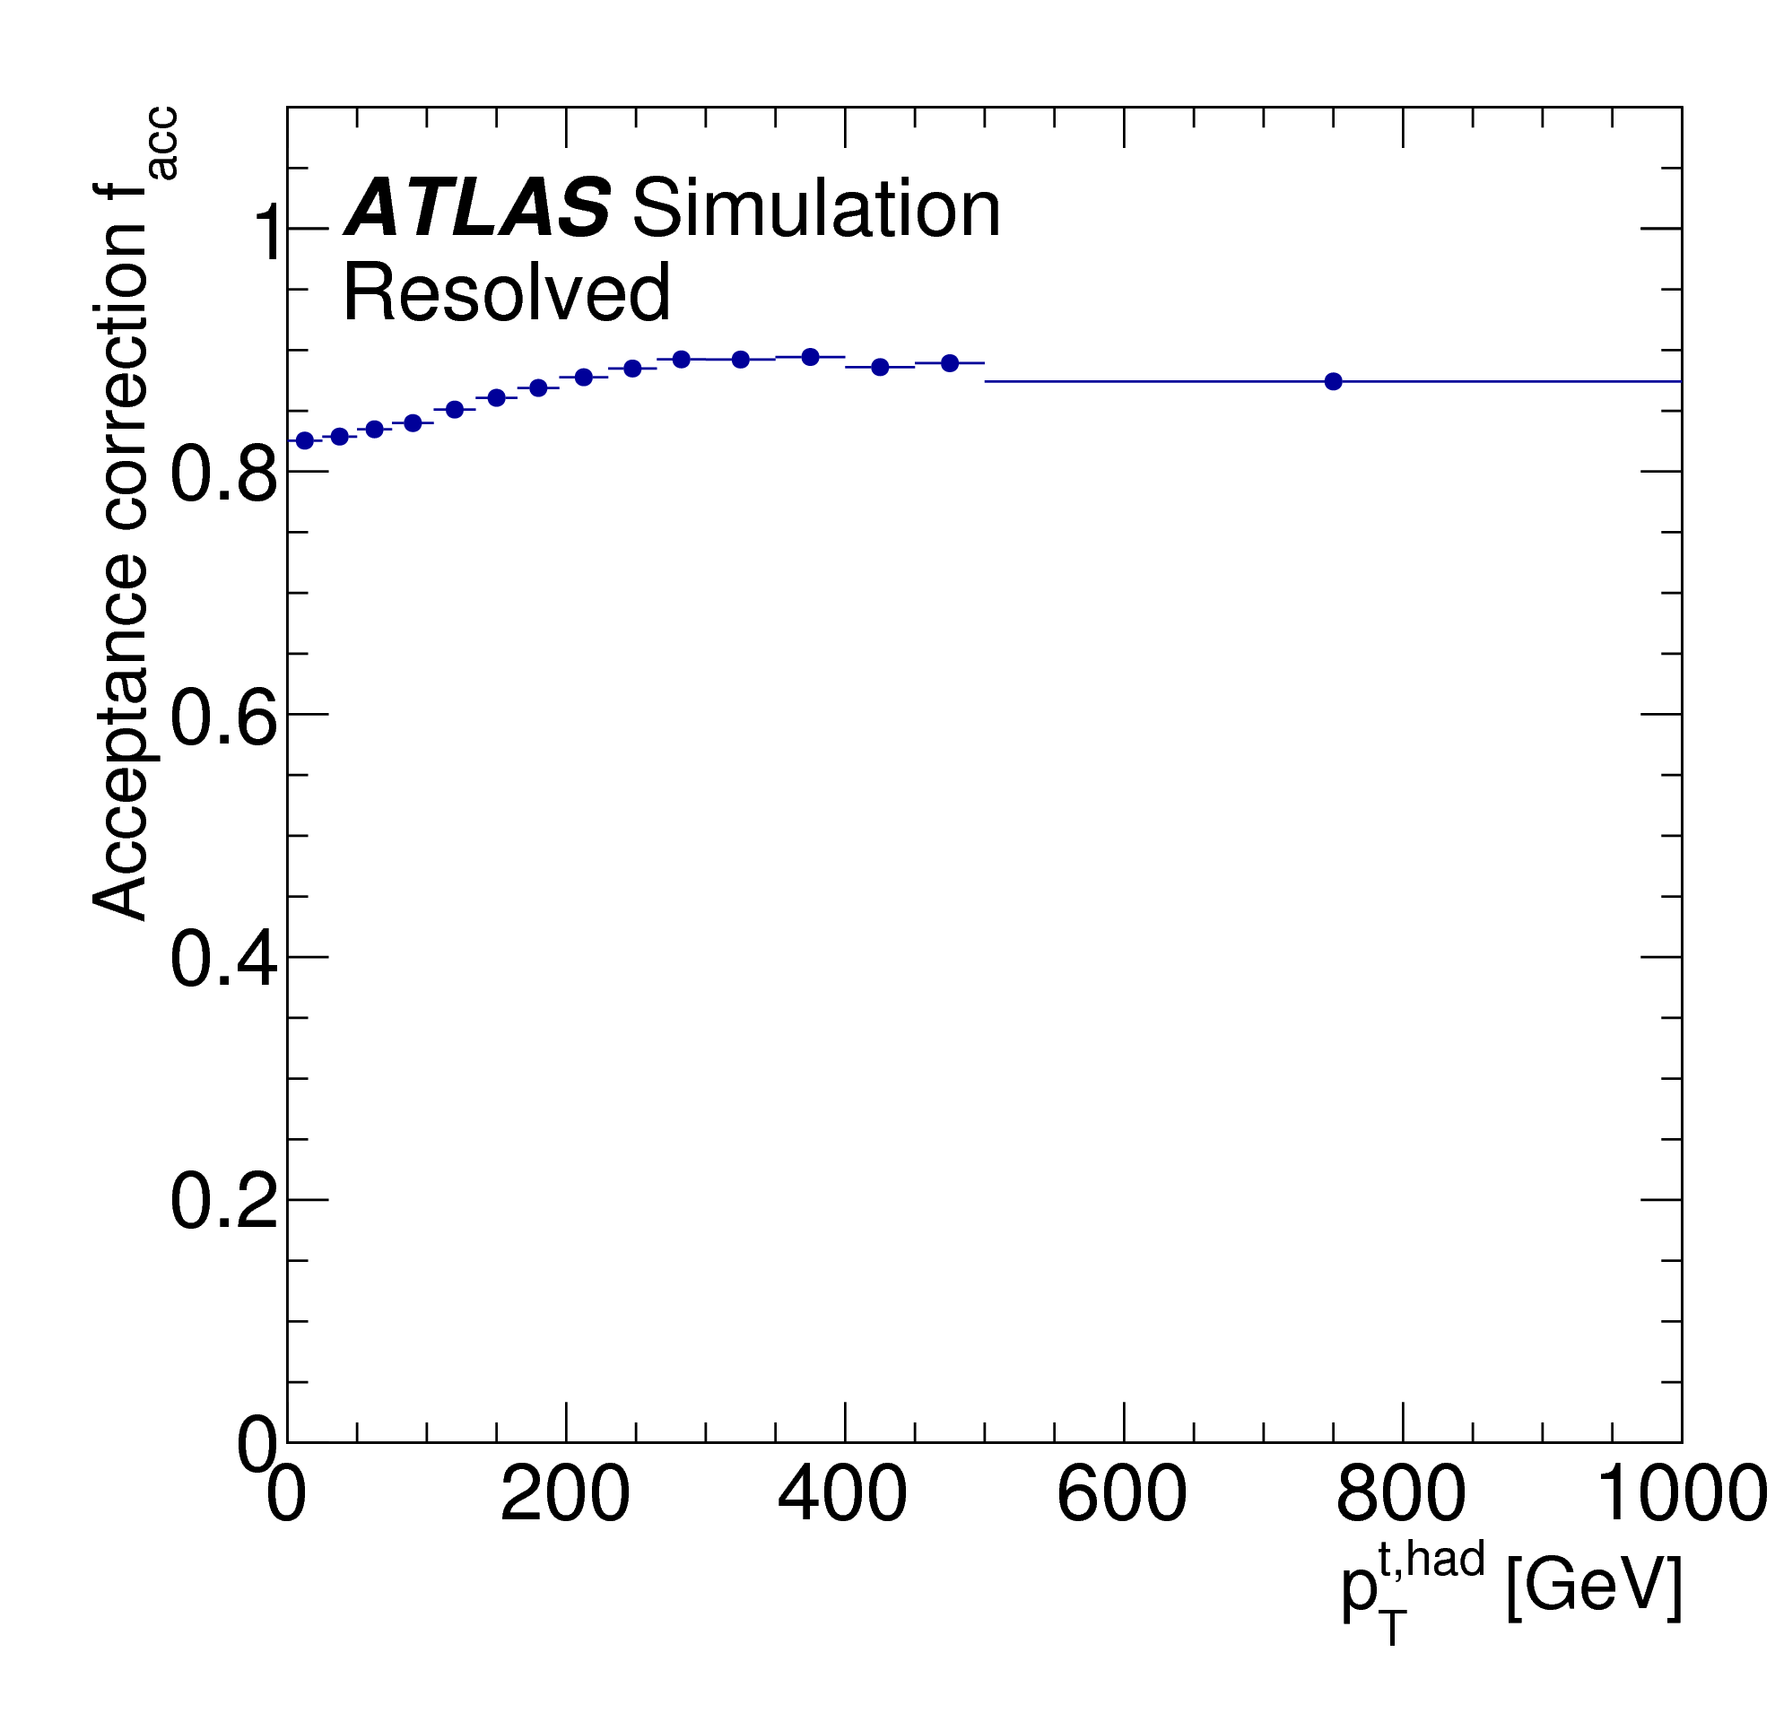
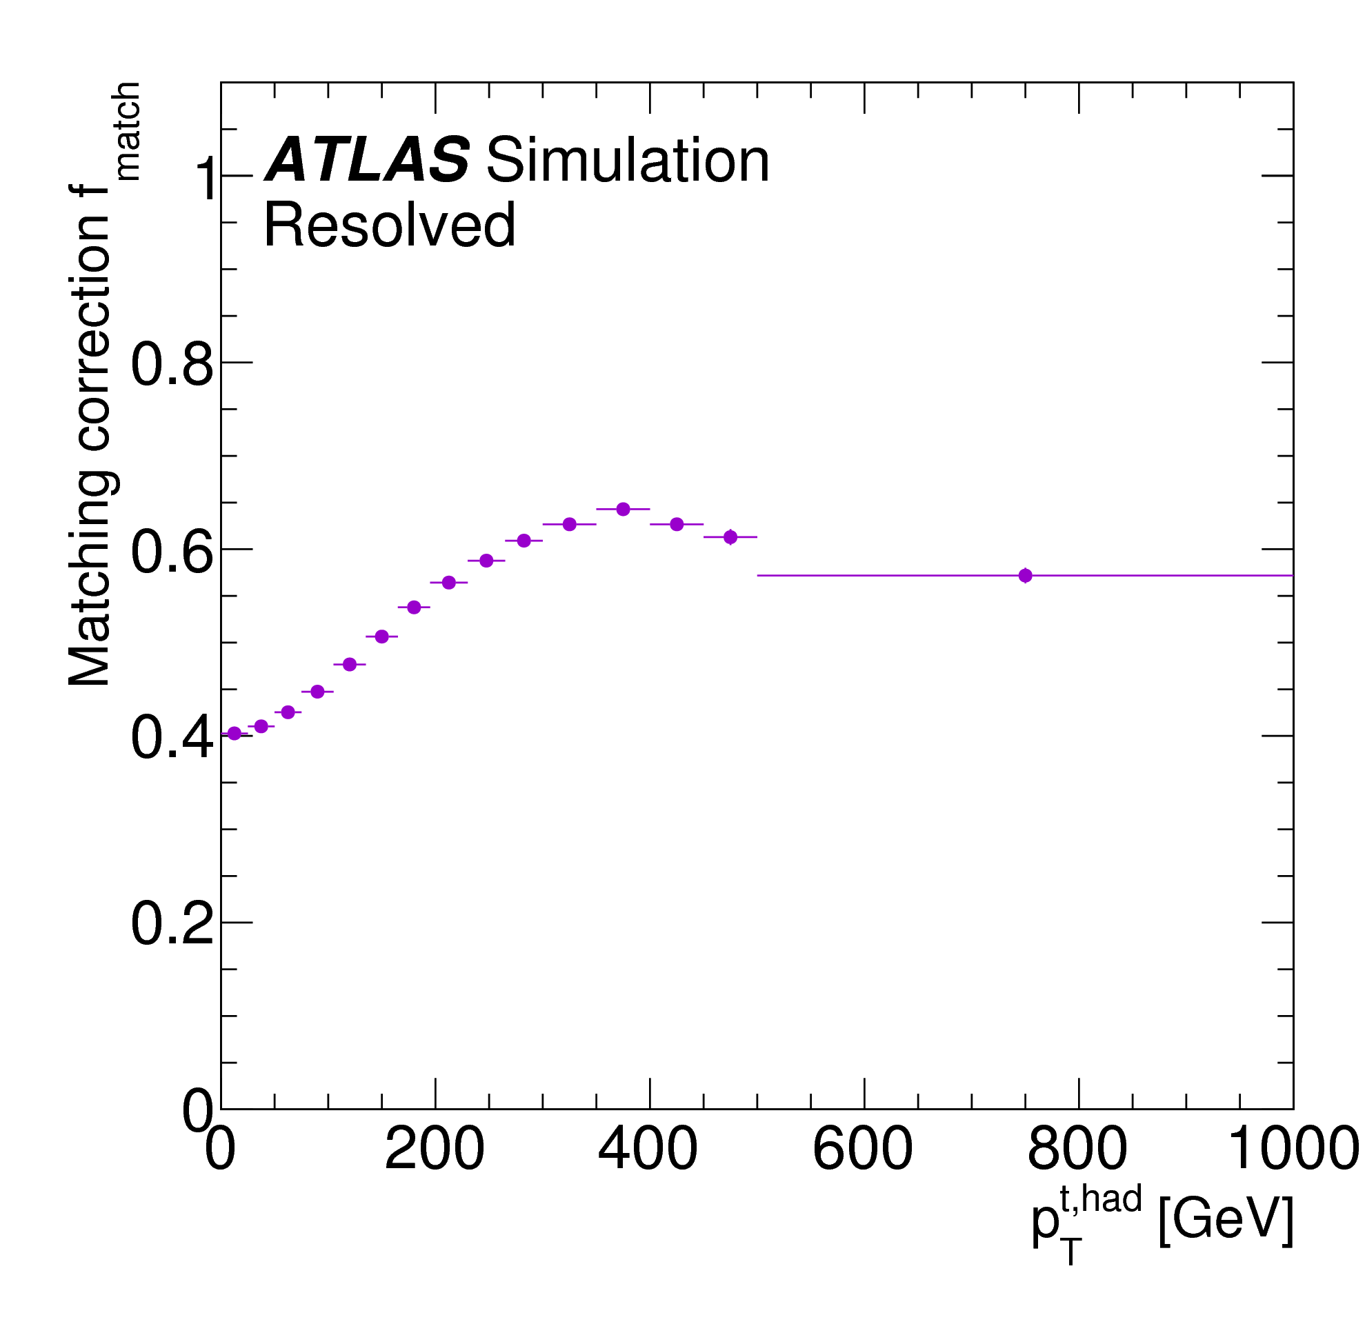
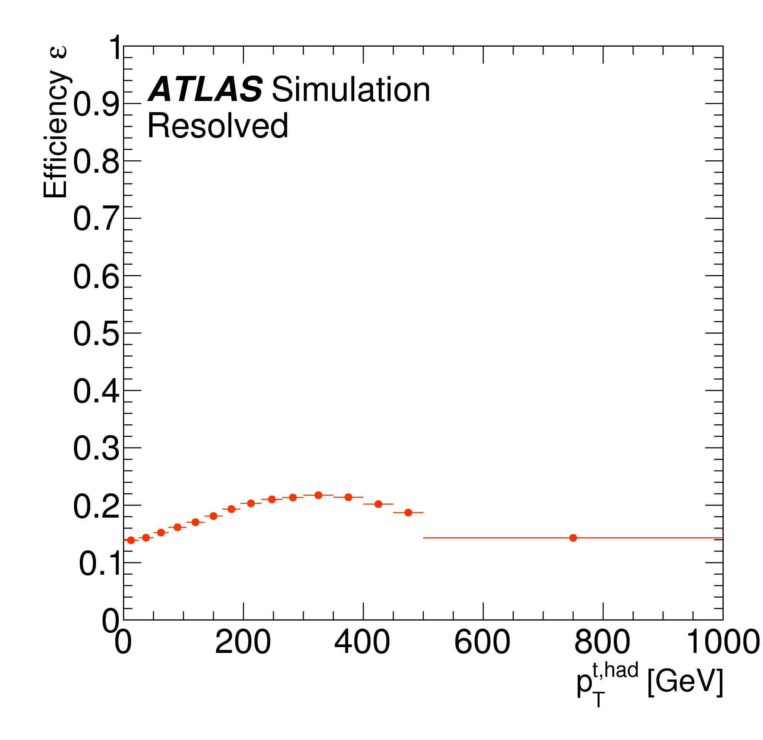
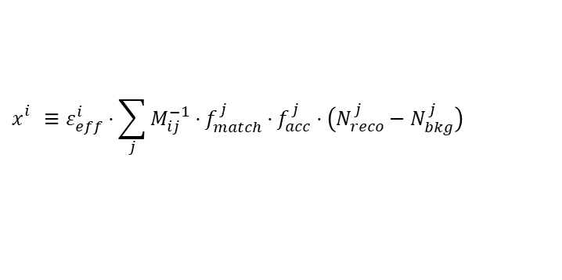
Unfolding
All 13 TeV analyses use the D’Agostini iterative unfolding
$$x_{}^{i}≡ε_{eff}^{i}⋅\sum_{j}{M_{ij}^{−1}}⋅f_{match}^{j}⋅f_{acc}^{j}⋅\left(N_{reco}^{j}−N_{bkg}^{j}\right)$$
The matching between detector and particle level objects is only applied in the l+jet resolved channel.
This requirement produces more diagonal matrices, helping the unfolding procedure

Slide 7
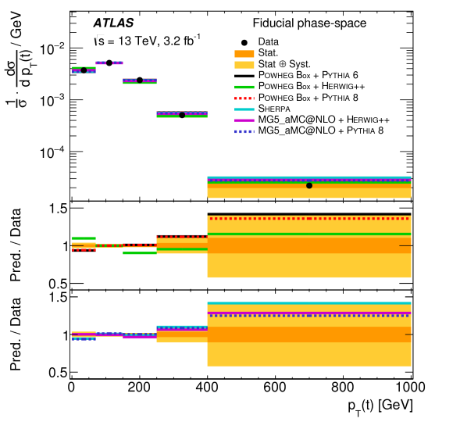
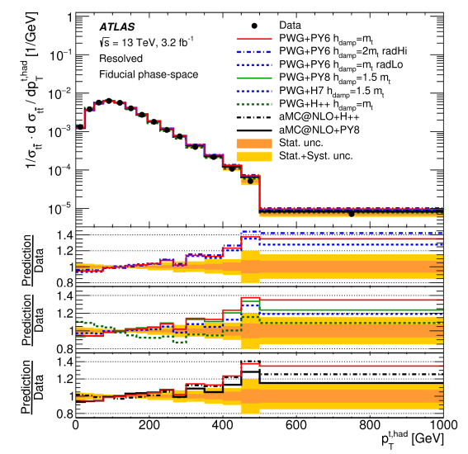
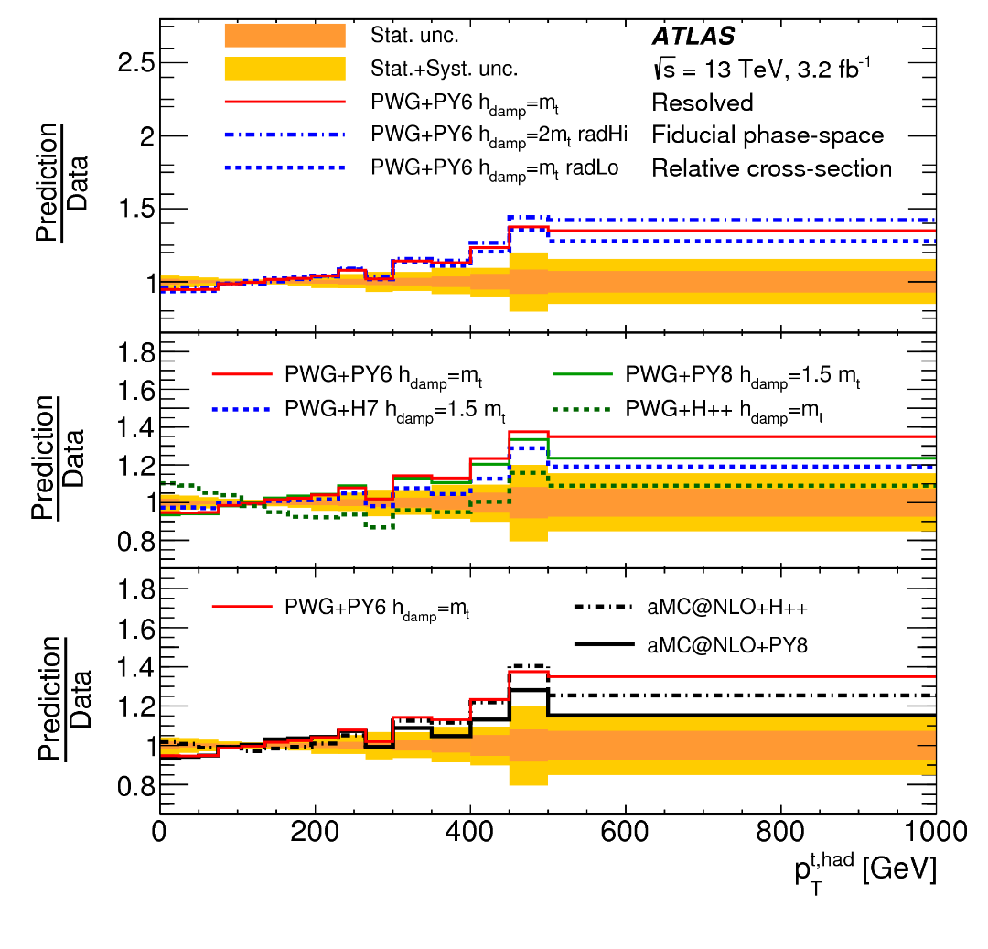
Result: top p_{T} resolved
di-lepton
l+jets
All MC predicts a higher cross-section at high p_{T} than what is observed in data
Same shape in both channels

Slide 8
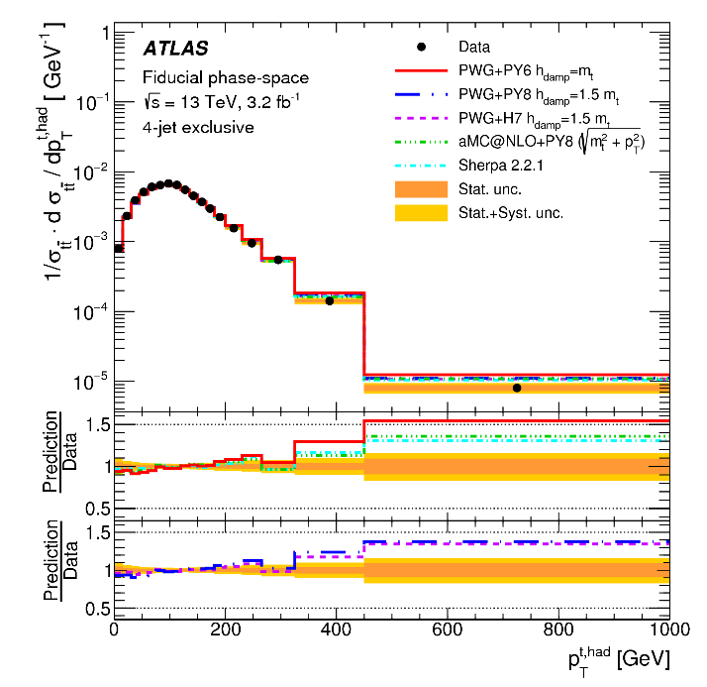
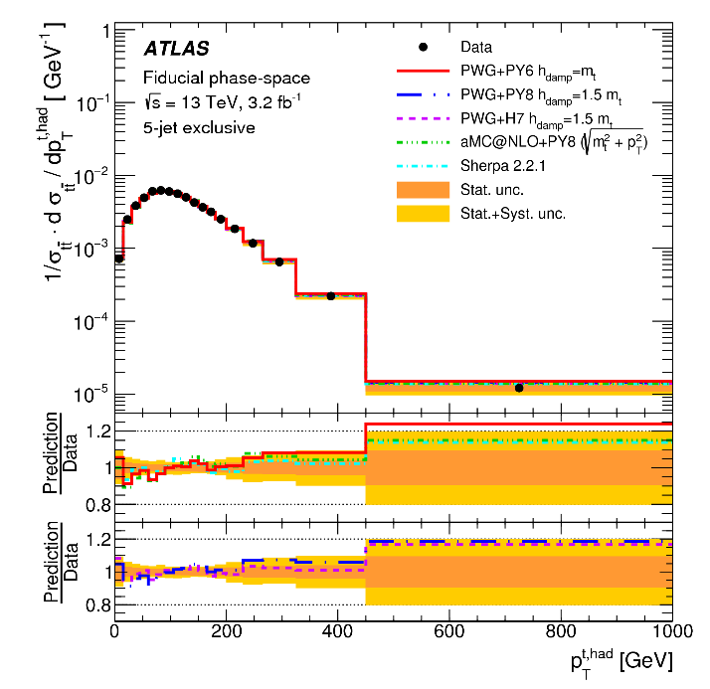
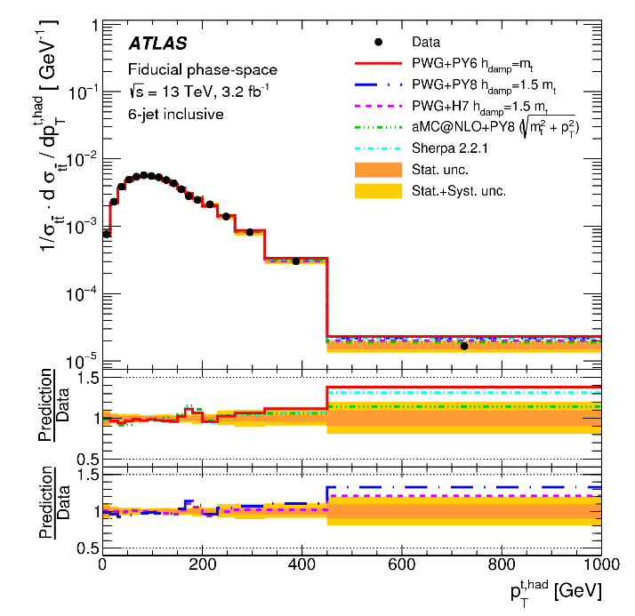
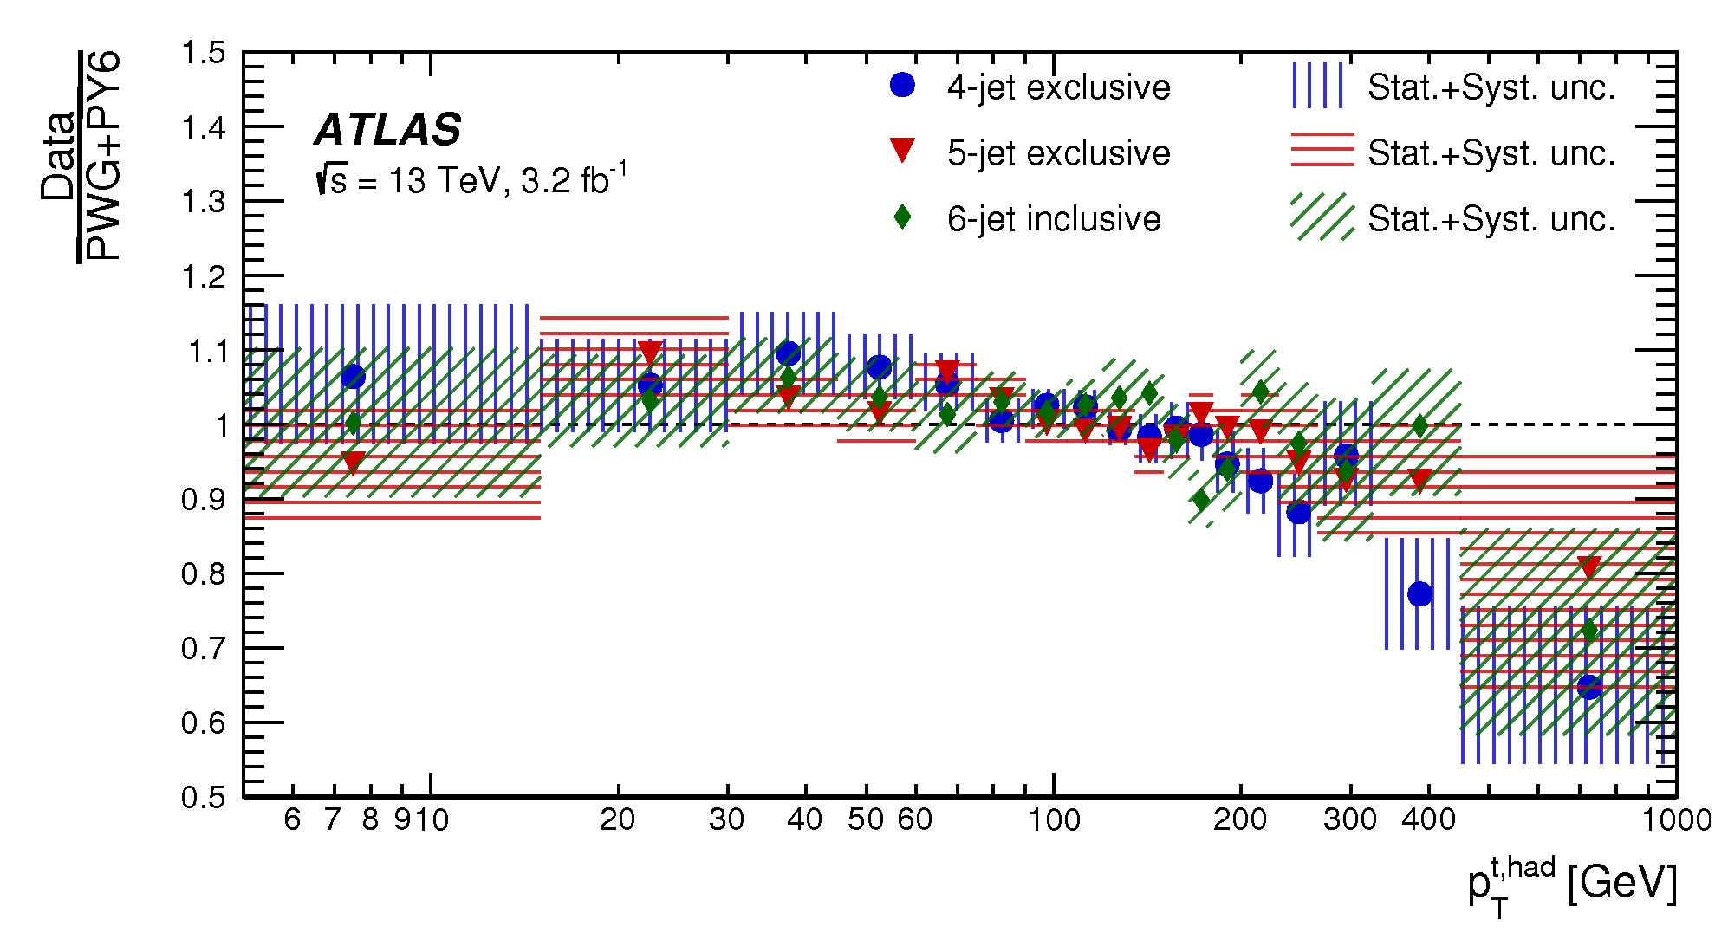
Result: top p_{T} in n-jets
4 jets
5 jets
6+ jets
This measurement tries to find out more about the slope in the ratio between predictions and data observed since 7 TeV
Most of the slope seen in inclusive measurements is due to the 4-jet region
The top pT mismodelling is smaller in the ttH signal region

Slide 9
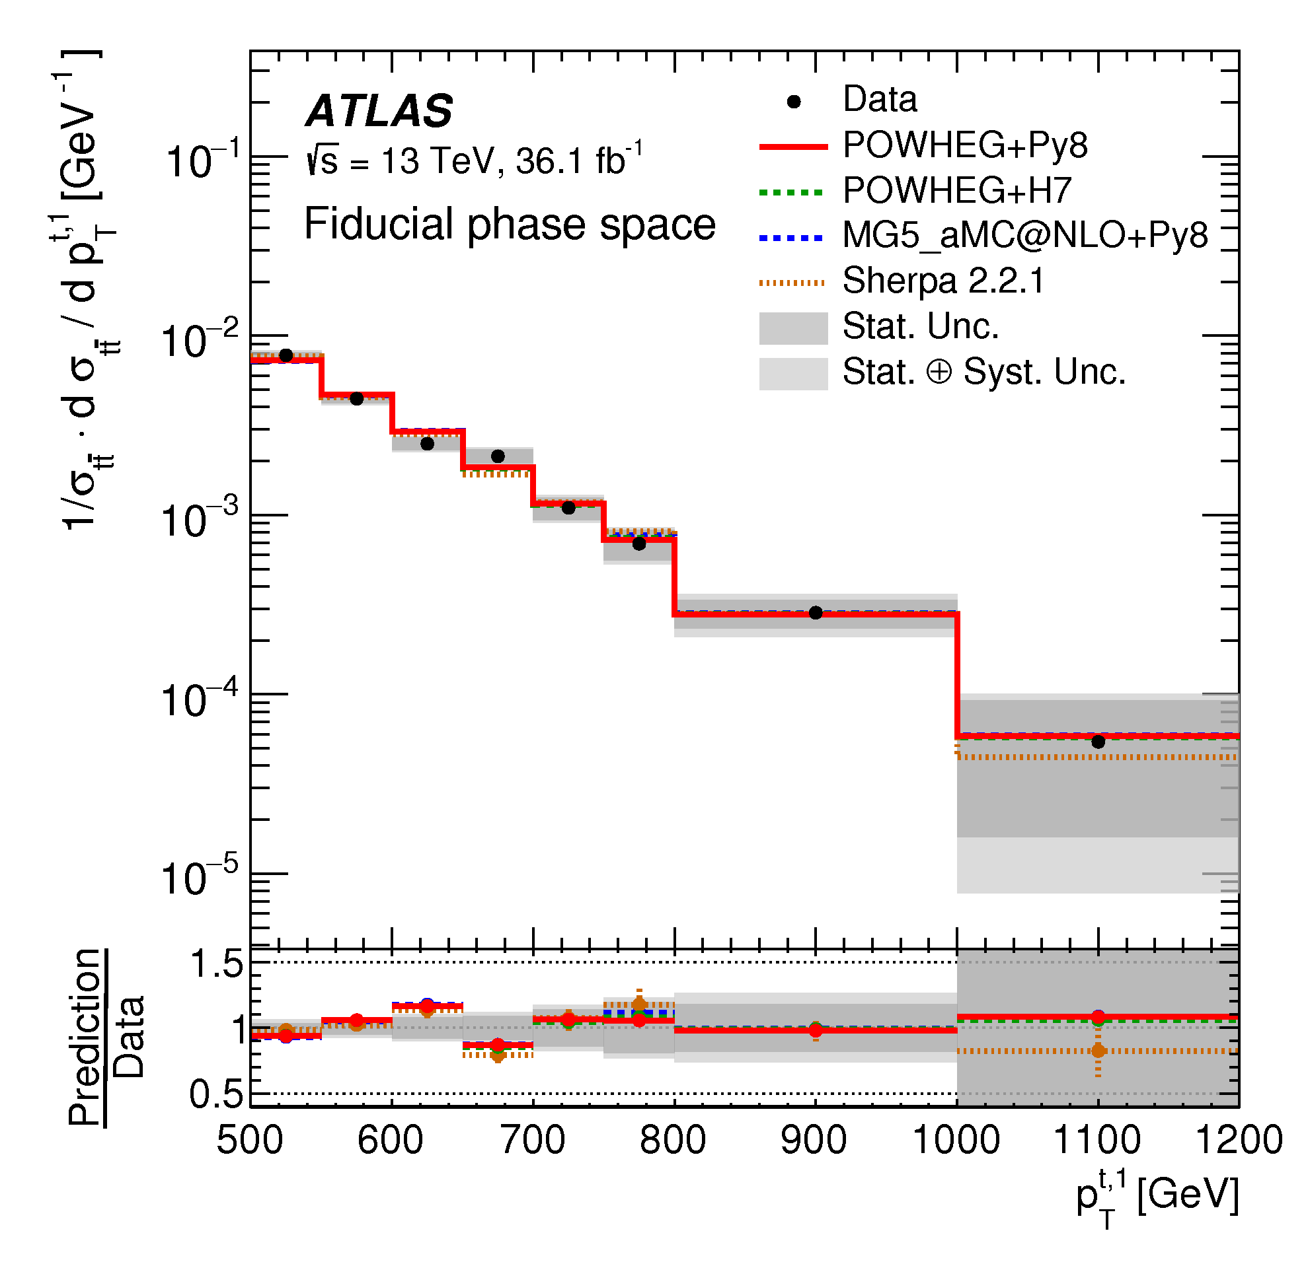
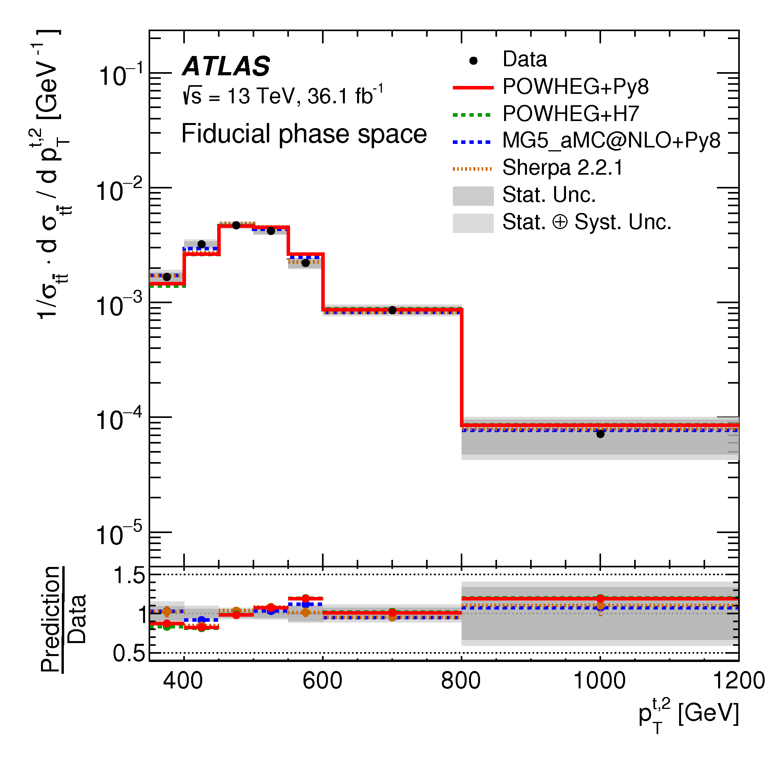
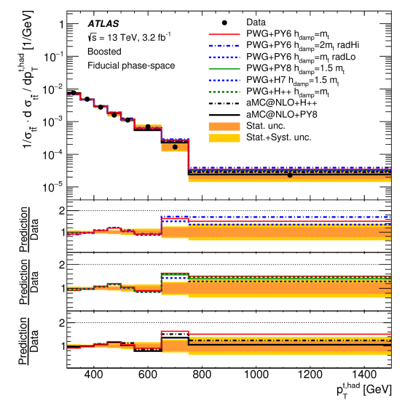
Result: top p_{T} boosted
Di-boosted
Leading top
Di-boosted
Sub-leading top
l+jets boosted
Similar agreement between leading and sub-leading or “average” tops
A slope is visible which is consistent with previous slides

Slide 10
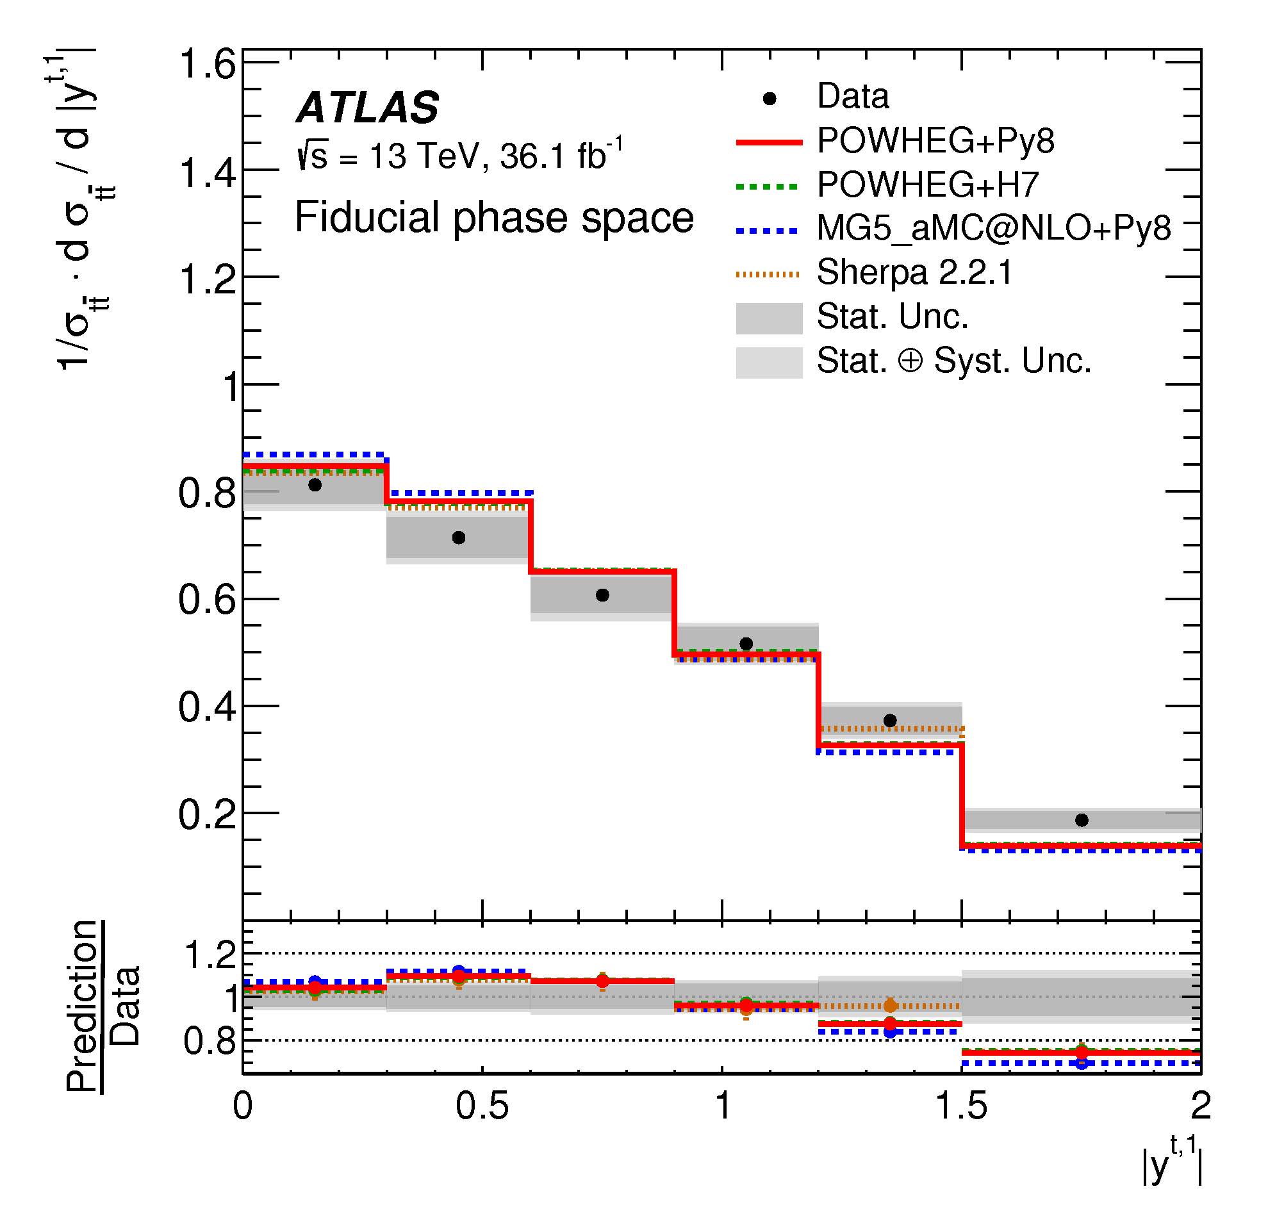
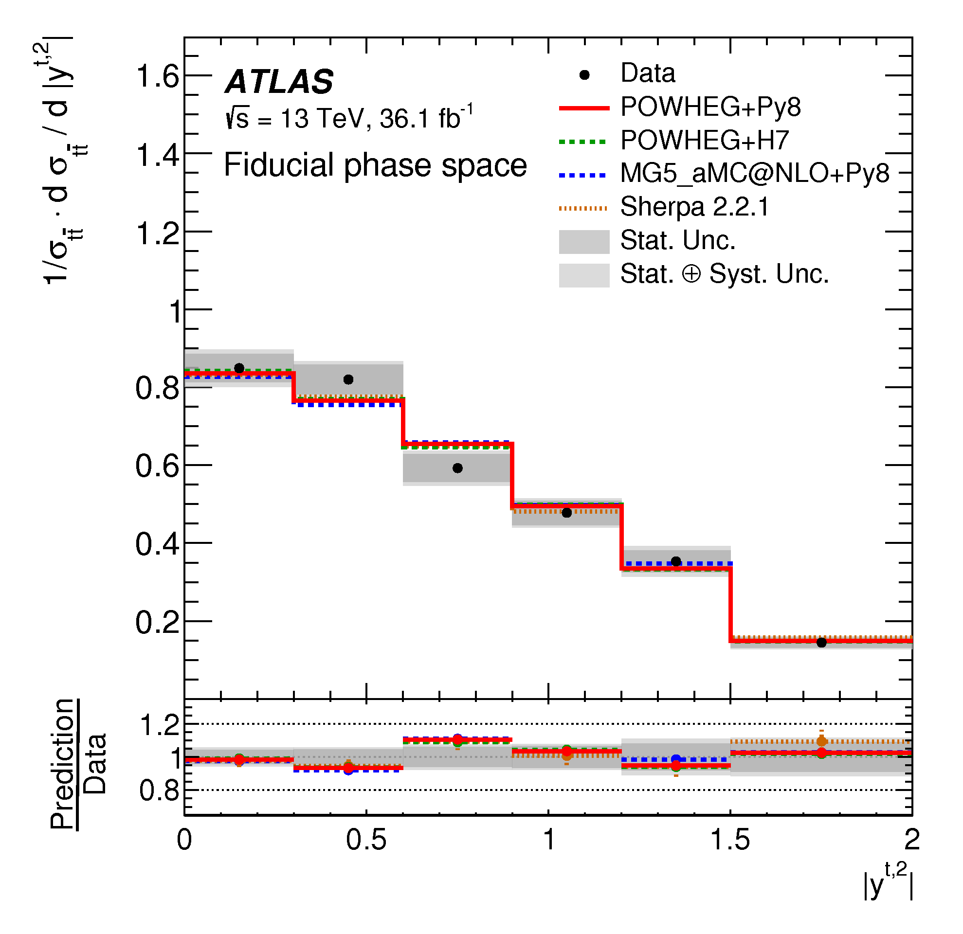
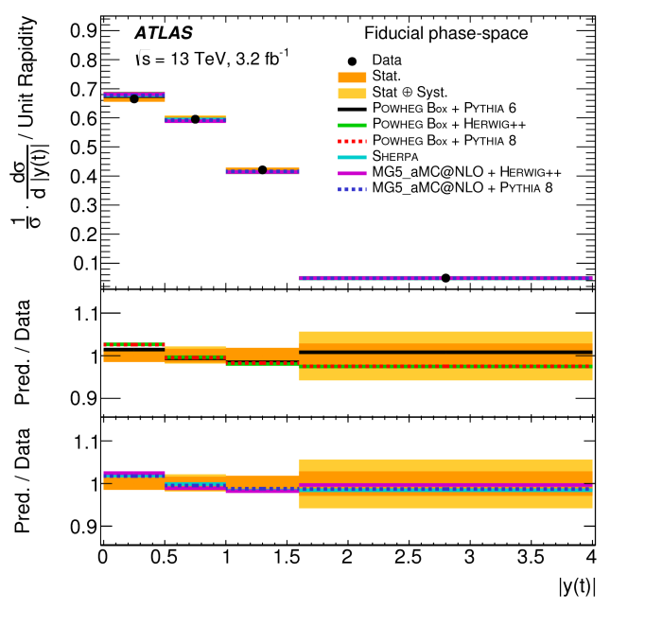
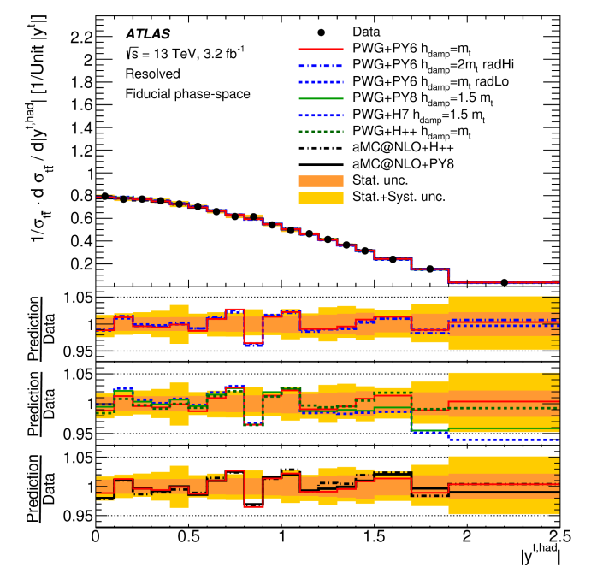
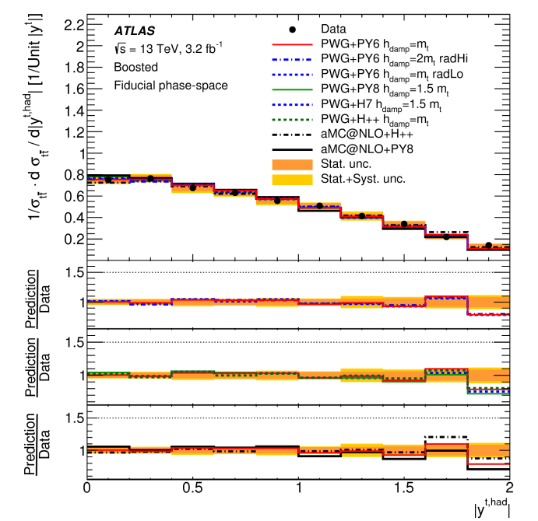
Result: Top rapidity
Di-lepton
Di-boosted
Di-boosted
All predictions are compatible with data
l+jets
l+jets

Slide 11
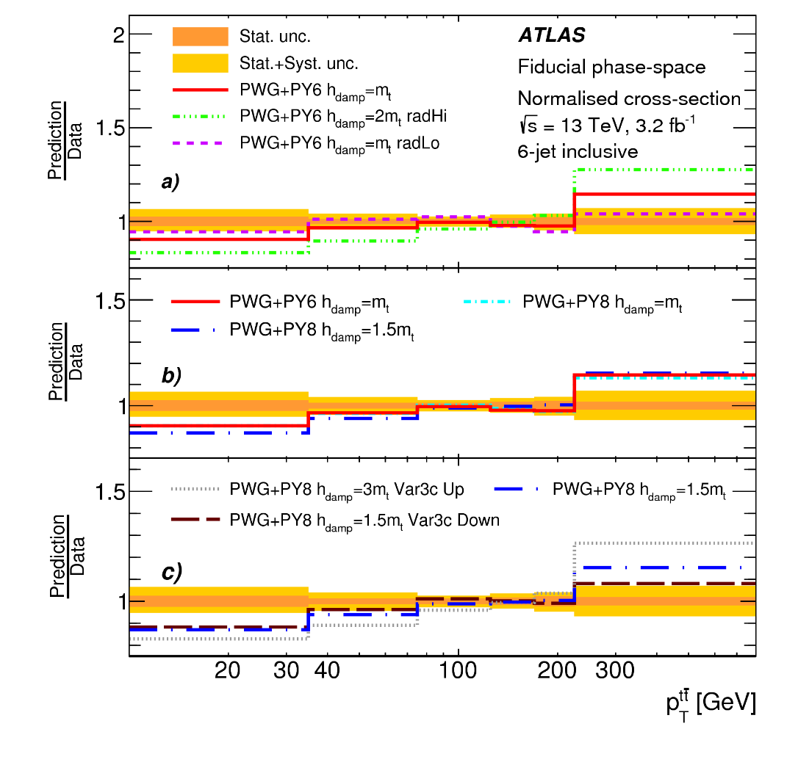
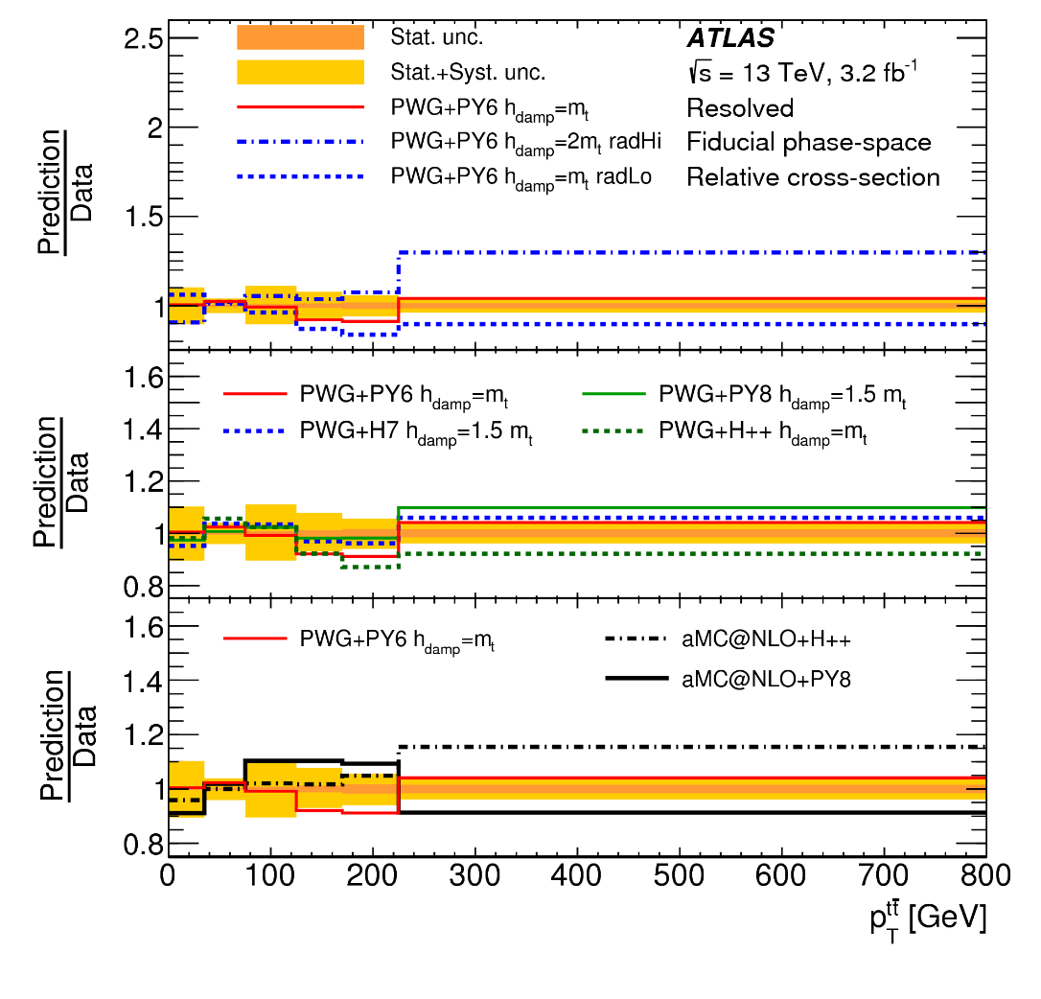
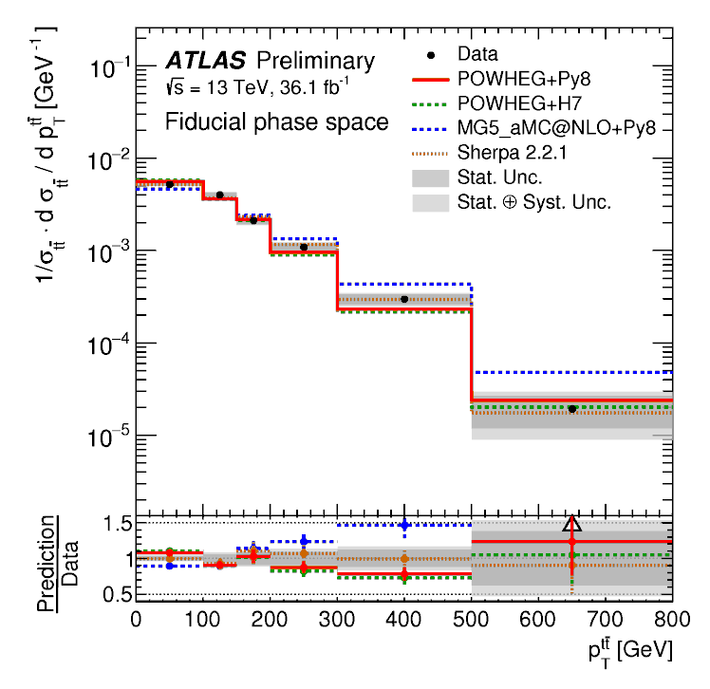
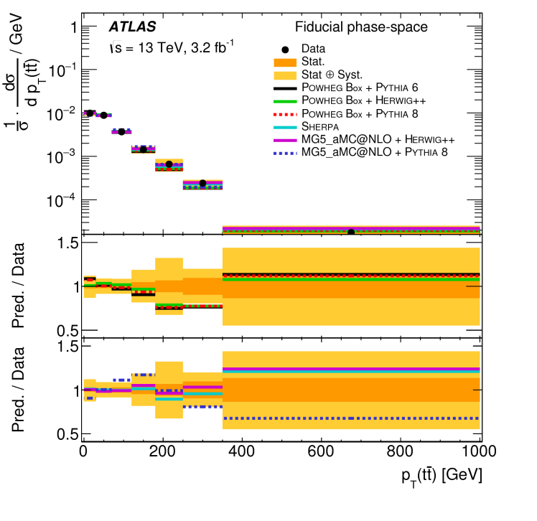
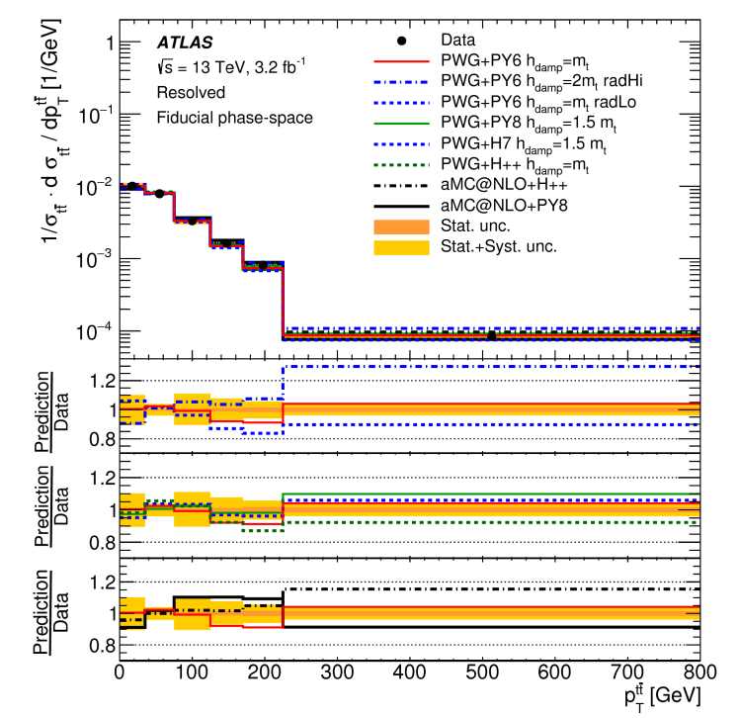

Result: $t\overline{t}$ p_{T}
4 or more jets
6 or more jets
di-boosted
di-lepton
l+jets
While the MC samples shows a reasonably good agreement with the data in a standard 4+ jet selection, when requesting 6 jets the MC prediction do not model data well
This variable is sensitive to additional radiation
Not all predictions can describe the high p_{T} region

Slide 12
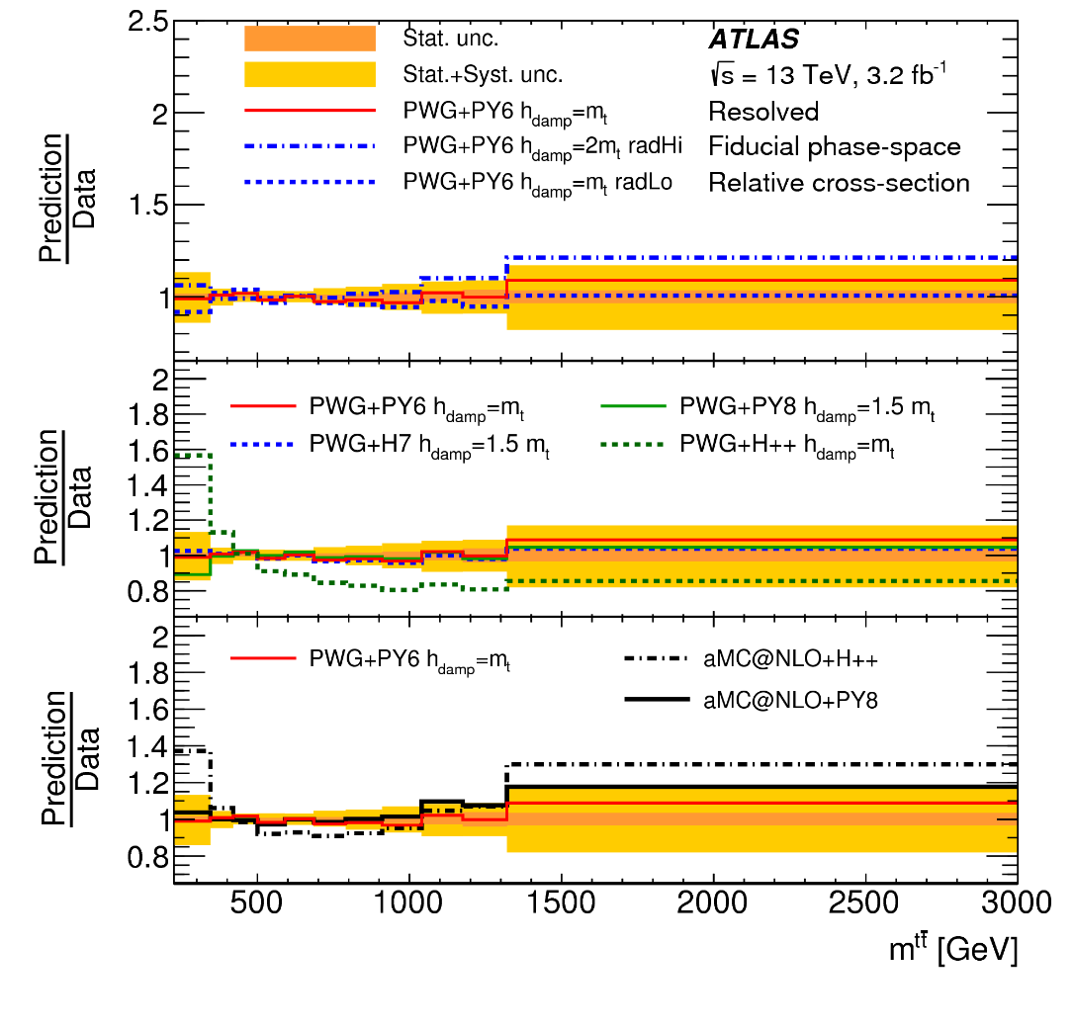
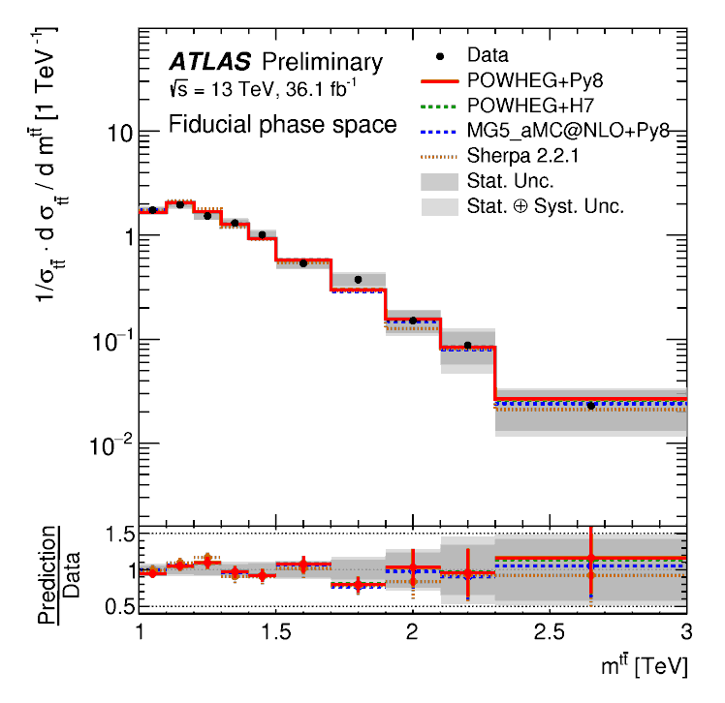
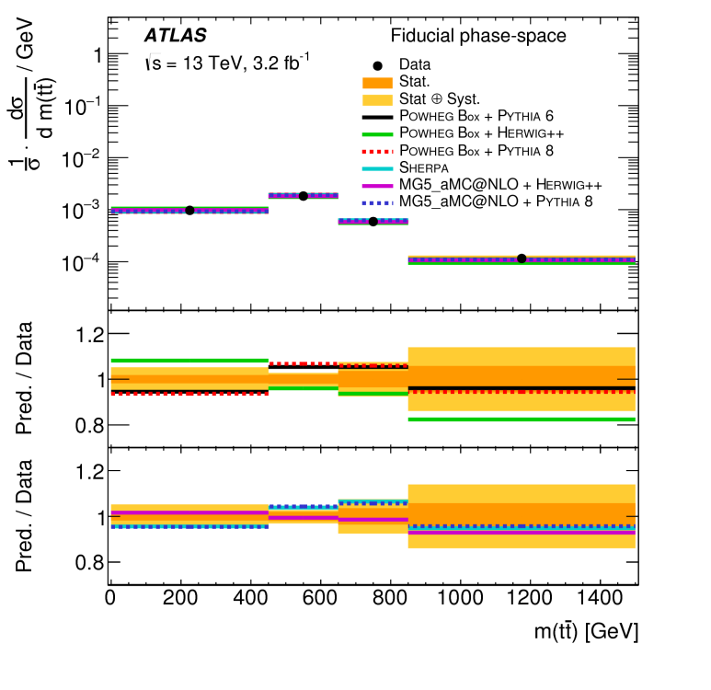
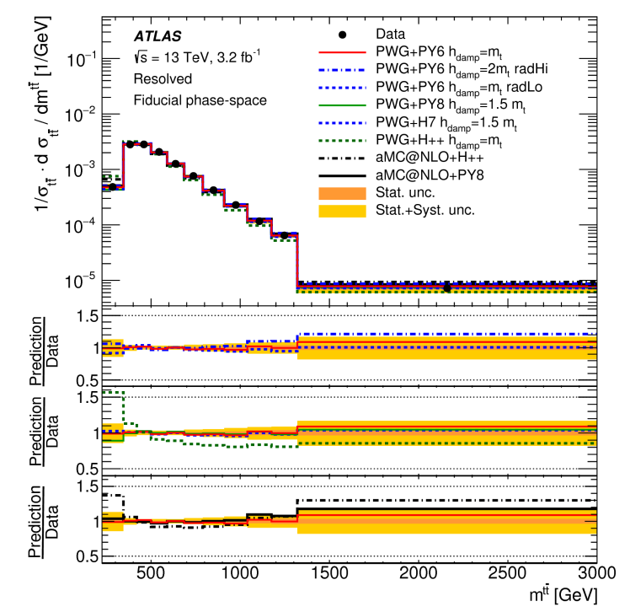

Result: $t\overline{t}$ mass
di-boosted
di-lepton
l+jets
Many predictions using Herwig++ are not compatible with data

Slide 13
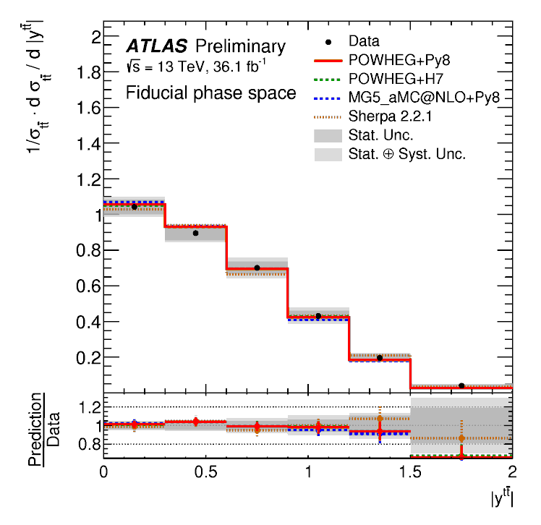
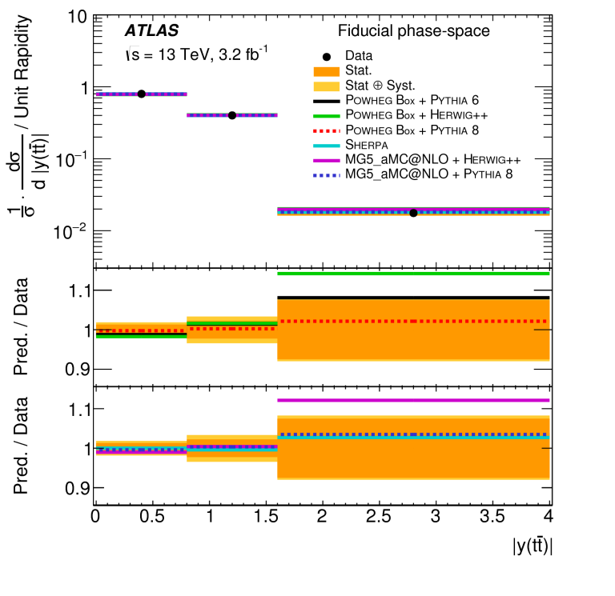
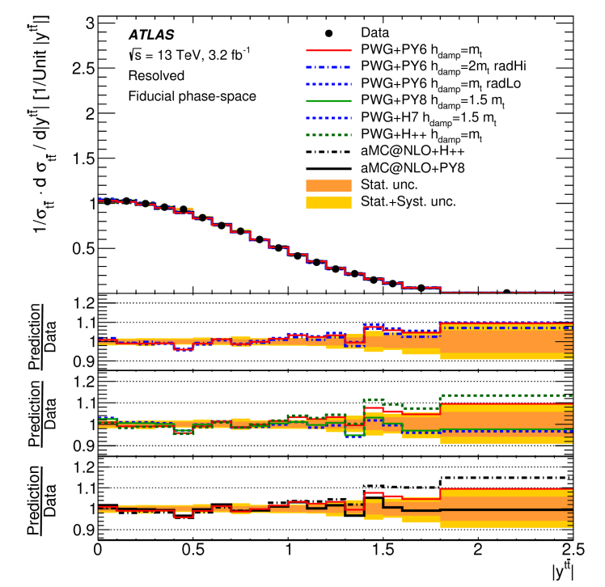

Result: $t\overline{t}$ rapidity
di-boosted
di-lepton
l+jets
All predictions are compatible with data

Slide 14
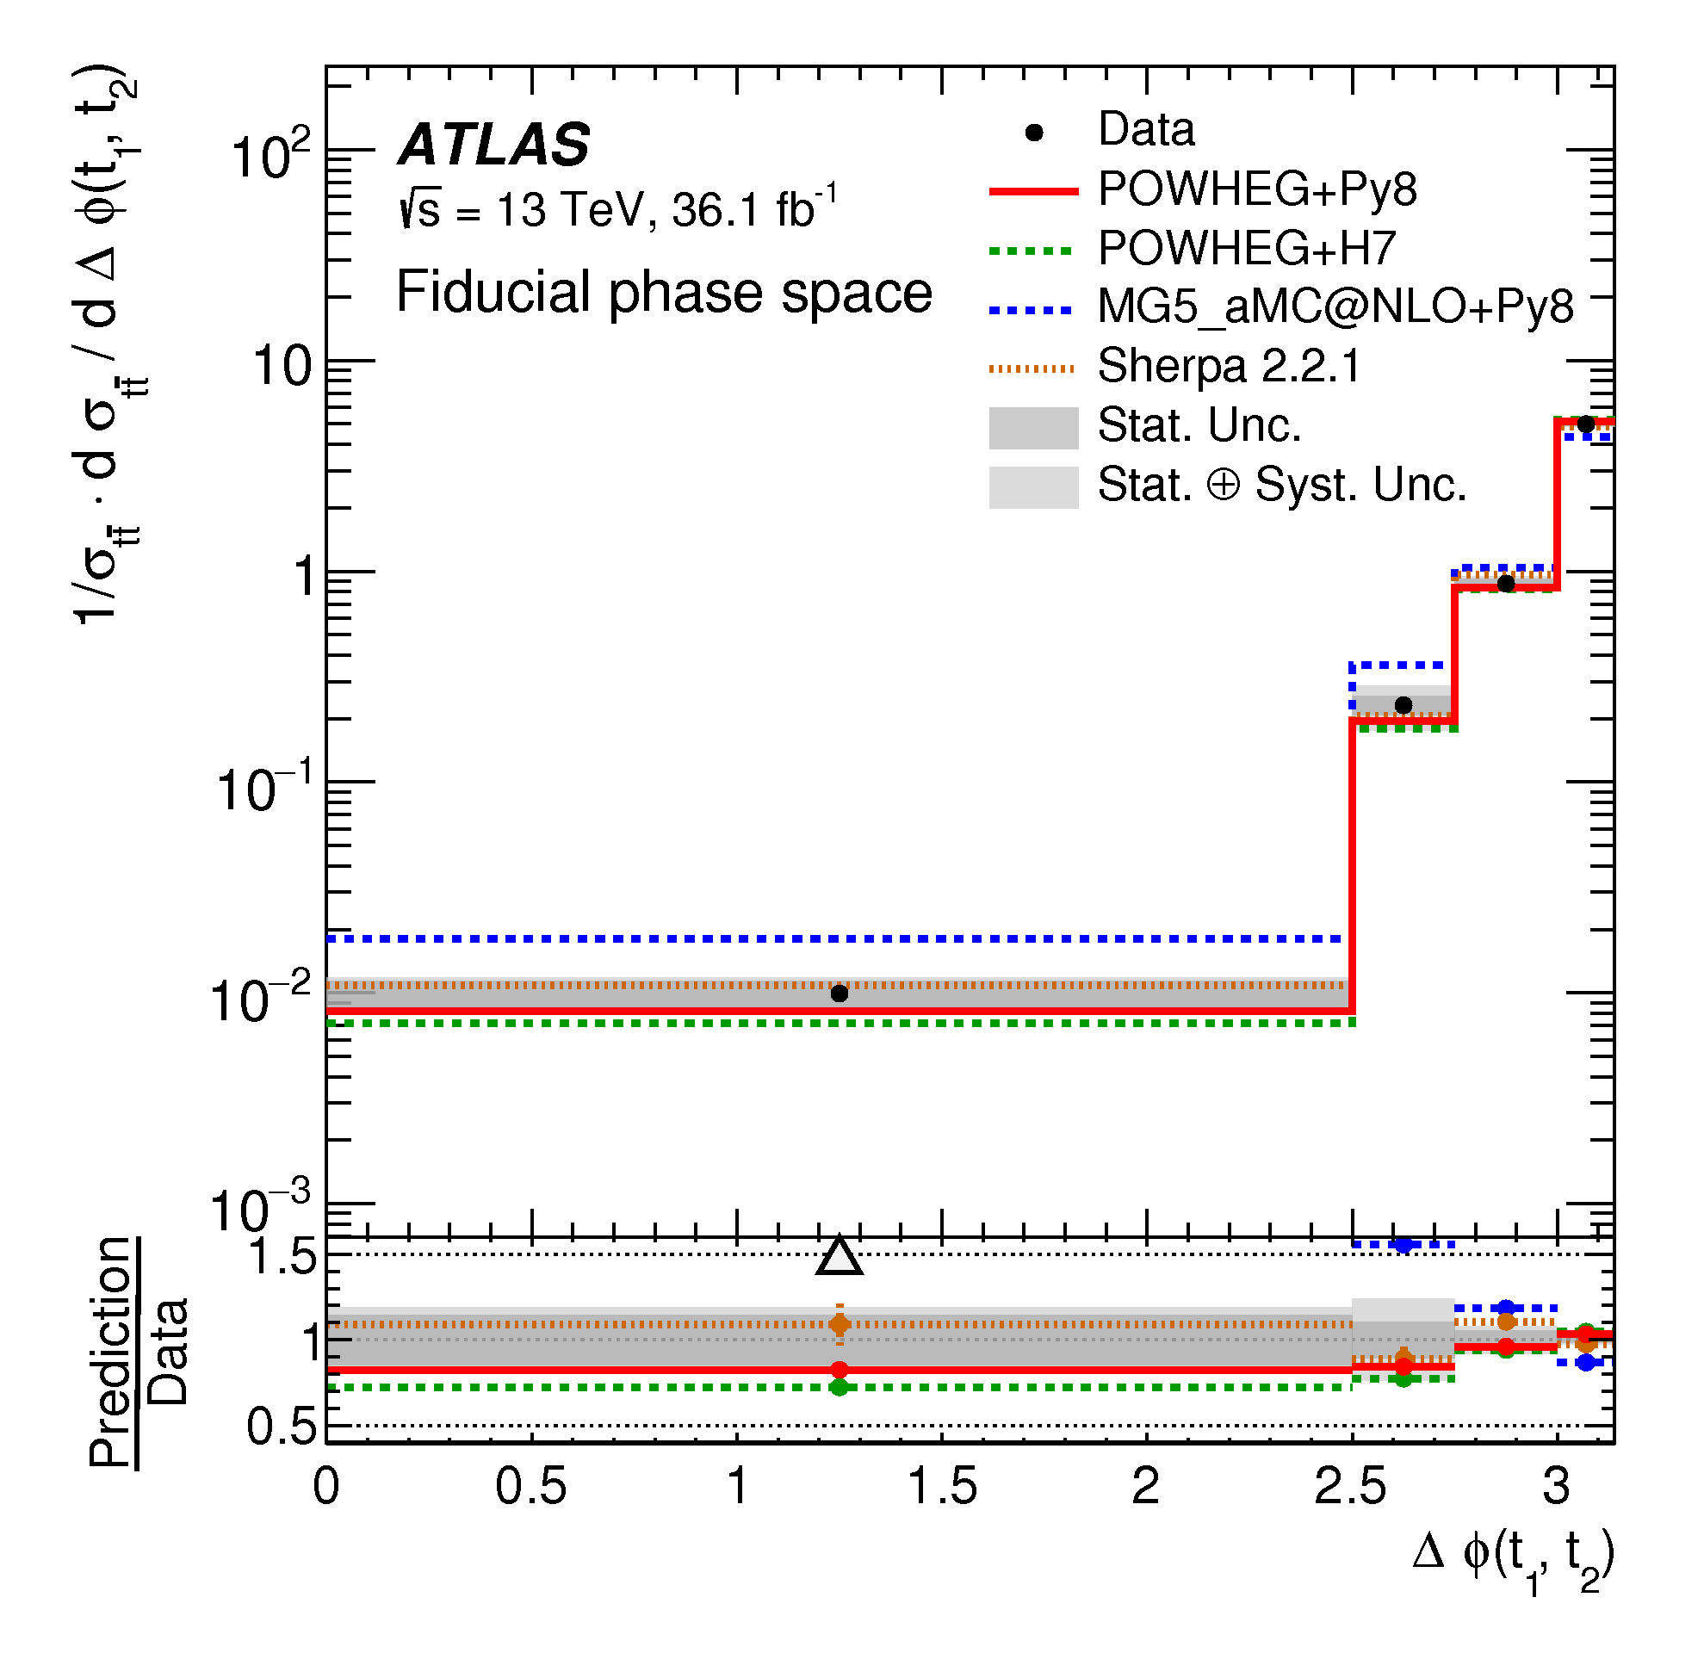
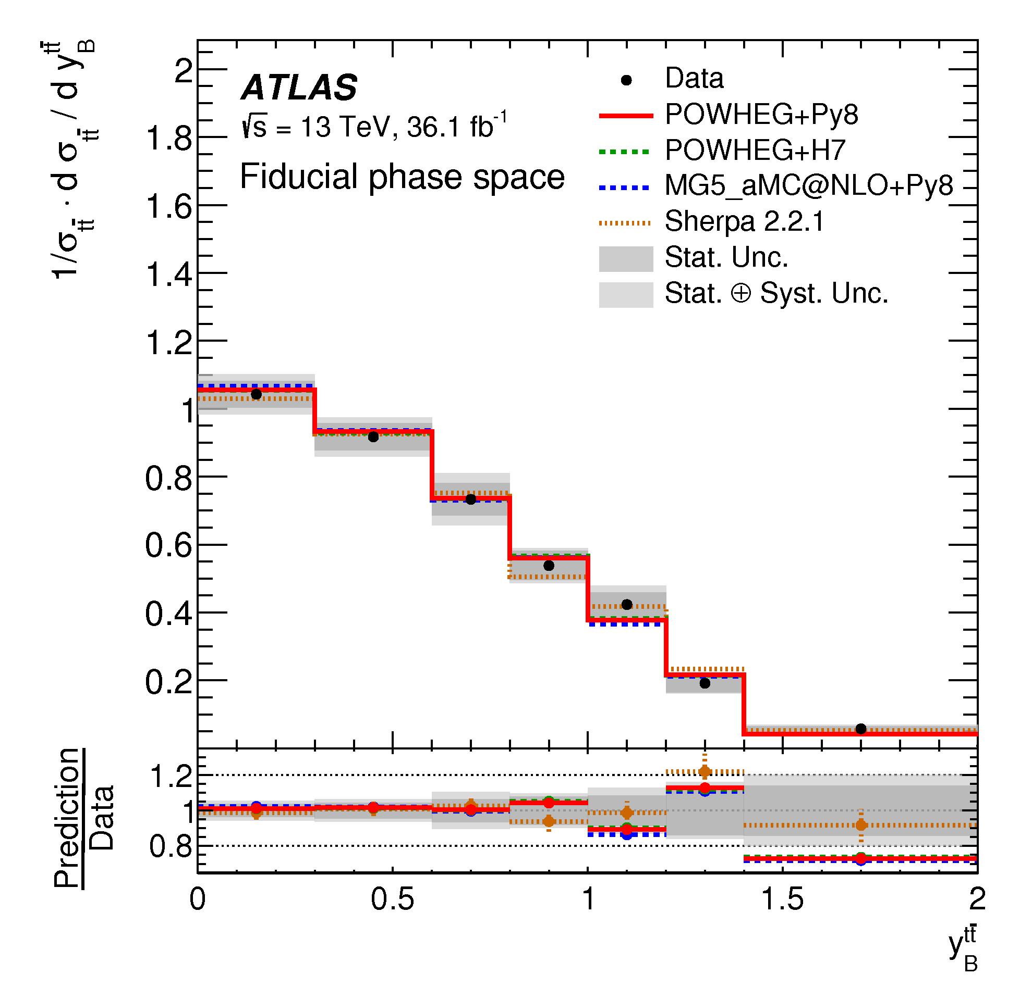
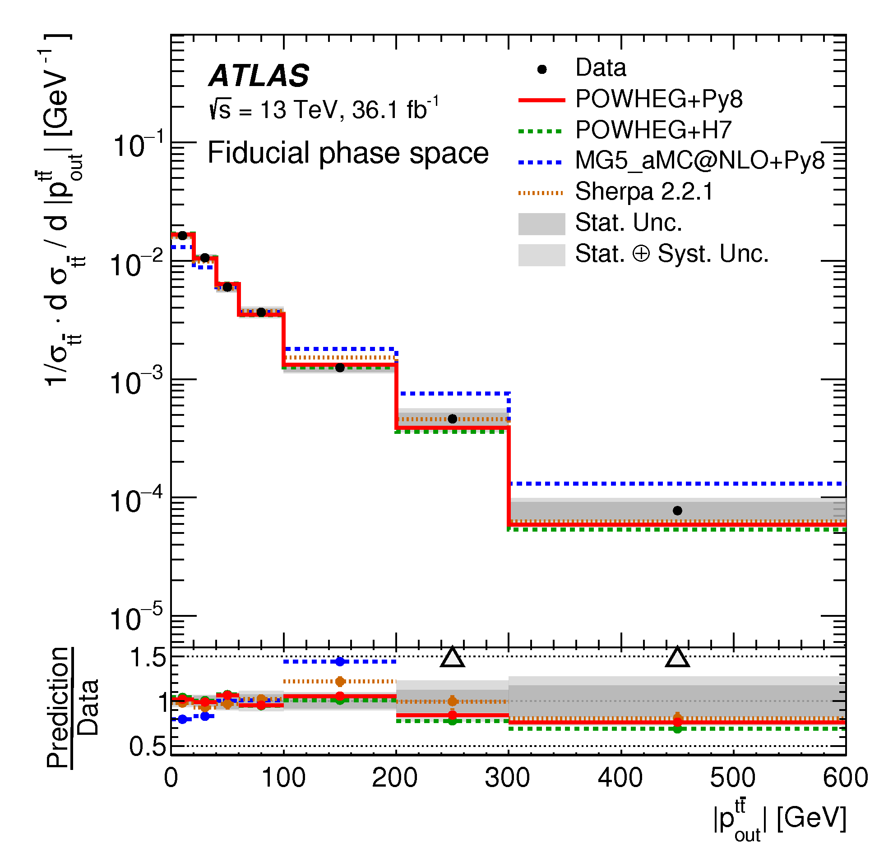
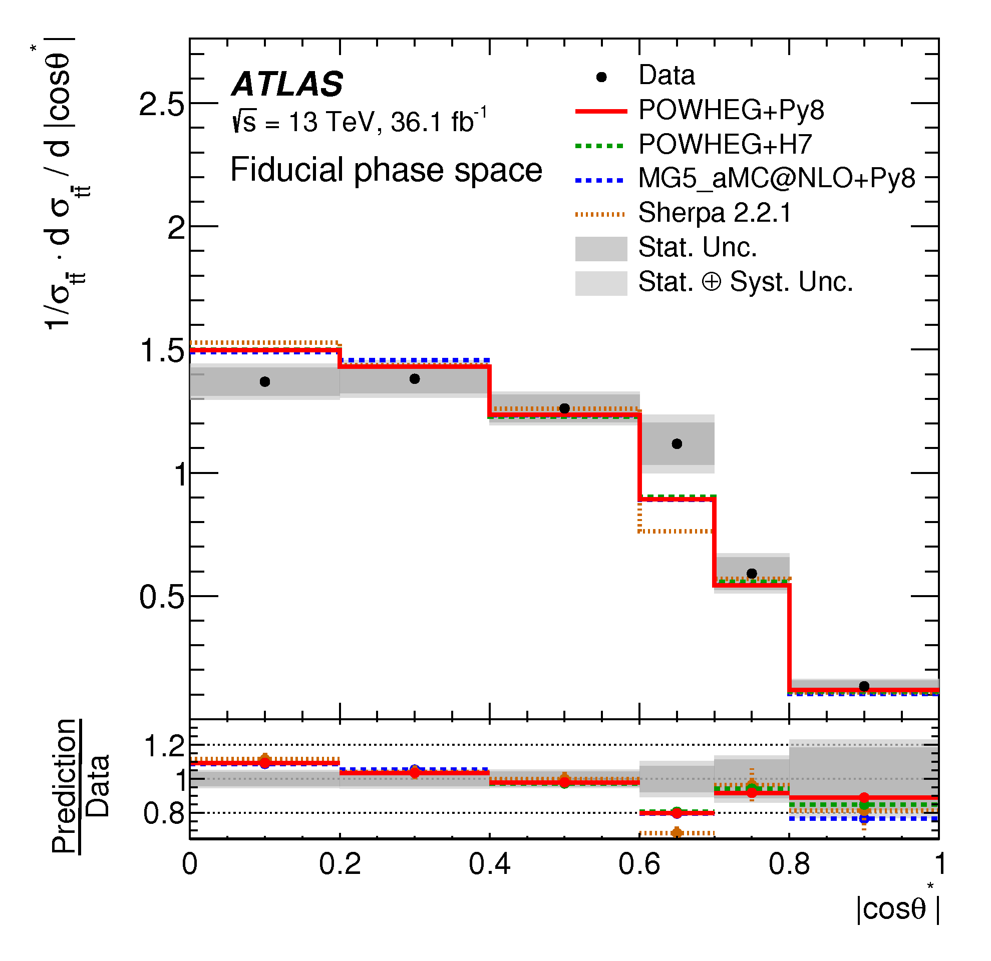
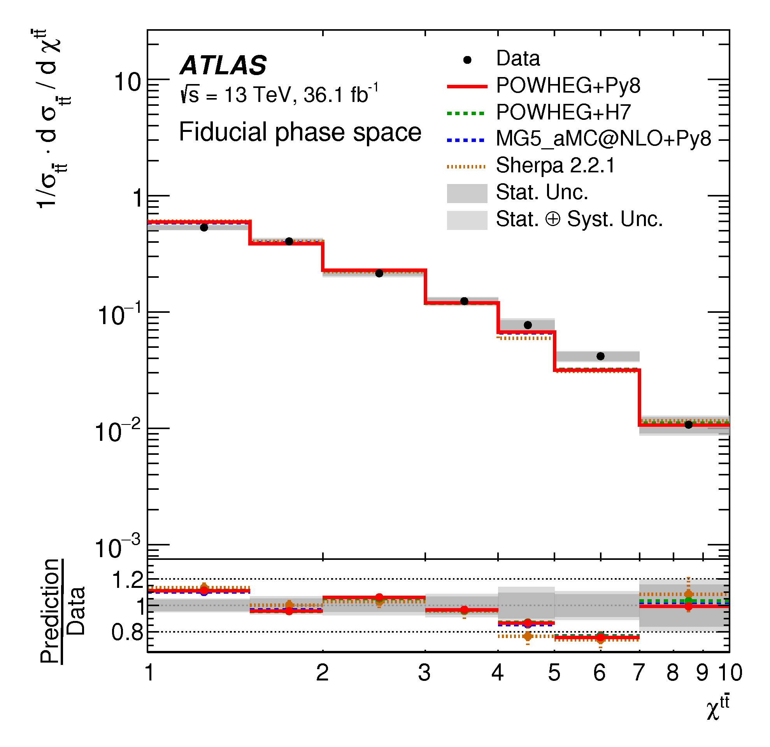

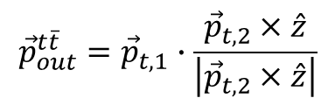
Di-boosted hadronic: Other variables
di-boosted
Only MG5_aMC@NLO is not compatible with data
$${\vec{p}}_{out}^{t\overline{t}}={\vec{p}}_{t,1}∙\frac{{\vec{p}}_{t,2}×\hat{z}}{\left|{\vec{p}}_{t,2}×\hat{z}\right|}$$
$χ_{t\overline{t}}=exp\left[y_{t,1}−y_{t,2}\right]$

Slide 15
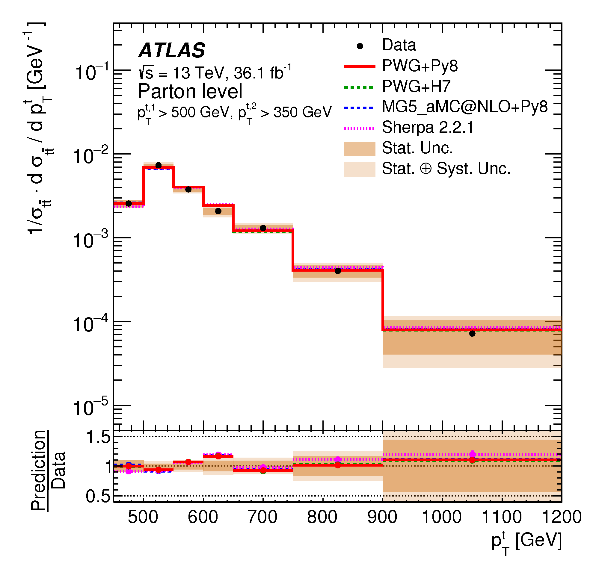
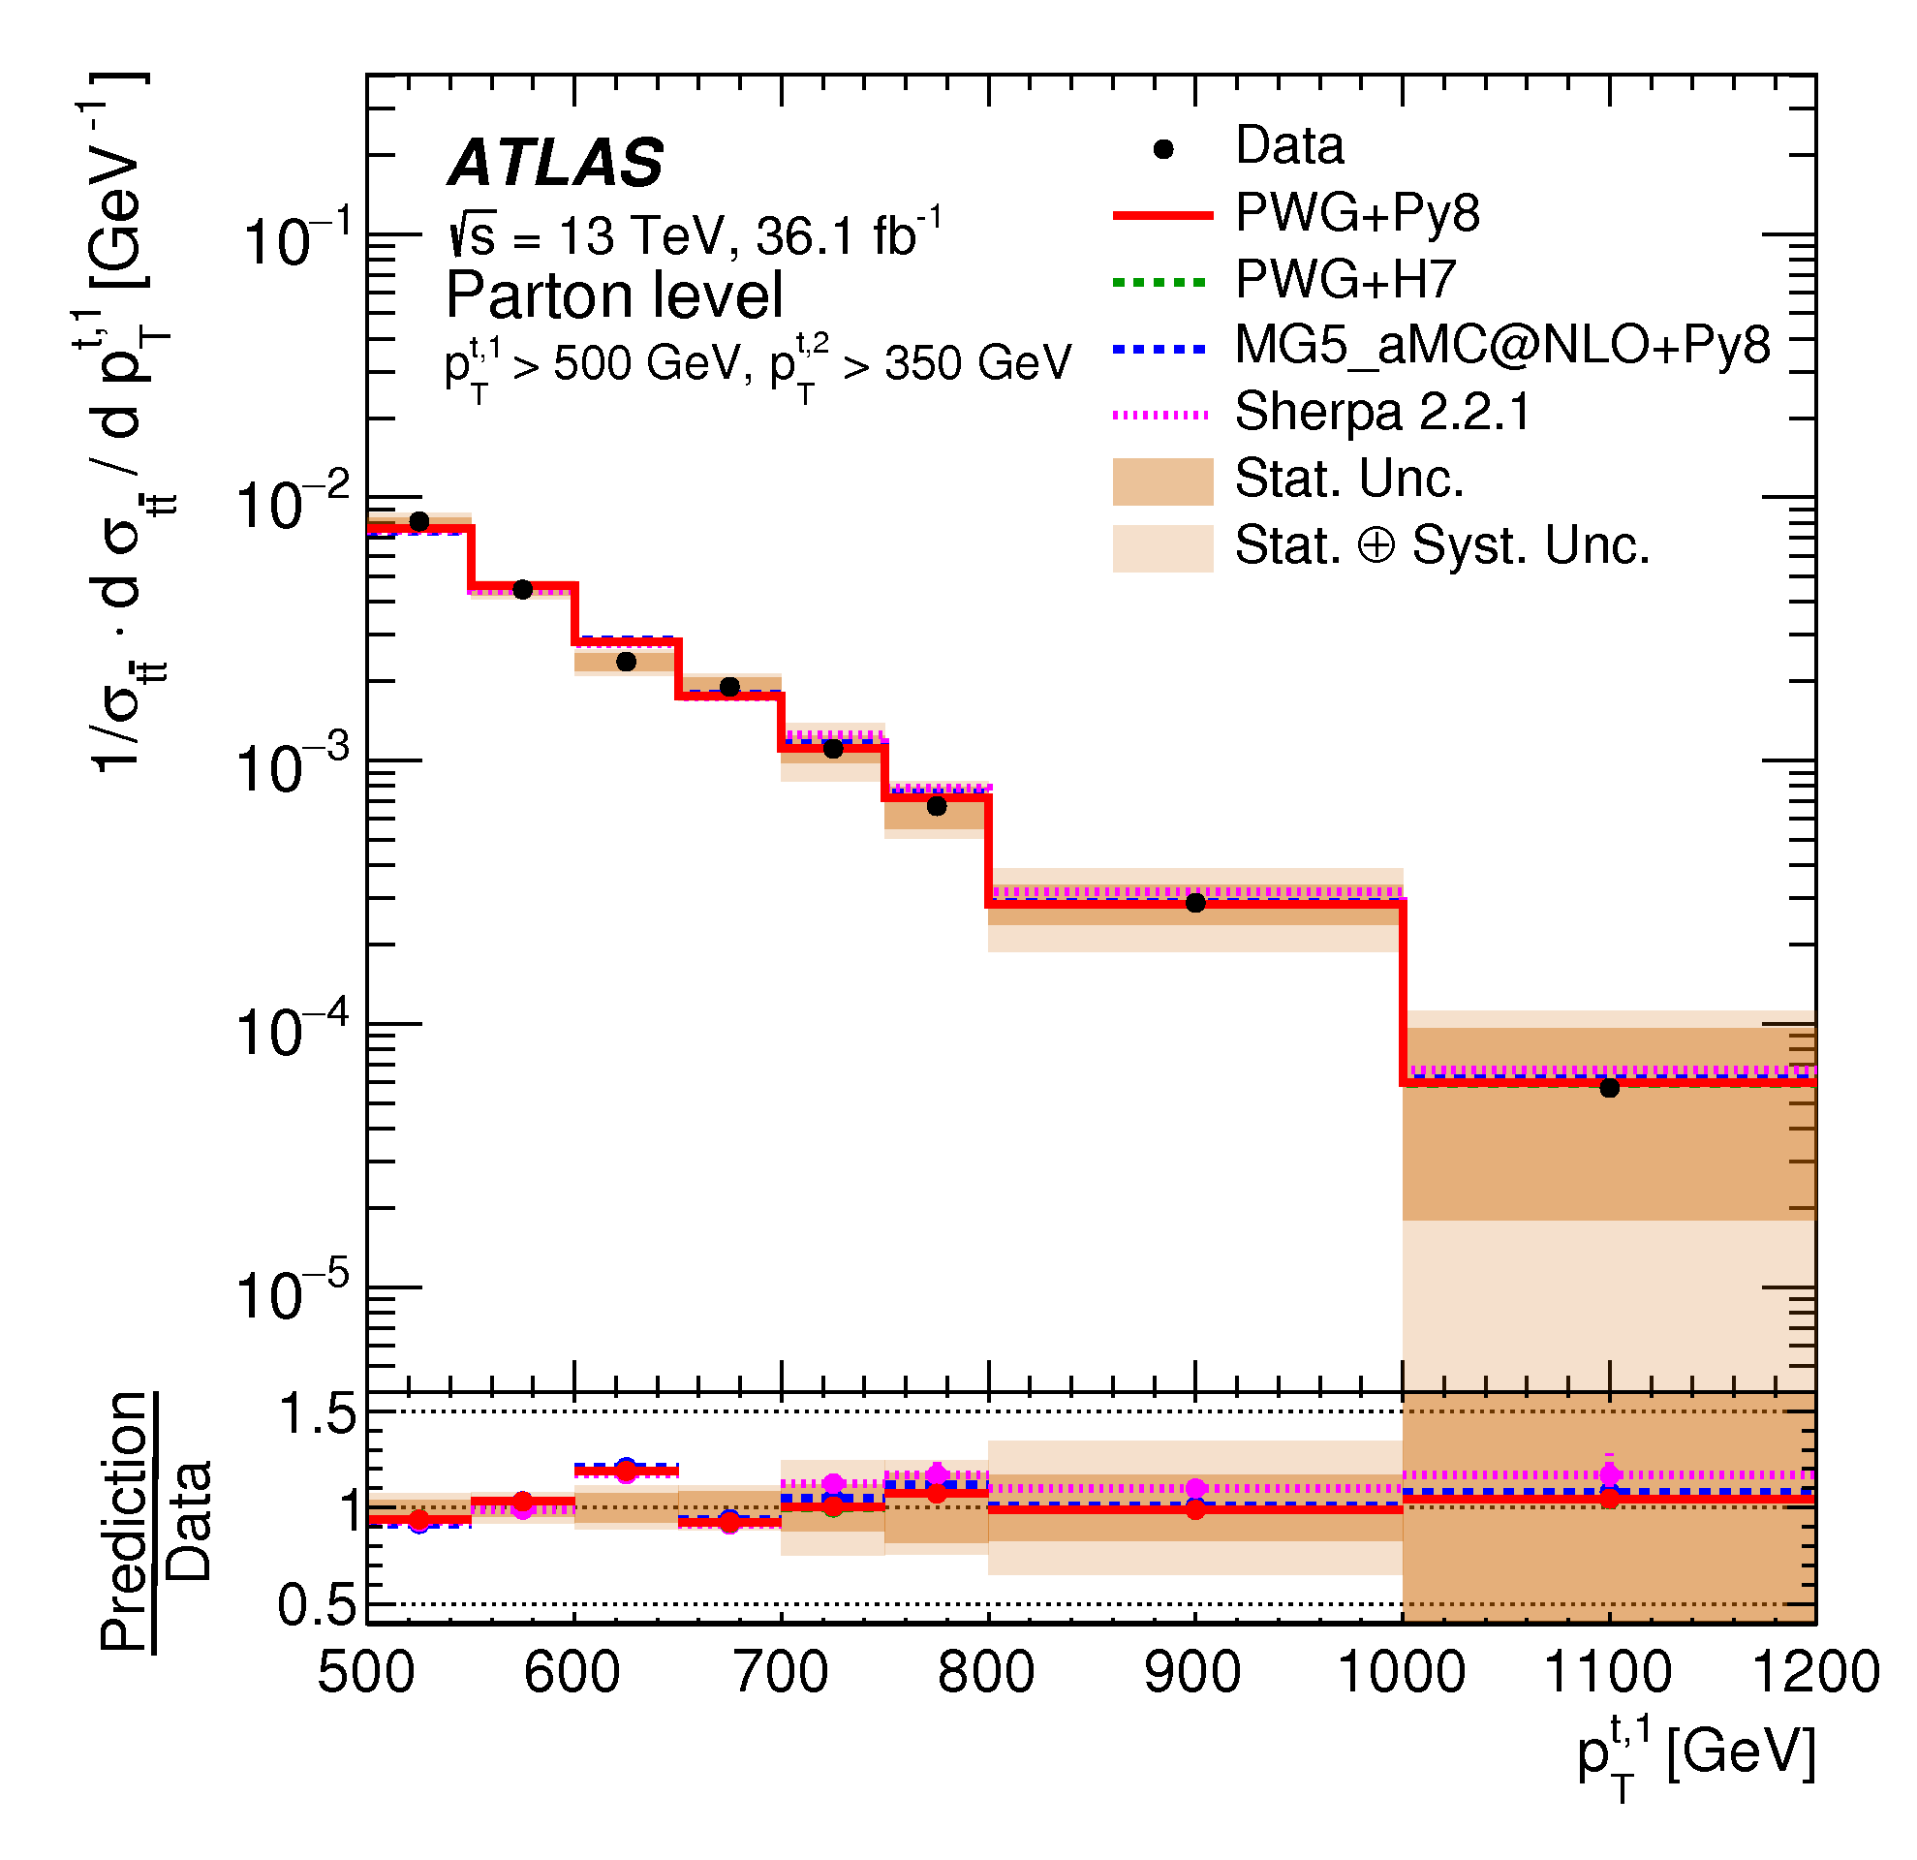
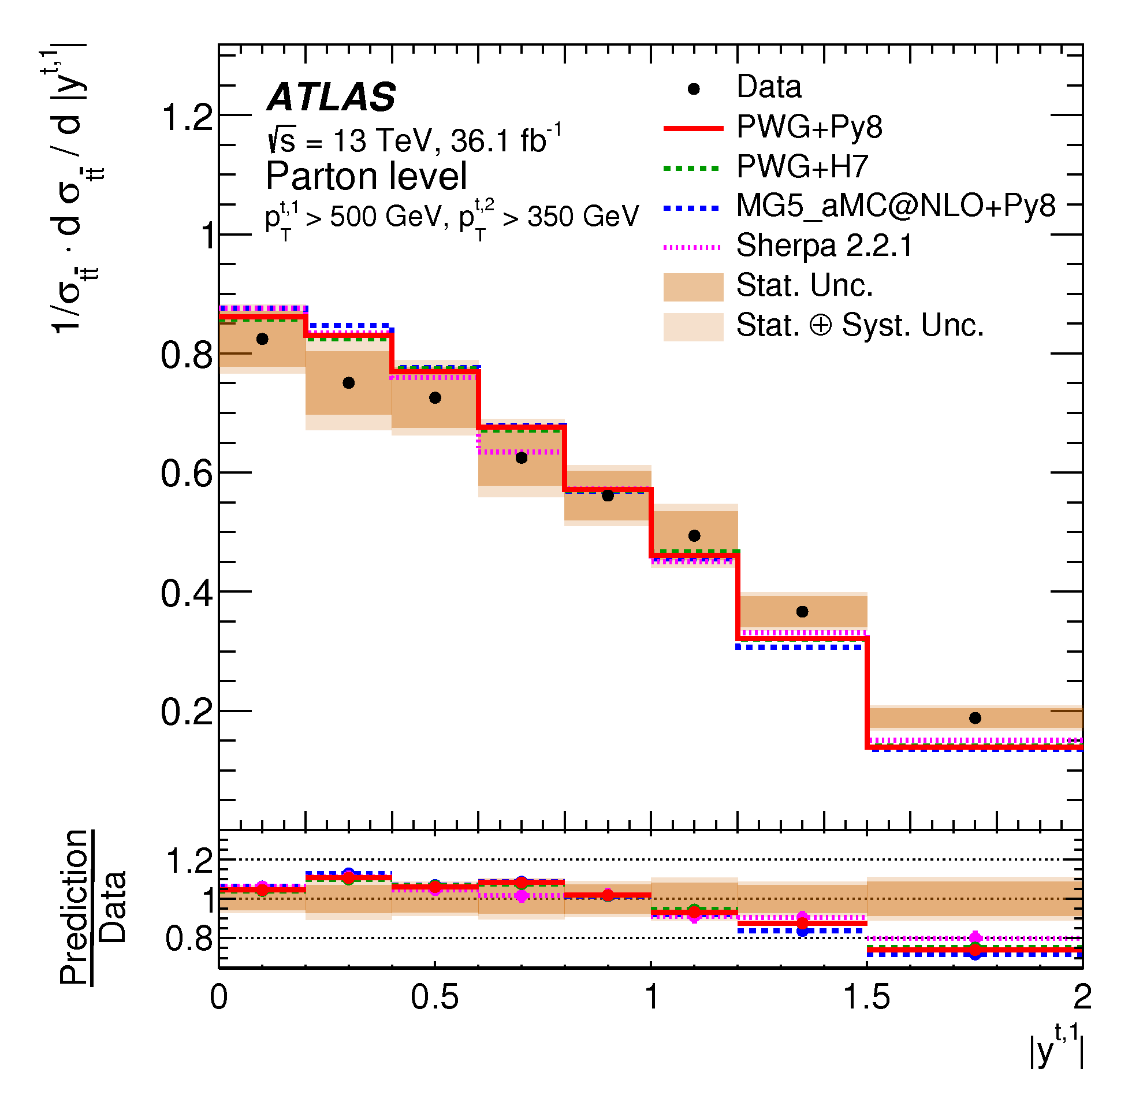
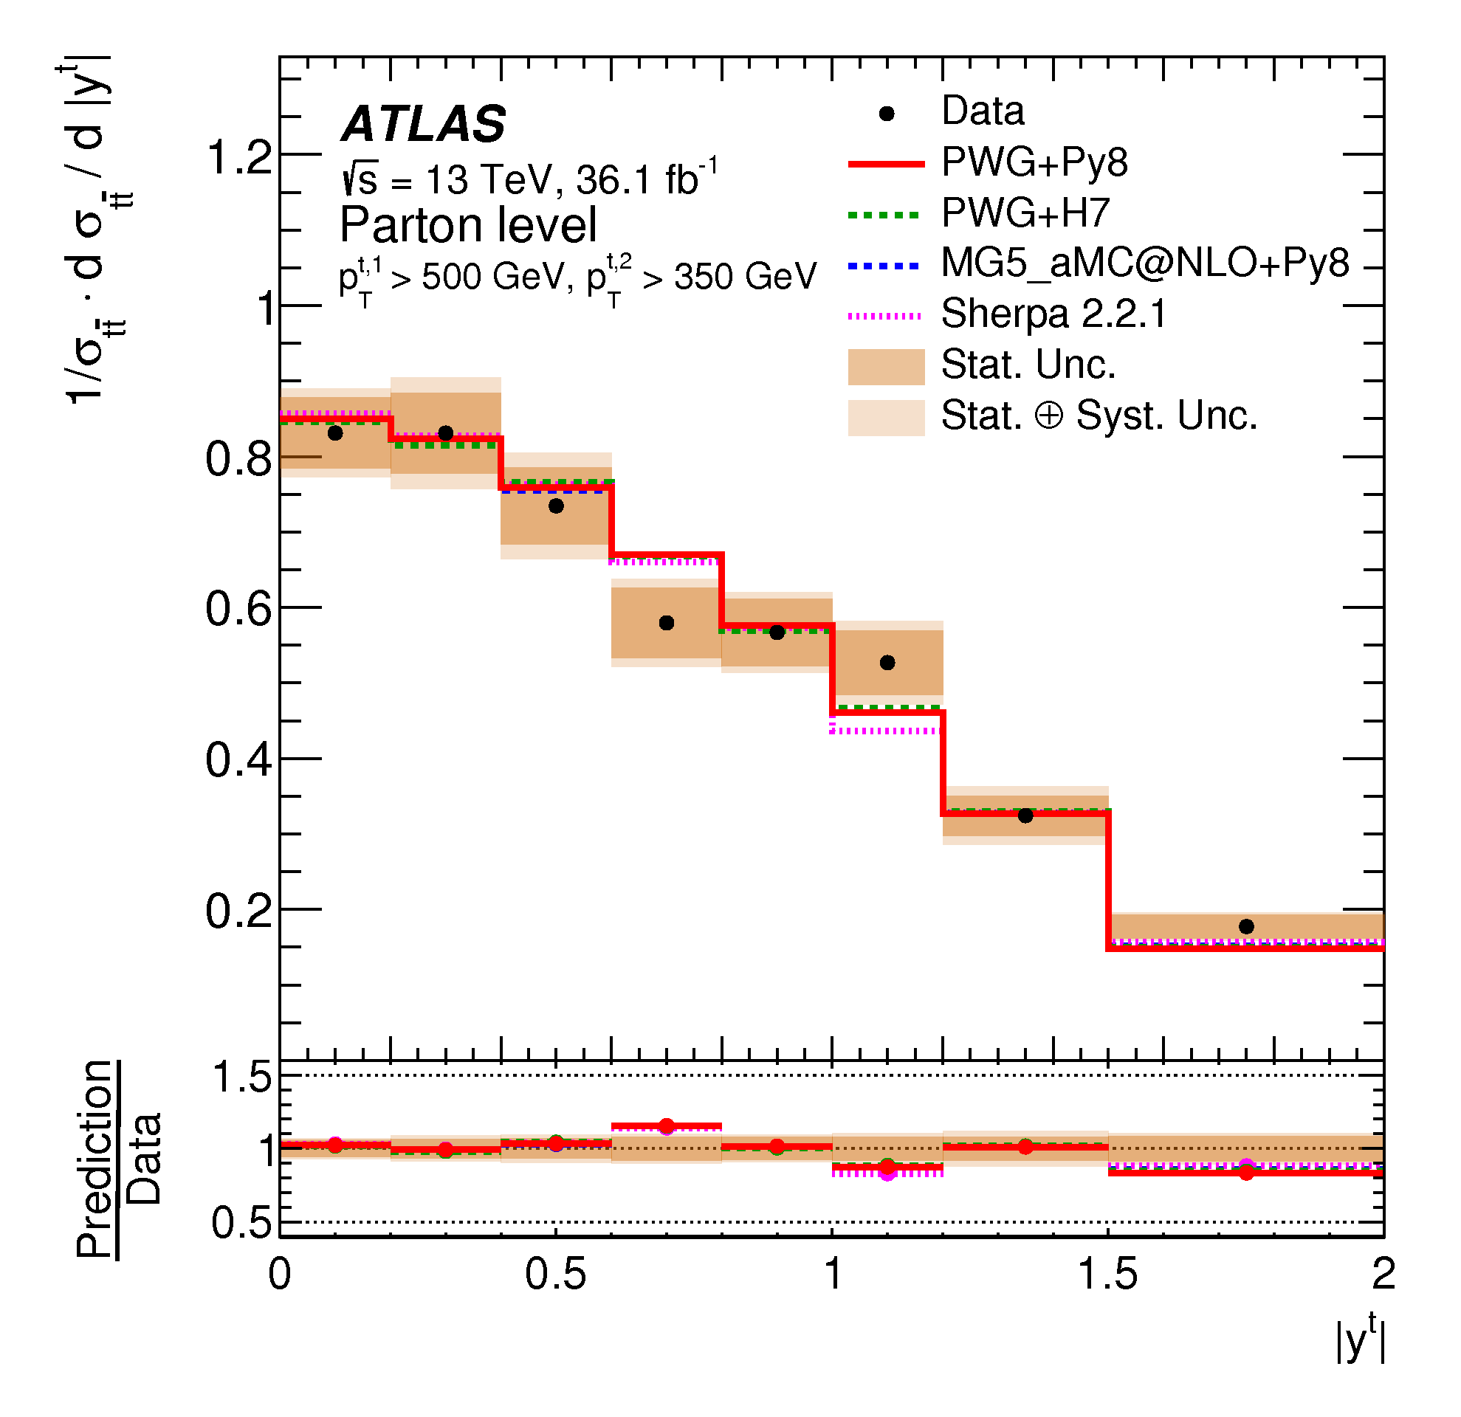
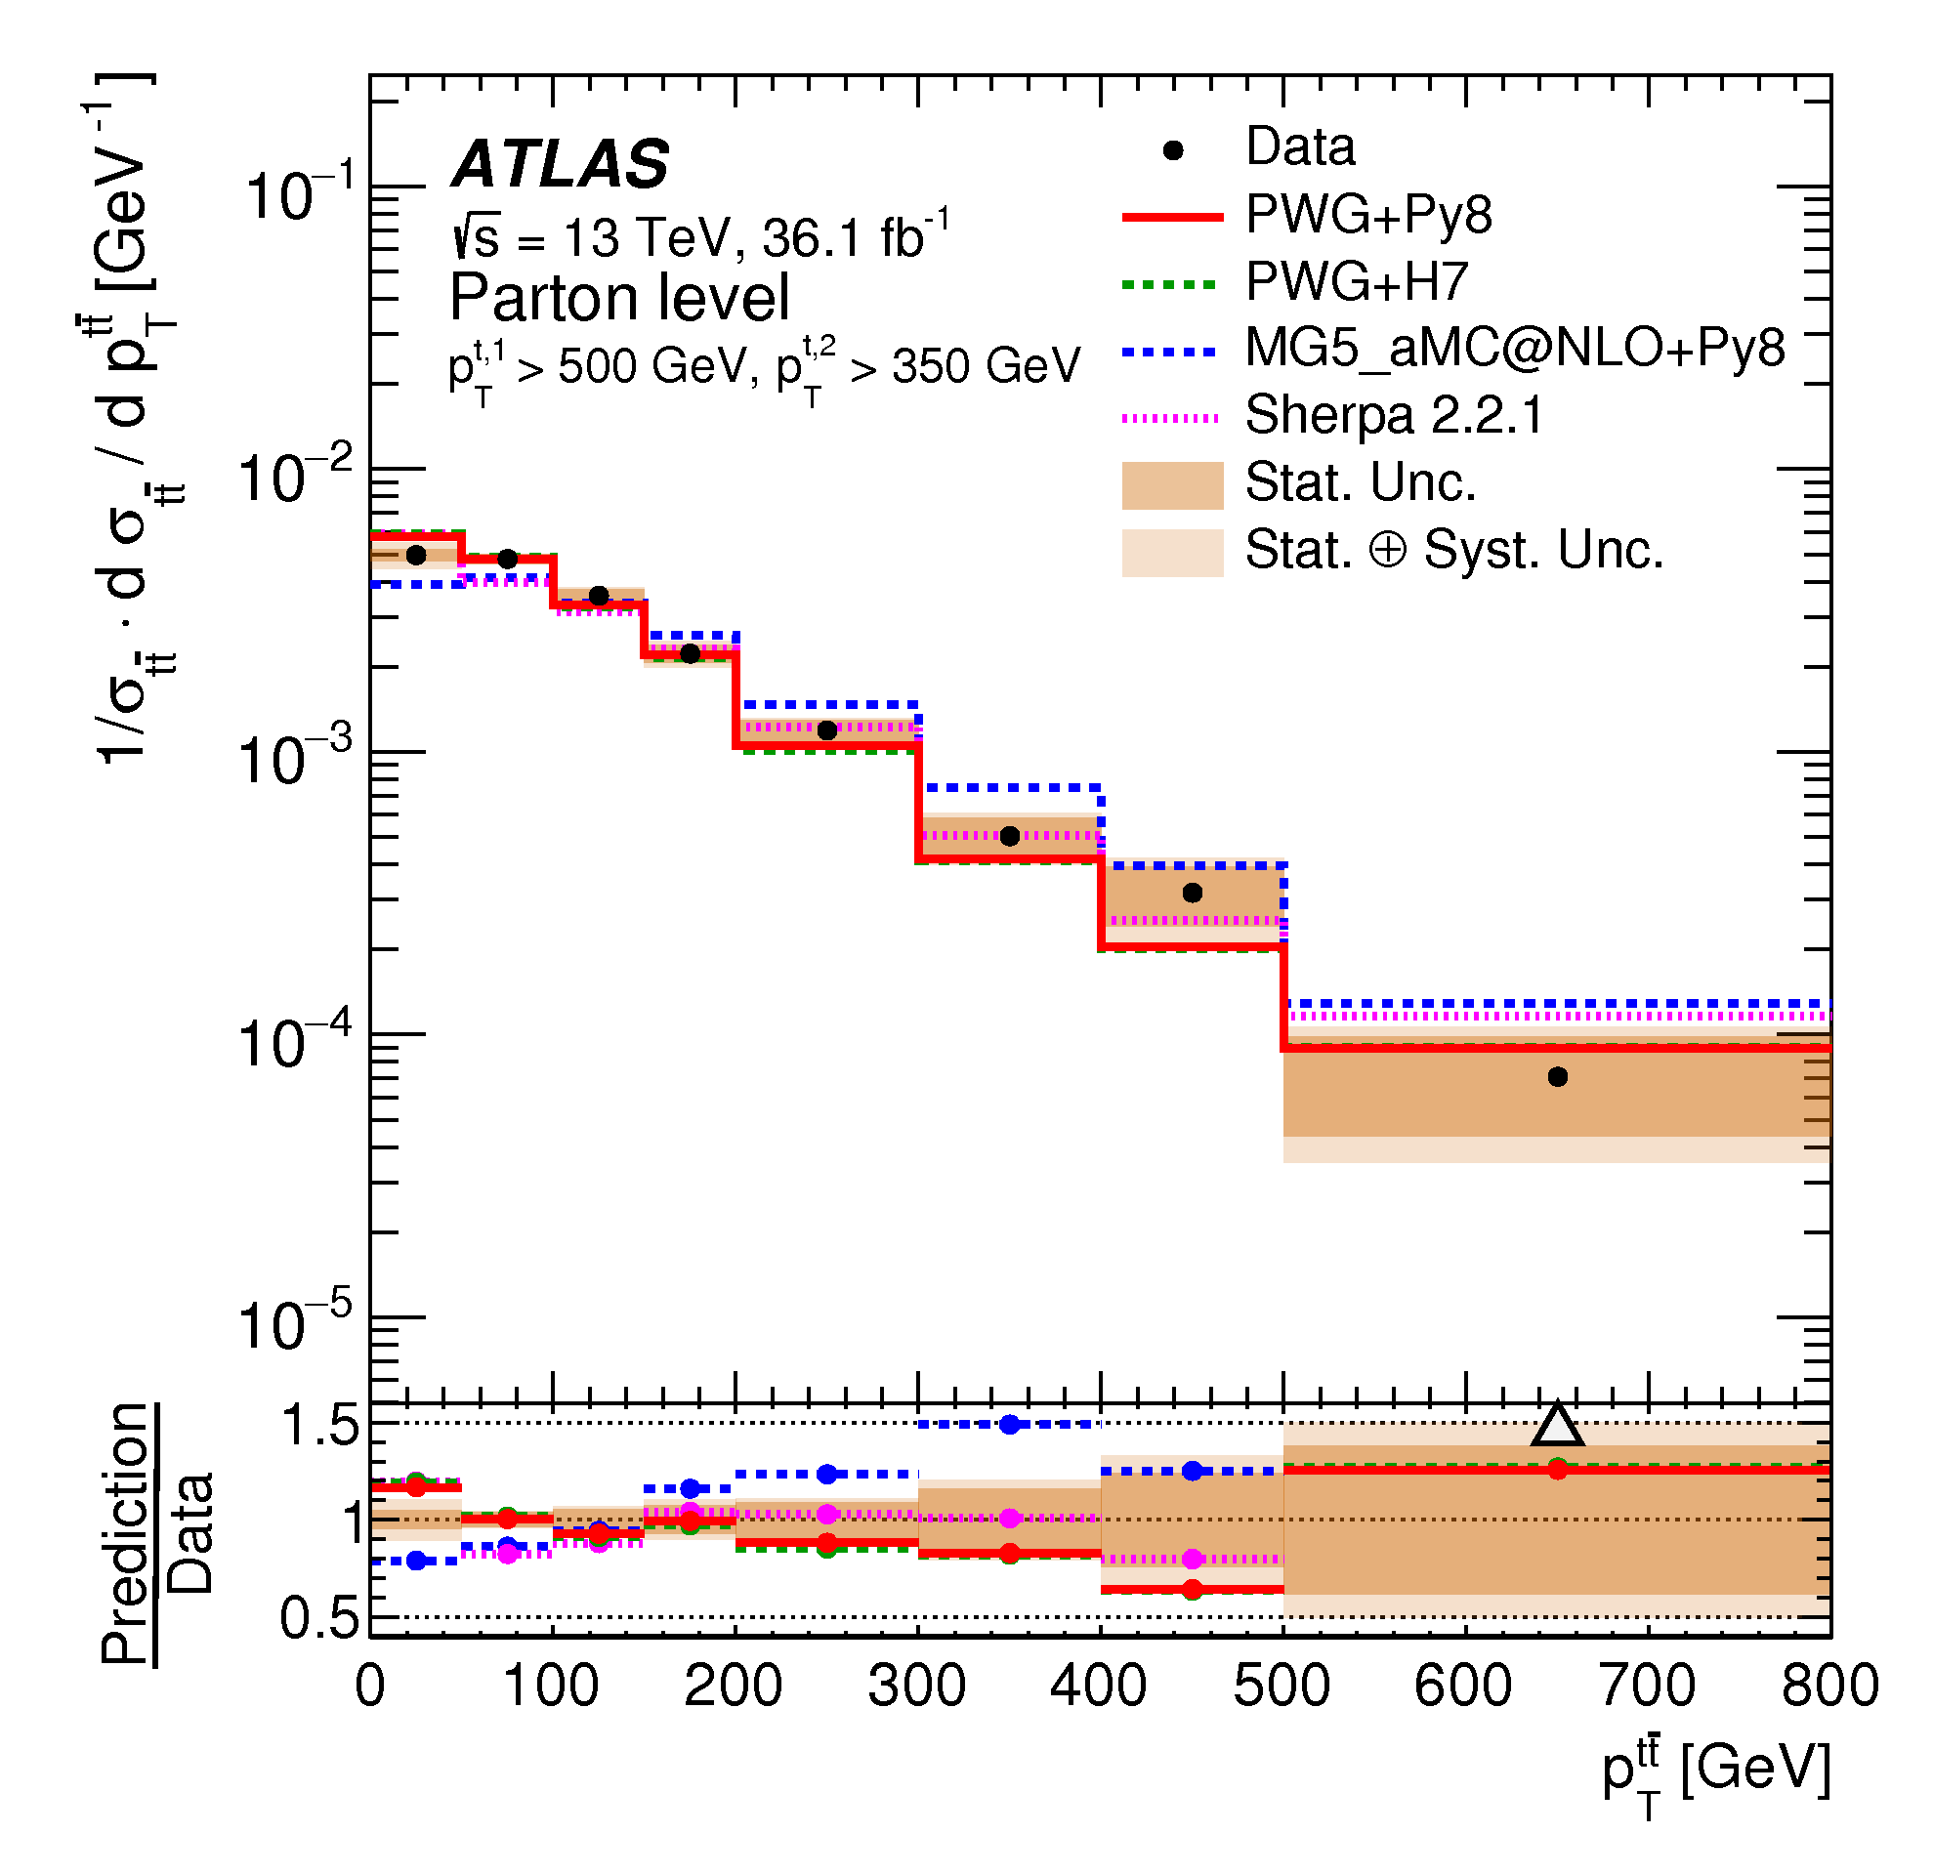
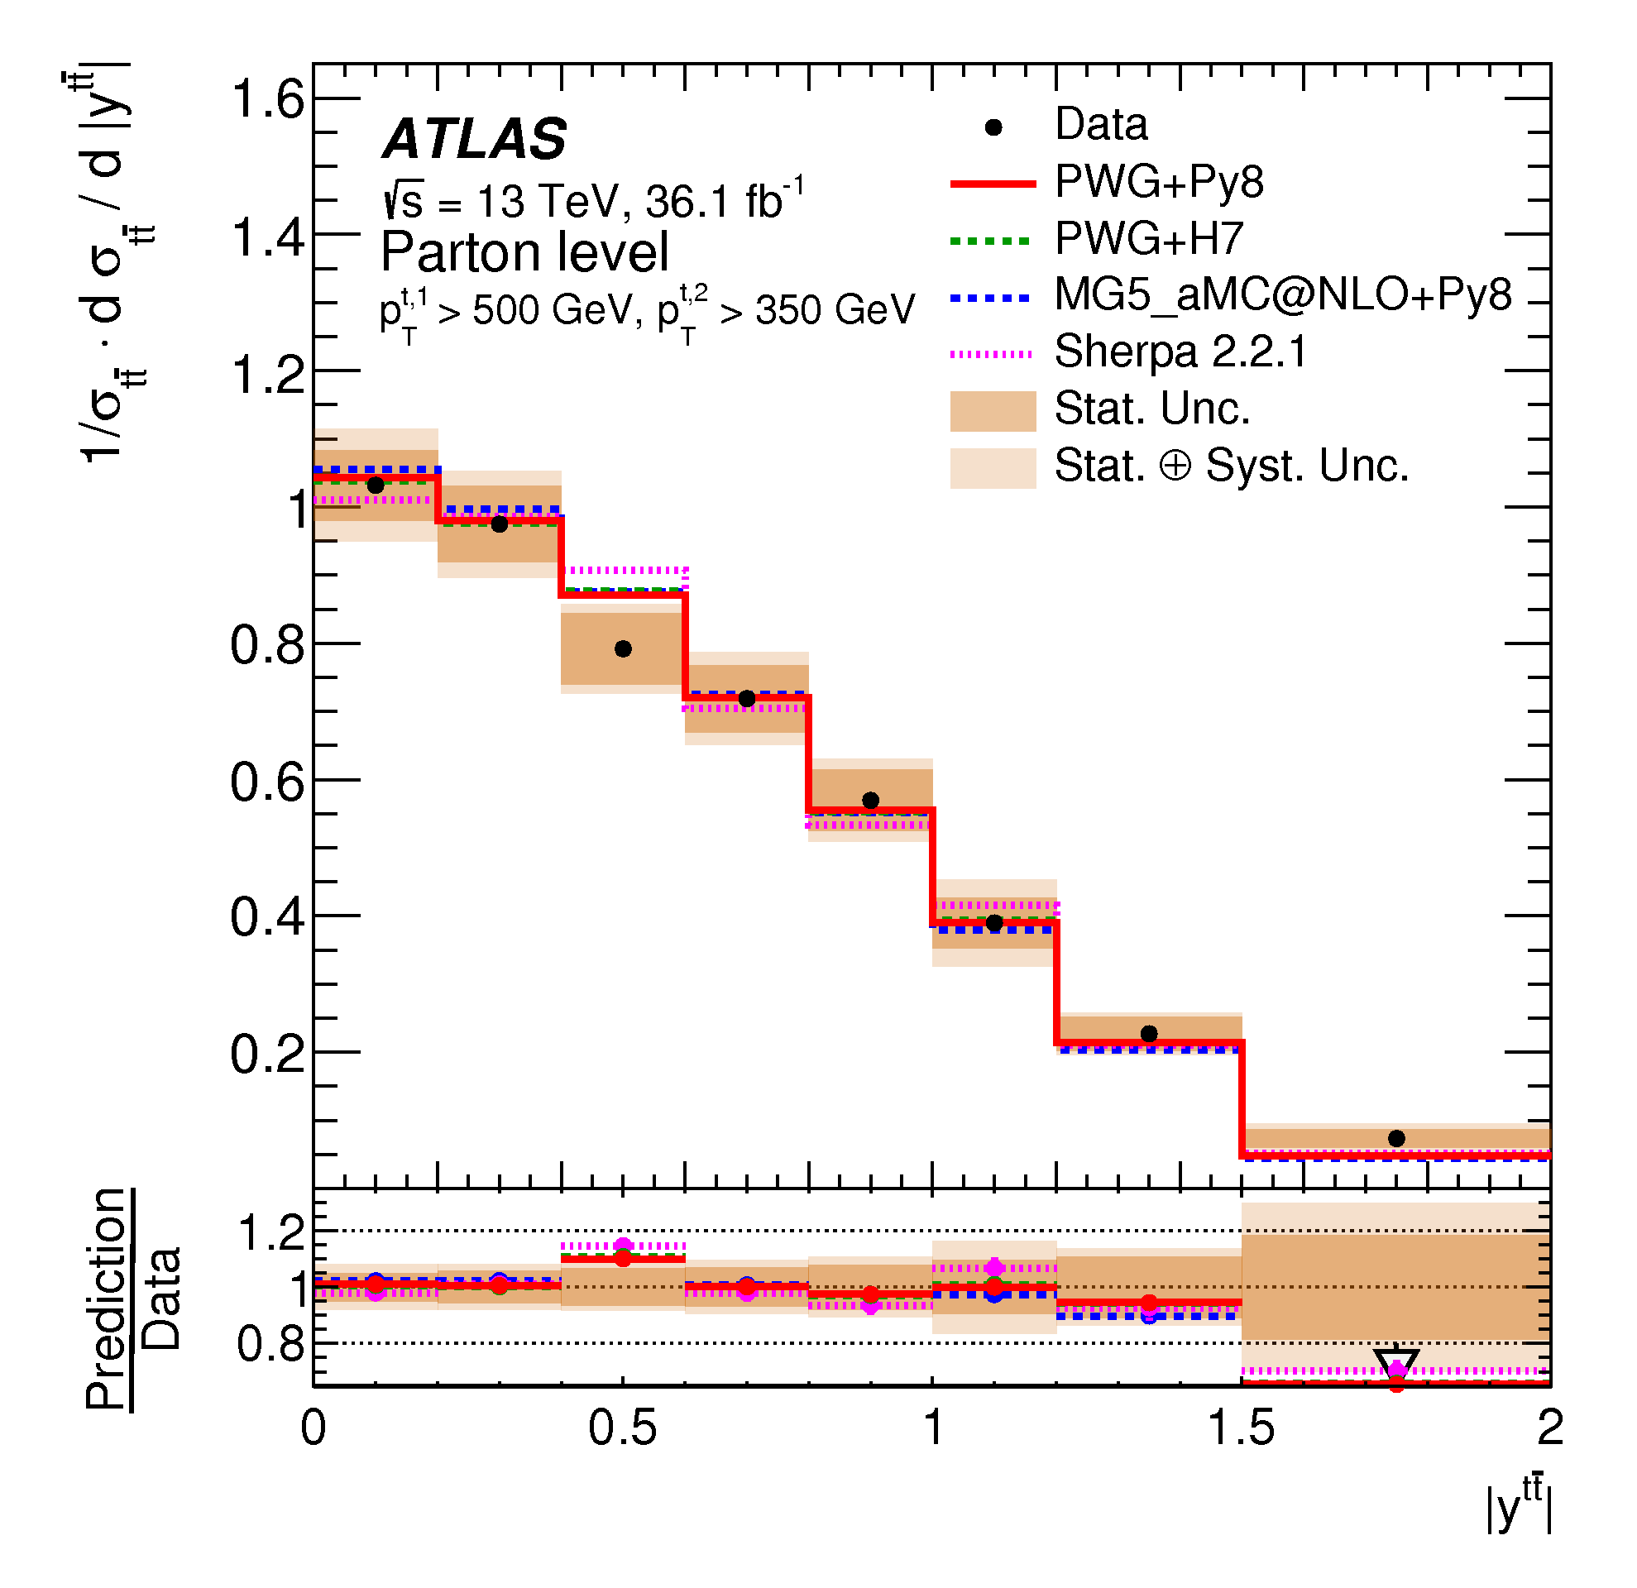
Di-boosted hadronic: Parton level

Slide 16
Conclusion
Many results produced in the last years
  All channels considered
Some tensions are visible between data and predictions in different channels
  A slope is visible for the top p_{T}
  No MC can describe all variables perfectly
The new measurements can be used to improve the tuning of the next generation of MC
  A better agreement is seen for the MC predictions tuned with Run1 and 2015 data

Slide 17
Backup

Slide 18
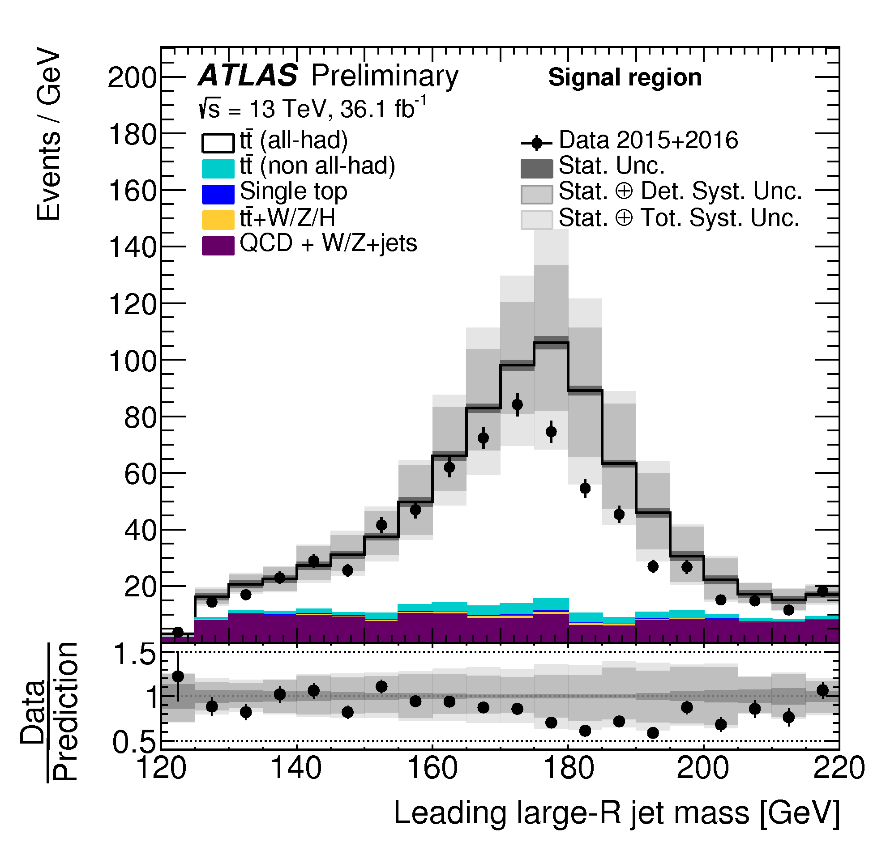
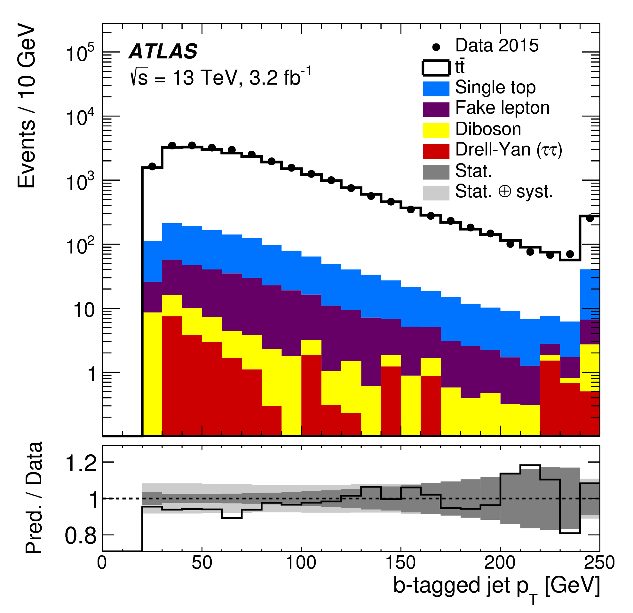
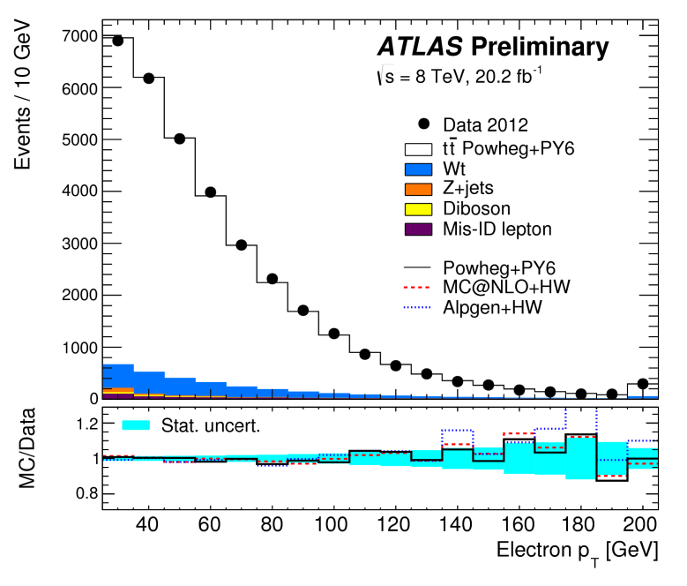
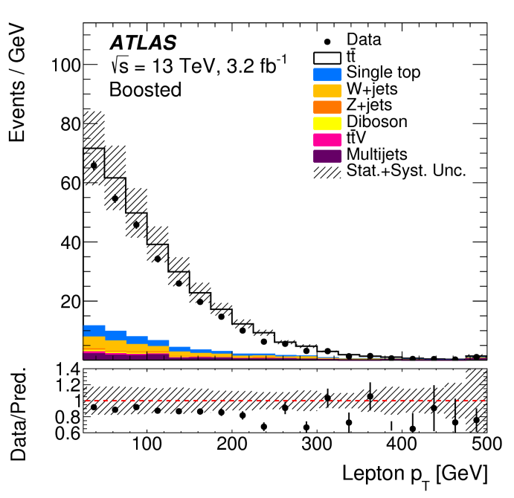
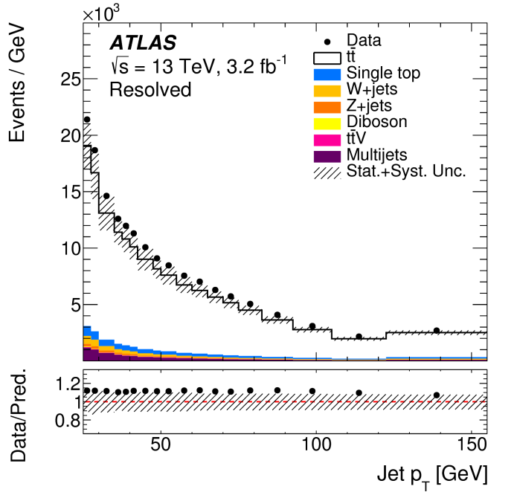
Data/MC agreement
di-lepton
di-boosted
di-lepton
l+jets
l+jets
The background is small in all channels

Slide 19

Data and MC samples used
$$\sqrt{\text{s}}\text{=13 }\text{TeV}$$
di-lepton and l+jets
  2015 data (3.2 fb⁻¹)
di-boosted
  2015+2016 data (36.1 fb⁻¹)
MC predictions:
  PowHeg+Pythia6 (old nominal)
  PowHeg+Herwig++
  PowHeg+Pythia8 (new nominal)
  PowHeg+Pythia6/8 IFSR variations
  PowHeg+Herwig7
  MG5_aMC@NLO+Herwig++
  MG5_aMC@NLO+Pythia8
  Sherpa (2.2.1)

Slide 20
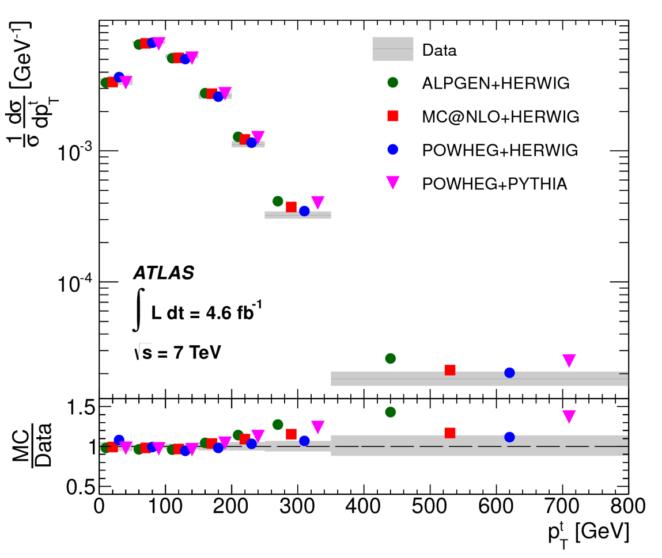

Top p_{T}: an history at particle…

Slide 21


and parton level

Slide 22
Selections

Slide 23

Di-lepton analysis: topology and selection
1 electron and 1 muon with opposite sign
Both leptons with p_{T} > 25 GeV
lepton
At least 2 jets with p_{T} > 25 GeV
υ
At least one b-jets (77% WP)
W
b
t
t
lepton
The reconstruction uses the neutrino weighting method
W
b
υ

Slide 24
Resolved l+jet analysis: topology and selection
Single lepton with p_{T} > 25 GeV
lepton
At least 4 jets with p_{T} > 25 GeV
υ
W
b
Leptonic Top:
lepton
E_{T}^{Miss}
Closest b-jet to lepton
t
W reconstruction:
two jets that best reconstruct W mass
t
Select two highest p_{T} b-jets (70% WP)
W
light quark
b
light quark
Hadronic Top:
two light jets
other b-jet
Top selection is identical at reconstruction and particle level

Slide 25
Boosted l+jets: topology and selection
Single lepton with p_{T} > 25 GeV
1 b-jet with p_{T} > 25 GeV (R=0.4)
lepton
E_{T}^{Miss} > 20 GeV
m_{T}(W) > 60 GeV
υ
W
ΔR(l, jet) < 1.5
t
ΔR(l, l-jet) < 1.5
b
t
W
ΔR(b-jet, l-jet) < 1.5
b
light quarks
Large jet R=1: p_{T}>300GeV, mass> 100 GeV

Slide 26
Di-boosted hadronic: topology and selection
2 Large-R jets:
J1 > 500 GeV
J2 > 300 GeV
light quarks
W
2 b-tag jets (>25 GeV, 70% WP)
They bust be inside the large-R jet cone
t
b
t
W
b
light quarks

Slide 27
Particle level objects
γ
Charged leptons not decaying from a hadrons are “dressed” with the energy from all photons within a R=0.1 cone around the lepton
l
ν
μ
π
K
Jets are clustered from stable MC particles using anti-k_{t} with R=0.4 (R=1 for boosted objects)
Neutrinos and muons from hadrons are included
E_{T}^{Miss} defined as sum of all other neutrinos
B tagging defined by matching a jet with a b quark with R<0.35
Overlap removal is not applied at particle level in 2015 only results

Slide 28
Pout

