Slide 1

High efficiency RF power sources.
I. Syratchev, CERN.

Slide 2
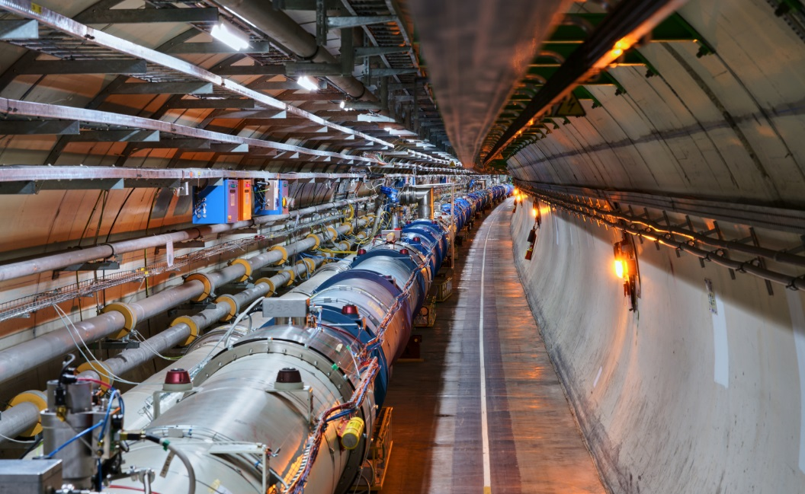
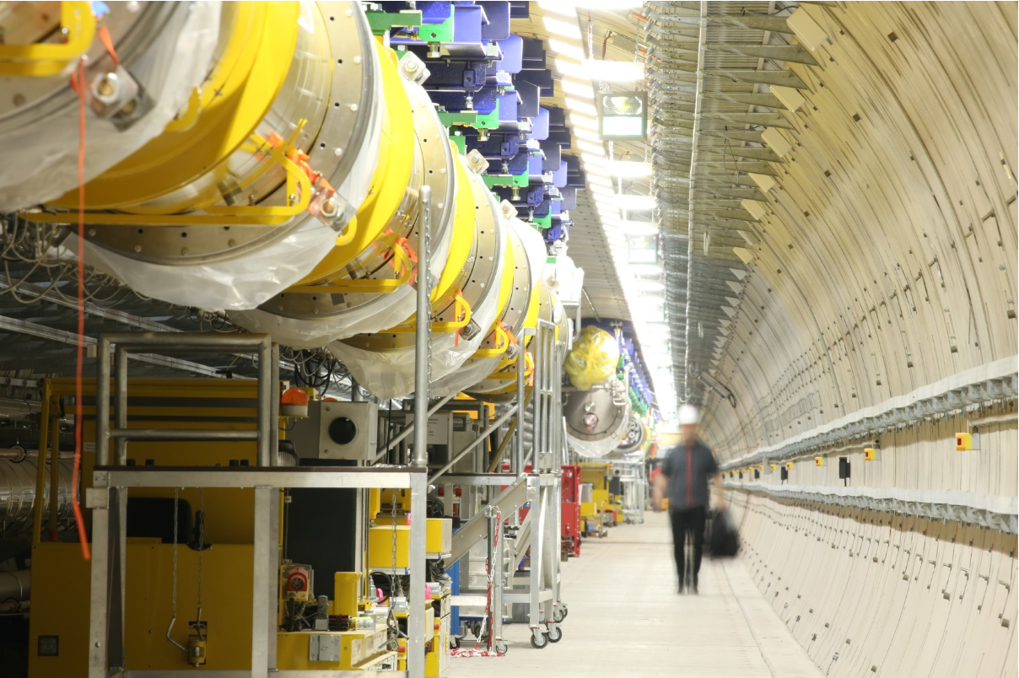
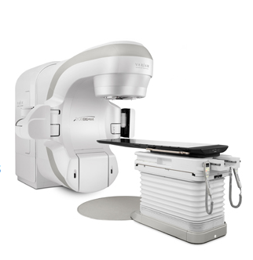
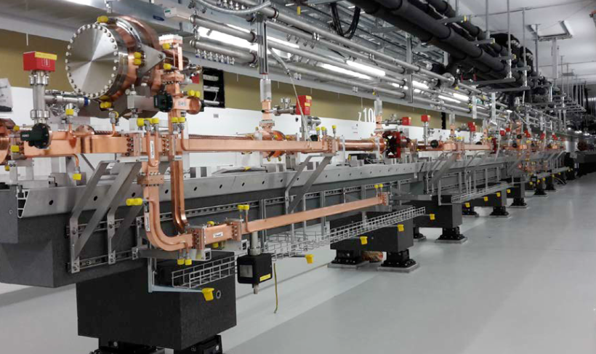
Every modern accelerator needs RF power sources to provide the electromagnetic field for the charged particle acceleration.
Accelerator tunnel at the LHC (Picture: CERN)
Accelerator tunnel at the European XFEL (Picture: DESY)
‘TrueBeam’ X-ray radiotherapy
Accelerator tunnel at the C-band XFEL (Picture: PSI)
(Picture: Varian)

Slide 3
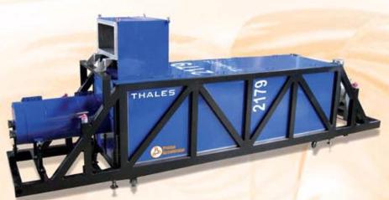
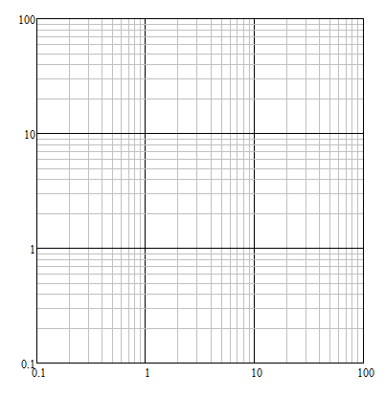



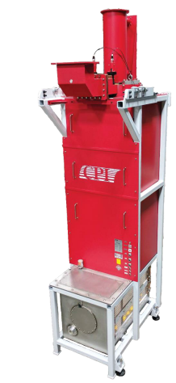
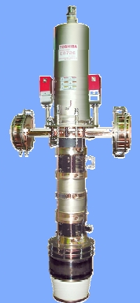
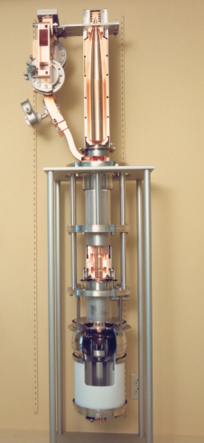
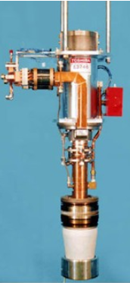
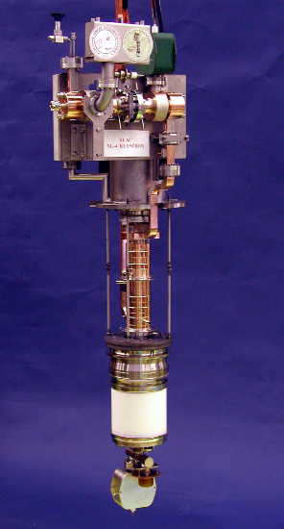
The accelerators technology is very diverse and could require the RF signals in a wide range of the frequencies (few 100 MHz – 12 GHz), peak power levels (few 100 kW – 100 MW) and pulse lengths (CW -100ns).
The klystron amplifiers technology is the one that covers almost all RF frequency/power demands of the modern accelerators.
Electro vacuum devices for science
electron & proton rings
SC e/p Linacs
electron Linacs
0.4 GHz, 0.3MW/LHC
high intensity
high gradient
USA
PAL
NLC
SLAC
France
PSI
SACLA
CLIC’k
e-rings
injectors
Japan
CLIC
MBK
0.7 GHz, 1.5MW/ESS
1.3 GHz, 10MW/DESY
3 GHz, 60MW/SLAC
6 GHz, 50MW/PSI
12 GHz, 50MW/SLAC-CLIC
FNAL
ILC
DESY
Industrial/Medical
Peak power, MW
J-PARC
LHC
ESS
Magnetron
(oscillator)
SLAC-BF
FCC_{ee}
KEK
CEPC
Tetrode
LHC
Klystrons
Pulsed
Continuous Wave
SSA tower
IOT
single beam
MBK
Frequency, GHz

Slide 4
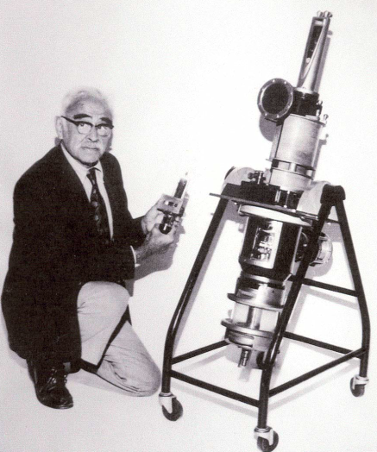
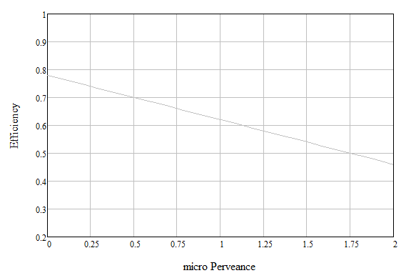
The klystrons have been used in the particle accelerators for more than 7 decades.
The experimental results from hundred’s of different devices have shown that higher efficiency is associated with lower perveance.
Accounting for technological and cost reasons (µA/V^{1.5}>0.25), the 73% efficiency was predicted to be the utmost limit.
Efficiency performance for the selected commercial klystrons. State of art.
1948. The first multi-megawatt (33 MW) S-band klystron ITT 2960 Mark III (Stanford, USA)
L-MBK CLIC, 20 MW
L-SNS, 0.55 MW
L-MBK ILC,10 MW
L-ESS,1.5 MW
UHF-LHC
0.3 MW
UHF-B-factory
1.25 MW
industrial empirical limit
X-CERN
6 MW
X-KEK
PPM, 50 MW
S-SLAC
65 MW
X-CERN
50 MW
S-band
Industry
S-SLAC
150 MW
ITT 2960
33 MW
Klystrons for science
M. Chodorow
(µA/V^{1.5})

Slide 5
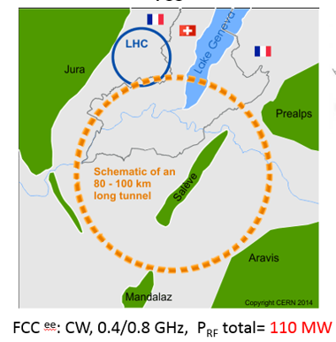
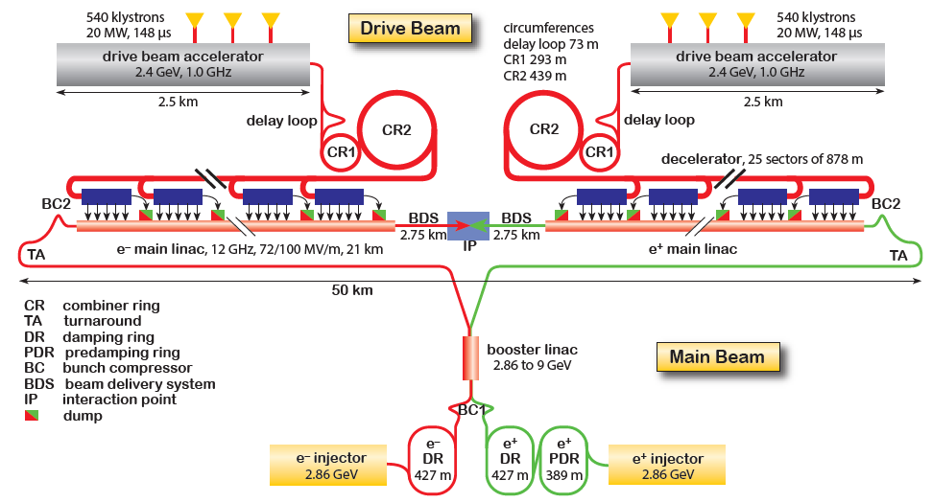
Average RF power needs of the large-scale HEP Accelerators Projects
The klystron efficiency impact on the CLIC 3TeV power consumption.
Example of the efficiency upgrade from 70% to 85%.
 | Klystron eff. 70% | Klystron eff. 85% | Difference
RF power needed for 3TeV CLIC | 180 MW
DC input power | 257 MW | 211 MW | -46MW
Waste heat | 77 MW | 31 MW | -46MW
Annual consumption (5500 h assumed) | 1413 GWh | 1160 GWh | -253 GWh
Annual cost (60 CHF/MWh assumed) | 84.8 MCHF | 69.6 MCHF | -15.2 MCHF
Electricity installation dimensioned for | 257 MW | 211 MW | -18%
CV installation dimensioned for | 77 MW | 31 MW | -60%
105 MW
Potential saving are 2.53 TWh in 10 years (152 MCHF in 10 years).
Reduced environmental impact (cooling and ventilation)
Reduced installation cost (stored energy in modulators).
Reduced maintenance cost (klystron life time).
R&D on increasing the useable efficiency is worth every penny/cent invested!
3.0 TeV CLIC^{e+e-} ; pulsed, 1.0 GHz, P_{RF} total = 180 MW

Slide 6
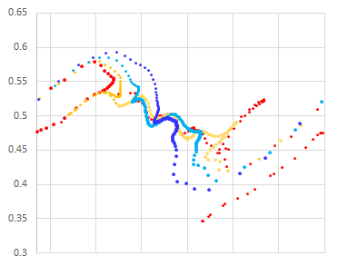
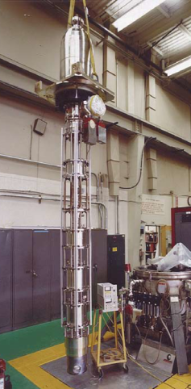
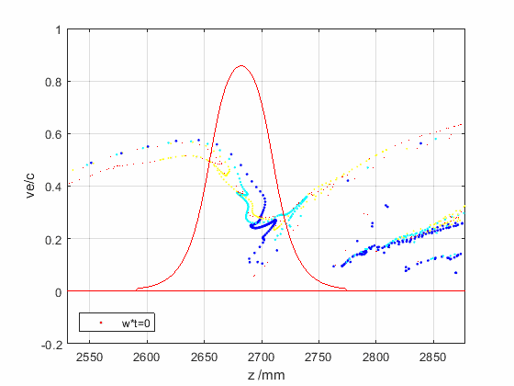
The factors limiting efficient RF power extraction from the bunched beam in RF cavity
Bunch phase space in the vicinity of the klystron output cavity
bunch
E field expansion in the drift tubes causes beam reacceleration when it leaves the output cavity.
Ohmic loses are proportional to the operating frequency.
Space charge depression is a partial conversion of the beam kinetic energy into the potential DC energy of beam traveling in the drift tube.
Bunch saturation is optimal, when all the elections populate only the useful RF phase bucket leaving the anti-bunch empty.
Bunch congregation is a normalized elections velocity spread along the bunch. It has an optimal value for every given bunch length.
Bunch stratification is a radial dependence of the bunch length and congregation. The ideal bunch should not have such a dependency.
Radial bunch expansion happens during beam deceleration in the output cavity in the presence of external solenoidal magnetic field.
Reflected electrons could be generated if some of the above effects are not balanced.
SLAC B-factory CW
0.478GHz, 1.25 MW
Velocity Ve/c
2π
<- arrival time (t/w)
0
Arrival plane
Efficiency 61%
Driven by klystron general parameters.
Driven by RF design and space charge effects.

Slide 7
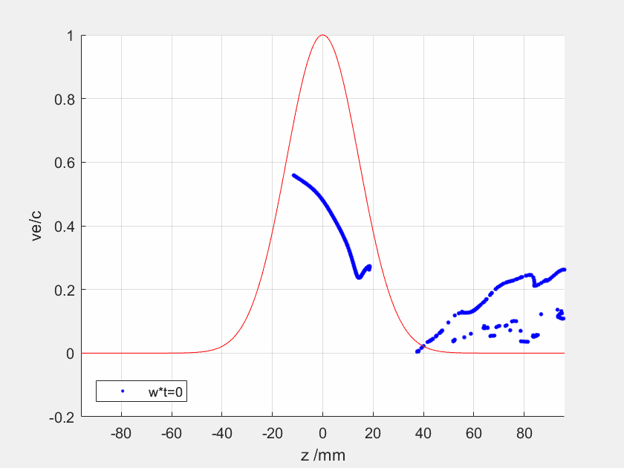
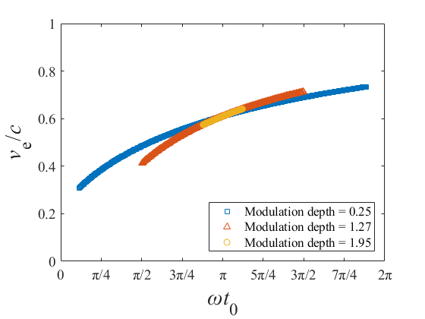
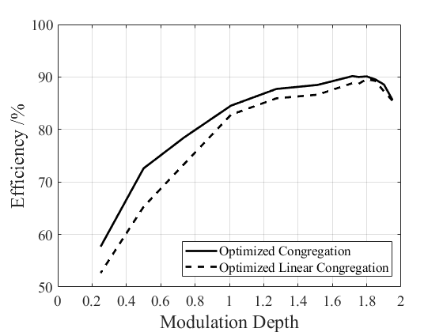
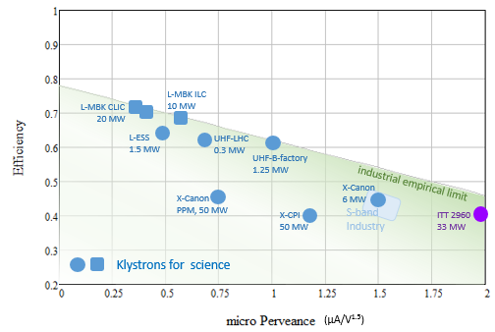
The ultimate power extraction efficiency in the linear beam devices
Example of 0.8 GHz FCC_{ee} klystron. Voltage 133 kV, Current 12.6 A (µP=0.26 µA/V^{3/2})
Fully saturated bunch with optimised congregation
Optimised congregation for the different bunch lengths.
Effect of the bunch length
90.1 %
Optimum at L _{bunch} ≈ λ_{RF} /3
Ultimate limit
High efficiency Klystrons design objectives
Ultimate limit
E field expansion in the drift tubes
Ohmic Losses
Space charge depression
Bunch saturation
Bunch congregation
Bunch stratification
Radial bunch expansion
Optimised RF bunching circuit

Slide 8
The High Efficiency International Klystron Activity has been initiated at CERN (2013-2017) targeting the improvement of klystron efficiency performance through the development of the new electron bunching methods and the new reliable simulation tools adopted for the massive optimization processes.
The new bunching technologies have been developed to balance the space charge forces and RF impedances in order to provide the full bunch saturation with an optimal congregation:
Core Oscillation Method (COM) relies on the de-bunching/bunching alternation between space-charge forces and impedances of the RF cavities. COM requires the long bunching circuit. Cost effective solution for the high frequency devices.
Core stabilization Method (CSM) implies the RF cavities with higher harmonic number (2nd and 3rd) that allows the fast collecting of the peripheral electrons into the bunch. Most suitable for the low frequency devices.
The fast and reliable computer code for the klystron simulations (KlyC) has been developed at CERN. KlyC is in a public domain and now is adopted by Labs, Universities and industrial partners in Europe, USA, Japan, China, Russia and India.
Using the new tools and methods, a number of the high efficiency klystrons for the large scale accelerators (LHC, FCC and CLIC) has been developed at CERN and few completed designs have already been communicated to the industry for the technical evaluation and prototyping.

Slide 9
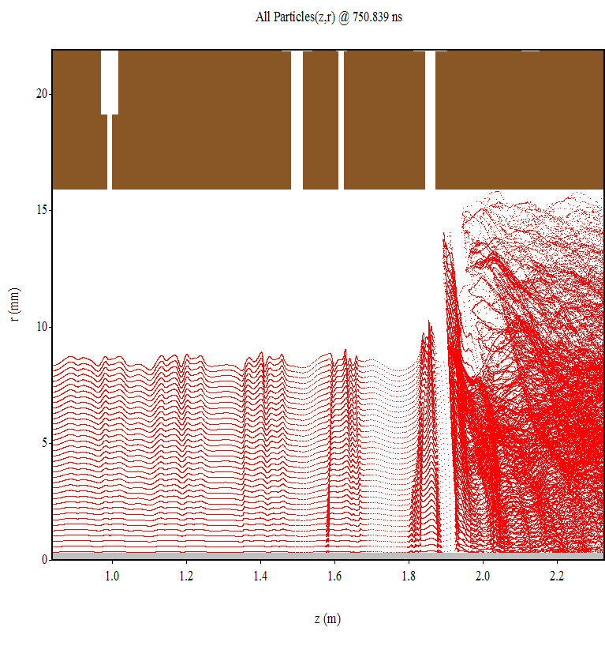
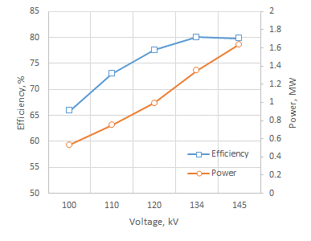
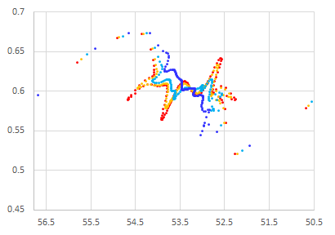
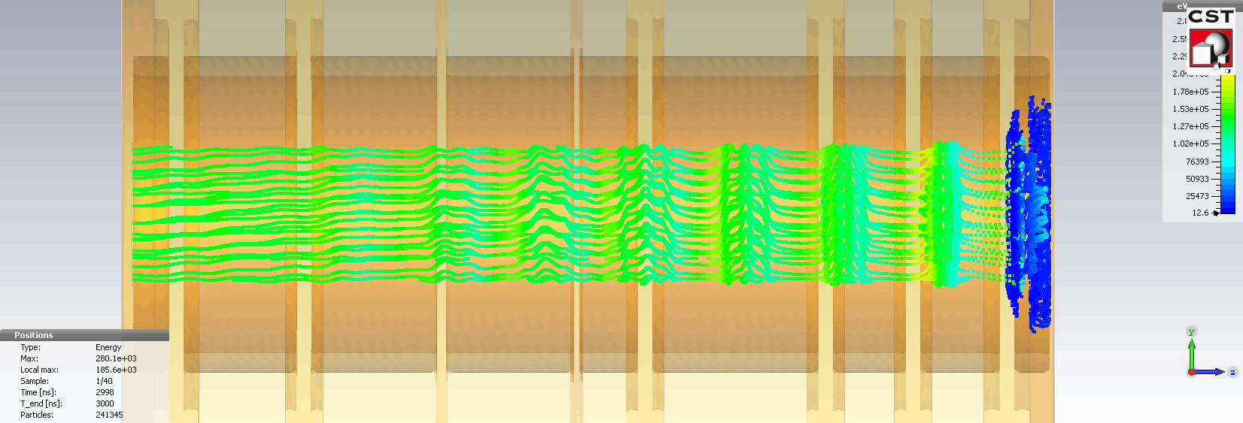
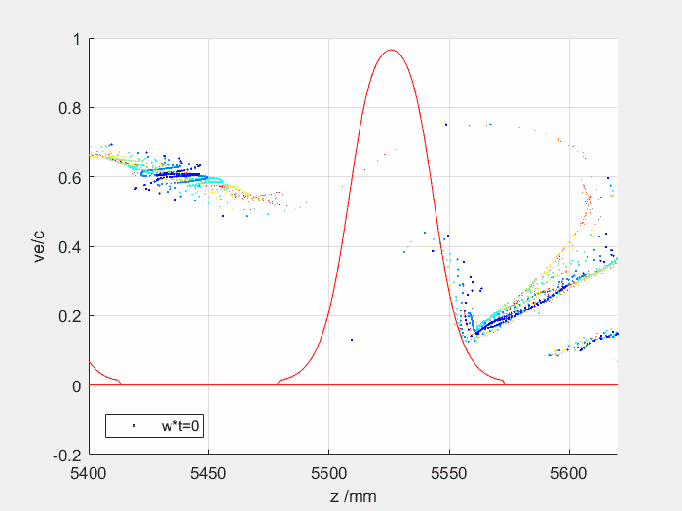

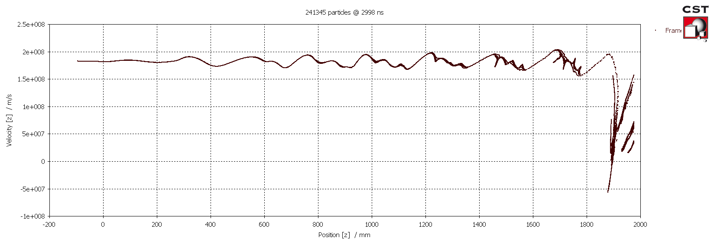
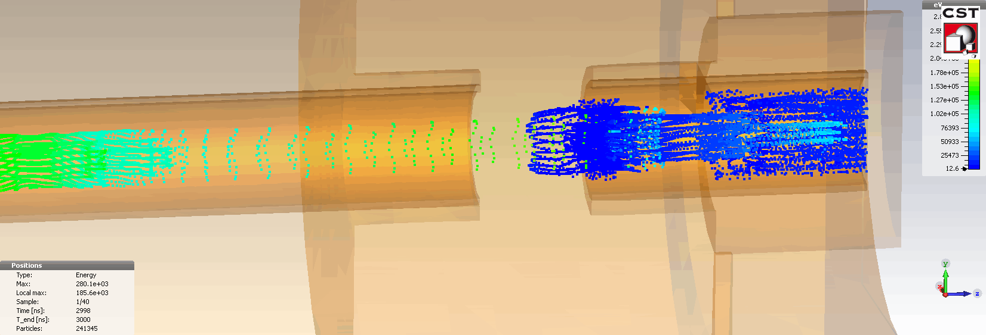
High Efficiency (80%) 1.4 MW, 0.8 GHz, CW FCC_{ee} CSM klystron (CERN/Thales).
Bunch phase space in the vicinity of the klystron output cavity
Particle-In cell simulations (MAGIC 2D)
bunch
79.7%
Velocity Ve/c
2π
<- arrival time (t/w)
0
Particle-In cell simulations (CST 3D)
79.9%
1.5D
Arrival plane
79.5%

Slide 10
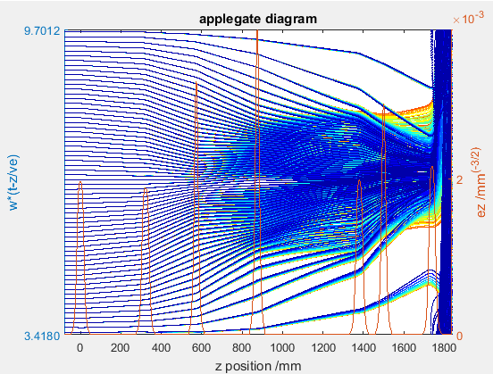
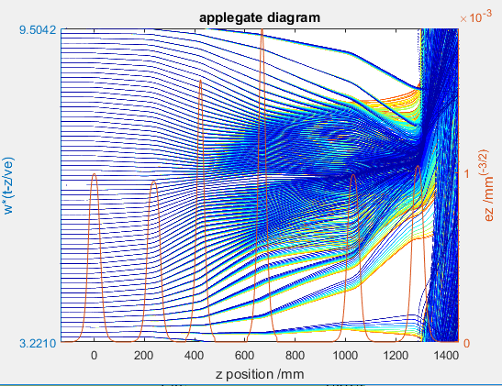
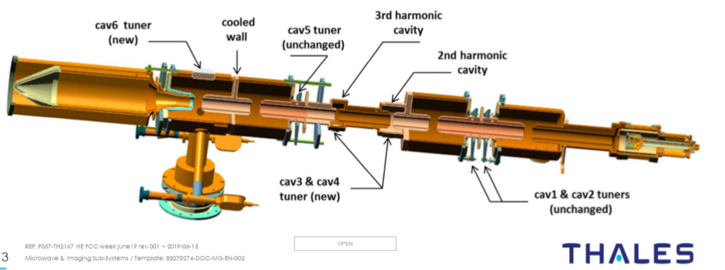
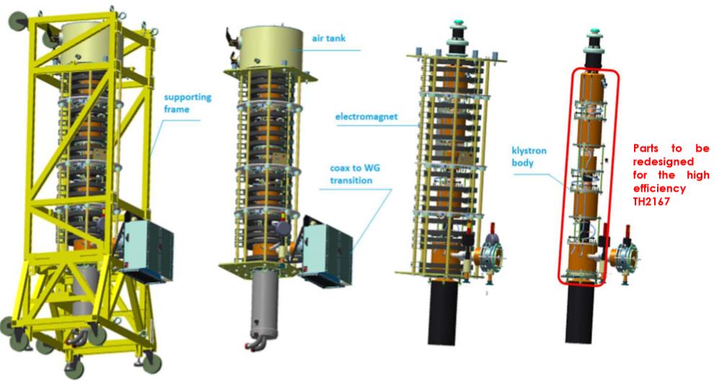
Parametric Scaling Procedure. High Efficiency (70%) 350kW, 0.4 GHz, LHC klystron upgrade.
Design of any new klystron is rather time consuming. It requires high level of the related experience/expertise.
The PSP was developed at CERN as a set of semi-analytical procedures that allow to scale the existing klystron design to the new one (beam power, frequency and perveance) and to preserve the bunching processes.
Design cycle ~ 6 month
Design cycle ~ 2 weeks
 | FCC
Frequency, GHZ | 0.8
Beam power, MW | 1.68
Perveance, | 0.26
RF power, MW | 1.34
Efficiency, % | 80
 | LHC | LHC/Thales
Frequency, GHZ | 0.4 | 0.4
Beam power, MW | 0.5 | 0.5
Perveance, | 0.72 | 0.72
RF power, MW | 0.35 | 0.30
Efficiency, % | 70 | 60
Re-used housing, electron gun and solenoid
Cut-off view of the LHC CSM klystron

Slide 11
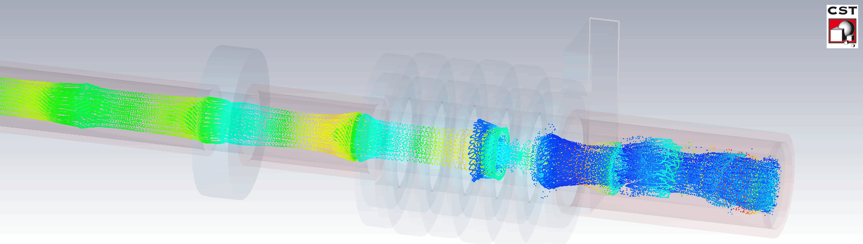
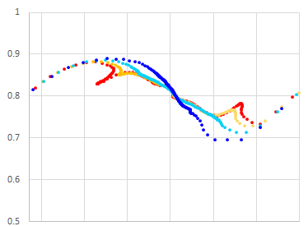

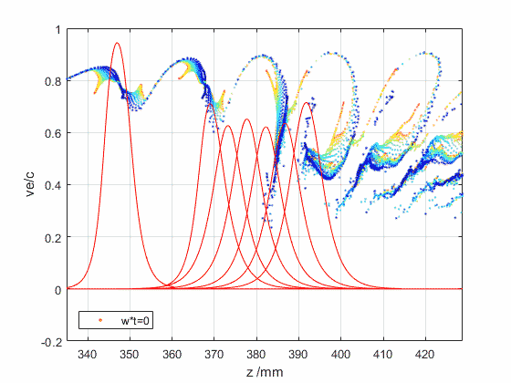

High Efficiency (65%) 50 MW, 12 GHz, CLIC COM klystrons (CERN/CPI).
Bunch phase space in the vicinity of the klystron output cavity
HEX COM_2M; 0.35T; 64.2%
Velocity Ve/c
 | VKX-8311A | HEX COM_2M/CERN | HEX COM/CERN
Voltage, kV | 410 | 400 | 400
Current, A | 310 | 190 | 190
Frequency, GHz | 11.994 | 11.994 | 11.994
Peak power, MW | 50 | 48.8 | 49.8
Sat. gain, dB | 48 | 58 | 58
Efficiency, % | 40 | 67.7_{KlyC}/ 64.2_{CST} | 68.7_{KlyC}/ 65.5_{CST}
Life time, hours | 30 000 | 85 000 | 85 000
Solenoidal magnetic field, T | 0.6 | 0.35 | 0.35
RF circuit length, m | 0.32 | 0.39 | 0.86
2π
<- arrival time (t/w)
0
Arrival plane
HEX COM_2M
67.7%
VKX-8311A

Slide 12
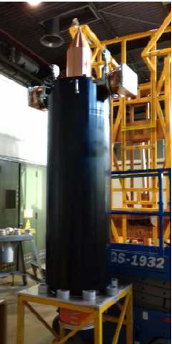
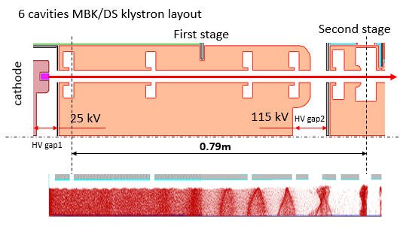
Tailored Technologies. High Efficiency (85%) 24 MW, 1 GHz, CLIC MBK/2S klystron.
Industrial CLIC MBK prototypes delivers ~70 % RF power production efficiency
The CLIC MBK with two high voltage stages.
Electron efficiency measured in PIC simulations is 84%.
Canon E37503
6 beams MBK
Thales TH1803
10 beams MBK
Conceptual features:
The new klystron bunching technologies cannot be directly adopted to the CLIC MBK:
COM requires very long (5m) RF circuit.
In CMS, the 3rd harmonic cavity is not compatible with MB-type cavities layout.
Bunching at a low voltage (high perveance). Very compact RF bunching circuit.
Bunched beam acceleration and cooling (reducing Δp/p) along the short DC voltage gap.
Final power extraction from high voltage (low perveance) beam. High efficiency.

Slide 13
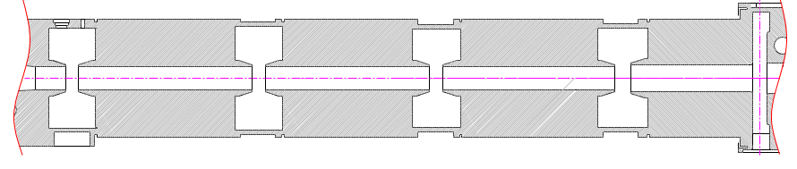
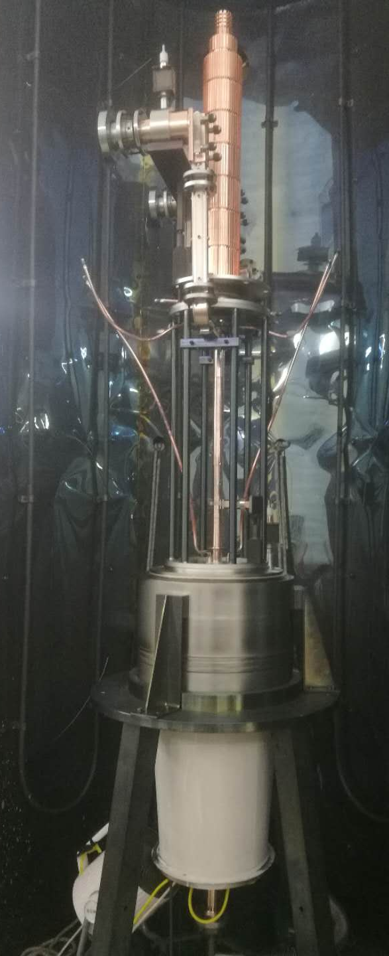
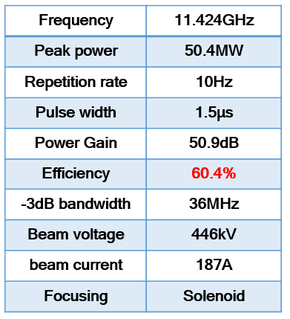
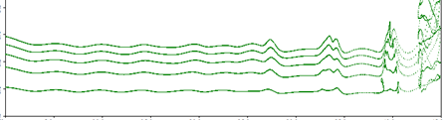
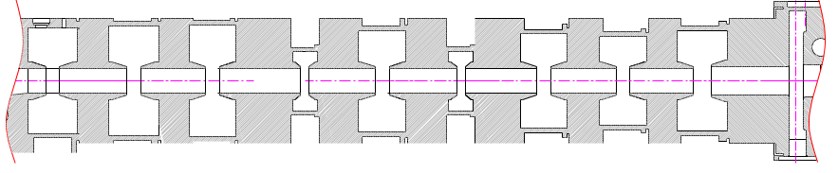
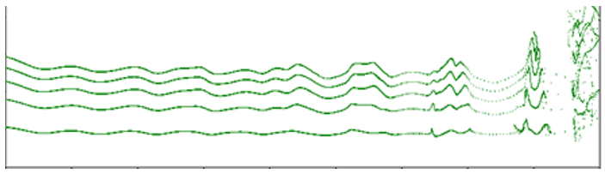
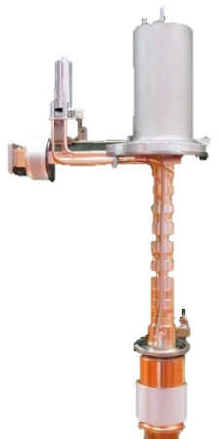
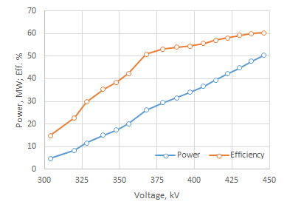

High Efficiency klystrons industrialization efforts.
The first ‘off shelf’ commercial 7.5 MW S-band (2.856 GHz) HE klystron by …….
Commercial prototype of the 50 MW HE X-band (11.424 GHz) COM klystron by BVERI (China)
Original design (5 cavities):
Voltage: 155 kV
Current: 109 A
Peak power: 7.5 MW
Efficiency: 45%
High efficiency COM upgrade (10 cavities):
Voltage: 140.2 kV
Current: 88 A
Peak power: 7.3 MW
Efficiency: 59.2%

Slide 14
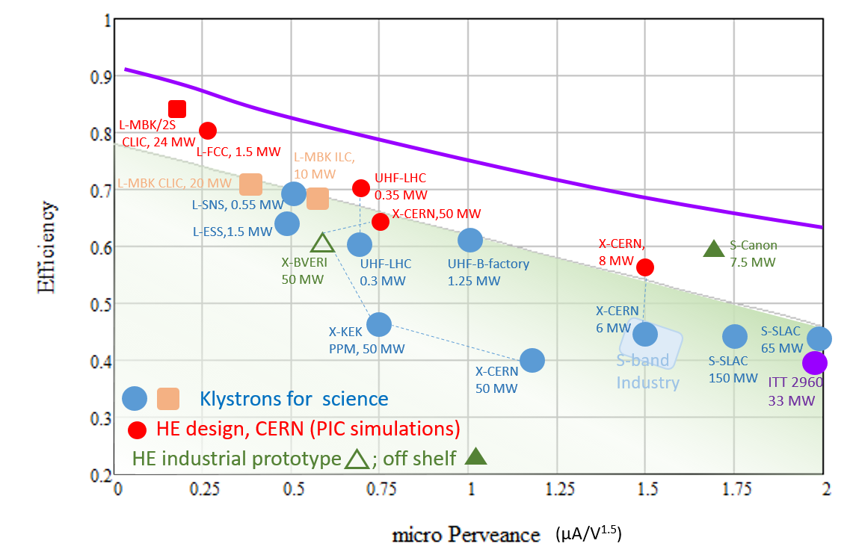
Efficiency performance of the selected commercial klystrons and the new HE klystrons (July 2019).
Efficiency
micro Perveance

Slide 15













Special thanks to many colleagues from Labs, Universities and industry who have been actively involved into the high efficiency klystrons development:
T. Anno, A. Baikov, A. Beunas, O. Brunner, G. Burt, J. Cai, D. Constable, I. Guzilov, P. Hamel, V. Hill, A. Jensen, E. Jensen, T. Kimura, A. Leggieri, R. Kowalczyk, C. Lingwood, Z. Liu, R. Marchesin, C. Marrelli, J. Neilson, F. Peauger, J. Plouin, V. Teryaev, B. Weatherford…

