Slide 1



NICA accelerator complex at JINR
Olha Kazinova
on behalf of the NICA team
Joint Institute for Nuclear Research
10-17 July 2019
Ghent, Belgium

Slide 2

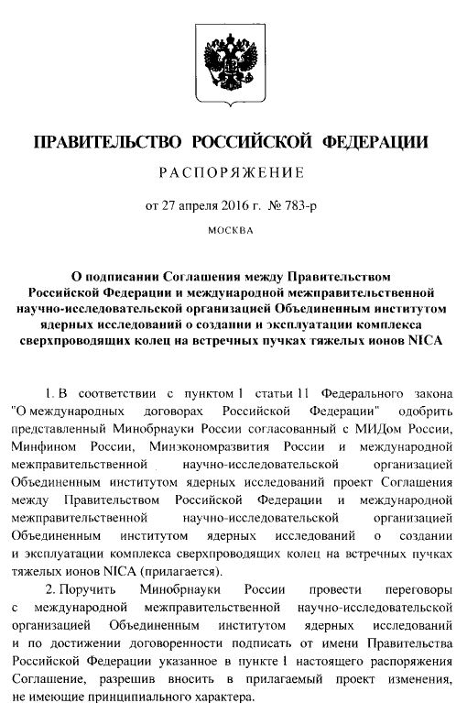
NICA (Nuclotron based Ion Collider fAcility)
Agreement between Government of the RF and JINR
(April 2016)
Armenia
Australia
Azerbaijan
Belarus
Brazil
Bulgaria
China
Czech Republic
DPRK
France
Georgia
Germany
Greece
India
Italy
Japan
Kazakhstan
Mexico
Moldova
Mongolia
Poland
Romania
RSA
Russia
Serbia
Slovakia
Ukraine
USA
Uzbekistan
Vietnam
http://nica.jinr.ru/

Slide 3
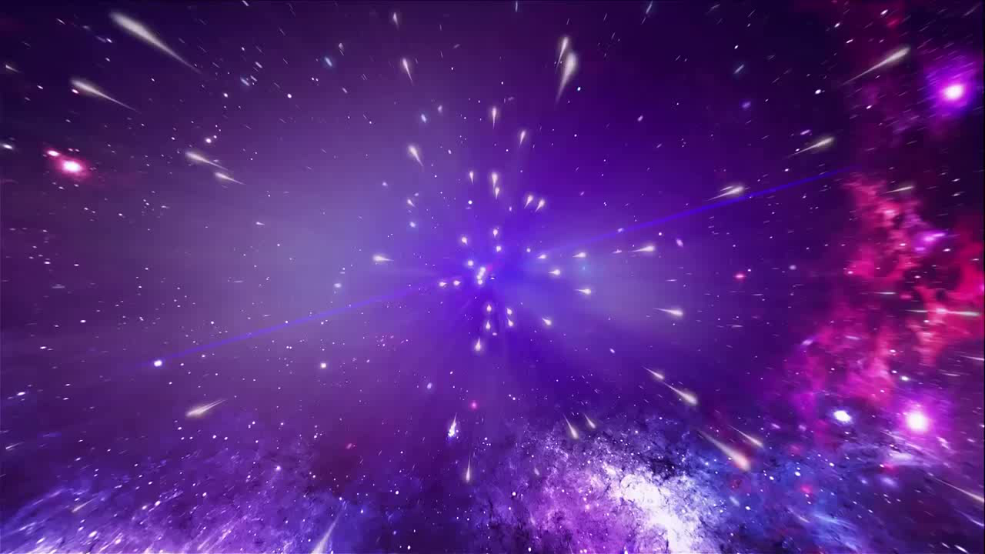
NICA: Recreating the first moments of the Universe in the Lab

Slide 4
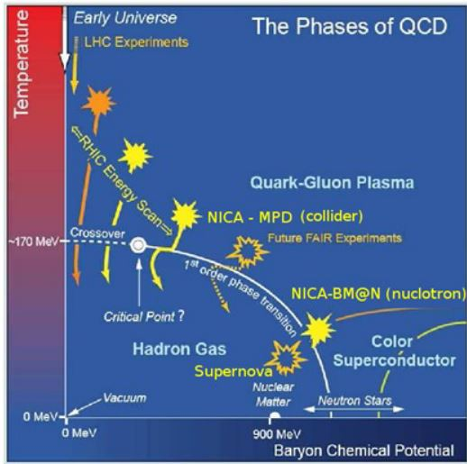
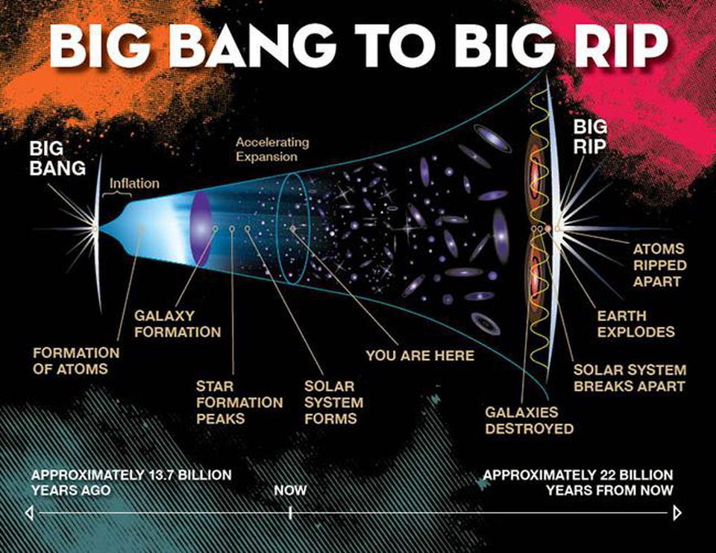
NICA Physics
Nuclear matter in the region of the maximum baryonic density

Slide 5
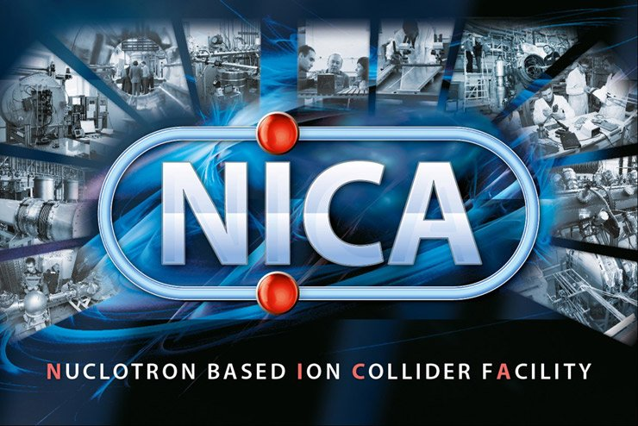
Main tasks of the NICA project
• study of hot and dense baryonic matter
• investigation of nucleon spin structure, polarization phenomena
• modernization of existing accelerator facility
– relativistic ions from p to Au at energy range √S_{NN}= 4 - 11 GeV
  – polarized p and d at energy up to
  √S =27 GeV (p)

Slide 6
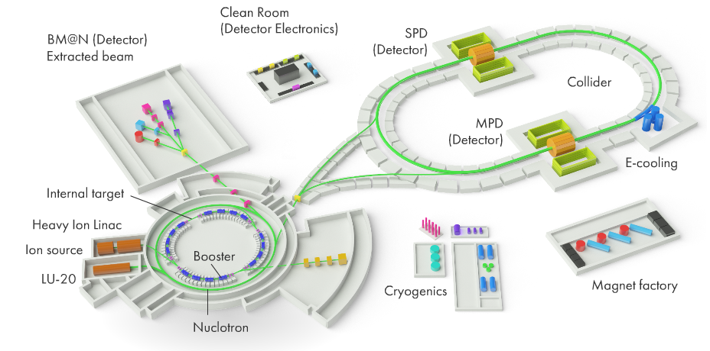
NICA Complex

Slide 7
Facility components: status
KRION
Linac HILac
KRION
Linac HILac
Ion sources
Booster (25 Tm)
1(2-3) single-turn injection,
storage of (2 ÷ 4)×10⁹ ions,
acceleration up to 100 MeV/u,
electron cooling, acceleration
up to 578 MeV/u
Ion sources
Linac LU-20
Linac LU-20
Fixed Target Area
Fixed Target Area
Slow resonance extraction
Stripping (80%) ¹⁹⁷Au³¹⁺ => ¹⁹⁷Au⁷⁹⁺
IP-2
Nuclotron (45 Tm)
injection of one bunch
of ≤ 2×10⁹ ions,
acceleration up to
1 - 4.5 GeV/u max.
Nuclotron (45 Tm)
injection of one bunch
of ≤ 2×10⁹ ions,
acceleration up to
1 - 4.5 GeV/u max.
Collider
L ≥ 10²⁷ см⁻²с⁻¹
IP-1
work in progress
assembly
commissioned / existing

Slide 8
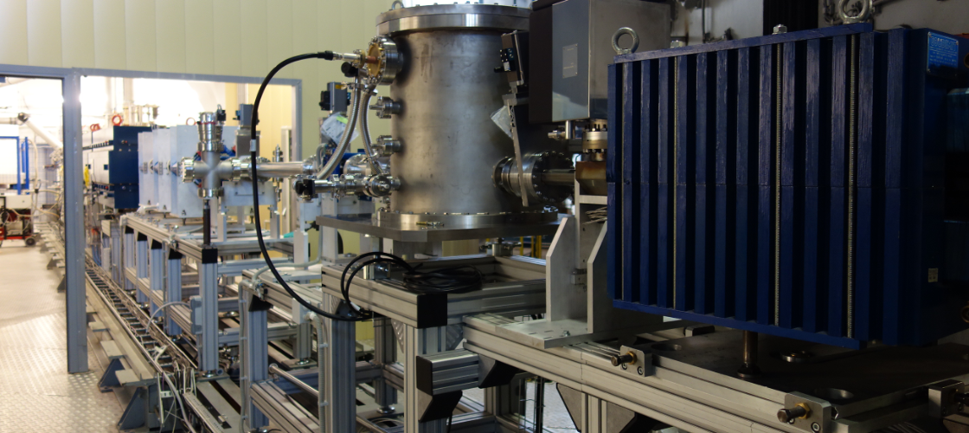
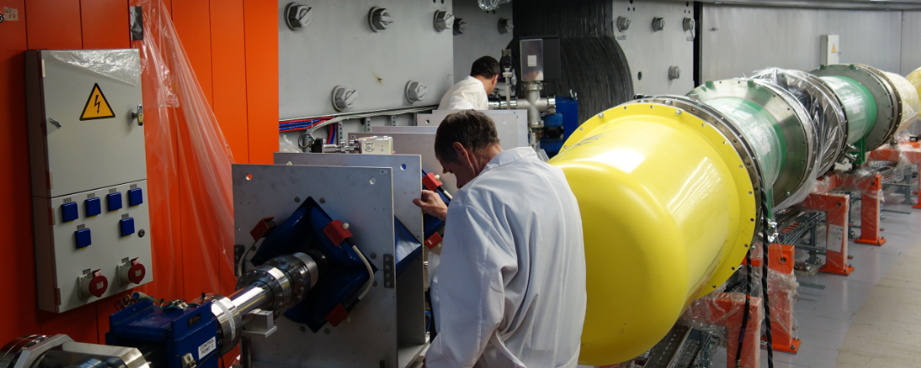
Injection complex
• cryogenic heavy ion source KRION of Electron String Ion Source (ESIS) type,
• laser source,
• source of polarized protons and deuterons,
• modernized linac LU-20 (existing),
• new heavy ion linear accelerator (HILAC),
• transfer channels.

Slide 9
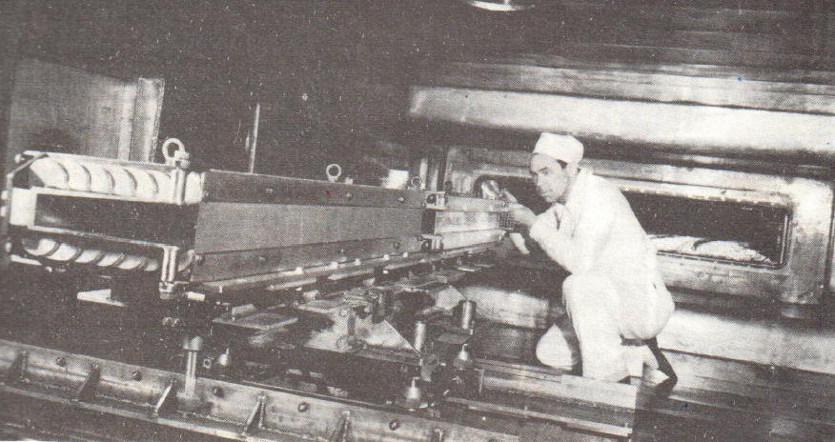
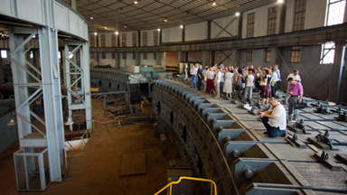
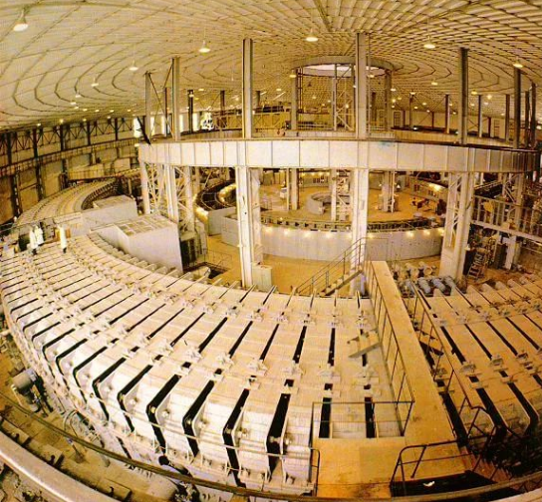
JINR Synchrophasotron
Magnetic system weight –
36 000 tons !!
most heaviest accelerator people ever built
The last weak focusing machine for high energy physics

Slide 10
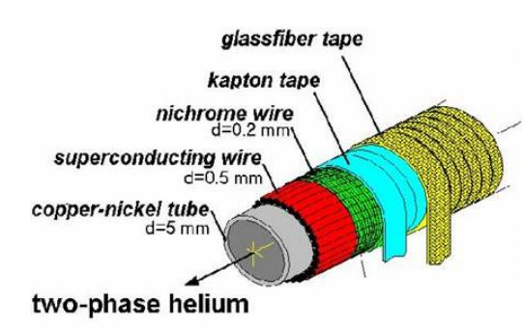
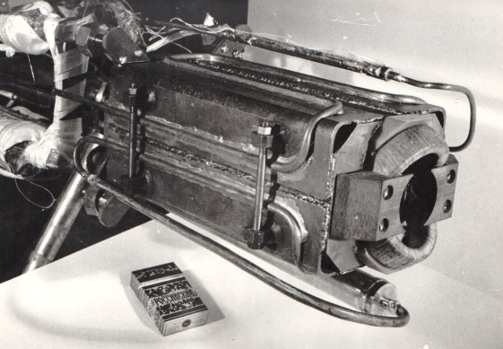
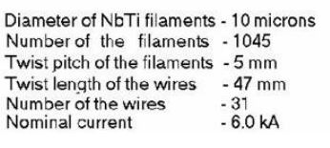
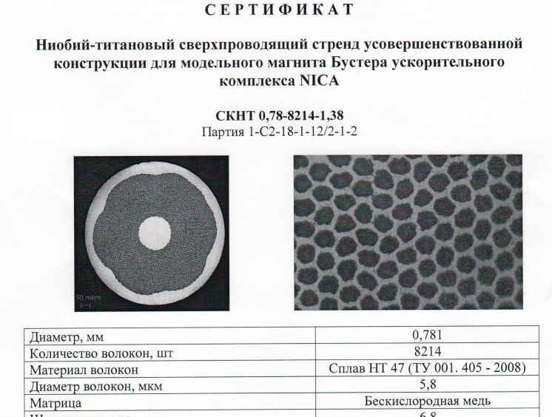
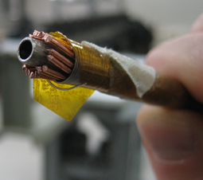
Nuclotron cable technology
Developed at 1980th

Slide 11
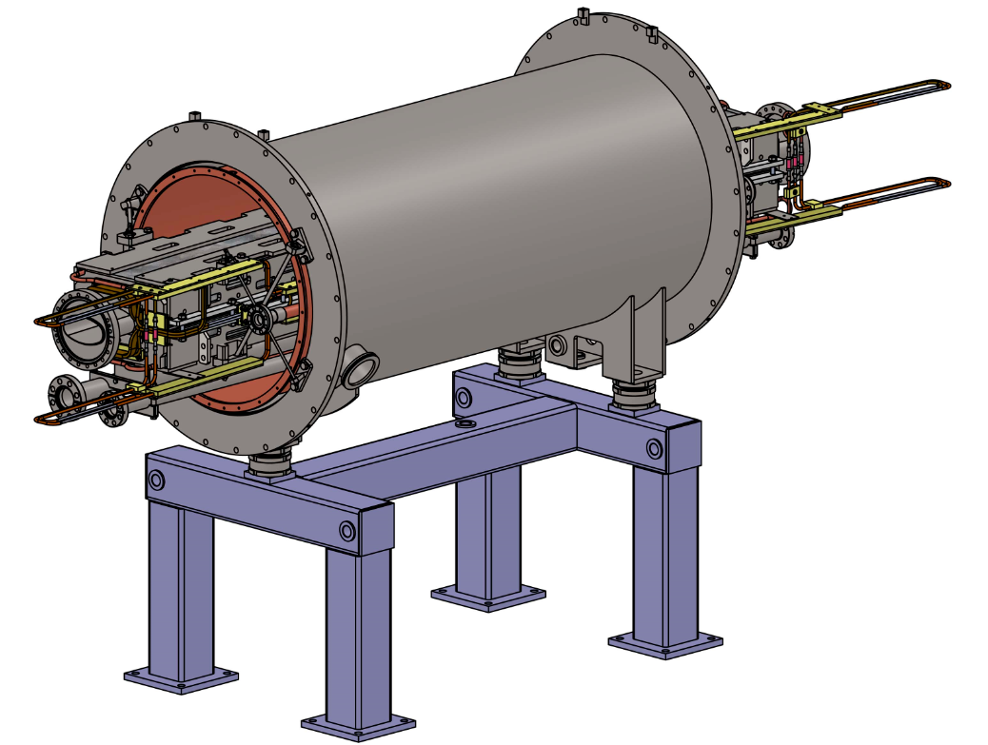
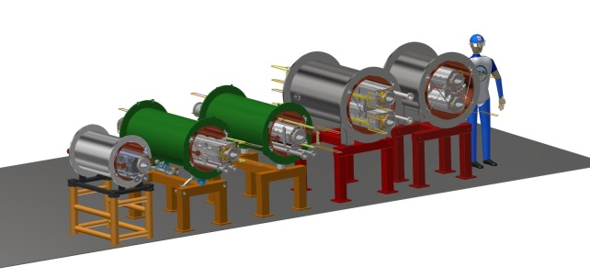
SC dipole for the NICA Booster
Thermal shield
Iron Yoke
Beam Pipe
Vacuum shell
Support
SC coil

Slide 12
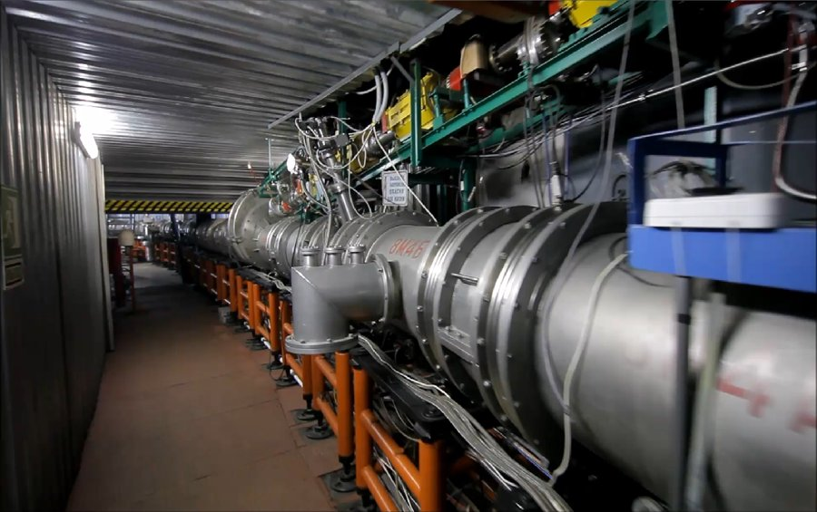
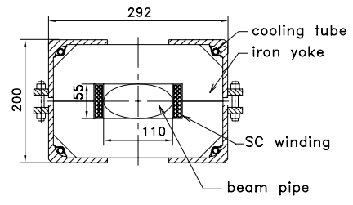
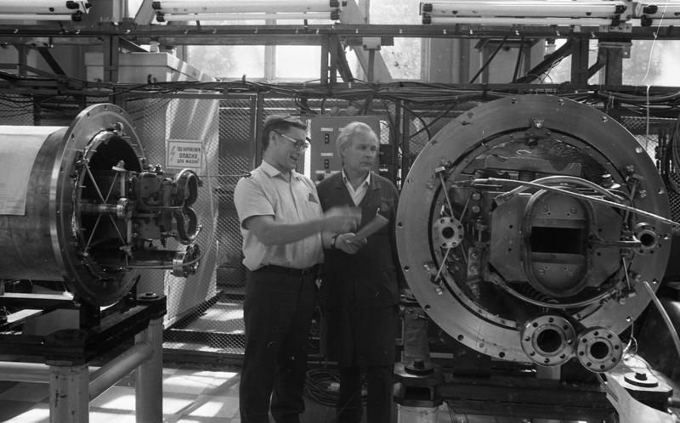

First superconducting heavy ion accelerator
Nuclotron – Superconducting Synchrotron
operation since 1993

Slide 13
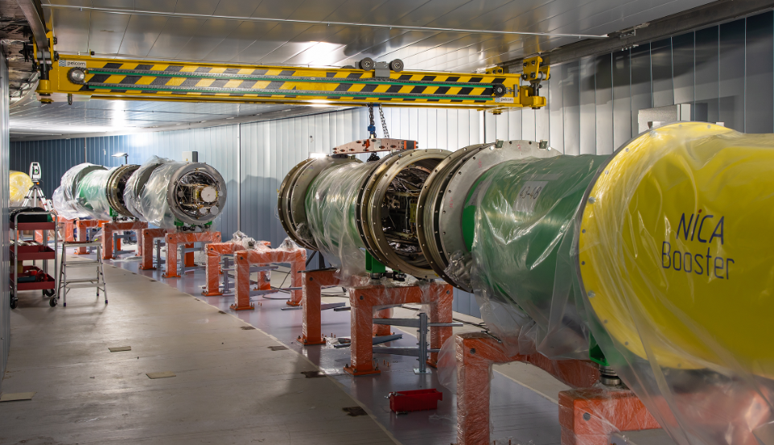
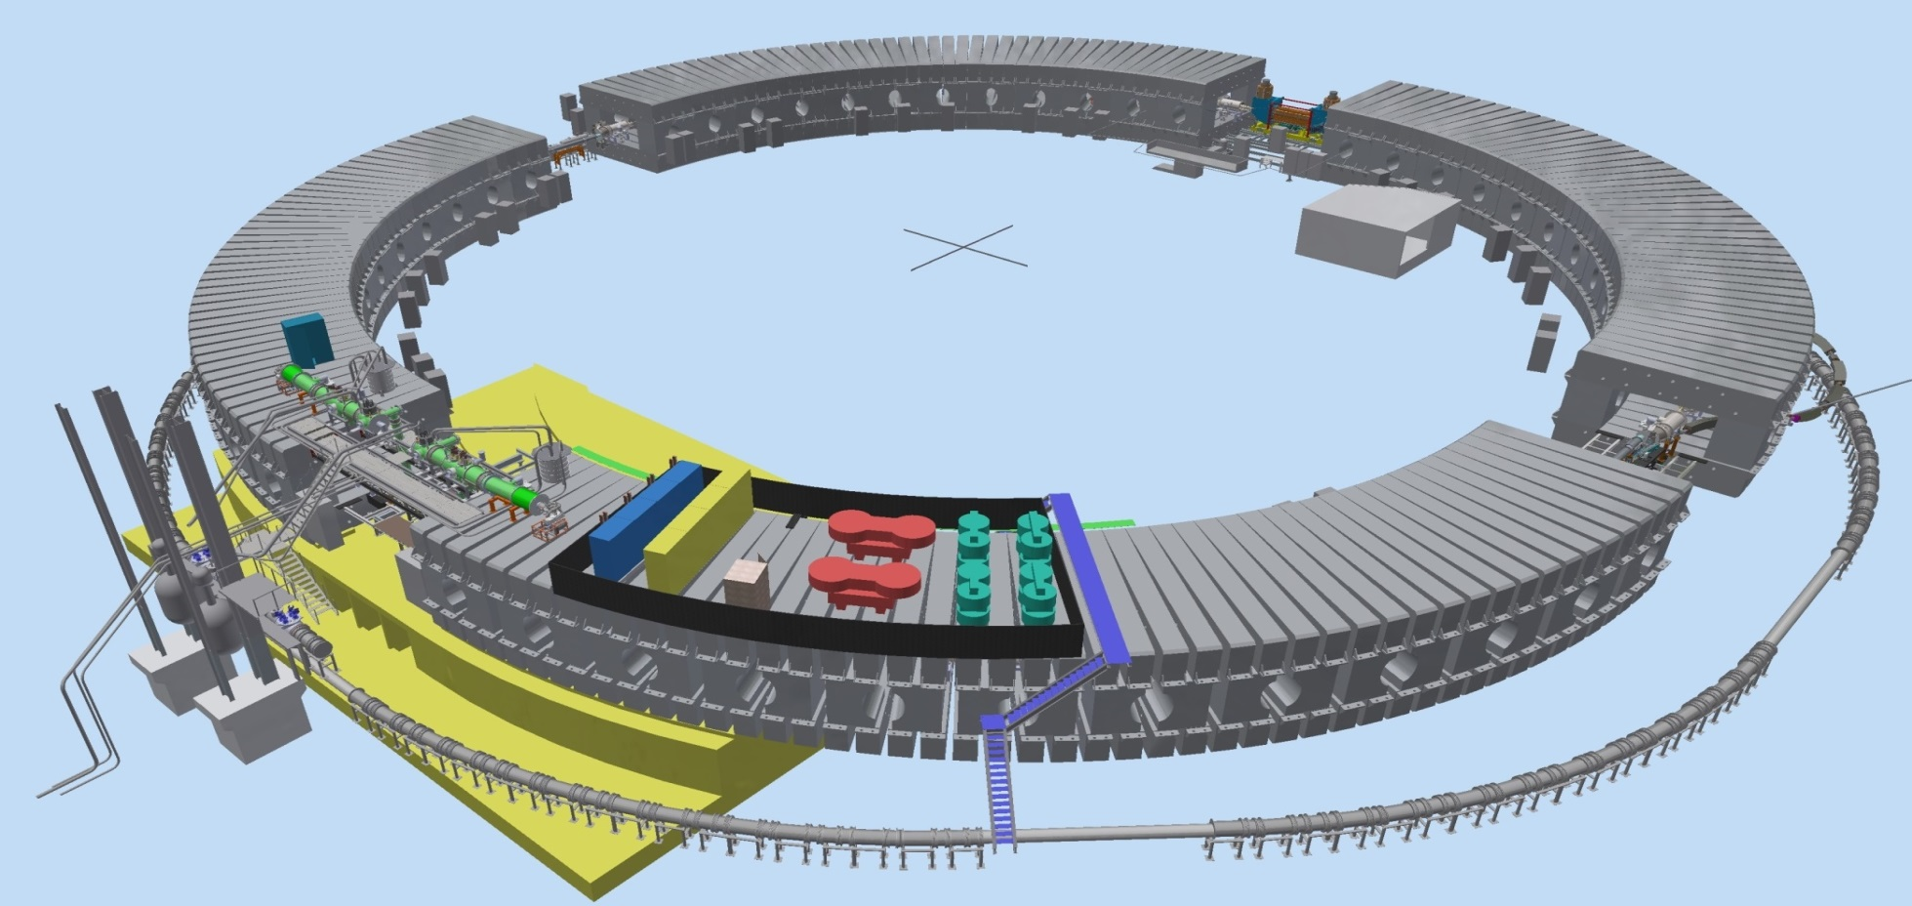
NICA Booster
Ions | Au31+
Circumference, m | 211
Fold symmetry | 4
Max energy, MeV | 578
Max magnetic rigidity, T·m | 25
Dipole field, T | 1.8
Vacuum, Torr | 10⁻¹¹
Beam intensity, ions/pulse | 1.5*10⁹
E-cooling system
Injection system
Feed box
Extraction system
Power supply
Accelerating station
Nuclotron

Slide 14
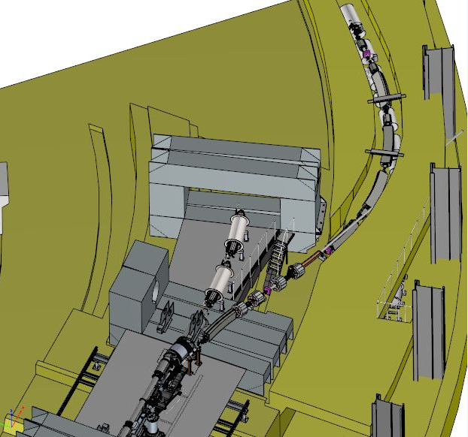
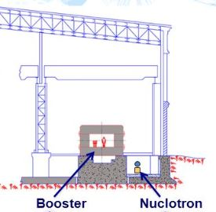
Booster-Nuclotron transport channel
under contract with BINP
Channel delivery
March 2020
…April 2020 start mounting

Slide 15
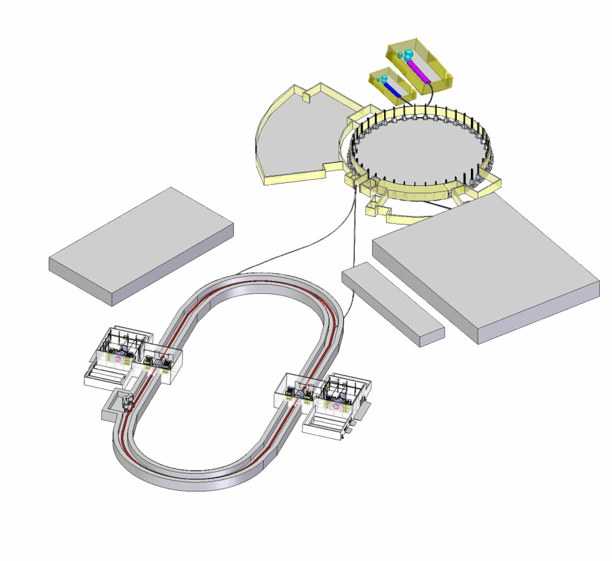
Nuclotron
• Acceleration of heavy ions for storage in the collider
0.6 ÷ 4.5 GeV/u
1 ÷ 1.5⋅10⁹ ions
• Acceleration of polarized protons and deuterons for feeding the collider
p 20 MeV ÷ 12 GeV
d 5 MeV/u ÷ 5.6 GeV/u
10¹⁰ particles
• Acceleration of both polarized and unpolarized protons and deuterons and heavy ions for internal target experiments or slow extraction to fixed target experiments

Slide 16
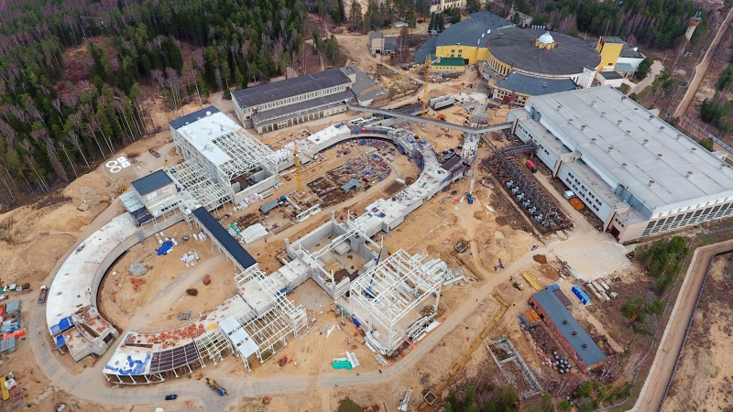
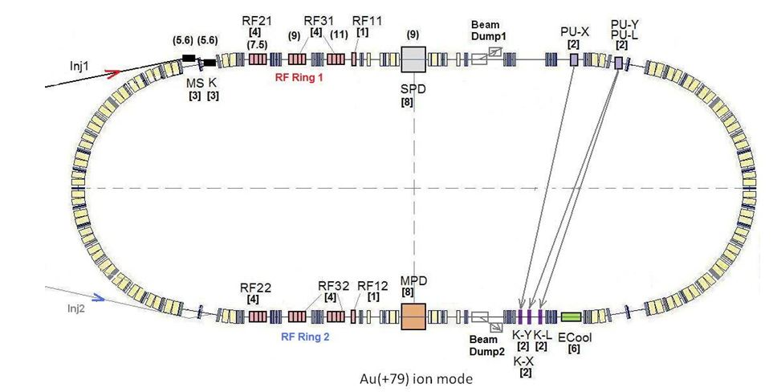
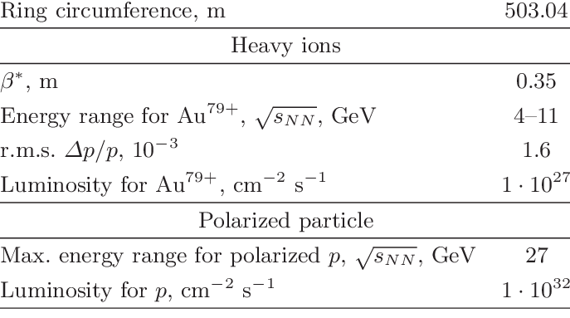
NICA Collider

Slide 17
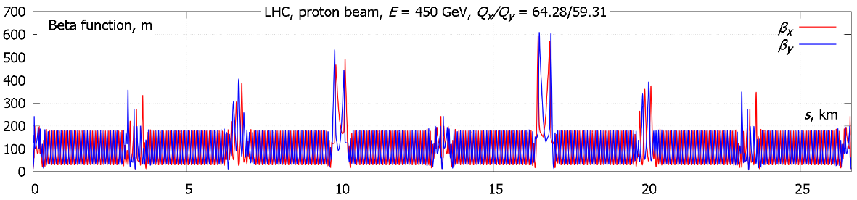
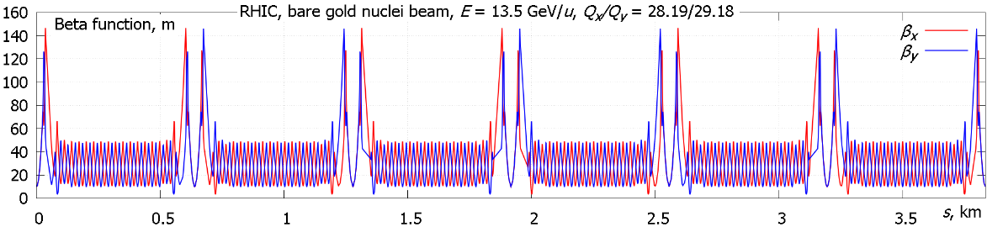
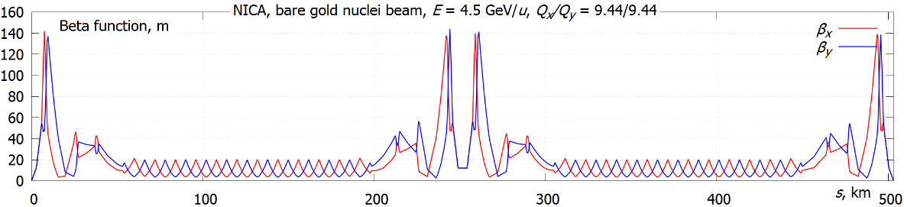
How does NICA collider look like?
β-functions
LHC
RHIC
NICA
s, m
…like others

Slide 18
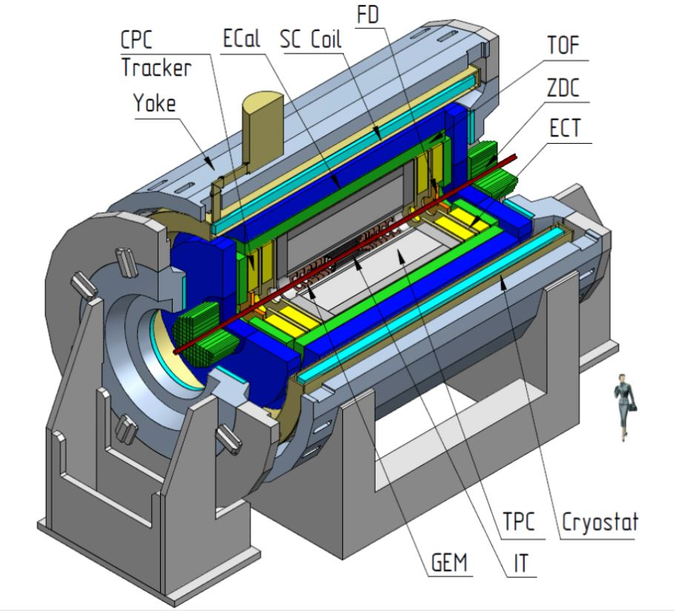
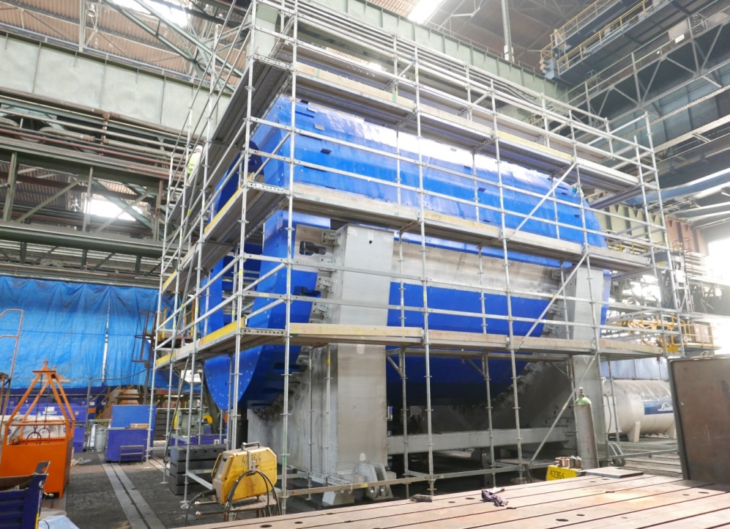
NICA Multi Purpose Detector
SC Coil – superconducting solenoid
IT – inner detector
ECT – straw-tube tracker
TPC – time-projection chamber
TOF – time-of-flight stop counters
FD – fast forward detectors
ZDC – zero degree calorimeter
BBC – beam-beam counter

Slide 19
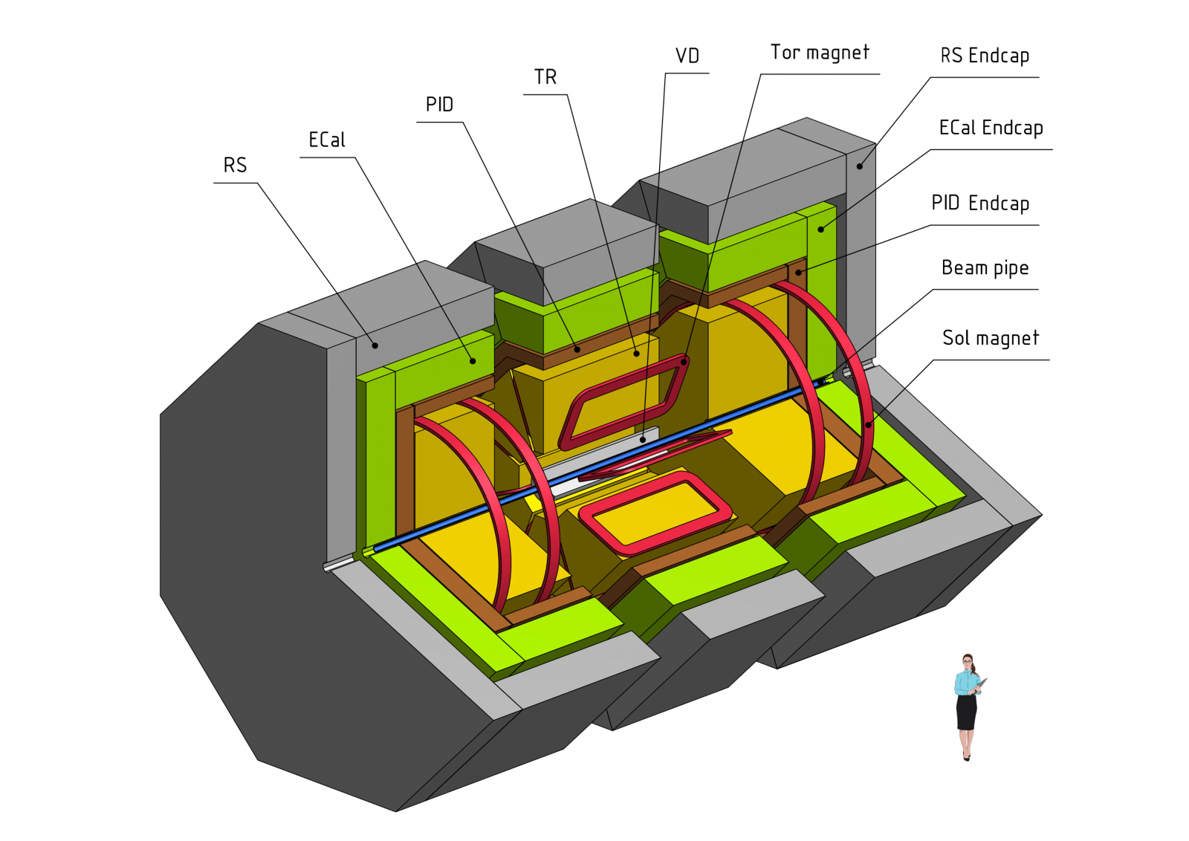

Spin Physics Detector
• Drell-Yan pair, J/ψ and prompt-photon production with longitudinally and transversely polarized p and d beams aiming at extraction of unknown (poorly known) parton distribution functions;
• spin effects in baryon, meson and photon production in various exclusive reactions;
• diffractive processes;
• multiquark states and correlations;
• studies of cross sections, spin asymmetries (Krisch effect) and spin-dependent amplitudes in elastic scattering.

Slide 20
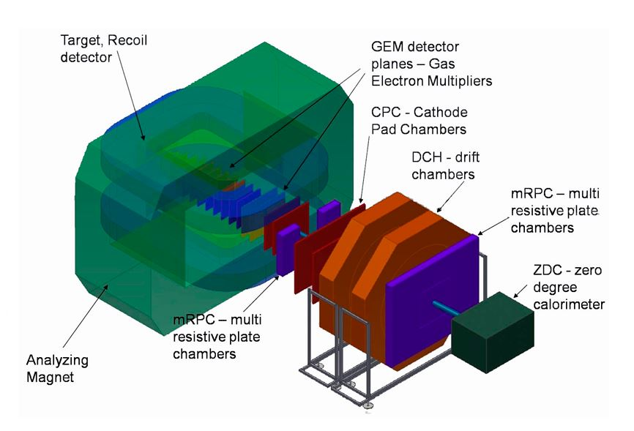
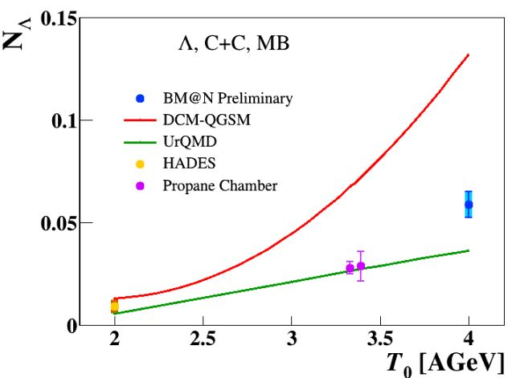
Baryonic Matter at Nuclotron (BM@N)
• study of elementary reactions and “cold” nuclear matter
• study of the properties of dense nuclear matter with strangeness
• hypermatter production
• hadron femtoscopy

Slide 21

Thank you for your attention!

