Slide 1
Phase 3 beam commissioning
of SuperKEKB
OKI, Toshiyuki (KEK)
on behalf of the SuperKEKB commissioning group
2019/JUL/13th
EPS-HEP2019

Slide 2
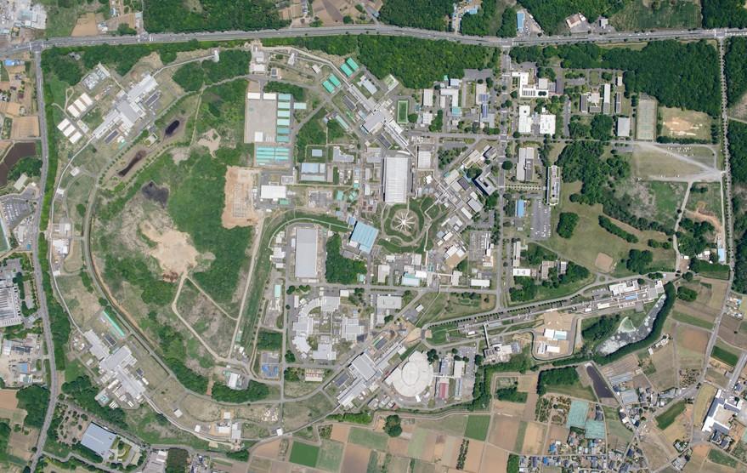
Top view of SuperKEKB collider
  SuperKEKB: asymmetric-energy electron-positron collider
  constructed by upgrading the KEKB B-factory
  High-energy electron ring
  HER: 7 GeV, 2.6 A
  e⁺
  e⁻
  Low-energy positron ring
  LER: 4 GeV, 3.6 A
  Belle II
  900 m
  Linac
  PF-AR
  Damping ring for positron beam
  PF

Slide 3
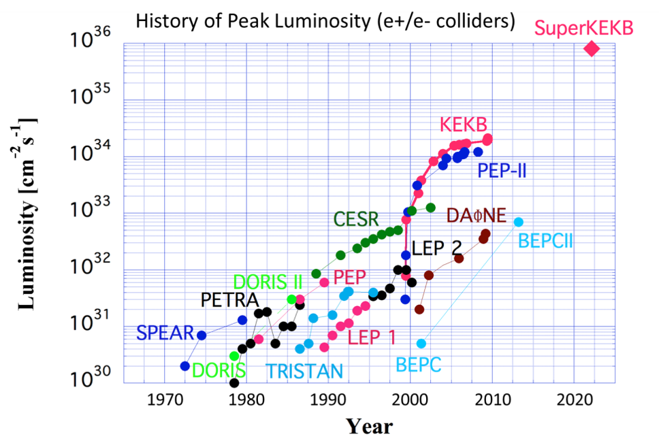
Aiming for 40 times higher luminosity than KEKB
  1.23×10³⁴ achieved
  (2019/7/1)
  Collision tuning was started in 2018 Mar. after upgrade and test operation.

Slide 4
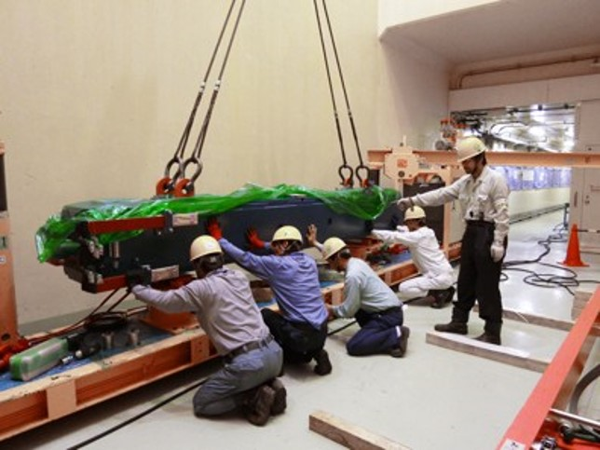
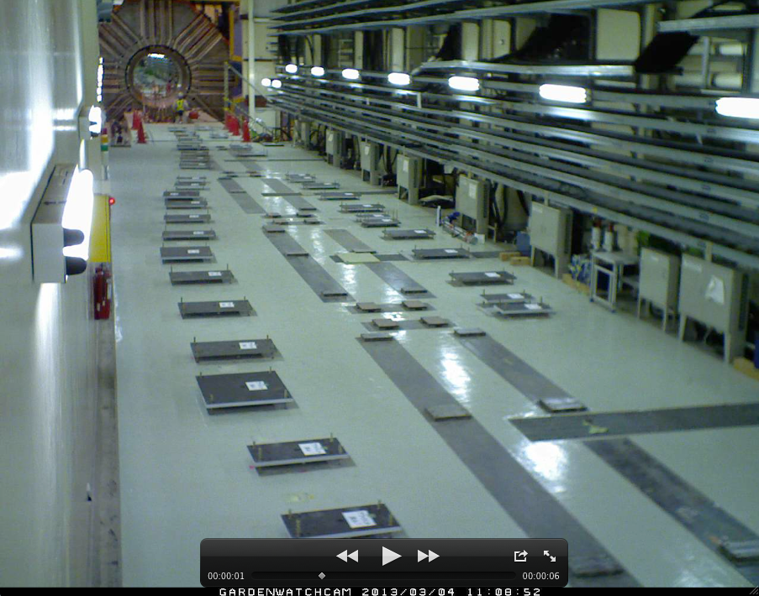
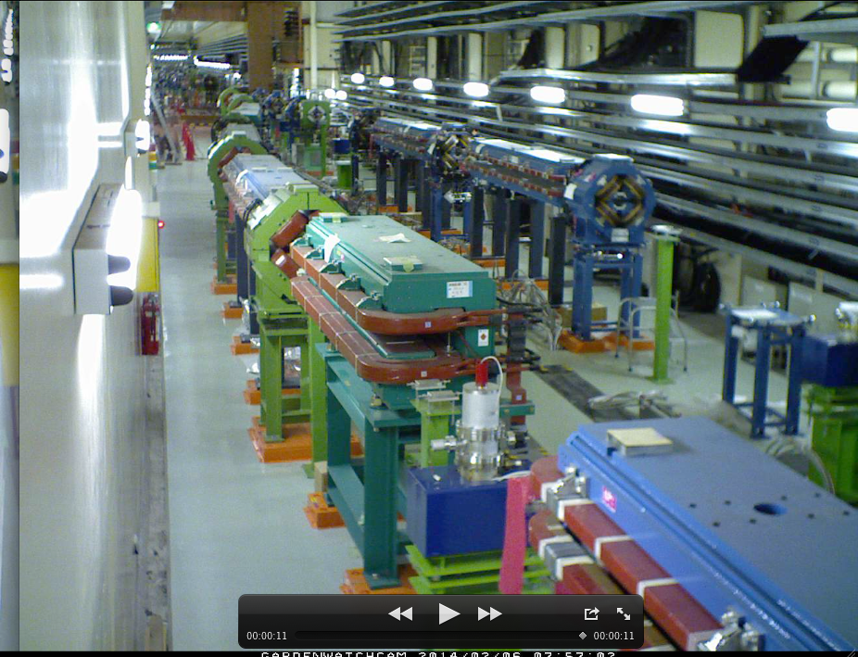
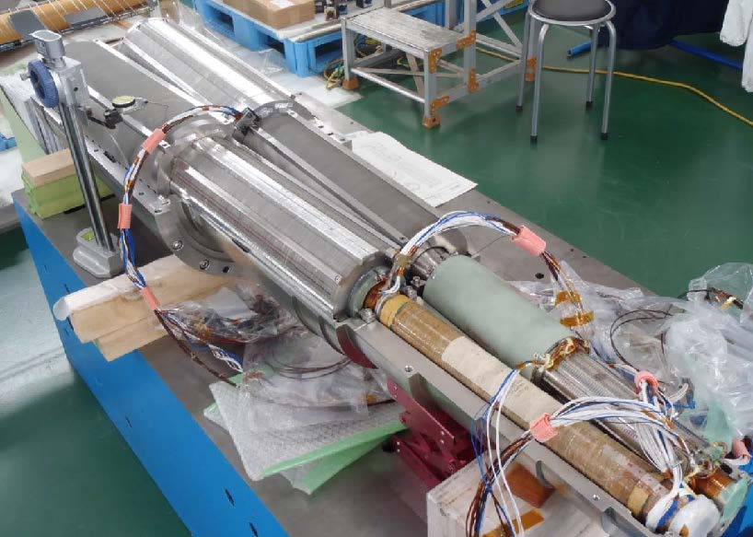
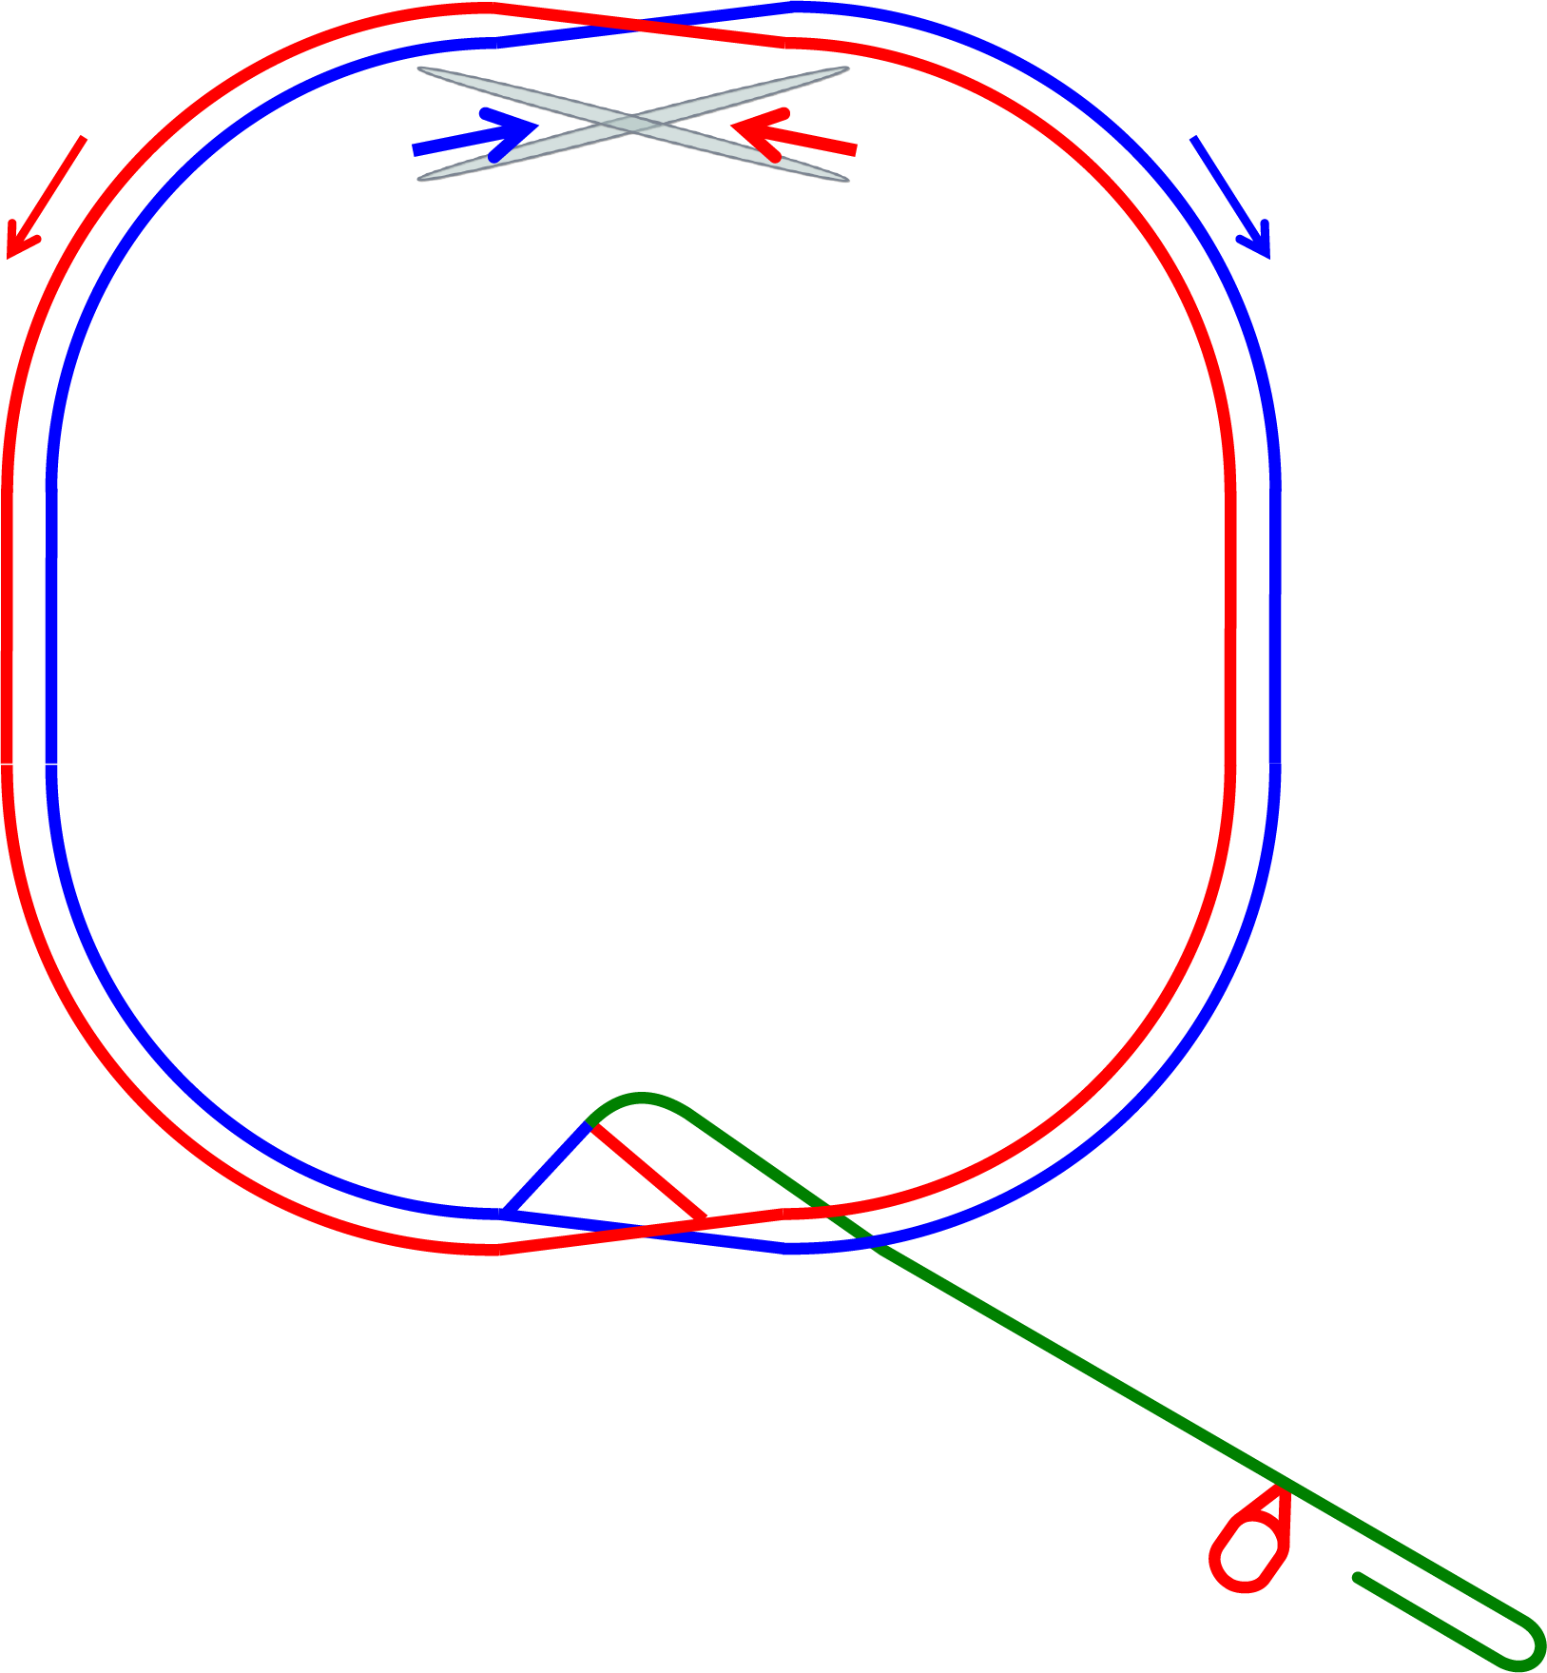
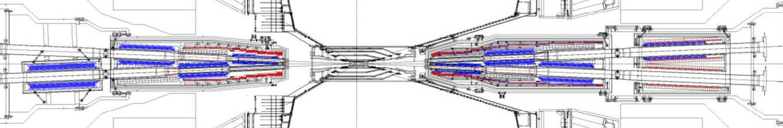
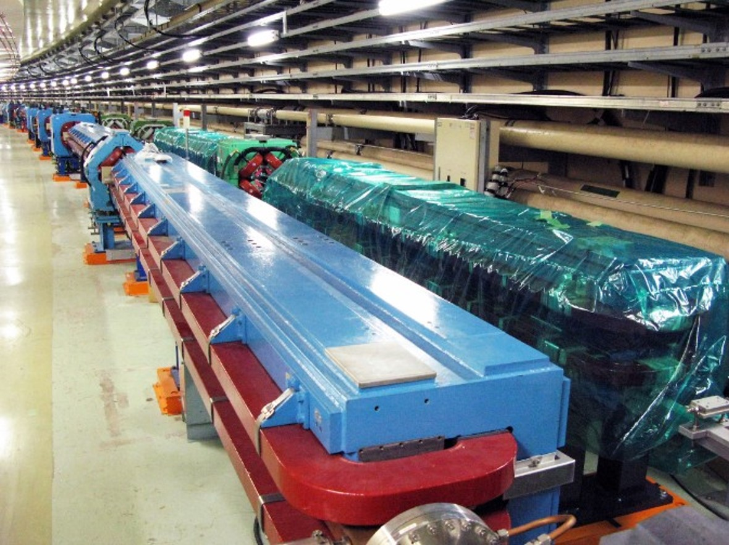
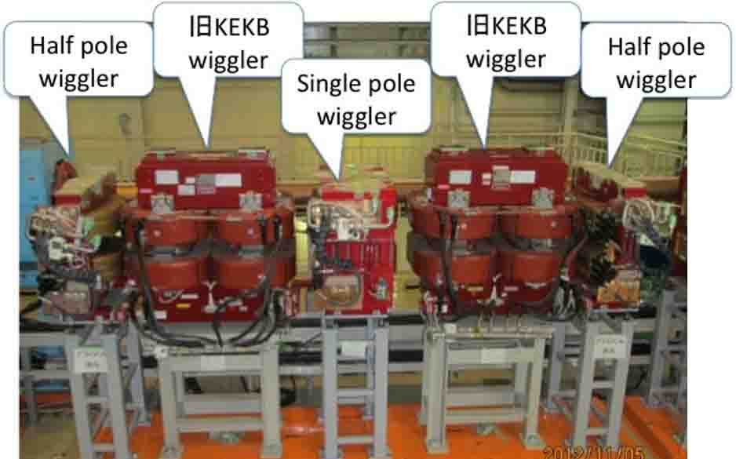
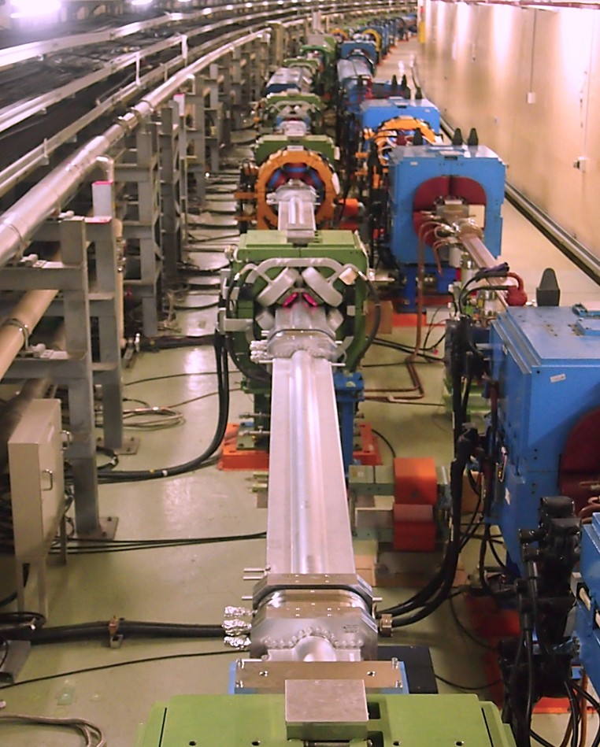

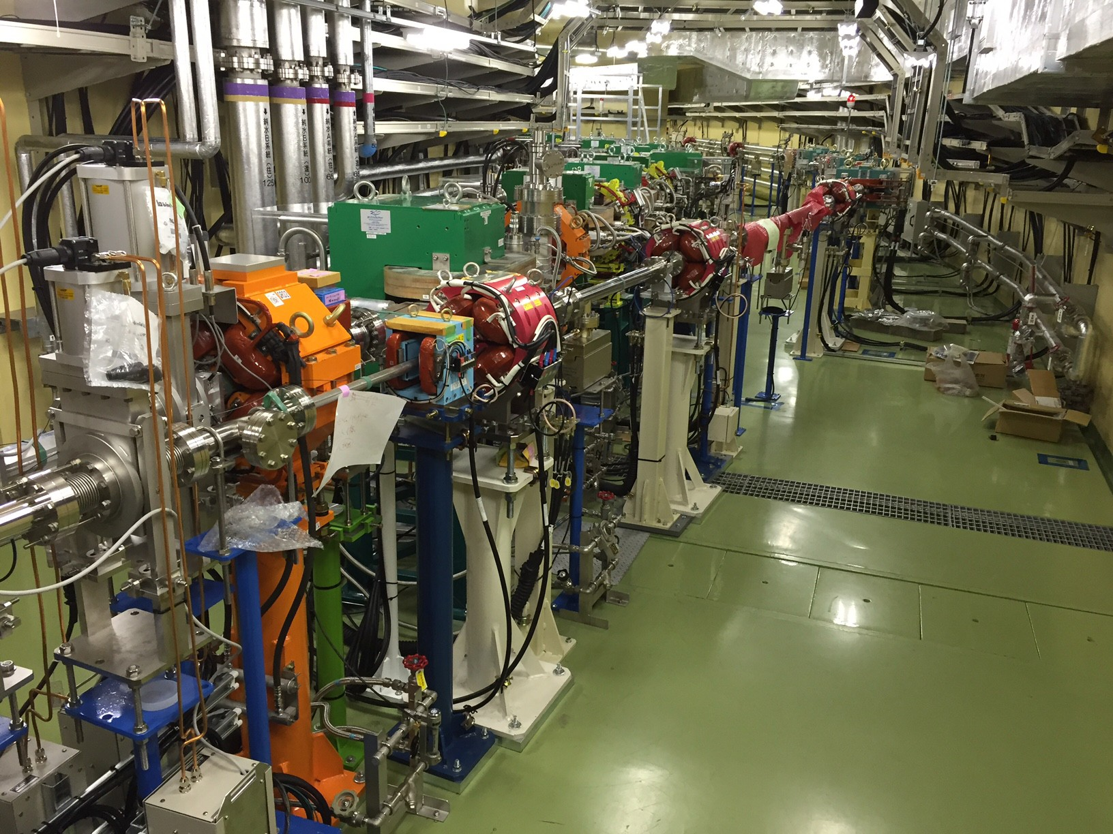
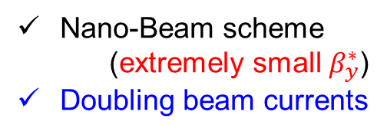
Upgrades to be 40 times higher luminosity
Redesign the lattice to squeeze emittance (replace short dipoles with longer ones, increase wiggler cycles)
IP
e⁺ 3.6A
e⁻ 2.6A
New final focus SC magnets at IP
Luminosity
All of LER main bends (100, 4m) are installed instead of shorter one.
Nano-Beam scheme
(extremely small $β_{y}^{∗}$)
Doubling beam currents
Upgrading (LER) and new (HER) wigglers
- Low emittance
RF electron gun
- Upgrade positron
capture section
Replace beam pipes with TiN-coated beam pipes with antechambers
New e+ Damping Ring
Reinforce RF systems for higher beam currents

Slide 5
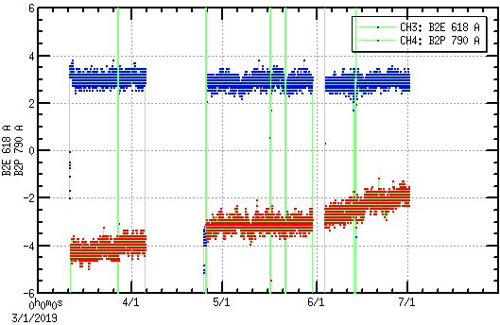
Stability of main bending magnet PSs（860A, 1.1kV）
power off/on and initializing for maintenance day etc.
B2E (618A)
1 month
Output current (2 ppm/div)
2 ppm
B2P (790A)
off-momentum
operation
・Newly developed 24-bit board and digital FB control are used.
・2.0～4.0 ppm stability obtained over Phase 3 operation.
・Good repeatability after power off and initializing operation.

Slide 6
Commissioning in a phased manner
  we are here
2016
2017
2018
2019
・・・
JFY2016
JFY2017
JFY2018
JFY2019
w/o QCS
w/o Belle II
w/ QCS
w/ Belle II (no VXD)
w/ full Belle II
Phase 1
Phase 2
Phase 3
MR startup
Installation of QCS and Belle II at IR
VXD installation
DR installation and startup
DR commissioning
  Phase 1：
  Basic machine test without collision/
  Low emittance beam tuning/Vacuum scrubbing
  Phase 2：
  Squeezing beta at IP/“nano-beam” collision tuning/
  Physics run w/o VXD starts under BG study
  Phase 3：
  Physics run starts with a fully equipped Belle II detector
  Further collision tuning and collimator tuning/cont. inj.

Slide 7
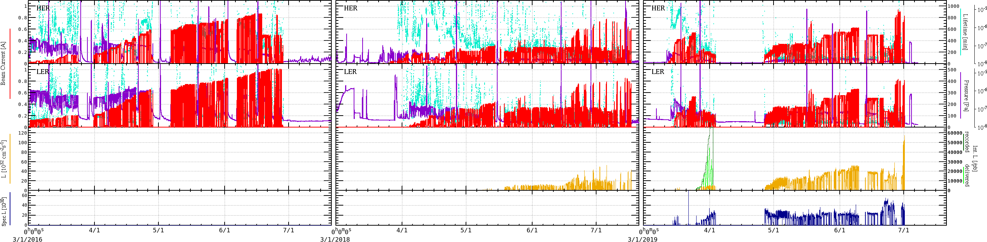
History of phase 1, 2, 3 beam commissioning
Phase 1
Phase 2
Phase 3
HER current
940mA
LER current
1010mA
  1.23×10³⁴
  LER 820 mA
  HER 830 mA
  ß_{y} = 2 mm
  n_{b} = 1576
Peak Luminosity
Specific Luminosity
  No collision
  Vacuum scrubbing
  Squeezing
  Collision tuning
  Physics run starts
  Physics run starts
  with full Belle II
  Further tuning and continuous injection

Slide 8
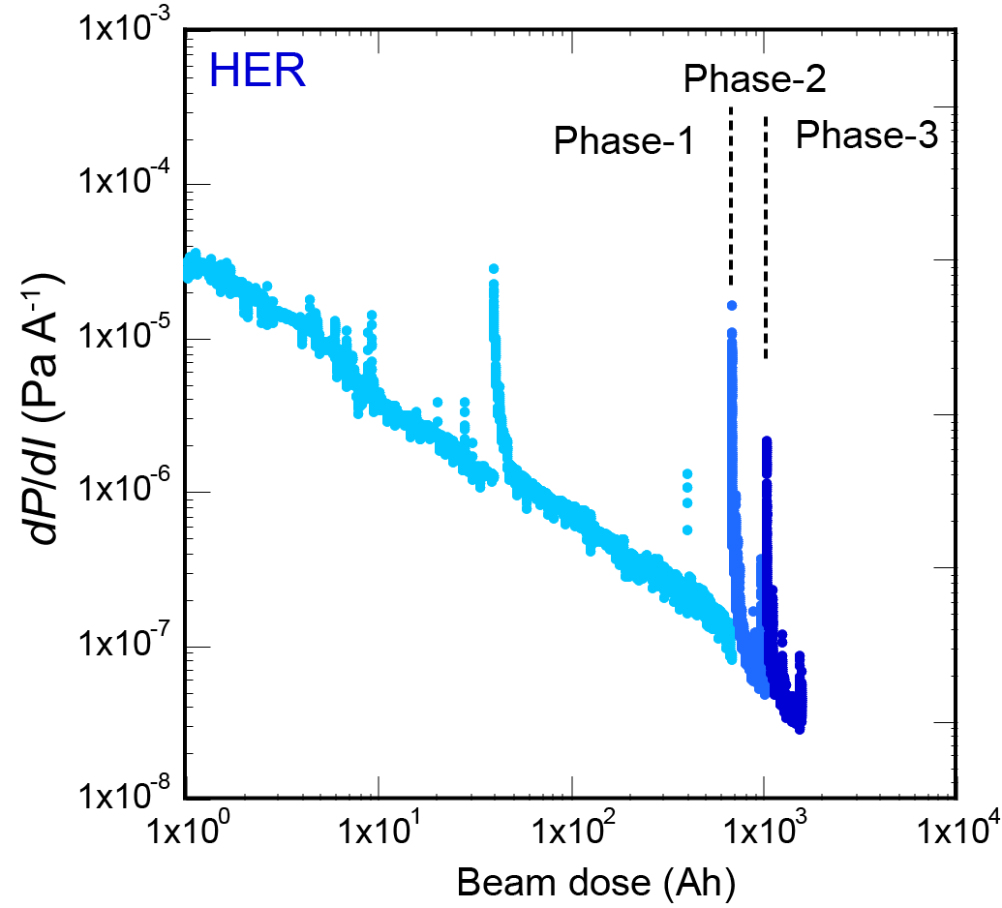
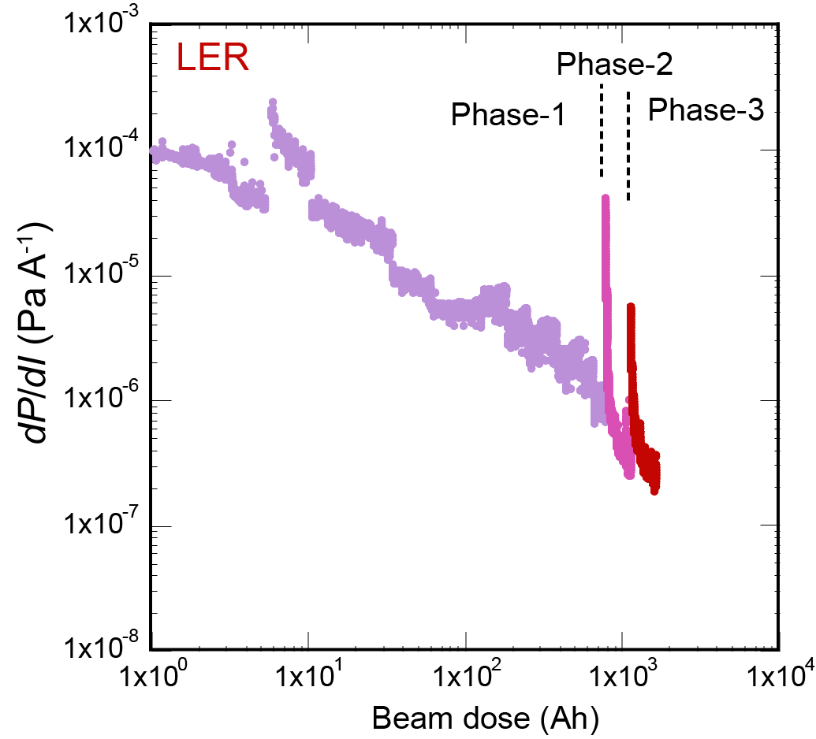
Status of ring vacuum pressures
Average ring vacuum pressures normalized by a unit beam currents.
1×10⁻⁷ Pa@design current 2.6 A
1×10⁻⁷ Pa@design current 3.6 A
Vacuum pressure should be kept lower than 1×10⁻⁷ Pa, in order to increase beam lifetime and decrease beam-gas detector background.
HER vacuum pressure has reached the target value.
Further scrubbing (5 kAh for 1/3 pressure) is necessary for LER, where newly installed beam pipes are used.

Slide 9
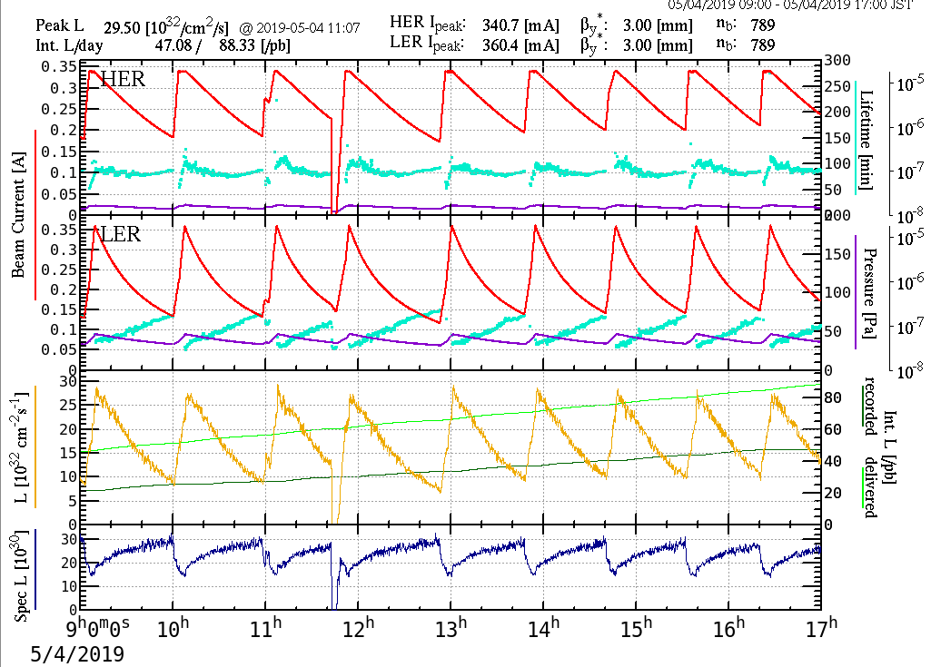
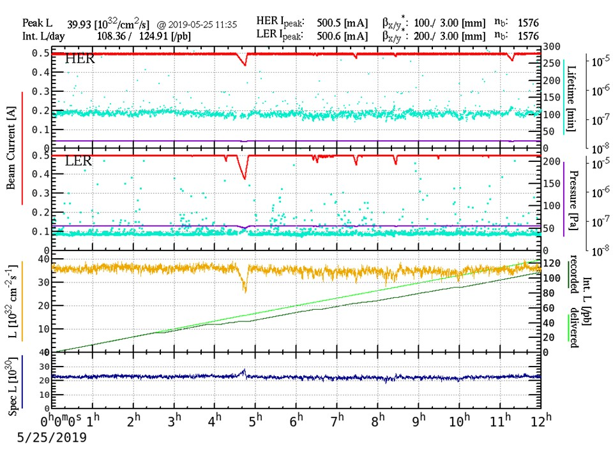
Continuous injection
In Phase 3, “continuous injection” starts, so that
e– and e+ beams are continuously injected into HER and LER.
It is realized after successful background reduction by elaborate tunings of injection parameters and collimators.
Stored beam currents are kept constant, and
integrated luminosity is increased.

Slide 10
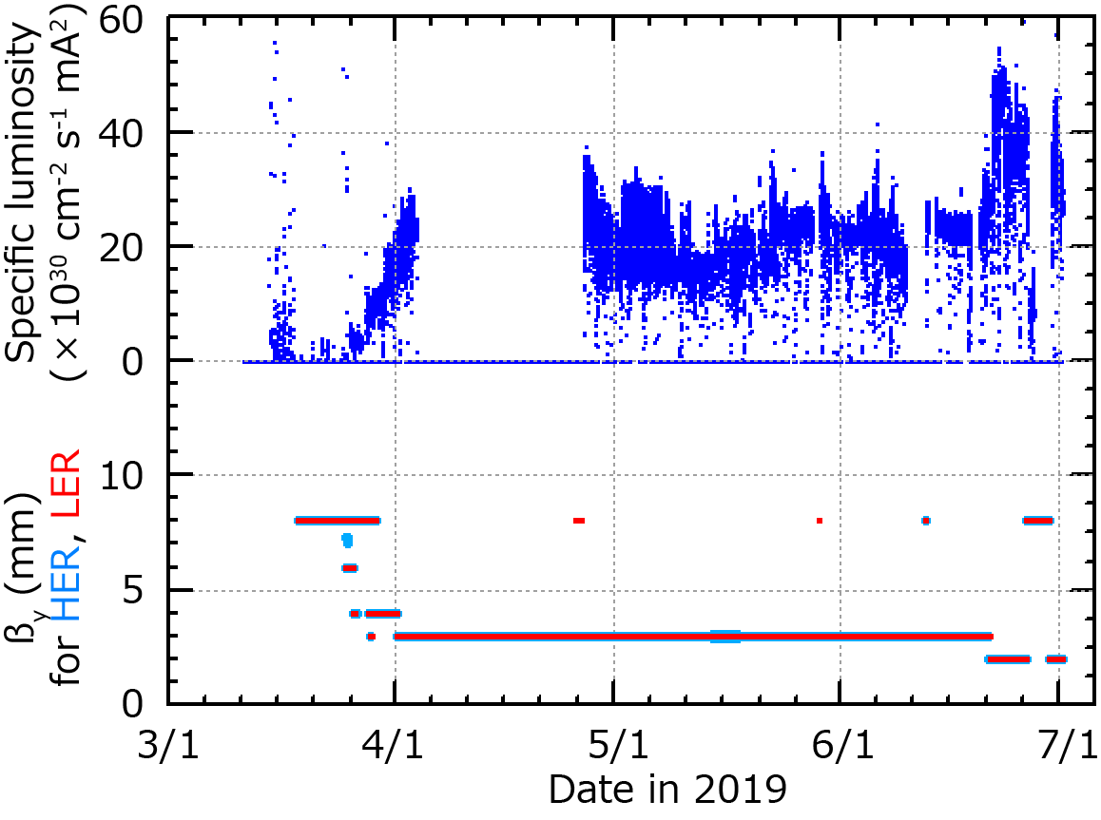
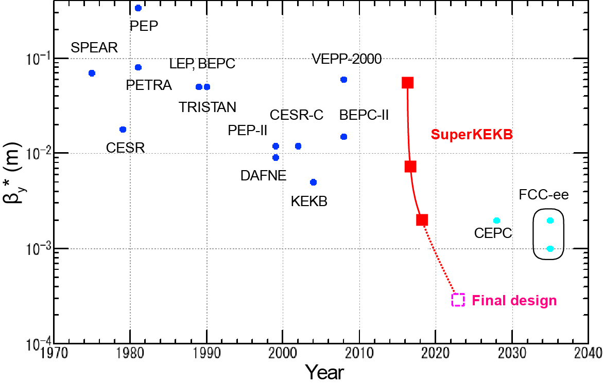
Squeezing beta function
Luminosity is increased by smaller vertical beta function at IP.
Beta function is squeezed gradually.
Smallest β_{y}*=2 mm is achieved up to now.
(final design = 0.3 mm)

Slide 11
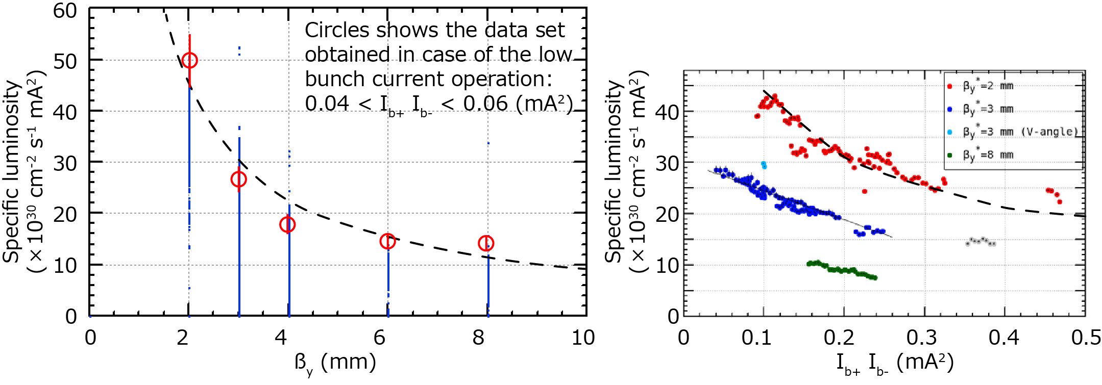
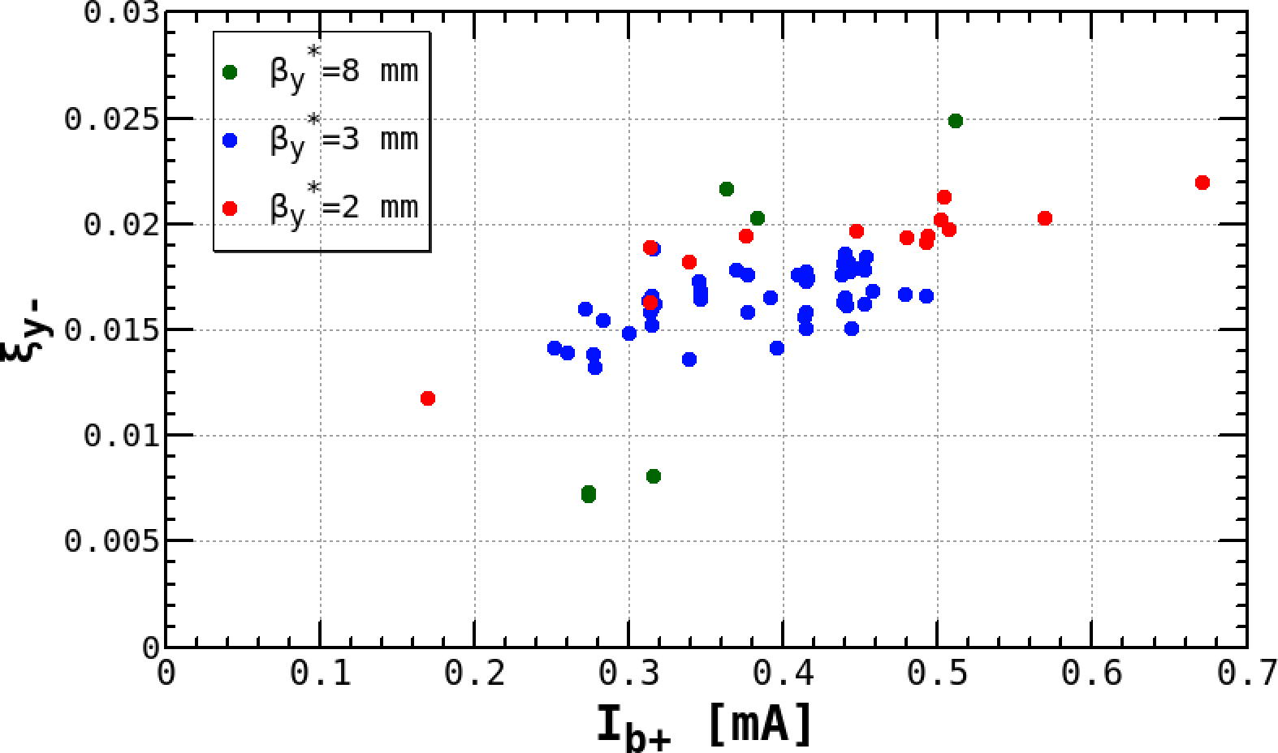
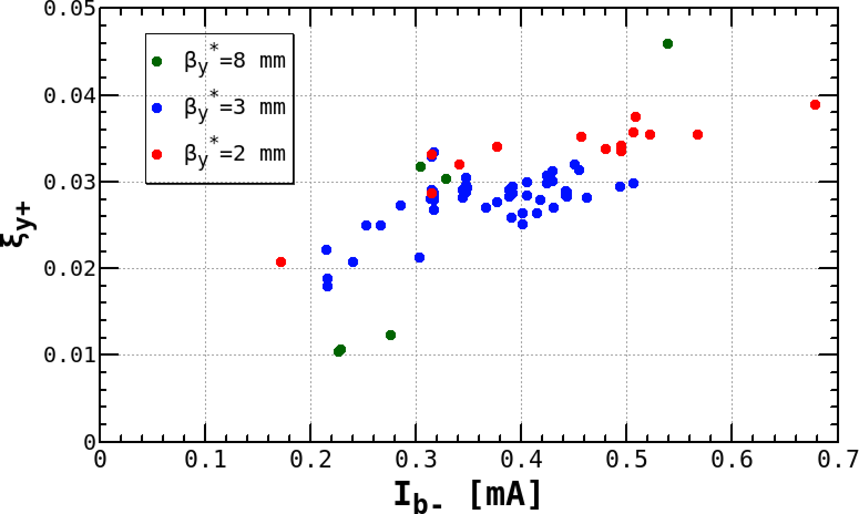
Specific luminosity
Spec. luminosity: normalized by bunch current product × # of bunch.
L_{sp} is increased by squeezing βy*.
(ξ_{±y} can be kept while squeezing)

Slide 12
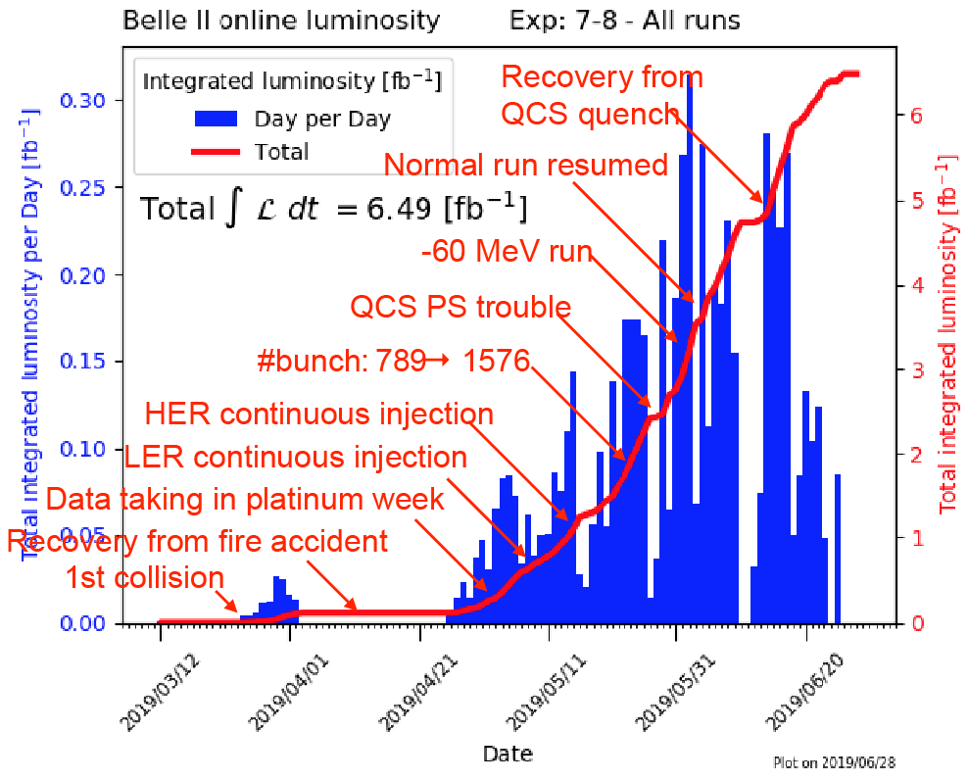
Status of physics run on phase 3 commissioning
Iijima, reported in the 23rd KEKB Accelerator Review Committee

Slide 13
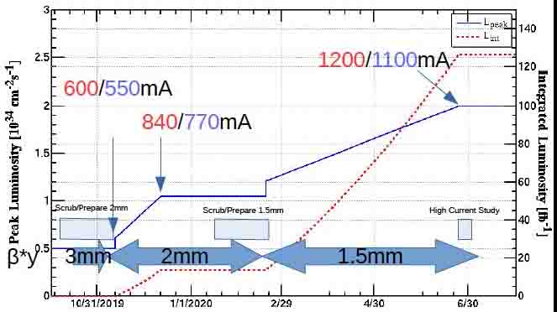
Luminosity projection (2019 Oct. – 2020 Jun.)
Morita reported in the 33rd B2GM (2019 Jun)
127 fb⁻¹
Peak luminosity (10³⁴ cm⁻² s⁻¹)
Integrated luminosity (fb⁻¹)
Note:
L= 1.23×10³⁴ cm⁻² s⁻¹
is achieved w/o Belle II due to BG.
β_{y}*
Assumptions
No machine study time for future beam development
Detector background independent of βy*
×2 improvement of CDC current limit
No current limit for protecting detector

Slide 14
Summary
SuperKEKB is an electron-positron collider that aims for a 40 times higher peak luminosity than that of KEKB.
Indeed, many of accelerator components have been upgraded.
Newly developed 24-bit control board and digital feedback control scheme are used for main bending magnet power supplies, so that 2.0～4.0 ppm stability was obtained over Phase 3 operation.
Full scale physics run has started.
The “nano beam scheme” collision was demonstrated down to β_{y}*= 2 mm.
Continuous injection for both rings is used in regular operation.
Peak luminosity of 1.23×10³⁴ cm⁻² s⁻¹ was recorded at β_{y}*= 2 mm, LER 820 mA, HER 830 mA, 1576 bunches.
Although there are several issues for challenging higher luminosity, we will keep trying to solve them.

Slide 15
Key issues for higher luminosity (1/2)
Stored beam current
No issues at present. Current will be increased, watching for overheating of vacuum components. Several RF klystrons for high-power RF system will be add in future for the design beam current.
Tuning
Injection-, optics-, tune-, collision- (offset, angle, waist, phase, …), collimators-, such a further beam tuning is necessary. V-angle tuning improves a Lsp. Beam-beam parameter is still half of its design. Beam blowup is observed in LER, which is not yet understand.
Quench on the final focus superconducting magnet
Collimator tuning reduces the number of quench occurrences at present. For more squeezing of beam, additional collimators may be required. Additional fast beam abort signal may be helpful for a quench protection.

Slide 16
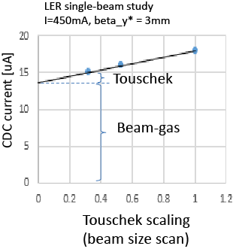
Key issues for higher luminosity (2/2)
LER beam transport lines
Injection beam emittance is a little bit larger than expected. Extracted beam emittance from a dumping ring is small enough, so that BT will be check the reason.
Background
Further scrubbing (5 kAh for 1/3 pressure)
is necessary for LER.
Dominant source is LER beam gas BG.
Touschek BG is small enough,
due to newly installed horizontal collimators.
Beam-dust events (called UFO's at LHC) ?
Pressure bursts are observed occasionally.
Preliminary test result presented
by Nakayama in the 23rd KEKB
Accelerator Review Committee

Slide 17
presented by Ohnishi in the 23rd
KEKB Accelerator Review Committee
Beam-beam blowup
Beam blowup is observed
in LER, but it is not yet clear why it happens.

Slide 18
Back-up slide

Slide 19
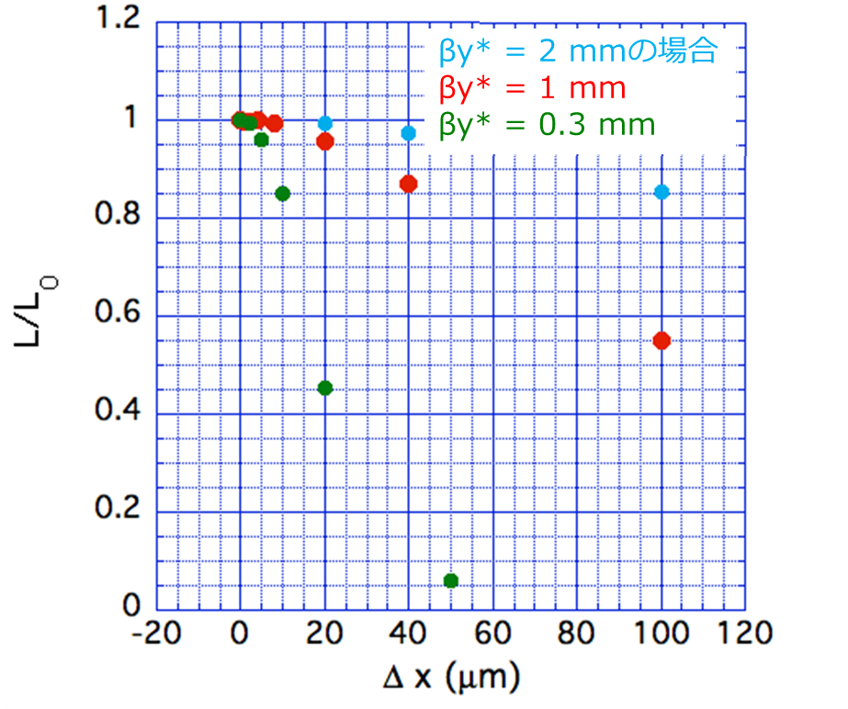
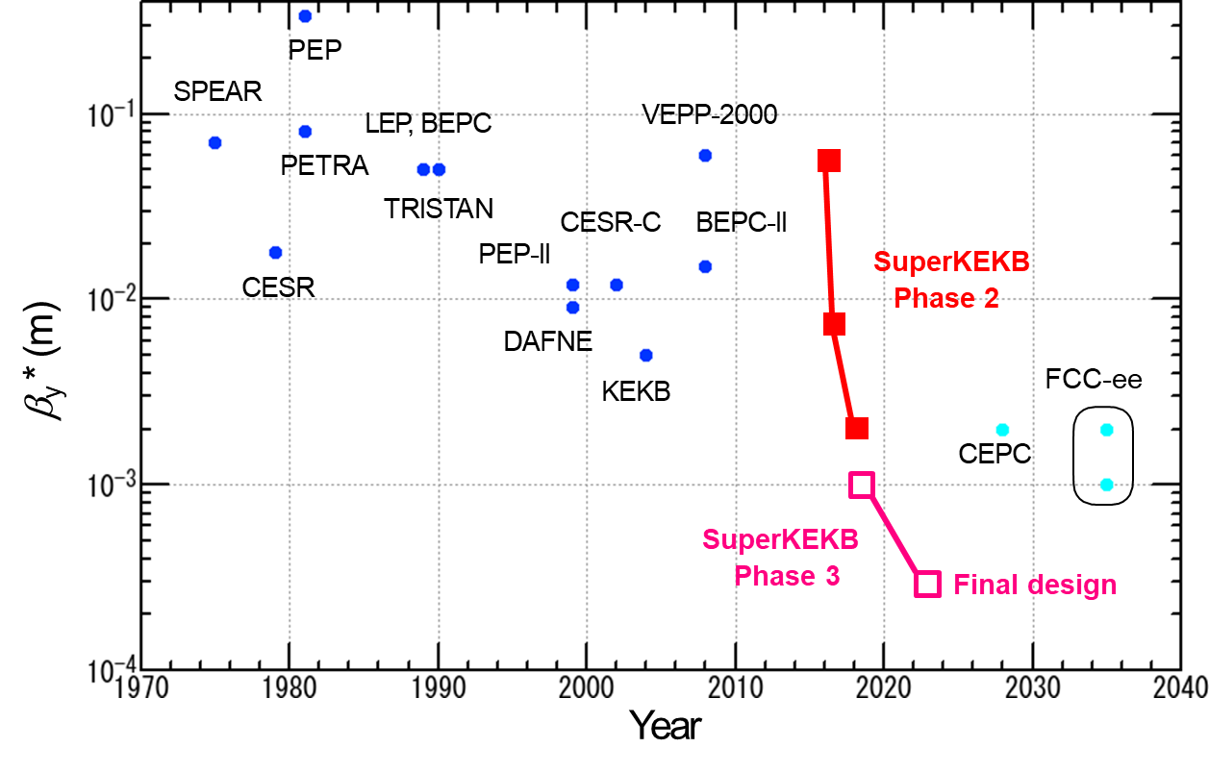
SuperKEKBでのビーム衝突： KEKBと比べて20倍細いビーム
・ナノサイズビームを如何に衝突、維持するか：最も重要な課題の一つ
LERの比較 | SuperKEKB | KEKB
β_{x}* / β_{y}* | 32 mm / 0.27 mm | 1200 mm / 5.9 mm
σ_{x}* / σ_{y}* | 10 μm / 48 nm | 147 μm / 940 nm
・水平方向に衝突ビームがずれた時のルミノシティの減少率（大見氏計算）
βy* = 2.2 mmの場合
βy* = 1.1 mm
βy* = 0.3 mm
Phase 2：
βy* = 2 mmまで
βy*を絞るほど、水平方向にずれた時のルミノシティ減少が厳しい
水平方向衝突軌道保持フィードバックシステムとして、PEP-IIで
実績のあるデザリングシステムをSuperKEKBで初めて導入した。

Slide 20
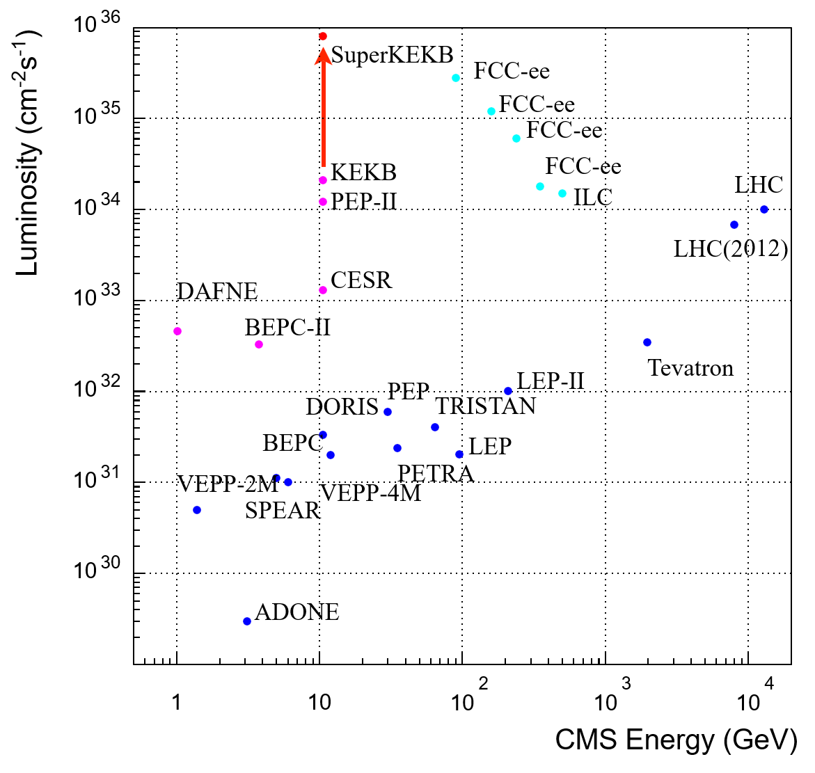
ルミノシティ／エネルギーフロンティア
Luminosity Frontier
Energy Frontier

Slide 21
ルミノシティとは
単位時間あたりに生成される物理事象数
ルミノシティ
・出会いの頻度、輝度
・加速器の性能で決まる
反応断面積
・自然法則で決まる
・ドウシヨウモナイ
=
×
例： の場合
反応断面積 10⁻³³ cm²
ルミノシティ 10³⁴ cm⁻² s⁻¹
B・反B中間子が毎秒10ペア生成される
物理事象数を増やすにはルミノシティを上げるしかない。
ビーム・バンチの粒子数
バンチ同士の衝突頻度
衝突点での水平・垂直ビームサイズ
幾何学的に決まる減衰率

Slide 22
ルミノシティの式変形：ビーム・ビームパラメータ ξ の導入
・バンチ内粒子数を増やせば、ルミノシティは幾らでも上がるか？
・衝突ビームサイズを小さくすれば、…？
→否：衝突する互いのビームが及ぼしあう力でビームサイズ増大
・衝突の強さを表す無次元量：ビーム・ビームパラメータ ξ
を導入してルミノシティを表現すると…
←いろいろ制限があって
あまり大きくできない
ルミノシティの3大要素
ビーム電流
ビーム・ビーム
パラメータ
ローレンツ因子
ビームアスペクト比
衝突点垂直ベータ関数
SuperKEKB: ベータを1/20絞り、ビーム電流を2倍に！

Slide 23
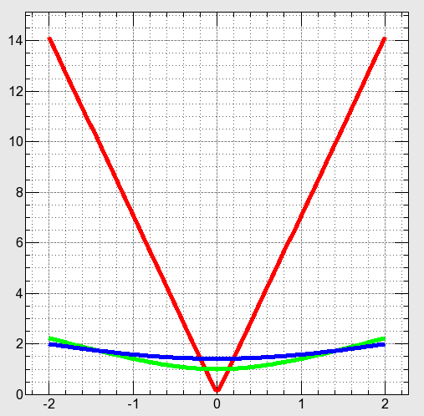
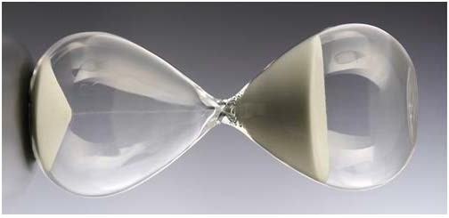
ベータを絞る制限：砂時計効果
・ルミノシティを上げるためにベータを絞りたい。どこまで絞れるか？
→絞りすぎると、衝突点(IP)の前後で砂時計の様にビームが太る。
→せいぜい、ビーム同士が重なる長さ程度しか絞れない。
垂直方向ビームサイズ（相対量）
β_{y}* = 1/20 σ_{z}
絞り過ぎ
β_{y}* = σ_{z}
適正な絞り
絞り不足
β_{y}* = 2σ_{z}
IP
どうすれば絞れるか

Slide 24
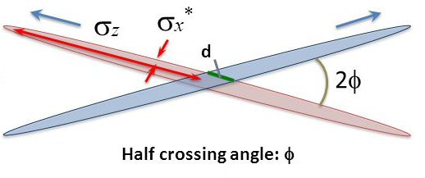
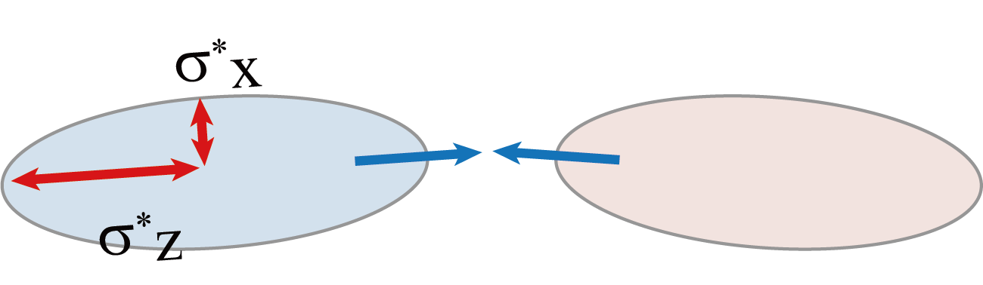
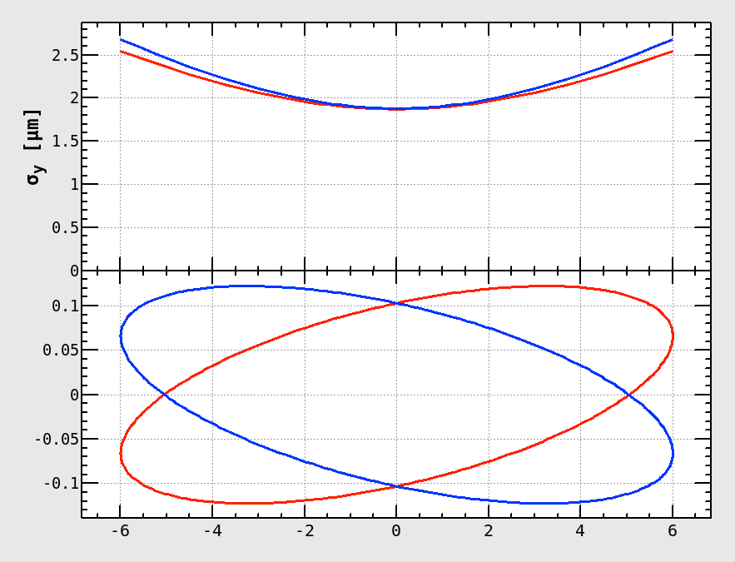
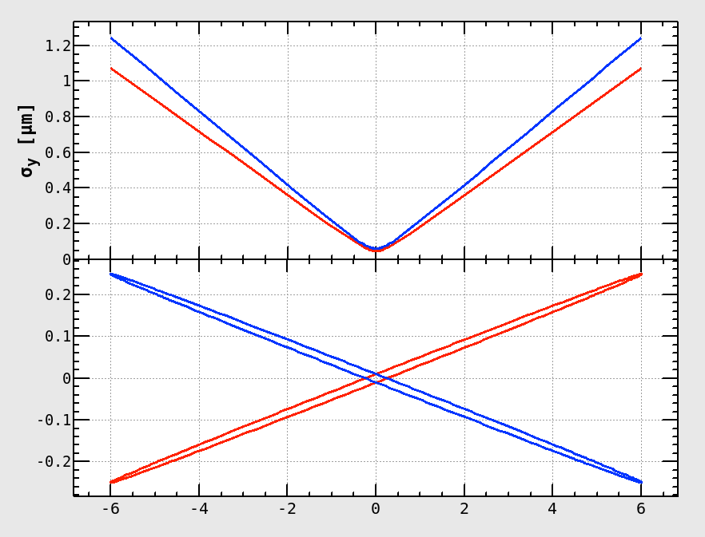
水平方向のビーム幅を絞る＋水平方向に大交差角を付ける
→砂時計効果を緩和できる（ナノビーム・スキーム）
KEKB
SuperKEKB
衝突長 ～ バンチ長
衝突長 ≠ バンチ長
σ_{y} (μm)
σ_{y} (μm)
β_{y} = 0.3 mm
β_{y} = 6 mm
x (mm)
衝突長～10 mm
x (mm)
衝突長～0.6 mm
s (mm)
s (mm)

Slide 25
SuperKEKB加速器の設計パラメーター
パラメータ |  | KEKB |  | SuperKEKB |  | 単位
 |  | LER(e⁺) | HER(e⁻) | LER | HER
ビームエネルギー | Eb | 3.5 | 8 | 4 | 7 | GeV
半交差角 | φ | 11 |  | 41.5 |  | mrad
水平エミッタンス | εx | 18 | 24 | 3.2 | 4.6 | nm
エミッタンス比(ε_{y}/ε_{x}) | κ | 0.88 | 0.66 | 0.27 | 0.25 | %
衝突点でのβ関数 | βx /βy | 1200/5.9 |  | 32/0.27 | 25/0.30 | mm
ビーム電流 | Ib | 1.64 | 1.19 | 3.6 | 2.6 | A
ビーム・ビーム パラメーター | ξy | 0.129 | 0.090 | 0.088 | 0.081
ルミノシティ | L | 2.1 x 10³⁴ |  | 8 x 10³⁵ |  | cm⁻²s⁻¹
・交差角を大きく、水平ベータ関数を小さくして砂時計効果を緩和
・垂直β関数を1/20に絞って、ビーム電流を2倍
・まずはKEKBのデザイン値10³⁴を、→40倍のルミノシティを目指す！

Slide 26
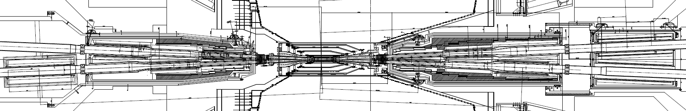
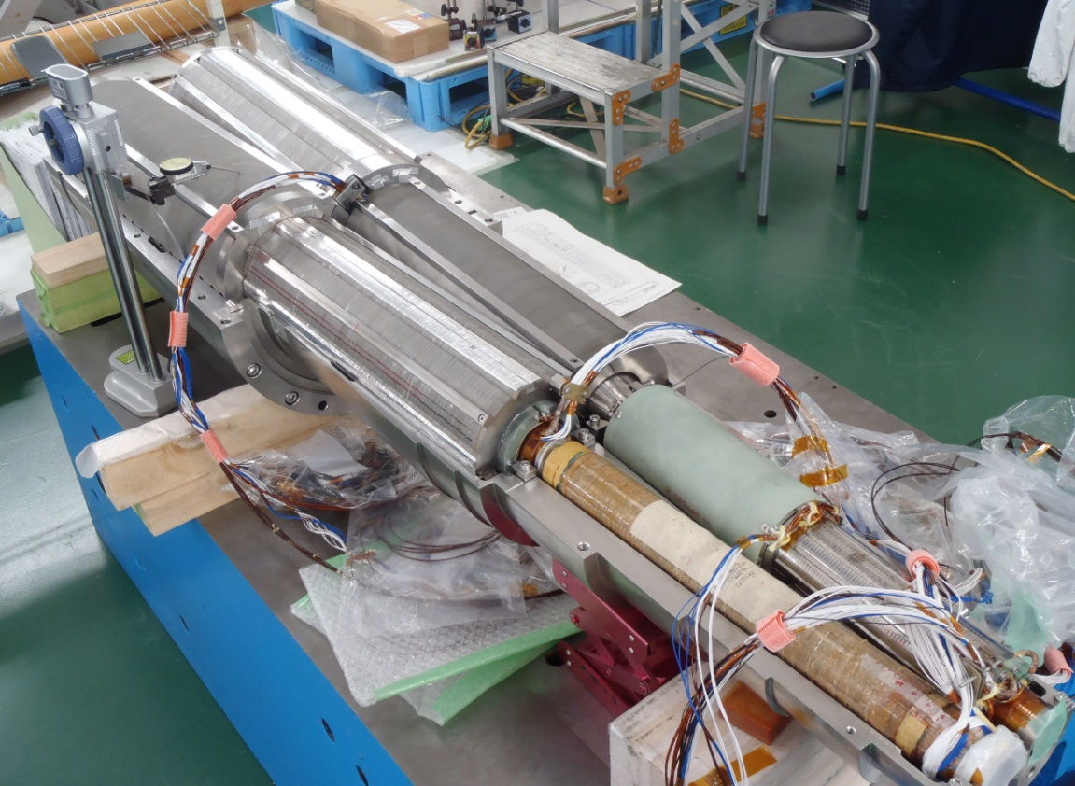
Final focus superconducting magnets around IP
Completely redesigned for SuperKEKB
ESR
QC2RE
QC2LP
ESL
QC1LP
QC1RE
IP
QC1LE
QC1RP
ESR-add
QC2LE
QC2RP
QC2LP main quad.
and a₁, b₁,a₂,b₄
corrector coils
QC1LP
and a₁, b₁,a₂,b₄
QC1LE
and a₁, b₁,a₂,b₄
Anti-solenoid coils (ESL, ESR, ESR-add) are also prepared against Belle II detector solenoid field.
Leak field cancel coil for QC1LP
and b₃, b₄,b₅,b₆

Slide 27
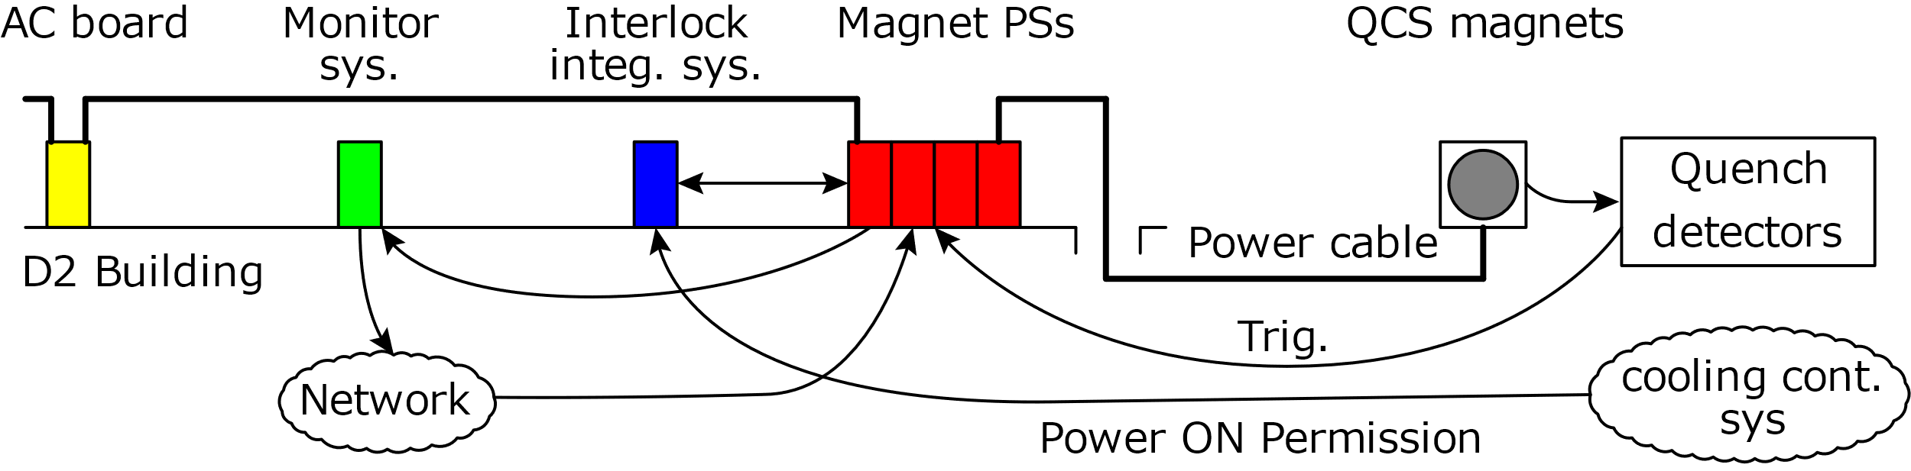
System overview
SC
System consist of
  SC magnets, quench detection and cooling control system,
  Magnet power supplies,
  AC power distribution board,
  Interlock integration and distribution system,
  Current monitor system and
  Remote control system.
The system is integrated with other systems.

Slide 28
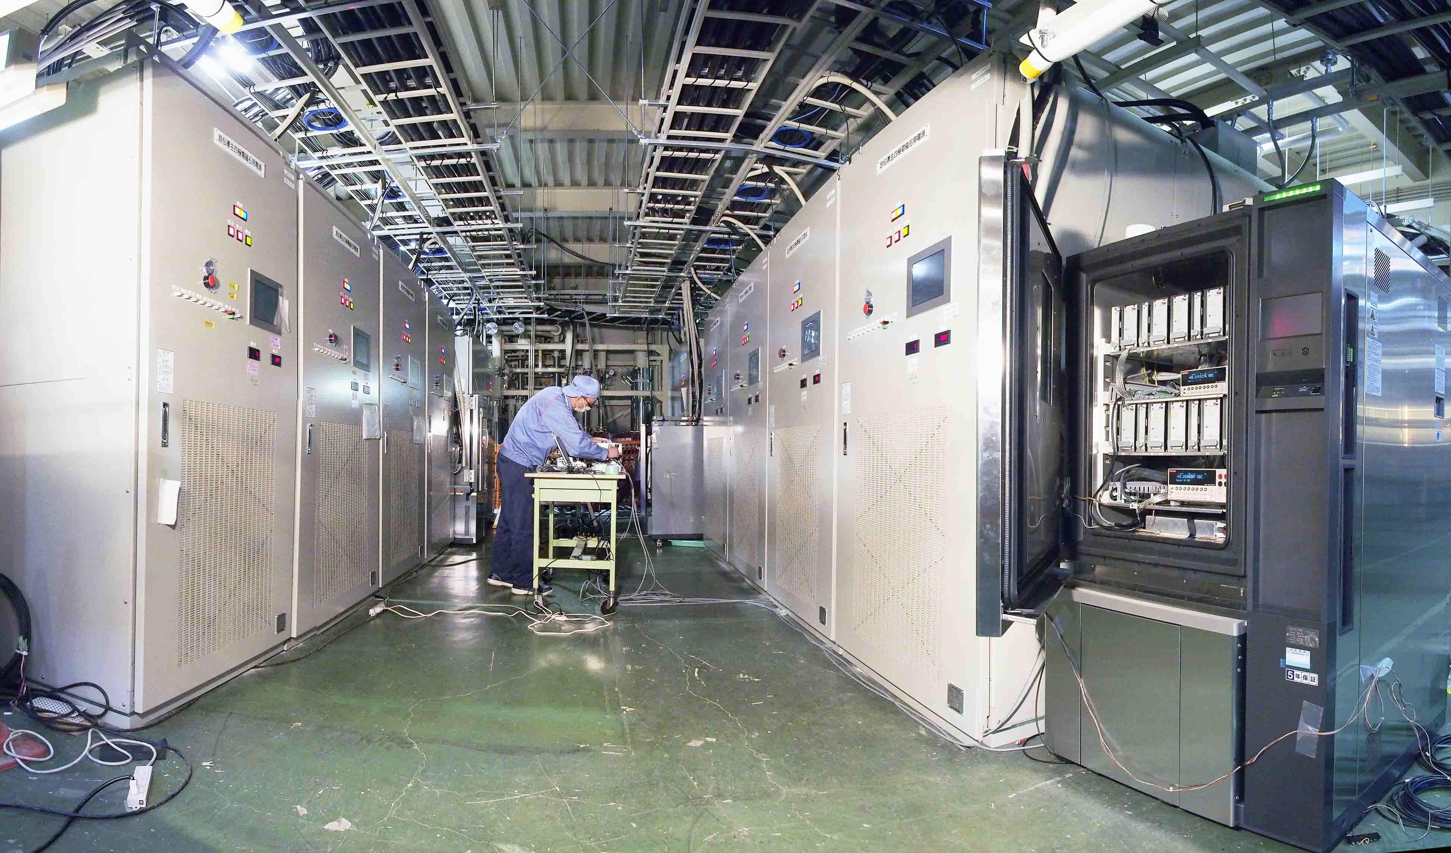
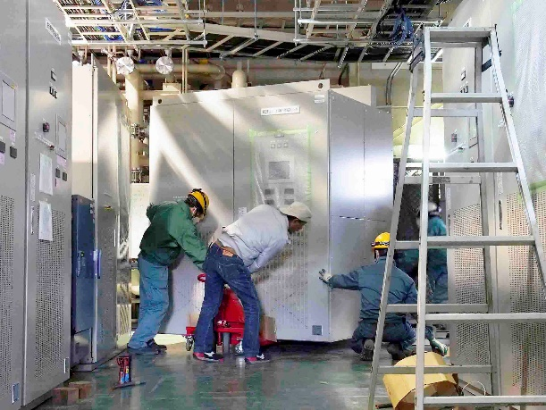
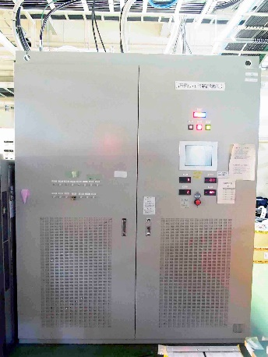
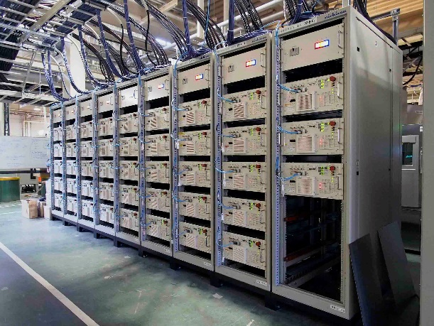
Installed power supplies
8 of main quad. PSs
Constant temp. cabinet for DCCTs and DMMS
3 of anti
-solenoid
PSs
43 of correction PSs

Slide 29
List of SC magnet power supplies
Rated output | # of PSs | Load
2 kA, 15 V | 8 | Main quad.
±70 A, ±10 V | 43 (+2 spare) | correction coil
410 A, 15+15 V | 1 | ESL
455 A, 15+30 V | 1 | ESR1
155 A, 15 V | 1 | ESR23
Special power supplies for …
Main quadrupole magnet:
2 ppm ultra high stability and 1 ppm low ripple.
Correction coils:
5 ppm high stability with low cost.
Anti-solenoid:
ESL and ESR1 has a middle tap. Current for each two sections divided by the tap should be controlled independently.

Slide 30
Development of main quad. power supply
Aiming spec.
Rated output | DC 2 kA, 15 V
Current setting resolution | < 0.1 ppm
Current stability | < 2 ppm/8 hrs.
Current ripple (< 10kHz) | < 1 ppm (rms)
Current noise (> 10kHz) | < 1 ppm (0-peak)
R&D items
1. High current setting resolution
2. High stability
3. low ripple

Slide 31
R&D item 1: High current setting resolution
・Example of step response: 16-bit KEKB PS (1 kA, 700 V)
Current setting value is changed by 1 bit.
15 mA
(15 ppm)
Output current(A)
Aiming 2 ppm stability, 0.1 ppm of setting resolution is required.
24-bit control board is developed using two 20-bit DACs. Analog Devices AD5791 is suitable due to its monotonicity spec.

Slide 32
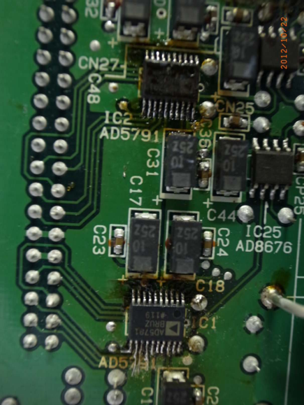
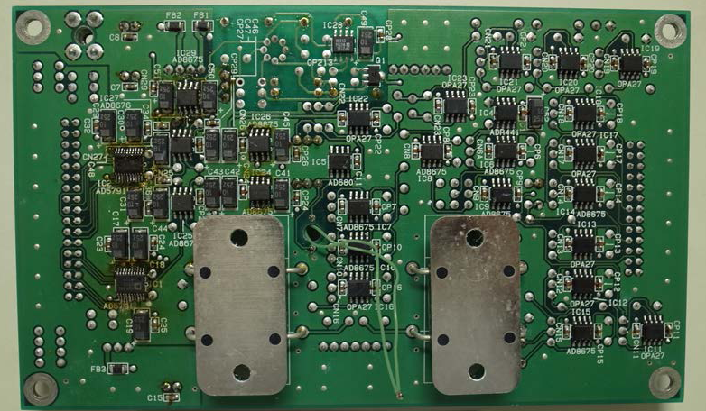
R&D item 1: Developed 24-bit board
Analog Devices
AD5791BRUZ
1/2²⁰
Setting value
in 20-bits (major)
+
DAC
+
1/2⁴
+
1/2⁴
Setting value
in 4-bits (minor)
DAC

Slide 33
R&D item 1: Test result of 24-bit board
Increasing DAC input digital value by 1 LSB, DAC output voltage is measured by Keithley 2002 DMM.
+2
0
−2
−4
−6
−8
DAC output (μV)
2 μV
0 1 2 3 4 5^{×1000}
Time (s)
Monotonic 1 LSB response,
that is corresponds to 0.6 μV/10 V F.S, is obtained.

Slide 34
R&D item 2: High stability
・Example of stability: KEKB SC Main Q. PS (4 kA, 15 V)
Output current (A)
10 ppm
Room temp.（℃）
moving average
Typ. stability is 10 ppm (peak to peak)/week.
Resulting in 1 ppm/K of temp. coeff., although a temp. controlled box and low temp. coeff. parts were used.
In order to suppress such a fluctuation in the output current, following digital feedback control is developed.

Slide 35
R&D item 2: Digital feedback control
24-bit control board
Major setting
value (20 bits)
+
+
DAC
+
-
-
Minor setting
value (4 bits)
+
1/2⁴
DAC
Current control
analog loop
(normal mode)
-
Error
Digital feedback
loop
(typ. 60 s rep.)
8.5-digit DMM
Only for
current
monitor
1/2
+
Output
terminal
P
N
DCCT(D)
DCCT(P)
1/2
DCCT(N)
DCCT(mon)

Slide 36
R&D item 2: Test result of the digital feedback loop
Performed by using a medium-class power supply (15 V, 500 A).
Digital feedback loop
well corrects DAC input
by 24bit resolution
Output current measured by DCCT (0.25 mA/div)
1 hour
1 ppm / h stability with low σ = 0.16 ppm

Slide 37

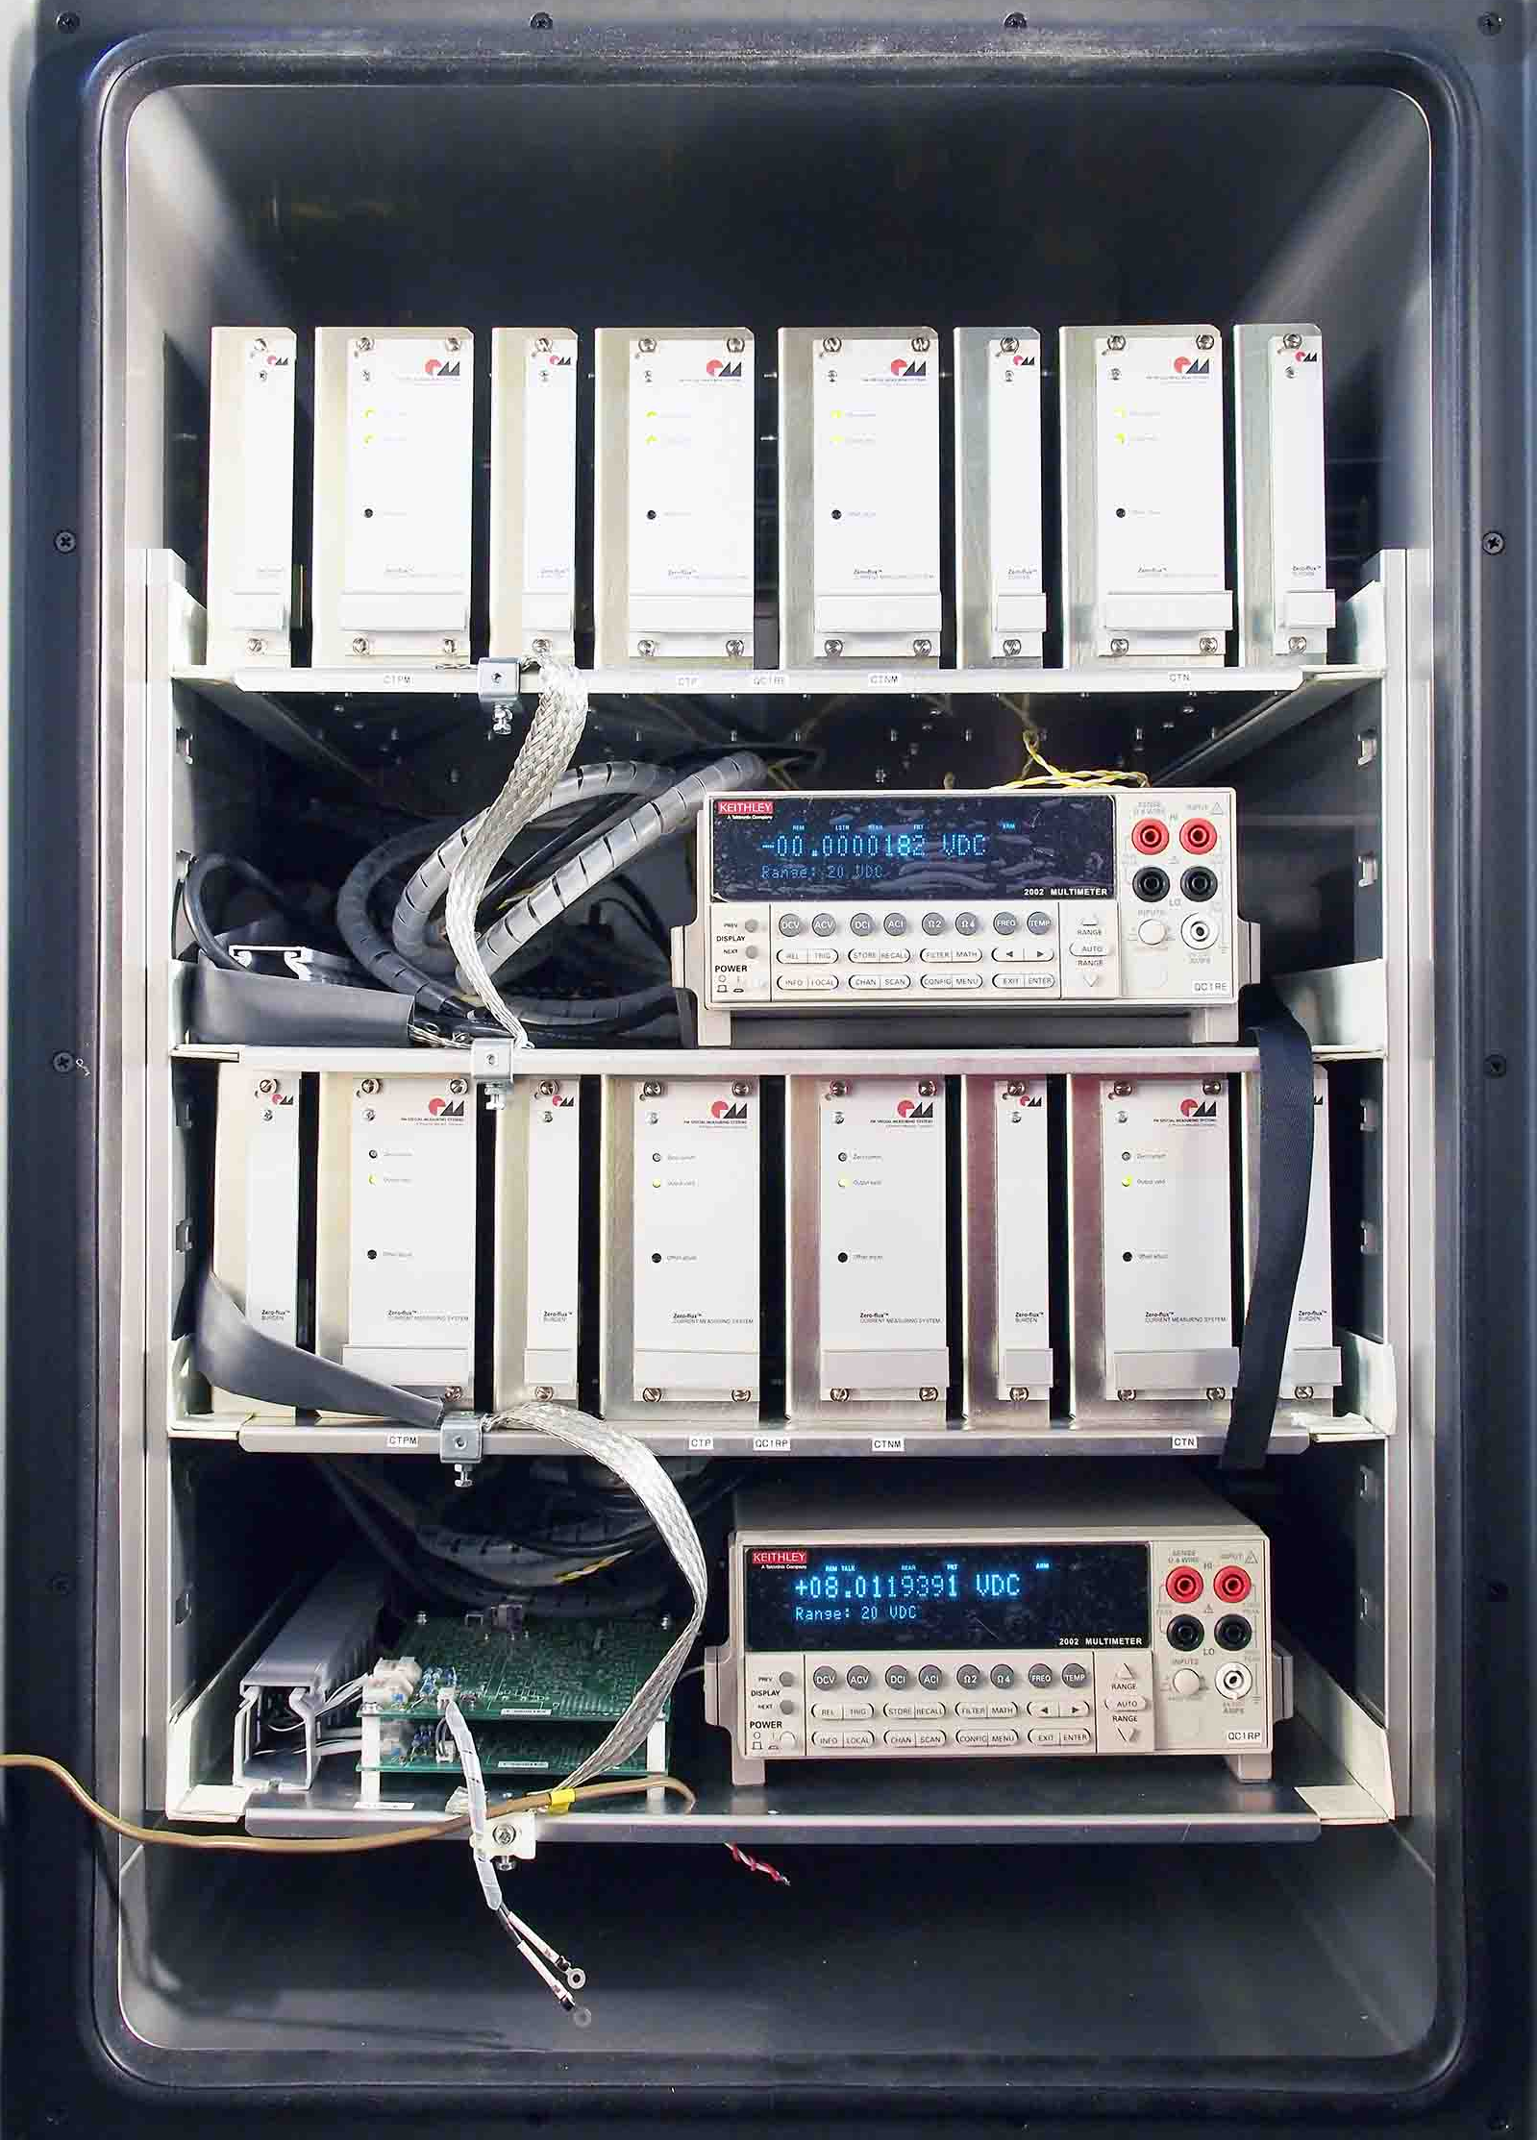
For high precision current measurement
Low temp. coefficients equipment.
0.3 ppm/K (Keithley 2002), 1.5 ppm/K (TOPACC DCCT)
Suitable grounding is a key point:
100 GΩ input impedance (DMM), 0.1 ppm =10 μV
This digit
Ground connection should be separated each other.
2 set of DCCTs and DMM inside
a constant temp. cabinet

Slide 38
R&D item 3: Low ripple for low impedance load
・Example of the load impedance (QC1LP)
Normal-mode impedance < several tens of Ω in the low freq.
(<10 kHz) range: Possibility of large current ripple.
Common-mode impedance < several tens of Ω in the high freq. (>10 kHz) range: Possibility of large switching noise.
Symmetrical design of circuit is essential to reduce ripple and noise.

Slide 39
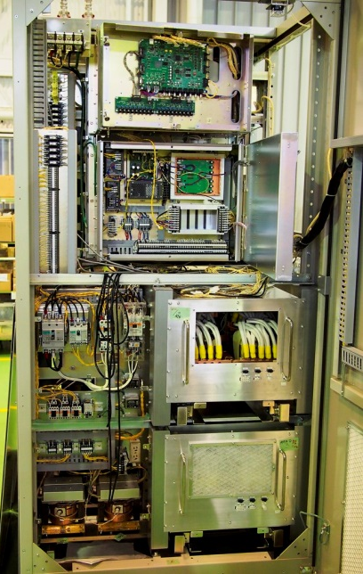
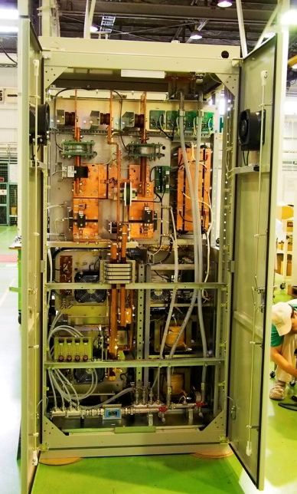
R&D item 3: Symmetric circuit design
DCCTs on both output terminals.
Symmetric circuit structure with respect to ground.
Shielded high-frequency transformer

Slide 40
Performance test results 1: QC1LP current ripple
Dividing the measured voltage ripple by the magnitude of the load impedance, the current ripple is obtained.
Less than 1 ppm of normal-mode ripple and noise.
Common-mode components are also measured: 0.5 ppm@57 kHz in the maximum.

Slide 41
Performance test results 2: QC2RE stability
10.5 hrs
1.5 ppm
Operation of an arc furnace outside of KEK.
Operation of phase advance capacitors/harmonic filters in facility.
~1.5 ppm / 10.5 hrs of current stability is obtained.
The rapid change in AC voltage leads to makes stability worse.

Slide 42
Feedback control of the DC voltage for chopper

Slide 43
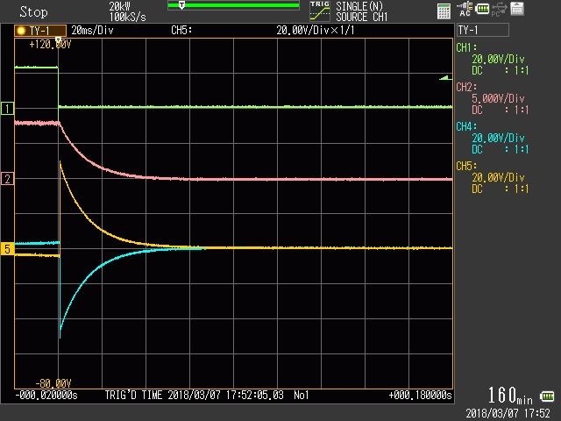
Full power test with actual load
Interlock test: ex. quench protection trip test result (QC1LP)
Trig. from Q.D.
Output
current
(1kA/div)
1.6 kA
11.7 ms
Output
voltage
(20V/div)
V_{PE}
V_{NE}
100 V
(20ms/div)
Good agreement with estimations
  Decay time constant：14.2 ms=0.9 mH / (3.5 mΩ + 60 mΩ)
  magnet cable + protection R
  Induced voltage V_{PE}-V_{NE}：96 V=1.6 kA×60 mΩ

Slide 44
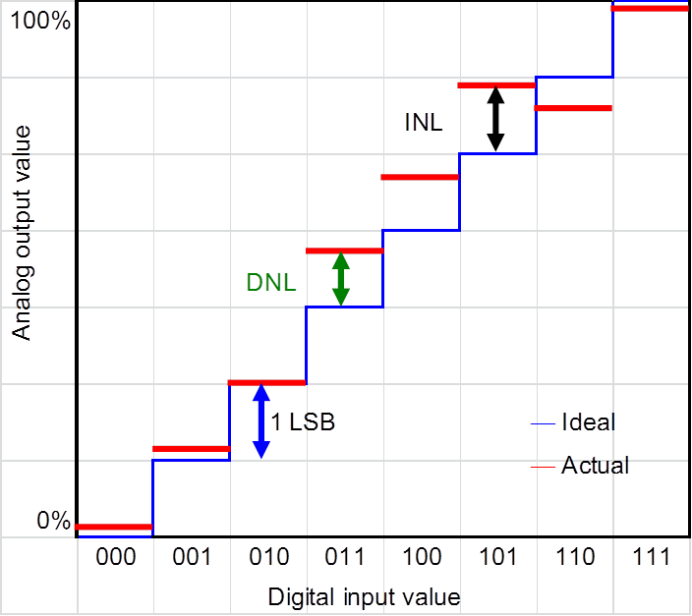
Non linearity and monotonicity
LSB: least significant bit
DNL: differential non linearity
INL: integral non linearity
Lose monotonicity
AD7846K (16-bit): DNL ±0.5 LSB max
INL ±2 LSB
AD5791B (20-bit): DNL ±0.75 LSB typ. (test result: <±0.1 LSB）
INL ±0.5 LSB typ. (test result: -0.2～+0.6 LSB）

Slide 45
Why sixteen DAC's 24-bit system?
Care must be taken to the monotonicity of two DAC’s 24-bit system
Not so bad
Bad

Slide 46

SC corrector power supply
45 of SC corrector power supplies was fabricated.
Rated output | DC ± 70 A, 10 V
Current setting resolution | < 1 ppm
Current stability | < 5 ppm/8 hrs.
Current ripple (< 10kHz) | < 5 ppm (rms)
Current noise (> 10kHz) | < 5 ppm (0-peak)
Test results: Stability 2.1 ppm/24 hrs. with temp. coeff. of 0.6 ppm/℃
24 hrs.
12.34 ppm
20.5 ℃
Ripple, noise, quench protection test and so on: also OK.

Slide 47



主要構成要素の温度係数と恒温槽温度変化
主要構成要素の温度係数（仕様値）
  0.125 ppm/K (AD5791 DAC with Buffer amps.)
  0.5 ppm/K (TOPACC optionalの場合：標準は1.5 ppm/K)
  0.3 ppm/K (Keithley 2002)
恒温槽（espec LU-123）の温度変化（2日間実測）
  ・周囲温度変化 5.5 ℃に対して、
  恒温槽内温度変化 0.2 ℃
デジタル帰還制御の温度係数の見積
  ・(0.5+0.3)×0.2=0.16 ppm程度
  ・(1.5+0.3)×0.2=0.36 ppm程度

Slide 48
DMM（keithley2002）のノイズ幅（測定値）
・入力を短絡し、設定を変えて調べた。（ゼロ調整は未実施）
・まとめ
設定 |  | 測定結果(μV) |  | 仕様
レンジ | PLC | 標準偏差 | σ×2√2 | (μVrms)
20 | 10 | 0.8 | 2.3 | 0.6
20 | 1 | 1.7 | 4.7 | 1.6
200 | 10 | 17 | 47 | 20
200 | 1 | 37 | 105 | 50
  10 Vの0.1 ppm = 1 μV
  仕様とよく合っている。
  20 Vレンジ、10 PLCなら、0.1 ppm以下の制御に使える

Slide 49




DAC出力の温度係数、変動幅の測定
・DAC AD5791＋バッファアンプ AD8675、8676：DMMで測定（20 V, 10PLC）
4.999345
4.999340
4.999335
4.999330
4.999325
5 μV=0.5 ppm
10 μV
DAC出力 (V)
2 μV
130分
周囲
恒温槽
恒温ユニット
5℃
AD5791 | 0.05 μV/℃
AD8676 | 0.6 μV/℃
AD8675 | 0.6 μV/℃
1.25 μV/℃ → 0.125 ppm/℃
温度係数：0.04 ppm/℃
ゆらぎ幅：1 ppm/2時間

Slide 50
DCCT・DMMの測定誤差、温度係数（仕様値）
DCCT: Hitec社 TOPACC（10 Vフルスケール、帯域：500 kHz）
・リップル：0.3 ppm (<100 Hz), 1.5 ppm (<10 kHz)
・温度係数：0.5 ppm/K (TOPACC optionalの場合：標準は1.5 ppm/K)
DMM: Keithley 2002（ 10 Vに対する値。条件：20V レンジ、10 PLC）
・ノイズ幅：0.06 ppm (rms)
・温度係数：0.3 ppm/K

