Slide 1




The European Research Council:
Funding opportunities for frontier science Ensuring equal treatment of applicants
Dr Luis Fariña Busto
Research Project Officer - Physical Sciences & Engineering
ERCEA Scientific Management Department
European Physical Society Conference
On High Energy Physics
July 10-17, 2019 - Ghent, Belgium
© Art & Build Architect / Montois Partners / credits: S. Brison

Slide 2
ERC messages for you
(i) ERC supports your community
(ii) ERC needs your help
(iii) Features and novelties of upcoming calls
(iv) Equality, diversity and inclusion at the ERC
– focus on gender
Notes:
Outline of presentation

Slide 3
(i) ERC supports your community
Notes:
Outline of presentation

Slide 4
ERC PE2 projects
 | Starting Grant | Consolidator Grant | Advanced Grant | Total
# projects | 220 | 104 | 159 | 483
# researchers (est.) | 1320 | 624 | 954 | 2898
Total € | 292.281.999 | 192.024.099 | 343.543.082 | 828 M€
Avg. grant M€ | 1,33 | 1,85 | 2,16
Notes:
Outline of presentation

Slide 5
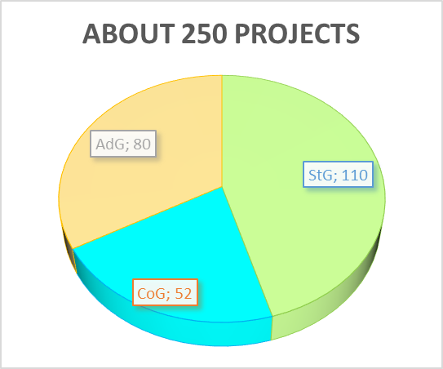
ERC Global HEP numbers
in 10 years
Some 1500 researchers
Well over 400 M€
In projects led by individual PIs
Notes:
Outline of presentation

Slide 6
(ii) ERC needs your help !
Notes:
Outline of presentation

Slide 7
Panel members
StG/CoG/AdG/SyG are Peers
Panel members: typically 375 / call (SyG:~90)
  High-level scientists
  Recruited by ScC from
  all over the world
  12 to 16 members plus a chair person
External Referees:
typically 3000 per call
  Nominated by panel
  They evaluate only a small number
  of proposals
Other
US
(7%)
(7%)
EU and
Associated
We need you !
Countries
(86%)

Slide 8
If you work in an ERC project …
Get the PI to read the contract
Respect the acknowledgement requirement
Respect the open access requirements

Slide 9
(iii) Features and novelties of upcoming calls
Notes:
Outline of presentation

Slide 10
What does ERC offer?
ERC Grant Schemes (2020)
Starting Grants
2-7 years after PhD
≥ 50% commitment
up to 1.5 M€
(+ 1 M€)
for 5 years
Consolidator Grants
7-12 years after PhD
≥ 40% commitment
up to 2 M€
(+ 1 M€) for 5 years
Advanced Grants
significant research records in the last
10 years
≥ 30% commitment
up to 2.5 M€
(+ 1 M€)
for 5 years
Proof-of-Concept
bridging gap between research and earliest stage of marketable innovation
up to €150,000 for ERC grant holders only
Synergy Grants
2 – 4 Principal Investigators
up to 10 (+ 4) M€
for 6 years
Notes:
We offer three main types of Grants: Starters, Consolidators and Advanced
Will concentrate today on Starting Grants for PIs 2-7 years past PhD
Not postdoctoral grants! Aimed at starting your first research group
For StG's and CoGs the eligibility window can be extended due to maternity leave, paternity leave, military service, etc
10

Slide 11
ERC 2020 Calls Calendar
 | Starting Grant | Consolidator Grant | Advanced Grant | Synergy Grant | Proof of Concept Grant
Call opens | 17/07/2019 | 24/10/2019 | 14/05/2020 | 18/07/2019 | 15/10/2019
Call closes (cut-off dates for PoC) | 16/10/2019 | 04/02/2020 | 26/08/2020 | 05/11/2019 | 21/01/2020 23/04/2020 17/09/2020
Indicative date for signature of grant agreements (by cut-off date for PoC) | 05/12/2020 | 03/04/2021 | 21/08/2021 | 19/03/2021 | 30/08/2020 28/11/2020 17/04/2021
now
soon
spring
now

Slide 12
ERC 2020 Calls
Expected Budget Distribution
Grant | Budget % | Est. budget M€
Starting Grant | 31% | 677
Consolidator Grant | 30% | 657
Advanced Grant | 23% | 492
Synergy Grant | 16% | 350
Total | 100% | 2176
Scientific Council’s key considerations
Budget priority given to early career stages (StG and CoG)
SyG 2019 : 288 applications with a 400 M€ budget versus SyG 2018 : 299 applications with 250 M€
Proof-of-Concept budget fixed at 25 M € (no change from WP 2019)

Slide 13
ERC 2020 Calls
New Amounts and cost category beyond grant maxima
Grant | Award max size (M€) | WP 2019 additional funding (M€) | WP 2020 additional funding (M€)
StG | 1.5 | 0.5 | 1
CoG | 2 | 0.75 | 1
AdG | 2.5 | 1 | 1
SyG | 10 | 4 | 4

Slide 14
ERC 2020 Calls
New Amounts and cost category beyond grant maxima
Ceiling for additional funding to be raised for StG and CoG up to 1 M€ under WP2020
Broadening of scope
    "start-up" costs for Principal Investigators moving to the EU or an Associated Country from elsewhere as a consequence of receiving the ERC grant and/or
    the purchase of major equipment and/or
    access to large facilities and/or
    other major experimental and field work costs, excluding personnel costs.

Slide 15
Two comments on proposals
The individual contribution of the PI must be clear
The originality of the proposal must be convincing

Slide 16
(iv) Equality, diversity and inclusion at the ERC – focus on gender
Notes:
Outline of presentation

Slide 17
Measures to improve equality of treatment (i)
Working Group on Gender Balance.
Continuous monitoring of results and consideration of possible actions.
ERC Gender Equality Plan (currently 2014-2020).
2007 - Eligibility extensions included 12 months per child born after PhD
2010 - Eligibility extensions included 18 months per child born before or after PhD
2013 - Scientific leadership potential (self-evaluation) section removed
2014 - Model CV template included in application forms

Slide 18
Measures to improve equality of treatment (ii)
2015
- No limit to eligibility extension (before it was 4,5 years)
- Care of sick relative counts for extension of the eligibility
- Track record focus on 5/10 publications
2016 - Video on unconscious bias shown to panel members
2017 - Activities promoting equal opportunities or gender balance can be considered as eligible costs
2018 - Training on unconscious bias for scientific officers
2019 - Training on unconscious bias for Scientific Council

Slide 19
Measures to improve equality of treatment (iii)
More details on extensions of eligibility window, possible for StG and CoG for documented cases of:
Maternity – 18 months per child (before or after PhD)
Paternity – actual time taken off (also before or after PhD)
Military service
Medical speciality training
Caring for seriously ill family members
No limit to the total extension

Slide 20
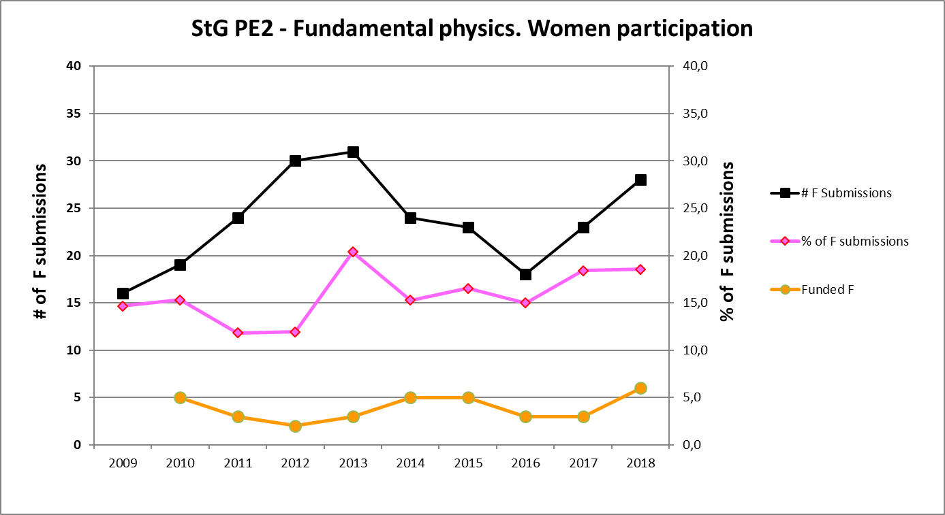
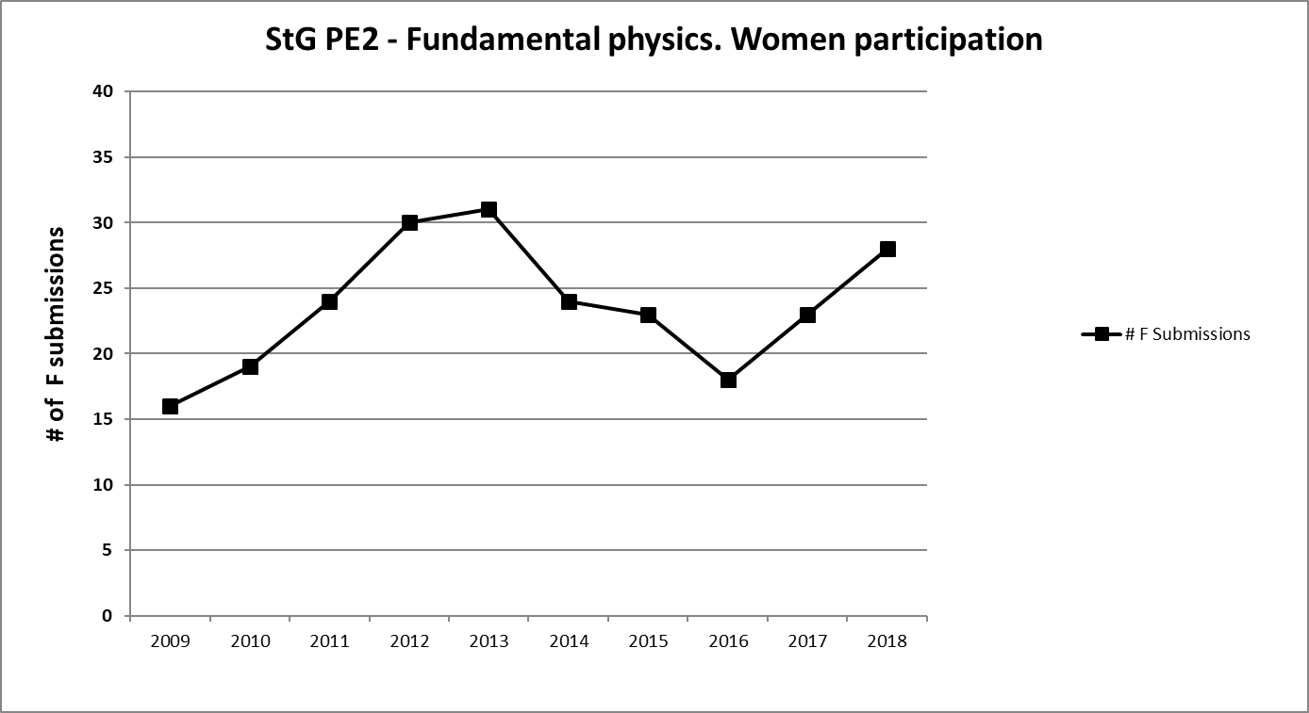
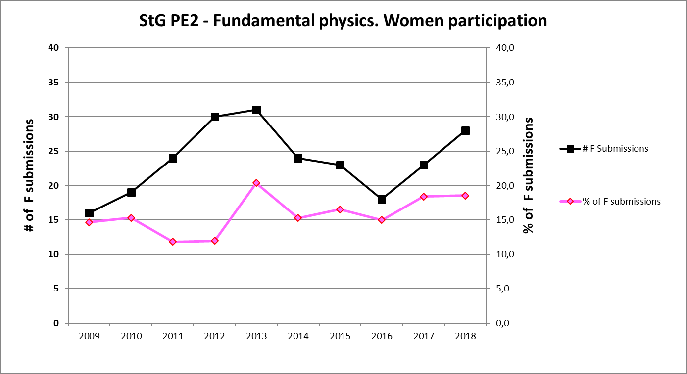
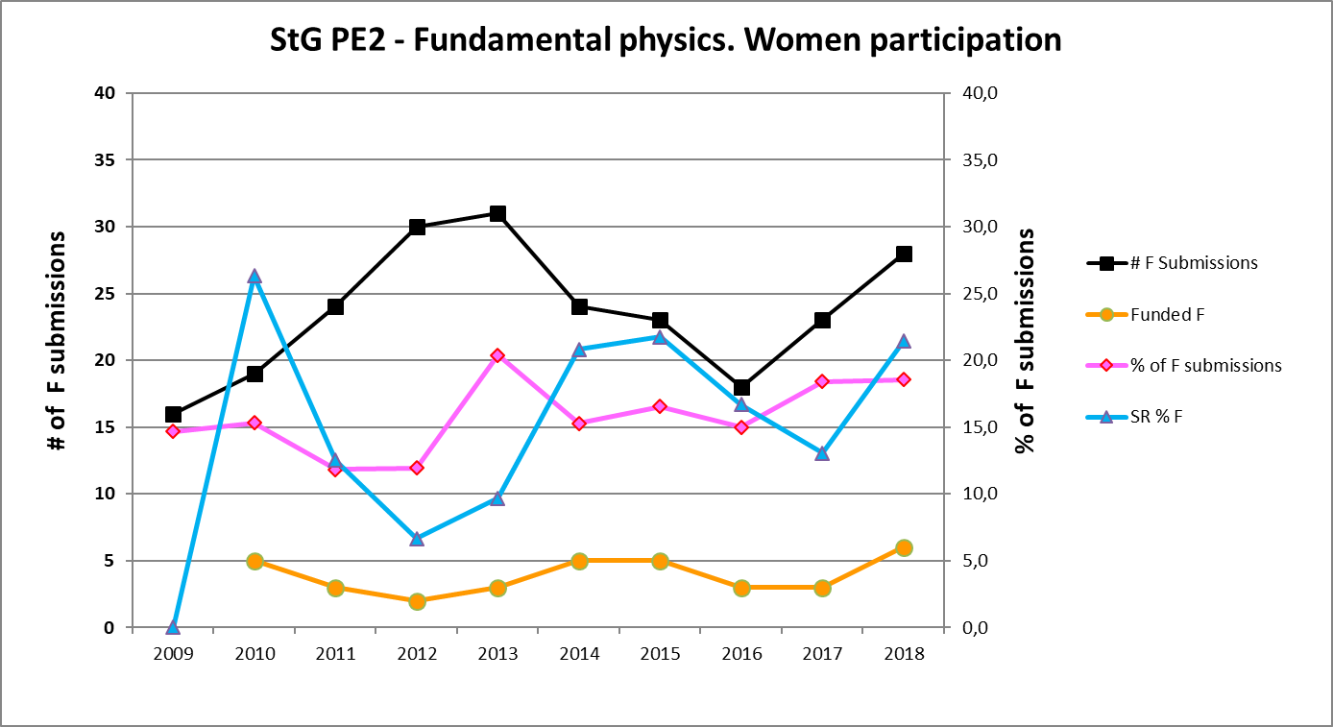
Women’s results in PE2
– Fundamental constituents of matter
Starting Grant

Slide 21
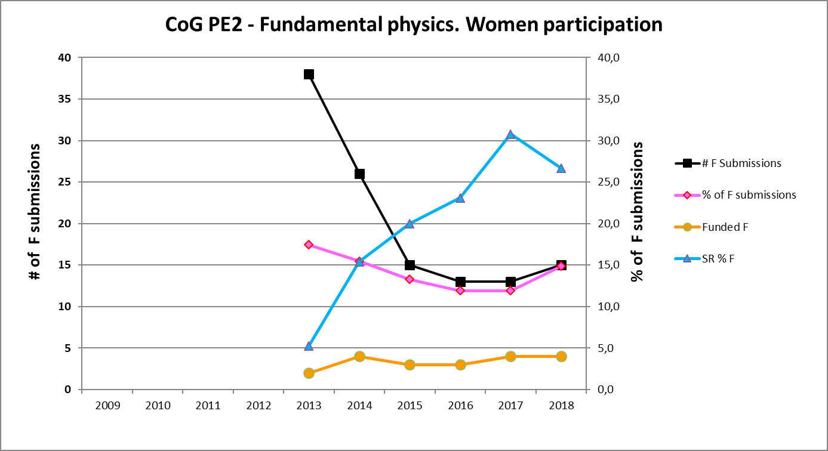
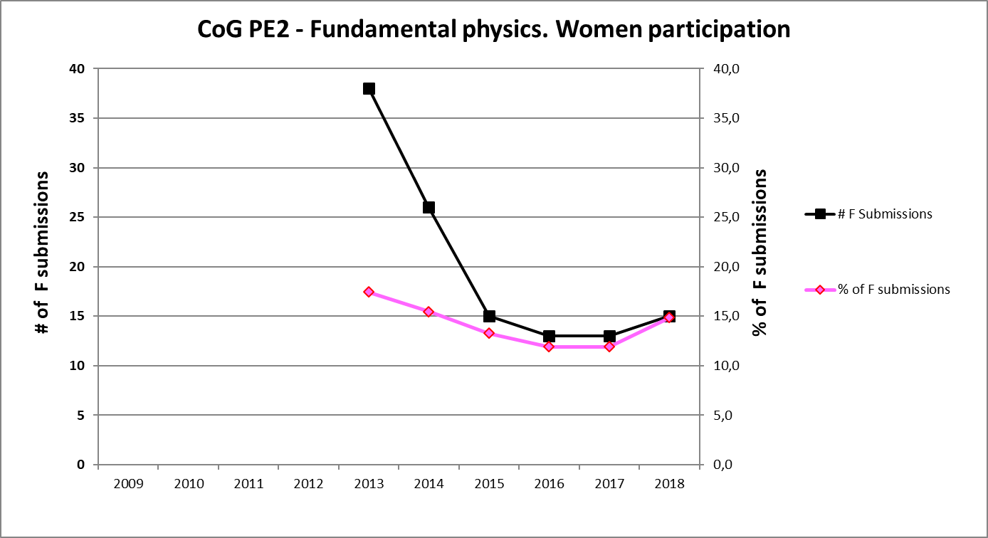
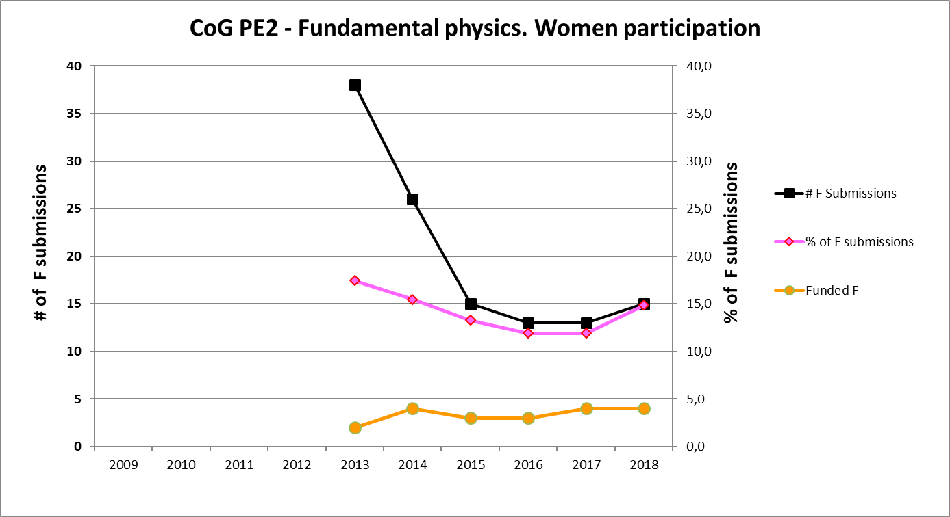
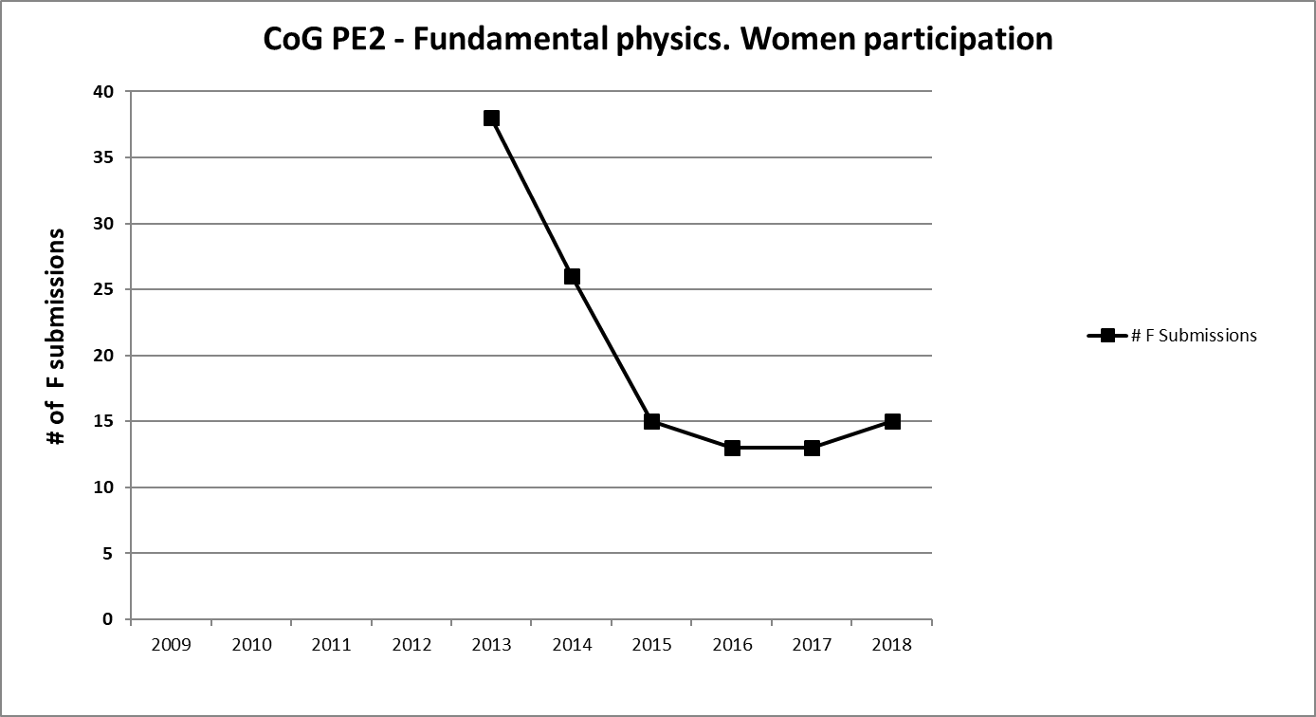
Women’s results in PE2
– Fundamental constituents of matter
Consolidator Grant

Slide 22
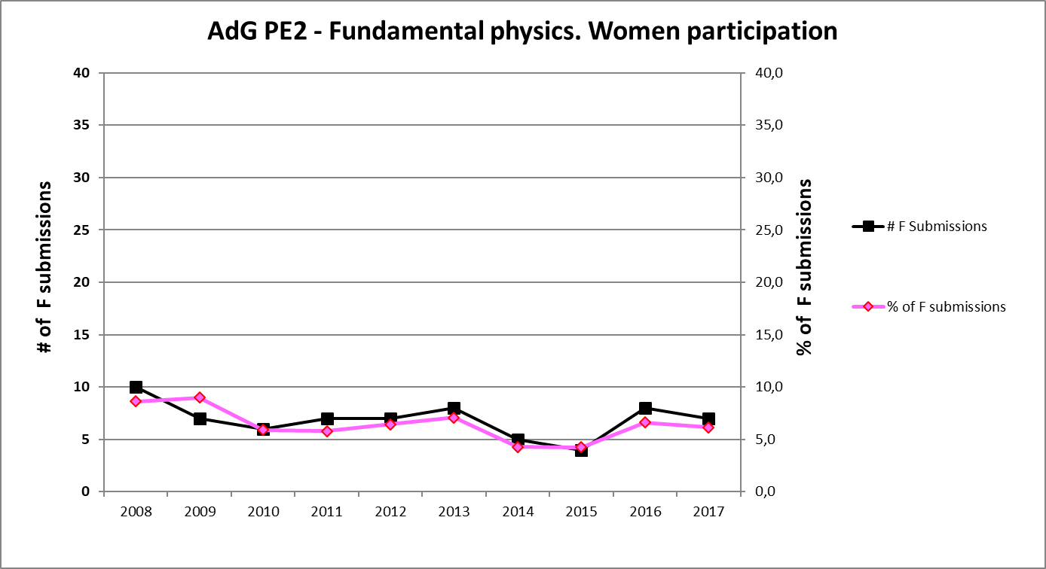
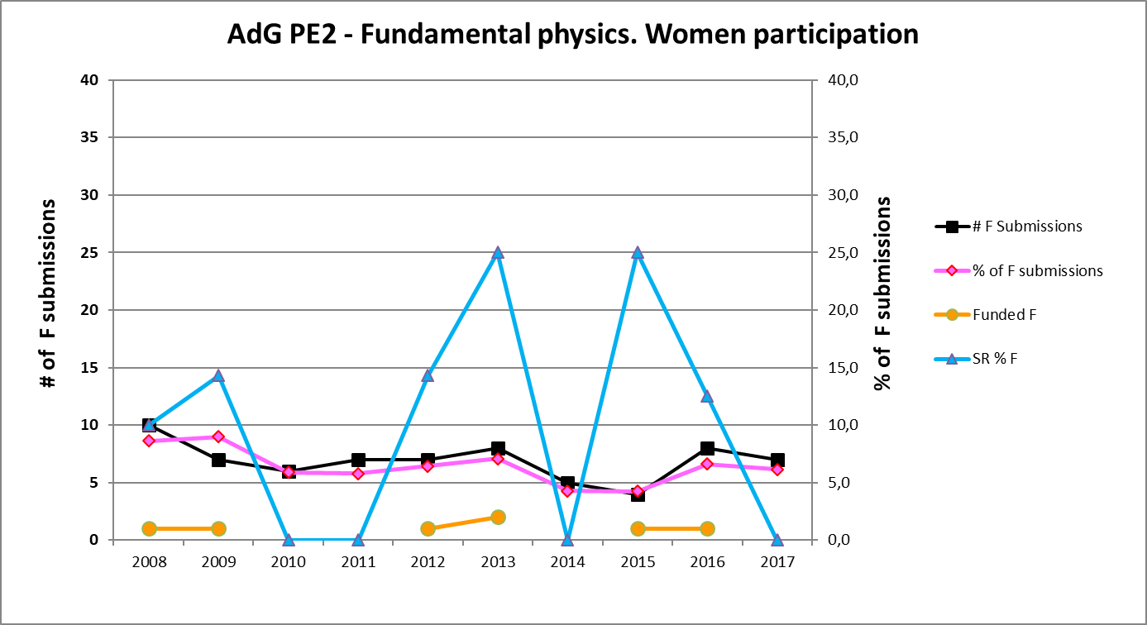
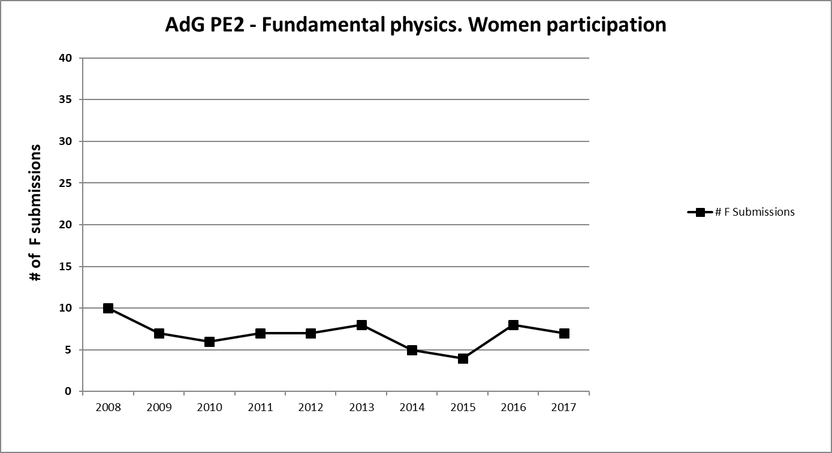
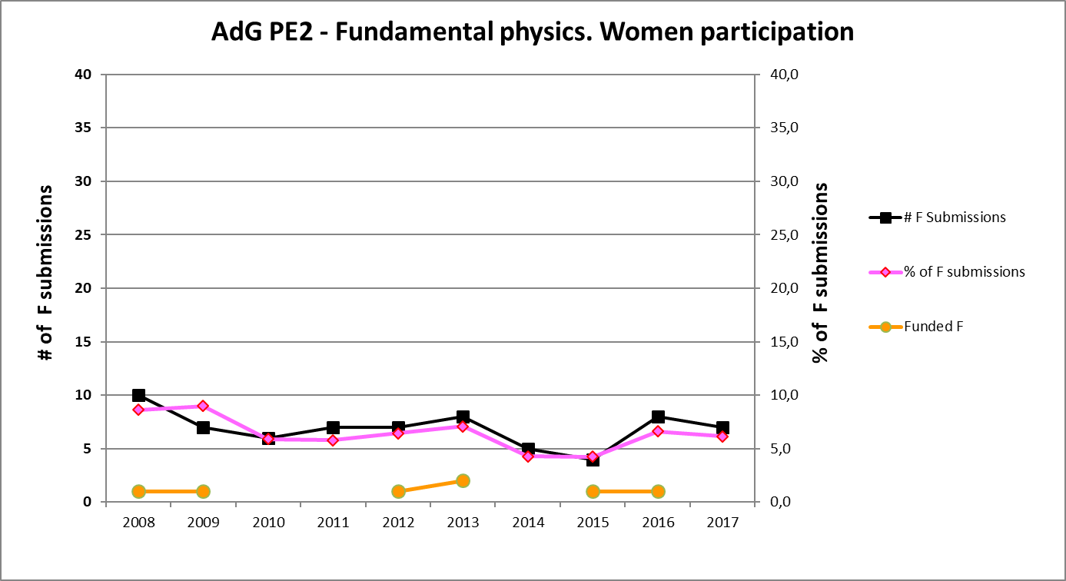
Women’s results in PE2
– Fundamental constituents of matter
Advanced Grant

Slide 23
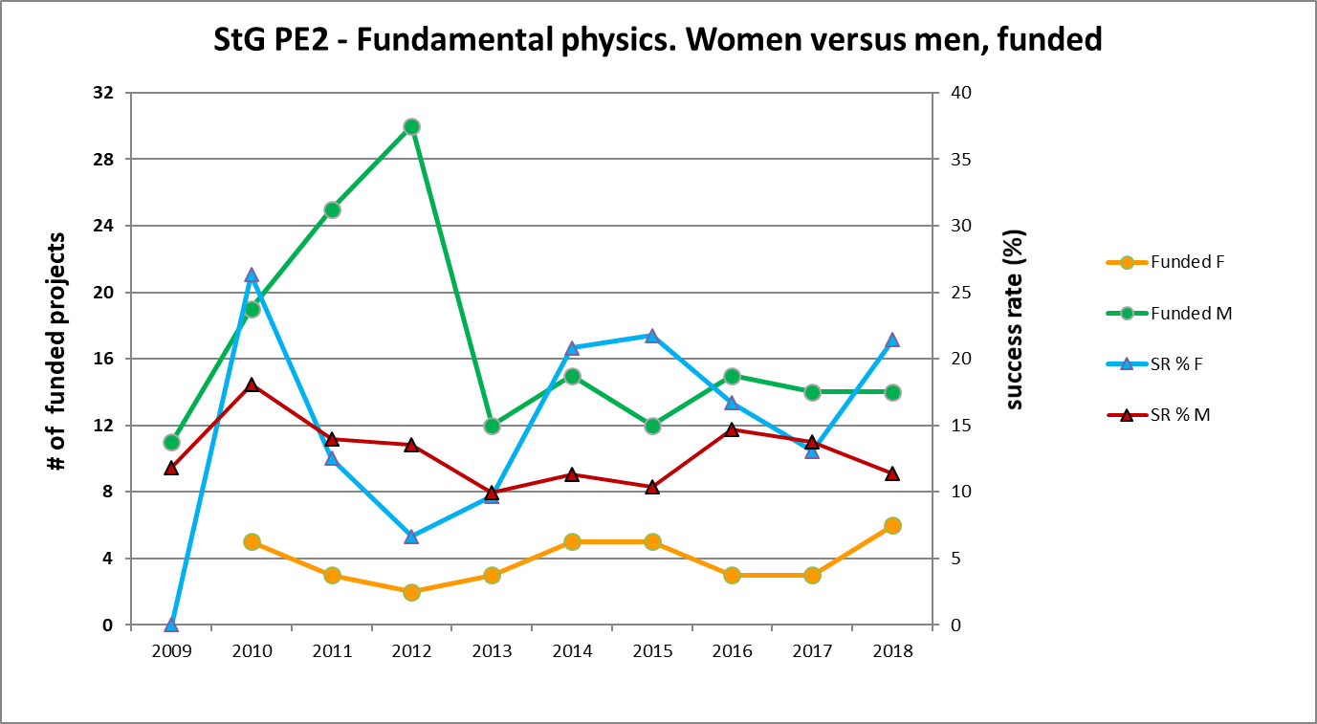
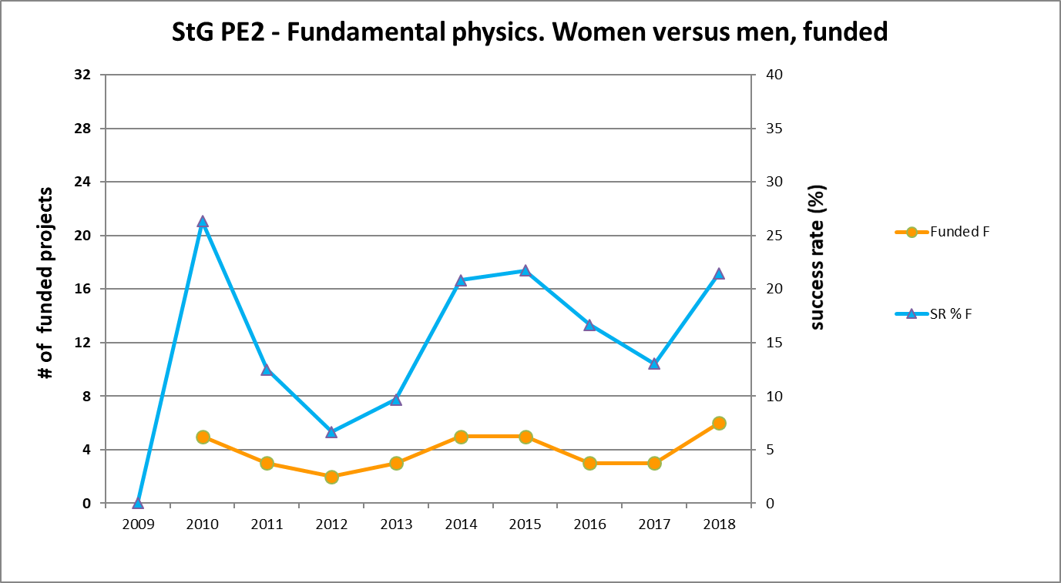
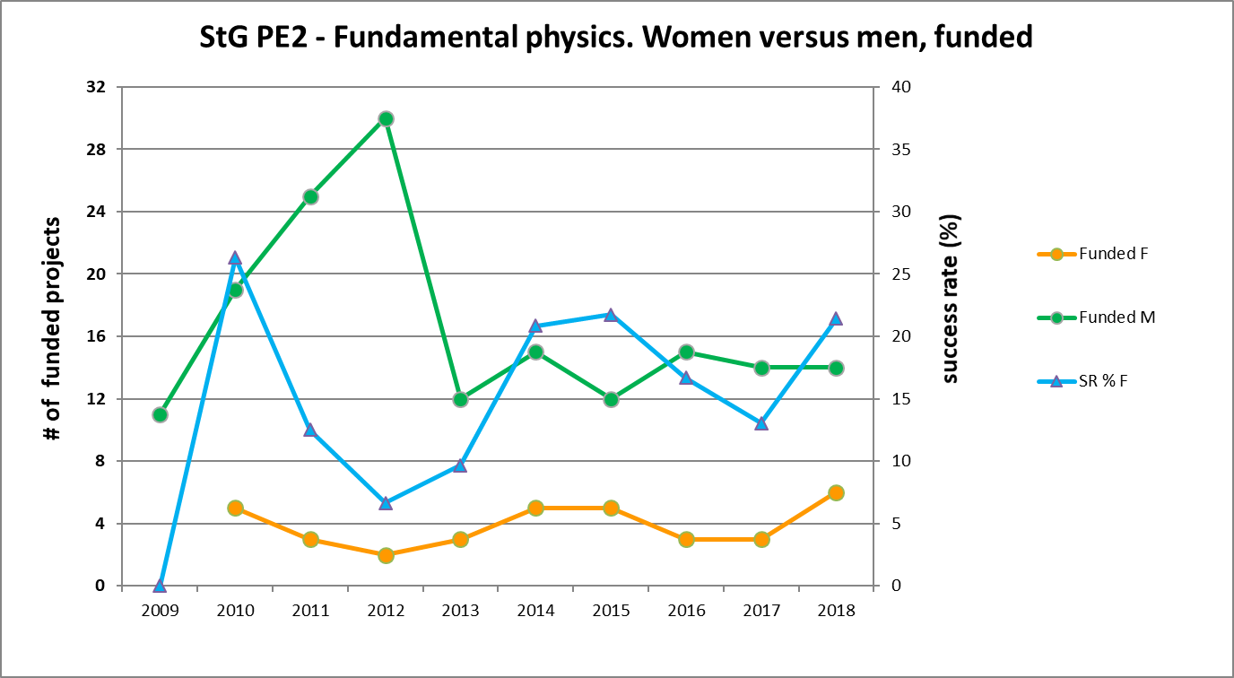
Women’s results in PE2 (m vs f)
– Fundamental constituents of matter
Starting Grant

Slide 24
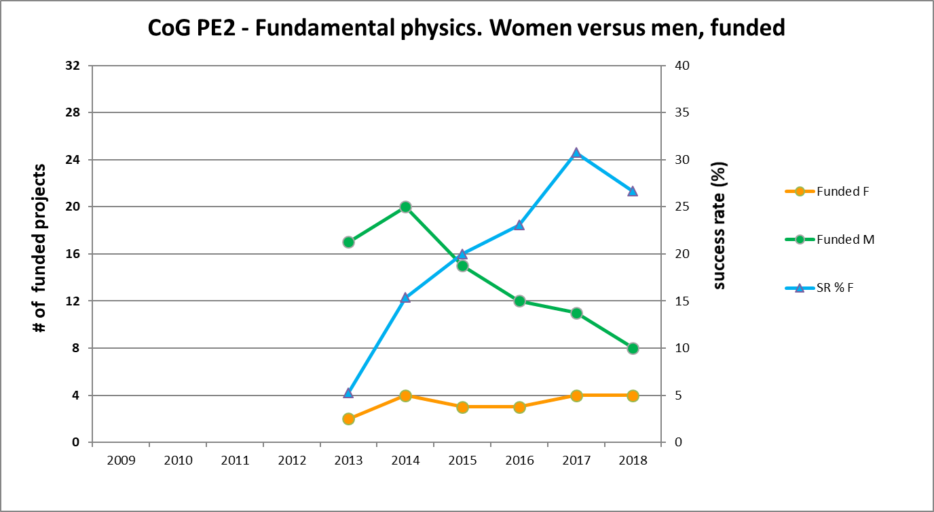
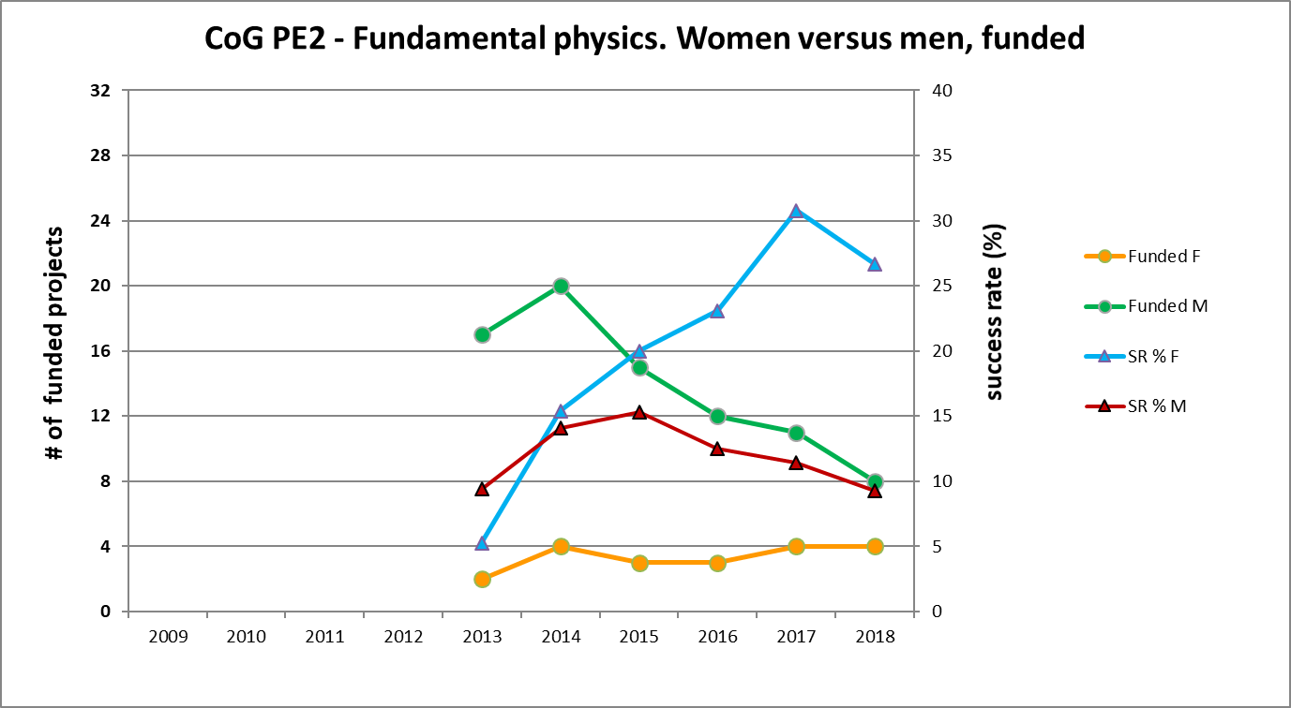
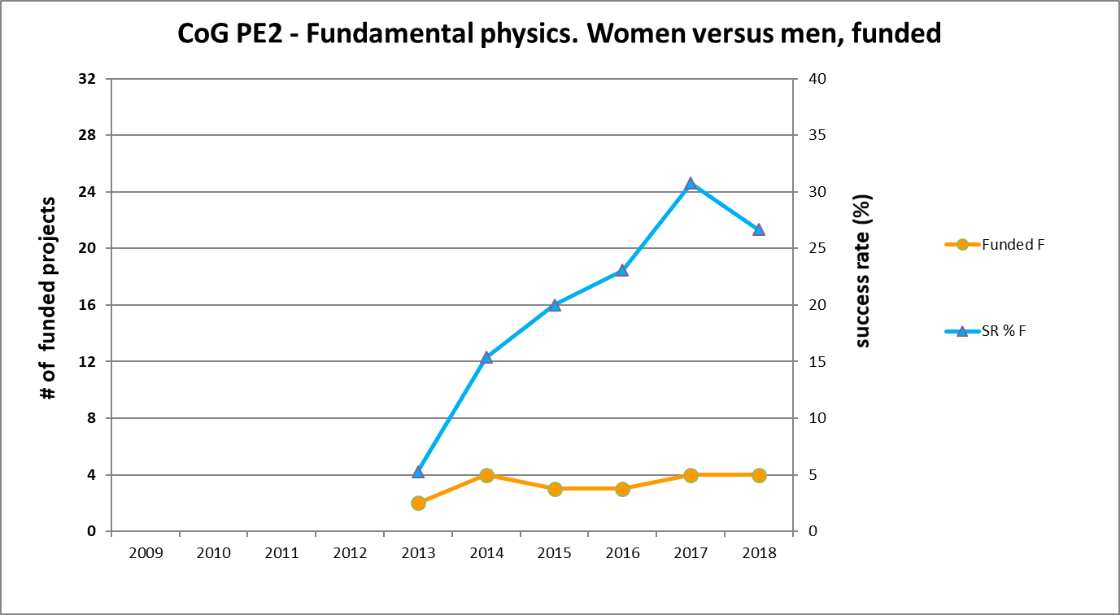
Women’s results in PE2 (m vs f)
– Fundamental constituents of matter
Consolidator Grant

Slide 25
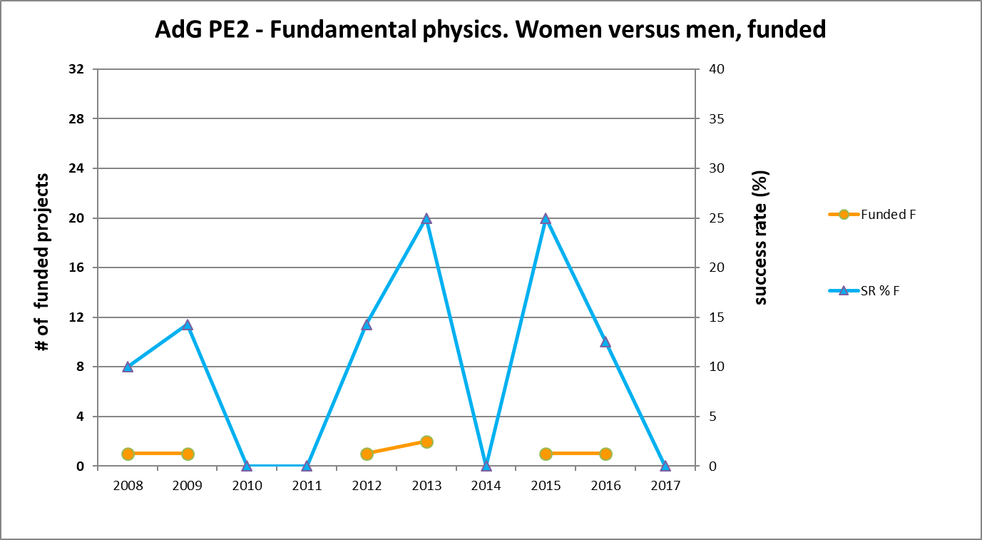
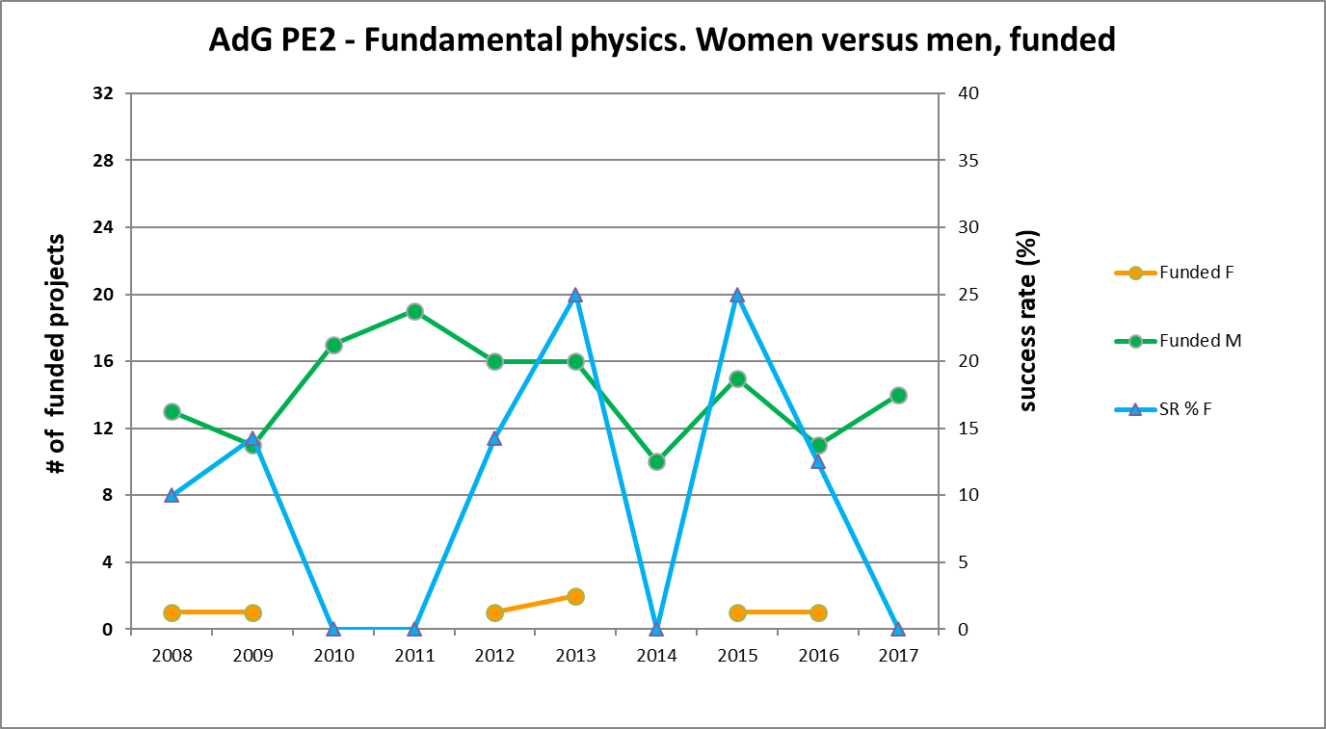
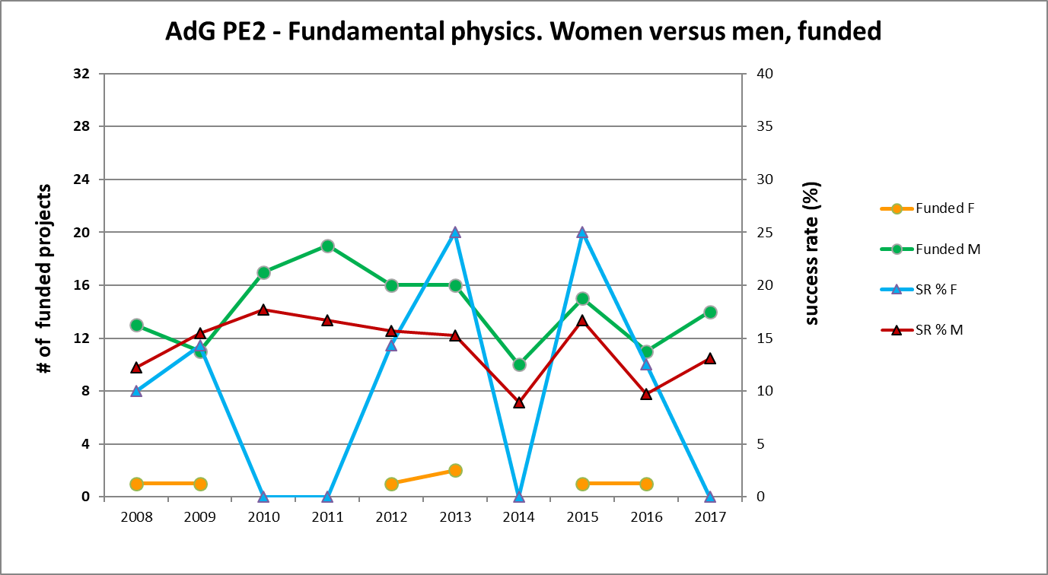
Women’s results in PE2 (m vs f)
– Fundamental constituents of matter
Advanced Grant

Slide 26
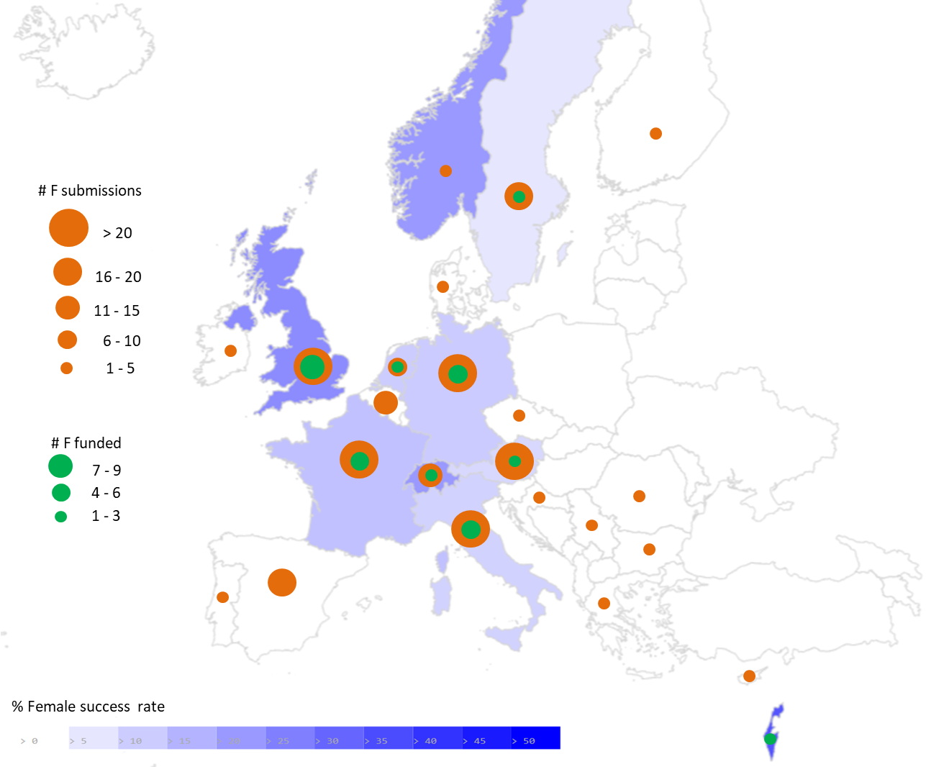
Women’s results in PE2
– Fundamental constituents of matter
Starting Grant
Starting Grant
2009-2017

Slide 27
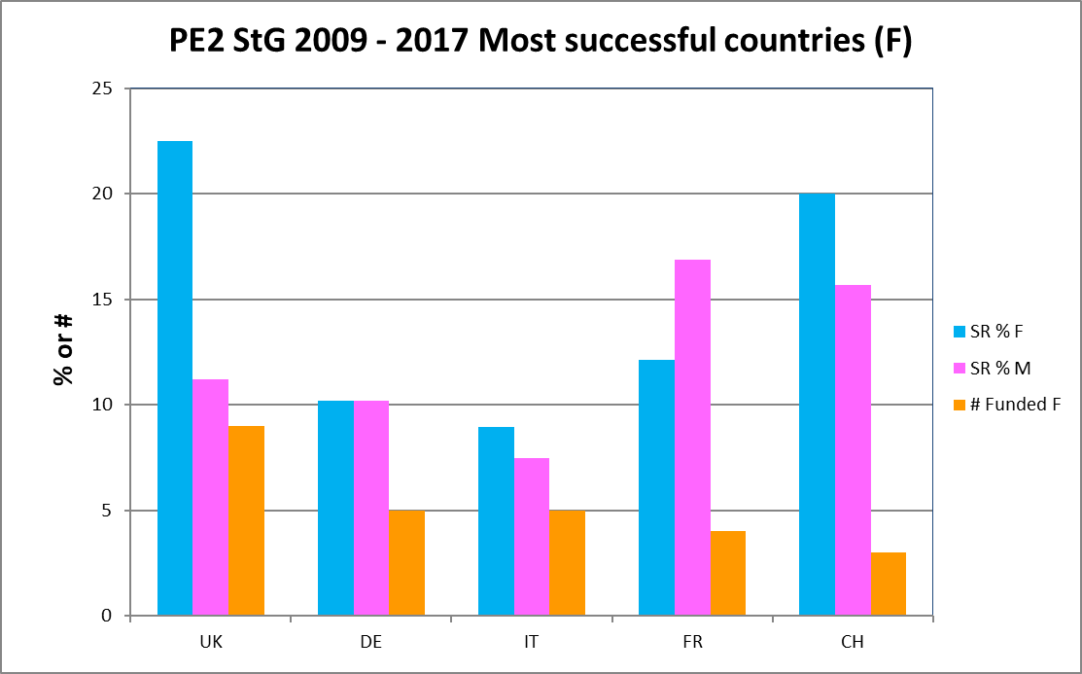

Women’s results in PE2
– Fundamental constituents of matter
Starting Grant
Starting Grant
2009-2017

Slide 28
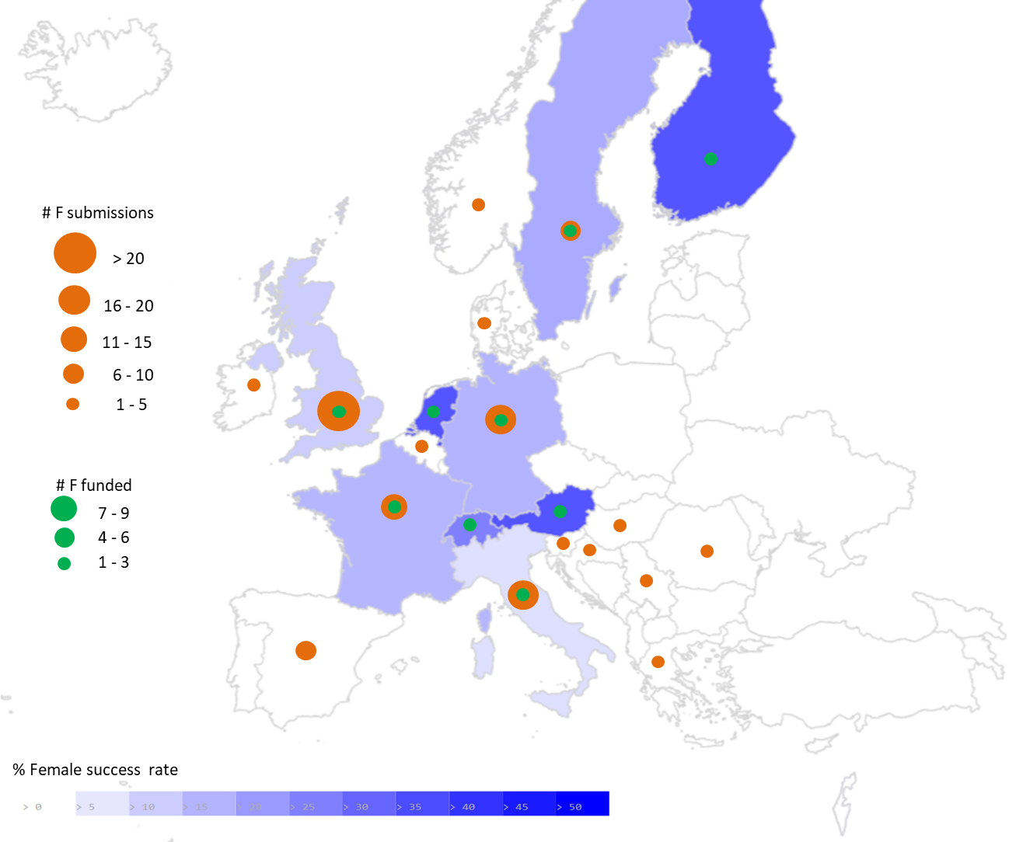
Women’s results in PE2
– Fundamental constituents of matter
Consolidator Grant
Consolidator Grant
2013-2017

Slide 29
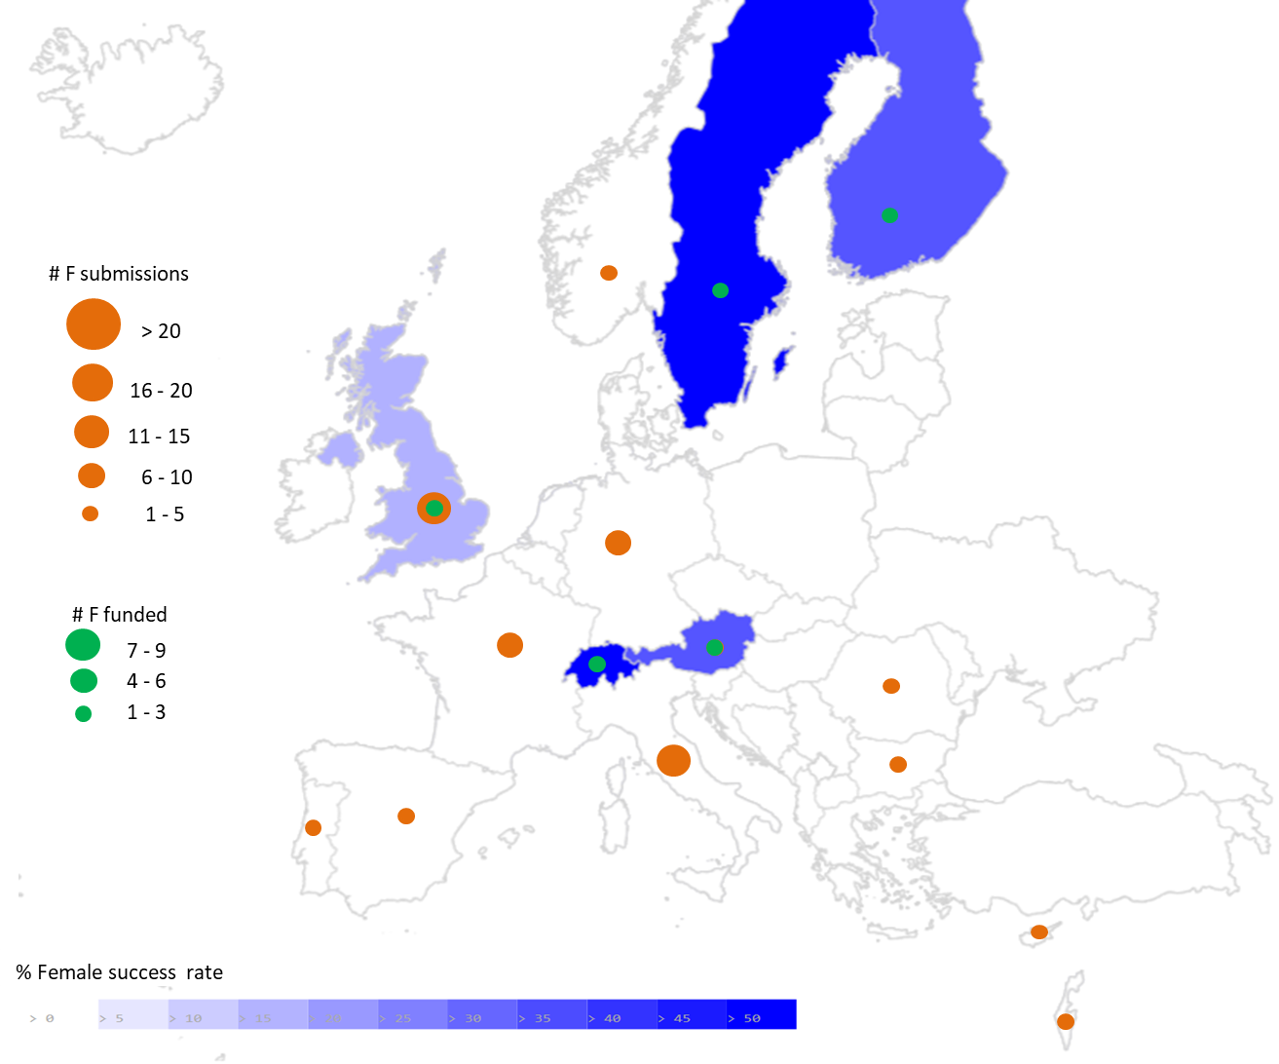
Women’s results in PE2
– Fundamental constituents of matter
Advanced Grant
Advanced Grant
2009-2017

Slide 30
In summary
ERC strives to
  * really make scientific excellence our only criterion and
  * maintain fairness to all applicants as a fundamental guiding principle
Notes:
Outline of presentation

Slide 31
  Thank you !
erc.europa.eu
erc.europa.eu/projects-figures/erc-funded-projects
https://cordis.europa.eu
luis.farina-busto@ec.europa.eu

Slide 32



The European Research Council
More information: erc.europa.eu
or watch: https://player.vimeo.com/video/154715819
Sign up for news alerts: erc.europa.eu/keep-updated-erc
Follow us on:
www.facebook.com/EuropeanResearchCouncil
twitter.com/ERC_Research
www.linkedin.com/company/european-research-council
Notes:
32

Slide 33


Some useful tools and links
Read the Work Programme and Information for Applicants
Contact your National Contact Point if you have questions
View the step-by-step video
Introduction to application process,
including tips & tricks for the interview
https://erc.europa.eu/get_video/4009
Consult ERC website for latest funding opportunities, view ERC funded projects
│ 33

