Slide 1
OVERMOS
CMOS HR detector for HEP applications
E. G. Villani
STFC Rutherford Appleton Laboratory
on behalf of OVERMOS project collaboration

Slide 2
Overview
OVERMOS1 description
First test results of irradiated / non –irradiated OVERMOS1
TCAD simulation
Conclusions and next steps
1

Slide 3
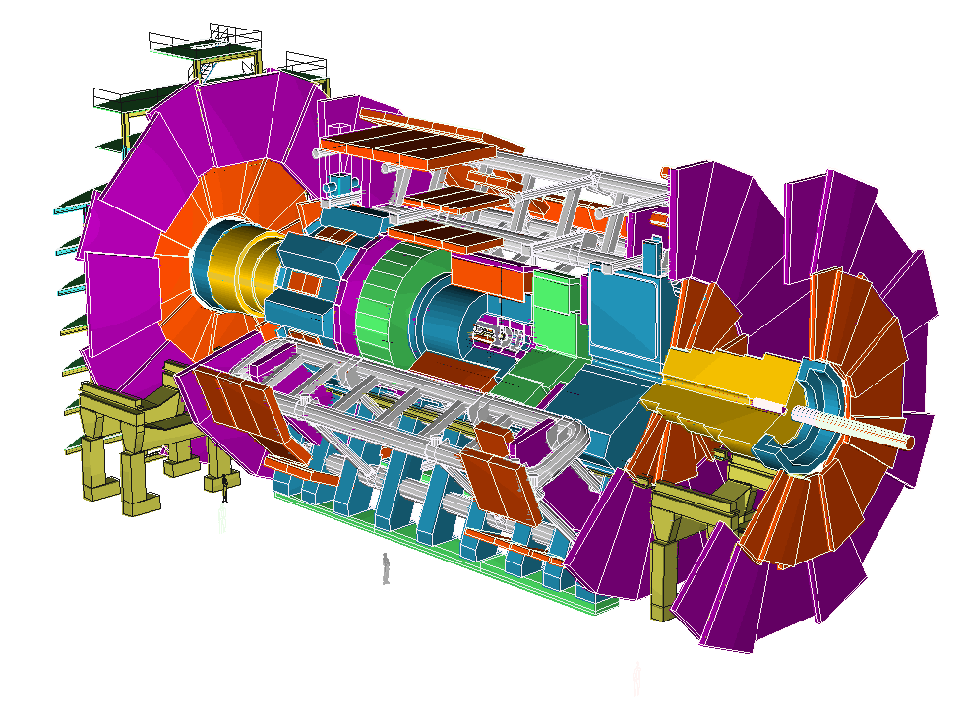
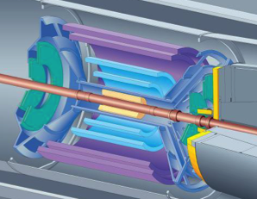
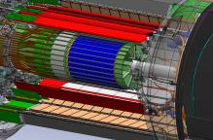
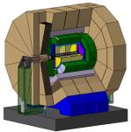
  Introduction – CMOS MAPS & HEP
ATLAS
ILC
ALICE-LHC
STAR at RICH
 | ATLAS HL LHC | ATLAS | ILC | ALICE | STAR
TID[Mrad] | 10³ | 80 | 0.4 | 0.7 | 0.3
Fluence[n_{eq} cm⁻²] | 10¹⁶ | 10¹⁵ | 10¹² | 10¹³ | 10¹²
P.Rate[kHz mm⁻² | 10⁴ | 10³ | 2.5•10² | 15 | 10²
Timing[ns] | 25 | 25 | 350 | 2•10⁴ | 2•10⁵
CMOS MAPS detectors solutions are and are going implemented in HEP
Further improvements needed for more challenging HEP use
HSTD11 – Okinawa, Japan - Dec 2017
1

Slide 4
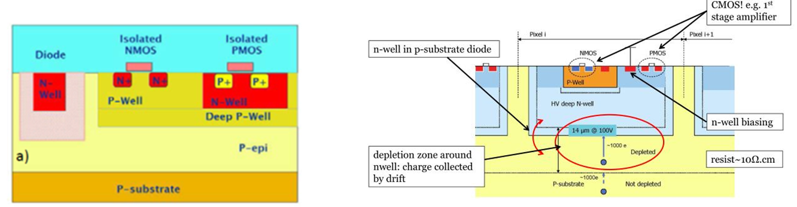

  Introduction – CMOS MAPS & HEP
Small collection well
Small capacitance = low noise, low power
Electronics shielded by DPW,
Longer drift distance and relatively low field region
Large collection well
Larger capacitance = higher noise, higher power
Short drift distances, high field
Possible Xtalk from RO to sensor, as electronics inside the DNW
To improve the CMOS MAPS radiation hardness a drift component needs adding, as the diffusion based charge collection drastically reduces their CCE past ~ 10¹³ cm⁻² 1 MeV n_{eq}
As the depletion region ~ one can either increase the resistivity ρ (HR CMOS) and / or the biasing V_{bias} (HV CMOS)
Ultimately the sought end result is the same, i.e. a depleted CMOS MAPS (DMAPS)
HSTD11 – Okinawa, Japan - Dec 2017
2

Slide 5
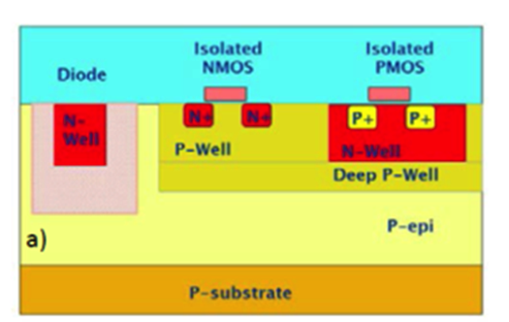
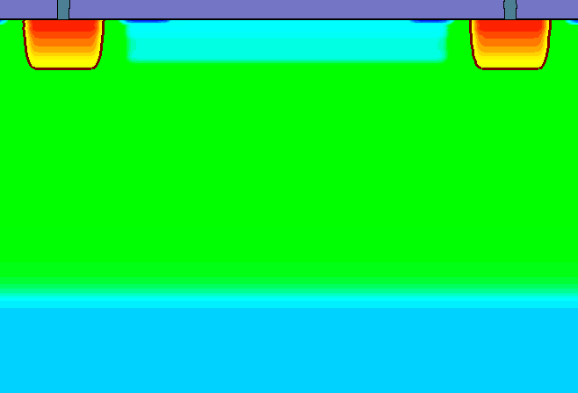
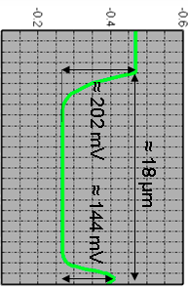
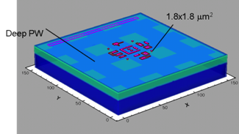
  OVERMOS description
N⁺⁺
SiO₂
DPW
18 μm
P-Epi
P⁺⁺-Sub
OVERMOS is a RAL project, in collaboration with IHEP, aimed at investigating and modelling performances of HR CMOS MAPS fabricated using:
TJ 180 nm Hi-res 18 μm thick epitaxial layer 1kOhm –cm
Small ( 4 x 4 μm²) 4 collecting nodes within each pixel
CMOS DPW or INMAPS, originally proposed TPAC for DECAL
of ILC
HSTD11 – Okinawa, Japan - Dec 2017
3

Slide 6
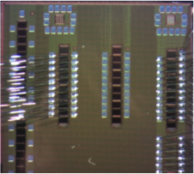
  OVERMOS1 description
PASSIVE
ACTIVE
The ASIC logically consists of PASSIVE and ACTIVE structures, i.e. without and with in-pixel electronics respectively;
HSTD11 – Okinawa, Japan - Dec 2017
4

Slide 7
  OVERMOS1 description
2: Basic Passive: 5x5 of 40 x 40 um
1: Symmetric Passive: 5x5 of 40 x 40 um
2
1
8: Basic Active Large 5x5 of 40 x 400 um
3: Basic Passive Large: 5x5 of 40 x 400 um merged
3
7: Basic Active Large Merged 5x5 of
40 x 400 um
8
7
6
6: Basic Active AC Large 5x5 of 40 x 400 um
independent diode biasing AC coupled
4: Basic Passive Large: 5x5 of 40 x 400 um
4
5
5: Basic Active: 5x5 of 40 x 40 um
PASSIVE
ACTIVE
The PASSIVE pixels consist of arrays of pixels with different arrangements of the 4 collecting nodes (of the same size) within each pixel
The ACTIVE pixels, i.e. with in-pixel electronics, all allow analogue readout of the pixels
HSTD11 – Okinawa, Japan - Dec 2017
5

Slide 8
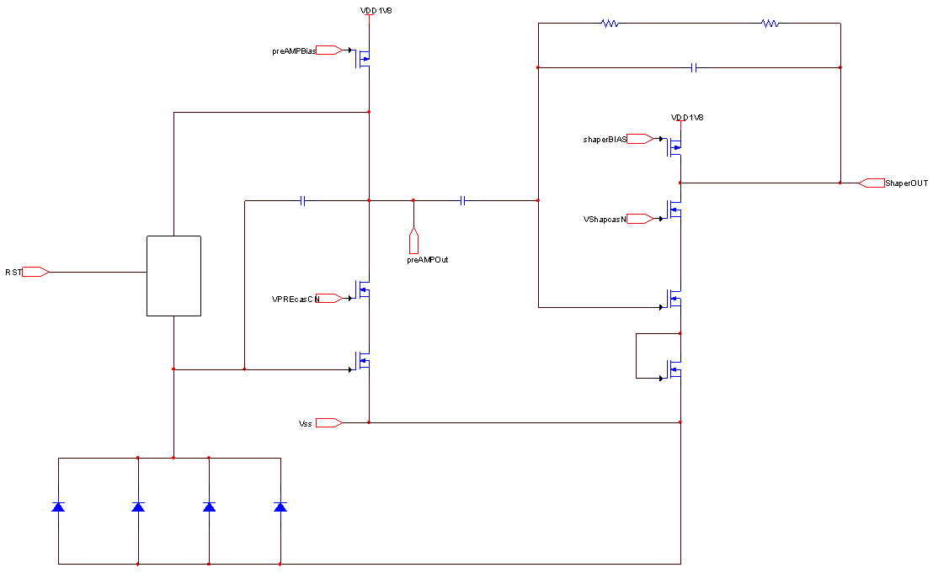
  OVERMOS1 description
charge amplifier
shaper
The ACTIVE pixels include a charge amplifier, shaper and Voltage follower with each output being routed out
Some flavours feature AC coupling to the RO, allowing for relatively high voltage biasing to the pixels
HSTD11 – Okinawa, Japan - Dec 2017
6

Slide 9
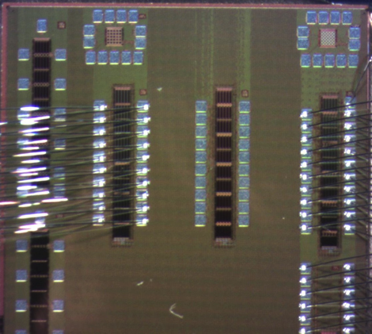
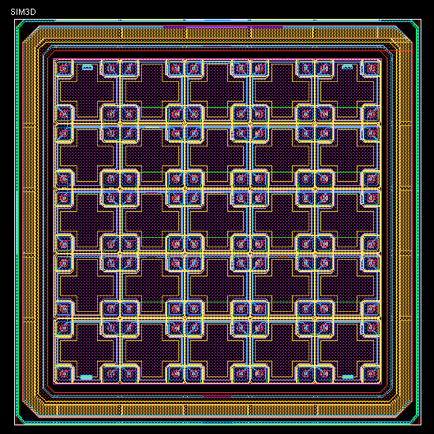
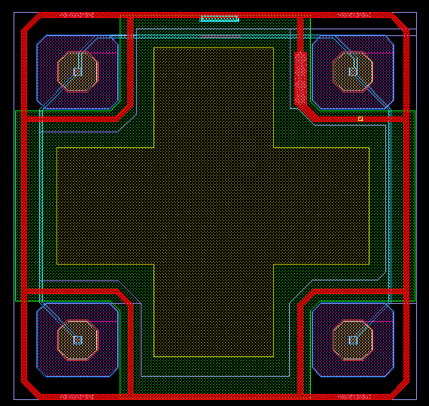
  OVERMOS1 description
40um
40um
Pixel 4
N++
P++
All the pixels in the OVERMOS1 include an p++ region around each diode to isolate them from neighbouring ones, an issue that plagued previous version of OVERMOS
The OVERMOS1 ASIC ‘basic passive’ has been tested before and after n-irradiation for DC and charge collection
HSTD11 – Okinawa, Japan - Dec 2017
7

Slide 10
  OVERMOS1 irradiation
  OVERMOS devices have been irradiated at Ljubljana in October 2017 to 1E13, 5E13,1E14 and 5E14 n fluence
  Estimated around 30% of fluence consisting of high energy neutrons (> 100keV)
HSTD11 – Okinawa, Japan - Dec 2017
8

Slide 11
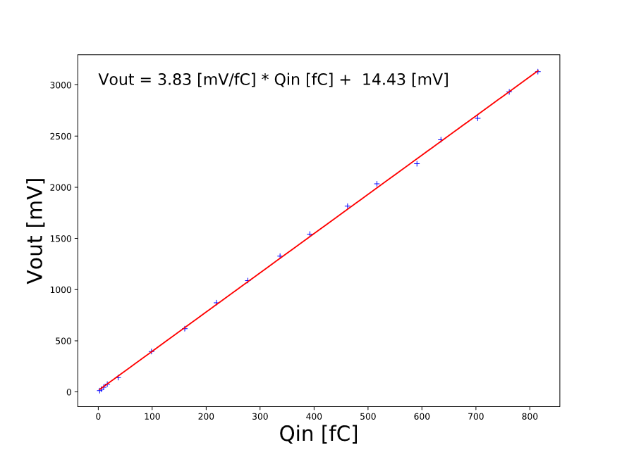
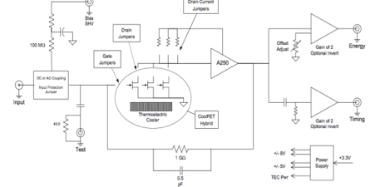
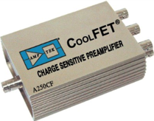
  OVERMOS1 Charge collection
Charge collection studies performed using Laser injection:
1: Amptek A250CF calibrated using mV voltage pulses injected through (measured) 1.2 pF capacitor to get V(Q). RMS Noise ≈ 76 e- @ OVERMOS capacitance
2: Trilite Laser 1064 nm calibration using a 300 um Si sensor, 1um top passivation. Laser beam size 5 x 5 um2 (measured with beam profiler), 4.1 ns FWHM (measured with FEMTO 2 GHz optoreceiver ), 50 Hz repetition rate. Up to 5 points measured on sensor to calculate average injected charge
HSTD11 – Okinawa, Japan - Dec 2017
9

Slide 12
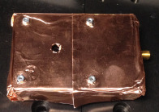
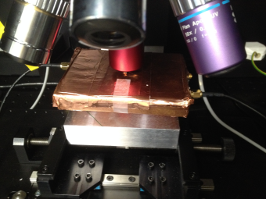
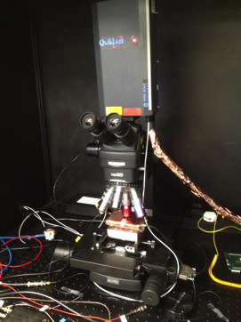
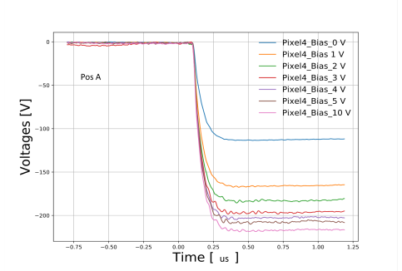
  OVERMOS1 Charge collection
OVERMOS
In metal box
to reduce EMP noise
OVERMOS
Under Laser 100x optics
  3: the calibrated Laser was used to inject <Q injected> = 541.66 fC or 1.805 fC/um (corresponding to the Laser attenuation settings which gave the minimum error %)
  (not taking into account IR reflection on ASIC’s top)
HSTD11 – Okinawa, Japan - Dec 2017
10

Slide 13
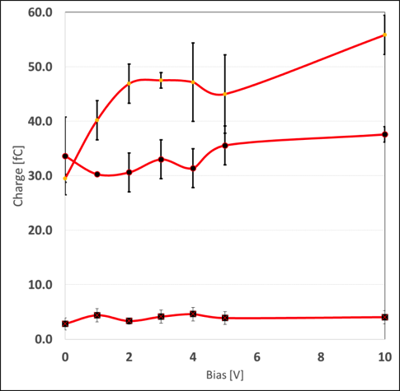
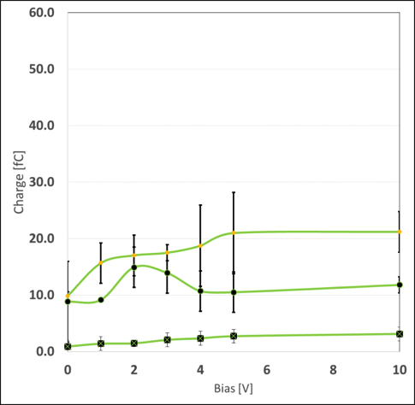
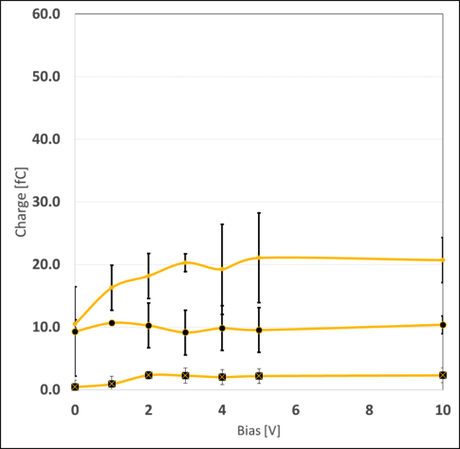
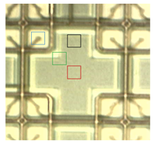
  OVERMOS1 Charge collection
  A
  Φ=1E13
  B
  C
  Φ=0
  Φ=1E13
  Φ=1E13
  Φ=0
  Φ=0
  Φ=1E14
  Φ=1E14
  Φ=1E14
  4.04fC ±29.7%
  3.14fC ±36.3%
  2.31fC ±5.4%
  Total collected charge vs. Vbias , points A,B,C. Integration time 400 ns
  <Q injected> = 1.805 fC/um
  HVbias =10V provided through the A250CF, via a 400 Meg resistor chain
  T = 21C in all tests
HSTD11 – Okinawa, Japan - Dec 2017
11

Slide 14
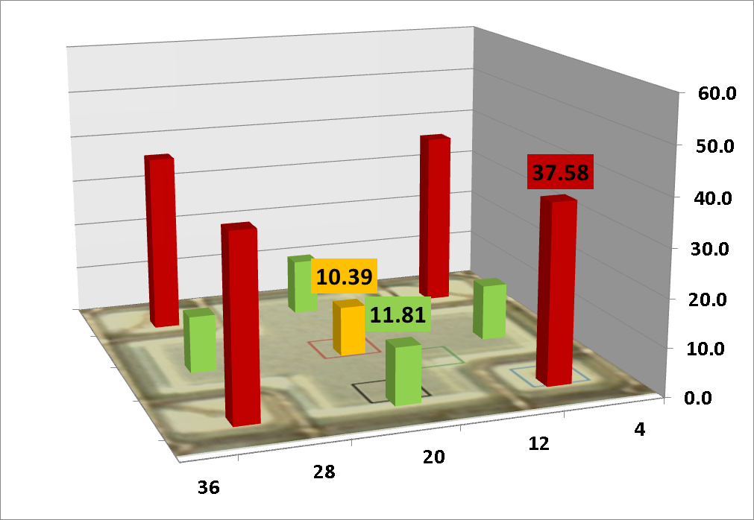
  OVERMOS1 Charge collection
  Φ=0
  Q[fC]
Laser injection test results (1064 nm, 5 x 5 um2 beam size)
Vbias = 10V
<Q injected> = 1.805 fC/um
HSTD11 – Okinawa, Japan - Dec 2017
12

Slide 15
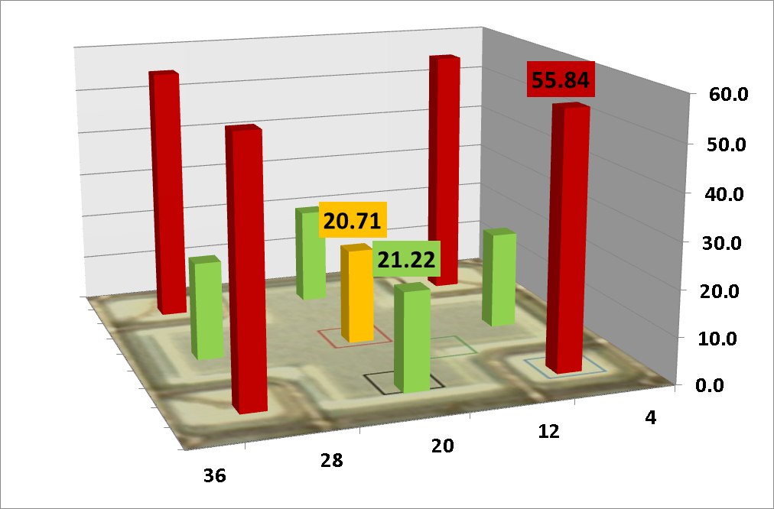
  OVERMOS1 Charge collection
  Φ=1E13
  Q[fC]
Laser injection test results (1064 nm, 5 x 5 um2 beam size)
Vbias = 10V
<Q injected> = 1.805 fC/um
HSTD11 – Okinawa, Japan - Dec 2017
13

Slide 16
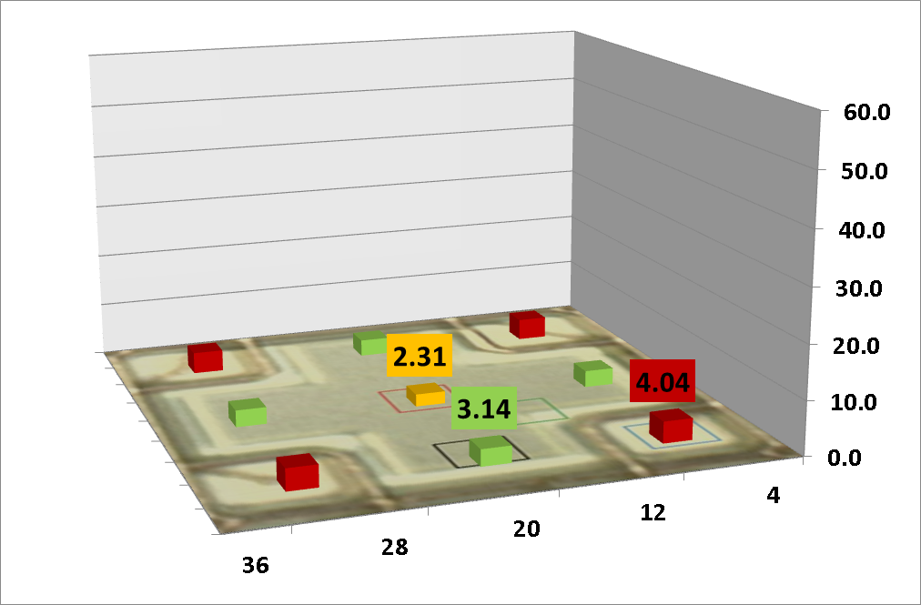
  OVERMOS1 Charge collection
  Φ=1E14
  Q[fC]
Laser injection test results (1064 nm, 5 x 5 um2 beam size)
Vbias = 10V
<Q injected> = 1.805 fC/um
HSTD11 – Okinawa, Japan - Dec 2017
14

Slide 17
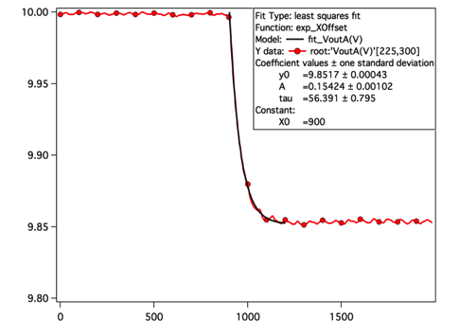
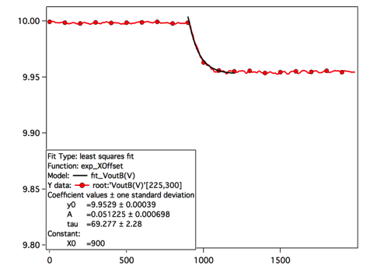
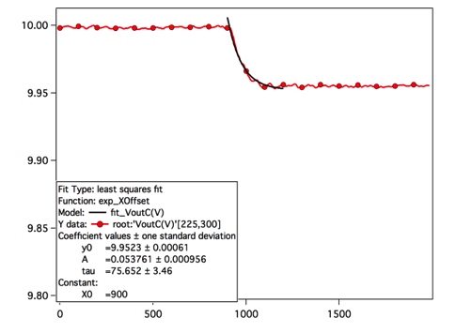
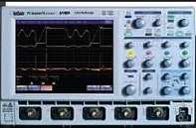

  OVERMOS1 collection time
  A
  B
  C
  τ_{FtotA}= ~ 123.9 ns
  τ_{FtotB}= ~ 152.18 ns
  τ_{FtotC}= ~ 166.2 ns
  Collected charge vs. time, points A,B,C Vbias = 10V, Φ = 0
  <Q injected> = 1.805 fC/um
  AMPTEK A250CF
  τ_{RAMP}= 15 ns
  τ_{Fs} ∼ sqrt((τ_{Ftot} )² - (τ_{RAMP} )² ) ∼
  A: 123 ns
  B: 151.4 ns
  C: 165.5 ns
HSTD11 – Okinawa, Japan - Dec 2017
15

Slide 18
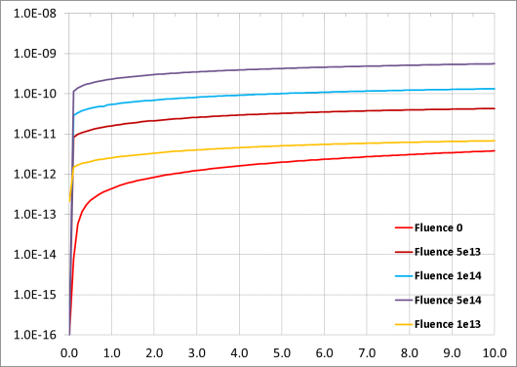
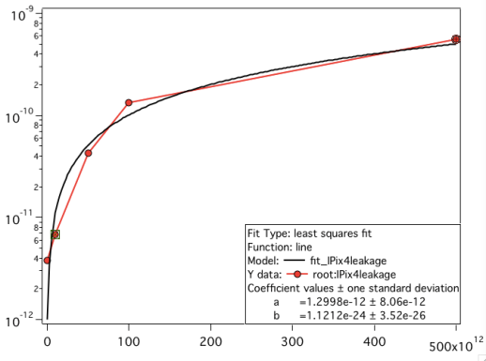
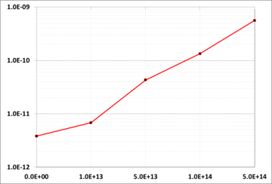
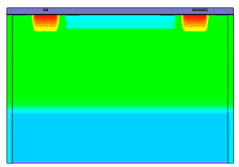
  OVERMOS1 DC test
Ipix4 (A)
K = 1.121e-24 ± 3.52e-26
Vbias (V)
Fluence( cm-2)
Vbias
  DC test results of leakage currents test of single pixel 4 with substrate and other pixels floating
  Linear increase with fluence, as expected
HSTD11 – Okinawa, Japan - Dec 2017
16

Slide 19
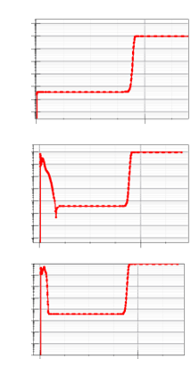
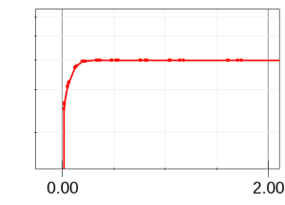
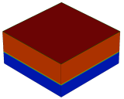

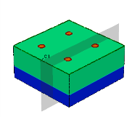

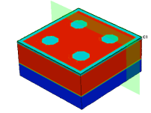

  Synopsys TCAD simulations
Epi-Bulk
B sucking from 8 nm SiO2
epi
sub
NW
epi
sub
PW
epi
sub
Individual doping profiles for OVERMOS were obtained using SPROCESS, to simulate a (simplified) CMOS fabrication by using TJ foundry process information
These (1D) doping profiles were then implemented in SDE
  Huge reduction in mesh size (O(3e5) points) and computation time
HSTD11 – Okinawa, Japan - Dec 2017
17

Slide 20
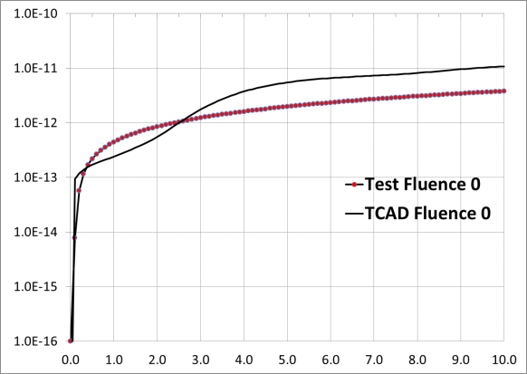
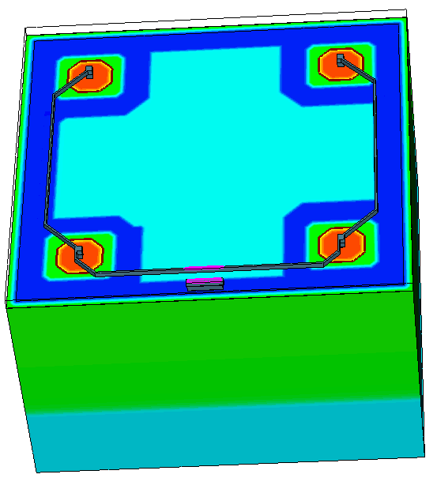
  TCAD DC initial results Leakage currents
Vbias
  R ~2.85 Max
  Φ=0
‘1D’ profiles from SPROCESS
  Leakage current for tested non irradiated pixel and TCAD results differ by ~ 3 max
  Surface Recombination velocity SRV=1e4
  SiO2/Si trap density 1e11
GND
HSTD11 – Okinawa, Japan - Dec 2017
18

Slide 21
Conclusions and next steps
First test results of OVERMOS1 basic flavor were presented
Measured with Laser injection, initial increase in CCE observed for irradiated device
Charge collection drops by tenfold at Φ = 1e14 w.r.t Φ = 0
DC tests showed expected leakage increase with n-fluence
Initial TCAD simulations for DC only off by ~ 3
Next step: to fully characterise the remaining sensors, both passive and active and TCAD simulations comparisons
THANK YOU
19

Slide 22
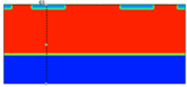








  Backup slides Mott-Gurney currents
V_{ss}
P⁺⁺
Epi- P
~
Sub - P⁺⁺
Leakage current is measured between P wells ( top and substrate)
For constant current and assuming only drift component
HSTD11 – Okinawa, Japan - Dec 2017
I

Slide 23
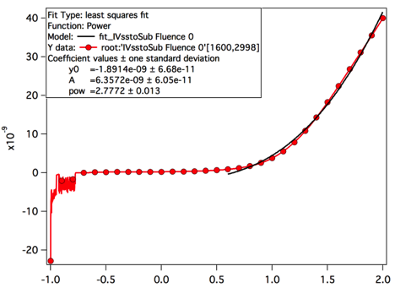
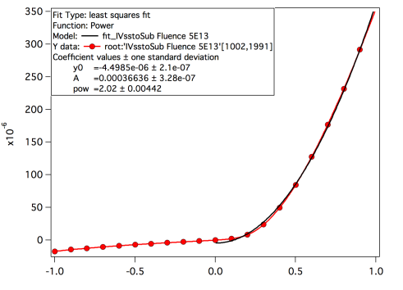
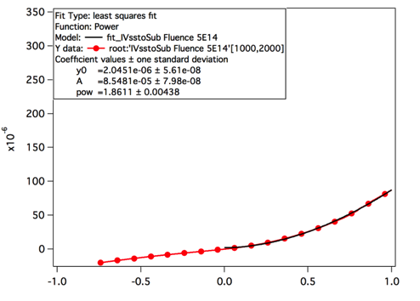
  Backup slides - Leakage currents
  Φ=0
  Φ=5E13
  Φ=5E14
I_{ss}
I_{ss}
I_{ss}
V_{ss}(V)
V_{ss}(V)
V_{ss}(V)
  Φ=0: I∝V^{2.72}
  Φ=5E13: I∝V^{2.02}
  Φ=5E14: I∝V^{1.86}
Fitting @ 5E13 shows a nearly ideal V^2 dependence
The power coefficient depends on the fitting
Only one device/ each radiation level
Asymmetry w.r.t. Vss may be due to conductive glue at the substrate
HSTD11 – Okinawa, Japan - Dec 2017
II

Slide 24
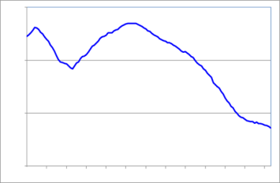
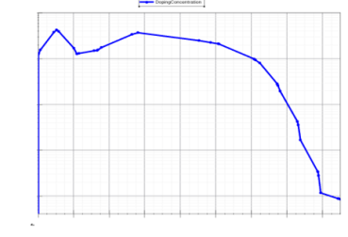
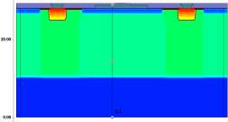






PW
TJ
SPROCESS
B sucking from 8 nm SiO2
NW
SiO2
TJ
SPROCESS
Epi
BSG
M1
NW
SiO2
Some approximations as a result but more affordable for big 3D simulations:
No B sucking
No lateral spread doping information
Coarser doping profiles
HSTD11 – Okinawa, Japan - Dec 2017
III

Slide 25


  BACKUP slides – Laser beam width
Laser beam size vs. focusing – Measured beam size with beam profiler
HSTD11 – Okinawa, Japan - Dec 2017
IV

Slide 26

  OVERMOS next steps
  Determine Neff by measuring depletion width vs. bias
  We use the Trilite Laser (~ 3 um minimum b.w. @ 1064 nm) to sample the OVERMOS1 along the edge
Laser (IR or GREEN)
OVERMOS1
bottom
top
XY table
HSTD11 – Okinawa, Japan - Dec 2017
V

