Slide 1
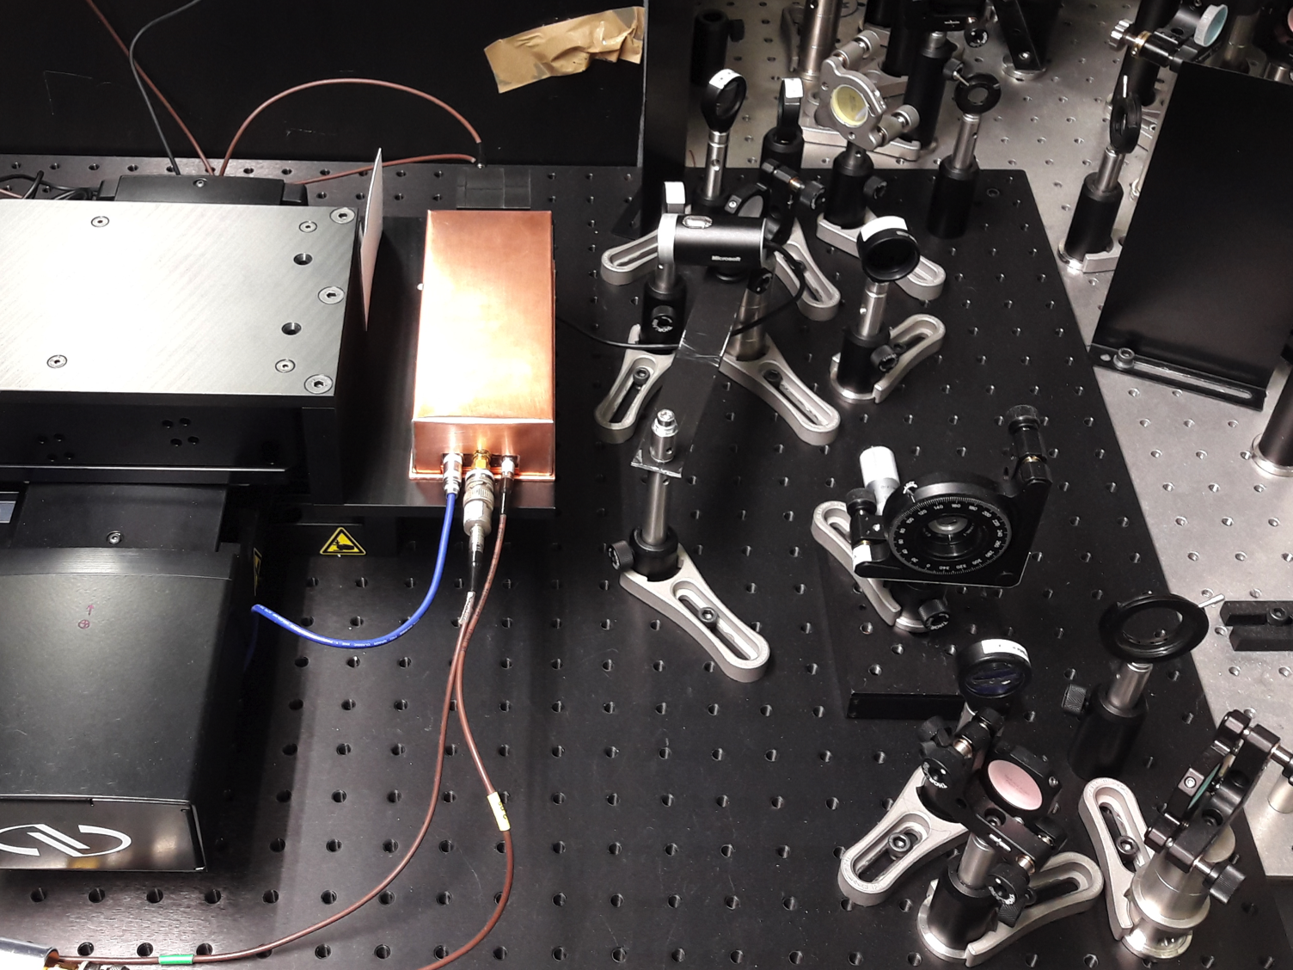
A novel Transient-Current-Technique based on
2-Photon Absorption in Diamond
Christian Dorfer, Dmitry Hits, ETH Zurich
11th International “Hiroshima” Symposium, 13 December 2017

Slide 2
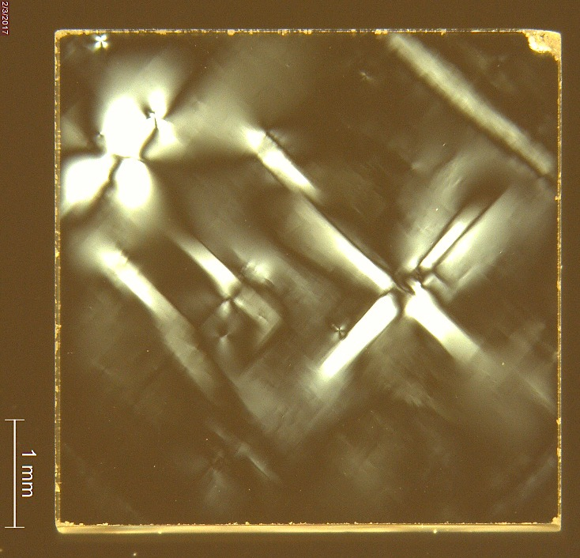
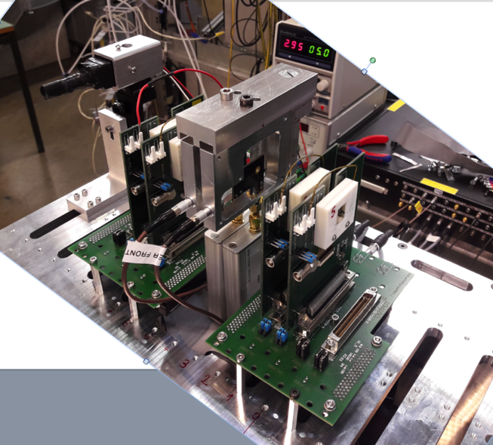
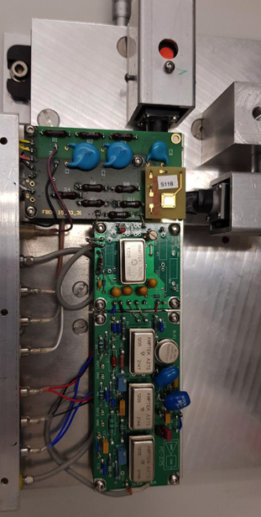
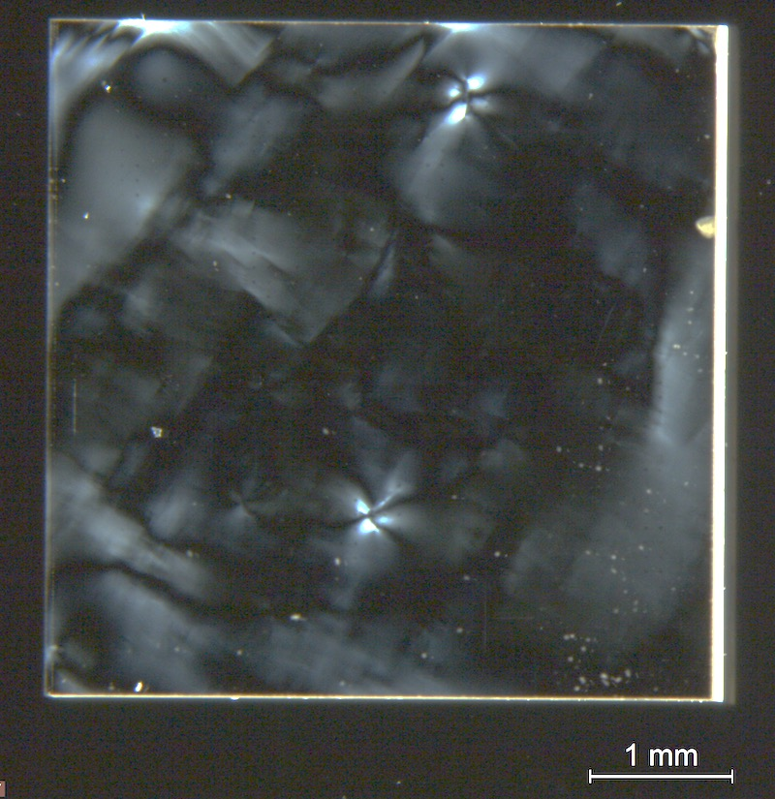
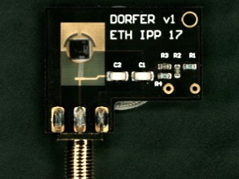
Motivation
Investigation of the charge transport properties of irradiated and un-irradiated single-crystalline diamond sensors.
A collection of measurements is compared for each diamond sample:
high rate beam tests at PSI
(3 kHz/cm² – 10 MHz/cm²)
⁹⁰Sr measurements
cross-polarization images
But the workhorse is ..

Slide 3
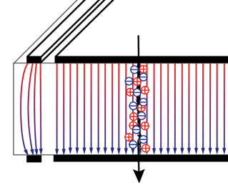
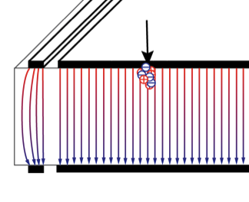
Edge-TCT
What are the advantages of edge-TCT compared to TCT with α, β-sources?
Trapping & E-Field entangled
β
α
bad position resolution
deposited energy not easily selectable
screening effects in case of α-particles
source handling
Particle traverses the whole sensor
Absorption in the first micrometers of the surface
Multi-Photon Absorption Laser Edge-TCT solves all those problems by:
generating charges locally (in the focal point) with sub-micrometer precision inside the sensor
allowing to select laser pulse energy thus the amount of injected charge
decouples effects due to the electric field profile from the effect due to trapping of charges
screening effects still possible
→ go to very low pulse energies → E-field not altered by measurement

Slide 4
Experimental Method and Setup
Introduction to edge-Transient Current Technique (edge-TCT)
Oscilloscope
40dB
Amplifier
Signal
HV
TRG
Sensor
-
-
-
-
pulsed Laser
-
-
+
-
+
+
+
+
+
y-axis
Lens
x-axis
z-axis
Extractable Quantities:
Wait, this has been done before!
Yes, but not in diamond.
electric field (independently of trapping) → space charge
trapping times
saturation velocity
mobility of electrons and holes
others but it gets difficult (CCE for example)

Slide 5
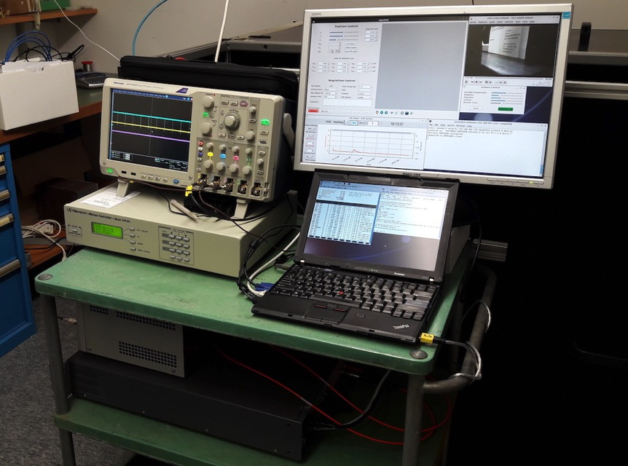
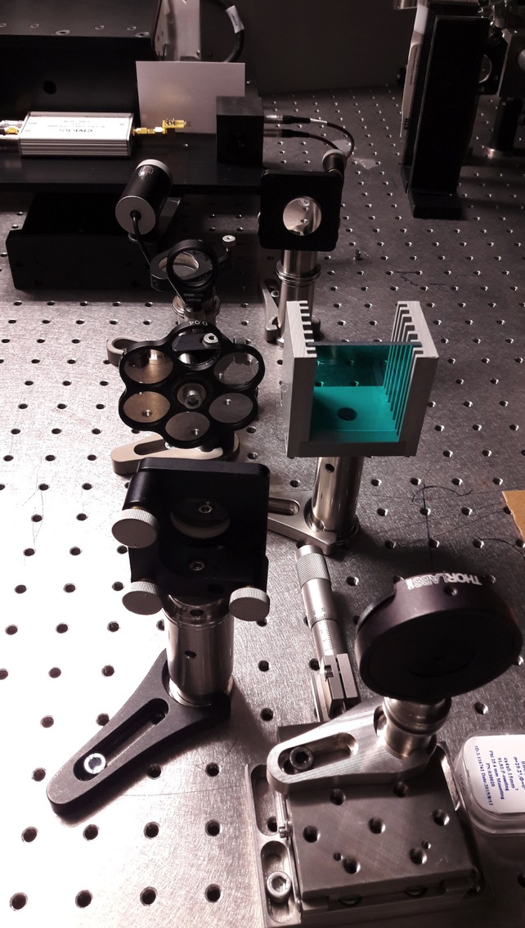
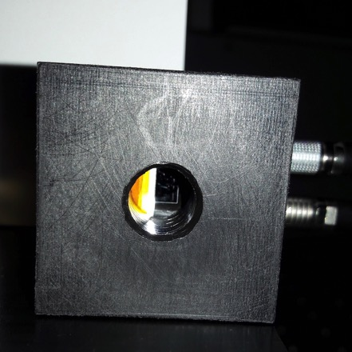
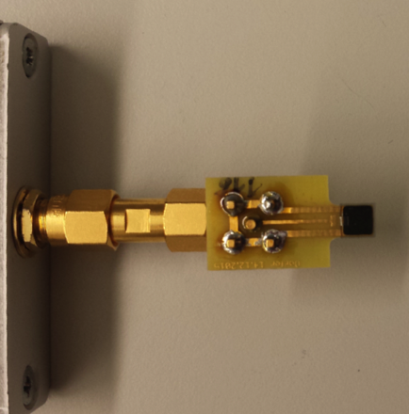
sample
photodiode
mirror
focusing lens
xyz-stage control
NDFs
(neutral density filters)
filter
low voltage supply
high voltage supply
mirror
BBO
(barium borate crystal)
1kHz, 800nm, ~25fs, 0.1-5nJ
photodiode
diamond holder
Setup end 2016

Slide 6
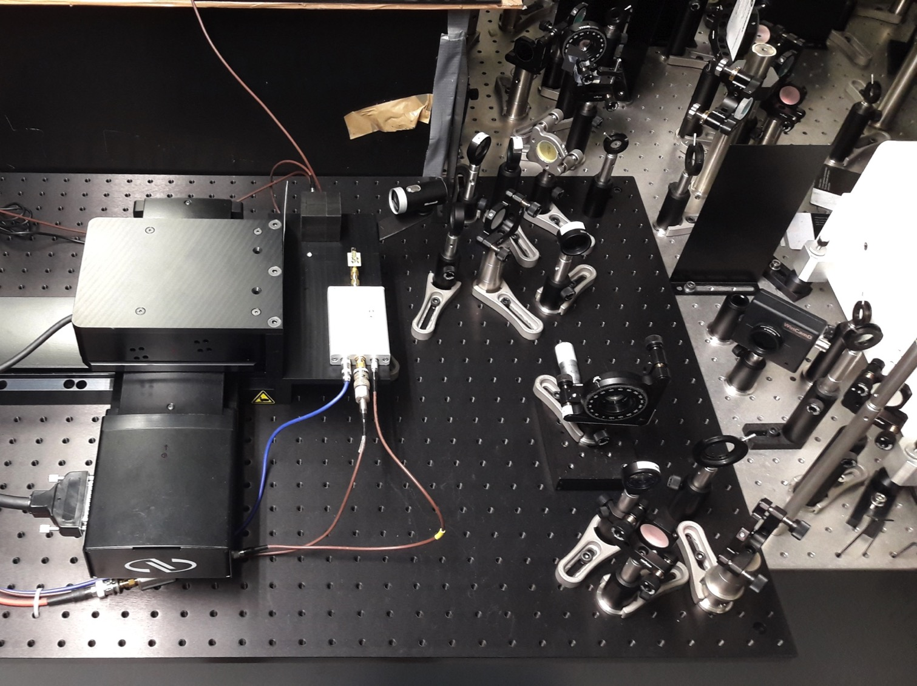
j
1kHz, 800nm, ~100fs
k
j λ/2 waveplate
k polarizing cube
l alignment irises
m mirrors
n barium borate crystal
o focusing lenses
p 100x attenuator
q dichroic mirror
r short-pass filter
s beam splitter
r
k
s
l
q
photodiode
o
o
m
p
sensor
&
amplifier
n
l
o
m
m
Setup end 2017

Slide 7
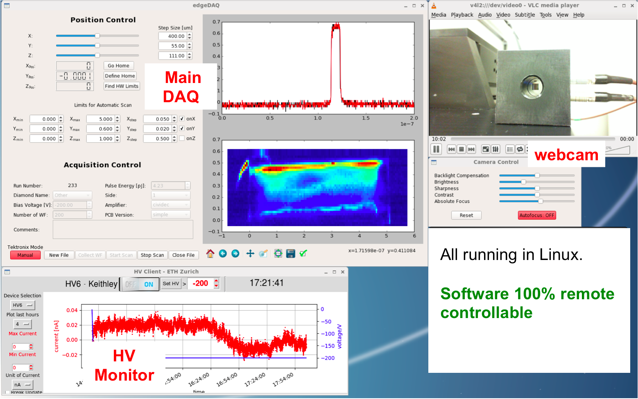
DAQ Software Screenshot
All running in Linux.
Setup 100% remote controllable!
(All Software available on Github)

Slide 8
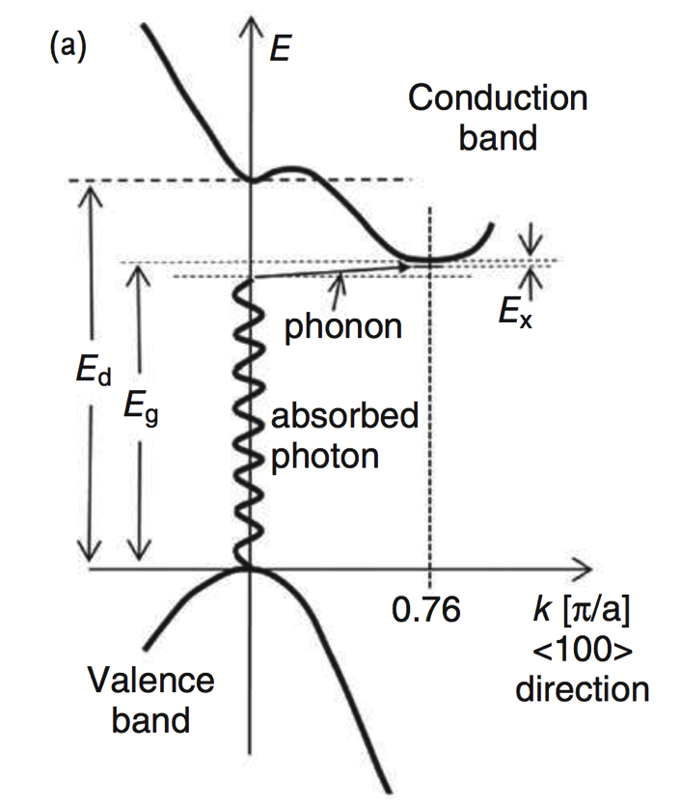
Electronic Band Diagram of Diamond
1-, 2-, and 3-photon absorption through indirect and direct bandgap
Direct Bandgap
required energy = 7.3 eV / 170 nm
1-photon absorption
2-photon absorption: E_{γ} = 3.65 eV / 340 nm
3-photon absorption: E_{γ} = 2.43 eV / 510 nm
Indirect Bandgap
required energy ≈ 5.47 eV / 226 nm
(minus phonon contribution and exciton energy)
1-photon absorption
2-photon absorption: E_{γ} ≈ 2.74 eV / 453 nm
Attoline Laser
photon energy 3.1 eV (400 nm)
~25 fs
0.1-5 nJ pulse energy eq. to 2*10⁸ – 10¹⁰ photons/pulse
1 kHz repetition rate

Slide 9
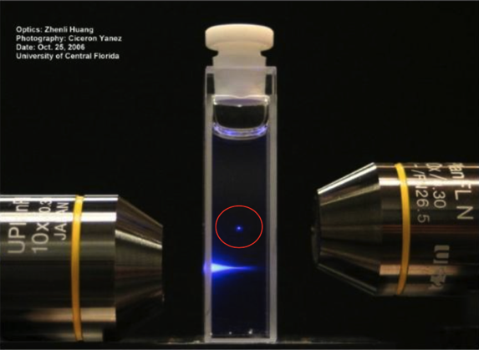

Charge Carrier Generation
Key Characteristic: Localized generation of charge carriers by multi-photon absorption
E_{Υ} < E_{Gap}
TWO Photons arriving within ~100 attoseconds
Excited State
Excited State
E_{γ}
E_{γ}
τ_{Virtual}
E_{Gap}
E_{γ}
Ground State
Ground State
Very dense spatial and timed packing of photons required to have two photons ‘in the same place at the same time’!
→ Focal Point of Femtosecond Laser
760nm, 200fs
760nm, 200fs
380nm,200fs

Slide 10
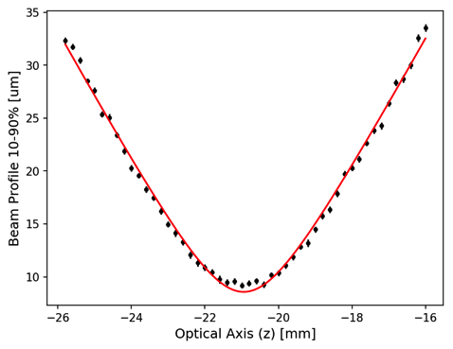
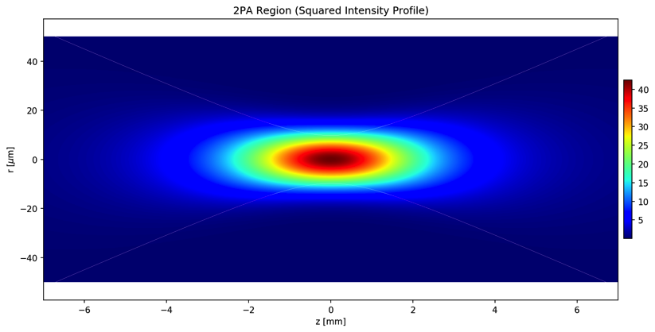
Charge Carrier’s Generation Volume
Result from beam profiling with a f=175mm lens
2PA ∝ I²
≈ 14μm
≈ 2mm
Beam profile from knife-edge scan in air
→ not accounting for aberration in diamond
Focus length (Rayleigh length) for initial measurements ≈2 mm (f=175mm lens)
Currently it is ≈0.6mm
The idea is to go to <0.1 mm in early 2018.
Higher NA → smaller focus point BUT bigger opening angle
beam loss outside of sensor!
X
ideally ≥2mm

Slide 11
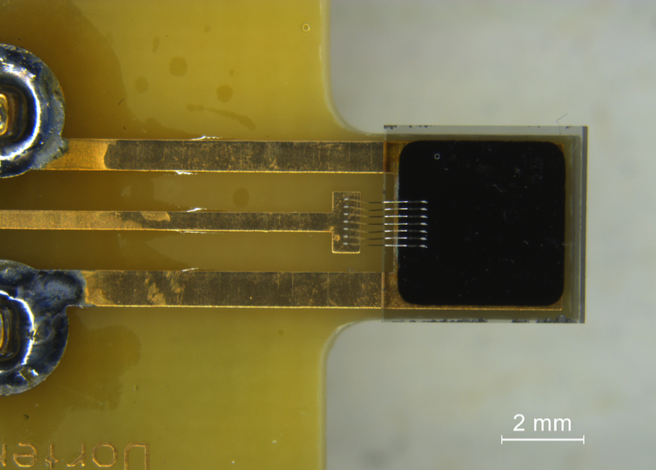
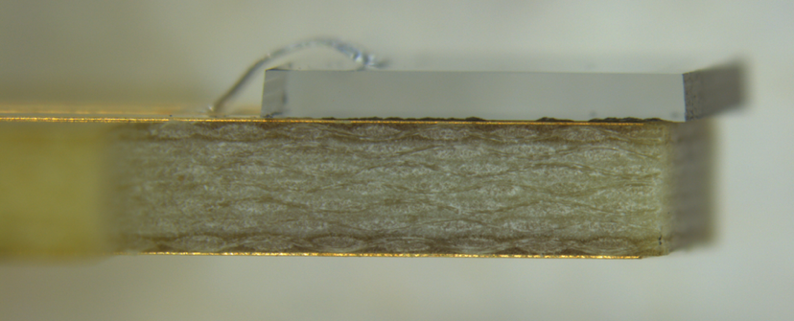
Selected sCVD Diamond Sample
The results shown in the following slides stem from data of this diamond
bought from Element 6 (through DDL)
Poor CCD performance
  requires high field to collect full charge
thickness – 566 um
Not irradiated
pad metallized by Rutgers University (TiW sputtered with shadow mask)
metallization distance from edge ≈400 μm
2 edges polished

Slide 12
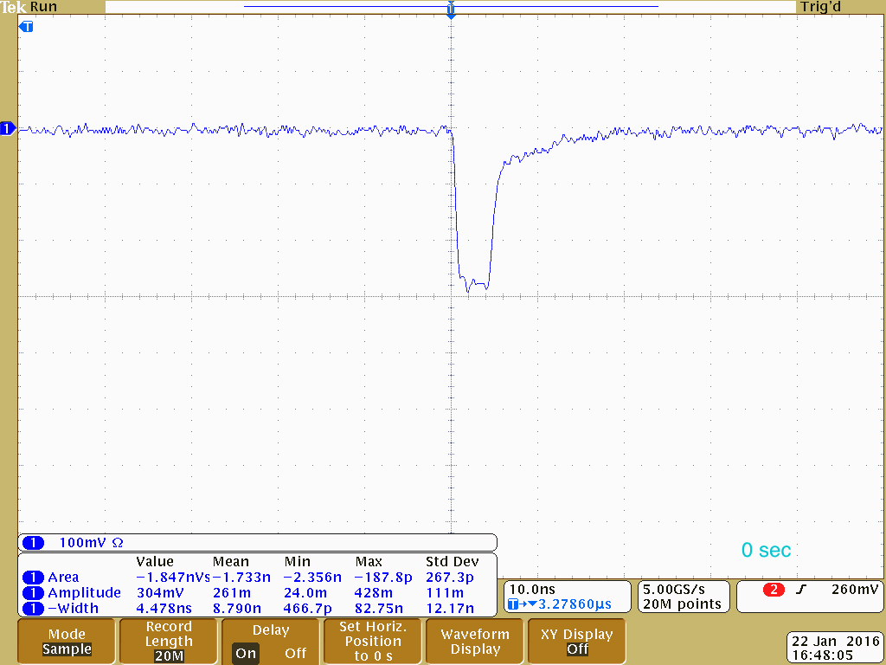
First Signal!
Confirmation of multi-photon absorption in sCVD diamond
January 22, 2016:
The first edge-TCT waveform in diamond was observed at ETH Zurich. Only 2/3 PA could allow this!.

Slide 13
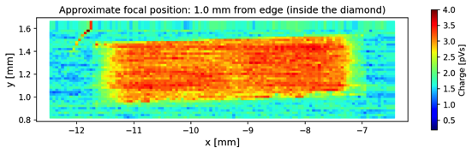
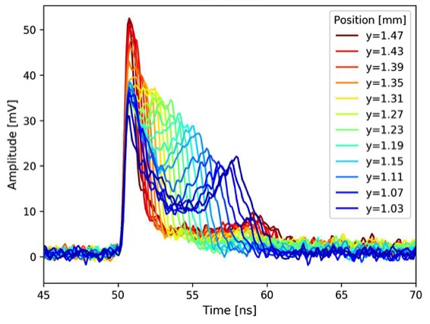
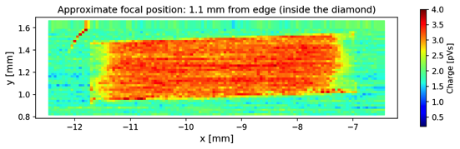
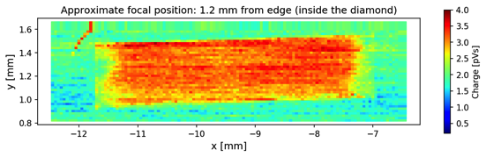
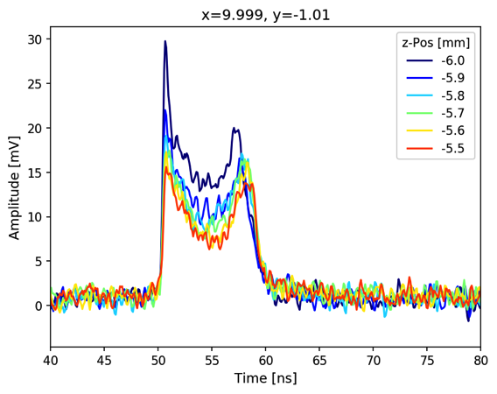
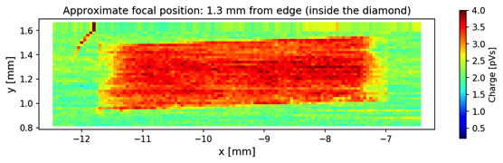
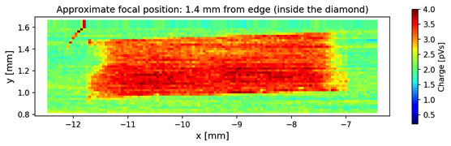
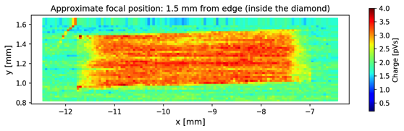
First 3D Scan
Bias voltage -400V (0.7V/um), 50 waveform averaging, 3993 scan points, 0.2 nJ pulse energy
y-scan
z=-6 mm
z=-5.9 mm
Parameters to extract:
total collected charge
drift speed
electrical field → space charge
...
z=-5.8 mm
z-scan
z=-5.7 mm
z=-5.6 mm
z=-5.5 mm

Slide 14
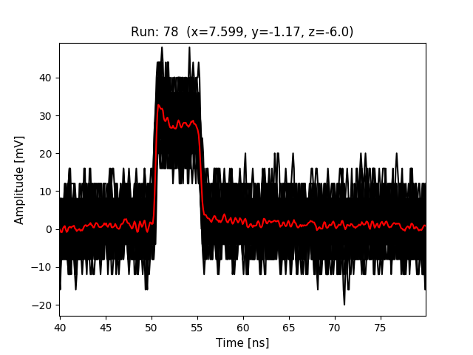
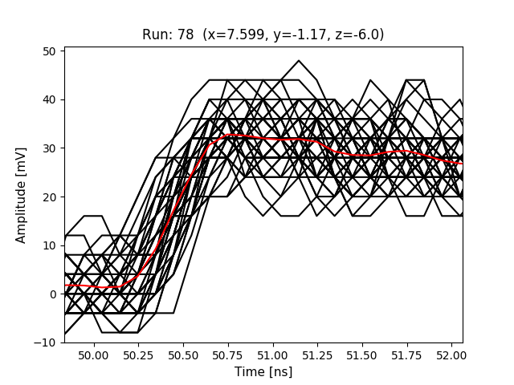
Waveform Analysis
Selected examples: total charge and prompt current
All waveforms are baseline corrected and averaged before further analysis.
I_{prompt} ∝ I(t=0)
Total Charge
Integral of the complete baseline corrected waveform [0-200 ns]
Prompt Current
0.3 ns-Integral around the center of the rising edge.
→ The electric field can be calculated from the result of the prompt current extraction!

Slide 15
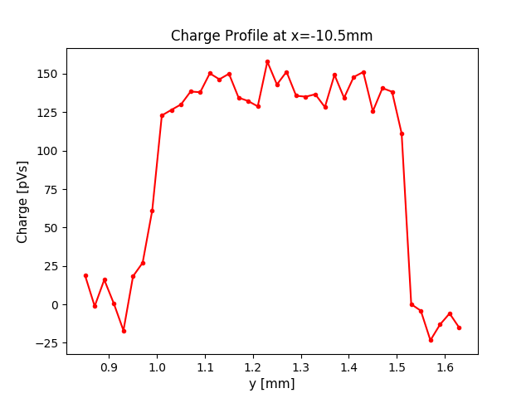
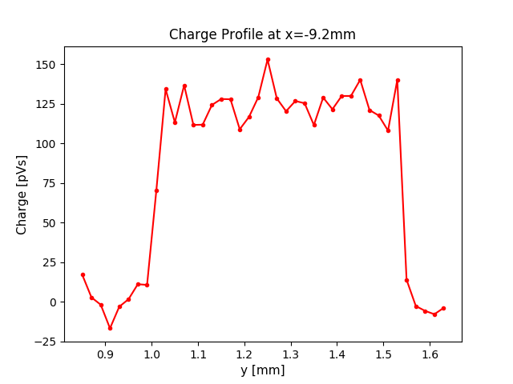
Total Charge
Example of a 2D map and charge profiles
-400V
GND

Slide 16
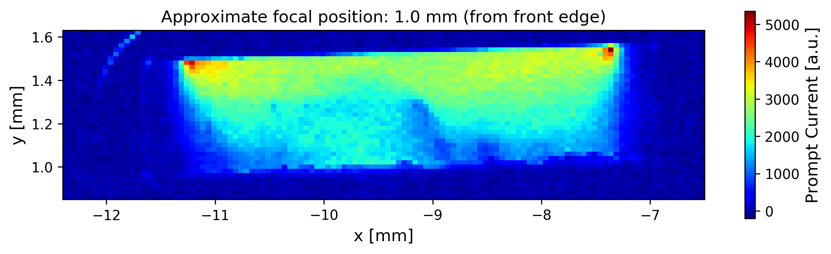
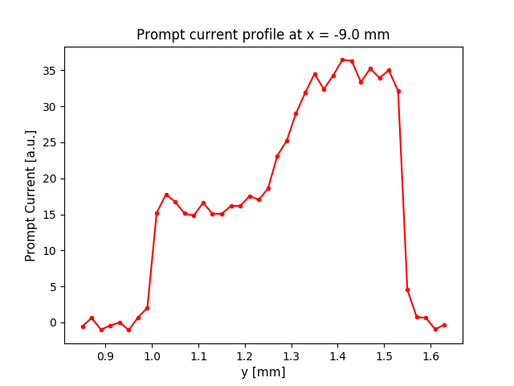
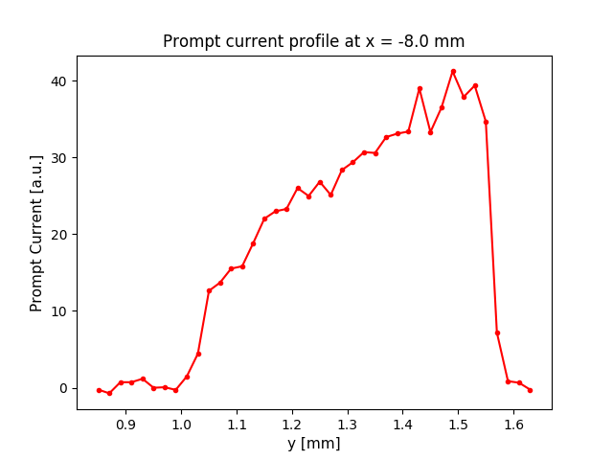
Prompt Current
Example of a 2D map and prompt current profiles
-400V
GND

Slide 17
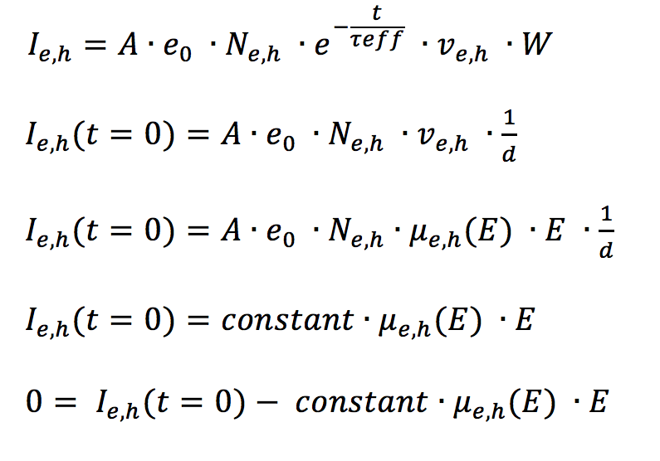
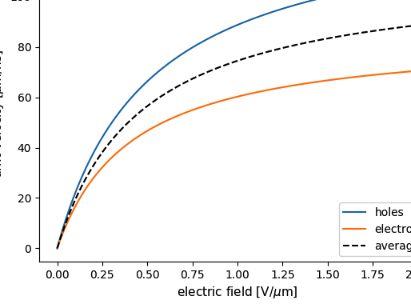
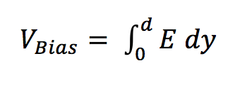
Electrical Field Extraction*
no trapping
A .. Amplification
e₀ .. electron charge
N_{e,h} .. number of e,h pairs
(constant in first order)
v_{e,h} .. avg. drift speed of e&h
W .. weighting field (=1/thickness for 2 parallel infinite 2D electrodes)
Mobility model
Characterization of single crystal CVD diamond particle detectors for hadron physics experiments (M.Pomorski)
I_{prompt} from data
scaling
Mobility model
Use ‘Bisection Method’ to solve for E with the constraint that:
*Investigation of Irradiated Silicon Detectors by Edge-TCT (G. Kramberger)

Slide 18
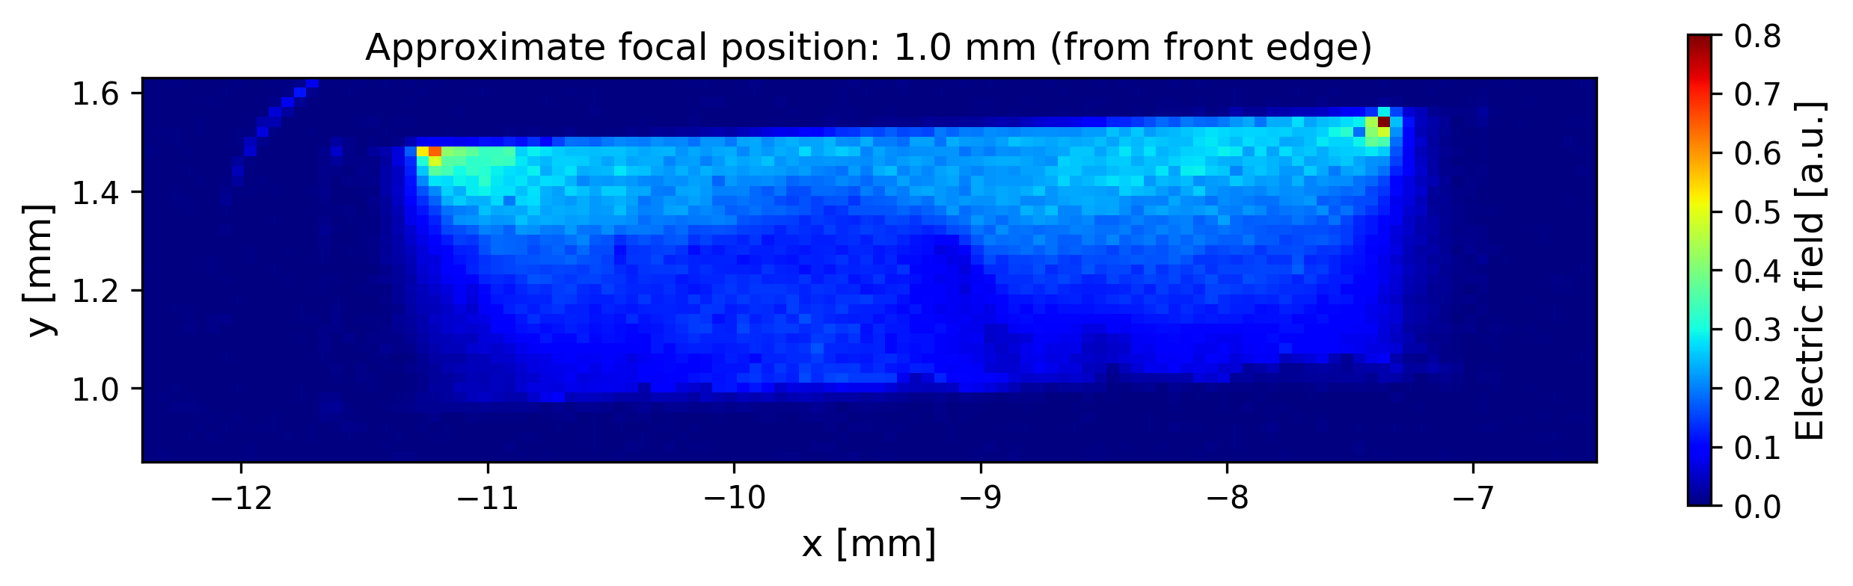
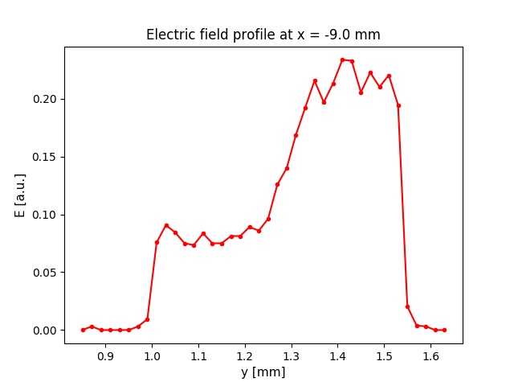
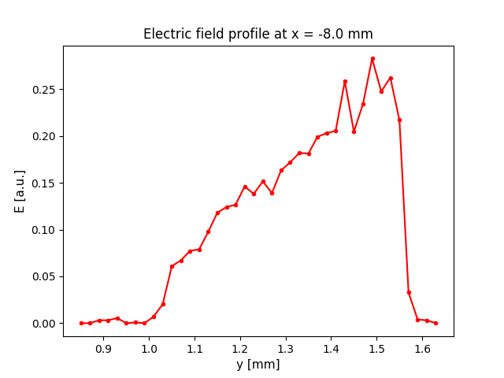
Electric Field
Example of a 2D map and electric field profiles

Slide 19
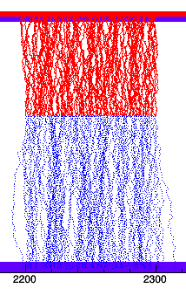
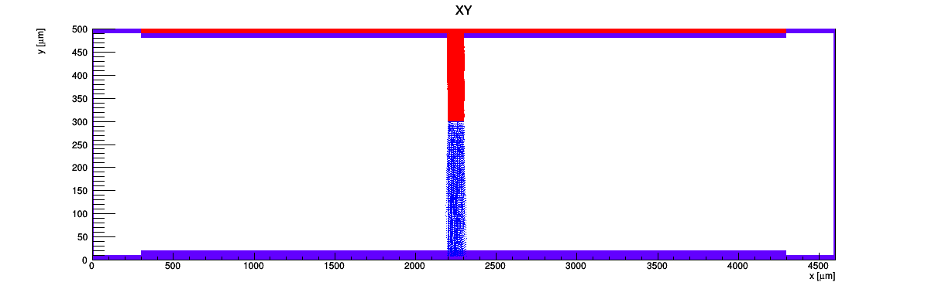
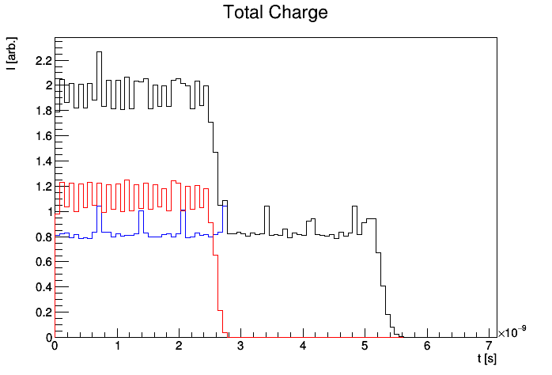
Detector Simulation with KDetSim
Example: Charge injection example along a linear path
-400V
holes
laser beam
(2200,300) → (2300, 400) MIP Track
electrons
GND
No RC filter applied!
Simulation allows to model signal’s shape:
Injection along a laser beam line
No space charge
Difusion = on
No RC filter
No trapping
total
holes
electrons
holes ≈7.7 μm/ns
electrons ≈5.8 μm/ns

Slide 20
Detector Simulation
Effect of the electric field close to the edge of the metallization
MIP along that line
metallization end
Effects due to non-uniform electric fields become apparent close to the edge of the metallization.

Slide 21
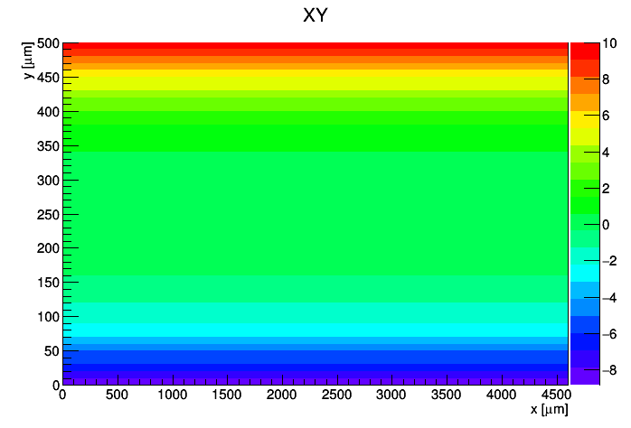
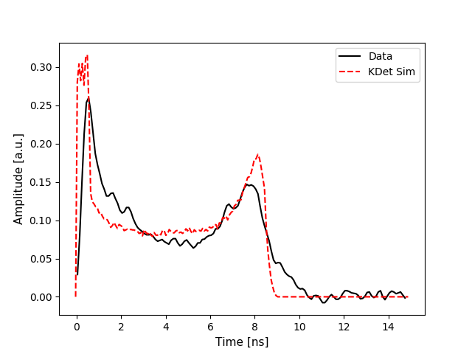
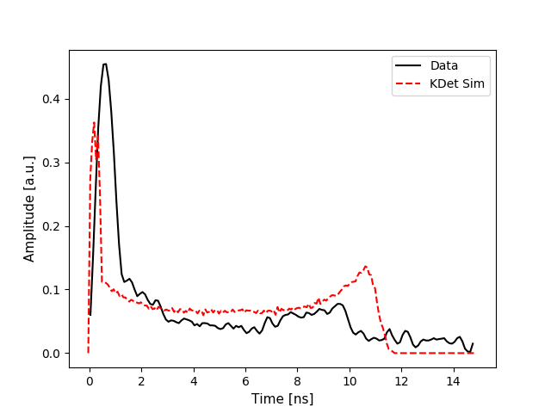
Space Charge Experiments with KDetSim
The goal was to find a space charge distribution that would resemble the waveforms seen in reality.
Another way to modify the signal shape is with space charge
cubic space charge distribution
Injection along a line
No RC filtering
No trapping
Cubic toy space
charge model!
y=50μm
y=450μm
Very preliminary!
Very preliminary!
slowly falling

Slide 22
Conclusions
Clear multi-photon edge-TCT signals in sCVD diamond have been observed
We have a working and fully automated edge-TCT setup
We are making the first steps in the analysis and simulation
Outlook
Light proof enclosure for edge-TCT setup
Introduce a shutter in the setup for on demand automatic light blocking to understand systematics due to light pumping
Better understand the shape of the focal point in diamond
Measure diamond with strip metallization pattern to confirm focal point shape
Micrometer precision focal finding
Systematic study of irradiated samples for different doses

Slide 23
Backup

Slide 24
Understanding Basic Optics
Refraction/Reflection
When light from an optically thin medium enters into a optically thick one the beam refracts toward the normal. – Snell’s law
LASER In
Diamond
Reflected
from diamond
(~17%)
expected
actual
Focal point position can be modeled with Snell’s law.(Finite elements simulation does not fully agree with approximation.)
The change in shape of the focal point on the other hand is, without small-angle approximation, not trivial.

Slide 25
Understanding Ultrafast Optics
Pulse widening due to dispersion effects
We previously worked with 25fs laser pulses.
The shorter the pulse the wider the spectrum (Fourier: short in time ←→ wide in frequency)
Different wavelengths travel at different speeds in materials (lenses, filters, ..)
red light speeds ahead while blue lacks behind (group velocity dispersion)
resulting in a longer pulse the more distance was travelled in material (e.g. diamond sensor)
longer pulse → less photons in given space at given time → less edge-TCT signal
1mm of glass
1mm of diamond

Slide 26
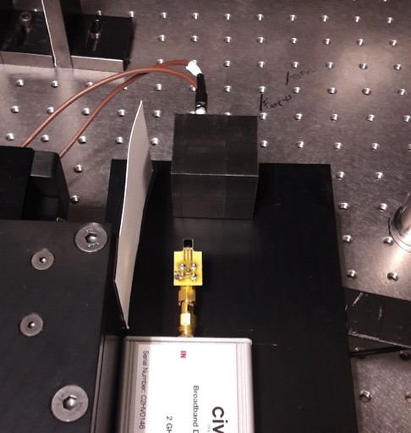
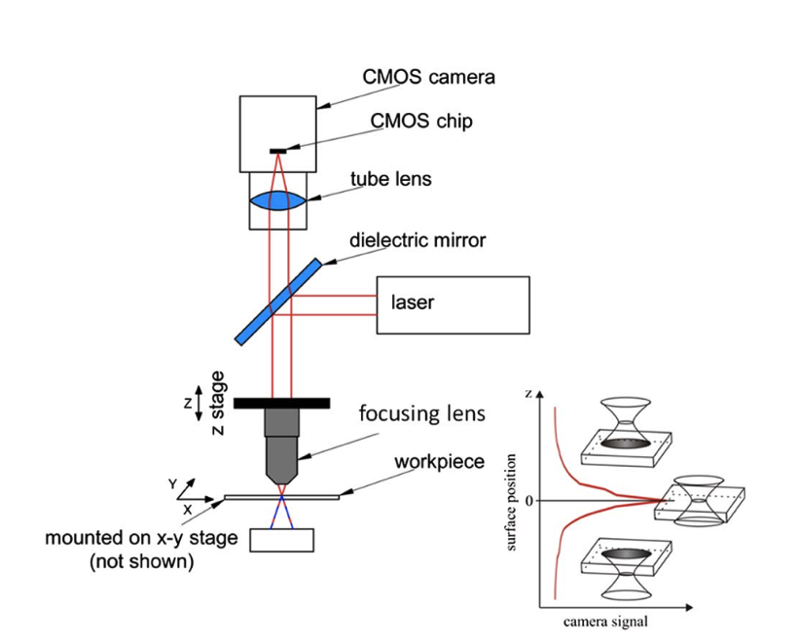

Understanding Basic Optics
How to determine the focal point position?
Knowing the exact position of the focal point along the optical axis is crucial and unfortunately not easy.
Potential Solution* (for rough surfaces)
Diode
can be measured
to sub-micrometer
hard to measure better than 0.5mm
Current Method
Problems in our case:
Sub-nano-Joule pulses of which only 17% percent gets reflected → sensitive CCD required
The diamond does not have a rough surface as required for this method
*Laser focus positioning method with submicrometer accuracy. - Ilya Alexeev

Slide 27




Bisection Method
A Simple Algorithm to Find Zero-Crossings
Start value is set
1
from data
2
LOOP
evaluate f(a), f(b), f(c)
if f(a) * f(b) > 0:
a = (a+c)/2
else:
c = (a+c)/2
if |a – c| < threshold:
found solution
solution
a
b
c
step 1
3
step 2
step 3
step 4
.
.
step 5

Slide 28






Fighting Noise
The laser’s pockels cells in the new lab caused huge noise on the edge-TCT waveforms
no shielding
small copper box
2 copper boxes
after baseline correction

Slide 29

Oscilloscope
LV supply
DAQ PC
Amplifier
xyz-stage
xyz-stage control
high voltage supply

Slide 30


Other Work Packages
In-House Sensor Making
Procedure for making strip- and pad-detectors developed at ETH’s FIRST cleanroom

Slide 31





Understanding Gaussian Optics
LUMERICAL Simulations of a Gaussian Beam – Intensity Profile
Simulation of focal point in air. Interference patterns due to thin lens approximation.
Thin lens filled with beam → causes airy discs.
LASER
2w₀
y
2z_{R}
y’
Simulation of focal point in diamond (Intensity)
y=40μm
y=50μm
y=60μm
y=70μm

Slide 32




Signal Stability
Higher pulse energy → stronger signal decline. Good SNR →Measurements at low energy.
0.2 nJ
1 nJ
^{PLT diamond plane}

Slide 33
Order of Photon Absorption
Purely quadratic dependence between beam power and signal → 2 PA
^{PLT diamond plane}

