Slide 1


Radiation Hardness of
Silicon-on-Insulator Pixel Devices
- Ten years of struggle -
K. Hara (Univ. Tsukuba)
Wataru Aoyagi (University of Tsukuba) Shun Endo (University of Tsukuba) Hiroki Yamauchi (University of Tsukuba) Ryuhei Abe (University of Tsukuba) Shikie iwanami (University of Tsukuba) Shunsuke Honda (University of Tsukuba)
Toru Tsuboyama (KEK) Ysuo Arai (KEK) Ikuo Kurachi (KEK) Toshinobu Miyoshi (KEK) Miho Yamada (KEK)
Project supported by
JSPS Grant-in-Aid for Scientific Research on Innovative Areas

Slide 2
OUTLINE
SOI Pixel and Radiation Damage
TID Damage and Compensation
- First Results
- BPW
  - Double SOI
  TrTEGs
  INTPIXh2
  FPIX2
  FPIX3
Conclusions

Slide 3
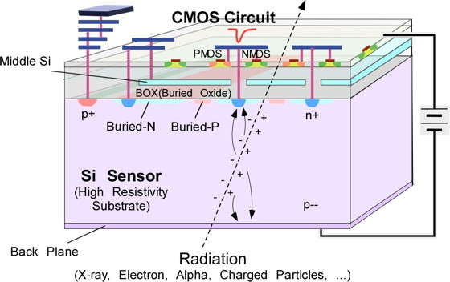
SOI PIXEL
SOI: Silicon-On-Insulator
CMOS circuitry fabricated on buried oxide(BOX)
LAPIS 0.2um FD-SOI
Features:
monolithic (no metal bumps)
SOI-CMOS (FETs fully isolated)
Can choose* substrate of optimum resistivity (fully depleted CMOS sensors possible)
*SOITEC SmartCutTM
many excellent features
Material budget
S/N
power dissipation
single event effects
latch up
Operation temp. (0.3K～570K)
speed
cost
Pixel size

Slide 4
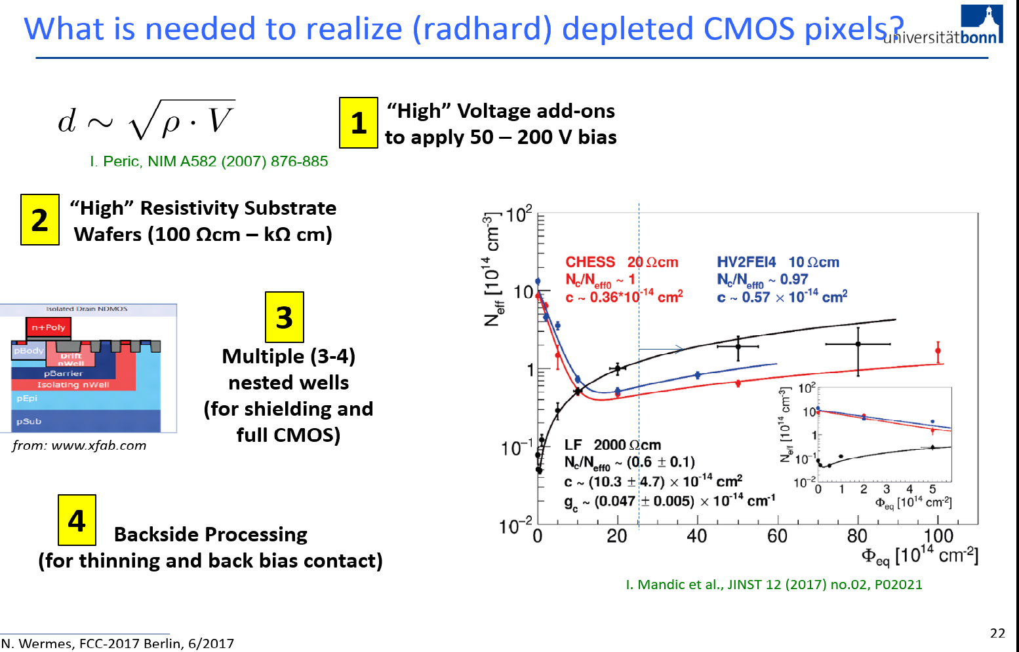
In summary…already
OK
OK
Not needed
OK
Notes:
norbert

Slide 5
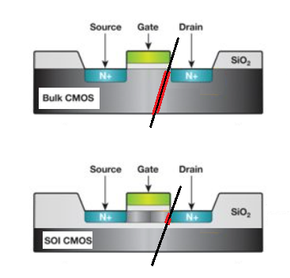
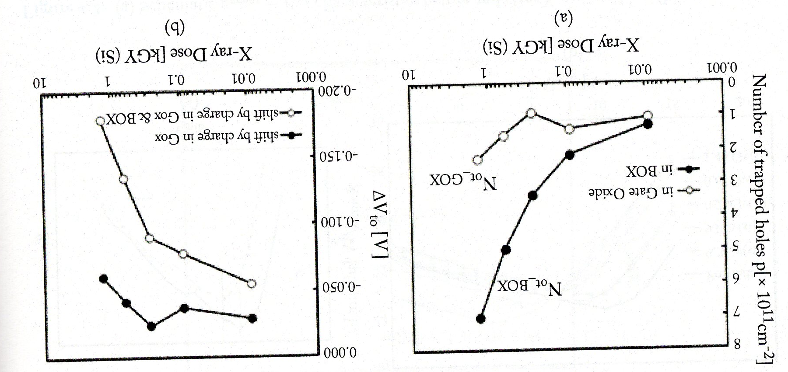
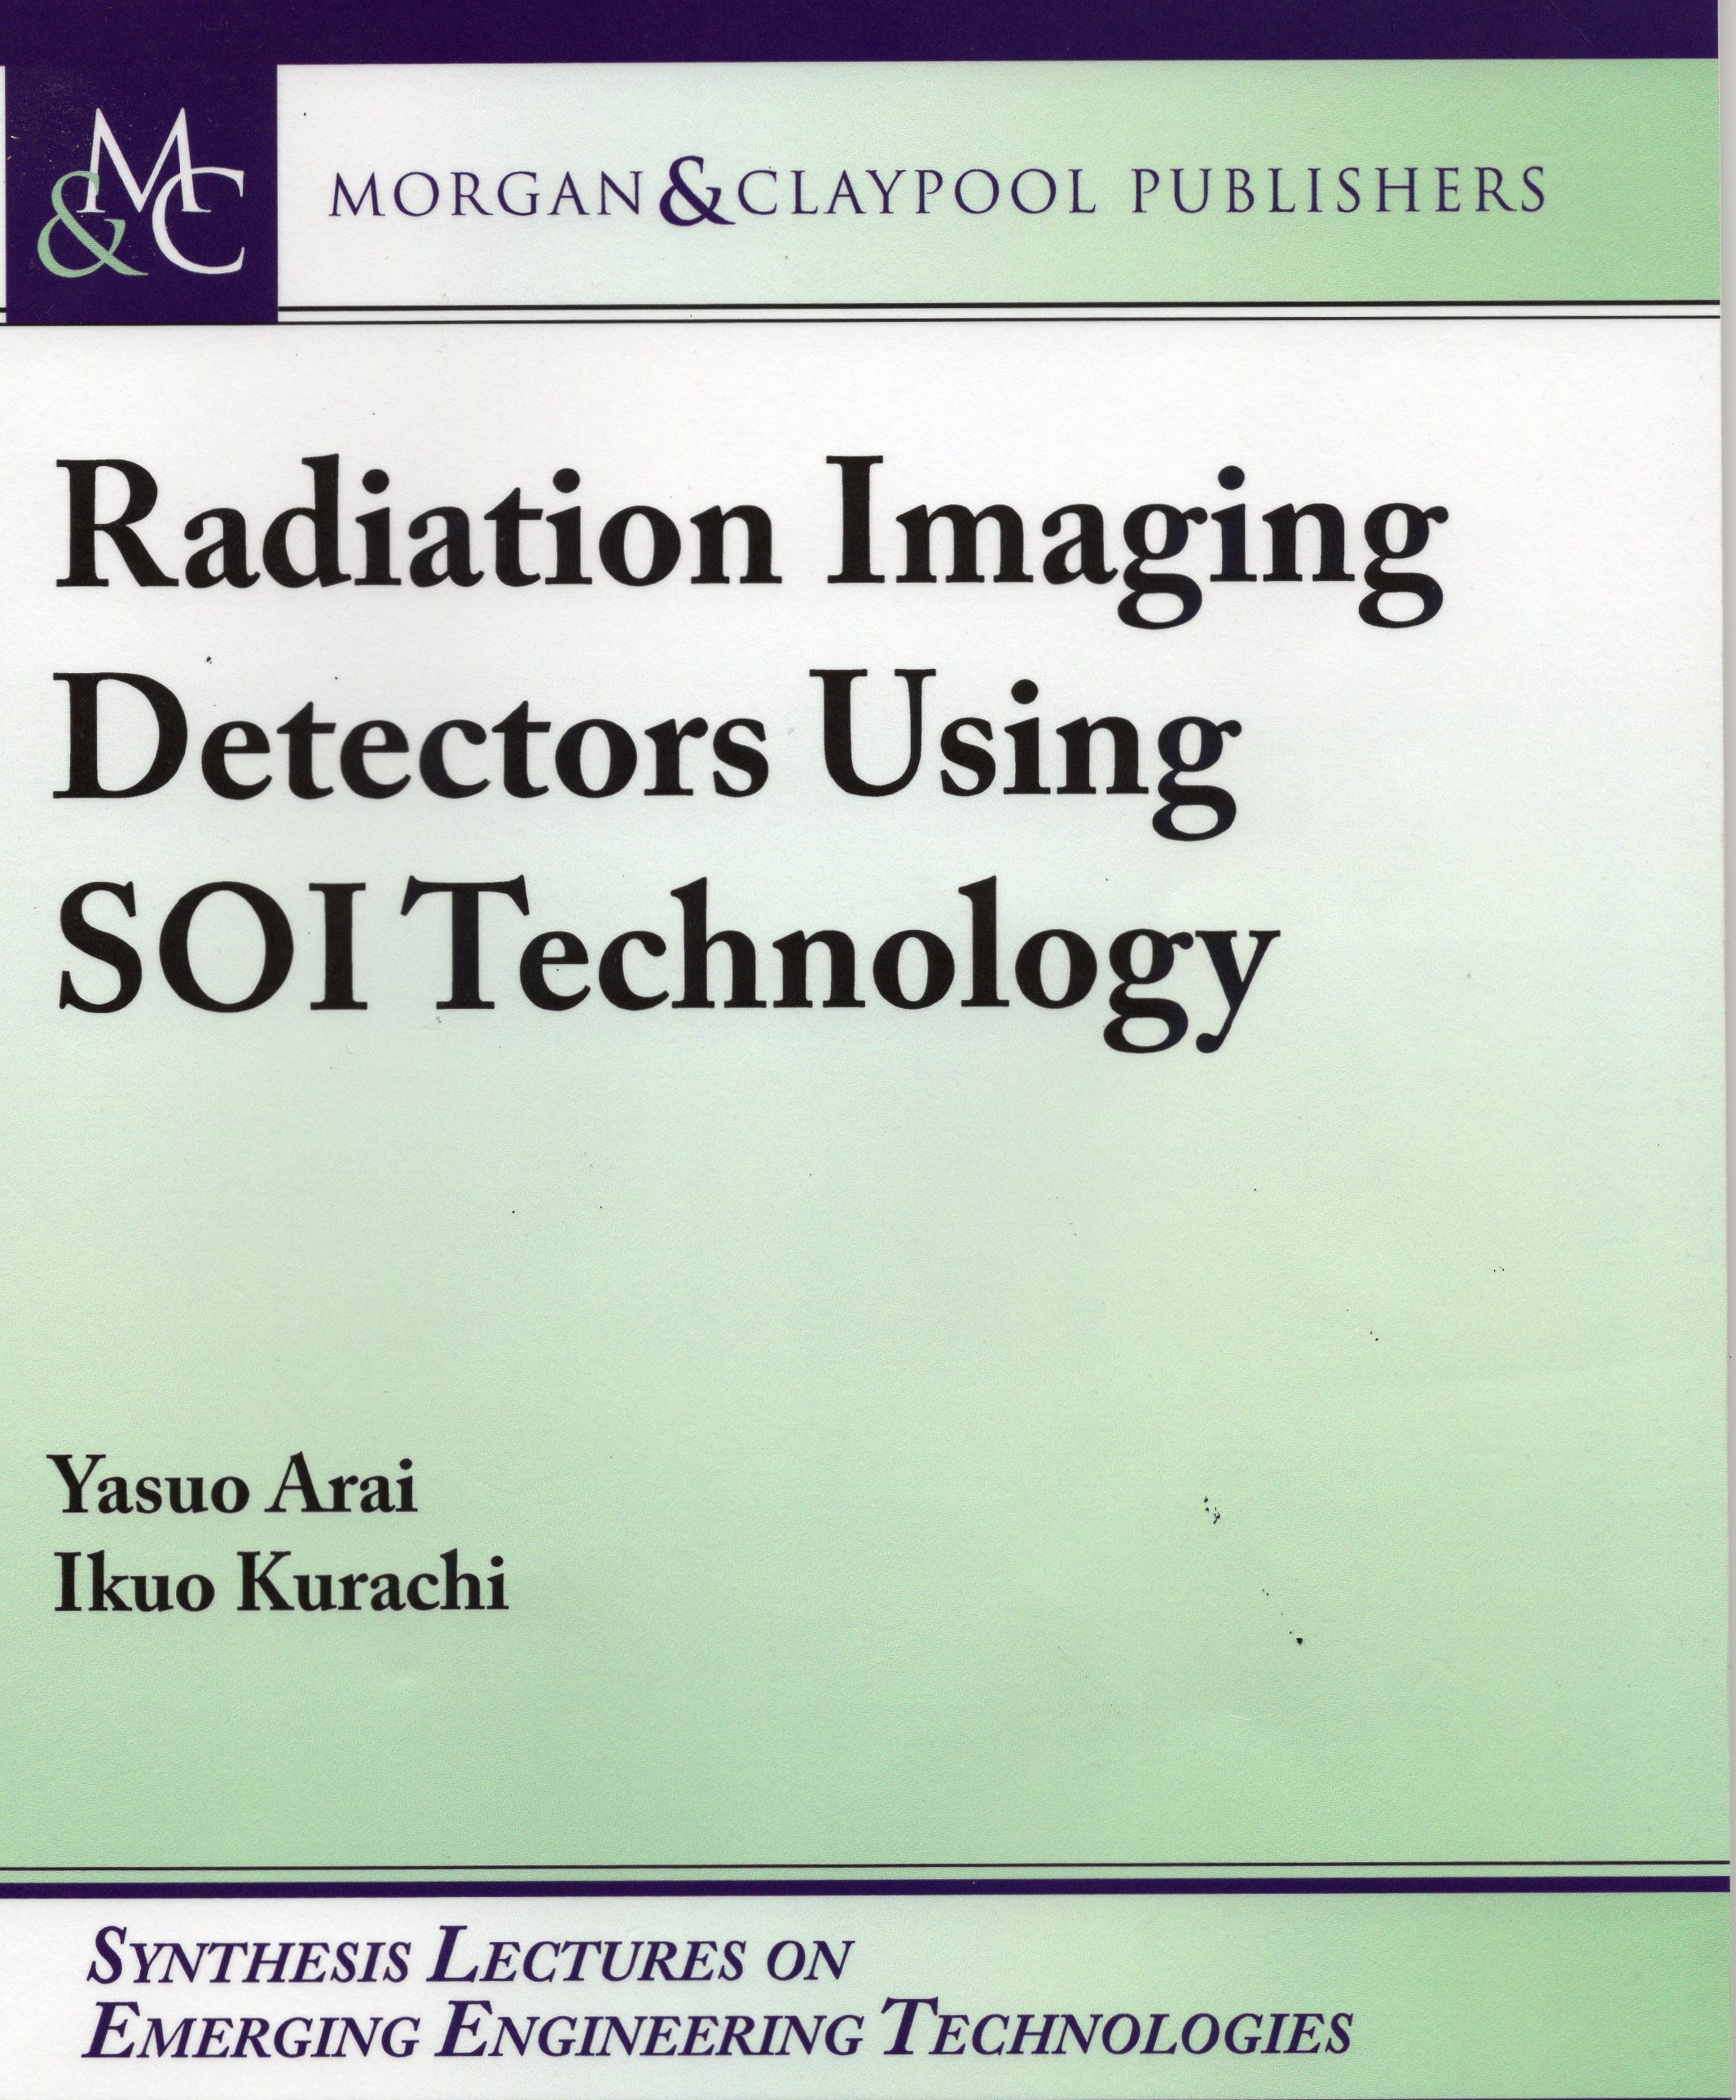
Rad-damage in SOI
~O(10)um
40nm
Surrounded by insulator
strong against SEE*
(thin active layer in SOI)
*SOI is a standard in space application
- affected by TID caused by accumulation of holes in insulator
Contribution from BOX is larger

Slide 6
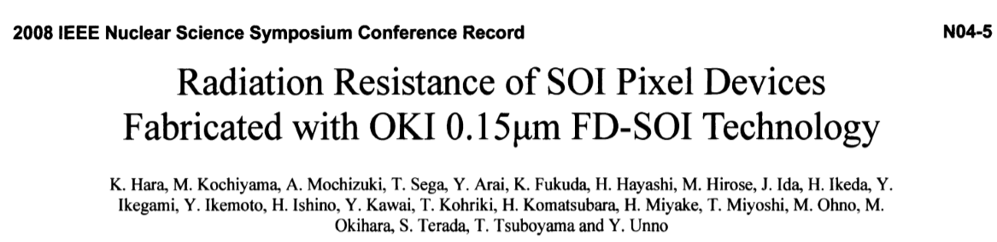
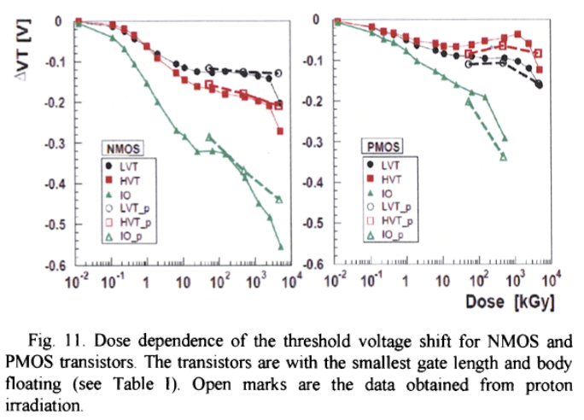
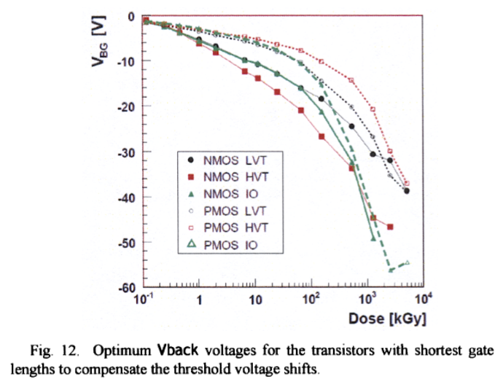
IEEE2008
Hole accumulation
⇒smaller Vgate required for turn-on
⇒V_{BG} can null the Vth shift
PMOS
NMOS
200nm
Back-gate biasing is
a clue to compensation
but the detector back is for sensor biasing…
BOX
The threshold shifts are significant (Vcc~1.8V)
Proton-induced damage ~ γ damage (TID)
350um

Slide 7
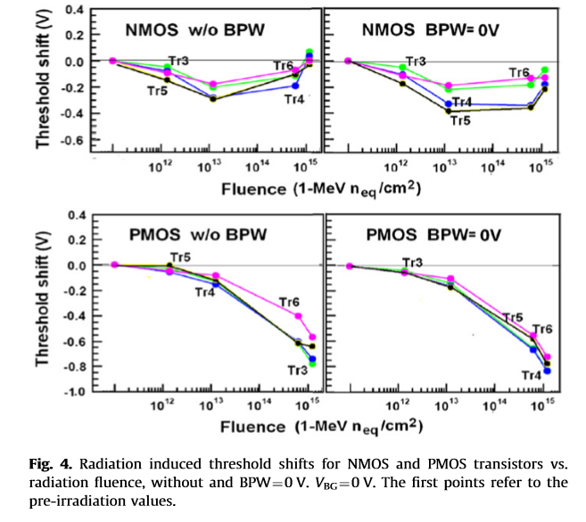
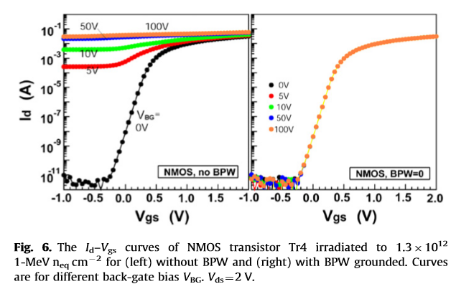
BPW (buried p-well)
HSTD9(2010)
Back-gate effect suppressed
~10kGy
FET
BOX
BPW
BPW suppresses the back-gate effect
N-sub
BPW(V=0) no effect for rad-damage
BPW(V<0) should improve, but
BPW tied to the pixel node … ⇒ nested structure

Slide 8
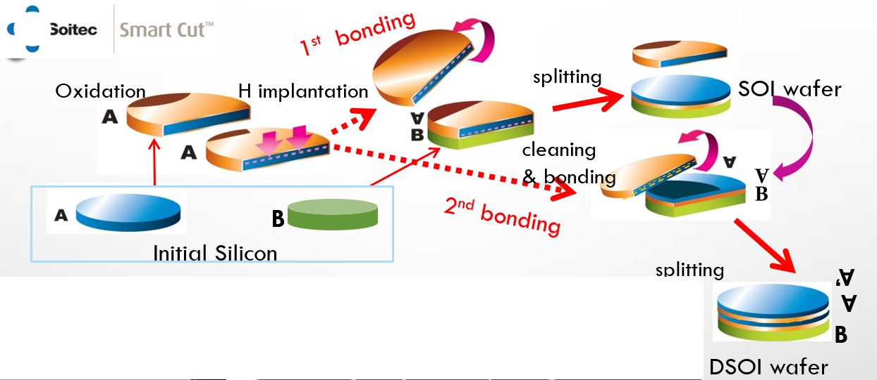
Double SOI wafer since 2011
Courtesy of Lapis semiconductor
SOITEC
nCz(0.6ｋΩｃｍ）
Shin-etsu
Oxy-Cz p (1ｋΩｃｍ）
pFZ (>5ｋΩｃｍ）

Slide 9
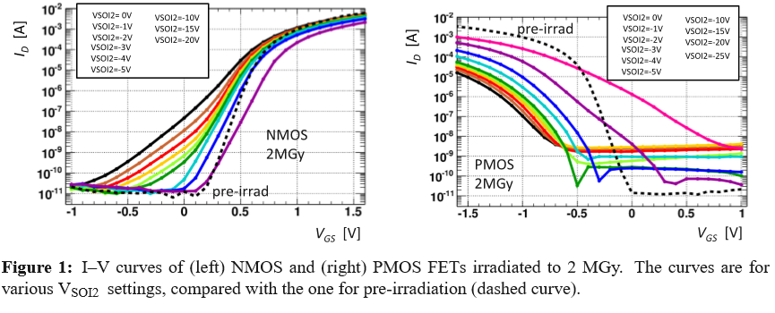
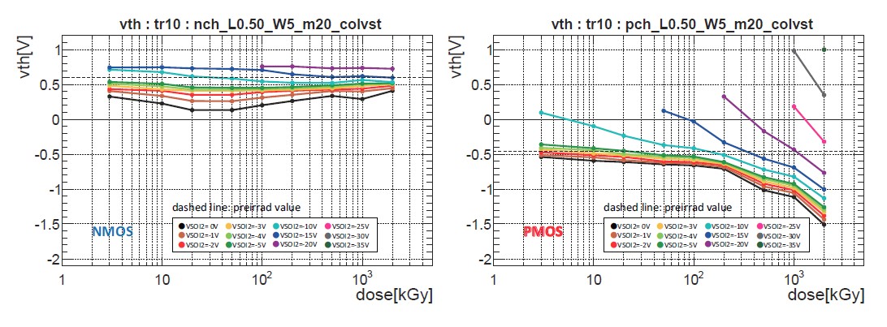
Double SOI
IEEE2013
V_{S}=0
V_{D}=1.8
V_{S}=-1.8
V_{D}=0
Vth Compensable by VSOI2 !

Slide 10
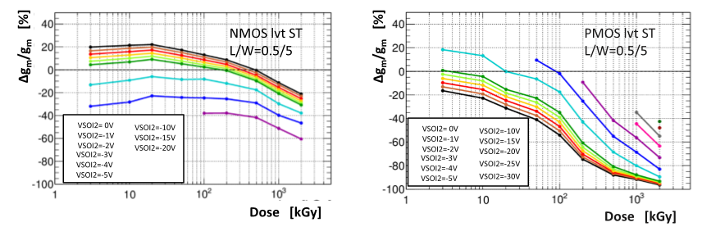
Double SOI
IEEE2013
However…
Substantial reduction of gm for PMOS…. ⇔ reason understood and solved
But, SOI works up to 100 kGy, good enough for ILC vertex

Slide 11
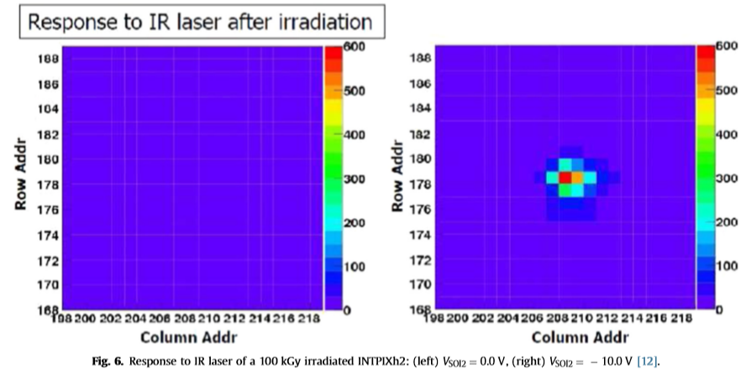
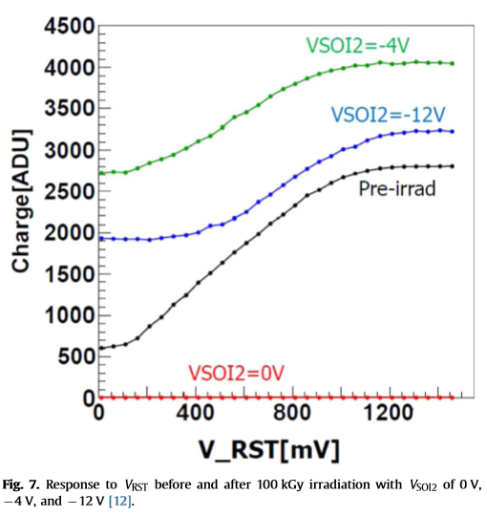
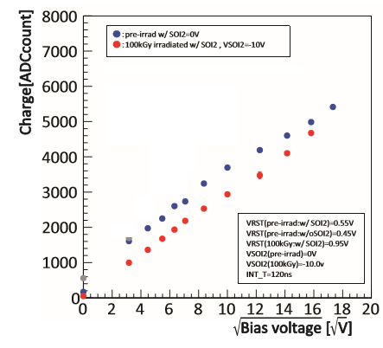
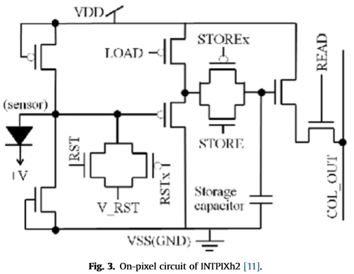
Double SOI PIXEL
HSTD10(2015)
Single VSOI2 control (INTPIXh2)
Response after 100kGy observed
though
V_{REST} response not fully recovered
Proportional to depl. thick (IR laser)

Slide 12
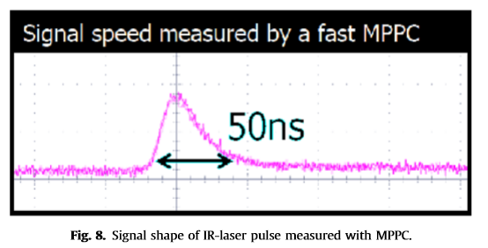
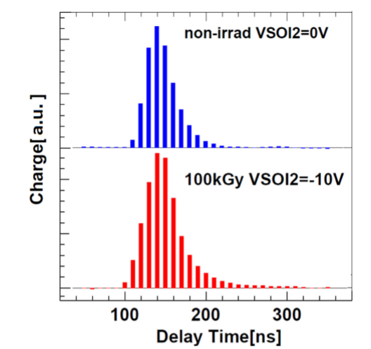
Double SOI PIXEL
HSTD10(2015)
Signal Shape (INTPIXh2)
The amplifier is not optimized for fast signal, but radiation-induced degradation in charge collection time seems small.

Slide 13
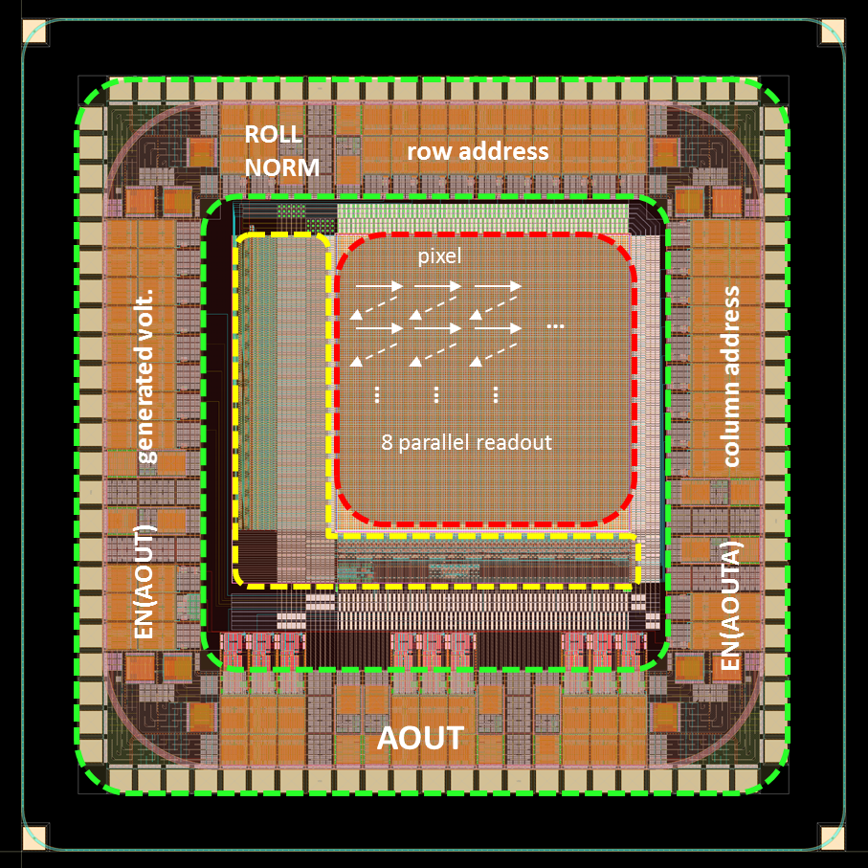
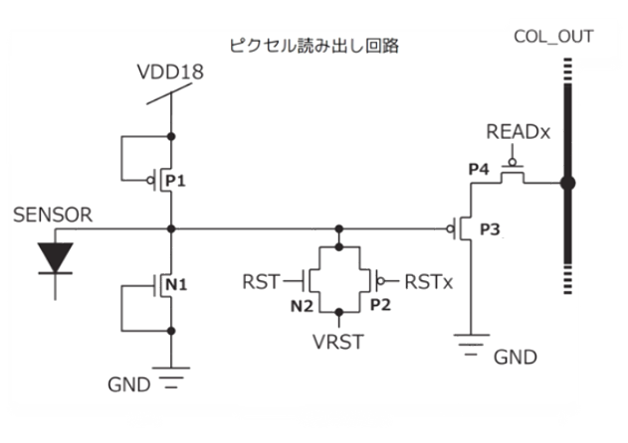
DouBLE SOI – 3 V_{SOI2} controls
JPS (2016)
VSOI2=(VSOI2 IO ,VSOI2 pix , VSOI2 dec)
FPIX2
SOI2 PIXEL
SOI2 DECORDER
SOI2 I/O
TID most critical on :
PIXEL … signal integration
DEC … voltages for gain control
IO … FET functioning for ESD
200kGy
500kGy
VSOI2(-5V,-10V,-21V)
preirrad
VSOI2(0V,0V,0V)
preirrad
VSOI2(0V,0V,0V)
VSOI2(-12.5V,-15V,-29V)
V_{RESET} response almost recovered
V_{RESET} response partially recovered

Slide 14
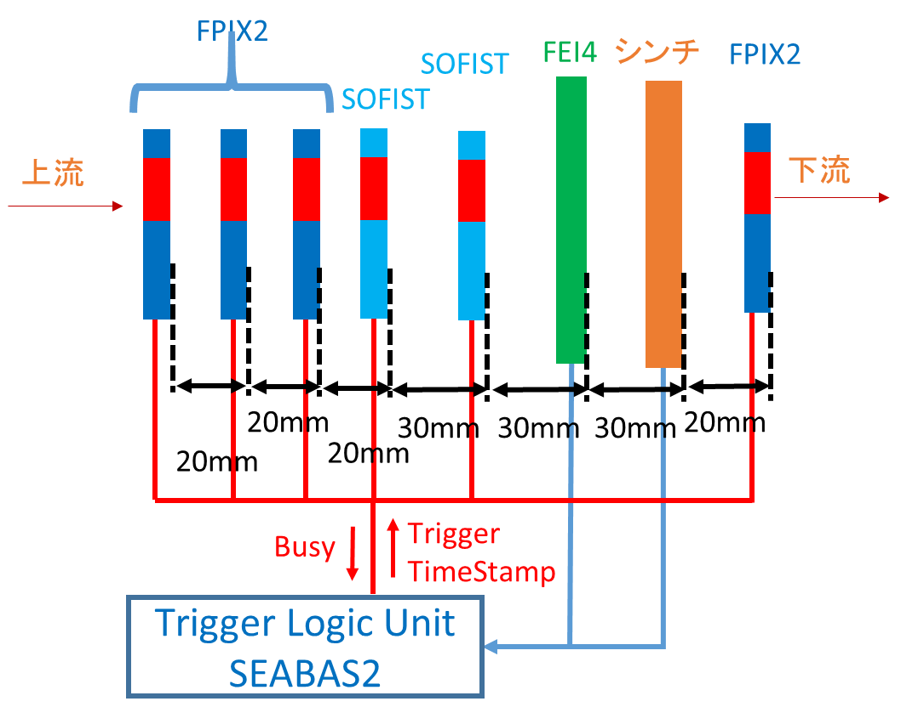
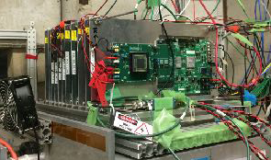
FNAL test beam
Jan (2017)
FTBF: 120GeV protons from Main Injector
scint.
4.2s beam spill every 1 minute
(view from downstream)
R.Nishimura et al. “high speed DAQ system…”
Trigger generated by a SEABAS2 board using Scint.(5mm-sq) and ATLAS FE-I4 (2mmx1.75ｍｍ ROI)
Data of 4 FPIX2 and 2 SOFIST sensors acquired per TLU request.
All R/O boards (SEABAS2) implemented with same TimeStamp firmware
Last FPIX2 made accessible for exchanging to irradiated DSOI
DAQ~1.2k/spill
SEABAS2（Soi EvAluation BoArd with Sitcp): 16ch 12bit 40MHz ADCs, Giga-bit Ethernet

Slide 15
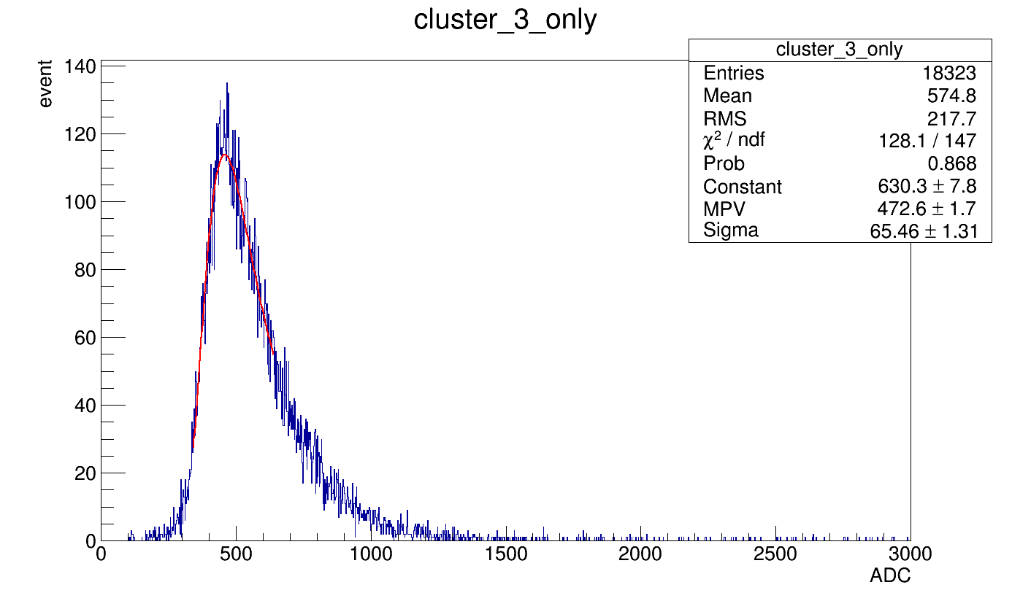

TID Damage compensation
TIPP (2017)
FNAL TB : FPIX2 100kGy
5x5 cluster charge about the maximum charge pixel in an event
5x5 cluster charge [ADC]
Non-irrad (200V)
VSOI2=0
~150um/300
depleted
100kGy (200V)
VSOI2 : I/0=-4V ,
Pixel=-8V , Dec=-12V
100
200
Innovative double-SOI allows operation of SOI devices @ 100kGy
Noise:1.8±0.1 ⇒5.4±0.5＠RT

Slide 16
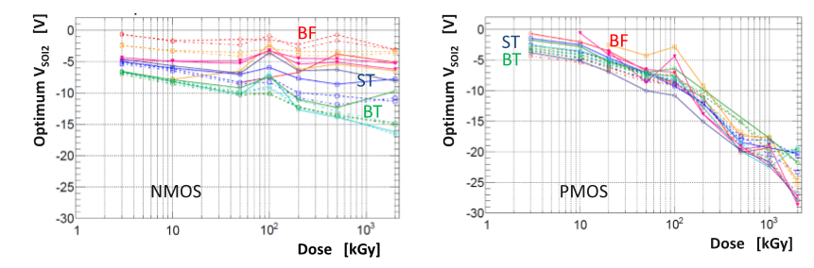
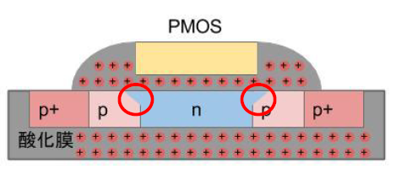
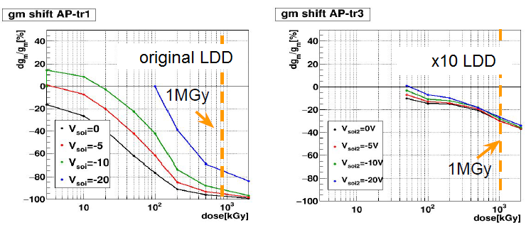
More compensation…
chip layout (3mm-sq)
FPIX2
FPIX3
Vth shift compensable by applying negative volts to SOI2: optimum volts differ for n/p as dose ~1MGy
Separate n/p SOI2 controls in FPIX3
PIXEL
p/n
DECODER
p/n
I/O
PMOS TID in sidewall: LDD loses control
(LDD: lightly doped drain)
increasing LDD by x10 (FPIX2-.>FPIX3),
Trans-conductance recovered significantly

Slide 17
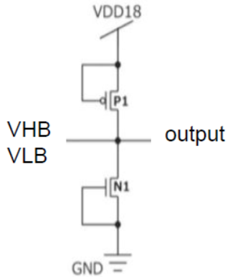
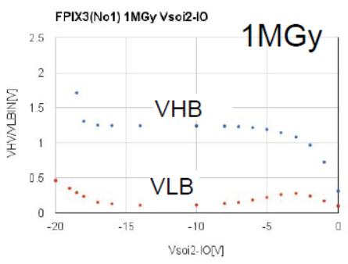
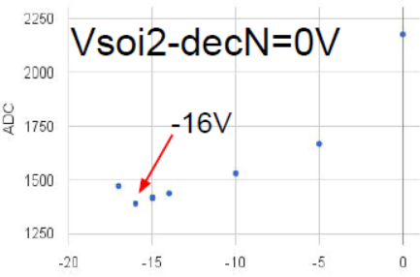
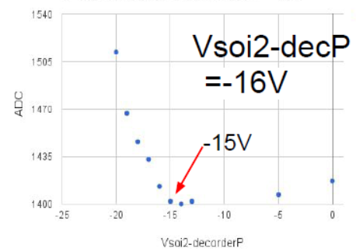
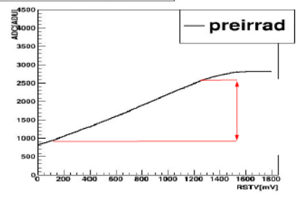
Compensation tuning
STEP-1 tune IO
IO outputs are clipped
due to always “ON” ESD
ESD protection
Wide range of VSOI2_IO
VSOI2_IO
STEP-2 tune DECODER
For V_{RESET}=100mV, tune to minimize the output
Typical V _{RESET} response (non-irrad)
ADC
dynamic range
V _{RESET}
VSOI2_decP
200kGy
VSOI2_decN
STEP-3 tune PIX to maximize the dynamic range and linearity

Slide 18
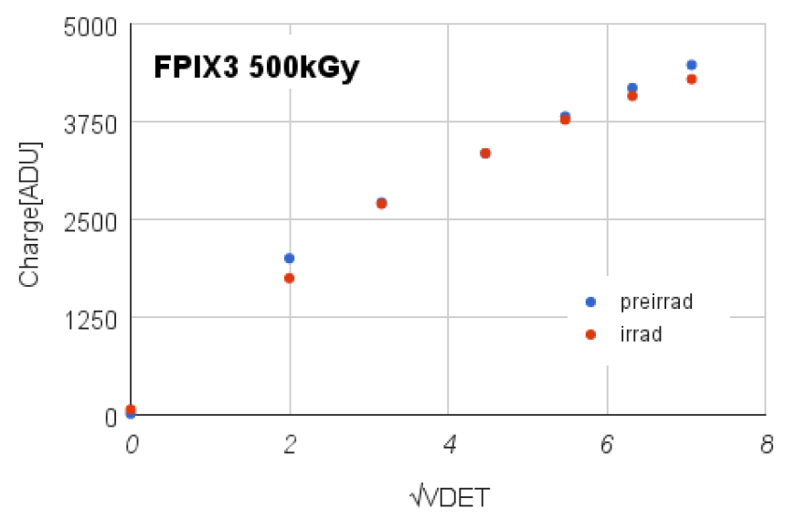
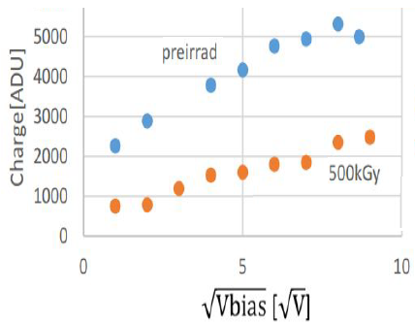
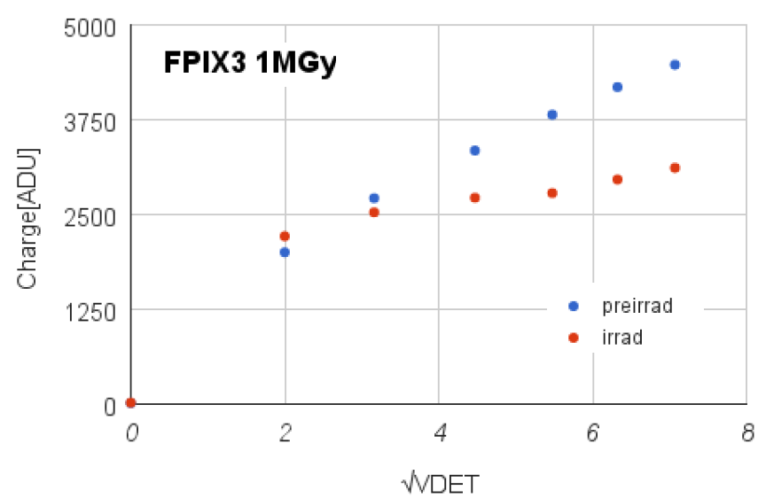
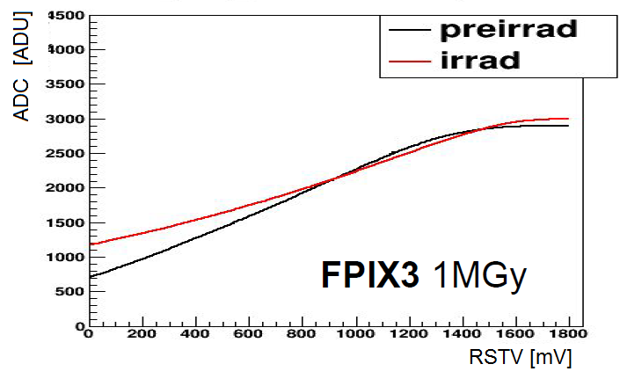
TID damage compensation
Response to pulsed IR-laser
FPIX3:500kGy
FPIX2:500kGy
V(IO)=-6
V(DecN/P)=-20/-30
V(PixN/P)=-9/-11
V(IO)=-12.5V
V(Dec)=-29V
V(Pix)=-15V
FPIX3:1MGy
Response fully recovered at 500kGy
Expect linear response at 1MGy
Test pulse
(test circuit only)
V(IO)=-6
V(DecN/P)=-26/-30
V(PixN/P)=-10/-11

Slide 19
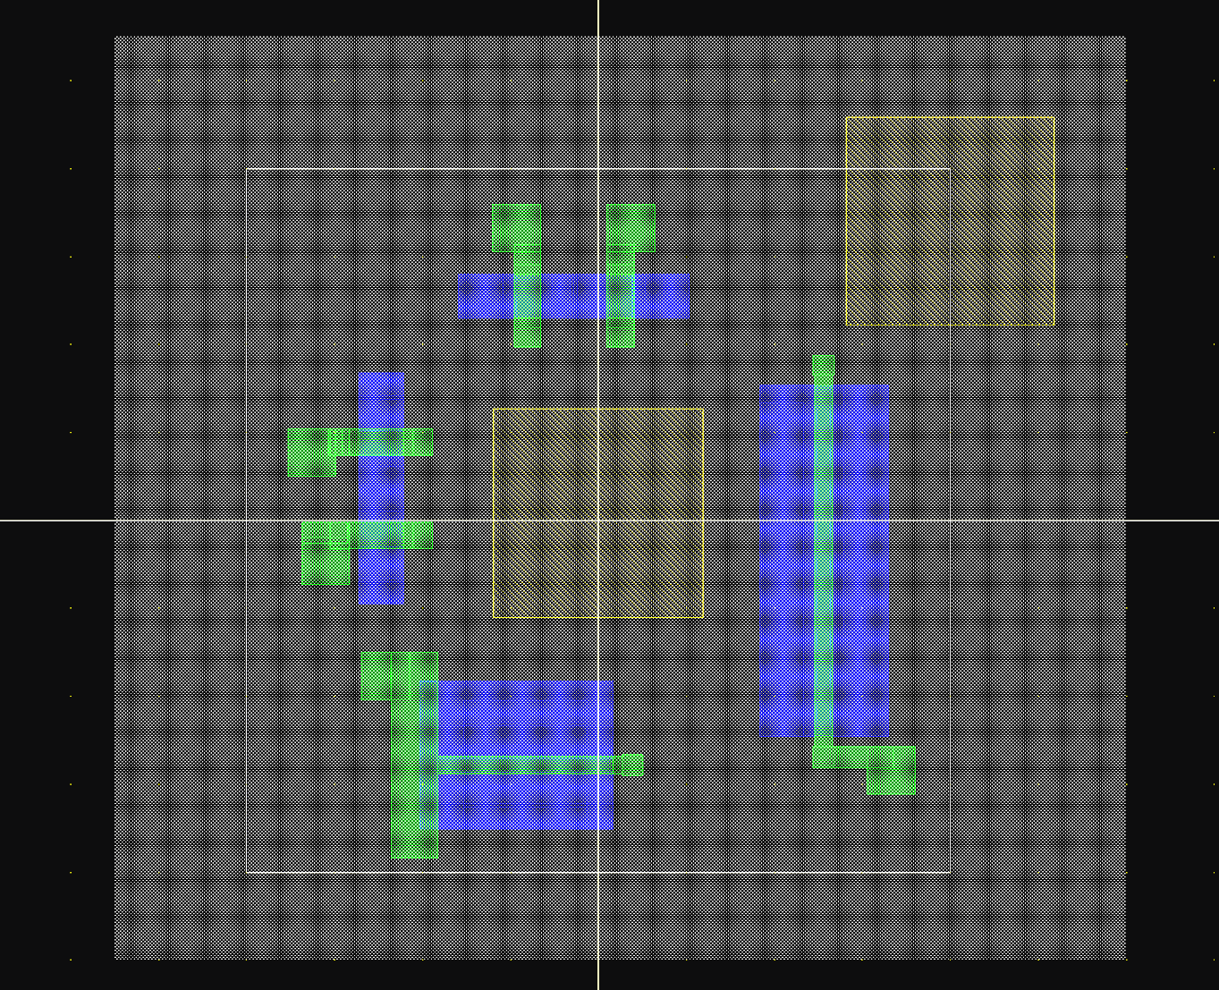
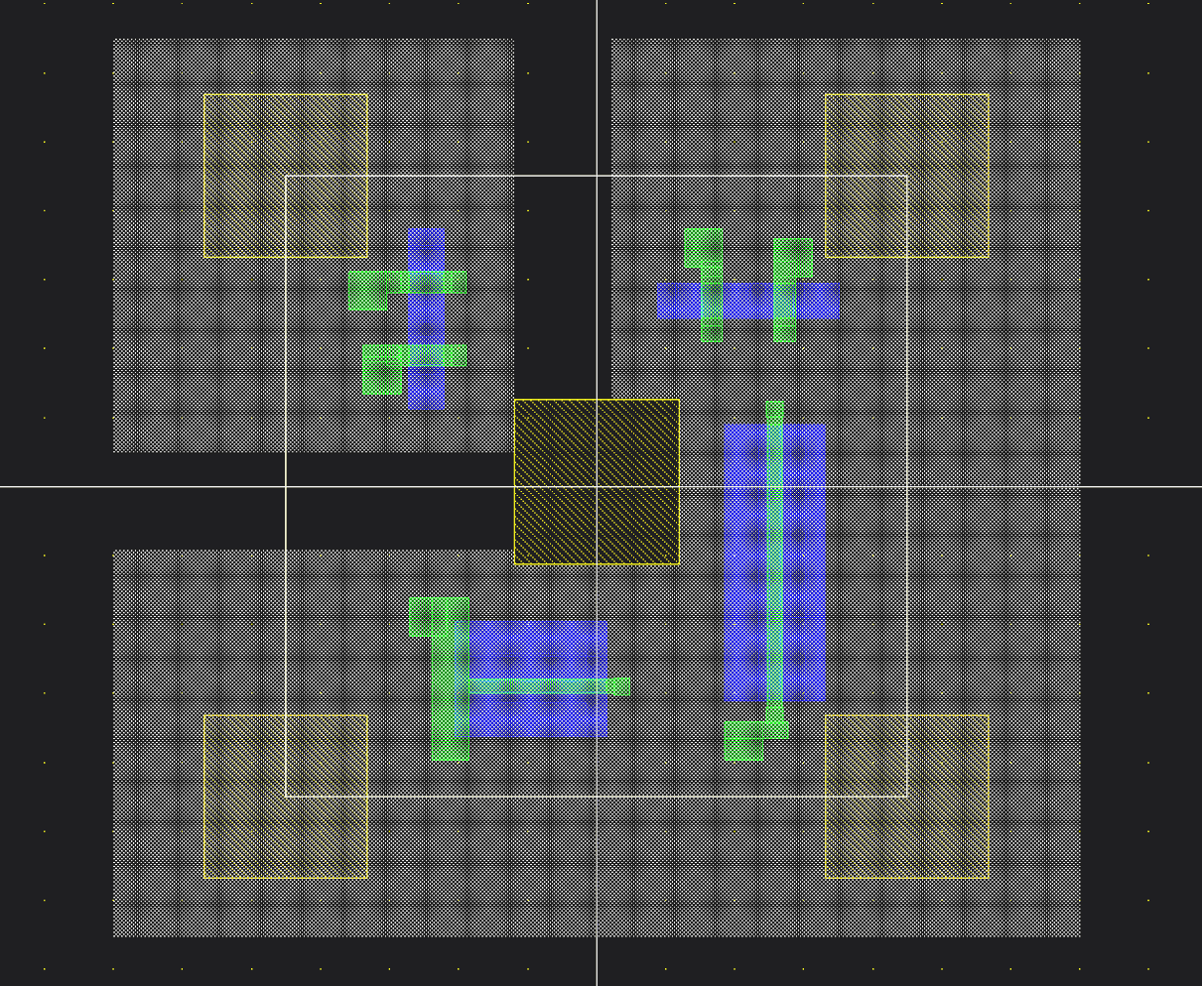
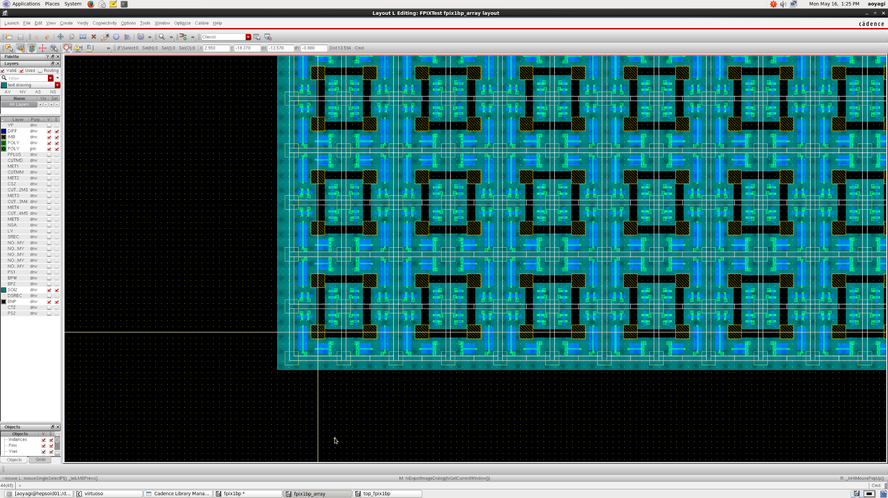
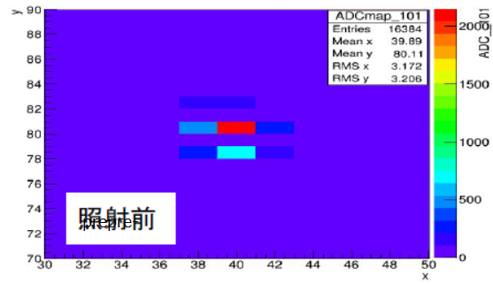
FPIX3 Pixel layout
FPIX2
FPIX3
8um
9um
PIXEL NMOS FETs (N1+N2) located at a corner
One VPIX_n for a group of 2×2 pixels
Rolling shutter R/O resets the signals in next row…
No response
from odd-row
OK w/ singleSOI
Pre-irrad

Slide 20
conclusions
TID identified as main concern for SOI applications in high-radiation environment
Innovative Double SOI solved many issues including TID. LDD profile revisited to enhance radiation tolerance
TID tolerance up to 500 kGy is achieved and good performance is expected also at 1 MGy (FPIX3)
SOI pixel (SOFIST) is being developed for the ILC.
SOI applications to wider area are encouraged.
Ten years of struggle …..

Slide 21
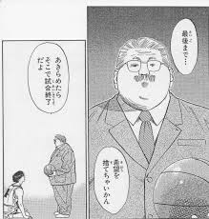
SLUM DUNK
By M. Inoue

Slide 22
spares

Slide 23
Fine-pixel detector: FPIX2
Pixel size: 8μm□
#Pixels: 128×128
Handle wafers:
>single SOI
25kΩ・cm p, 500 um^{t}
>double SOI
1kΩ・cm p, 300 um^{t}
Rolling shutter RO
8 parallel outputs
On-pixel circuit
In Development:
to demonstrate excellent spatial resolution achievable with SOI technology (=>tracker for SOFIST TB)
as demonstrator of TID tolerance (FPIX2 equipped with three middle-SOI regions)
chip layout (3mm-sq)
TID: hole accumulation in BOX/GOX
Middle-SOI: compensate TID effects by applied negative voltages
PIXEL
Analog signals are digitized (2ms) by external SEABAS2 12-b ADCs (8 parallel)
DECODER
I/O

