Slide 1


Synchrotron radiation X-ray experiments for a pulse-counting type SOI pixel for the soft X-ray measurements
KEK IMSS R. Hashimoto, S. Kishimoto, R. Kumai, N. Igarashi
KEK IPNS Y. Arai, I. Kurachi, T. Miyoshi
SOKENDAI R. Nishimura

Slide 2
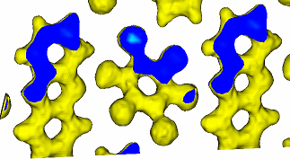

Introduction
Development of the SOI pixel detector for the X-ray structural analysis.
・ Small angle X-ray scattering
experiment for functional
thin films.
・ X-ray diffraction experiment
for functional materials such
as ferroelectrics.
etc…
Area detector using SOI
Precise analysis of position for hydrogen atoms
X rays
-P
+P
Crystal, Thin film
Complementary use of
hard and soft X-ray on
X-ray diffraction.
Time response of the domain structure by pulsed external electric field
Current status
・ Conducting the structural analysis experiment by use of a fine
pixelated detector, SOPHIAS.
・ Development of the pulse-counting type pixel detector.

Slide 3
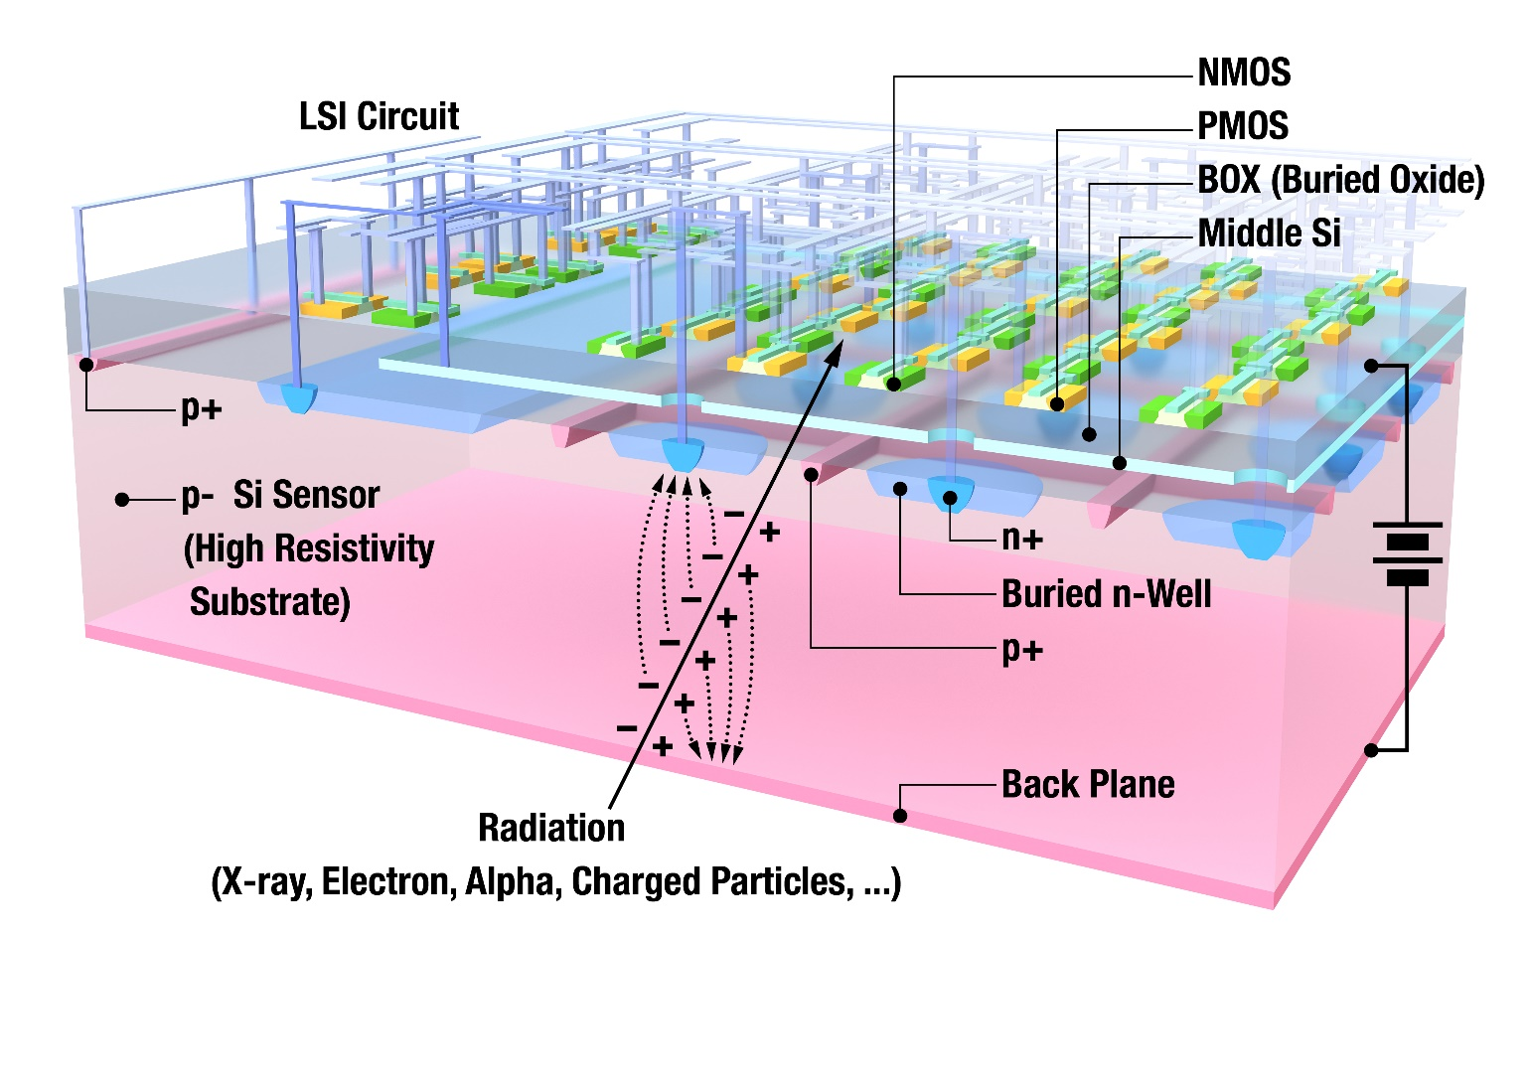
Introduction
SOI detector
Ground
Negative
Double-SOI wafer (p-type substrate)
Back plane : negative bias
Another Si layer (middle Si) is in BOX layer

Slide 4
Introduction
Requests for detectors from experiments
・high spatial resolution
→ pixel size is less than 50 μm square
・high sensitivity
→ detecting low energy X-ray ～2 keV
・high frame rate
→ more than 1 kHz
X-ray test for Test-Element-Group (TEG) chip including
pulse-counting type pixel TEG.
In this talk, the experimental results of the evaluation for the counting
type pixel TEG will be shown.

Slide 5
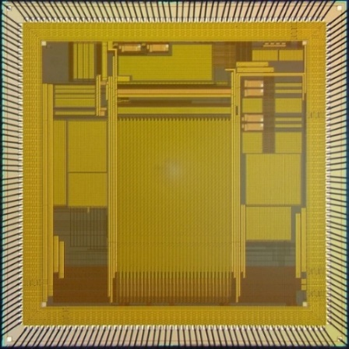
Evaluation of counting type pixel in KEK
CPIXPTEG1
CNPIX1
6 mm
・ 64 μm square pixel
・ 32 × 32 array
consists of 3 types
of pixel + TEGs
6 mm
18.4 mm
CPIXTEG3b
(collaborated work with IHEP)
6 mm
・ 50 μm square pixel
・ 64 × 64 array
12.2 mm
・ 52 μm pitch hexagonal pixel
・ 256 ×320 array + TEGs
6 mm

Slide 6

Evaluation of counting type pixel in KEK
CPIXPTEG1 → CPIXPTEG2
study of low energy
X-ray detection
CNPIX1
6 mm
・ 64 μm square pixel
・ 32 × 32 array
consists of 3 types
of pixel + TEGs
6 mm
18.4 mm
CPIXTEG3b
(collaborated work with IHEP)
6 mm
・ 50 μm square pixel
・ 64 × 64 array
12.2 mm
・ 52 μm pitch hexagonal pixel
・ 256 ×320 array + TEGs
6 mm

Slide 7
Chip overview
CPIXPTEG2
・ 64 μm square pixel
・ 32 × 32 array consists of 3 types
of pixel + TEGs
・ 16-bit counter
・ Double-SOI wafer
6 mm
6 mm

Slide 8
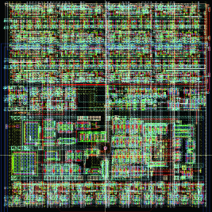
Chip overview
CPIXPTEG1 → CPIXPTEG2
・ Increasing contact via of the middle-SOI layer
Pixel layout of CPIXPTEG1
Counter
Shaper amp.
Discrim.
Preamp.
Register
Only 1 Middle-SOI contact

Slide 9
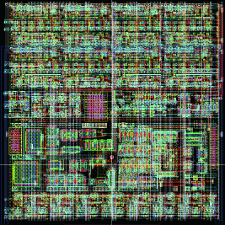
Chip overview
CPIXPTEG1 → CPIXPTEG2
・ Increasing contact via of the middle-SOI layer
Pixel layout of CPIXPTEG1
CPIXPTEG2
Counter
Shaper amp.
Discrim.
Preamp.
Register
Only 1 Middle-SOI contact
Increasing contacts

Slide 10
Chip overview
CPIXPTEG1 → CPIXPTEG2
・ Increasing contact via of the middle-SOI layer
・ Study of the backside process for the soft X-ray detection
⇒ Wafer thinning process
Total thickness 75 μm
Pixel layout of CPIXPTEG1
CPIXPTEG2
Counter
Shaper amp.
Discrim.
Preamp.
Register
Only 1 Middle-SOI contact
Increasing contacts

Slide 11
Schematic of the pixel circuit
Test input
Counter (16-bit)
Preamplifier
Shaper amplifier
Discriminator
Gain : 45 μV/e⁻
@designed value.
Gain : twice
@designed value.
・ 4-bit DAC for adjusting
threshold level.
・ Hysteresis comparator.
Total gain of preamp. and shaper amp. : 90 μV/e⁻
→ CPIXPTEG1 evaluation result 33.5 μV/e⁻

Slide 12
Hysteresis width of discriminator
Discriminator behavior
Signal from shaper amplifier
V_{th2}
Shaper signal level
V_{hyst}
V_{th1}
Discriminator output
Against malfunction due to the noise signal.
Designed value of V_{hyst} = 80 mV.
→ Cannot measure the lower level signal than V_{hyst}.

Slide 13
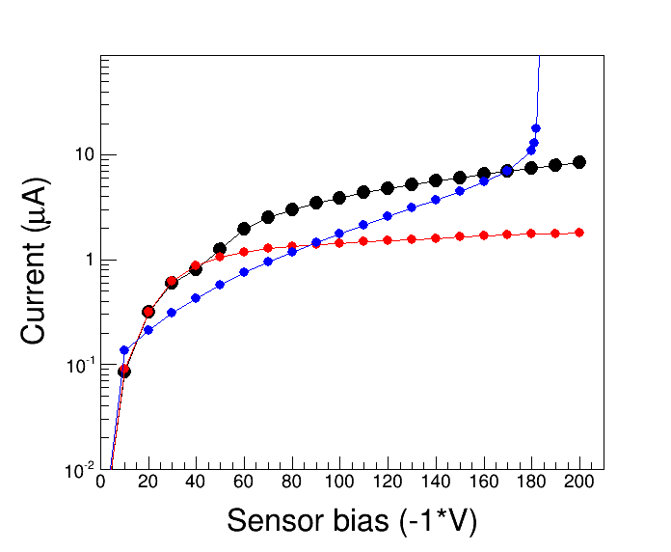
I-V curve measurement
CPIXPTEG2 (thinning)
CPIXPTEG2 (normal)
CPIXPTEG1 (normal)

Slide 14
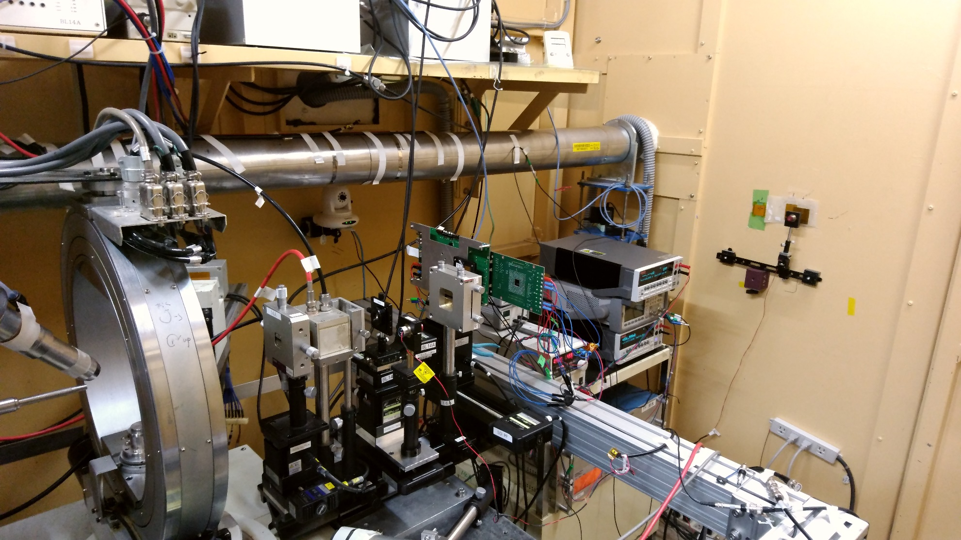
Experimental setup @KEK/PF BL-14A
Ionization chamber
Filter holder
Laser/pin-hole
exchange stage
CPIXPTEG2
(backside illumination)
X-ray
Slit

Slide 15
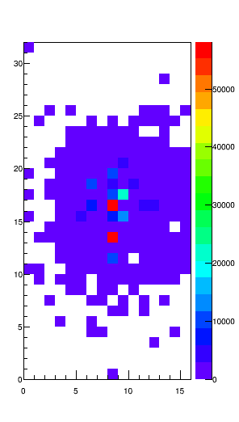
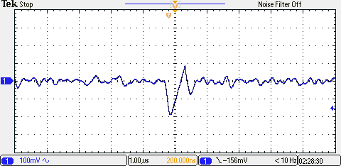
Measurement of X-ray profile
Exposing 6 keV X-rays with 0.8 mmφ in diameter with V_{det} = -10 V.
Obtained shaper output signal
15 pixel
-200 mV
Row
Counts
15 pixel
In measurement using X-ray micro
beam, we missed the position of
X-ray.
Column

Slide 16
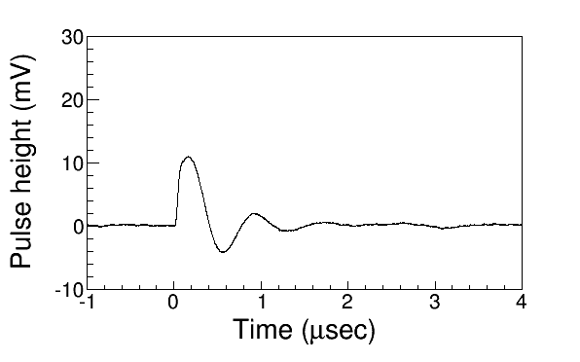
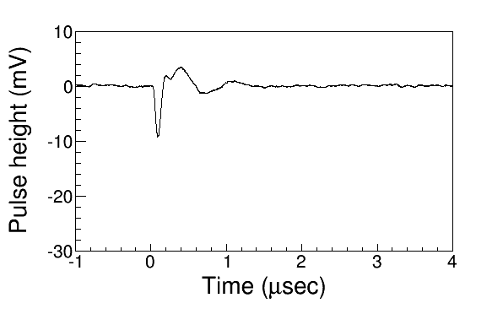
Study in test bench
Low gain problem
Preamplifier output signal
Test input capacity : 4.2 fF
Input signal : 62 mV
Output : 10 mV
→ Corresponding gain is 6 μV/e⁻
Shaper amplifier output signal
Gain was half of designed value.
Total gain is 5 times lower
than 33.5 6 μV/e⁻ of CPIXPTEG1.

Slide 17
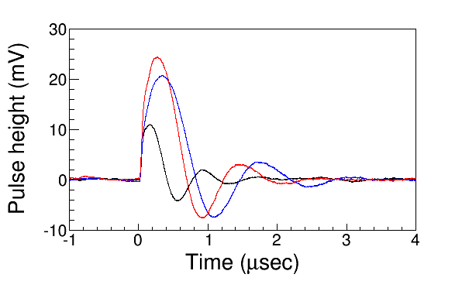
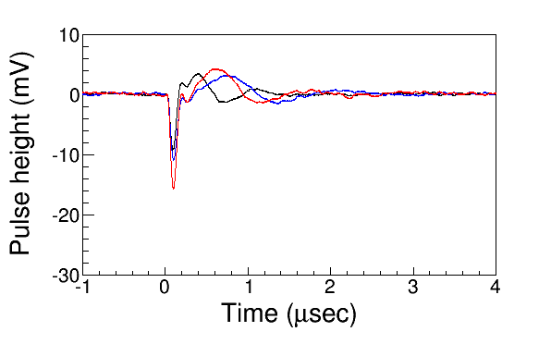
Study in test bench
Increasing the gain by adjusting bias current of Preamplifier.
Required setting of bias current for
core amp I_{core} and feedback amp I_{fb}.
I_{core} = 2 μA , I_{fb} = 2 μA
(I_{core}, I_{fb}) = (4, 0.5)
(2, 0.5)
(2, 2)
(2, 2)
(2, 0.5)
(4, 0.5)
Required I_{core} = 2μA
I_{fb} = 8 μA
*Shaper bias current was fixed.

Slide 18
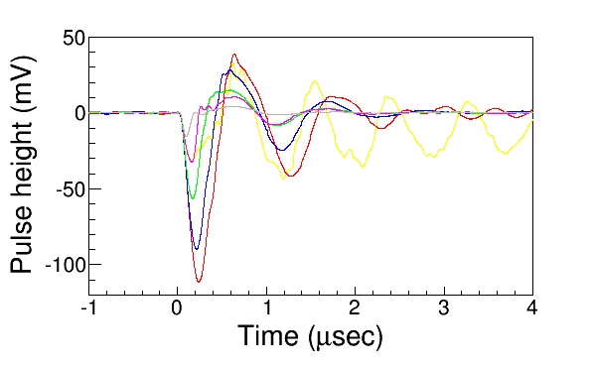
Study in test bench
Increasing the gain by adjusting bias current of a Shaper amplifier.
I_{core} and I_{fb} of preamplifier were 4 μA and 0.5 μA, respectively.
(I_{core}, I_{fb})
(2, 8) @required values
(2, 4)
(2, 2)
(4, 2)
(4, 1)
(4, 0.5)

Slide 19
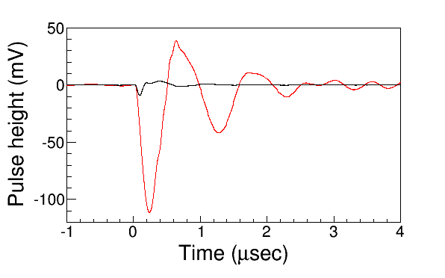
Study in test bench
Increasing the gain by adjusting bias current of amps.
Initial
Adjusted
Gain became almost 10 times
larger than initial setting.

Slide 20
Summary
We have started the study of counting type pixel for soft X-ray.
Back side process aiming the soft X-ray counting was performed.
The evaluation experiment by use of 6 keV X-ray was done but we
could not measure.
→ Shortage of the gain was found out so that we recovered that by
adjusting the bias current of amps.
After checking the discriminator and counter action and other tools
used for measurement, we try again the 6 keV X-ray experiment.
・ counting micro spot X-ray beam.
・ 1- and 2-dimentinal pixel scan, etc…
Future plan
For the soft X-ray counting
Using SOI-APD for the counting type pixel array.
Avalanche mechanism is helpful for soft X-ray measurements.

Slide 21
Thank you for your attention !

