Slide 1
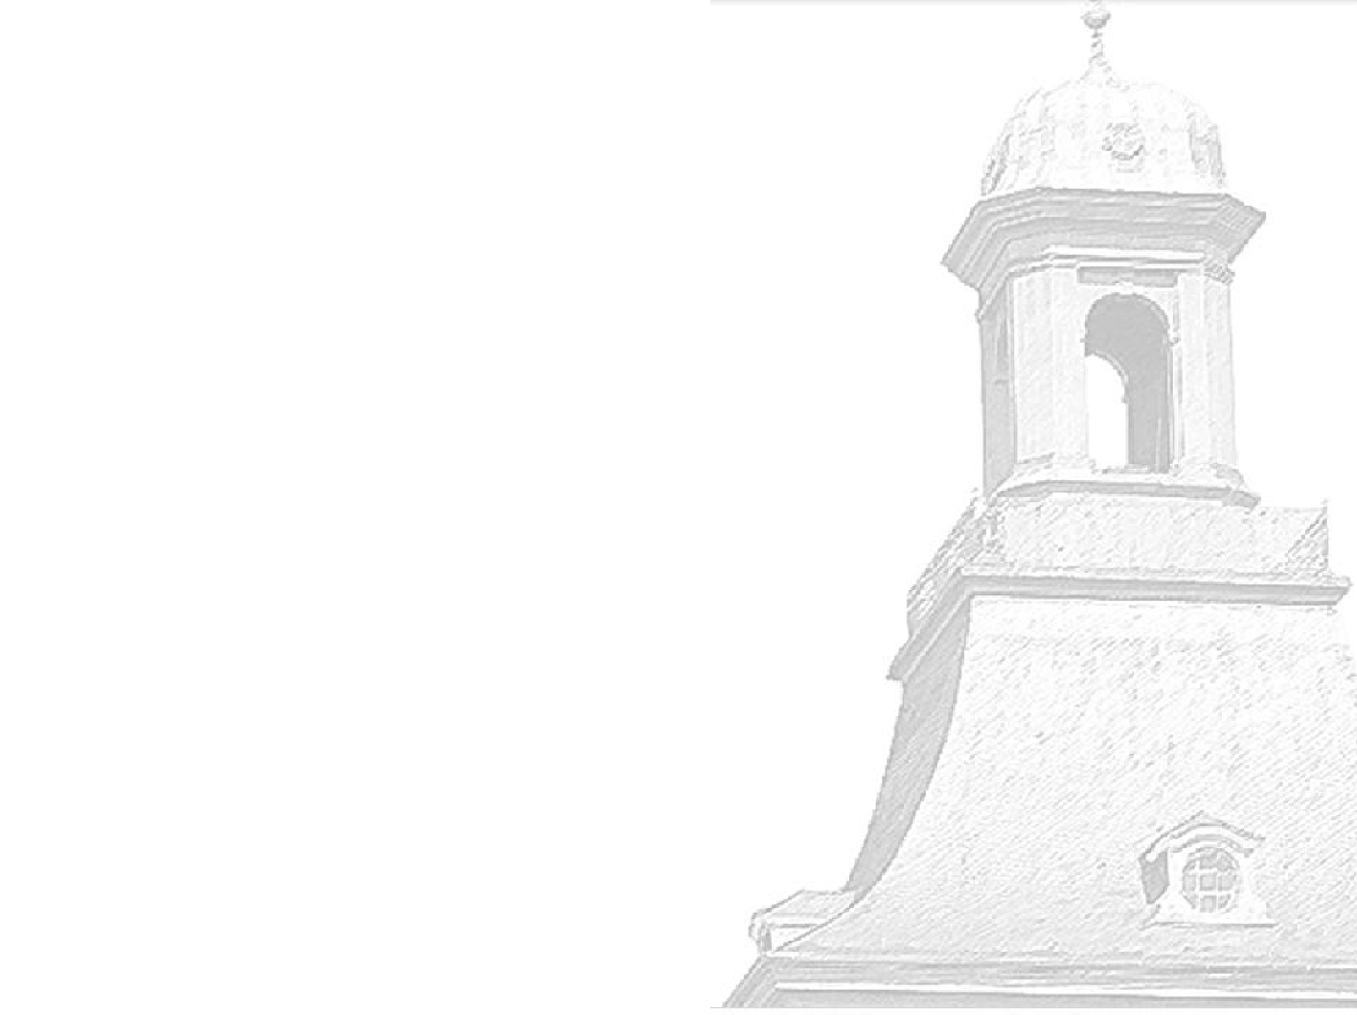


Hiroshima Conference HSTD 11
Okinawa, Dec 10 – 15, 2017
Pixel Detector Overview
Pixel Detectors ... where do we stand ?
in my very subjective opinion ... w/ apologies
Norbert Wermes
University of Bonn

Slide 2
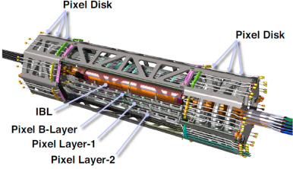
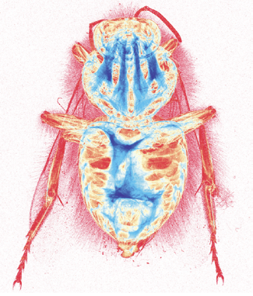
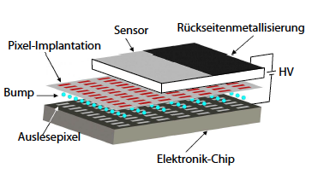
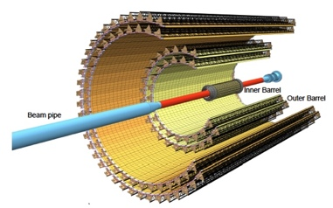
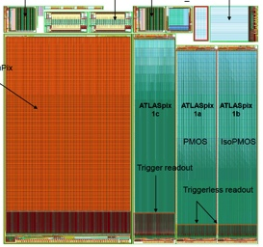
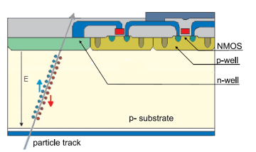
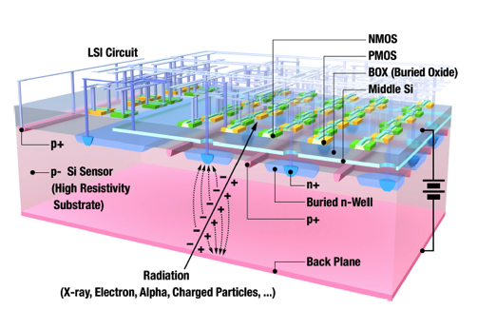
~1997
LHC
HI
ATLAS/CMS
HEP tracking
Imaging
Hybrid pixel detectors
biomedical
photon science
AGIPD
MEDIPIX
HI, B-FAC
ALICE ITS
ATLAS CMOS
Monolithic pixel detectors
HEP tracking
Imaging
LHC
2017
DSOI pixels
Notes:
DLTS = Deep level transient spectroscopy
TSC = Stimulated Current technique
n in p-type sensors provide cost efficient single sided processing

Slide 3
Some early prejudices
... e.g. about HL-LHC radiation levels
Tough for planar sensors ... !?
There is no alternative, though ... !?
Diamond will never become a pixel detector ... !?
You have to use p-type material ... !?
...

Slide 4
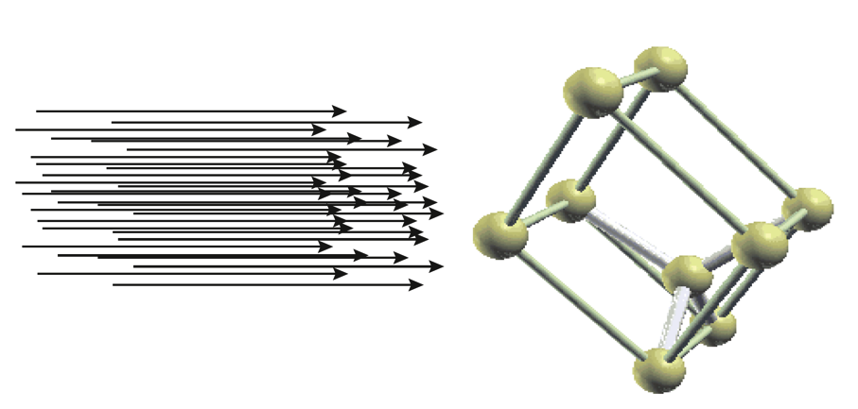
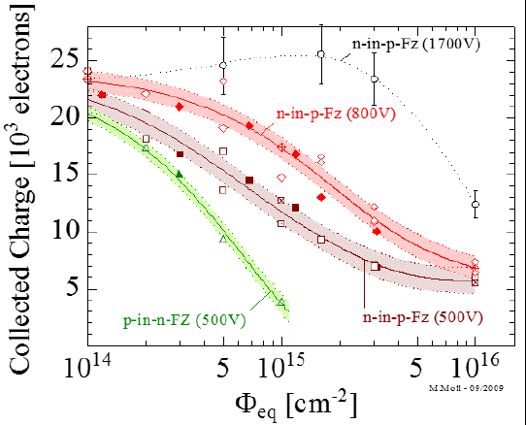
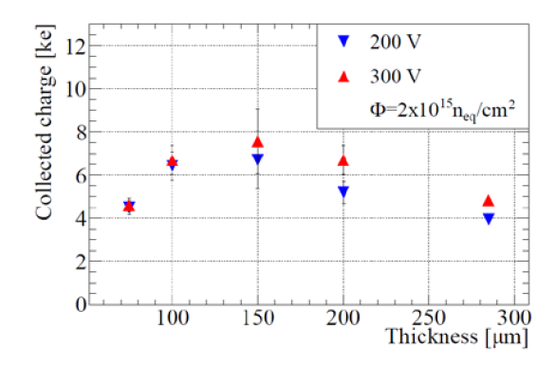
Radiation
talk by G. Kramberger
HL-LHC fluence =>every Si lattice cell sees about 50 mips
Readout at n⁺ electrodes (e⁻ collection)
Operate at high bias voltages
Carefully plan the annealing scenario
Provide proper electrode design and guard rings
Use p-substrates (rather than n-in-n) ... why?
Recipe
but more complex
for pixels
Q trapping
structured
weighting fields
E-field after
irradiation
evidence
Notes:
DLTS = Deep level transient spectroscopy
TSC = Stimulated Current technique
n in p-type sensors provide cost efficient single sided processing

Slide 5
What is actually different for p vs n bulk?
e- trap
positive space charge
higher conc. after proton
than neutron irradiation
depends on oxygen content
BD=bistable donor (e- trap)
positive space charge
strongly produced
in oxygen rich DOFZ material
triple vacancy, small cluster
negative space charge
-> high leakage current
E_{F}
V₂O complex (?)
negative space charge
causes leakage current,
strongly produced in oxygen lean STFZ
moves
with changes
to N_{eff}
extended acceptor defects
produced equally by n,p
negative space charge
-> reverse annealing
most defects show linear fluence dependence
cooling helps to keep I_{leak} and rev. annealing
smaller
N_{eff} changes
Radu et al., J. Appl. Phys. 117, 164503 (2015)
RD50, M. Moll et al., PoS (Vertex 2013) (2013) 026
Notes:
defecte become effective for N_eff when charged
this depends on Fermi-level which depends itself on the doping concentration and on N-eff

Slide 6
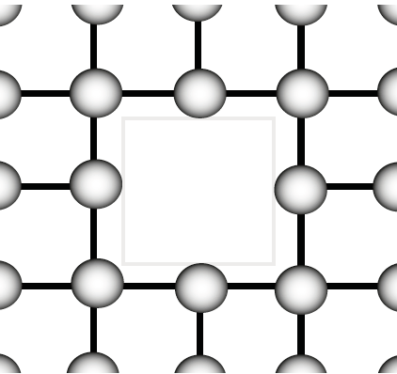
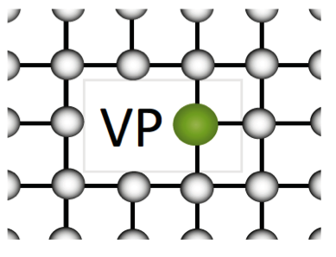

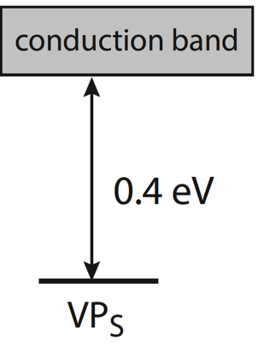
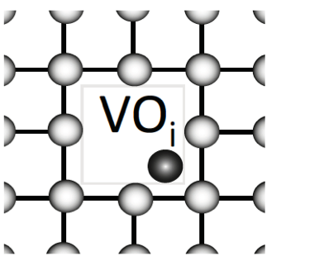

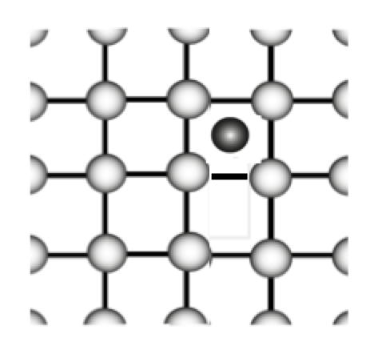
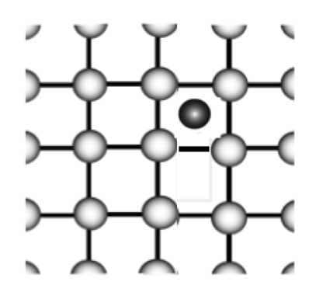
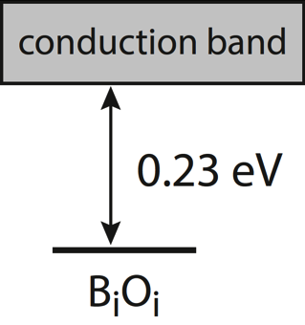
Donor removal/acceptor increase <-> acceptor removal
n – bulk
p - bulk
+
donor (P) removal
decreases pos. ρ
=>
P_{s}
radiation induced vacancy
(mobile even below RT)
harmless
VO_{i} defect
(E-center)
[O] ≫[P]
oxygen enriched silicon
+
acceptor (B) removal
decreases negative ρ
B_{i}
B_{i}O_{i}
Cure? C-enrichment?
(donor)
radiation induced oxygen interstitial
Junkes, E. Donegani, C. Neunbüser, IEEE TNS (2014)
10.1109/NSSMIC.2014.7431260
E. Donegani, Thesis U Hamburg (2017)
Notes:
mobile radiation induced vacancy defects can catch a Phosphorus atom (i.e. a donor) to form a VP complex and the donor is gone.
Wheras if we make it more likely that the vacancy hits an oxygen atom (e.g. by MCz grown ingots) ... a rather harmless VO complex is formed instead.
Furthermore, reverse annealing, i.e. activating lattice defects after some time, is hindered at low temperatures.

Slide 7
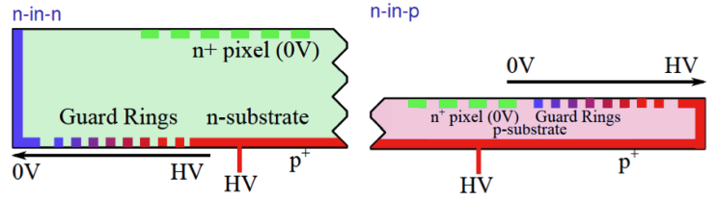

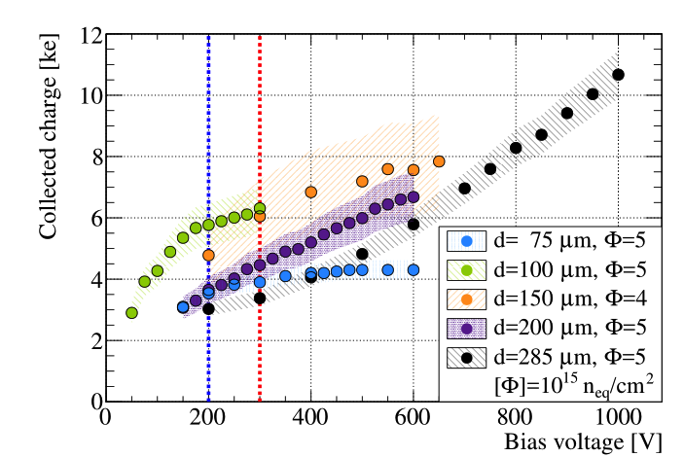
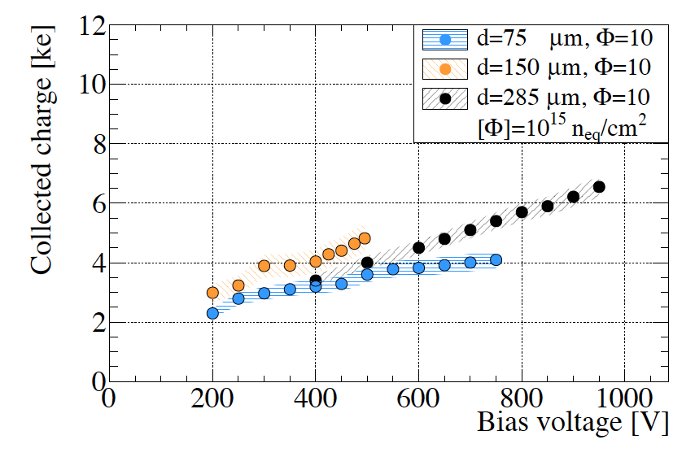
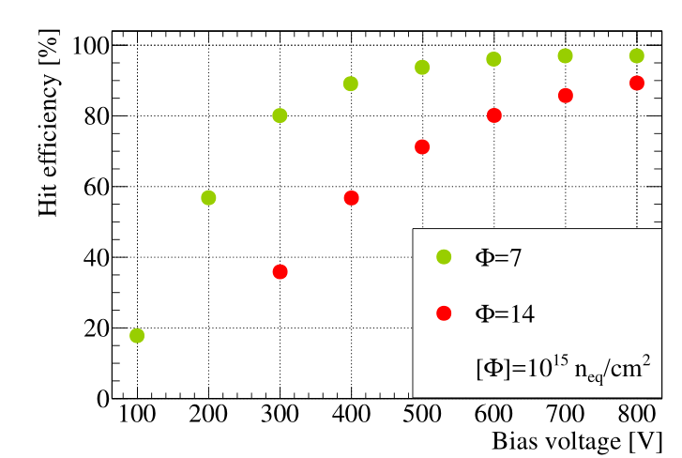
Radiation hard Si sensors -> (thin) planar pixel sensors
thin n⁺ in p sensors after high fluences (neutrons)
talk by K. Nakamura
best (100-150 µm)
4-5 x 10¹⁵ n^{eq}/cm²
10¹⁶ n^{eq}/cm²
6000 – 7000 e-
for 100 - 200 µm sensors @ 300 V – 600 V bias
hit efficiencies are still reasonable at Φ > 10¹⁶
7×10¹⁵
1.4×10¹⁶
Macchiolo, Nisius, Savic, Terzo, NIM A831:111–115, 2016.
Terzo, Andricek, Macchiolo, Nisius et al, JINST 9 (2014) C05023
K. Kimura et al., NIM A831 (2016) 140-146
Y. Unno et al.,NIM A699(2013)72–77.
Notes:
Wenn man die Guardring structure auf die Unterseite bringen will, benötigt man eine doppelseitige/teure Prozessierung.

Slide 8
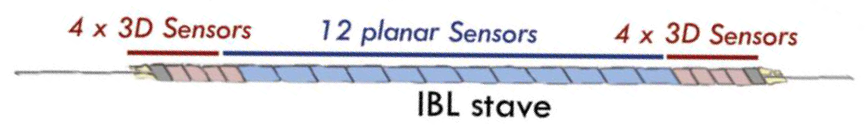
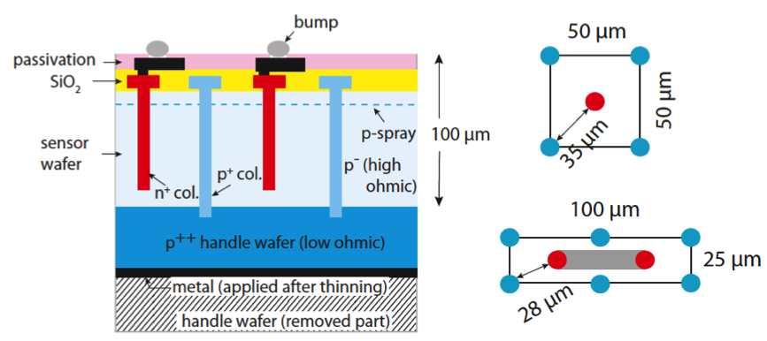
Radiation hard Si sensors -> 3D-Si sensors
ATLAS
3D sensors have been put to reality in ATLAS IBL detector since 2015 -> so far reliable and well performing
50 µm
talk by C.B. Martin
S. Parker, C. Kenney , J. Segal, ICFA Instr.Bull. 14 (1997) 30
C. Da Via, et al., NIM A49 (2005) 122-125,
NIM A 699 (2013) 18
FBK design
particle path (signal)
different from drift path
high field w/ low voltage
-> radiation tolerance
-> Q still 50% @ 10¹⁶ cm⁻²
slightly larger C_{in} (noise)
now also in diamond, CdTe
Development for
HL-LHC:
thin (100 µm)
6” wafers
electrodes thin (5µm) & narrowly spaced
slim or active edges
G.F. Dalla Betta et al., NSSMIC.2015, arXiv:1612.00608,
J. Lange et al., arXiv:1707.01045
talks by H. Oide, J. Lange
Notes:
A thin, highly resistive (p-type) sensor wafer is supported by a low ohmic (p++ ) handle wafer
that can be backside thinned after processing. While the p+ columns are deep
etched through to the handle wafer where they receive their electric potential,
the n+ columns stop about 15µm short from the handle wafer. Besides for
technical reasons (i.e.wafer-to-wafer bonding), studies have shown that also for
single-sided 3D-Si sensors the trade-off between signal efficiency and breakdown
performance favors non-passing-through n-columns

Slide 9
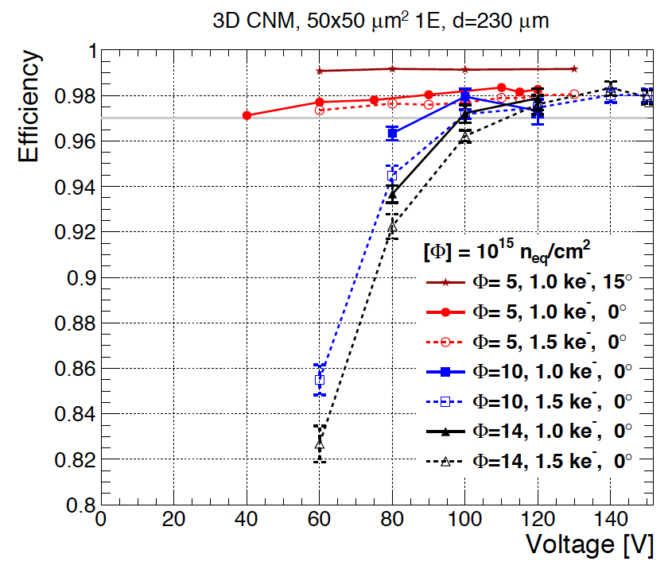
Radiation hard Si sensors -> 3D-Si sensors
ATLAS
3D sensors have been put to reality in ATLAS IBL detector since 2015 -> so far reliable and well performing
50 µm
talk by C.B. Martin
S. Parker, C. Kenney , J. Segal, ICFA Instr.Bull. 14 (1997) 30
C. Da Via, et al., NIM A49 (2005) 122-125,
NIM A 699 (2013) 18
FBK design
particle path (signal)
different from drift path
high field w/ low voltage
-> radiation tolerance
-> Q still 50% @ 10¹⁶ cm⁻²
slightly larger C_{in} (noise)
now also in diamond, CdTe
98%
after 10¹⁶
CNM
d = 230 µm
Development for
HL-LHC:
thin (100 µm)
6” wafers
electrodes thin (5µm) & narrowly spaced
slim or active edges
G.F. Dalla Betta et al., NSSMIC.2015, arXiv:1612.00608,
J. Lange et al., arXiv:1707.01045
talks by H. Oide, J. Lange
Notes:
A thin, highly resistive (p-type) sensor wafer is supported by a low ohmic (p++ ) handle wafer
that can be backside thinned after processing. While the p+ columns are deep
etched through to the handle wafer where they receive their electric potential,
the n+ columns stop about 15µm short from the handle wafer. Besides for
technical reasons (i.e.wafer-to-wafer bonding), studies have shown that also for
single-sided 3D-Si sensors the trade-off between signal efficiency and breakdown
performance favors non-passing-through n-columns

Slide 10
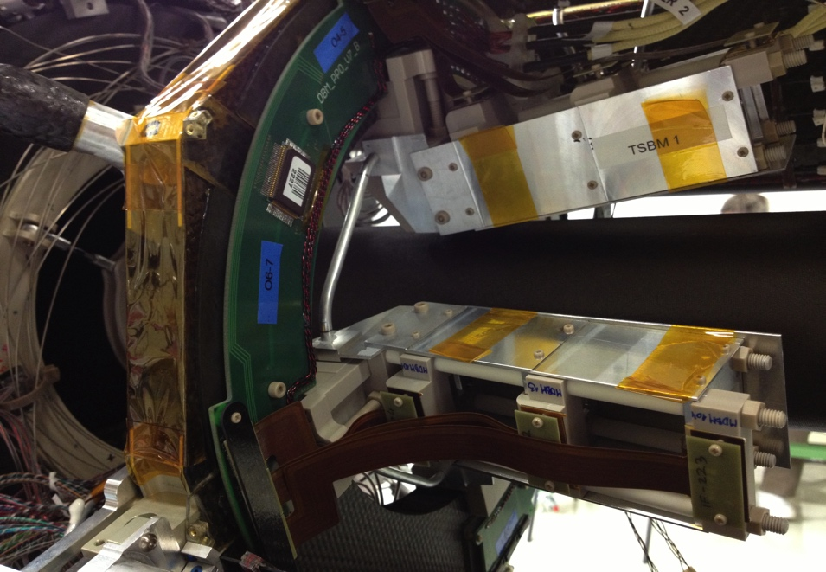
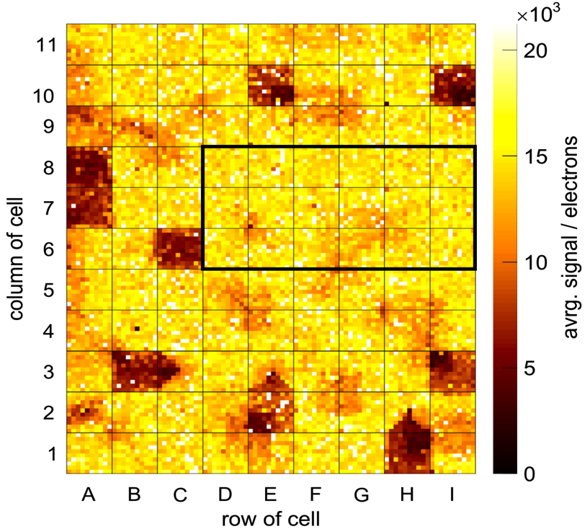

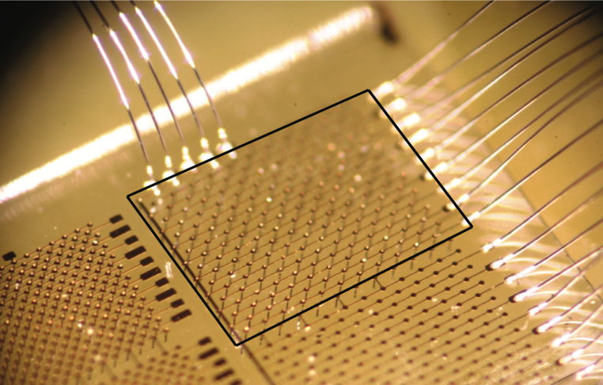
Diamond ...
... has been made into a radhard “quasi” tracker
ATLAS
DBM
beam monitor
(3 layer telescopes)
mean efficiency 87.6%
talks by
H. Kagan
N. Venturi
Kononenko et al., Diamond and Relat. Mater 18 (2009) 196
mpv ~13600 e⁻
3D Diamond
3D Diamond
F. Bachmair, RD42-Coll., doi.org/10.1016/j.nima.2016.03.039

Slide 11
You cannot use CMOS (technologies for) sensors.
They do not have the same properties as
“good” silicon sensors ... !?

Slide 12
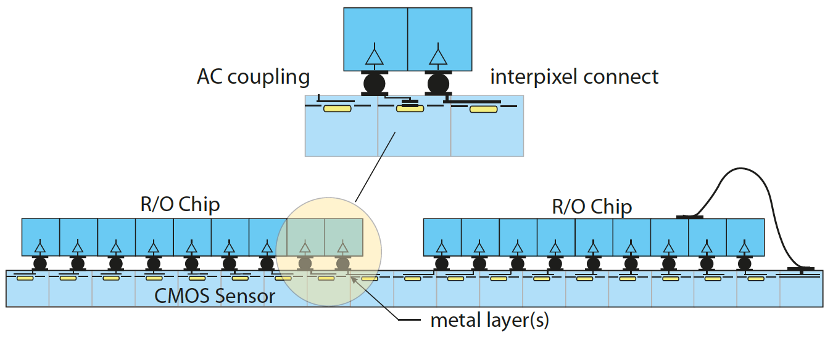
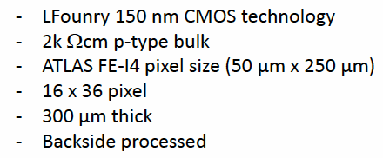
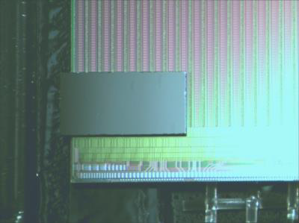
... passive CMOS sensors
can have in-pixel AC coupling
fancy RDL possibilities by metal layers
cheap large feature size technology possible
no extra bumping step, because bumps (C4)
come with CMOS fabrication
do flip-chipping in-house (large pitch)
large sensors possible (→ reticule stitching)
may be even wafer based flip-chipping (8“)
D.-L. Pohl et al., JINST 12 (2017) no.06, P06020

Slide 13
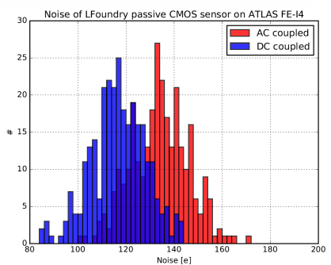
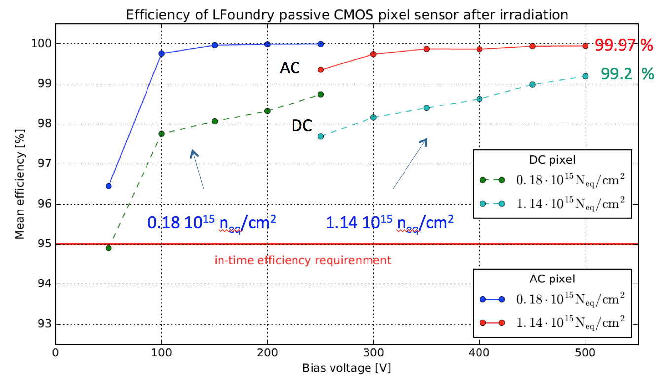
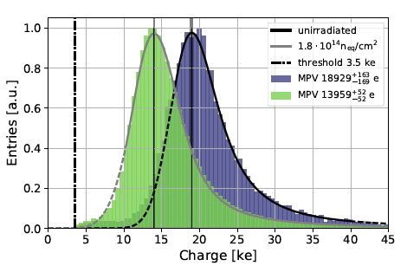
Performance of passive CMOS sensors
IV curves of all samples ok (bias 120 V -> 500 V)
about 220 µm depletion depth
leakage current 20 µA / cm³ (IBL: 15 µA/cm³)
noise as in standard sensors
- planar sensors (C_{D} = 117 fF): ENC = 120 e-
- 3D-Si sensors (C_{D} = 180 fF): ENC = 140 e-
high efficiency after irradiation (1 x 10¹⁵ n_{eq}/cm²)
116 e-
131 e-
noise
AC
DC
before
irradiation
after
irrad
3.2 GeV e-
3.2 GeV e-
D.-L. Pohl et al., JINST 12 (2017) no.06, P06020

Slide 14
FE chip
A complex chip (o(10⁹) transistors) in general can only be done by industry and needs many years of development ... !? ... and is too expensive ... !?
250 nm technology was radhard => 65 nm technology is even better ... !?

Slide 15
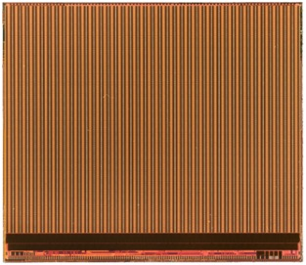
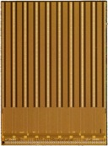
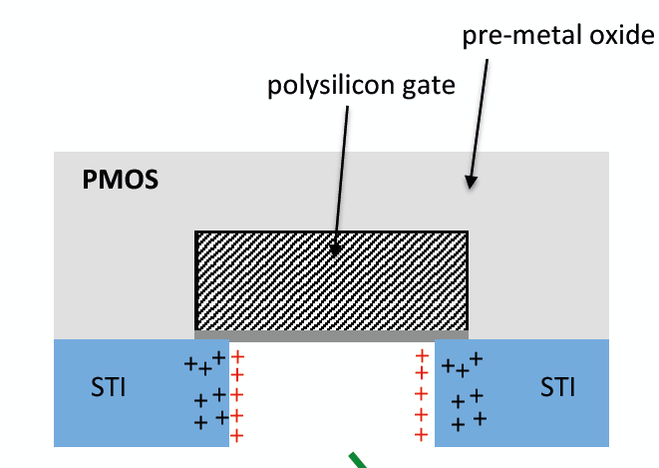
Pixel R/O-Chip for HL-LHC rates (and radiation)
Effort and costs so large that joint approach (cross experiments) is needed -> RD53 (20 Institutes)
High hit rate (not smaller pixel size) requires high logic density -> 65nm TSMC
FE-I4
FE-65
FE-I3
hit rate < 400 MHz/cm²
1.8 mW/mm²
rad hard: 5x10¹⁵/cm²
200 Mrad
hit rate 2-3 GHz/cm²
< 1 MHz trigger @12µs
3.5 mW/mm²
rad hard: 2x10¹⁶/cm²
1 Grad
< 100 MHz/cm²
< 100 Mrad
250 nm technology
pixel size 400 × 50 µm²
3.5 M. transistors
130 nm technology
pixel size 250 × 50 µm²
70 M transistors
65 nm technology
pixel size 50 × 50 µm²
~ 1000 M transistors
FE-65 prototypes (2016) -> RD53A (full size chip) -> back from foundry
Deep submicron (250 nm & 130 nm) saved LHC pixel R/O chips
65 nm has its own – geometry induced – radiation effects to deal with
Requires long and tedious study program ...
RINCE = Radiation Induced Narrow Channel Effects
RISCE = Radiation Induced Short Channel Effects
talk by F. Faccio ... “radiation strikes back”

Slide 16
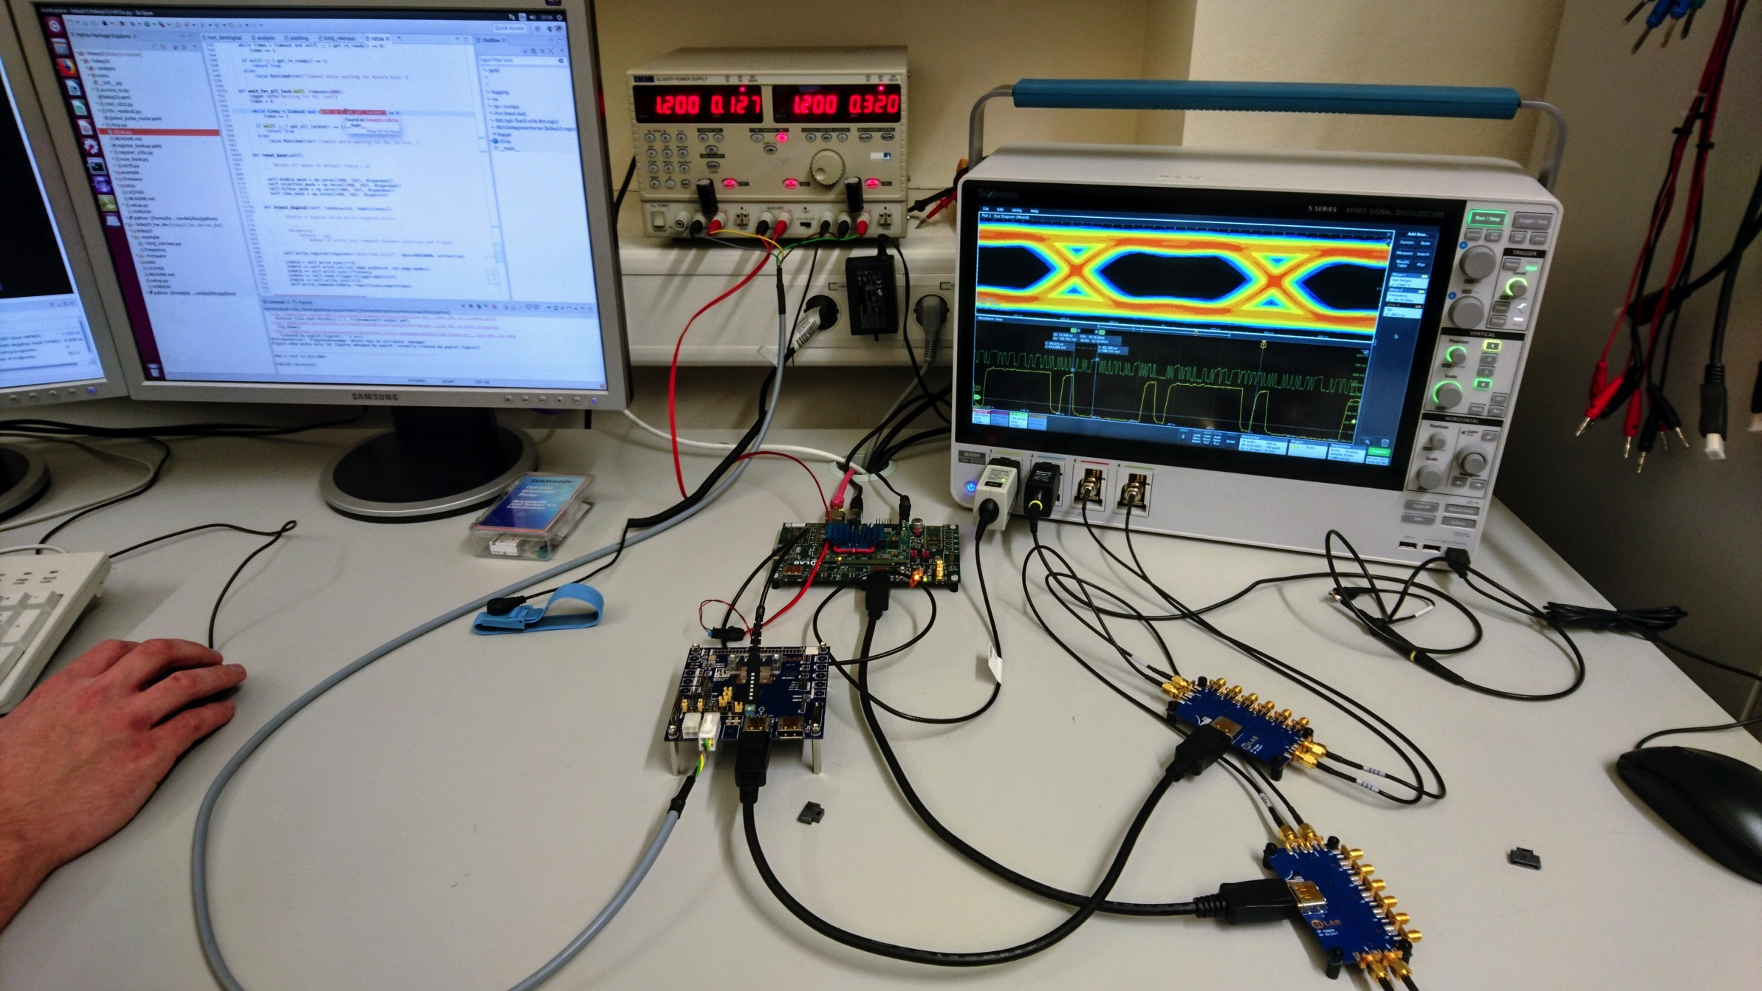
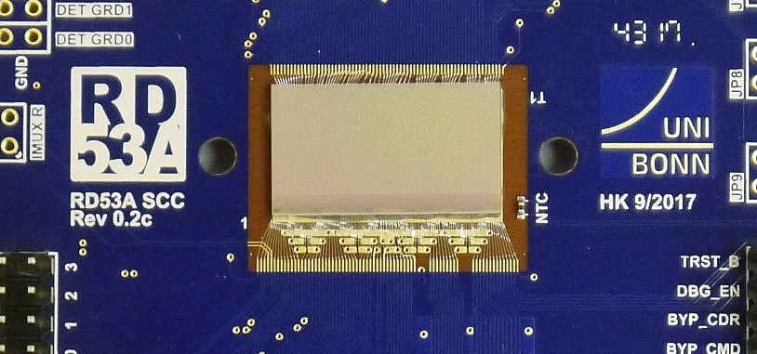
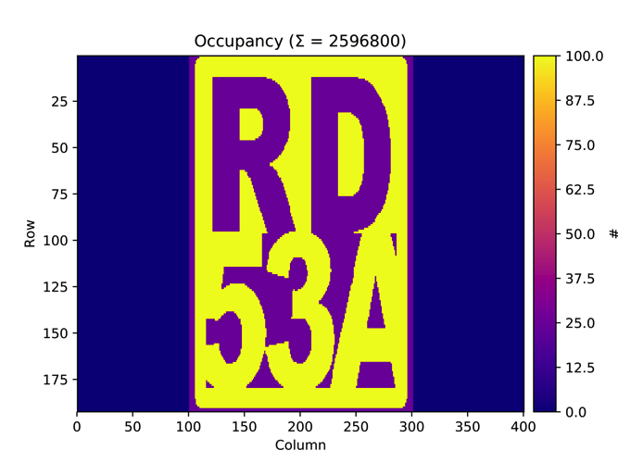
RD53A alive ... (received last Wednesday)
image produced by selective injections

Slide 17
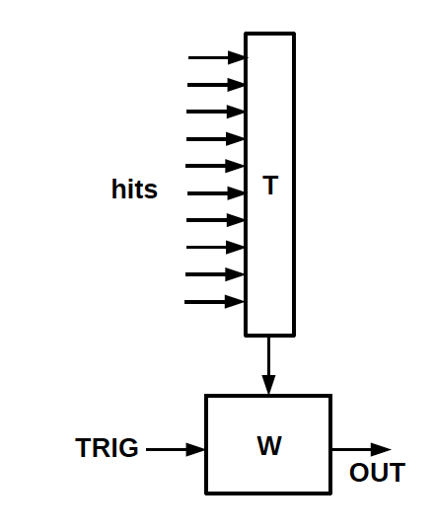
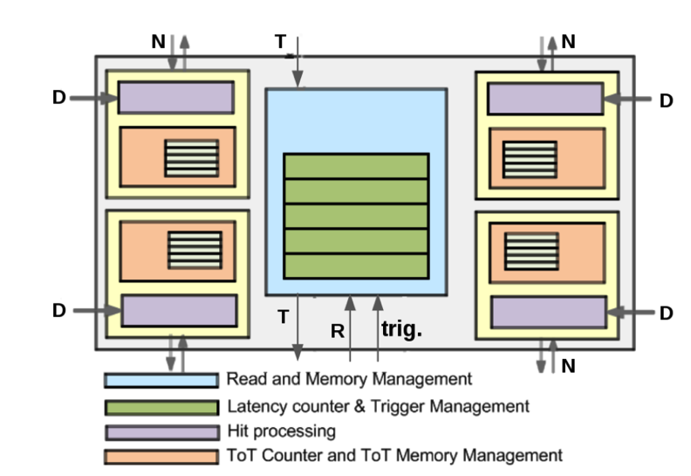
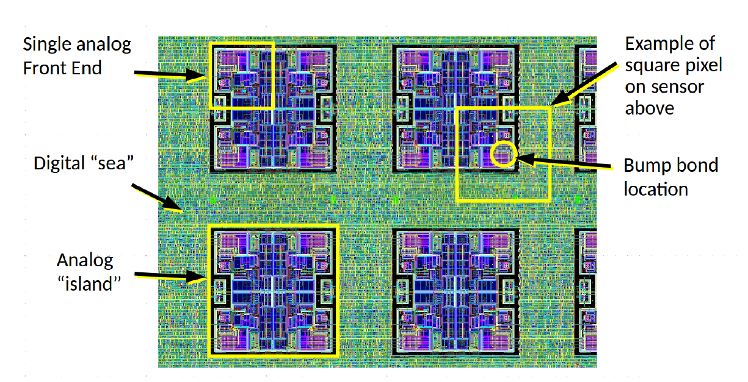
Pixel R/O philosophy changes -> better architectures
2nd generation
1st generation
4-pixel region
logic
efficient for clusters
FE-I4 like
column drain R/O
FE-I3 like
talk by M. Garcia-Sciveres
3rd generation
region architectures
with grouped logic
-> regional hit draining
surrounded by synthesized logic (“digital sea”)
RD53A like
“analog islands in digital sea”
... complex designs can be made much faster now than in the early LHC days.
Notes:
In the classic column drain architecture of 1st generation chips (fig. 29 (a) ), all pixels in a column share a data bus that only one pixel at a time can use.

Slide 18
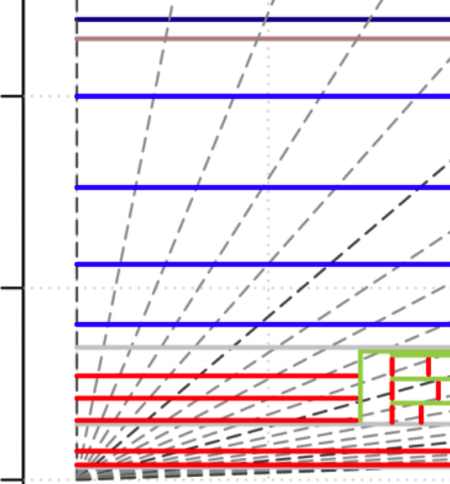
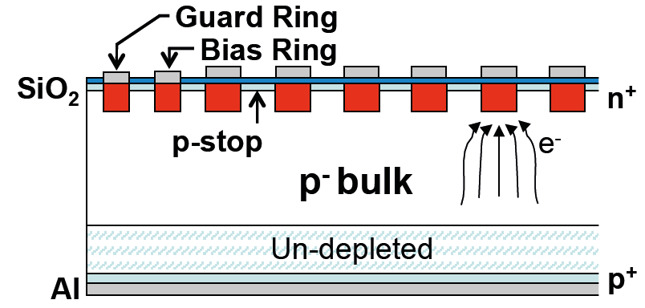
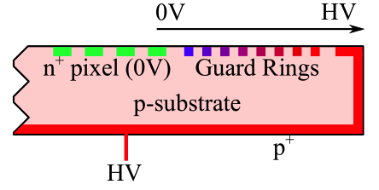
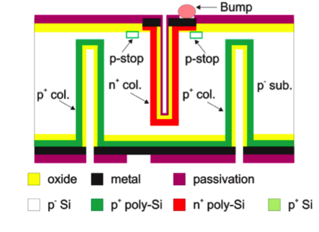
Current favorite large system layouts ...
n in p
strip modules
1.0
0.5
0.0
strips
depl. CMOS pixels
R (m)
outer
pixel
large modules
planar n in p pixels / CMOS?
inner
pixel
cost driven
3D silicon
dedicated
rad.-hard
detectors
talks by
L. Rossi
J. Schwandt
B. Agkun
radiation
driven
innermost
pixel

Slide 19
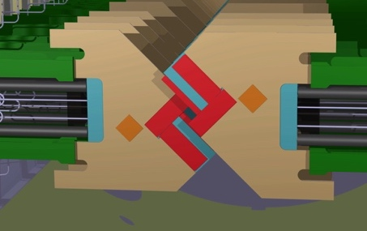
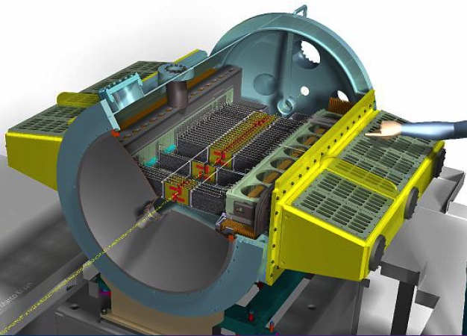
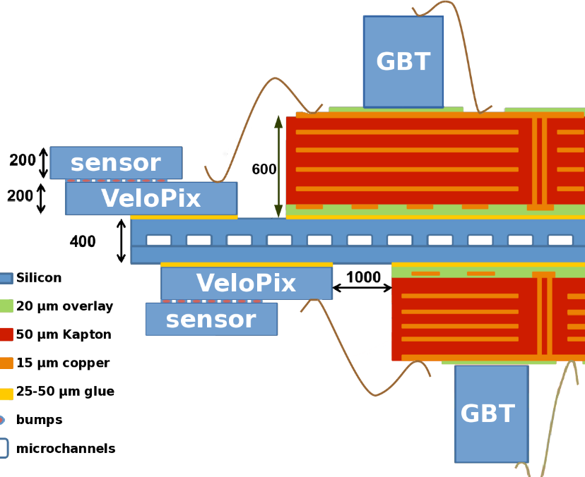
LHCb - Vertex Locator Upgrade (2019-2020)
bla
talk by
K. Cavalho Akiba
Vertex detector surrounding collision region
  In vacuum
  5.1 mm from beam
change from strips to pixels + VeloPix chip
~41 Mpix, 55 x 55 µm² pixels
triggerless R/O (~2.9 Tbits/s)
microchannel cooling (a first !)

Slide 20
Monolithic pixel modules
Monolithic pixels will never stand the LHC
rates and radiation environment ... !?
SOI pixel technology is fine, but it is difficult to get around the many challenges ... !?

Slide 21




Hybrid Pixel Detectors
  PROs (split functionality)
    complex signal processing in readout chip
    zero suppression and hit storage during L1 latency
    radiation hard chips and sensors to >10¹⁵ n_{eq}/cm²
    high rate capability (~MHz/mm²)
    spatial resolution ≈10 – 15 µm
    NEXT: 3D integration (TSVs) ... from C2W to W2W assemblies
  CONs
    relatively large material budget: >1.5% X₀ per layer
    sensor + chip + flex kapton + passive components
    support, cooling (-10ºC operation), services
    resolution could be better
    complex and laborious module production
    bump-bonding / flip-chip
    many production steps
    expensive
  hence: Monolithic pixels relying on commercial CMOS processes
  have come in focus (first outside LHC-pp -> also for HL-LHC)
STAR
MAPS
2014
0.16 m²
Belle II
DEPFET
2018
0.014 m²
ALICE upgrade
MAPS
2021
10 m²
talks by W. Snoeys. H. Pernegger, I. Peric,
T. Hirono, B. Hiti, D. Dannheim
ILC
DEPFET
MAPS
SOIPIX
20??

Slide 22


What is needed to realize (radhard) depleted CMOS pixels?
“High” Voltage add-ons
to apply 50 – 200 V bias
1
I. Peric, NIM A582 (2007) 876-885
“High” Resistivity Substrate
Wafers (100 Ωcm – kΩ cm)
2
3
~10 Ωcm
Multiple (3-4)
nested wells
(for shielding and full CMOS)
~100 Ωcm
from: www.xfab.com
kΩcm
4
Backside Processing
(for thinning and back bias contact)
I. Mandic et al., JINST 12 (2017) no.02, P02021

Slide 23

The question of the fill-factor / electrode geometry
Electronics inside charge collection well
Collection node with large electrode
→ no low field regions
→ on average short(er) drift distances
→ more radhard
Full CMOS with isolation between NW&DNW
Large (> 100 fF) sensor capacitance
(due to DNW/PW junction!)
→ noise & speed or power penalties
→ x-talk possible (from digital to sensor)
needs dedicated IC design
Electronics outside charge collection well
Very small sensor capacitance (~5 fF)
→ noise low, speed high, power low
on average longer drift distances and
low field regions
→ radhard?
also full CMOS with addn’l deep-p implant

Slide 24

TJ Process modification of small electrode design
TowerJazz 180 nm CMOS CIS
deep PW full CMOS in pixel
epi thickness: 18 – 40 µm
Design derived from ALICE development
Modified process to improve depletion & lateral E
Pixel dimensions:
36 x 42 µm² pixel size
3 µm diameter electrodes
Measured capacitance <5fF
W. Snoeys et al., NIM A871 (2017) 90 – 96.
3 µm
36 µm

Slide 25




Large (~1 cm²) full CMOS chips (=modules) w/ readout
ATLASPix
MuPix
TJ
Monopix
MALTA
LF-MONOPIX
LFoundry 150 nm
substrate ρ > 2 kΩcm
ams 180 nm
substrate ρ ~ 0.08 - 1 kΩcm
TowerJazz 180 nm epitaxial (25 µm)
substrate ρ > kΩ cm
talks by W. Snoeys. H. Pernegger, T. Hirono, I. Peric, D. Dannheim

Slide 26


Large (~1 cm²) full CMOS chips (=modules) w/ readout
ATLASPix
LF Monopix
MuPix
ATLASpix
TJ
Monopix
MALTA
LF-MONOPIX
LFoundry 150 nm
substrate ρ > 2 kΩcm
ams 180 nm
substrate ρ ~ 0.08 - 1 kΩcm
TowerJazz 180 nm epitaxial (25 µm)
substrate ρ > kΩ cm
talks by W. Snoeys. H. Pernegger, T. Hirono, I. Peric, D. Dannheim

Slide 27




Results extremely encouraging
radiation hardness
full depl.
efficiency
LFoundry
before irrad
after 10¹⁵ n_{eq} cm⁻²
99.7%
ATLASpix
98.9%
LF-Monopix
  1.5e15n_{eq}/cm²
100 µm
after 2x10¹⁵
I. Mandić et al., JINST 12 (2017) no.02, P02021
talks by H. Pernegger, T. Hirono, I. Peric
TID 1 MGy
timing
LFoundry
ams180 after 1 x 10¹⁵ n_{eq}/cm²
gain
with jitter reduction
w/o jitter reduction
noise
Timing [25ns bins]

Slide 28
SOI pixels
Note again dedicated workshop
included in this conference

Slide 29

SOI monolithic pixels
FD CMOS on SOI
fully depleted SOI (thin film)
@ Lapis / KEK
issues
  back gate effect
  coupling of sensor to circuit
  radiation (TID) issues due to BOX
cures developed in recent years
  buried p-well, nested wells
  “double SOI” structures
  => TID hard to 10 Mrad
talks Y. Arai, K. Fukuda, S. Kawahito + SOI workshop
FPIX, SOFIST | particle tracking
INTPIX | X-ray
XRPIX, SOIPIX-PDD | X-ray astro
SOPHIAS | synchrotron rad.
cryogenic | far infrared
CNTPIX | counting -> biomed
MALPIX | ion spectroscopy
SOIPIX-PDD
H. Kamehama et al., Sensors 2017
Notes:
There are a large number of applications spun off from this development whcih I have listed here.
I would like to emphasize here a new development to reduce the input capacitance.
SOIPIX-with pinned depleted diode structure .
-HV at backside -> depleted substrate.
BPW on backside of BOX for pinning the back-gate voltage of the SOI transistors and acting as shielding layer between the charge sensing node and the SOI circuits: against noise, coupling and dark current generation.
A BNW formed under the BPW is depleted and this layer acts as a buried channel to gather carriers generated in the pixel into the sensing node (n+) and to improve charge correction efficiency, because lateral electric field is created in this channel.
Like Tower Jazz moduified process.

Slide 30

SOI monolithic pixels
FD CMOS on SOI
fully depleted SOI (thin film)
@ Lapis/KEK
issues
  back gate effect
  coupling of sensor to circuit
  radiation (TID) issues due to BOX
cures developed in recent years
  buried p-well, nested wells
  “double SOI” structures
  => TID hard to 10 Mrad
FPIX
SOIPIX-PDD
0.65 µm
H. Kamehama et al., Sensors 2017
Notes:
There are a large number of applications spun off from this development whcih I have listed here.
I would like to emphasize here a new development to reduce the input capacitance.
SOIPIX-with pinned depleted diode structure .
-HV at backside -> depleted substrate.
BPW on backside of BOX for pinning the back-gate voltage of the SOI transistors and acting as shielding layer between the charge sensing node and the SOI circuits: against noise, coupling and dark current generation.
A BNW formed under the BPW is depleted and this layer acts as a buried channel to gather carriers generated in the pixel into the sensing node (n+) and to improve charge correction efficiency, because lateral electric field is created in this channel.
Like Tower Jazz moduified process.

Slide 31
SOI monolithic pixels
FD CMOS on SOI
fully depleted SOI (thin film)
@ Lapis/KEK
issues
  back gate effect
  coupling of sensor to circuit
  radiation (TID) issues due to BOX
cures developed in recent years
  buried p-well, nested wells
  “double SOI” structures
HV-SOI (thick film)
a promising alternative
doped, non-depleted P- and N-wells
prevent back gate effect and
increase the radiation tolerance
Hemperek, Kishishita, Krüger, Wermes, NIM A796 (2015) 8-12
Notes:
There are a large number of applications spun off from this development whcih I have listed here.
I would like to emphasize here a new development to reduce the input capacitance.
SOIPIX-with pinned depleted diode structure .
-HV at backside -> depleted substrate.
BPW on backside of BOX for pinning the back-gate voltage of the SOI transistors and acting as shielding layer between the charge sensing node and the SOI circuits: against noise, coupling and dark current generation.
A BNW formed under the BPW is depleted and this layer acts as a buried channel to gather carriers generated in the pixel into the sensing node (n+) and to improve charge correction efficiency, because lateral electric field is created in this channel.
Like Tower Jazz moduified process.

Slide 32
Time measurement with Si detectors
  Sub-ns timing with Si detectors is not possible ...!?
  Not with pixel detectors ...!?
4D tracking ... Δt = 30 ps <-> Δx = 1cm

Slide 33


Exploit charge amplification
  in “Geiger Mode” fashion (like in gas RPCs or in SiPMs)
  => σ_{t} governed by avalanche fluctuations
  OR .... in “linear mode” fashion -> Low Gain Avalanche Detectors (LGADs)
talks by N. Cartiglia, H. Sadrozinski, G. Pellegrini
H. Sadrozinski et al., NIM A730 (2013) 226-231, NIM A831 (2016) 18-23
N. Cartiglia et al., NIM A796:141–148, 2015; NIM A845 (2017) 47-51
H. Sadrozinski, A. Seiden, N. Cartiglia, arXiv:1704.08666
Separate the “collection” of charge from the signal gain
Figure of merit for σ_{t} is the “slew rate” dV/dt ≈ Signal/τ_{rise}
Need: fast drift + large S/N
  thin (!!)
  HV
  intr. amplification
  (small electrodes)
  broad-band amplifier
arrival
fluct.
distortion
low w-field
Notes:
How would one go about getting in to the 10 ps range with (structured) Si detectors?
typ. charge collection ~5 ns range and CSA rise time of several 10 ns?
ok, the induced current is immediately there, even though small pixel effect (weighting field) prevents from seeing much of it before the charge arrives at the pixel
use in-Si amplification (like APDs or in SiPMs) ?
Die 1.4 kommen von dem Sigma der landauartigen Zeitverteiilung (siehe Riegler)

Slide 34


LGAD – successes so far ... and current challenges
Ultimate Goal: simultaneous space (~10µm) AND time resolution (< 50 ps) ... no pixels yet !
Concrete application: ATLAS (HighGranularityTimingDetector; Forward) -> pile-up killer
CMS-TOTEM (in Roman Pots)
LGAD
pad (~1 mm²)
detectors
CNM LGADs
G. Pellegrini et. al, NIM A 765 (2014) 12–16.
G. Pellegrini et al., HSTD 2015, arXiv:1511.07175
H. Sadrozinski et al., NIM A730 (2013) 226-231, NIM A831 (2016) 18-23
N. Cartiglia et al., NIM A796:141–148, 2015;
NIM A845 (2017) 47-51
main problem: gain variation with fluence (due to high doping of amplification region)
(especially annoying in varying radiation fields)
also: amplification no longer in metallurgical p-n junction only (so what!)
current directions:
    (1) substitute B with Ga as acceptor dopant -> ?
    (2) Carbon-enriched p-silicon wafers ... ?

Slide 35
Pixel Imaging SYSTEMS (!!)

Slide 36

Hybrid Pixels for SLS @ PSI
dynamic gain switching (1-10⁴)
for swissFEL (exp. just started)
PILATUS successor
high frame rates
23 kHZ
smallest pixels
low noise => low eneries
talk by G. Carini

Slide 37


Hybrid Pixels for SLS @ PSI
mask made from photo
100 µm
interpolated image with Mönch
(~1 μm resolution after interpolation)
EIGER 500k
75 µm pixels
Photon Counting
MÖNCH 0.3
25 µm pixels
Charge Integrating
JUNGFRAU 1M
75 µm pixels
Charge Integrating
25 x 25 μm² bumped (!) pixels
320 eV energy resolution FWHM -> interpolation possible -> 1 µm res.
Large dynamic range

Slide 38



AGIPD (adaptive gain) ... EU XFEL Pixel Detector
First XFEL Light
addressing >10⁴ dynamic range @ EU XFEL
by “adaptive gain stages” (as JUNGFRAU)
first XFEL Light has been seen ...

Slide 39

X-ray imaging with Monolithic SOI Pixels
Double SOI pixel detector
with > 10 Mrad TID tolerance
Image taken with single SOI pixel detector
17 x 17 µm² pixels, 500 µm bulk thickness
Notes:
DSOI = repeating the layer transfer step twice during wafer production

Slide 40
Conclusions
Silicon detectors remain the working horse for tracking and
imaging detectors, especially in high rate and/or high radiation environments.
This HSTD11 (2017) Conference is an excellent forum presenting the current state of the art.

Slide 41
BACKUP

Slide 42






Radiation effects in 65 nm CMOS small channel devices
W = moderate size
W = minimum size
L = moderate size
L = minimum size
heating
trap release
cartoons: F. Faccio, TWEPP2015

Slide 43

Performance of sensor fabricated in CMOS
IV curves of all samples ok (bias 120 V -> 500 V)
about 220 µm depletion depth
leakage current 20 µA / cm³ (IBL: 15 µA/cm³)
noise as in standard sensors
- planar sensors (C_{D} = 117 fF): ENC = 120 e-
- 3D-Si sensors (C_{D} = 180 fF): ENC = 140 e-
high efficiency after irradiation (1 x 10¹⁵ n_{eq}/cm²)
before
irradiation
110 V
116 e-
131 e-
noise
AC
before
irradiation
DC
after
irrad
3.2 GeV e-
compare IBL
- planar sensors (C_{D} = 117 fF): ENC = 120 e-
- 3D-Si sensors (C_{D} = 180 fF): ENC = 140 e-
D.-L. Pohl et al., JINST 12 (2017) no.06, P06020

