Slide 1

HSDT11 & SOIPIX2 closing remarks
G. Hall

Slide 2
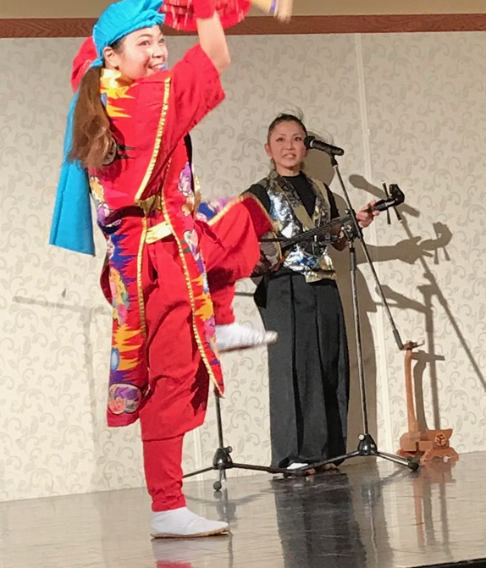
First, a few important things…
Thank you for…
Immaculate organisation
  thanks!!! to Nobu and his small team for an outstanding job done
  which he plans to repeat in 2019…
  I will return to this point at the end
Wonderful location and facilities
  the OIST campus is a beautiful and remarkable place
  and we have been aided by a lot of local support
Fitness lessons from Okinawa
and of course to participants for their contributions

Slide 3
... not the end of your work
All contributions, orals and posters, are eligible for inclusion in the special issue (Proceedings) of Nuclear Instruments and Methods, Section A.
The manuscripts should be submitted between
  1st Jan. and 5th Feb., 2018
  then, peer-reviewed by referees including the participants (staff) to this conference, i.e. we need your help
The quality of papers should be to the same standard as required for normal publication and conform to the rules of Elsevier:
  http://authors.elsevier.com/journal/nima
  And, if you have already published the content, your work is done.
  No need to submit, i.e., avoid duplicated publication.

Slide 4
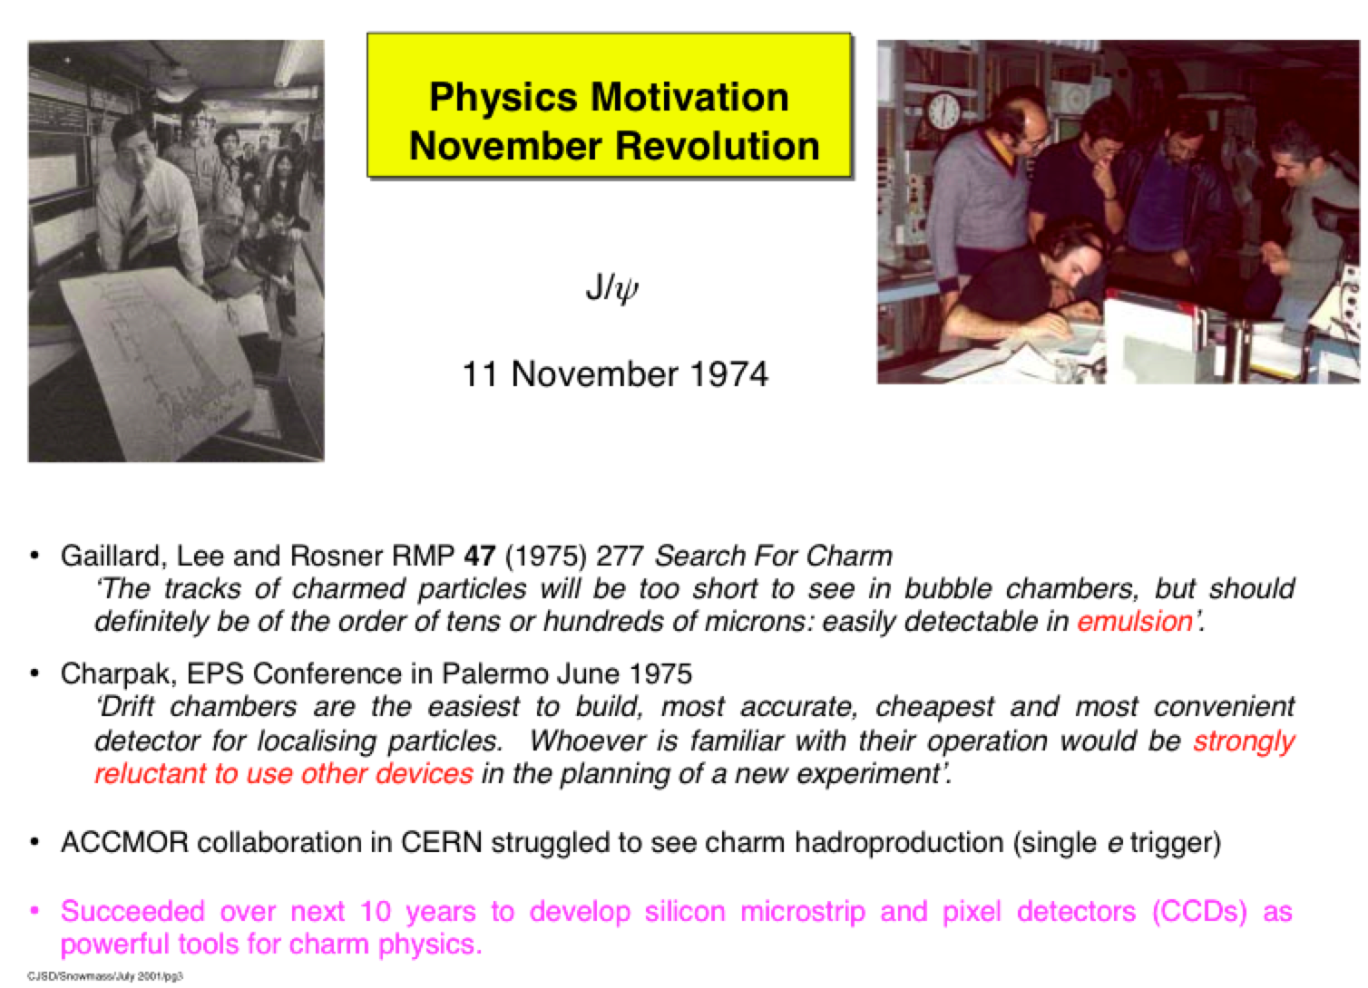
Contributions to the conference
Very impressive content
  from invited speakers
  from speakers
  and also from poster contributions
Too much to do justice to
  and I have no intention to review them all
  just to make a few remarks
Semiconductor sensors and electronics now have ~40 year history
  starting with experiments searching for charm

Slide 5
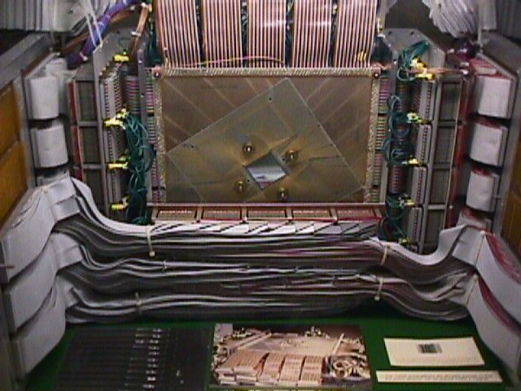
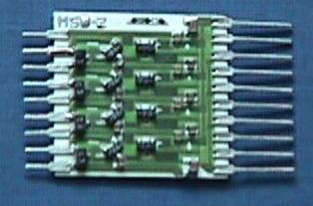
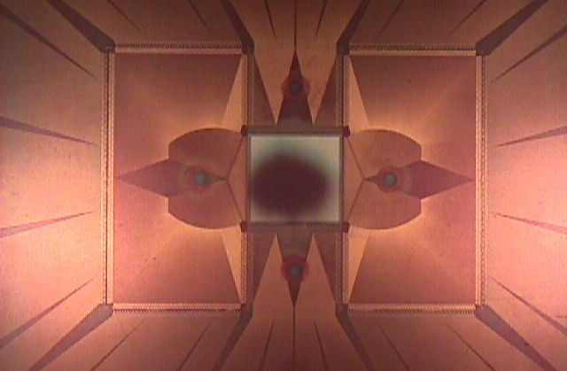
We have come a long way
Vertex detector early 1980s
  “second generation”
    NA14 at CERN
4 channel amplifier
15mW per channel
10 silicon detectors
10,000 microstrips
Power ~150W
1000 microstrips
50µm pitch

Slide 6
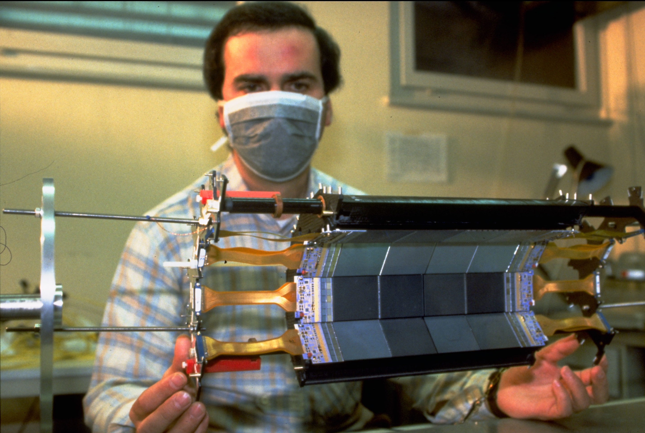
Vertex detector early 1990s

Slide 7
History of Hamamatsu Si wafer size
9/32
Wafer size | Production term
φ1.5inch | 1972～1985
Φ2inch | 1975～1986
Φ3inch | 1983～1996
Φ4inch | 1987～2008
Φ6inch | 1998～
Φ8inch | developing
(1.5inch) (2inch) (3inch) (4inch) (6inch) (8inch)

Slide 8
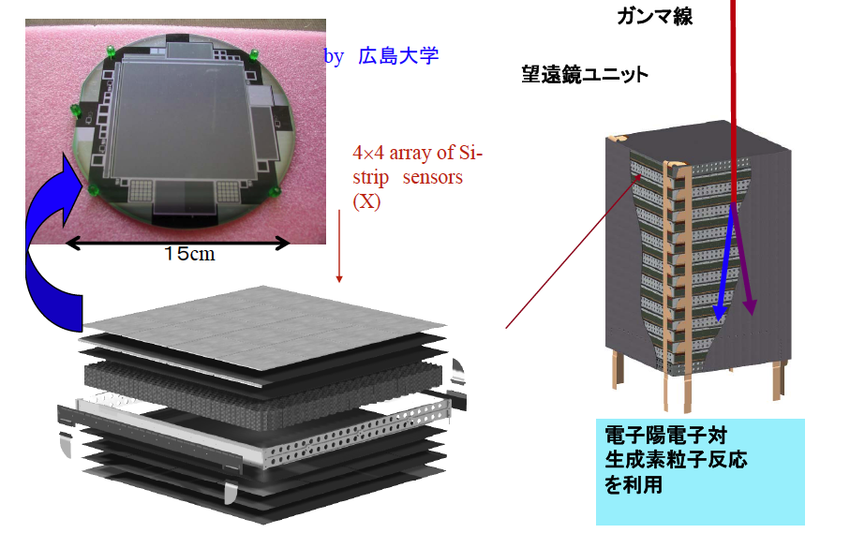
Fermi(GLAST)-SSSD
7/32
Total strip detectors:11,000pcs
8.95x8.95 mm 228μm pitch
provided from GLAST
experiment groups

Slide 9
Review of main SSDs
made by Hamamatsu （2000～）
4/32

Slide 10
LHC has driven many significant developments
and the experiment upgrades are continuing to do so
  this was made clear again in the conference
already upgrades to pixel systems
  generally very successful but not without issues
  lessons for the future?
and very substantial developments foreseen for HL-LHC
  ambitious, both technically and for timescale
  new types of detectors, some of which have been dreamt of but not yet realised
    integrated sensors and electronics
    detectors providing data to the trigger
    systems with precise time information
    more new technologies, like 3D

Slide 11
Pixels

Slide 12
Complex systems
need significant care, time and effort – including evaluation

Slide 13
Collaboration
It seems essential to master the art of team work
  and some seem already to be achieving that

Slide 14
Really new detector modules
Complex in every respect - to deliver data for the L1 trigger

Slide 15
Really new features

Slide 16
Advanced technologies
Our field has profited from technology evolution
  will this continue to even more complex developments?

Slide 17
A lot has been learned about radiation damage
but will it (ever?) be enough for another 20 years?

Slide 18
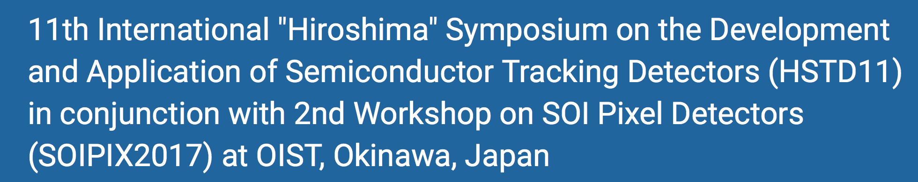
Applications
Perhaps a little less on applications than developments this time
  much recent R&D progress, including many SOI contributions
But some applications, such as photon science, have really come of age
  fully exploiting pixel systems
  in some respects, like data rates, possibly overtaking LHC

Slide 19
Photon imaging systems
Several (many?) large imaging systems now in use

Slide 20
Another application of silicon
which will soon be seen in LHC

Slide 21
Regularly studied using silicon telescopes
and tested inside the LHC machine

Slide 22
Another thing I learned
In photon science, not only TLAs are permitted
  it is possible to name your detectors after mountains with imaginative use of acronyms
  there is a lot of scope here

Slide 23
My attempt
(blame Google)
Hiroshima Symposium on the Development and Application of Semiconductor Tracking Detectors
Sayounara etc
Goodbye!
but not quite…

Slide 24
Acknowledgements
The organizers are deeply thankful for help from the secretaries:
OIST Conference & Workshop section:
  Matsuda, Nakamatsu, Tomimoto, Nishi, Yana –sans
    We would like to show our appreciation with bouquets.
Scientific secretaries:
  Hamasaki, Iwanami, Nishimura, Ohnaru –sans
    Our appreciation with OIST USB memory stick ☺
Thank you very much to them all!

Slide 25
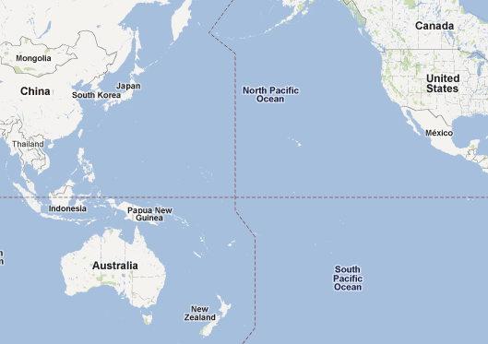
See you again in 2019
“Hiroshima” symp. around the Pacific rim, every 2-3 yrs, alternating between Hiroshima and outside, in tradition…
HSTD12 is scheduled to be held in 2019 at Hiroshima, Japan
1st SOIPIX, Sendai
Xi’an:2015
Hiroshima:
1993, 1995, 2000, 2004, 2009, 2013, 2019
Okinawa:2017
Carmel:2006
Taipei:2011
Melbourne:1997
©Google map

