Slide 1
2016 the first year it all came together
Injectors
Operational efficiency
Understanding and control
Availability

Slide 2
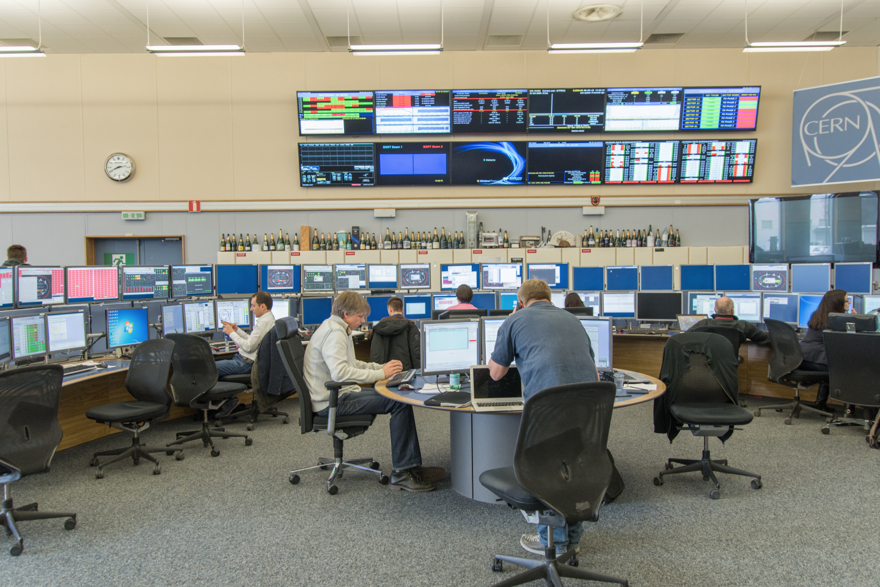
A very calm hardware commissioning

Slide 3
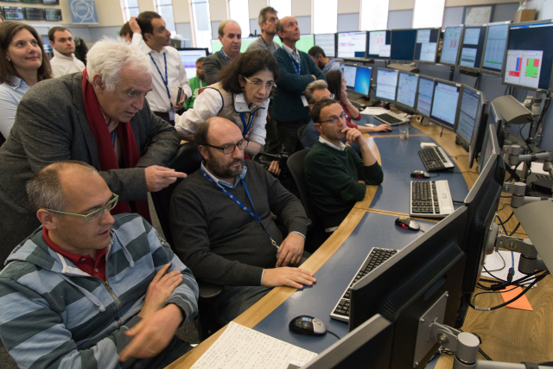
Usual high level of interest for first circulating beams

Slide 4
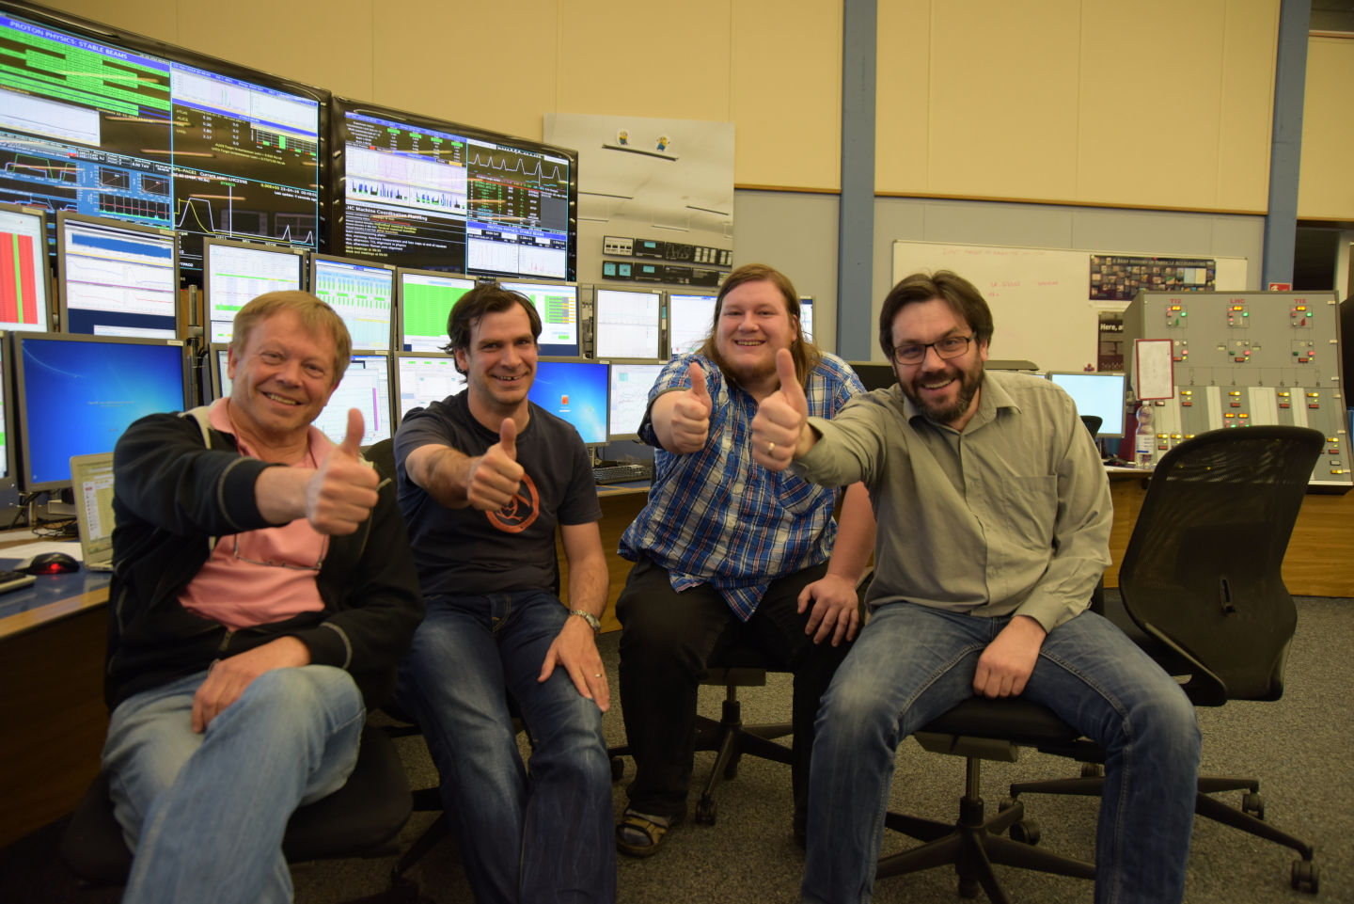
First stable beams 2016 – four hitch hikers

Slide 5
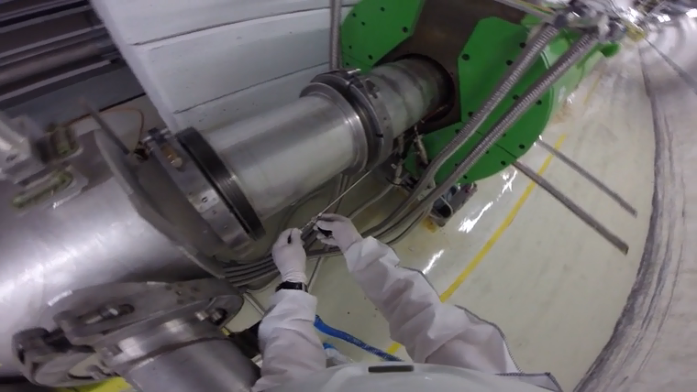
Manual leak detection April 28th
Marco Calviani and Simone Gilardoni

Slide 6
F…..G WEASEL !!!
ML
09/12/2016
Gildas LANGLOIS

Slide 7
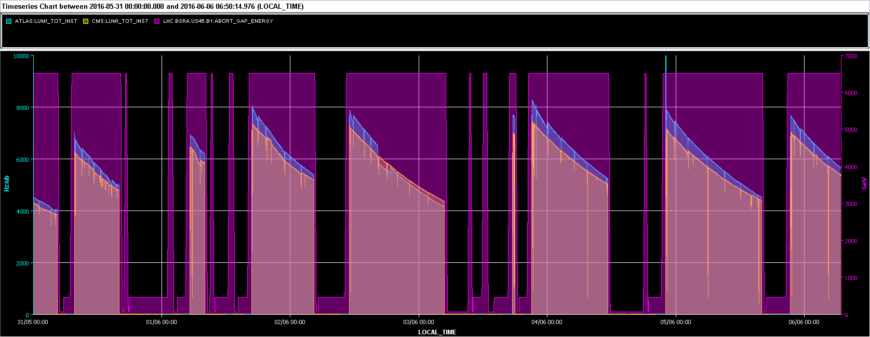
Since POPS recovery
Ramped up number of bunches to 2040 per beam
  Maximum with 72 bunches per injection
  Bunch population 1.1x10¹¹
Peak luminosity ~8 x10³³ cm⁻²s⁻¹
Excellent availability

Slide 8
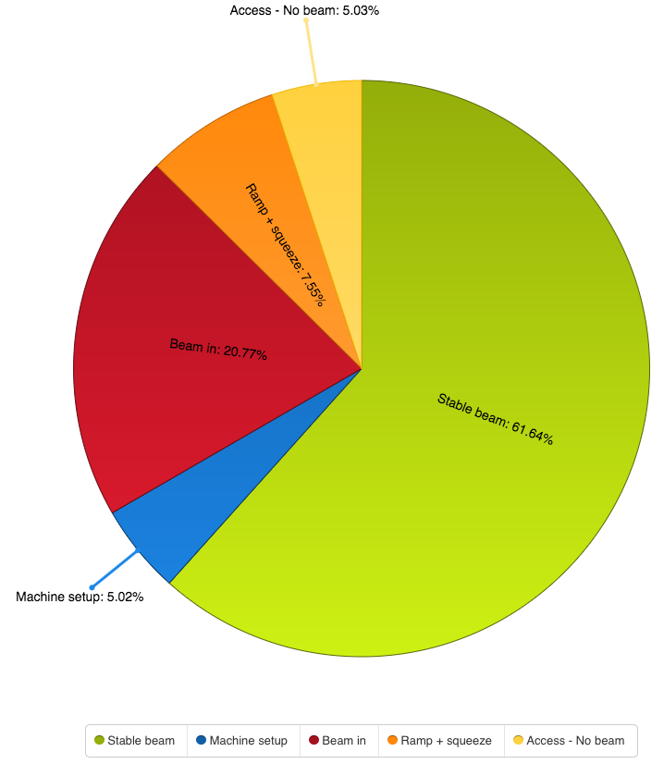
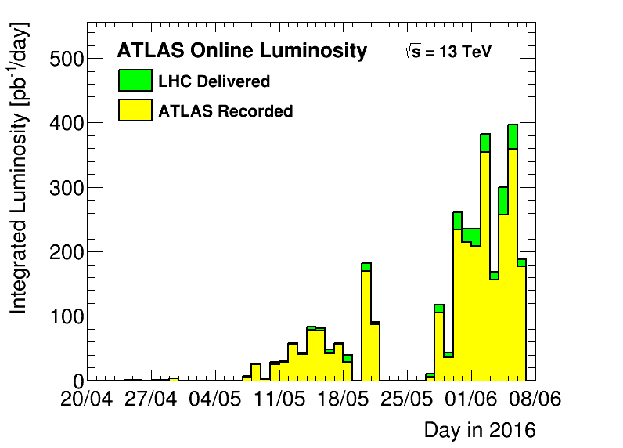
Mon 30th May – Sun 5th June
Record luminosity in fill: 380 pb⁻¹
Record luminosity per day: 390 pb⁻¹
Record luminosity per week: 1.98 fb⁻¹
Stable Beams 62%

Slide 9
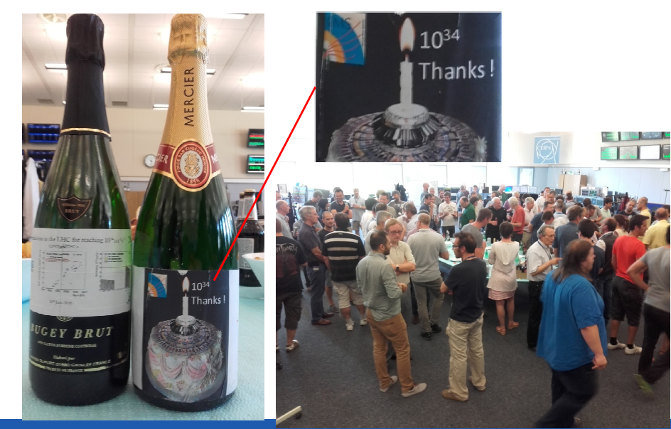
Design luminosity reached
  Reduced beta* and lower transverse beam sizes from the injectors compensating the lower number of bunches

Slide 10

Beams
Jean-Francois Comblin
ISOGPS | ISOHRS | TOF | AD | EAST_North | EAST_Irrad | SFTPRO
Intensity of Isolde beam up to 3.6e13 ppp.
Staggered beam on both target at the same time.
LHC 25ns | LHC Indiv | LHC probe | BCMS 25ns | LHC 100 ns
+ All the variants:
Indiv: VdM, Hi int., Hi emit., Low long. Emitt., Hi brightness, …
BCMS: Hi int., Low brightness, …, …
25 ns: Hi int., Scrubbing, Long. Emitt. blow-up, …

Slide 11
New recrutiment processs

Slide 12
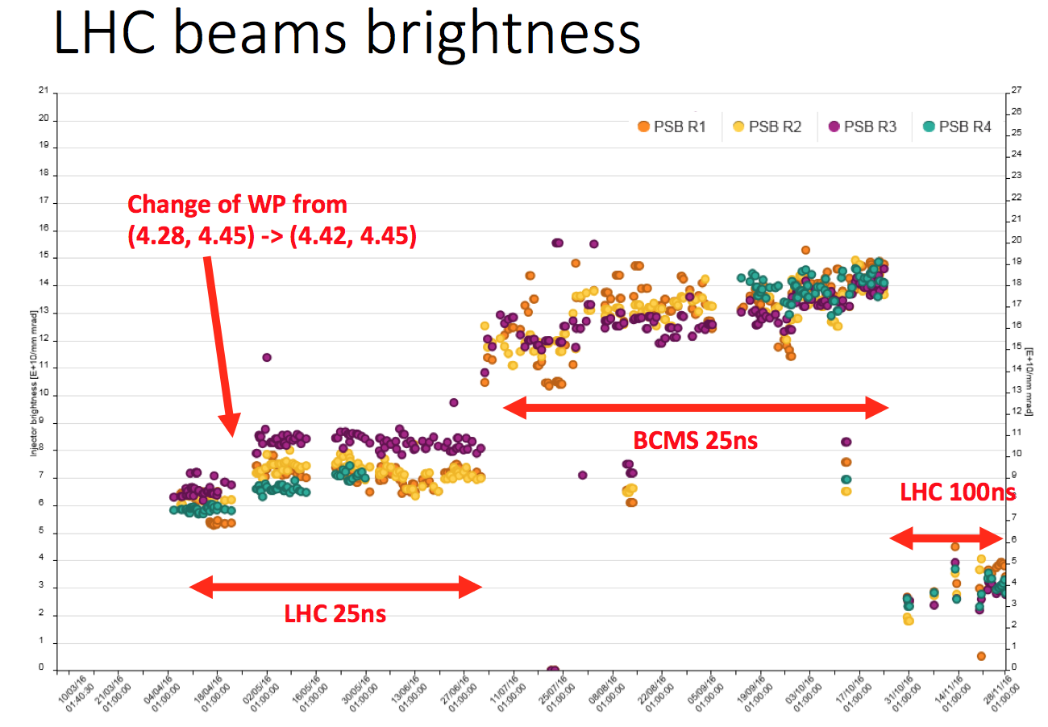

Slide 13

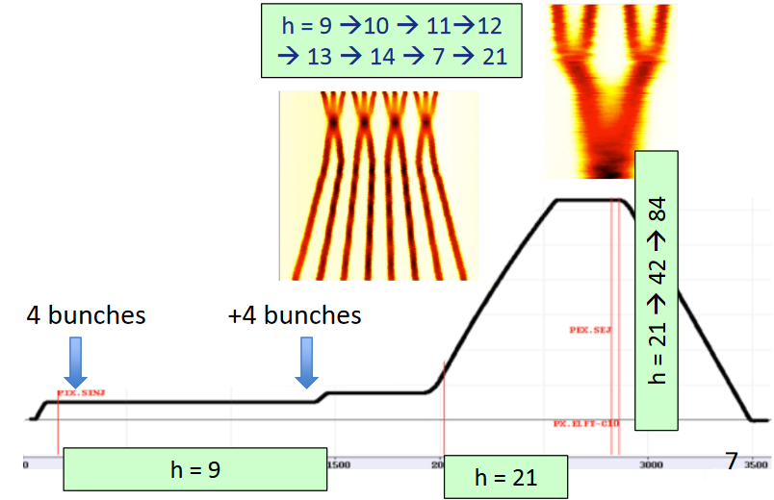
New LHC (BCMS type) beam
In July, PS started to deliver BCMS beam to LHC.
Peak luminosity of around +20% and a new record of 1.2 x 10^34 cm⁻²s⁻¹.
Denis Cotte

Slide 14
Good peak performance
Beta* = 40 cm
BCMS
Reduced crossing angle, bunch length
Limited in number of bunches
Limited in bunch intensity (injection kicker vac.)
Bunch population | ~1.1e11
Number of bunches | 2220
Beta* | 40 cm
Crossing angle | 280 urad
Emittance (BCMS) | ~2.0 um
Peak (CMS) | ~1.5e34 cm⁻²s⁻¹
Crossing angle reduced end September
X-angle [urad] | F
370 | 0.59
280 | 0.7

Slide 15
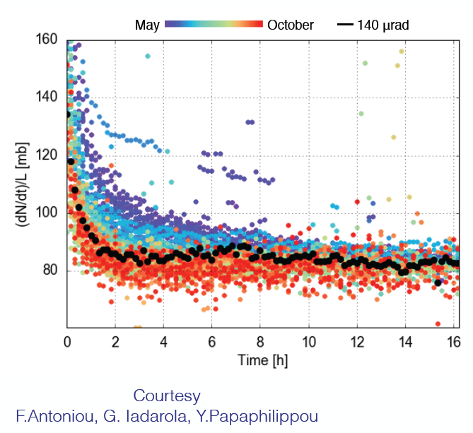
Lifetime in Stable Beams

Slide 16
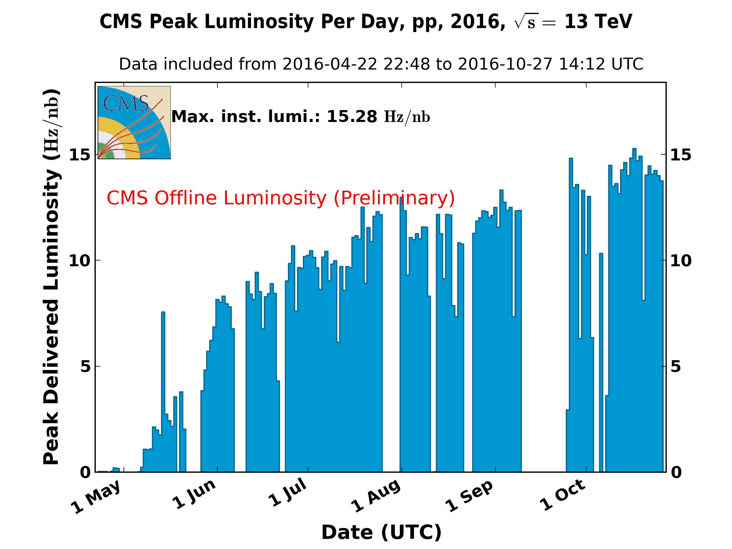
1.5 x 10³⁴ cm⁻²s⁻¹
10³⁴
BCMS
Reduced crossing angle

Slide 17
Machine status - summary
Excellent and improved system performance
Magnets behaving well at 6.5 TeV
Good beam lifetime through the cycle
Operationally things well under control
Magnetically reproducible as ever
Optically good, corrected to excellent
Aperture is fine and compatible with the collimation hierarchy.
Collimation can take anything that’s thrown at it

Slide 18
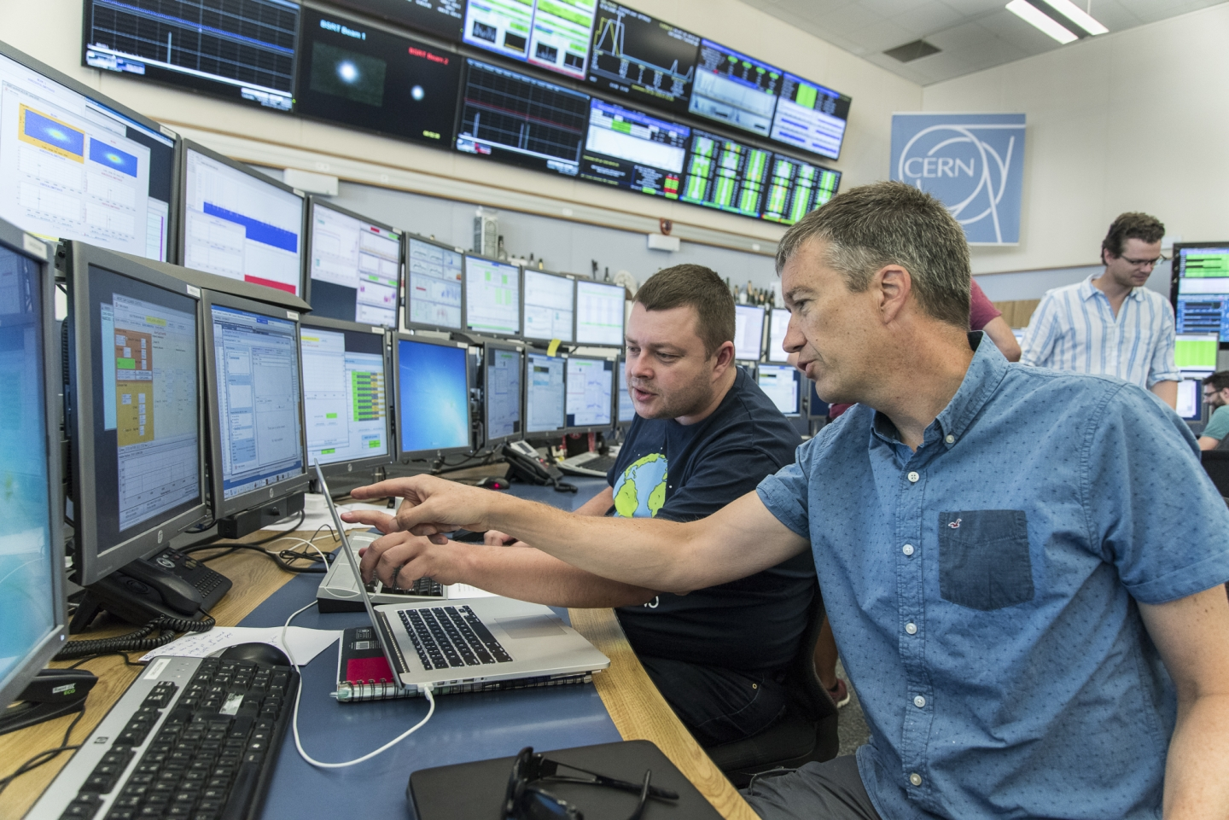

Understanding and control

Slide 19
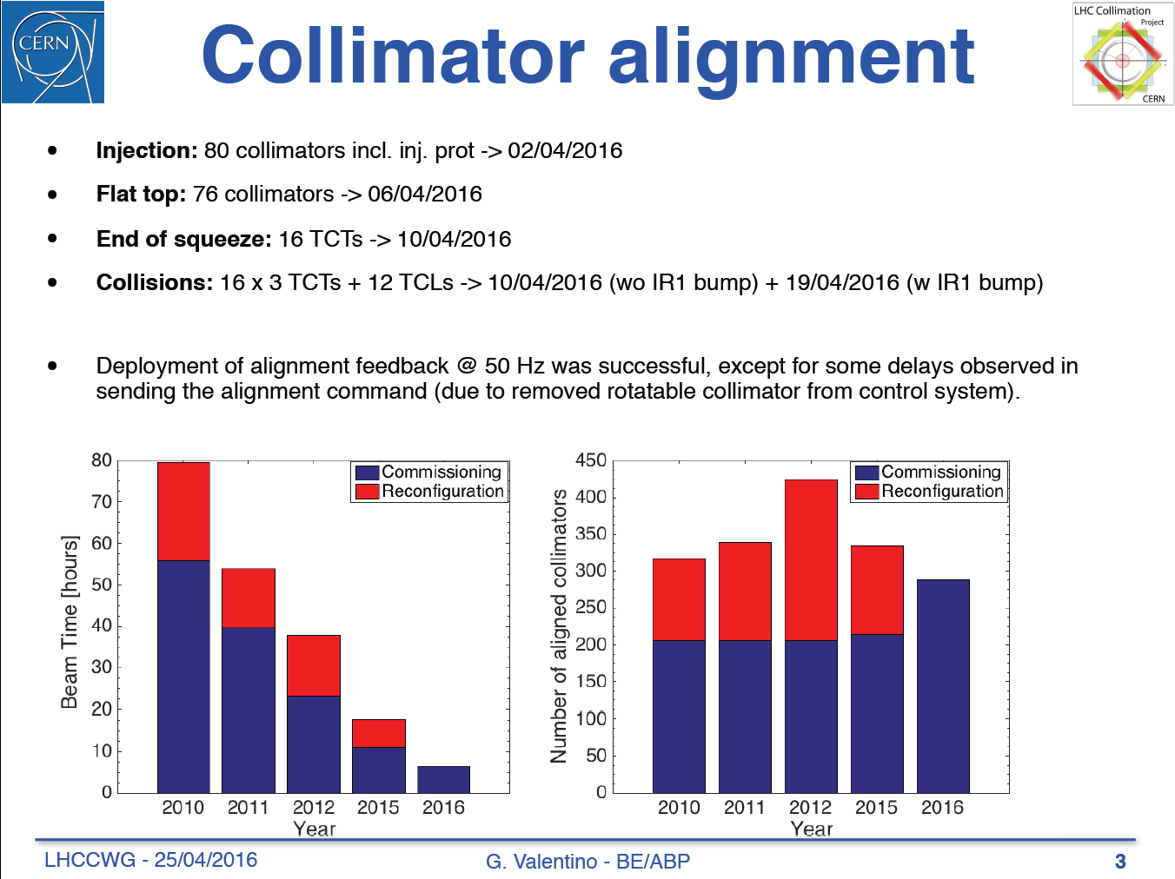

Slide 20
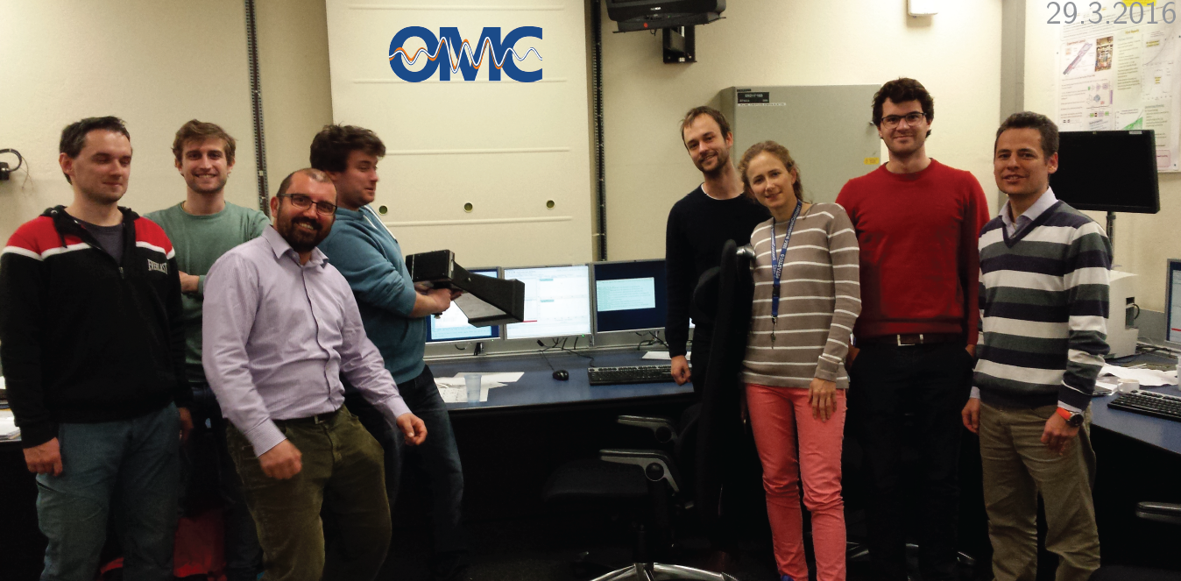
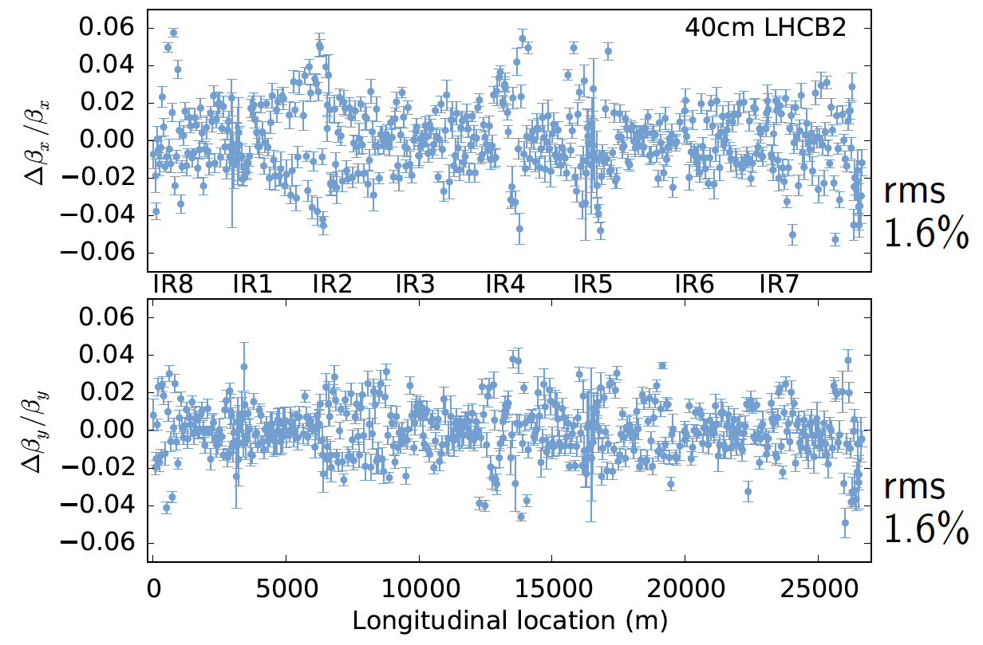
2016: 1% rms beta-beating, C- of 0.0002 and lot more to celebrate!

Slide 21
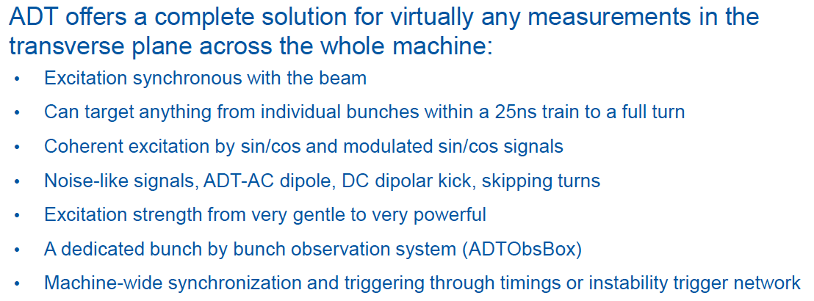
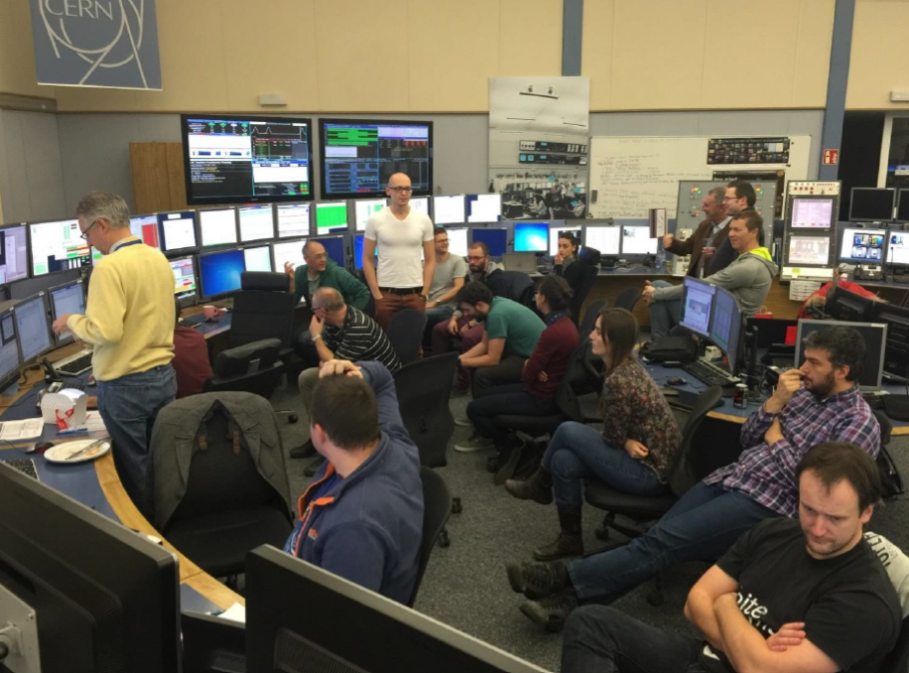
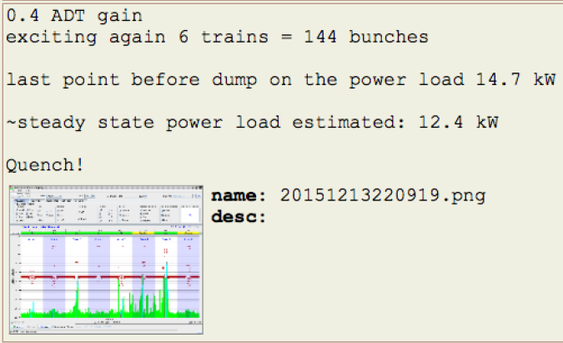
Courtesy Daniel Valuch

Slide 22

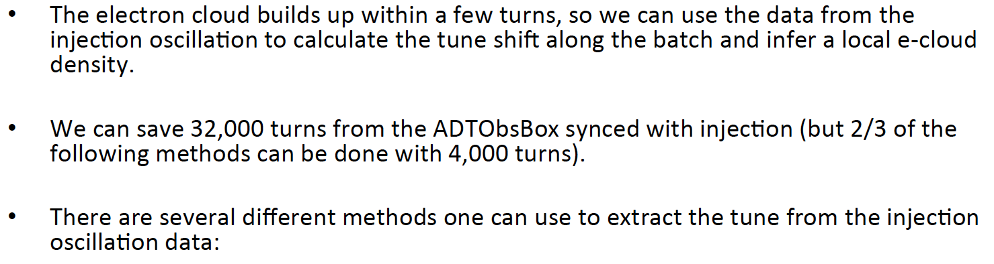
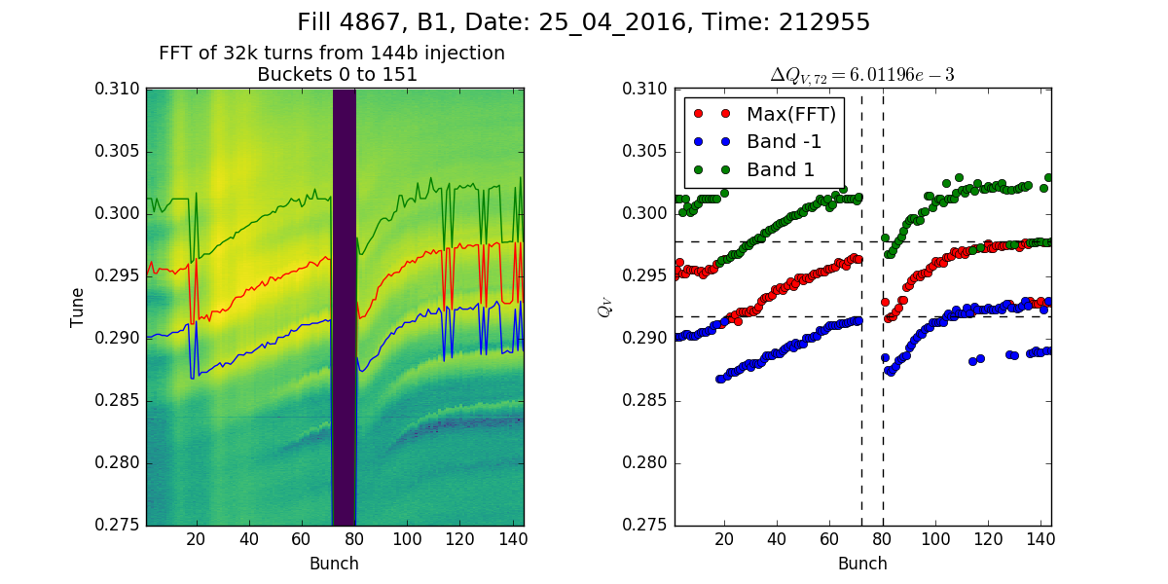

Slide 23
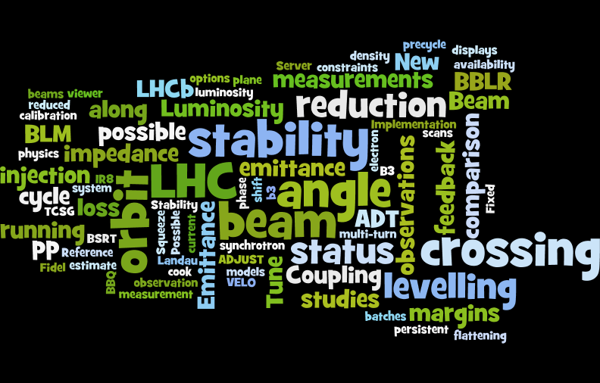

Slide 24
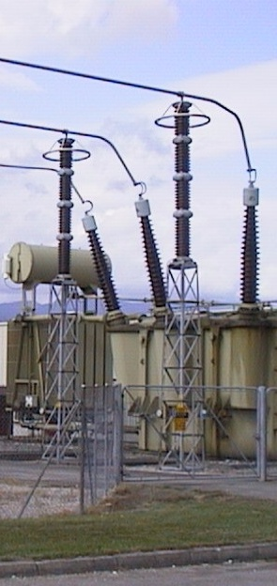

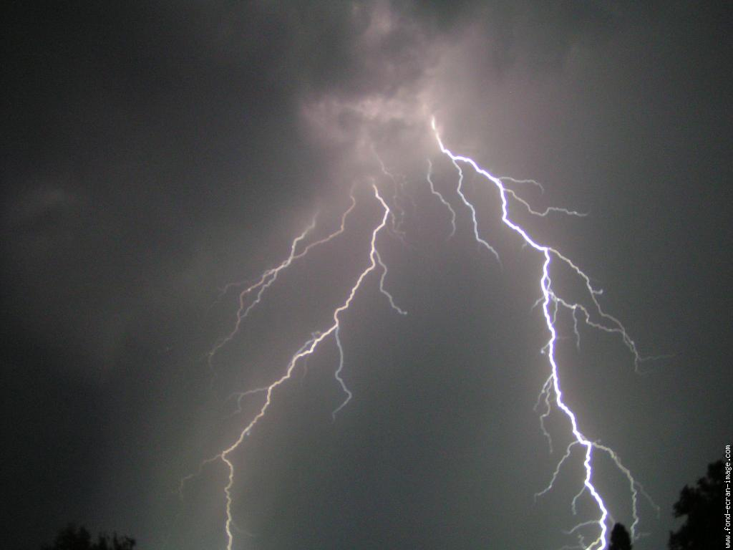

NO !!!
F. WEASEL
II
Le retour
The come back
Le 20 Novembre 2016…
09/12/2016
Gildas LANGLOIS

Slide 25
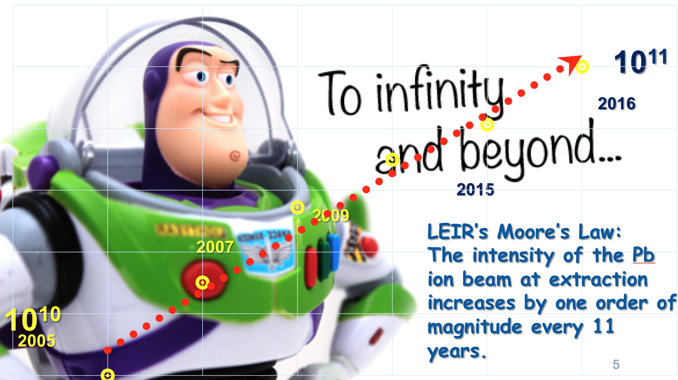
Django

Slide 26
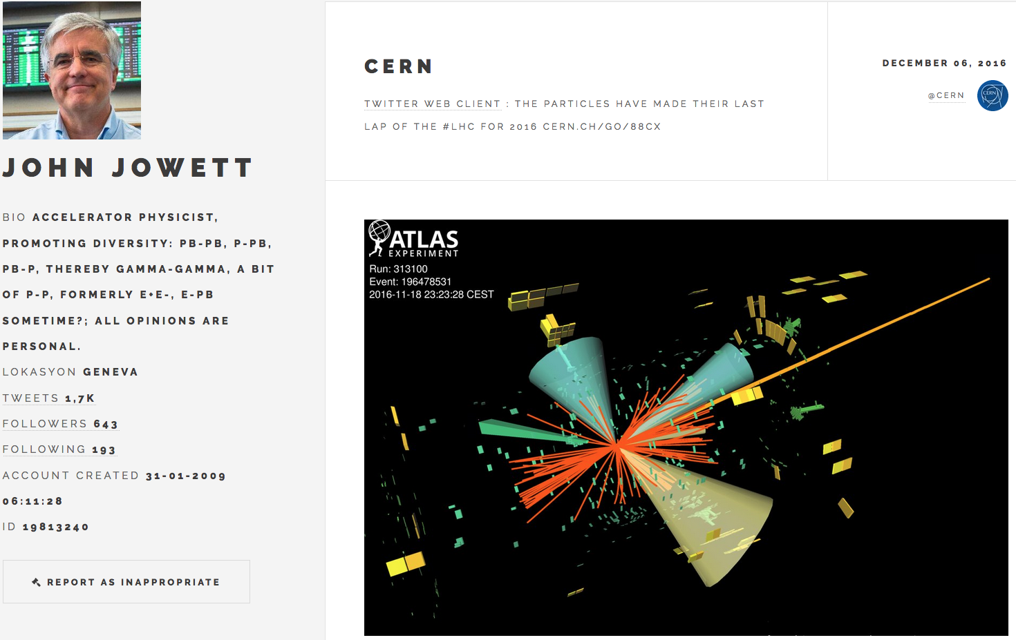

Slide 27
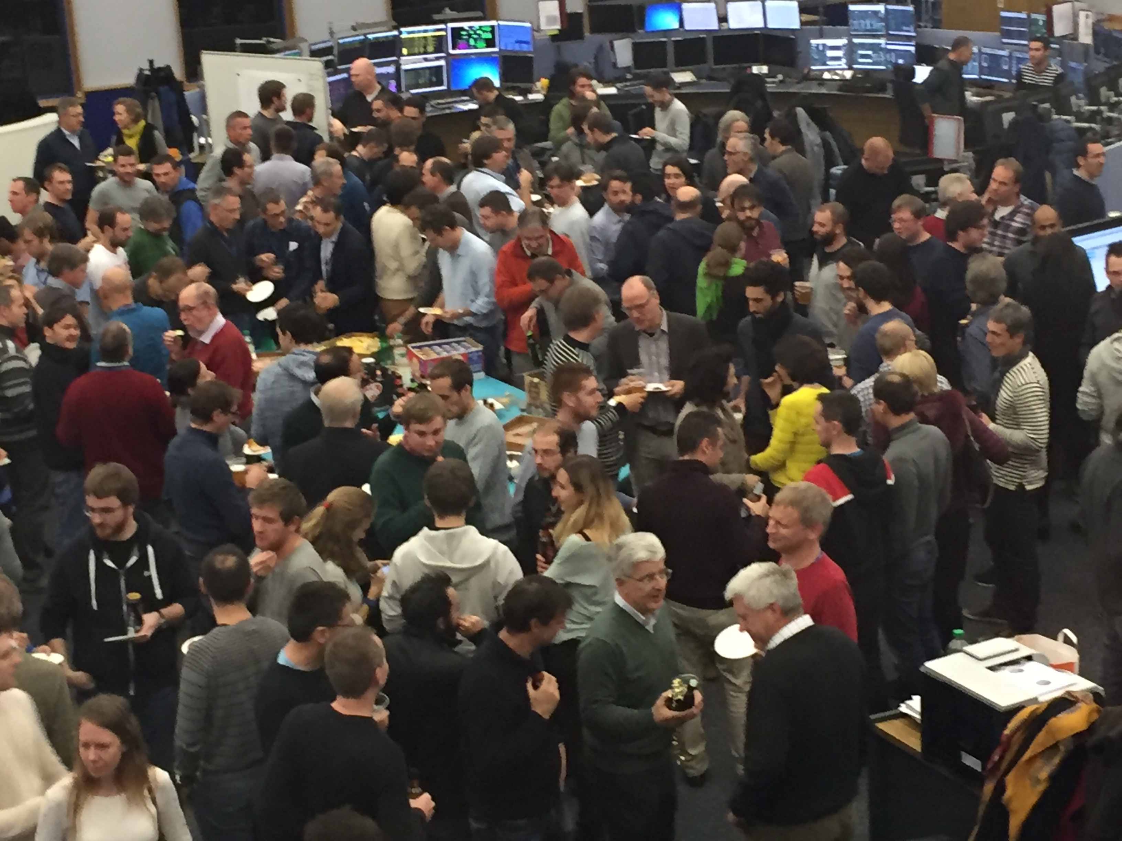
2016

Slide 28
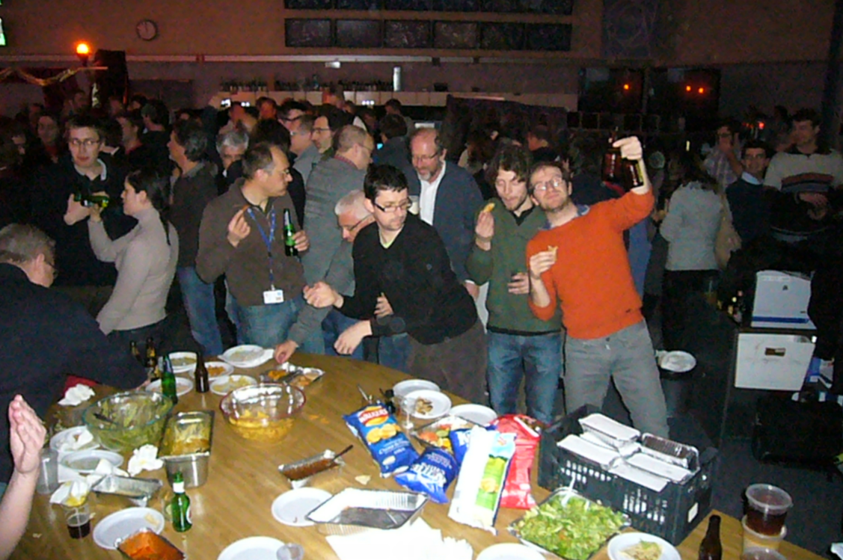
2012

