Slide 2
LHC Availability
2016 Proton Run
7th Evian Workshop, 13/12/2016
A. Apollonio
On behalf of AWG-core team (L. Ponce, B. Todd)
Acknowledgements: Availability Working Group, AFT Team
andrea.apollonio@cern.ch
v1

Slide 3
Who…
AWG Core Team | B. Todd (TE/EPC) L. Ponce (BE/OP) A. Apollonio (TE/MPE)
AFT Team | C. Roderick (BE/CO)
Controls | M. Gourber Pace (BE/CO) C. Roderick (BE/CO)
Access System | S. Di Luca (BE/ICS) T. Ladzinski (BE/ICS)
Access Management | L. Ponce (BE/OP)
Beam Exciters | R. Barlow (TE/ABT) N. Magnin (TE/ABT)
Beam Induced Quenches | A. Verweij (TE/MPE)
Injection | L. Ponce (BE/OP)
Instrumentation | E. Bravin (BE/BI)
Beam Losses | L. Ponce (BE/OP)
Collimation | S. Redaelli (BE/ABP) A. Masi (EN/STI)
Cryogenics | L. Delprat (TE/CRG) G. Ferlin (TE/CRG)
Experiments | B. Gorini (EP/ADO)
Injection Systems | R. Barlow (TE/ABT) A. Masi (EN/STI)
Injector Complex | J.-F. Comblin (BE/OP) D. Cotte (BE/OP) J. Dalla-Costa (BE/OP) V. Kain (BE/OP) B. Mikulec (BE/OP) R. Steerenberg (BE/OP)
IT Services | E. Dafonte (IT/DB)
Beam Dumping System | N. Magnin (TE/ABT)
Machine Protection | J. Uythoven (TE/MPE) D. Wollmann (TE/MPE) M. Zerlauth (TE/MPE)
Magnet Circuits | Z. Charifoulline (TE/MPE)
Operation | L. Ponce (BE/OP)
Orbit | J. Wenninger (BE/OP)
Power Converters | M. Bastos (TE/EPC) V. Montabonnet (TE/EPC) C. Mugnier (TE/EPC) H. Thiesen (TE/EPC)
Quench Protection | R. Denz (TE/MPE)
Radio Frequency | O. Brunner (BE/RF) A. Butterworth (BE/RF) N. Schwerg (BE/RF)
Software Interlocks | J. Wenninger (BE/OP)
Technical Services | J. Nielsen (BE/IO) R. Ledru (BE/IO)
Transverse Damper | W. Hofle (BE/RF) E. Montesinos (BE/RF) D. Valuch (BE/RF)
Vacuum | G. Bregliozzi (TE/VSC) J. Sestak (TE/VSC)

Slide 4
References
2016 LHC Availability Reports
(B. Todd, L. Ponce, A. Apollonio)
Restart – TS1:
TS1 – TS2:
TS2 – TS3:
Proton Run:
https://cds.cern.ch/record/2195706?ln=en
https://cds.cern.ch/record/2235082?ln=en
https://cds.cern.ch/record/2235079?ln=en
https://cds.cern.ch/record/2237325?ln=en

Slide 5
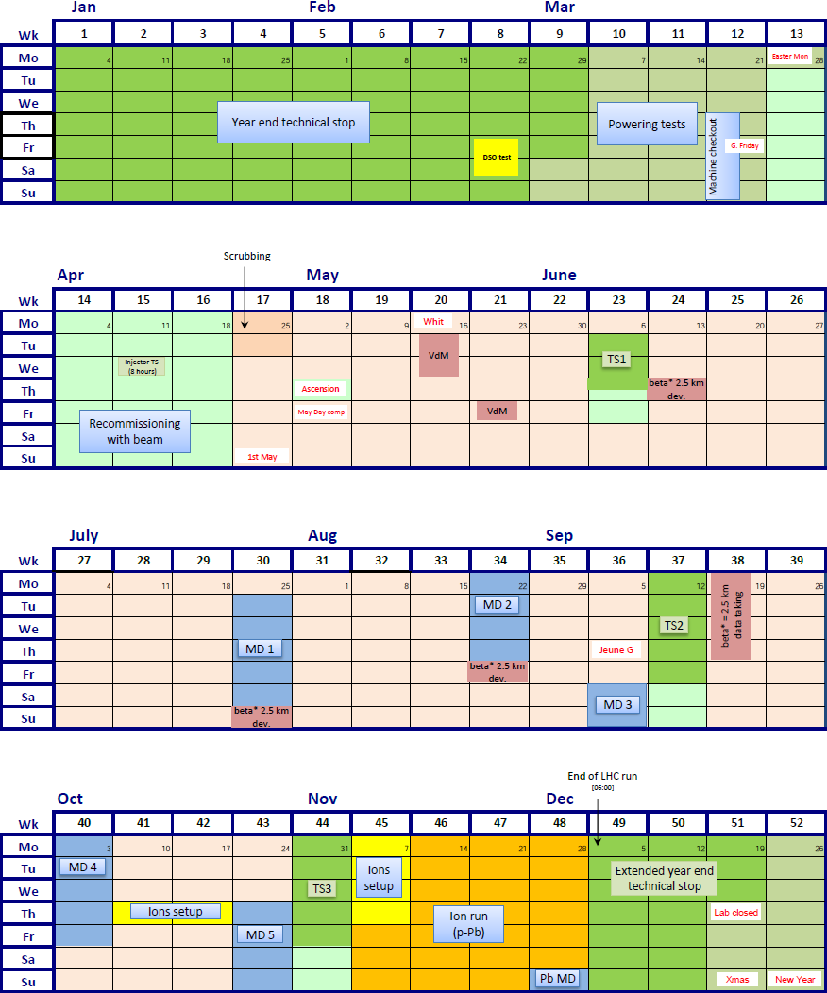
Machine Exploitation
25th March
31st October

Slide 6
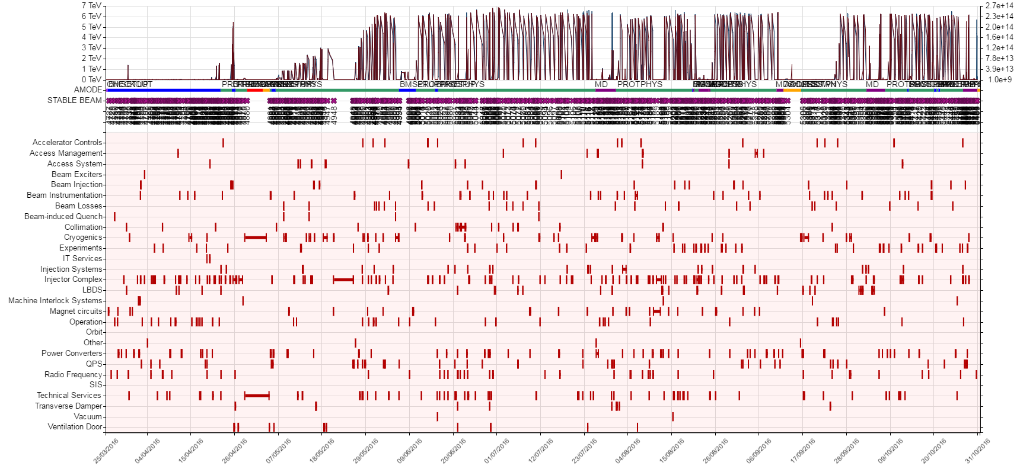
Machine Exploitation
25th March
31st October
782 Faults registered and analyzed (manually!)
65 Parent/child relationships identified
New categories: Access Management, Ventilation Doors

Slide 7
Machine Exploitation
 | Restart – TS1 | TS1 – TS2 | TS2 – TS3
Beam Commissioning | 29 | 1 ½ | 2 ½ | 33
Ion Cycle Setup | 0 | 0 | 2 | 2
Special Physics Commissioning | 0 | 3 | 0 | 3
Scrubbing | 2 | 0 | 0 | 2
Machine Development | 0 | 11 | 9 | 20
Special Physics | 3 | 0 | 4 | 7
Physics | 40 | 79 | 27 | 146
= 213 days

Slide 8
Machine Exploitation
 | Restart – TS1 | TS1 – TS2 | TS2 – TS3
Beam Commissioning | 29 | 1 ½ | 2 ½ | 33
Ion Cycle Setup | 0 | 0 | 2 | 2
Special Physics Commissioning | 0 | 3 | 0 | 3
Scrubbing | 2 | 0 | 0 | 2
Machine Development | 0 | 11 | 9 | 20
Special Physics | 3 | 0 | 4 | 7
Physics | 40 | 79 | 27 | 146
= 213 days
= 153 days

Slide 9
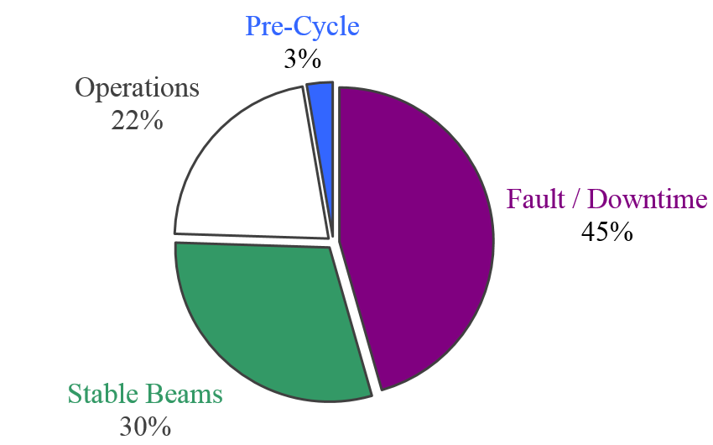
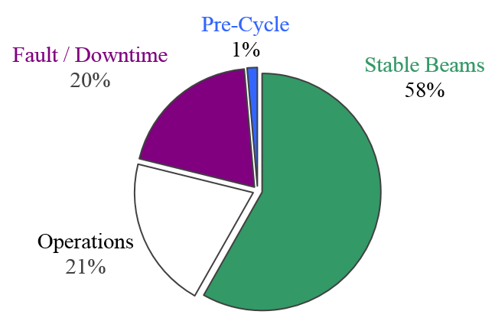
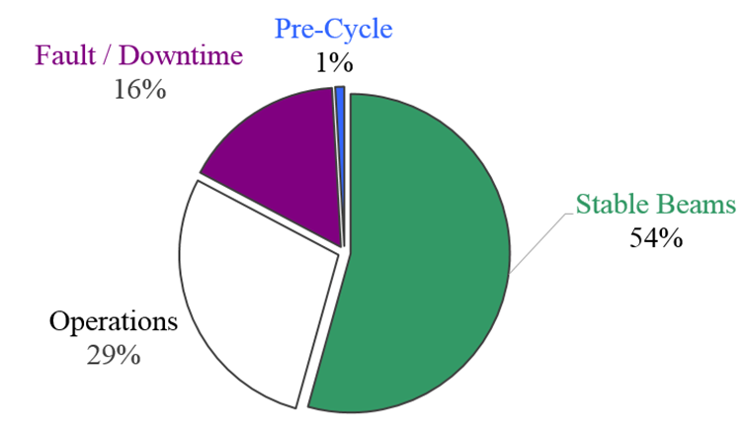
Mode Breakdown
Restart – TS1
TS1 – TS2
TS2 – TS3
Operations contains nominal cycle + extra measurements (116h) + injection setting-up (23h) + some loss maps (35h) + planned accesses

Slide 10
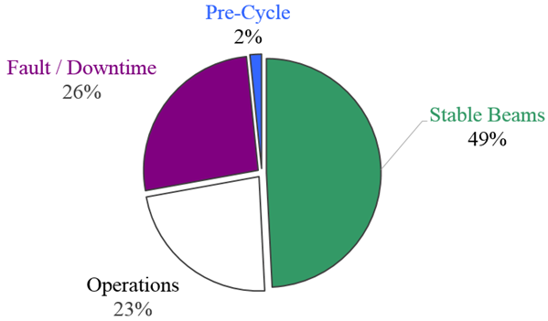
Mode Breakdown
153 days physics ≈ 3738.7 hours
[4 %]
 | Duration [h]
Stable Beams | 1839.5
Fault / Downtime | 980.0
Operations | 857.9
Pre-Cycle | 61.3
[31 %]
[33 %]
= 3738.7
Operations contains nominal cycle + extra measurements (116h) + injection setting-up (23h) + some loss maps (35h) + planned accesses
[32 %]
[25 ns Run in 2015]

Slide 11
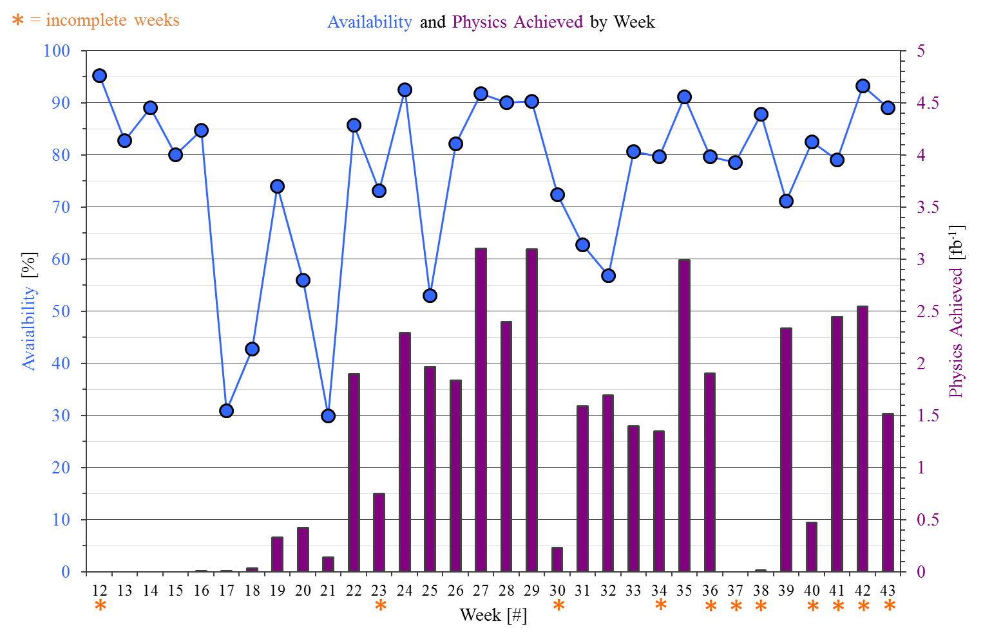
Availability
TS1
TS2

Slide 12
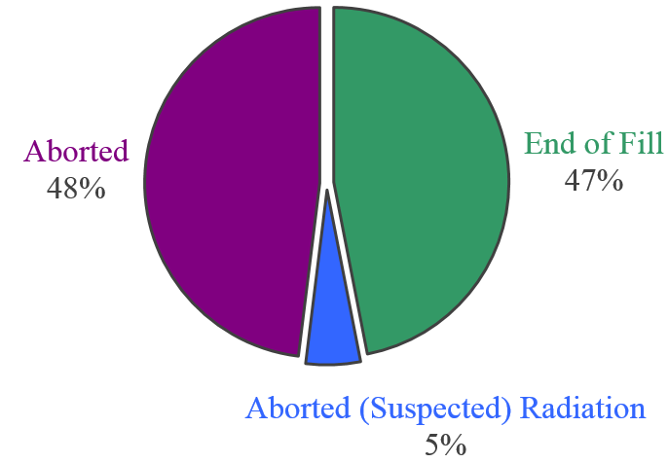
Physics Beam Aborts
 | [#]
Total Fills | 762
Fills with Stable Beams | 175
Fills with Physics in Adjust | 4
→ End of Fill | 84
→ Aborted | 86
→ Aborted (suspected) R2E | 9
[31 %]
[69 %]
[M. Zerlauth, S2]
Main categories
  Mains Disturbances (being addressed EYETS)
  Unidentified Falling Objects (manageable)
Premature Beam Aborts:
[J. Nielsen, S2]
[A. Lechner, S7]
[25 ns Run in 2015]

Slide 13
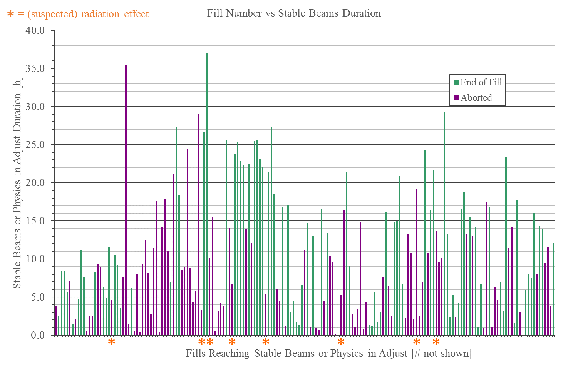
Stable Beams
175 + 4 fills with stable beams
TS1
MD3 + TS2
6.9 h
8.0 h
BCMS
16.2 h
7.7 h
11.5 h
7.8 h
MD1
MD2
MD4

Slide 14
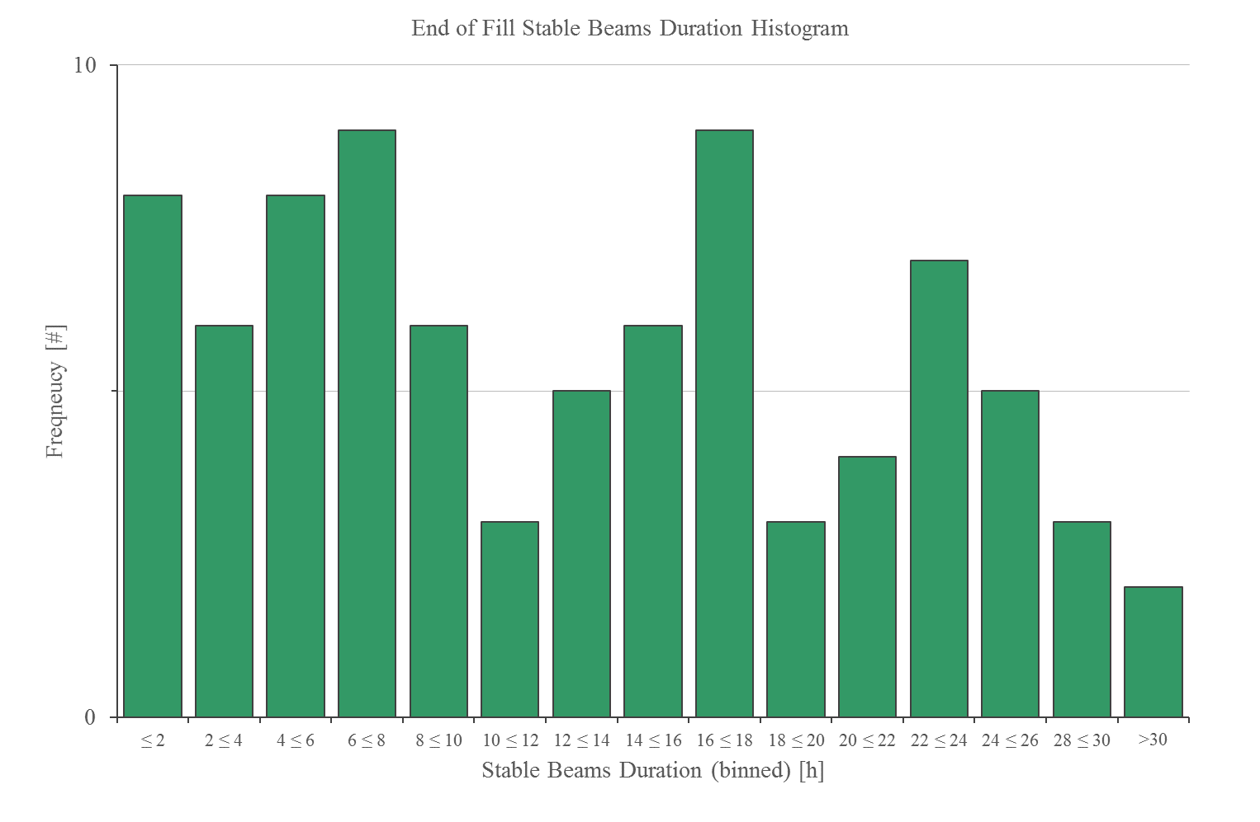
Stable Beams
84 fills reaching End Of Fill
Intensity ramp-up +
Access requests +
Anticipate loss of cryo conditions +
Measurements (e.g. e-cloud reference)

Slide 15
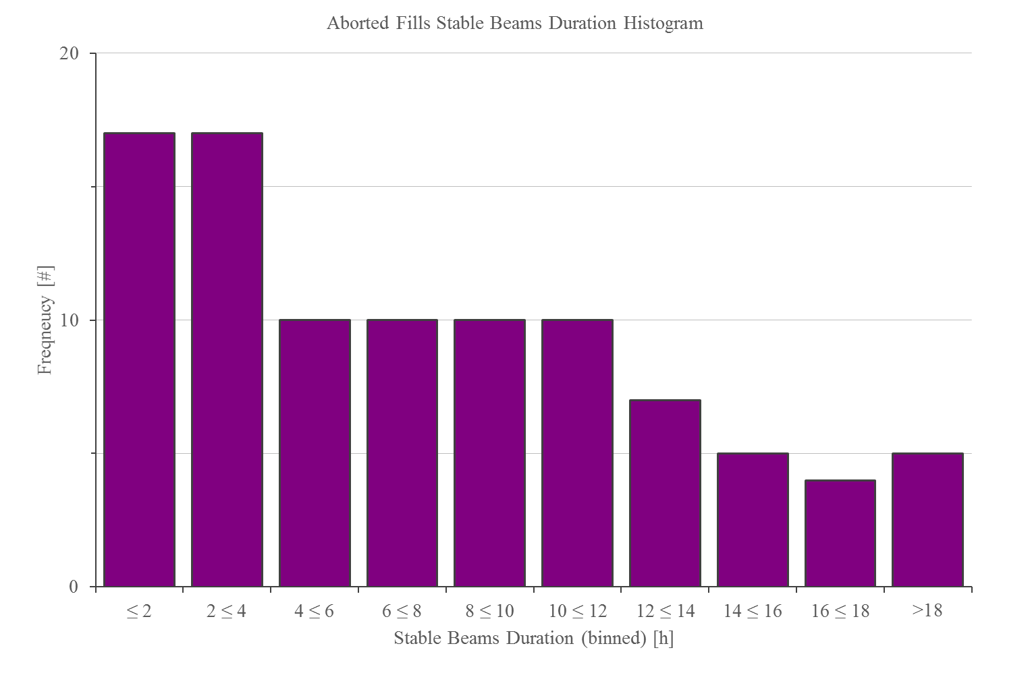
Stable Beams
86 + 9 fills prematurely Aborted

Slide 16
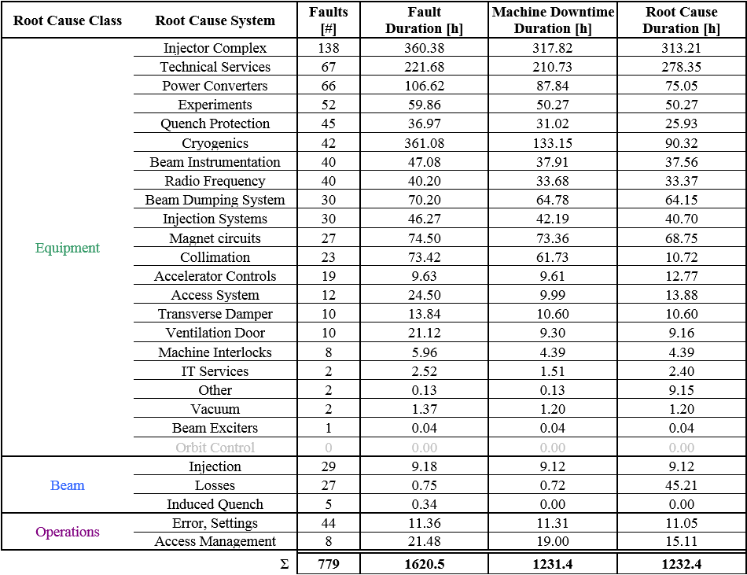
Faults
Full period = 779 faults & 77 pre-cycles due to faults

Slide 17
Faults
Full period = 779 faults & 77 pre-cycles due to faults

Slide 18
Faults
Full period = 779 faults & 77 pre-cycles due to faults
Fault Duration =
Integrated time logged for fault
Machine Downtime =
Corrects for parallelism
Root Cause Duration =
Corrects for dependencies
parent / child / shadow

Slide 19
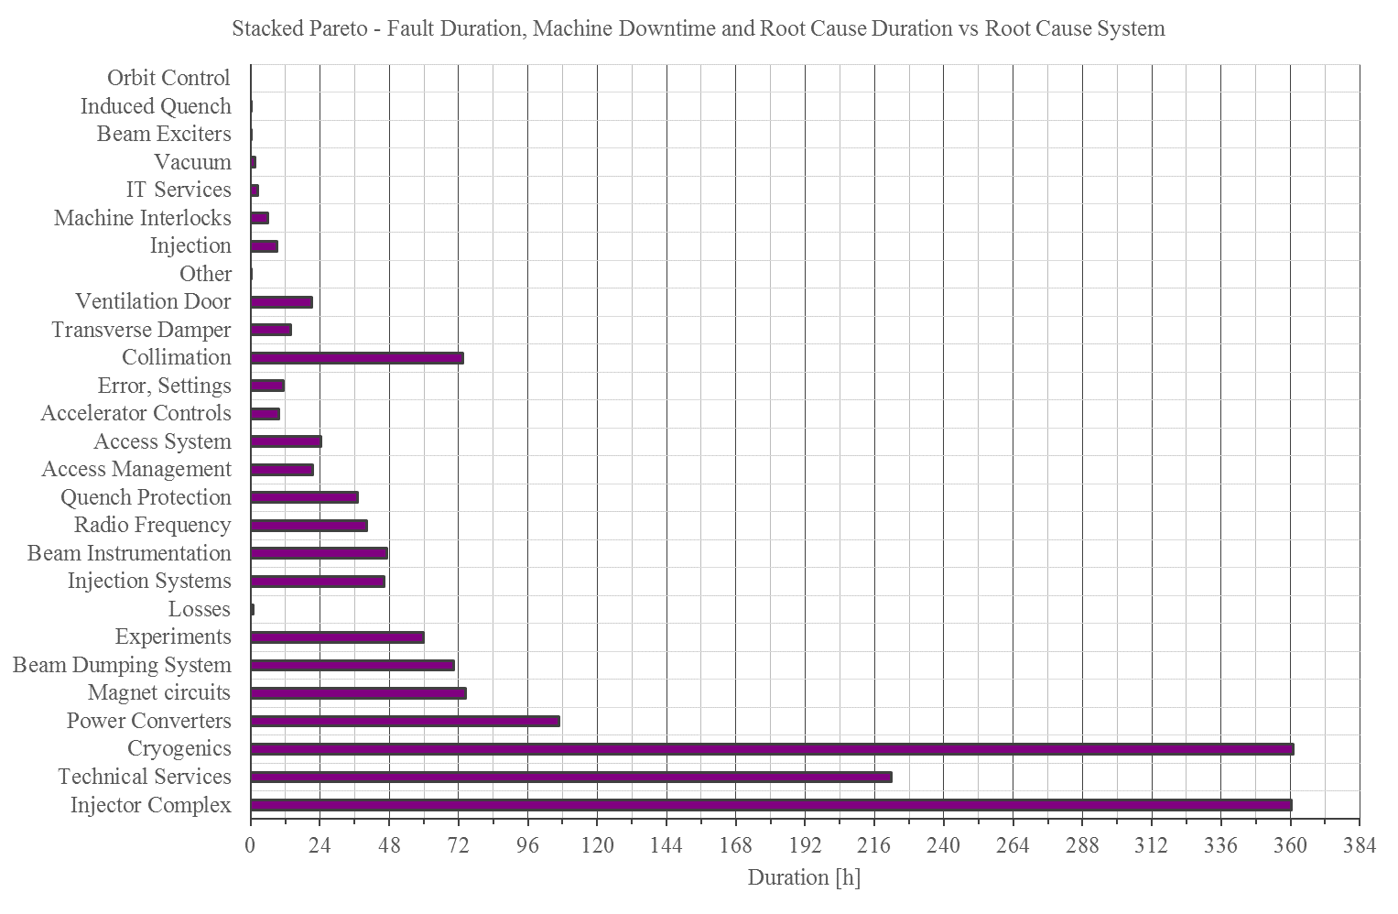
Faults
Fault Duration =
Integrated time logged for fault
Machine Downtime =
Corrects for parallelism
Root Cause Duration =
Corrects for dependencies
parent / child / shadow

Slide 20
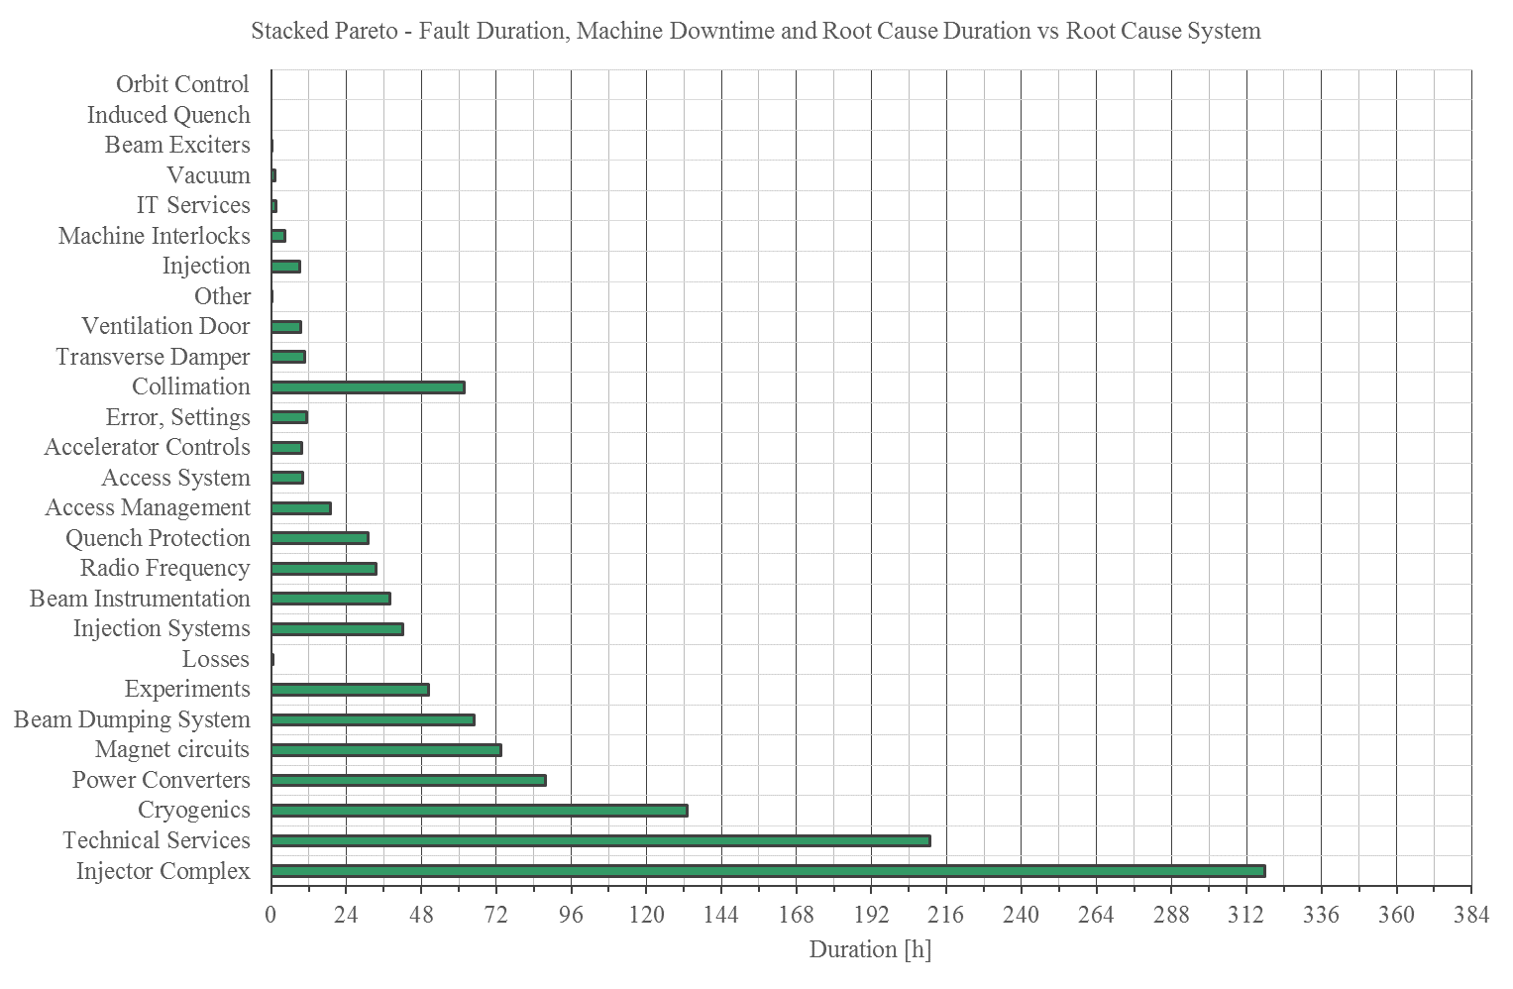
Faults
Fault Duration =
Integrated time logged for fault
Machine Downtime =
Corrects for parallelism
Root Cause Duration =
Corrects for dependencies
parent / child / shadow

Slide 21
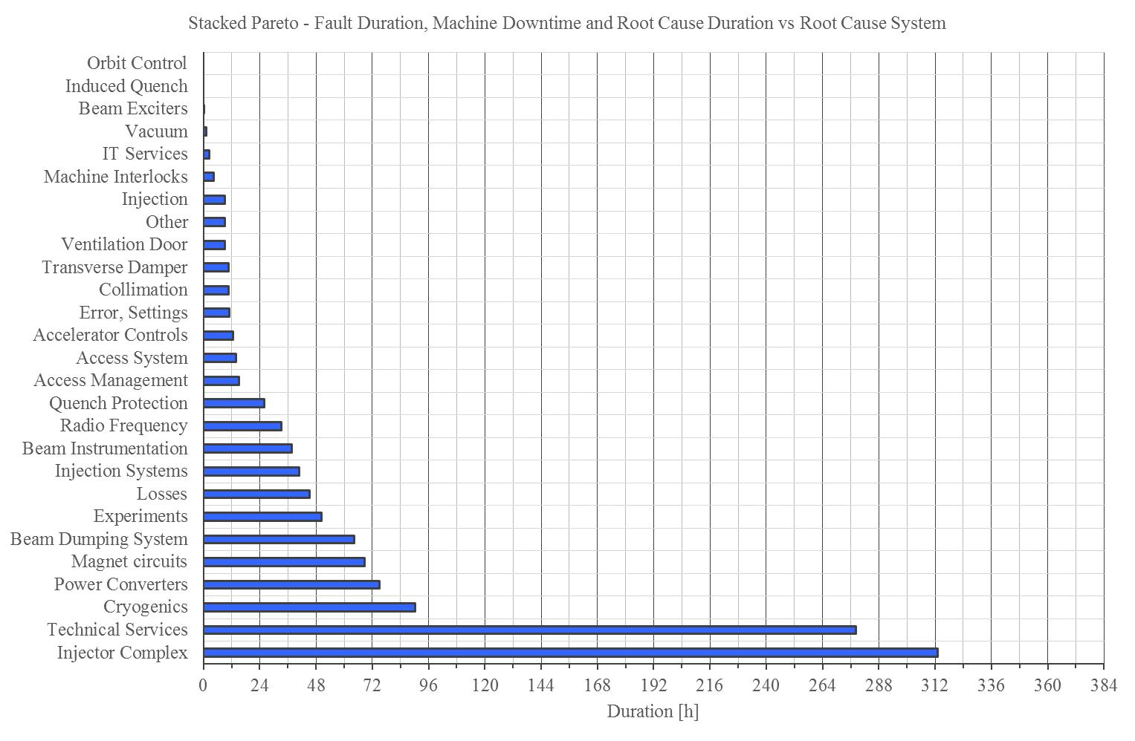
Faults
Fault Duration =
Integrated time logged for fault
Machine Downtime =
Corrects for parallelism
Root Cause Duration =
Corrects for dependencies
parent / child / shadow

Slide 22
Top Faulty Systems
5 systems ≈67%
Root Cause System | Root Cause Duration [h] | % of Total Duration
Injector Complex | 313.21 | 25.4
Technical Services | 278.35 | 22.6
Cryogenics | 90.32 | 7.3
Power Converters | 75.05 | 6.1
Magnet Circuits | 68.75 | 5.6
= 825.7 hours
= 67.0%
Dominated by high-impact faults:
  Injector Complex: PS main power supply, PS vacuum leak.
  Technical Services: 66kV transformer issue, flooding in point 3.
  Cryogenics: PLC, cold compressor failures.
  Magnet Circuits: Investigation of suspected inter-turn short in RB.A12.
  In addition, LBDS: 3x MKBH erratic triggering (1 during ion run).
[B. Mikulec, S2]
[J. Nielsen, S2]
[K. Brodzinski, S2]
[D. Wollmann, S7]
[E. Carlier, S7]

Slide 23
Big Improvers vs 2015
Quench Protection System
  Almost invisible to OP (except trips during ramp-down & pre-cycle)
Radiation Effects to Electronics
  Significantly fewer events than predicted
Cryogenic System
  Impact of e-cloud under control
  Solved recurring sources of faults
[J. Steckert, S7]
[S. Danzeca, S6]
[K. Brodzinski, S2]

Slide 24
Conclusions
Availability:
Excellent
  Several weeks > 90% , > 3 fb⁻¹
  Key: very reproducible operating conditions
Typically due to long-isolated issues
  66kV transformer issue, flooding in point 3, …
Un-Availability:
Premature beam aborts
  Mains Disturbances (being addressed EYETS)
  Unidentified Falling Objects (manageable)
2017 Outlook:
No reason to expect worse availability than 2016 with same operating conditions
  Possibly learning required if 288 b/ injection
  Deconditioning of S12 following magnet replacement (e-cloud and UFOs)

Slide 25
Thank you!
Questions?
2012 – Availability Working Group Established

Slide 26
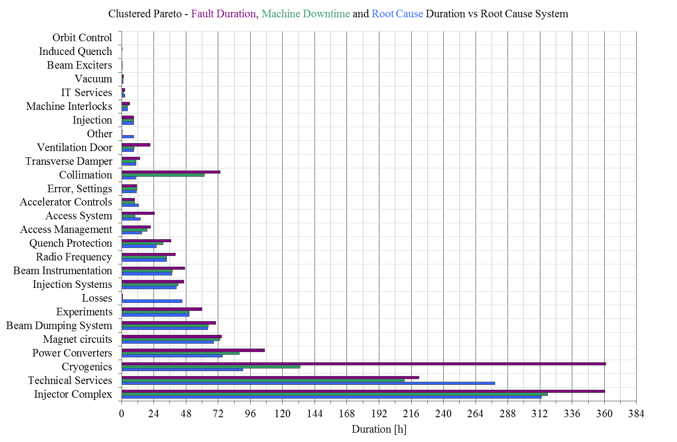
Faults
Fault Duration =
Integrated time logged for fault
Machine Downtime =
Corrects for parallelism
Root Cause Duration =
Corrects for dependencies
parent / child / shadow

Slide 27
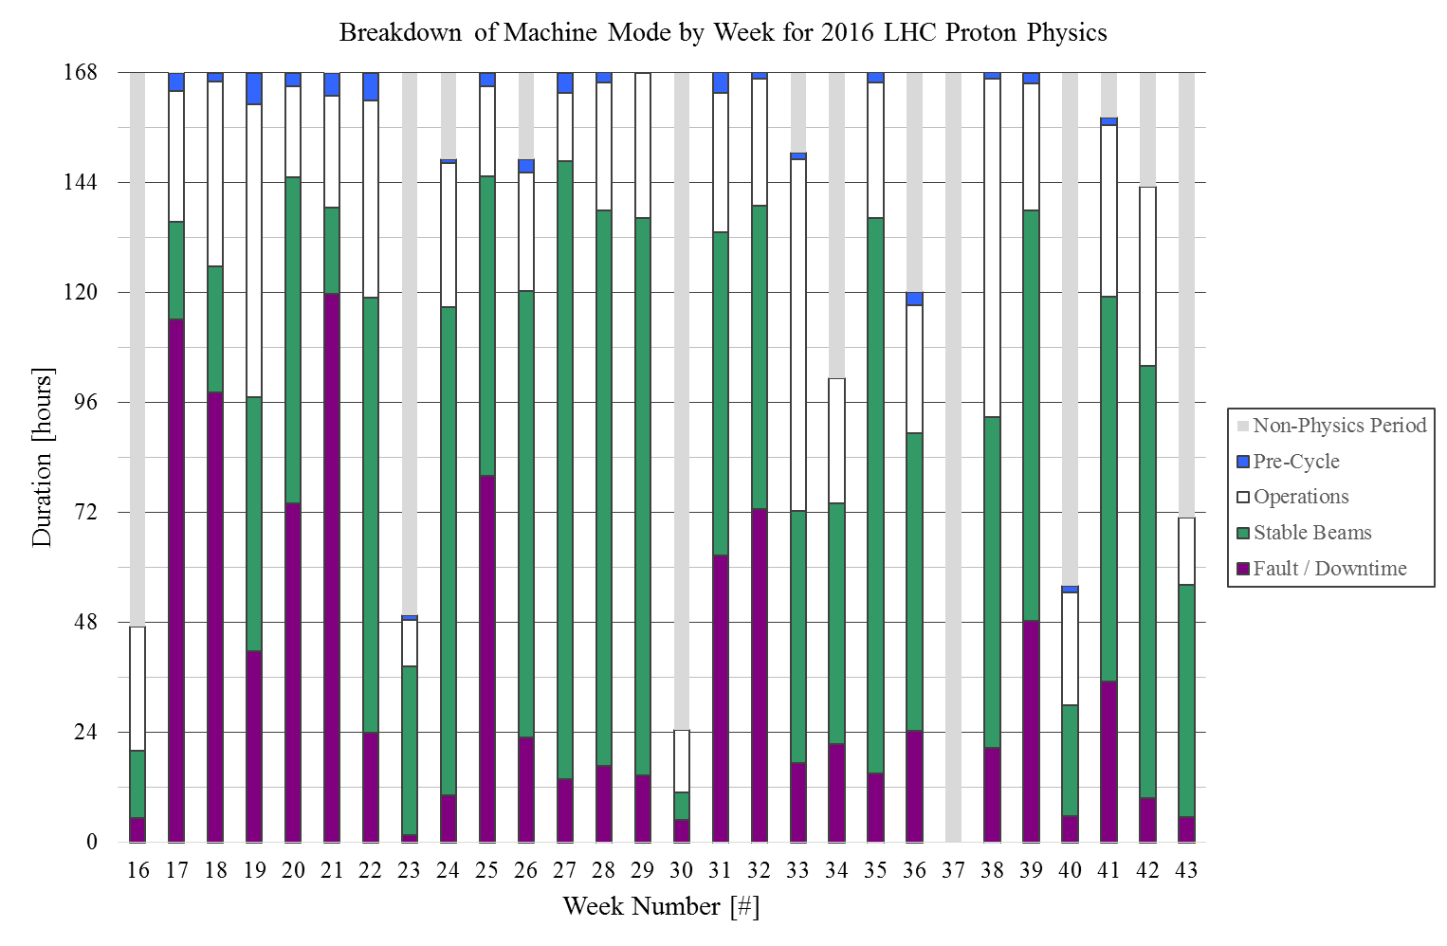
Mode Breakdown

Slide 28
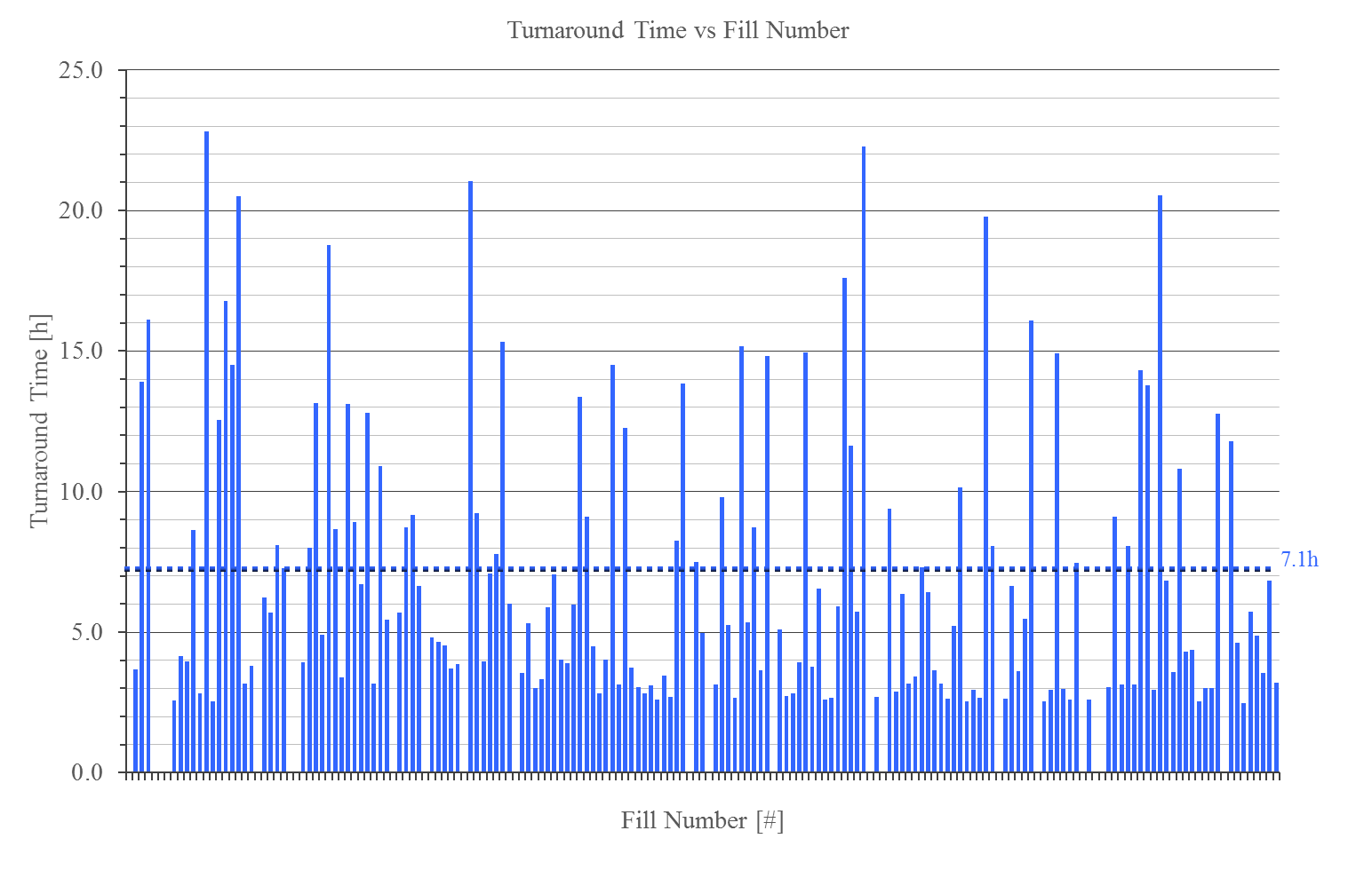
Turnaround
175 + 4 fills with stable beams, time to get to fill # from previous fill
Ignore 12 mode changes
Ignore 10 long faults
=157 turnarounds

Slide 29
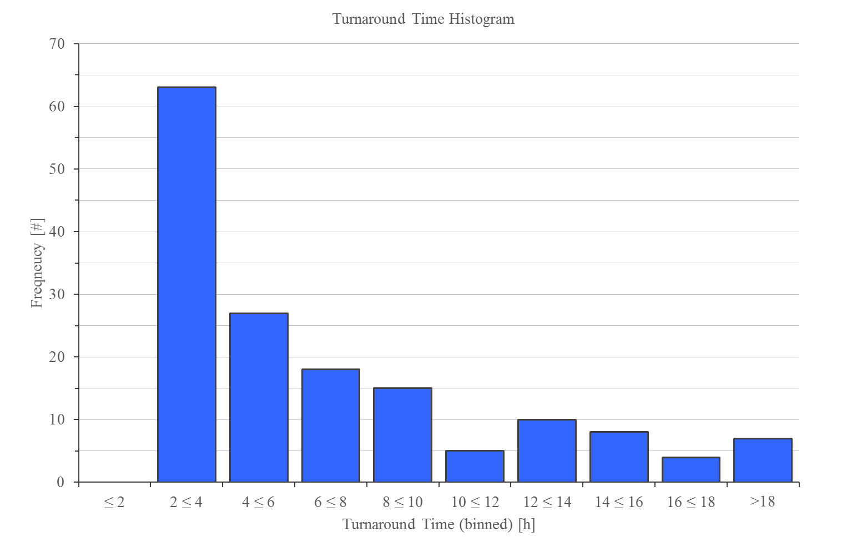
Turnaround
175 + 4 fills with stable beams, time to get to fill # from previous fill
Ignore 12 mode changes
Ignore 10 long faults
=157 turnarounds

