Slide 1
Using the LHC Control System –
2016 Retrospective and Short Term Plans
Guy Crockford
BE/OP/LHC
Many thanks for discussions with…
Kajetan Fuchsberger, Laurette Ponce, Matteo Solfaroli, Delphine Jacquet, Georges-Henri Hemelsoet, Michi Hostettler, Giulia Papotti, Jorg Wenninger, Markus Albert, Roman Gorbonosov,, Marine Gourber-Pace, Grzegorz Kruk

Slide 2
Content
2016 Retrospective
Human Error & Controls
Plans for EYETS
Summary

Slide 3
Content
2016 Retrospective
Human Error & Controls
Plans for EYETS
Summary

Slide 4
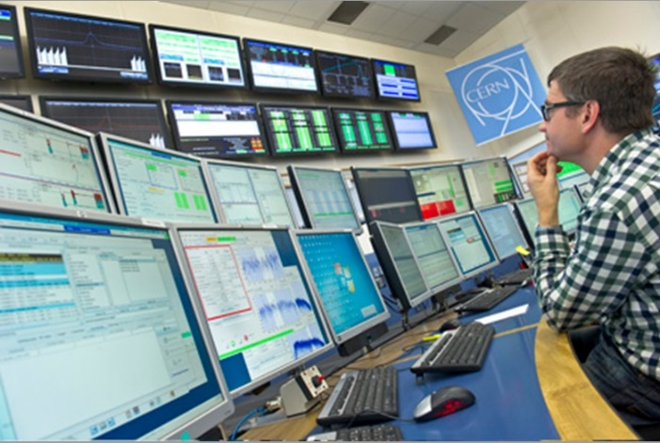
2016 Retrospective – User View
The LHC Control System very stable in 2016
Suite of applications, fixed displays & feedbacks have evolved & matured over 5 full years of LHC beam operation
Early problems of database slowness in regenerating settings for BP mitigated
Still room for some improvements

Slide 5

Priorities from Evian 2015
Kajetan’s talk, “Controls - an OP perspective”, revised
Improved Filling Diagnostics
Improve integration of QPS/PIC/Equipstate
Improved Automation of Sequencer, Scripting
Know the State of the machine at a given time
  Important to improve robustness of PC interlock system
  First step towards a real state machine
Improve Window Management on Consoles
  Startup scripts implemented to configure default applications and their window positioning (for upper tier fixed display screens)
Non-exhaustive list! More “nice to have” requests

Slide 6
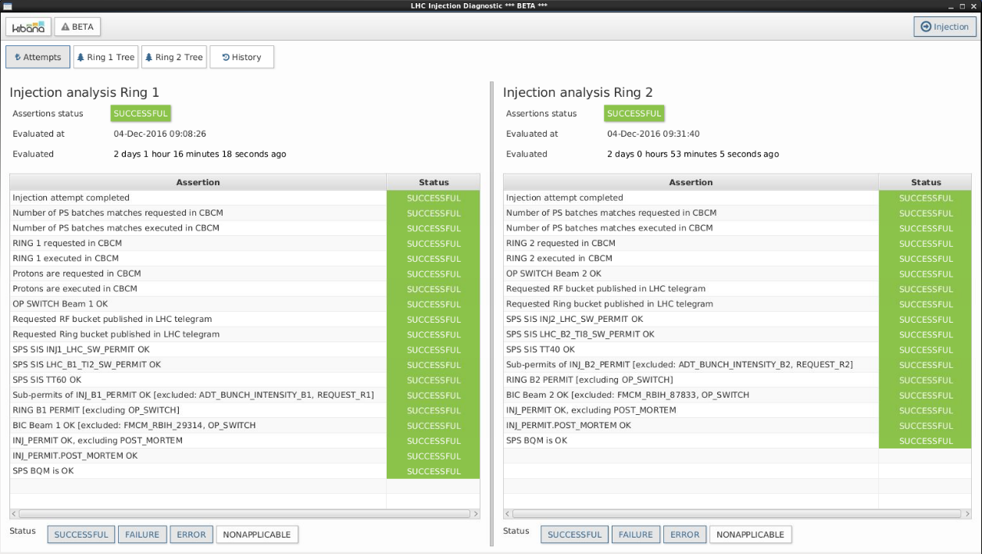
Improved Filling Diagnostics
Quick analysis of injections problems between SPS & LHC
Uses a generic analysis framework which can be used by other applications
  Used in the next version of the BIS

Slide 7
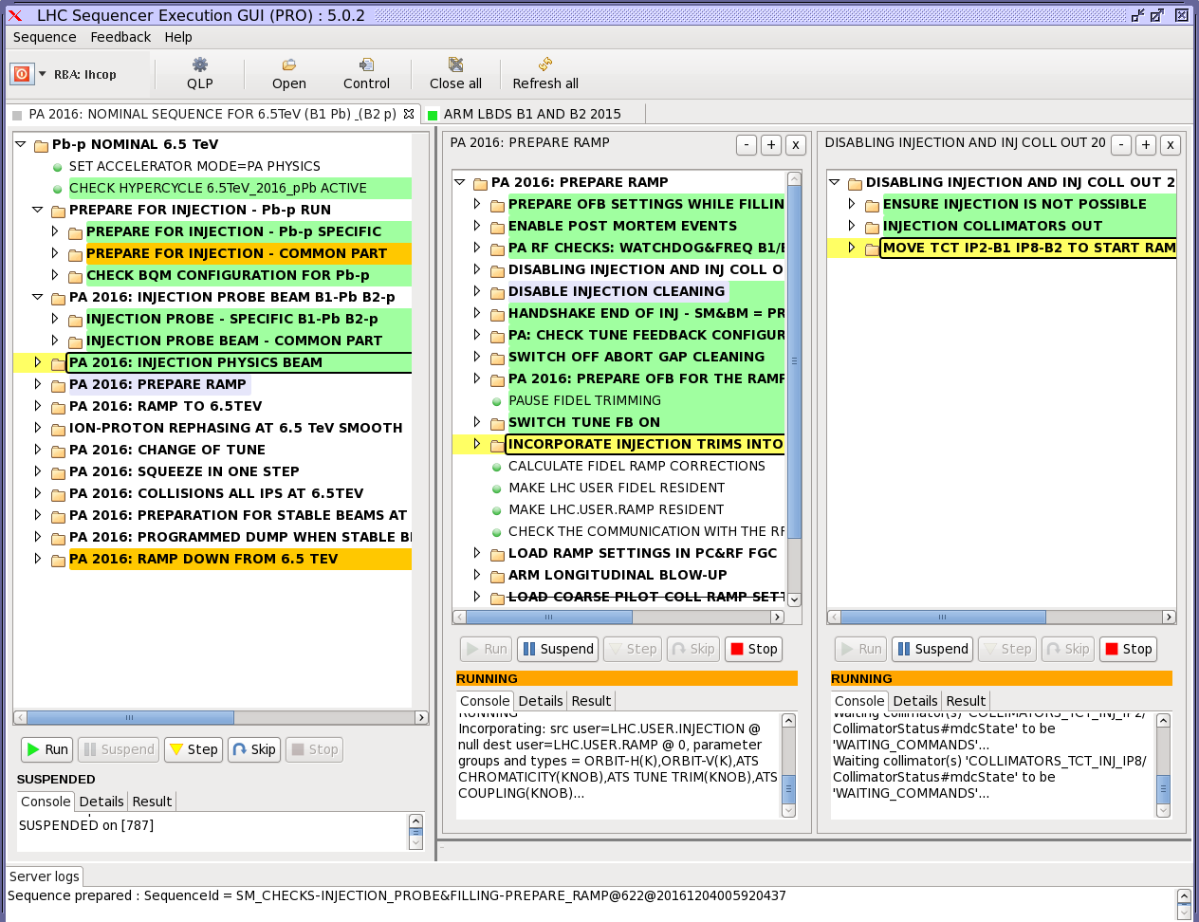
Sequencer: multi-tasking
Heavily used and working very well
Manual option for parallel execution of sequences
Time savings possible if this could be automated
But still keep shift crew
“in the loop”
Example:
Prepare Ramp…
Move out injection
protection collimators

Slide 8
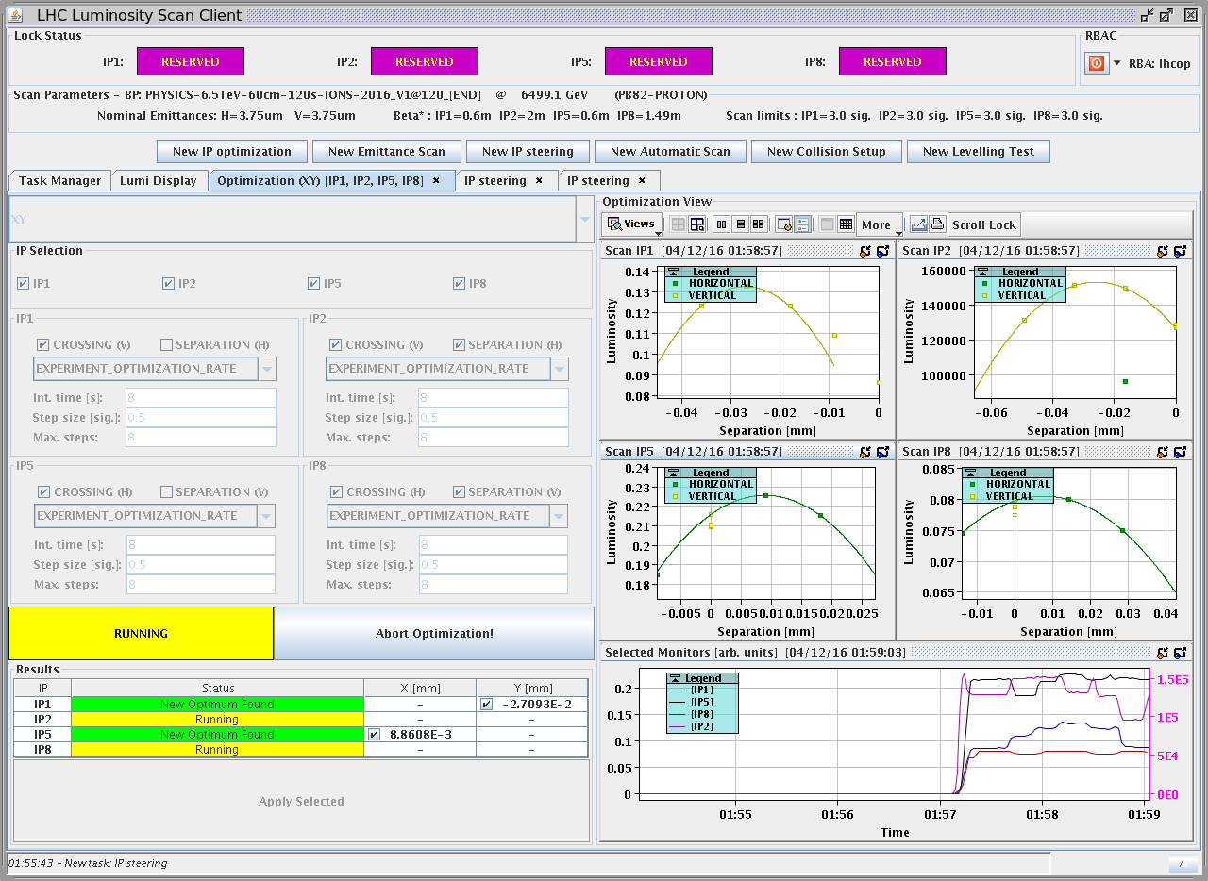
Luminosity Scan Client/Server
Very nice tool for luminosity optimization & Emittance scans
Proper reservation management via server, avoid conflicts
Used intensively during physics fills
New features for VdM scans
Reliable and robust
Further developments
planned for EYETS
  Levelling

Slide 9
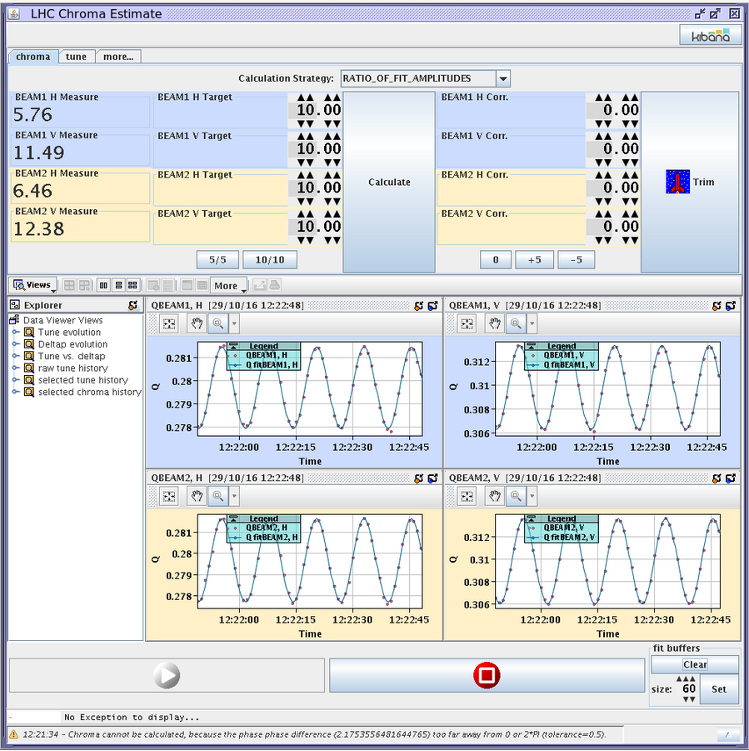
Tune &Chromaticity Estimate
Convenient tool to quickly measure and correct Tune and Chromaticity
Time saving on routine trims
during filling process

Slide 10
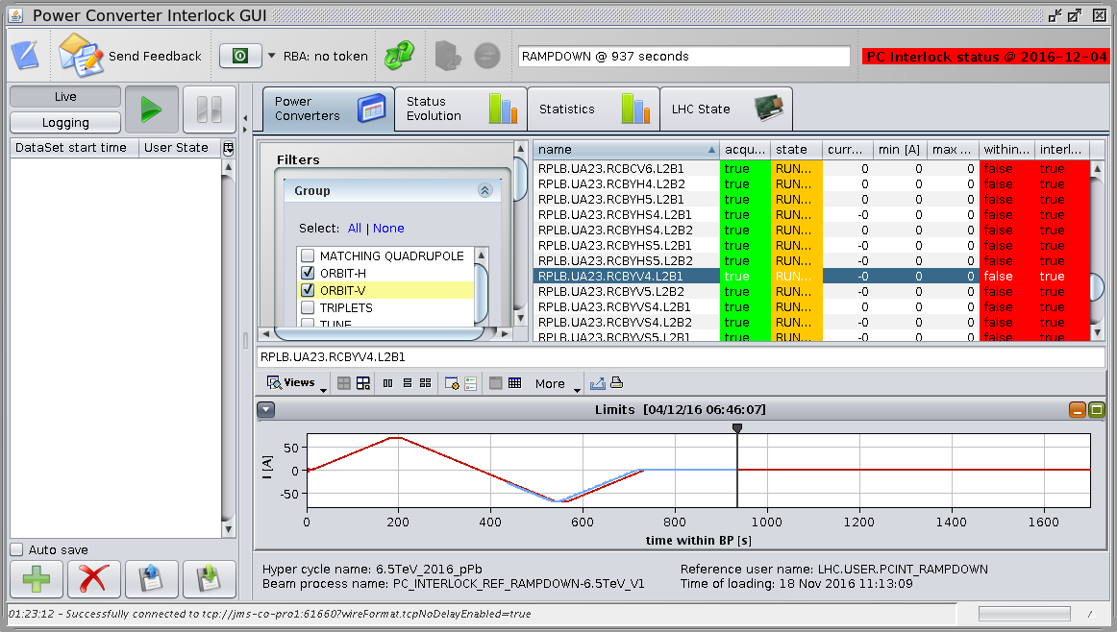
Power Converter Interlock
Checking Power converter currents within tolerance
Connected to SIS interlock
Also a useful display of time remaining in Beam Process
  Ramp, Squeeze, etc

Slide 11
Content
2016 Retrospective
Human Error & Controls
Plans for EYETS
Summary

Slide 12
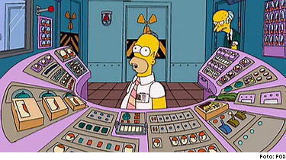
Human Error & Controls 1
Human variability is a force to harness (especially at 4AM)
Ask why the control system defenses did not catch the (human) error (rather than blame the individual)
Machine Protection defenses proved to be very robust
  All cases caught by clean beam dumps
Downtime due to human error could be improved
52 events “Ops Mistake”
  63% Injection
  17% Ramp + prepare
  10% Squeeze
  10% Stable Beams

Slide 13
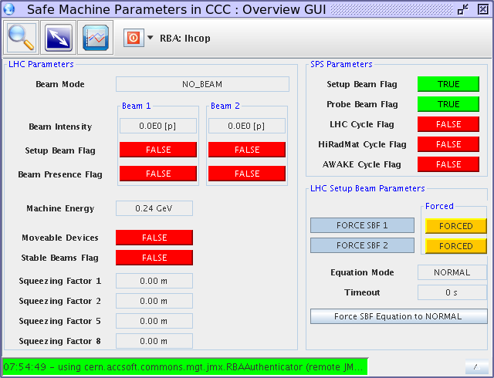
Human Error: Some examples
Beam bumps with PM, Category “Operational Mistake”
Errors mostly during MD and Beam Commissioning
Errors on override of SBF with setup beam
  Unintentionally forced to SBF false
  Errors with masks, hidden interlocks
  Intensity over threshold wrt energy
Incorrect sequence execution
  Switch on ALICE Dipole instead of Solenoid
Errors in MD Setup/recovery from MD
  E.g. Coarse collimator setting without BETS-TCDQ mask
Preparing Hypercycle change with circulating Beam

Slide 14
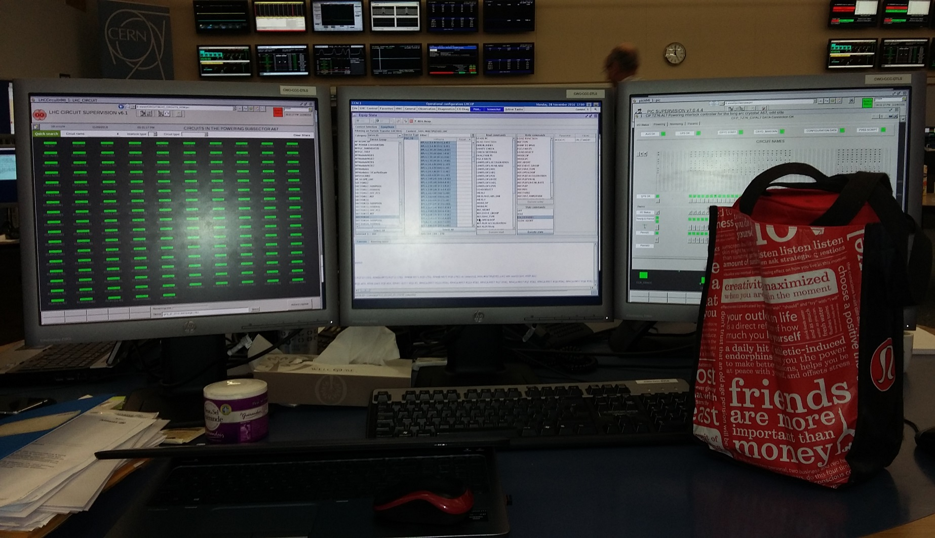
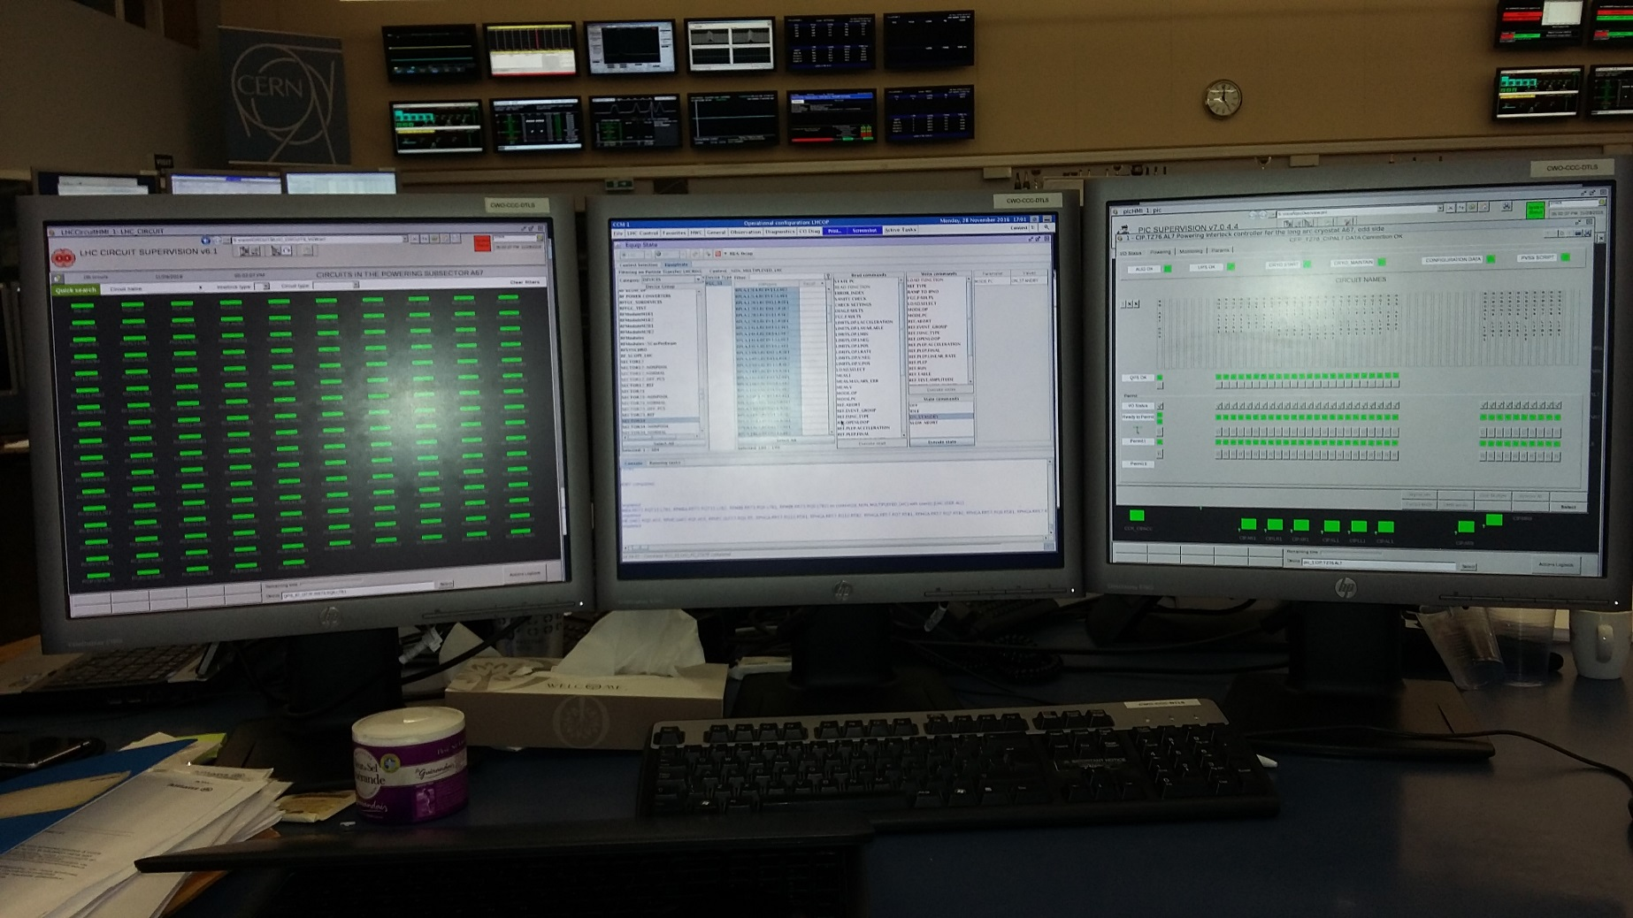
Human Error & EquipState
Recovery from PC faults, frequent occurrence
Risk to switch off a sector by mistake
  Cost: At least 1 Precycle, 40 minutes
QPS
EquipState
PIC

Slide 15
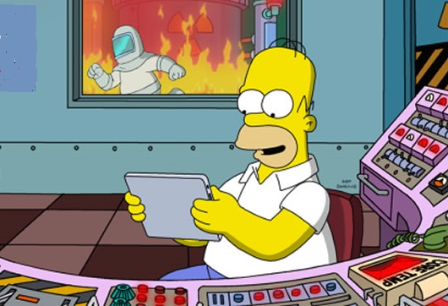
Human Error: Defences
Popup confirmation on global execution commands (eg EquipState)
Improve SBF override checks
  Possibly via improved state machine
MD pre-planning detail and tidy up after
Mitigation measures already added to SIS or Sequences following some operational errors
Keep 2 sets of eyes on tasks
even seemingly trivial
(Especially at 4AM!)

Slide 16
Content
2016 Retrospective
Human Error & Controls
Plans for EYETS
Summary

Slide 17
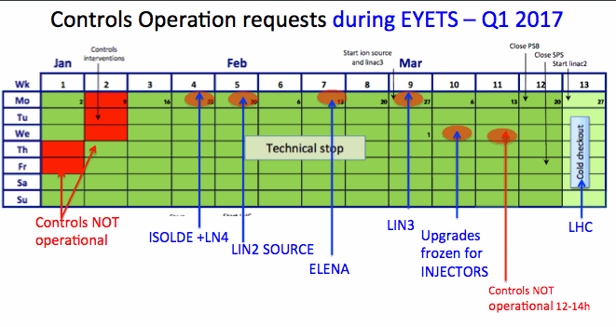
EYETS Controls Schedule
5 days CO maintenance from 5 – 13 January
CO core services frozen by 30th January (LHC last to start)
CBNG build tool (CommonBuild replacement) Tests in progress
  Training for application developers in February
See: https://wikis.cern.ch/display/SUWG/EYETS+2016-2017
Courtesy
Marine Gourber-Pace

Slide 18
EYETS work, LSA team
Function & Function List Type (FESA3, CMW, FGCs)
Better Settings Archiving
  Problems with Cache size early in the run
  Clone BPs at beginning of run (with Trim History)
Consolidate LSA Suite
  Eventual eradication of individual LSA applications

Slide 19
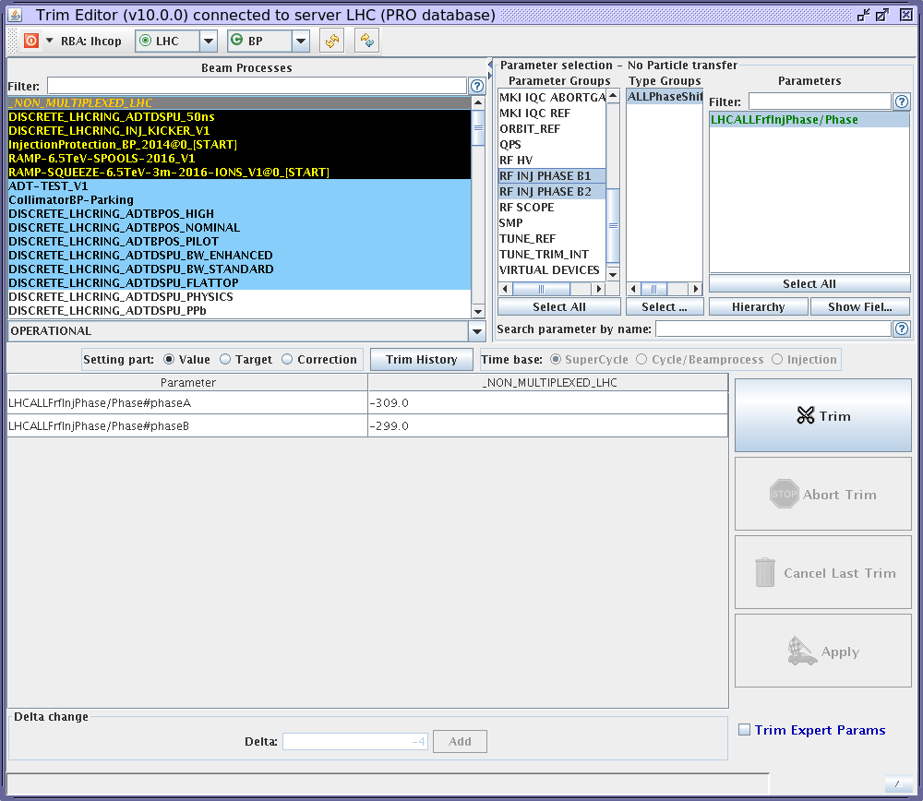
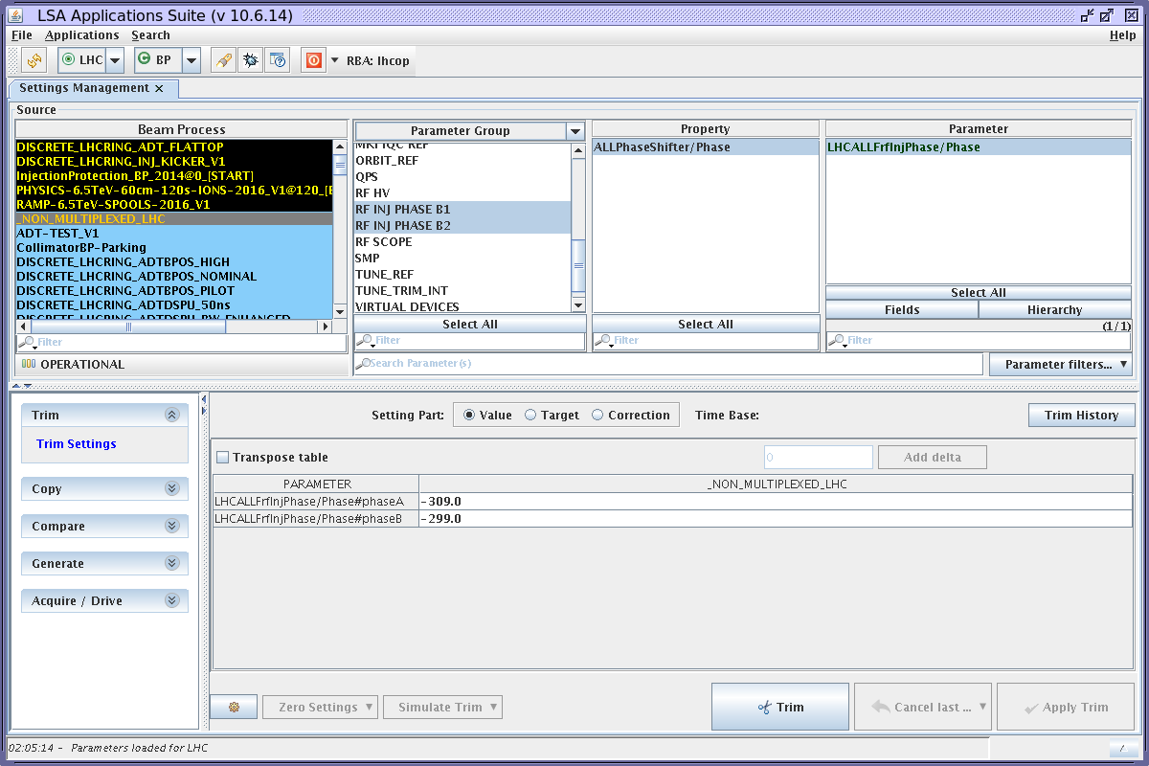
LSA Suite Consolidation
Work in progress between OP (requirements) and CO (implementation)
Essential functionality needs to be incorporated into LSA Suite
BUT OP also need to keep an open mind to changing working habits
In both CO and OP interest to operate the machine from LSA suite in 2017
Liberate CO from maintaining duplicate applications
Trim Application
LSA Suite Trim

Slide 20
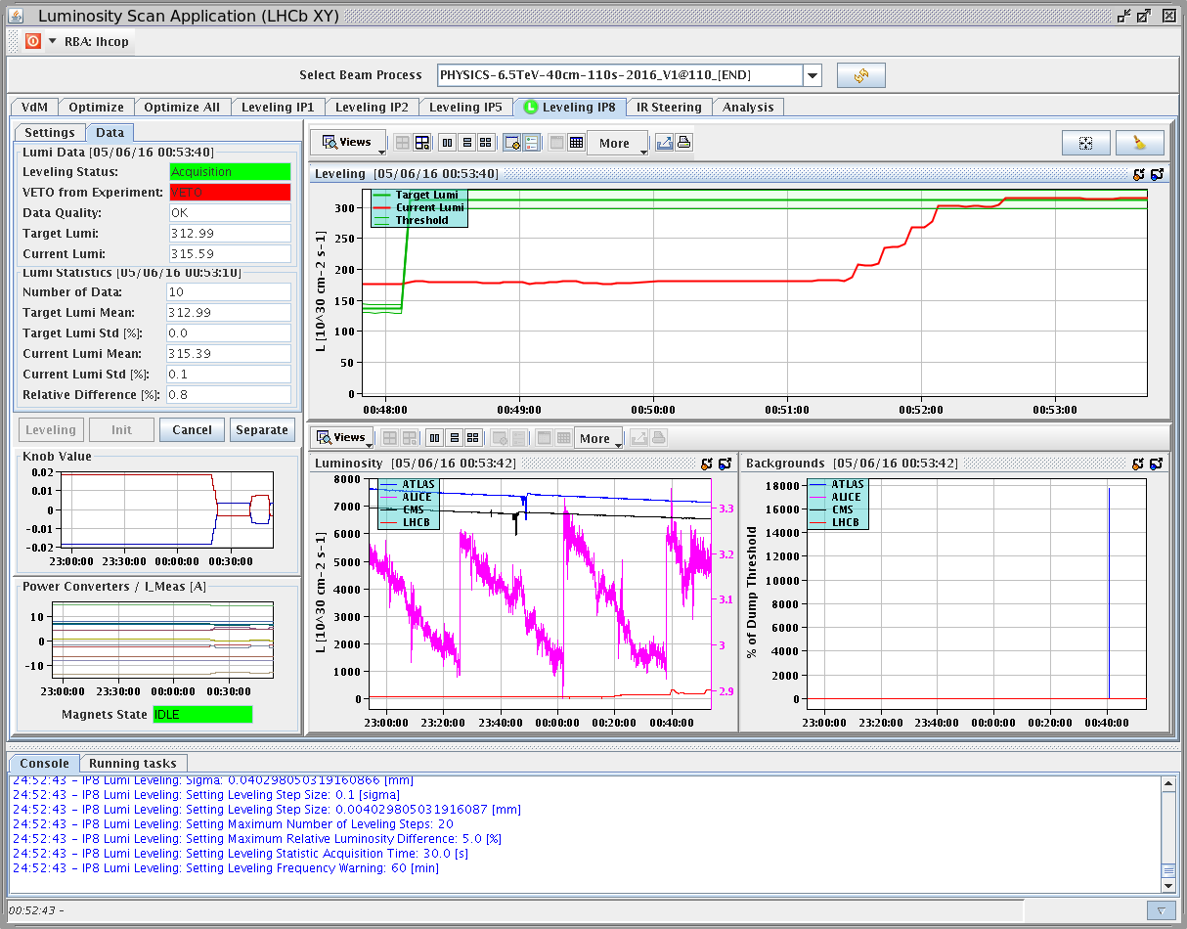
EYETS OP Team projects
Luminosity Scan Client improvements, Levelling
Separation plane levelling first
Followed by Crossing Angle levelling
Preparing the way for Beta* Levelling (later)
Complex software implementation
  LSA Expertise help required
  Close collaboration
  with CO/APP planned
Eradicate old Lumi scan
application

Slide 21
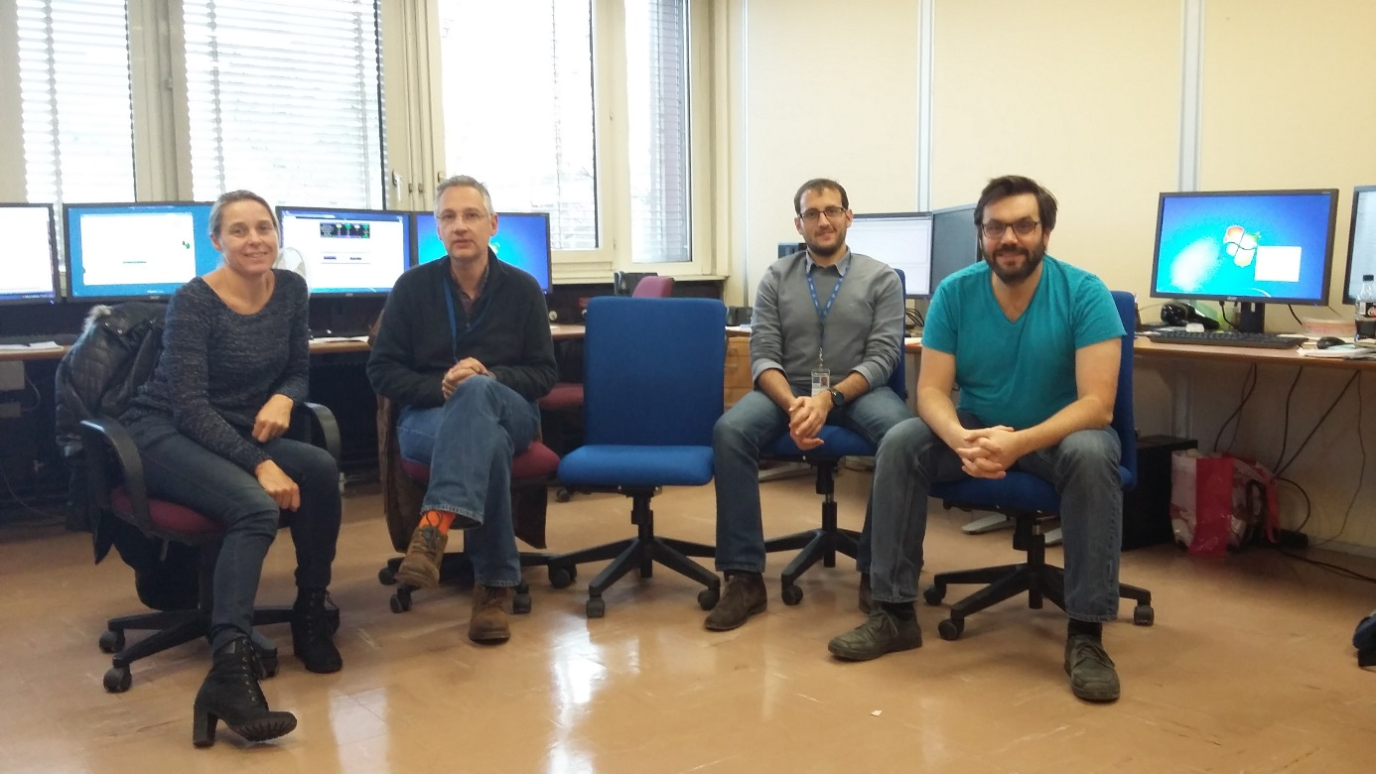
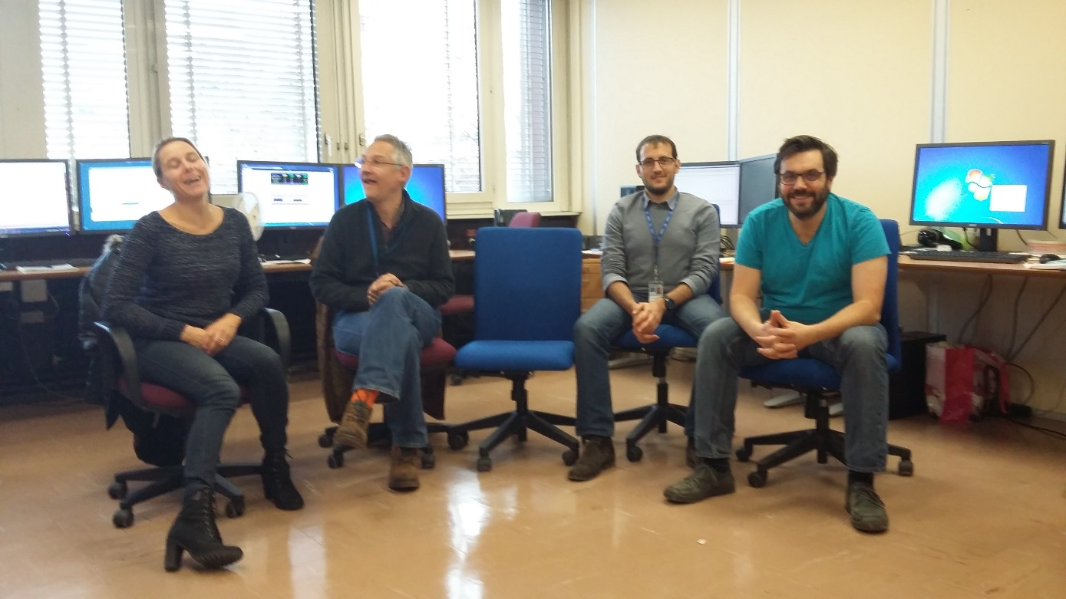


OP soft teamwork approach
OP Team trying a teamwork approach to software development
(other OP members also developing LHC software outside the team)
Slow to get started using new approach, but payoff in long term
Team meet-ups hampered by shiftwork duty
Heavy burden to maintain software following authors departure
This problem is alleviated by a teamwork approach
Room for more volunteers in the team!
C O
MICHI
MICHI

Slide 22
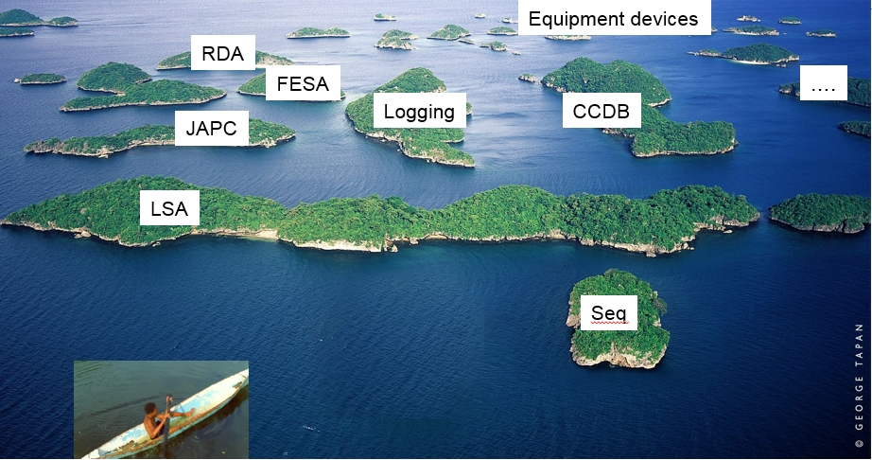

Teamwork software approach
Still navigating in a complex environment
BE CO-OP Voyager
But in greater comfort as a team

Slide 23
Content
2016 Retrospective
Human Error & Controls
Plans for EYETS
Summary

Slide 24
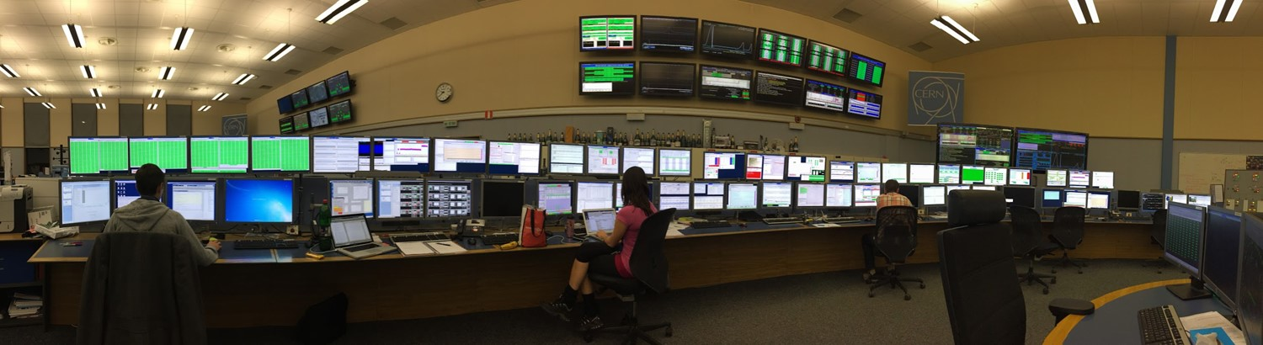
Summary
The LHC Control System has reached an excellent level of stability and efficiency in 2016
New tools are contributing to fast and efficient operation
Keep in mind the Human factor, and try to catch the errors
Teamwork on software development projects, the way forwards
EYETS is not so “Extended” for Controls
Plenty of work-in-progress during EYETS in preparation for the 2017 startup: CBNG, LSA Suite, Lumi Levelling etc
Photo courtesy of Daniel Valuch

Slide 25
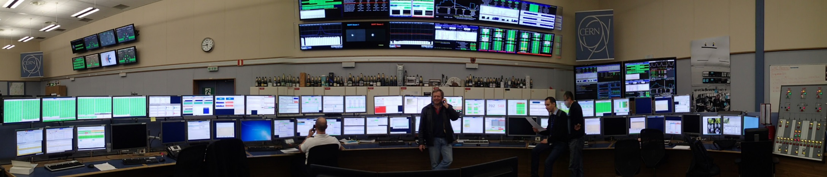
Thanks for Your Attention!

