Slide 1
Jet Energy Scale calibration
OUTLINE
Introduction
Jet energy scale calibration method
Table of process cross sections with generator cuts only.
Background rejection
Event selection cuts and luminosity factors.
Results: process selection efficiencies.
Table of process cross sections and event rates after event
selection.
Summary and prospects

Slide 2
Introduction
CLIC will run according to a staging scenario.
At each energy sub-detector calibration and alignment is essential to guarantee data quality.
The main issues to address are:
Tracker alignment
Calorimeter calibration
Jet energy scale calibration
At LEP2, each year at start of operation a few pb⁻¹ of luminosity was dedicated to Z running for calibration.
At √s= 91 GeV σ(e⁺ e⁻ → Z → q q ̄) ~ 30000 pb; a small amount of integrated luminosity allows collecting a significant number of calibration events; depends on L(√s=91 GeV)

Slide 3
Introduction
At CLIC Z running calibration is not an option.
Question: At the CLIC energies, are there physics processes with significant cross sections allowing sub-detector calibration and accurate jet energy scale calibration?
For a first discussion I focused on the jet energy scale calibration with physics events. I made a list of possible processes, estimated the cross sections and the number of events available. I did the study at generator level using Whizard2
The choice of the processes is based on work done by Tim Barklow (ILC).

Slide 4
Jet Energy Scale Calibration Method
Assuming sub-detector alignment and calibration is done.
Jet energies are measured with some accuracy, but the absolute scale may be biased.
To adjust the jet energy scale requires the selection of di-jet events originating from W or Z events.
Hadronic events are selected reconstructed and forced into two jets
The jet energies Ej1 and Ej2 and the angles ϑj1 and ϑj2 are known
The di-jet invariant mass M²(j1j2) = 2 k Ej1 Ej2 (1-cos θj1j2);
k = energy scale. If the angle between the two jets is well measured
M(j1j2) can be adjusted to Mw or Mz. => k;
The jet energies and angles depend on the jet radius R and the jet separation ΔR² = (Δζ² +Δφ²) ; R and ΔR depend on √s.
θj1j2 = 60 ° corresponds to ΔR=1.1, correlation plot in backup slides.
Event selection used θqq̄ > 60 °

Slide 5
Jet Energy Scale Calibration
For e⁺ e⁻ → Z γ→ q q ̄γ events, when the γ is in the part of the detector where Eγ can be measured accurately, an additional constraint exists.
s’=s-2.Eγ.√s
Use E or Pt balance between the γ and the di-jet.
Allows to measure the JES as a function of Pt of the γ.
I didn’t test this method for the time.
ATLAS and CMS experiments perform in situ calibration using Z+jets, γ+jet or tt̄ events (b, W->JJ)

Slide 6
Process Cross Sections with Generation Cuts
Event generation cuts: Eq,q̄ > 10 GeV and 10 ° < ϑq, ϑq̄ < 170 °
Calibration Process | Cross Section (fb) √s=3 TeV | Cross Section (fb) √s=1.4 TeV | Cross Section (fb) √s=0.35 TeV
e⁺ e⁻ → q q̄ γ (Z) | 306 | 1220 | 17000
e⁺ e⁻→ e⁺ e⁻ q q̄ (Z) | 198 | 500 | 1872
e⁺ e⁻→ e⁻ ν q q̄ (W) | 1540 | 1210 | 1170
e⁻ γ → e⁻ q q̄ (Z) | 4200 x 2 | 8400 x 2 | 12060 x 2
e⁻ γ → ν q q ̄ (W) | 14630 x 2 | 12700 x 2 | 560 x2
Background
e⁺ e⁻→ q q̄ q q̄ | 131 | 599 | 5200
γ γ → q q ̄ | 100500 | 162000 | 112000
Depending on √s the main calibration processes are different
At all energies γ γ → q q̄ is the dominant background

Slide 7
γ γ → q q ̄ Background Rejection
Low Pt jets, F/B peaked, back to back in phi; Pt(qq̄)=0
Use cut on Pt(qq̄) to suppress these events

Slide 8
Event Selection and Luminosity Correction
Event selection cuts
Pt(qq̄) > 2 GeV to suppress γγ→qq̄ events
ϑqq̄ > 60 ° to minimize jet confusion;
Mqq̄ > 40 GeV to reduce low mass background
e⁺ e⁻→ q q̄ q q̄ can be reduced using charged multiplicity cuts.
The rate estimation requires taking into account the e γ luminosity correction factors: Lc=0.79; 0.75; 0.45 (at 3, 1.4, 0.35 TeV)
(From Andre)
Selection efficiency results:
Start with the process having the largest cross section at 3 TeV.

Slide 9
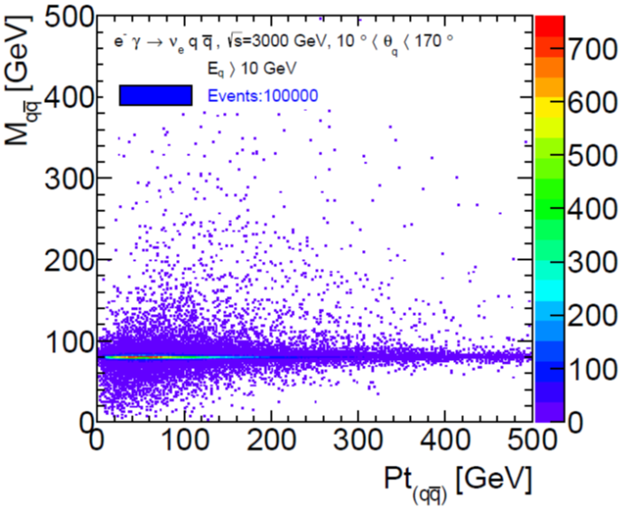
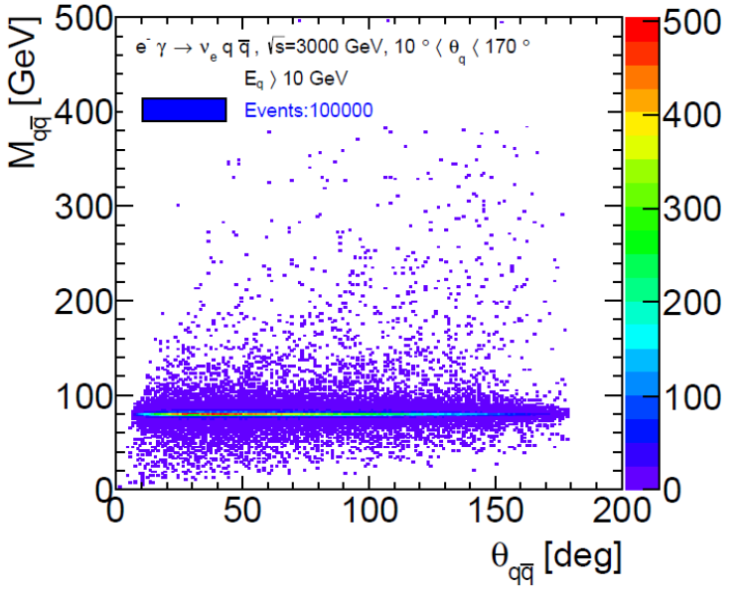
e γ → ν q q̄ (W) 3 TeV
(No selection)
Jet energy:
Peak~ 40 GeV
Jet angle
Peak ~ 170 °
Di-jet Pt:
Peak ~ 40 GeV
Boost =>
Many events
ϑqq̄ < 60 °

Slide 10
e γ → ν q q ̄(W) 3 TeV
Left: Mqq̄ vs ϑqq̄ for ϑqq̄ > 60 ° and Mqq̄ > 40 GeV
Right: Mqq; W mass peak;
3 TeV, selection efficiency ε=53%,
At 1.4 TeV ε=65% ; lower boost

Slide 11
e γ → ν q q ̄ ( 0.35 TeV)
Left Mqq̄ vs ϑqq̄ without selection
W jets are less boosted, most events have ϑqq̄ > 60 °
Right: Mqq for ϑqq̄ > 60 ° and Mqq̄ > 40 GeV
At 350 GeV good selection efficiency, ε=96%

Slide 12
e γ → e q q (Z)̄ 3 TeV
Left: Mqq̄ vs ϑqq̄ without selection; ϑqq̄<60°
Right: Mqq; ϑqq̄ > 60 ° and Mqq̄ > 40 GeV
At 3 TeV and 1.4 TeV it’s not a very good
calibration process; ε=1% and ε=2%;
At 350 the efficiency is larger but still small 8%

Slide 13
e e → e ν q q ̄ (W) 3 TeV
Left Mqq̄ vs ϑqq̄ without selection;
many events with ϑqq̄<60
Right: Mqq; ϑqq̄ > 60 ° and Mqq̄ > 40 GeV;
High efficiency process:
At 3 TeV ε=48%; at 1.4 TeV ε=56%;
At 350 GeV ε=76% ; smaller boost

Slide 14
e e → e e q q (Z)̄
Left: Mqq̄ vs ϑqq̄; no selection; Z not visible
Right: Mqq; ϑqq̄ > 60 ° and Mqq̄ > 40 GeV
It’s not a good calibration process.
At 3 TeV ε=5%; at 1.4 TeV ε=6%
At 350 GeV it is slightly better ε=15%

Slide 15
e e → q q ̄γ (Z) 3 TeV
Left: Mqq̄ vs ϑqq̄ without selection; most Z events have ϑqq̄ ~ 10 °
Right: Mqq; Z mass peak for ϑqq̄ > 60 ° and Mqq̄ > 40 GeV;
At 3 TeV selection efficiency: ε ~ 7%
At 1.4 TeV ε=5%

Slide 16
e e → q q ̄γ (Z) (0.35 TeV)
Left: Mqq̄ vs ϑqq̄ without selection; most Z events have ϑqq̄>60 °
Right: Mqq; for ϑqq̄ > 60 ° and Mqq̄ > 40 GeV;
Selection efficiency ε=26%;
For ϑqq̄ > 50 ° ε=31%; not a significant gain

Slide 17
Cross Sections After Selection
Rates with luminosity correction
Calibration Process | Cross Section (fb) √s=3 TeV, ∫L=2000 fb⁻¹ | Cross Section (fb) √s=1.4 TeV, ∫L=1500 | Cross Section (fb) √s=0.35 TeV,∫L=500
e⁺ e⁻ → q q̄ γ (Z) | 20 (ε=0.07) | 60 (ε=0.05) | 4420 (ε=0.26)
e⁺ e⁻→ e⁺ e⁻ q q̄ (Z) | 10 (ε=0.05) | 30 (ε=0.06) | 280 (ε=0.15)
e⁺ e⁻→ e⁻ ν q q̄ (W) | 740 (ε=0.48) | 680 (ε=0.56) | 890 (ε=0.76)
e⁻ γ → e⁻ q q̄ (Z) | 80 (ε=0.01) | 330 (ε=0.02) | 1930 (ε=0.08)
e⁻ γ → ν q q ̄ (W) | 15500 (ε=0.53) | 16500 (ε=0.65) | 1060 (ε=0.96)
e⁺ e⁻ lumi factor | 1 | 1 | 1
e⁻ γ lumi factor | 0.79 | 0.75 | 0.45
Events in 1% of ∫L | 2.6E+05 | 2.0E+05 | 3.5E+04
At 3 TeV and 1.4 TeV, significant rate, most events originate from Ws
At 350 GeV, rate much lower, 20% of events from Ws, 80% from Zs.
The selection efficiencies depend on ϑqq̄ (ΔR); need full simulation tests to know the optimum jet radius R and separation ΔR <-> ϑqq̄

Slide 18
Summary And Prospects
At 3 TeV and 1.4 TeV, the cross sections after event selection are significant allowing jet energy scale calibration with a few % of integrated luminosity.
Data sample for B-tagging calibration is small
At 350 GeV the statistics is about 10 times smaller.
Must use other calibration processes:
e⁺e⁻ → tt̄ (σ~500 fb), e⁺e⁻ → ZZ -> qq̄qq̄ (σ~500 fb)
But can’t increase the rate significantly; Other ideas?
Good data sample for B-Tagging
Need full simulation tests to know the optimum jet radius R and jet separation ΔR at the different energies; ϑqq̄ is a crucial parameter of the selection efficiency. The rates may decrease.

Slide 19
Thank You

Slide 20
Backup

Slide 21
ϑqq̄ vs ΔR

Slide 22
Fractional Luminosity
From Andre

Slide 23
e γ → e q q̄ (Z) (No selection)
The jet energies are very low and ϑqq̄ is small; it’s not a good calibration process

Slide 24
e e → e ν q q ̄ (W) (No selection)

Slide 25
e e → e e q q̄ (Z) (No selection)

Slide 26
e e → q q ̄γ (Z) (No selection)

Slide 27
ATLAS

Slide 28
ATLAS

Slide 29
Tim’s conclusion

Slide 30
Tim’s conclusion

Slide 31
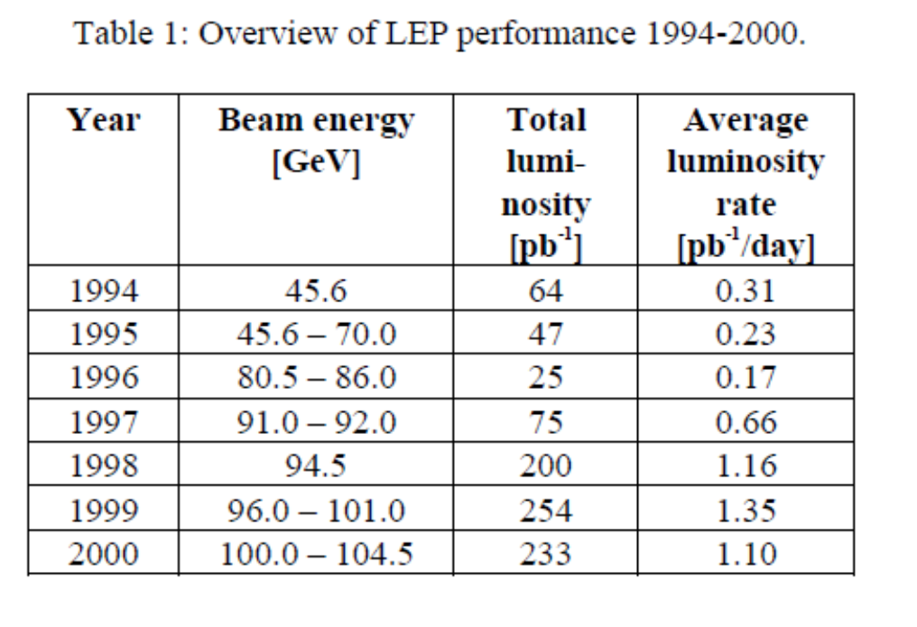
LEP

