Slide 1
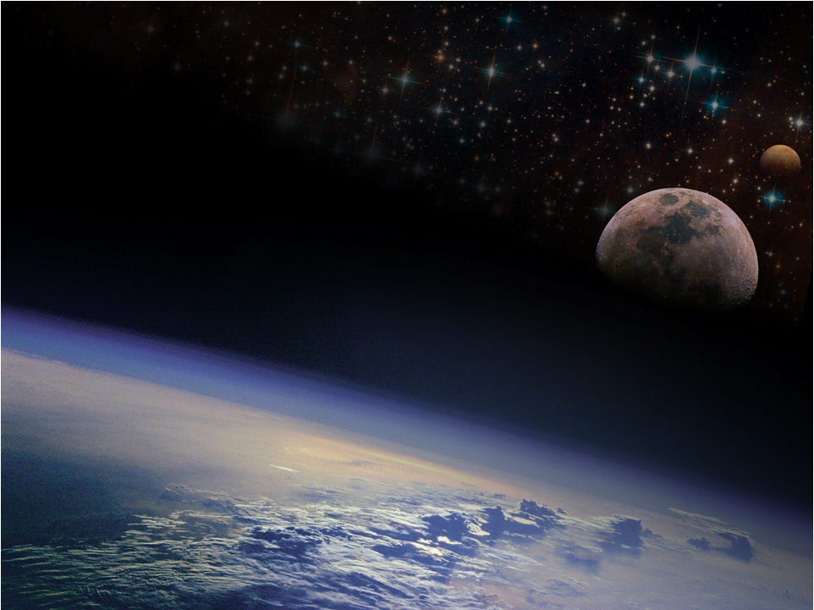

Cryogenic Engineering Conference
Madison, WI
Experimental Effervescence Measurements of Nitrogen in Liquid Methane-Ethane Mixtures to Support an Extraterrestrial Submarine for Titan
Ian Richardson
July 10, 2017
Notes:
Specifically Helium Dissolved in Liquid Hydrogen.

Slide 2
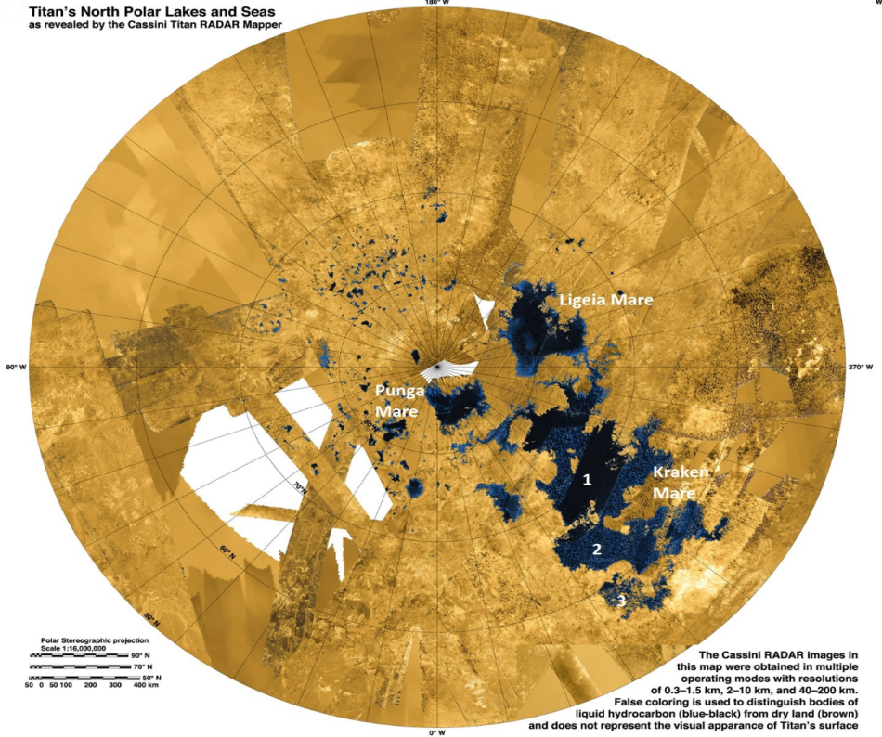
Titan’s Cryogenic Environment
1. Titan is the only known body (other than Earth) within the Solar System with stable seas
  Stable hydrocarbon seas similar in size/depth as Great Lakes on Earth
  Liquid surface temperature 90-96 K; near freezing point of ethane and methane
  Seas ~96% Liquid (ethane or methane), 4% GN₂
  Density variations of 30%

Slide 3
Titan’s Cryogenic Environment
2. Only known moon with significant atmosphere
  Organic compounds accumulate to form thick haze, clouds
  1.5 atm, 95% GN2, 5% GCH₄
  5x density of Earth
  14% of Earth’s gravity
3. GN₂ solubility increases with increasing pressure, decreasing temperature and increasing mole fraction of methane
4. At Titan’s surface (95 K, 22 psia)
  15% dissolved GN₂ in pure liquid methane
  3% dissolved GN₂ in pure liquid ethane

Slide 4
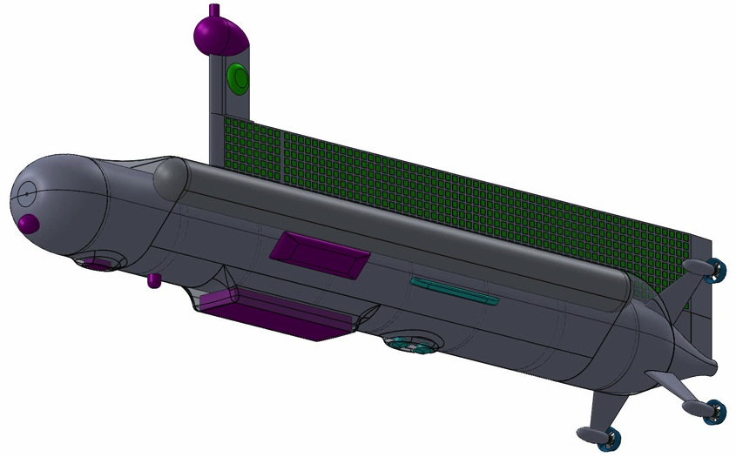
Titan Submarine
Meteorology Sensor
1200 kg submarine
6m long x 1m wide x 2m high
Science
Control/Propulsion
Communication
Surface Imager
Hydrodynamic Skin
X-Band Omni Antenna
Ballast Tank
X-Band Phased Array Antenna
Stabilizer
Light
Physical Properties Package
Benthic Sample Acquisition
Doppler Velocimeter
Depth Sounder
Side Scan Sonar Array
Sonar Transducer
Thrusters

Slide 5
Design Challenges
When will effervescence occur?
How will the nitrogen bubbles behave?
What affects will nitrogen bubbles have on the ballast systems, scientific instruments, and propellers?

Slide 6
Experimental Apparatus

Slide 7
Effervescence Results
Data Point | CH₄ [mol %] | C₂H₆ [mol %] | N₂ [mol %] | Pressure [bar] | Sea Temp. [K] | Heater Surface Temp. [K] | Heat Flux at Bubble Incipience [W/m²]
1 | 87.1 | 0.0 | 12.9 | 1.546 | 96.2 | 101.4 | 10830
2 | 87.7 | 0.0 | 12.3 | 1.65 | 93.5 | 100.2 | 13029
3 | 82.5 | 0.0 | 17.5 | 1.782 | 95.9 | 99.6 | 3257
4 | 72.3 | 0.0 | 27.7 | 4.53 | 97.0 | 104.1 | 17915
5 | 0.0 | 97.3 | 2.7 | 1.73 | 103.6 | 118.7 | 28810
6 | 0.0 | 94.6 | 5.4 | 4.41 | 92.5 | 107.2 | 24559
7 | 50.6 | 44.2 | 5.2 | 1.85 | 97.8 | 108.7 | 18729
8 | 57.5 | 37.2 | 5.3 | 1.561 | 92.7 | 107.8 | 26448
9 | 47.6 | 30.9 | 21.5 | 3.21 | 91.9 | 97.8 | 11074
10 | 24.9 | 48.3 | 26.8 | 3.44 | 91.9 | 94.2 | 2475
11 | 27.0 | 61.4 | 11.6 | 3.85 | 91.8 | 98.8 | 10244
12 | 30.2 | 63.9 | 5.9 | 2.133 | 93.6 | 111.6 | 31758
- Likelihood of effervescence increases with increased nitrogen content.

Slide 8
Freezing Point Depression Measurements
Freezing point measurements showed 16 K subcooling below the triple point temperature of methane (90.7 K) and ethane (90.4 K)
Data Point | Methane [mol %] | Ethane [mol %] | Nitrogen [mol %] | Pressure [bar] | Sea Temp. [K]
F1 | 61.0 | 25.6 | 13.4 | 0.290 | 71.5
F2 | 46.9 | 45.3 | 7.9 | 0.517 | 74.0

Slide 9
Measurement Video
Video available at: http://hdl.handle.net/2376/12183

Slide 10

Acknowledgements
NASA Research Grant NNC16MF93P
Dr. Jason Hartwig (GRC)
Dr. Jacob Leachman (WSU)
NSTRF Grant NNX14AL59H
Notes:
Before closing I would like to thank Steve Barsi from NASA Glenn who has been my mentor over the last year as part of the NASA Space Technology Research Fellowship that funds this work and a special thanks to Mark McLinden at NIST who is a leading expert in density measurements and has been a tremendous help in everything from helping to troubleshoot our system to calibrating the sinker for us.

Slide 11

THANK
YOU

